Slide 1
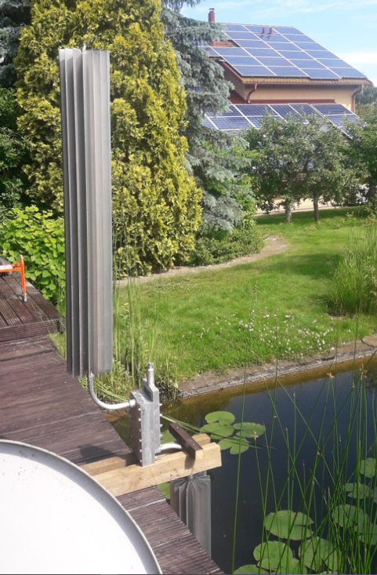
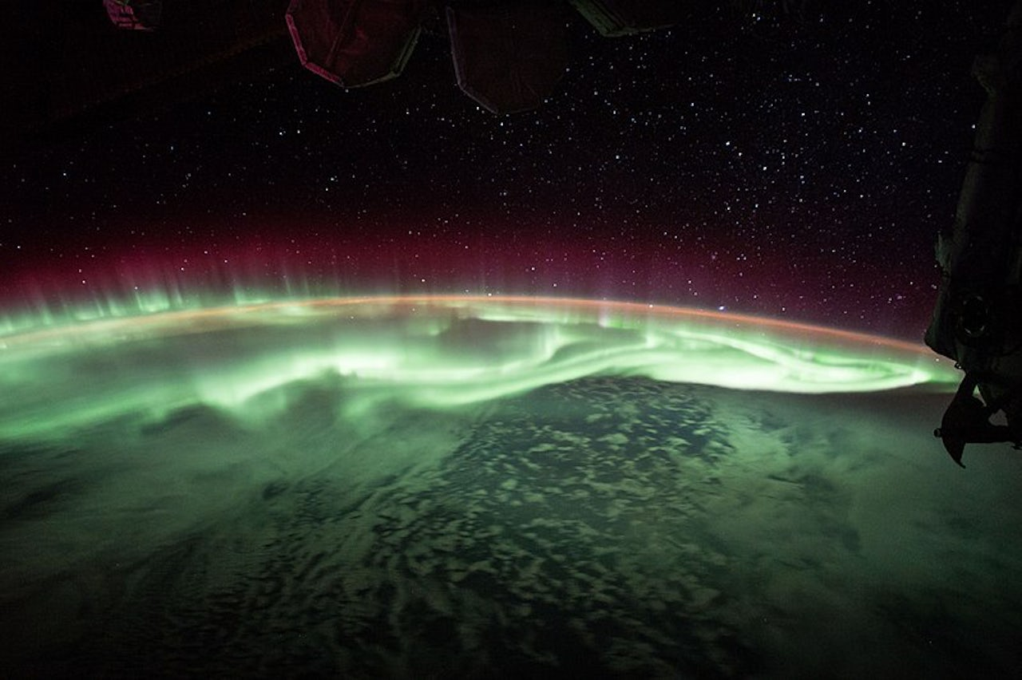
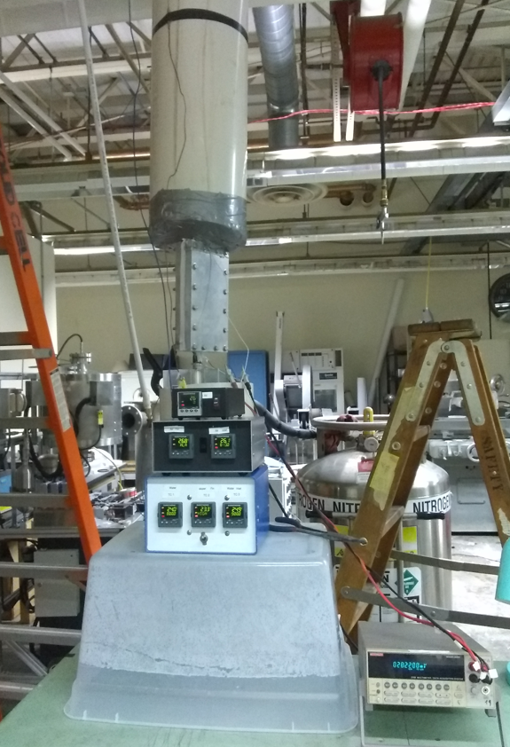
Scalable Antarctic Thermoelectric Generator for Harvesting Ocean Thermal Energy In-Situ for Free Floating or Ice-Tethered Antarctic Observation Buoys
Notes:
1
1

Slide 2
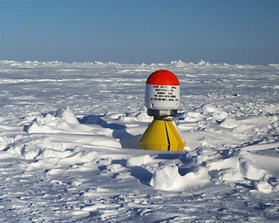
Buoy of Today
Buoy of Tomorrow
Operating Principles
Challenges
SATEG Solution
SATEG As Designed
New Value Proposition
Polar Buoys Today
Collection of Environmental & Meteorological Data
Transmission of Data to Low Orbit Satellites and Manual Data Collection
SATEG CORP
Notes:
2
2

Slide 3
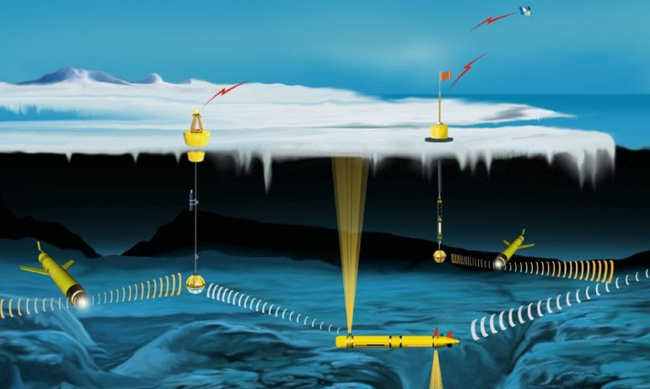
Buoy of Today
Buoy of Tomorrow
Operating Principles
Challenges
SATEG Solution
SATEG As Designed
New Value Proposition
Polar Buoys Tomorrow
Docking & Charging of Autonomous Underwater Vehicles (AUVs) Under the Arctic and Antarctic Ice
Two-way Communications & Upload of AUV Data to Satellites
SATEG CORP
Notes:
3
3

Slide 4
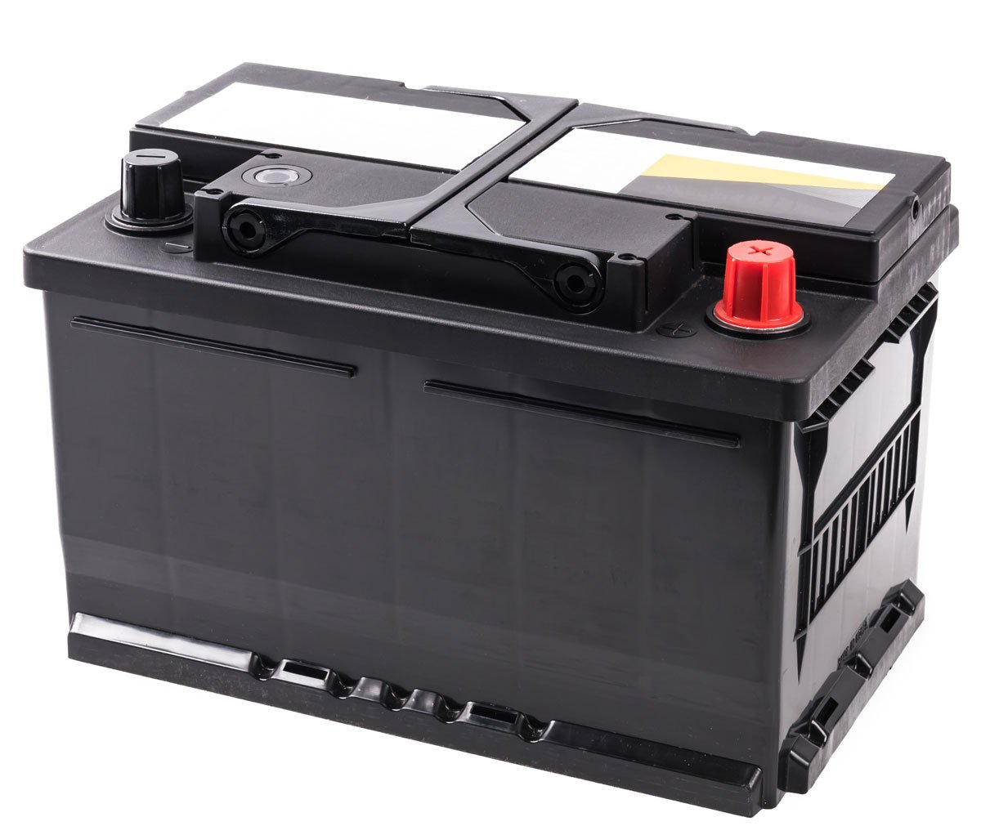
Buoy of Today
Buoy of Tomorrow
Operating Principles
Challenges
SATEG Solution
SATEG As Designed
New Value Proposition
Power Requirements
Polar Ice Buoy
64 kWh / year =
Tethys LRAUV Docking Buoy
280 kWh / year =
REMUS 600 Docking Buoy
2500 kWh / year = x 50
SATEG CORP
Notes:
4
4

Slide 5
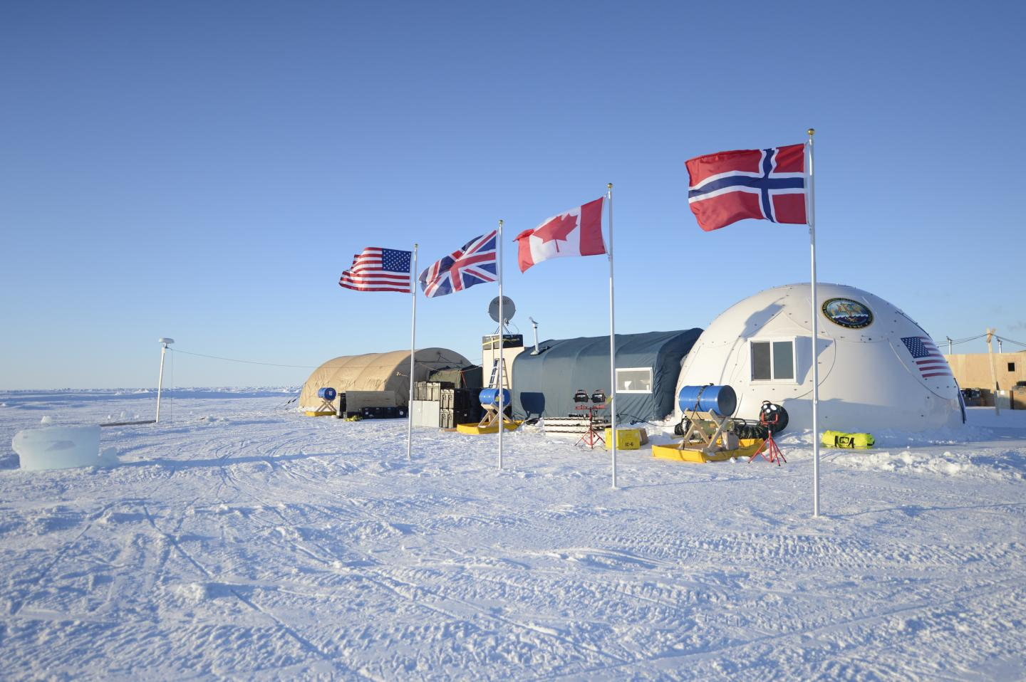
Buoy of Today
Buoy of Tomorrow
Operating Principles
Challenges
SATEG Solution
SATEG As Designed
New Value Proposition
Problems / Challenges
Energy Needs Constrain Persistent AUV Operations
Ocean floor mapping
Ice thickness monitoring
Submarine warfare & mine sweeping
Oil & gas exploration
Rapid response to oil spills (pipeline repairs)
Monitoring shipping lanes
Mass, Volume and Cost Limit Practical Use of Batteries
Insufficient Radiant Energy for Reliable Solar Power (Polar Night)
Prohibitively High Cost of Onsite Service (Requires Flight or Icebreaker)
SATEG CORP
Notes:
5
5

Slide 6
Buoy of Today
Buoy of Tomorrow
Operating Principles
Challenges
SATEG Solution
SATEG As Designed
New Value Proposition
Solution
SATEG Power Module
(Scalable Arctic / Antarctic ThermoElectric Generator)
Harvesting Temperature Differences between Polar Air
& Ocean Water
Survivability in Harsh Polar Environment
Integrable with Existing Polar Buoy Platforms
Scalable & Modular
Low Cost Year-round Operations Alongside Solar
SATEG CORP
Notes:
6
6

Slide 7
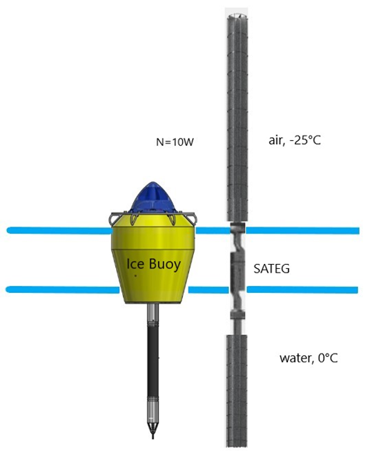
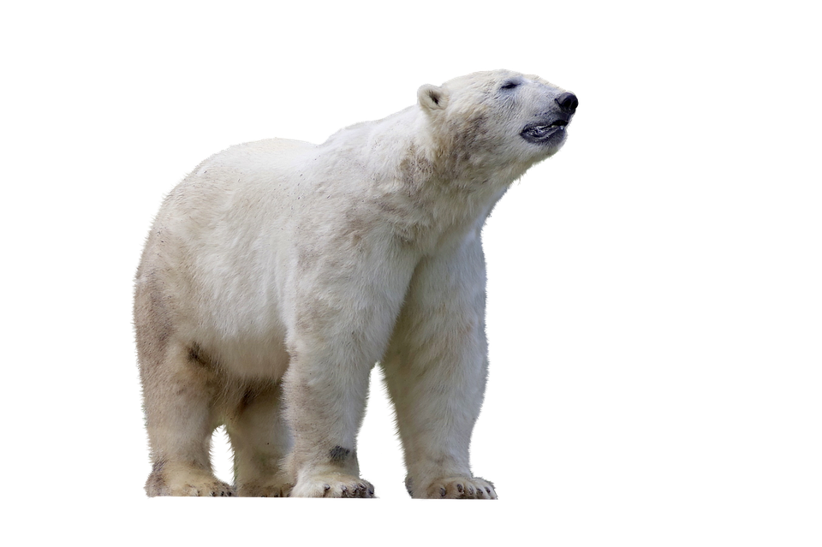
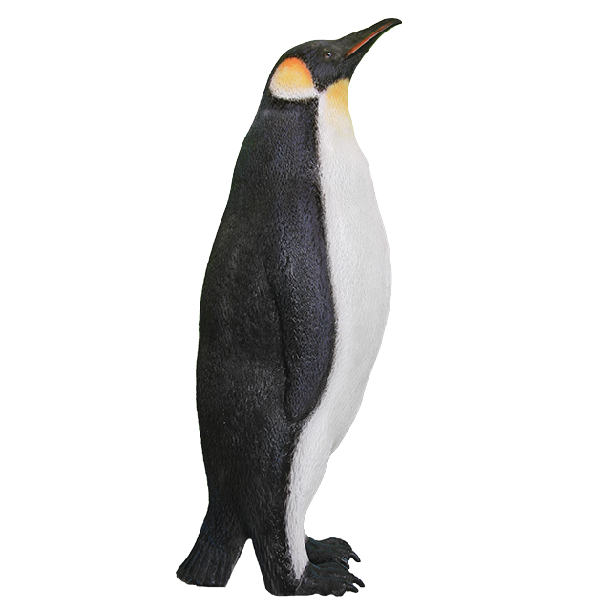
Buoy of Today
Buoy of Tomorrow
Operating Principles
Challenges
SATEG Solution
SATEG As Designed
New Value Proposition
SATEG Power Module
Polar Buoy with 1 SATEG Module Generates 70 kWh/yr @ 83ºN, 33ºW
Can we apply this in Antarctica?
Absolutely!
Wildlife poses less of a danger & poses less danger to wildlife than alternatives
Internal temperatures are colder
High wind speed accelerates cooling
Land based units are possible
SATEG CORP
Notes:
7
7

Slide 8
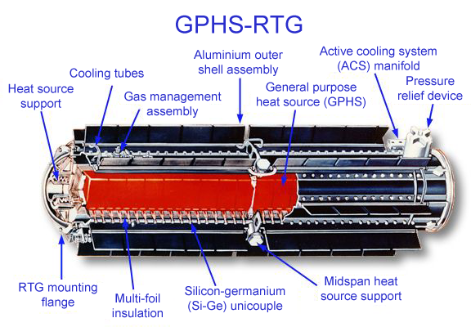
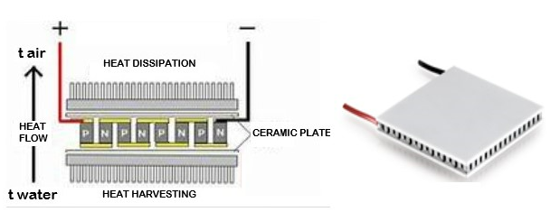
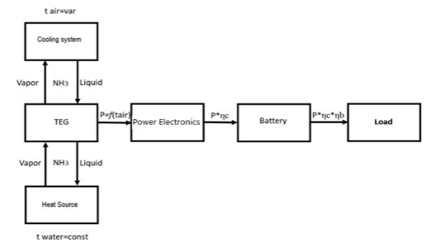
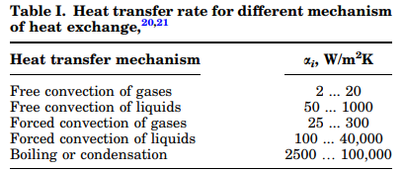
Buoy of Today
Buoy of Tomorrow
Operating Principles
Challenges
SATEG Solution
SATEG As Designed
New Value Proposition
Operating Principles
A non-radioactive thermoelectric generator
Reliable Power without the risk
Colder air means more power
Natural circulation and phase change
SATEG CORP
Notes:
8
8

Slide 9
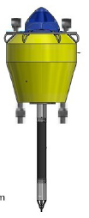
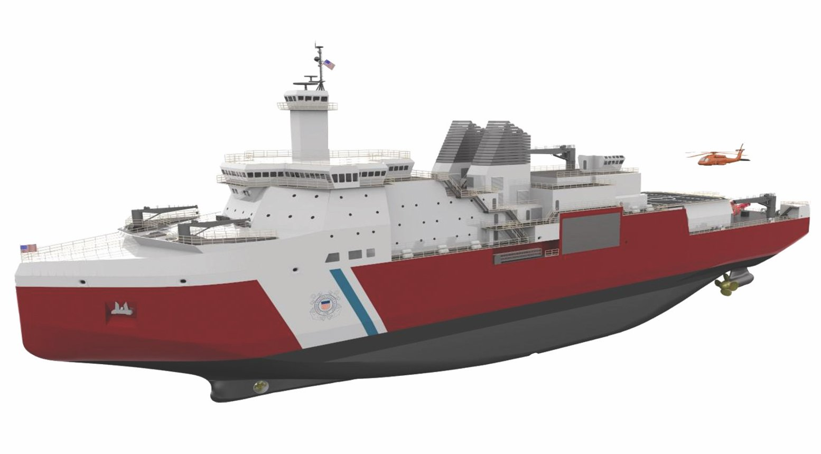
Buoy of Today
Buoy of Tomorrow
Operating Principles
Challenges
SATEG Solution
SATEG As Designed
New Value Proposition
Original Value Proposition
5 Year Mission for Polar Buoy with Docking & Recharging for AUV
Conventional Approach
SATEG
+
+
750 kWh
+
+
50 kWh
Icebreaker
Service Trip
4 x 40 kg
SATEG CORP
Notes:
9
9

Slide 10
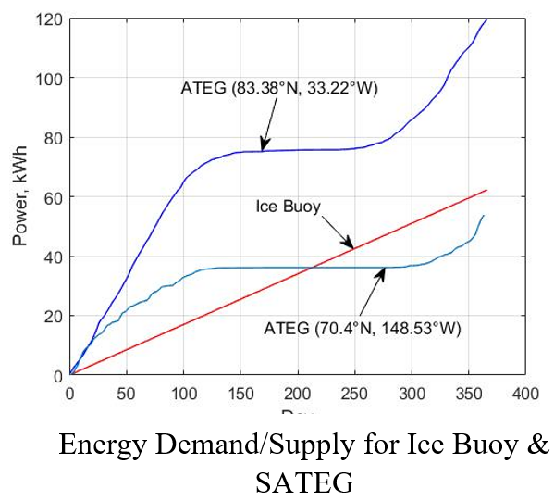
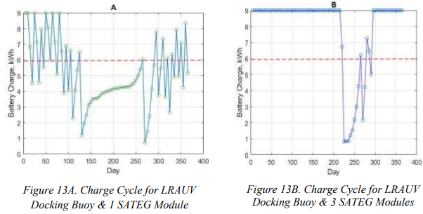
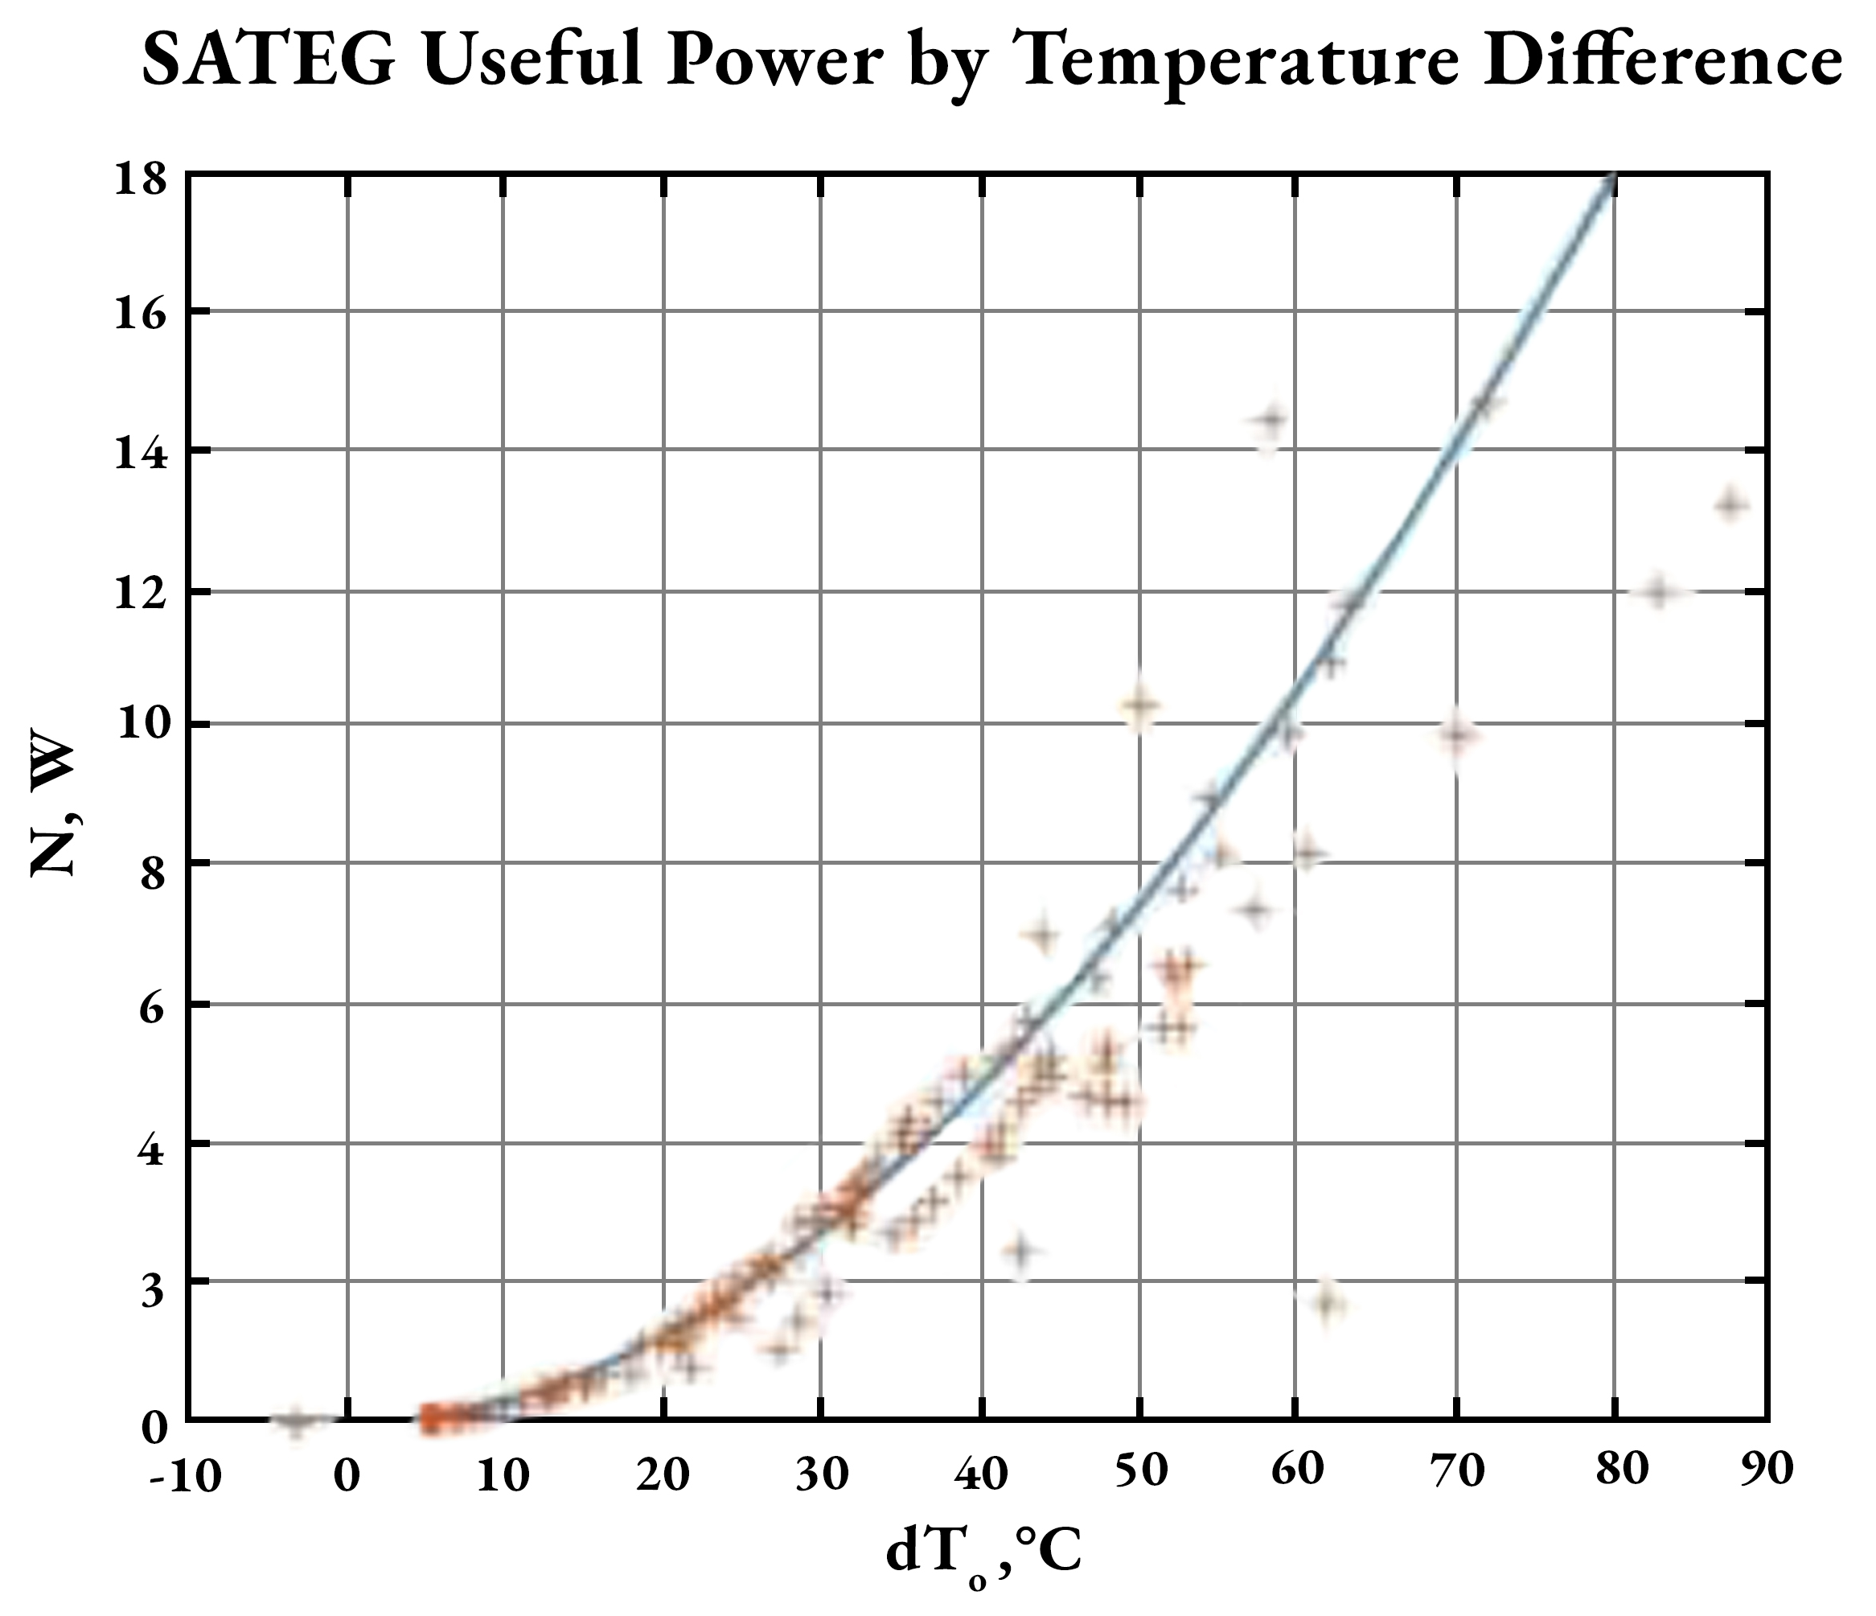
Buoy of Today
Buoy of Tomorrow
Operating Principles
Challenges
SATEG Solution
SATEG As Designed
New Value Proposition
Test Development and Results
Prototypes in Kyiv, Ukraine (right) and Rochester, NY (left) were used to test the SATEG’s heat transfer properties under real world and laboratory conditions, respectively.
1 40kg unit generates 2-10 W
SATEG CORP
Notes:
10
10

Slide 11
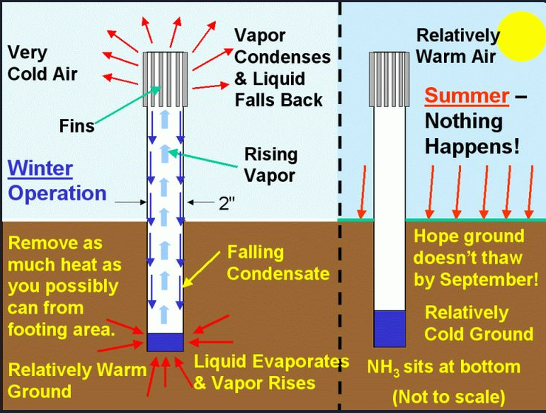
Buoy of Today
Buoy of Tomorrow
Operating Principles
Challenges
SATEG Solution
SATEG As Designed
New Value Proposition
Future Value Proposition
Continuous Operation of Autonomous Weather Stations and Tracking Movement of Ice Sheets
Collaboration: Solar Panels by day and SATEG by night
Can be embedded within permafrost
Smaller batteries = more functional equipment
Transmit location and temperature data – Machine Learning
SATEG CORP
Notes:
11
11

Slide 12
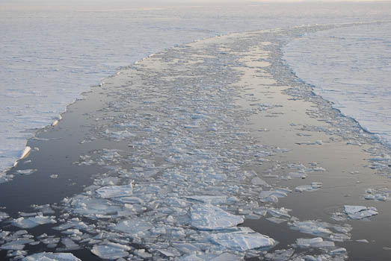
SATEG
Harvesting Clean Power
SATEG CORP
Questions?
Notes:
12
12

