Slide 1





March 2022 East Antarctic Heatwave Under Different Background Climate Conditions
Xun Zou¹, Penny M. Rowe², Irina V. Gorodetskaya³, Zhenhai Zhang¹, Dan Lubin¹, Jason M.
Cordeira¹, F. Martin Ralph¹
¹Scripps Institution of Oceanography, University of California San Diego, La Jolla, CA, USA
²North West Research Associates, Redmond, WA, USA
³CIIMAR, Interdisciplinary Centre of Marine and Environmental Research, University of Porto,
Porto, Portugal
NSF OPP Grants 2229392 & 2331992

Slide 2
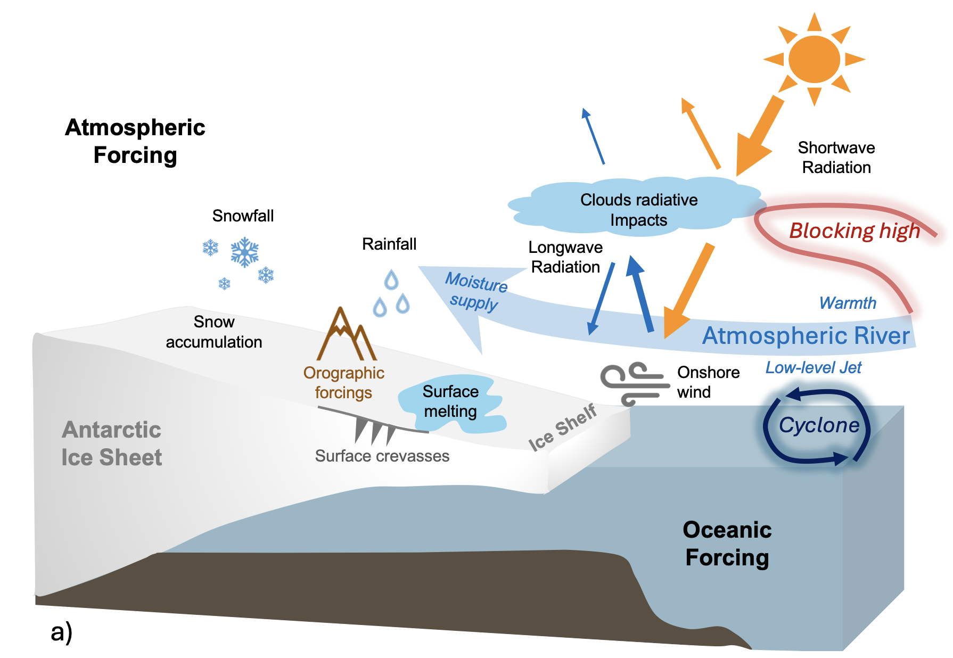
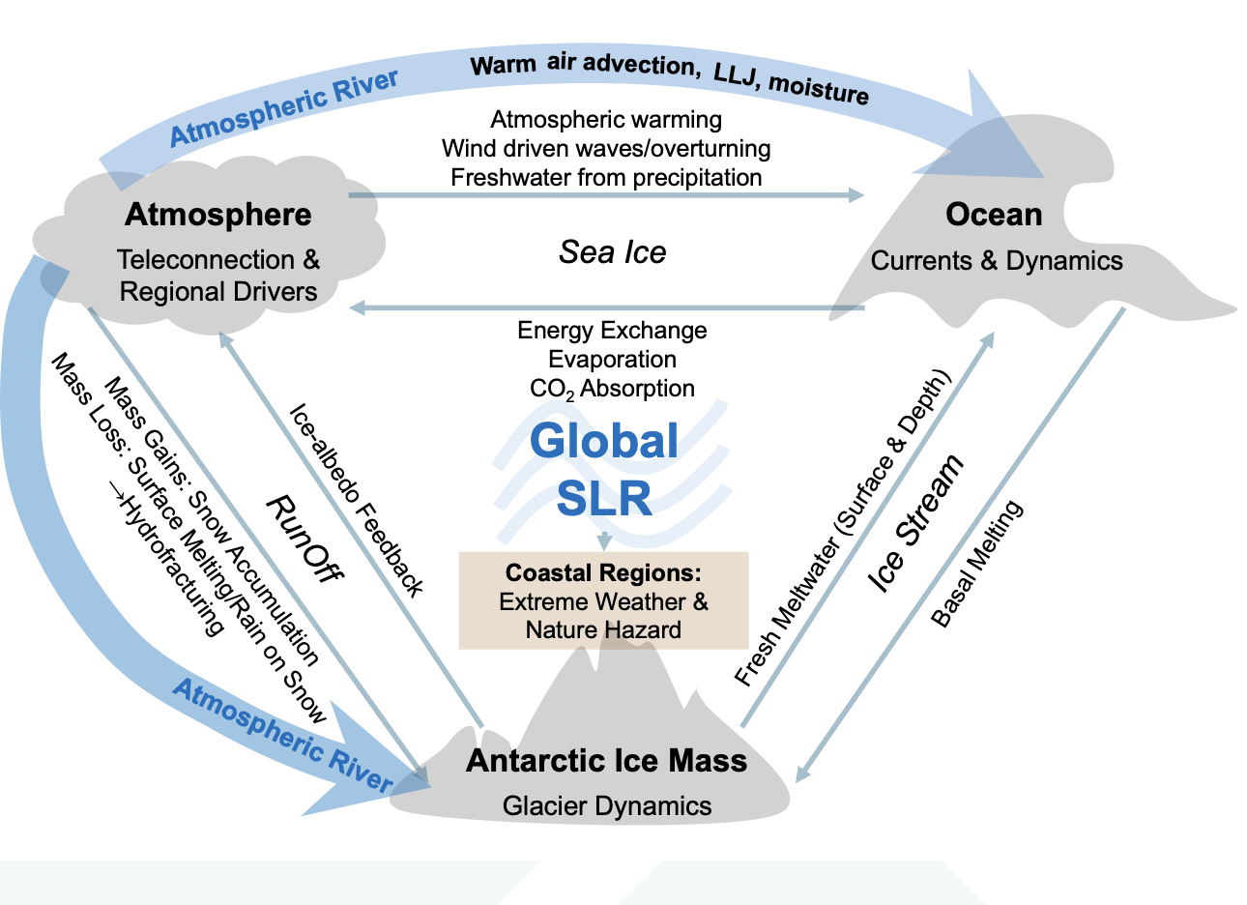
Introduction
AR → Surface melting → Ice loss
2022 February, the Antarctic Peninsula experienced surface melting caused by a strong AR, leading to a ~20 Gt of ice mass loss
AR → Intense snowfall → Ice gain
2022 March East Antarctica heatwave triggered by an unprecedented AR led to ~306Gt snow accumulation over Dome C region.
*AR → Regional circulation
*AR → Interaction among different Earth systems
Zou et al. 2025c in prep
Zou et al. 2025c in prep
While AR is not the sole phenomenon occurring over Antarctica, it does have a significant impact on the surface.
(Zou et al. 2023; 2025b,c in prep; Gorodetskaya et al. 2023; Wille et al. 2024a,b; 2025; Fricker et al. 2025)
Notes:
32%
32% of the total AIS precipitation for that month,

Slide 3
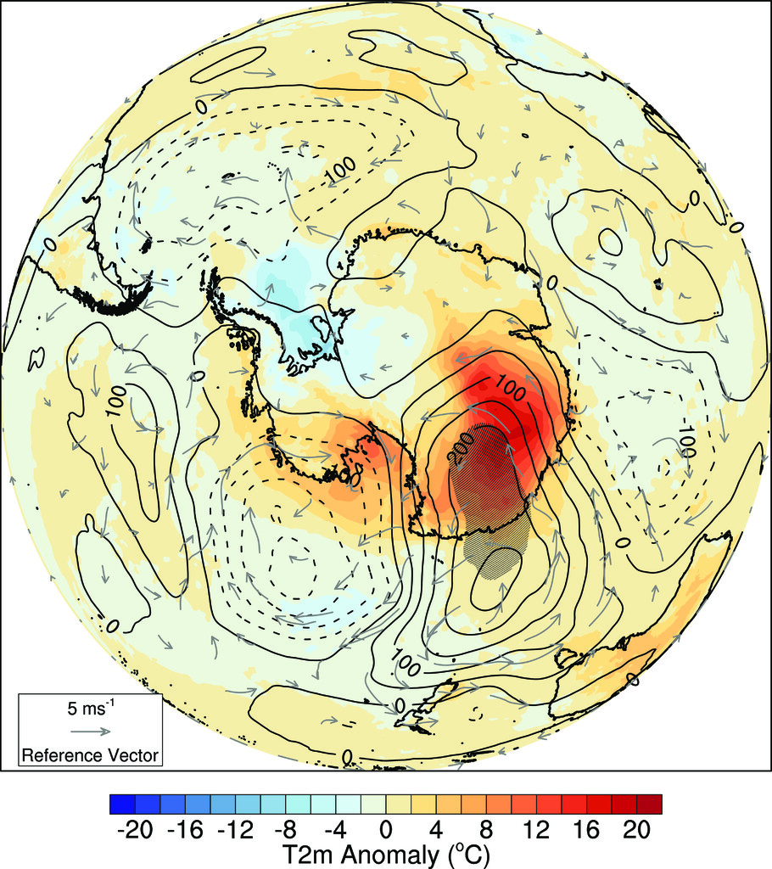
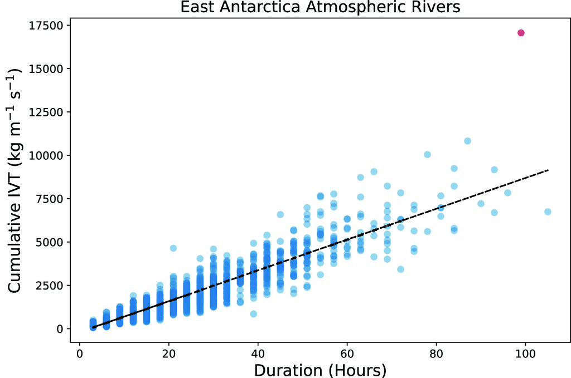
2022 March East Antarctic Heatwave event
March 15 -19 2022, East Antarctica (EA) experienced an exceptional heat wave.
Widespread 30°– 40°C temperature anomalies across the ice sheet.
A new all-time temperature record of −9.4°C on 18 March at Concordia Station
Intense atmospheric river (AR) transport lower latitudes heat and moisture deep into the Antarctica
AR and warm conveyor belt intensification near the coastline → reinforced atmospheric blocking.
Wille et al. 2024a,b

Slide 4
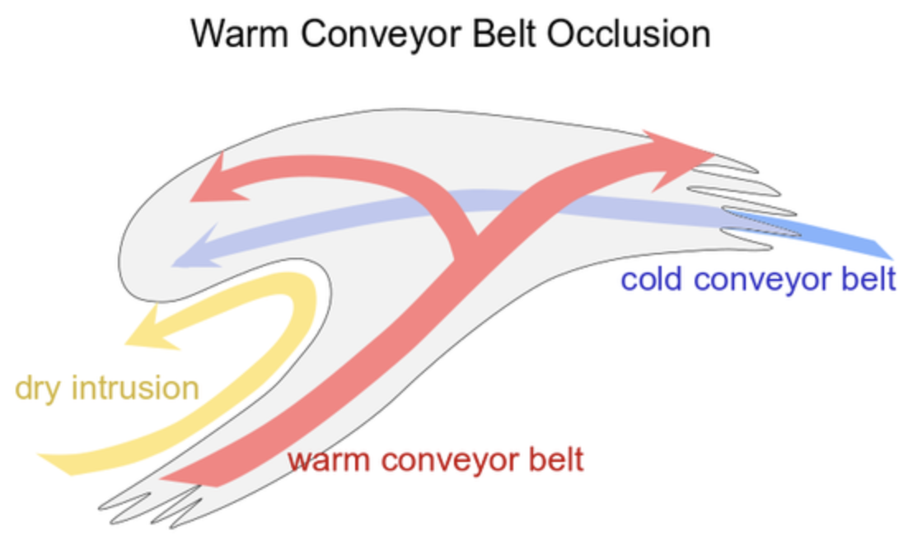
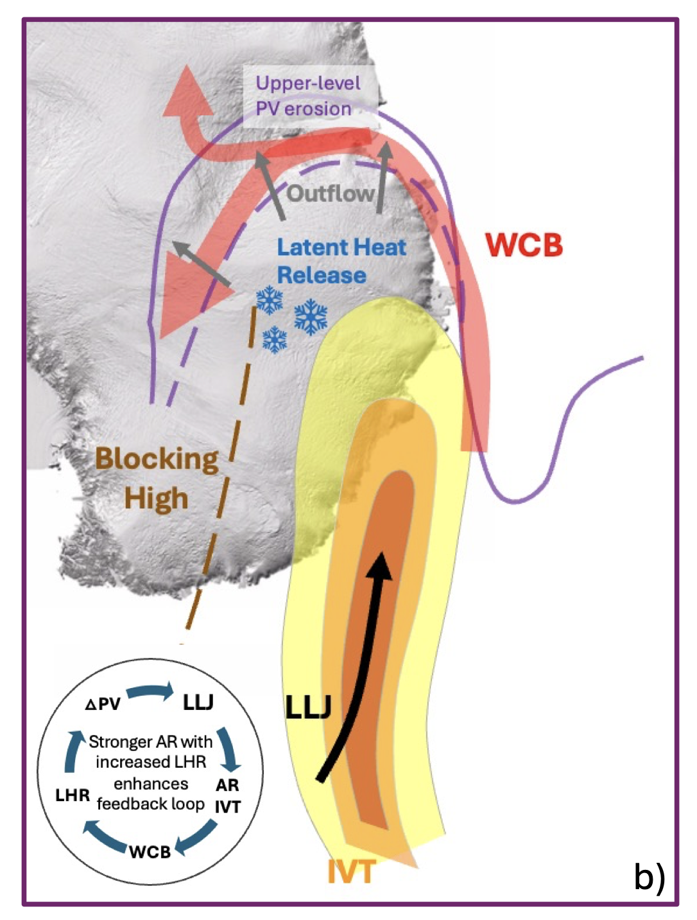
Atmospheric River and Warm Conveyor Belt (WCB)
What will this EA heatwave event look like in a future climate?
The WCB developed a ridge-like hook and then split into two parts ⟶ enhances ridge and ETC.
The WCB is sensitive to clouds and convection
Latent heat release → Air ascent
(Martínez‐Alvarado et al., 2013; Dacre et al., 2019; Binder et al., 2023)

Slide 5
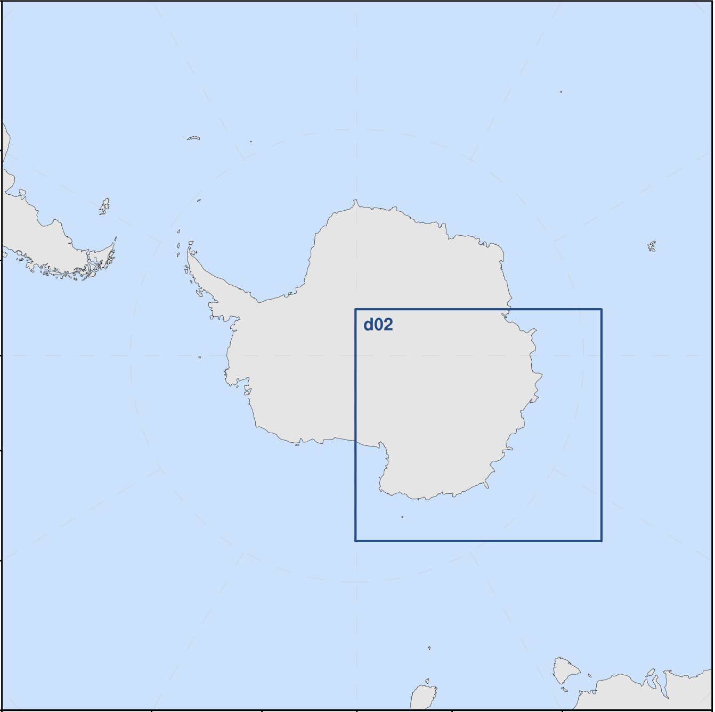
Polar WRF (PWRF) Model Setting
 | PWRF V4.3.3
Input Data | ECMWF Reanalysis Data (ERA5)
Horizontal Resolution | 20km / 4km
Vertical levels | 71 levels (lowest level 4m above the surface)
Temporal Resolution | Hourly
Spin-up | 24 h
Microphysics | P3
PBL Scheme | MYNN
Shortwave and Longwave | Both RRTMG
Land Surface Options | Noah MP
Surface Layer Options | MYNN
High-Res Topo | REMA 1km topo (Gerber and Lehning, 2020, Howat et al., 2019)
d01
Init: 2022-03-15: 00Z
End: 2022-03-20: 00Z
Control | Benchmark
No LHR | No Latent Heat Release
RH20 | Increase RH by 20%
SST05% | Increase SST by 0.5%
SST1% | Increase SST by 1%
SSTCI | Swap March with April
(Zou et al. 2023; 2025a)

Slide 6
Preliminary Results
2022-03-18: 00Z
No LHR
Weakest AR core during the heatwave peak
AR tilted way from the continent
Increase SST (0.5 - 1%)
Stronger AR core
AR intruded further inland
More obvious with higher SST increase
Atmospheric Process
Control
No LHR
RH20
Control | Benchmark
No LHR | No Latent Heat Release
SST0.5% | Increase SST by 0.5%
Ocean Forcing
SST0.5% (1-2K)
SST1% (2-3K)
SST&SI_Apr.

Slide 7
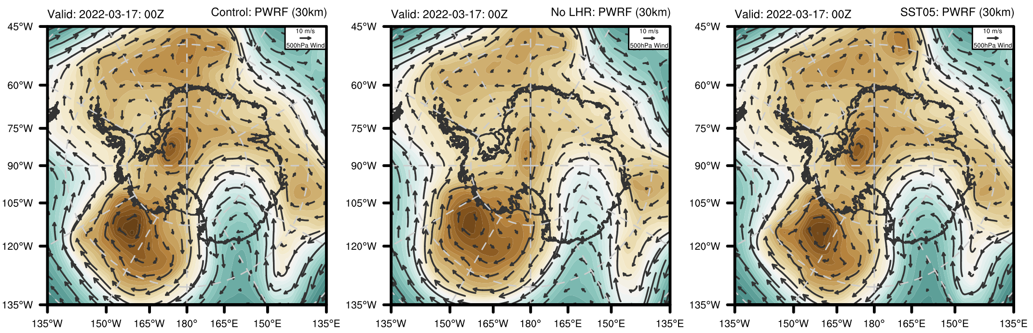
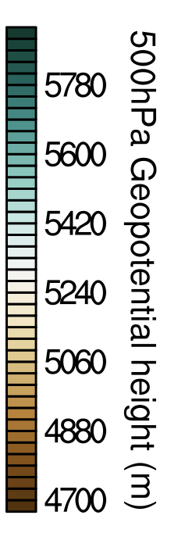
Synoptic Circulations – Blocking High
500hPa Geopotential Height and Wind
Control
No LHR
SST0.5% (1-2K)
Control: Blocking high over Victoria Land direct the AR intruded inland
No LHR: Blocking high much is weaker and narrower & Weaker upper-level wind
SST0.5%: Blocking high stronger

Slide 8
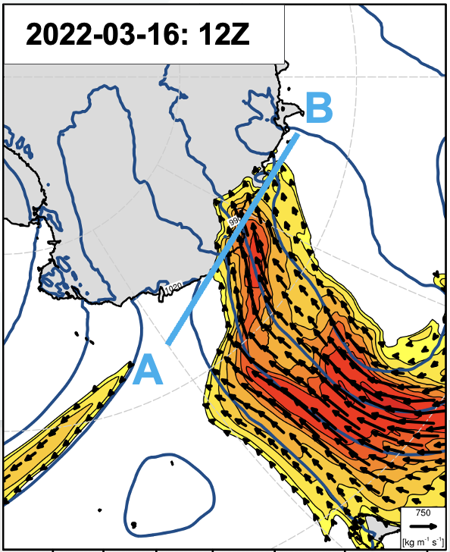
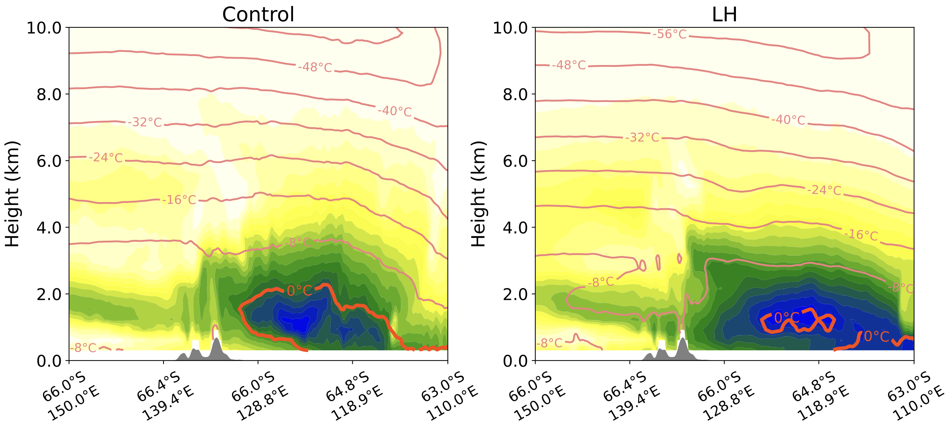
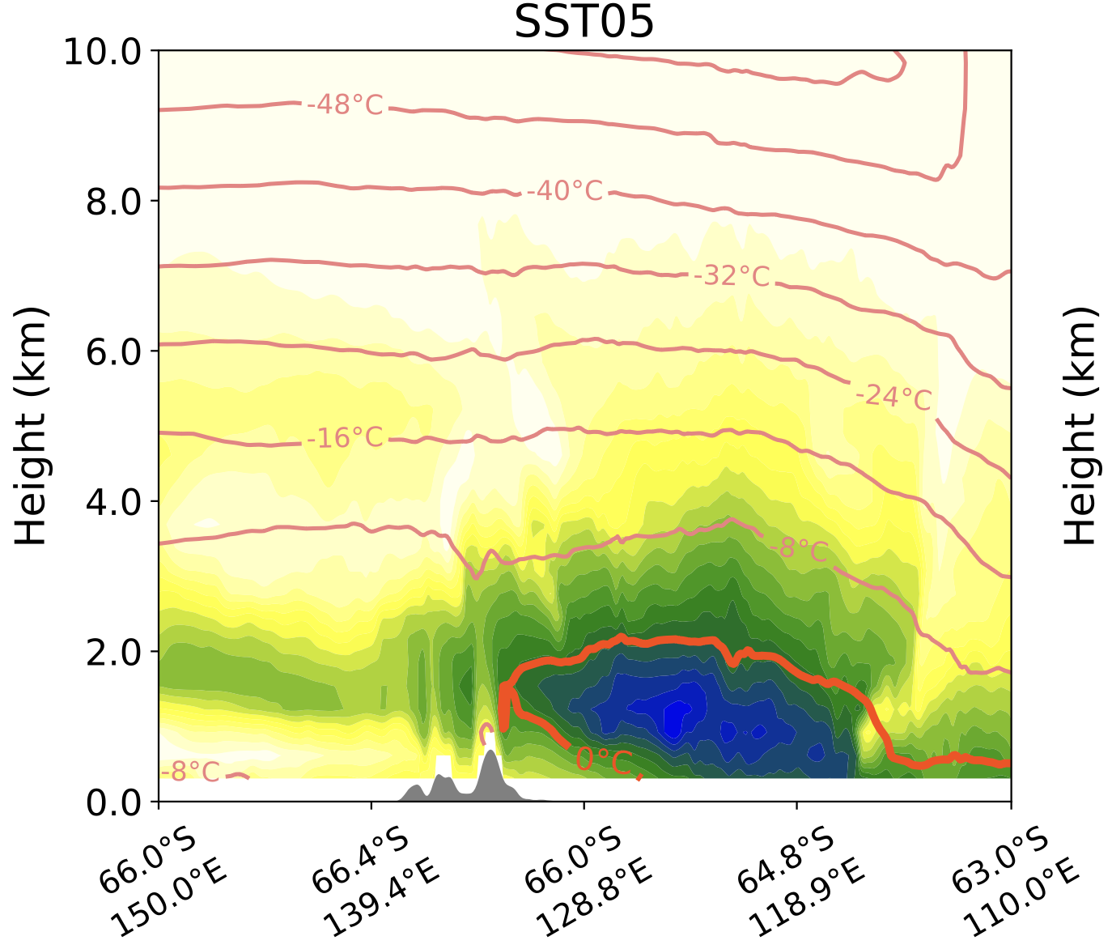
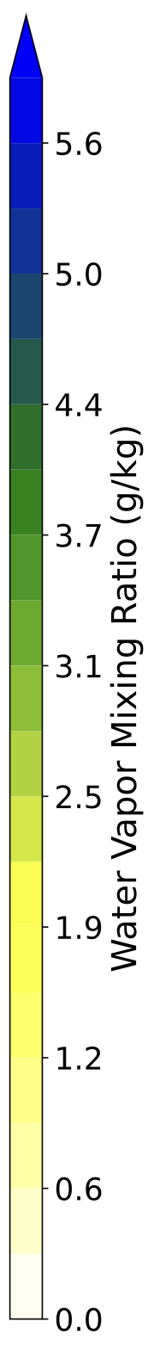
Cross-Sections of Moisture and Temperature – AR Landfall
Coastal cross-section during AR landfall shows the vertical structure of the system.
No LHR case exhibits high moisture content but lower temperatures near the AR core & a lower freezing level.
At the beginning stage, SST0.5% vertical profile remains similar to the Control run.
Control
Control
No LHR
SST0.5% (1-2K)
A
B
A
B
A
B
A

Slide 9
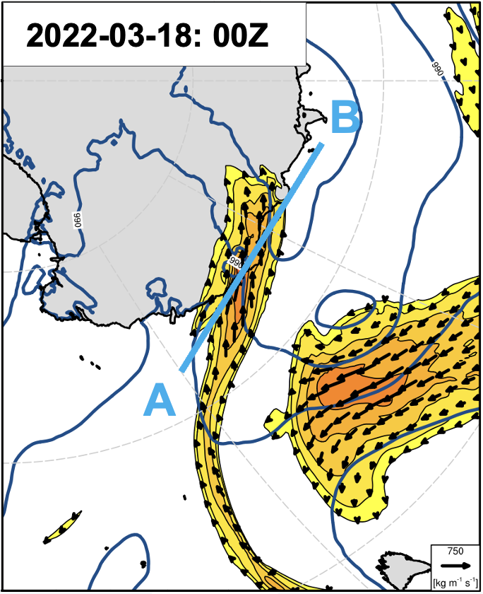
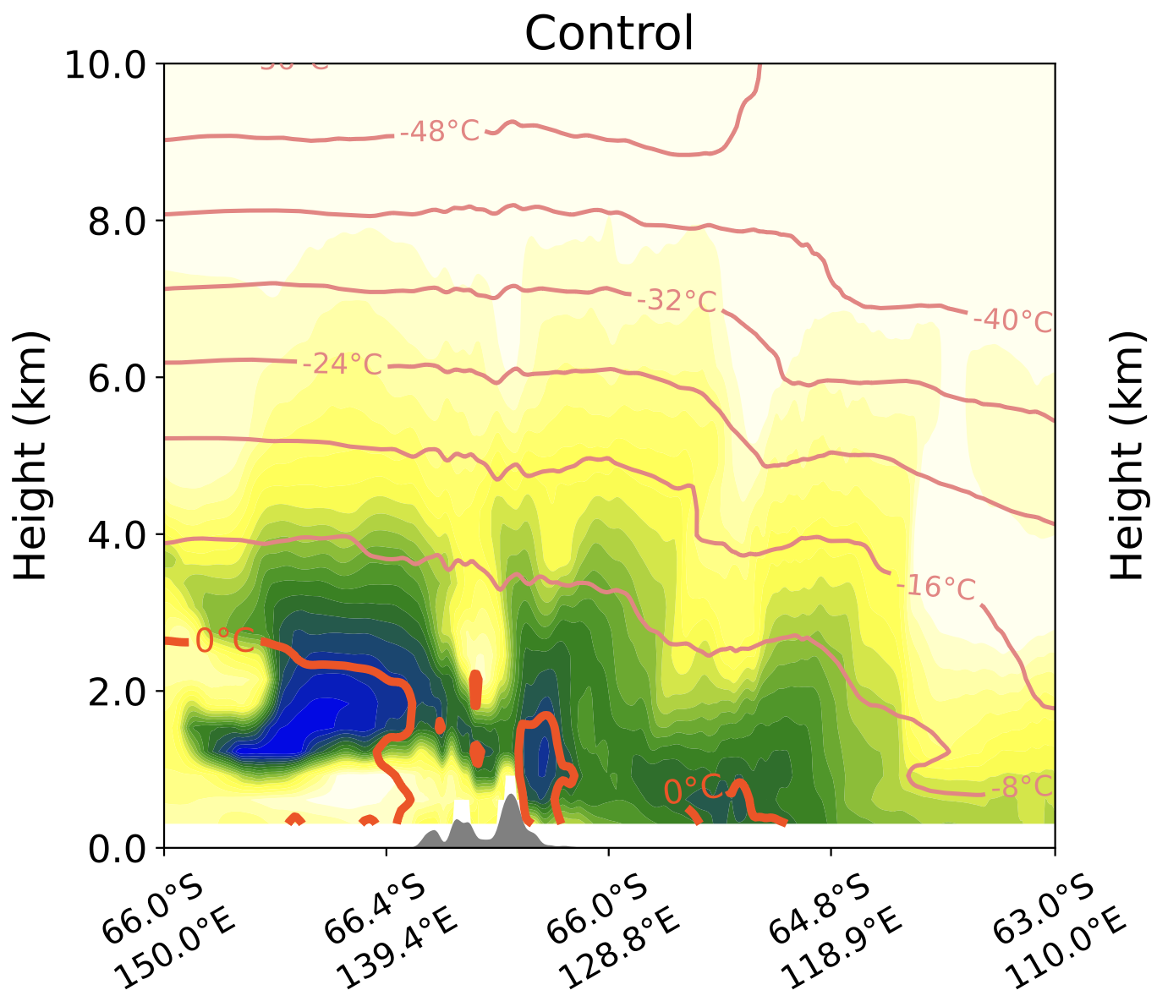
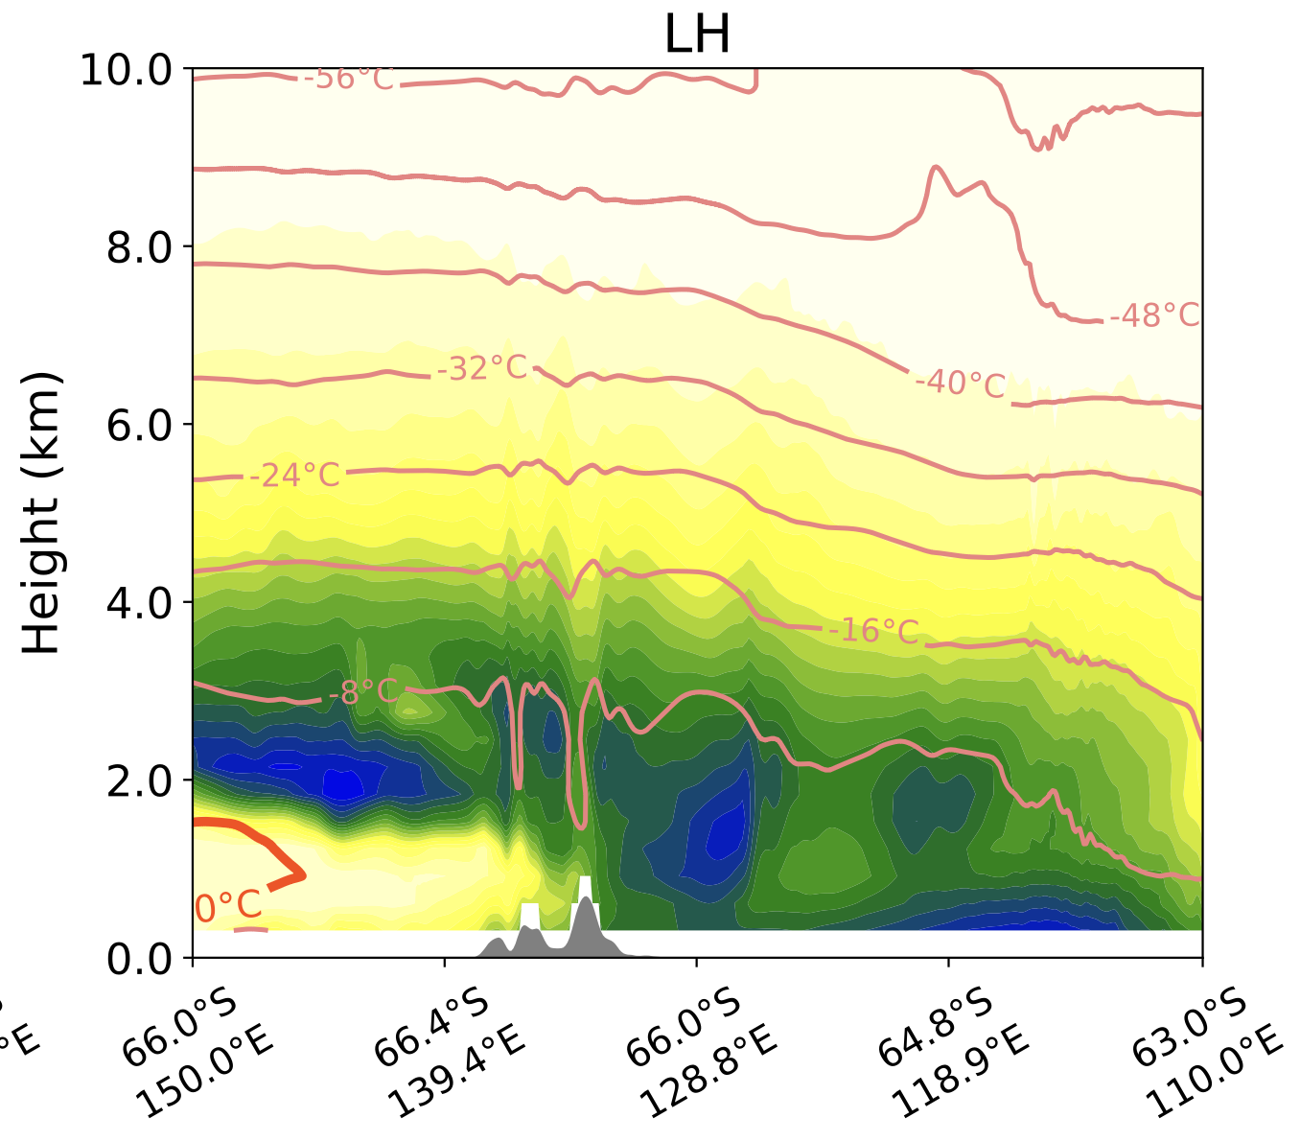
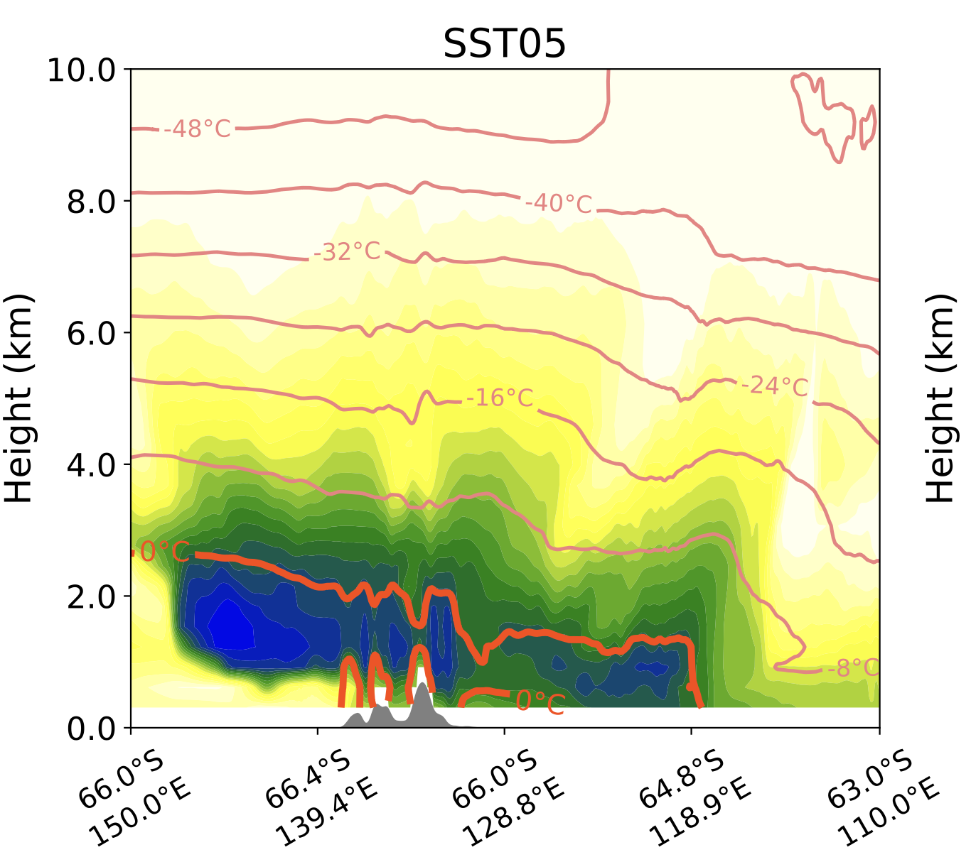
Cross-Sections of Moisture and Temperature – Heatwave Peak
Coastal cross-section during heatwave peak shows the vertical structure of the system.
No-LHR: Lowest moisture at AR core; broader moisture spread in surrounding atmosphere. Lowest freezing level
SST0.5%: Highest moisture at AR core; more moisture in the surrounding; broader area with elevated freezing level.
Control
Control
No LHR
SST0.5% (1-2K)
A
B
A
B
A
B

Slide 10
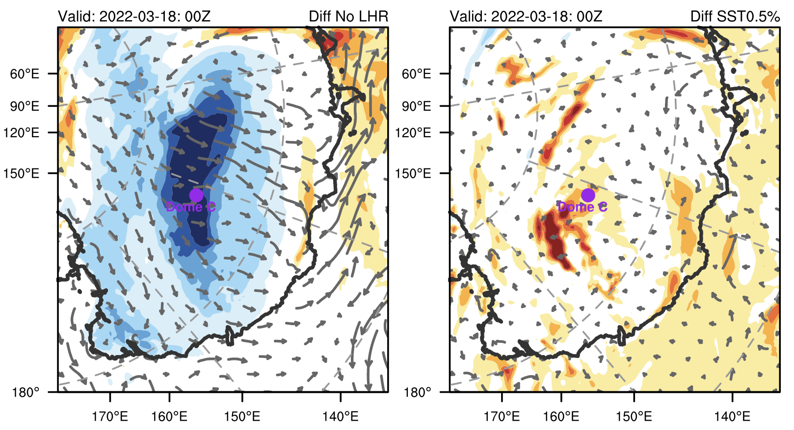
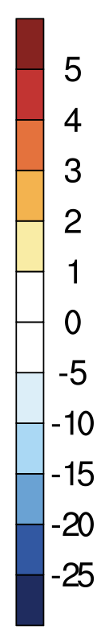
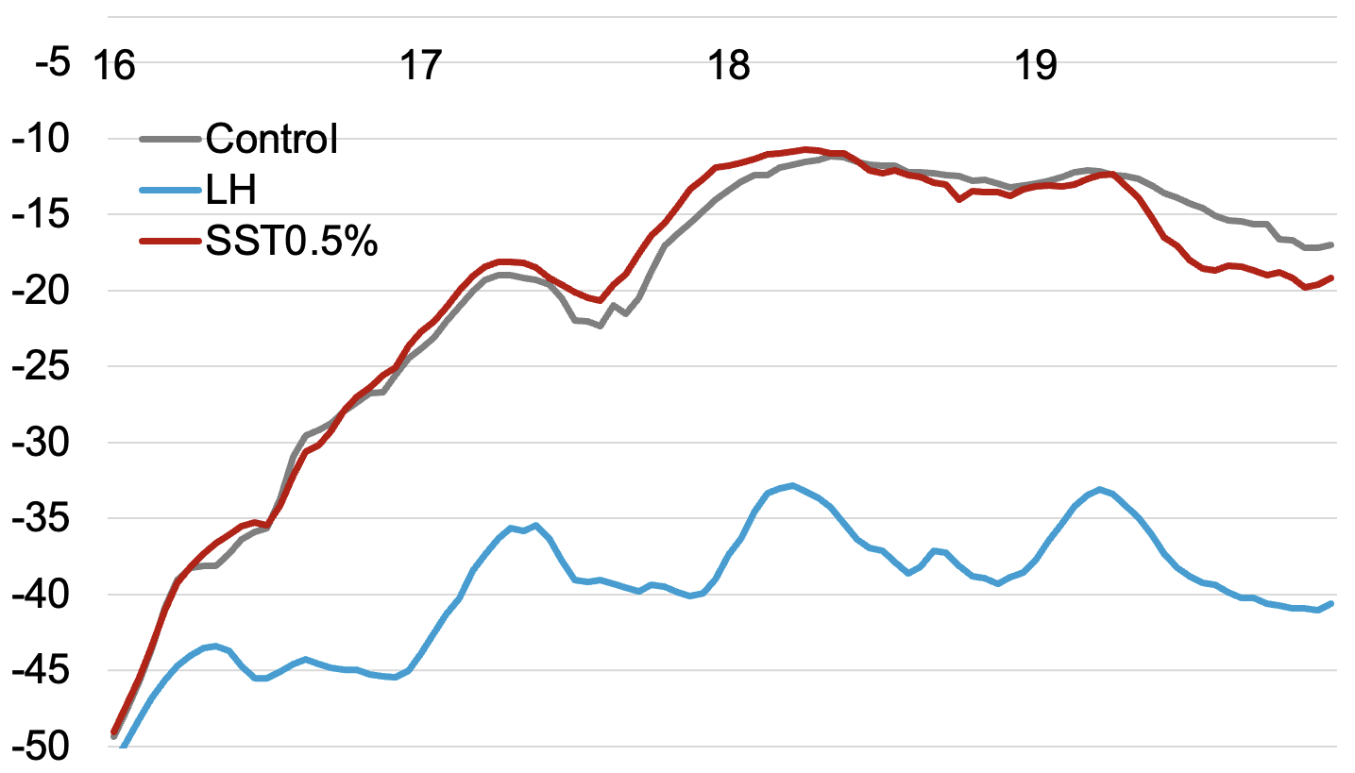
Surface Conditions – Temperature
Surface Temperature & Wind Difference
Temperature @ Dome C
No LHR
SST0.5% (1-2K)
SST0.5% warmer than Control for up to 2.9 ℃
No LHR colder than Control for up to 26.4 ℃
2022-03-18: 00Z
No-LHR: AR did not intrude further inland; different surface wind pattern; no heatwave at Dome C.
SST0.5%: Higher temperatures at Dome C, especially on 18 March; uneven warmer surface compared to Control likely linked to cloud distribution; quicker cooling over Dome C due to blocking high position.

Slide 11
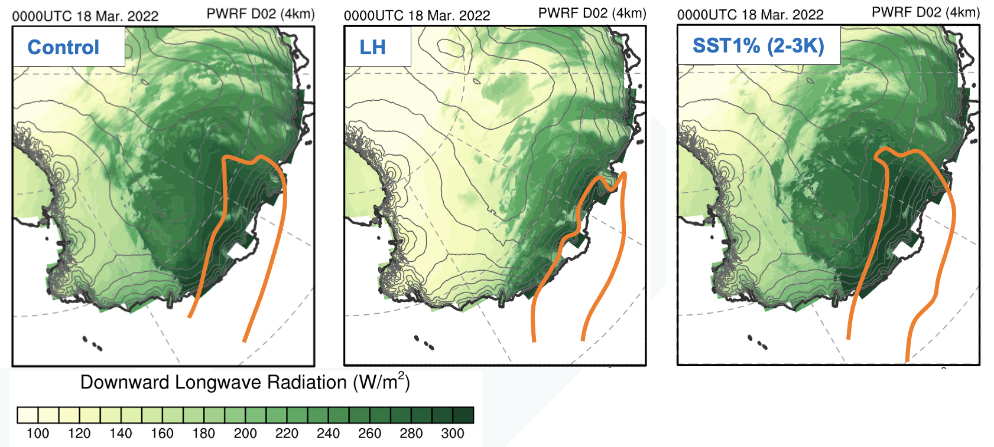
Surface Energy Balance – Downward Longwave
SST0.5%(1-2K)
Consistent with AR patterns.
Downward longwave radiation is likely the main driver for surface warming over EA.
SST1% > Control > No LHR

Slide 12
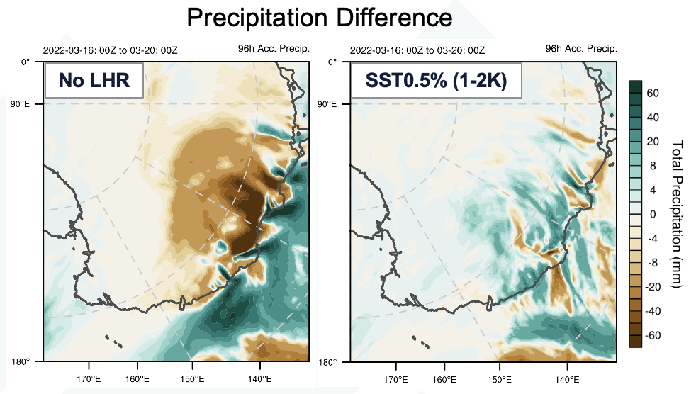
Surface Conditions – Precipitation
No-LHR:
More precipitation over the ocean; reduced precipitation over land.
SST0.5%:
Increased land precipitation with a distinct stripe pattern; requires further investigation.

Slide 13
Summary
Key Atmospheric Process & Oceanic Forcing
Without the energy from latent heat release:
LHR - Key mechanism that amplifies the heatwave event
Alter circulation pattern (weaken WCB) ⟶ change in temperature, cloud radiative impact and precipitation.
Freezing level height decreases ⟶ rain vs snow
Increase in SST:
Enhance the AR magnitude the most during the heatwave peak.
Most precipitation over the Antarctic continent
Temp drops after 03-19 – further investigation needed
Freezing level height increases & warmer low-level air ⟶ rain vs snow

Slide 14

Next Step
Refine experimental PWRF runs (SST&Sea Ice; key region of SST perturbation)
Trajectory analysis to track latent heat exchange.
Other AR-related extreme events
Thank you!

