Slide 1
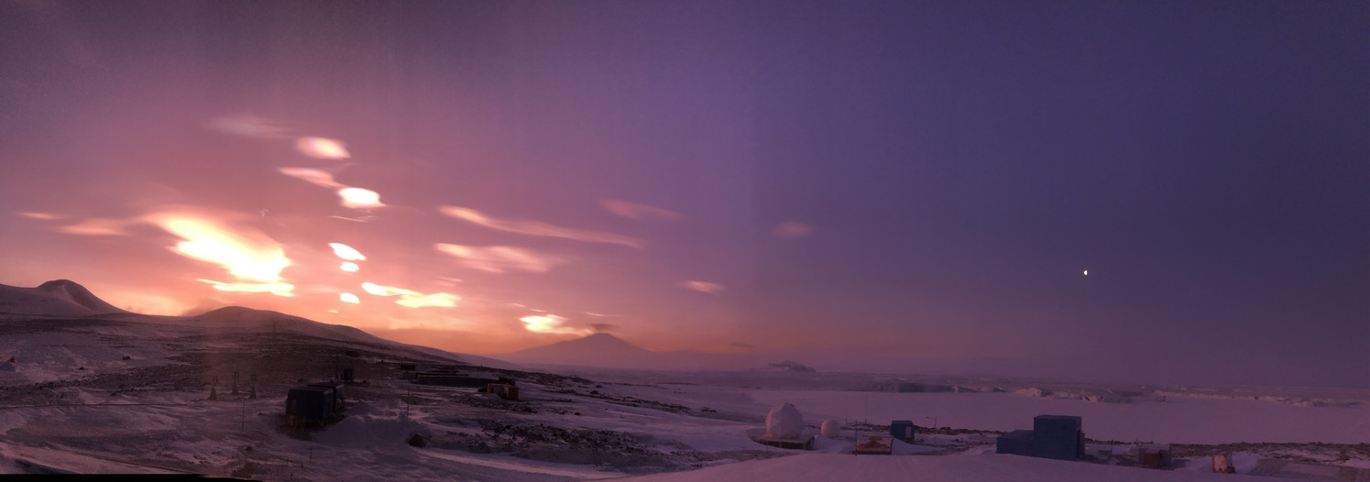
Ten-Year Measurements of Surface Radiation
and Turbulent Heat Flux
at Jang Bogo Station, Terra Nova Bay, Antarctica
Taejin Choi and Wonseok Seo
Korea Polar Research Institute
(The 30th ISPS/The 20th WAMC, KORPRI, Incheon, Korea)
2020.07.28

Slide 2
Introduction:
Major Events Since Jang Bogo station Opening at Terra Nova BAY in 2014
Sea Ice Breaking in Mid-Winter
  July 29 – Aug. 2, 2022 (sea ice airstrip unusable; high temperature in October)
  Aug. 5 – Aug. 17, 2023 (Sea ice airstrip usable; low temperature in October)
Pronounced and consistent temperature Rise, especially in winter (2015-2022)
Record-Breaking Warm Events
  March 2022: Highest temperature (8.8℃, 2022)
  June 2025: -0.6 ℃ (vs. -3.1 ℃ in June 2000)
  January 2025: 8.1 ℃ (vs. 6.7 ℃ in January 2021 Jan)

Slide 3
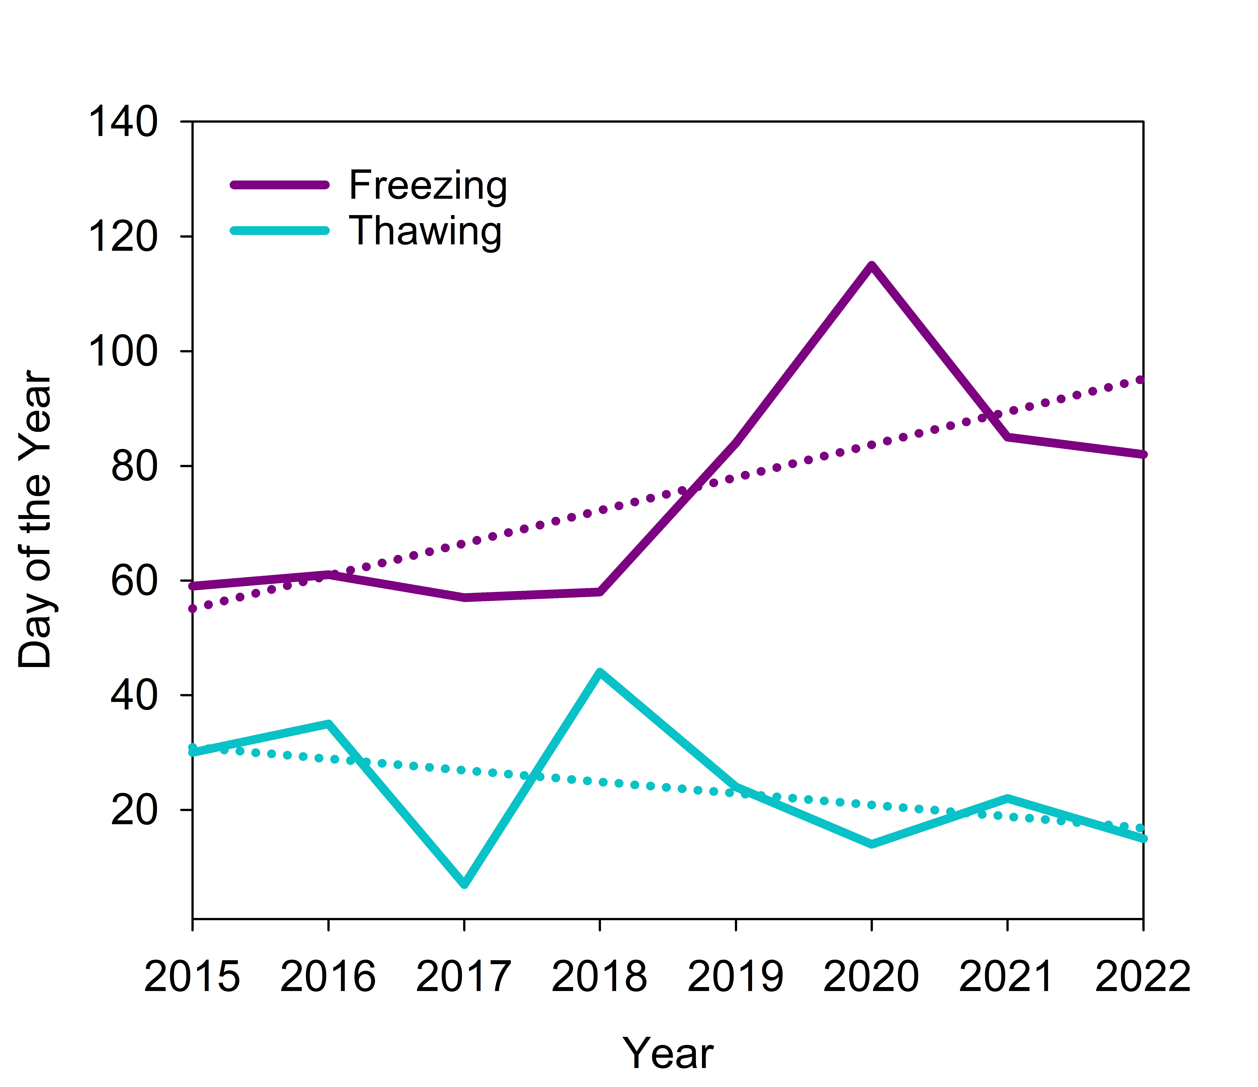
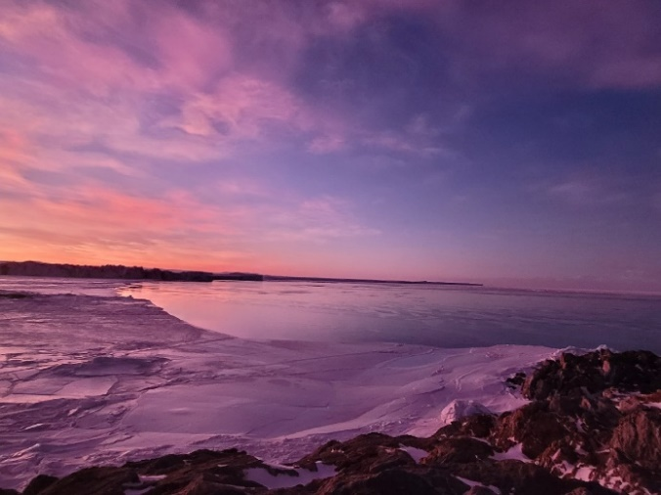
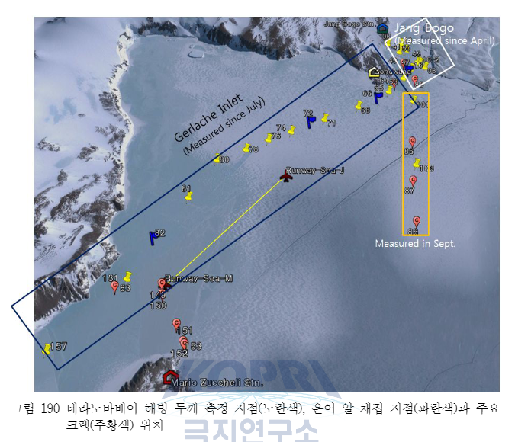
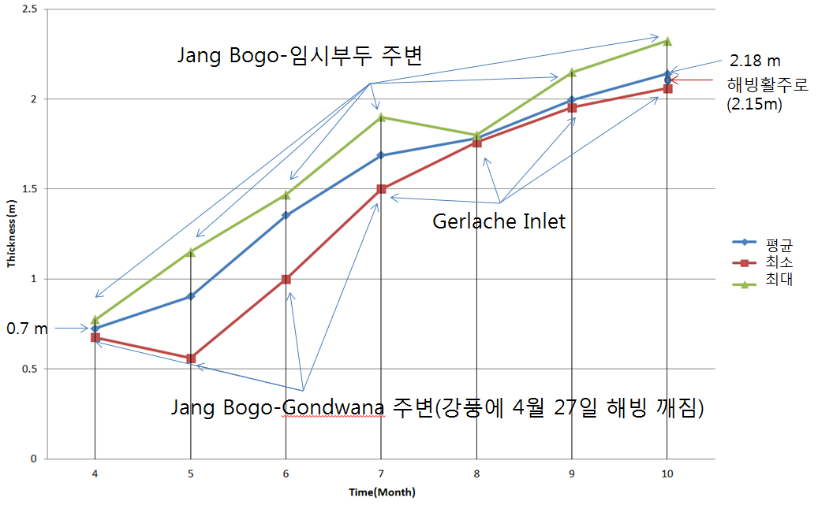
2023.08.07
2014

Slide 4
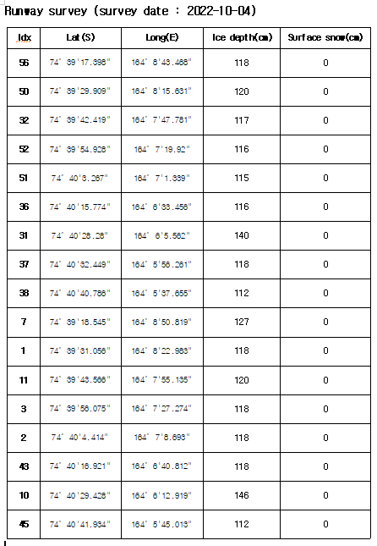
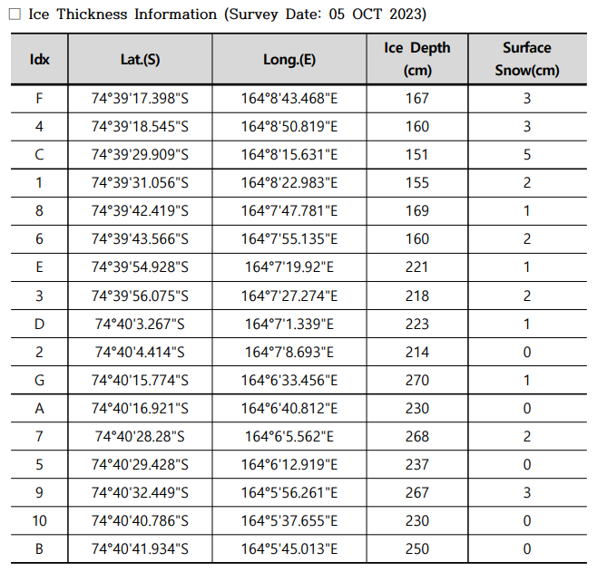

Slide 5
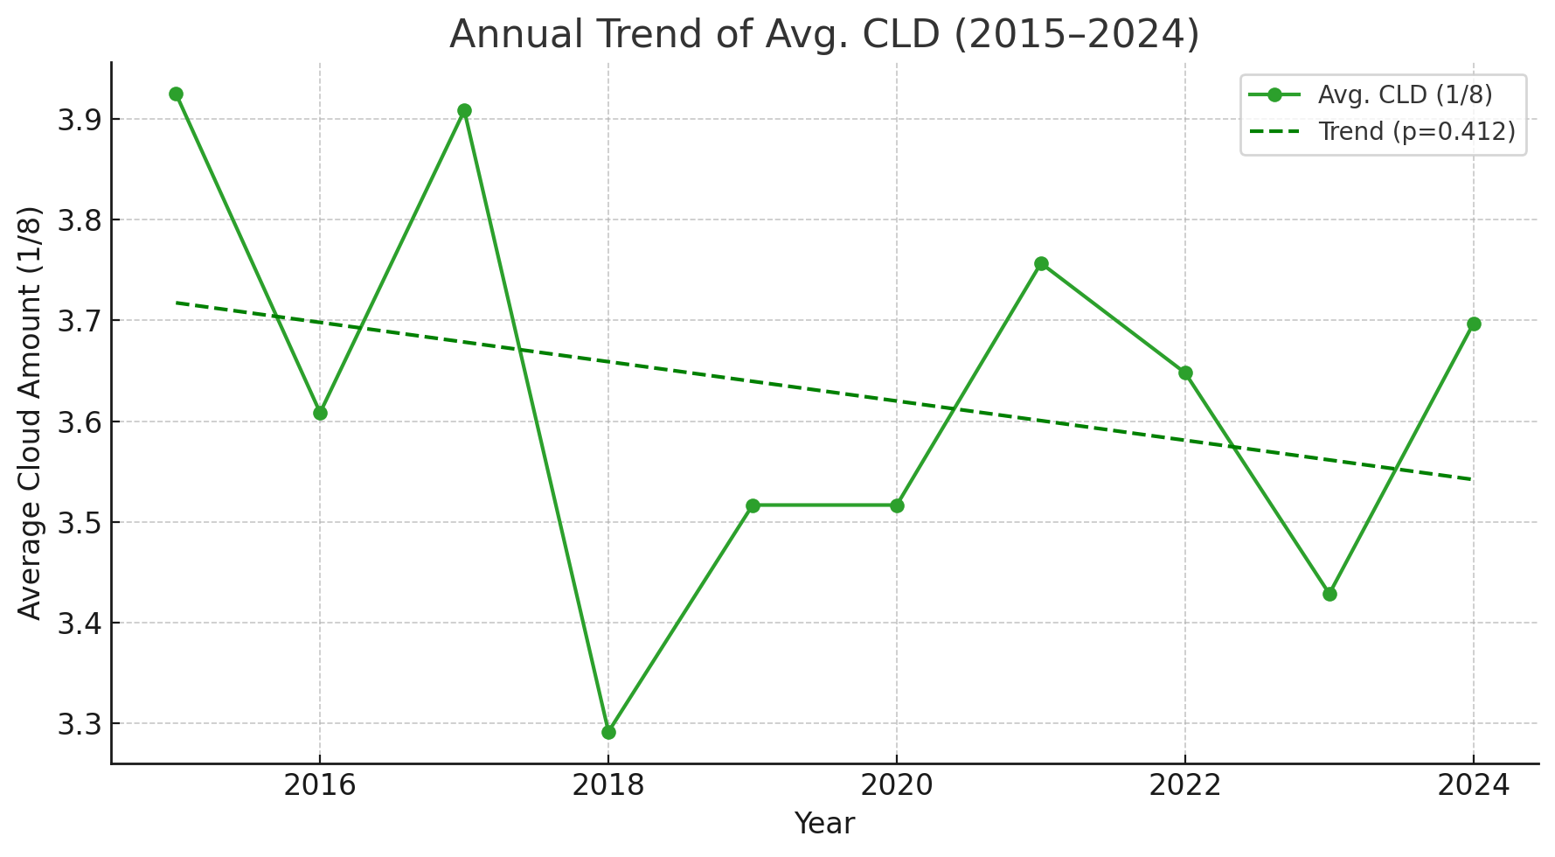
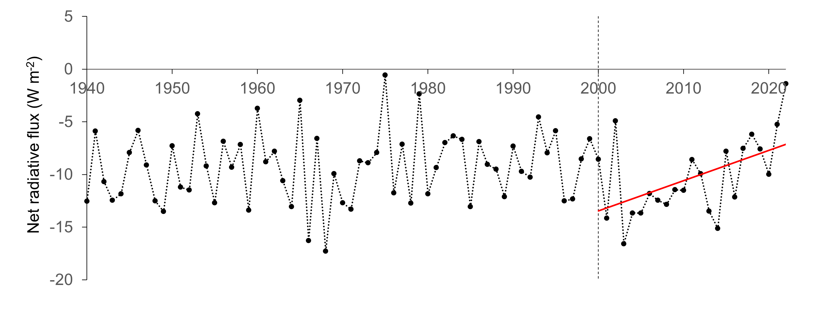
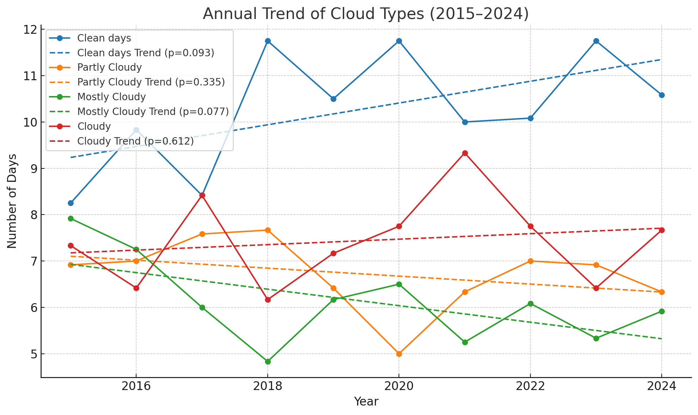
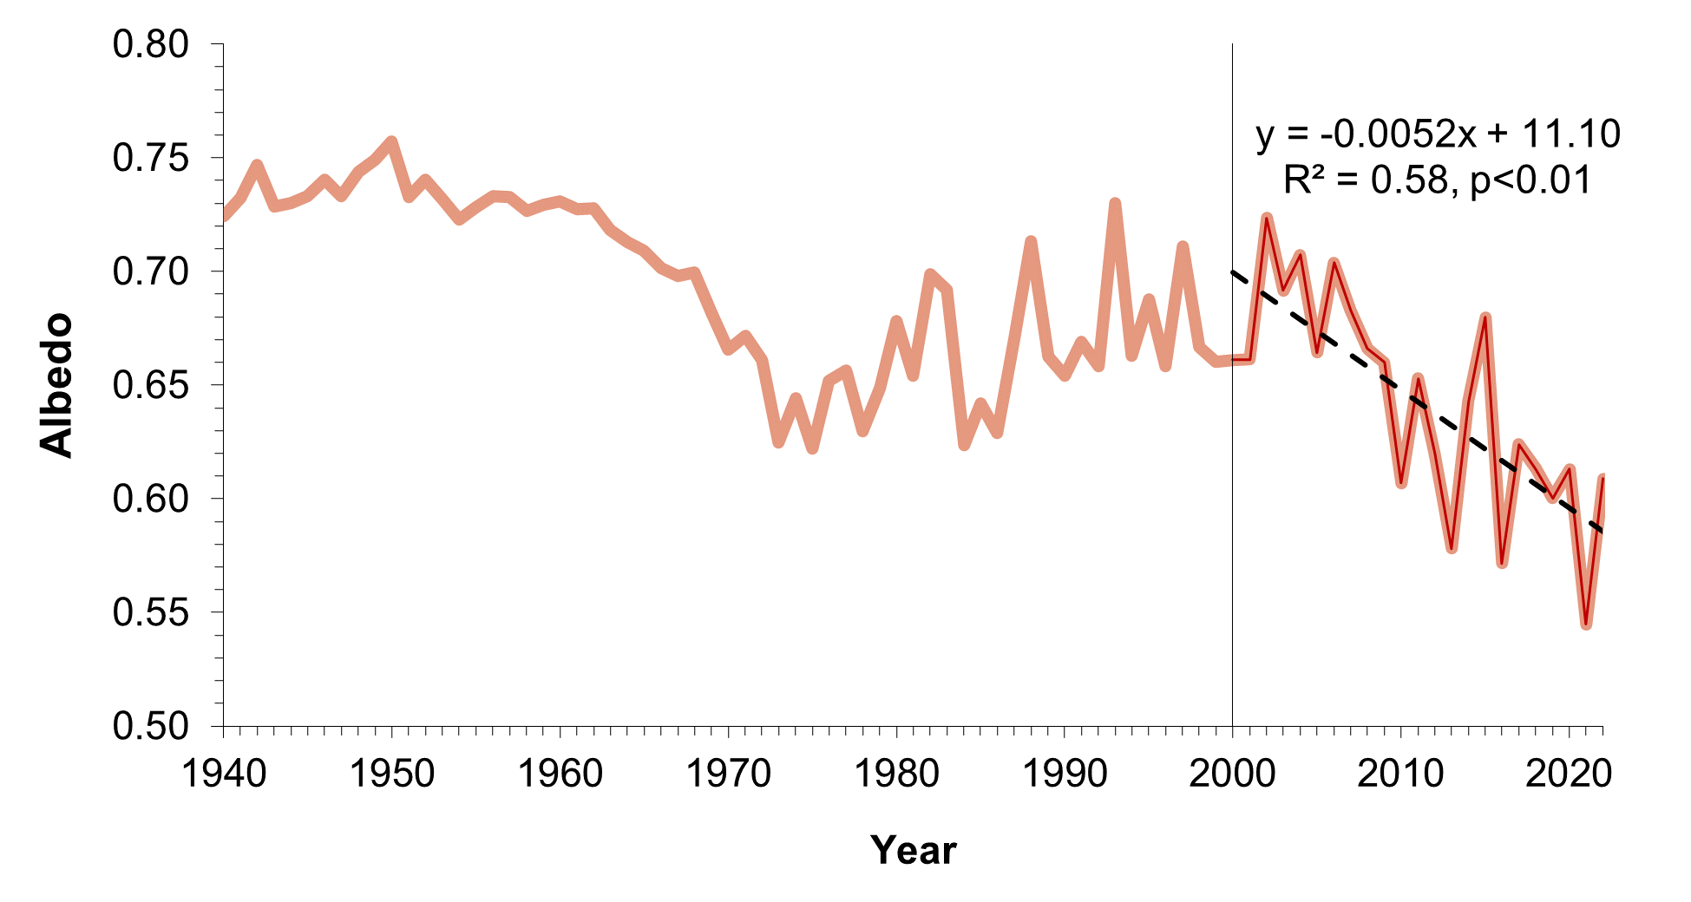
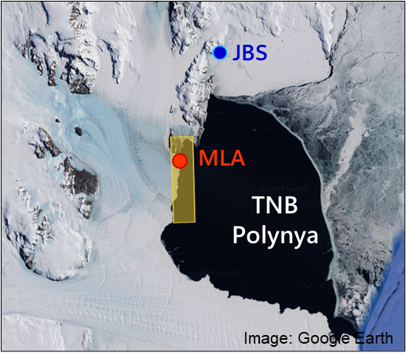
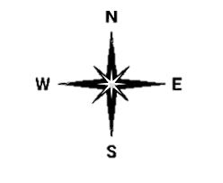
Changes in Cloud/Surface radiation
Cloud Cover Trend at Jang Bogo station(Observation)
Surface Net Radiation Trend at Dome-C (ERA5)
Albedo Trend in Spring at TNBP (ERA5)
Notes:
남극 지표 기온은 많은 경우 대기 순환에 의해 지배당함.
남극 내륙의 inversion이 강화되지 않았다면 원인은 종관적 변화에 있을 것임

Slide 6
Objective of the Study:
Before continuous observation on the fast ice thermodynamics near JBS from next year,
Examine changes in surface radiation and wind over the past ten years
Evaluate their role in turbulent energy exchanges.

Slide 7
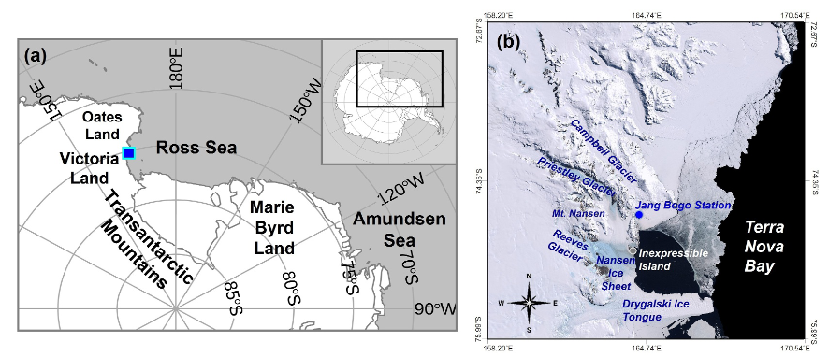
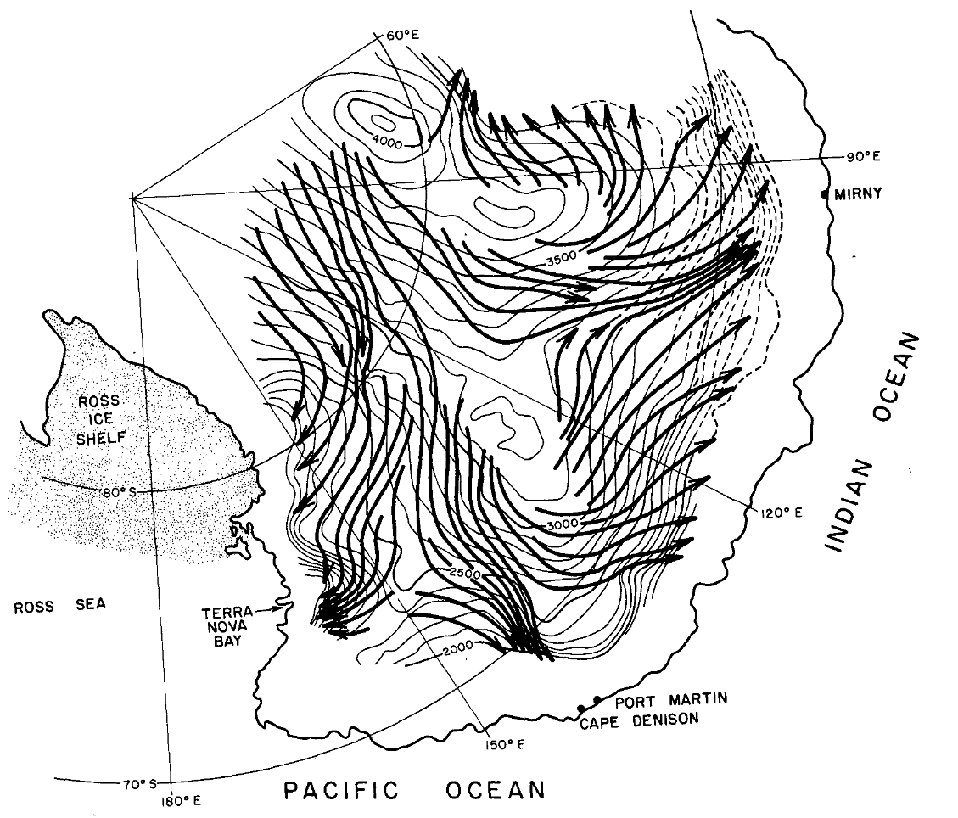
Site:
- Location: Jang Bogo Station, Terra Nova Bay
- Annual Mean Wind Speed: ~4.6 m/s
- Not directly influenced by katabatic wind
Parish (1982)

Slide 8
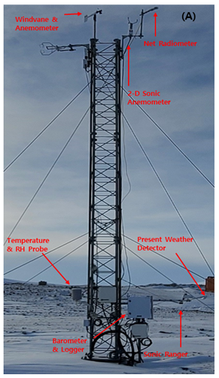
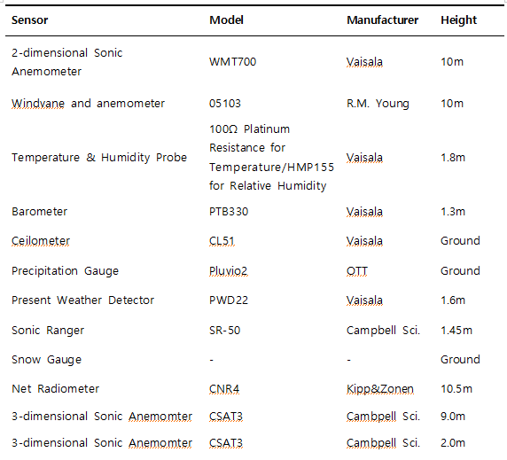
Measurements
3D Sonic Anemo.

Slide 9
Data processing
for turbulent flux data
Raw Data
Coordinate rotation
Water vapor correction
Kang et al. (2018)
Wutzler et al.(2018)
L0 (Eddypro advanced mode)
Air density correction
Biomet data QC
EC150 slow-response Temperature correction
Storage flux calculation
Papale et al. (2006)
L1 (Reddyproc QC)
Spike detection
Biomet data Gap-filling
U star filtering(NEE)
Reichstein et al. (2005)
Lasslop et al.(2010)
Sensible heat Flux Gap-filling
L2 (Reddyproc Partitoning)
Partitioning(GPP, RECO)
Notes:
The eddy covariance data were processed in three stages according to standard procedures.

Slide 10
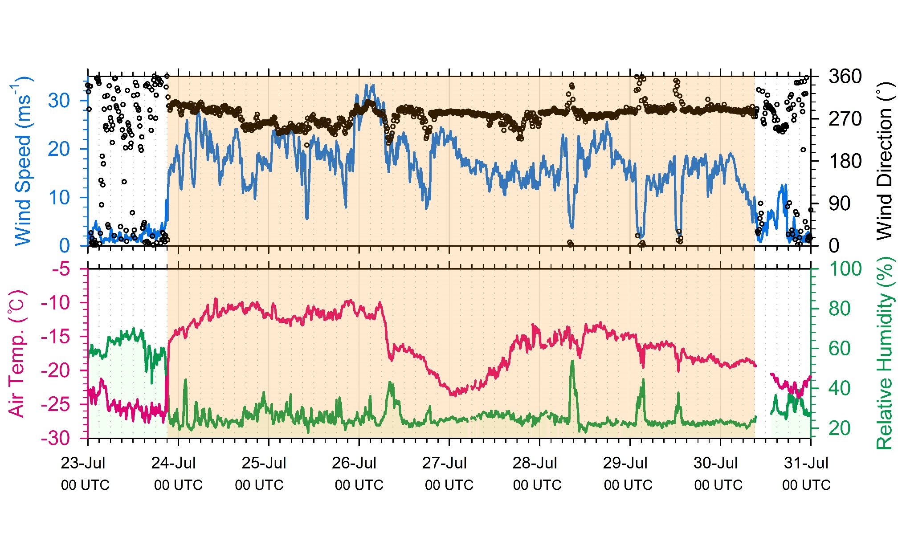
Strong wind case study: July 23, 2022
Strong westerly winds
Air temperature increased from -27.7 ℃ → -9.4℃ (+18.3 ℃)
Wind speed up to 33 m s⁻¹
Relative humidity decreased by ~ -52%

Slide 11
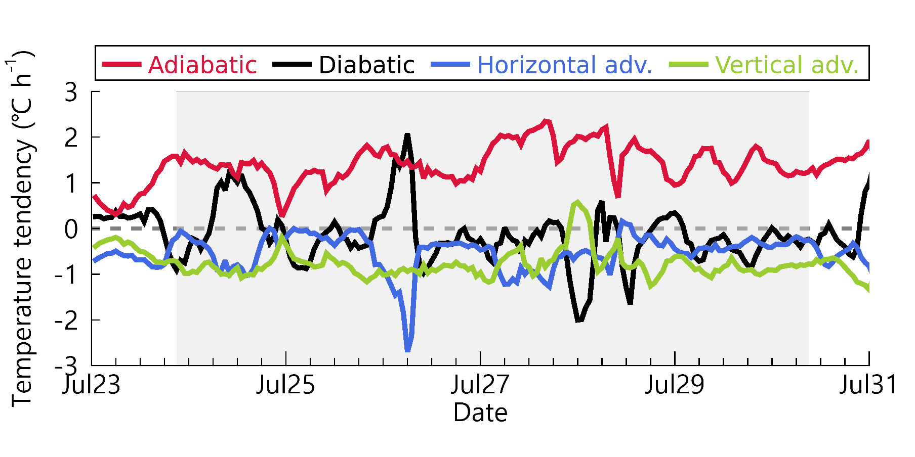

Warming Mechanism during strong wind events
$\frac{∂T}{∂t}$=-[$(u\left(\frac{∂T}{∂x}\right)+v\left(\frac{∂T}{∂y}\right)]+\left(\frac{RT}{C_{p}p}−\frac{∂T}{∂p}\right)\text{ω}+\frac{J}{C_{p}}$
(Thermodynamic equation)
Temperature rise is mainly driven by
(foehn effect)
1) Adiabatic heating due to the descending air masses over the mountains
2) Diabatic heating
(Vertical mixing in a stable boundary layer)

Slide 12
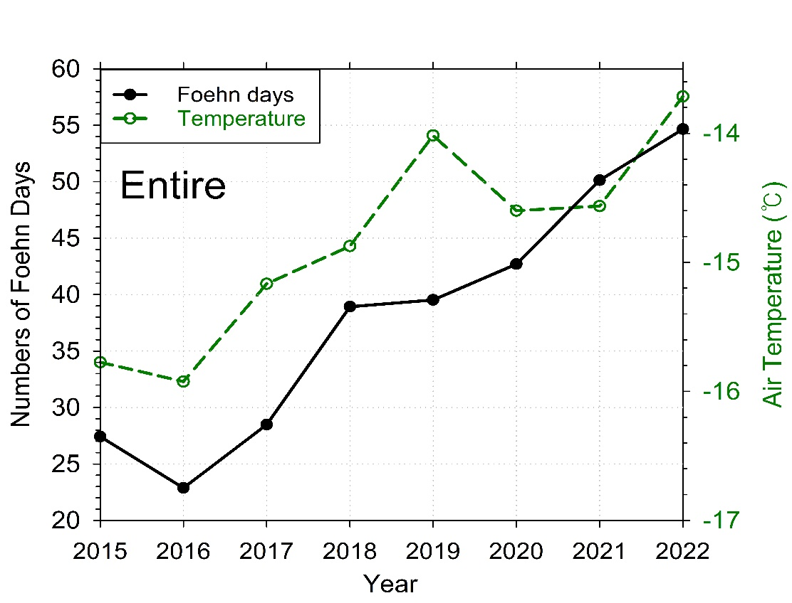
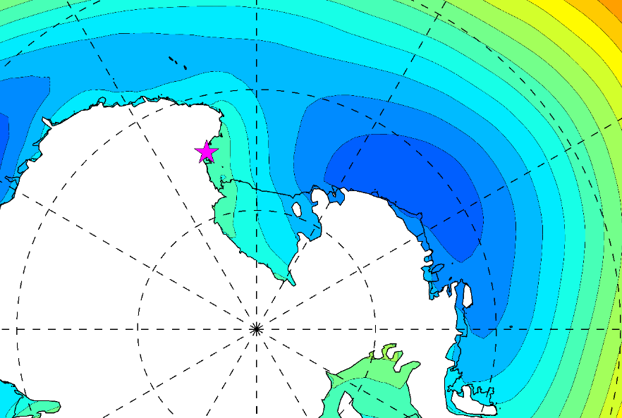
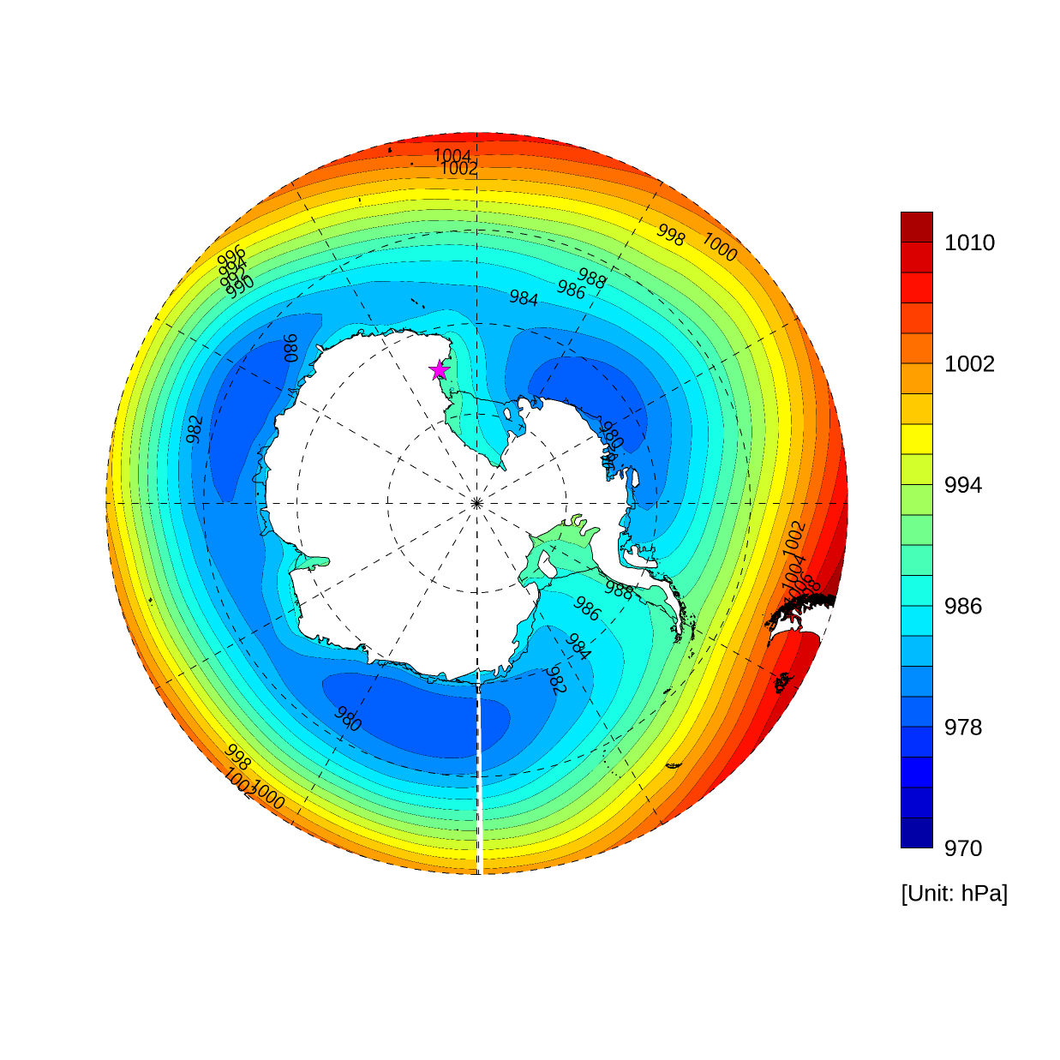
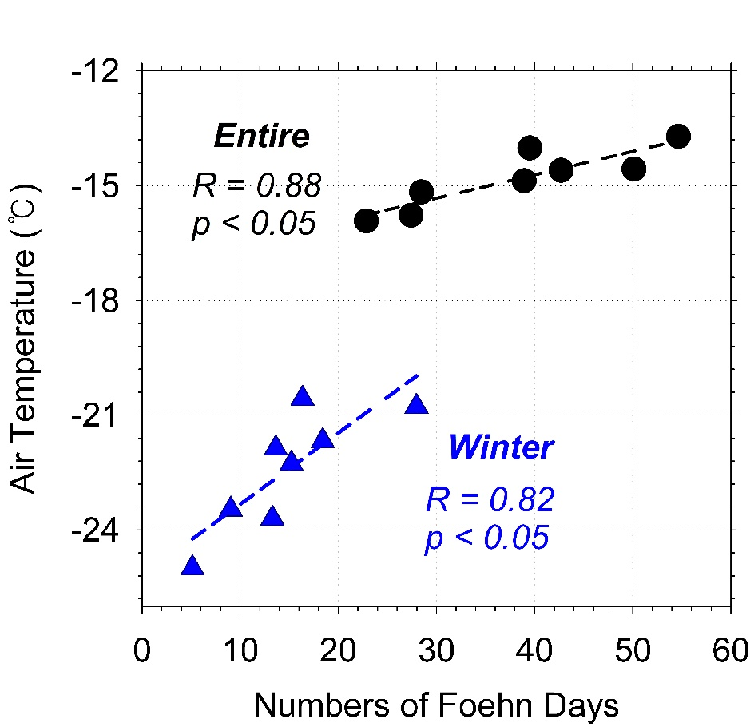
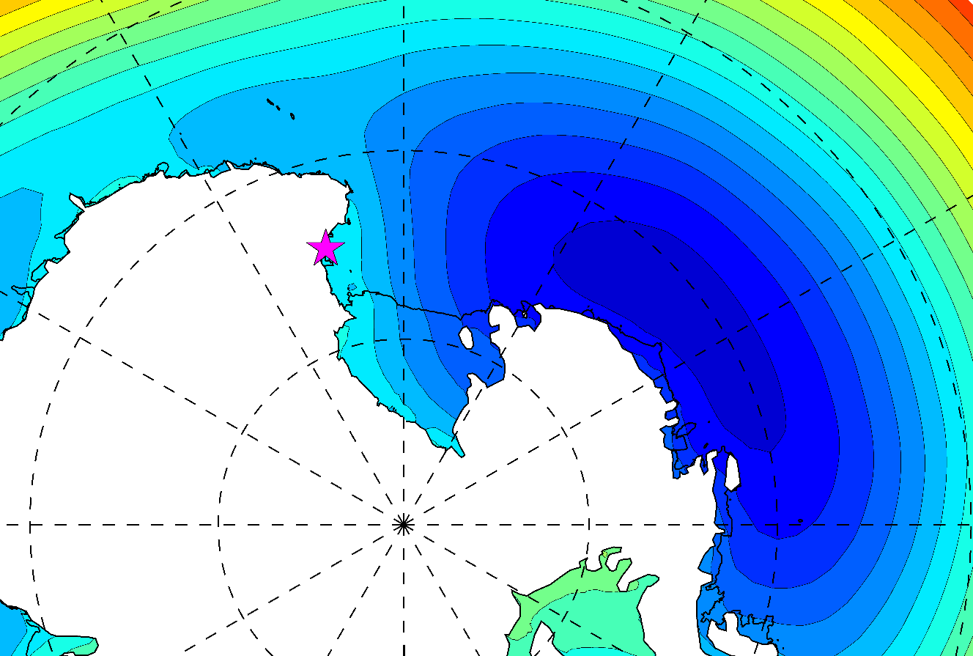
Correlation between temperature and foehn occurrence
2016
The cumulative frequency of foehn occurrence and temperature are increasing almost simultaneously at JBS, and the correlation between the two in winter is remarkable.
A higher frequency of foehn occurrences is associated with the development of cyclones east of the Ross Sea/west of the Amundsen Sea.
984
982
980
2022
978
976
974

Slide 13
Diabatic heating changes?

Slide 14
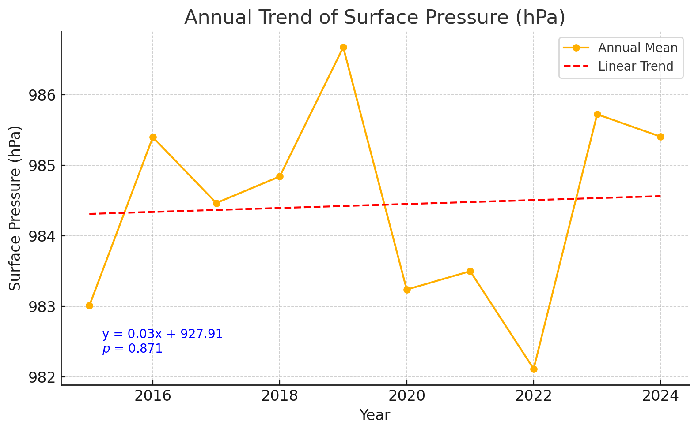
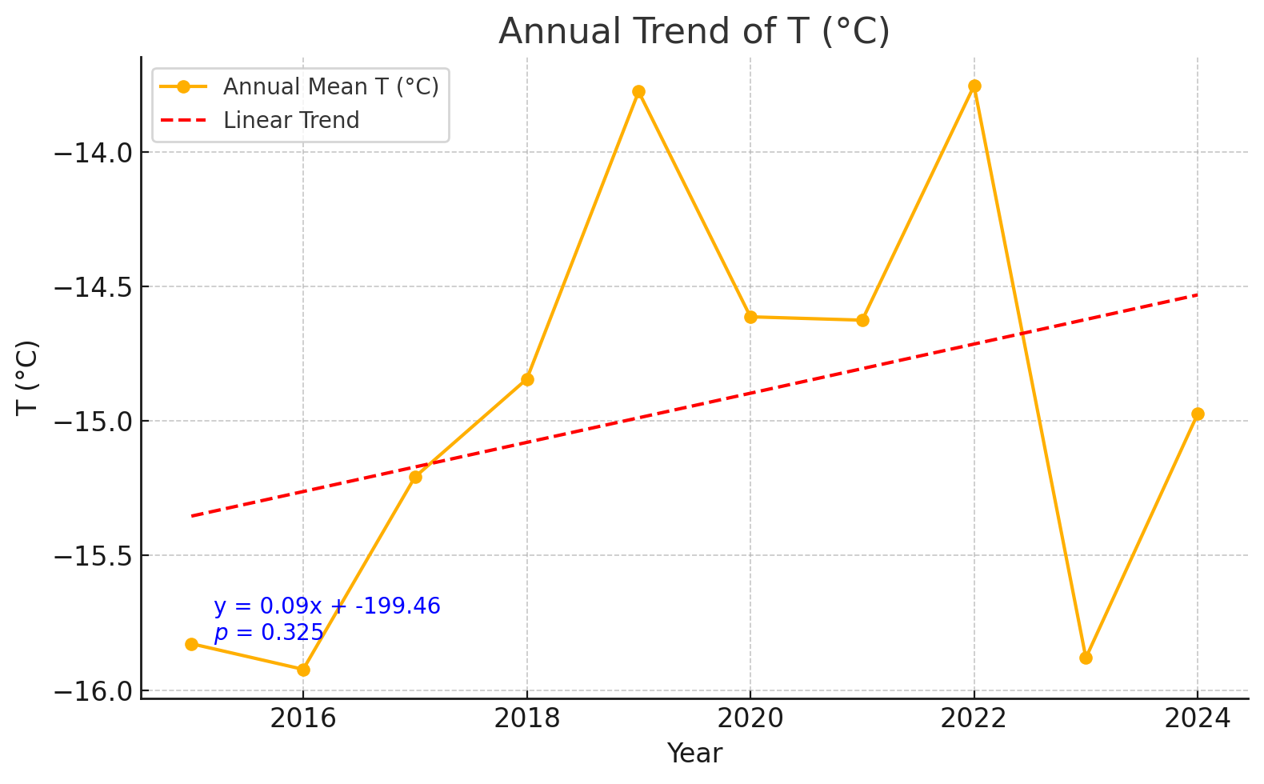
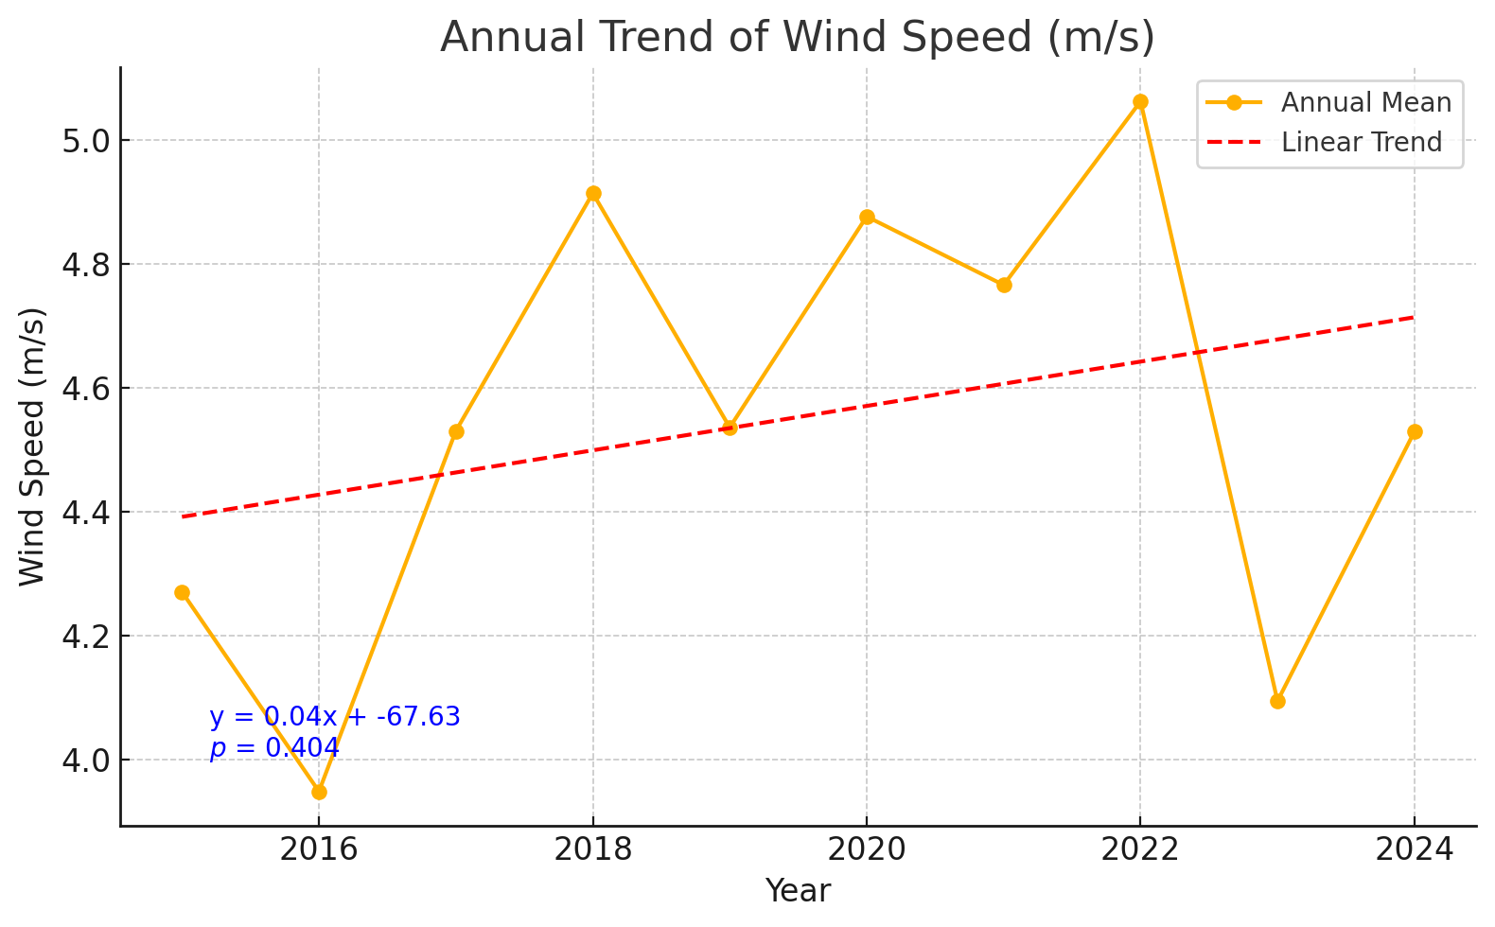
Analysis Period: 2015-2024
Significant changes before 2022
Mid Winter sea ice breakups/unusable air strip
Mid Winter sea ice breakups/usable air strip

Slide 15
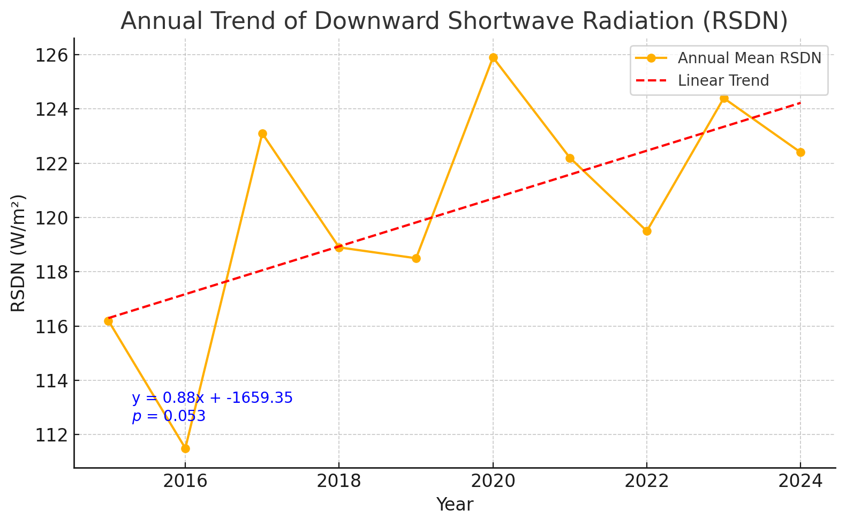
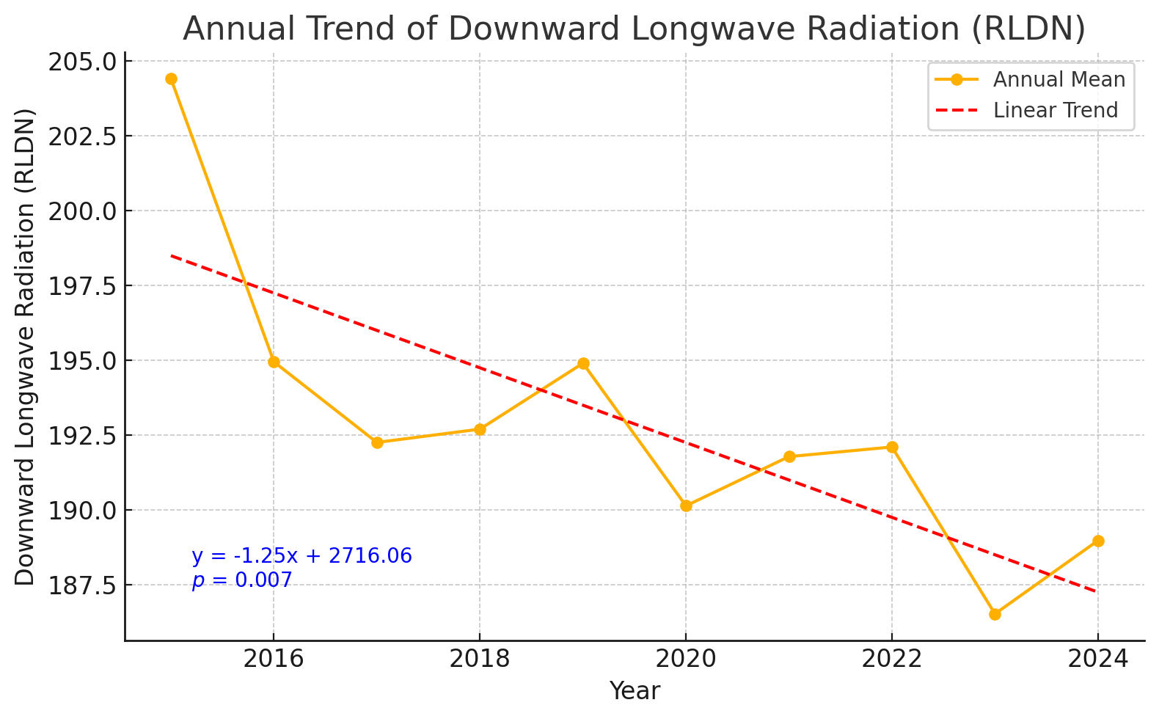
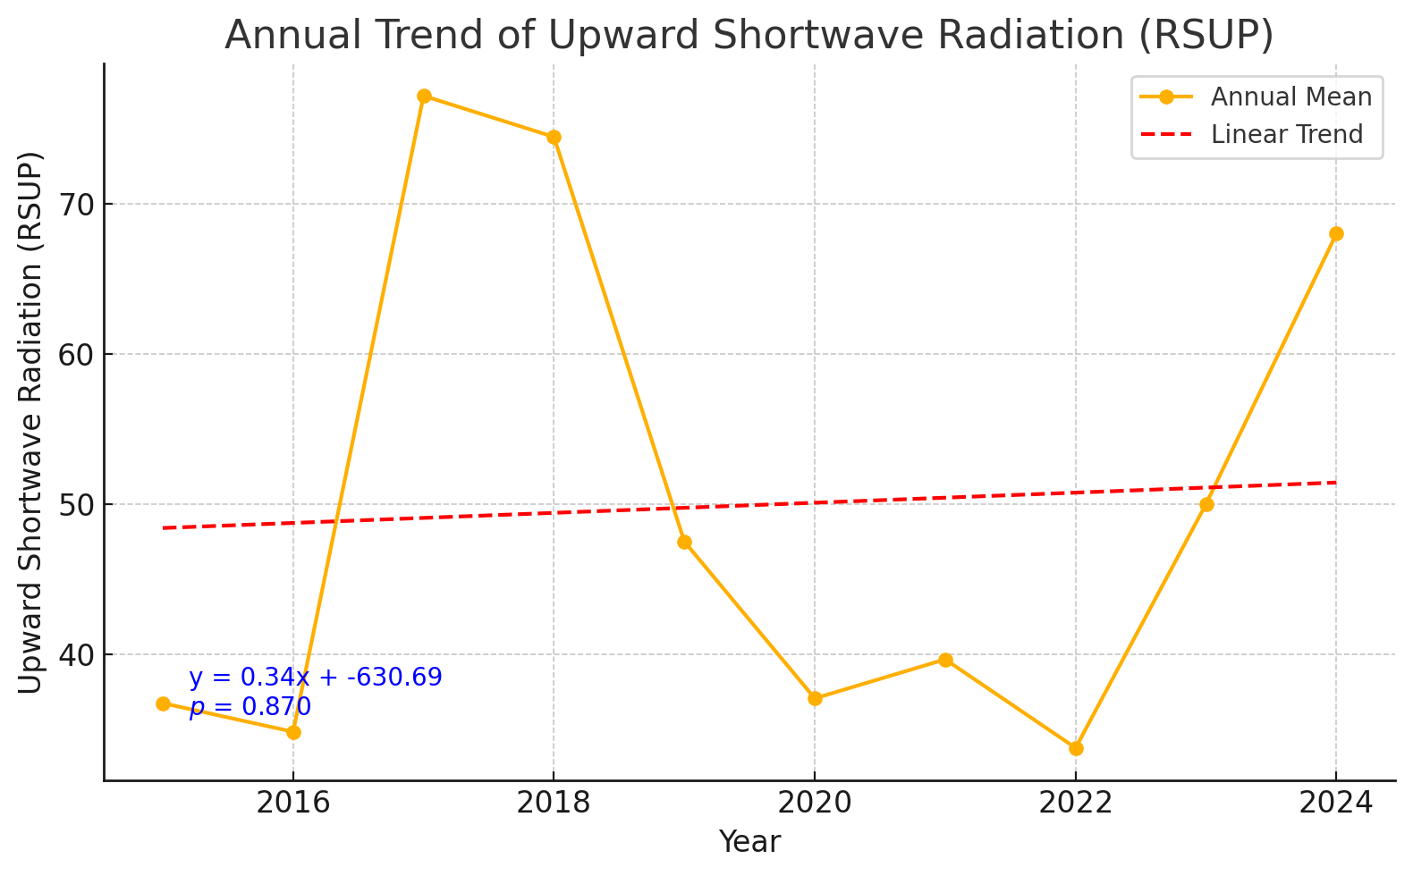
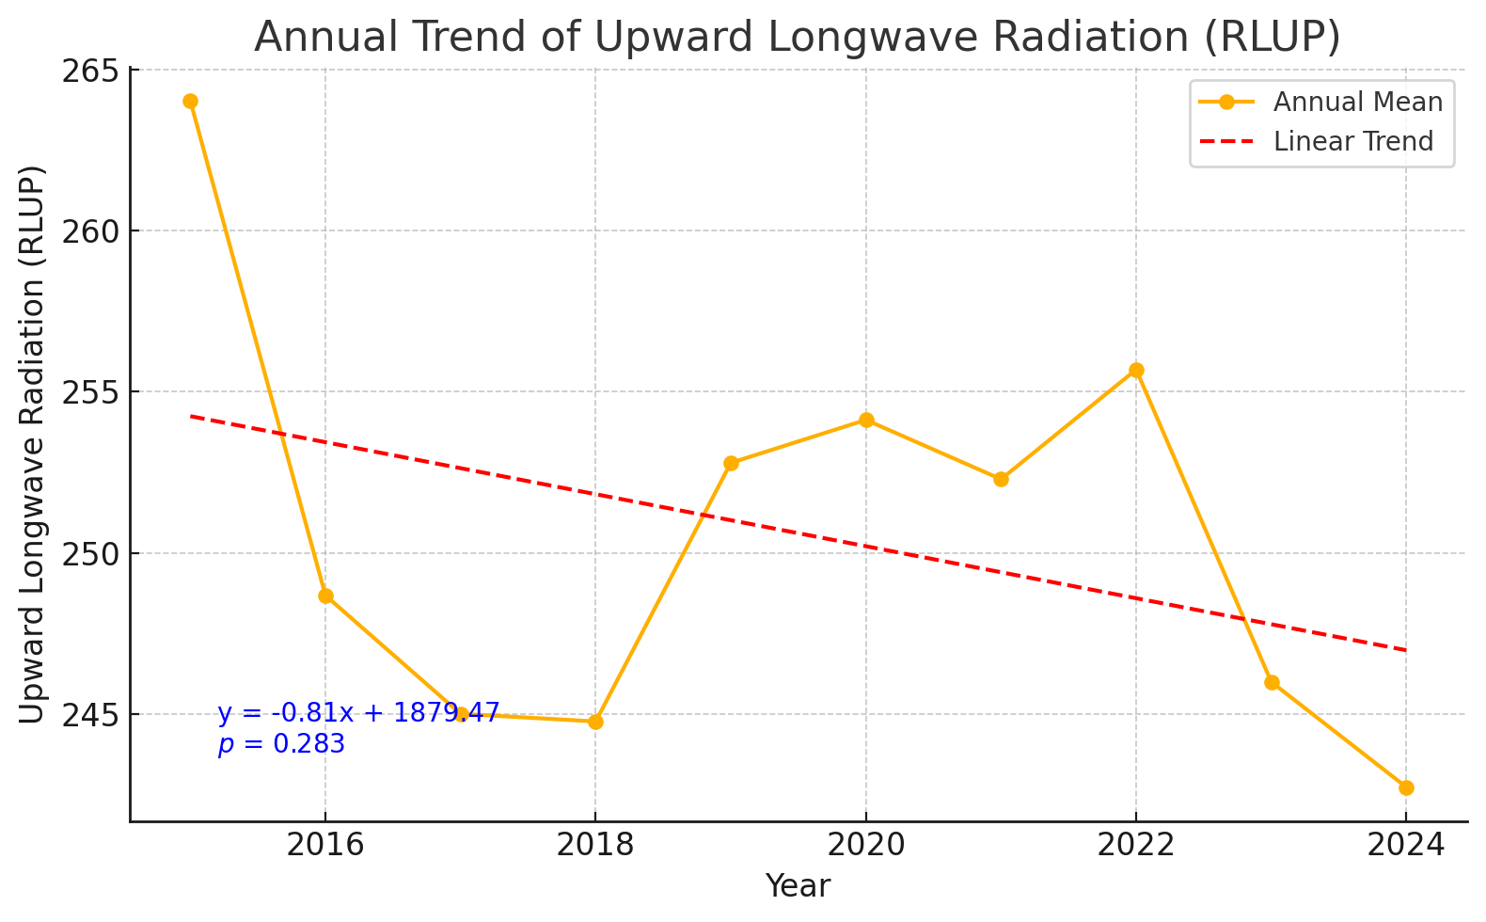
Cloud effect
Snow effect

Slide 16
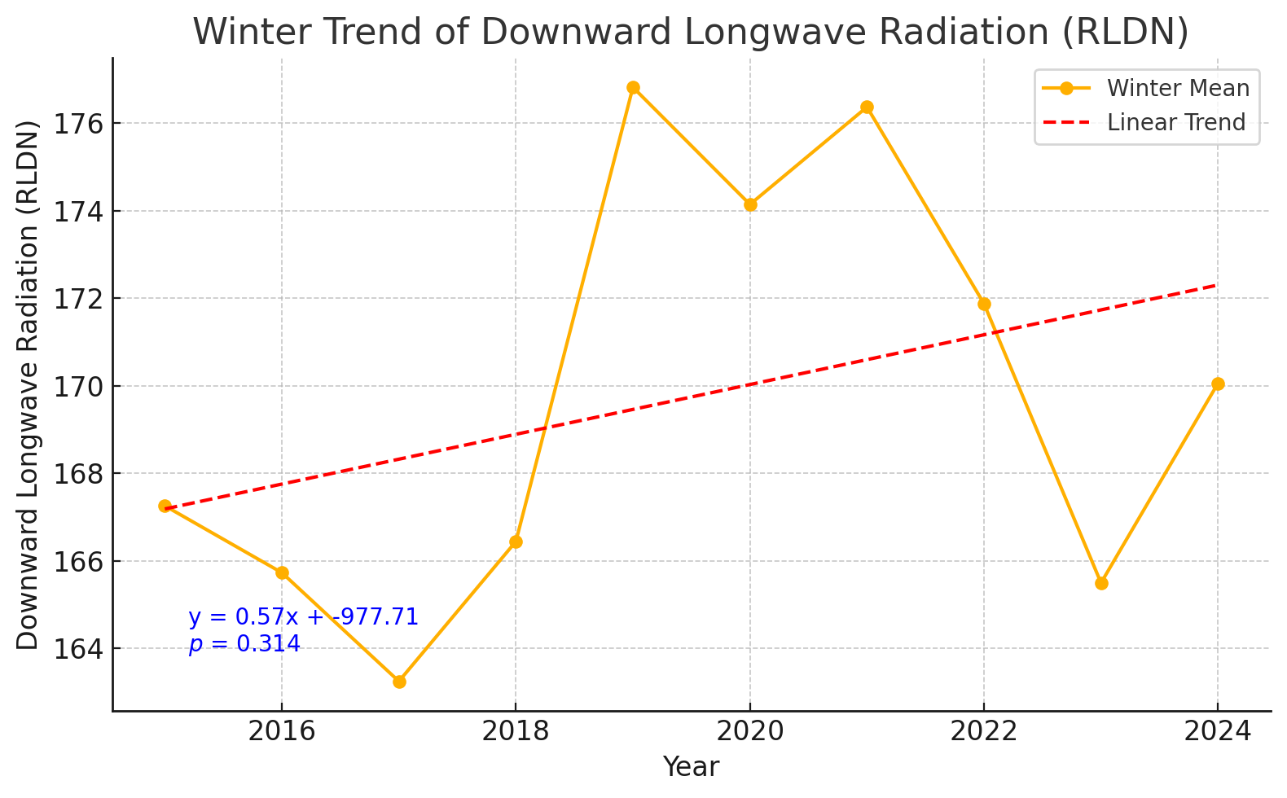
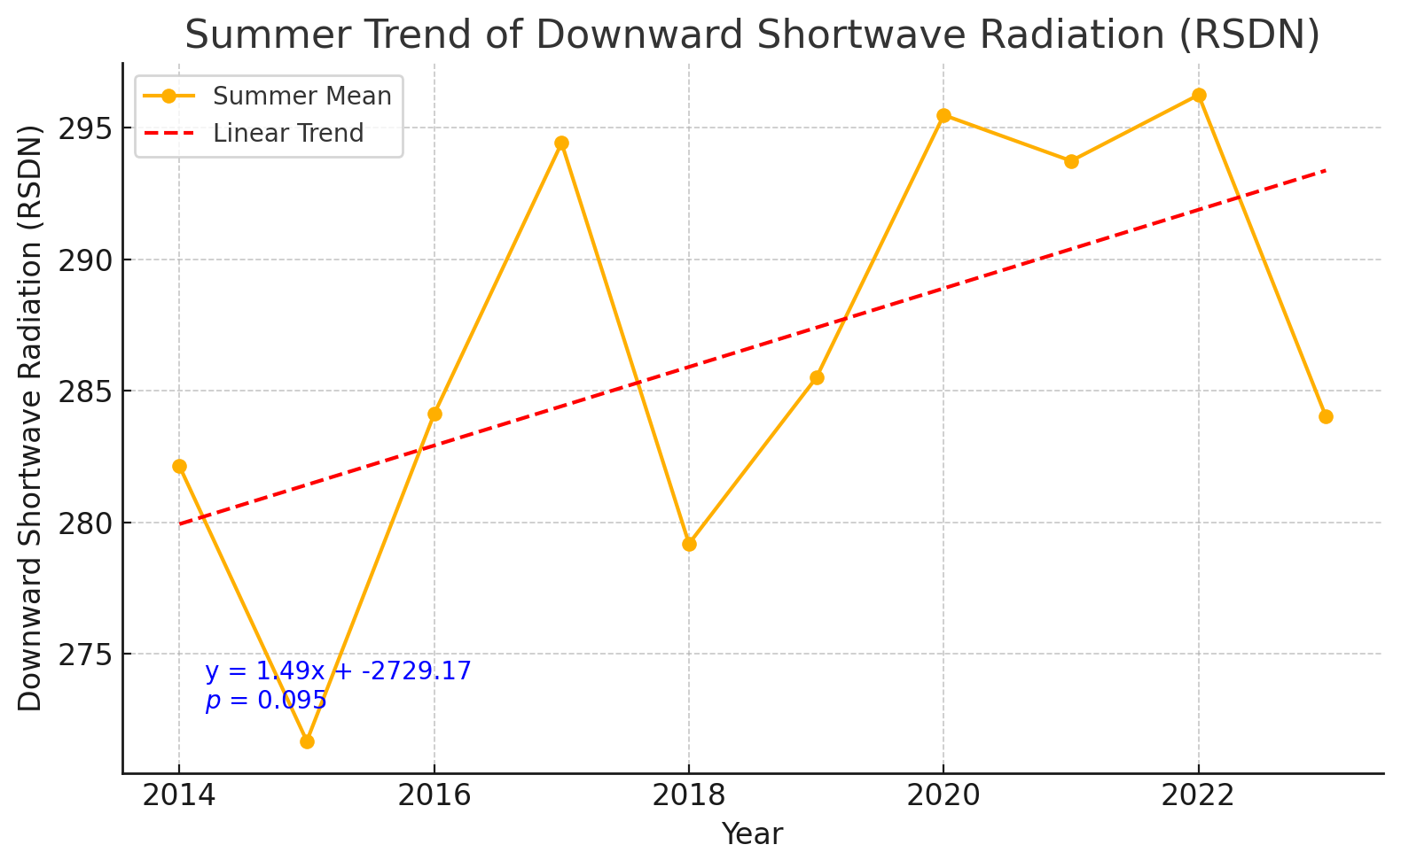
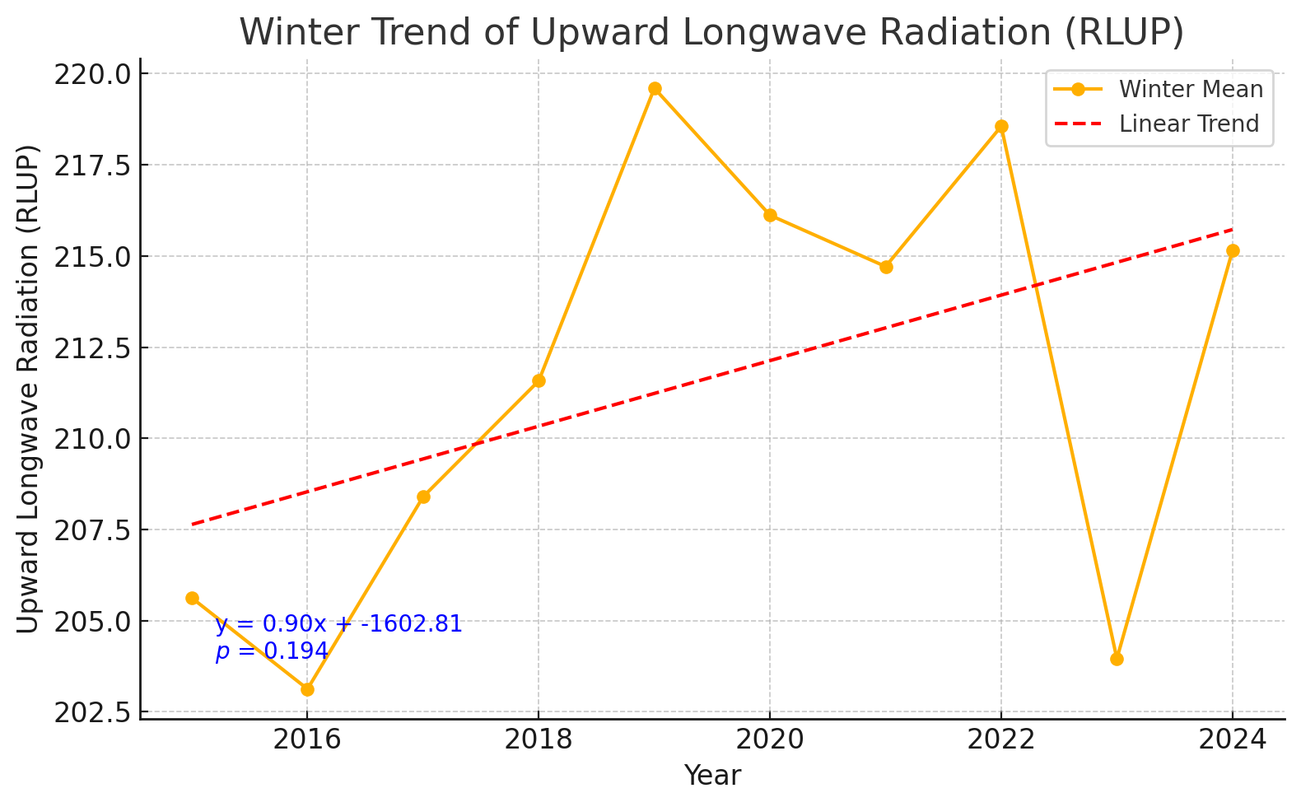
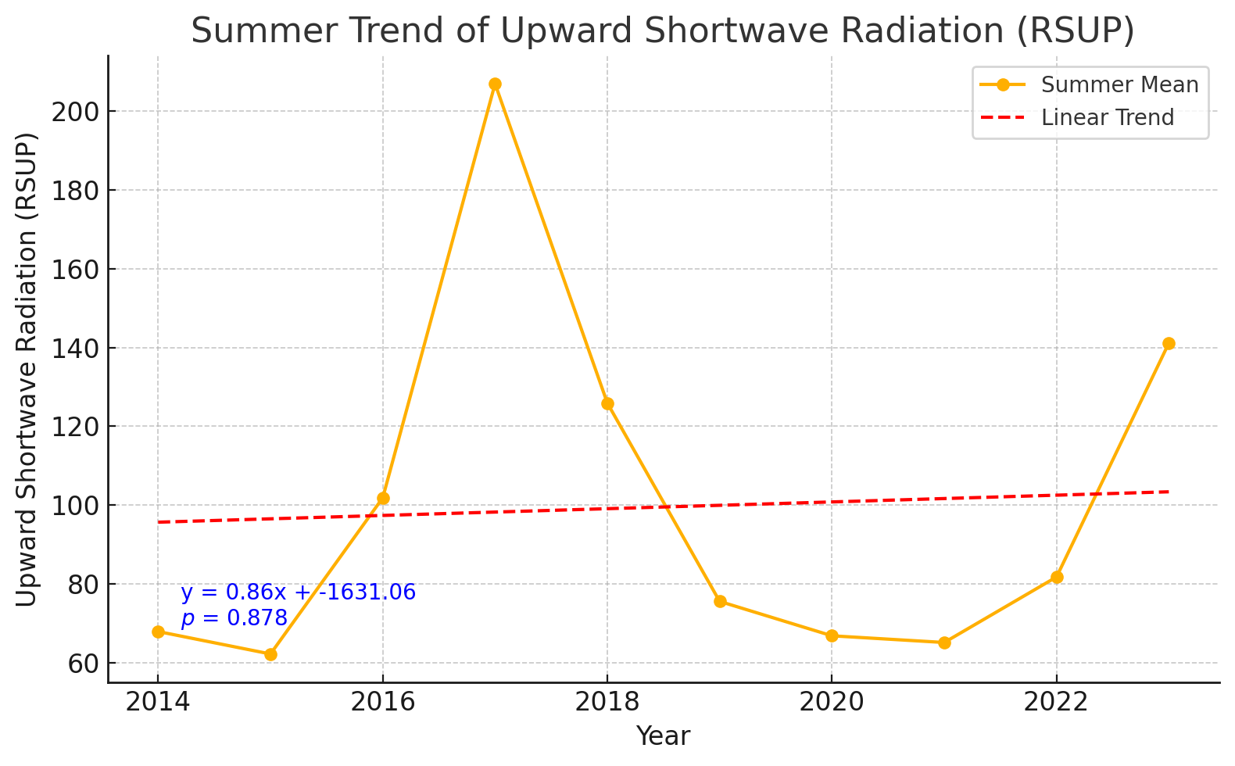
Suppressed
radiation cooling effect
to keep high temperature
Enhanced
radiation heating effect
High albedo
Low albedo

Slide 17
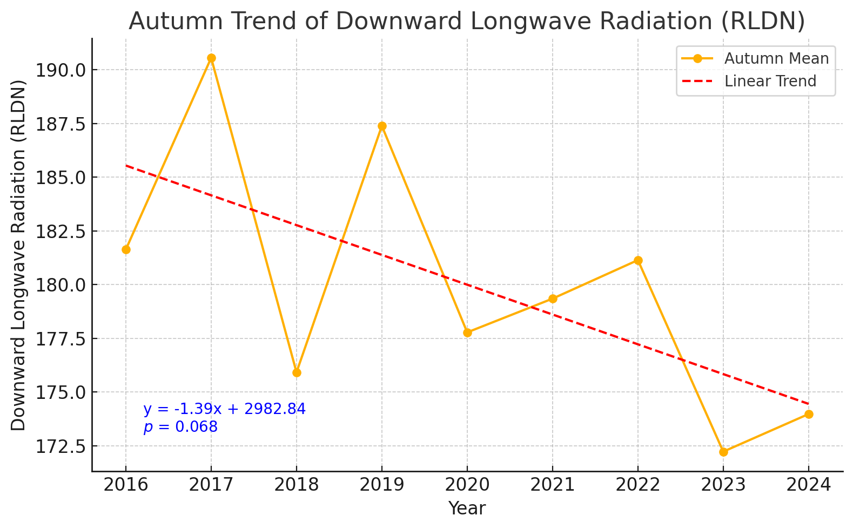
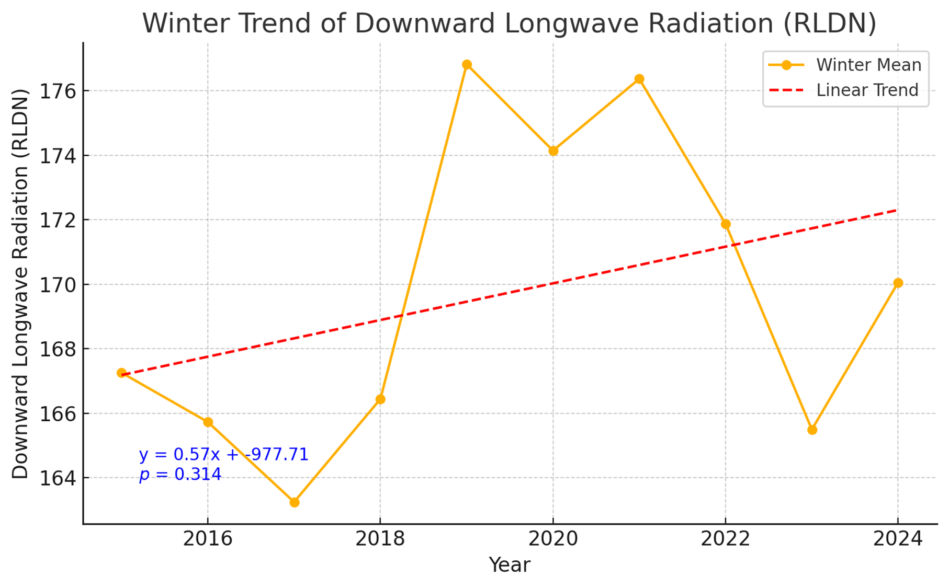
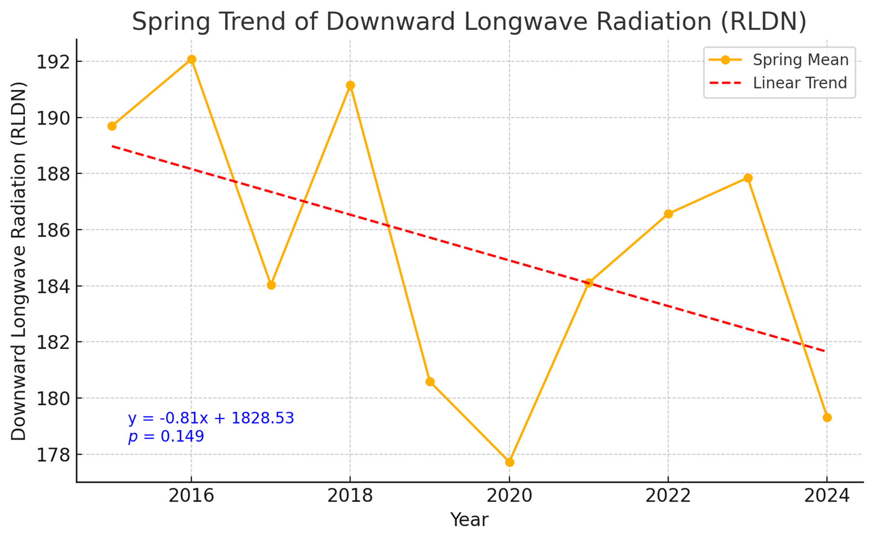
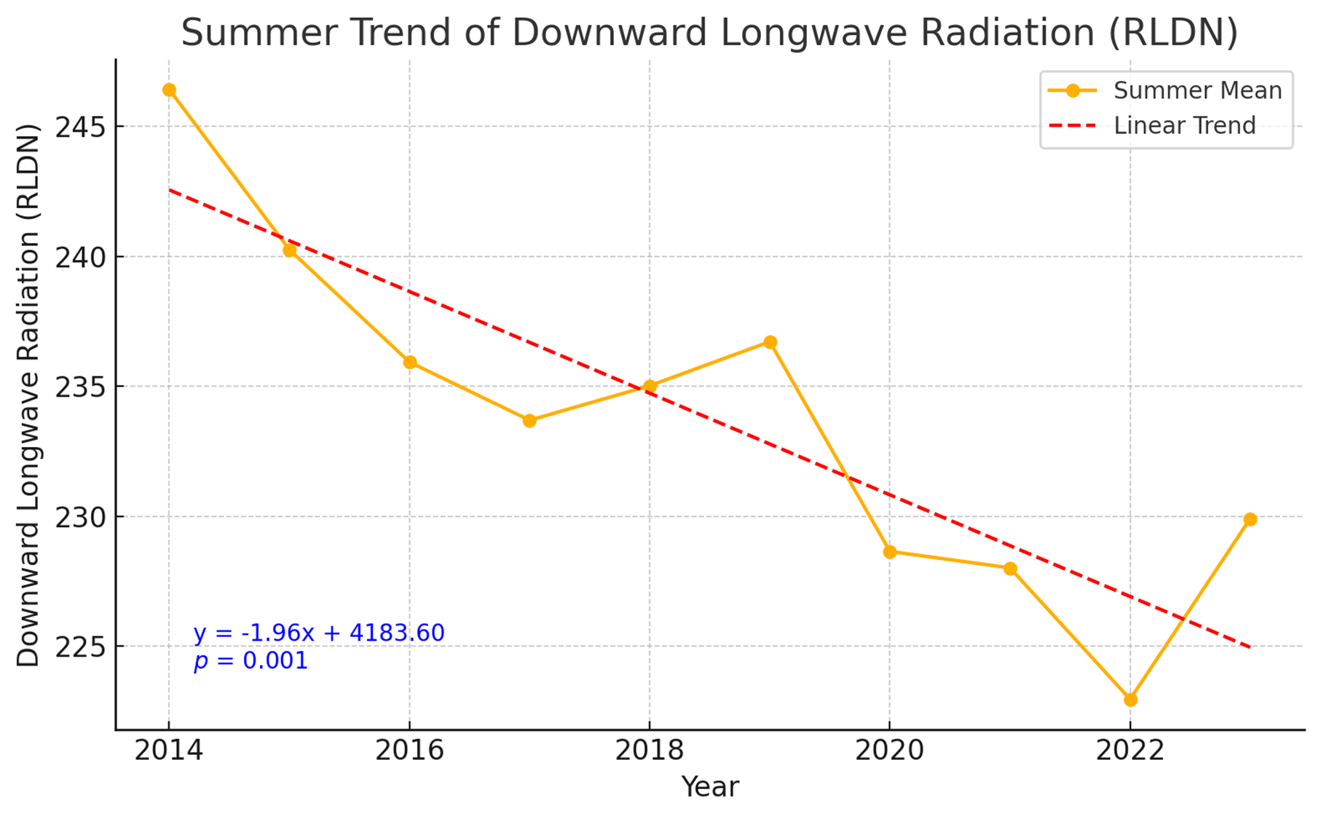

Slide 18
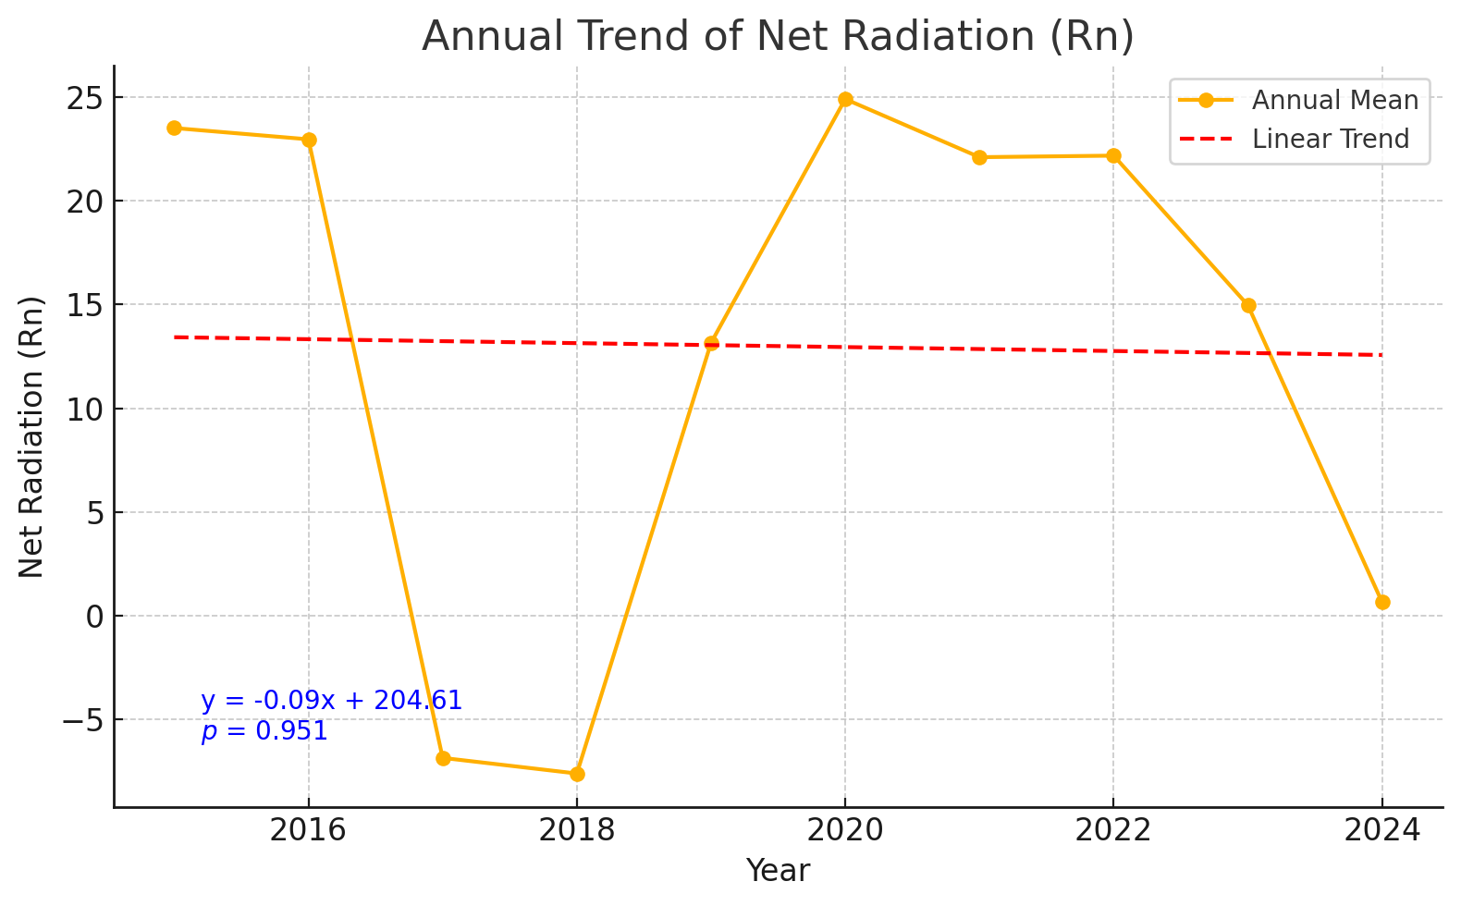
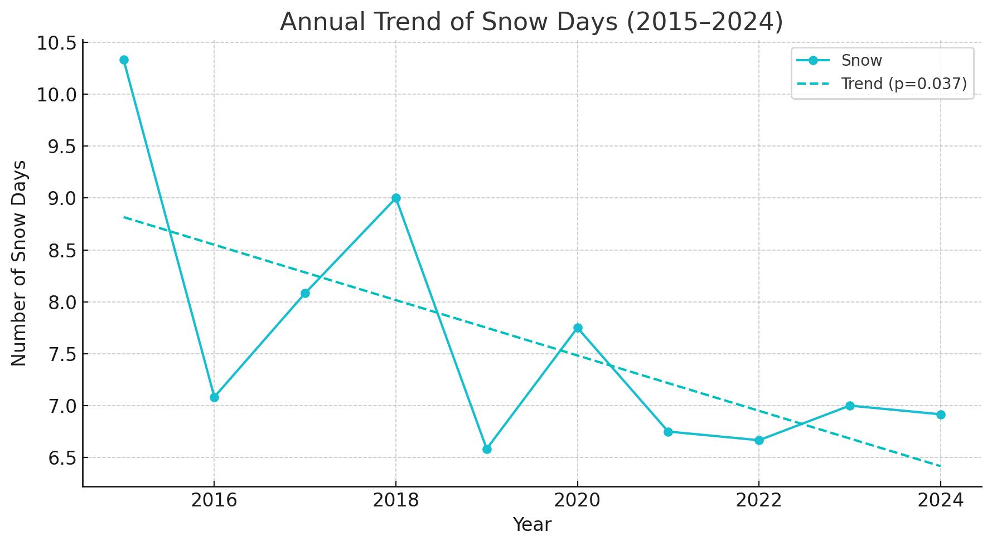
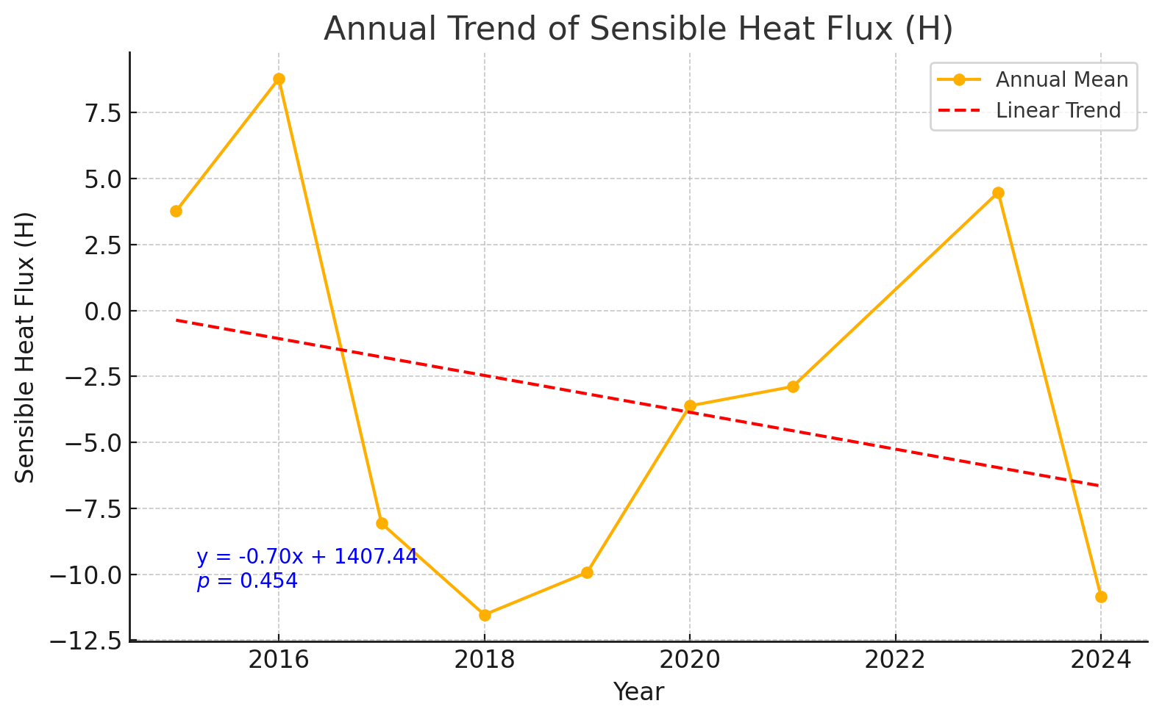
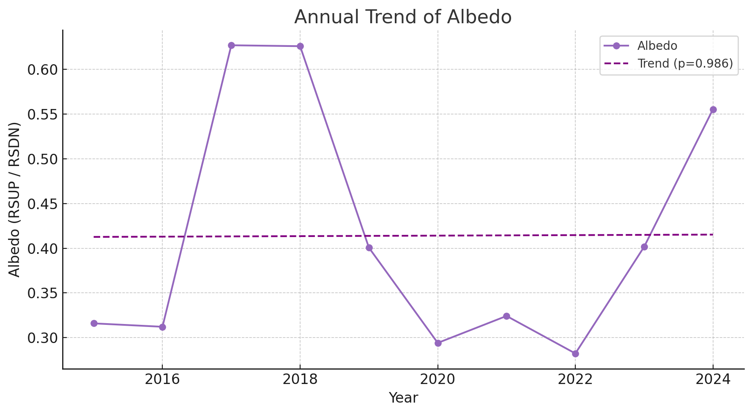

Slide 19
The effects of Wind vs. Net radiation
on turbulent heat flux

Slide 20
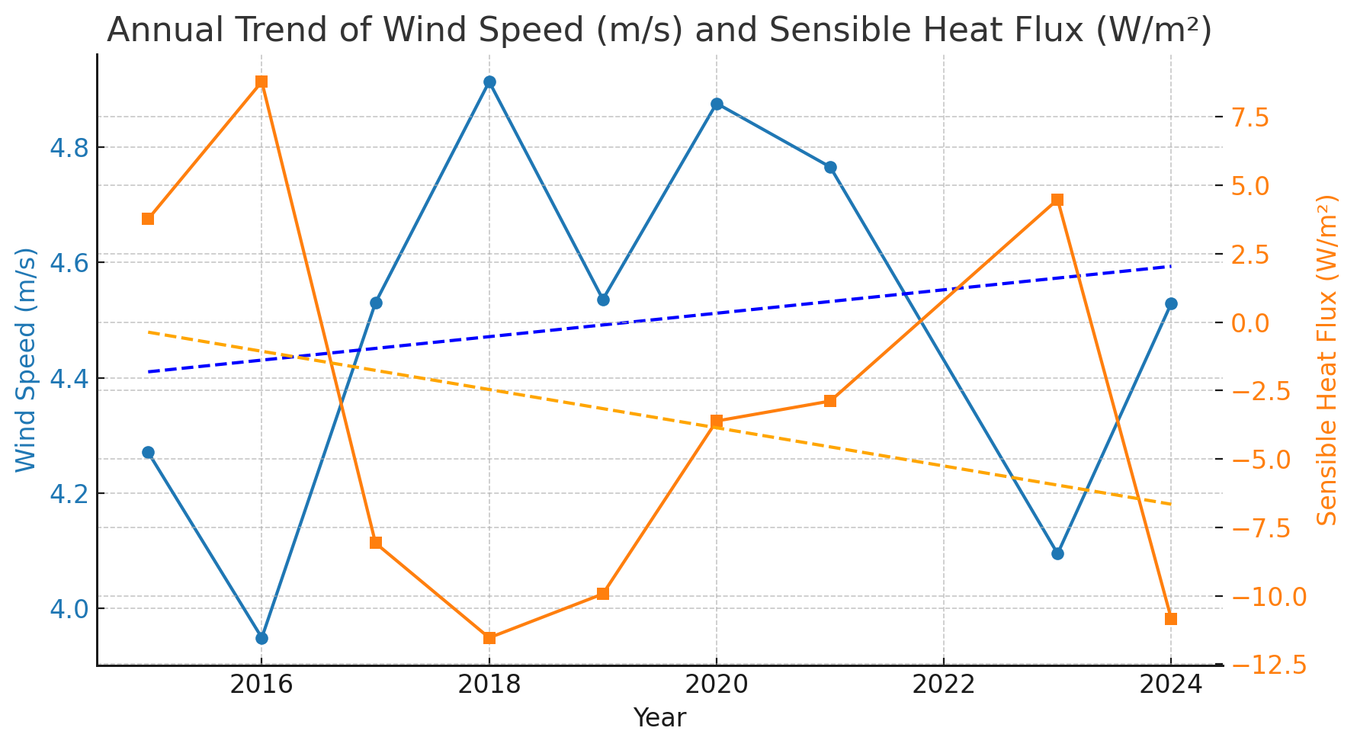
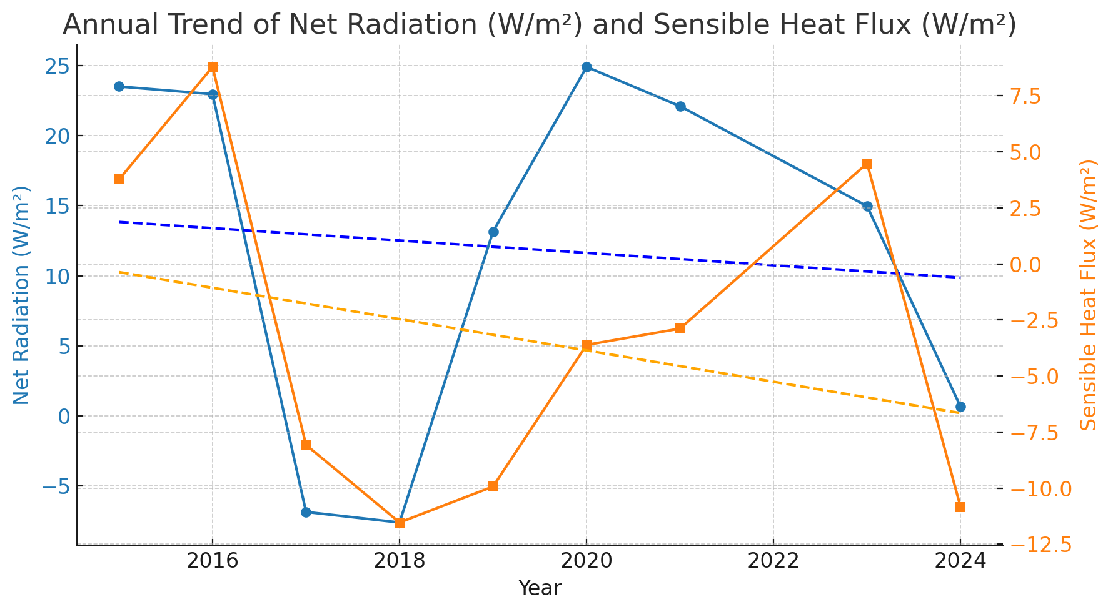
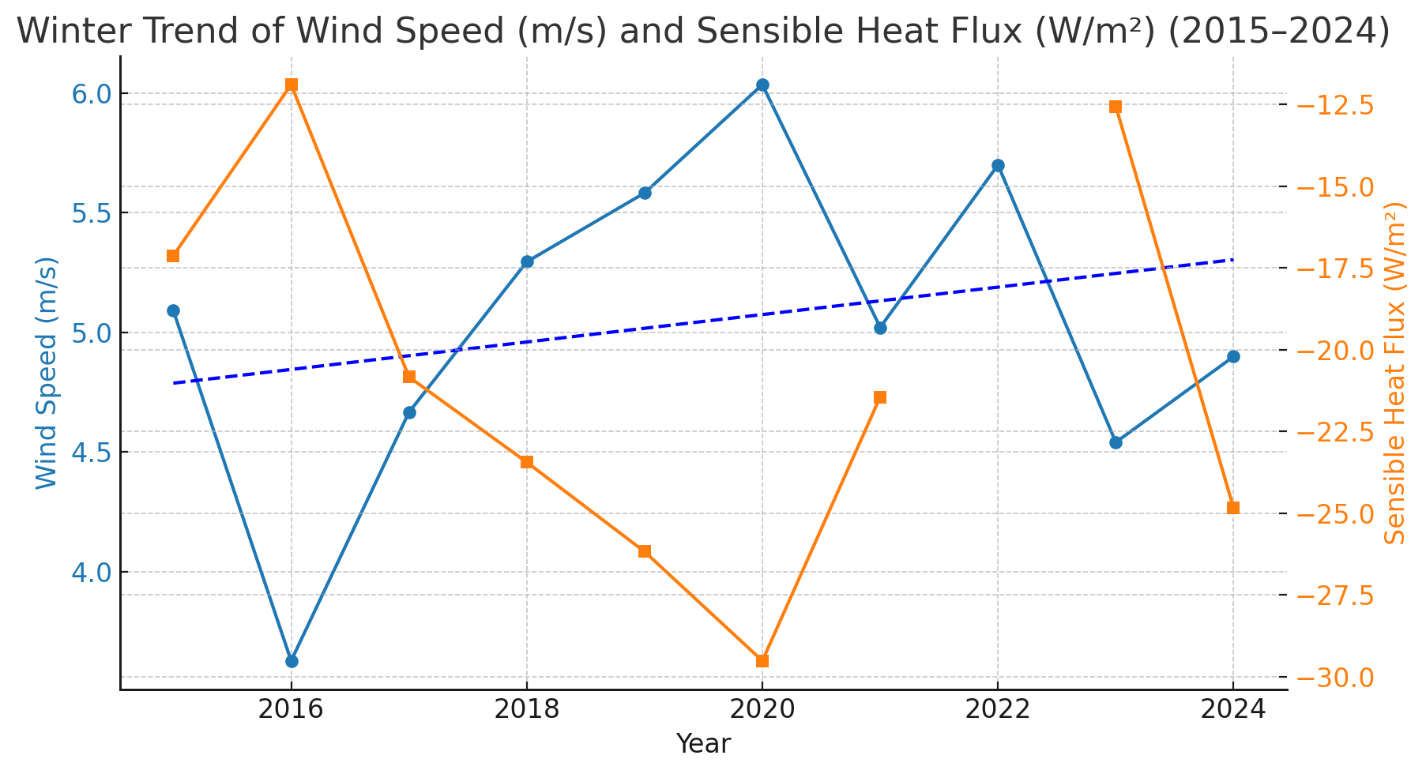
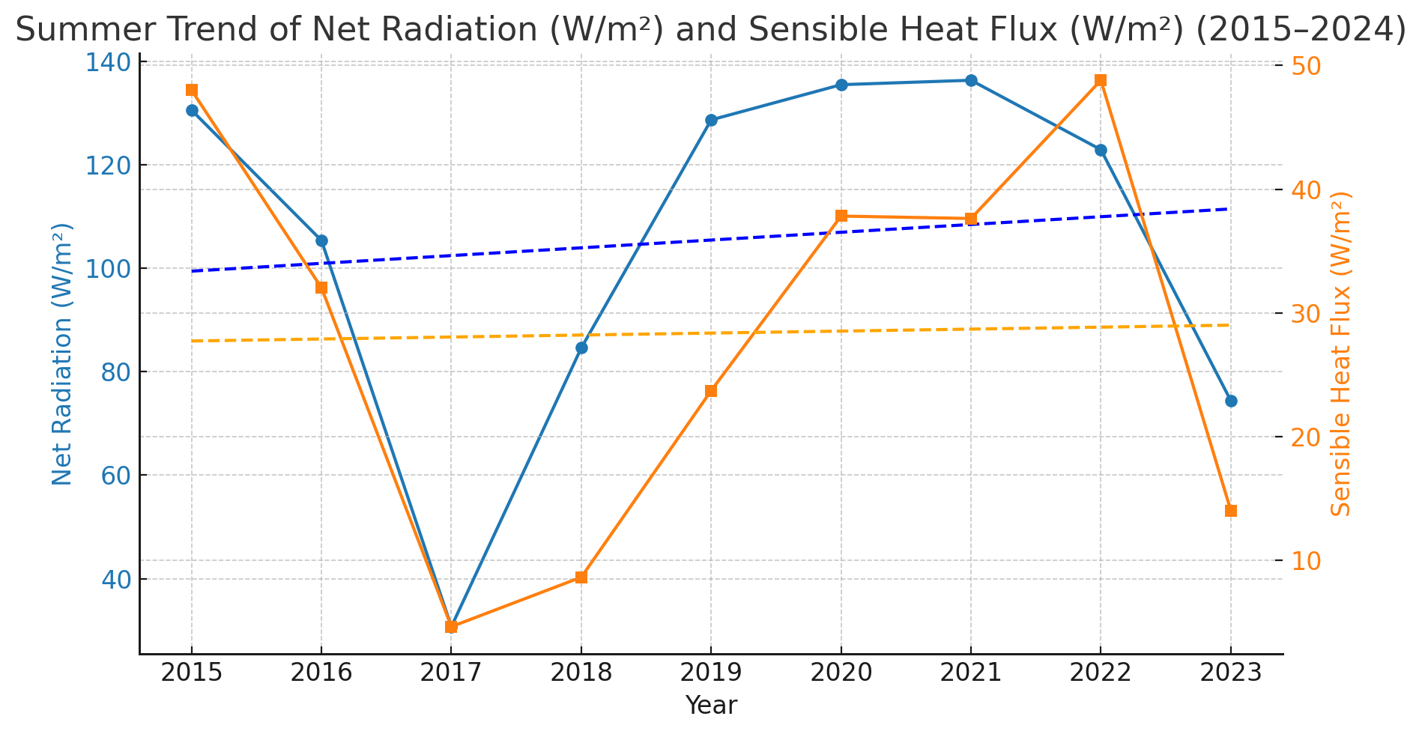

Slide 21
Conclusion
Over the past decade at Jang Bogo Station
The change in large scale air circulation have resulted in the decrease in cloud cover(No. of falling snow days), resulting in the changes in downward radiation and enhanced heating effect in spring and summer.
Changes in turbulent sensible heat flux is explained by the change in wind speed, especially in winter, when cooling effect by long wave radiation were suppressed.
The changes at Jang Bogo station should impact near Sea Ice stability, even in solid winter ice.
Studies on the thermodynamic processes in sea ice and sea as well as atmosphere are needed to understand the annual sea ice stability change.

Slide 22
Thank you for your attention.
This research was supported by Korea Institute of Marine Science & Technology Promotion (KIMST) funded by the Ministry of Oceans and Fisheries (RS-2025-02219198; PM25010) and Korea Polar Research Institute (KORPI).

