Slide 1
Early Career Perspective on Antarctic Operations
20th Workshop on Antarctic
Meteorology & Climate
16 July 2025
Isabella Onsi
(isabella.i.onsi.civ@us.navy.mil)
Staff Meteorologist
NIWC LANT Polar Programs

Slide 2
Most Common Advice for Early Career Professionals
Ask Questions
  Why is something done a specific way?
  Get clarification
  Understanding the jobs of the people around you will help you succeed in your own position
Collaboration
  Willingness to listen and adapt
  Figure out the larger impacts of your work

Slide 3
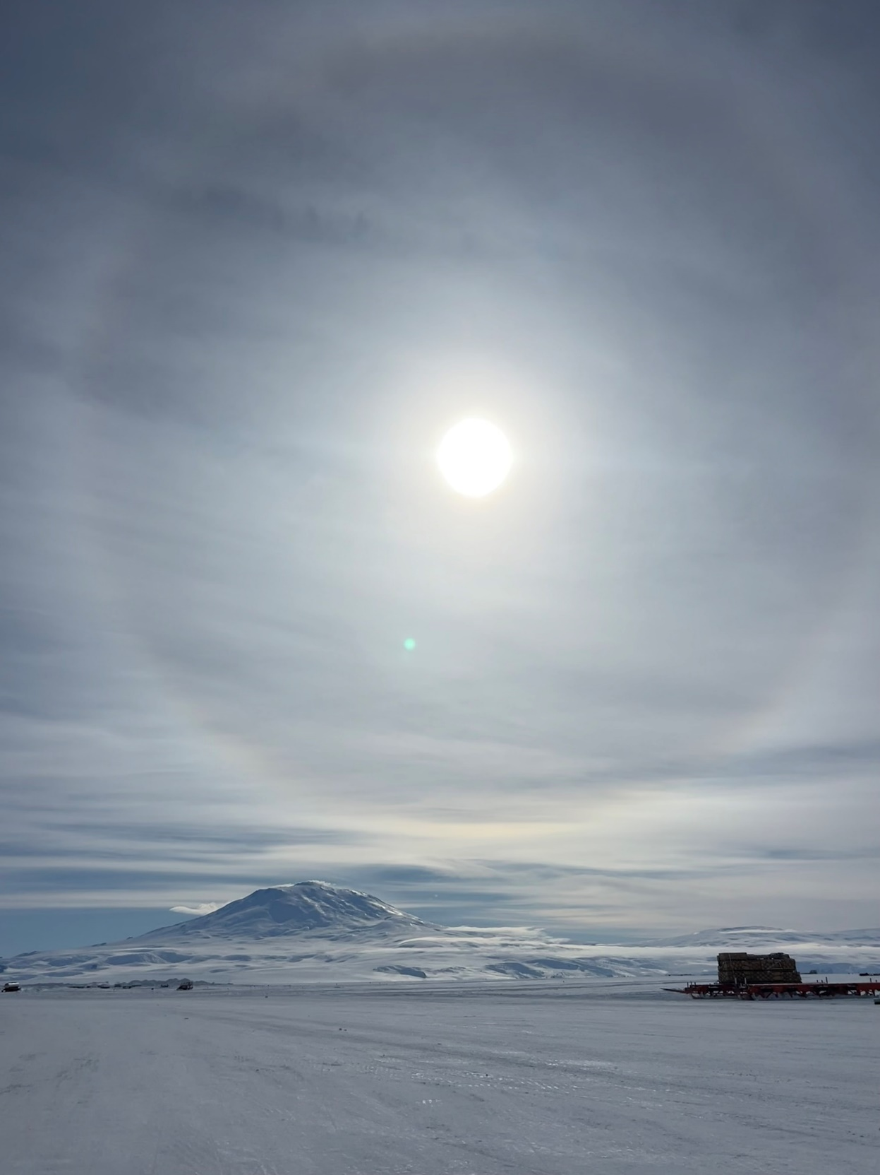
Communication
How can we best communicate our forecasts?
  Different at McMurdo, airfields, and field camps
  Is everyone who needs the information able to receive it?

Slide 4
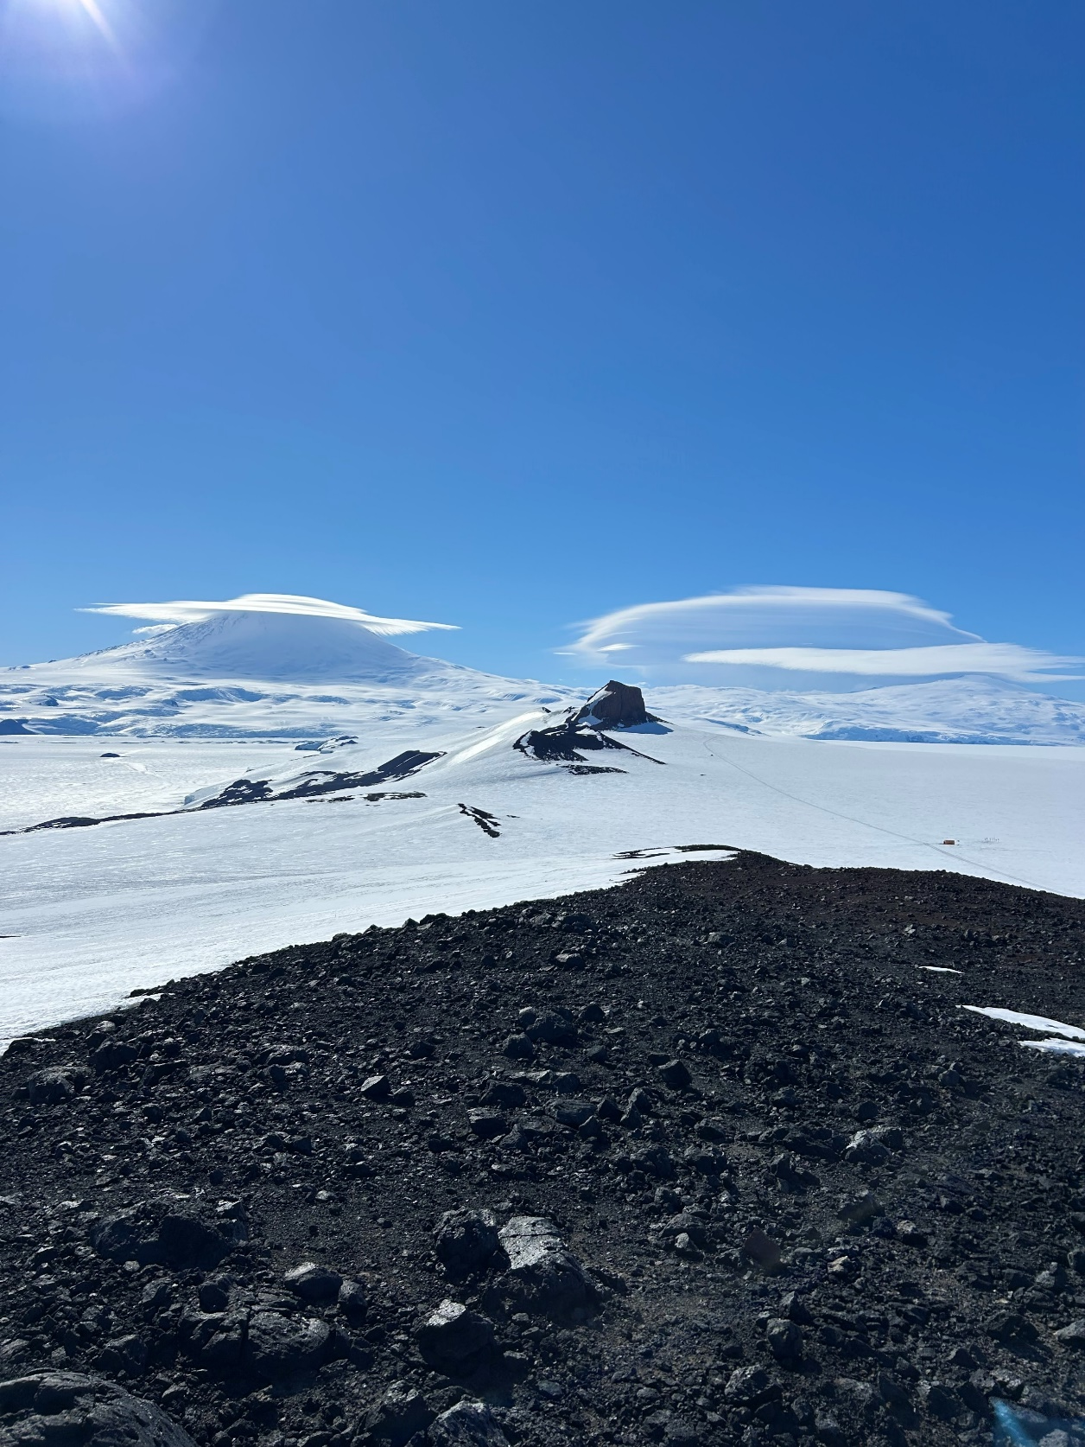
Standardized Products
Making sure our forecast products evolve with the changing needs of the station
  Warnings and conditions
  Incorporating potential space weather or HF issues
Importance of feedback and survey information

Slide 5
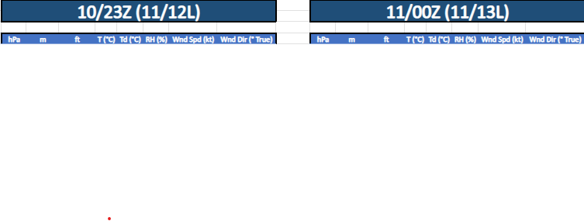
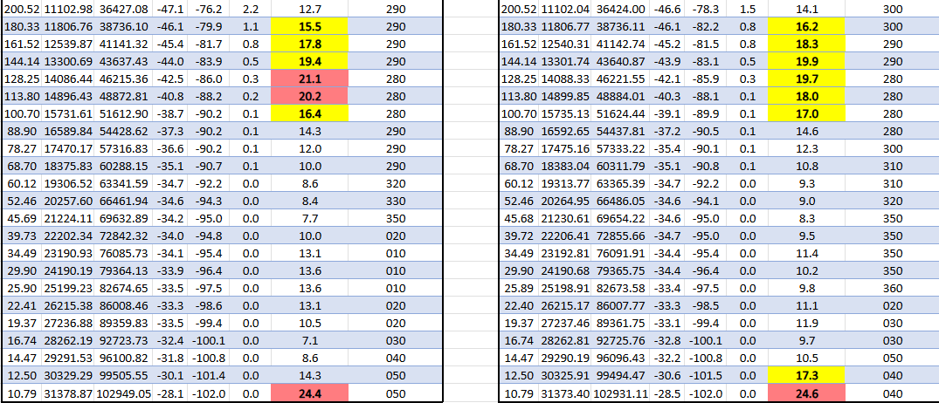
Specific Request Products & Information
Requests are anything from daily wind reports, to whole new products
Worked with scientific groups to create tailored forecast products to best fit the needs of their specific research project or tasking
Archival AWS data requests

