Slide 1



ISPS & WAMC 2025
Spatiotemporal characteristics of Antarctic springtime tropopause from ozonesonde observations and
its relationship with total ozone column
Minju Park¹, Ja-Ho Koo¹, Taejin Choi²
¹Department of Atmospheric Science, Yonsei University
²Korea Polar Research Institute
17 JUL 2025
17:50 – 18:10

Slide 2
ISPS & WAMC 2025
Spatiotemporal characteristics of Antarctic springtime tropopause from ozonesonde observations and its relationship with total ozone column
Index
Intro
Data & Method
Results
Summary
Conclusion & References

Slide 3
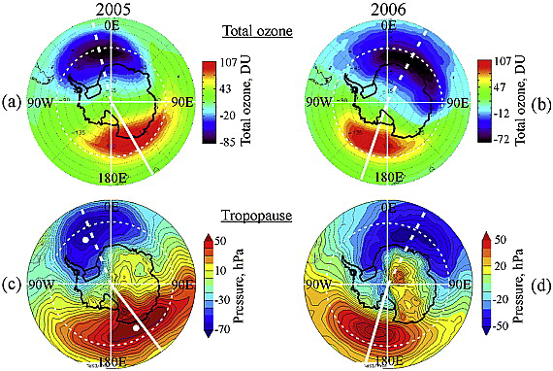
1. Intro
Ozonesonde provides high resolution vertical profile of several variables, such as pressure, temperature, and ozone mixing ratio.
Using long-term ozonesonde datasets, climatological characteristics of tropopause height in the Anatarctica can be found.
Tropopause heights need to be considered when understanding difference between upper and lower air characteristics and dynamical phenomena in polar region.
Also, it is known that there is a negative relationship between tropopause height and total ozone column during October, when ozone hole exists over the south pole. (Evtushevsky et al., 2008)
Using the in-situ observations, we studied the spatiotemporal characteristics of Antarctic springtime tropopause.
Zonal asymmetry of Total ozone (upper)
and Tropopause (lower) for 2 years (2005-2006).
Total ozone : TOMS+OMI satellite
Tropopause : NCEP-NCAR reanalysis
(Evtushevsky et al., 2008)
(LRT: Thermal Tropopause)

Slide 4
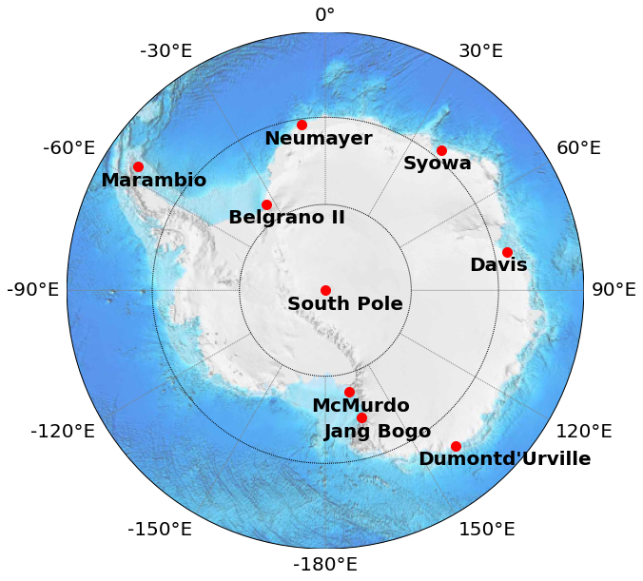



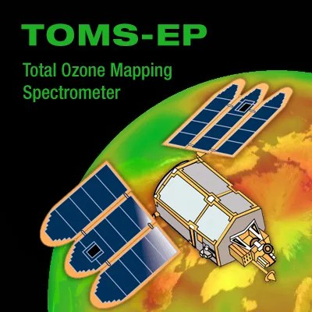
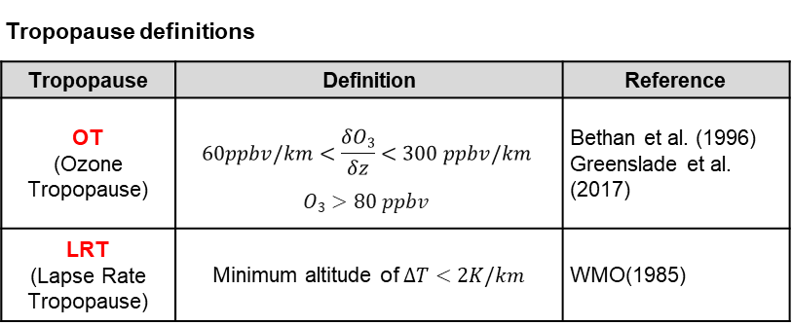
2. Data & Method
List of stations
Station | Code | Flights | Date Range | Location
Belgrano (II) | BLG | 124 | 2016.08–2022.09 | 77.877°S 34.627°W
Davis | DAS | 651 | 2006.04–2023.02 | 68.577°S 77.969°E
Dumont d’Urville | DDU | 649 | 1991.01–2019.12 | 66.663°S 140.003°E
Jang Bogo | JBG | 151 | 2015.08–2022.06 | 74.636°S 164.235°E
Marambio | MBO | 904 | 2004.01–2019.11 | 64.240°S 56.625°W
Mcmurdo | MCM | 789 | 1986.08–2010.10 | 77.850°S 166.667°E
Neumayer | NMY | 2171 | 1992.03–2022.10 | 70.666°S 8.266°W
Syowa | SYO | 968 | 2003.01–2022.07 | 69.005°S 39.581°E
Ozonesonde (Data source: WOUDC, NDACC)
8 Antarctic stations with long-term observation datasets (>5 years)
Vertical profiles are fitted into 0.1km resolution.
Ozone partial pressure and temperature were utilized to calculate the tropopause heights, following the definitions from previous studies.
Tropopause definitions
Tropopause | Definition | Reference
OT (Ozone Tropopause) | $$60ppbv/km<\frac{δO3}{δz}<300 ppbv/km$$ $$O3>80 ppbv$$ | Bethan et al. (1996) Greenslade et al. (2017)
LRT (Lapse Rate Tropopause) | Minimum altitude of $∆T<2K/km$ | WMO(1985)
Ozonesonde Variables
Variable | Unit | Variable | Unit
O₃ | mPa | U_{dir} | degrees
T | °C | U_{speed} | m/s
RH | % | Time | sec
P | hPa | Lon | degE
GPH | m | Lat | degN
Satellite Total Ozone Column [DU]
TOMS-EP : 1996-2004
Aura OMI : 2005-2024
ECC
Ozone
Sonde

Slide 5
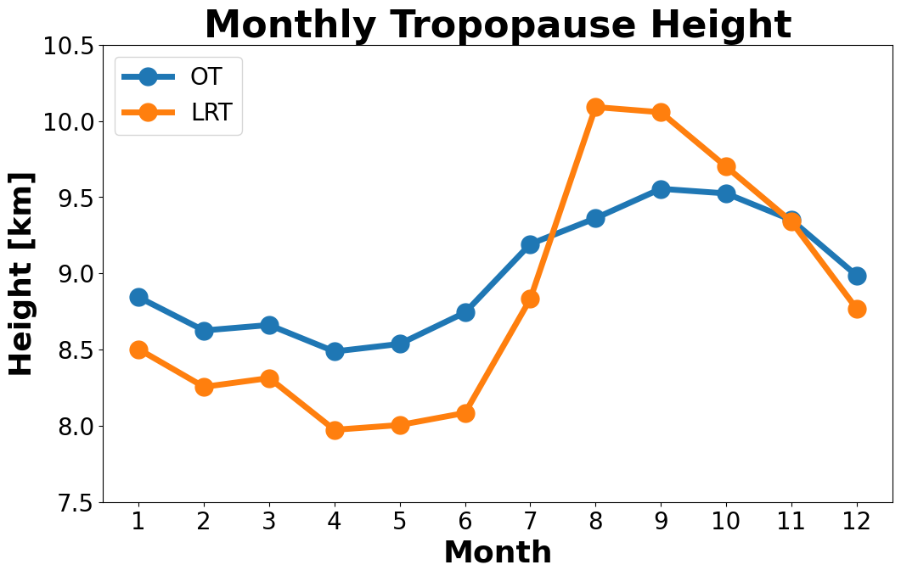
3. Results
(1) Monthly averaged tropopause heights
* Averaging process
Monthly mean value
by years & stations
Averaging over
observed years
Averaging over
observed stations
During the south hemisphere’s springtime, from SEP to NOV (SON),
both tropopauses are relatively higher than other seasons.
SON tropopause heights get lowered by months,
implying the change of temperature & ozone vertical profiles.
Monthly averaged heights
of Antarctic

Slide 6
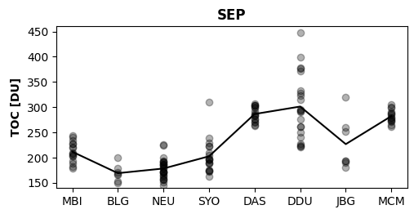
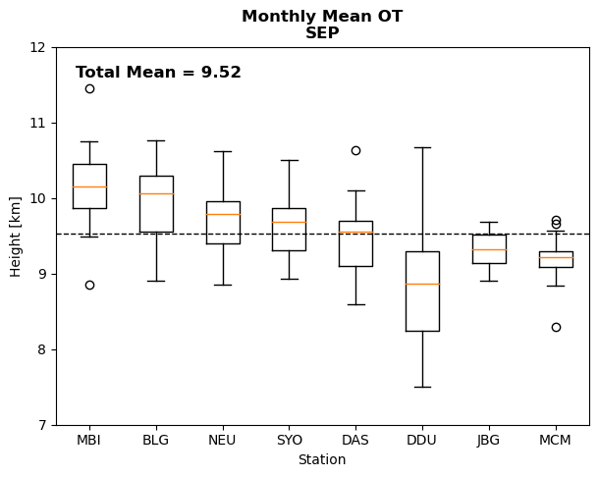
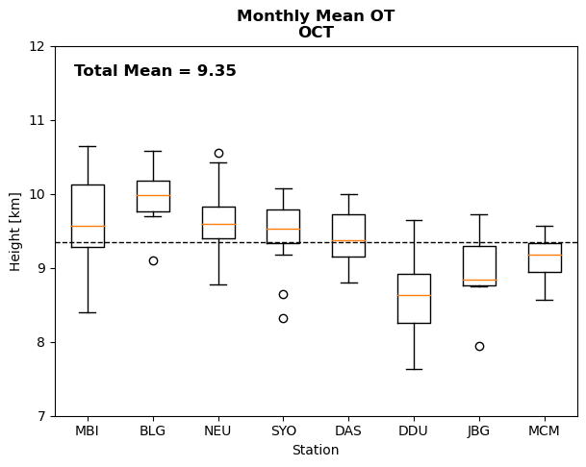
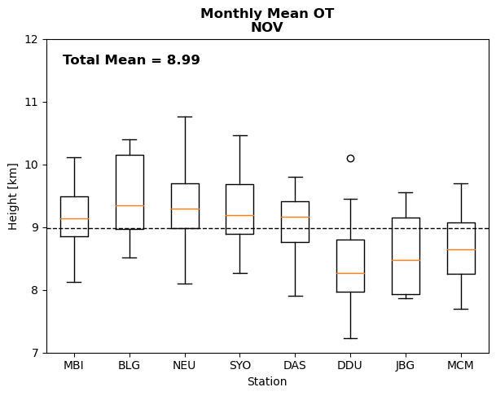
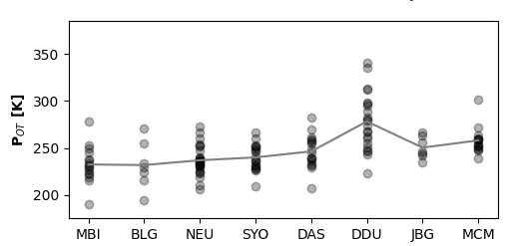
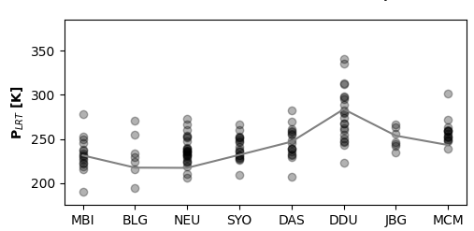
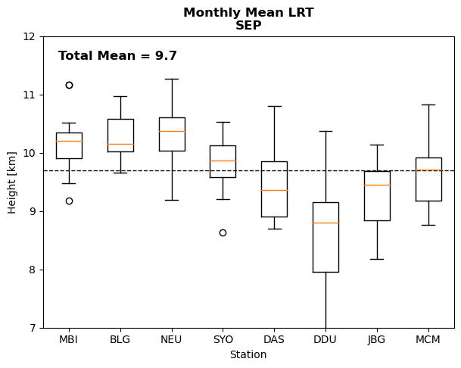
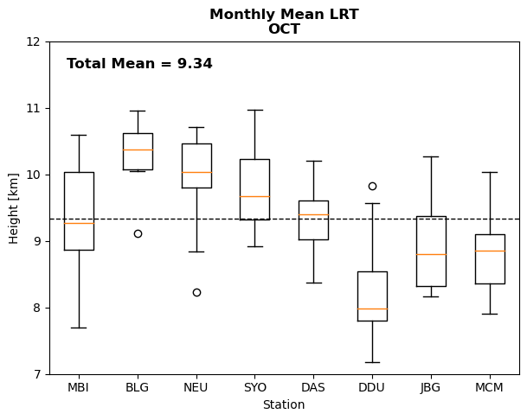
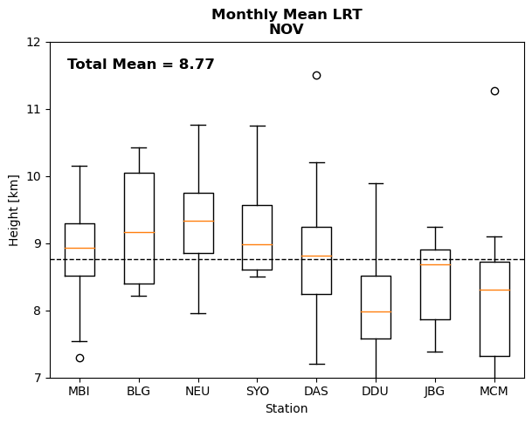
3. Results
During springtime, Western Antarctica’s 3 stations (Marambio, Belgrano, Neumayer),
locating near Weddell Sea, showed higher tropopauses than Eastern stations.
The lowest tropopause is found from Dumont d’Urville station (66.66°S, 140.00°E).
Pressure of the tropopause was high when the tropopause height was low,
corresponding to the typical structure of the atmosphere.
High TOC (Total Ozone Column) was found with lower tropopause.
  → Changes in tropopause heights might have causality on
  chemical changes in stratospheric Ozone layer.
(2) Regional characteristics of tropopauses
SEP
TOC
SEP
OCT
NOV
Mean: 9.52km
Mean: 9.35km
Mean: 8.99km
P_{OT}
[hPa]
OT
[hPa]
P_{LRT}
Mean: 9.7km
Mean: 9.34km
Mean: 8.77km
LRT
(W) Stations sorted by longitude (E)

Slide 7
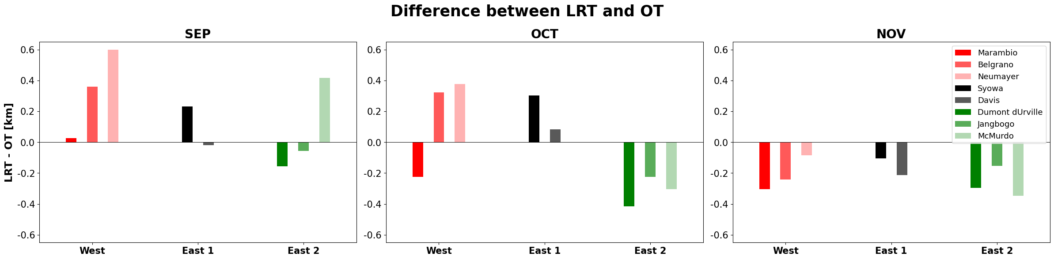
3. Results
(3) Differences by tropopause definitions (Thermal VS. Chemical)
Thermal LRT (Lapse Rate Tropopause) VS. Chemical OT (Ozone Tropopause)
In September, [LRT – OT] difference is mostly positive (LRT>OT) over Western Antarctica.
However, in November, LRT is lowered below OT for all stations.
  → Thermal structure reacts to the seasonal change faster than atmospheric composition.
[LRT – OT] by months
Mean: -0.011 km
Mean: -0.218 km
Mean: 0.176 km
LRT
OT
OT
LRT

Slide 8
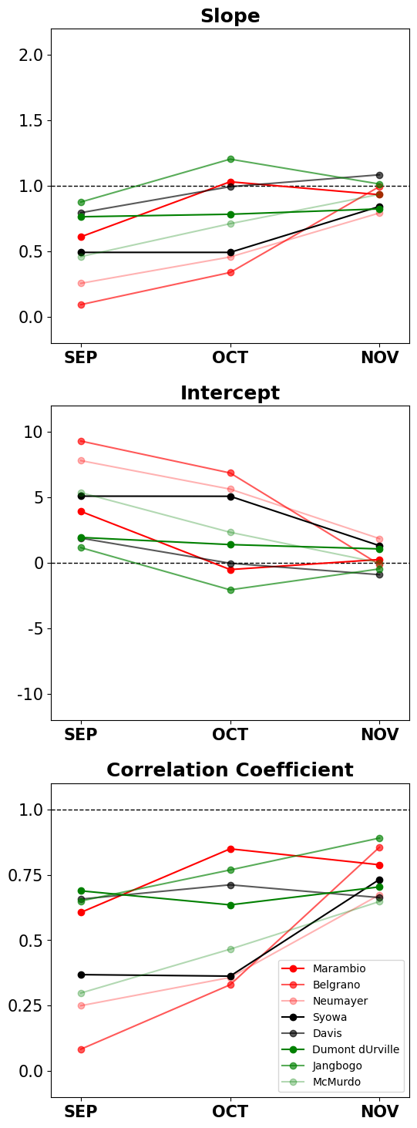
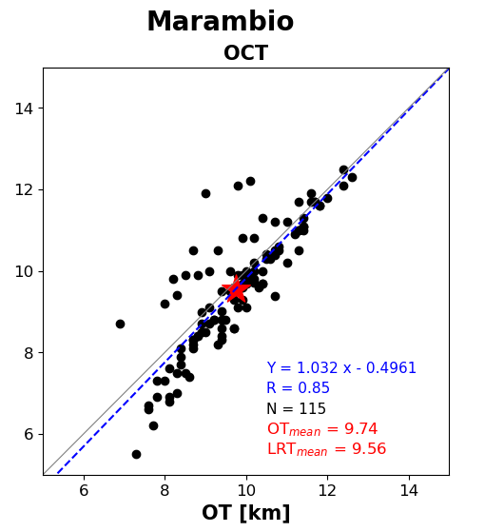
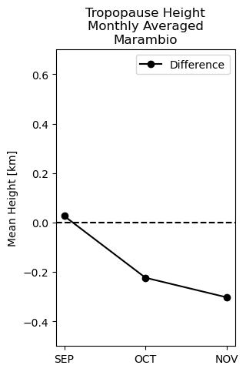
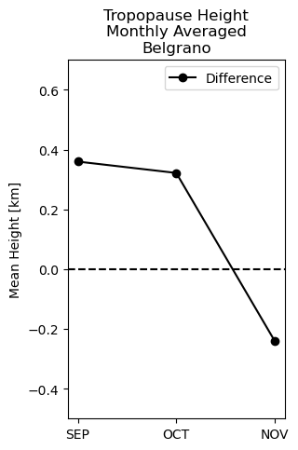
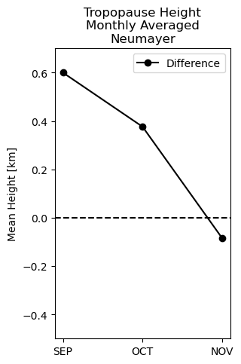
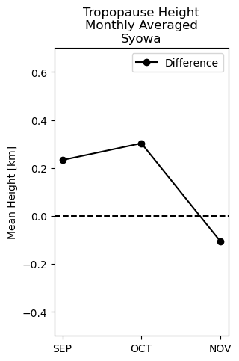
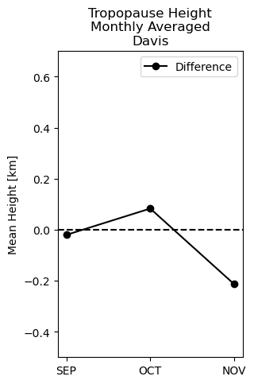
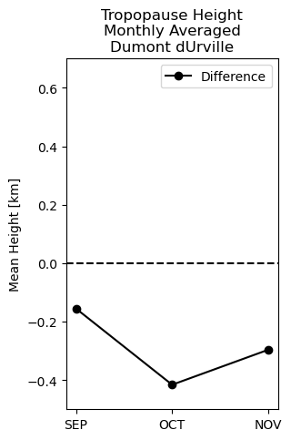
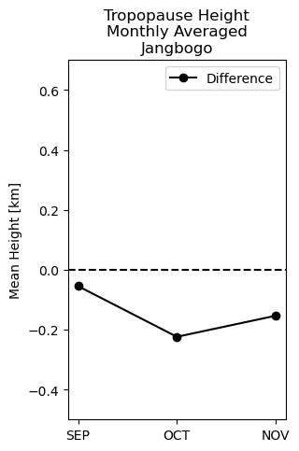
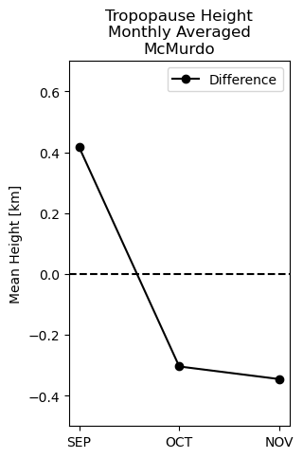
3. Results
Linear regression between LRT and OT showed that the slope, intercept, and correlation coefficient each get close to the value [1.0, 0.0, 1.0] in November.
The result refers to the overall correspondence between tropopause definitions increases by time in spring.
It should be careful choosing the tropopause definition from late winter to early spring, especially when calculating stratospheric ozone amount from sonde data.
(3) Differences by tropopause definitions (Thermal VS. Chemical)
Correspondence between OT & LRT (example)
Slope
SON [LRT – OT] by stations
LRT [km]
Intercept
Correlation
Coefficient

Slide 9
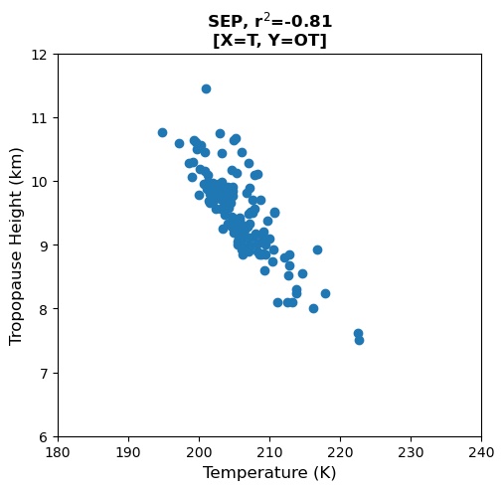
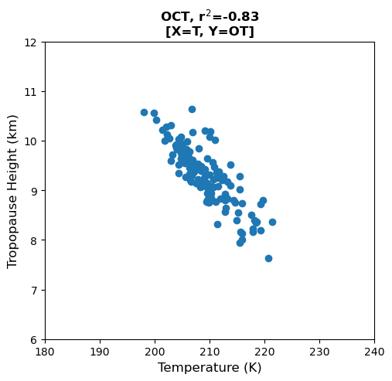
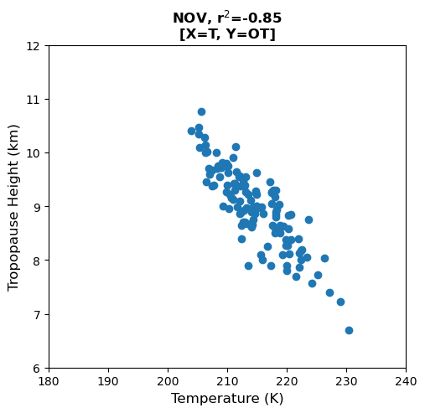
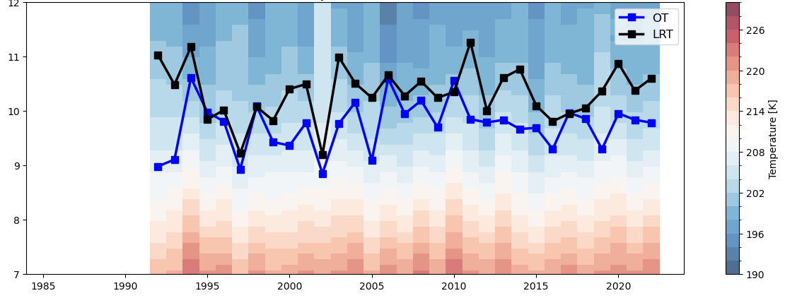
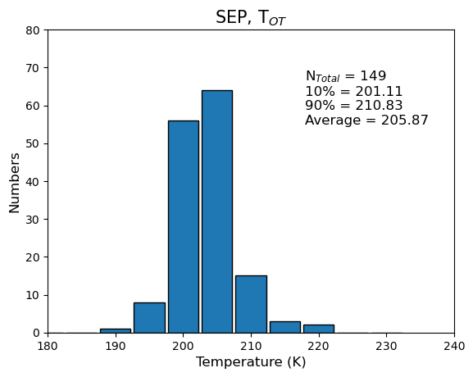
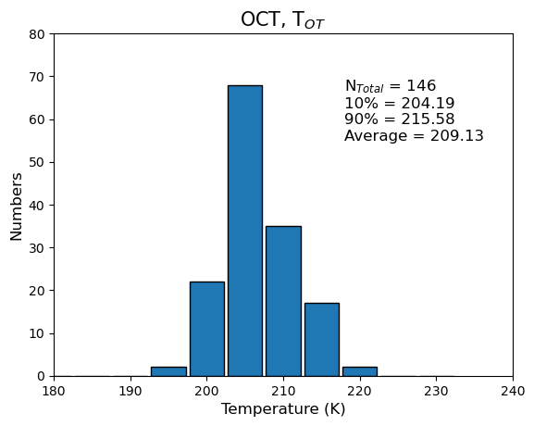
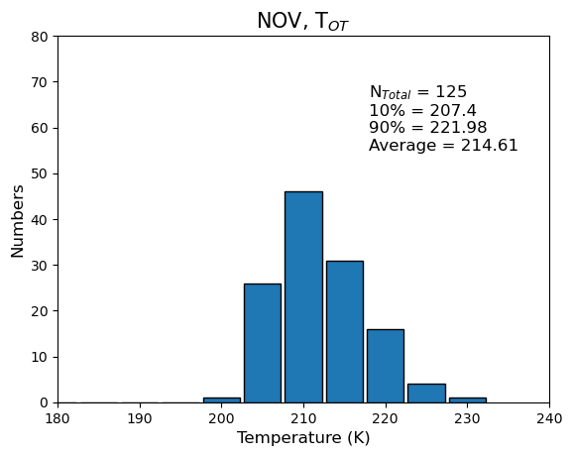
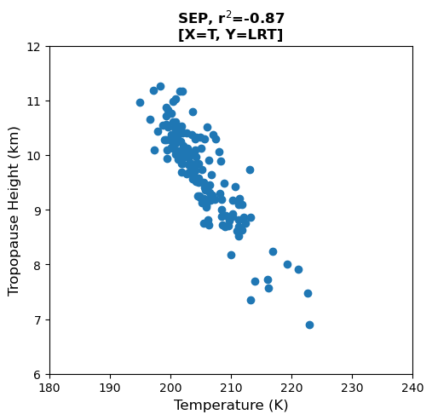
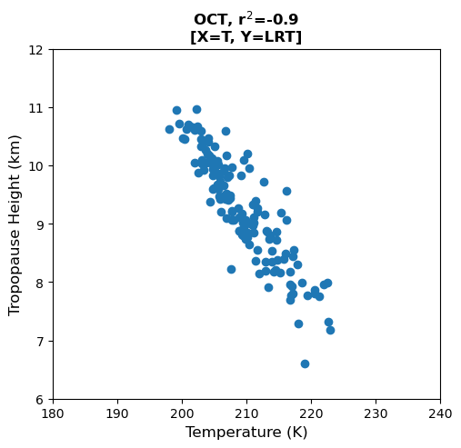
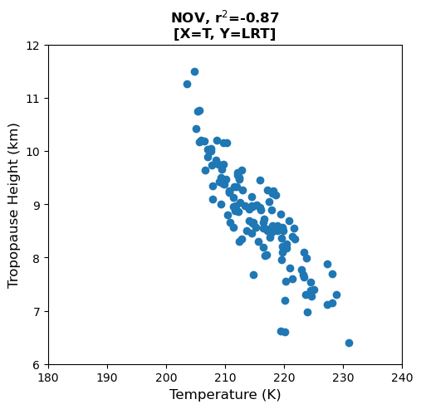
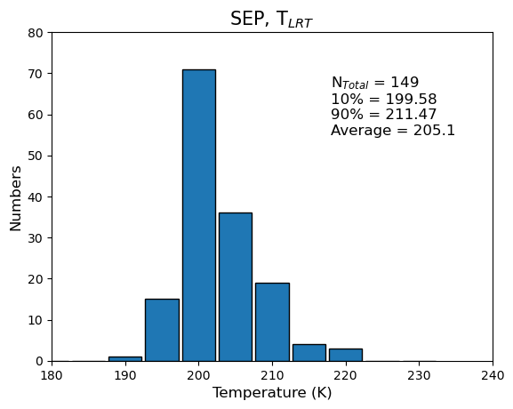
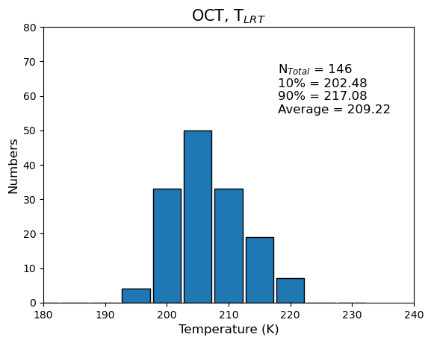
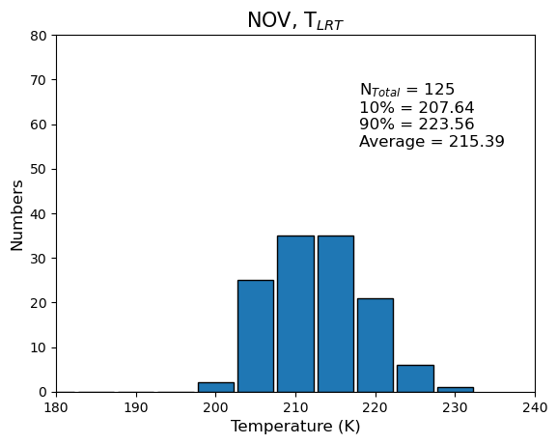
3. Results
(4) Tropopause temperature and buoyancy (N², Brunt-Vaisala Frequency)
Temperature (All stations)
SEP
OCT
NOV
X: Temperature
Y: Tropopause
Neumayer, SEP, 1992-2022
OT
LRT
OT
Height (7-12 km)
X: Temperature
Y: N of data
T
(190-230 K)
SEP
OCT
NOV
Year (1985-2024)
X: Temperature
Y: Tropopause
Temperature and height of the tropopause have negative relation, like the pressure did.
LRT
X: Temperature
Y: N of data

Slide 10
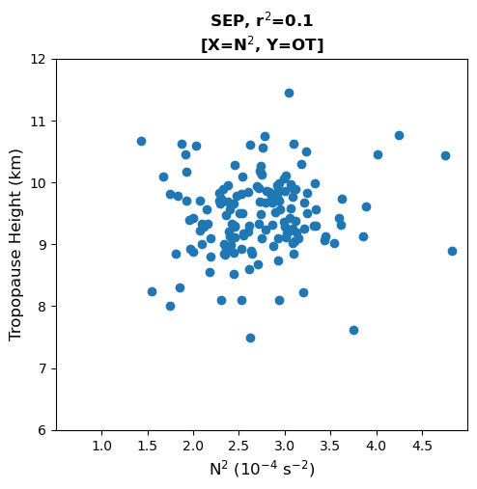
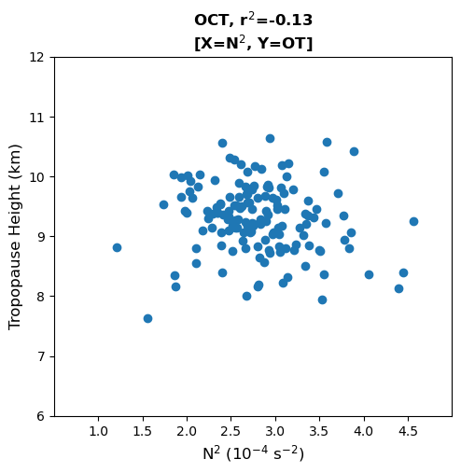
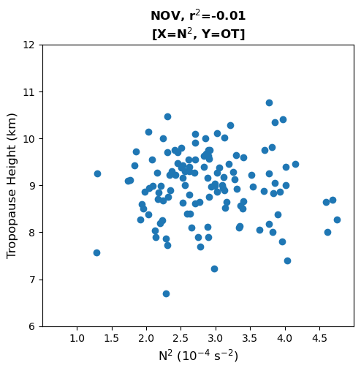
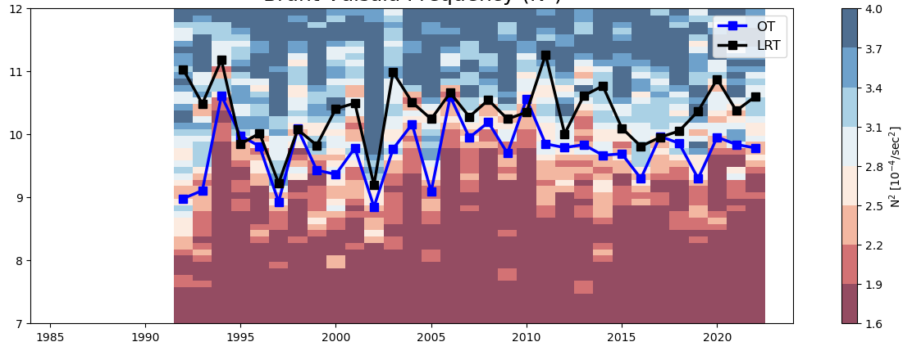
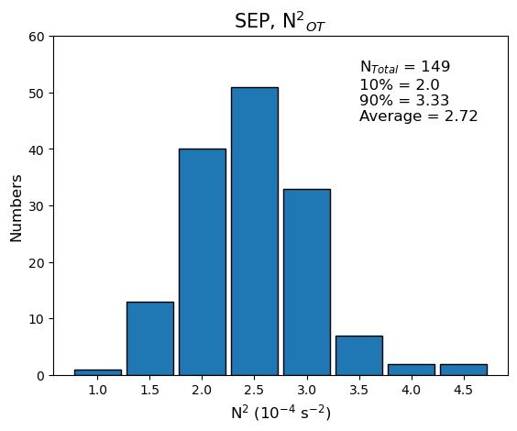
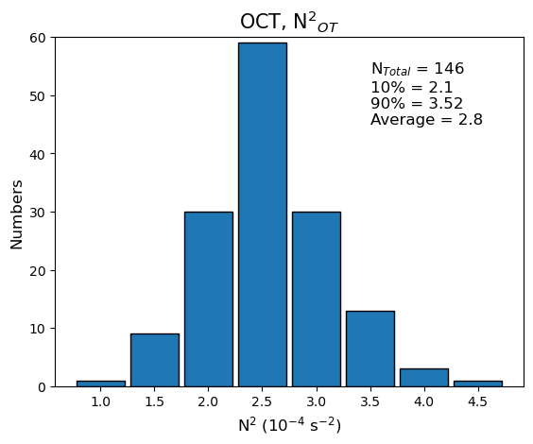
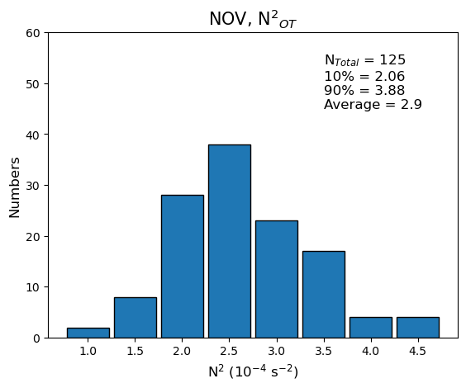
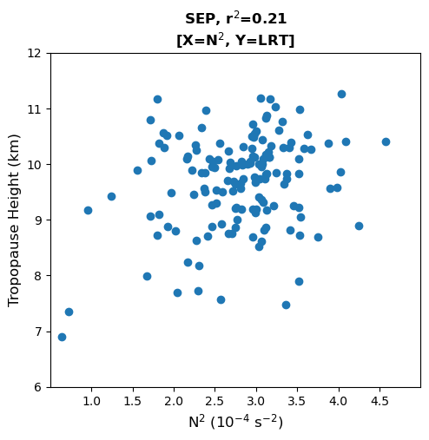
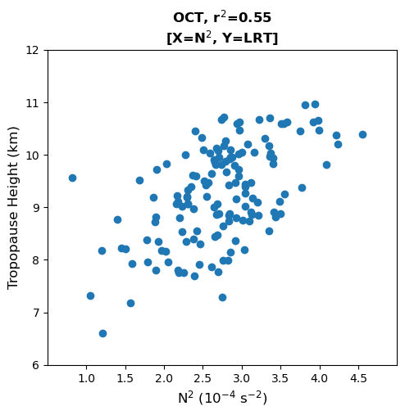
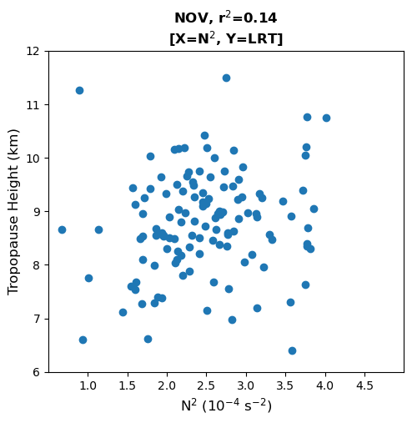
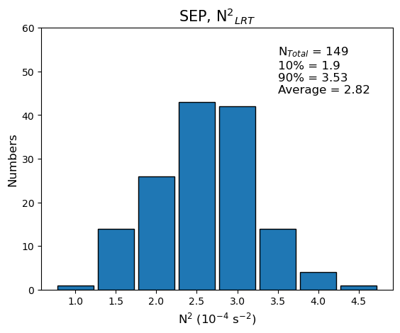
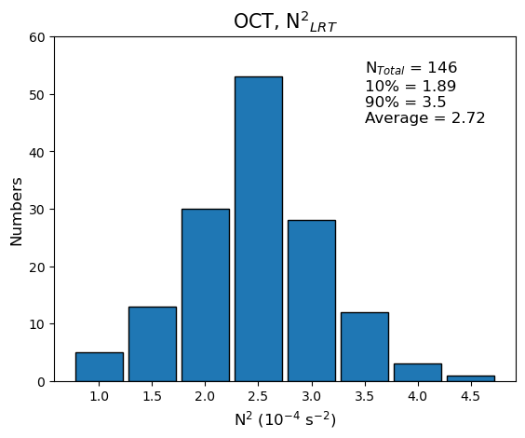


3. Results
(4) Tropopause temperature and buoyancy (N², Brunt-Vaisala Frequency)
$$Brunt−V\ddot{a}is\ddot{a}l\ddot{a} Frequency$$
$$N=\sqrt{\frac{g}{θ}\frac{dθ}{dz}}$$
Buoyancy (N²) (All stations)
SEP
OCT
NOV
X: Buoyancy
Y: Tropopause
Neumayer, SEP, 1992-2022
OT
LRT
OT
Height (7-12 km)
X: Buoyancy
Y: N of data
N²
(0-8 10⁻⁴/sec²)
SEP
OCT
NOV
Year (1985-2024)
X: Buoyancy
Y: Tropopause
Buoyancy, which is calculated from the vertical potential temperature profile, showed no specific variation by tropopause height.
However, tropopauses mostly located in a height range where 2.2 < N² < 2.8.
In September, when the two definitions of tropopause height have difference,
OT showed larger number of data in the range compared to LRT.
It is noticeable that the chemical tropopause agrees better with the buoyancy component.
LRT
X: Buoyancy
Y: N of data

Slide 11
4. Summary
(1) Monthly averaged tropopause heights
In Antarctica, higher tropopause is found during SON period (Austral springtime) compared to the other seasons.
From SEP to NOV, the tropopause height gets lowered.
(2) Regional characteristics of tropopauses
There is regional variation of tropopause height, high in Western stations and low in Eastern ones.
Especially in September, when Ozone hole exists over Antarctica, total ozone column has certain negative relationship with tropopause height.
(3) Differences by tropopause definitions
In this study, two definitions of tropopause were compared.
Thermal tropopause showed more variability than chemical tropopause.
Two tropopause definitions matched each other well in late spring.
(4) Tropopause temperature and buoyancy
Temperature at the tropopause has negative relationship with the height,
explained by the usual vertical structure of the atmosphere.
However, buoyancy at the tropopause is in specific value range despite of tropopause height variations.

Slide 12
5. Conclusion
Variability of tropopause height may influence the total ozone column by changing stratosphere’s thermal characteristics, which is related to the large ozone depleting chemical reactions.
By comparing tropopause definitions, thermal structure was found to be reacting faster than chemical composition.
Ozone tropopause was found to be well matching with buoyancy value. The relationship between the two variables and its meaning should be studied so far.
Thank you for listening
References
Bethan, S., Vaughan, G. and Reid, S.J. (1996), A comparison of ozone and thermal tropopause heights and the impact of tropopause definition on quantifying the ozone content of the troposphere. Q.J.R. Meteorol. Soc., 122: 929-944. https://doi.org/10.1002/qj.49712253207
Evtushevsky, O. M., A. V. Grytsai, A. R. Klekociuk, and G. P. Milinevsky (2008), Total ozone and tropopause zonal asymmetry during the Antarctic spring, J. Geophys. Res., 113, D00B06, doi:10.1029/2008JD009881.
Greenslade, J. W., Alexander, S. P., Schofield, R., Fisher, J. A., and Klekociuk, A. K.: Stratospheric ozone intrusion events and their impacts on tropospheric ozone in the Southern Hemisphere, Atmos. Chem. Phys., 17, 10269–10290, https://doi.org/10.5194/acp-17-10269-2017, 2017.
Ko, H., H. Chun, M. A. Geller, and B. Ingleby, 2024: Global Distributions of Atmospheric Turbulence Estimated Using Operational High Vertical-Resolution Radiosonde Data. Bull. Amer. Meteor. Soc., 105, E2551–E2566, https://doi.org/10.1175/BAMS-D-23-0193.1.
Tuck, A. F. et al., (1985). "Strat-trop exchange". Atmospheric Ozone 1985 – WMO Global Ozone Research and Monitoring Project Report No. 16. World Meteorological Organization. 1: 151–240.
Zhang, Yu, Li, Jing, Zhou, Libo, The Relationship between Polar Vortex and Ozone Depletion in the Antarctic Stratosphere during the Period 1979–2016, Advances in Meteorology, 2017, 3078079, 12 pages, 2017. https://doi.org/10.1155/2017/3078079

