Slide 1
2025.07.17 ISPS 2025/WAMC 2025
How does Antarctic ozone depletion affect
the Southern Hemisphere climate?
Dong-Chan Hong and Seok-Woo Son
eaudetint@snu.ac.kr
Notes:
hello, everyone. my name is dong-chan hong, a ph.d. student in Seoul national university. today i will present ‘How does Antarctic ozone depletion affect the southern hemisphere climate”

Slide 2
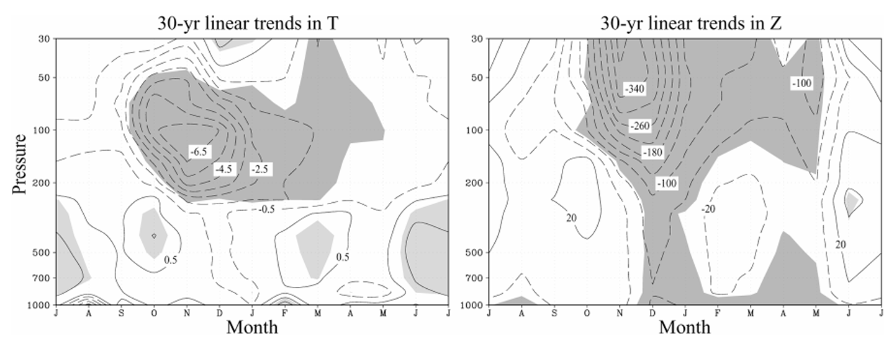
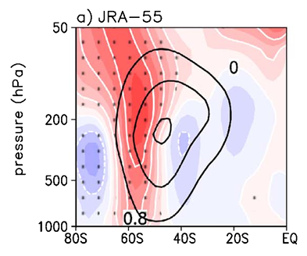
Tropospheric impacts of Antarctic ozone depletion
DJF U trend in JRA-55
Poleward shift of jet
(Thompson and Solomon, 2002)
(Son et al., 2018)
Antarctic Ozone depletion
Cold & Strong
Polar vortex
Positive SAM &
Poleward shift of jet
Reduced radiative heating
Stratosphere-Troposphere coupling
Notes:
Since about the 1970s, anthropogenic emissions of ozone-depleting gases have led to depletion of ~3–4% of the total ozone averaged over the globe.
The strongest depletion is found over Antarctica during spring, when photochemical processes combine with meteorological conditions.
This ozone depletion leads to cooling of the polar stratosphere and acceleration of the stratospheric polar vortex.
Also This eastward acceleration extends to the Earth’s surface during the summer season (Positive SAM ~ Poleward shift of jet).

Slide 3
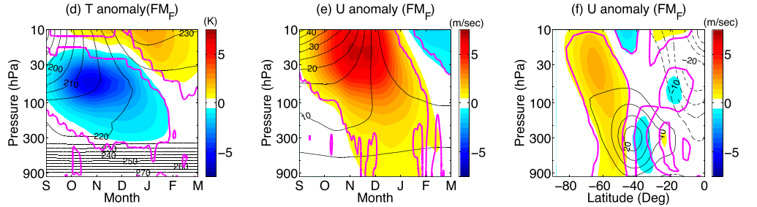
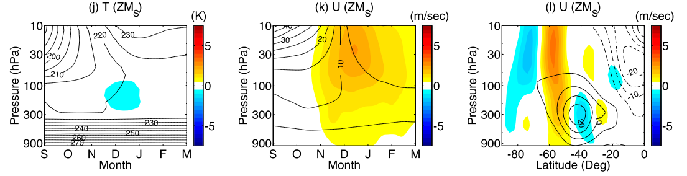
Mechanism for Stratosphere-Troposphere coupling
Ozone depletion
forcing exp.
Extract synoptic-
eddy response
Synoptic eddy
forcing exp.
w/o Planetary eddy
& Thermal forcing
Antarctic O₃ depletion → Synoptic eddy → Poleward shift of jet
(Yang et al., 2015)
Notes:
To understand the mechanism of stratosphere-troposphere coupling during ozone depletion, previous study perform the ozone depletion forcing experiment with simple dynamical model.
The cooling thermal forcing which mimics the ozone depletion could induces the tropospheric impacts such as poleward shift of jet.
And they extract synoptic eddy response, and they only impose the synoptic eddy forcing to additional experiment.
Although without planetary and thermal forcing, this synoptic eddy experiment could simulates the tropospheric impacts of ozone depletion.
So this study and several previous studies highlighted the importance of synoptic eddy for coupling.

Slide 4
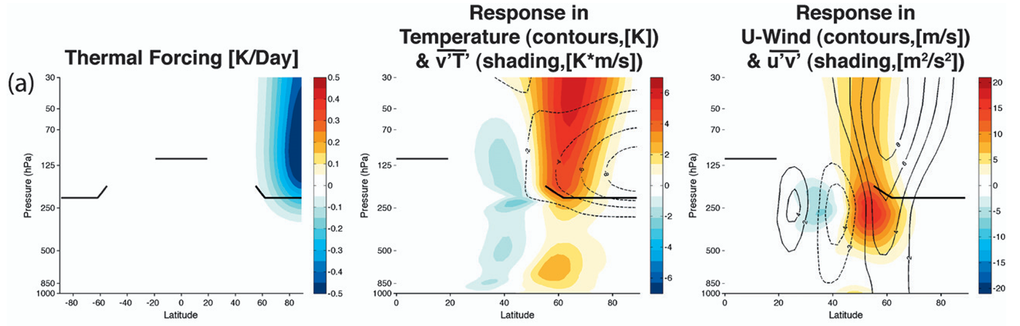
Research questions
(Butler et al., 2010)
Q1: How does the eddy momentum flux near the tropopause induce a barotropic shift of jet?
Notes:
However there are some limitations in the mechanism in previous studies.
First one is that the eddy momentum flux is focused near the tropopause.
This study impose the cooling in the polar lower stratosphere which mimics the Antarctic ozone depletion.
It could simulates the barotropic shift of jet in the troposphere.
However, the eddy momentum flux have maximum below the tropopause with very weak amplitude near the surface.
So if based on momentum budget analysis, it is hard to explain the shift of jet near the surface with eddy momentum flux.

Slide 5
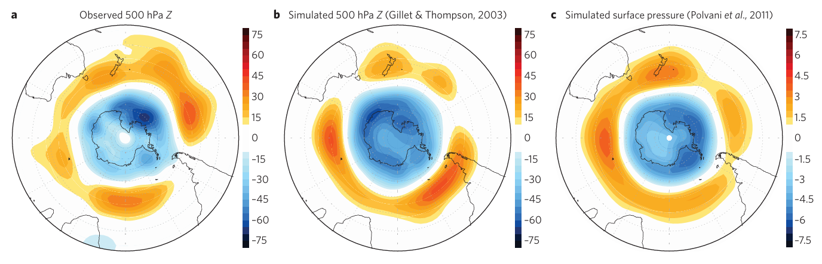
Research questions
Results from ozone depletion experiments
(Thompson et al., 2011)
Q2: How does the eddy momentum flux reduce the Antarctic mass fields?
Notes:
Second one is the reduction in Antarctic mass field such as surface pressure and geopotential height.
There is reduction in the 500 hPa geopotential height field, and this kind of reduction is also reported in the ozone depletion experiment.
Also this reduction in geopotential height look similar with its in surface pressure.
Although the middle and right panels are from different simulations, the response look quite similar each other.
However with momentum analysis which is usually used in previous studies, it is hard to explain the mass change explicitly.

Slide 6
Research goals
Previous studies
Momentum perspective
Antarctic O₃ depletion
Synoptic eddy
Poleward shift of jet
Mass transport perspective
Hypothesis
Synoptic eddy
Antarctic SP reduction
Positive SAM & Poleward shift of jet
Surface pressure budget
Kuo-Eliassen equation
Geopotential decomposition
Notes:
To summarize, previous studies usually highlight the importance of synoptic eddy for tropospheric impacts of ozone depletion in momentum perspective.
But my research goal is to explain the tropospheric impacts with mass transport perspective.
So my hypothesis is that the synoptic eddy reduces Antarctic surface pressure, and it results in the positive Southern annular mode and poleward shift of jet.
For the relationship between the surface pressure and southern annular mode, I use the geopotential height decomposition.
And to explain how the synoptic eddy reduces the Antarctic surface pressure, I use the surface pressure budget and kuo-eliassen equation.
These methods will be explained in after.

Slide 7
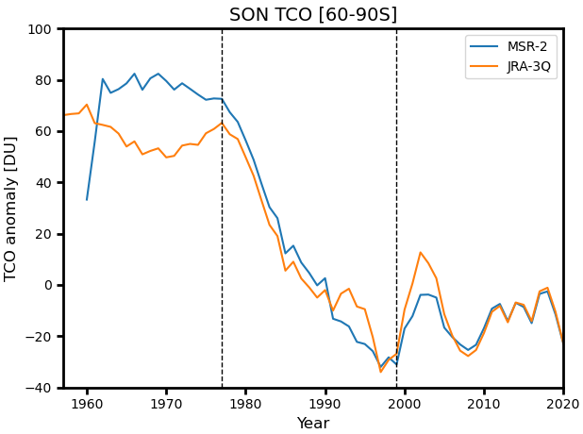
Data & Methods
JRA-3Q
Temporal resolution: daily
Spatial resolution: 1.25° x 1.25°
Vertical resolution: L45 (Pressure level), L100 (Model level)
7-days running mean
O₃ (ozone), Z (geopotential height), T (air temperature),
U (zonal wind), SP (surface pressure)
1999
Pre
Post
1977
Pre-O₃: 1957-1976 (20 years)
Post-O₃: 2000-2020 (20 years; except 2002)
Diff: (Post-O₃)-(Pre-O₃)
Anomaly from 1980-2000
5-years running mean
Notes:
jra 3q reanalysis dataset are used in this study.
The information for used data are shown in here.
Left figure shows the Antarctic total column ozone anomaly during austral summer. There is rapid decreasing trend from 1977 to 1999.
So I define the Pre ozone era and post ozone era, and hereafter all results are differences between the post and pre ozone era.

Slide 8
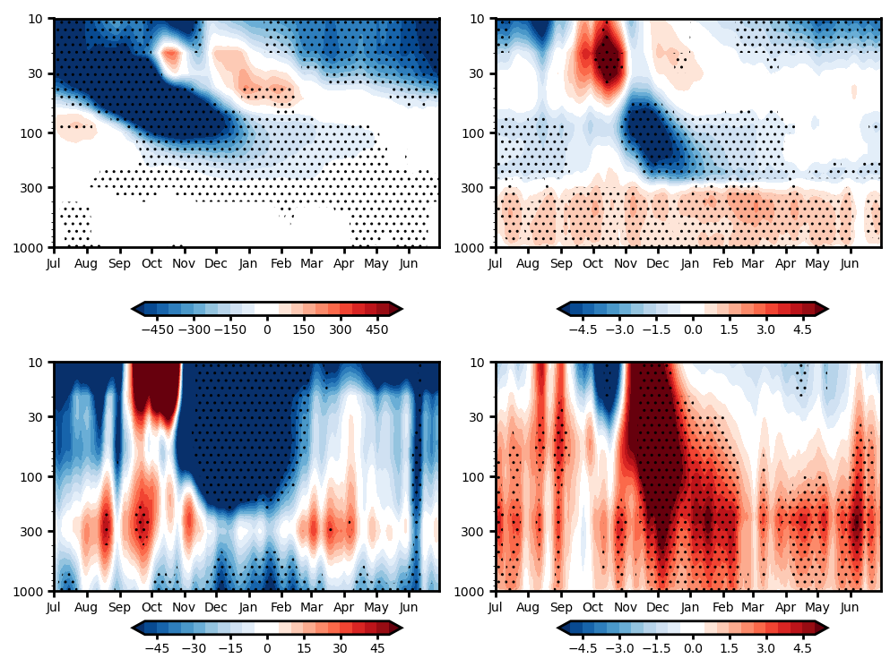
Results: Impacts of Antarctic ozone depletion
Polar-cap O₃ diff.
Polar-cap T diff.
O₃, T, Z: 60-90°S averaged
U: 55-65°S averaged
Dotted: 95% significant
Antarctic O₃ depletion
→ Strong polar vortex
(cold T & negative Z)
→ Positive SAM (negative Z) & Poleward shift of jet in the troposphere
[ppbv]
[K]
Polar-cap Z diff.
Zonal-mean U diff.
[m]
[m s⁻¹]
Notes:
These figures show the impacts of Antarctic ozone depletion. Because of ozone reduction in Antarctic stratosphere, the stratospheric polar vortex is strengthened, such as cold temperature, negative geopotential height, acceleration of vortex. And this impacts are extended to surface, so there is the negative geopotential height and poleward shift of jet in the troposphere.

Slide 9
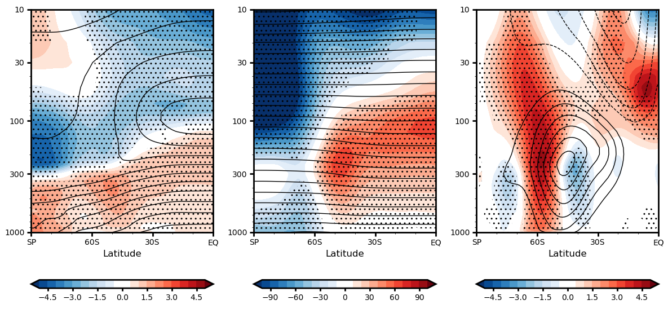
Results: Impacts of Antarctic ozone depletion (DJF)
DJF T diff.
DJF Z diff.
DJF U diff.
DJF averaged
Dotted: 95% significant
Contour: climatology
Shading: difference
[K]
[m]
[m s⁻¹]
Cold stratosphere & Warm troposphere
Negative polar-cap Z (~Positive SAM)
Poleward shift of jet
Notes:
Because these impacts are strong in austral summer season, these figures show the differences averaged djf.
As shown in previous slides, there is cold temperature difference in the polar stratosphere. And this warm temperature difference may be attributed to increasing green house gases.
then negative in pole and positive in midlatitude are shown in geopotential height differences.
This kind of difference pattern is consistent with the poleward shift of jet which is shown in the right panel through the geostrophic balance.
And we if we focus on the temperature and geopotential height differences, because the geopotential is vertical integration of thickness, there shoule be warm geopotential height in Antarctic troposphere because of warm temperature.
However it shows negative, so it implies that there should be other reason for negative height in Antarctic.

Slide 10
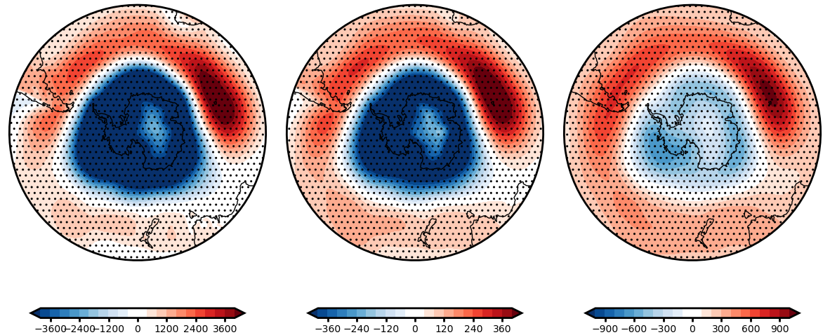
Results: Reduction in mass fields (DJF)
DJF SP diff.
DJF Z850 diff.
DJF Z500 diff.
[Pa]
[m]
[m]
DJF averaged
Dotted: 95% significant
Antarctic O₃ depletion → Barotropic responses in mass field
Notes:
Then the mass could be cloud for negative geopotential height in Antarctic region.
These figures show the differences for surface pressure and geopotential height in 850 and 500 hpa pressure levels.
Although the amplitude of reduction in 500 hpa pressure level are weaker than the others, they all show similar pattern.
It indicates that there is barotropic reduction in geopotential height and this reduction could be attributed to surface pressure.

Slide 11
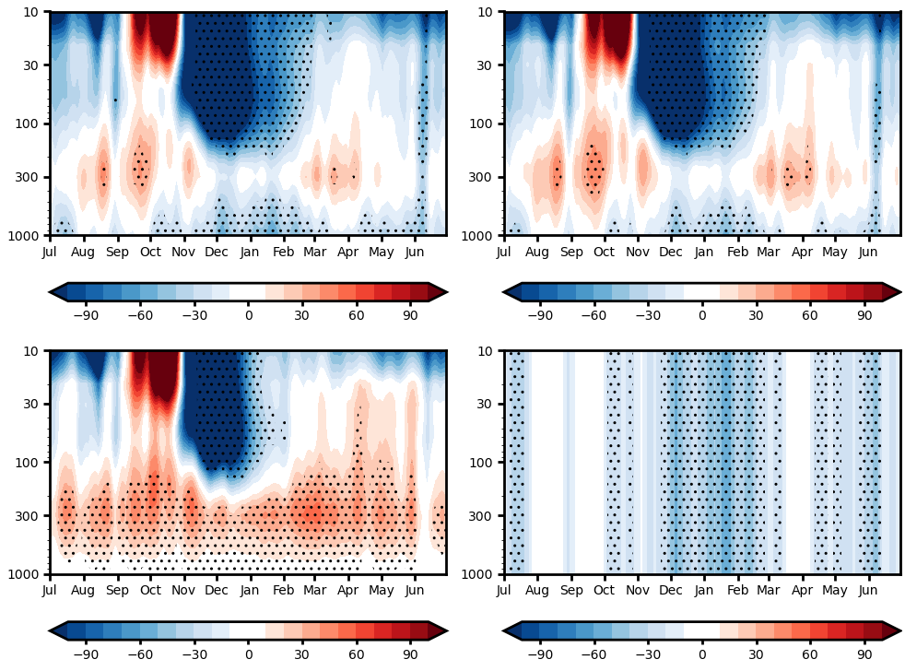
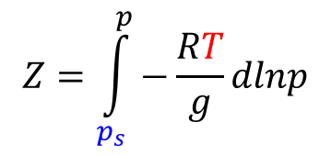
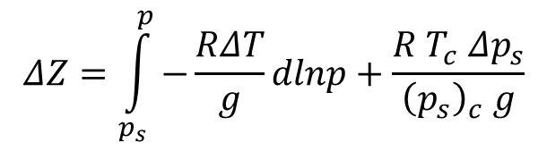
Results: Importance of Antarctic SP reduction
$$Z=\int_{p_{s}}^{p}{−\frac{RT}{g}dlnp}$$
Polar-cap Z diff.
Reconstructed Z diff.
T contrib.
SP contrib.
$$ΔZ=\int_{p_{s}}^{p}{−\frac{RΔT}{g}dlnp}+\frac{R T_{c} Δp_{s}}{{\left(p_{s}\right)}_{c} g}$$
T contrib.
SP contrib.
(Mudryk and Kushner, 2011)
Antarctic O₃ depletion
→ Antarctic SP reduction
→ Positive SAM (negative Z)
60-90°S averaged
Dotted: 95% significant
[m]
[m]
Notes:
To quantify the contribution of surface pressure and temperature, I use this anomaly decomposition equation. Because the geopotential is balanced with the surface pressure and temperature, its anomaly could be decomposed to their contribution. Although this equation neglects the nonlinear component, the reconstructed geopotential height differences are almost same with original geopotential height differences. Then we check the contributions of each terms. While the air temperature increase the geopotential height in Antarctic region, the negative geopotential height is attributed to surface pressure contribution.

Slide 12
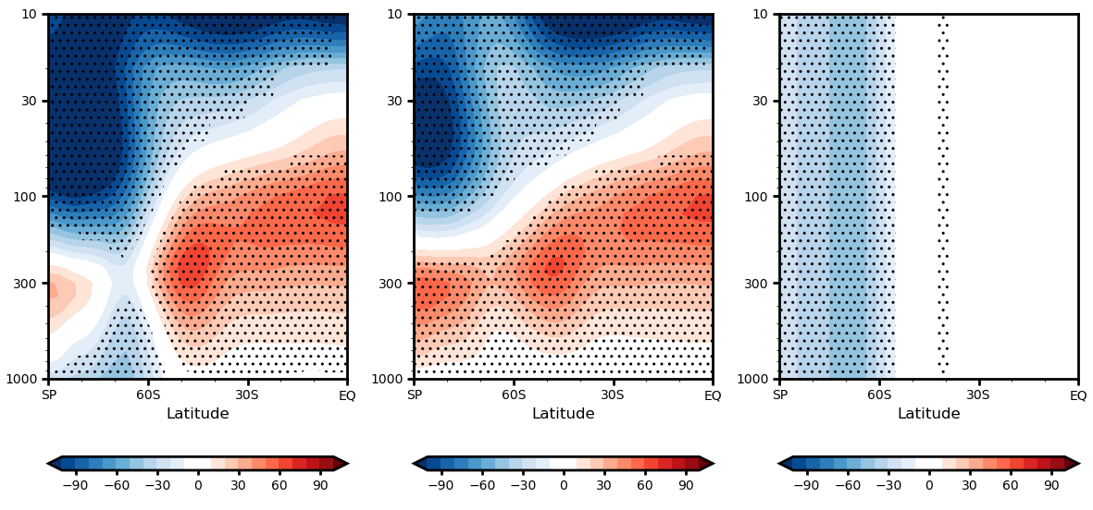
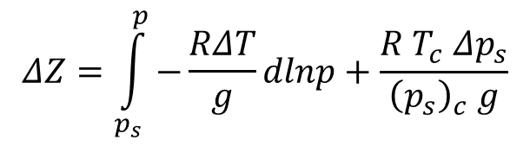
Results: Importance of Antarctic SP reduction (DJF)
Reconstructed Z diff.
T contrib.
SP contrib.
DJF averaged
Dotted: 95% significant
[m]
[m]
[m]
$$ΔZ=\int_{p_{s}}^{p}{−\frac{RΔT}{g}dlnp}+\frac{R T_{c} Δp_{s}}{{\left(p_{s}\right)}_{c} g}$$
SP contrib.
Antarctic SP reduction
→ Negative polar-cap Z
T contrib.
(Mudryk and Kushner, 2011)
Notes:
This contribution of surface pressure is also significant during the austral summer season.
So the geopotential height decomposition reveals that for the negative geopotential height which is consistent with positive southern annular model is attributed to Antarctic surface pressure decrease.

Slide 13
Results: What causes the decrease in Antarctic SP?
DJF SP diff.
Equatorward mass transport
= Antarctic mass divergence
Notes:
Then what causes the derecase in Antarctic surface pressure?
This surface pressure differences illustrates that there is mass increase in mid latitude and mass decrease in Antarctic.
And this mass differences imply that there sould be mass divergence in Antarctic region.
To quantify this mass divergence and investigate the vertical profile of mass transport, I perform the surface pressure budget analysis.

Slide 14
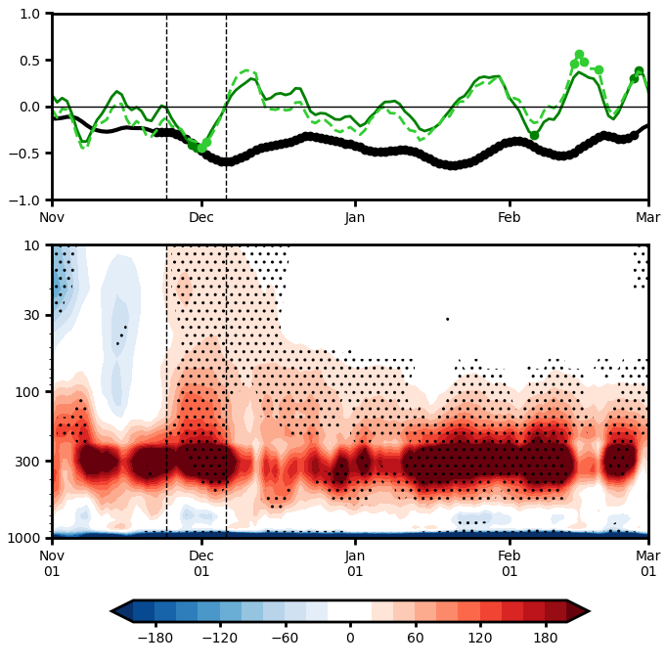

Results: Surface pressure budget
Polar-cap SP, change, budget diff.
Surface pressure budget
$$\frac{∂}{∂t}\left(\int_{90°S}^{60°S}{\overline{p_{s}}cosφ dφ}\right)=\frac{1}{a}\int_{1}^{0}{{(\overline{\tilde{ρ}v}cosφ)}_{60°S}}$$
[hPa]
Polar-cap SP change
Mass transport across Antarctic circle
Meridional mass flux diff.
Equatorward mass transport in the upper level
> Poleward mass transport near the surface
→ Antarctic mass divergence (reduction)
SP: 60-90°S averaged
Budget: 60°S averaged
Dotted: 95% significant
Southward
(Poleward)
Northward
(Equatorward)
[Pa s⁻¹]
Notes:
This equation is the surface pressure budget equation. Left hand side indicates the polar-cap surface pressure change and the right hand side indicates the mass transport across Antarctic circle. If we compare the green and light green lines which indicate the surface pressure change and its budget, they are almost same, so this surface pressure budget could explain the surface pressure change in quantitative sense. The black line indicates the surface pressure difference and there is significant surface pressure decrease after late November. And it is due to the significant surface pressure decrease in late November and early December.
Then we check the vertical profile of mass transport. If we calculate the vertical integration this mass transport, it is same as above surface pressure budget.
This vertical profile shows that there is northward mass transport in the upper troposphere and stratosphere. While there is strong southward mass transport near the surface, the total mass transport is northward, so it leads to Antarctic surface pressure decrease.
Because the important surface pressure decrease is focused in the late November and early December, hereafter results are averaged for this period.

Slide 15
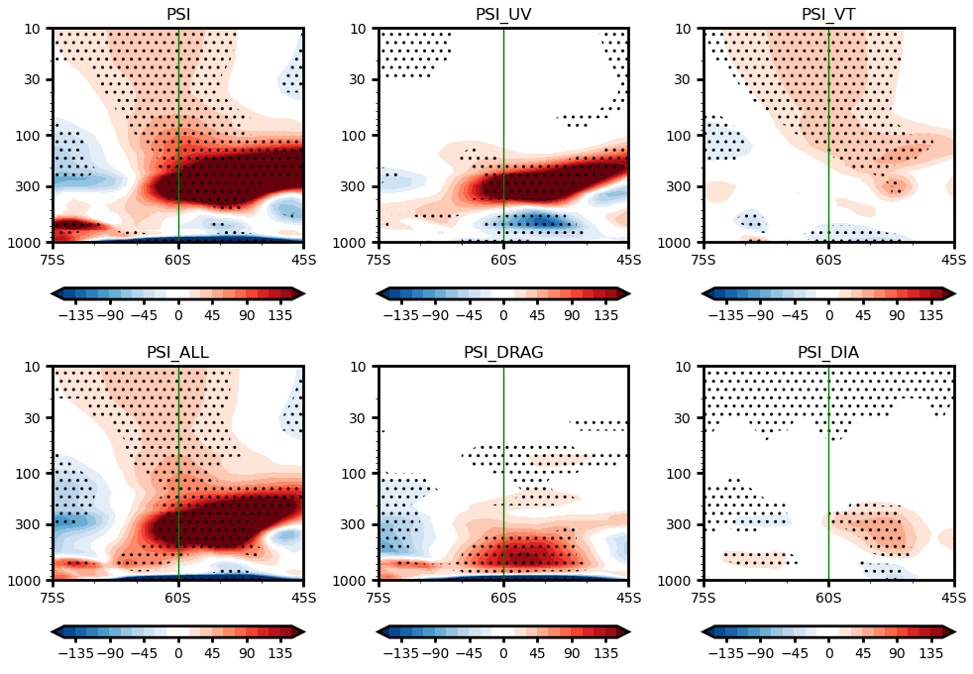
Results: Meridional circulation change
Meridional mass flux diff.
Equatorward mass transport > Poleward mass transport
→ Antarctic mass divergence (reduction)
Equatorward
Poleward
[Pa s⁻¹]
Notes:
Left figure shows the austral spring Antarctic total column ozone anomaly in MSR2 and JRA3Q data. There is linear decrease from 1977 to 1999.

Slide 16
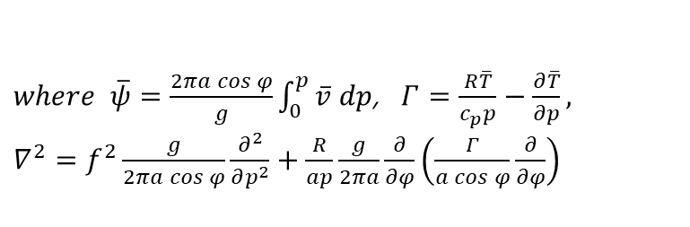
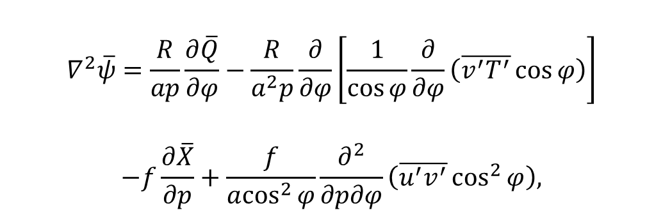
Results: Kuo-Eliassen equation
Kuo-Eliassen equation
Meridional mass flux diff.
diagnoses how the ageostrophic (meridional) circulation in the LHS is adapted to the geostrophic forcings in the RHS.
Diabatic heating
Eddy heat flux
$$∇^{2}\overline{ψ}=\frac{R}{ap}\frac{∂\overline{Q}}{∂φ}−\frac{R}{a^{2}p}\frac{∂}{∂φ}\left[\frac{1}{\cos{φ}}\frac{∂}{∂φ}\left(\overline{v^{′}T^{′}}\cos{φ}\right)\right]$$
$$−f\frac{∂\overline{X}}{∂p}+\frac{f}{a\cos^{2}{φ}}\frac{∂^{2}}{∂p∂φ}\left(\overline{u^{′}v^{′}}\cos^{2}{φ}\right),$$
KE inverted
Zonal drag
Eddy momentum flux
$where \overline{ψ}=\frac{2πa\cos{φ}}{g}\int_{0}^{p}{\overline{v} dp}$, $Γ=\frac{R\overline{T}}{c_{p}p}−\frac{∂\overline{T}}{∂p},$
$∇^{2}=f^{2}\frac{g}{2πa\cos{φ}}\frac{∂^{2}}{∂p^{2}}+\frac{R}{ap}\frac{g}{2πa}\frac{∂}{∂φ}\left(\frac{Γ}{a\cos{φ}}\frac{∂}{∂φ}\right)$
Period averaged
Dotted: 95% significant
Notes:
Left figure shows the austral spring Antarctic total column ozone anomaly in MSR2 and JRA3Q data. There is linear decrease from 1977 to 1999.

Slide 17
Results: Importance of eddy momentum flux
Meridional mass flux diff.
Eddy momentum flux
Eddy heat flux
KE inverted
Zonal drag
Diabatic heating
[Pa s⁻¹]
Notes:
Left figure shows the austral spring Antarctic total column ozone anomaly in MSR2 and JRA3Q data. There is linear decrease from 1977 to 1999.

Slide 18
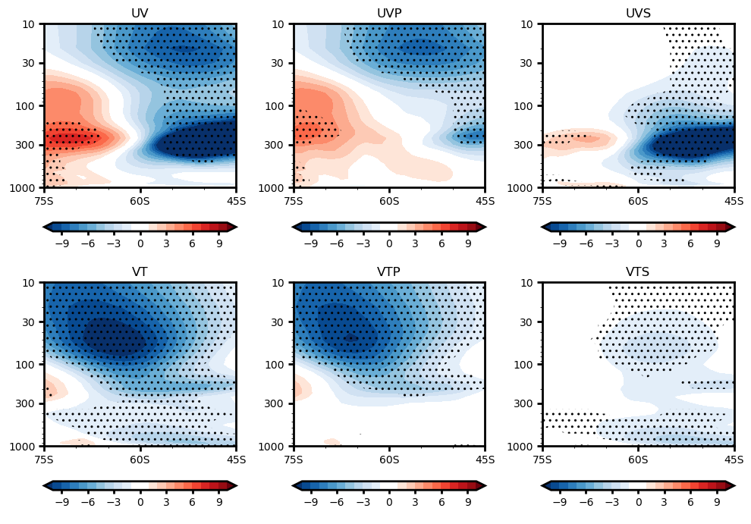
Results: Importance of synoptic eddy
Eddy momentum flux diff.
Planetary eddy (k≤3)
Synoptic eddy (k>3)
Conv.
[m² s⁻¹]
[m² s⁻¹]
[m² s⁻¹]
Eddy momentum flux convergence → Zonal wind acceleration in the UTLS
→ Northward wind for Coriolis deceleration (Clockwise circulation)
→ Zonal wind acceleration near the surface through Coriolis acceleration
Period averaged
Dotted: 95% significant
Notes:
Left figure shows the austral spring Antarctic total column ozone anomaly in MSR2 and JRA3Q data. There is linear decrease from 1977 to 1999.

Slide 19
Summary
Antarctic O₃ depletion
Eddy momentum flux
Meridional mass transport
Equatorward
Conv.
[ppbv]
[m² s⁻¹]
[Pa s⁻¹]
Antarctic SP decrease
Positive SAM (Negative Z) & Poleward shift of jet
[Pa]
[m]
[m s⁻¹]
Notes:
Left figure shows the austral spring Antarctic total column ozone anomaly in MSR2 and JRA3Q data. There is linear decrease from 1977 to 1999.

Slide 20
Conclusions
Antarctic O₃ depletion
SP reduction→ Negative Z in the troposphere
Synoptic eddy
Antarctic SP reduction
Positive SAM & Poleward shift of jet
Eddy momentum flux convergence
→ Northward mass transport in the upper level
Future plans
Investigate how Antarctic O₃ depletion changes the synoptic eddy.
Compare the impacts of O₃ with that of other anthropogenic forcings (GHGs, aerosols, etc.).
Notes:
Left figure shows the austral spring Antarctic total column ozone anomaly in MSR2 and JRA3Q data. There is linear decrease from 1977 to 1999.

Slide 21
Results: Importance of eddy heat flux
Eddy heat flux diff.
Planetary eddy (k≤3)
Synoptic eddy (k>3)
Warming
Cooling
Period averaged
Dotted: 95% significant
Northward: Eddy heat flux divergence (cooling) → Downward for adiabatic warming
Southward: Eddy heat flux convergence (warming) → Upward for adiabatic cooling
→ Clockwise circulation for mass continuity
Notes:
Left figure shows the austral spring Antarctic total column ozone anomaly in MSR2 and JRA3Q data. There is linear decrease from 1977 to 1999.

Slide 22
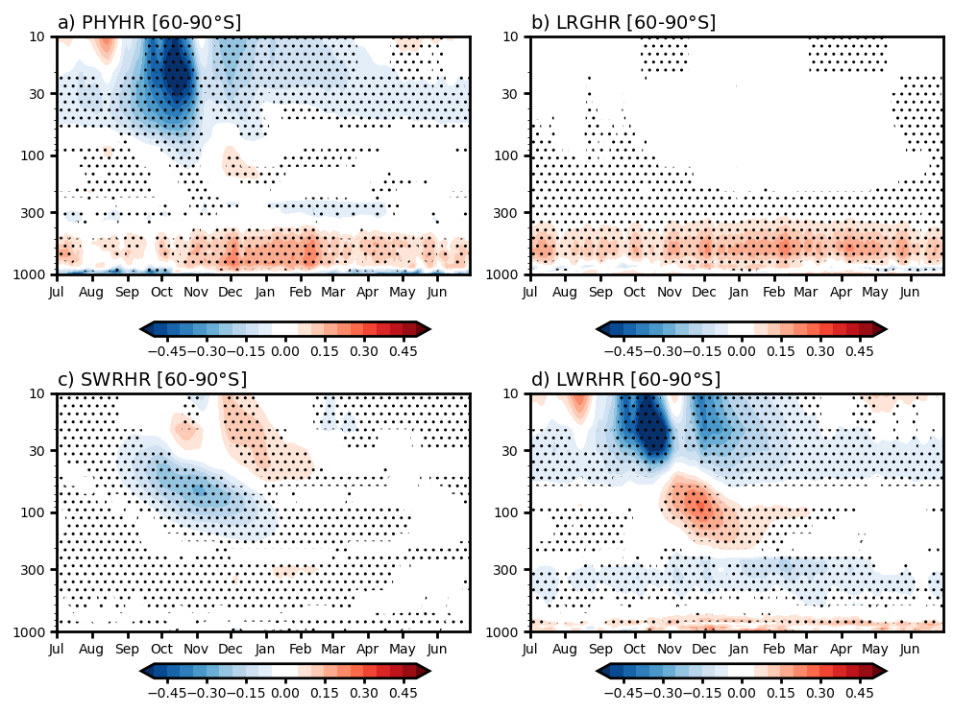
Heating rates
Notes:
Left figure shows the austral spring Antarctic total column ozone anomaly in MSR2 and JRA3Q data. There is linear decrease from 1977 to 1999.

Slide 23
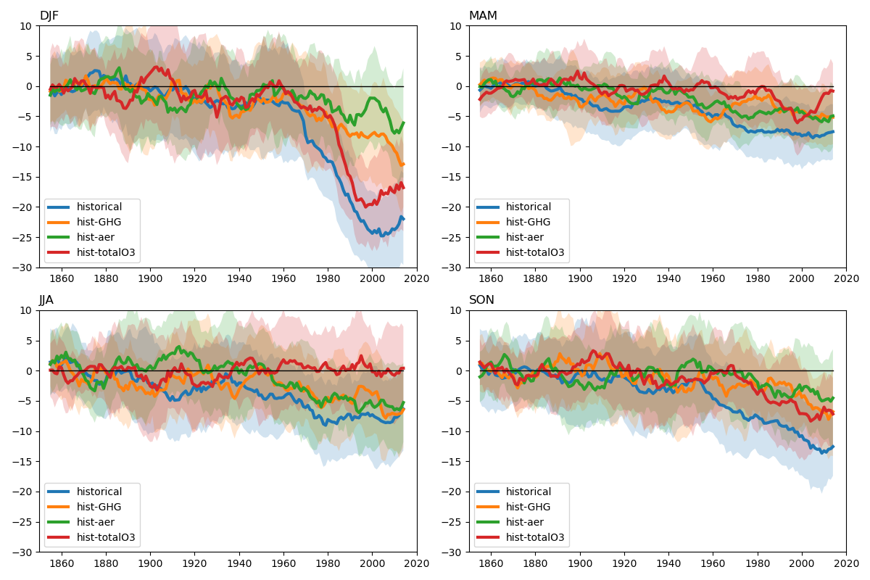
Polar-cap Z850

Slide 24
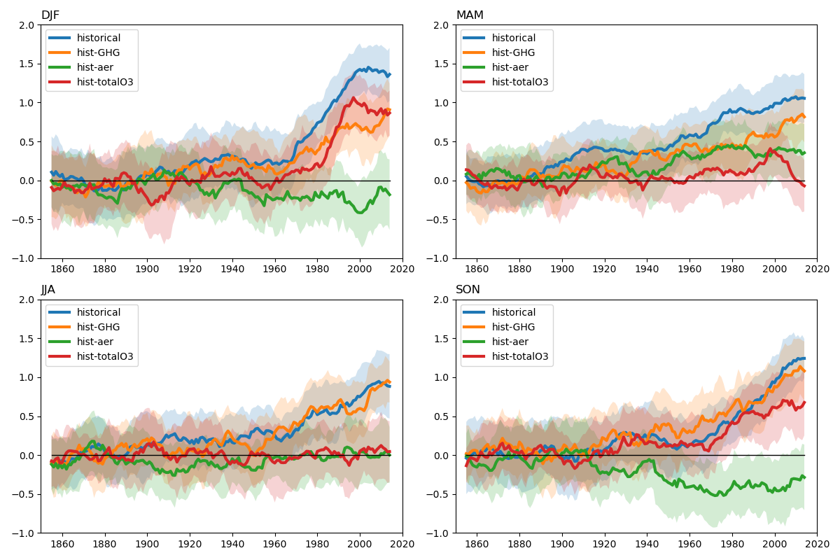
SAM (PSL40 – PSL65)

Slide 25
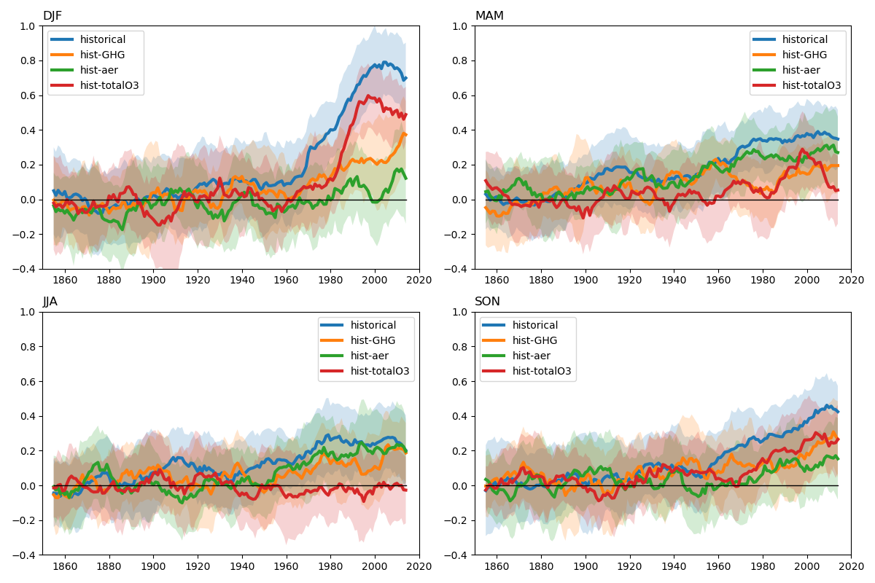
SAM (Polar-cap Z850)

Slide 26
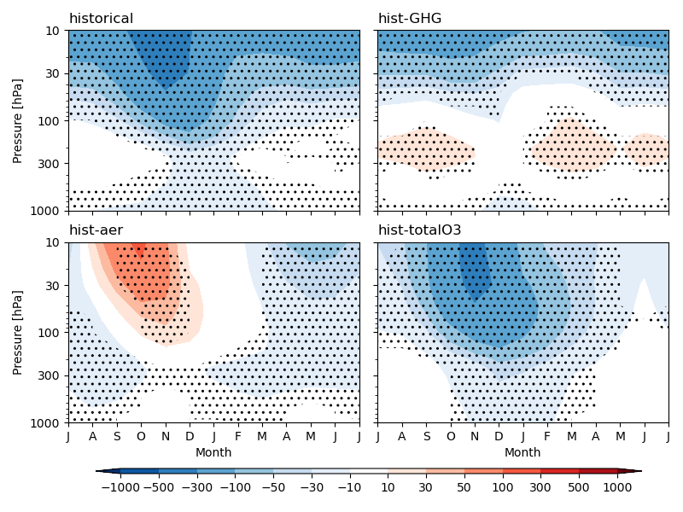
Polar-cap Z (Last 35 years – First 35 years)

Slide 27

Polar-cap Z (Last 35 years – First 35 years) (Reconstructed)

Slide 28
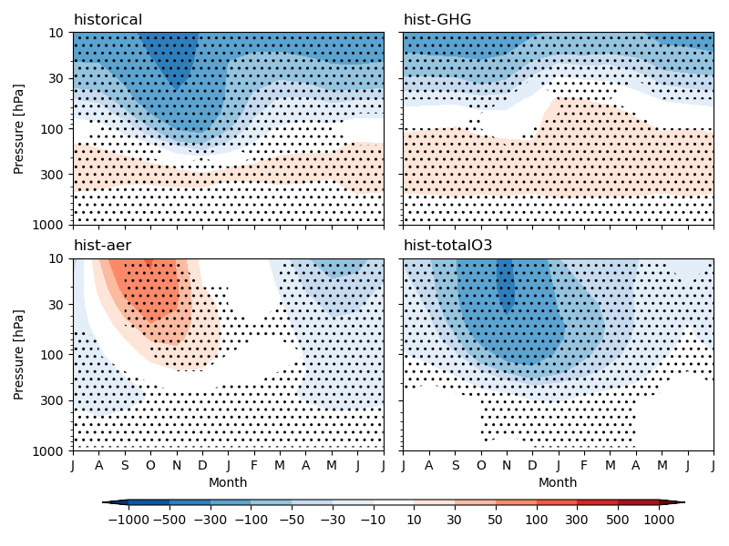
Polar-cap Z (Last 35 years – First 35 years) (T contribution)

Slide 29
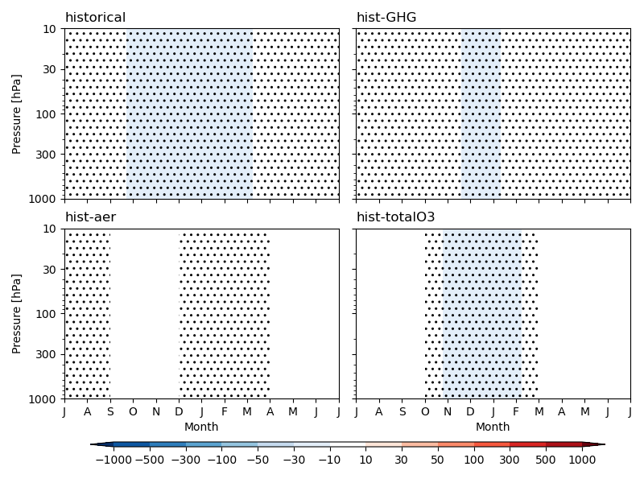
Polar-cap Z (Last 35 years – First 35 years) (SP contribution)

Slide 30
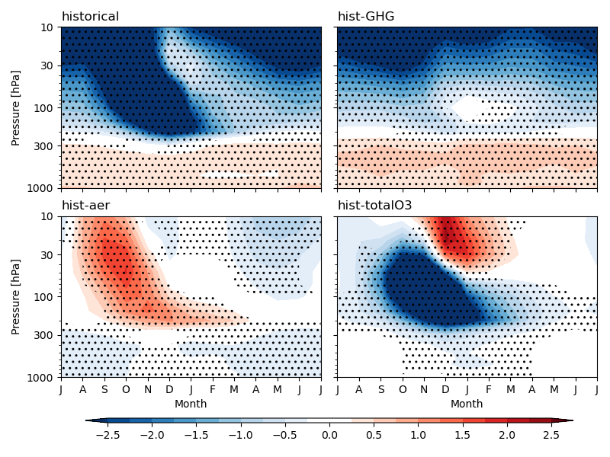
Polar-cap T (Last 35 years – First 35 years)

Slide 31
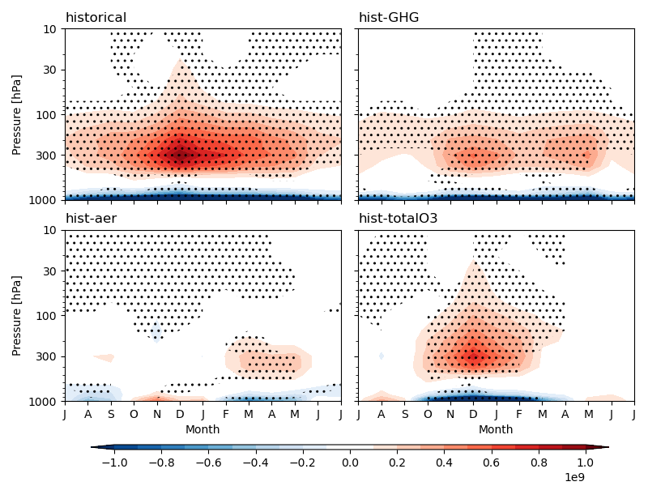
Meridional mass flux @60N (Last 35 years – First 35 years)

Slide 32
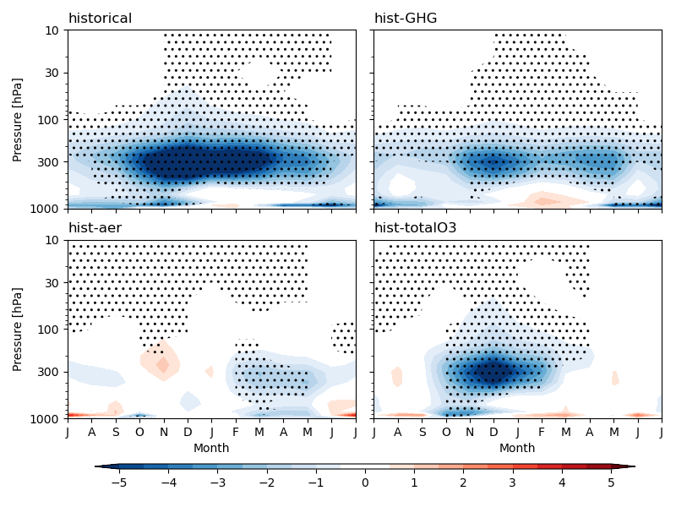
Eddy momentum flux div. @60N (Last 35 years – First 35 years)

Slide 33
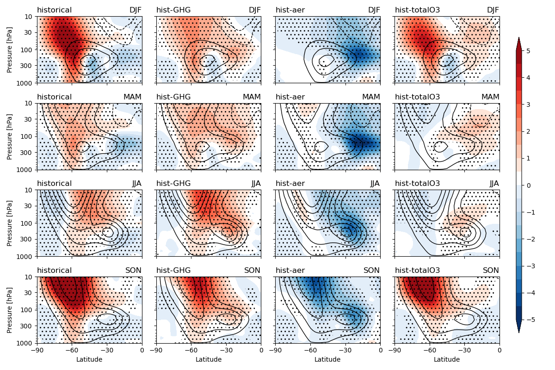
Seasonal U diff. (Last 35 years – First 35 years)

Slide 34
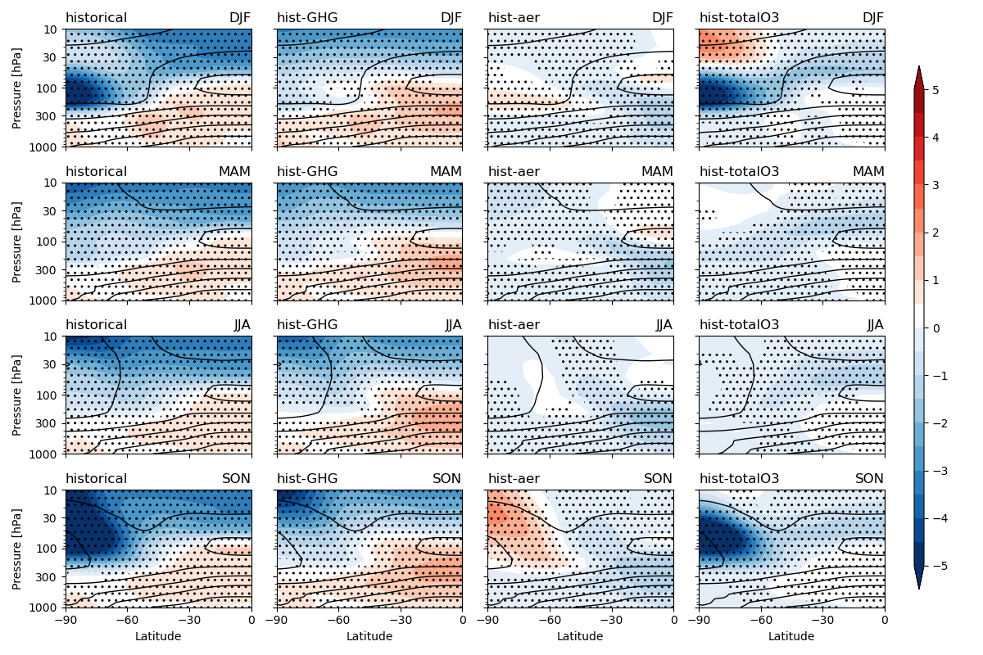
Seasonal T diff. (Last 35 years – First 35 years)

Slide 35
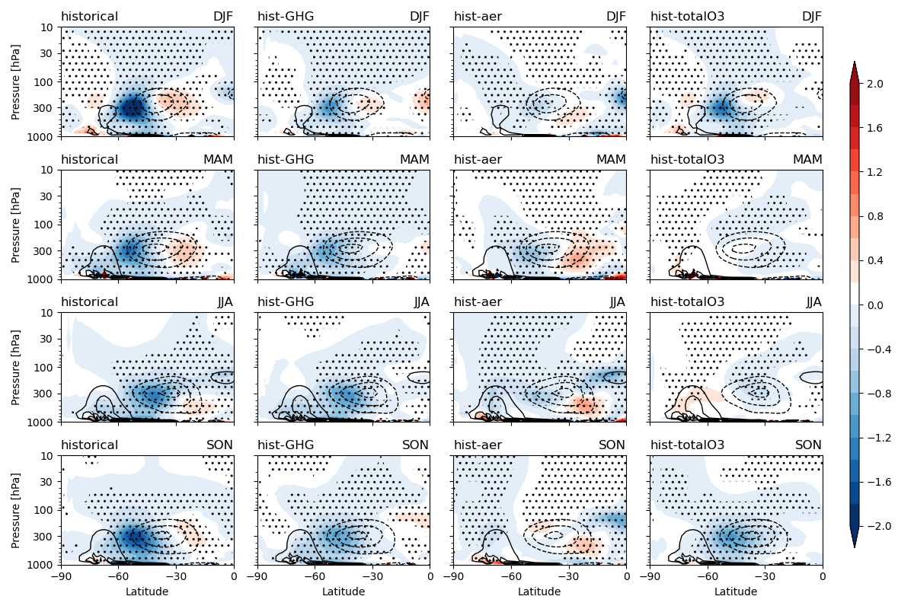
Seasonal U’V’ diff. (Last 35 years – First 35 years)

Slide 36
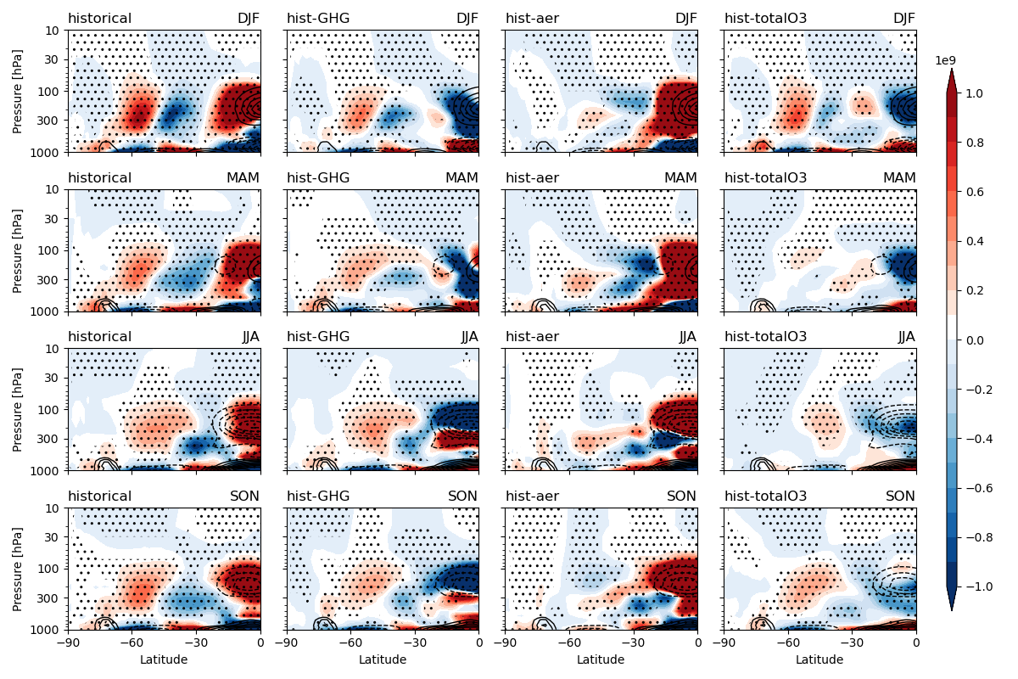
Seasonal meridional mass flux diff. (Last 35 years – First 35 years)

