Slide 1


Forecast Impact of Additional Radiosonde Ascents During the YOPP-SH Winter Campaign
Mariana Fontolan Litell, David h. Bromwich, Jordan G. Powers, Kevin W. Manning and Sheng-Hung Wang
20th WAMC
Supported by nsf grant 2205398

Slide 2
Outline
Introduction
YOPP-SH
TOP Experiments
Results
Conclusion

Slide 3
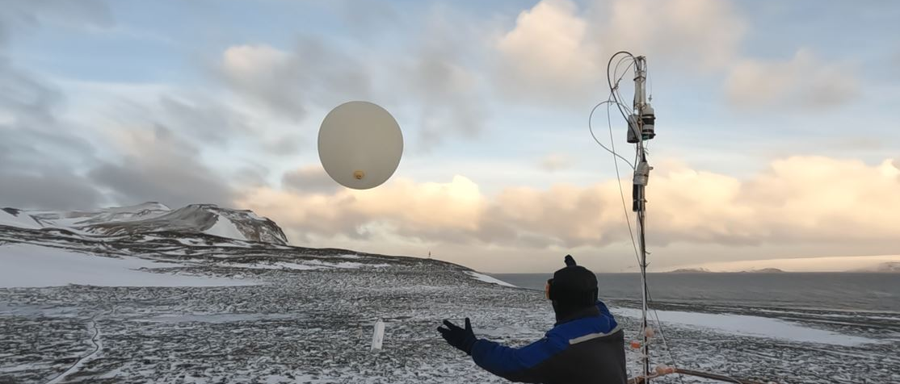
Introduction
Existing polar prediction capability requires improvement
Why access to a reliable forecast for Antarctica is important?
  Importance for climate change studies: More observational data improves the representation of physical processes in the climate models. This strengthens their ability to project long-term trends and assess the impacts of climate change.
  Importance for the Southern Ocean and Antarctica: Additional atmospheric observations over this region of the globe improve forecasts which further safe and efficient logistical operations, assist in the safeguard of personnel in the stations, and facilitate equipment maintenance.
  Enhancing forecast models: Better understanding of the Antarctic atmosphere significantly improves the forecast accuracy for the southern mid-latitudes as well.
Increasing observational is a key for better forecasting skill for the continent!
King Sejong Station – Radiosonde launch during TOP2.

Slide 4
YOPP-SH
  This project is involved with the Year of Polar Prediction in the Southern Hemisphere (YOPP-SH) that is part of the WMO Polar Prediction Project (PPP)
  Main goal: Promote research toward improved environmental prediction for the polar regions
  Summer Special Observing Period (SOP): November 2018-February 2019
  Winter Special Observing Period (SOP): April 15 – August 31, 2022
    Within the Winter SOP - Targeted Observing Periods (TOPs) - Have additional radiosonde ascents
    Combined effort of 14 international Antarctic programs

Slide 5
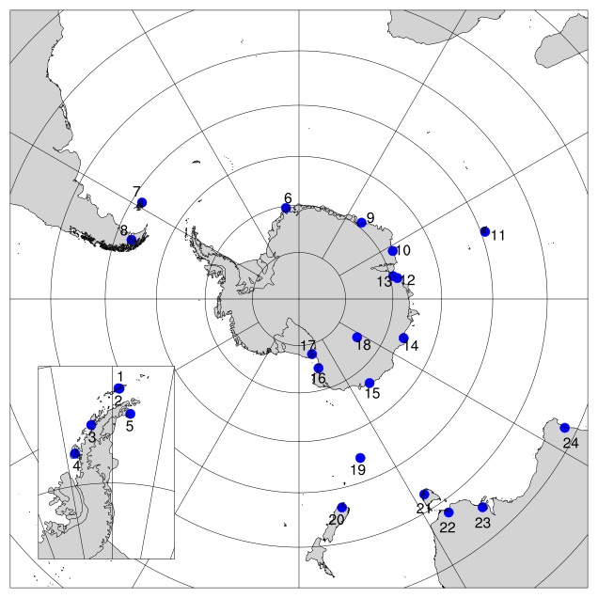
Stations Participating in the YOPP-SH
Number | Station Name
1 | King Sejong
2 | Escudero
3 | Vernadsky
4 | Rothera
5 | Marambio
6 | Neumayer
7 | Mount Pleasant
8 | Punta Arenas
9 | Syowa
10 | Mawson
11 | Kerguelen
12 | Davis
13 | Zhongshan
14 | Casey
15 | Dumont d’Urville
16 | Jang Bogo
17 | McMurdo
18 | Concordia
19 | Macquarie
20 | Invercargill
21 | Hobart
22 | Melbourne
23 | Adelaide
24 | Perth
Notes:
24 stations released extra radiosondes during the winter SOP

Slide 6

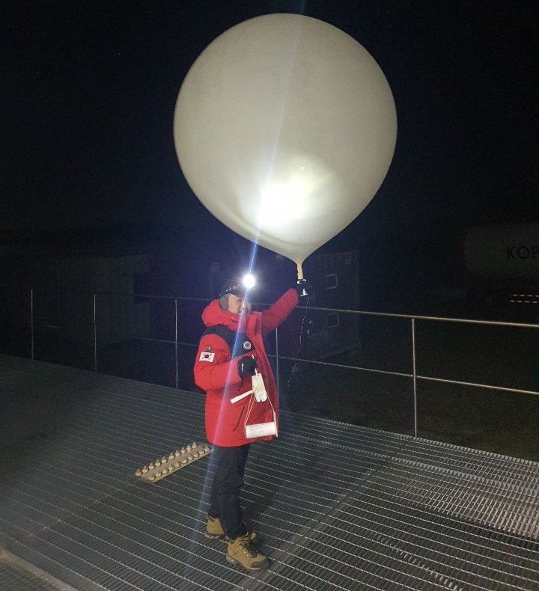
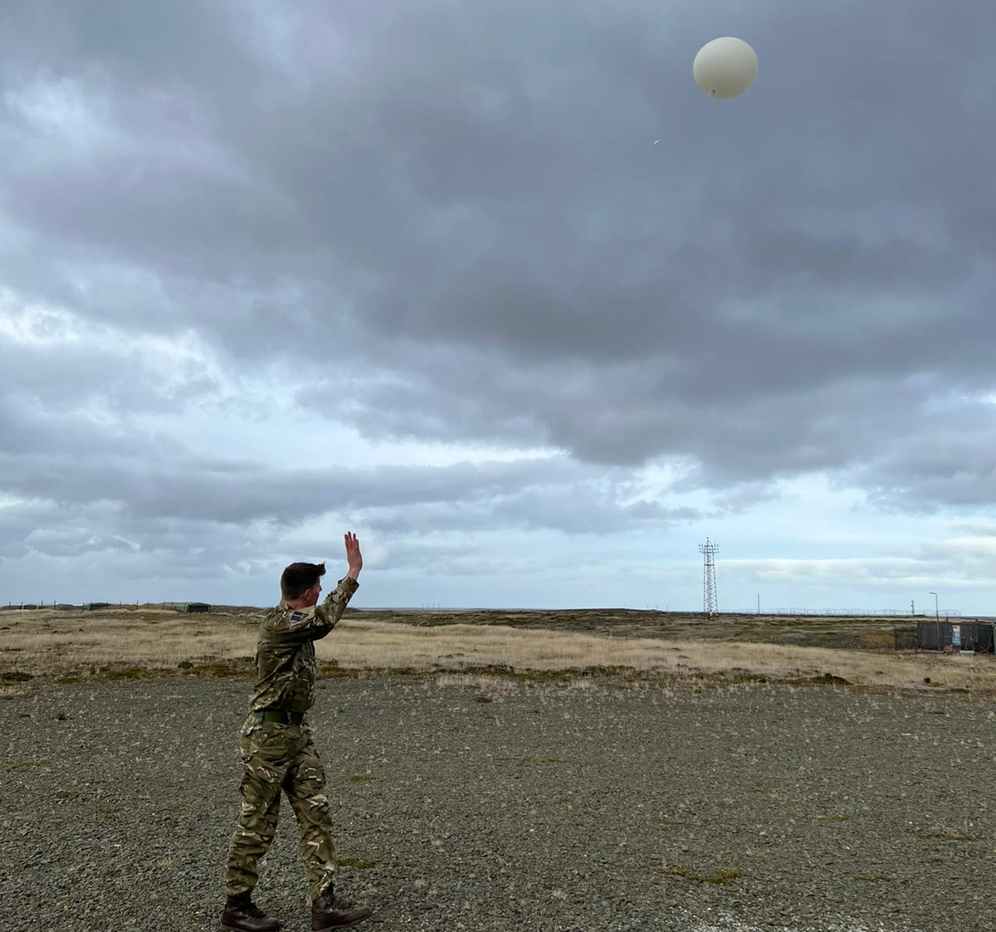
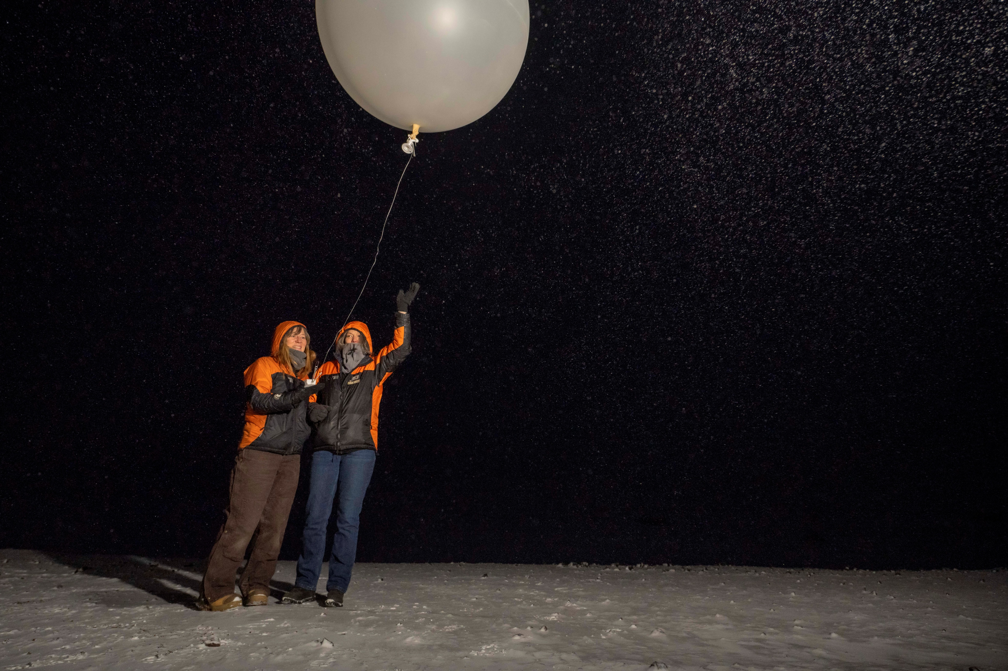
Targeted Observing Periods (TOPs)
9–16 May
TOP1
Antarctic wide
2–7 June
TOP2
Antarctic wide
1–9 July
TOP3
East Antarctica
14–19 July
TOP4
Antarctic wide
23–30 July
TOP5
Antarctic Peninsula
29 July – 3 Aug.
TOP6
East Antarctica
20–30 Aug.
TOP7
Antarctic wide
Vernadsky
Jang Bogo
Falkland Islands
McMurdo

Slide 7
TOP EXPERIMENTS
  NCAR performed forecasting experiments using the Weather Research and Forecast (WRF) model setup in the Antarctic Mesoscale Prediction System (AMPS) framework
  For the model initial conditions, the observations were both assimilated using 3-Dimensional Ensemble Variational DA (3DEnVar) and Multi-Resolution Incremental 4DVAR DA (MRI-4DVAR)
Two forecasts were generated
Assimilating all routine observations
Assimilating all routine observations + extra soundings
TOP experiment WRF grids. Horizontal grid spacings of 24 km and 8 km (Powers et al. 2023).
EXTRA
ROUTINE

Slide 8
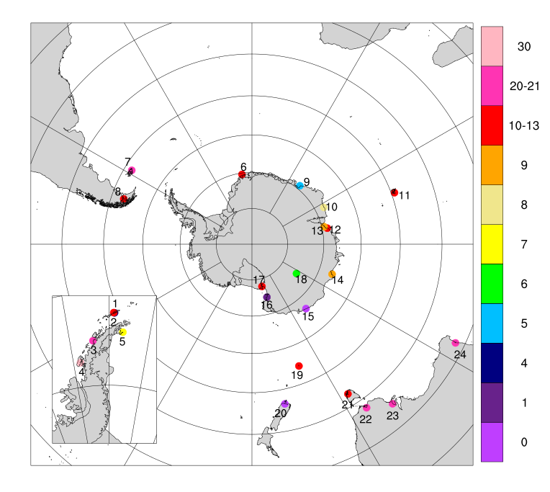
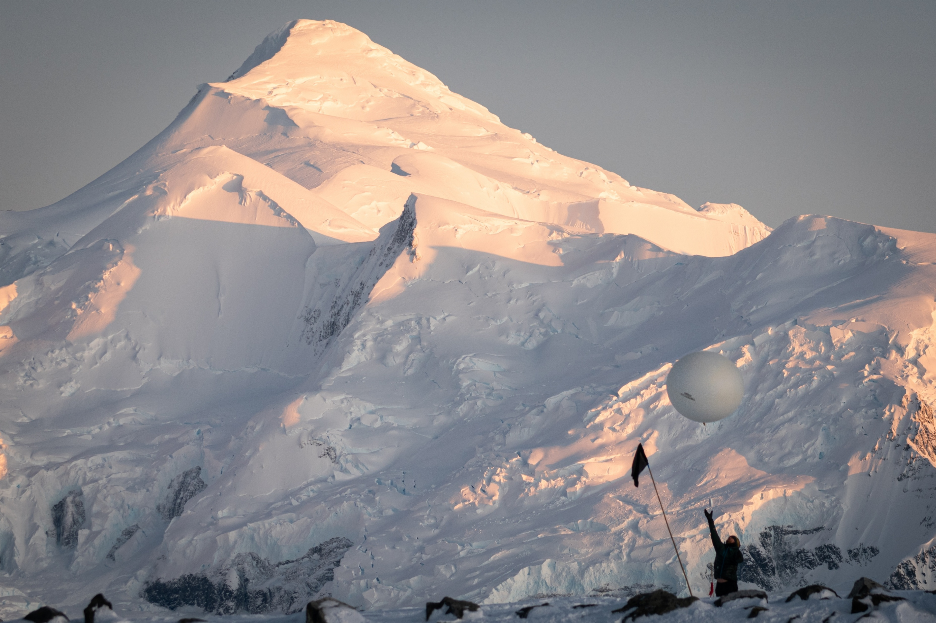
TOP7 Description
TOP7: August 20-30, 2022
Antarctic Wide
Motives for this TOP:
  Peninsula: High precipitation, higher temperatures, AR2
  Ross Sea: Cyclone
~ 25 extra soundings per day!
Balloon launch at Rothera during TOP7 – Picture source: Sam Hunt
Colors represent the number of extra sounding

Slide 9
Results: TOP7 Experiments
  21 WRF forecasts were generated:
    Starting on August 20, 2022 at 1200UTC
    Ending on August 30, 2022 at 0000UTC
    With 12-hour intervals between each forecast time
    Each run for 5 forecast days
Experiments
3DEnVar
EXTRA
ROUTINE
MRI-4DVAR
EXTRA
ROUTINE
Notes:
The observations were assimilated with 3DEnVar and 4DVAR

Slide 10
Determination of Forecast Impact
  Methods to quantify the benefits of the additional radiosondes for the winter SOP
  Calculate forecast errors against ECMWF reanalysis version 5 (ERA5) that is a close approximation to reality
  Mean Absolute Error and Student’s t–test of the significance of the MAE
  Statistical analyses performed for:
    Entire domain
    South of 60°S – where the positive effect of the extra radiosondes was more prominent in the summer YOPP-SH (Bromwich et al. 2022)
    50-70°S – area with largest forecast impact with the extra dropsondes from the Concordiasi field experiment (Boullot et al. 2014)

Slide 11
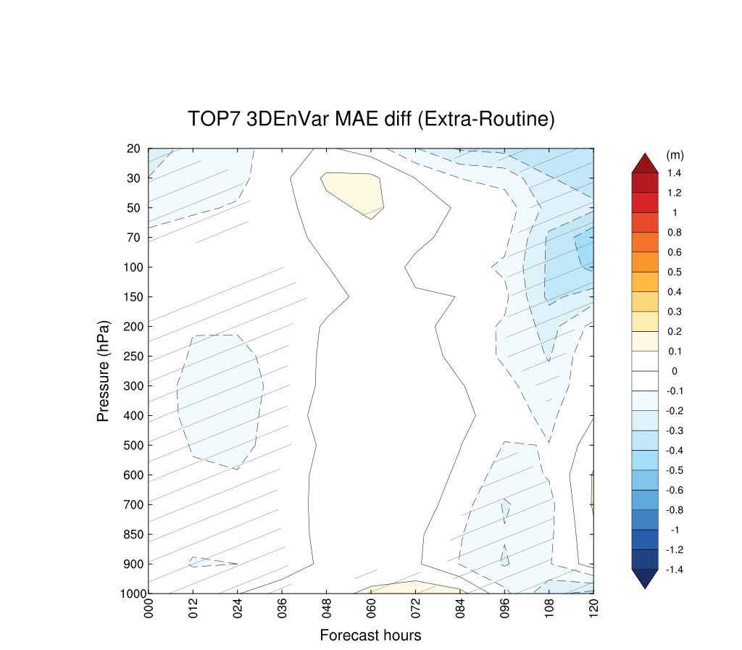
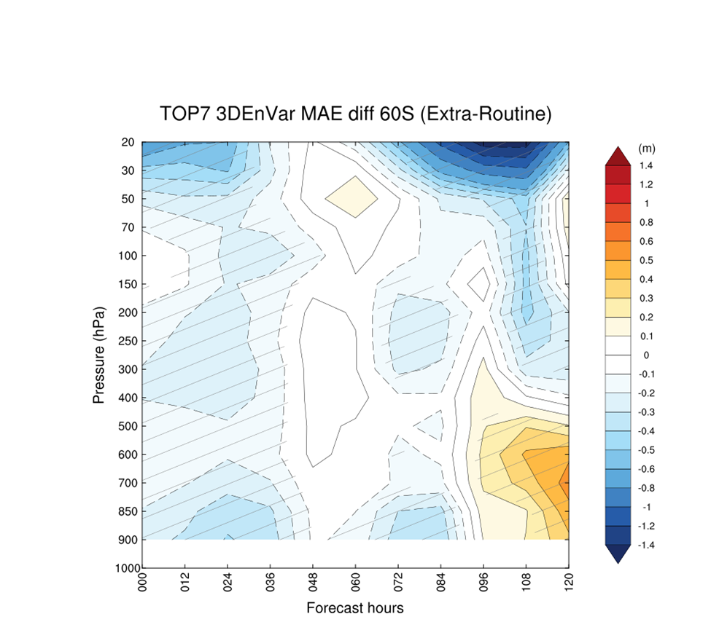
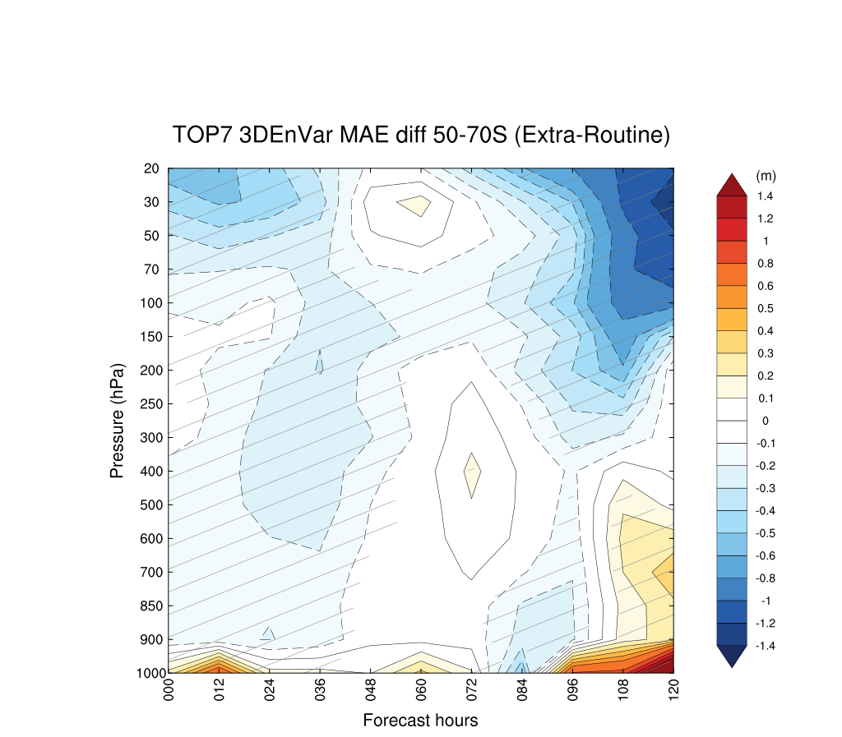
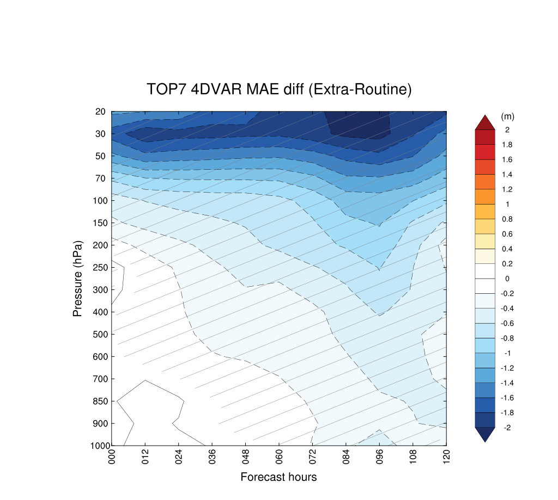
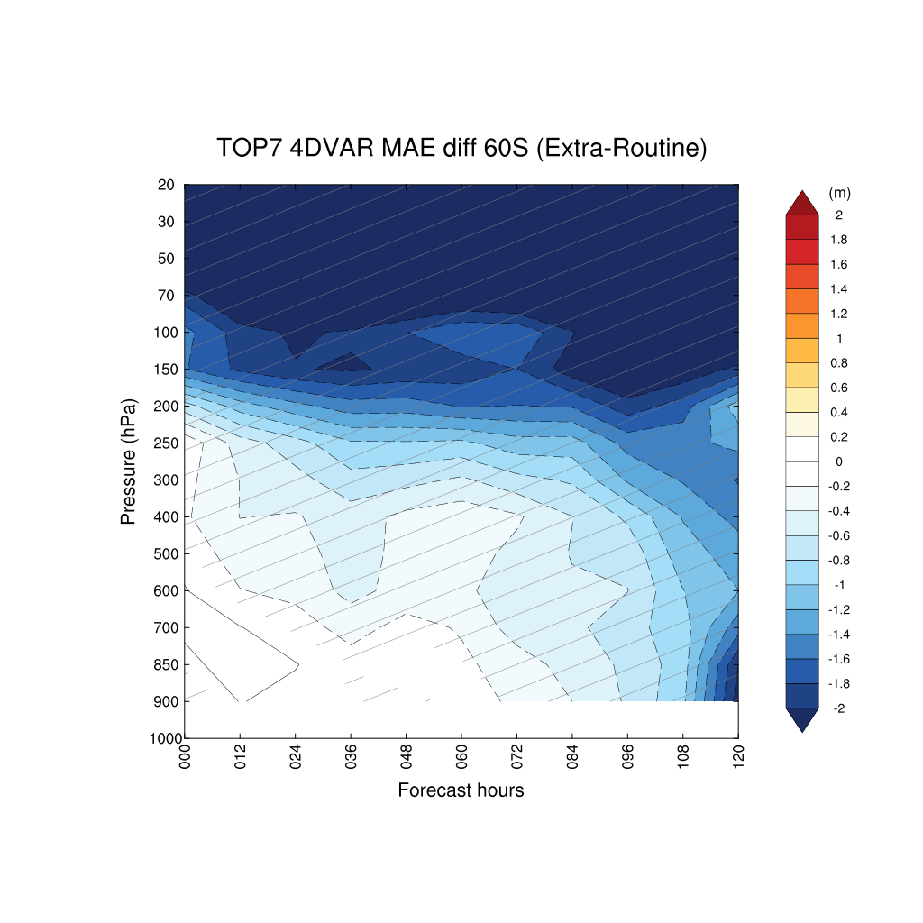
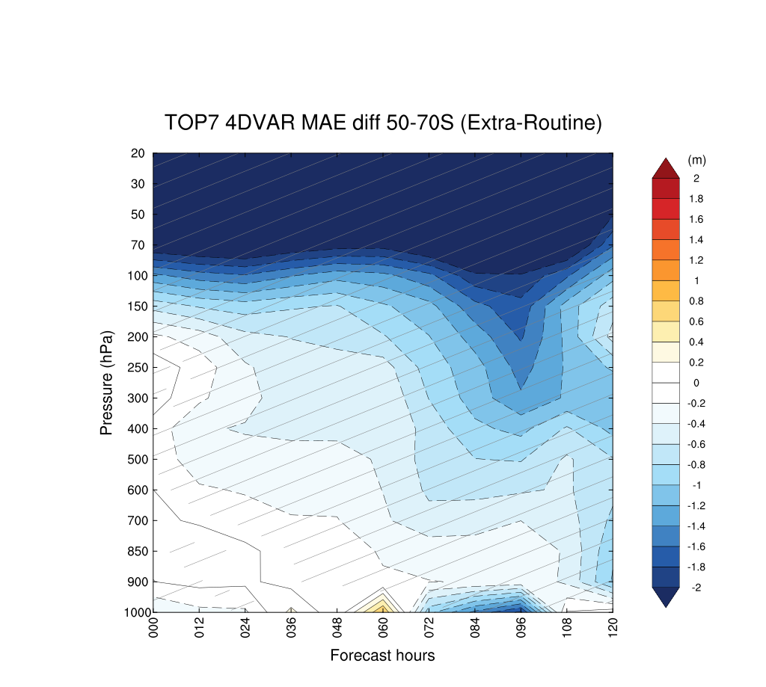
Geopotential Heights
MAE difference (MAE [Extra-ERA5] – MAE [Routine-ERA5]) averaged for each forecast hour
Blue = Extra better Red = Routine better (Hatching: significance >95%)
3DEnVar for entire domain
3DEnVar averaged for south of 60°S
3DEnVar averaged for south of 50-70°S
4DVAR for entire domain
4DVAR for averaged for south of 60°S
4DVAR for averaged for south of 50-70°S

Slide 12
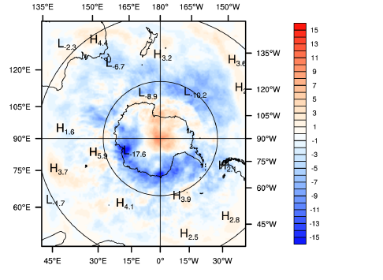
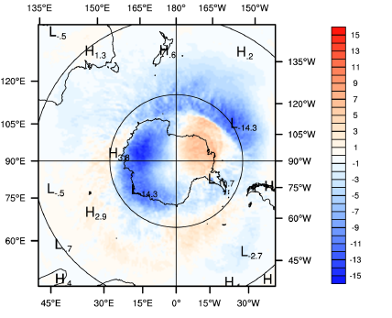
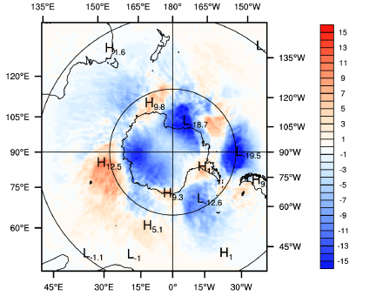
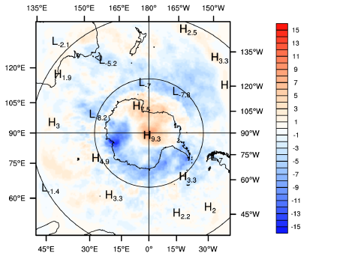
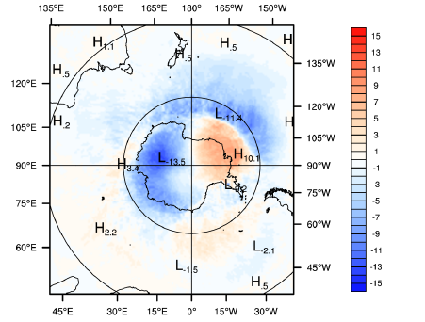
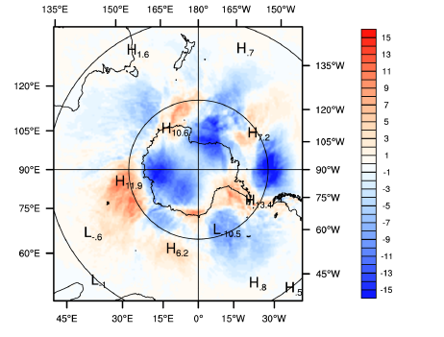
Geopotential Heights at 50 hPa
000h 060h 120h
Looking at the MAE differences: Spatial plots were generated to verify the accuracy of the zonal means on previous cross sections
Geopotential Heights
4DVAR for averaged for south of 60°S
~ -5.5 to -7
Geopotential Heights at 70 hPa
000h 060h 120h

Slide 13
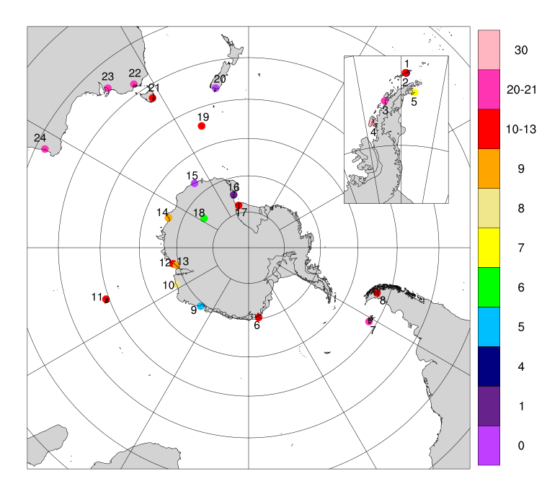
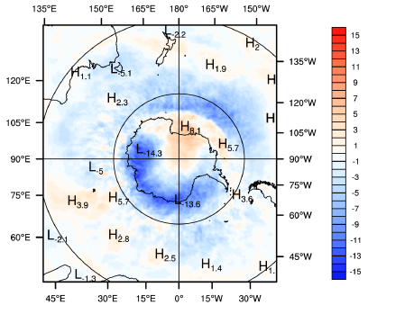
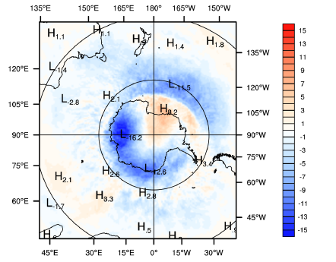
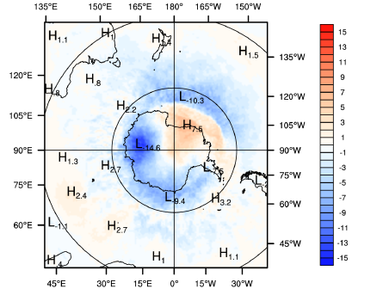
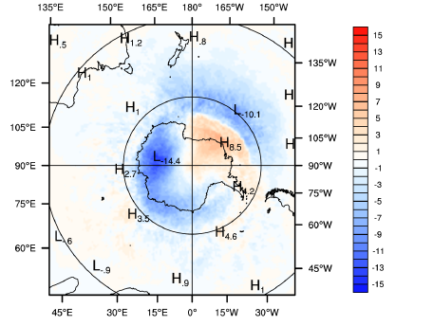
Geopotential Heights at 50 hPa
000h 012h 024h
4DVAR
Geopotential Heights at 70 hPa
000h 012h 024h
Looking at the MAE differences: Spatial plots were generated to verify the accuracy of the zonal means on previous cross sections
Regions where extra soundings were assimilated showed improvements in forecast accuracy!

Slide 14
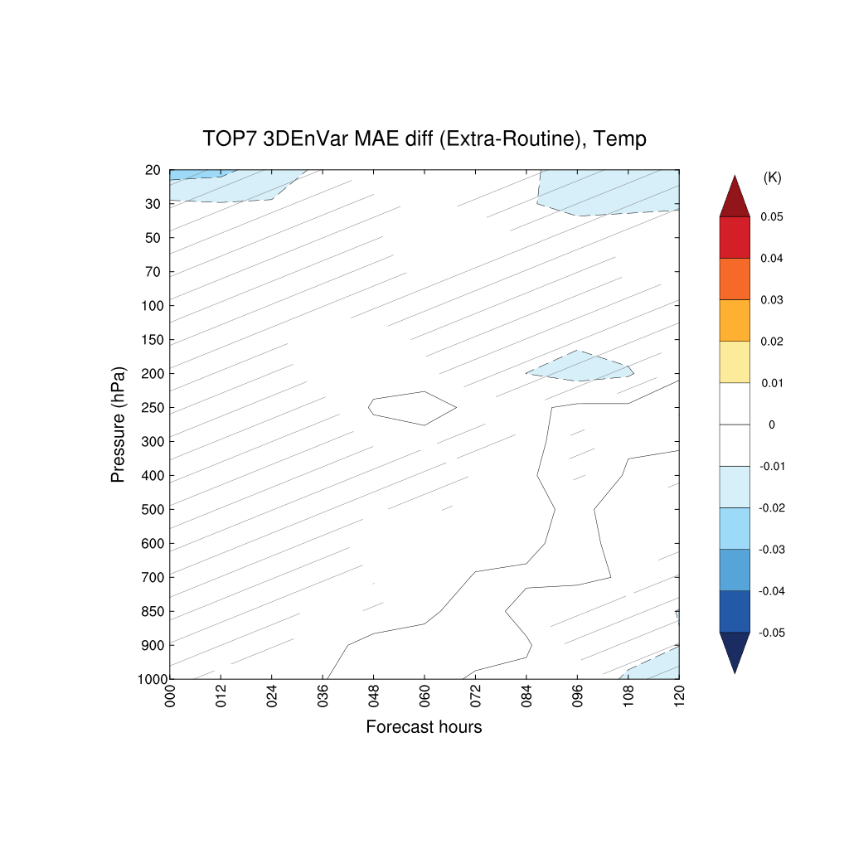
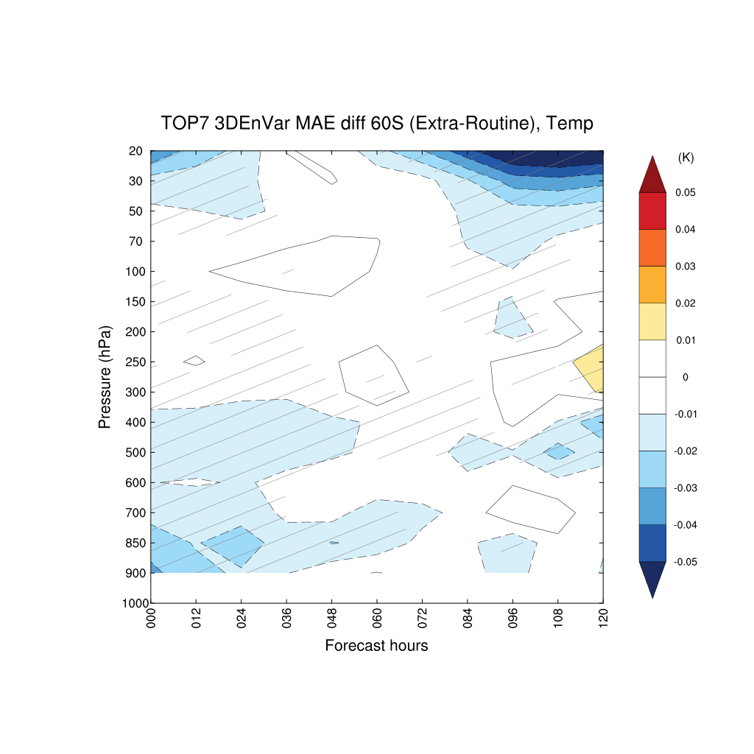
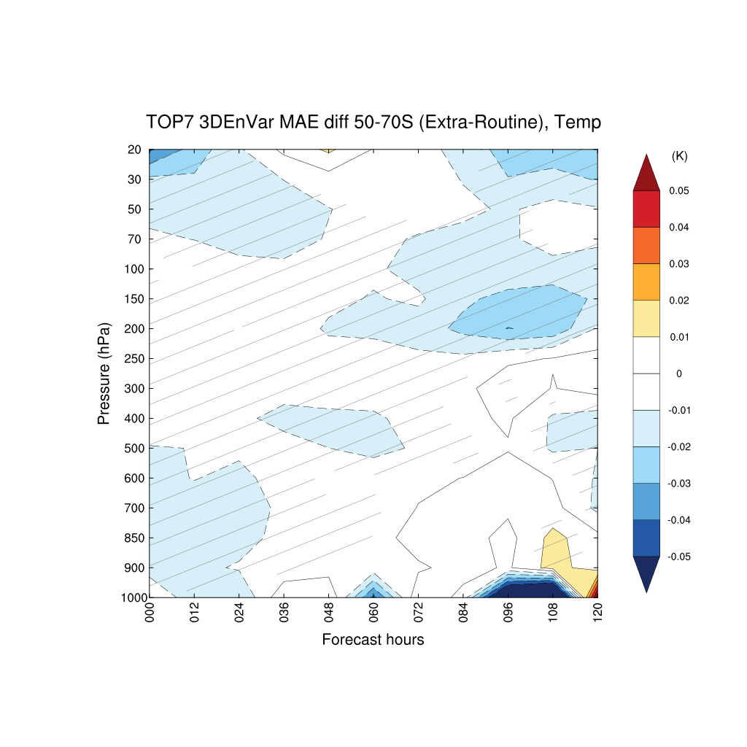
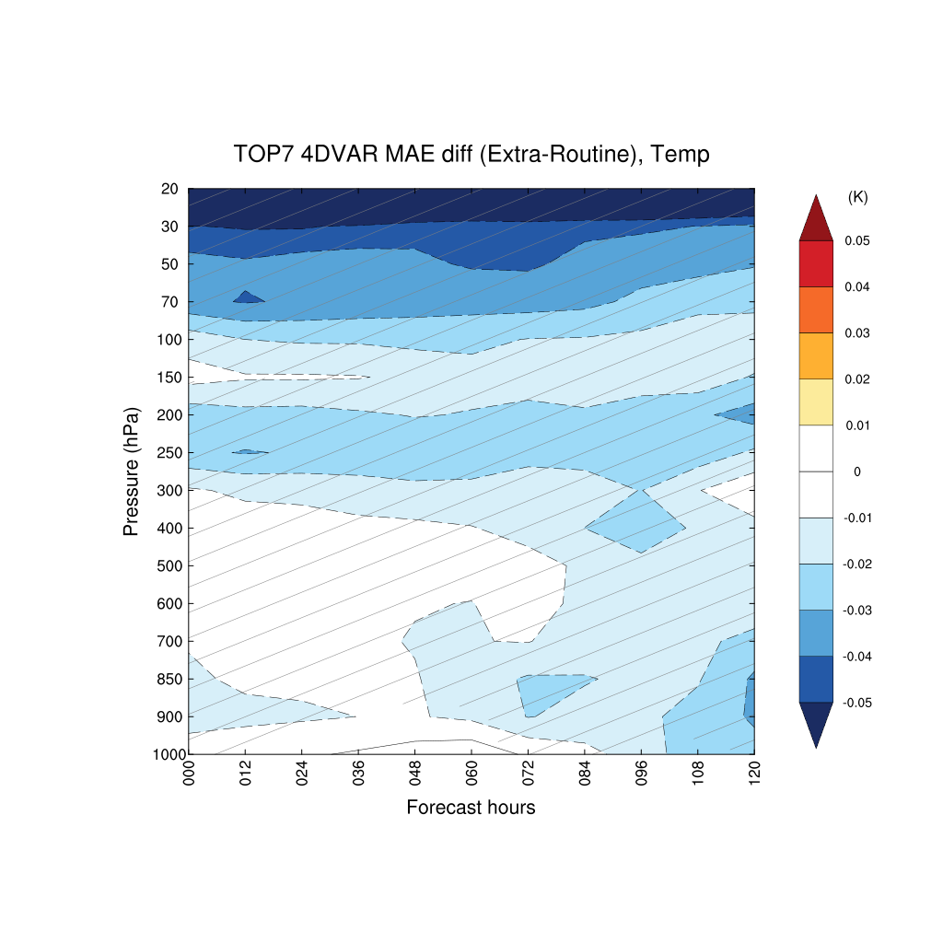
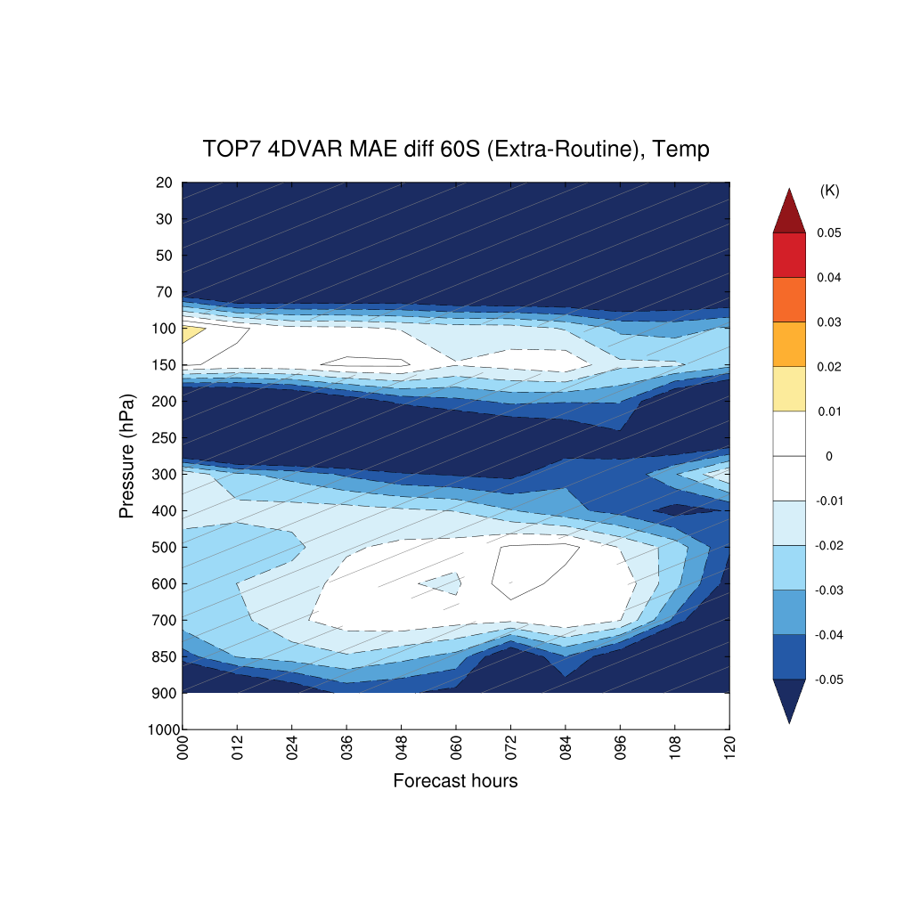
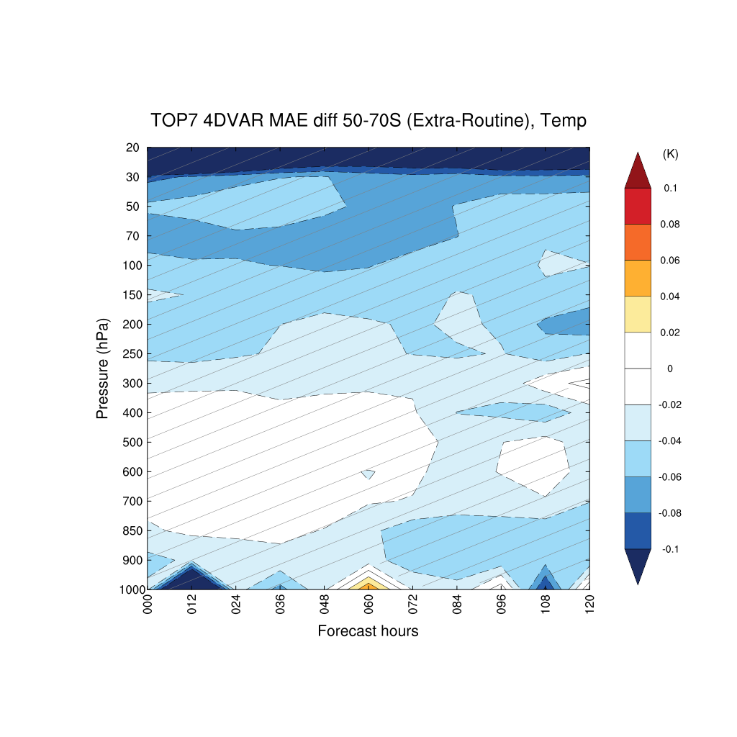
Temperature
MAE difference (MAE [Extra-ERA5] – MAE [Routine-ERA5]) averaged for each forecast hour
Blue = Extra better Red = Routine better (Hatching: significance >95%)
3DEnVar for entire domain
3DEnVar averaged for south of 60°S
3DEnVar averaged for south of 50-70°S
4DVAR for entire domain
4DVAR for averaged for south of 60°S
4DVAR for averaged for south of 50-70°S

Slide 15
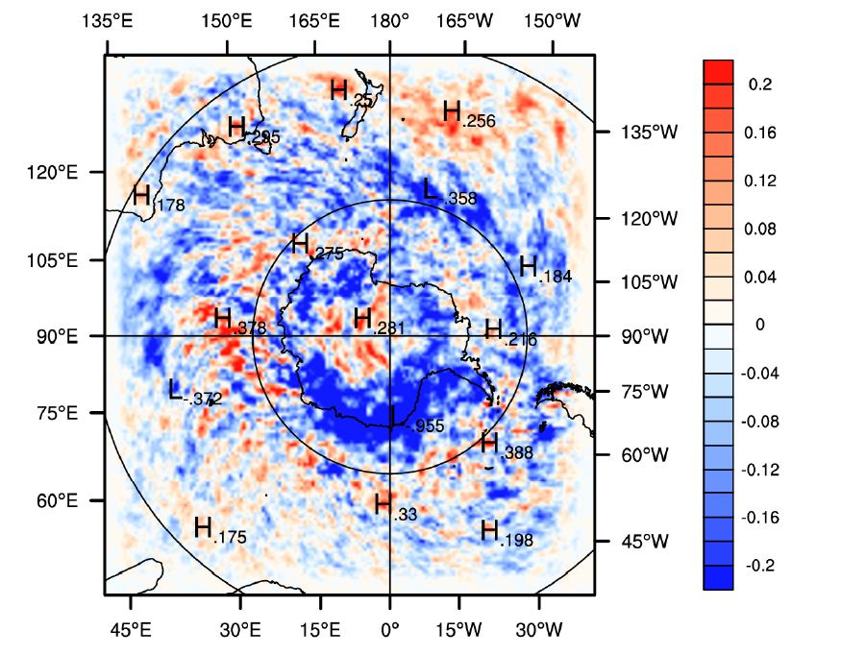
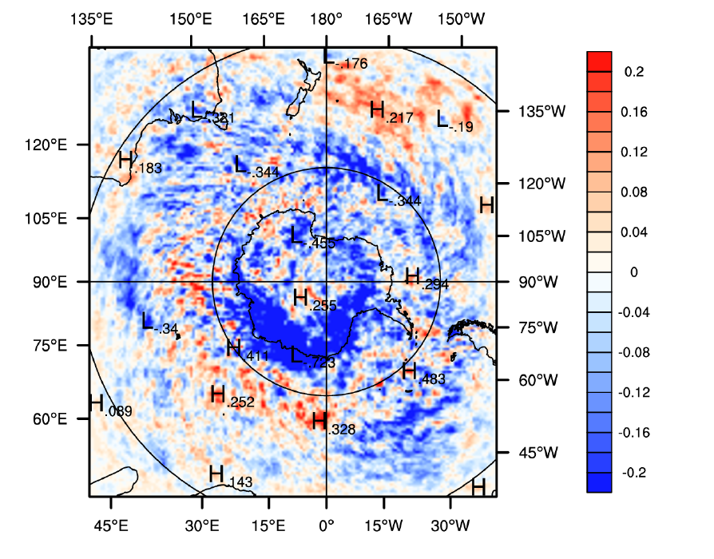
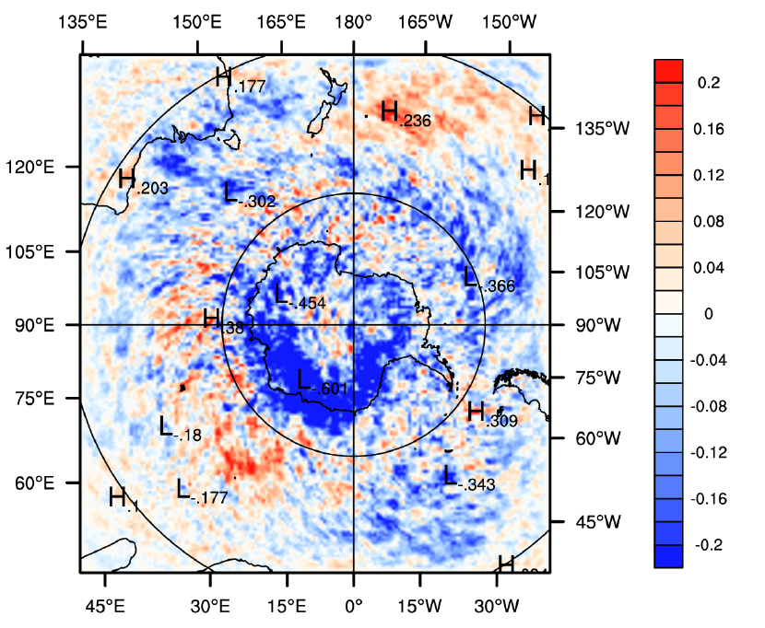
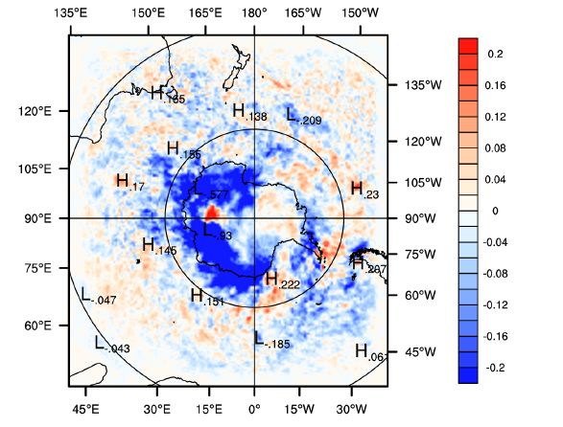
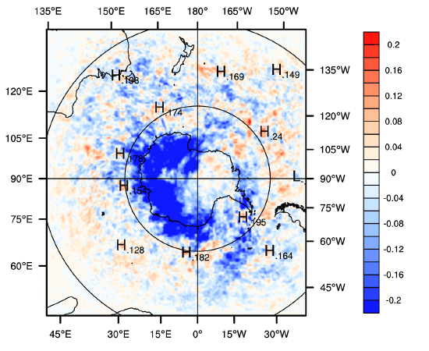
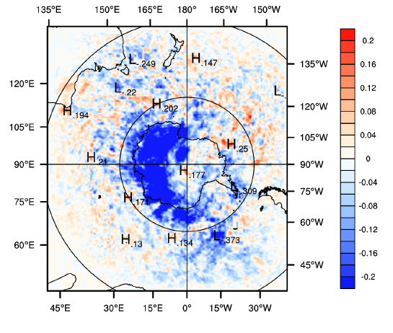
Looking at the MAE differences: Spatial plots were generated to verify the accuracy of the zonal means on previous cross sections
4DVAR for averaged for south of 60°S
Temperature at 50 hPa
000h 012h 024h
~ -0.22
Temperature at 250 hPa
000h 012h 024h
Regions where extra soundings were assimilated showed improvements in forecast accuracy!

Slide 16
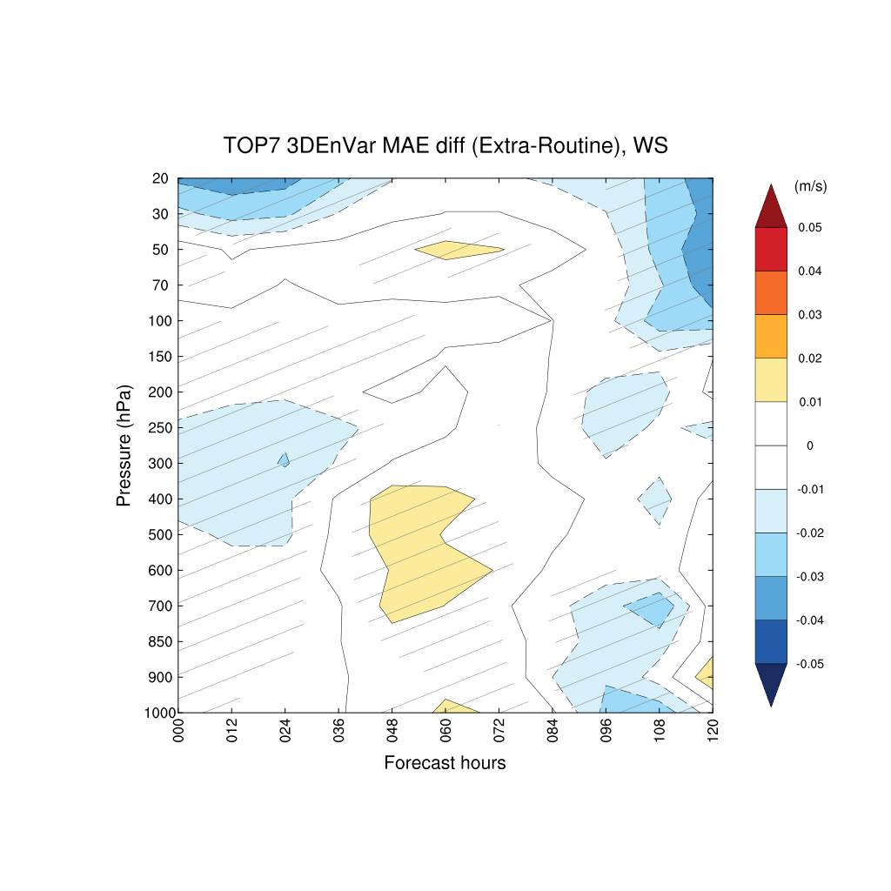
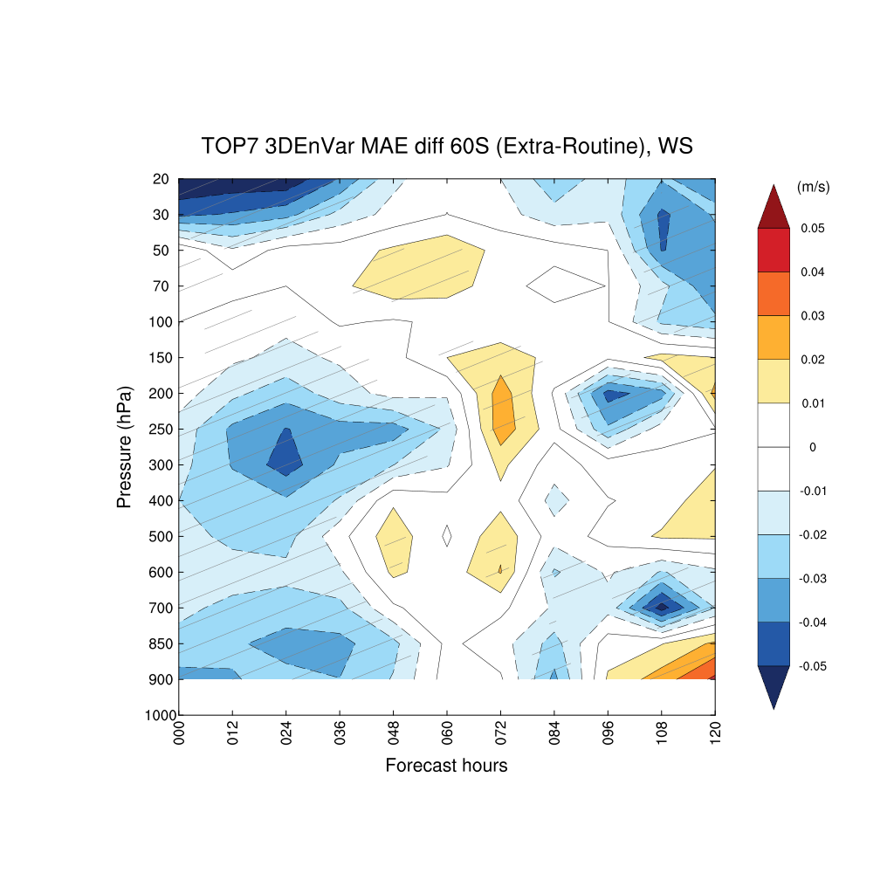
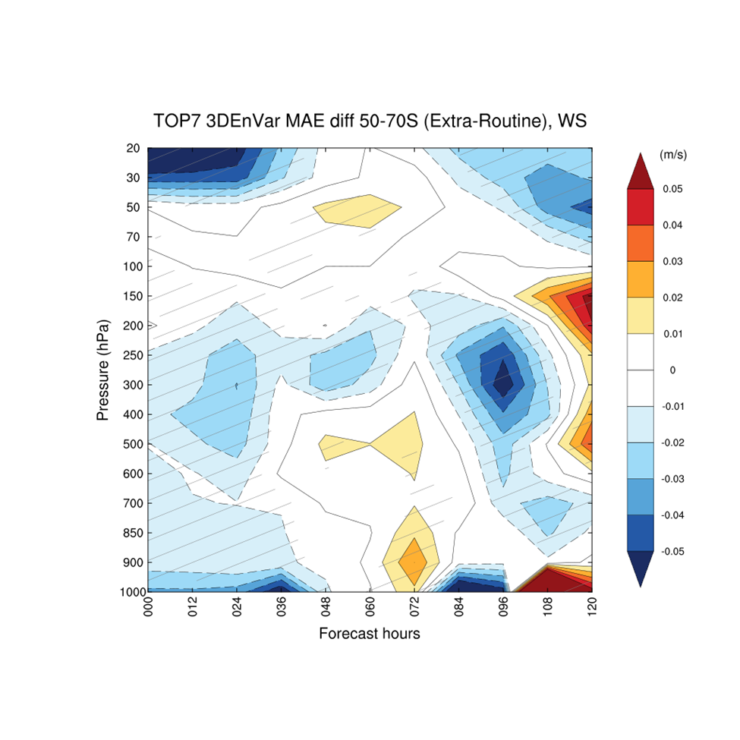
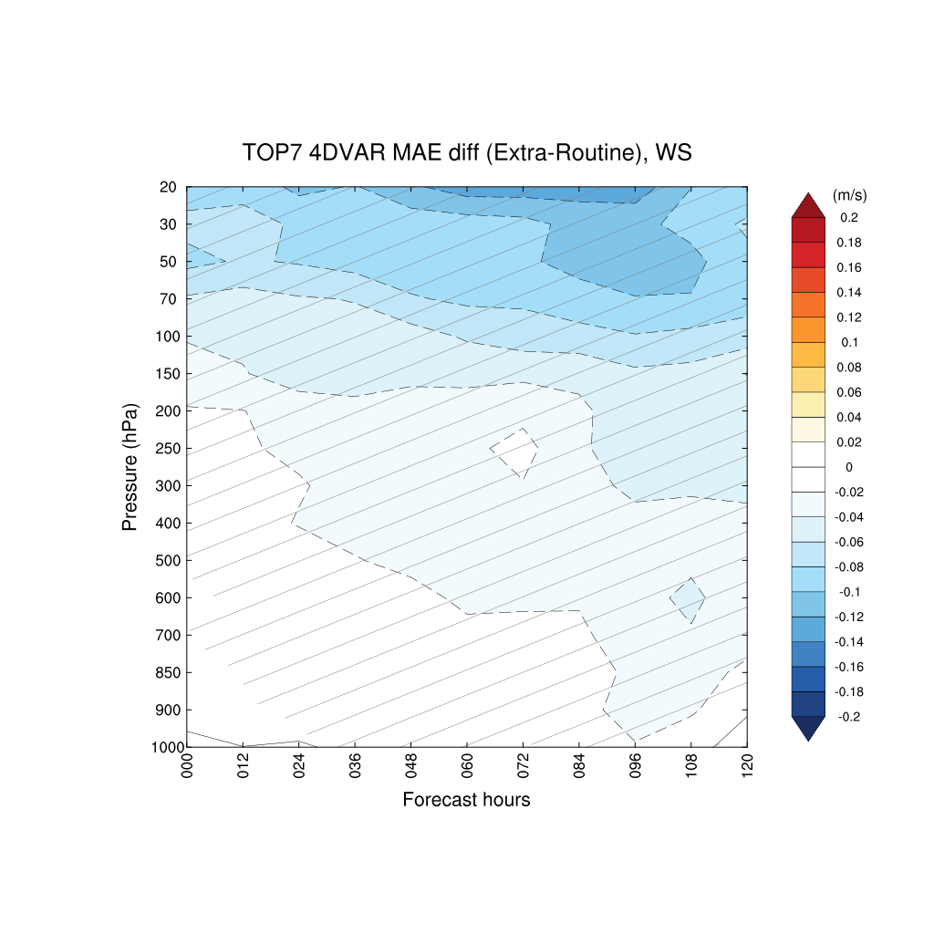
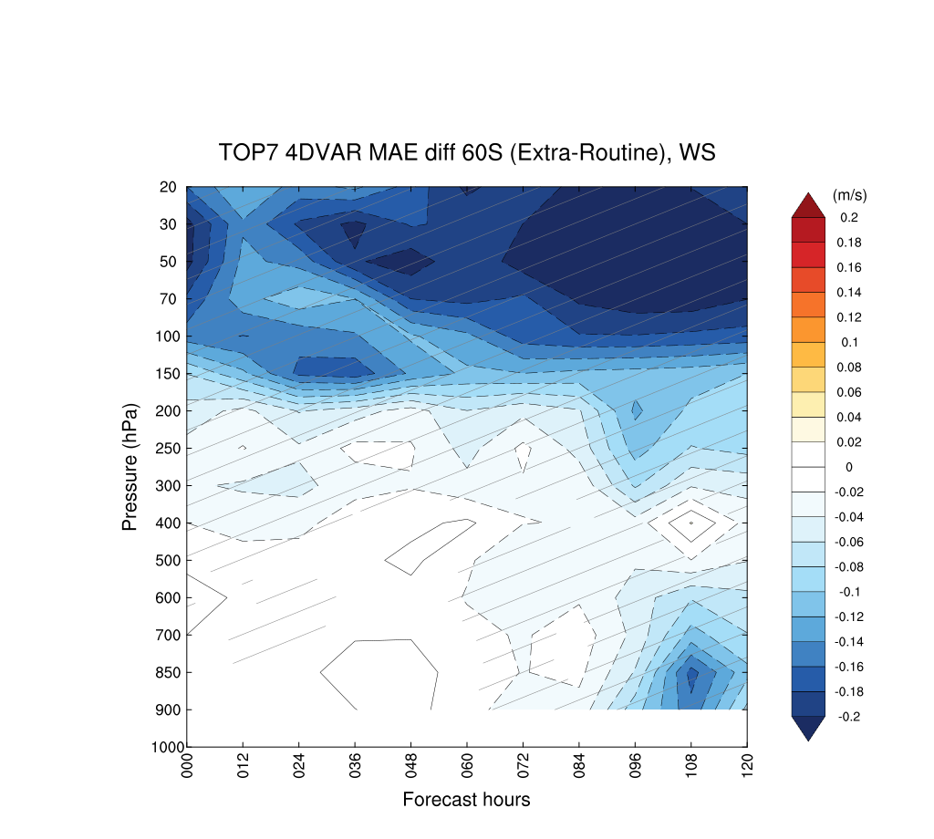
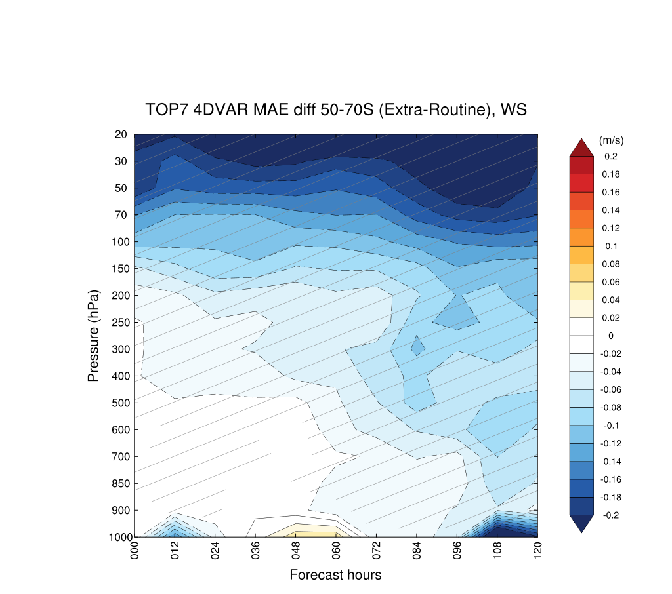
Wind Speed
MAE difference (MAE [Extra-ERA5] – MAE [Routine-ERA5]) averaged for each forecast hour
Blue = Extra better Red = Routine better (Hatching: significance >95%)
3DEnVar for entire domain
3DEnVar averaged for south of 60°S
3DEnVar averaged for south of 50-70°S
4DVAR for entire domain
4DVAR for averaged for south of 60°S
4DVAR for averaged for south of 50-70°S

Slide 17
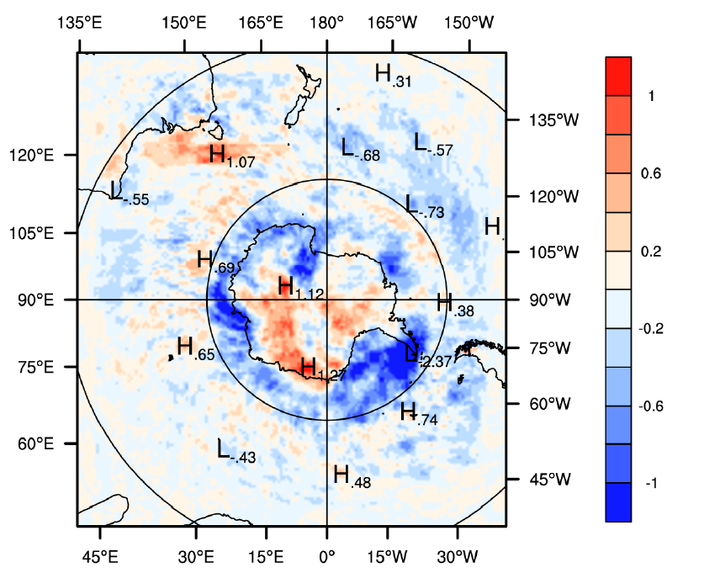
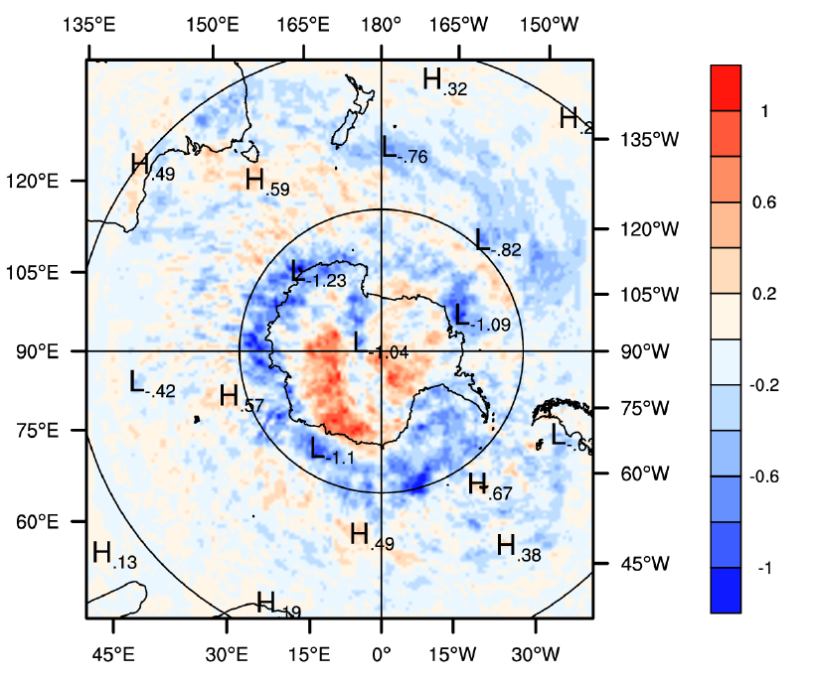
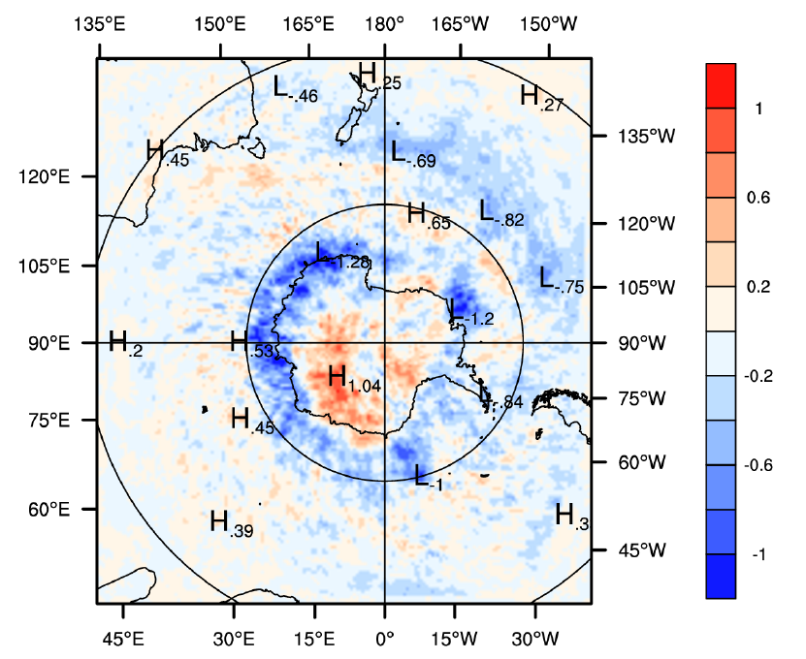
4DVAR for averaged for south of 60°S
Looking at the MAE differences: Spatial plots were generated to verify the accuracy of the zonal means on previous cross sections
Wind Speed at 50 hPa
000h 012h 024h

Slide 18
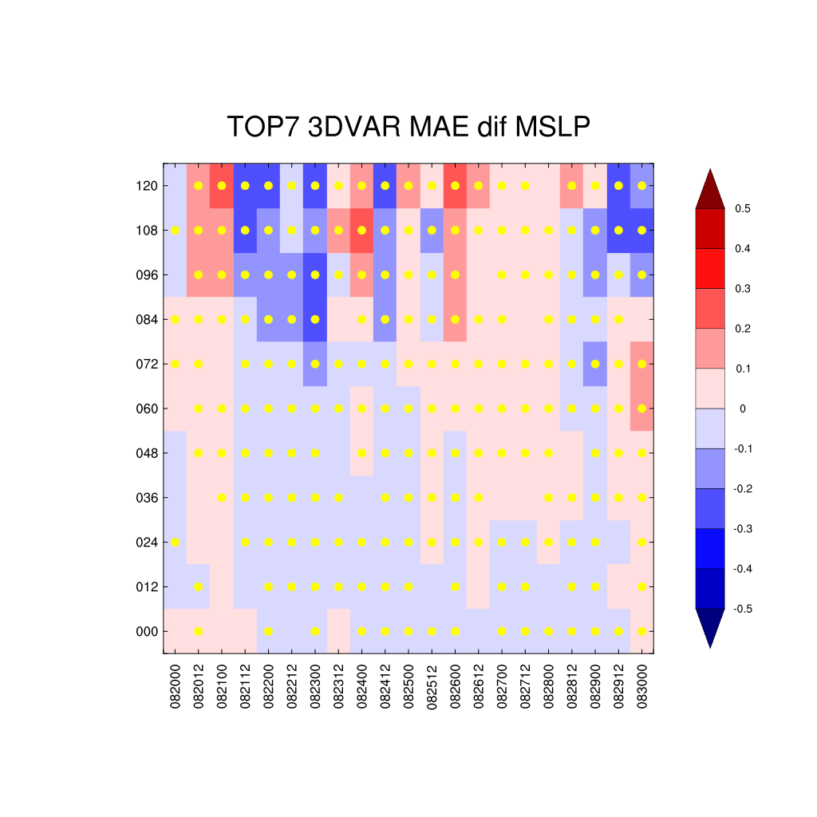
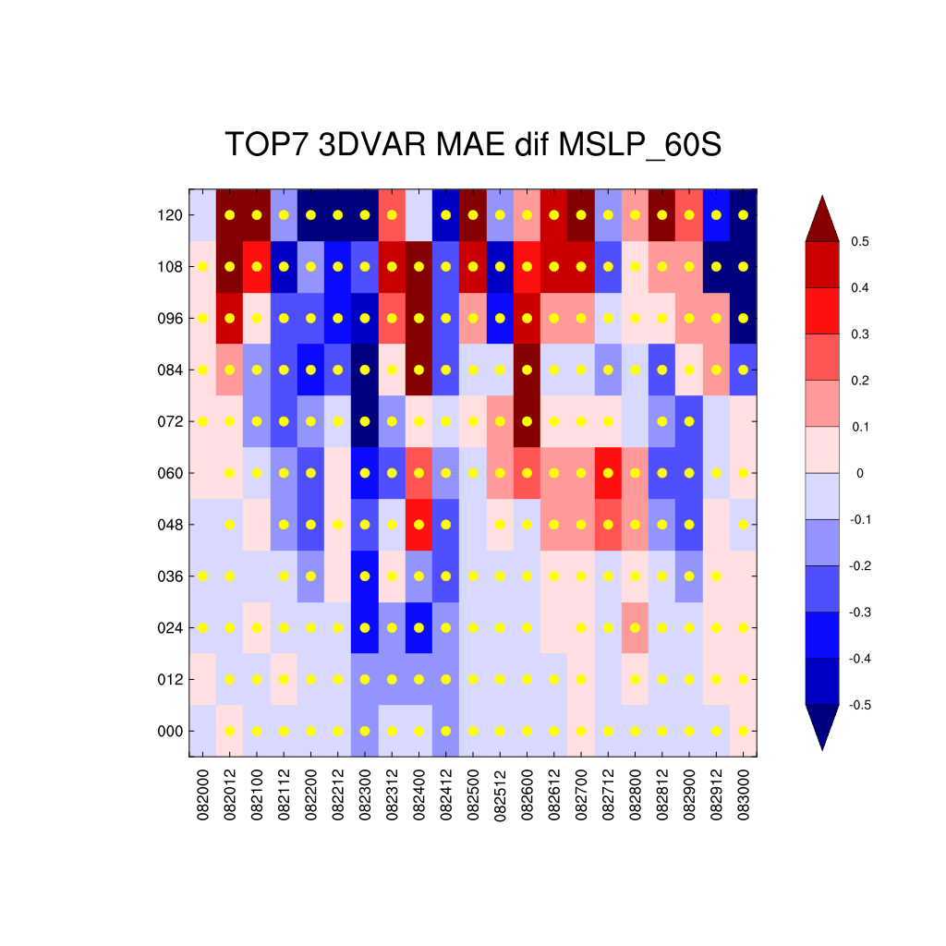
Case study for MSLP 3DEnVar
MAE difference (MAE [Extra-ERA5] – MAE [Routine-ERA5]) for each forecast and forecast lead time
Blue = Extra better Red = Routine better (Yellow dots: significance > 95% )
For most times, there is enhancement in the forecast with the extra radiosondes.
This is particularly pronounced when averaged for regions south of 60°S..

Slide 19
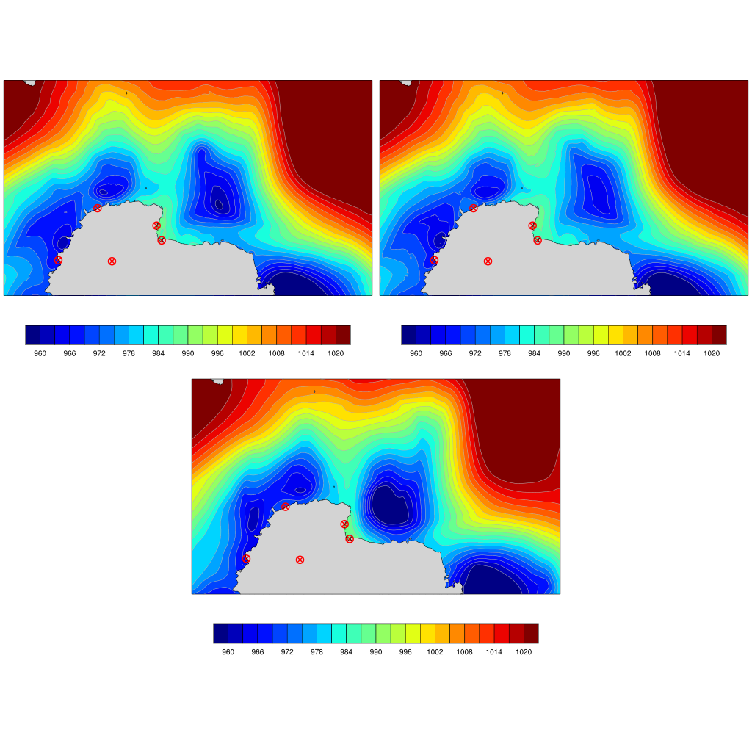
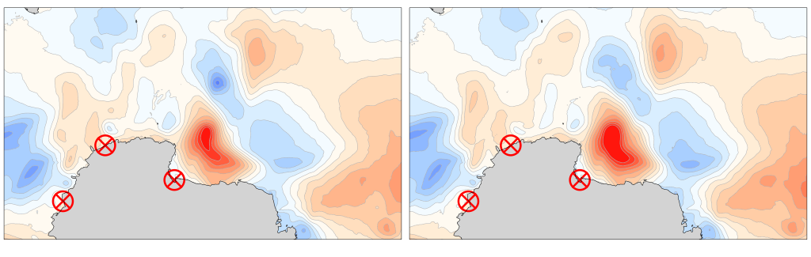
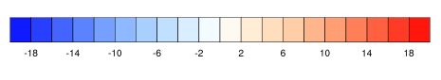
Example of Spatial Impact of Extra Radiosondes
  3DEnVar-initialized simulation is for August 25, 2022, at 0000UTC, after 48 forecast hours (initial time at 0000UTC, August 23, 2022) for SLP.
  ROUTINE (Figure b) experiment underintensifies the low-pressure systems
  EXTRA (Figure a) simulation is closer to ERA5 (Figure c).
  The bias for EXTRA (calculated from ERA5) is less than the bias for ROUTINE (Figures d and e respectively)
  Experiment with extra radiosondes substantially improved the forecast of a cyclone along the coast of West Antarctica during summer YOPP-SH (Bromwich et al., 2022)
a
b
c
d
e
Dumont
D’Urvile
Jang
Bogo
Casey
McMurdo
Dome C
(a) EXTRA forecast, (b) ROUTINE forecast, (c) ERA5, (d) Bias (EXTRA-ERA5) and (e) Bias (ROUTINE-ERA5)

Slide 20
Conclusions
Conclusion
  The need for improvement in Antarctic weather forecast is imperative, but challenging due to several limitations such as lack of observations for assimilation.
  For TOP7: 4DVAR experiments produced larger differences in the Extra and Routine forecasts, and the enhancement is observed in all forecast hours. In contrast, 3DEnVar forecasts had lower differences, and the enhancement is observed in later forecast hours.
  Overall, the results of the TOP experiments with the winter YOPP-SH extra radiosondes show a positive forecast impact from the soundings, particularly for south of 60°S and between 50-70°S.
  TOP7 had better results compared to other TOPs, suggesting that having longer periods with extra observations are more effective for significant forecast enhancement.
  Analyses are continuing to verify the impact of additional soundings for all seven TOPs.

Slide 21
References
Boullot N, Rabier F, Langland R, et al. Observation impact over the southern polar area during the Concordiasi field campaign. Q J R Meteorol Soc. 2016;142(695):597-610. doi:10.1002/qj.2470
Bromwich D. H., and Coauthors, 2024: Winter Targeted Observing Periods during the Year of Polar Prediction in the Southern Hemisphere (YOPP-SH), Bull. Amer. Meteor. Soc., 105, E1662–E1684, https://doi.org/10.1175/BAMS-D-22-0249.1
Bromwich D. H., D. F. Steinhoff, I. Simmonds, K. Keay, and R. L. Fogt, 2011: Climatological aspects of cyclogenesis near Ad´elie Land Antarctica. Tellus A: Dynamic Meteorology and Oceanography, 63, 921, https://doi.org/10.1111/j.1600-0870.2011.00537.x.
Bromwich D. H., J. G. Powers, K. W. Manning, and X. Zou, 2022: Antarctic data impact experiments with Polar WRF during the YOPP‐SH summer special observing period. Quarterly Journal of the Royal Meteorological Society, https://doi.org/10.1002/qj.4298.
Chen, S.-Y., T.-K. Wee, Y.-H. Kuo, and D. H. Bromwich, 2014: An Impact Assessment of GPS Radio Occultation Data on Prediction of a Rapidly Developing Cyclone over the Southern Ocean. Monthly Weather Review, 142, 4187–4206, https://doi.org/10.1175/MWR-D-14-00024.1.
Hoskins, B. J., and K. I. Hodges, 2005: A New Perspective on Southern Hemisphere Storm Tracks. Journal of Climate, 18, 4108–4129, https://doi.org/10.1175/JCLI3570.1.
Powers, J. G., K. W. Manning, and D. H. Bromwich, 2023: THE AMPS WINTER YOPP-SH DATA IMPACT STUDY. The 18th Workshop on Antarctic Meteorology and Climate, Madison, WI, 7 https://amrc.ssec.wisc.edu/meetings/meeting2023/program.shtml.

Slide 22

Thank you!
Davis Station – Radiosonde launch during TOP4.

