Slide 1
Atmospheric Triggers of February 2021 Brunt Ice Shelf and September 2019 Amery Ice Shelf Calving Events
https://www.ku.ac.ae/engeos/
Diana Francis¹, Kyle Mattingly², Stef Lhermitte³, Ricardo Fonseca¹, Charfeddine Cherif¹, Marouane Temimi⁴, Oliver Marsh⁵, Petra Heil⁶
¹The Environmental and Geophysical Sciences (ENGEOS) Lab, Khalifa University, Abu Dhabi, UAE
²Space Science and Engineering Center, University of Wisconsin-Madison, Madison, WI, USA
³Department of Geosciences and Remote Sensing, Delft University of Technology, Delft, The Netherlands
⁴Department of Civil, Environmental, and Ocean Engineering (CEOE), Stevens Institute of Technology, Hoboken, NJ 07030, USA
⁵British Antarctic Survey, Cambridge, United Kingdom, UK
⁶Australian Antarctic Division and Australian Antarctic Program Partnership, University of Tasmania, Hobart, Tasmania 7001, Australia
17 JULY 2025
Francis et al. (2021) https://doi.org/10.5194/tc-15-2147-2021
Francis et al. (2022) https://doi.org/10.1029/2021JD036424

Slide 2
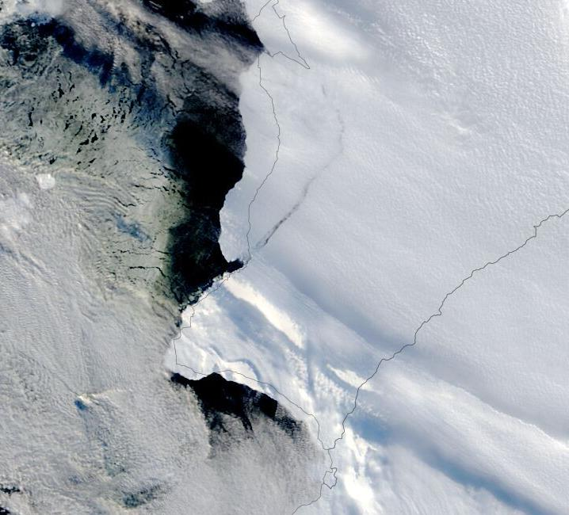
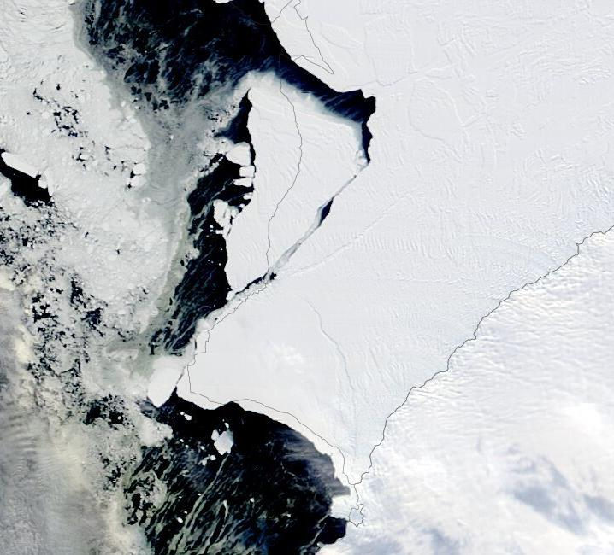
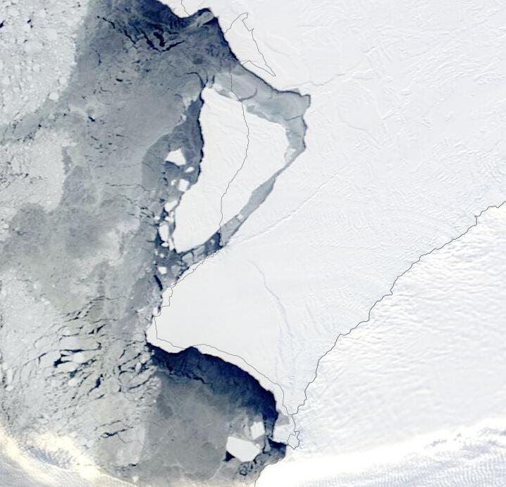
Calving of Iceberg A-74 in February 2021
Most studies on ice shelf calving focus on ocean dynamics but atmospheric forcing can also play a role. This is explored for calving of iceberg A-74 from Brunt Ice Shelf in February 2021 with ERA-5 reanalysis, satellite-derived & in-situ meteorological data. Calving occurred on 26 February 2021, with 1,270 km² iceberg drifting into Southern Ocean in the following weeks at a speed in excess of 700 m day⁻¹.
27 February 2021
14 March 2021
22 March 2021
A74
Brunt Ice Shelf
1.270 km²
Weddell Sea
© NASA Worldview
© NASA Worldview
© NASA Worldview

Slide 3
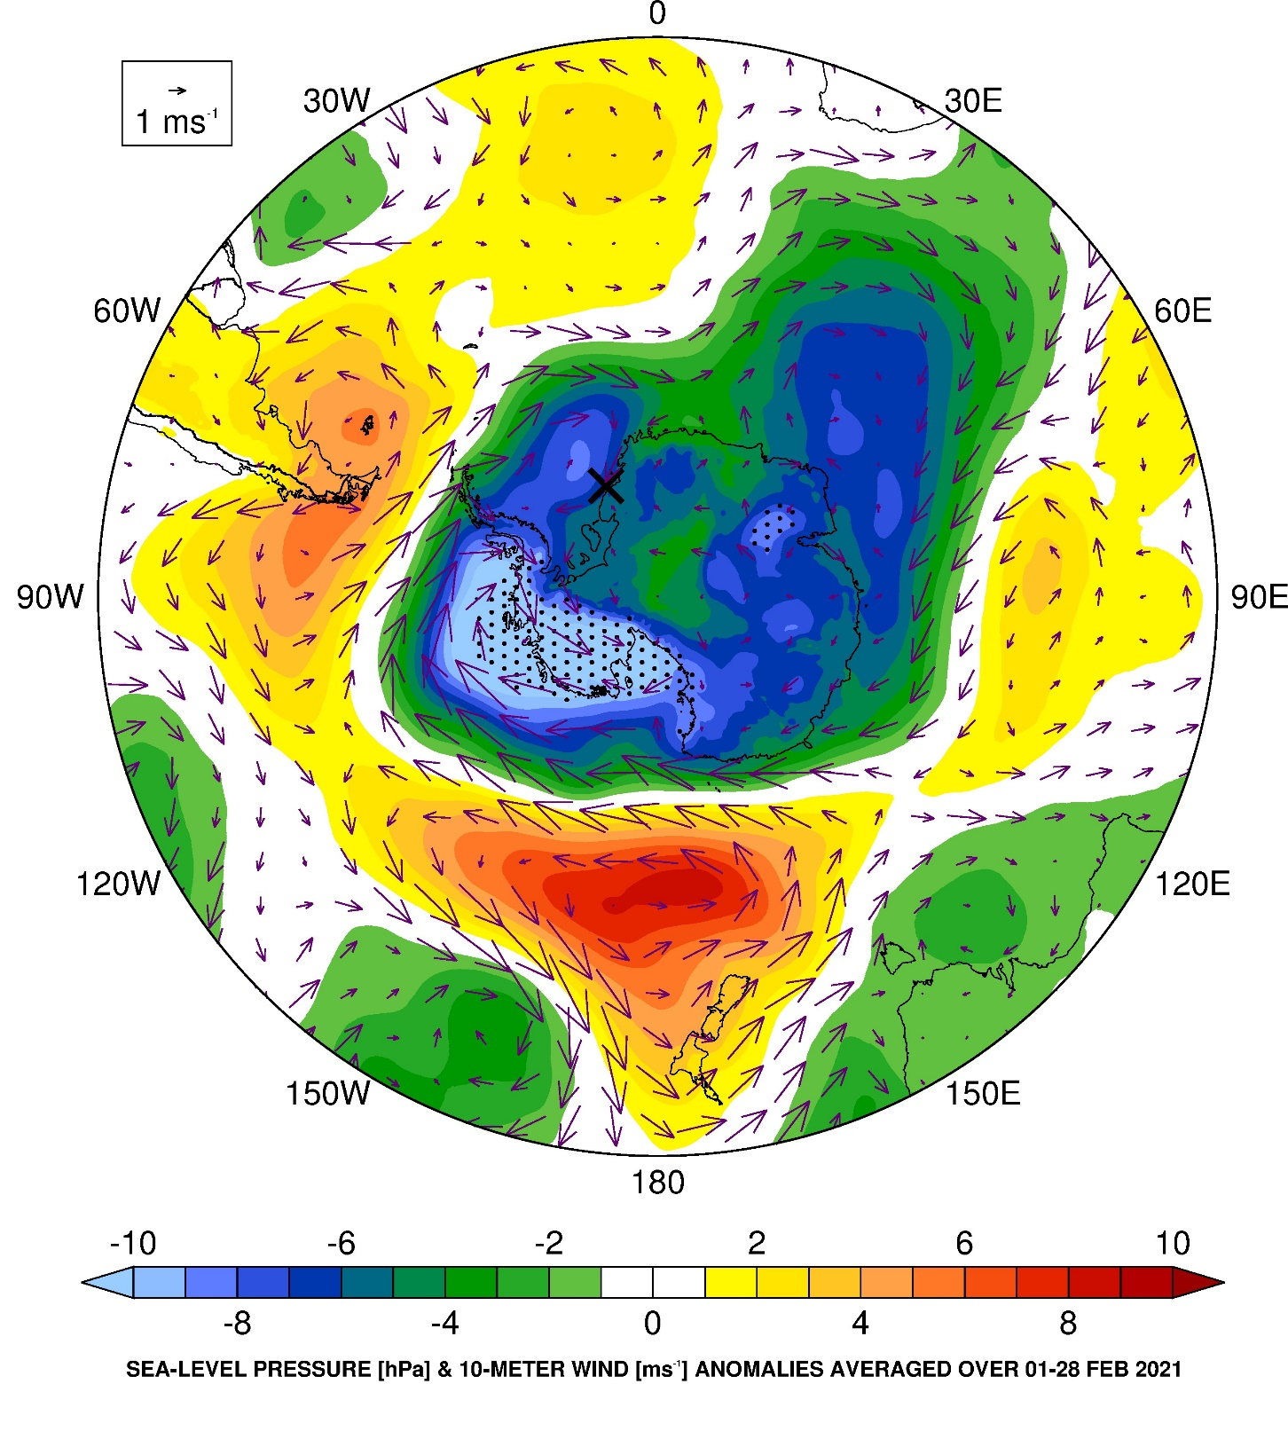
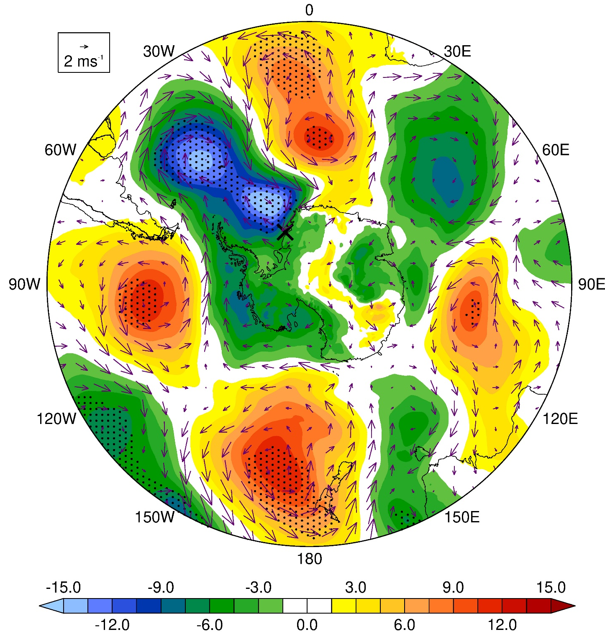
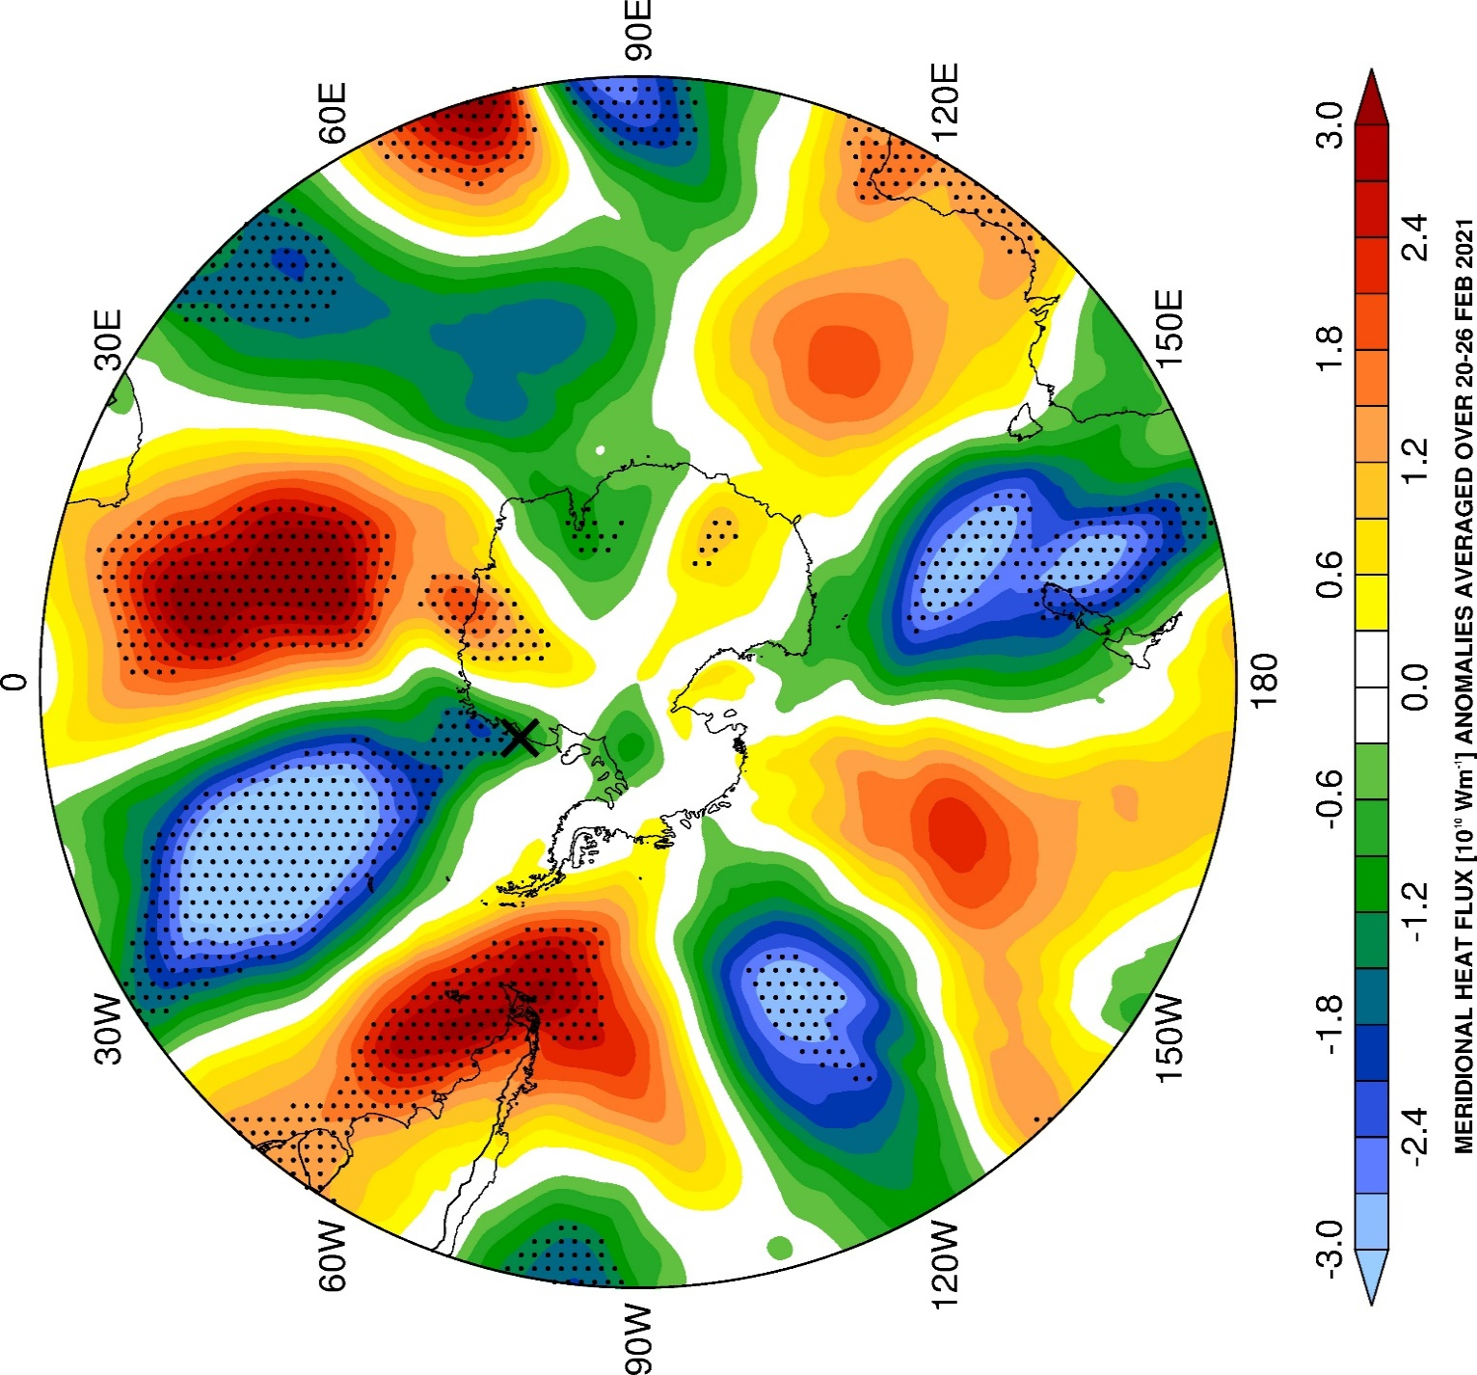
Large-scale Circulation from ERA-5 reanalysis
Sea-Level Pressure (hPa) and 10-m Wind (m s⁻¹) Anomalies
Meridional Heat Flux (10¹⁰ Ws⁻¹) Anomalies over 20-26 February 2021
01-28 February 2021
20-26 February 2021
Brunt Ice Shelf (BIS)
H
L
Stronger Amundsen Sea Low and positive SAM in February 2021, likely due to La Nina.
Poleward advection of warm & moist air mass into Brunt Ice Shelf (BIS) in late February 2021
Stipple: more than 1σ away from climatological (1979-2020) mean

Slide 4
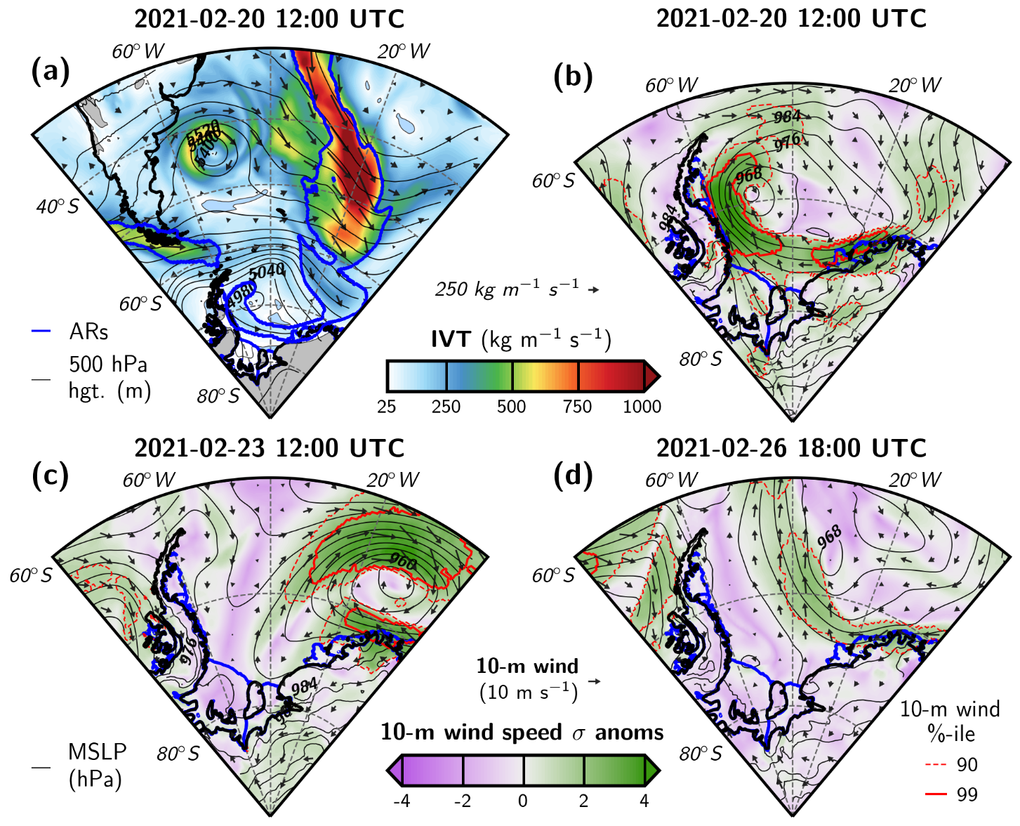
Atmospheric Conditions Prior to Calving
L
ERA-5 area-averaged (74.8°-75.8°S and 24°-28°W) hourly 10-m wind speed over DJF 1979-2019.

Slide 5
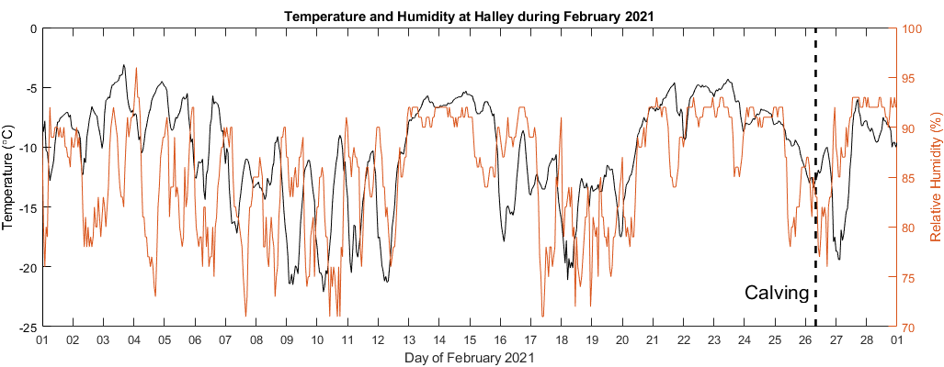
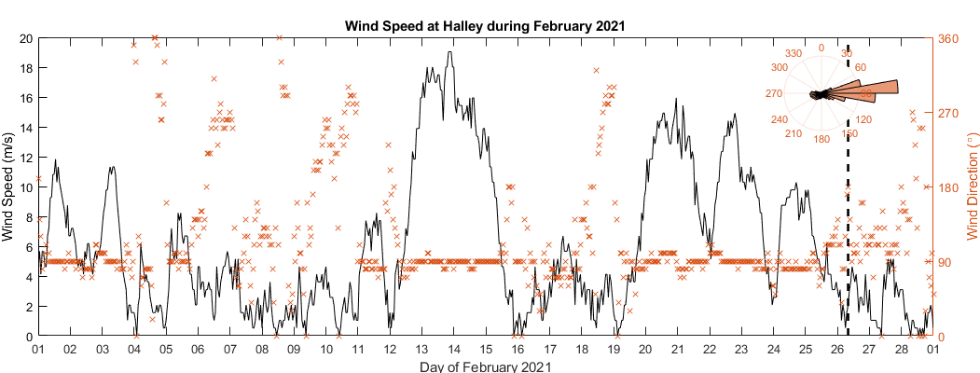
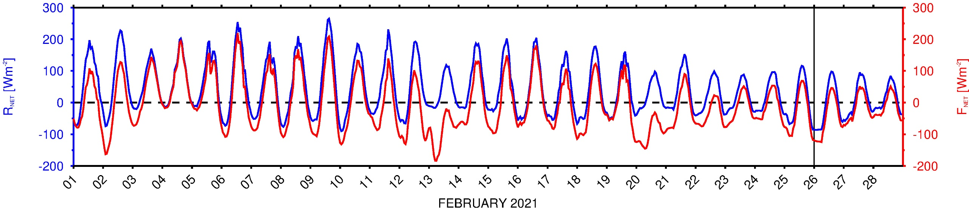
In-situ Measurements and ERA-5 Fluxes
Observations at Halley VIa station on BIS
Warm and moist low-latitude air intrusions
R_{net} and F_{net} values similar to those seen during opening of Weddell Sea polynya in 1973 and 2017 (Francis et al., 2020, Sci. Adv.).
Halley VIa station
(75.5681°S;
25.5083°W)
74.7°–75.7°S & 26.2°–25.2°W
ERA-5 Surface Fluxes
(positive if downwards towards surface)
R_{net}: Surface net radiation flux
F_{net}: Surface total energy flux

Slide 6
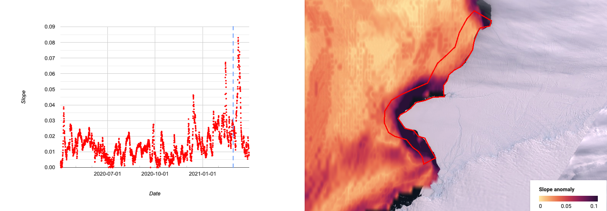
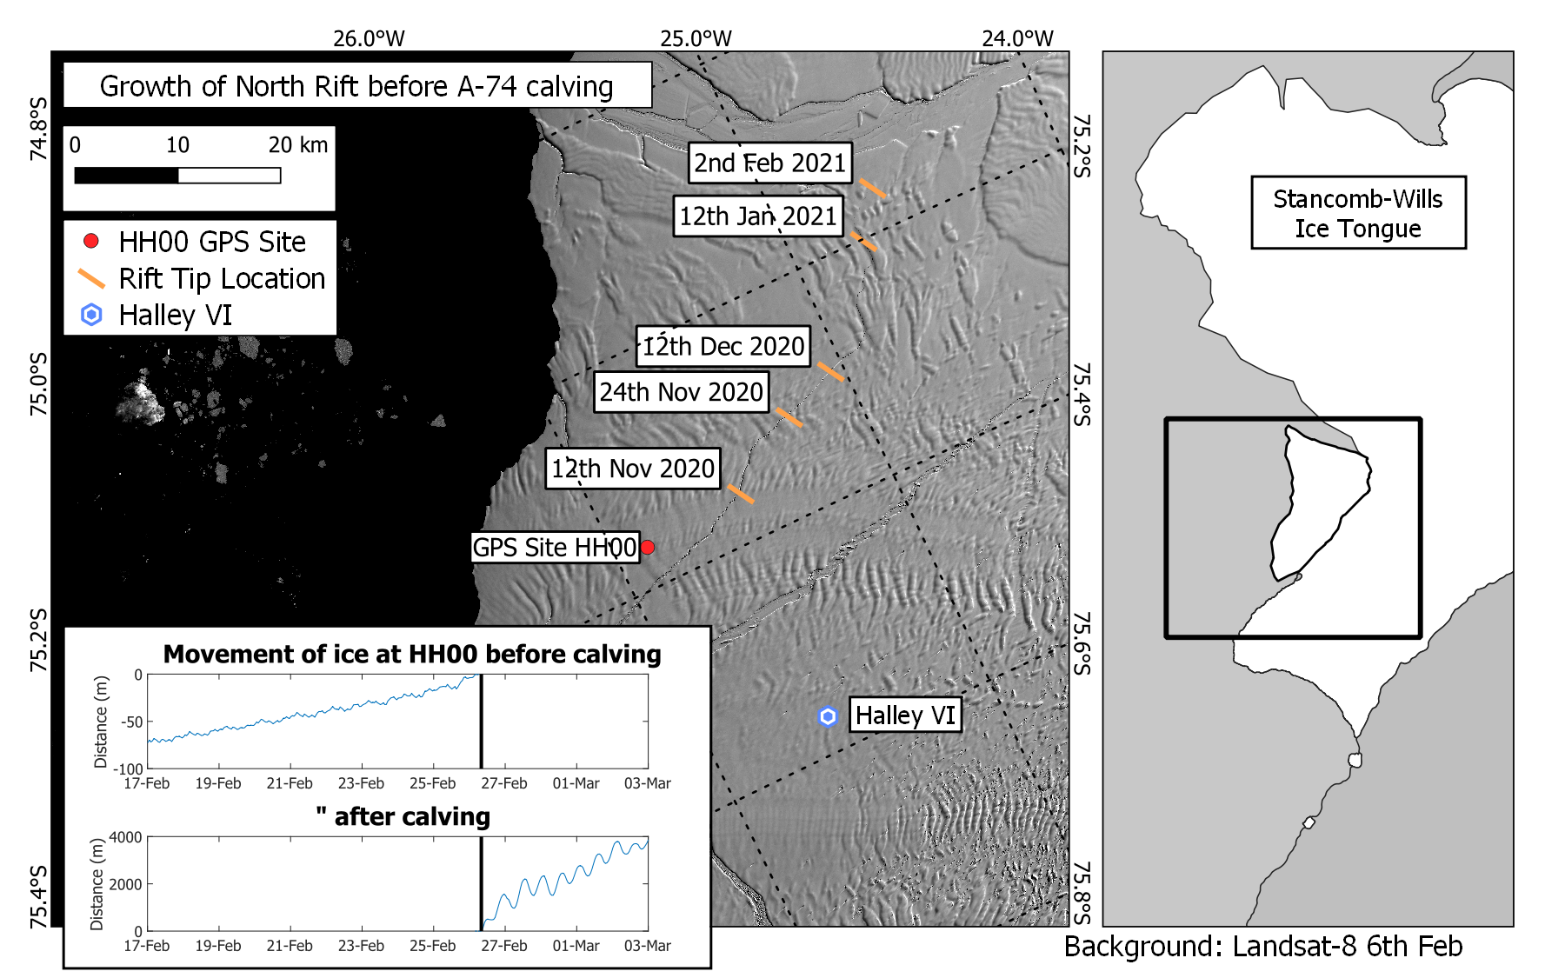
Ocean Slope and Ice Conditions
HYCOM (~9 km; 3-h)
Ocean Slope: horizontal gradient of height of water column (larger values indicate higher water levels away from ice shelf)
~6 m day⁻¹
~700 m day⁻¹
15-28 Feb 2021 w.r.t. Apr 2020 – Mar 2021

Slide 7
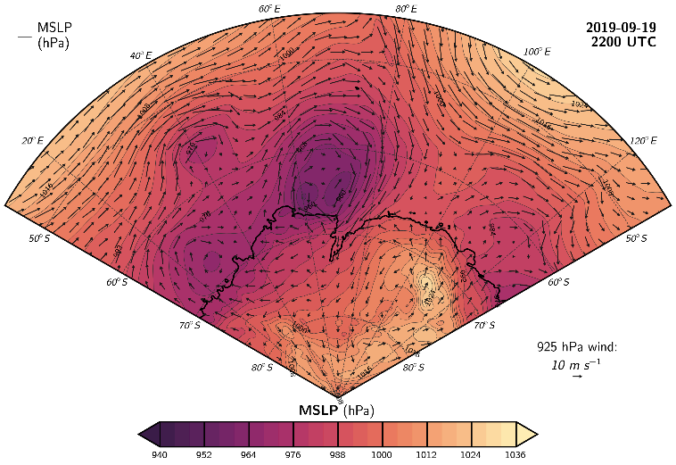
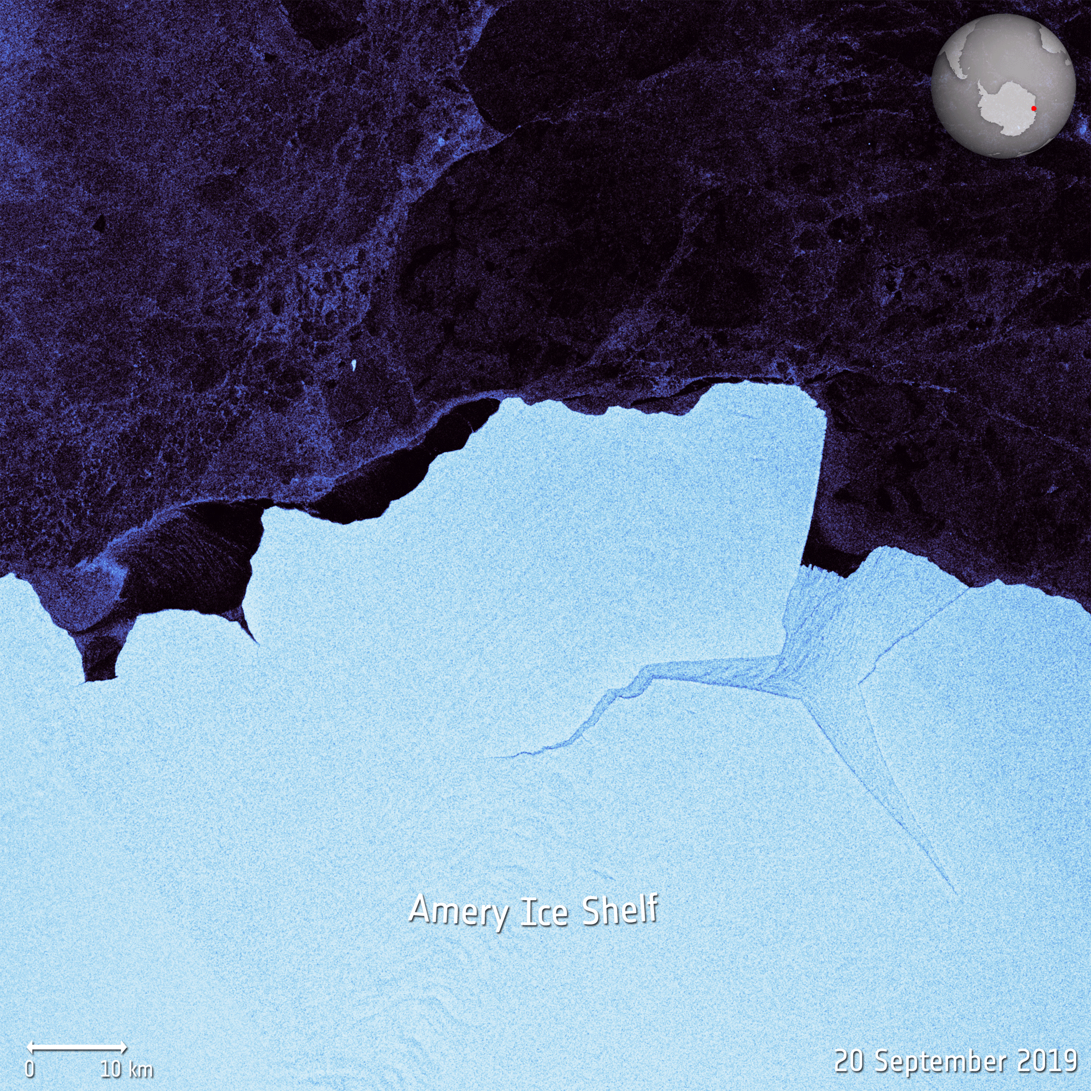
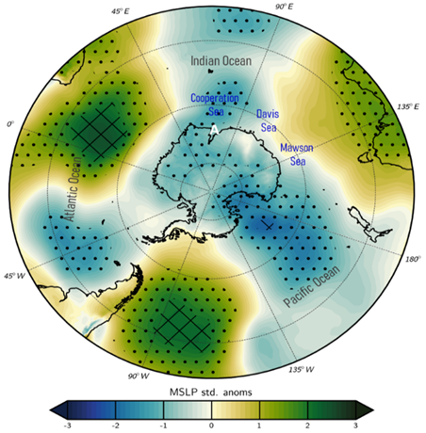
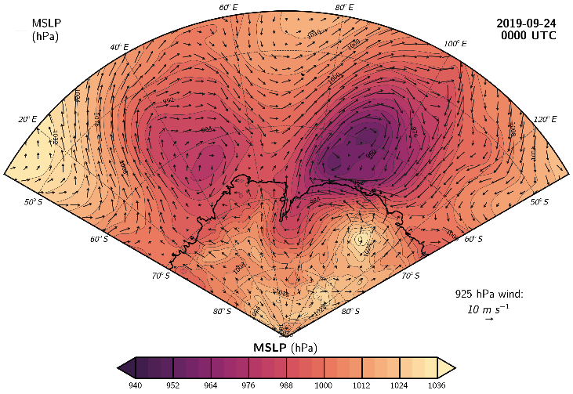
Calving of Iceberg D-28 in September 2019
Deep cyclones during 18-22 and 23-25 September pre-conditioned ice shelf and promoted calving event
Sep 2019 MSLP std. anomalies
2σ away
from mean
1σ away
from mean

Slide 8
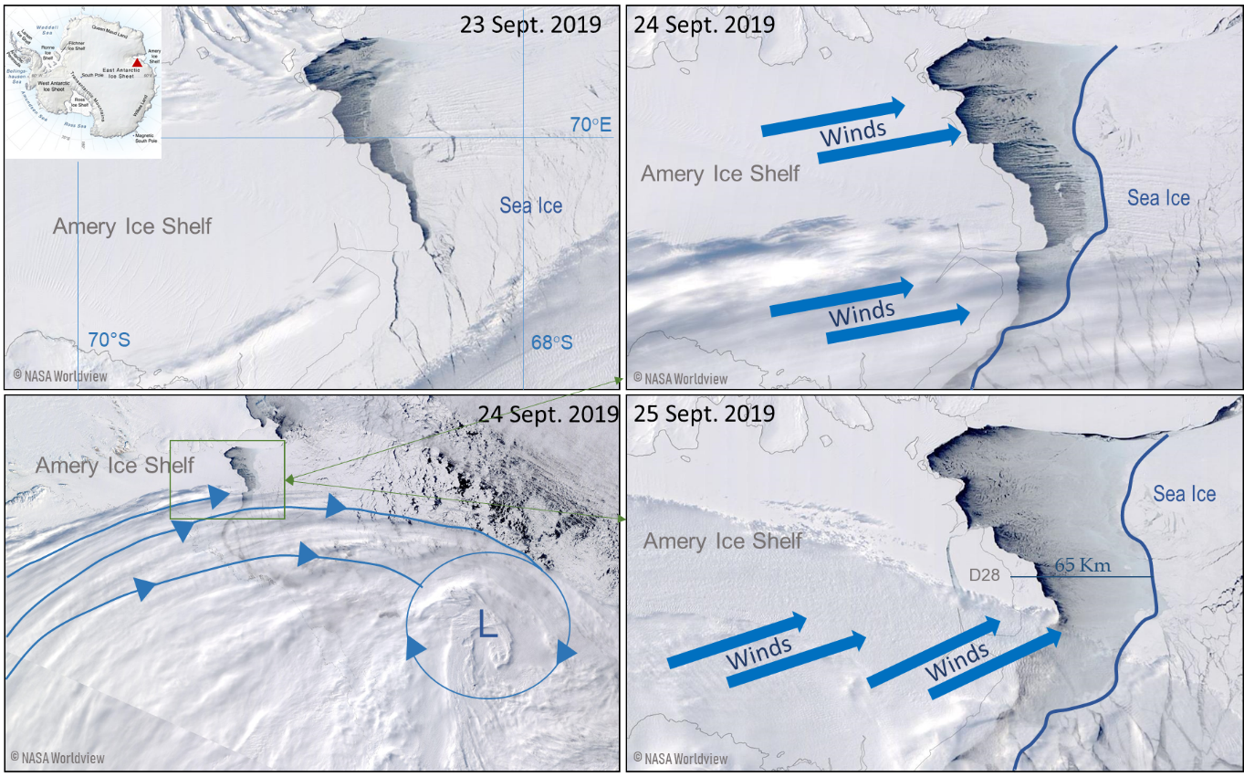
Calving of Iceberg D-28 in September 2019
Sea-ice pushed 65 km away from ice shelf on 23-24 September 2019;
MODIS images show sea-ice front retreated more on western side;
Sea-ice concentration dropped to as low as 40%, with sea-ice drift speeds of 50 km day⁻¹;
Offshore winds triggered calving and subsequent drifting of D28 iceberg into Southern Ocean.

Slide 9
Conclusions
Role of atmospheric forcing in calving of A-74 iceberg from Brunt Ice Shelf in February 2021 & D-28 iceberg from Amery Ice Shelf in September 2019 investigated using reanalysis, observational, and satellite-derived data;
Brunt Ice Shelf: Strong cyclone prior to calving (20-21 February) led to warm & moist air advection into ice shelf → surface total energy flux F_{net} increased to 100 W m⁻². Wet snow & strong winds (speeds up to 3σ above mean) combined with high ocean waves & swells wekened ice shelf front. During 24-25 February, offshore winds led to high sea-surface slope towards ocean → calving of A-74 iceberg on 26 February & drift towards Southern Ocean;
Amery Ice Shelf: explosive cyclones on 18 September (evolving into two stationary cyclones in 19-22 September) and 23 September (twin cyclones on 24-25 September) brought strong winds and warm and moist air into ice shelf. Offshore wind direction on 23-25 September led to high sea-surface slope and triggered calving on 25 September.
Publications
Francis, D., et al. (2022), JGR Atmospheres. https://doi.org/10.1029/2021JD036424
Francis, D., et al. (2021), The Cryosphere. https://doi.org/10.5194/tc-15-2147-2021
https://www.ku.ac.ae/engeos/

