Slide 1



Blocking Events in East Antarctica
Sai Wang, Minghu Ding, Ge Liu, et al.
Institute of Global Change and Polar Meteorology, CAMS, China
July,2025
The 20th Workshop on Antarctic Meteorology and Climate

Slide 2

1
Motivation
2
Data and methods
CONTENTS
3
Main Results
4
Summary

Slide 3
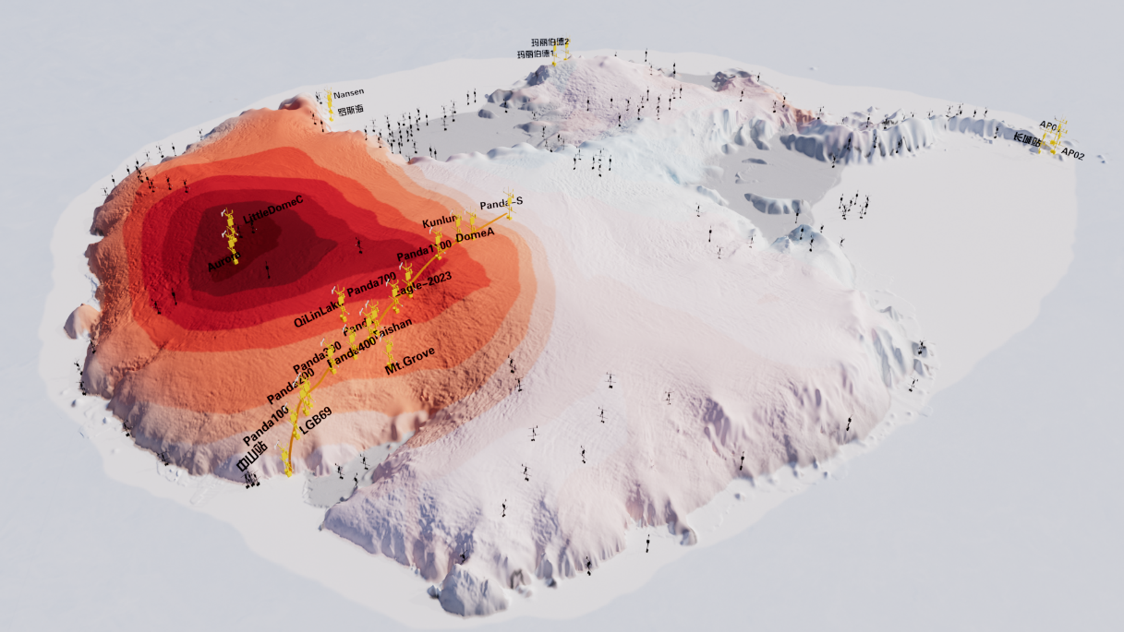
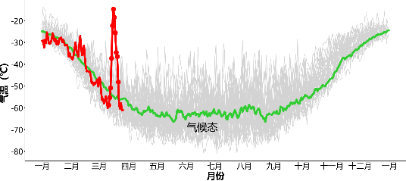
Record-breaking warming event in Antarctica (and on Earth)
18th Mar, 2022: AirT increased by ~44℃ around Dome C
Observed SAT at the Concordia station experienced a rapid increase from the 15th to 18th of March 2022
A salient increase in the SAT occurred over the region from Wilkes Land to Victoria Land, with the maximal warming anomalies over the Dome C region

Slide 4
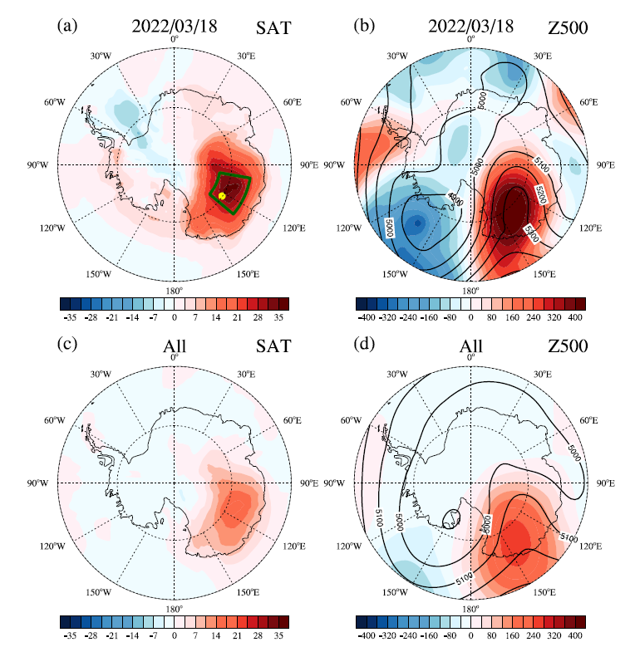
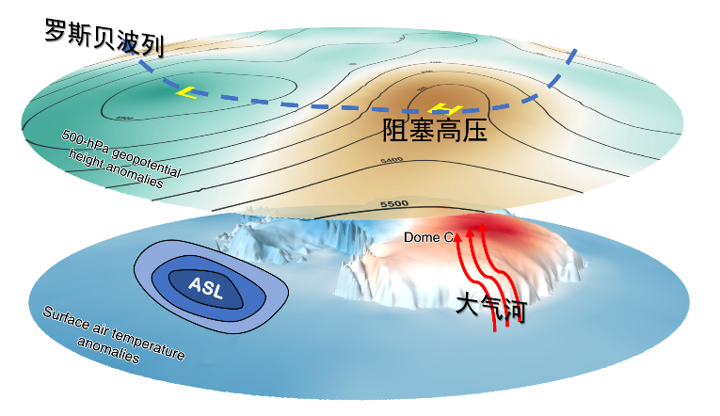
Mechanism
Rossby Wave
Blocking
Atmospheric River

Slide 5
Composite anomalies of explosive warmings
During the past 40 years (January 1979–March 2022), 58 explosive warming events were detected over the Dome C region.
The typical structure of blocking high can be observed during the explosive warmings, with a high-pressure anomaly over the Wilkes Land and two low-pressure anomalies on the east and west sides of this ridge.
The blocking high over the Wilkes Land guides the intense poleward moisture fluxes to the Antarctic ice sheet, which cause immediate warming over Dome C due to the large amounts of water vapor and cloud liquid water.

Slide 6
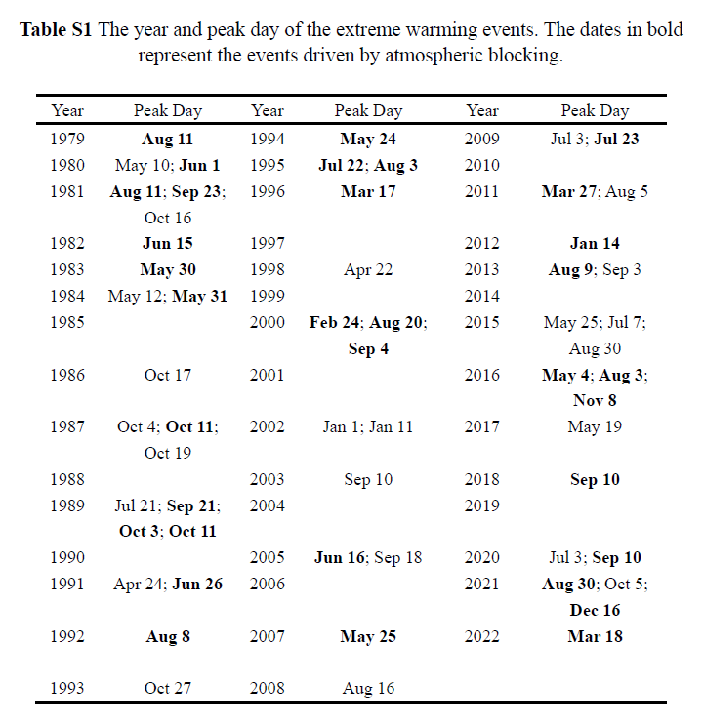
Influence of Blocking on explosive warming over Dome C
Composite blocking frequency (%)
Among the 58 explosive warming events, 34 were driven by Wilkes Land blocking.

Slide 7
Blocking circulation intensity vs warming intensity
The magnitude of warming depends largely on the circulation intensity of the blocking high. A blocking high with stronger circulation intensity can transport more heat and moisture from low latitudes to the interior of Antarctica, thereby causing warm anomalies over Dome C.
The unprecedented explosive warming on March 18, 2022 was driven by the blocking high with the strongest circulation intensity.

Slide 8
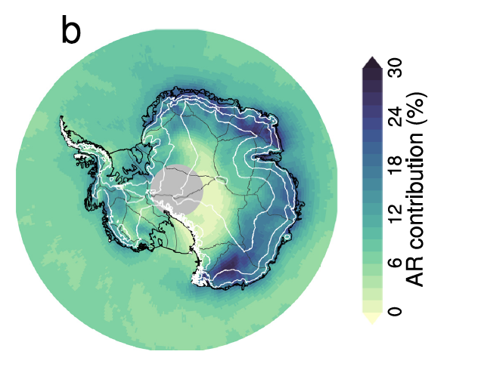
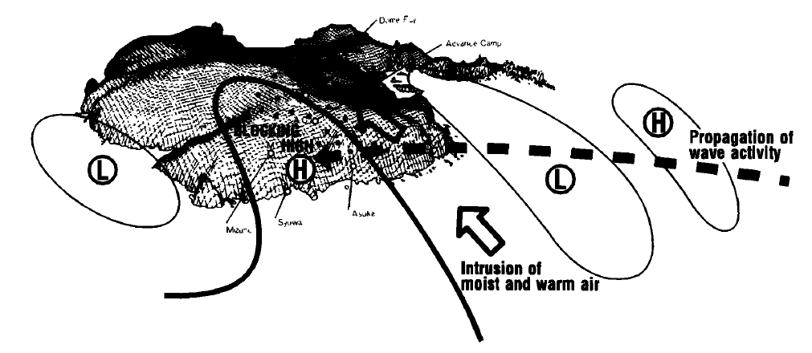
More research related
Atmospheric rivers (ARs) can cause extreme precipitation on the AIS(Wille et al., 2021; Maclennan et al., 2022); they can also trigger extreme high temperatures, leading to extreme melt in certain regions (Turner et al., 2022; Hirasawa et al., 2000).
The occurrence of blocking is more conducive to the landfall of ARs on the Antarctic ice sheet (Wille et al., 2021; 2024).
AR’s contribution to annual precipitation
Schematic diagram of blocking affecting ARs
Current issue: No research has systematically studied the climatological characteristics and climatic impacts of Antarctic blocking.
(Maclennan et al., 2022)
(Hirasawa et al., 2000)

Slide 9
1
Motivation
2
Data and methods
CONTENTS
3
Main Results
4
Summary

Slide 10
2. Data and methods
Data:
Reanalysis: ERA5
Observations: The Reference Antarctic Data for Environmental Research project
Methods:
Two-dimensional blocking index (Scherrer et al., 2006)
Projection index (Feldstein, 2003)
Linear correlation
Composite analysis
Two-tailed Student's t test

Slide 11
1
Motivation
2
Data and methods
CONTENTS
3
Main Results
4
Summary

Slide 12
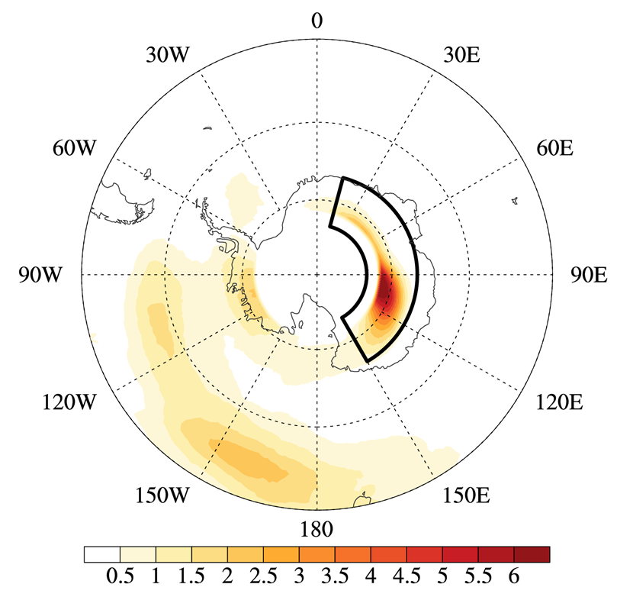
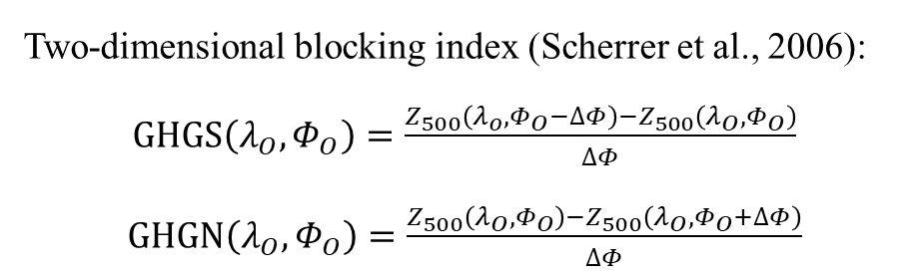
The climatology of annual blocking frequency
Annual blocking frequency (%)
Two-dimensional blocking index (Scherrer et al., 2006):
$GHGS\left(λ_{O},Φ_{O}\right)=\frac{{Z_{500}\left(λ_{o},Φ_{O}−∆Φ\right)−Z}_{500}\left(λ_{O},Φ_{O}\right)}{∆Φ}$
$GHGN\left(λ_{O},Φ_{O}\right)=\frac{Z_{500}\left(λ_{O},Φ_{O}\right)−Z_{500}\left(λ_{O},Φ_{O}+∆Φ\right)}{∆Φ}$

Slide 13
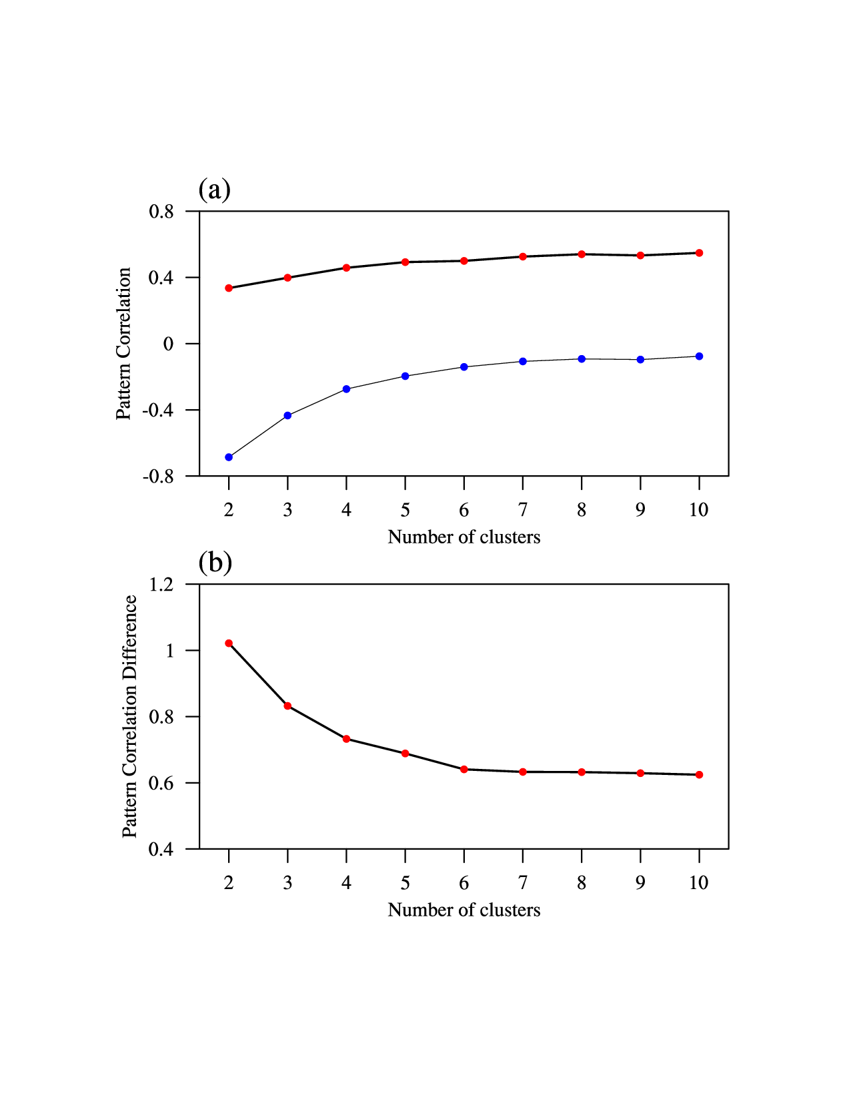
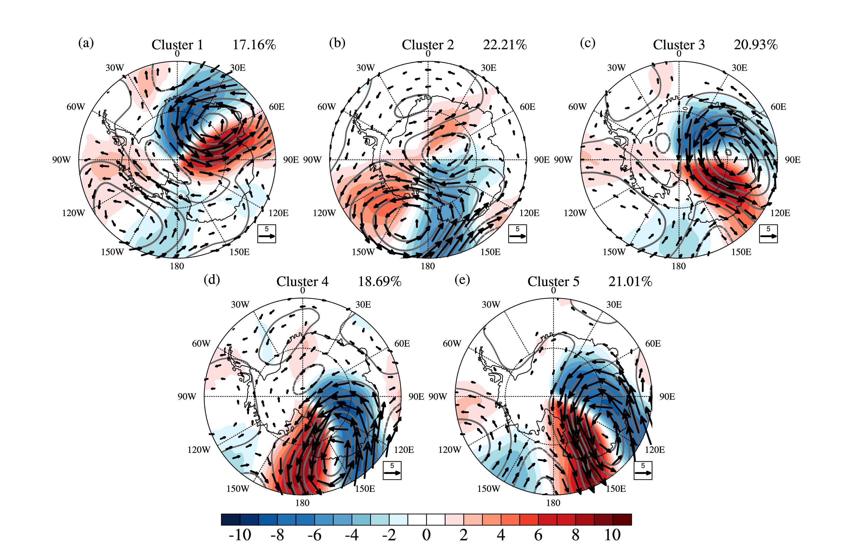
Classification of East Antarctic （EA） Blockings​
within clusters
between clusters
The optimal number of clusters is 5

Slide 14
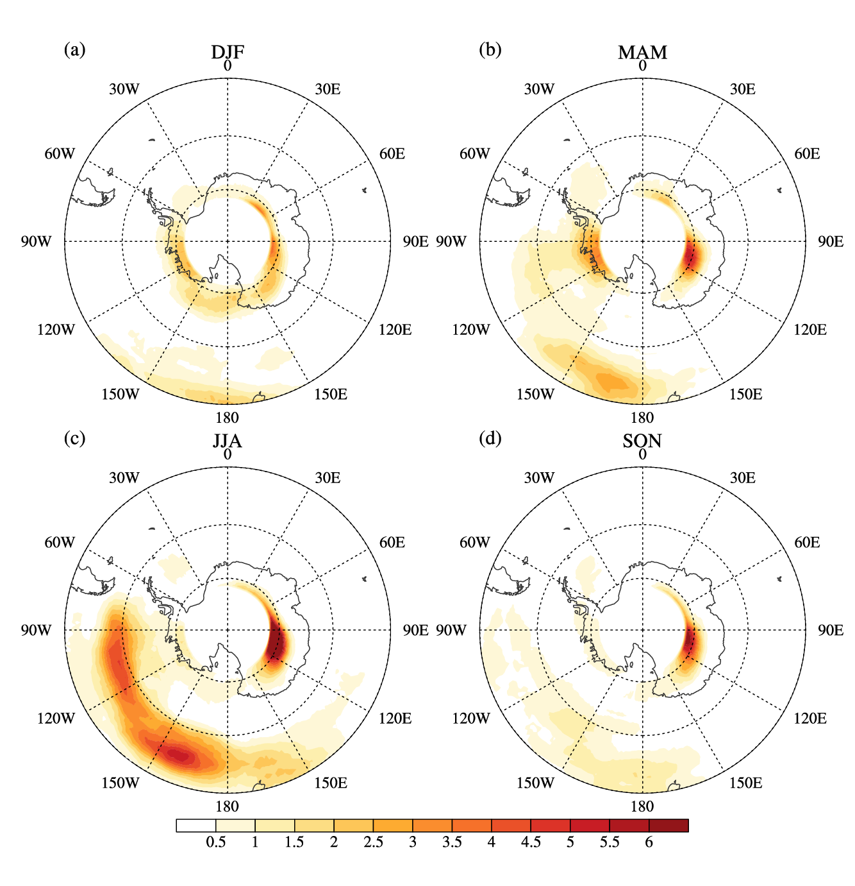
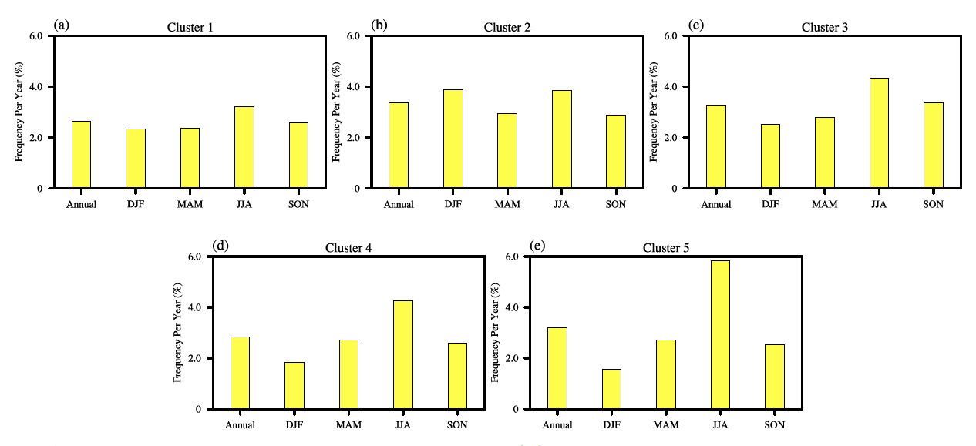
The climatology of seasonal blocking frequency
Seasonal blocking frequency (%)

Slide 15
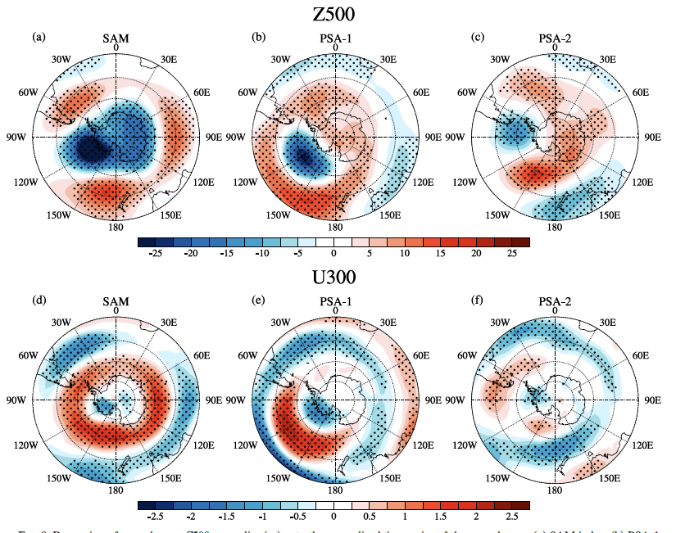
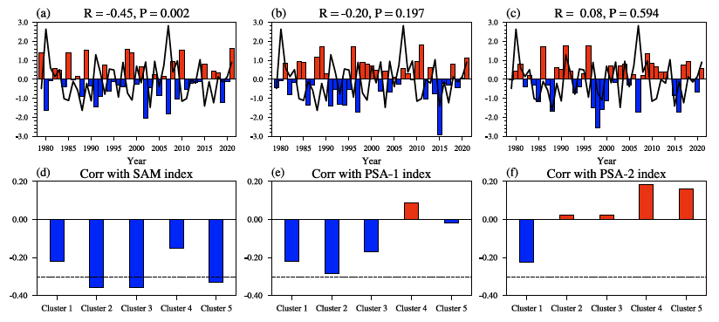
Relationship Between EA Blocking and Atmospheric Circulation Modes
Positive SAM, with strengthened circumpolar westerlies, hinders Rossby wave amplification, reducing blocking; negative SAM, with weakened westerlies, enables such amplification and more East Antarctic blocking.
The phase variability of the PSA-1 and PSA-2 modes does not significantly impact the intensity of the circumpolar westerlies surrounding the East Antarctica, and thus does not modulate the blocking frequency in the region

Slide 16
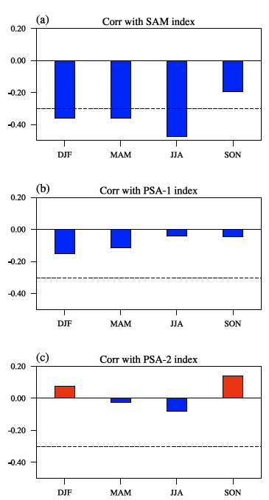
Relationship Between EA Blocking and Atmospheric Circulation Modes on Seasonal Scale
95% confidence level

Slide 17
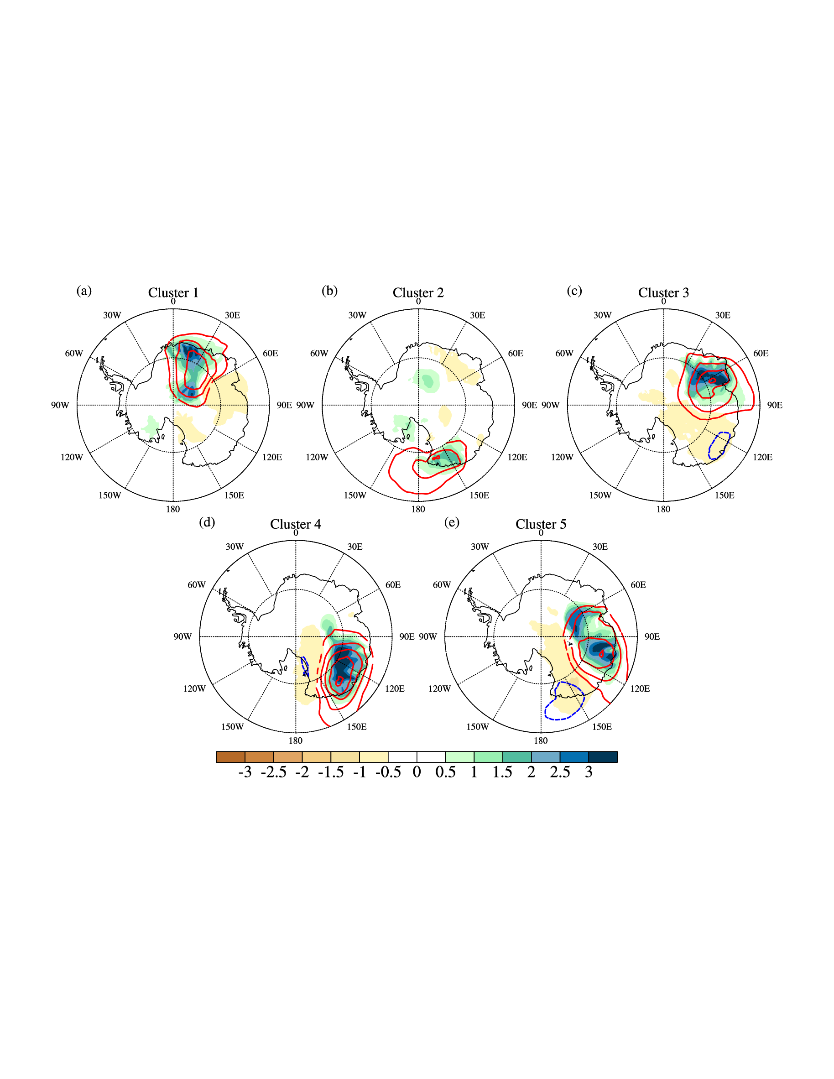
Influence of EA Blocking on precipitation
Precipitation anomalies (shaded); water vapor anomalies (contour lines)
On the western flank of the blocking high, warm and humid air was transported into inland Antarctica, instigating regional snowfall.

Slide 18
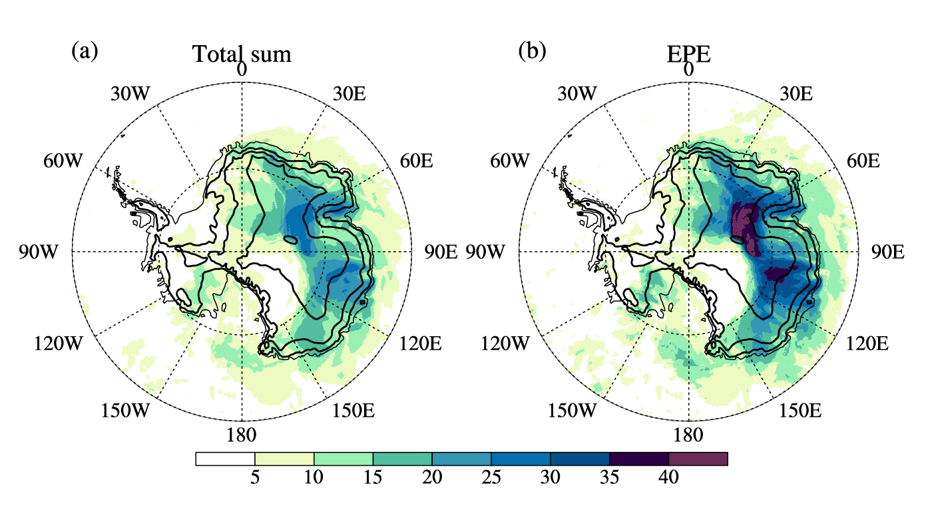
Contribution of EA Blocking on precipitation
Contribution of EA blocking to precipitation (%)
Annual mean
Extreme precipitation
The relative contribution of atmospheric blockings to total annual precipitation and extreme precipitation events increases from coastal to inland.
Over the East Antarctic plateau, the blockings are responsible for at least 15% of total accumulated snowfall and 30% of extreme precipitation events.
Precipitation in regions where composite precipitation anomalies are greater than 0 and pass the 95% significance test is considered blocking-driven precipitation

Slide 19
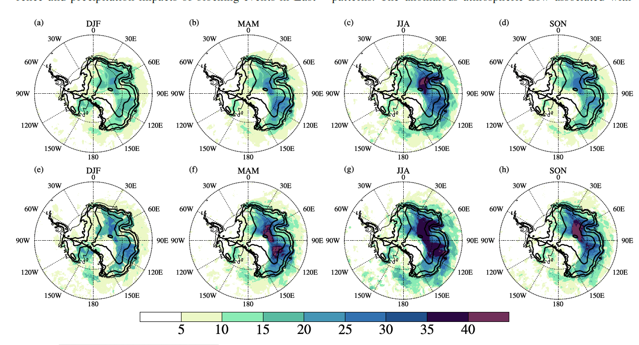
Seasonal contribution of EA Blocking on precipitation
Total sum
Extreme precipitation

Slide 20
1
Motivation
2
Data and methods
CONTENTS
3
Main Results
4
Summary

Slide 21
Summary
East Antarctica is a region with frequent blocking in the Southern Hemisphere, with the highest frequency in the austral winter and the lowest in summer.
The variation in East Antarctic blocking frequency is regulated by the phase change of SAM; positive phase SAM is unfavorable for the occurrence of blocking in East Antarctica.
East Antarctic blocking has an important impact on the occurrence of extreme climate events in inland Antarctica: approximately 30% of extreme precipitation in the Antarctic Plateau region is contributed by blocking; more than half of the explosive warmings over the Dome C region are driven by blocking located in Wilkes Land.
For more details, please refer to:
Sai Wang, Minghu Ding*, Ge Liu, et al. New record of explosive warmings in East Antarctica, Science Bulletin. 2023, 68(2) :129-132
Sai Wang, Minghu Ding*, Ge Liu, et al. Blocking Events in East Antarctica: Impact on Precipitation and their Association with Large-Scale Atmospheric Circulation Modes, Journal of Climate. 2024,37(4): 1333-1345

Slide 22
Thanks for listening！

