Slide 1
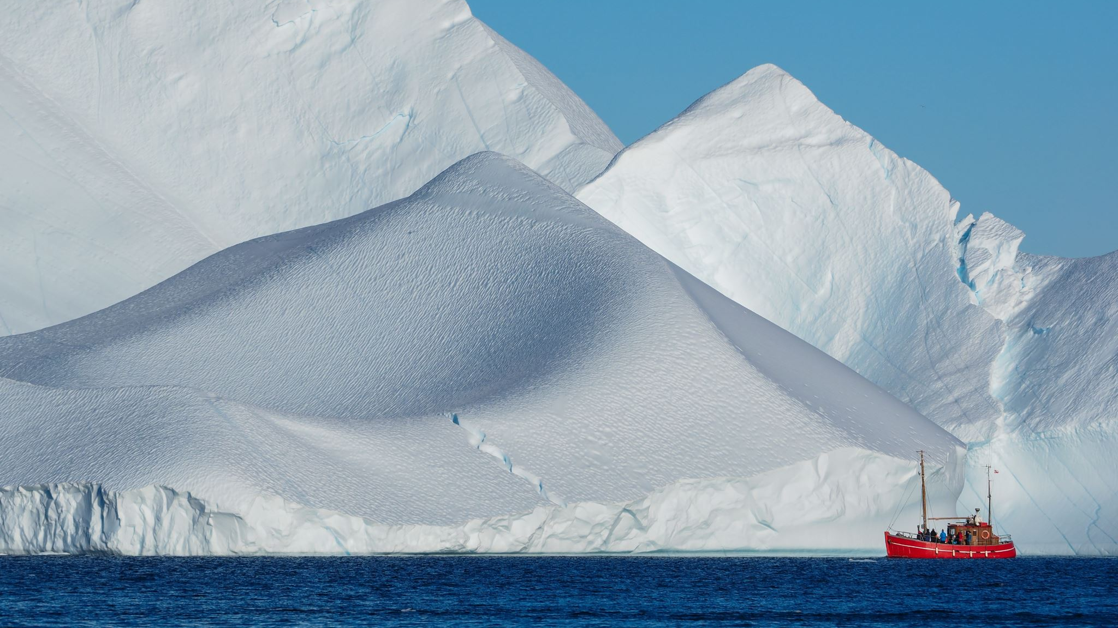





Is Interior Antarctica on the Threshold of Major Climate Change?
David H. Bromwich¹, Xun Zou², Sheng-Hung Wang¹
¹Polar Meteorology Group, Byrd Polar and Climate Research Center,
The Ohio State University, Columbus, OH, USA
²Center for Western Weather and Water Extremes (CW3E),
Scripps Institution of Oceanography, University of California San Diego, CA, USA

Slide 2
Background
NOAA’s climate record has 2023 as the warmest year in its 174-year history. Unlike the Arctic, which has experienced a nearly fourfold increase in temperature compared to the global average since 1979 (Rantanen et al. 2022), Antarctic climate presents a more complex picture. From 1958 to 2012, the middle and high latitudes of the Southern Hemisphere (SH) exhibited widespread warming, characterized by a 0.08 ± 0.03°C dec⁻¹ trend over the Antarctic continent (Jones et al. 2019).
Antarctic Surface Air temperature (SAT) trend shows substantial spatial and temporal variations due to:
Various tropical forcing (Ding et al. 2011; Bromwich et al. 2013; Li et al. 2014; Turner et al. 2016; Clem et al. 2020).
Westerly wind impact due to the Southern Annular Mode (SAM) (Marshall 2007; Thompson et al. 2011).
Regional influence of coastal warm and moist air intrusions (Wille et al. 2024).
Antarctic Peninsula (AP): overall long-term warming; significant cooling since the late 1990s (Turner et al. 2016; Oliva et al. 2017) & a reversal to warming in the mid-2010s (Carrasco et al. 2021).
West Antarctica (WA): warming period between 1958 and 2012 (Bromwich et al. 2013, 2014); a cooling trend in the early 2010s (Zhang et al. 2023).
East Antarctica (EA): an initially negligible SAT trend → inland warming since the late twentieth century, notably during austral autumn (Stammerjohn and Scambos 2020; Clem et al. 2020).
Is Interior Antarctica on the Threshold of Major Climate Change?

Slide 3
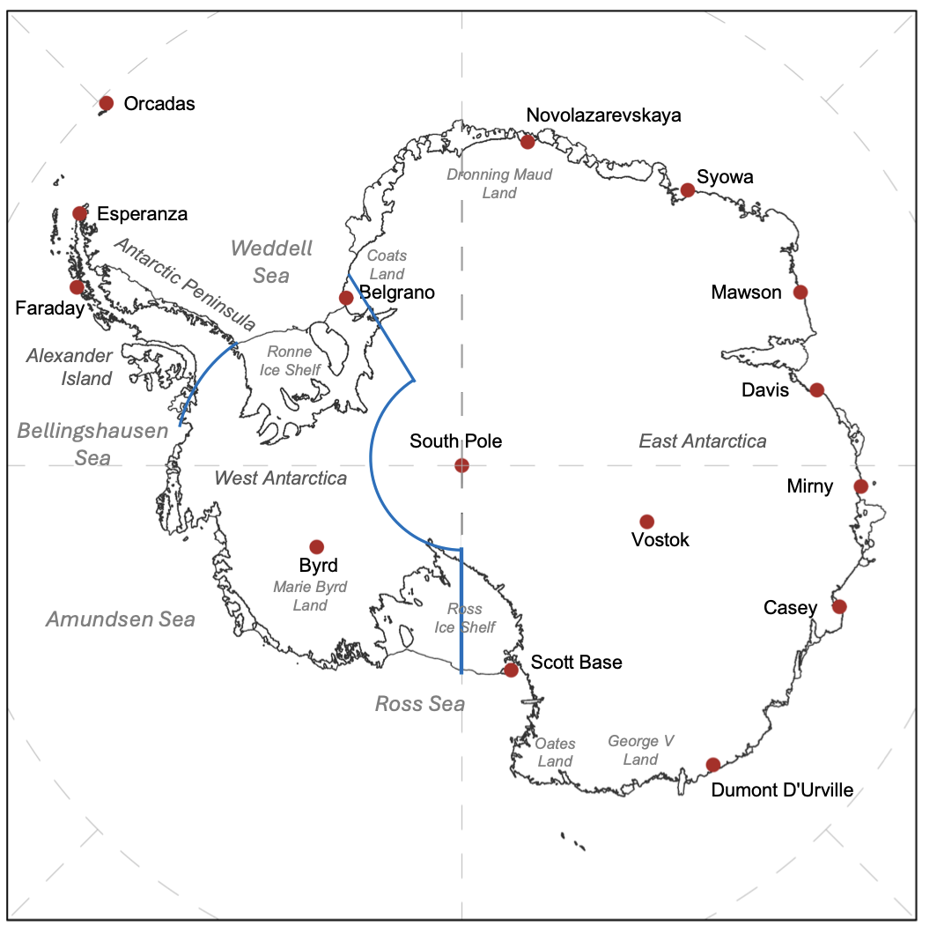
Temperature Reconstruction
Locations of stations used for Antarctic temperature reconstruction (RECON)
The 2-m air temperature anomalies at monthly intervals for 1958-2022 over Antarctica at 60 km grid spacing are reconstructed based on the methodology of Nicolas and Bromwich (2014).
The ERA5 global reanalysis provides the weights to spatially extrapolate the monthly mean temperature anomalies (1981-2010) from 15 fixed stations. 14 stations used by Nicolas and Bromwich are employed along with Belgrano that replaces Halley.
(Bromwich et al., 2025)

Slide 4
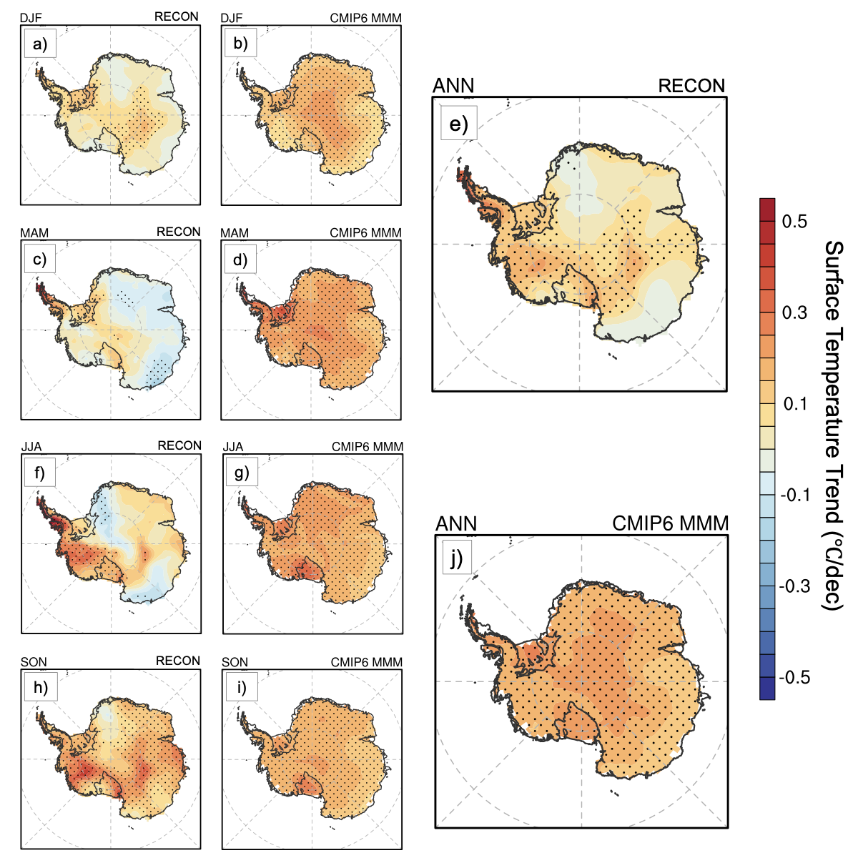
Temperature Trend: RECON VS. CMIP6 MMM
Annual and seasonal SAT trend from 1958 to 2022 based on RECON and CMIP6 MMM
RECON
Most pronounced annual warming (up to 0.47°C per decade): northern tip of the AP, central WA, and the vicinity of Scott Base and Vostok Station.
Winter temperatures (JJA) exhibit the strongest spatial variation and govern the annual temperature anomalies.
AP - consistent long-term warming across all seasons & most pronounced warming during winter and autumn.
Central WA - significant warming during spring and winter.
EA - intricate pattern, cooling in autumn and overall warming in spring.
CMIP6 MMM (44 ensemble members)
A widespread warming trend across all seasons over the Antarctic continent with a maximum in the interior.
Enhanced warming is observed over the South Pole and the Ronne Ice Shelf in autumn, and over the Ross Ice Shelf in winter and spring
CMIP6 MMM represents the forced response to anthropogenic climate change while RECON over the long-term is assumed to similarly reflect
this change.
RECON and CMIP6 MMM exhibited stronger agreement over the AP region, followed by WA, showcasing a discernible long-term warming trend.
CMIP6 MMM did not reflect the spatial variation in SAT trends across EA, indicating an overestimation of warming.
Notes:
This study selected 44 CMIP6 ensemble members from 15 groups (Table S1), incorporating historical data spanning from 1950 to 2014 and SSP5-8.5 future projections (high emissions) from 2015 to 2022.

Slide 5
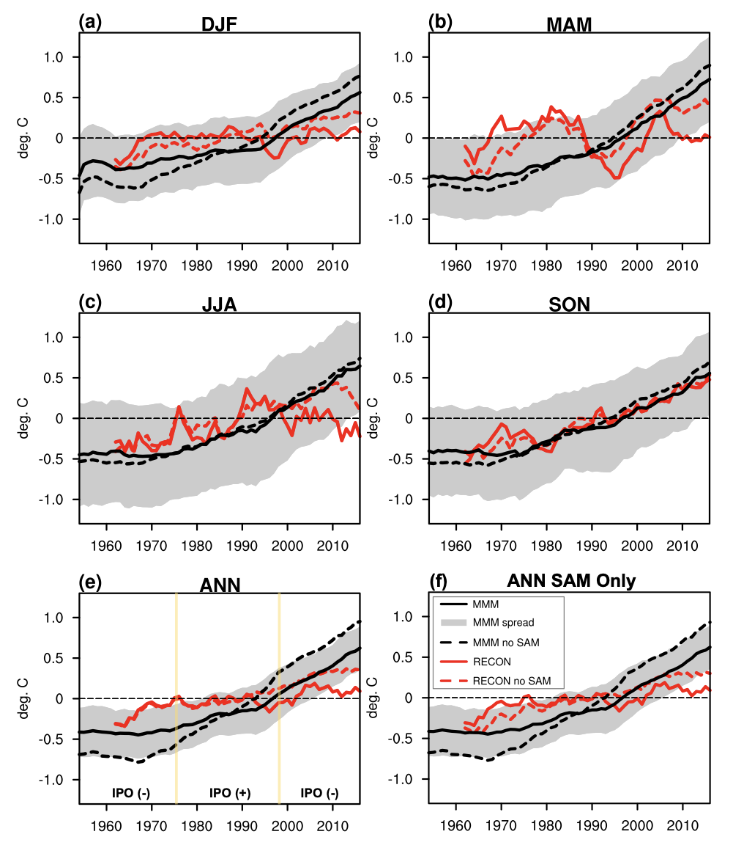
Temperature Trend: RECON VS. CMIP6 MMM & Removing SAM
Antarctic-average temperature time series from the CMIP6 MMM (thick black line) and the RECON (red line) for 1958–2022. Dashed shows the SAM impact removed via linear congruence analysis.
Again, the CMIP6 MMM represents the forced response to anthropogenic climate change while RECON is assumed to primarily reflect the actual forced response, especially annually when IPO phase had a minimal impact. SAM impact must be considered.
Similar to the RECON, SAM has a cooling impact in CMIP6 MMM, especially during DJF (summer) and MAM (autumn).
In MAM, the CMIP6 MMM exhibited a strong warming trend of 0.2 ± 0.02 °C per decade that is inconsistent with the RECON, regardless of SAM impact.
In JJA (winter) and DJF, CMIP6 MMM tripled and quadrupled the warming trend compared to the RECON, particularly post-2000. SAM removal somewhat lessens the disagreement.
In SON (spring), RECON and CMIP6 MMM trends agree; SAM impact is small/negligible.
Overall, CMIP6 MMM overestimated the forced Antarctic warming, exhibiting a trend akin to global warming when the SAM impact was removed. We conclude that the climate models can show the potential climate change, but the rate and magnitude are not reliable.

Slide 6
Temperature Trend:
Linear regression trends of smoothed Antarctic and global temperature time series (°C decade⁻¹) for 1958 -2022
Antarctica
 | DJF |  | MAM |  | JJA |  | SON |  | ANN
 | Slope | CI | Slope | CI | Slope | CI | Slope | CI | Slope | CI
RECON | 0.03 | 0.02 | -0.01 | 0.04 | 0.06 | 0.03 | 0.16 | 0.02 | 0.06 | 0.01
RECON DeSAM | 0.11 | 0.01 | 0.12 | 0.03 | 0.12 | 0.02 | 0.17 | 0.01 | 0.13 | 0.01
CMIP6 | 0.14 | 0.01 | 0.20 | 0.02 | 0.18 | 0.02 | 0.16 | 0.01 | 0.17 | 0.02
CMIP6 DeSAM | 0.23 | 0.02 | 0.25 | 0.02 | 0.22 | 0.02 | 0.21 | 0.01 | 0.29 | 0.02
Global
CMIP6 | 0.25 | 0.02 | 0.23 | 0.02 | 0.23 | 0.02 | 0.27 | 0.03 | 0.25 | 0.02
Hot Models vs. Normal Models for Antarctica
 | DJF |  | MAM |  | JJA |  | SON |  | ANN
 | Slope | CI | Slope | CI | Slope | CI | Slope | CI | Slope | CI
CMIP6 (H) | 0.19 | 0.02 | 0.29 | 0.03 | 0.23 | 0.03 | 0.19 | 0.02 | 0.23 | 0.02
CMIP6 DeSAM (H) | 0.29 | 0.02 | 0.34 | 0.03 | 0.26 | 0.03 | 0.25 | 0.01 | 0.38 | 0.02
CMIP6 (N) | 0.12 | 0.01 | 0.15 | 0.01 | 0.16 | 0.01 | 0.15 | 0.01 | 0.14 | 0.01
CMIP6 DeSAM (N) | 0.22 | 0.01 | 0.25 | 0.02 | 0.21 | 0.01 | 0.20 | 0.02 | 0.29 | 0.02
15 CMIP6 groups also divide into two categories: “hot models” (5) and “normal models” (10).
CMIP6 members mentioned above exhibit higher climate sensitivities, driven by intensified positive feedback from low clouds over the Southern Ocean, ultimately contributing to faster warming trends.
Notes:
with two standard error confidence intervals (CI) after correction for autocorrelation in regression residuals following⁷⁶ (Top). Linear regression trends of smoothed temperature time series (°C decade⁻¹) for 1958 -2022 together with two standard error confidence intervals (CI) after correction for both “hot models” and “normal models” (Bottom).

Slide 7
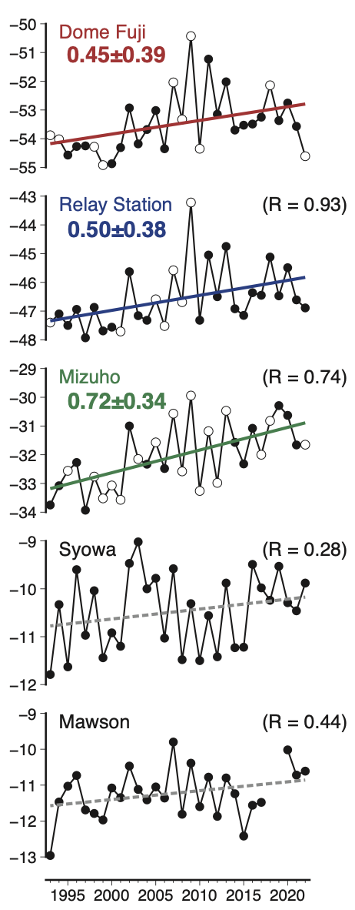
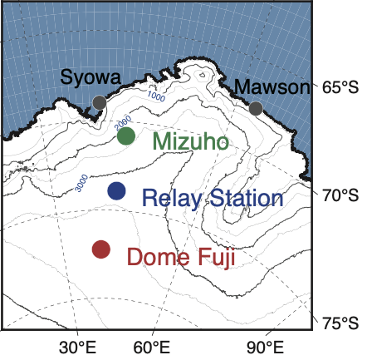
Temperature Trends: Continental Interior vs. Coastal Region
Stronger and statistically significant warming trend for all three inland stations between 1995 and 2020 compared to the insignificant warming at two coastal stations. Kurita et al. (2025).
South Pole observed 0.61 ± 0.34 °C per decade warming from 1989–2018 (Clem et al. 2020). Warming has slackened since.
 |  | CESM | MIROC | ERA5 | RECON
 | DJF | +0.35 | +0.11 | +0.19 | +0.02
 | MAM | +0.42 | +0.17 | -0.03 | +0.02
 | JJA | +0.36 | +0.05 | -0.02 | -0.03
 | SON | +0.24 | +0.16 | +0.28 | +0.20
 | ANN | +0.34 | +0.12 | +0.10 | +0.05
Selected CMIP6 models, CESM2 (H) and MIROC6 (N), exhibit a stronger overall warming trend than ERA5 from 1979 to 2022.
While MIROC6 shows a trend more consistent with ERA5, it is characterized by a pronounced warm bias.
CESM2's overestimated warming trend is largely driven by a cold bias in the model prior to 2000.

Slide 8
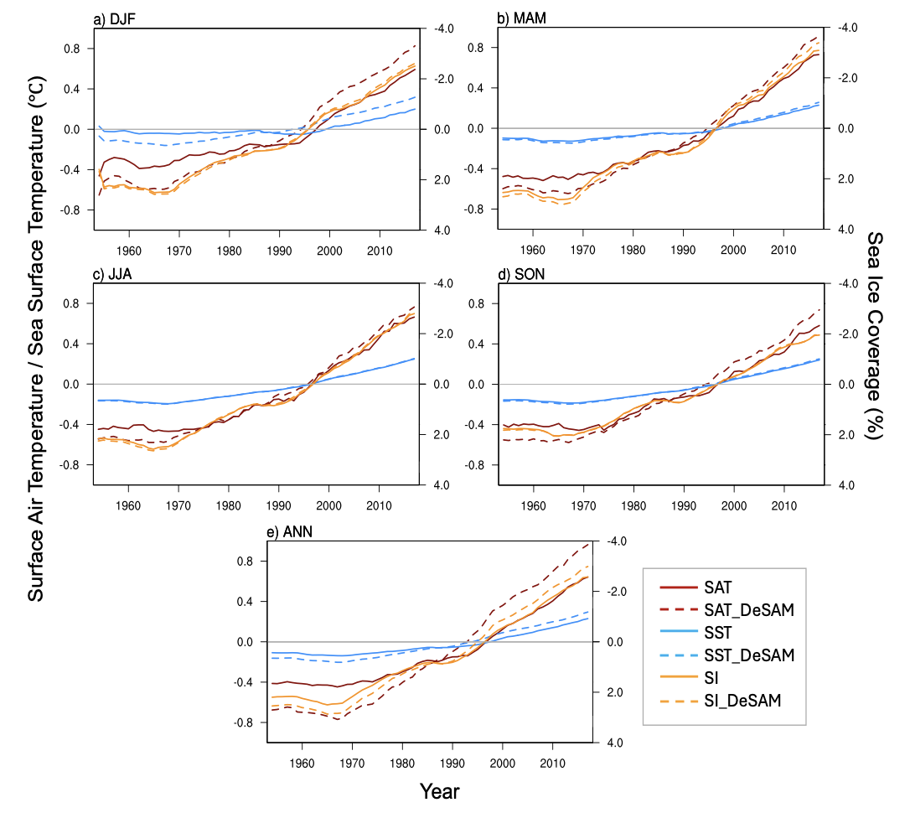
Temperature, Sea Ice and SST in CMIP6 MMM
Seasonal and annual time series of Antarctic near-surface temperature, sea surface temperature (50–60°S), and sea ice cover (60°S south) from CMIP6 MMM with a 10-year running mean.
CMIP6 MMM revealed an acceleration of SAT increase since 1995, corresponding to the rapid warming in SST (50 to 60°S) and decline in sea ice concentration (SI; south of 60°S).
Acceleration of SAT increase post-1995 is more pronounced in summer. Both SST and SI exhibited weaker seasonality. SST displayed a consistent warming pattern with a rapid increase post-1995, whereas SI experienced two periods of accelerated decline (1970-1985 and 1995-present).
Both SST and SI are subject to a smaller impact from the SAM compared to SAT.

Slide 9
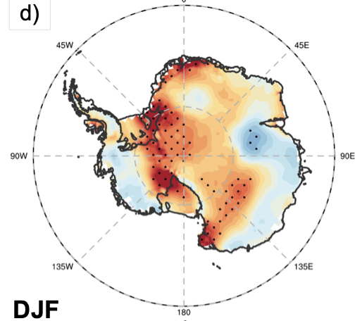
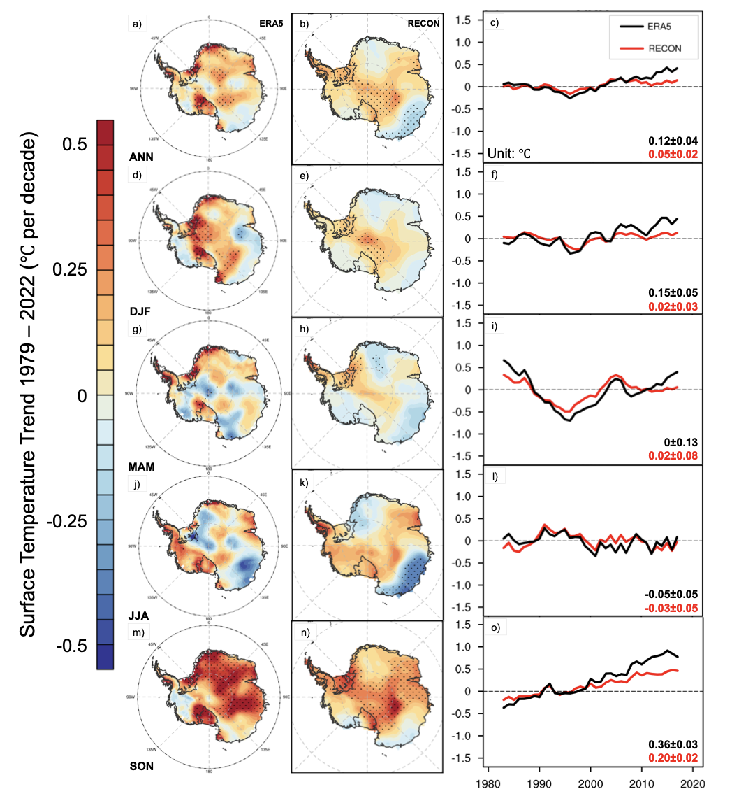
“Observed” Temperature Trends: Post 1979
Annual and seasonal surface air temperature (SAT) trend from 1979 to 2022 based on monthly anomalies from ERA5 reanalysis data (left column) and RECON data (middle).
Artificial “hot spots”, persist after 1979
Although the temperature trends before 1979 were unreliable and certain locations exhibited artificial “hot spots”, ERA5 effectively captures internal variability from 1979 onward.
Notes:
Annual and seasonal surface air temperature (SAT) trend from 1979 to 2022 based on monthly anomalies from ERA5 reanalysis data (left column) and RECON data (middle). The time series with 5-year running mean of monthly temperature anomalies from both ERA5 and RECON are shown in the right column. The dash pattern represents trends that are significantly different from zero at P < 0.05. The climatology baseline is 1981 – 2010 (Adapted from¹). The numbers in the bottom right corner of the rightmost column represent the linear regression trends of the smoothed temperature time series (°C per decade) for 1979–2022, along with the two-standard-error confidence intervals.

Slide 10
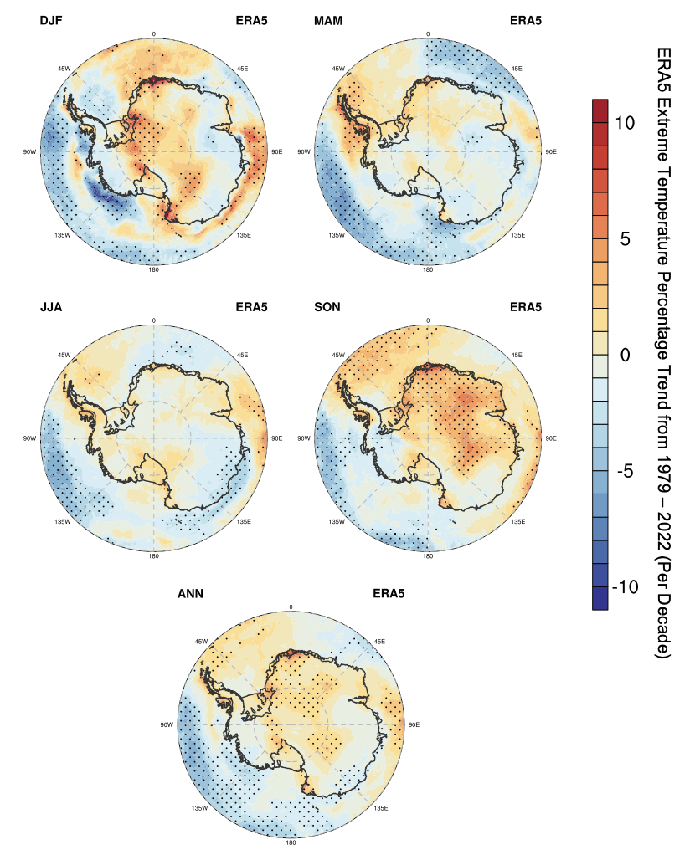
Temperature Extremes in ERA5
Annual and seasonal extreme warm temperature trend based on 3-hrly ERA5 reanalysis data from 1979 to 2022.
Majority of EA and the AP: significant increases in extreme warm temperatures during spring.
AP: strongest positive trend during the autumn, followed by spring and winter ← positive SAM and atmospheric river (Gorodetskaya et al. 2023).
Coastal EA between 60° and 180°E: negative trend during most seasons except for spring.
Marie Byrd Land: a negative trend except for winter.
ERA5 dataset
Suspicious positive trends during summer along the coastal regions of Dronning Maud Land, Coats Land, Siple Coast, and Oates Land.
Artificial “hot spots” are also observed in these areas, except Oates Land, as rapid warming trends in long-term temperature in ERA5, especially in summer and autumn and continue after 1979.

Slide 11
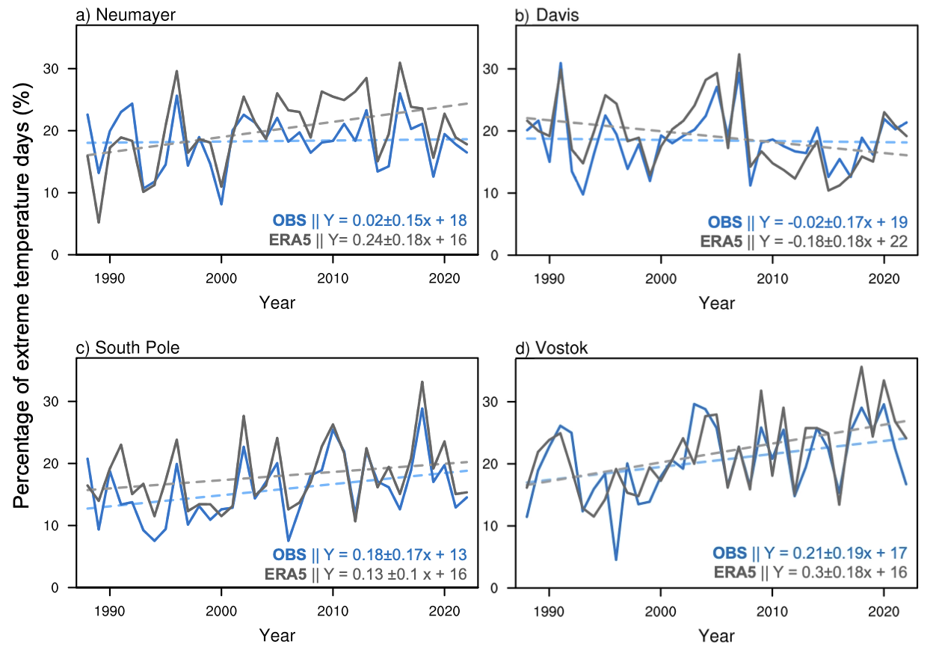
Temperature Extremes: ERA5 vs. Obs
Annual extreme warm temperature trend based on 6-hrly station observation data and ERA5 reanalysis data at a) Neumayer, b) Davis, c) South Pole and d) Vostok from 1988 to 2022
Temperature extremes in station observations, however, indicate variable results.
Neumayer Station exhibits a near neutral annual trend in 3-hourly data from 1988 to 2022 , contrasting with ERA5 "hot spot" near 0°E along the coast.
Davis Station demonstrates a weaker cooling trend compared to ERA5.
Vostok Station and South Pole Station (two inland stations), however, exhibit consistent results with ERA5, showing a positive trend, suggesting widespread extreme temperature increases in interior East Antarctica .
(units: percentage/yr)
Notes:
. Extreme warm temperature trend is calculated based on the percentage of timesteps with a daily maximum temperature greater than the reference threshold. Temperature reference threshold is calculated as the 90th percentile of daily maximum temperatures of a five-day window centered on each calendar day of between 1988 – 2022, instead of 1981 – 2010 as used in Fig. 5. Linear trends are represented by dashed lines.

Slide 12
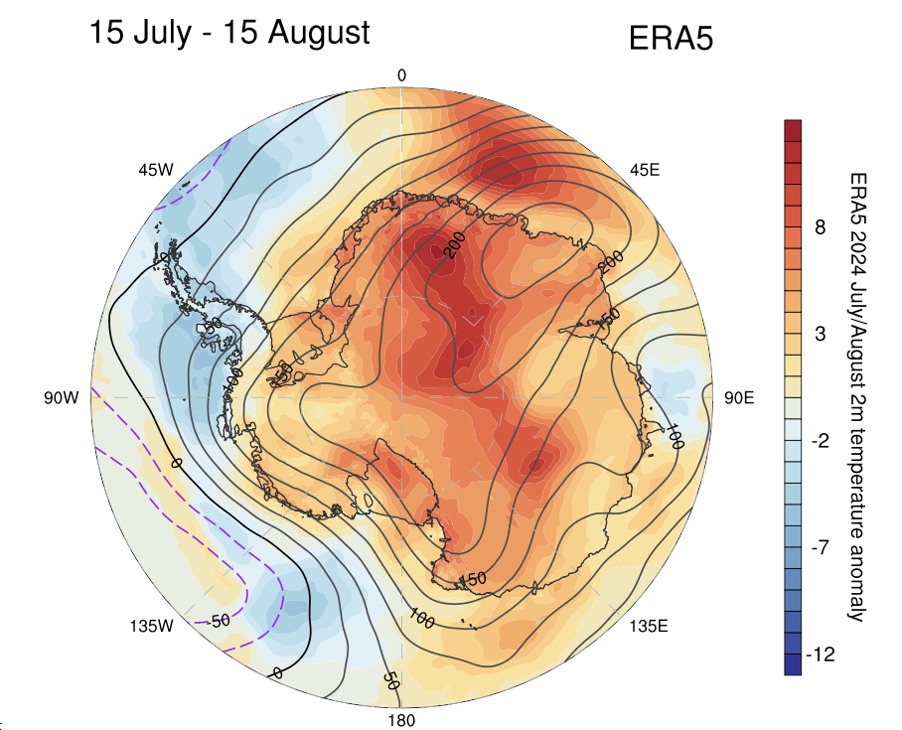
Recent Temperature Extremes over Interior Antarctica
Monthly 2m temperature (color fill) and 500-hPa geopotential height (contour line) anomaly from ERA5 reanalysis during heatwave from 15 July to 15 August 2024
2m Temperature anomaly on March 18, 2022
East Antarctic Heatwave Event from ERA5
(Wille et al., 2024)
Notes:
The
climatology baseline is the average monthly 2m temperature and 500-hPa geopotential height in
August and July during 1981 – 2010.

Slide 13
Conclusions
Our Antarctic temperature reconstruction reveals long-term warming in the Antarctic Peninsula (AP) and West Antarctica (WA), with modest cooling in parts of East Antarctica (EA), particularly during austral autumn and winter. We assume that, after accounting for the SAM impact, the remainder primarily reflects the forced response to greenhouse gas increases.
CMIP6 substantially overestimates the forced Antarctic warming at a rate similar to the global average and lacks accurate spatial patterns. We conclude that the climate models cannot be relied on to project the future rate and magnitude of Antarctic climate change, but do show the potential change. One possibility is that the CMIP6 prominent interior warming is overdue.
Observations of the averages and extremes actually suggest that interior Antarctica is experiencing/or about to experience marked climate change, as is currently happening in the northern Antarctic Peninsula and coastal West Antarctica. Climate change is muted along the East Antarctic coast and there the future trajectory is unclear.

