Slide 1





Strong Warming over the Antarctic Peninsula during Combined Atmospheric River and Foehn Events
Xun Zou¹, Penny M. Rowe², Irina Gorodetskaya^{3,4}, David H. Bromwich⁵, Matthew A. Lazzara⁶, Raul R. Cordero⁷, Zhenhai Zhang¹, Brian Kawzenuk¹, Jason M. Cordeira¹, Jonathan D. Wille⁸, F. Martin Ralph¹, Le-Sheng Bai⁵
¹ CW3E, Scripps Institution of Oceanography, University of California San Diego, CA, USA
² NorthWest Research Associates, Redmond, WA, USA.
³ CESAM - Centre for Environmental and Marine Studies, Department of Physics, University of Aveiro, Aveiro, Portugal.
⁴ IIMAR | Interdisciplinary Centre of Marine and Environmental Research of the University of Porto, Porto, Portugal
⁵ Byrd Polar and Climate Research Center, The Ohio State University, Columbus, OH, USA.
⁶ Antarctic Meteorological Research and Data Center, Space Science and Engineering Center, University of Wisconsin-Madison, and Department of Physical Sciences, School of Engineering, Science, and Mathematics, Madison Area Technical College, Madison, WI, USA.
⁷ Department of Physics, University of Santiago de Chile, Av. Bernardo O’Higgins 3363, Santiago, Chile.
⁸ IGE/CNRS, University Grenoble-Alpes, France.
05/31/2023
Rowe and Zou are grateful for funding from NSF awards 2229392 and 2127632

Slide 2

Contents
Introduction
Polar WRF (PWRF) Model
  Model Setting
  Brief Evaluation
2018 & 2022 Melt Cases
Synoptic circulation
Atmospheric rivers & Foehn Warming
Summary & Future Works

Slide 3
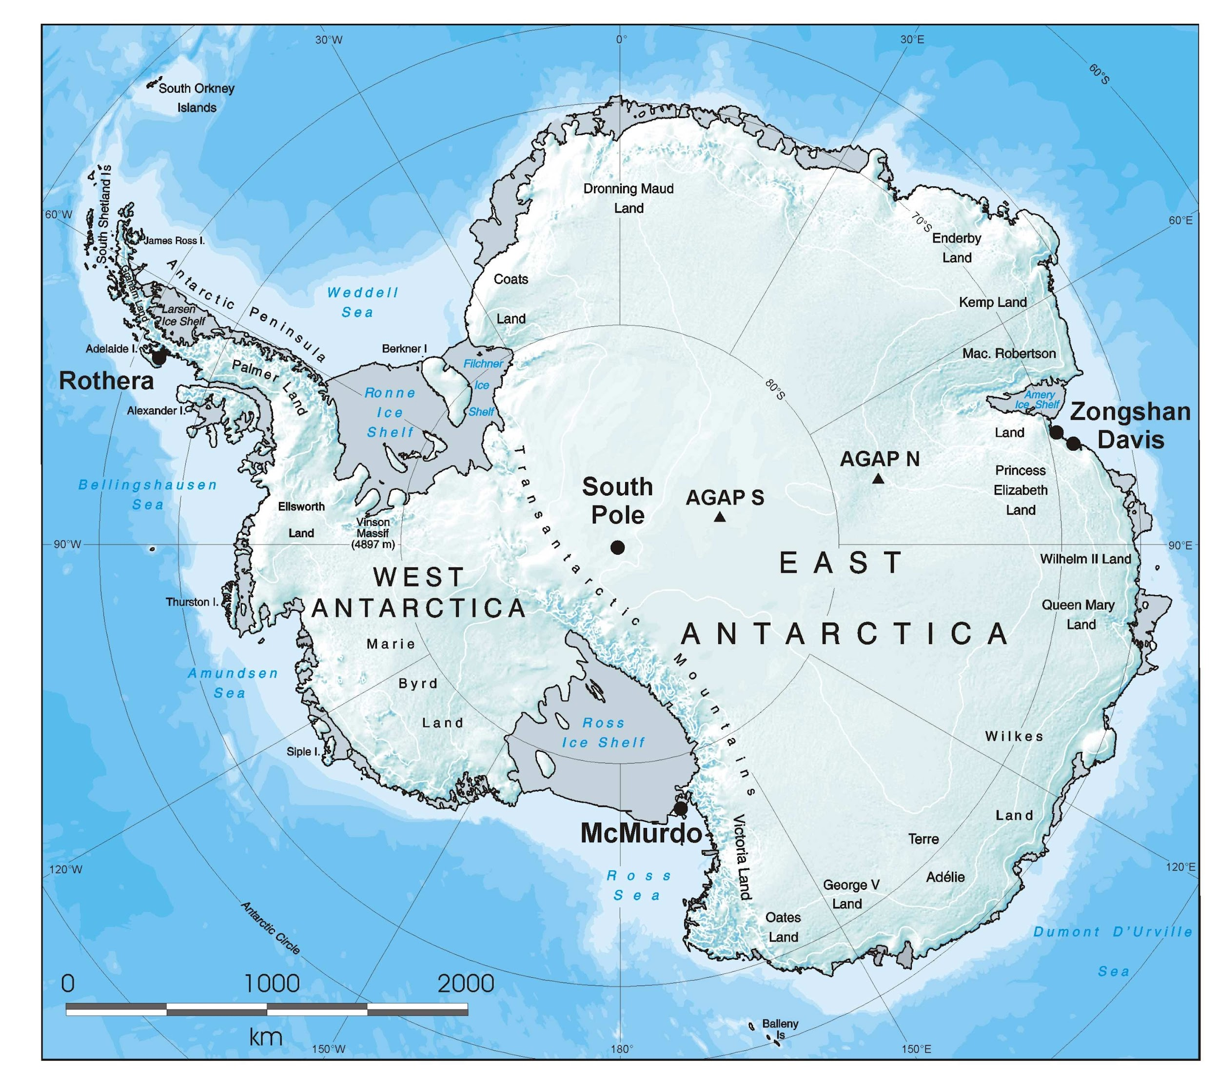
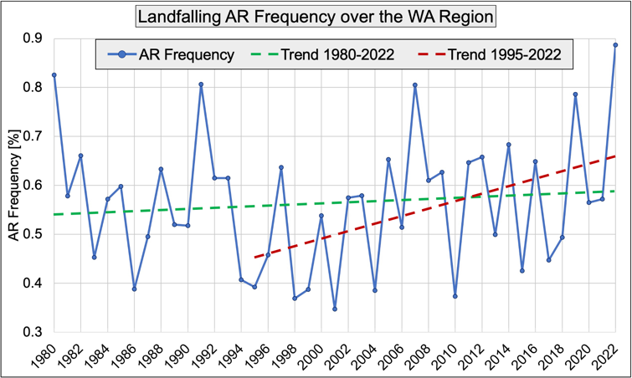
Atmospheric Rivers Over Antarctica
Selected AR triggered extreme weather events
Positive Polar ARs trend in West Antarctica
Ice Loss or Ice Gain?
Synoptic or Regional Drivers?
Climate Model & High-resolution model?
Ground & Satellite observations?
Multiple AR triggered
Ice Shelf Collapse
May 2009 and Feb. 2011
Snow Accumulation
Dec. 1989
Record High Temp
Jan. 2019
AR & foehn
2013-2014
Surface Glacier Melt
Multiple AR triggered
Intense Melt Event
Mar. 2022
Record High Temp
2019 Austral Winter
Surface Height Increase
Provided by Zhenhai Zhang
British Antarctic Survey
(e.g., Adusumilli et al, 2019; Bozkurt et al., 2018; Wille et al. 2022, 2023a,b; Gorodetskaya et al. 2014; Turner et al. 2022; Djoumna et al. 2021, Zou et al. 2020a,b)

Slide 4
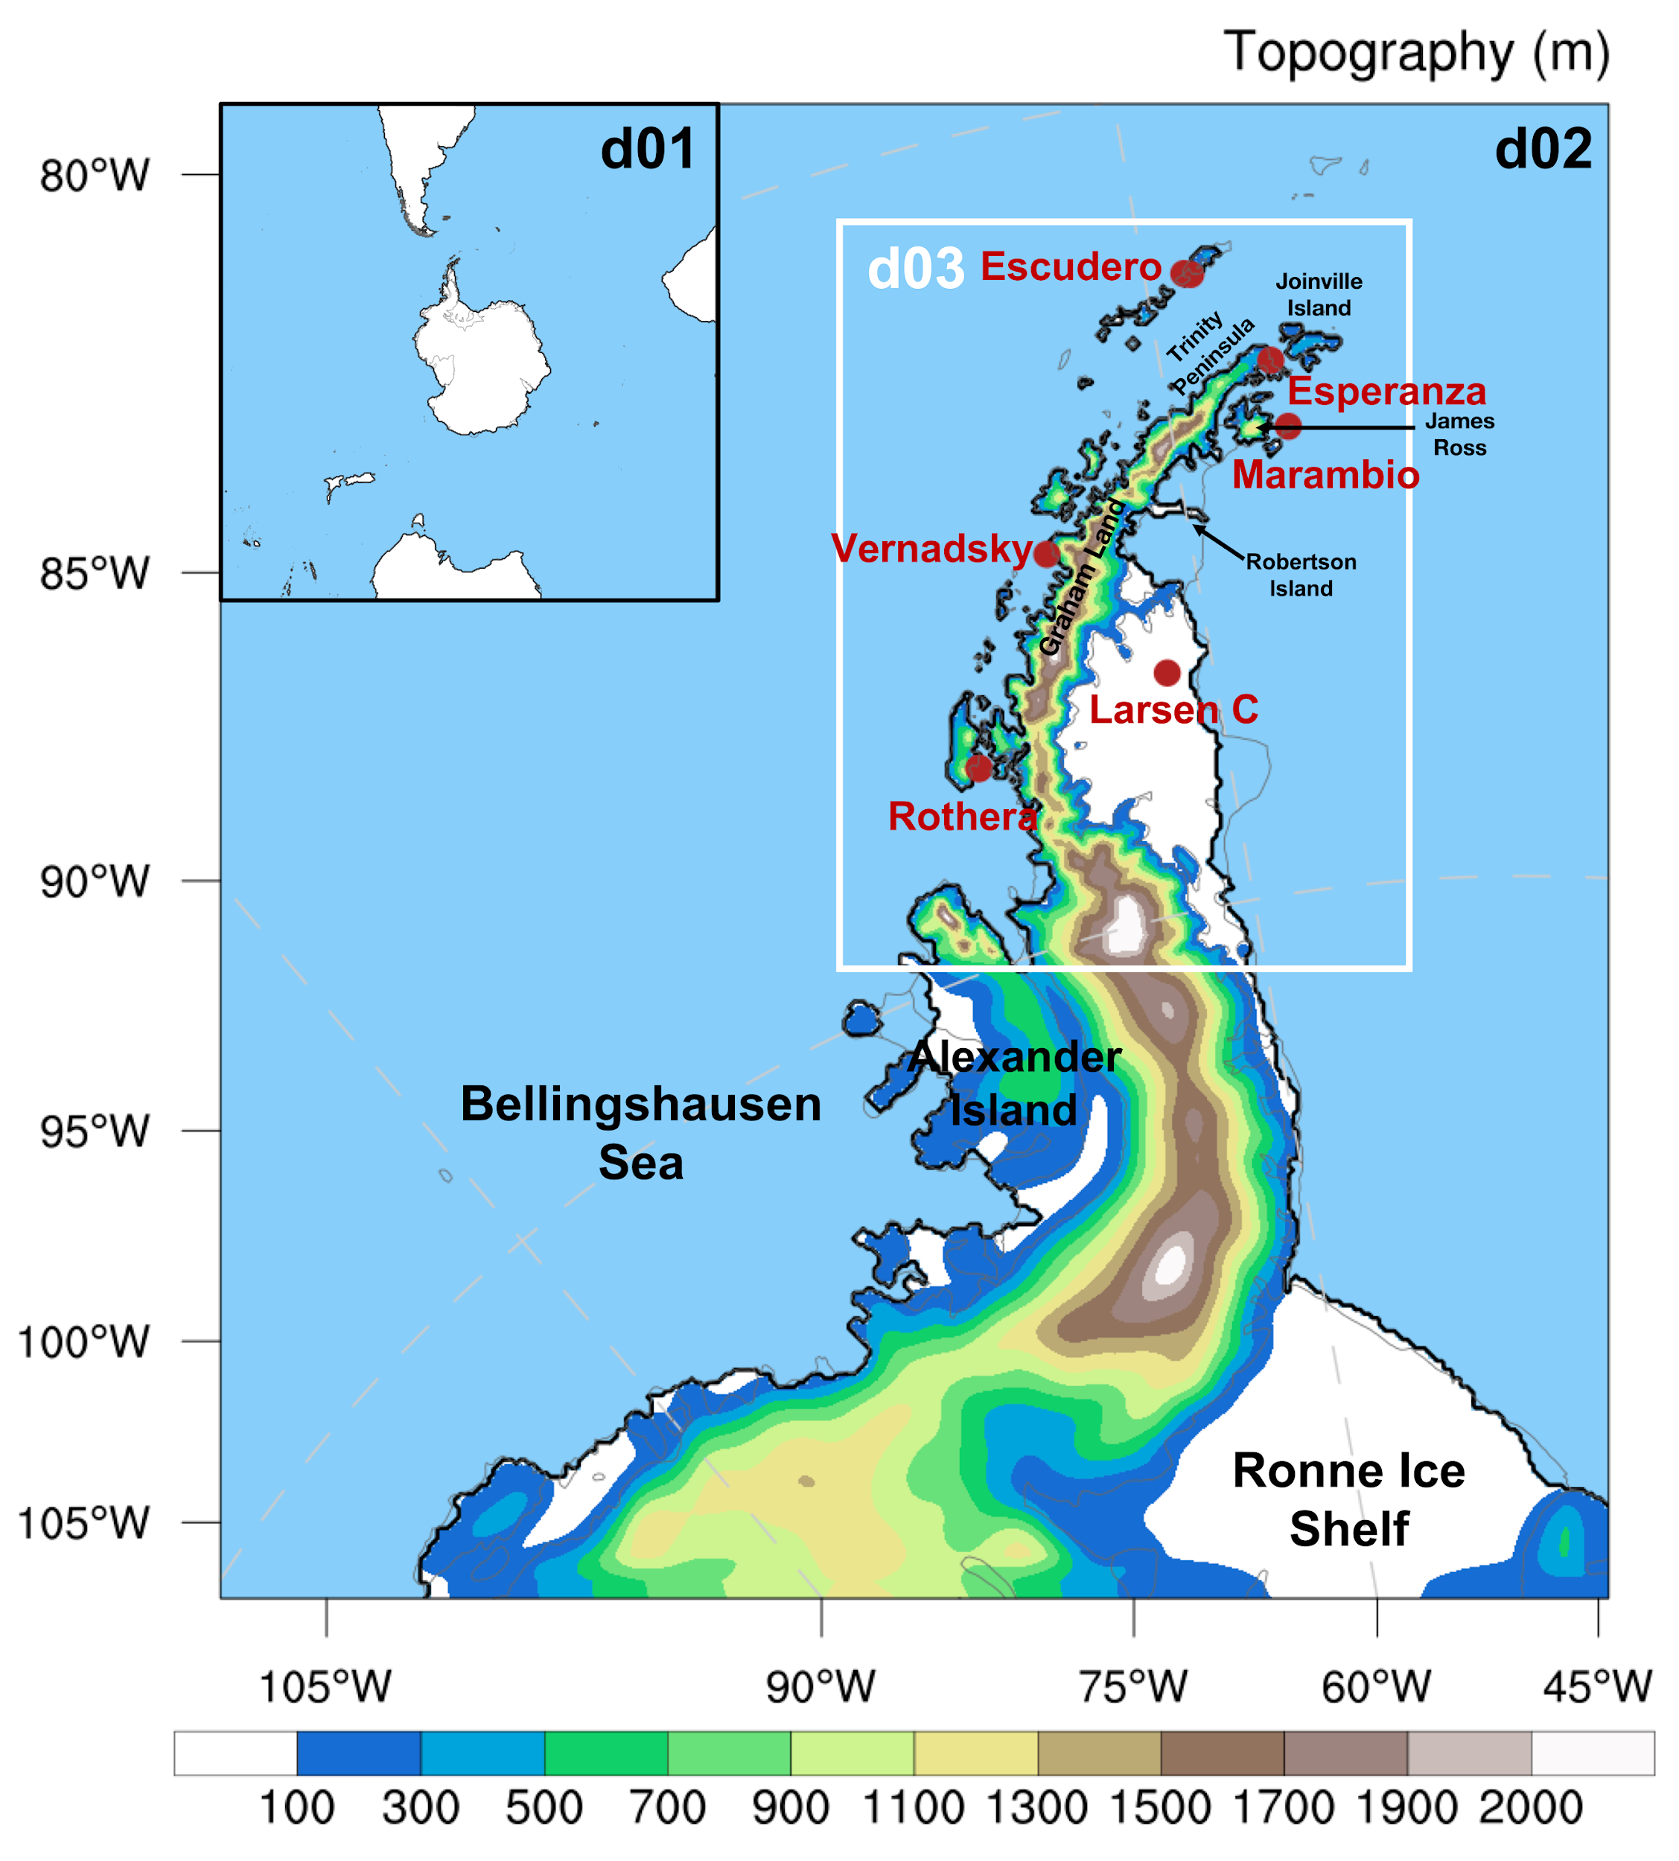
Polar WRF Setting
 | PWRF V4.3.3
Input Data | ECMWF Reanalysis Data (ERA5)
Horizontal Resolution | 30 km / 6 km / 1.2km
Vertical levels | 71 levels (lowest level 4m above the surface)
Temporal Resolution | hourly
Spin-up | 24 h
Microphysics | P3
PBL Scheme | MYNN
Shortwave and Longwave | Both RRTMG
Land Surface Options | Noah MP
Surface Layer Options | MYNN
Surface Albedo | MODIS (MCD43C3, Schaaf and Wang 2021)
High-Res Topo | REMA 1km topo (Gerber and Lehning, 2020, Howat et al., 2019)
Nudging | Every 6 hours; nudging to u, v wind, temperature and water vapor from ERA5 for model level 40 (~ 400 hPa) and above.
(Zou et al. 2023)

Slide 5
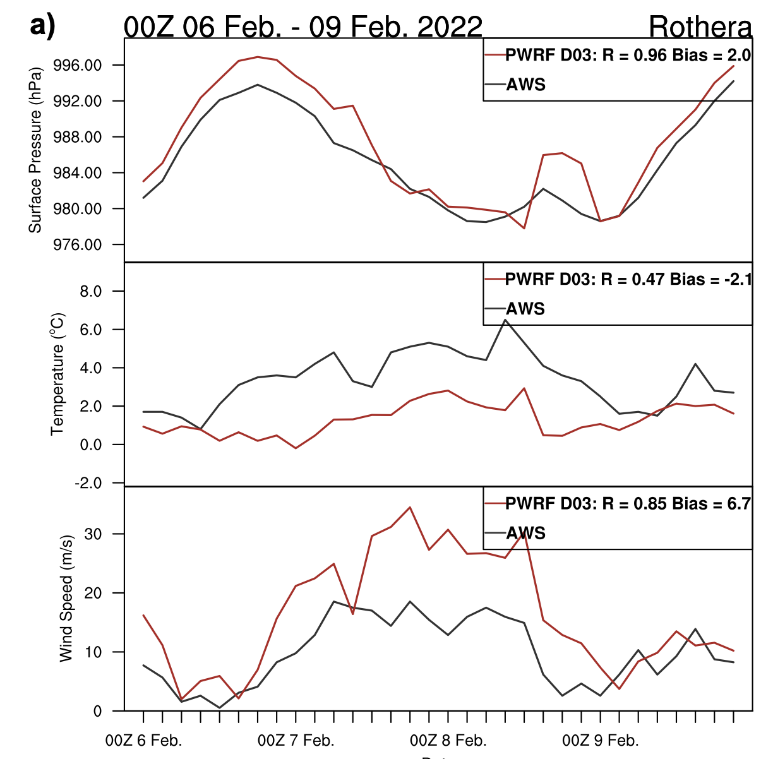
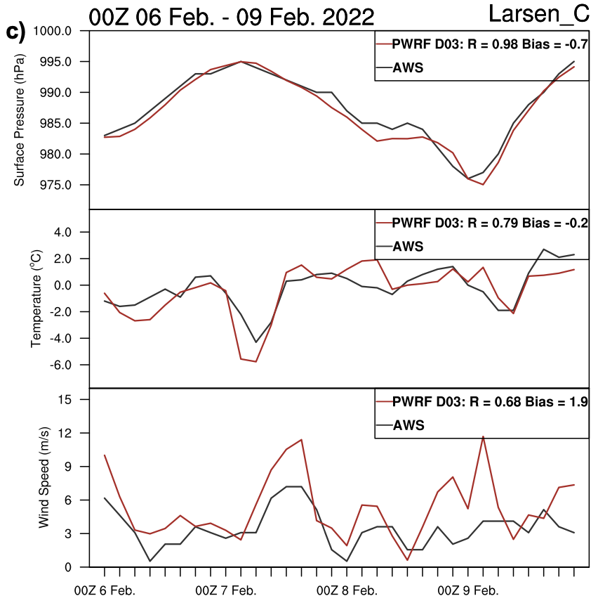
Brief Evaluation
Upwind side.
PWRF overestimates the barrier jet
Leeside
PWRF performs better
PWRF Bias
Rothera
Wind speed: 6.7m/s
Temperature: -2 ºC (during foehn)
Larsen C
Wind speed: 1.9 m/s
Temperature: -0.2 ºC.
The horizontal resolution of PWRF domain 3 (1.2km) might still not be high enough to describe the complicate topography on the upwind side of the Antarctica Peninsula (AP).
AWS data provided by AMRDC
Notes:
Pressure, temperature, wind speed
PWRF-red, station-black

Slide 6
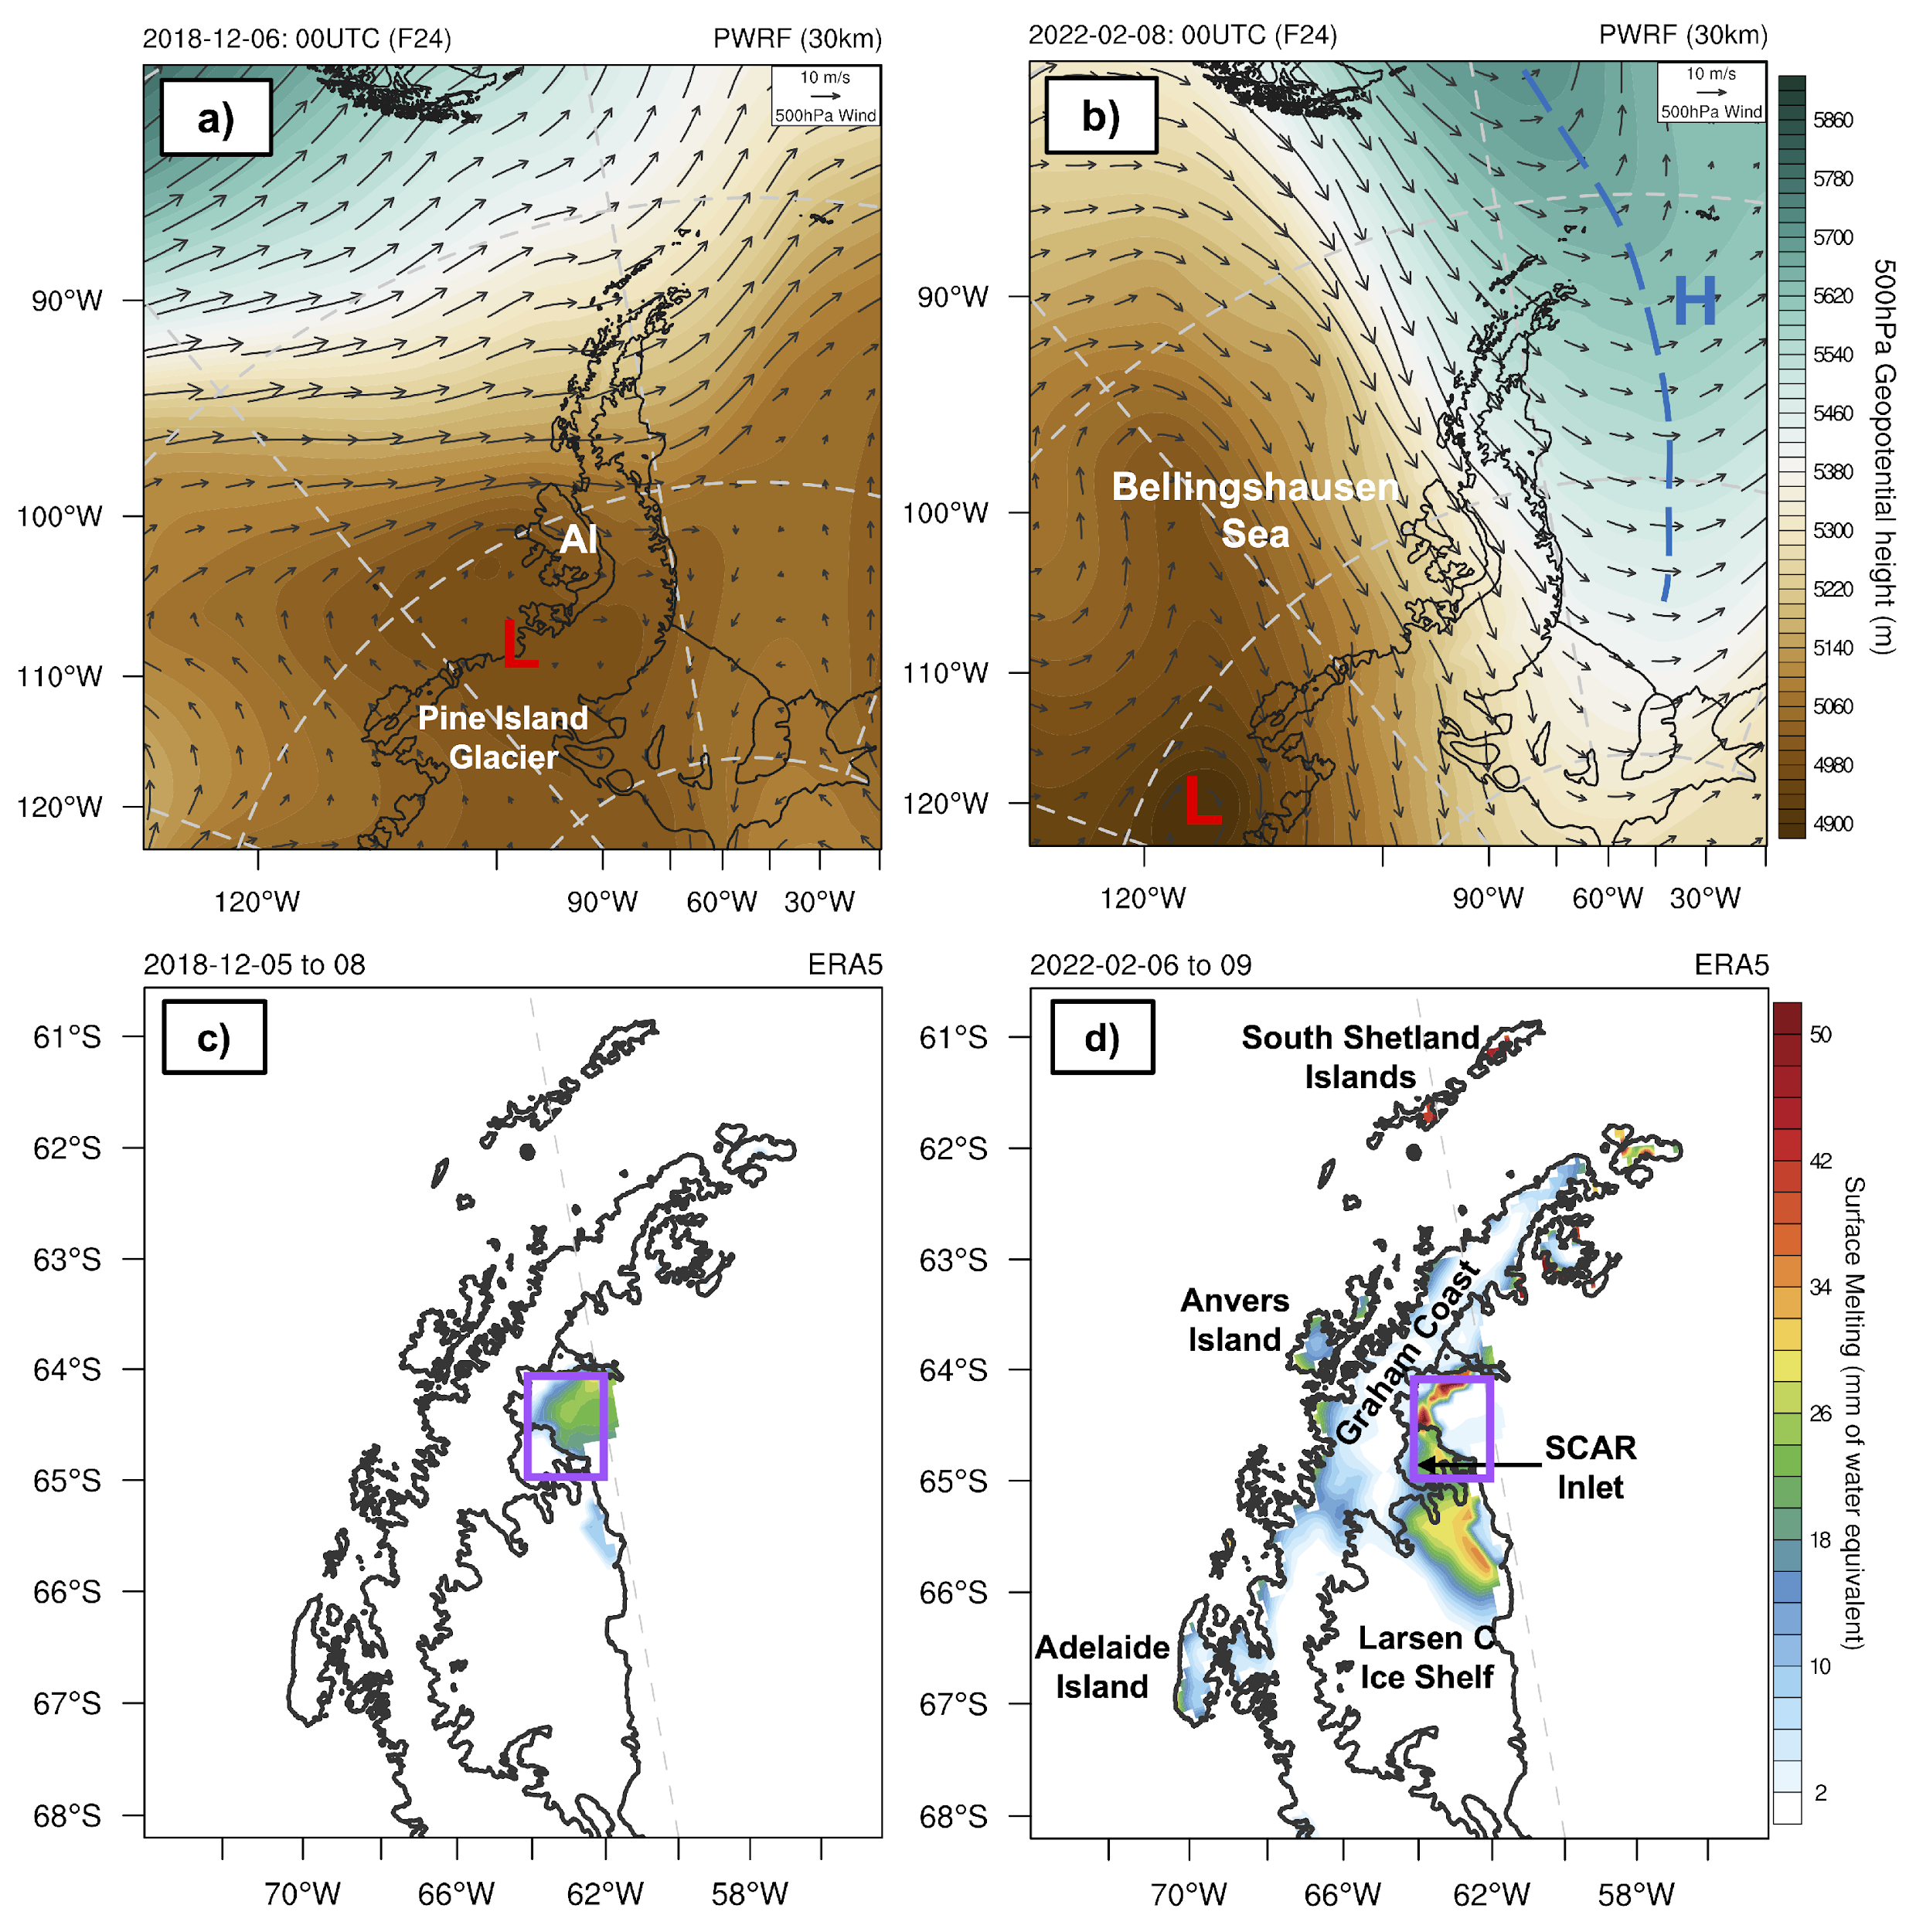
2018 & 2022 Melt Events
2018 Case
First low developed over the Pine Island Glacier
Secondary low developed over the Weddell Sea.
Two lows cover the entire AP region -> Marine air advection only affects the north tip for 1 day.
Moderate melting on the leeside
2022 Case
First low at coastal Pine Island Glacier
Second low moving from Bellingshausen Sea towards Alexander Island.
Blocking-high developed over the Weddell Sea.
This pattern leads to continuous, warm air advection towards the AP region for almost 3 days.
Strong Melting on both sides.

Slide 7
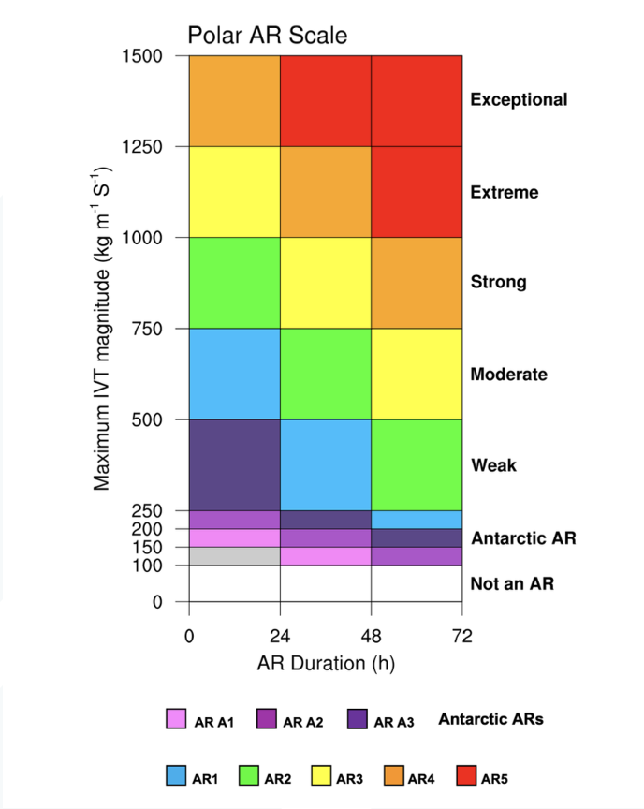
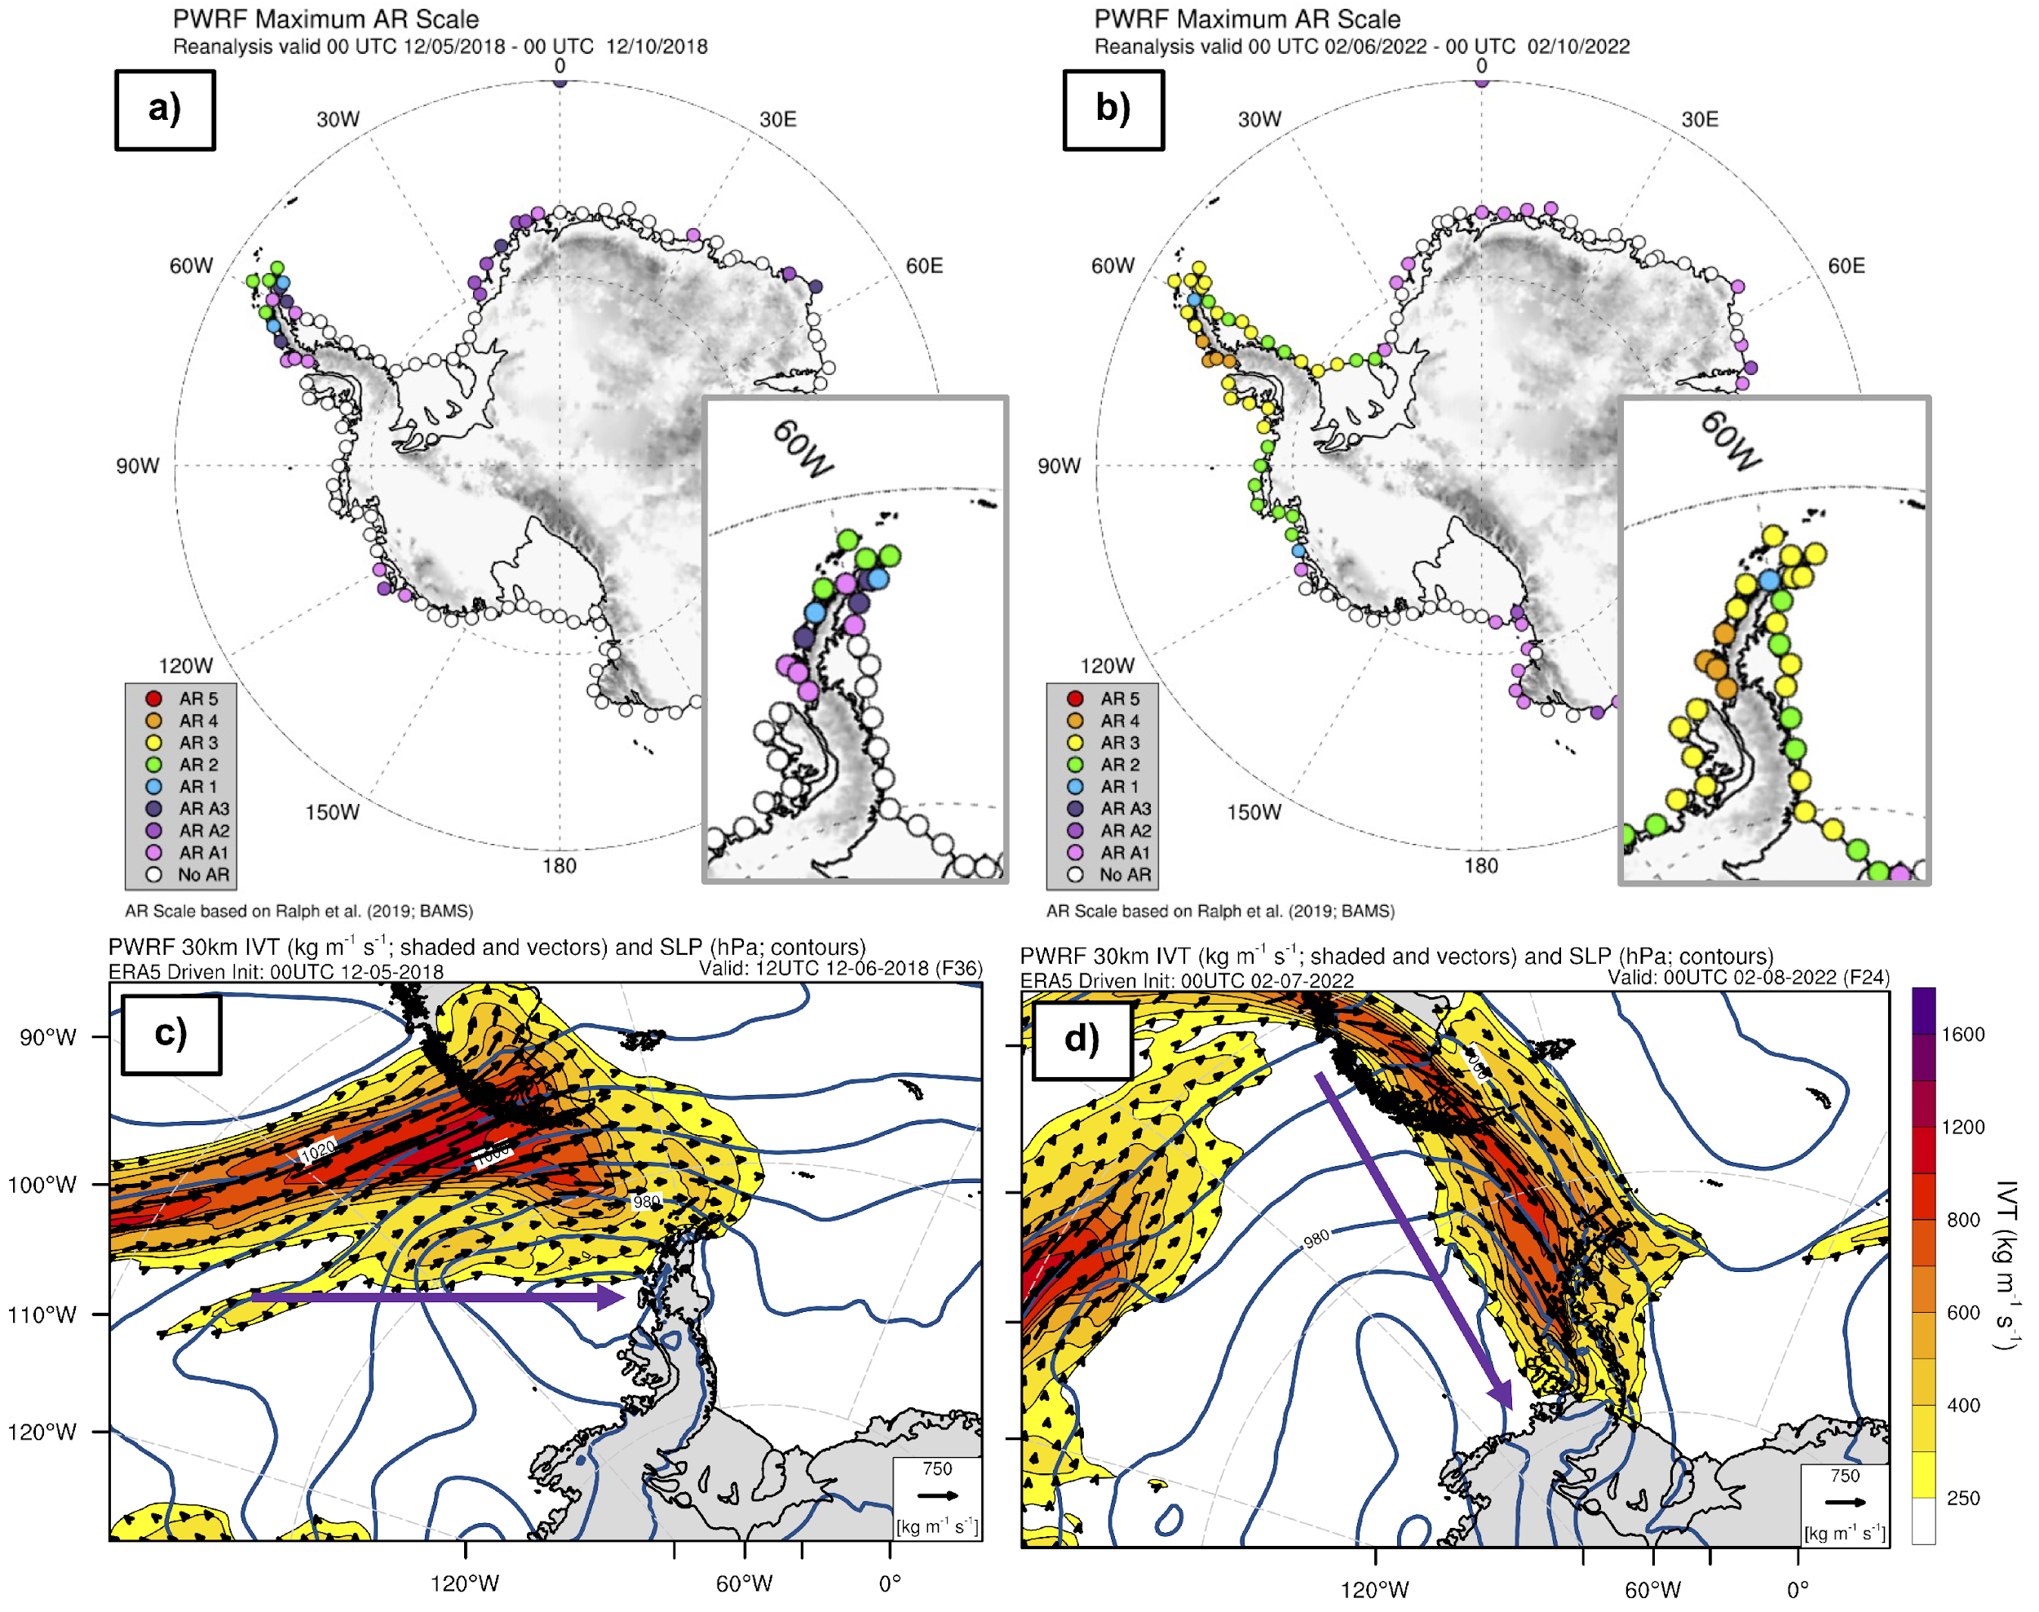
Atmospheric Rivers & Foehn Warming
For both cases, the AP region experienced moderate/strong AR impact.
2018 | 2022
Max AR2 | Max AR3 (PWRF – AR3/4)
1 day | 3 days
Upwind side of the northern tip of the AP | Entire AP region, coastal Pine Island Glacier and Ronne Ice Shelf.
AR hits the AP via southwesterly wind | AR hits the AP via northwesterly wind
(Zhang et al. 2023)

Slide 8
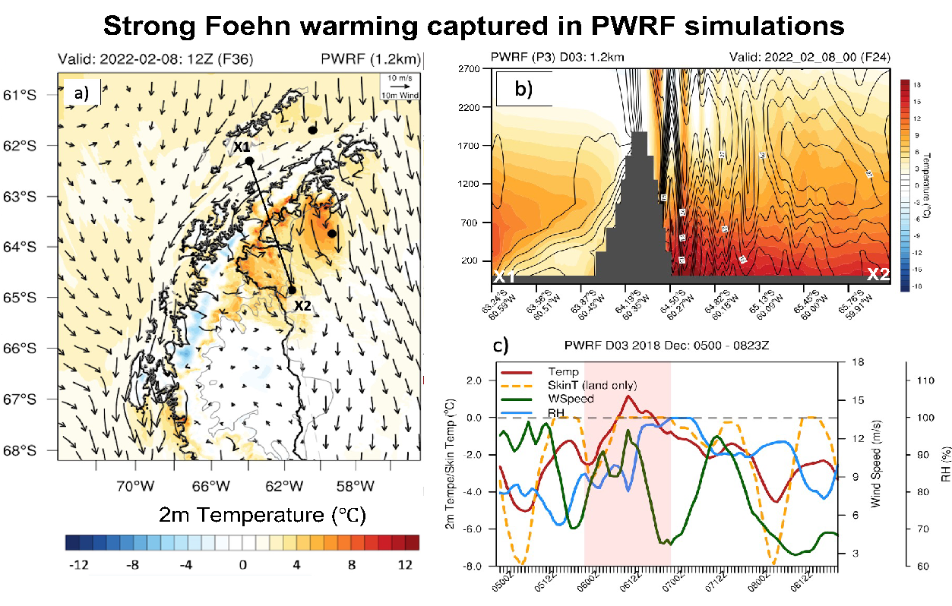
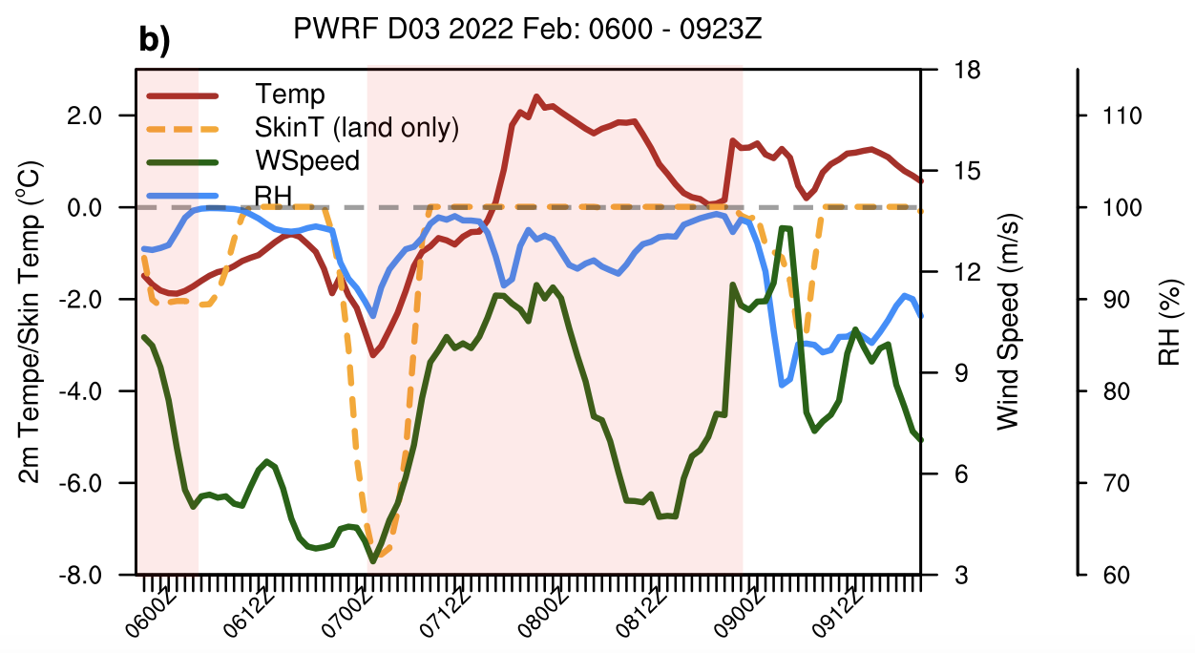
Atmospheric Rivers & Foehn Warming
Two foehn warming spots on the leeside:
Over the Larsen B embayment
Leeside of James Ross Island
Warming belt along the mountain base
Relatively cooler gap close to Robertson Island (foehn jet).
Temperature inversion on the upwind side with warm core ~500m above the surface.
Barrier jet near the base of upwind side.
Strong mountain waves on the leeside
Over the Larsen B (Purple box) – 00Z 7 to 00Z 8 February – within 24h
2m temperature ↑ >5°C
10m wind speed ↑ ~6m s⁻¹
2m RH ↓ 20% after the peak of AR/foehn impact.
Strong foehn warming captured in PWRF simulations
c)

Slide 9
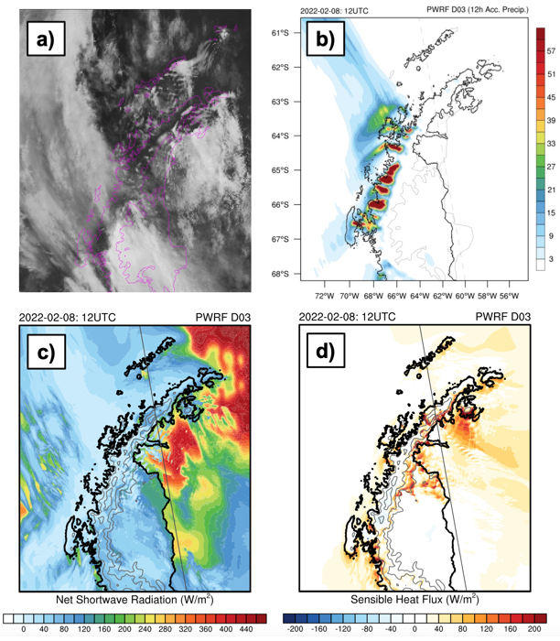
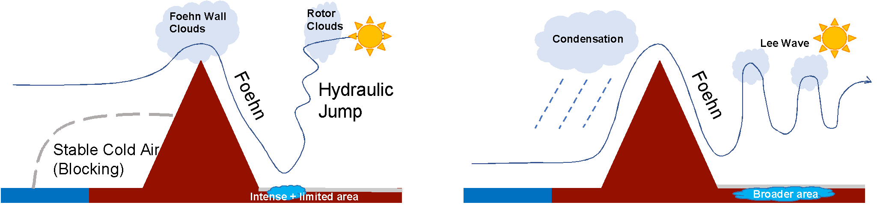
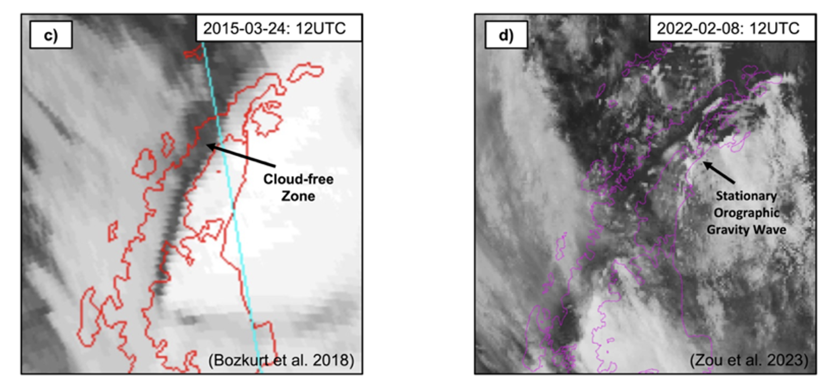
Atmospheric Rivers & Foehn Warming – Deep Foehn
Why AR matters to foehn warming ?
Shallow foehn | Deep foehn
Relative weak upcoming wind Stably stratified atmosphere Low-level blocking | Strong upcoming wind Weakly stratified atmosphere
Hydraulic jump → Immediate temperature increase Intense turbulence→ Strong SHF Cloud-free zone → Intense SWD Surface warming over limited region | Stationary mountain waves Strong upwind side precipitation SHF + SWD + LH release Surface warming/melting over a wider area
AR (LLJ & Moisture) – moisture content, IVT direction, duration & strength - All matters

Slide 10
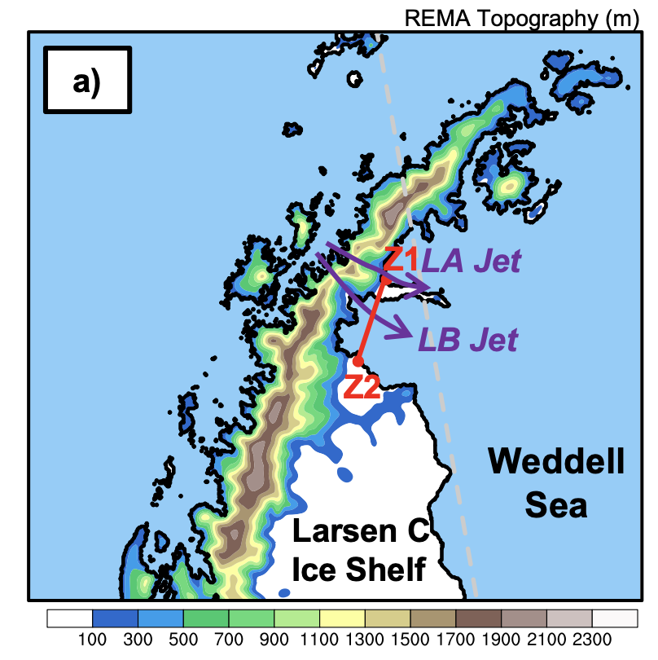
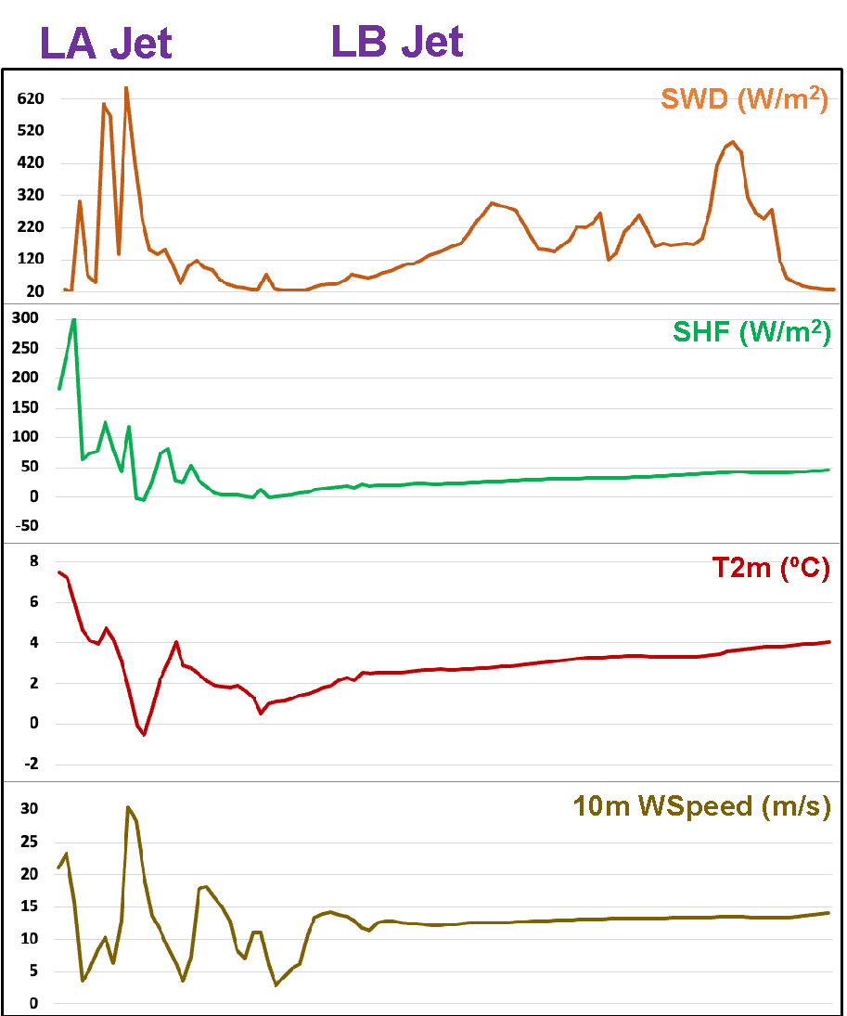
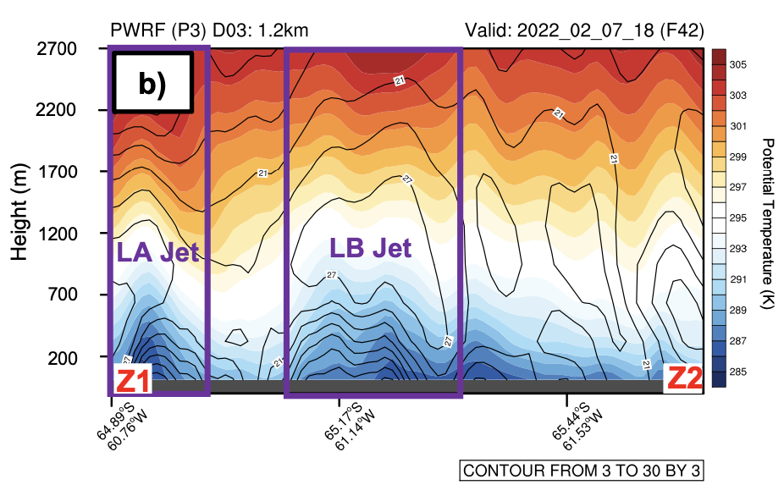
Atmospheric Rivers & Foehn Warming – Foehn Jets
c)
LA and LB jet first discovered in Laffin et al. (2022).
Both jets reduce temperatures and the impacts from SW_{net} via extra moisture input from AR.
LA jet brings SHF.
Both jets accelerate the ice shelf disintegration via pushing ice to the ocean.
The occurrence of AR and complicated local topography introduce more uncertainties to foehn studies over the AP.
Z1
Z2

Slide 11
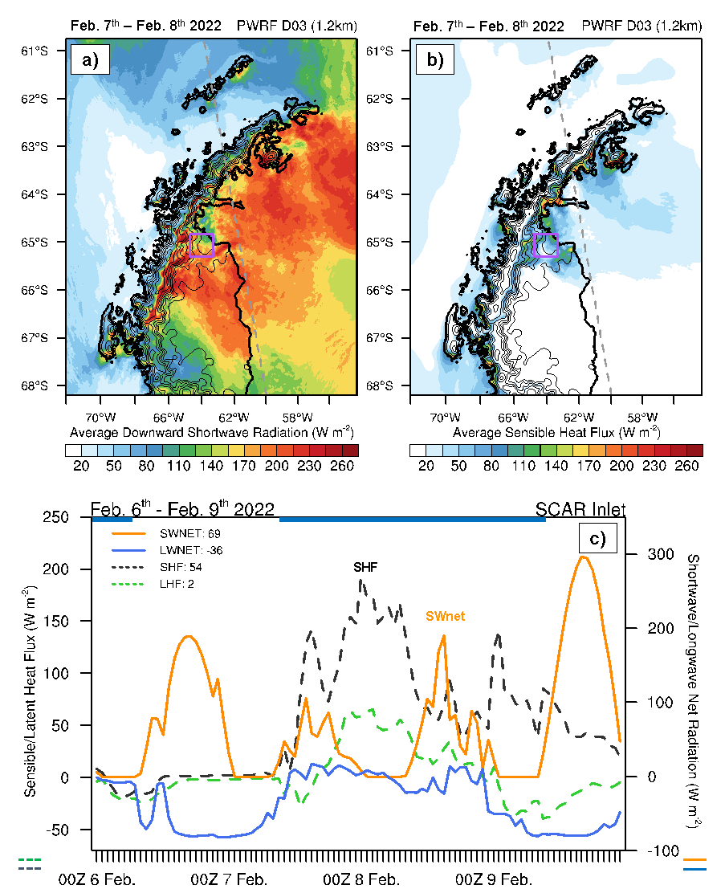
Atmospheric Rivers & Foehn Warming – SEB
Leeside:
Over most of the ice surface on the leeside: SW_{net} is the major contributor to the surface warming (Daytime).
The dominant contribution of SW_{net} after the foehn event mainly comes from stronger SWD (clear skies).
The mountain base or areas strongly affected by the cloud formation (AR): SHF has an equal impact as SW_{net} (both ~140 Wm⁻²).
SCAR Inlet:
SW_{net} (Avg. 69 Wm⁻²) ~1.3 times as much as the SHF (Avg. 54 Wm⁻²) from 00Z 6 to 23Z 9 February.
SHF maximum occurs on 03Z 8 February (~foehn peak).

Slide 12
Summary & Future Work
Summary
A combined impact from AR and foehn during both 2018 and 2022 cases.
In 2022 case, blocking high → Northwesterly AR3 over the AP (~3 days).
The persistent impact of the AR led to strong foehn warming → 5 °C ↑ in 2m temperature within 24 hours.
The 2022 deep foehn case has strong stationary orographic gravity waves on the leeside, which also features foehn jets.
Overall, shortwave radiation contributed the most to the ice surface warming, followed by sensible heat flux.
Ongoing
1. Categorize all historical AR cases based on Polar AR Scale.
2. Divide cases into different groups based on AR scale, IVT direction, etc.
3. Investigate the drivers and their impacts, as well as the relationship between AR & foehn.
(Gorodetskaya et al. 2023; Zou et al. 2023)

Slide 13
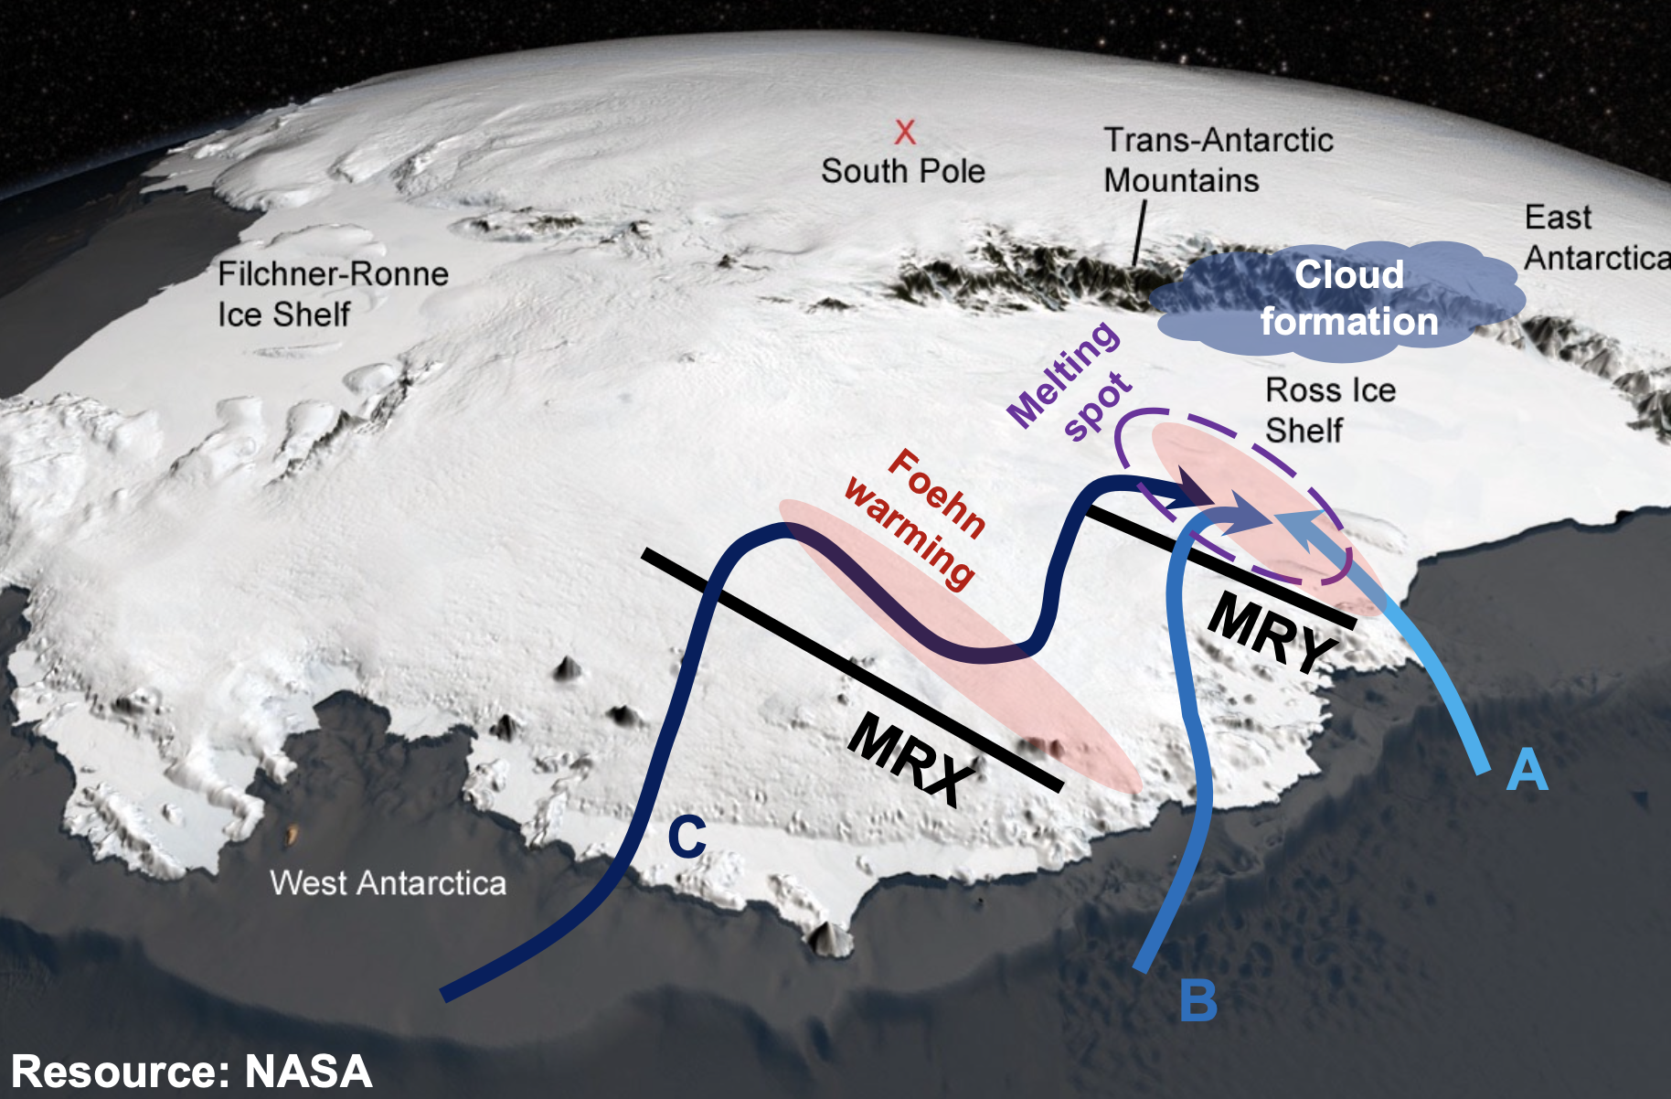
Summary & Future Work
What about West Antarctica?
MERRA-2 datasets and ERA5 reanalysis data both indicate a positive trend of AR events over coastal west Antarctica (e.g., Maclennan et al. 2023).
Coastal West Antarctic ice shelves have experienced increased basal melting and widespread grounding line retreat (Rignot et al. 2014; Alley et al. 2021; Milillo et al. 2022; Wild et al. 2022; Tinto et al. 2019).
In the context of both oceanic and atmospheric forcing, West Antarctica may become the next “hot spot” for rapid ice loss following the AP.
More complicated case?

Slide 14


Slide 15
References
Adusumilli, S., M. A. Fish, H. A. Fricker, and B. Medley, 2021: Atmospheric River Precipitation Contributed to Rapid Increases in Surface Height of the West Antarctic Ice Sheet in 2019. Geophys. Res. Lett., 48, e2020GL091076, https://doi.org/10.1029/2020GL091076.
Bozkurt, D., R. Rondanelli, J. C. Marín, and R. Garreaud, 2018: Foehn Event Triggered by an Atmospheric River Underlies Record-Setting Temperature Along Continental Antarctica. J. Geophys. Res. Atmos., 123, 3871–3892, https://doi.org/10.1002/2017JD027796.
Djoumna, G., and D. M. Holland, 2021: Atmospheric Rivers, Warm Air Intrusions, and Surface Radiation Balance in the Amundsen Sea Embayment. J. Geophys. Res. Atmos., 126, e2020JD034119, https://doi.org/10.1029/2020JD034119.
Howat, I. M., C. Porter, B. E. Smith, M.-J. Noh, and P. Morin, 2019: The Reference Elevation Model of Antarctica. Cryosphere, 13, 665–674, https://doi.org/10.5194/tc-13-665-2019.
Gerber, Franziska; Lehning, Michael (2020). REMA topography and AntarcticaLC2000 for WRF. EnviDat. [Dataset]. https://doi.org/10.16904/envidat.190.
Turner, J., H. Lu, J. C. King, S. Carpentier, M. Lazzara, T. Phillips, and J. Wille, 2022: An Extreme High Temperature Event in Coastal East Antarctica Associated with an Atmospheric River and Record Summer Downslope Winds. Geophys. Res. Lett., 49, e2021GL097108, https://doi.org/10.1029/2021GL097108.
Gorodetskaya, I. V., M. Tsukernik, K. Claes, M. F. Ralph, W. D. Neff, and N. P. M. Van Lipzig, 2014: The role of atmospheric rivers in anomalous snow accumulation in East Antarctica. Geophys. Res. Lett., 41, 6199–6206, https://doi.org/10.1002/2014GL060881.
Gorodetskaya, I. V., and Coauthors, 2023: Compound drivers behind new record high temperatures and surface melt at the Antarctic Peninsula in February 2022. NPJ Clim. Atmos. Sci. https://doi.org/10.21203/rs.3.rs-2544063/v1. In review.
Maclennan, M. L., and Coauthors, 2023: Climatology and Surface Impacts of Atmospheric Rivers on West Antarctica. Cryosphere, 17, 865–881, https://doi.org/10.5194/tc-17-865-2023.

Slide 16
Milillo, P., E. Rignot, P. Rizzoli, B. Scheuchl, J. Mouginot, J. L. Bueso-Bello, P. Prats-Iraola, and L. Dini, 2022: Rapid glacier retreat rates observed in West Antarctica. Nat. Geosci., 15, 48–53, https://doi.org/10.1038/s41561-021-00877-z.
Rignot, E., J. Mouginot, M. Morlighem, H. Seroussi, and B. Scheuchl, 2014: Widespread, rapid grounding line retreat of Pine Island, Thwaites, Smith, and Kohler glaciers, West Antarctica, from 1992 to 2011. Geophys. Res. Lett., 41, 3502–3509, https://doi.org/10.1002/2014GL060140.
Schaaf, C., Wang, Z. (2021). MODIS/Terra+Aqua BRDF/Albedo Albedo Daily L3 Global 0.05Deg CMG V061 [Data set]. NASA EOSDIS Land Processes DAAC. Accessed 2023-05-31 from https://doi.org/10.5067/MODIS/MCD43C3.061
Tinto, K. J., and Coauthors, 2019: Ross Ice Shelf response to climate driven by the tectonic imprint on seafloor bathymetry. Nat. Geosci., 12, 441–449, https://doi.org/10.1038/s41561-019-0370-2.
Wild, C. T., K. E. Alley, A. Muto, M. Truffer, T. A. Scambos, and E. C. Pettit, 2022: Weakening of the pinning point buttressing Thwaites Glacier, West Antarctica. Cryosphere, 16, 397–417, https://doi.org/10.5194/tc-16-397-2022.
Wille, J. D., and Coauthors, 2022: Intense atmospheric rivers can weaken ice shelf stability at the Antarctic Peninsula. Commun. Earth. Environ., 3, 1–14, https://doi.org/10.1038/s43247-022-00422-9.
Wille, J. D., and Coauthors, 2023: The extraordinary March 2022 East Antarctica “heat” wave. Part I: observations and meteorological drivers. J. Clim. In review.
Wille, J. D., and Coauthors, 2023: The extraordinary March 2022 East Antarctica “heat” wave. Part II: impacts on the Antarctic ice sheet. J. Clim. In review.
Zou, Xun and Coauthors, 2023: Strong Warming over the Antarctic Peninsula during Combined Atmospheric River and Foehn Events: Contribution of Shortwave Radiation and Turbulence. J. Geophys. Res. Atmos. https://doi.org/10.1002/essoar.10512808.1. In review.

Slide 17
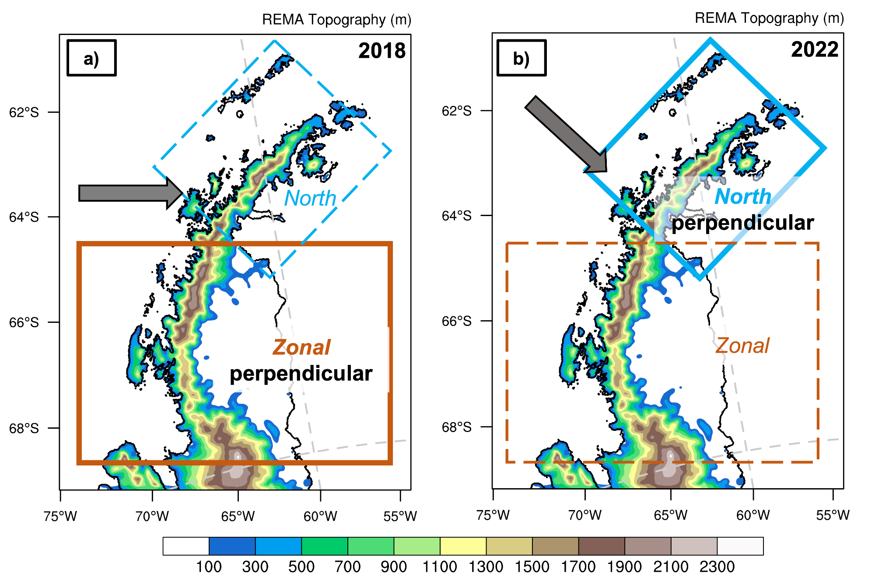
IVT Direction

