Slide 1


Toward an
Antarctic Radiation
Regional Network
(ARRN)
Claudia Frangipani^{1,2}, Angelo Lupi², Giulio Verazzo², Vito Vitale², Piero Di Carlo¹, Thomas Bracegirdle³, Ilana Wainer⁴
¹University G. D'Annunzio of Chieti - Pescara, Chieti, Italy
²Institute of Polar Science - CNR, Bologna, Italy
³British Antarctic Survey, Cambridge, UK
⁴University of Sao Paulo, Sao Paulo, Brazil

Slide 2
why surface radiation in Antarctica? as you all know…
“uncertainties remain in regional surface energy budget estimates as well as their representation in climate models” (IPCC 2021, Physical Science Basis) and is especially true when it comes to Antarctica due to its most challenging environment. Remote sensing data also need confirmation from comparison with surface measurements.
The radiation balance controls the evolution of surface temperature and fluxes of sensible and latent heat, affecting ice mass balance, atmospheric and oceanic dynamics and processes.
The different feedback mechanisms involving snow/ice surface and clouds make surface radiation measurements a probe to monitor climate variations.
Therefore to characterise the above processes the target measurements are:
radiation components
albedo/surface reflectance
clouds/cloud cover

Slide 3
and why a network?
achieve good regional representation so to make measurements useful for climate models and detect climate trends;
observation harmonisation/optimisation in order to implement the best practises and to obtain the most suitable data representing the Antarctic region;
find solutions to common issues profiting from experience and knowledge
https://bsrn.awi.de/nc/stations/maps/
Cox et al. (2021)

Slide 4
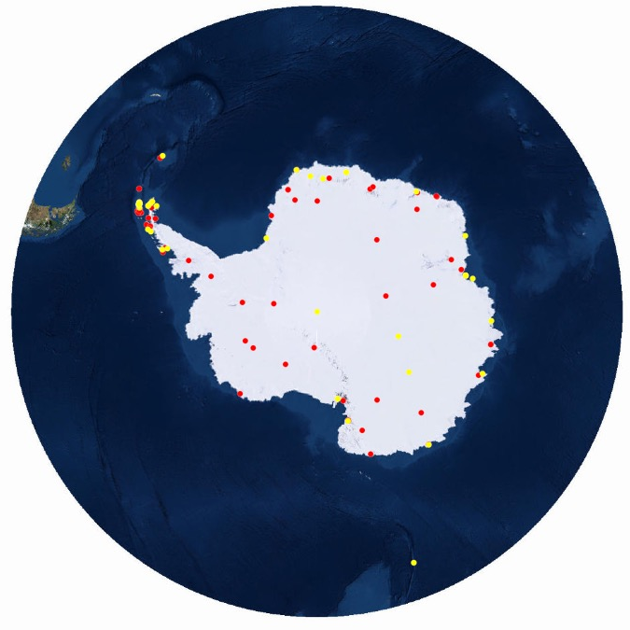
present infrastracture: potentiality for the network
manned stations
seasonal station
year around station
https://amrc.ssec.wisc.edu/aws/
https://www.comnap.aq/antarctic-facilities-information

Slide 5
present status: observations
what we know
Mawson
Dumont D’Urville
pyranometer/pyrgeometer data
Summer 2015/2016
Aboa
Marambio
pyranometer, pyrgeometer data
since 2019
Professor Julio Escudero
pyranometer, pyrgeometer data
since 2016, not continuously
Davis
pyranometer/pyrgeometer data
November 2018 – November 2019
Rothera
McMurdo
seasonal campaigns only?
Zhongshan
Pyranometer data
Since 2008?
Sanae IV
JangBogo
pyranometer data since 2018
pyrgeometer since 2021
Johann Gregor Mendel
Vernadsky
Maitri
pyanometer data
Since?
Troll
AWS14 Larsen C North
pyranometer,pyrgeometer data
2009 – present, maybe?

Slide 6
present status: best practises in Antarctica
Baseline Surface Radiation Network
(https://bsrn.awi.de/)
designated as a Global Climate Observing System recognized network for global surface radiation measurements
essential and ancillary measurements (with instruments of the highest available accuracy and with high temporal resolution [1 to 3 minutes]):
  global shortwave radiation & UV b radiation & UV a radiation
  diffuse shortwave radiation & UV b radiation
  direct shortwave radiation & UV b radiation
  upward shortwave radiation & UV b radiation
  downward longwave radiation
  upward longwave radiation
  T, RH, P
  Total cloud amount, cloud base height, cloud liquid water
  + other measurements at different heights
specific quality controls tests

Slide 7
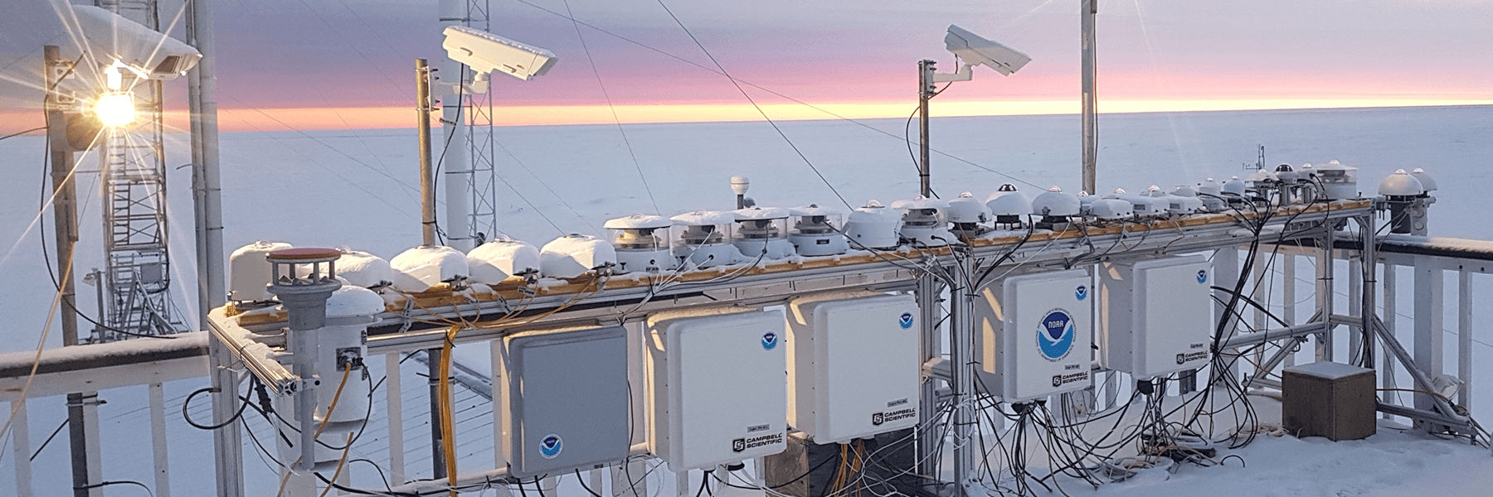
present status: operating challenges in harsh, cold environment
D-ICE instrumentation (credit: Bryan Thomas, NOAA)
https://psl.noaa.gov/news/2021/020221.html
Cold climate regimes give rise to adverse frost, riming, and snow, affecting both instrumentation and measurements.
Other problems can arise from using the instrumentation at much colder temperatures than usually manufactured for.
Schioppo et al. (2008)
Cox et al. (2021)

Slide 8








Data system
Connect and serve different partners from different scientific or society domains
by means of: subject areas; organization; digital systems
No “common solution/specification” imposition
Use of open standards
Interoperability
Common “high-level” entry point platform for discovering, accessing, providing common services

Slide 9
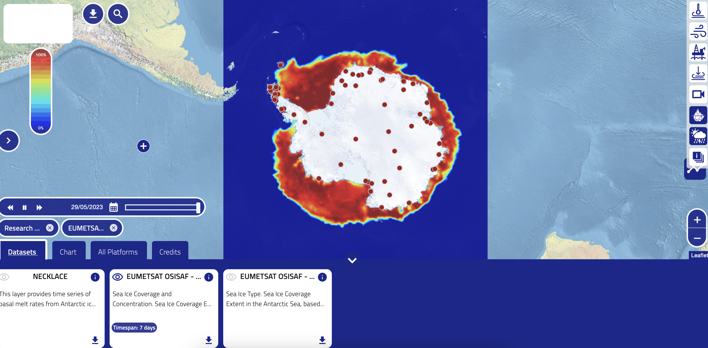
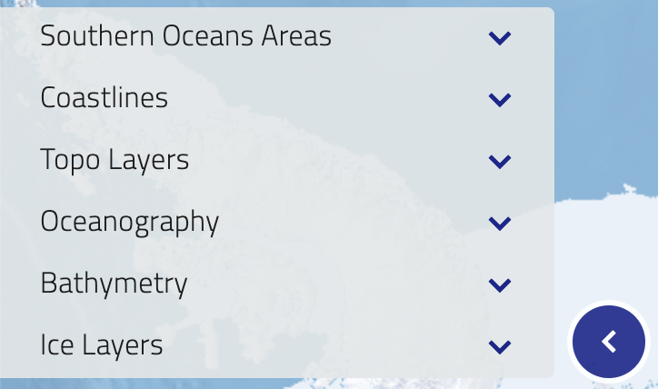
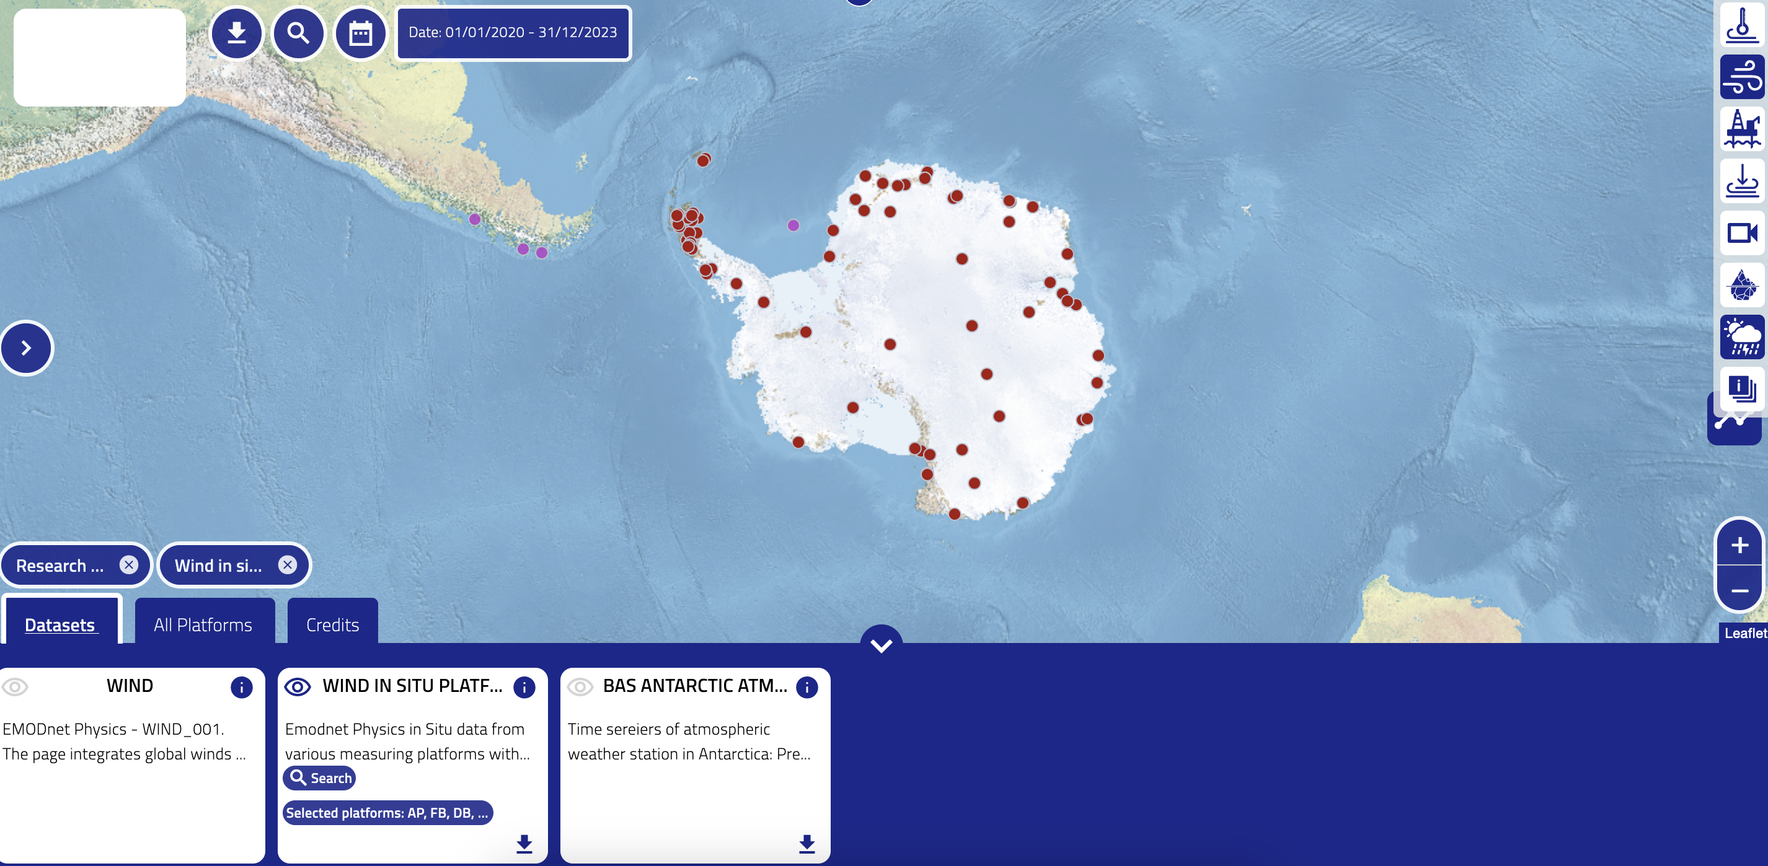
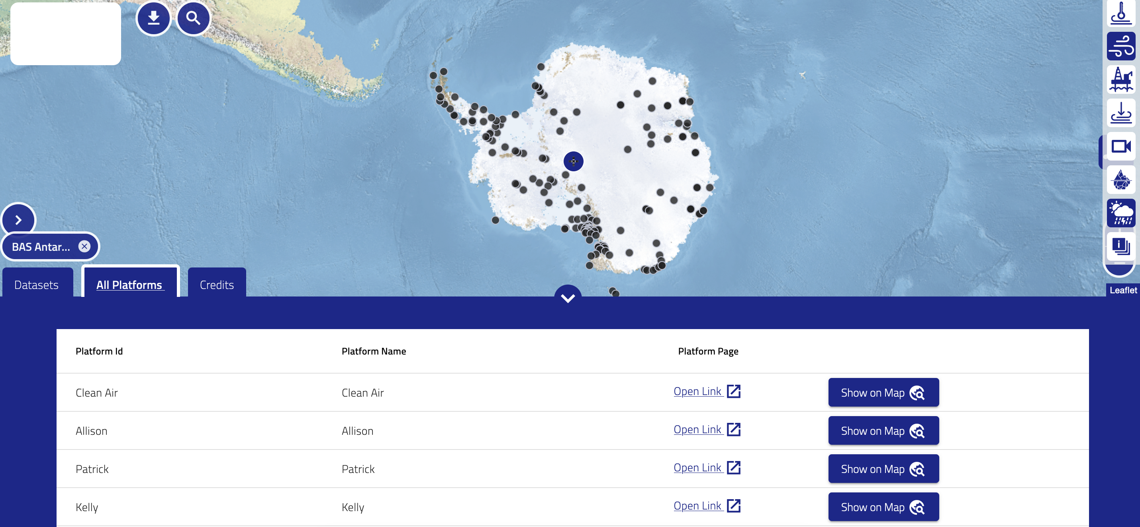
Antarctic Data Hub (https://map.sochic-h2020.eu/ADH/)

Slide 10
5– 7 July 2023, online workshop outline
5 July, session 1 “Climate models and climate indicators”
dedicated to discuss in which way observations can be used in connection with models and help improving our application capability, knowledge, system representation, aimed at assessing necessary inputs related to radiation budget for climate models (including ancillary information on cloudiness and surface characteristics)
Talks by Dr. Ohmura Atsumu, Dr. Yamanouchi Takashi
6 July, session 2 “Assessment of the state of observations in Antarctica”
all participants can present what is routinely performed, instruments, analysis and methodology, data management, historical data sets at disposal, faced challenges (of both instruments and methodology) and future plans.
7 July, session 3 “Moving toward an Antarctic Radiation Regional Network”
starting from the information collected in the previous days, the session is thought to discuss a possible strategy to lay the groundwork for a regional network, trying to transfer and optimally use BSRN best practices, identify one or more common methodologies and develop a possible common data management plan (DMP).
Talk by Dr. Christian Lanconelli

Slide 11
18 July 2023, (hybrid) meeting at IUGG 2023 Berlin
summarise online workshop outcomes:
information collected
next steps toward the creation of the network
align network with SCAR Scientific Research Programme (SRP) Near-term Variability and Prediction of the Antarctic Climate System (AntClim^{now}), in particular with Antarctic Climate Indicators (ACIs)
AntClim^{now}
  Theme 1. Antarctic climate variability and its linkages to the global climate system
  Theme 2. Understanding present-day climate trends in Antarctica
  Theme 3. Predictability of the Antarctic climate system
  Theme 4. Global and regional cross-disciplinary impacts
  Theme 5. Communication of results to stakeholders
…

Slide 12
thank you! if you are interested in the workshop you can write me for further information on how to attend (claudia.frangipani@unich.it) many thanks to the AntClim^{now} SCAR SRP for the support
References
Cox et al. (2021): “The De-Icing Comparison Experiment (D-ICE): a study of broadband radiometric measurements under icing conditions in the Arctic ”, Atmos. Meas. Tech., 14, 1205–1224, doi: 10.5194/amt-14-1205-2021
Schioppo et al.(2008): “Use of an 2AP Tracker in a Measuring Site over the Antarctic Plateau”, 10th BSRN Scientific Review and Workshop

