Slide 1
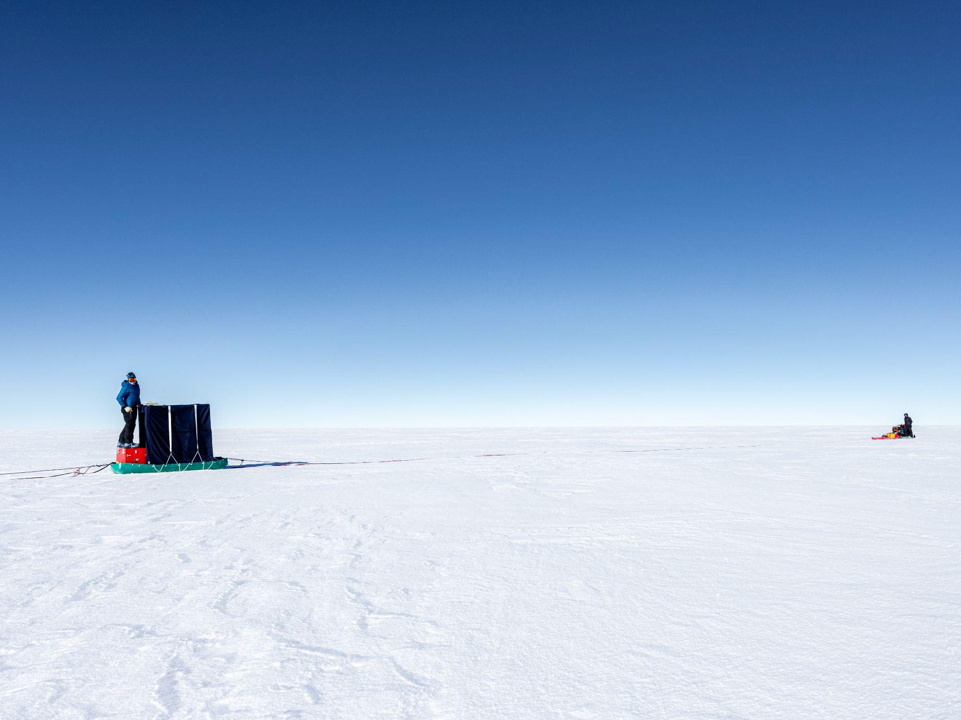





Understanding precipitation, accumulation and meteorology at Hercules Dome
David B. Reusch
University of Washington
dreusch@uw.edu
Matthew Lazzara and the AWS Team*
University of Wisconsin-Madison
and Madison Area Technical College
mattl@ssec.wisc.edu
The Hercules Dome Team
University of Washington and elsewhere!
Photo of 2022/23 field season from Ben Hills, UWashington
* Funded by award 1924730, Office of Polar Programs, National Science Foundation
18th Workshop on Antarctic Meteorology & Climatology, 6/1/23

Slide 2
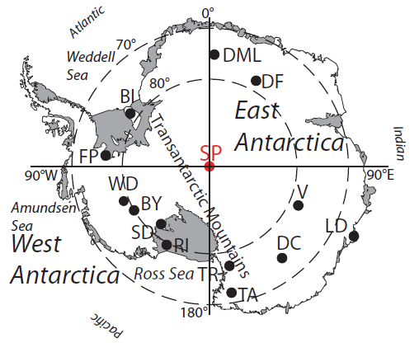
Where deep (to the bed) ice cores exist
We’re interested in Last Interglacial Ice (~130,000 years ago)

Slide 3
Where Last Interglacial Ice has been found

Slide 4
Hercules Dome retains deep ice during a WAIS collapse
86º S, 105º W
DeConto and Pollard, 2016, Nature

Slide 5
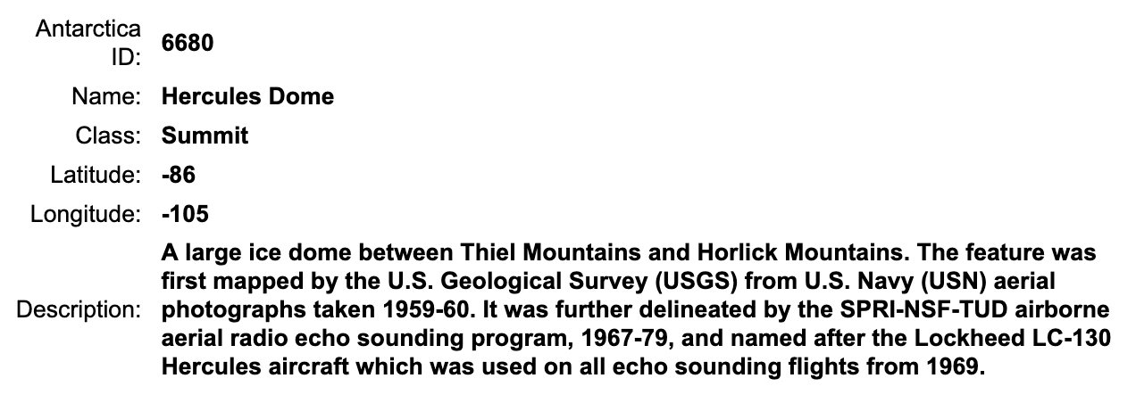
What’s in a name?
From the USGS Geographic Names Information System

Slide 6
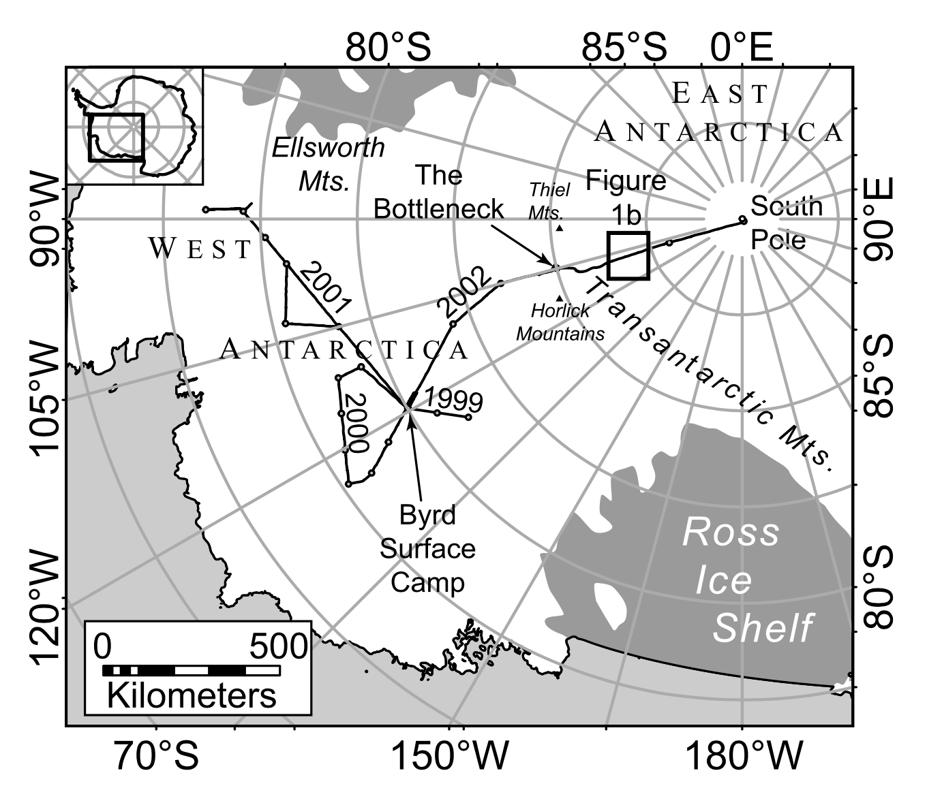
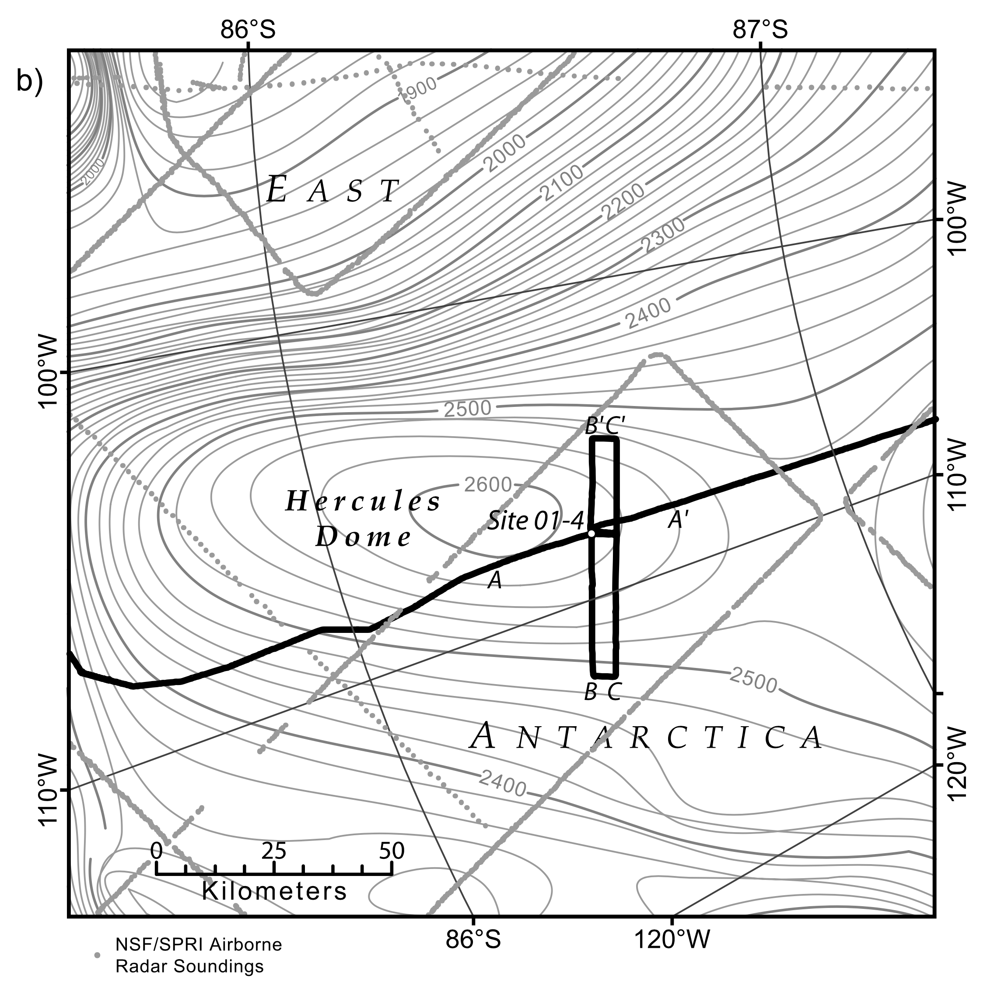
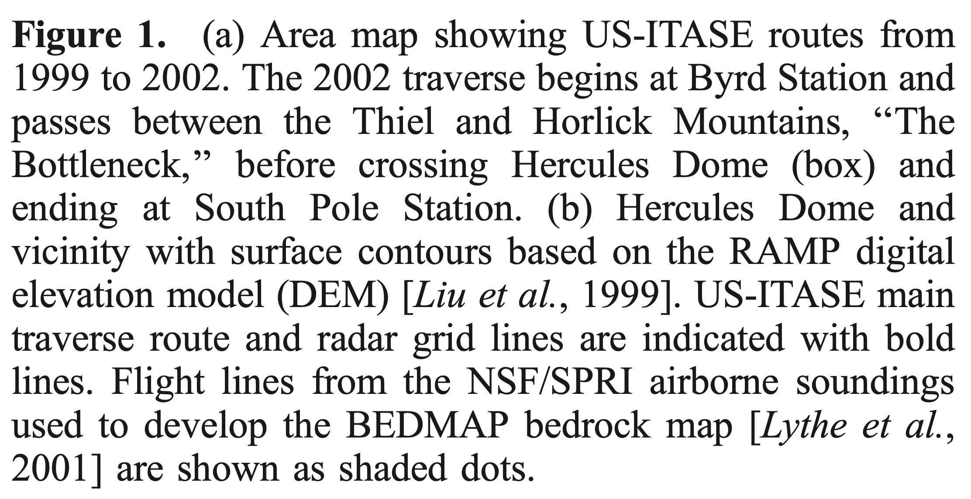
Hercules Dome in 2002
Jacobel et al 2005, JGR

Slide 7
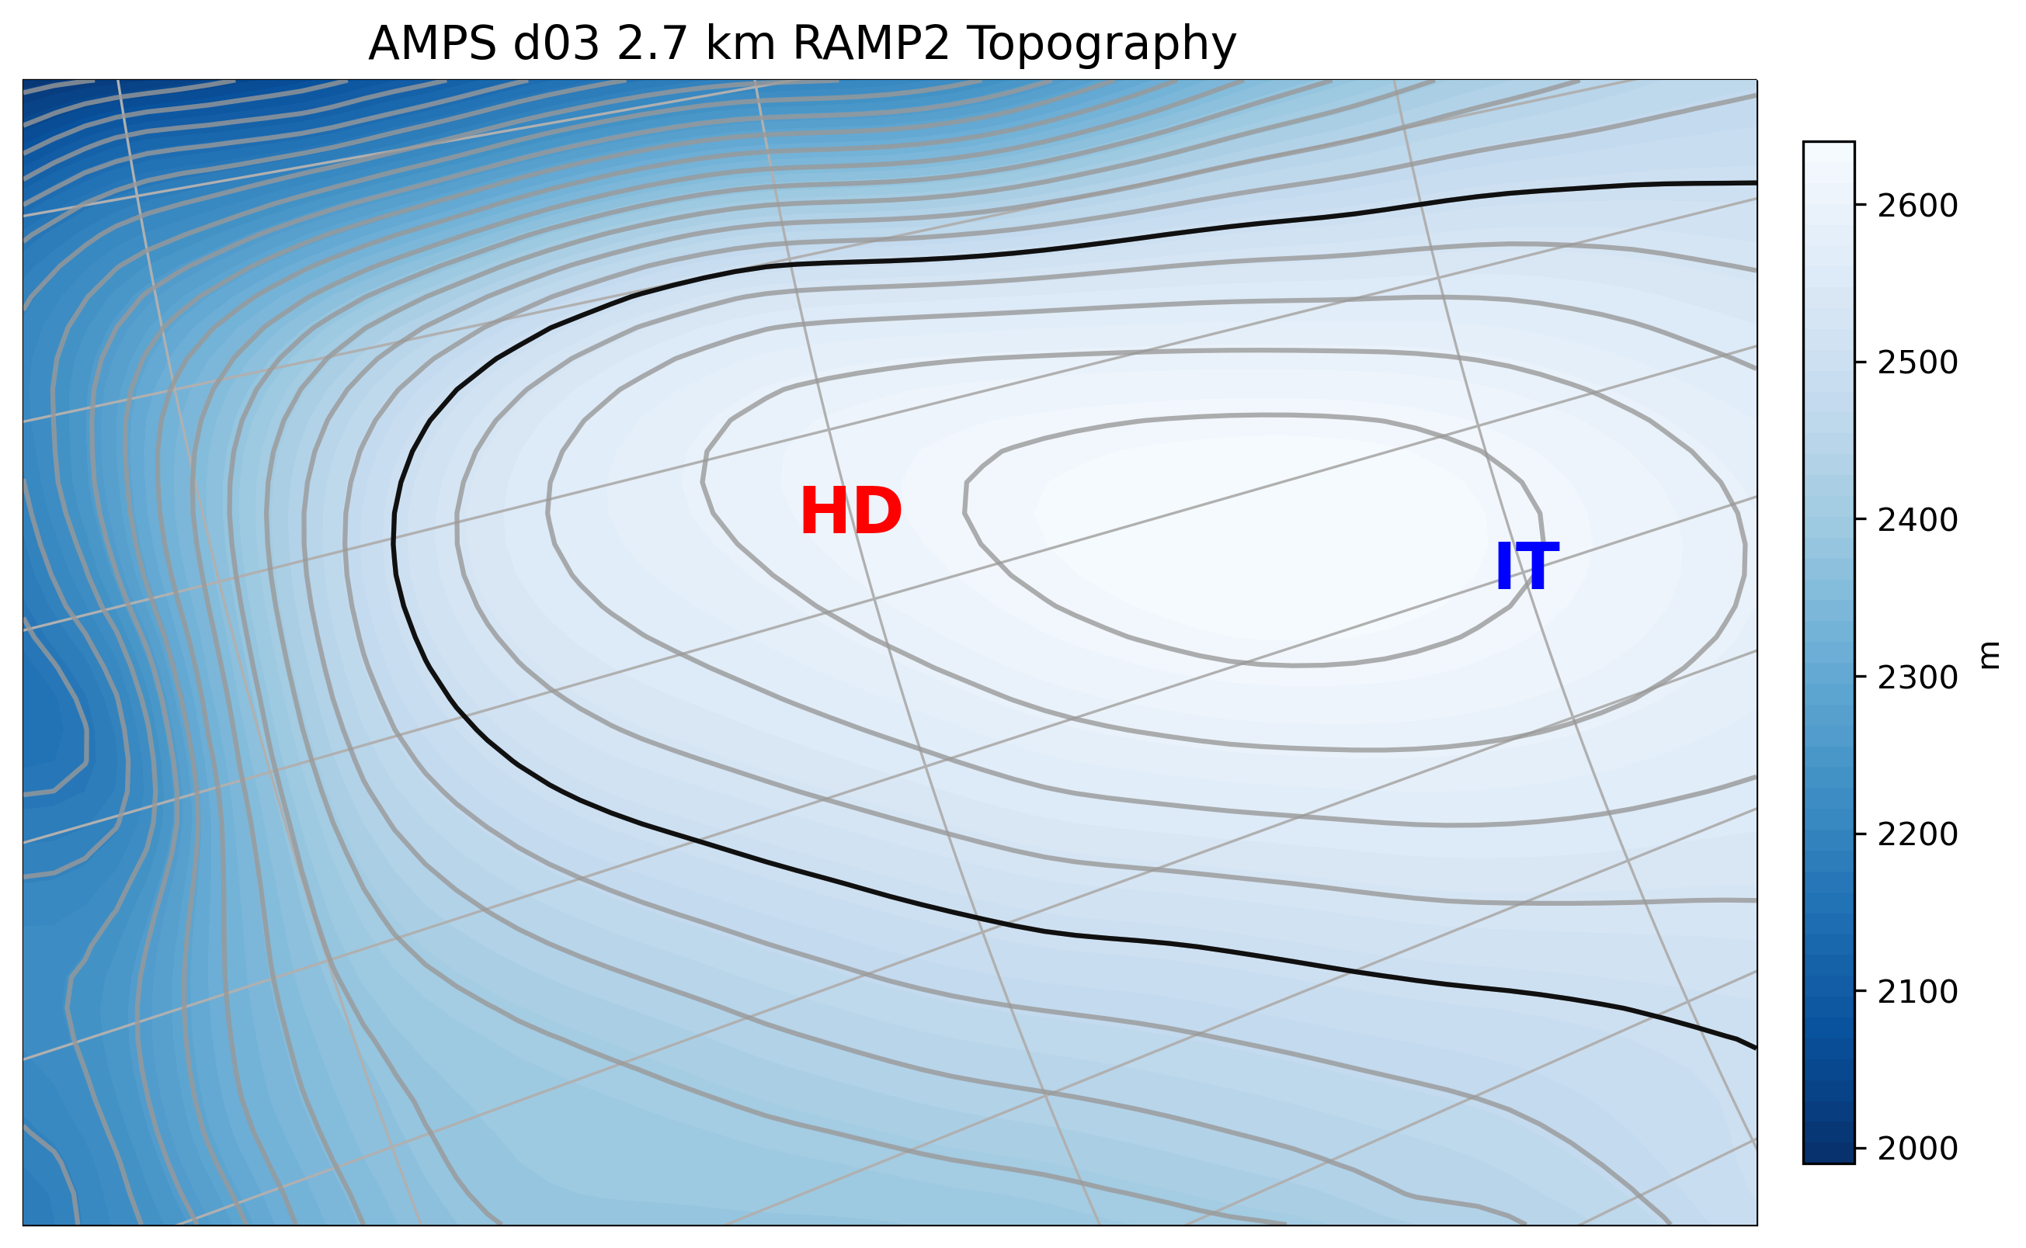

Slide 8
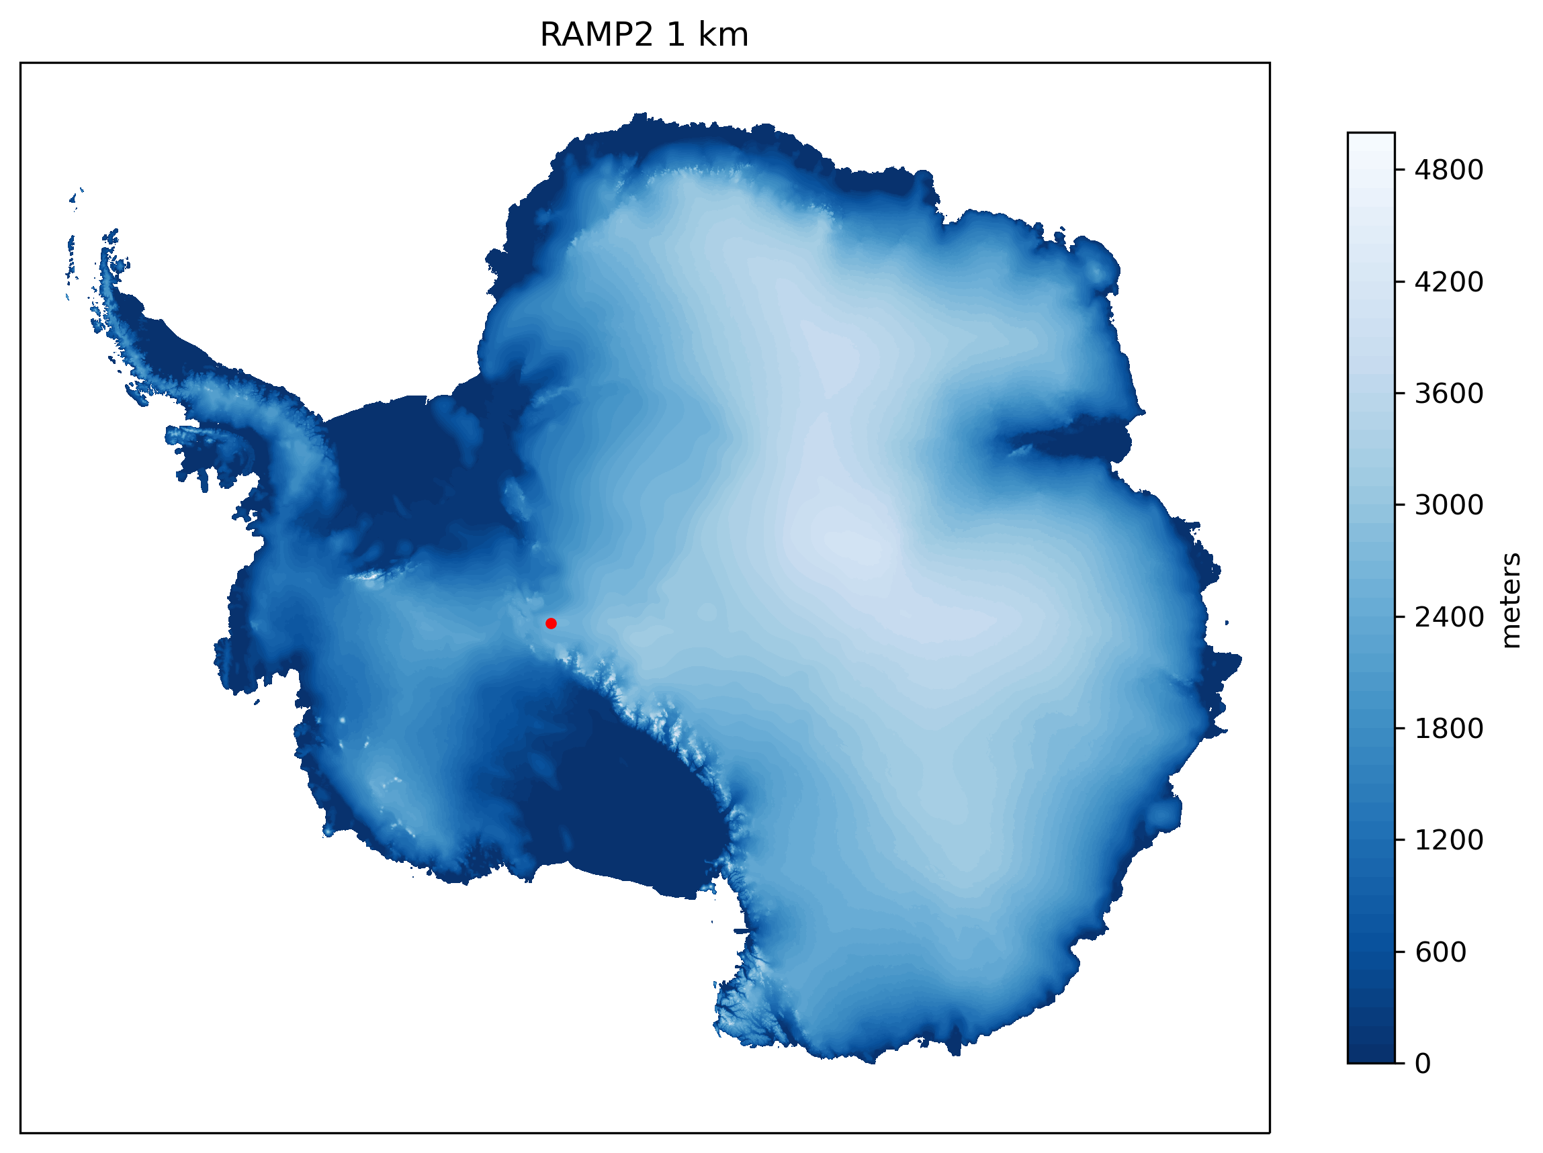
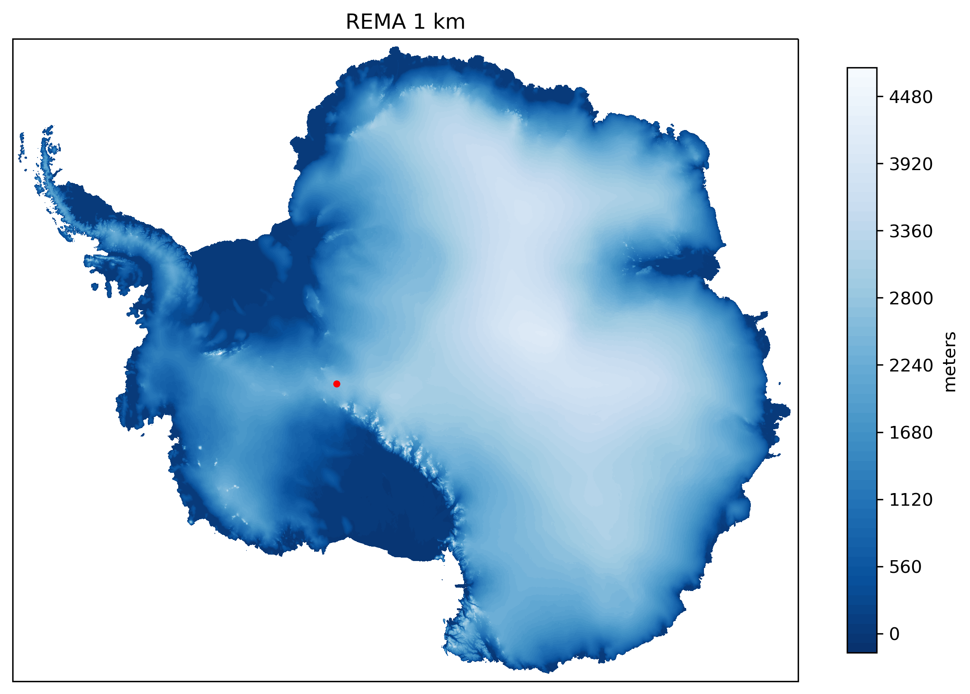
RAMP2: Radarsat Antarctic Mapping Project
REMA: The Reference Elevation Model of Antarctica
Liu et al 1999, JGR
Howat et al 2018, The Cryosphere

Slide 9
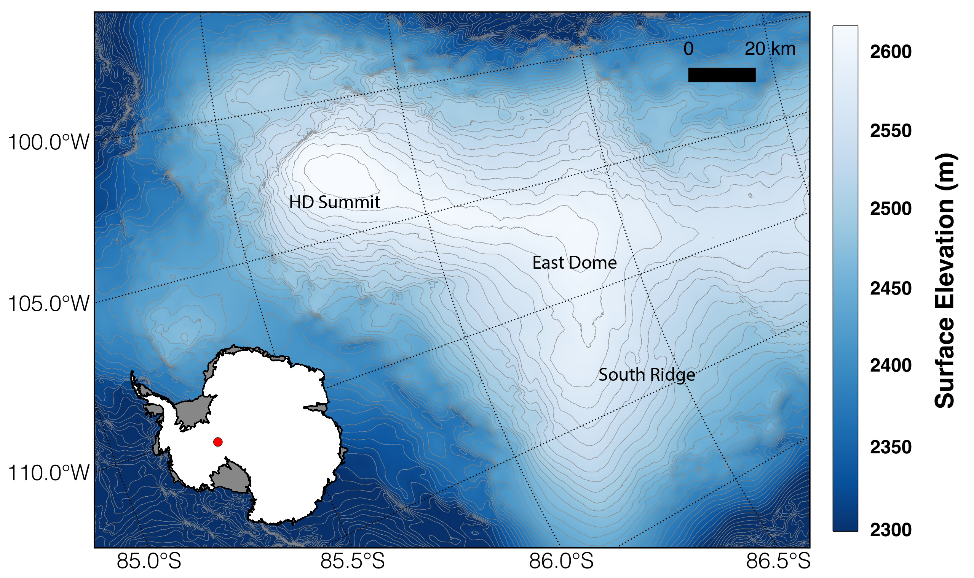
REMA: The Reference Elevation Model of Antarctica

Slide 10
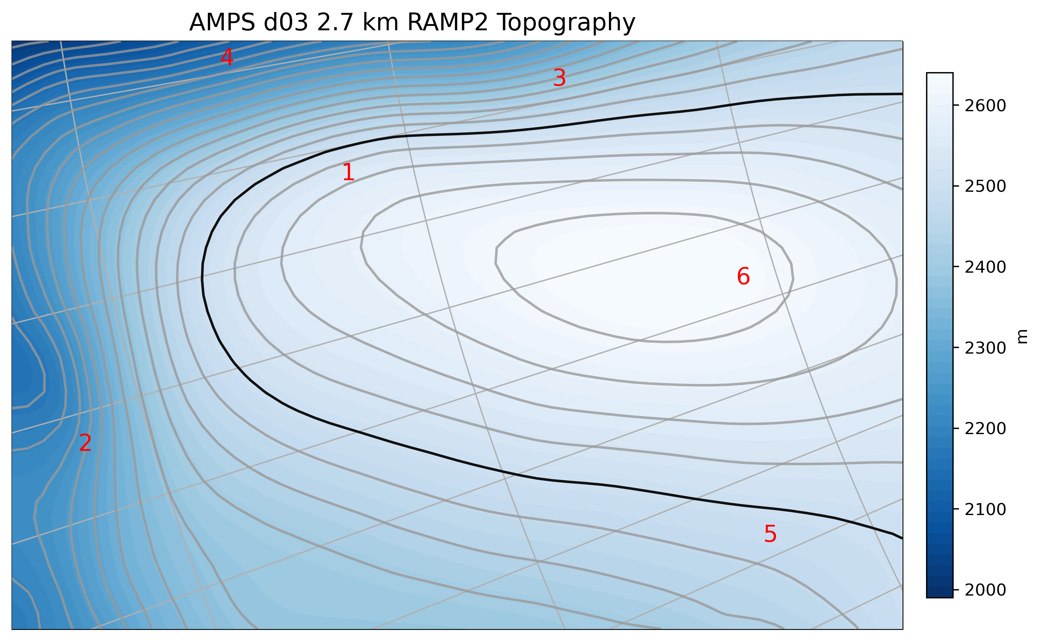
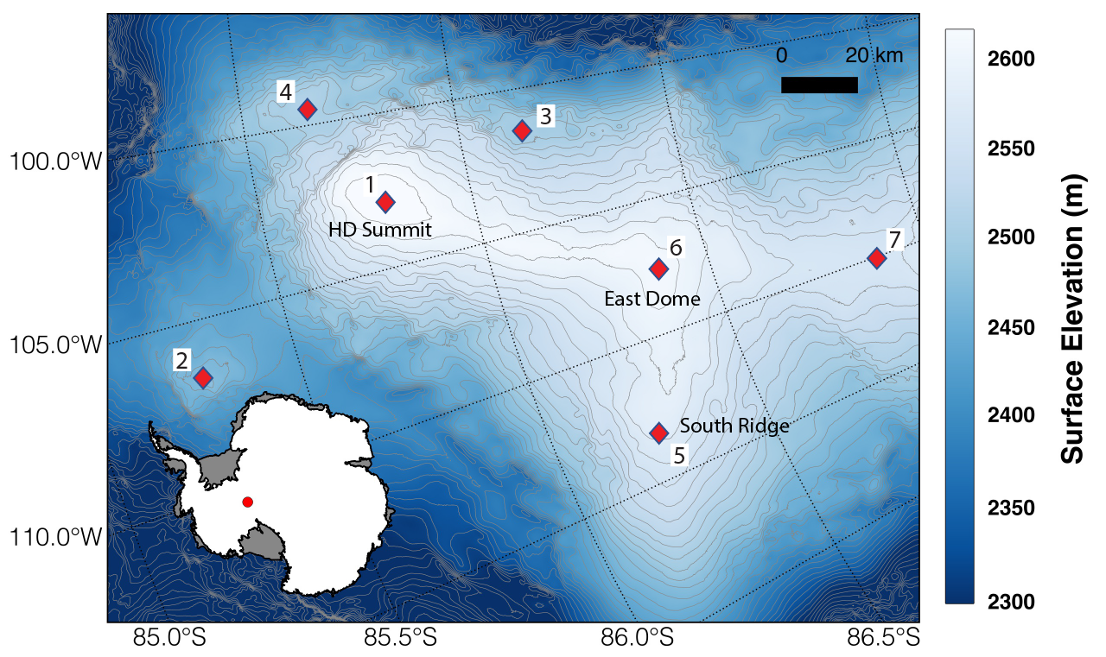
REMA: The Reference Elevation Model of Antarctica

Slide 11
AMPS
Antarctic Mesoscale Prediction System
Operational weather forecasting
  Two 5-day forecast runs per day at NCAR
  Uses regional model Polar WRF
US Ice Core Science Meeting “Outreach”
  Who has been to Antarctica? Who has overwintered?
  Does anyone know someone who was evacuated?
  Who has heard of AMPS?

Slide 12
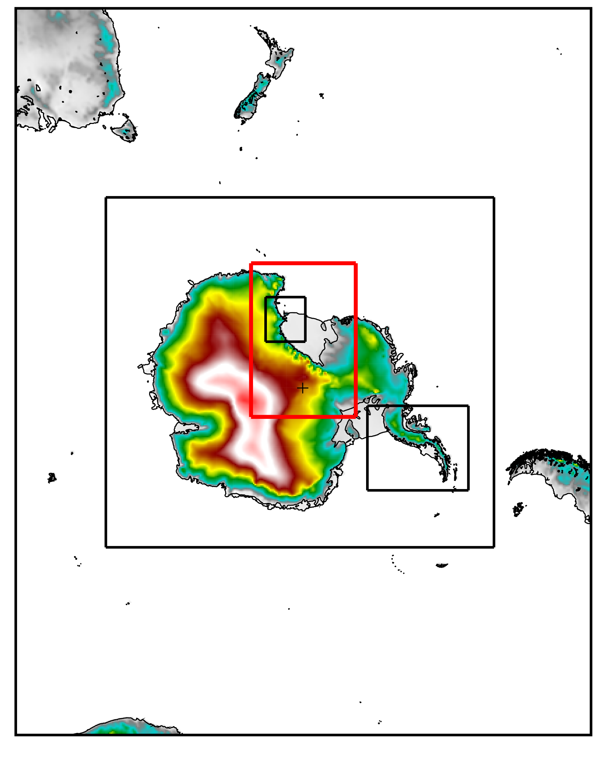
AMPS
Antarctic Mesoscale Prediction System
Operational weather forecasting
Spatial resolution
  Set of nested domains:
  24, 8, 2.67, 0.89 km
  Hercules Dome is in domain 3
Figure by Kevin Manning

Slide 13
AMPS
Antarctic Mesoscale Prediction System
Operational weather forecasting
Spatial resolution
The archive
  Started in 2001 @ 90 km; WRF in 2006 @ 60 km
  Not a climate dataset, too many changes over time

Slide 14
AMPS for Hercules Dome
Focus on the last 5 years (2018-2022)
Created regular time series from the forecast files
  Subdaily (1h, 3h), daily, monthly
  Temperature, pressure, wind, precipitation
AMPS precipitation versus UW radar accumulation
Comparisons to Wisconsin AWS observations
Synthetic AWS around the Dome

Slide 15
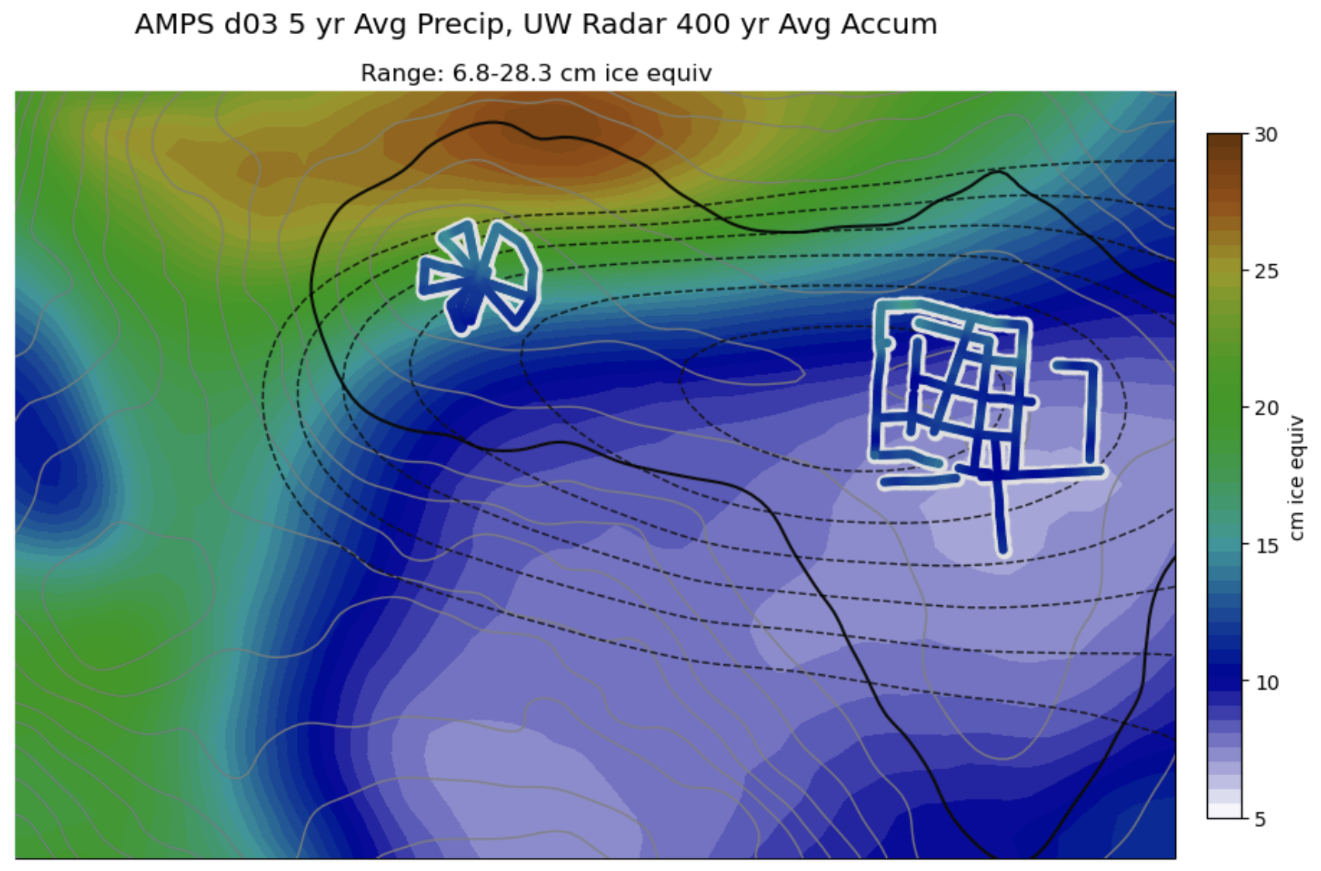
AMPS precipitation vs radar accumulation
Radar accumulation data (and colormap) from Annika Horlings, UW

Slide 16
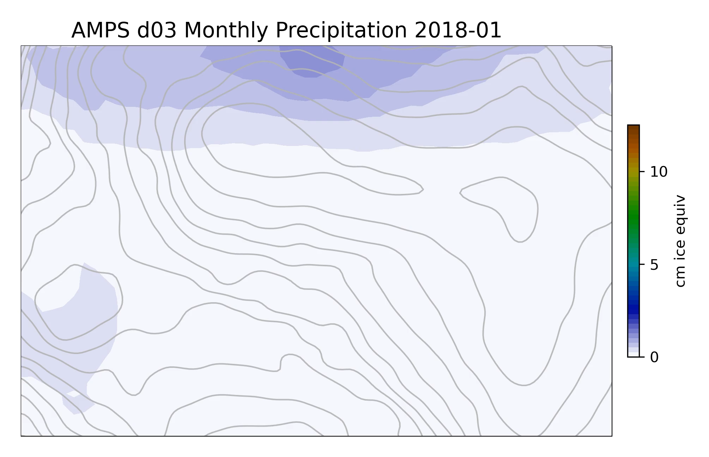
AMPS monthly precipitation 2018-2022
Colormap from Annika Horlings, UW

Slide 17
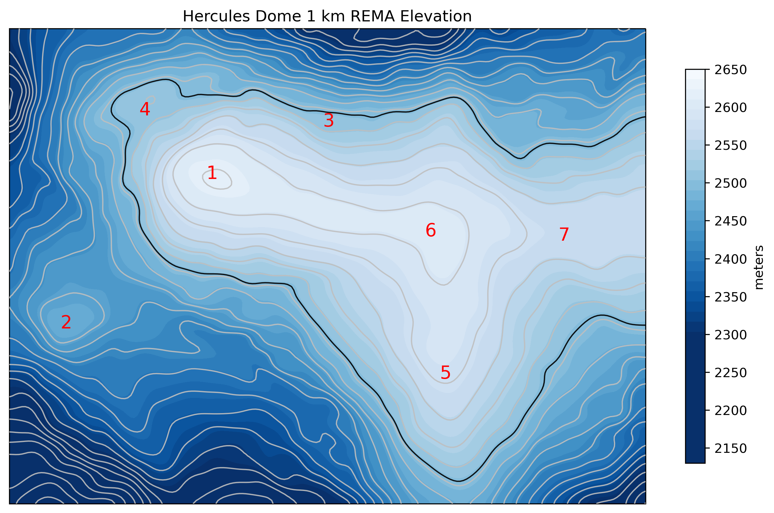
Problems with modeling
Topography
  AMPS still uses RAMP2
  Hercules Dome looks very different in REMA

Slide 18
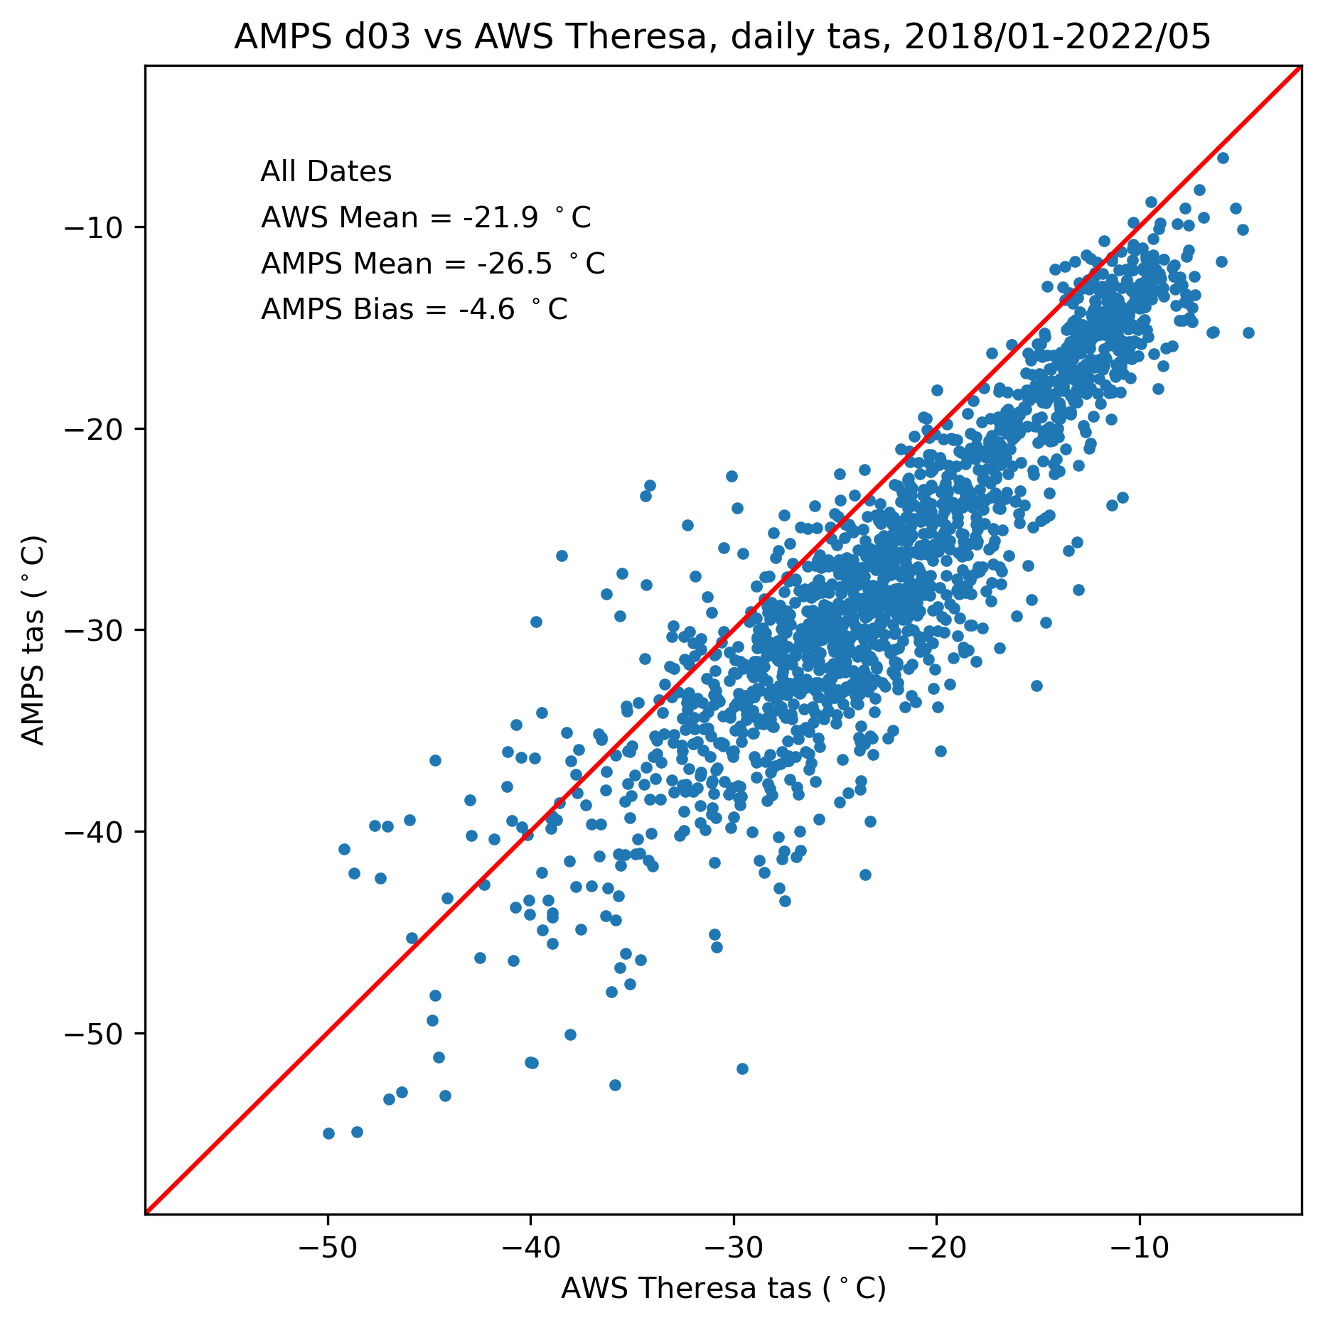
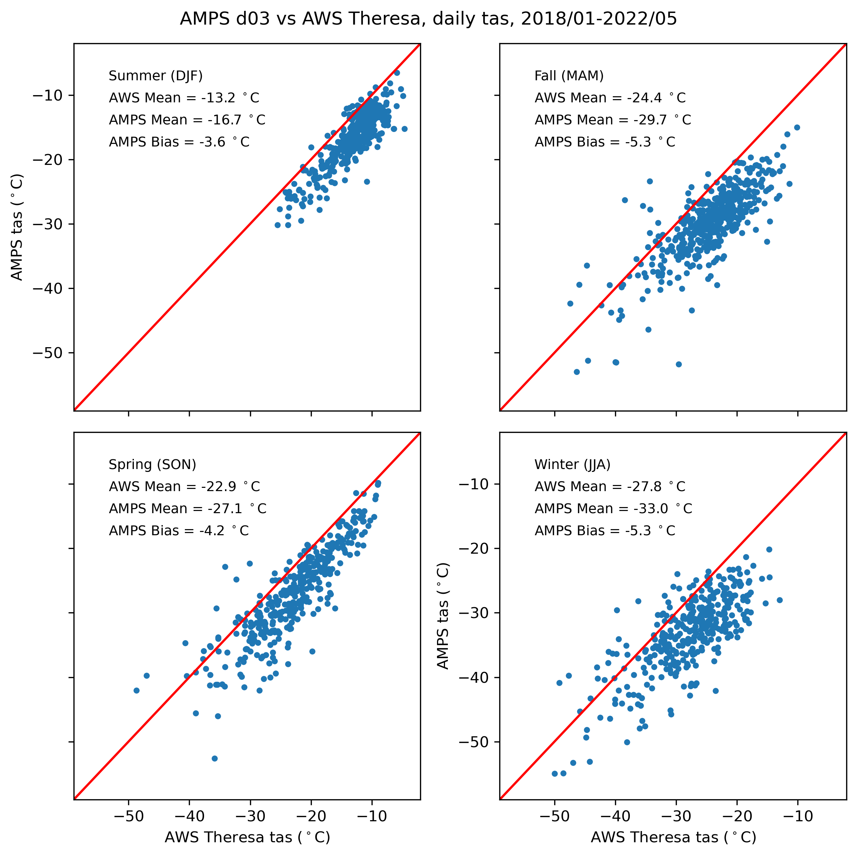
Problems with modeling
Topography
WRF cold bias
Annual
Seasonal

Slide 19
Problems with modeling
Topography
WRF cold bias
Spatial resolution
  Herc Dome features probably need ~1 km grid
  Contingent on good topo!
Parameterizations
Precipitation is not the same as accumulation
Lack of validation observations

Slide 20
UW & UW Pending Proposal
We have just submitted a proposal in the works to “advance our understanding”
Learn about:
  Precipitation/accumulation at subannual scale
  Precipitation (& clouds?) in lower troposphere
  Seasonality of meteorology/climate in region
Collect new data in a network of observing sites at/around Hercules Dome over multiple years
Higher-resolution WRF modeling

Slide 21
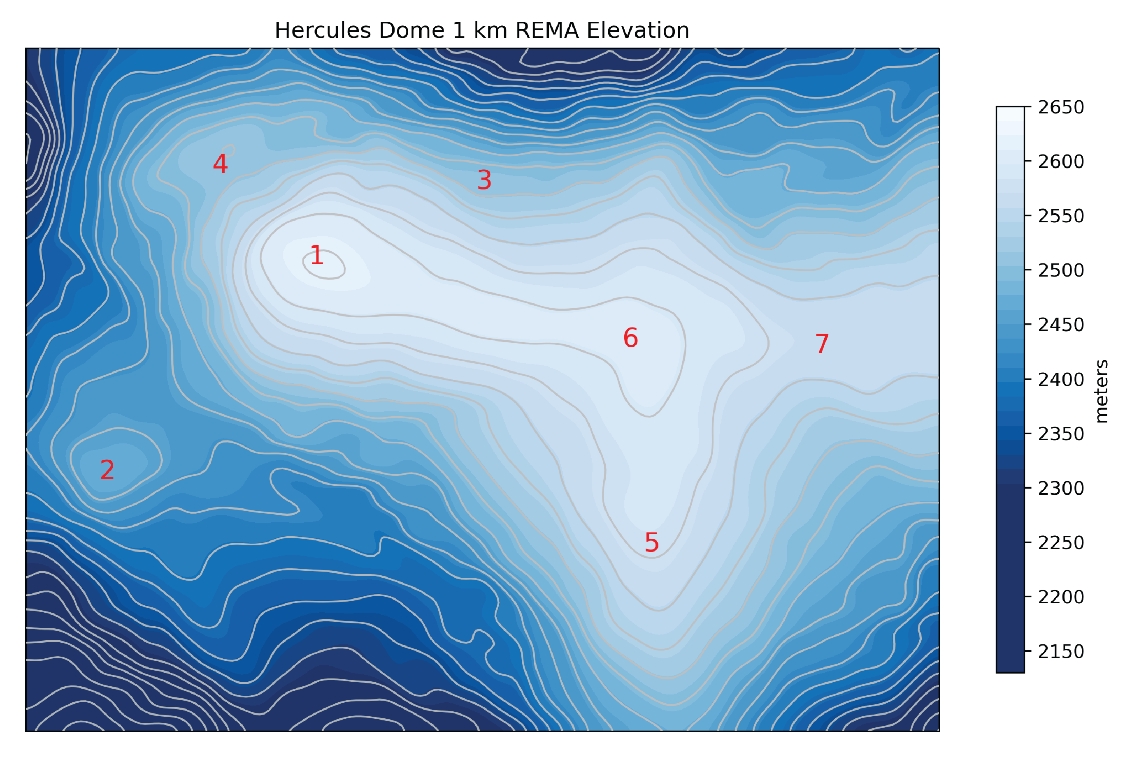

Slide 22
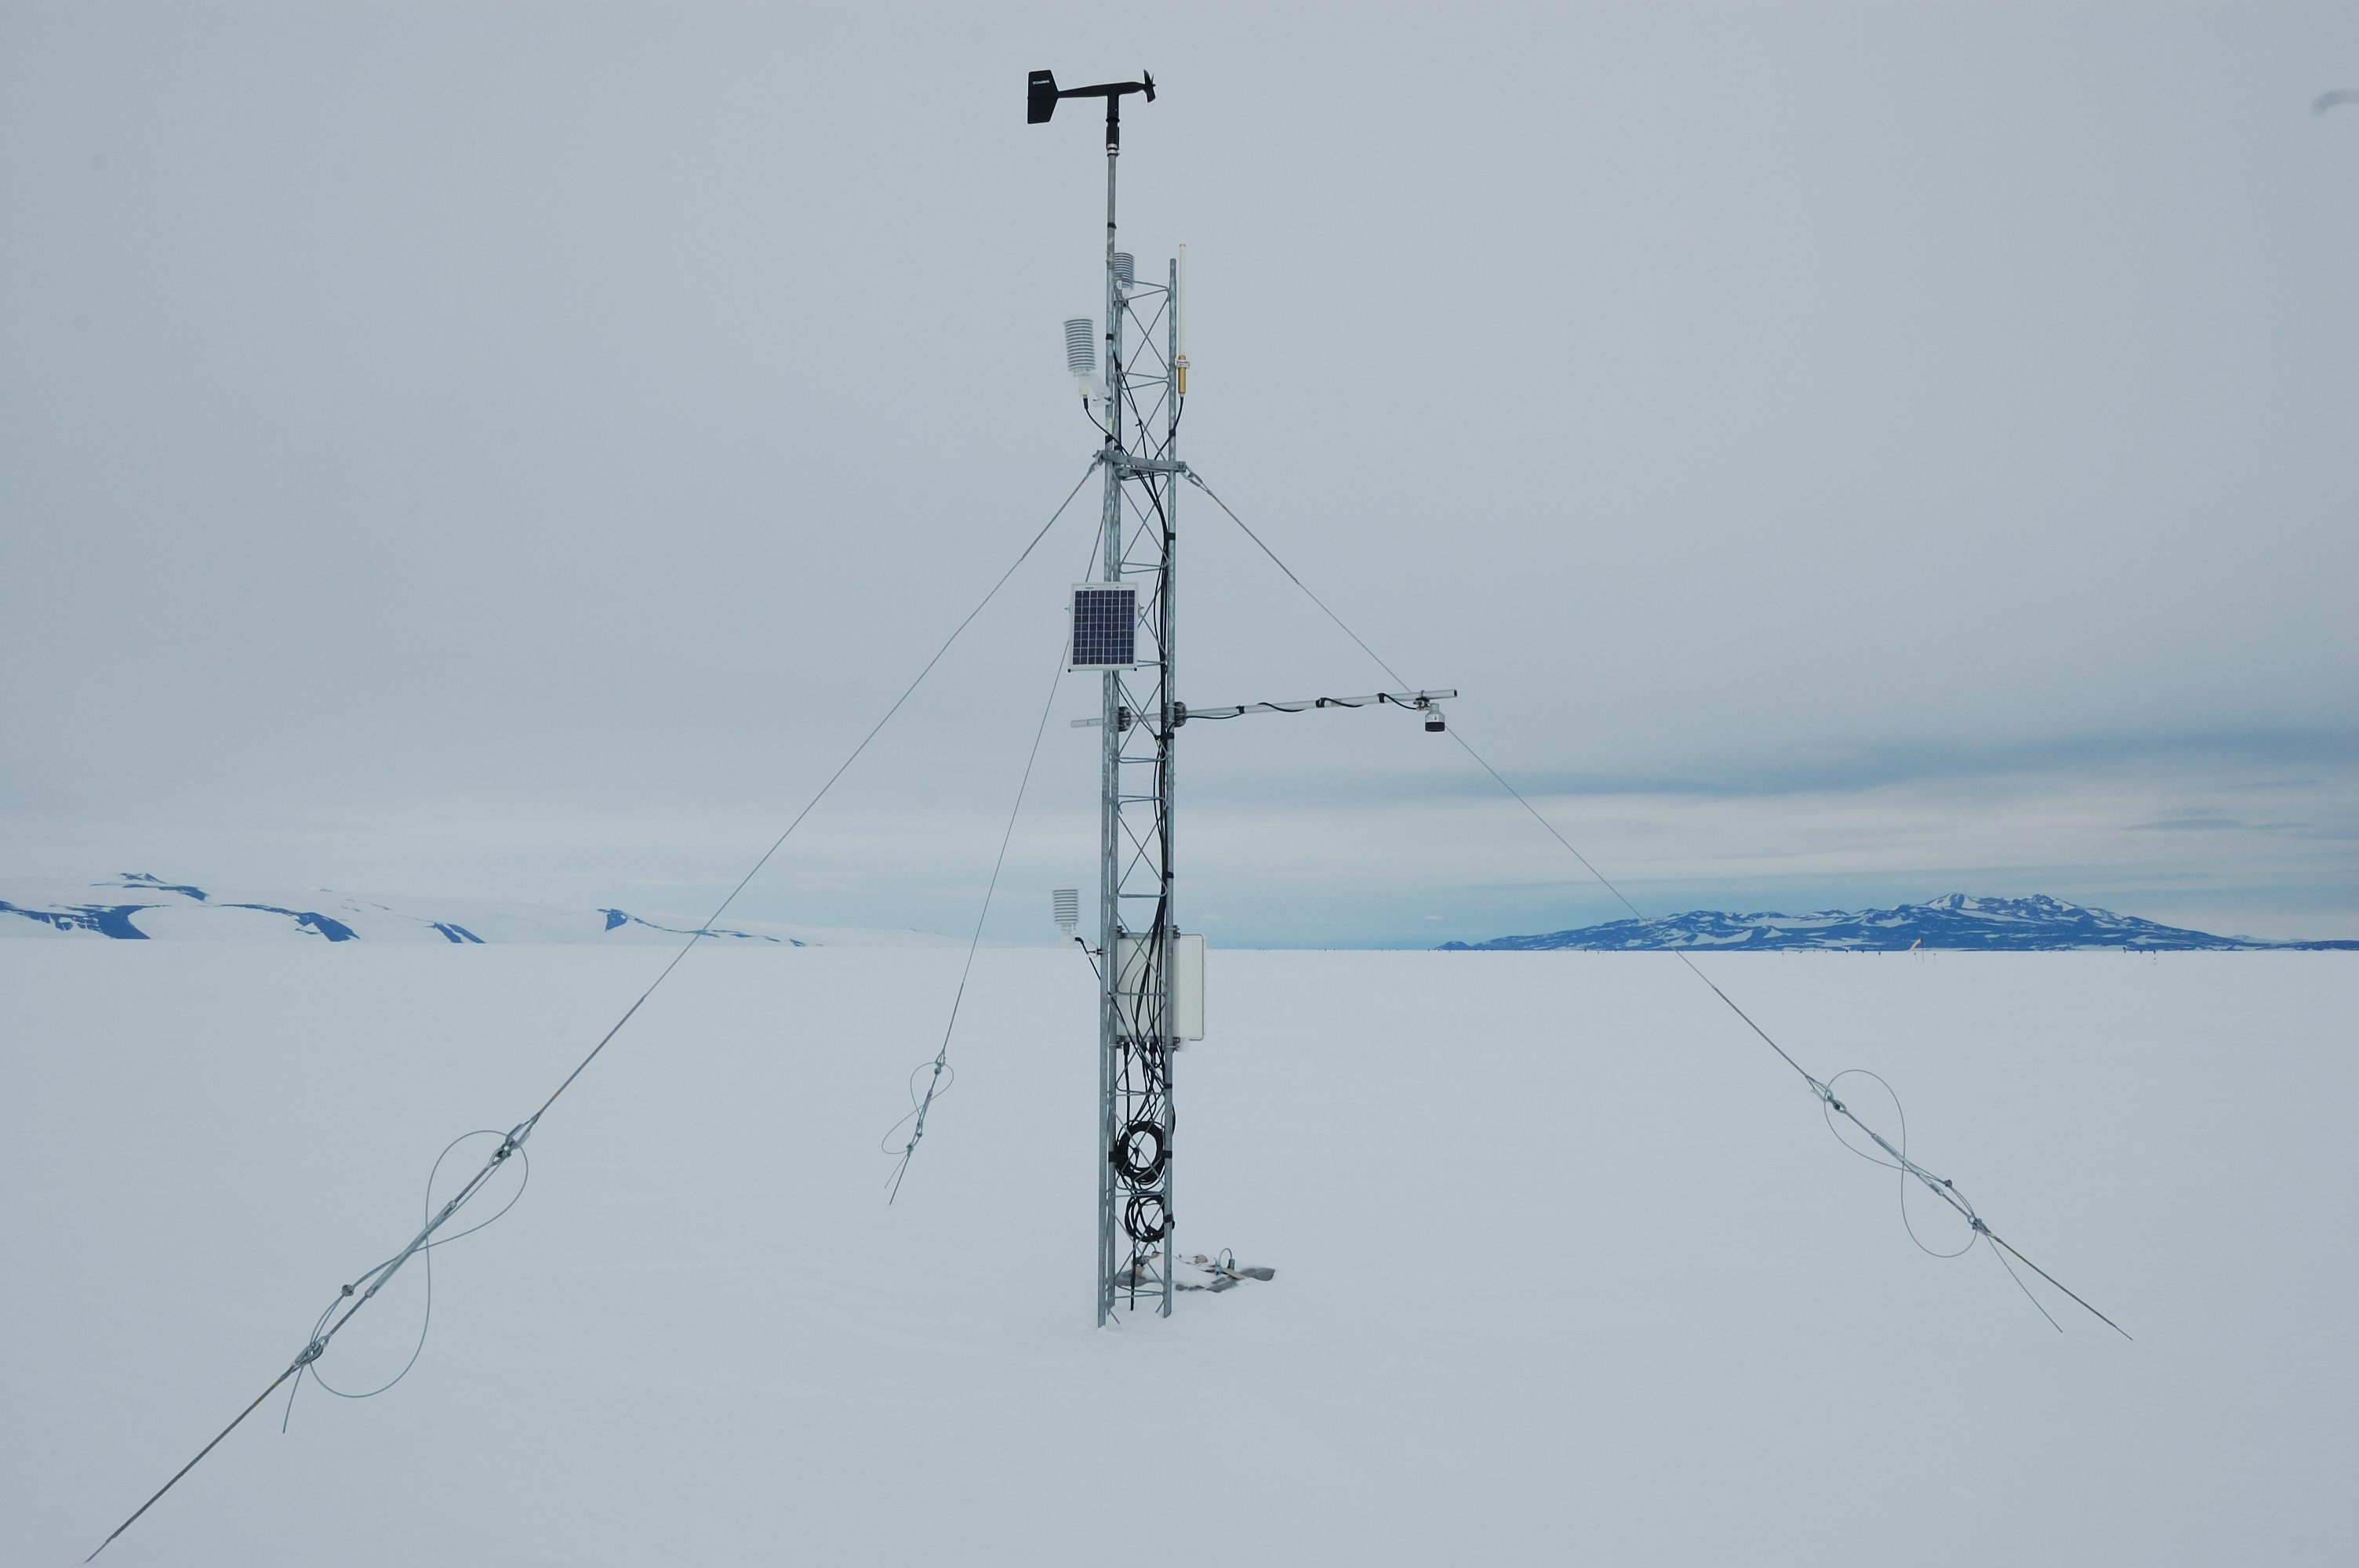
Observing network
Wisconsin AWS
  Standard meteorology/radiation
  ADGs for surface height
  Flowcapt FC4 acoustic particle flux sensor

Slide 23
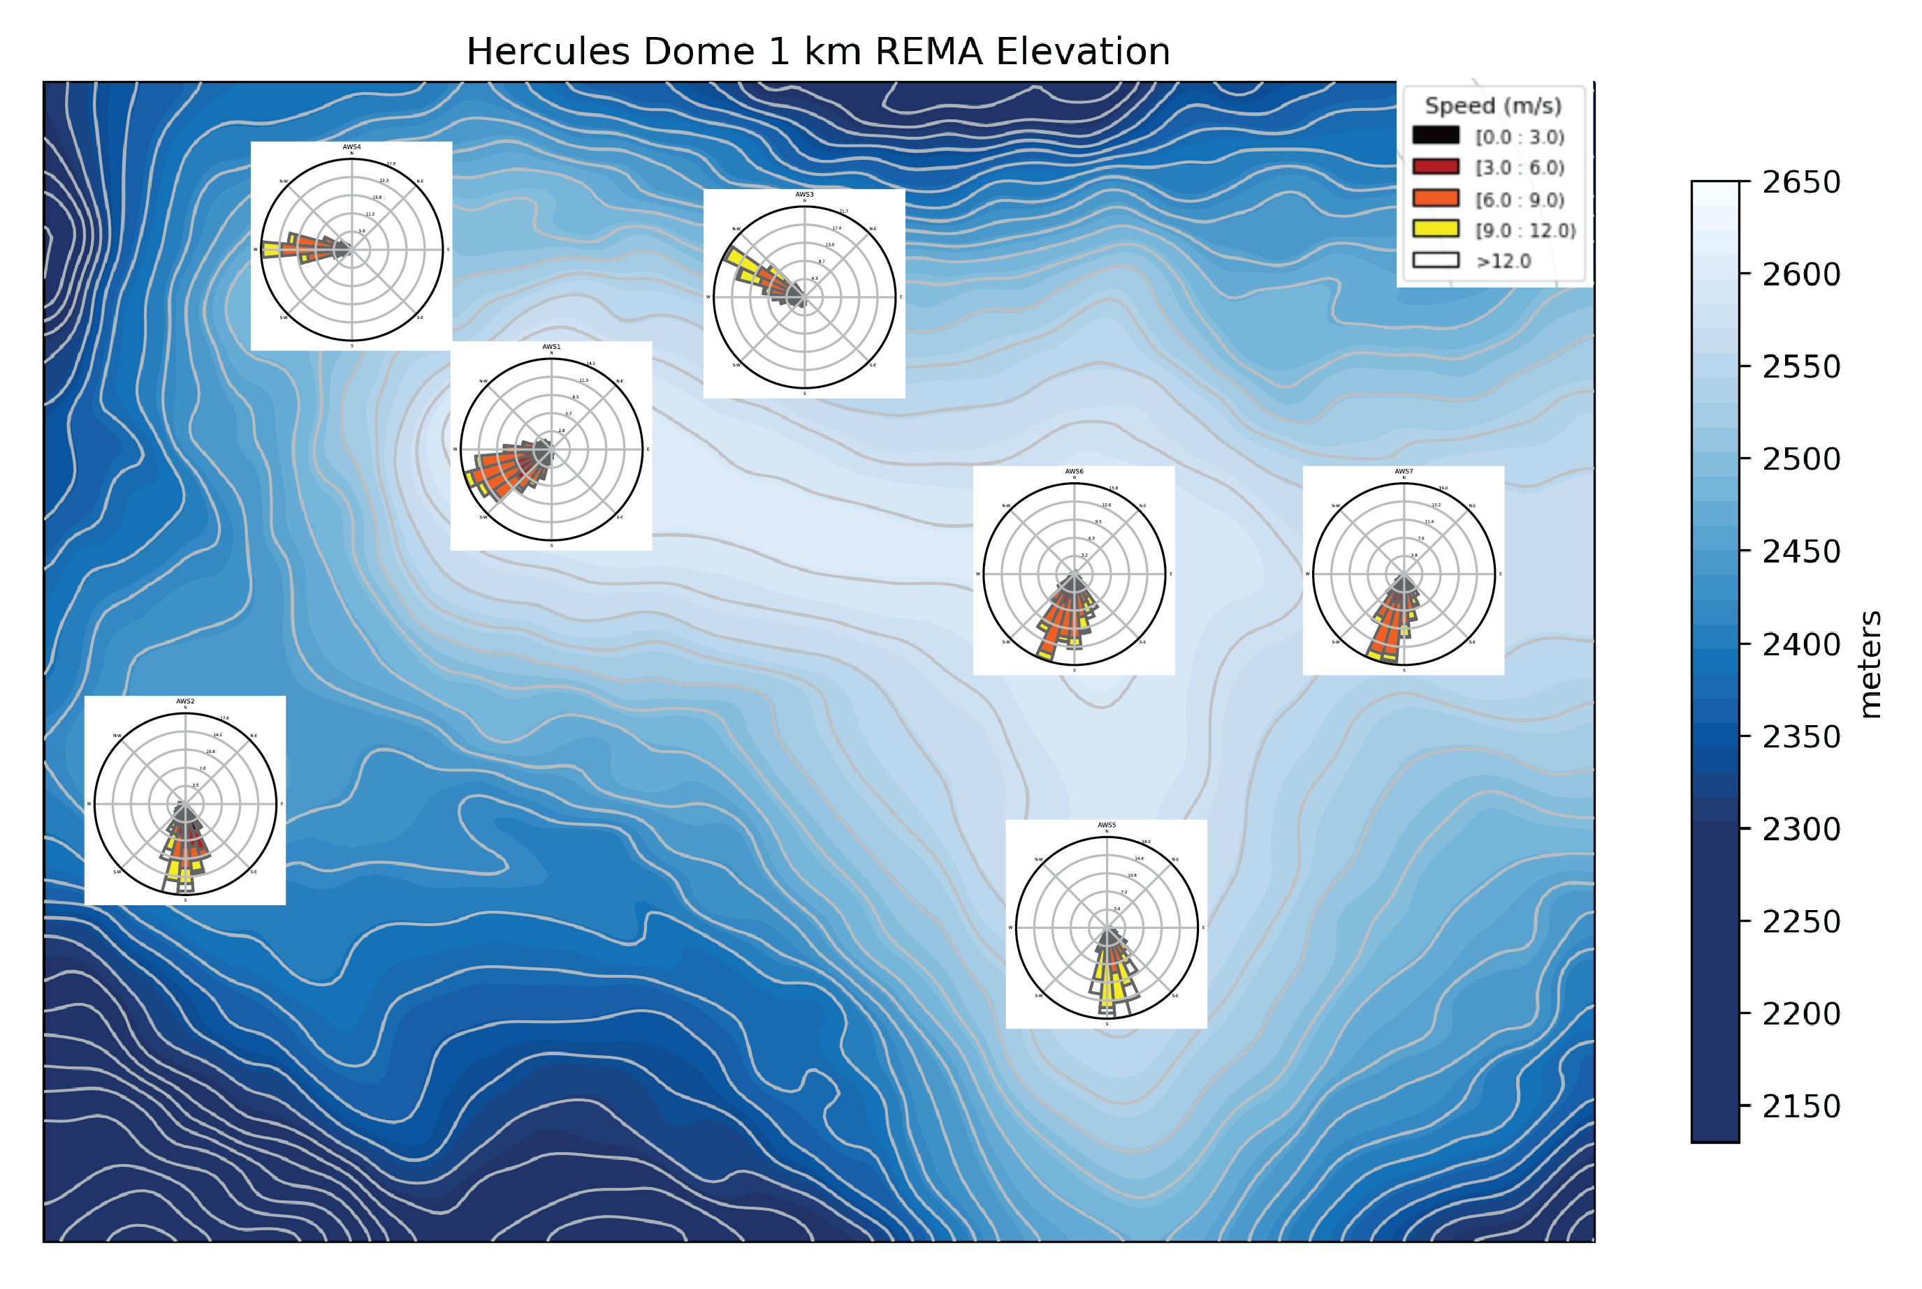
Bear in mind that these wind fields are on the WRONG topography!

Slide 24
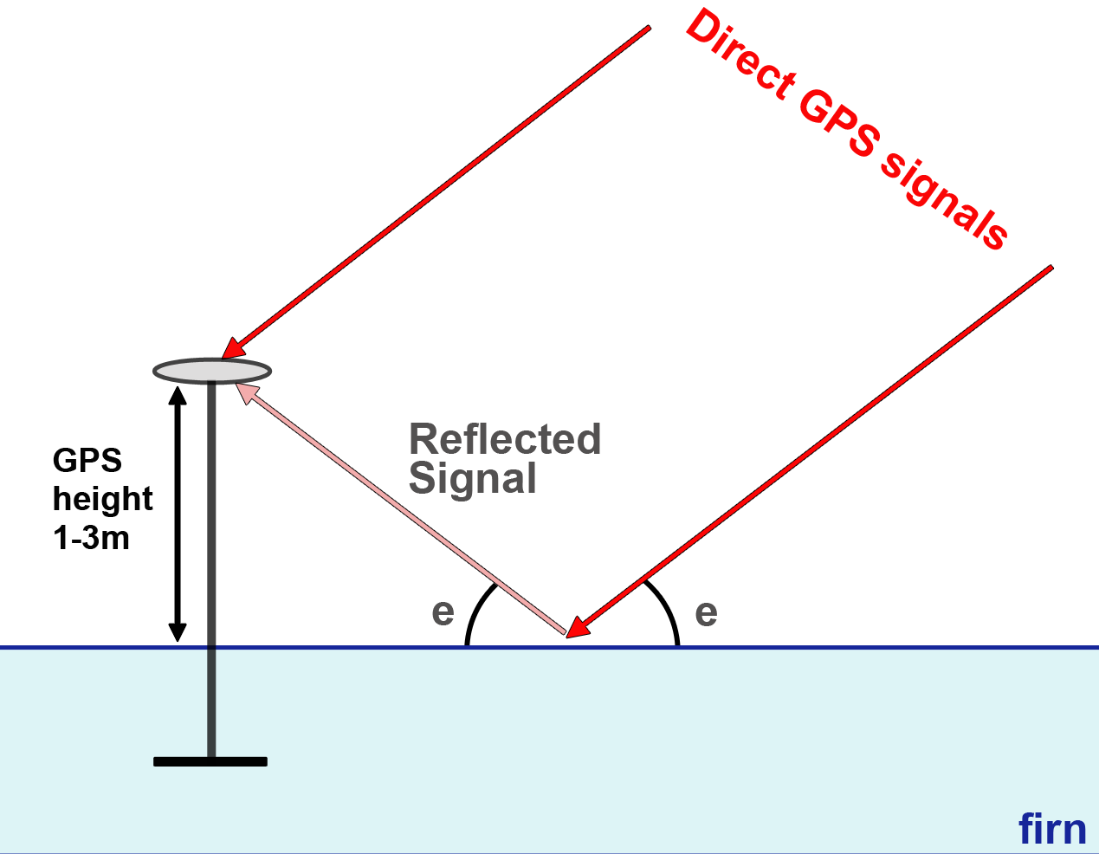
Observing network
Wisconsin AWS
  Standard meteorology/radiation
  ADGs for surface height
  Flowcapt FC4 acoustic particle flux sensor
GPS/GNSS interferometric reflectometry
  Surface height from interference between direct and reflected GPS signals
  Larger footprint than ADG

Slide 25
Main-site only
Cosmic ray neutron sensor (CRNS)
  HydroInnova SnowFox
  Measures overlying snow water-equivalent depth
  See Ian Howat’s work at Summit & South Pole
Micro rain radar, seasonally
  Metek MRR-PRO
  24 GHz K-band vertical radar
  Precipitation profile up to 6 km

Slide 26
Understanding precipitation, accumulation and meteorology at Hercules Dome
David B. Reusch
University of Washington
dreusch@uw.edu
Matthew Lazzara and the AWS Team*
University of Wisconsin-Madison
and Madison Area Technical College
mattl@ssec.wisc.edu
The Hercules Dome Team
University of Washington and elsewhere!
Photo of 2022/23 field season from Ben Hills, UWashington
* Funded by award 1924730, Office of Polar Programs, National Science Foundation
18th Workshop on Antarctic Meteorology & Climatology, 6/1/23

Slide 27
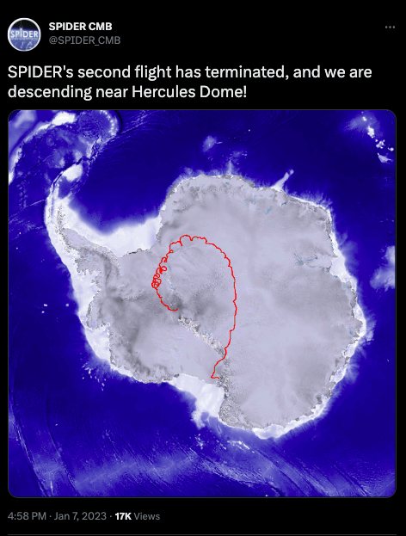
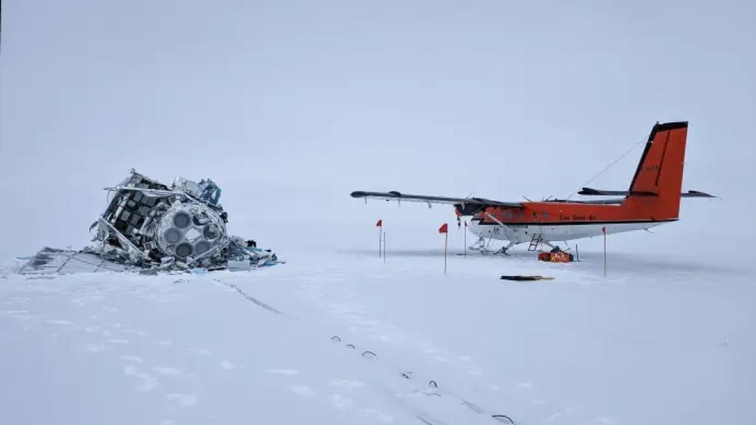
The Balloon Incident
Photo of 2022/23 field season from Ben Hills, UWashington

Slide 28
Recap
All models have shortcomings
AMPS/WRF has a Very Useful data archive
We have just submitted a proposal in the works to collect new observations and do new WRF modeling
Note: I’ll be presenting an updated version of this talk at IUGG in Berlin (Symposium M14 “Climate Change in the Polar Regions”, Thu 7/13)
dreusch@uw.edu

