Slide 1
AMPS WINTER YOPP-SH FORECAST
DATA IMPACT STUDY Jordan G. Powers¹, Kevin W. Manning¹,and David H. Bromwich²
¹ Mesoscale and Microscale Meteorology Laboratory
National Center for Atmospheric Research
Boulder, Colorado, USA
² Atmospheric Sciences Program and Byrd Polar and Climate Research Center
The Ohio State University
Columbus, Ohio , USA
YOPP-SH Workshop
Madison, Wisconsin, USA
May 31–June 2, 2023

Slide 2
BACKGROUND
• WMO Polar Prediction Project (PPP) (2013–2022)
– Goal: Research to improve environmental prediction for the polar regions
– YOPP-SH: Year of Polar Prediction— Southern Hemisphere
• Program of the PPP: Observation and prediction in the
high southern latitudes
– YOPP-SH Winter Campaign: April–August 2022
• Approach: Targeted Observing Periods (TOPs) (1–2 weeks)
with enhanced atmospheric observing
• Cf: YOPP-SH Summer (Nov 2018 – Feb 2019) campaign with continuous observation activities

Slide 3
BACKGROUND
• YOPP-SH Winter Campaign Data
(i) Extra radiosonde launches from Antarctic/sub-Antarctic stations
(ii) Enhanced observation systems at selected stations
(e.g., Micro Rain Radar, Anasphere sonde instruments)
• Current Ohio State/NCAR Study: Use YOPP Winter Datasets to Improve WRF and AMPS Forecasts for Antarctica
– Methodology: Model forecast experiments and case simulations
– Tools:
• Weather Research and Forecasting (WRF) Model
• WRF data assimilation (DA) systems
• YOPP-SH winter sounding and special surface data

Slide 4
OSU/NCAR STUDY AREAS
1) Investigate Effects of Enhanced-Sounding Dataset on AMPS Winter Forecasts (Data Impact Study)
– Analyze forecast impacts of augmented SH sounding program
– Assess potential of new DA approach for use in AMPS
2) Examine WRF Polar Cloud Simulations (Ohio State)
– Apply YOPP-SH special observations for evaluation of WRF cloud simulations by microphysics schemes:
Davis, Vernadsky
– Special measurements: Microwave radar;
ceilometer cloud phase; cloud constituent data
– Aim: Improve microphysics for WRF polar applications

Slide 5
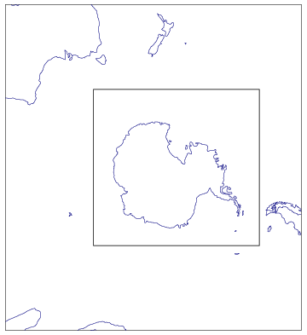
DATA IMPACT STUDY
• Approach: Data Assimilation Experiments
(1) Test enhanced TOP sonde dataset
(2) Test new data assimilation (DA) method for AMPS
– Multi-Resolution Incremental 4DVAR (MRI-4DVAR)
• Tool: Modified AMPS WRF configuration
– 24-km Southern Ocean grid: Expanded from
AMPS 24-km grid to capture more of
Australia
– 8-km Antarctic grid: Same as AMPS WRF
24 km
8 km
8 km

Slide 6
DATASET EXPERIMENTS
• Experiment 1— STD: AMPS WRF Standard Observations
– Surface AWS and station obs
– Radiosondes
– Ships and buoys
– Aircraft reports
– Satellite winds
– Satellite radiance measurements
– GPSRO (radio occultation) measurements
• Experiment 2— TOP: AMPS Standard Observations
+ TOP Extra Soundings

Slide 7
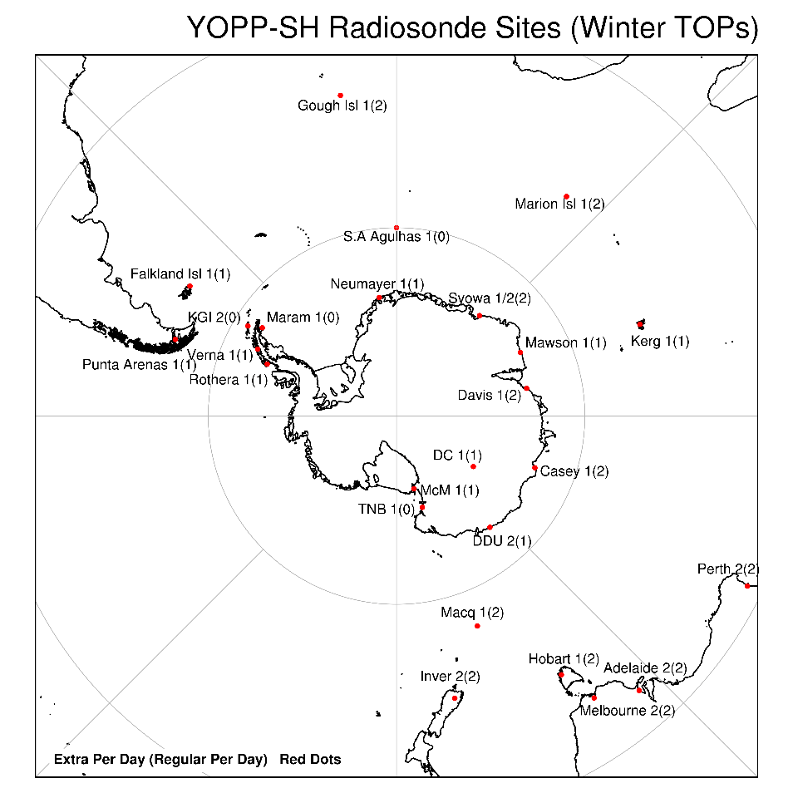
YOPP-SH TOP RADIOSONDE SITES
YOPP-SH TOP
Radiosonde Sites
Numbers: X (Y)
X= No. extra sondes/day
(Y)= No. regular sondes/day
Approx. total for TOPS: 1200
Invercargill
2 (2)
2 extra (2 regular)

Slide 8
DATA ASSIMILATION EXPERIMENTS: APPROACH 1— MRI-4DVAR
1) MRI-4DVAR: Multi-Resolution Incremental 4-D Variational DA
– 4DVAR: Obs assimilated at their actual times within a time window
• Cf. 3DVAR: Single-time attribution for all obs
• 6-hr assimilation window
– 4DVAR: Better analyses and forecasts than 3DVAR, but much
more computationally expensive
– Multi-Resolution Incremental: Two-phased approach using coarser and finer horizontal grid spacings on the assimilation domain in different steps to save cost
(i) Calculation of background–obs departures:
Regular grid spacing used— 24 km
(ii) Generation of analysis increments (minimization): Coarser grid spacing used— 72 km
Experiment assimilation domain

Slide 9
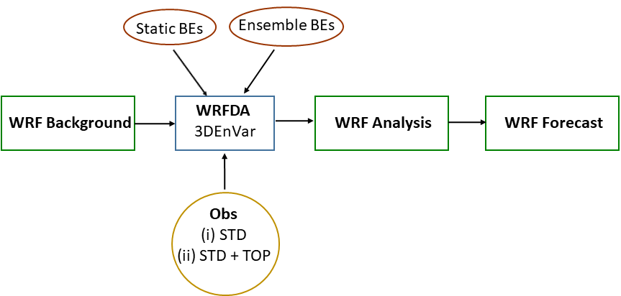
DATA ASSIMILATION EXPERIMENTS: APPROACH 2— 3DEnVar
2) 3DEnVar: 3-Dimensional Ensemble-Variational DA
– Used by WRF in AMPS
– Ensemble-Variational: Process uses background error (BE) information from a (WRF) forecast ensemble
– 2 BE sources in 3DEnVar: Static and Ensemble
(1) BEs derived from previous fcsts:
Static BEs
(2) BEs derived from current ensemble of fcsts:
Ensemble BEs (“flow-dependent” errors)
WRF forecast preparation path
Observations (incl. TOP soundings)

Slide 10
FORECAST EXPERIMENTS
• WRF Forecasts for TOPs
– Initializations: 0000 and 1200 UTC for every TOP day
– Length: 120 hrs
– 6-hr cycled forecasts with DA performed leading up to each target forecast
• TOPs Period Region of Extra Sondes
1 9–16 May 2022 pan-Antarctic
2 2–8 June pan-Antarctic
3 1–9 July East Antarctica–Ross Sea
4 14–19 July pan-Antarctic
5 23–29 July Antarctic Peninsula
6 29 July–3 August East Antarctica
7 20–30 August pan-Antarctic

Slide 11
Lessons Learned: WRF Cycling
• Issue: WRF time step formulation
– WRF adaptive model time step (dt) found to result in noise
• Adaptive dt: Time step adjusts automatically to get longer when model stability allows
• Permits a longer model time step and thus shorter forecast wallclock times
– Fix: Constant dt specified
• Issue: Noise early in cycling forecasts
– Digital Filter Initialization (DFI): WRF feature to eliminate gravity waves at model startup
– Fix: DFI implemented

Slide 12
Lessons Learned: WRF Cycling
• Issue: Forecast temperature bias aloft
– Problem: Significant cold bias seen around 200 mb
– Fix: Apply spectral nudging at model upper levels in cycling periods
– Nudging source: GFS 3-hr forecasts
– Selected scale nudging applied for: T, GHT, u, v
• Issue: Model top noise
– Seen with WRF option of layer of implicit gravity wave damping from the AMPS configuration
Purpose: Handle wave reflection from model top
– Fix: Explicit upper diffusion layer option applied
→ Option used by Ohio State

Slide 13
Lessons Learned: MRI-4DVAR
• MRI-4DVAR complicated: Much time required to
configure/tune system
Thanks to:
• Kevin Manning (NCAR)
• Anastasiia Chyhareva
(Ukrainian Hydrometeorological Institute and National Antarctic Science Center)
• Compute hardware issues: Trial and error testing needed to determine HPC memory and CPU requirements for 4DVAR
• Data issue: Assimilation of satellite radiance data— 4DVAR crashed in testing apparently due to inconsistent observation thinning
• 4DVAR may be computationally unaffordable:
Testing to be done on new NCAR community HPC this summer

Slide 14
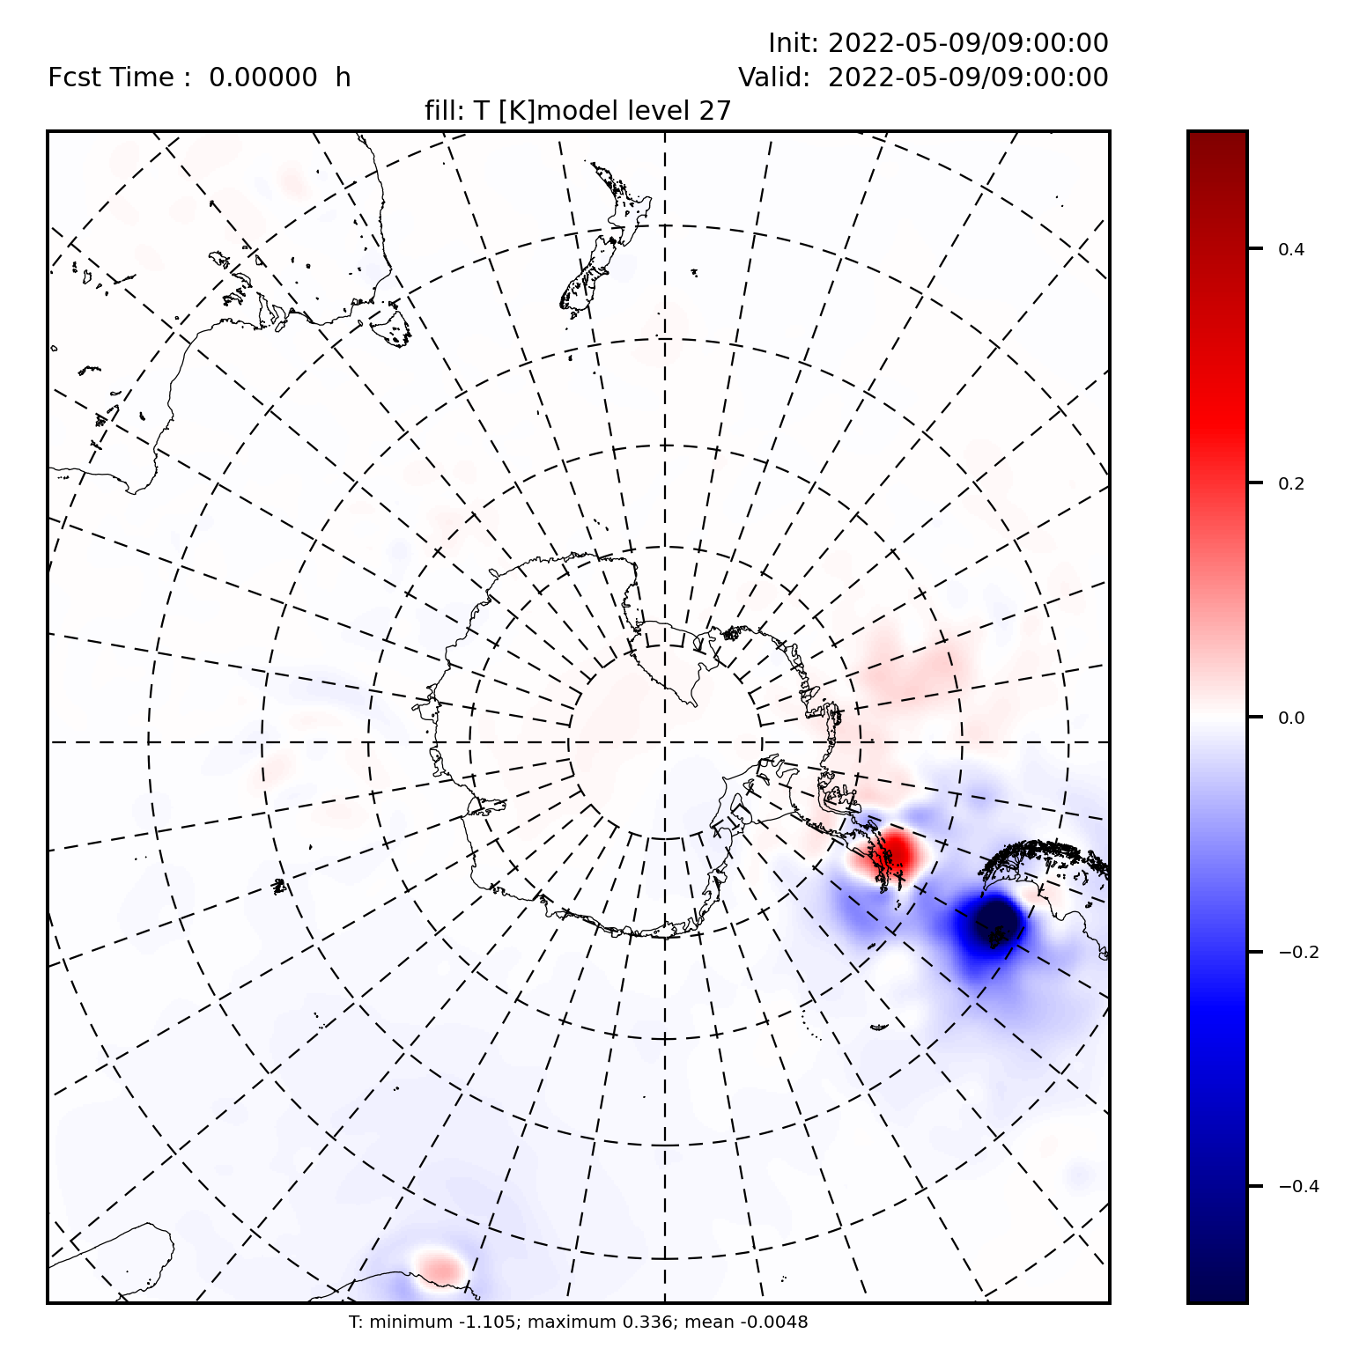
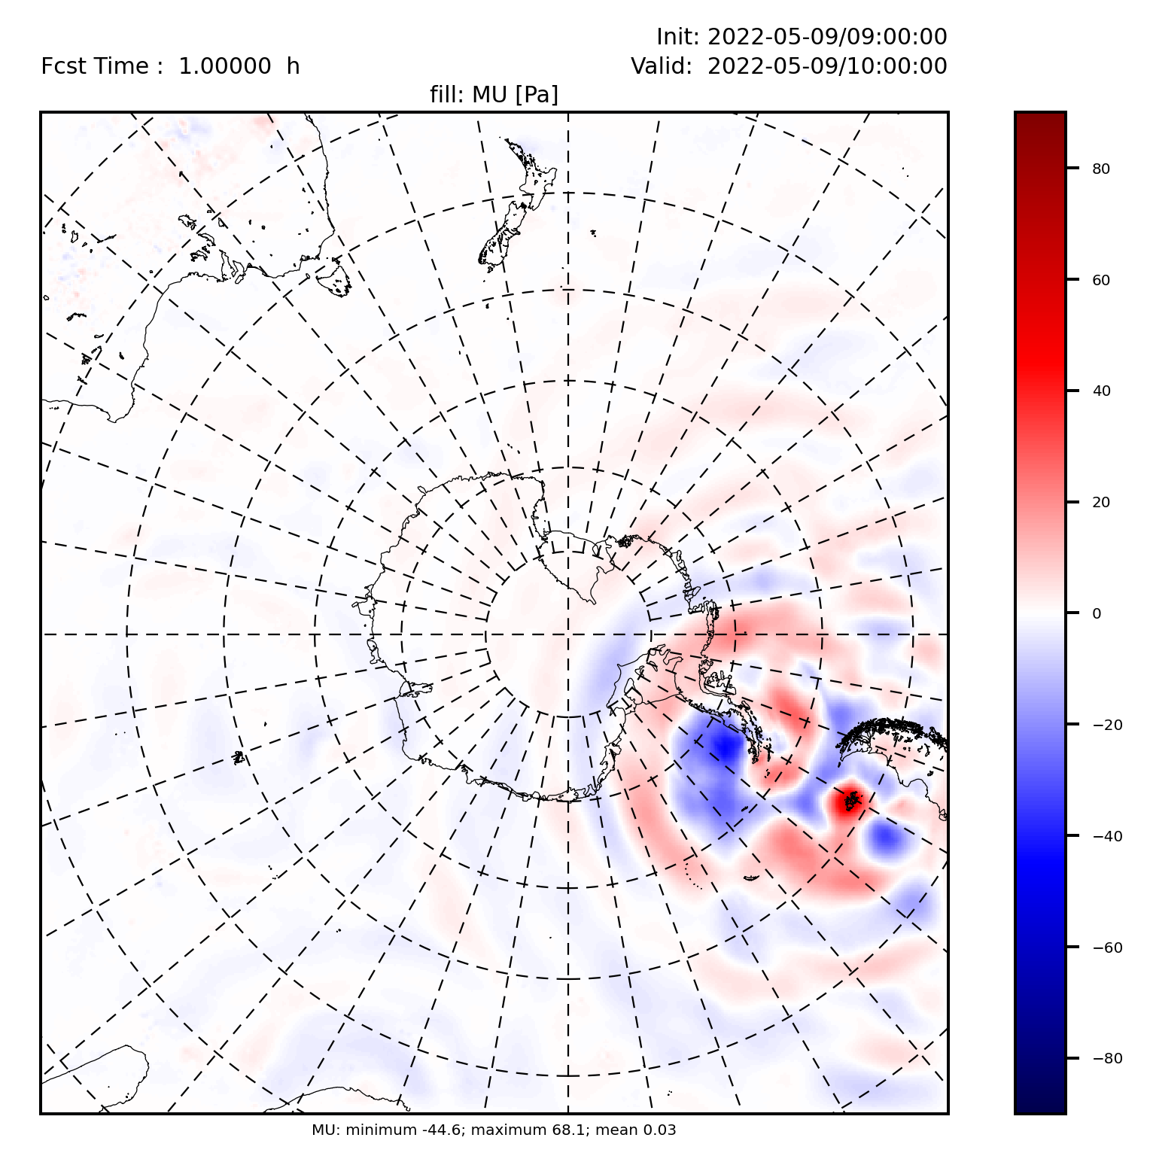
Sounding Assimilation Testing: TOP 1 (9 May 2022)
– Clear effects of extra soundings
– Differences propagate from modified regions: Wavelike patterns
T Difference, Hr 0 TOP – STD
Model Column Pressure (μ)
Difference, Hr 1 TOP – STD
+.5 C
+.9 mb
Extra sounding
Locations:
Mt. Pleasant, Marambio,
Vernadsky, Rothera
+.35 C
-1.1 C
Wavelike
difference
patterns
-.5 C
-.9 mb
~500 mb (level 27) T difference (K)
TOP – STD Hr 0
0900 UTC 9 May 2022
μ: p_{surface} – p_{top} difference (hPa)
TOP – STD Hr 1
1000 UTC 9 May 2022 p_{top}=10 mb
Notes:
14

Slide 15
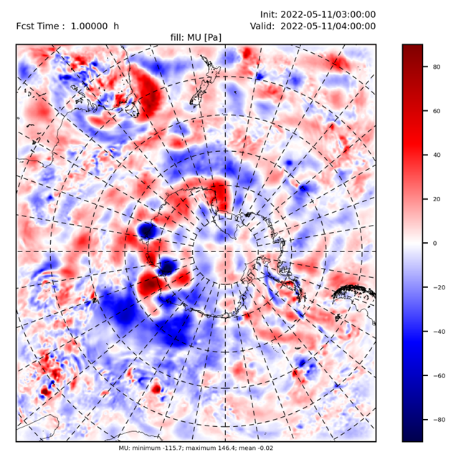
Sounding Assimilation Testing: TOP 1 (11 May 2022)
– Signals of extra soundings in East Antarctica seen:
Syowa, Mawson, Davis, Zhongshan, Casey, Dumont d’Urville
Model Column Pressure (μ)
Difference, Hr 1
+.9 mb
μ TOP – μ STD
μ (p_{surface} – p_{top})
difference (hPa)
TOP – STD Hr 1
0400 UTC 11 May 2022
0300 UTC 11 May initialization
Extra sounding
locations
-.9 mb
Notes:
15

Slide 16
SUMMARY: Winter YOPP-SH Data Impact Study
• Experiment Status
– Data assimilation setup: Much time put into MRI-4DVAR
configuration and adjustment
– WRF setup: Model configuration tweaking required
• Nudging applied (cycling period)
• DFI applied
• Upper diffusion damping layer implemented
• Preliminary Results
– Cold bias aloft in WRF cycling period → Nudging fix
– Clear differences from soundings
– Difference propagate from sounding locations
– TOP/STD forecast differences become “noisy” by Hr 6

Slide 17
EXPERIMENTS: DATA ASSIMILATION APPROACH 2
2) 3DEnVar: 3-Dimensional Ensemble-Variational DA
– DA method used by WRF in AMPS
– Observations gathered in a time window around the initialization time (e.g., 3 hrs), but the obs are considered valid at init time
– Esnemble-Variational method: Uses some background error (BE) information from a (WRF) forecast ensemble
(i) BEs derived from AMPS fcsts:
Static BEs
(ii) BEs from AMPS ensemble:
Ensemble BEs (flow-dependent)
WRF DA and
forecast path

