Slide 1
Observational Analysis of an Atmospheric River Impacting the Antarctic Peninsula During the Winter YOPP-SH Special Observing Period
Mariana Fontolan Litell^{1,2}, David H. Bromwich^{1,2}, Keith M. Hines¹, Sheng-Hung Wang¹
¹Byrd Polar and Climate Research Center, The Ohio State University, Columbus, OH, USA
²Atmospheric Sciences Program, Department of Geography, The Ohio State University,
Columbus, OH, USA
Supported by NSF grant 2205398

Slide 2
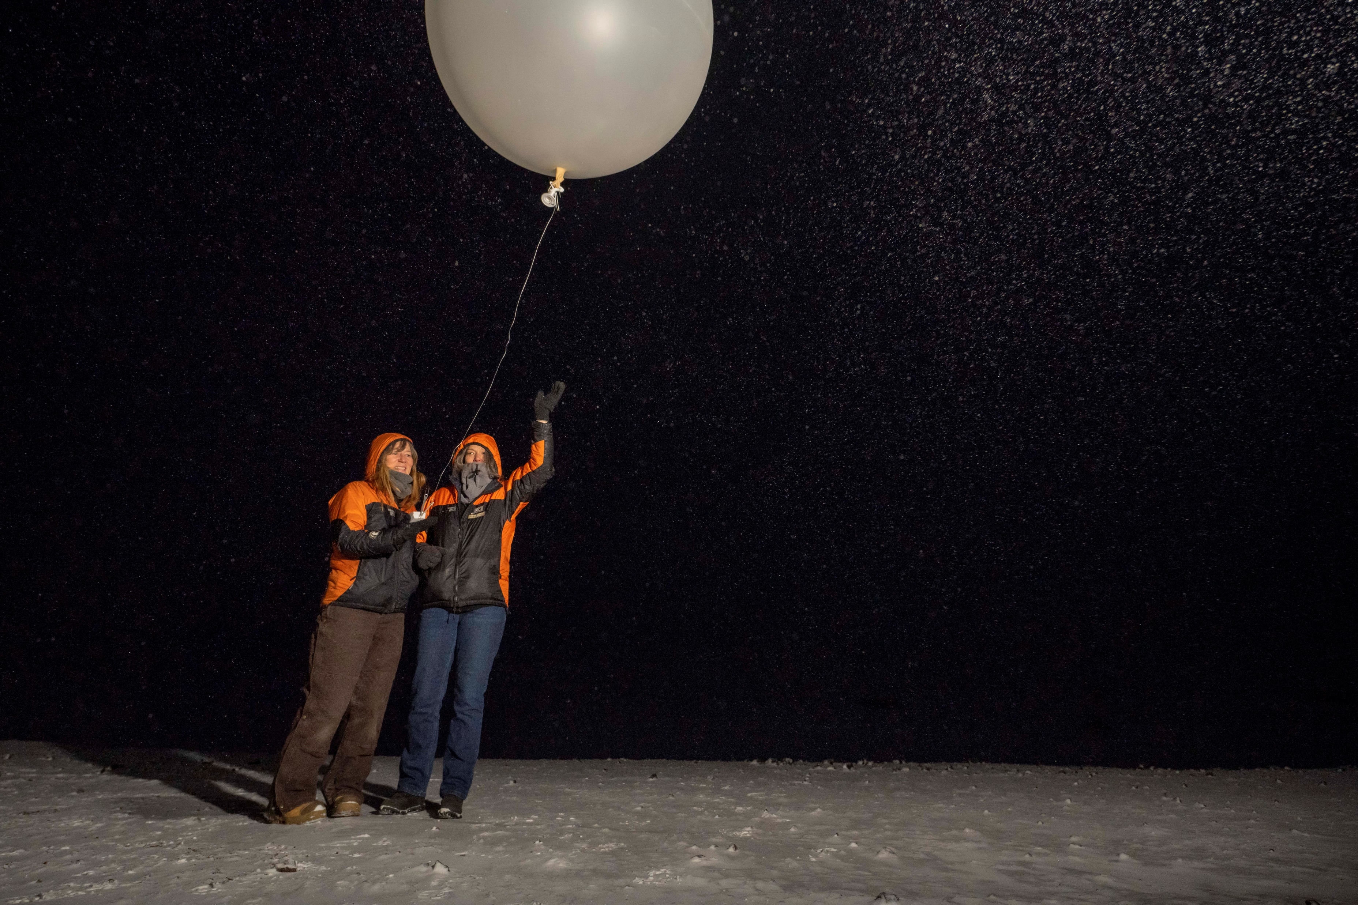
Outline
Introduction
TOP1 characteristics
Relative Humidity and Temperature variations
Conclusions
Picture source: McMurdo station

Slide 3
Introduction
The Year of Polar Prediction in the Southern Hemisphere (YOPP-SH): improve the weather forecasts for Antarctica
Winter Special Observing Period (SOP): April 15 - August 31, 2022.
Targeted Observing Periods (TOPs) featured extra radiosondes launches to capture intense weather events, such as major oceanic cyclones and atmospheric rivers (ARs).
This study focused on TOP1 (May 9-16, 2022).

Slide 4
TOP 1: May 9-16, 2022
Sequence of three AR events:
May 10
May 12
May 16
AR on May 10: AR1 based on the Center for Western Weather and Water Extremes (CW3E) AR scale
Moisture was transported by the AR into the AP region, along with high temperatures, abundant precipitation, and strong winds.
Picture source: Vernadsky station

Slide 5
Station Locations
Escudero
Vernadsky
Rothera
Weddell sea
Bellingshausen sea
EAST ANTARCTICA
WEST ANTARCTICA
Amundsen sea
Ross Ice Shelf

Slide 6
The soundings of three stations were analyzed to investigate the AR.
The ERA5 global reanalysis was used to explore the spatial structure of the AR.
No soundings from May 7-10 for Escudero.
Escudero station surface observations reported heavy blowing snow.
Video: Escudero May 8, 2022
ERA5 assimilated the extra radiosondes.
Video source: YOPP project group chat

Slide 7
Relative Humidity
Observations and ERA5

Slide 8
Observations and ERA5: RH – May 09 at 12Z
ERA5
No sounding for Escudero
No AR intrusion at this time
High RH at Vernadsky at lower levels
Very low RH at Rothera near 4000 m
A
Notes:
Contour lines – geopotential height

Slide 9
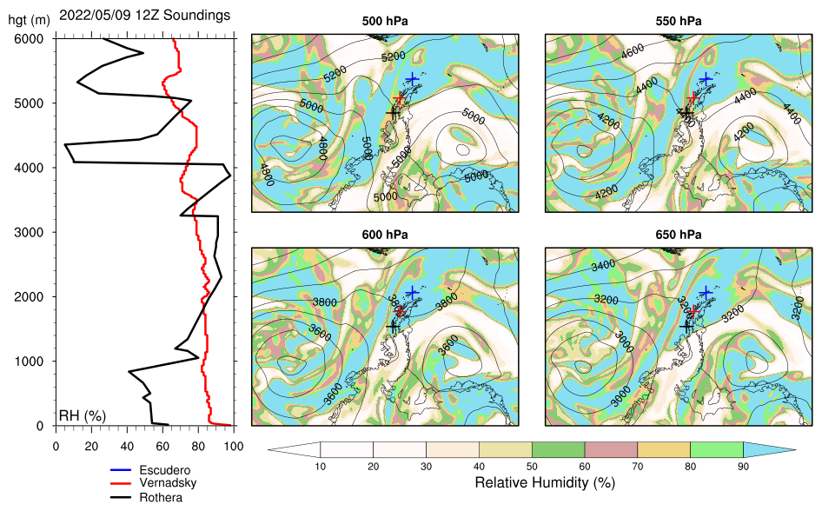
Observations and ERA5: RH – May 09 at 12Z
ERA5
4000m low RH at Rothera in the observations
At 500 hPa and 550 hPa ERA5 shows that the station is in the dry air region
Notes:
Contour lines – geopotential height

Slide 10
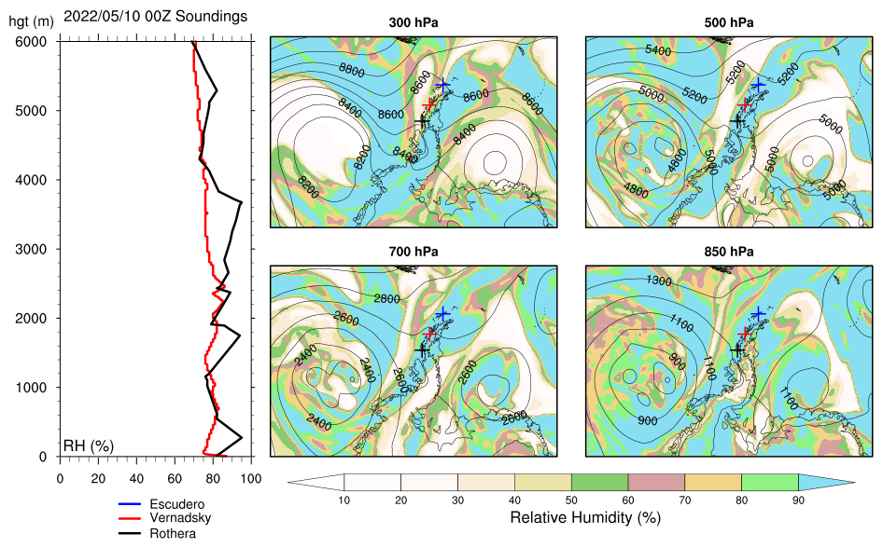
Observations and ERA5: RH – May 10 at 00Z
ERA5
No sounding for Escudero
High RH at other two stations at all levels - ERA5 confirms
AR intrusion begins
A

Slide 11
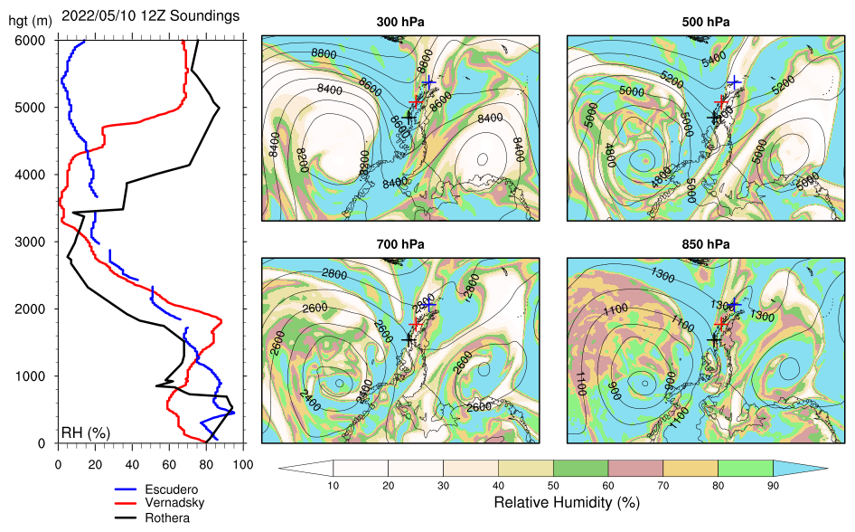
Observations and ERA5: RH – May 10 at 12Z
ERA5
High RH at all three stations at lower levels – due to moist intrusion of AR
ERA5 shows slot of dry air in the vicinity of the stations, most marked at 700 hPa and 500 hPa
The soundings show the driest air around 700 hPa overlying the moist air layer.
B
A

Slide 12
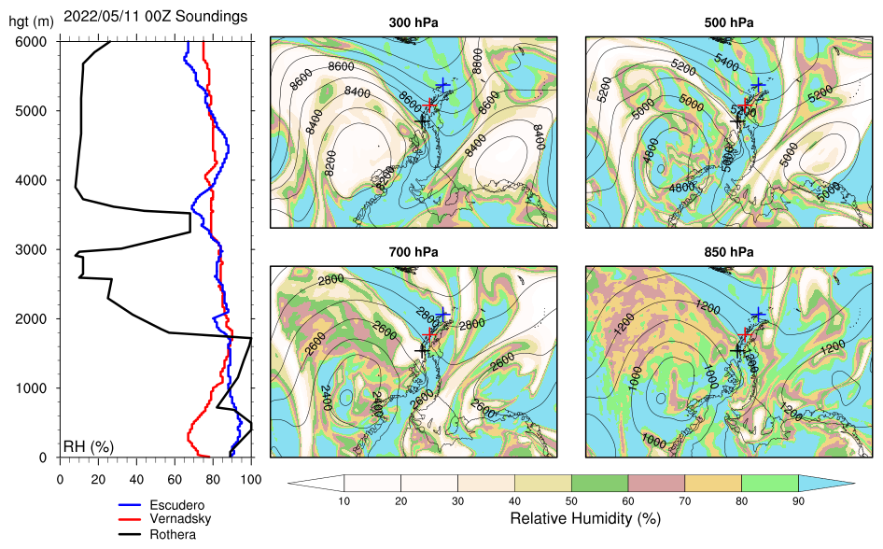
Observations and ERA5: RH – May 11 at 00Z
ERA5
High RH at Escudero and Vernadsky at all levels
Rothera observed lower RH above 1800 m, except near 3500 m
Rothera - dry air analyzed by ERA5 at 700 hPa and 500 hPa
B
A

Slide 13
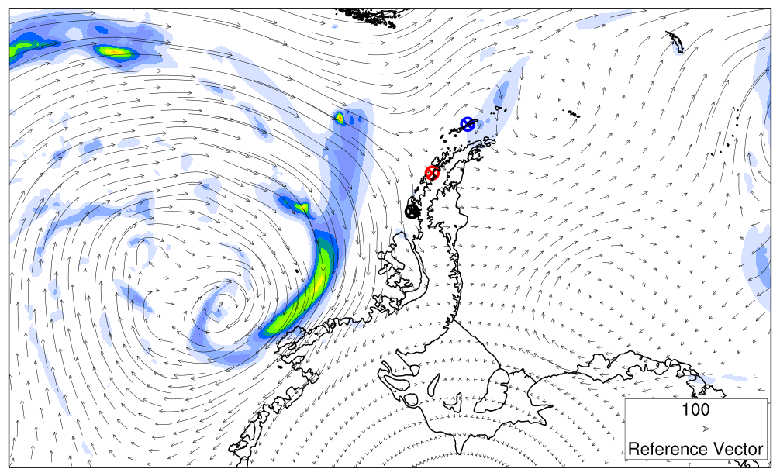
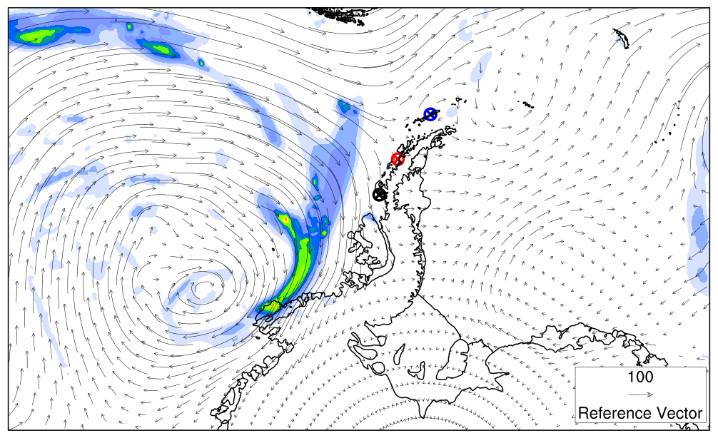
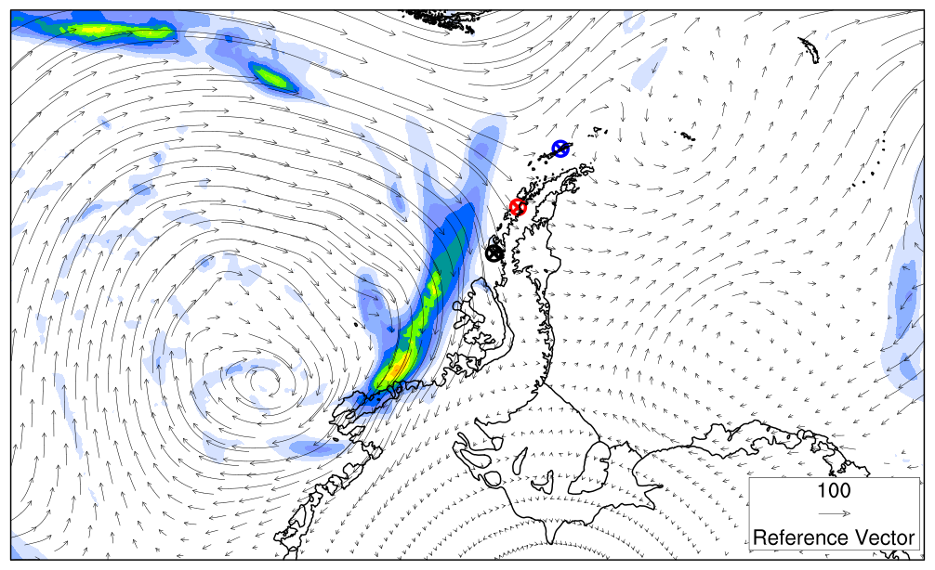
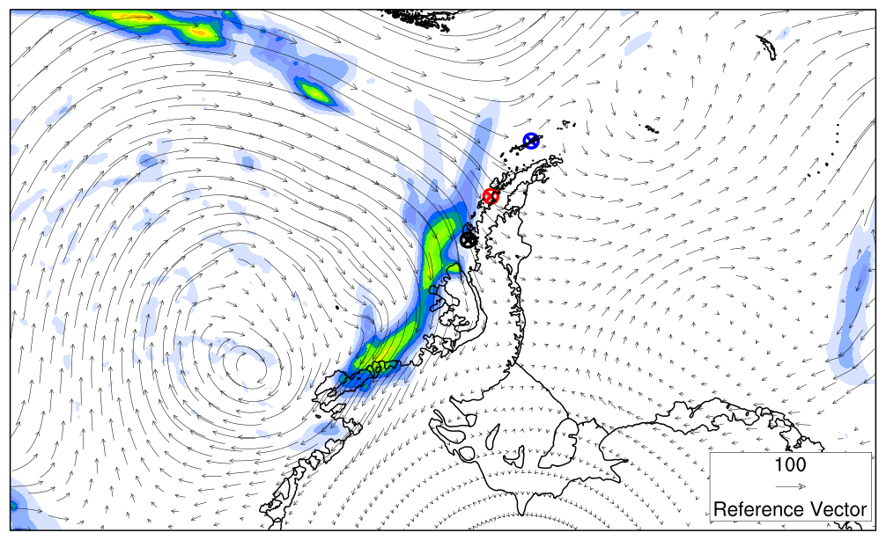
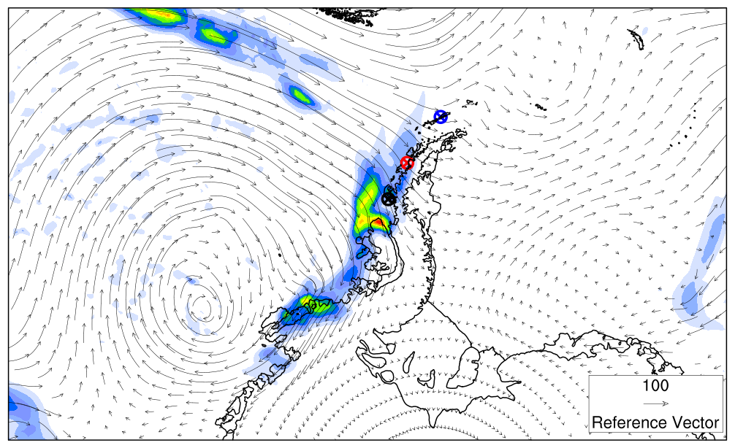
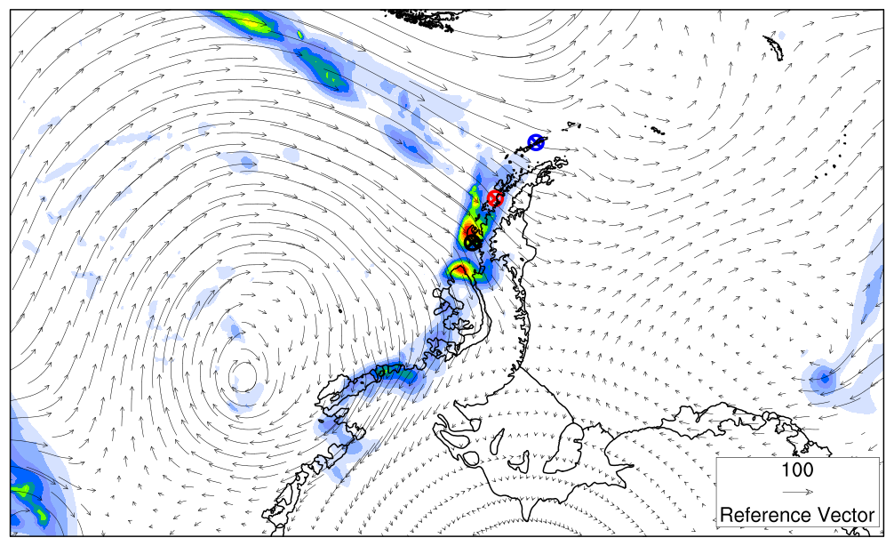
ERA5 IVT and 1-hour Accum. Precip. for May 10
AR near the stations on May 10.
IVT maximum moving through the Antarctic Peninsula at 21Z.
06Z
09Z
12Z
15Z
18Z
21Z
mm kg m⁻¹ s⁻¹

Slide 14
Temperature
Observations and ERA5 Interpolation

Slide 15
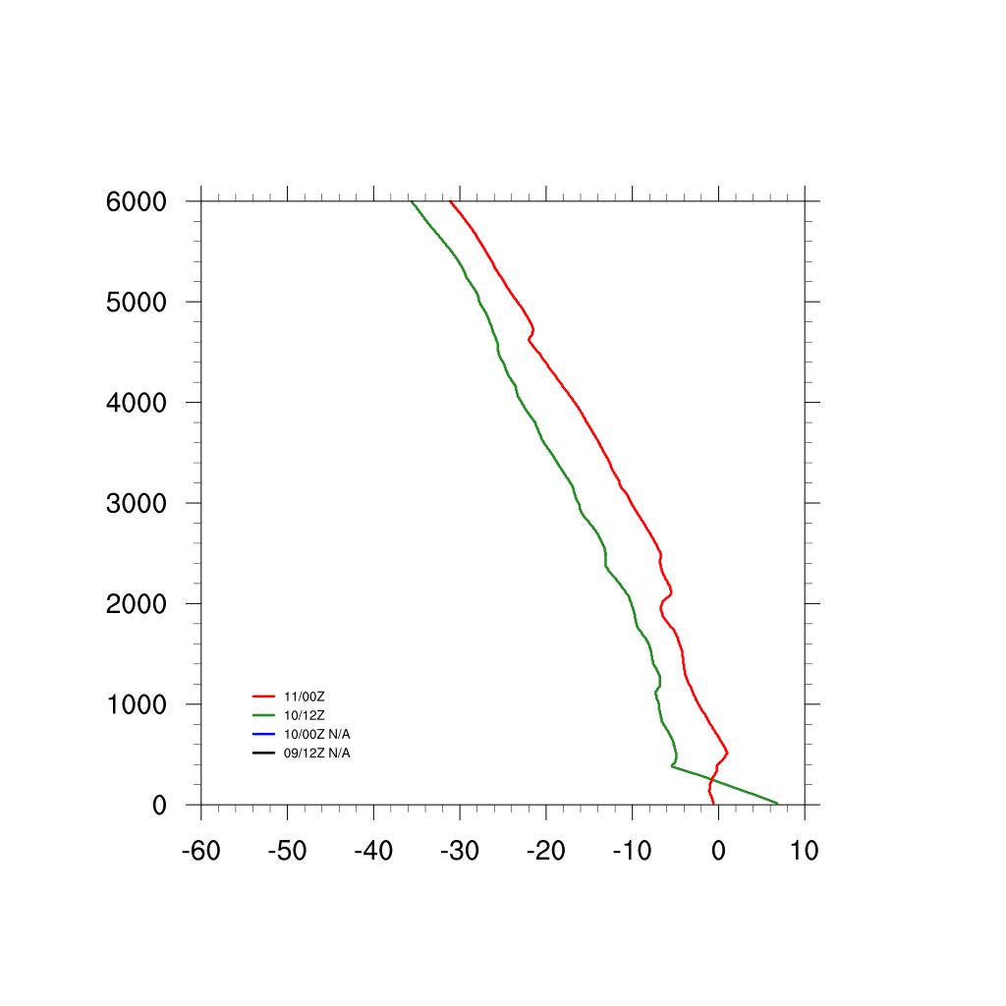
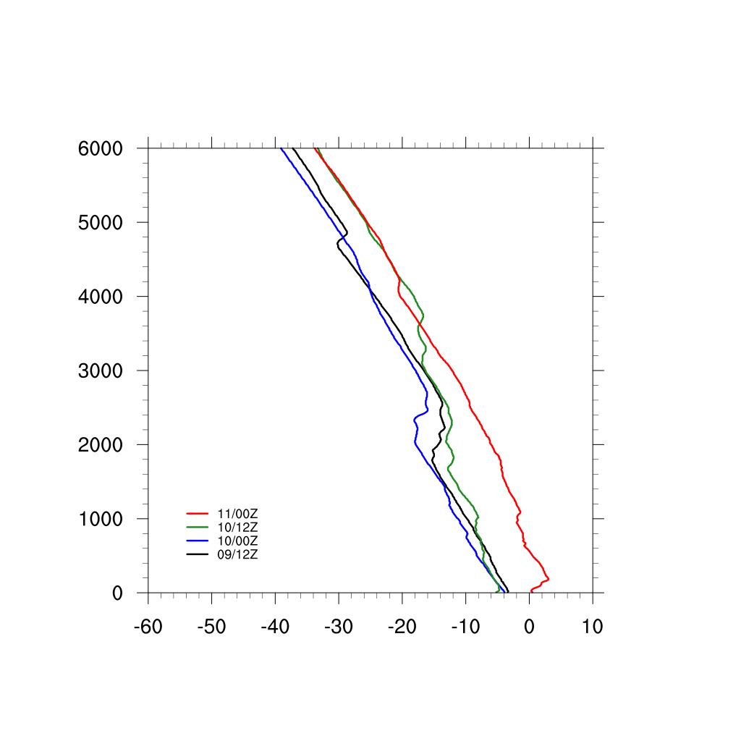
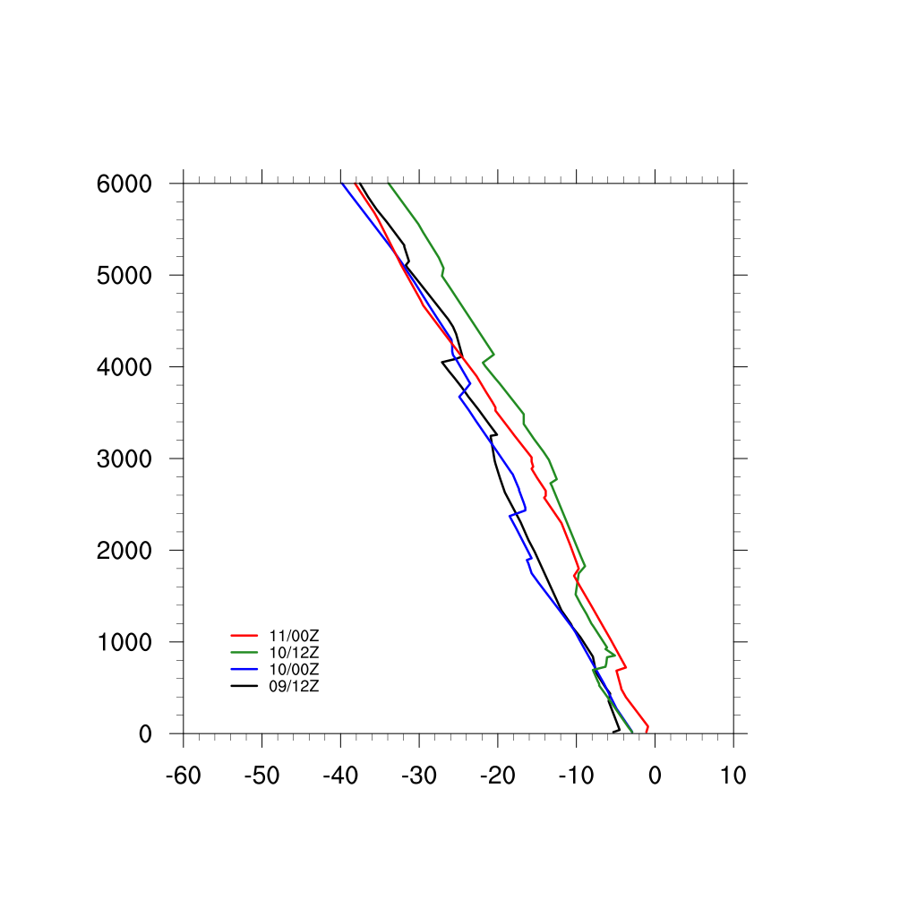
Temperature Observations
In general, temperatures increased with the AR event between May 10 12Z and May 11 00Z
Greater increase was at Vernadsky
Escudero
Vernadsky
Rothera
m
m
m

Slide 16
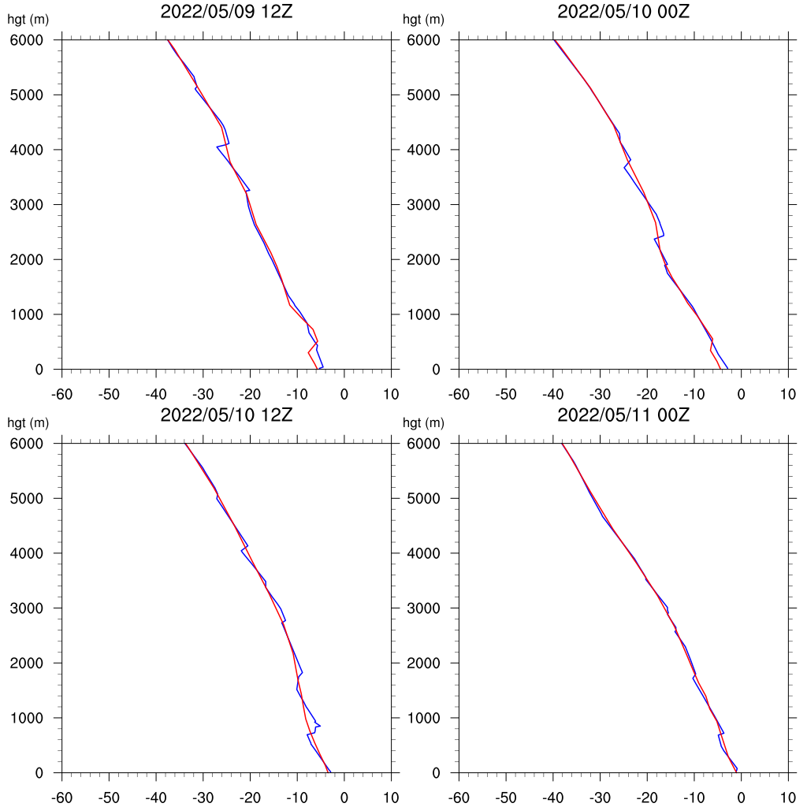
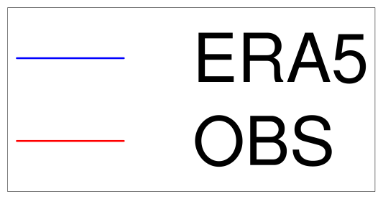
Temperature - Rothera
Example shows that ERA5 well represents the temperature of the soundings

Slide 17
Relative Humidity Cross Sections
From ERA5

Slide 18
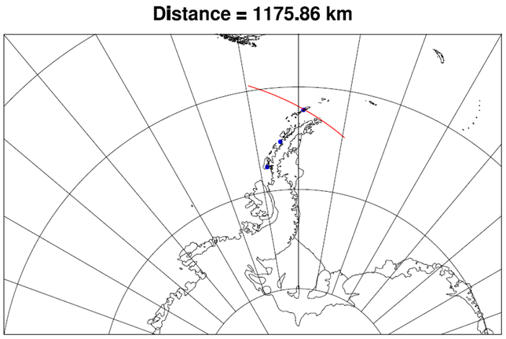
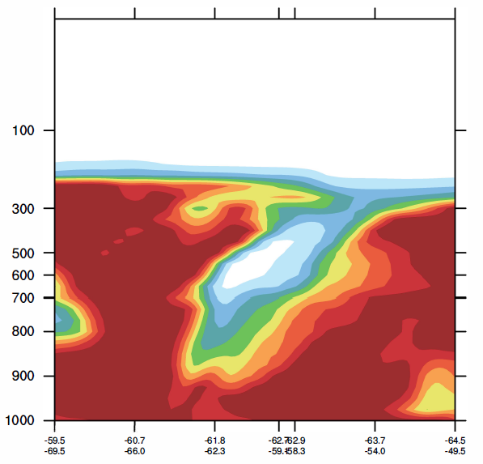
Escudero
2022/05/09 12Z
2022/05/10 00Z
%
2022/05/10 12Z
2022/05/11 00Z
Complicated event: A dry pocket observed around 700 hPa on May 10 at 12Z.
Notes:
Cros section – starting point – ending point: from west to east

Slide 19
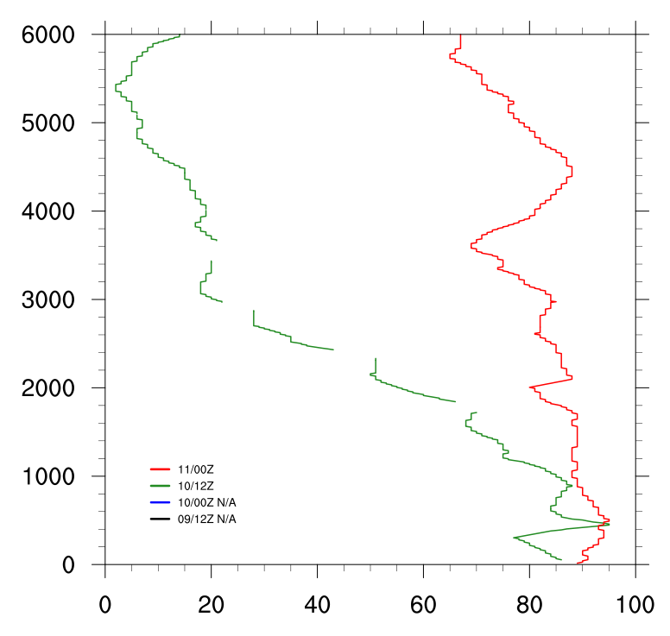
Escudero
2022/05/09 12Z
2022/05/10 00Z
%
May 10 – 12Z: Dry area A observed in the sounding
May 11 – 00Z: High RH all levels also observed in the sounding
A
2022/05/10 12Z
2022/05/11 00Z
A
A
Notes:
Cros section – starting point – ending point: from west to east

Slide 20
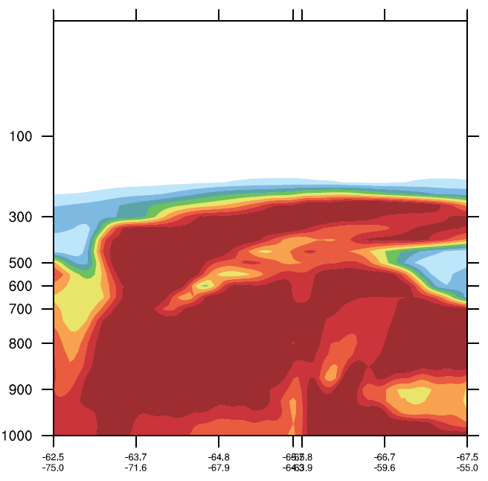
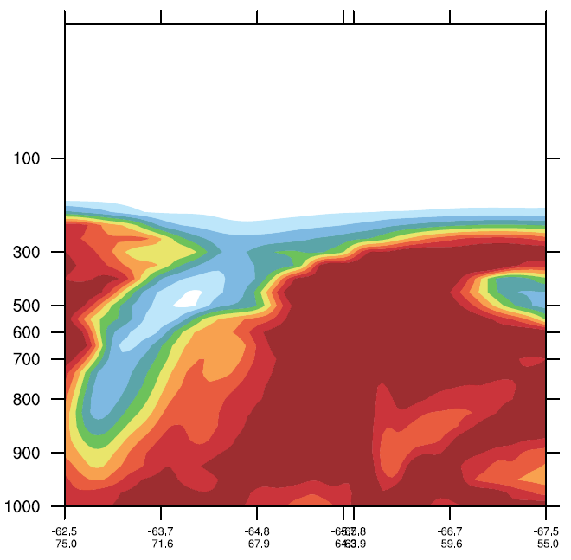
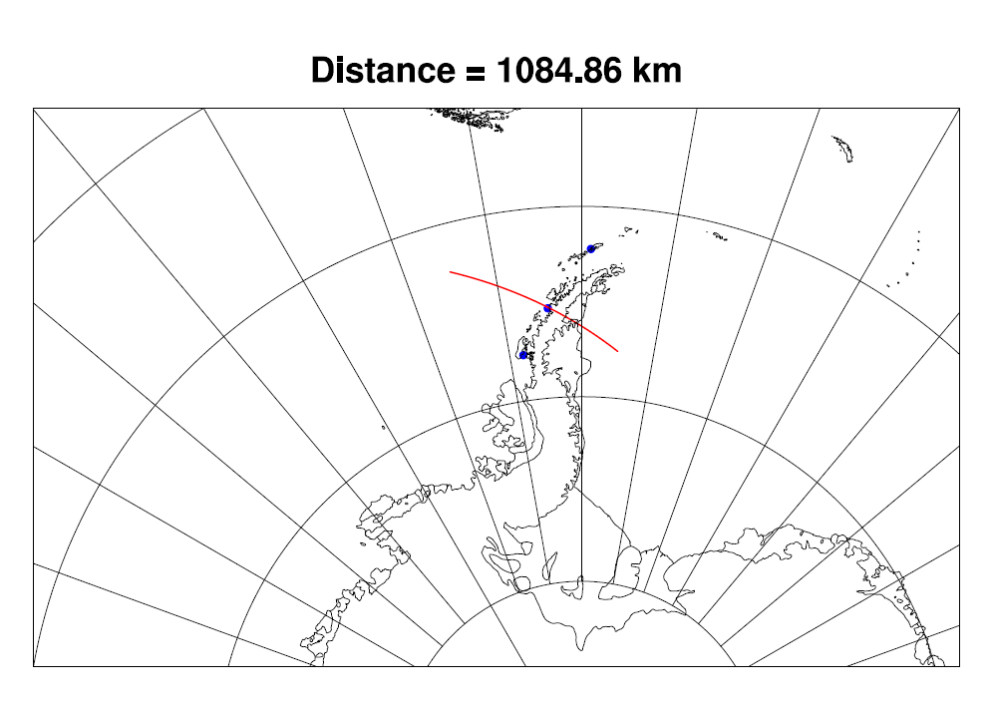
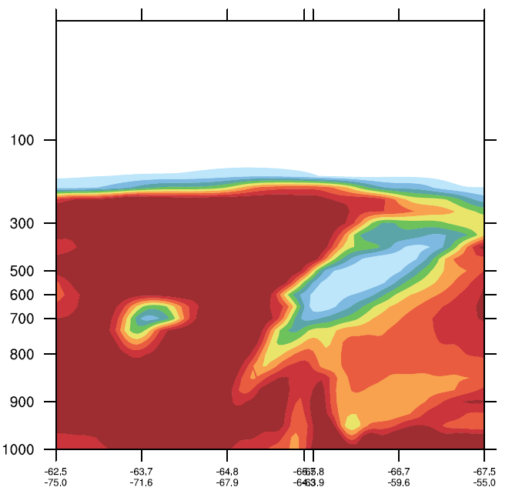
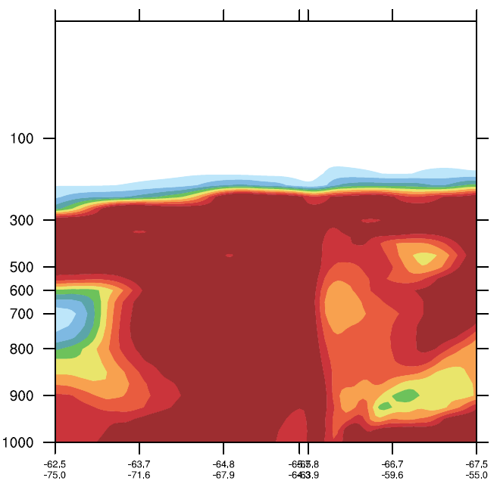
Vernadsky
2022/05/09 12Z
2022/05/10 00Z
%
2022/05/10 12Z
2022/05/11 00Z
Dry pocket passing through station near 700 hPa on May 10 at 12Z

Slide 21
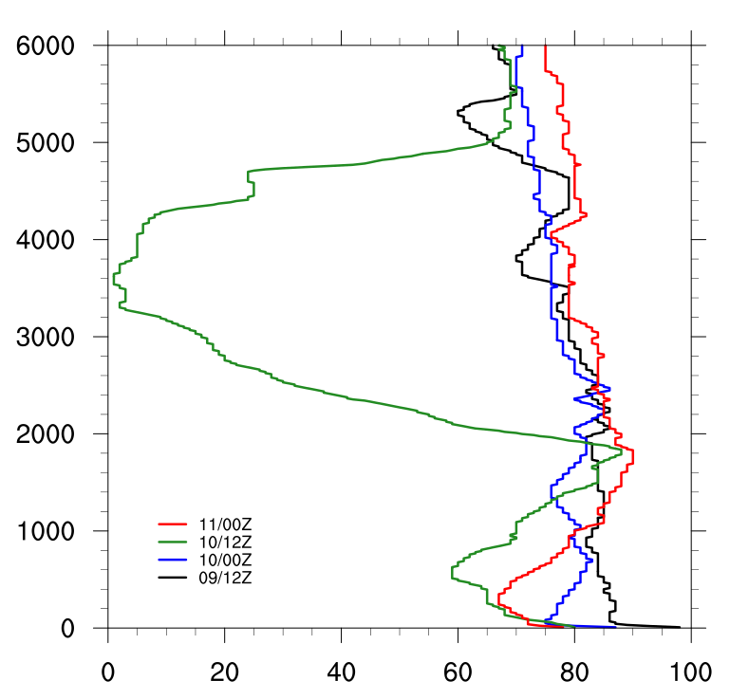
Vernadsky
May 9 – 12Z and May 10 – 00Z: High RH
May 10 – 12Z: Dry area A observed in the sounding
May 11 – 00Z: High RH all levels also observed in the sounding
2022/05/09 12Z
2022/05/10 00Z
%
A
2022/05/10 12Z
2022/05/11 00Z
A
B
A

Slide 22
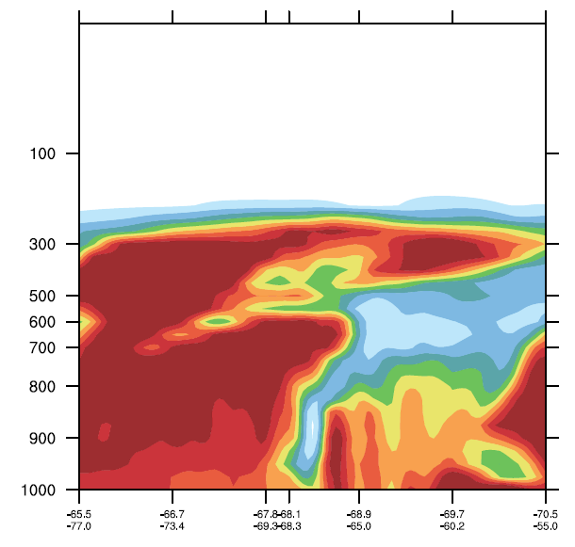
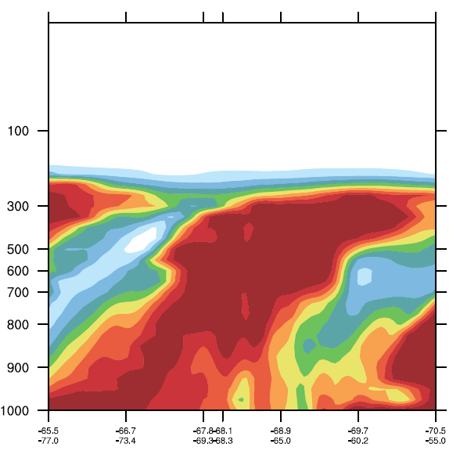
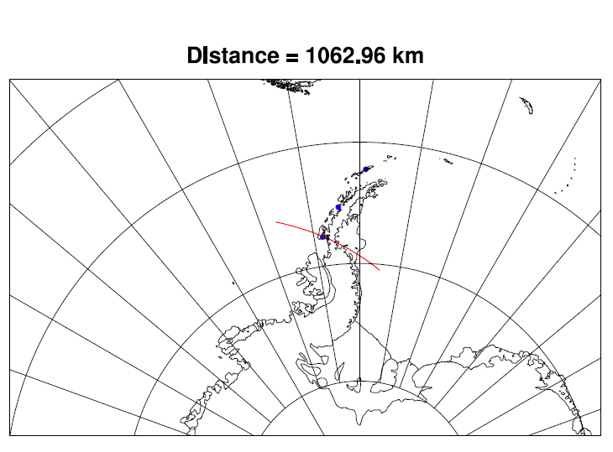
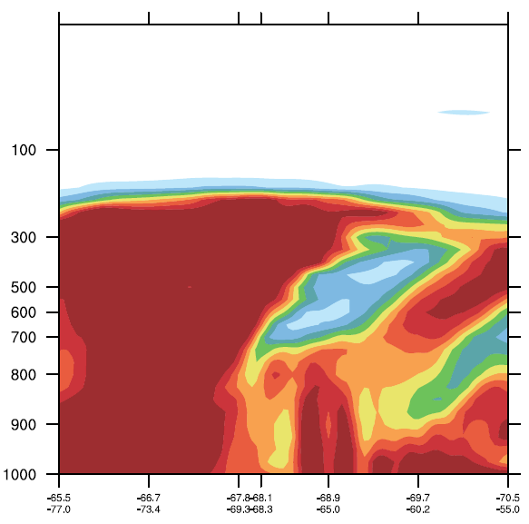
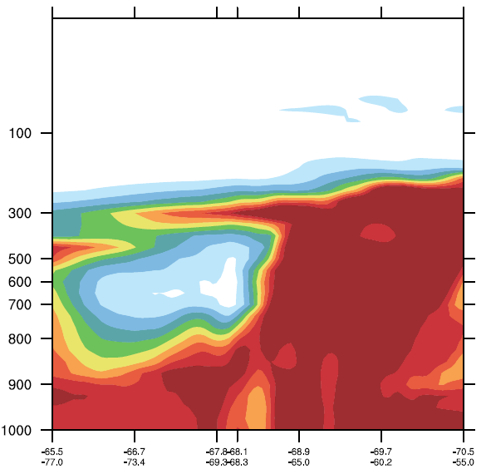
Rothera
2022/05/09 12Z
2022/05/10 00Z
%
2022/05/10 12Z
2022/05/11 00Z
Dry pocket passing through station near 700 hPa on May 10 at 12Z

Slide 23
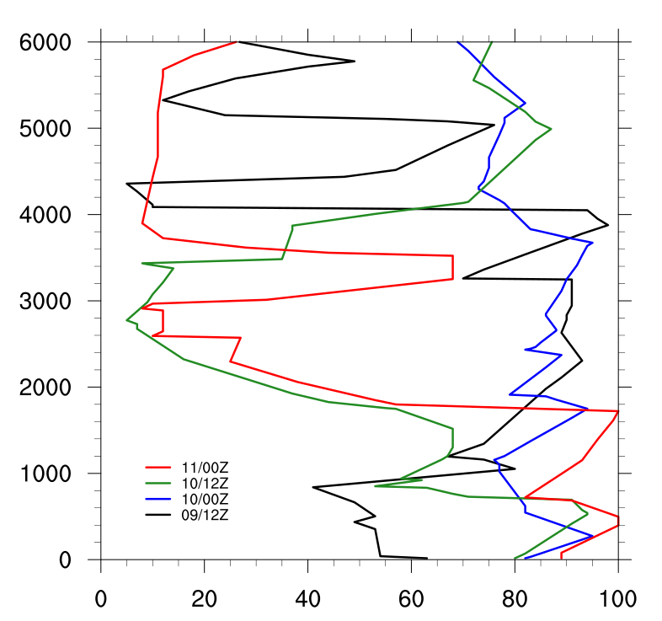
Rothera
2022/05/09 12Z
2022/05/10 00Z
May 9 – 12Z: High and low RH
May 10 – 00Z: High RH
May 10 – 12Z: Dry area A observed in the sounding
May 11 – 00Z: Second dry area B approaching the station
%
A
2022/05/10 12Z
2022/05/11 00Z
A
B

Slide 24
Conclusion
May 10 at 1200 UTC:
Observed a synoptic event that combines moist precipitating areas and dry descending air in a complicated pattern.
High RH at low levels caused by the AR intrusion in the region.
Dry area A moving southeast.
On May 11 at 0000 UTC, high RH at all levels also due to the AR.
This AR event resulted in warm and moist air impacting the Peninsula.
Keith’s presentation next: PWRF modeling of this event.

Slide 25
Thank You!
Questions and Comments?
Image from: https://www.wwf.org.uk

