Slide 1
AMPS UPDATE – June 2023
Workshop on Antarctic Meteorology and Climate – Madison, WI
Kevin W. Manning & Jordan G. Powers
National Center for Atmospheric Research
Boulder, CO
02 June 2023
Notes:
NOTE: Background image can be used as is or changed for a particular presentation in the “Slide Master” button found under the “View” tab.

Slide 2
The Antarctic Mesoscale Prediction System
Real-time NWP customized for Antarctica
Funded by NSF-OPP for support of USAP weather forecasters
Based on NCAR’s WRF and MPAS community models
  Antarctic tunings and modifications
  Long-term collaboration with OSU/BPCRC’s Polar-WRF effort
Run on NCAR’s supercomputers
  Funding from NSF-OPP for computing time and support
Real-time graphics, tables, data files posted to AMPS web site
  https://www2.mmm.ucar.edu/rt/amps
  Many products designed in consultation with Antarctic forecasters
20+ year archive of AMPS forecast data (MM5 and WRF eras)
Field experiment support
International collaborations
AMPS Update – WAMC 2023

Slide 3
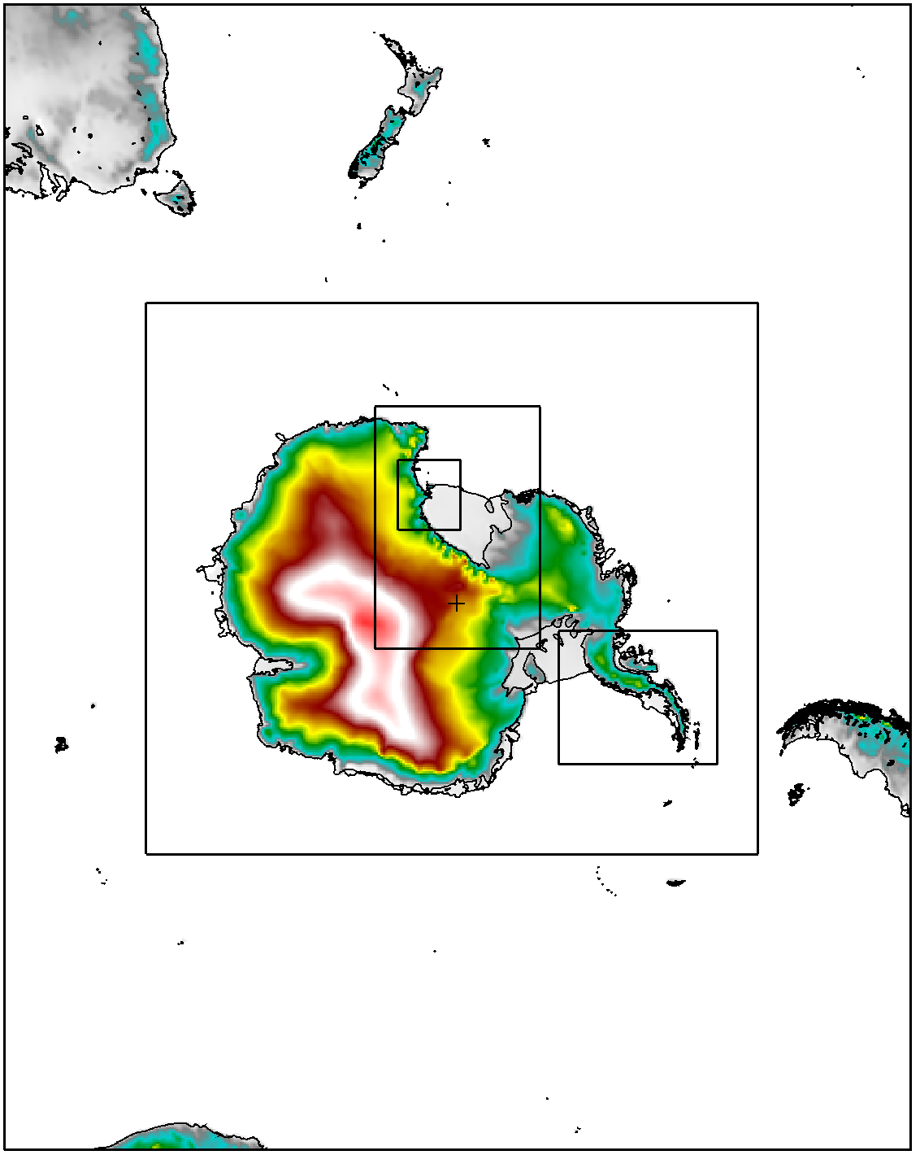
AMPS grids (WRF)
24-km
8-km
2.7-km
0.89-km
2.7-km
AMPS Update – WAMC 2023
3

Slide 4

AMPS Computing Update
New NCAR supercomputer “Derecho” on-site
  NSF-OPP contributed funds to Derecho acquisition for running AMPS
  NCAR community supercomputer (hosts thousands of users)
  Currently being tested and configured
  https://www2.cisl.ucar.edu/computing-data/computing
Expect to be running AMPS on Derecho before the year’s end
  Expect ~2.5x computing power for AMPS over current hardware
    More detailed microphysics
    Enhance AMPS ensemble with more members
    MPAS development
AMPS Update – WAMC 2023

Slide 5
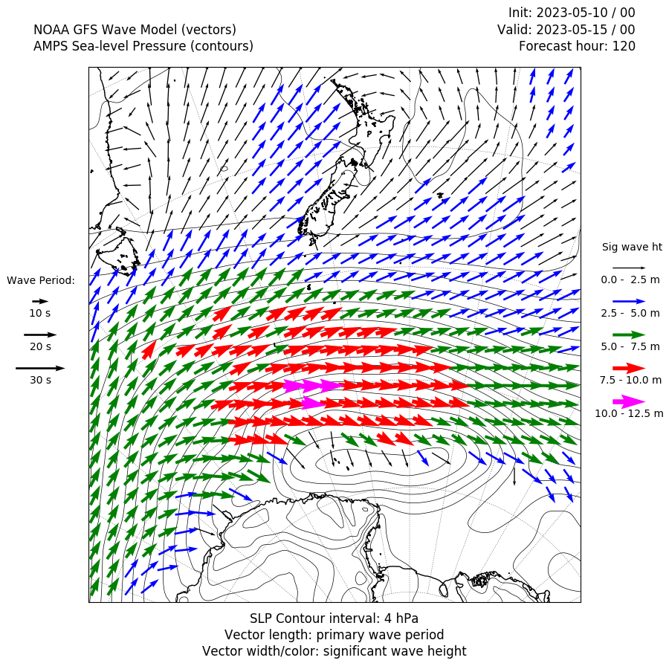
New product – external wave model output
Wave products derived from NOAA’s WAVEWATCH III model output
  Independent of AMPS
  Reflects the forcing (winds, storm systems, etc.) of NOAA’s models, not AMPS
  Fields available on ship-following windows and Christchurch-McMurdo window
  Significant wave height, wave period, and wave direction
AMPS Update – WAMC 2023

Slide 6
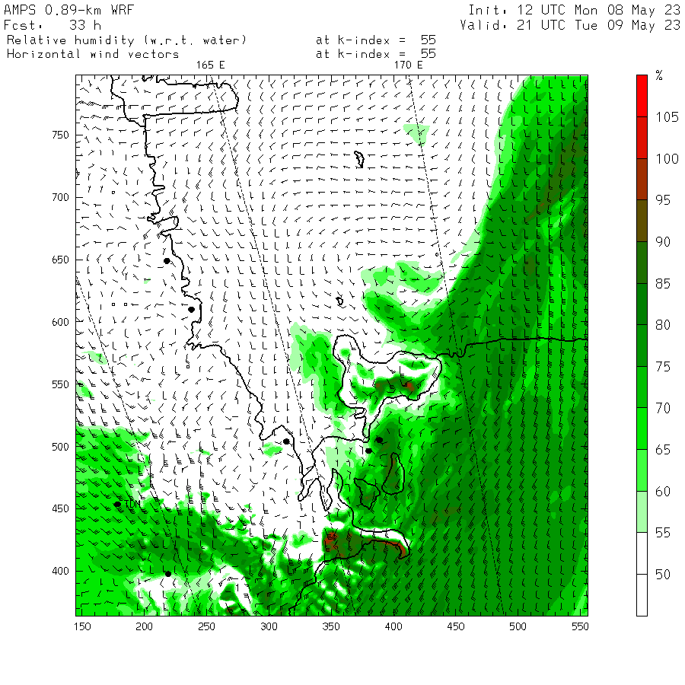
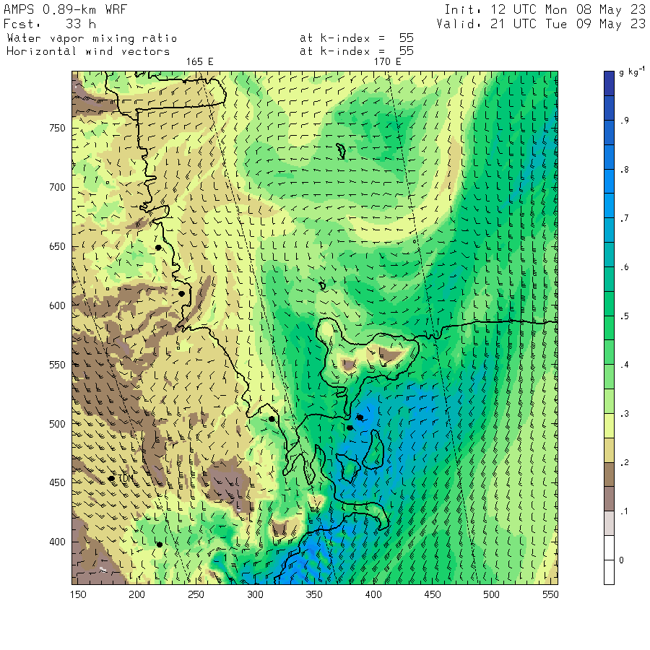
Mixing ratio fields
as an additional view of moisture
AMPS Update – WAMC 2023

Slide 7
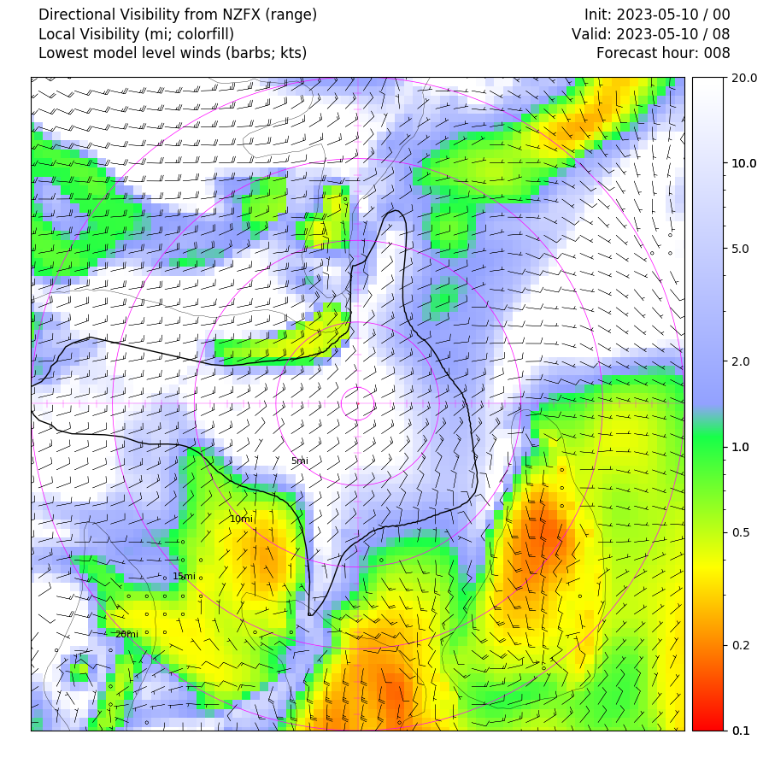
Visibility as a function of direction from site
Implemented for Phoenix airfield and McMurdo Station
Plot is a merging of:
  gridpoint-computed visibility (colorfill)
  horizontal integration resulting in visibility limit (solid black outline)
  near-surface winds
Could make an interesting statistical compilation
  E.g. “visibility rose” for a season
  Challenging verification
AMPS Update – WAMC 2023

Slide 8
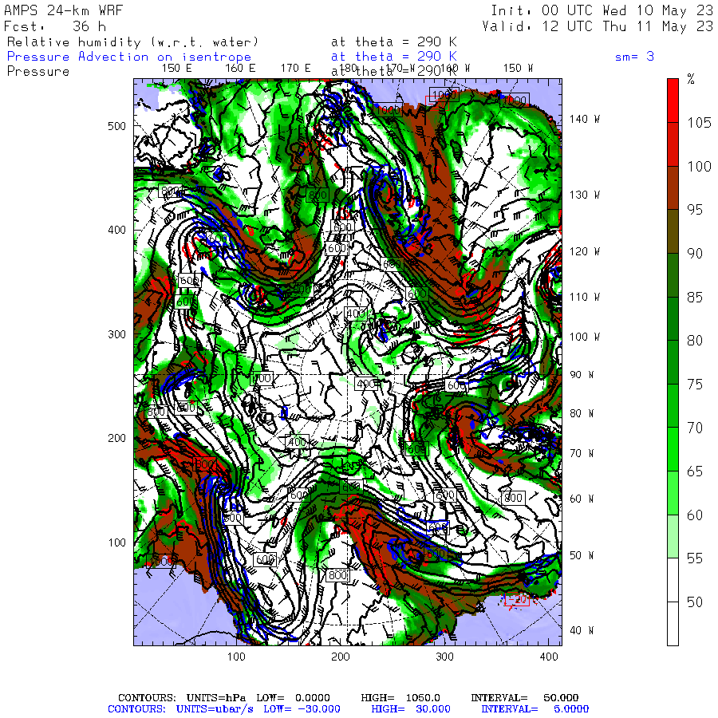
Isentropic-level fields
Humidity, pressure, winds, and pressure advection on selected isentropic surfaces
Larger-scale, lower-resolution grids (8- and 24-km) at present
AMPS Update – WAMC 2023

Slide 9
Plans – near term
Transition AMPS to new supercomputer Derecho
  Update WRF version (from version 3.9 to 4.3 or later)
  More detailed microphysics
  Noah-MP LSM
  Expand number of AMPS ensemble members (from 10 to ~20)
  Higher-resolution MPAS mesh refinement
AMPS Update – WAMC 2023

Slide 10
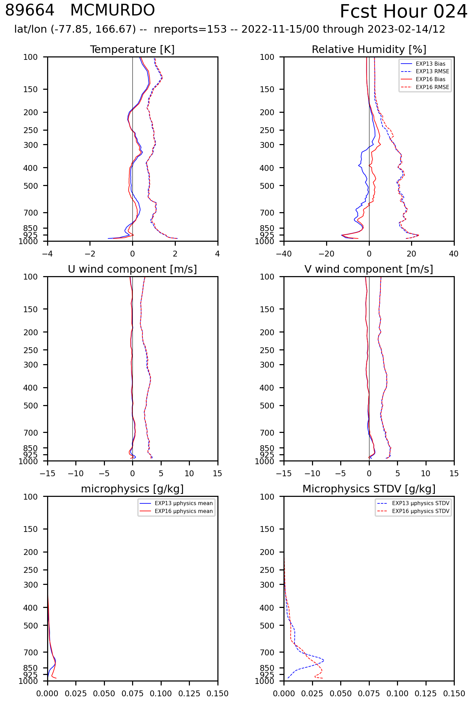
Higher-order microphysics – More cloud?
McMurdo – total microphysical species content – mean & standard deviation
24-hour forecasts – 15 Nov 2022 through 14 Feb 2023
BLUE: Noah/WSM5 – current setup
RED: Noah-MP/Morrison – proposed
AMPS Update – WAMC 2023

Slide 11
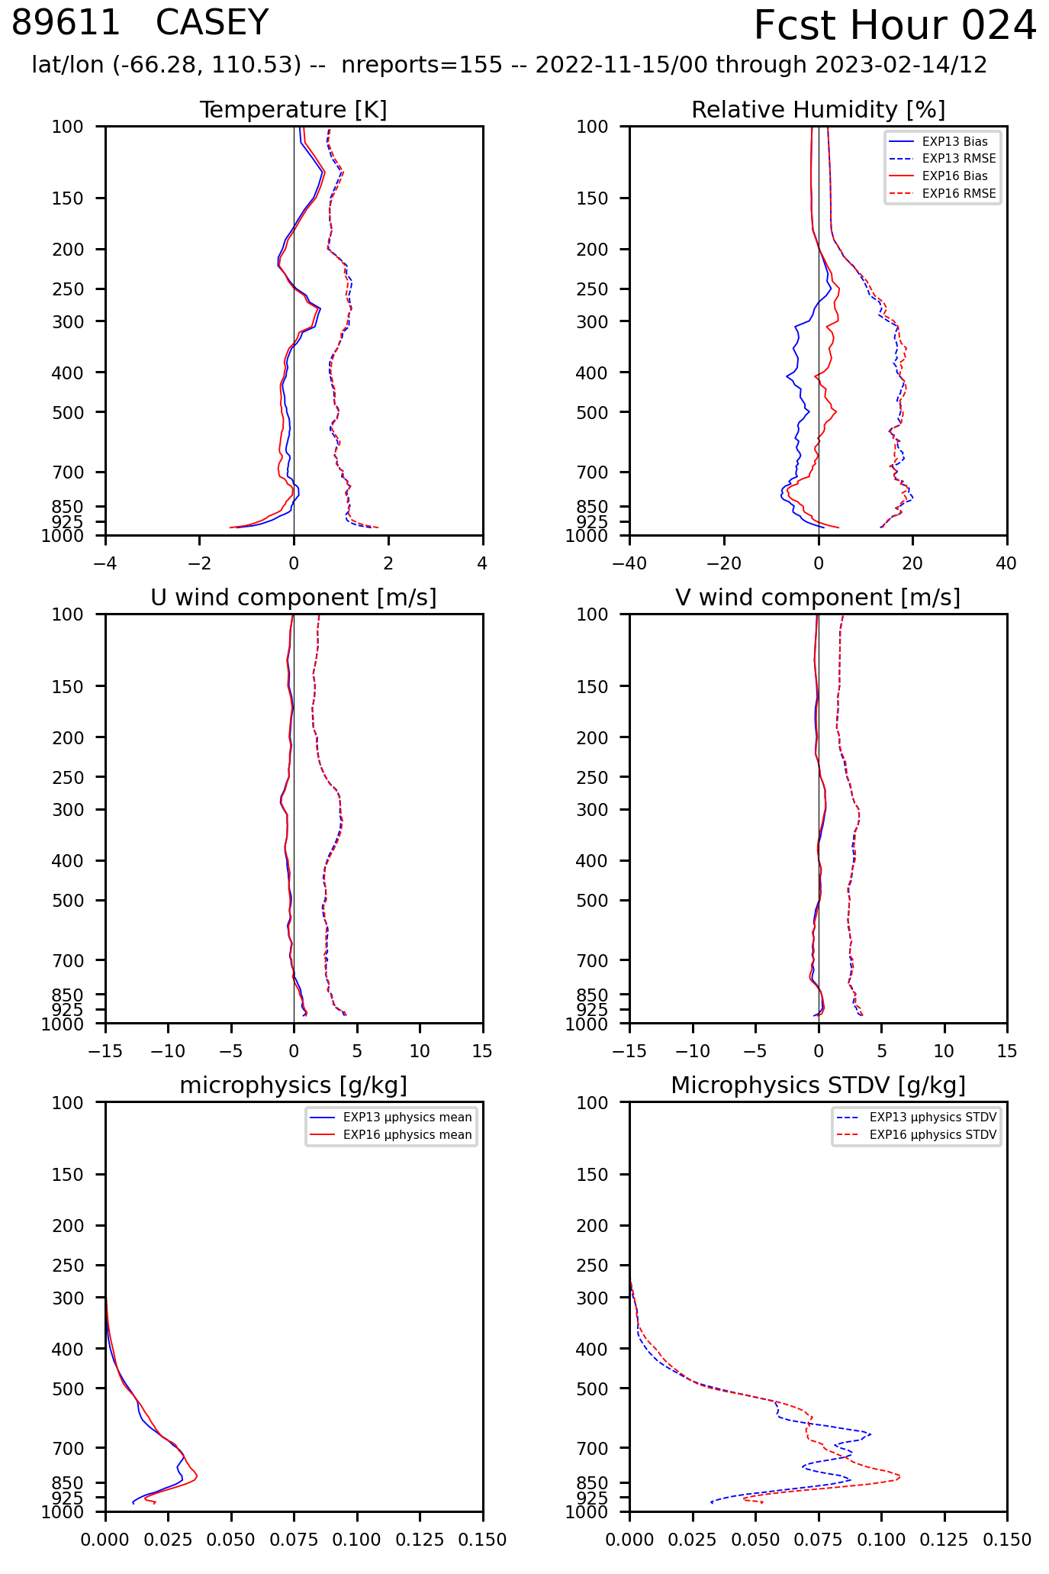
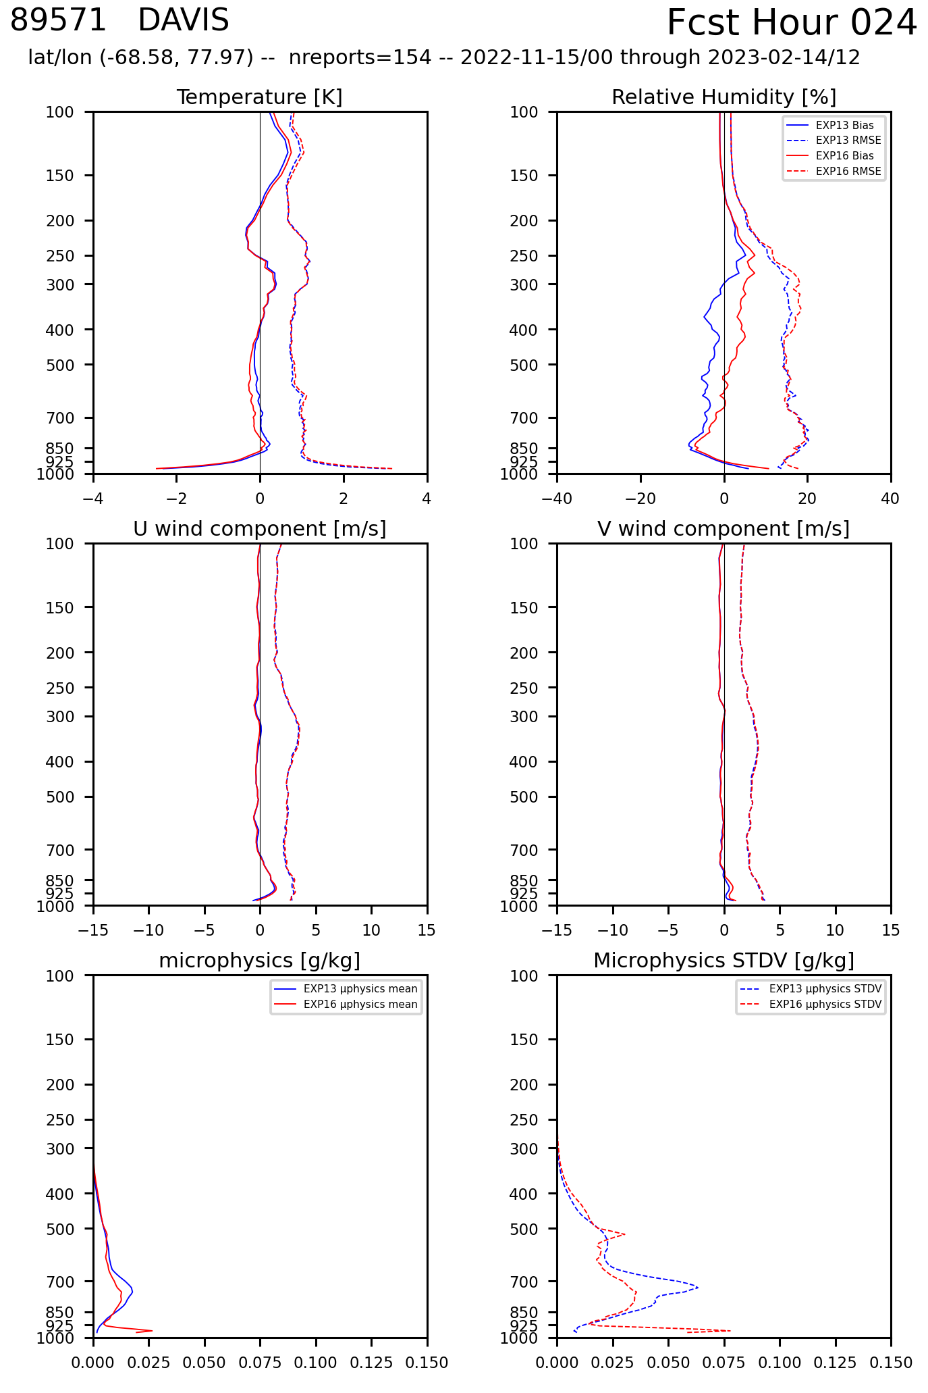
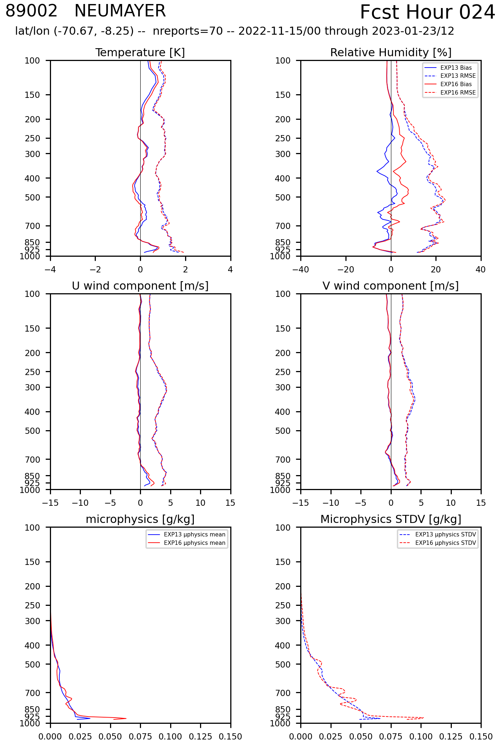
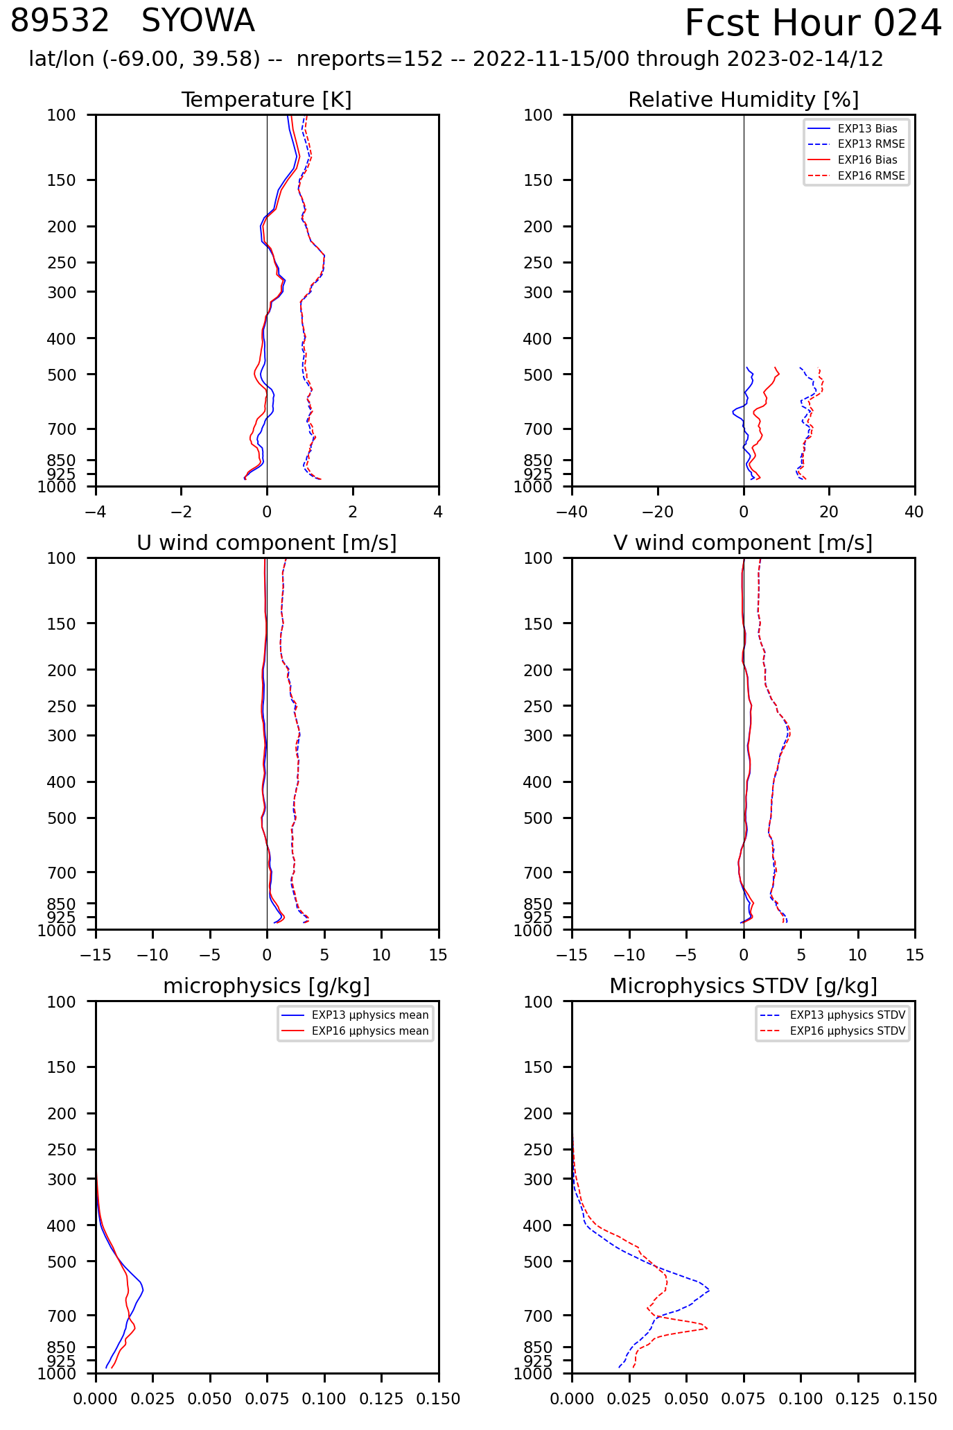
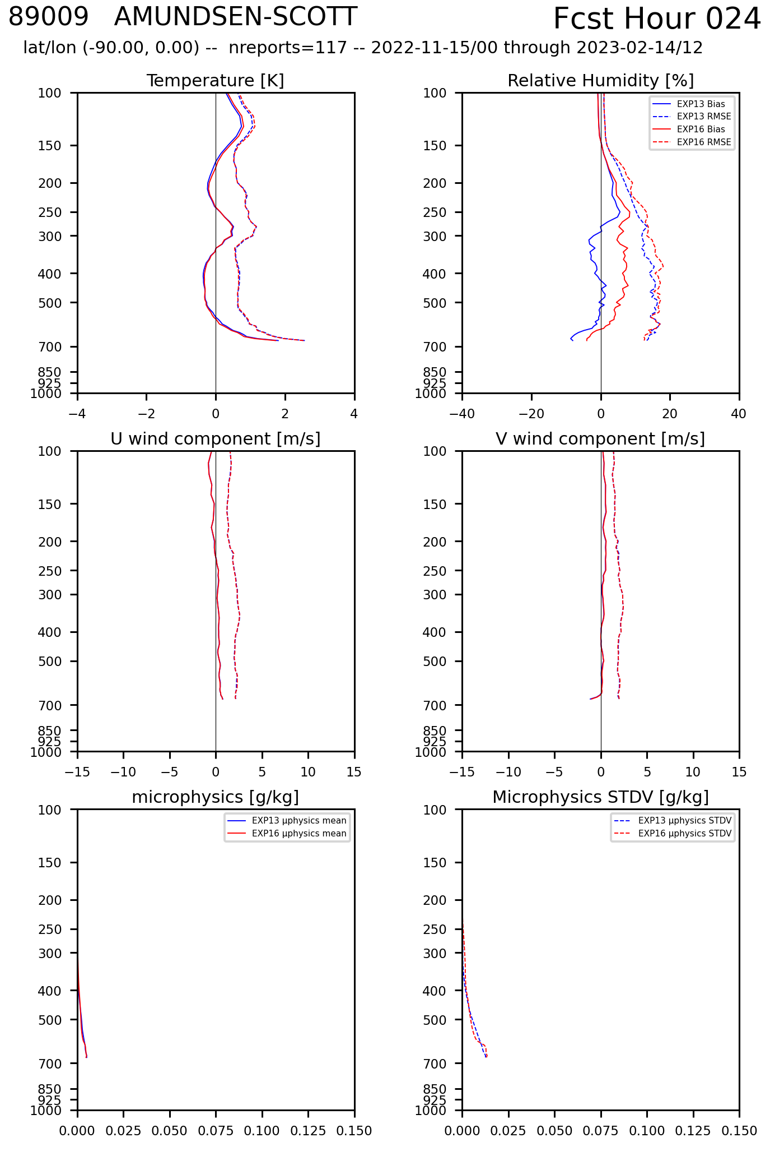
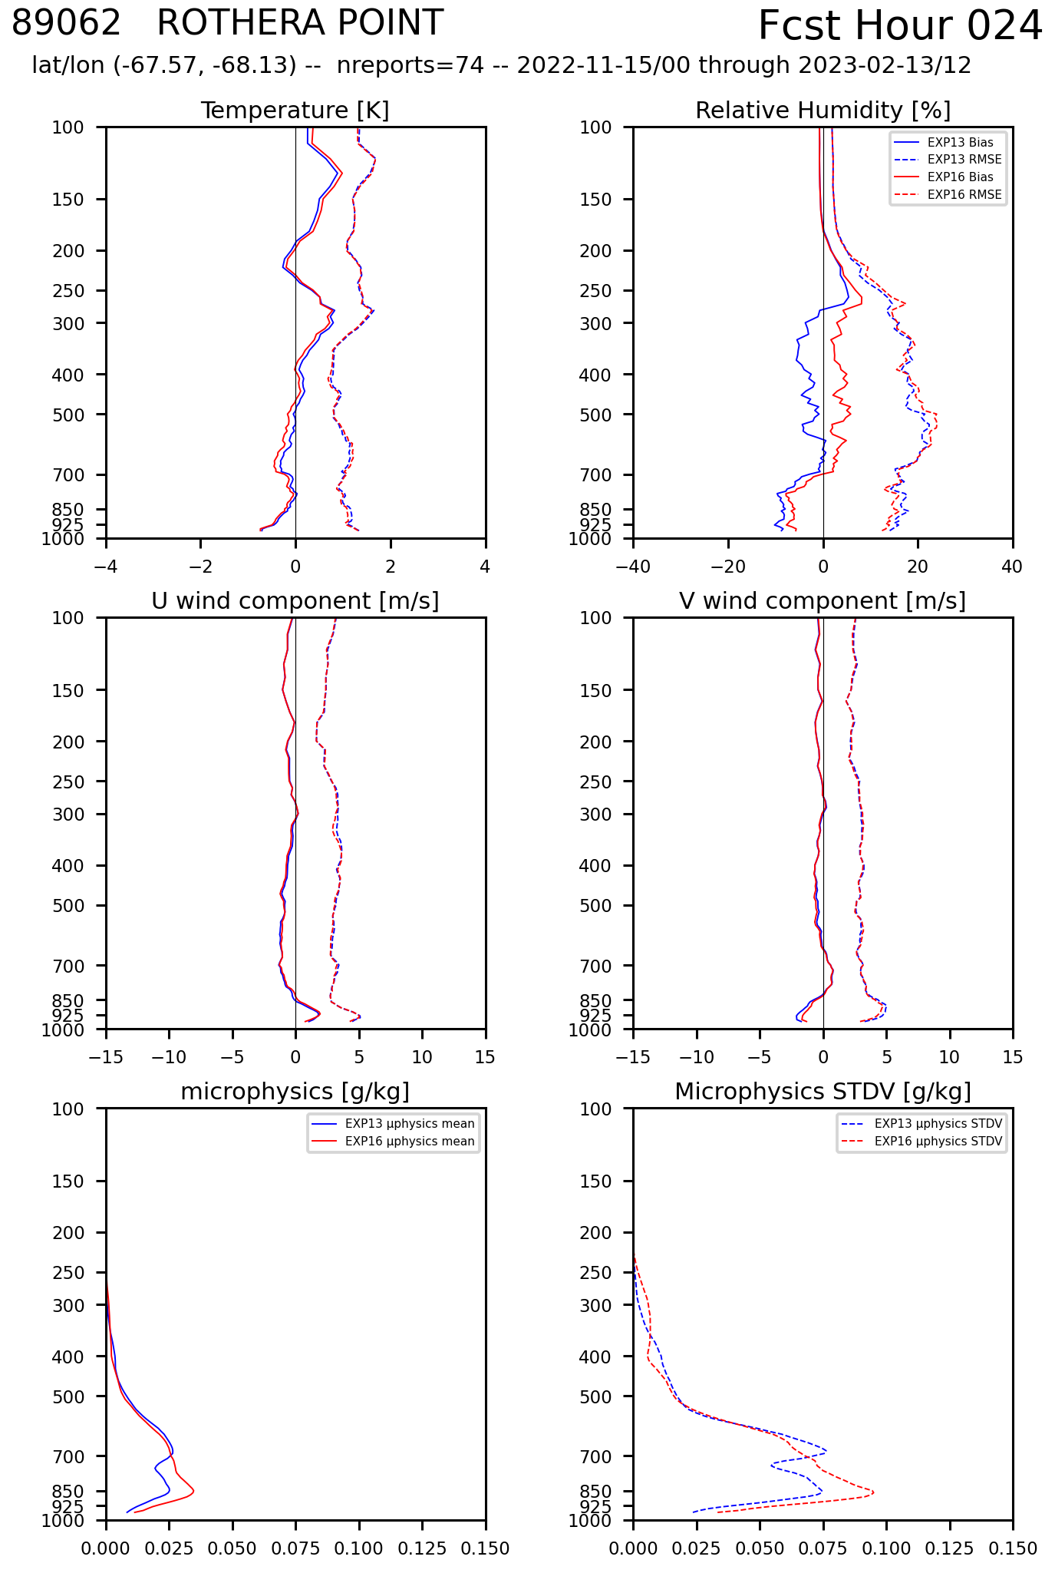
Casey
Davis
Neumayer
Syowa
Pole
Rothera

Slide 12
Plans – longer term
Possible use of Graphical Processing Units (GPU):
  AMPS (WRF) ensemble (two domains)
    Full 5-domain WRF configuration not well suited to GPU processing
  MPAS
    GPU version of latest MPAS needed
Explore transition away from WRF and toward MPAS
  Challenges:
    Broad range of mesh resolution (24 km to 888 m in WRF).
    Ensemble
  Possibly make use of
    Regional MPAS
    GPUs
    One-way nesting (MPAS –to– MPAS)
    One-way nesting (MPAS –to– WRF)
AMPS Update – WAMC 2023

Slide 13
Questions
AMPS Update – WAMC 2023

Slide 15
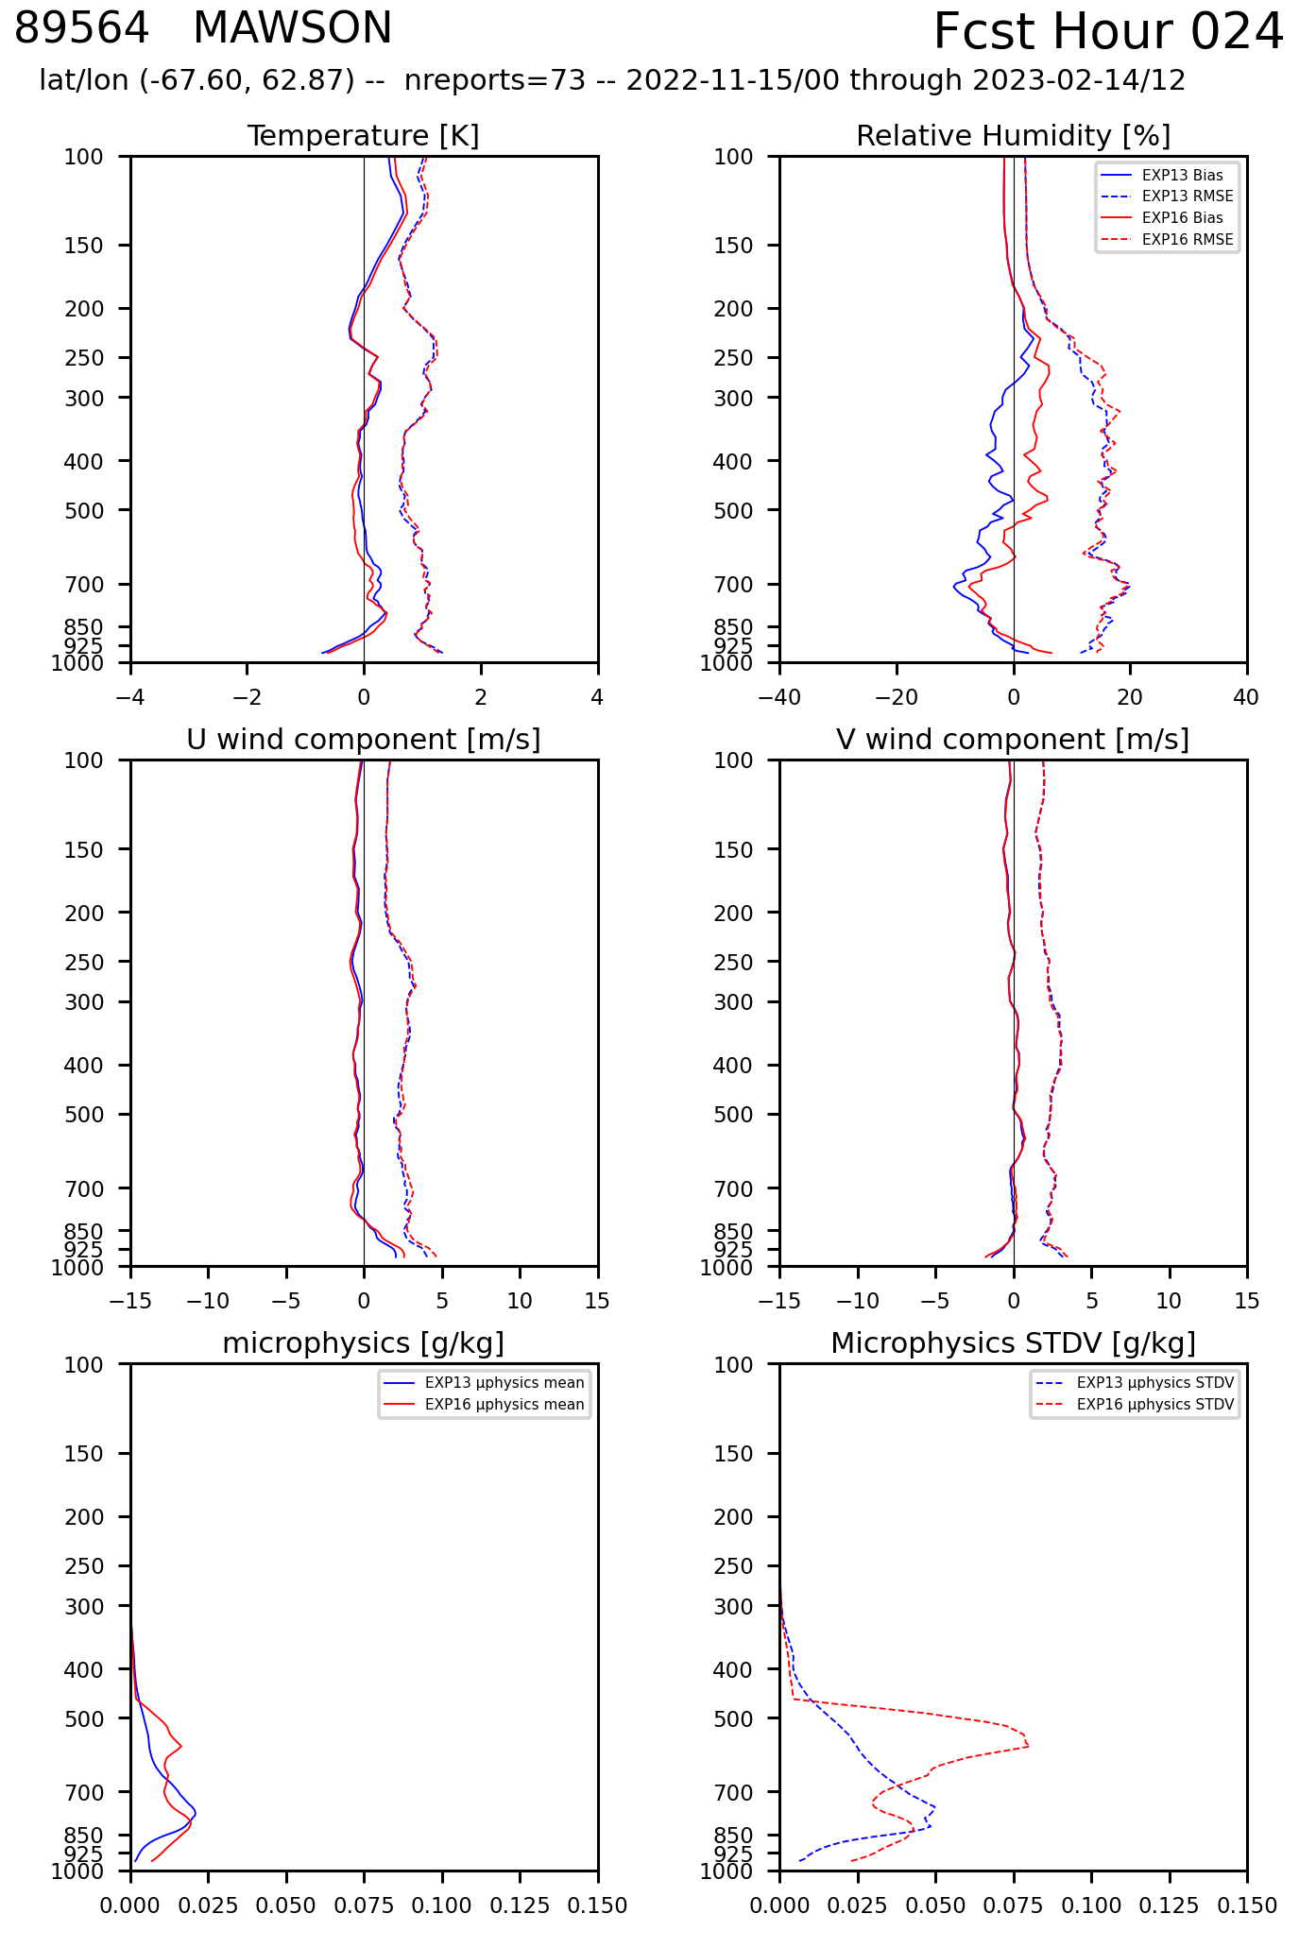

Slide 18
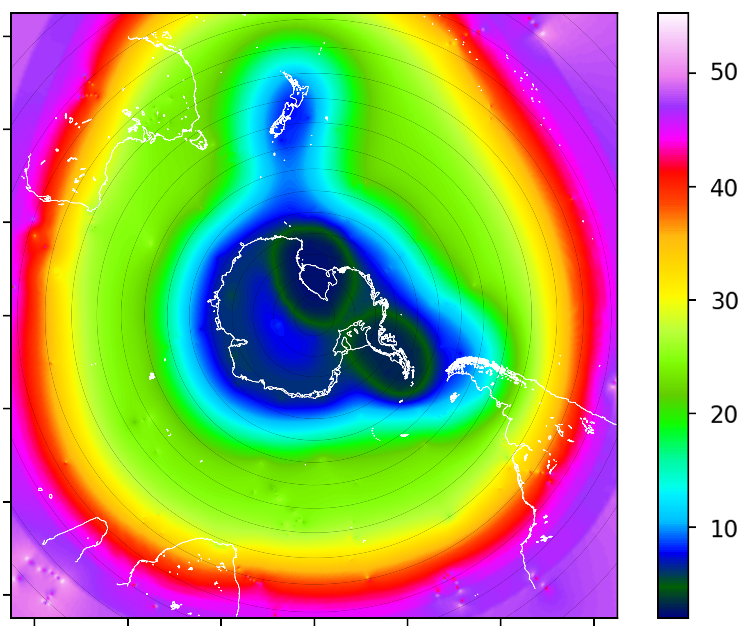
km

