Slide 1
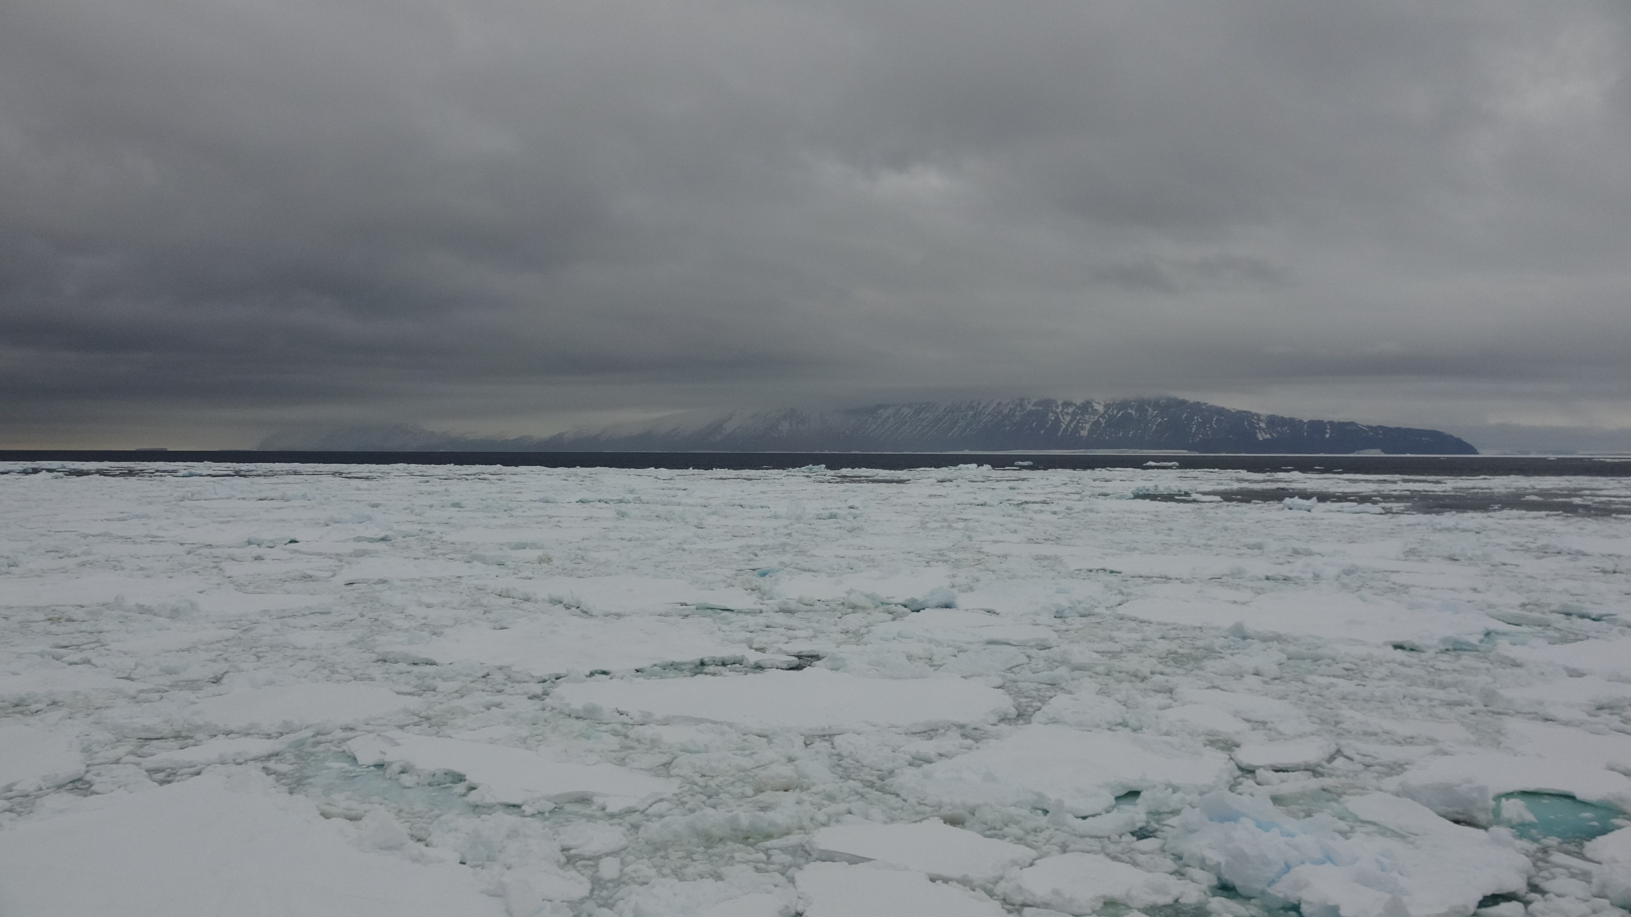

The Role of Atmospheric Rivers in Antarctic Sea Ice Variations
Kaixin Liang¹, Jinfei Wang¹, Hao Luo¹, Qinghua Yang^{1*}
¹School of Atmospheric Sciences, Sun Yat-sen University, and Southern Marine Science and Engineering Guangdong Laboratory (Zhuhai), Zhuhai, China
Email: liangkx6@mail2.sysu.edu.cn
May 31, 2023, online

Slide 2
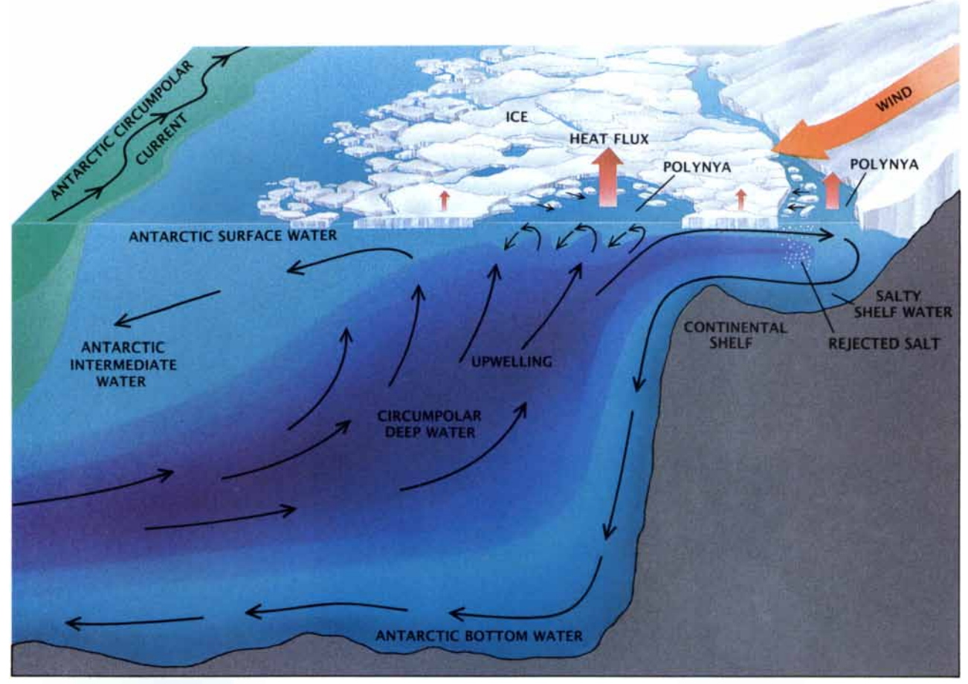
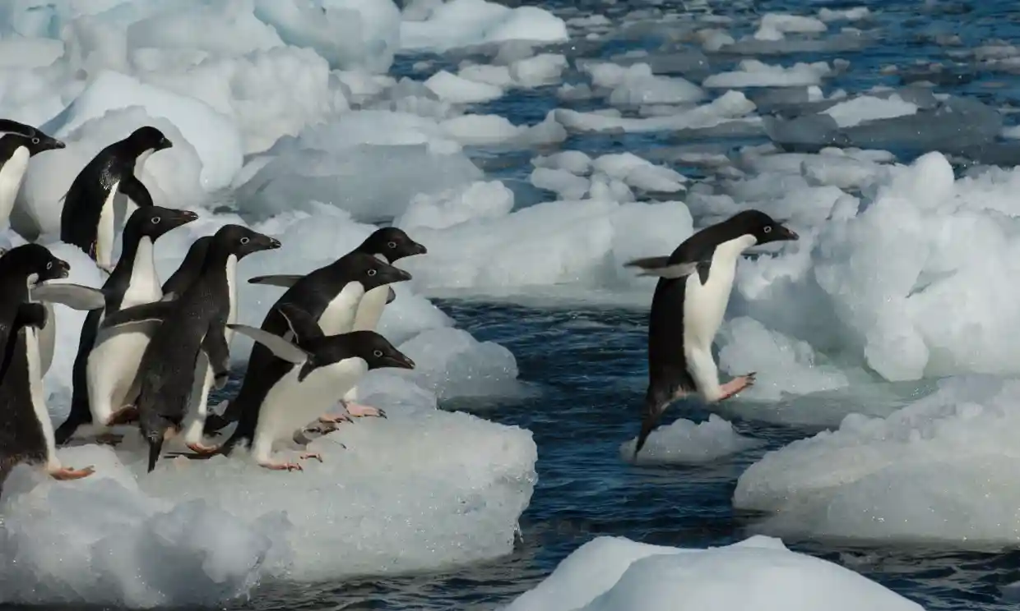
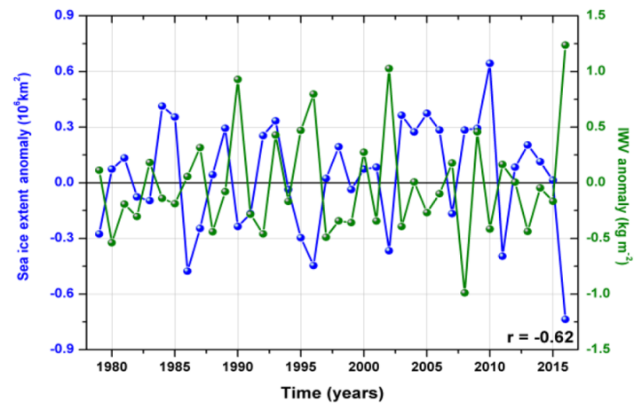
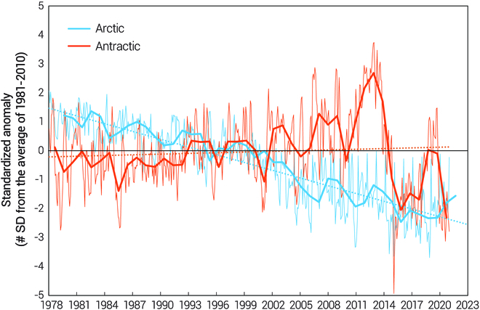
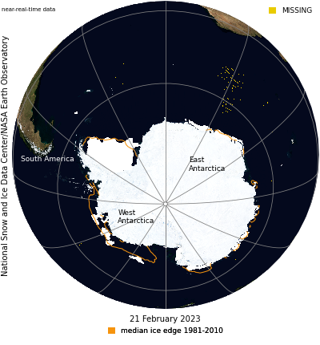
1. Motivation: Variations of Antarctic Sea Ice
(Gordon and Comiso, 1998)
Credit: Wolfgang Kaehler
SIE is negatively correlated with moisture content (Ionita et al., 2018)
Antarctic sea ice plays a significant role in the global climate system and local ecosystem
The puzzle of Antarctic sea ice change
Moisture transport plays a key role in sea ice variability
(Shokr & Ye, 2023)
Credit: NSIDC/NASA Earth Observatory

Slide 3
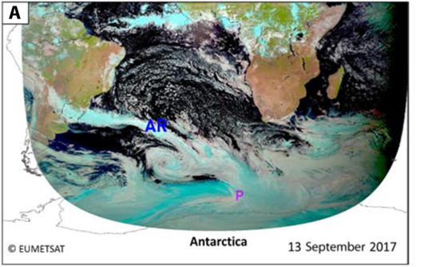
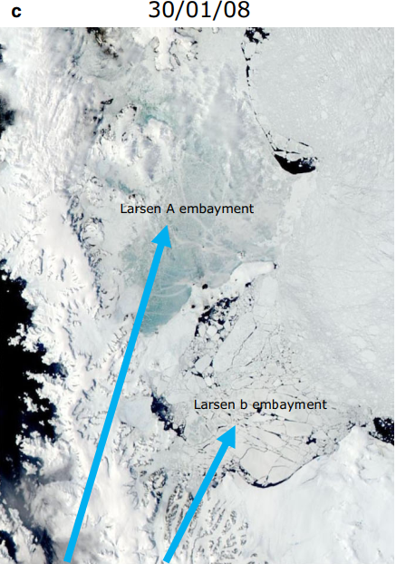
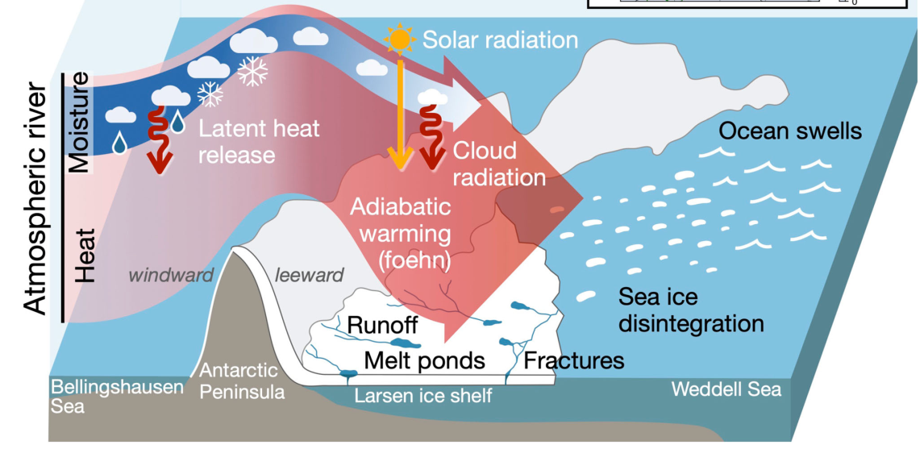
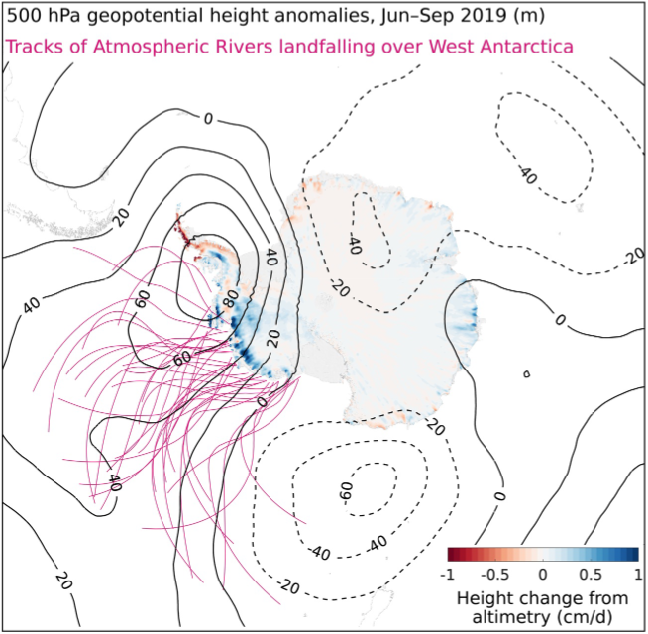
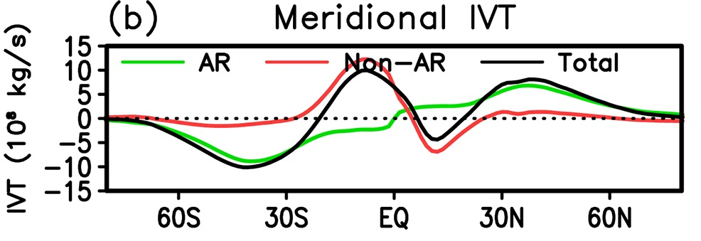
1. Motivation : the Importance of Atmospheric Rivers
(Francis et al., 2020)
(Wille et al., 2022)
Atmospheric rivers (ARs) : long, narrow transient water vapour corridors
ARs influence on surface mass balance of Antarctic ice sheet:
Snow accumulation
Melting and calving of Antarctic ice shelves
Extreme temperature events
The influences of synoptic-scale ARs on the Southern Ocean and sea ice remain relatively unclear
(Guan and Waliser, 2015)
More than 90% of moisture is transported ARs in high latitudes
(Adusumilli et al., 2021)

Slide 4
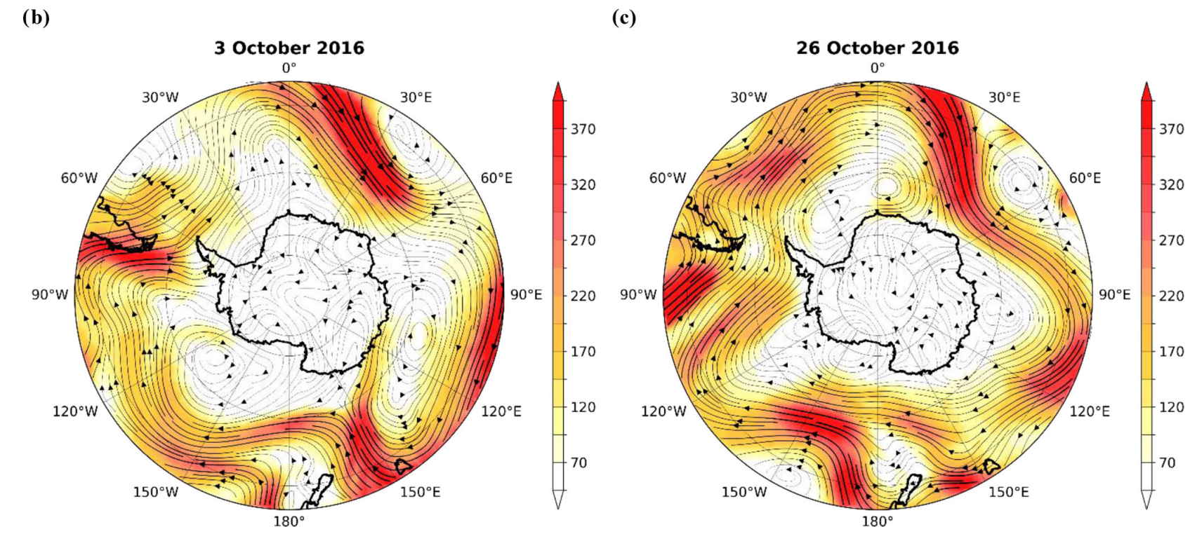
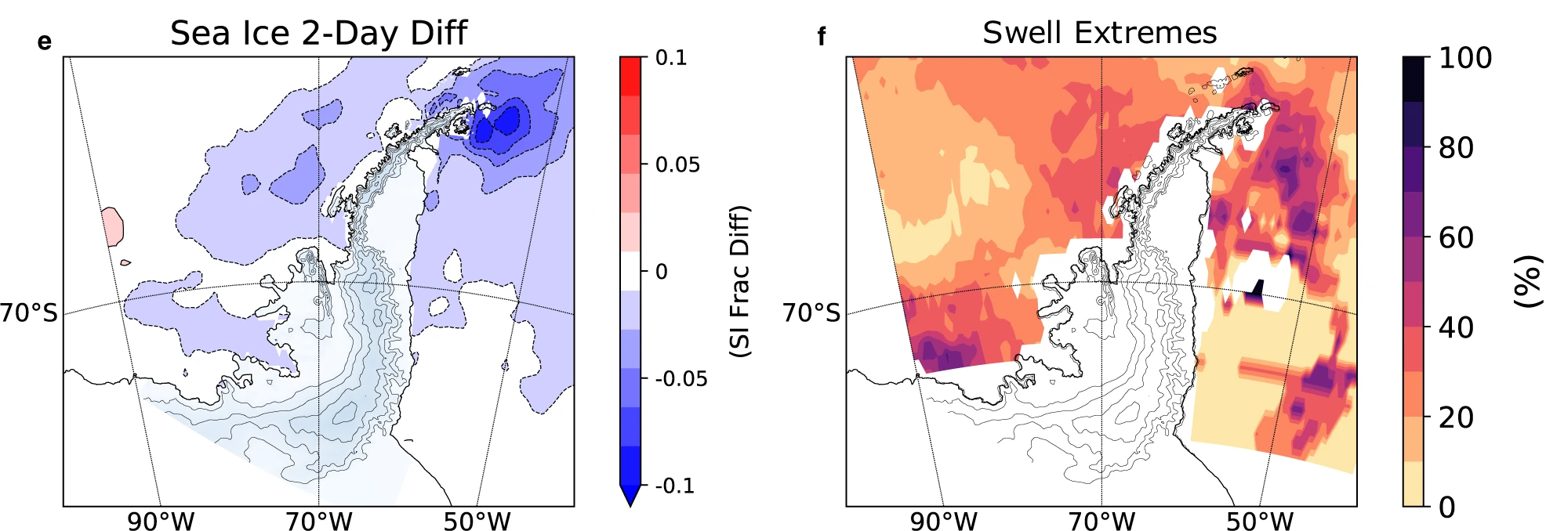
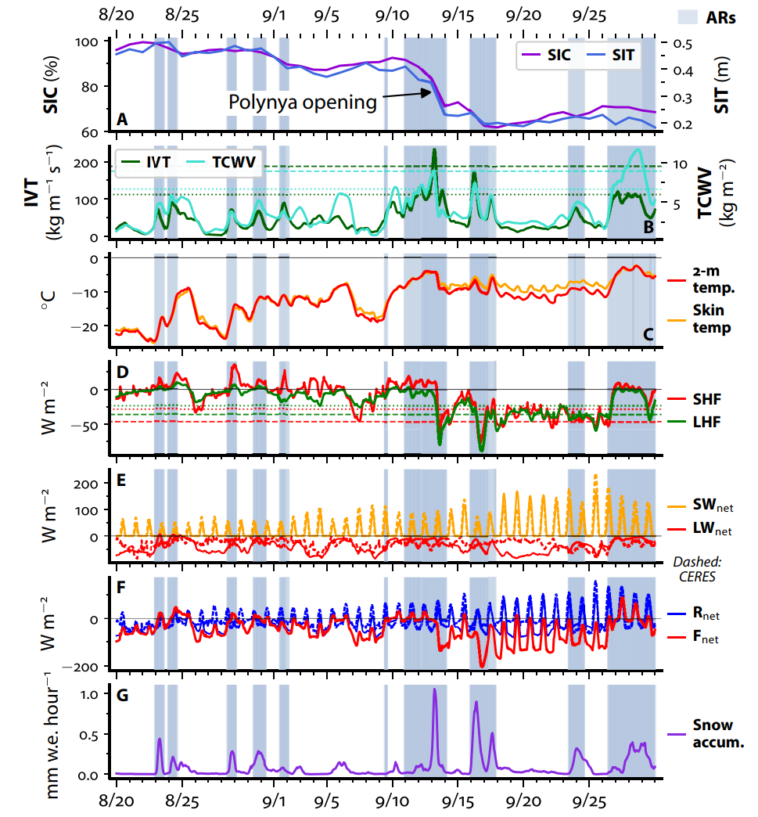
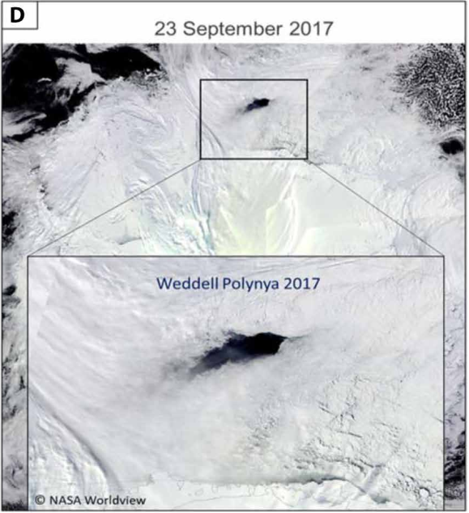
1. Motivation : the Importance of Atmospheric Rivers
ARs were one of the main contributors to the 2016 unprecedented sea ice retreat (Ionita et al., 2018)
(Wille et al., 2022)
Potential mechanisms of ARs effect on sea ice:
Extreme warm-moist air advection: anomaly net surface heat flux, precipitation
Strong wind: sea ice drift, high swell
The overall pattern and impacts of ARs on sea ice from the climatology perspective were poorly understood
ARs facilitated the opening of the Weddell Polynya (Francis et al., 2020)

Slide 5
2. Data and Methods
Atmospheric data
ERA5 reanalysis
-Variables: surface net shortwave (SW_{net}) and longwave radiation (LW_{net}), surface latent (LHF) and sensible heat (SHF) flux, 2-m and skin temperature, total precipitation
-Resolution: 6-hourly interval (1-hourly interval for total precipitation), 0.25°×0.25°
Edition 4A of CERES Synoptic 1degree (CERES SYN1deg Ed4A) product
-Variables: cloud cover and cloud liquid water path
-Resolution: daily, 1°×1°
Sea ice data
NOAA/NSIDC Climate Data Record of Passive Microwave Sea Ice Concentration, Version 4
-Resolution: daily, 25 km×25 km
Polar Pathfinder Daily 25 km EASE-Grid Sea Ice Motion Vectors Version 4
-Resolution: daily, 25 km×25 km

Slide 6
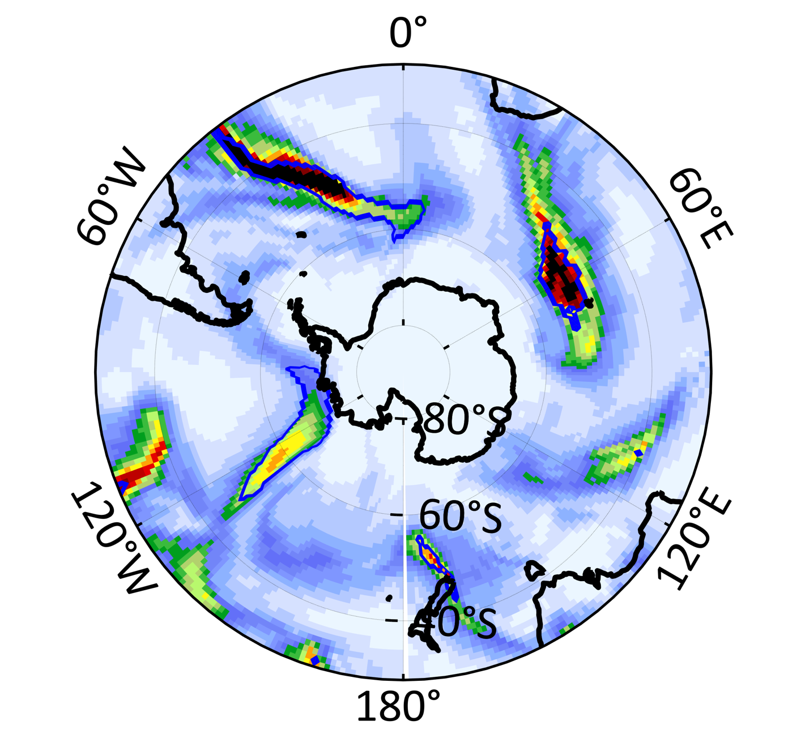
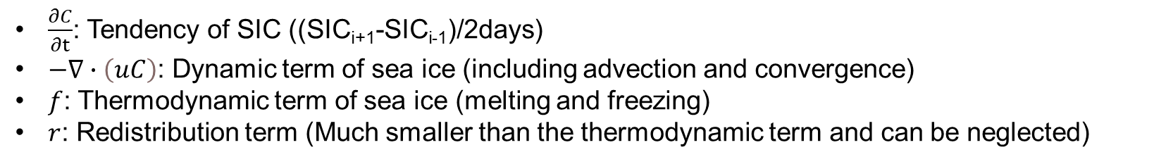

2. Data and Methods
AR detection algorithm (Gorodetskaya et al., 2014; Wille et al., 2021)
$$\begin{aligned}&IVT=\sqrt{{\left(\frac{1}{g}\int_{1000hPa}^{300hPa}{qu}dp\right)}^{2}+{\left(\frac{1}{g}\int_{1000hPa}^{300hPa}{qv}dp\right)}^{2} }\#（1）\end{aligned}$$
IVT: integrated water vapour transport, units: kg m⁻¹ s⁻¹
Thresholds of ARs: IVT ≥ 98th percentile of monthly climatology and 50 kg m⁻¹ s⁻¹, length ≥ 20°.
ARs
NOT ARs
Sea ice budget (Holland & Kwok, 2012)
$$\begin{aligned}&\frac{∂C}{∂t}=−∇∙\left(uC\right)+f−r \#\left(2\right)\end{aligned}$$
$\frac{∂C}{∂t}$: Tendency of SIC ((SIC_{i+1}-SIC_{i-1})/2days)
$−∇∙\left(uC\right)$: Dynamic term of sea ice (including advection and convergence)
$f$: Thermodynamic term of sea ice (melting and freezing)
$r$: Redistribution term (Much smaller than the thermodynamic term and can be neglected)

Slide 7
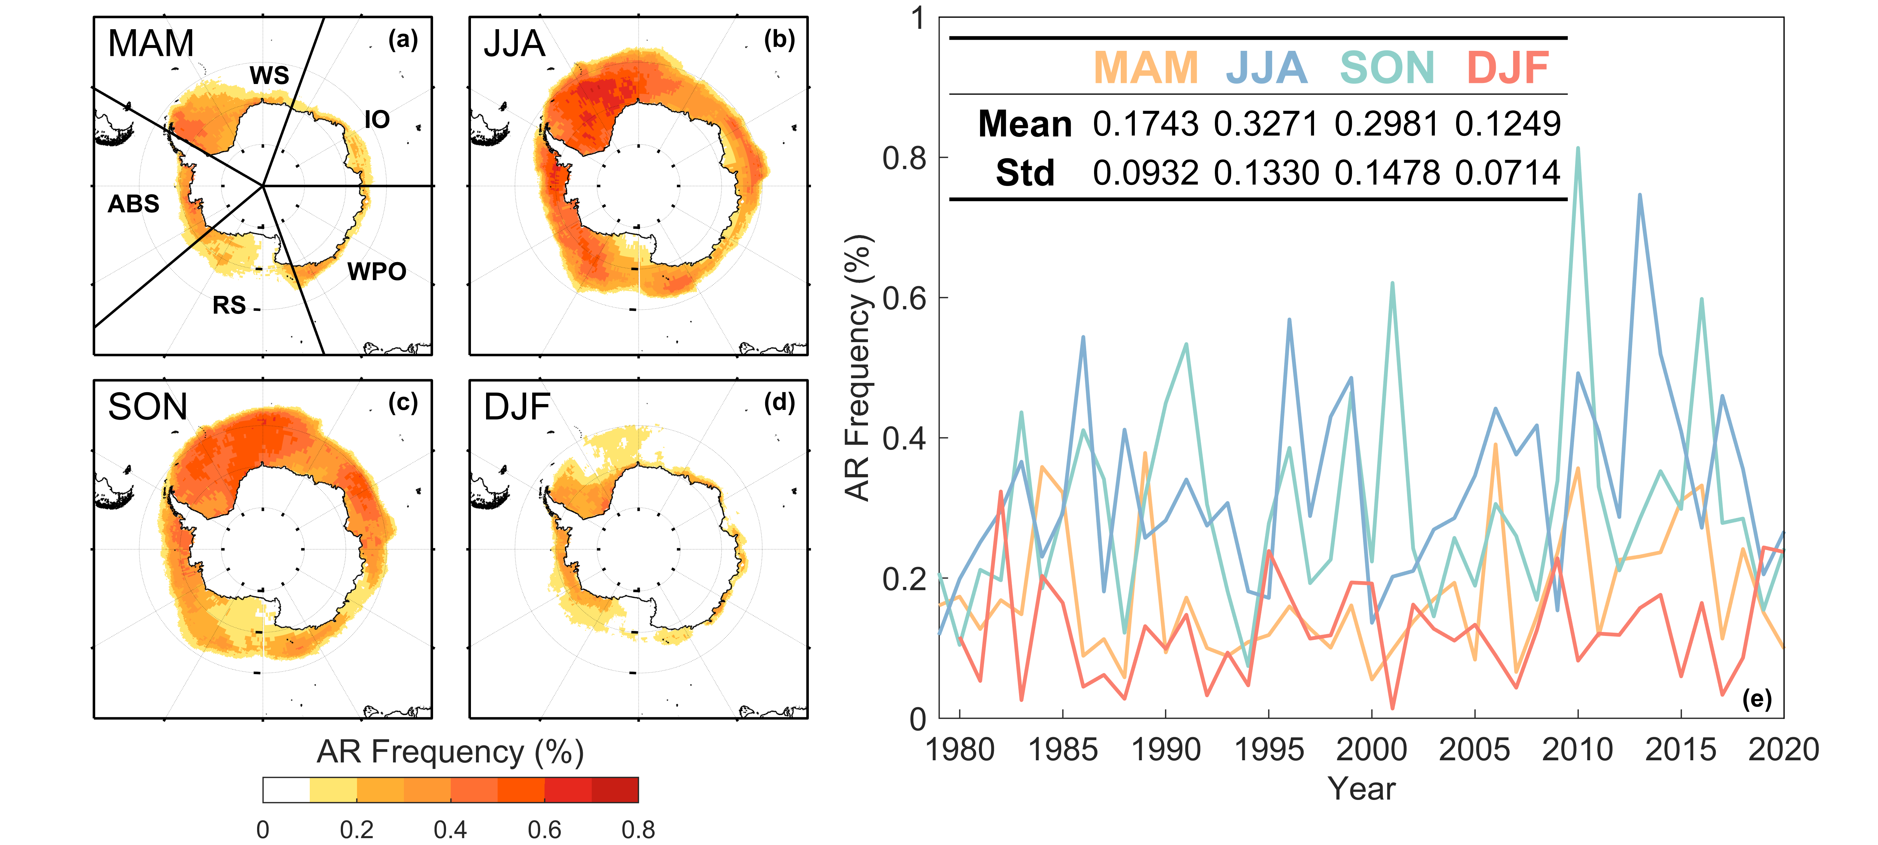
3. Results: Atmospheric River Frequency over Sea Ice
AR frequency is higher in winter and spring, lower in autumn and summer
Large frequency areas are consistent with strong cyclone track centers or vigorous blocking activities in downstream
AR frequency vary greatly from year to year, without a significant seasonal trend
Figure 1. Seasonal average AR frequency over sea ice ((a)-(d)), and (e) the spatial average time series from 1979 to 2020 and their mean and standard deviation
AR frequency: the ratio of time steps when ARs occur above sea ice to all time steps

Slide 8
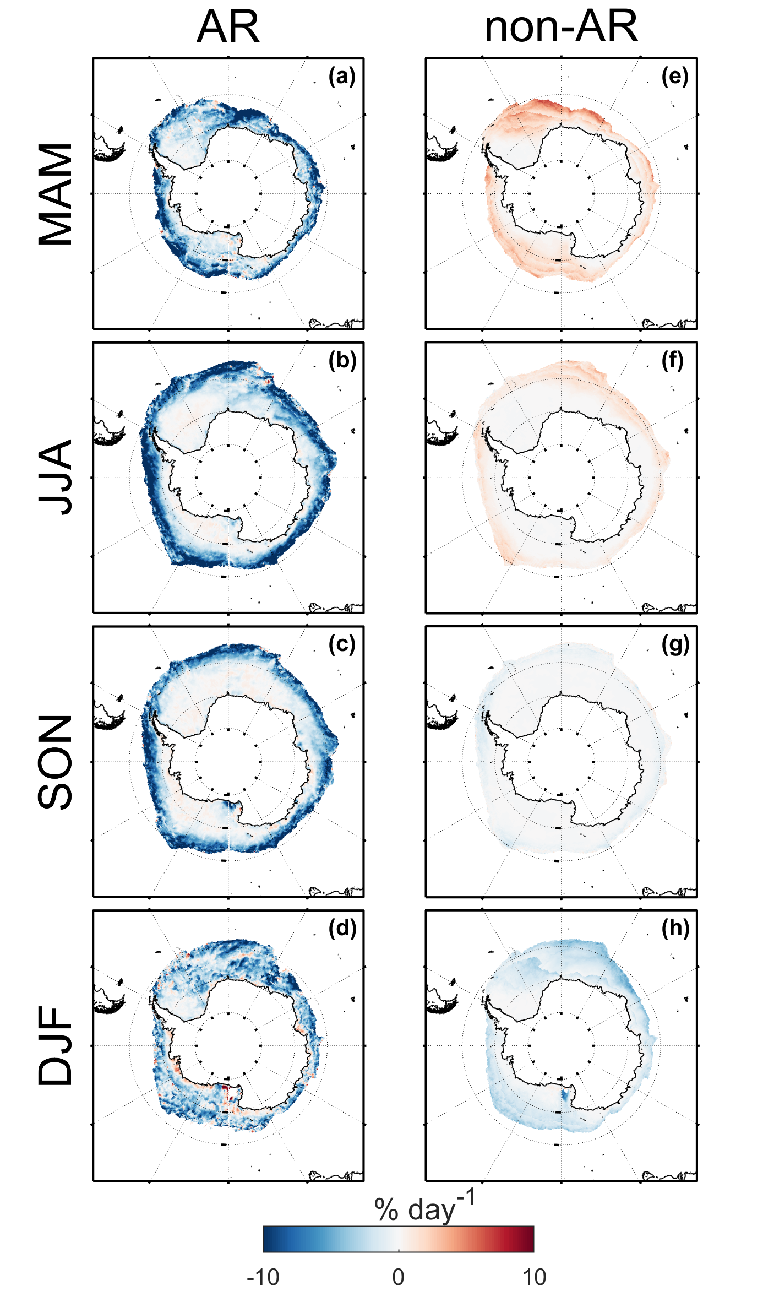
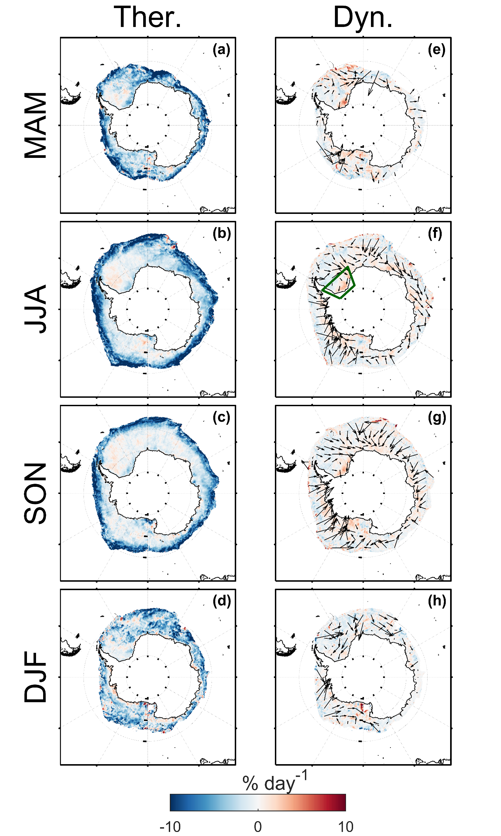
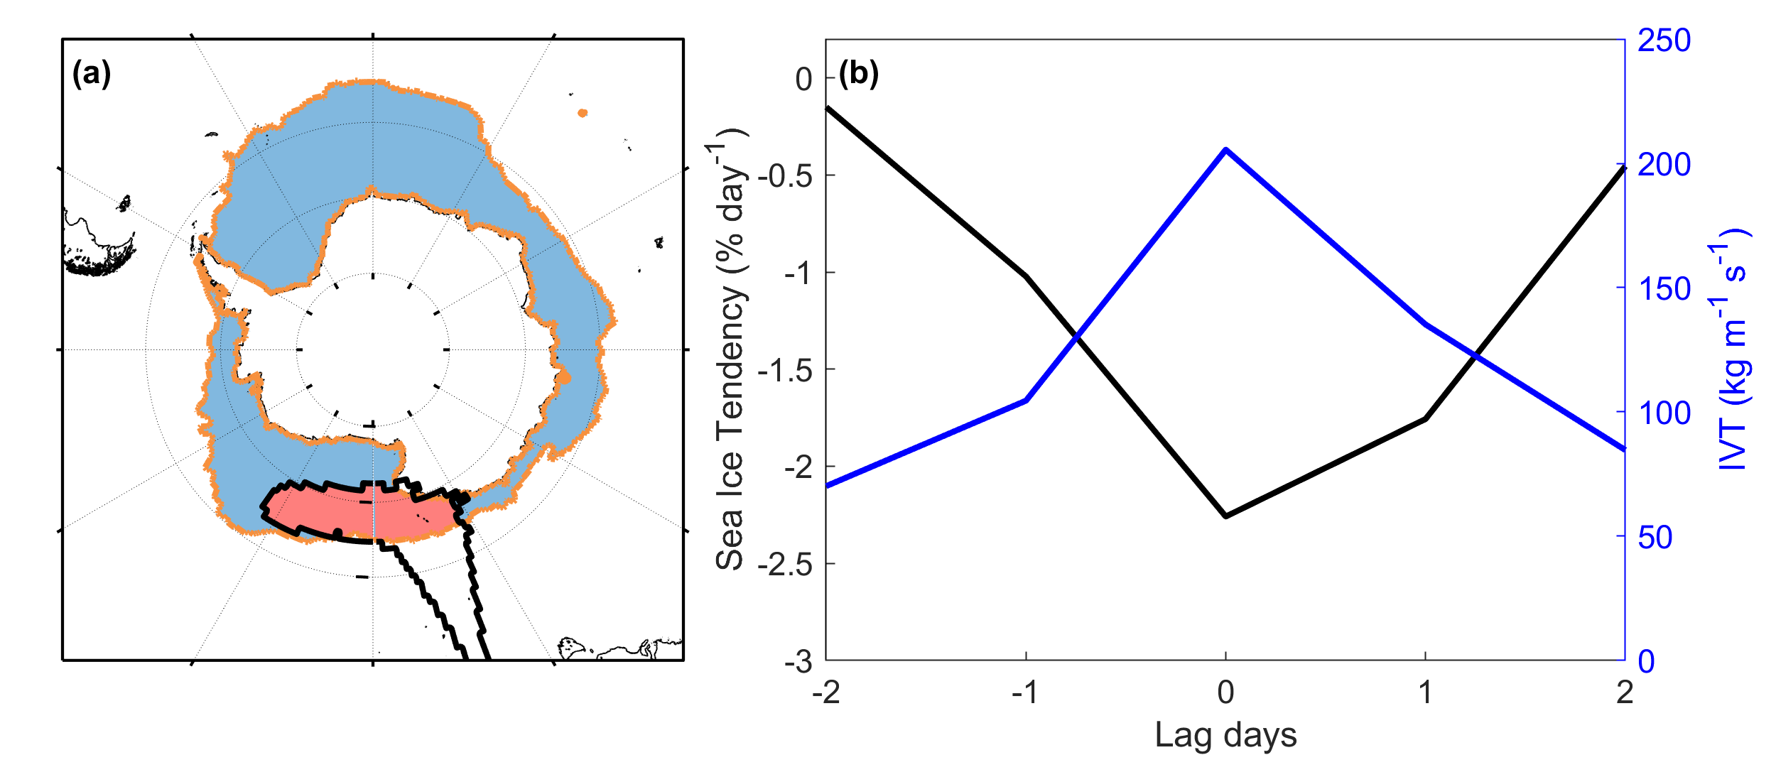
3. Results: Sea Ice Budget during ARs
ARs lead to severe decline of more than 10%/day at the marginal ice zone in all seasons
Thermodynamic term of sea ice budget contribute mostly to the SIC decline in marginal ice zone
Dynamic processes push sea ice towards the coast
Figure S1. Schematic diagram of AR-impact and non-AR regions for a specific day
Figure 2. Seasonal composite daily mean sea ice tendency anomaly

Slide 9
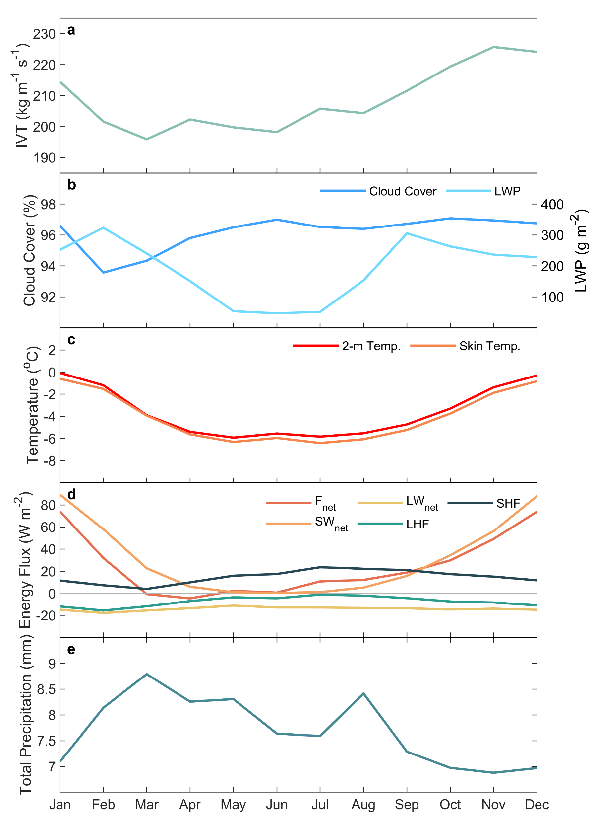
3. Results: Atmospheric Forcing during ARs
Anomaly
Raw
Extremely high IVT is in favour of dense cloud cover and large amounts of liquid cloud, while 2-m air temperature and skin temperature also increased
Figure 3. Area-averaged monthly mean of the anomaly for (raw) daily-mean (a) IVT, (b) cloud cover and LWP, (c) 2-m and skin temperature

Slide 10
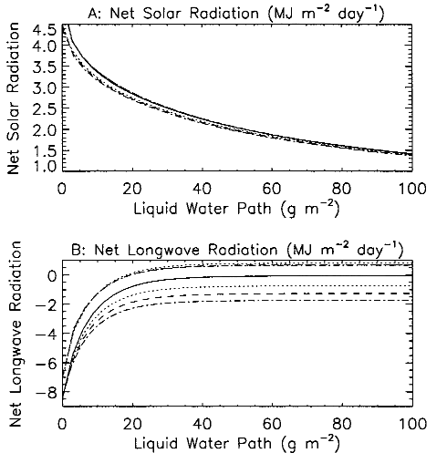
3. Results: Atmospheric Forcing during ARs
In summer, SW_{net} contributes most of the F_{net}, and F_{net} is extremely low in December and January due to ARs block most of the solar radiation.
In cold seasons, exceptionally high SHF is the primary contributor to a significantly positive F_{net} anomaly.
Anomaly
Raw
Figure 4. Area-averaged monthly mean of the anomaly for (raw) daily-mean (d) surface heat flux (F_{net}, SW_{net}, LW_{net}, LHF and SHF, all components are positive downwards)
Net solar radiation (SW_{net}) and net longwave radiation (LW_{net}) vary with liquid water path (LWP) increased (Zhang et al., 1996)

Slide 11
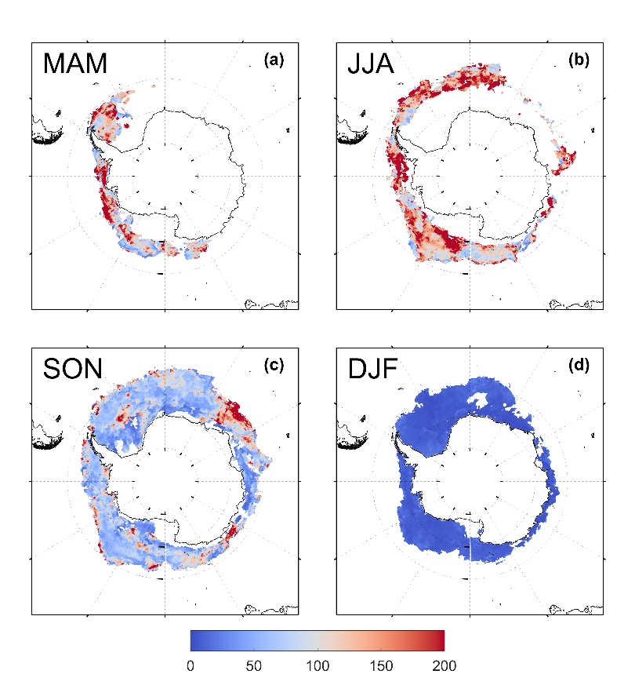
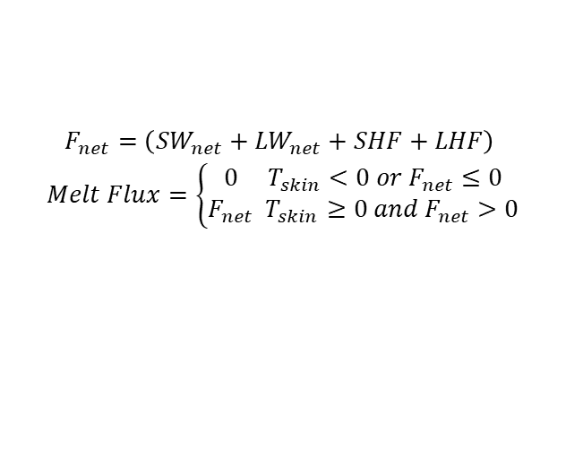
3. Results: Atmospheric Forcing during ARs
The calculation of surface melt flux (Parkinson & Washington, 1979; Zhang et al., 1996)
$$\begin{aligned}F_{net}=\left({SW}_{net}+{LW}_{net}+SHF+LHF\right)\# \end{aligned}$$
$$\begin{aligned}Melt Flux=\left\{\begin{aligned}0 T_{skin}<0 or F_{net}≤0 \\ F_{net} T_{skin}≥0 and F_{net}>0\end{aligned}\right.\#\end{aligned}$$
Warm, moist and cloudy weather during ARs boosts sea ice melting in cold seasons but has a limited effect in summer
Figure S2. Ratio of seasonal composite AR-induced and non-AR daily mean melt flux (units: %)
Figure 2. Seasonal composite daily mean sea ice tendency anomaly

Slide 12
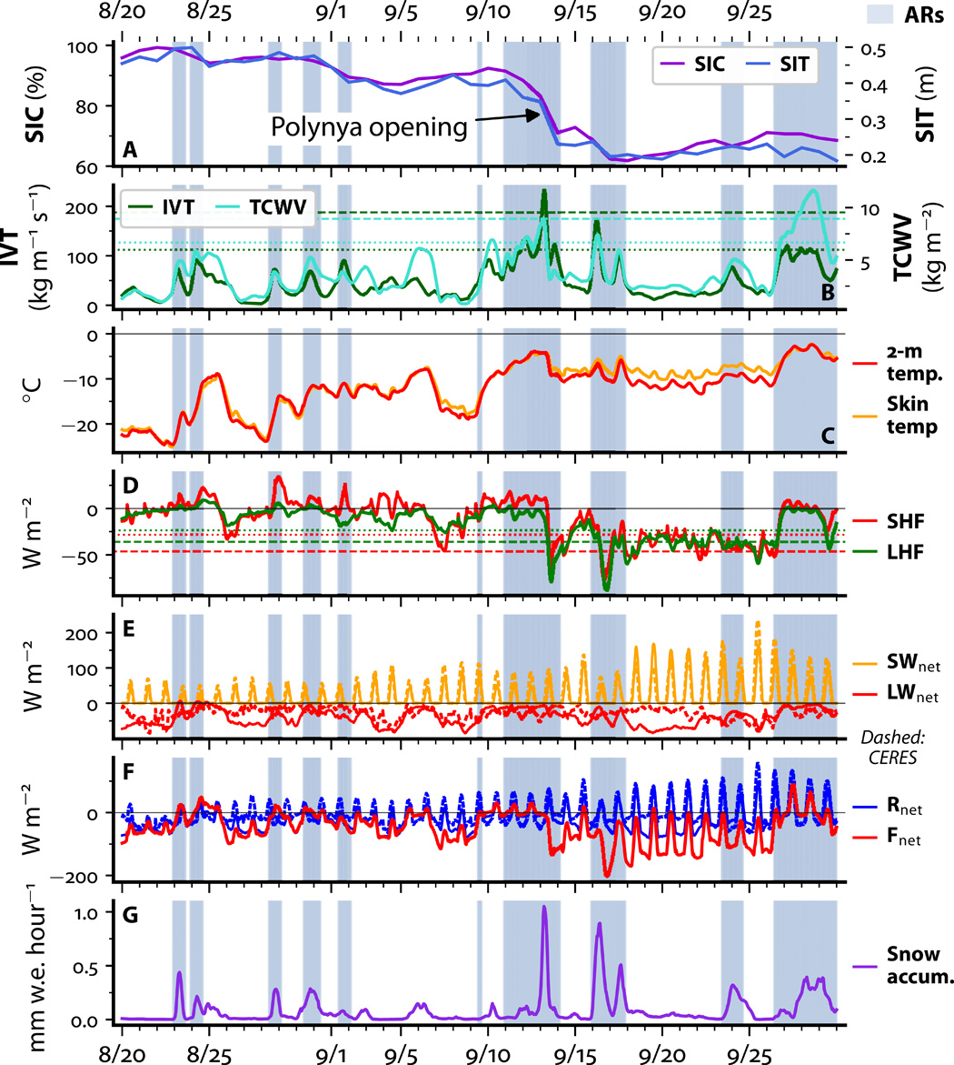
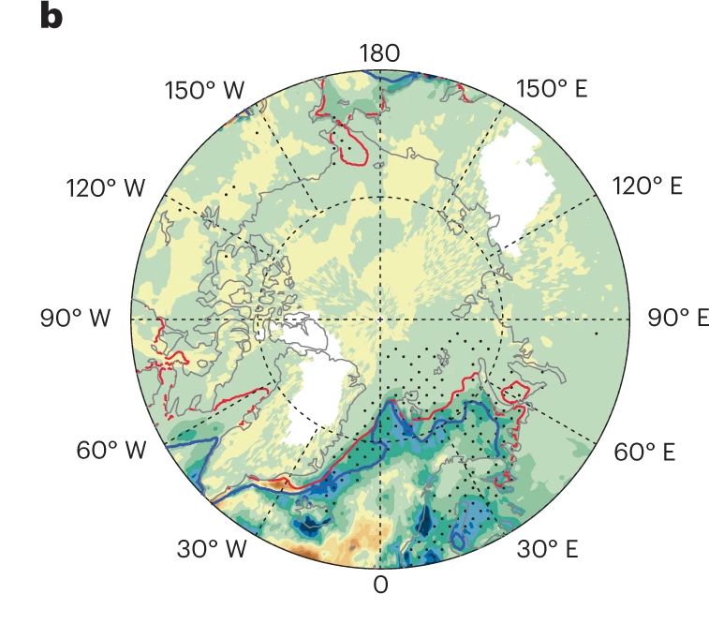

3. Results: Atmospheric Forcing during ARs
Anomaly
Warm snow during ARs may insulate the cold air at night and inhibit sea ice from refreezing (Francis et al., 2020)
Figure 5. Area-averaged monthly mean of the anomaly for daily-mean total precipitation
Extensive precipitation associated with ARs may result in severe daily sea ice decline especially in summer
Liquid rain heat flux has not been emphasized on sea ice (Zhang et al., 2023)

Slide 13
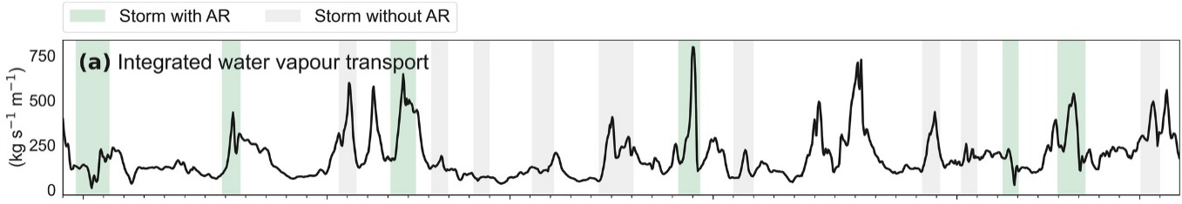
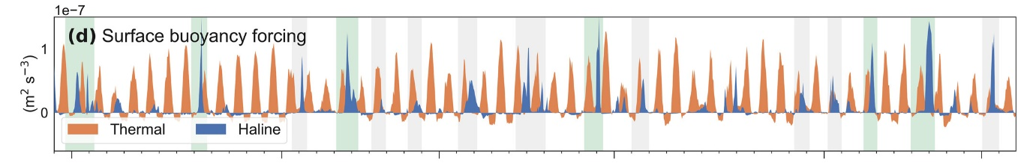
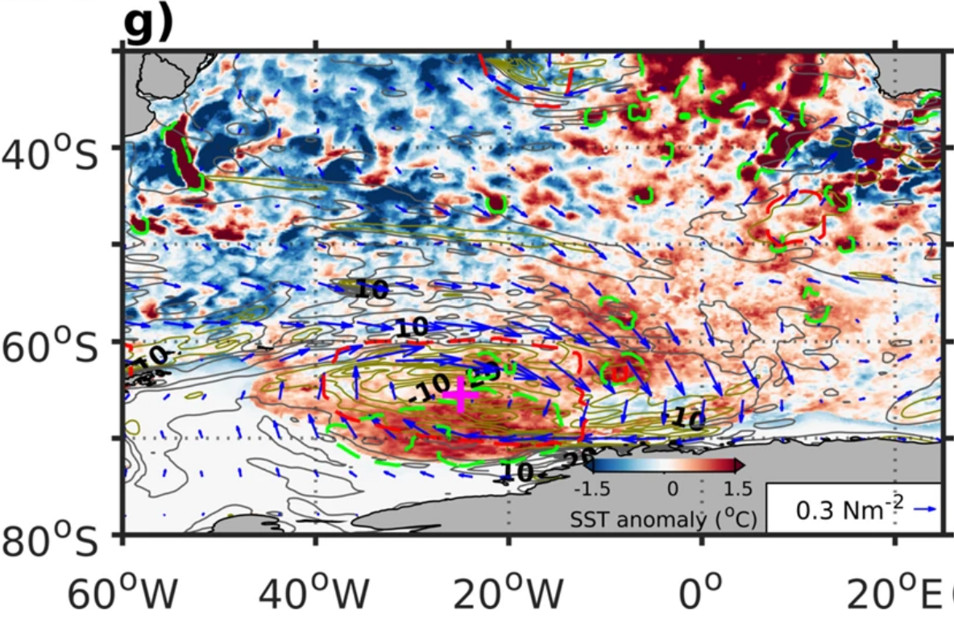
4. Discussion
The underlying mechanism of ARs impact on sea ice variations may be more complicated: direct vs. indirect impact
AR-induced ocean change and its contribution to sea ice melt are poorly understood: gain or lose stability?
ARs inject fresh water into ocean surface and then initiate rapid surface buoyancy gain (Edholm et al., 2022)
AR warm up SST via subsurface warm water upwelling (Jena et al., 2022)

Slide 14
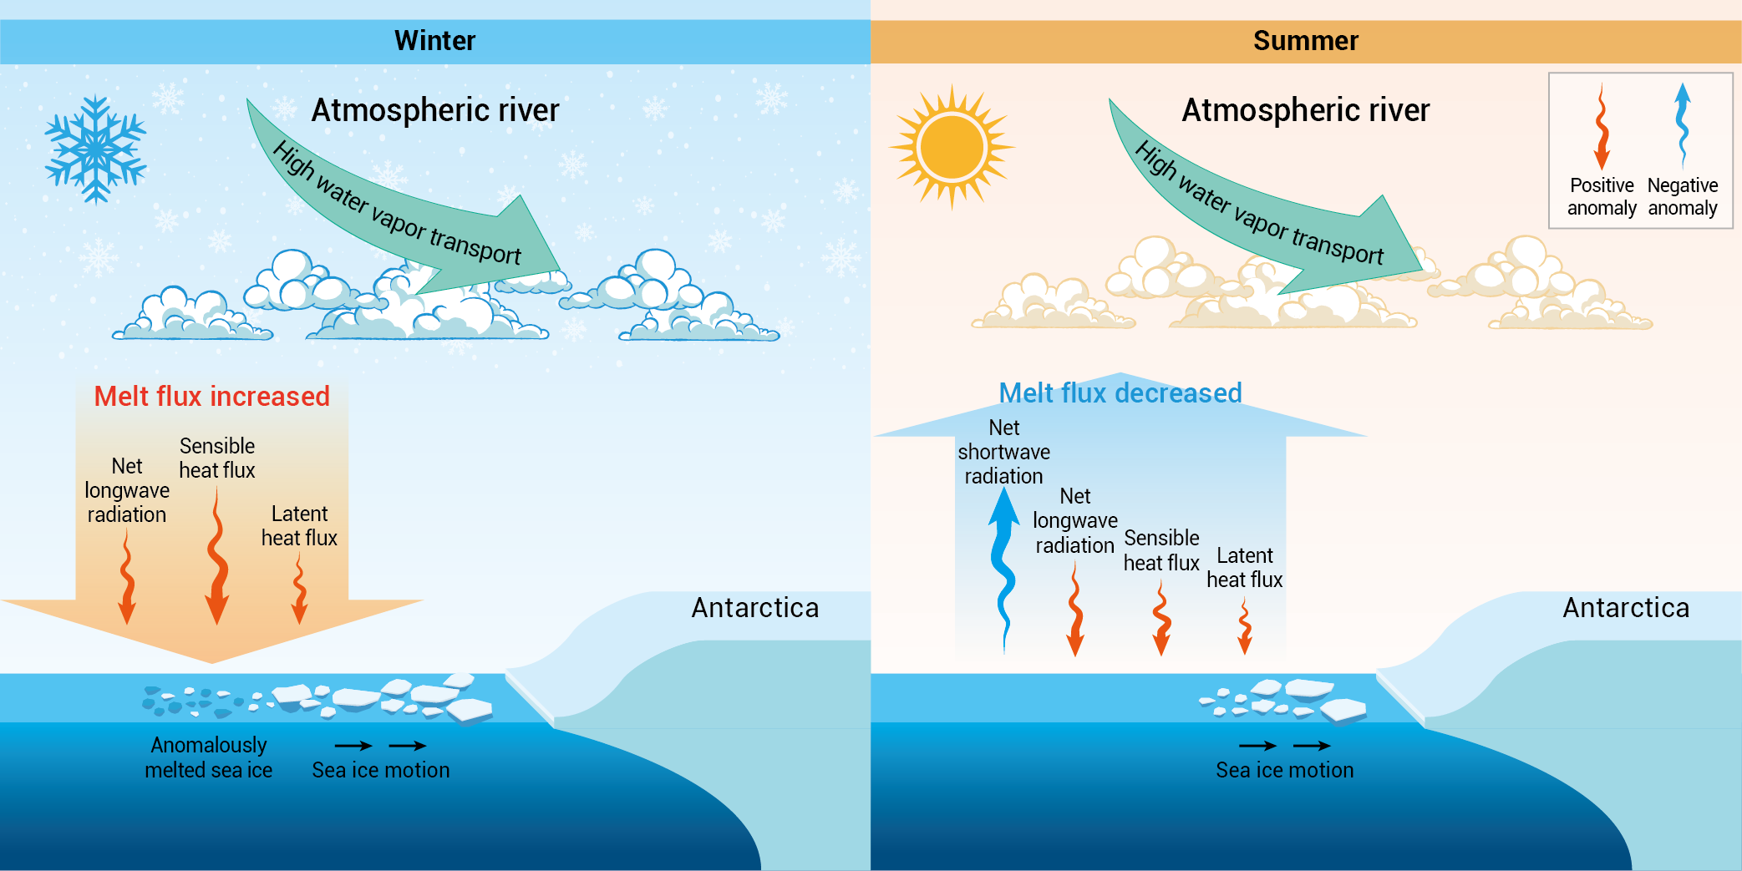
5. Conclusion
Low-frequency ARs can lead to prominent sea ice reduction over marginal ice zone primarily through thermodynamic processes.
Warm, moist and cloudy weather during ARs boosts sea ice melting in cold seasons but has a limited effect in summer.

Slide 15
6. Reference
Adusumilli, S., Fish, M., Fricker, H. A., & Medley, B. (2021). Atmospheric River Precipitation Contributed to Rapid Increases in Surface Height of the West Antarctic Ice Sheet in 2019. Geophysical Research Letters, 48(5). https://doi.org/10.1029/2020GL091076
Arblaster, J. M., & Meehl, G. A. (2006). Contributions of External Forcings to Southern Annular Mode Trends. Journal of Climate, 19(12), 2896–2905. https://doi.org/10.1175/JCLI3774.1
Edholm, J. M., Swart, S., Plessis, M. D., & Nicholson, S. (2022). Atmospheric Rivers Contribute to Summer Surface Buoyancy Forcing in the Atlantic Sector of the Southern Ocean. Geophysical Research Letters, 49(17). https://doi.org/10.1029/2022GL100149
Francis, D., Mattingly, K. S., Temimi, M., Massom, R., & Heil, P. (2020). On the crucial role of atmospheric rivers in the two major Weddell Polynya events in 1973 and 2017 in Antarctica. Science Advances, 6(46), eabc2695. https://doi.org/10.1126/sciadv.abc2695
Gordon, A. L., & Comiso, J. C. (1988). Polynyas in the Southern Ocean. Scientific American, 258(6), 90–97. https://doi.org/10.1038/scientificamerican0688-90
Guan, B., & Waliser, D. E. (2015). Detection of atmospheric rivers: Evaluation and application of an algorithm for global studies: Detection of Atmospheric Rivers. Journal of Geophysical Research: Atmospheres, 120(24), 12514–12535. https://doi.org/10.1002/2015JD024257
Ionita, M., Scholz, P., Grosfeld, K., & Treffeisen, R. (2018). Moisture transport and Antarctic sea ice: Austral spring 2016 event. Earth System Dynamics, 9. https://doi.org/10.5194/esd-9-939-2018
Jena, B., Bajish, C. C., Turner, J., Ravichandran, M., Anilkumar, N., & Kshitija, S. (2022). Record low sea ice extent in the Weddell Sea, Antarctica in April/May 2019 driven by intense and explosive polar cyclones. Npj Climate and Atmospheric Science, 5(1), 19. https://doi.org/10.1038/s41612-022-00243-9
Li, X., Cai, W., Meehl, G. A., Chen, D., Yuan, X., Raphael, M., et al. (2021). Tropical teleconnection impacts on Antarctic climate changes. Nature Reviews Earth & Environment, 2(10), 680–698. https://doi.org/10.1038/s43017-021-00204-5
Purich, A., & England, M. H. (2019). Tropical Teleconnections to Antarctic Sea Ice During Austral Spring 2016 in Coupled Pacemaker Experiments. Geophysical Research Letters, 46(12), 6848–6858. https://doi.org/10.1029/2019GL082671
Shokr, M., & Ye, Y. (2023). Why Does Arctic Sea Ice Respond More Evidently than Antarctic Sea Ice to Climate Change? Ocean-Land-Atmosphere Research, 2, 0006. https://doi.org/10.34133/olar.0006
Stark, J. S., Raymond, T., Deppeler, S. L., & Morrison, A. K. (2019). Chapter 1 - Antarctic Seas. In C. Sheppard (Ed.), World Seas: an Environmental Evaluation (Second Edition) (pp. 1–44). Academic Press. https://doi.org/10.1016/B978-0-12-805068-2.00002-4
Wille, J. D., Favier, V., Jourdain, N. C., Kittel, C., Turton, J. V., Agosta, C., et al. (2022). Intense atmospheric rivers can weaken ice shelf stability at the Antarctic Peninsula. Communications Earth & Environment, 3(1), 90. https://doi.org/10.1038/s43247-022-00422-9
Zhang, P., Chen, G., Ting, M., Ruby Leung, L., Guan, B., & Li, L. (2023). More frequent atmospheric rivers slow the seasonal recovery of Arctic sea ice. Nature Climate Change, 1–8. https://doi.org/10.1038/s41558-023-01599-3
Zhang, T., Stamnes, K., & Bowling, S. A. (1996). Impact of Clouds on Surface Radiative Fluxes and Snowmelt in the Arctic and Subarctic. Journal of Climate, 9(9), 2110–2123. https://doi.org/10.1175/1520-0442(1996)009<2110:IOCOSR>2.0.CO;2

Slide 16
Thanks for Your Listening

