Slide 1






Working Group on Observational Data (WG/OD):
Implications for the US Antarctic Program
Matthew Lazzara
Antarctic Meteorological Research and Data Center
Madison Area Technical College
&
University of Wisconsin-Madison

Slide 2
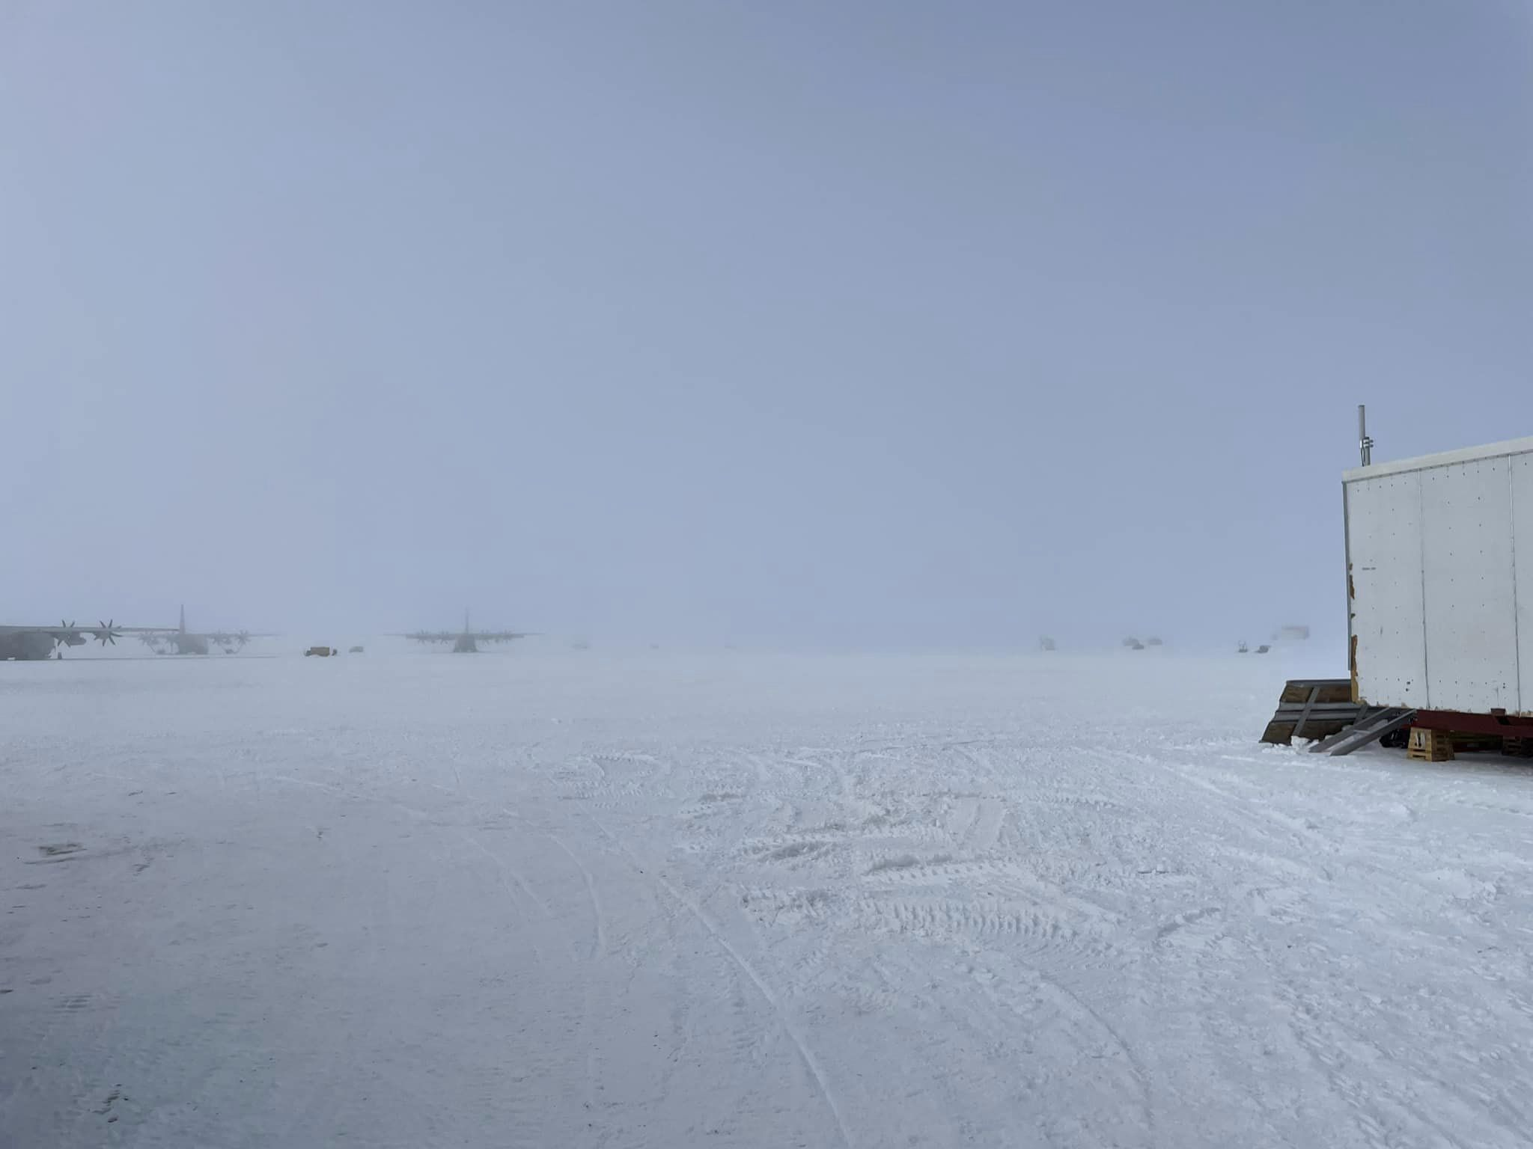
Matthew is…
The sub-focal point for the United States (National Science Foundation) for World Meteorological Organization (WMO)’s Integrated Global Observing System(WIGOS)
So what is this exactly??
Fog at Williams Field, Antarctica (Photo Courtesy of Taylor Norton)

Slide 3
What is this?
(at the request of NSF) Matthew is the NSF representative to:
  Working Group on Observational Data (WG/OD)
    Which is a part of the Subcommittee for Operational Processing Centers (SCOPC)
    And that is a part of the Committee on Cyber Facilities & Infrastructure (CCyFI)
      NSF has a representative on this committee
    This is all a part of the Interagency Council for Advancing Meteorological Services (ICAMS)
      Formally the Office of the Federal Coordinator for Meteorology
  WG/OD and all of this is supported by Interagency Meteorological Coordinator Office (IMCO)
  Office of Science Technology and Policy (OSTP)
    An office in the Whitehouse
“… specific issues and information needs in sharing and using meteorological Earth system observations…” – FHM13 Executive Summary

Slide 4
Tasks
Representing Antarctica (US Antarctic Program) and the NSF more broadly
There are specific tasks:
  Evolution to new WIGOS Station Identifiers (WSI)
    And managing NSF’s assigned list of WSIs
  Improving Metadata availability
  Getting observations available to the community – and more specifically the world via GTS
  etc.
This role is a part of the Antarctic Meteorological Research and Data Center project funded by the NSF Office of Polar Programs with direction from Alex Isern, Assistant Director of the Geoscience Directorate
  (Alex asked Matthew to do this…)

Slide 5
New WIGOS IDs
Moving away from old WMO block numbers
  Example: 89324
  These are no longer issued/available/near exhausted
New World Meteorological Organization (WMO) Integrated Global Observing System (WIGOS) or WIGOS Station Identifiers (WSI)
  Example of a station with existing WMO block number:
    0-20000-0-89324
  Example of a station with no existing WMO block number:
    0-840-15002-Byrd
    We are establishing these as “secondary” WSIs for stations with existing WMO block number WSI styled numbers (Thank you Luis & WMO!!)
    See poster!

Slide 6
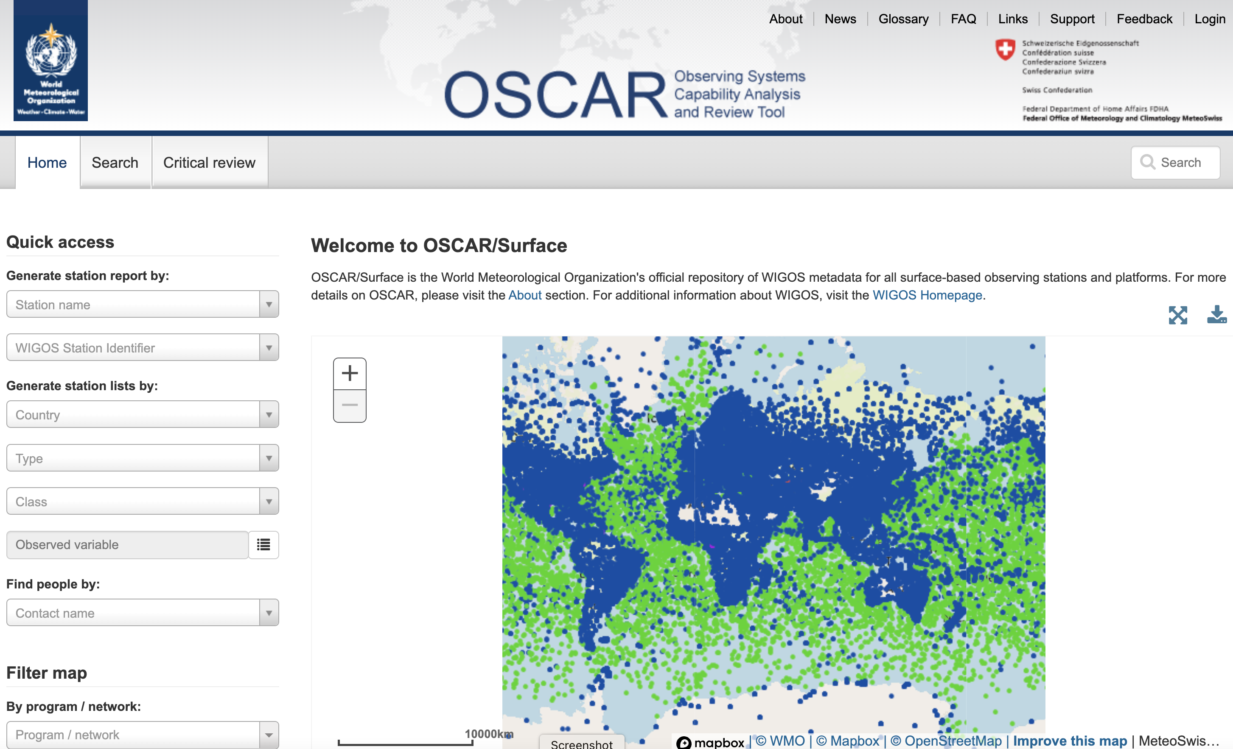

Slide 7
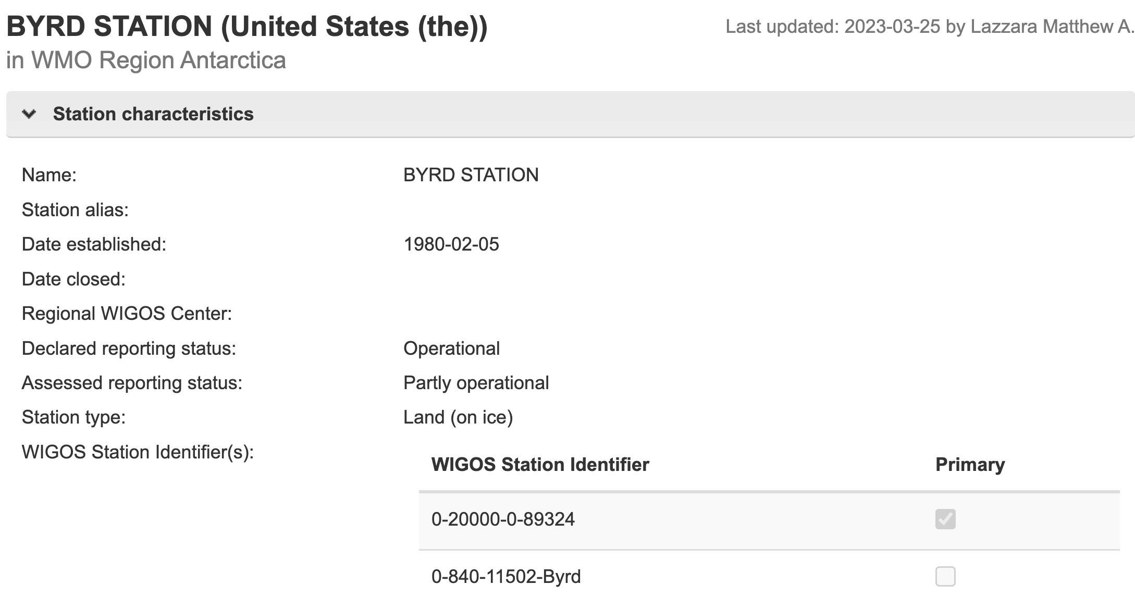

Slide 8
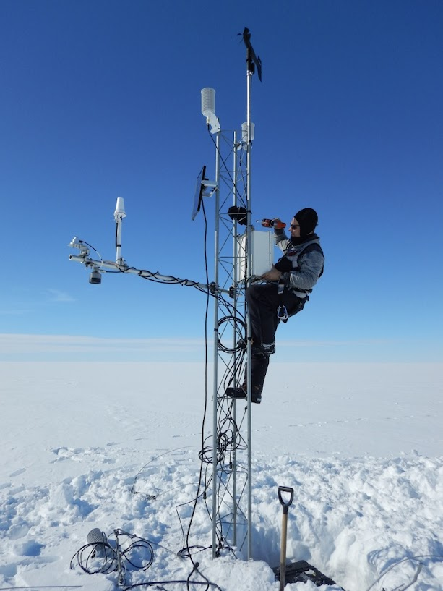
US Antarctic Program Activities
Getting US AWS Observations into BUFR format
  Accomplished
  (with a few corrections over the last two years)
Having the BUFR relayed to GTS via NOAA NCO
  Accomplished
  Using LDM relay
Updating and creating entries in WMO OSCAR (see poster on this)
  In progress
Adding WIGOS IDs to the BUFR messages
  In progress

Slide 9
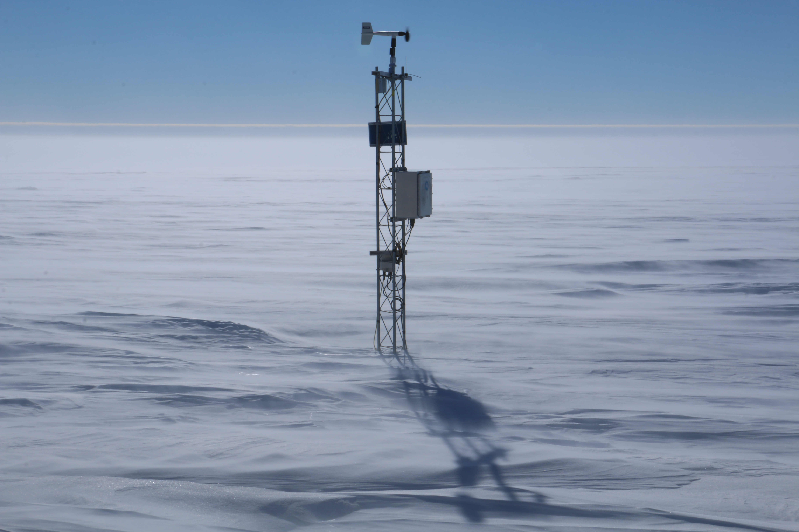
Future Activities
Complete
  OSCAR Entries for US (Wisconsin) AWS
  The addition of WIGOS IDs to BUFR messages
Update (after getting edit access):
  Amundsen-Scott South Pole Station
  Palmer Station
  McMurdo Station
    Some issues to deal with regarding GRUAN….
Historical information/stations added to OSCAR?
  Not a fully funded activity
Dave Mikolajczyk – Theresa AWS

Slide 10
USAP Associated Concerns
McMurdo Station’s GRUAN situation
  McMurdo Radiosonde observations are folded into New Zealand’s GRUAN filing for Arrival Heights…
CLIMAT Message production
  How long can we keep running WMO’s CLIREP software?
    (which is difficult to run due to the age of the software and security issues)
    Investment in CLIMAT creation software?
    Partner with others who do create this?
  Does the US want to have BAS/UK keep making the CLIMAT message for Palmer Station?
    A US policy determination

Slide 11
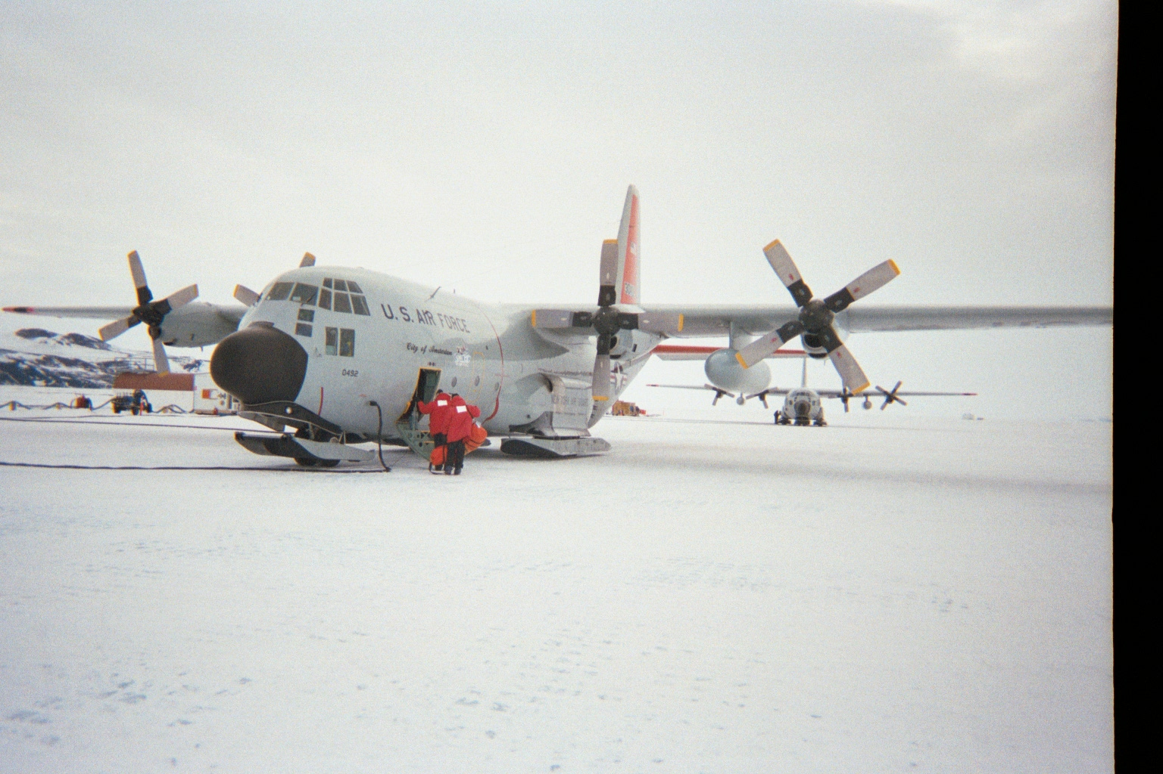
Thank You! Questions??
Acknowledgements:
Thank you to the NSF
  Grant #1951603
  Alex Isern for her support
Thank you to my colleagues on the WG/OD
  Tony Ramirez
  Ken Barnett
  Jeff Ator
  Holly Uhlenhake
  …
LC-130 Williams Field – circa 2003

