Slide 1
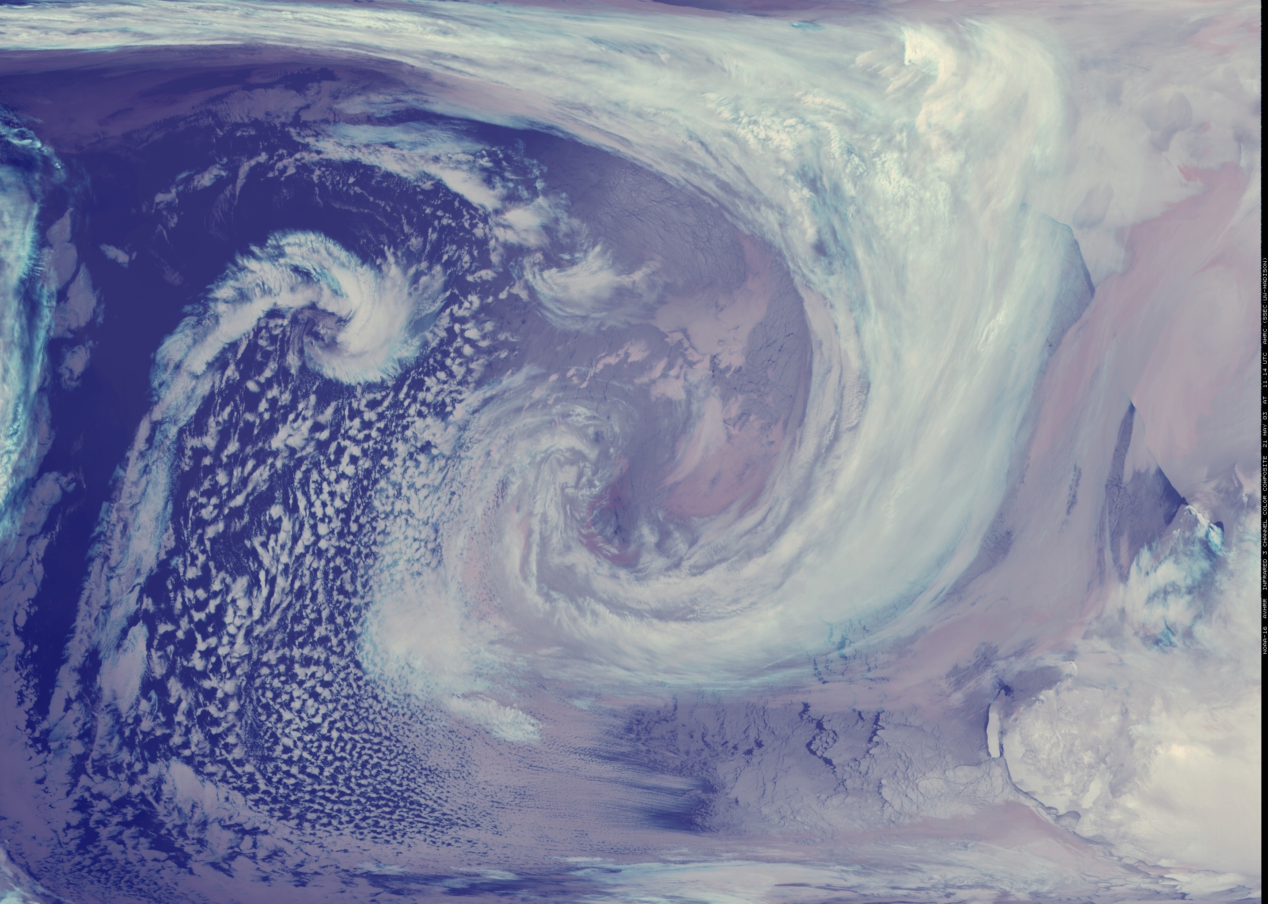





AMRDC version 1.0
Dr. Matthew A. Lazzara
Antarctic Meteorological Research and Data Center
Department of Physical Sciences, Madison Area Technical College
Space Science and Engineering Center, University of Wisconsin-Madison

Slide 2


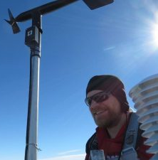












Outline
AMRC Team →
AMRDC Data Repository
- Version 1.0
  About AMRDC Data Repository…
  Datasets
  Collections
  File your data with us!
The end of the AMRC FTP site
Other elements associated with the AMRDC project
A word about the Antarctic-IDD
Questions - Acknowledgements

Slide 3
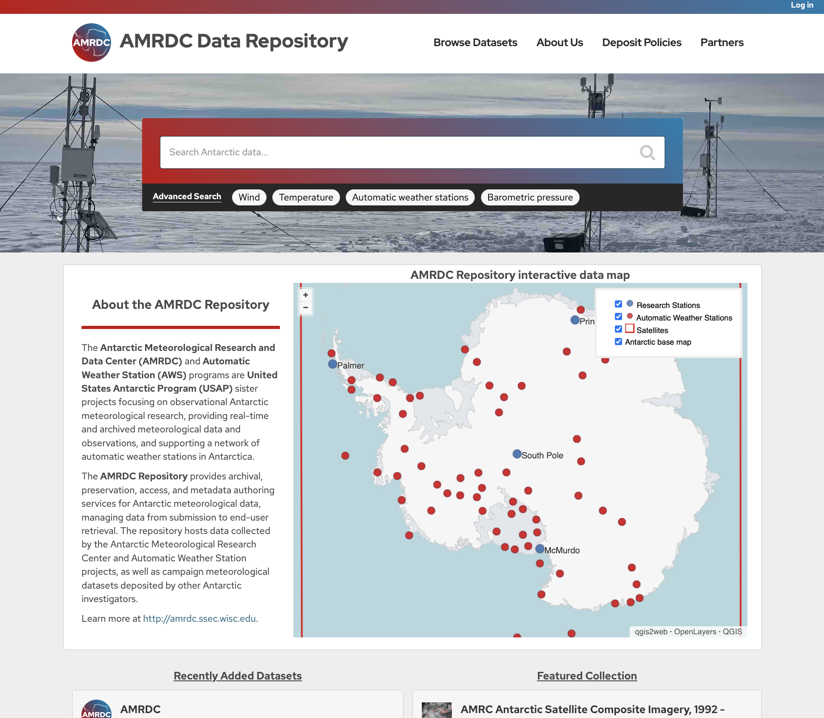

Slide 4
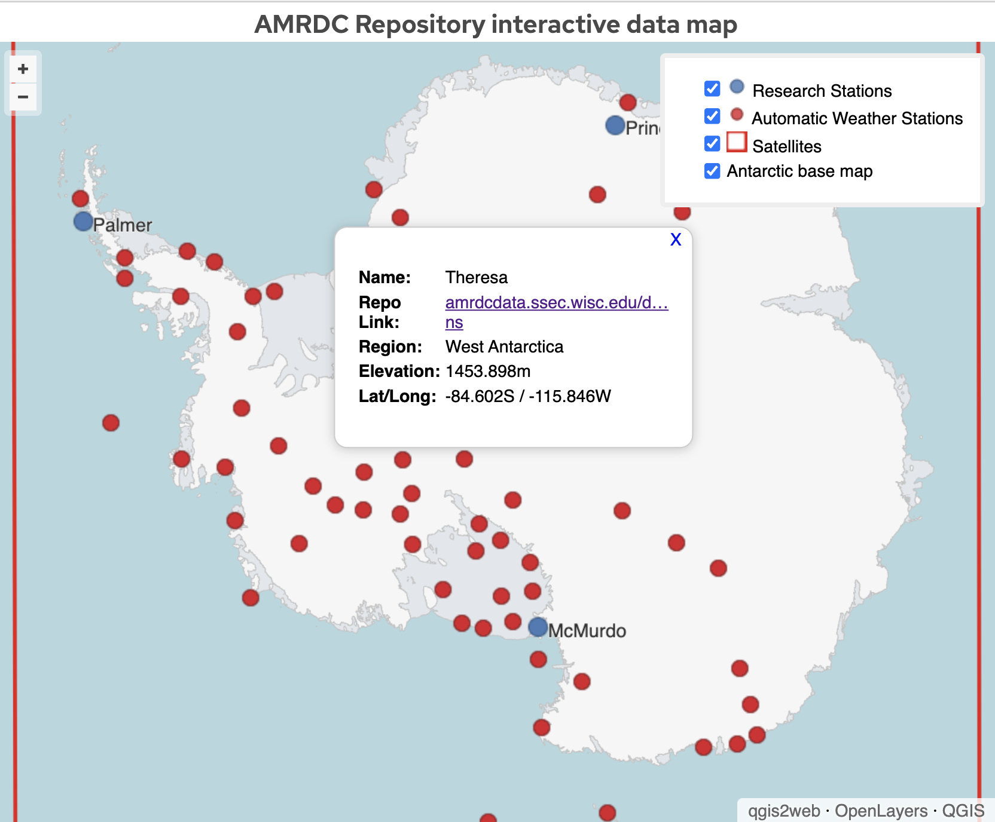

Slide 5
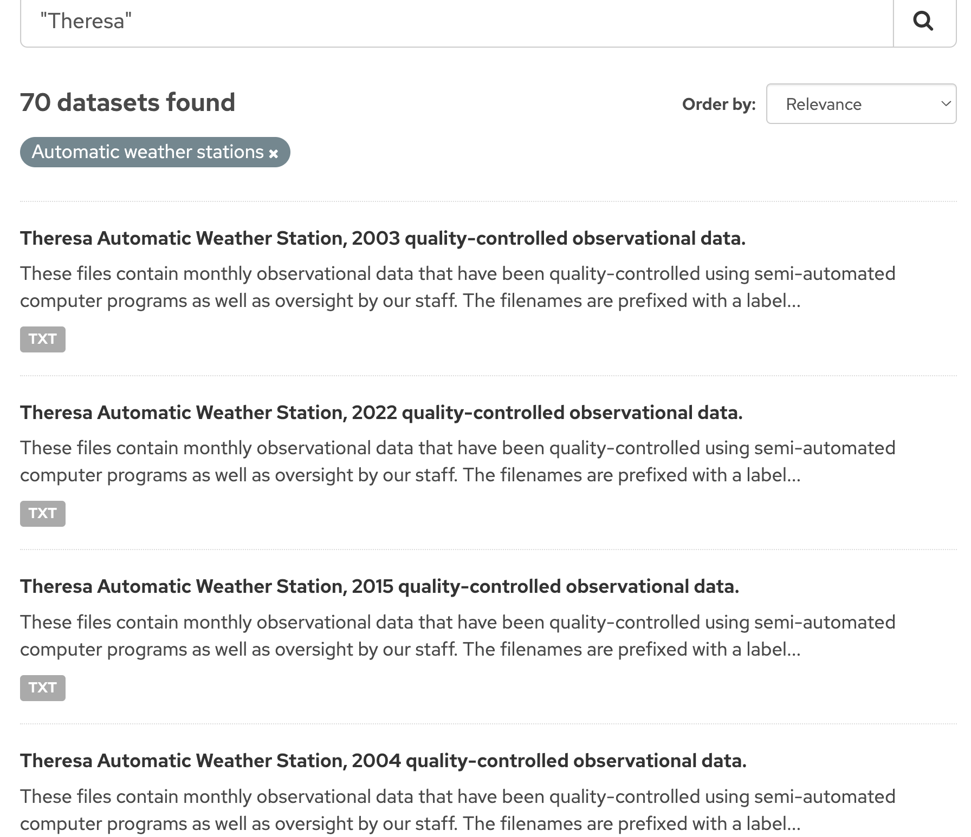

Slide 6
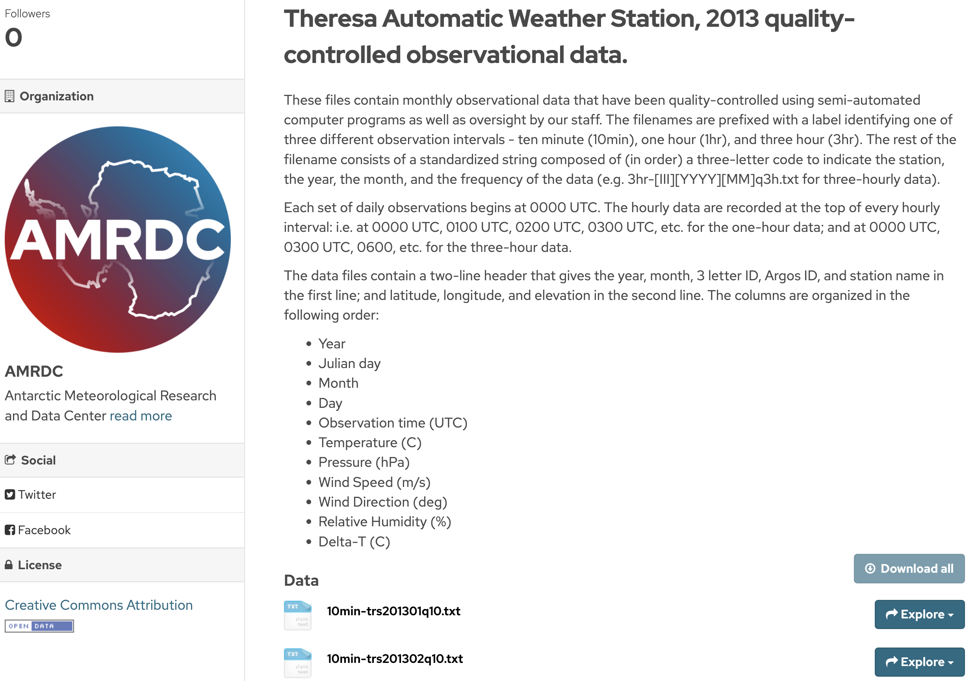

Slide 7
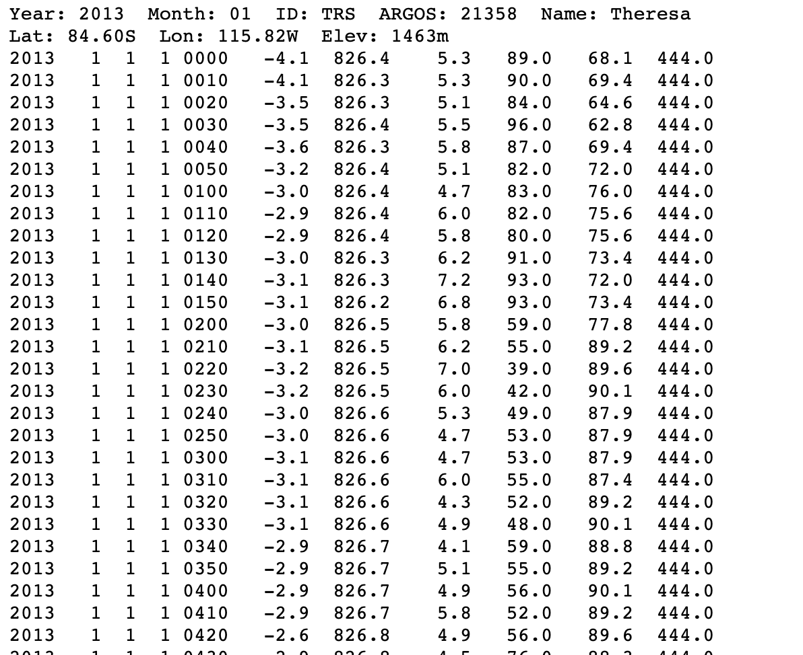

Slide 8
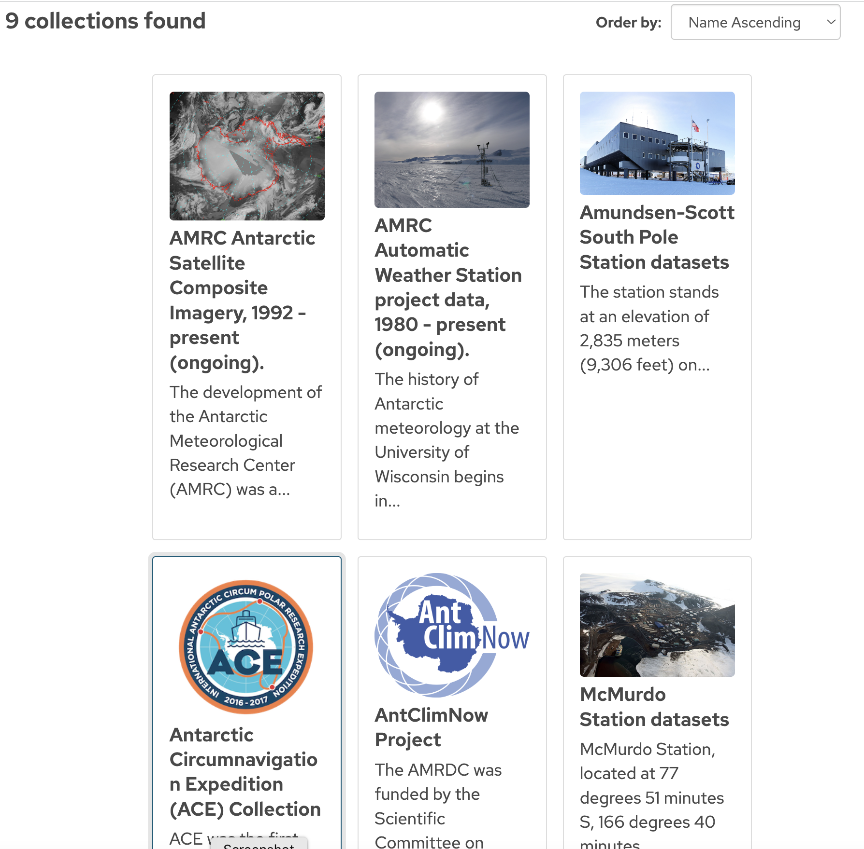

Slide 9
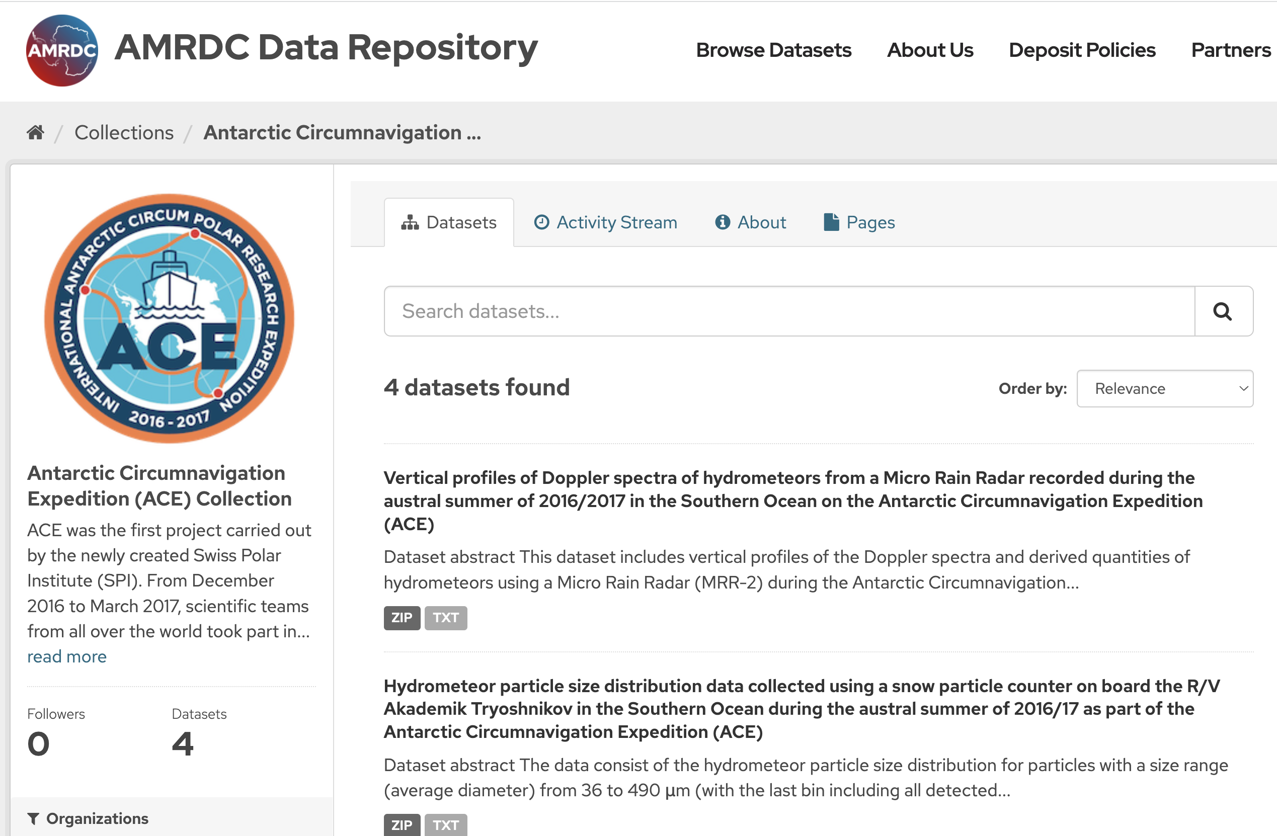

Slide 10
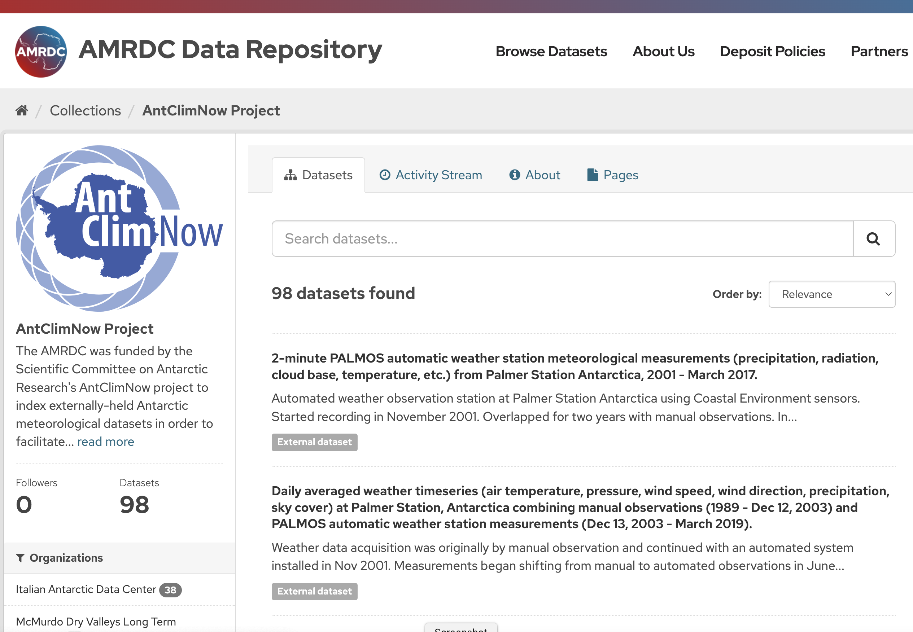

Slide 11
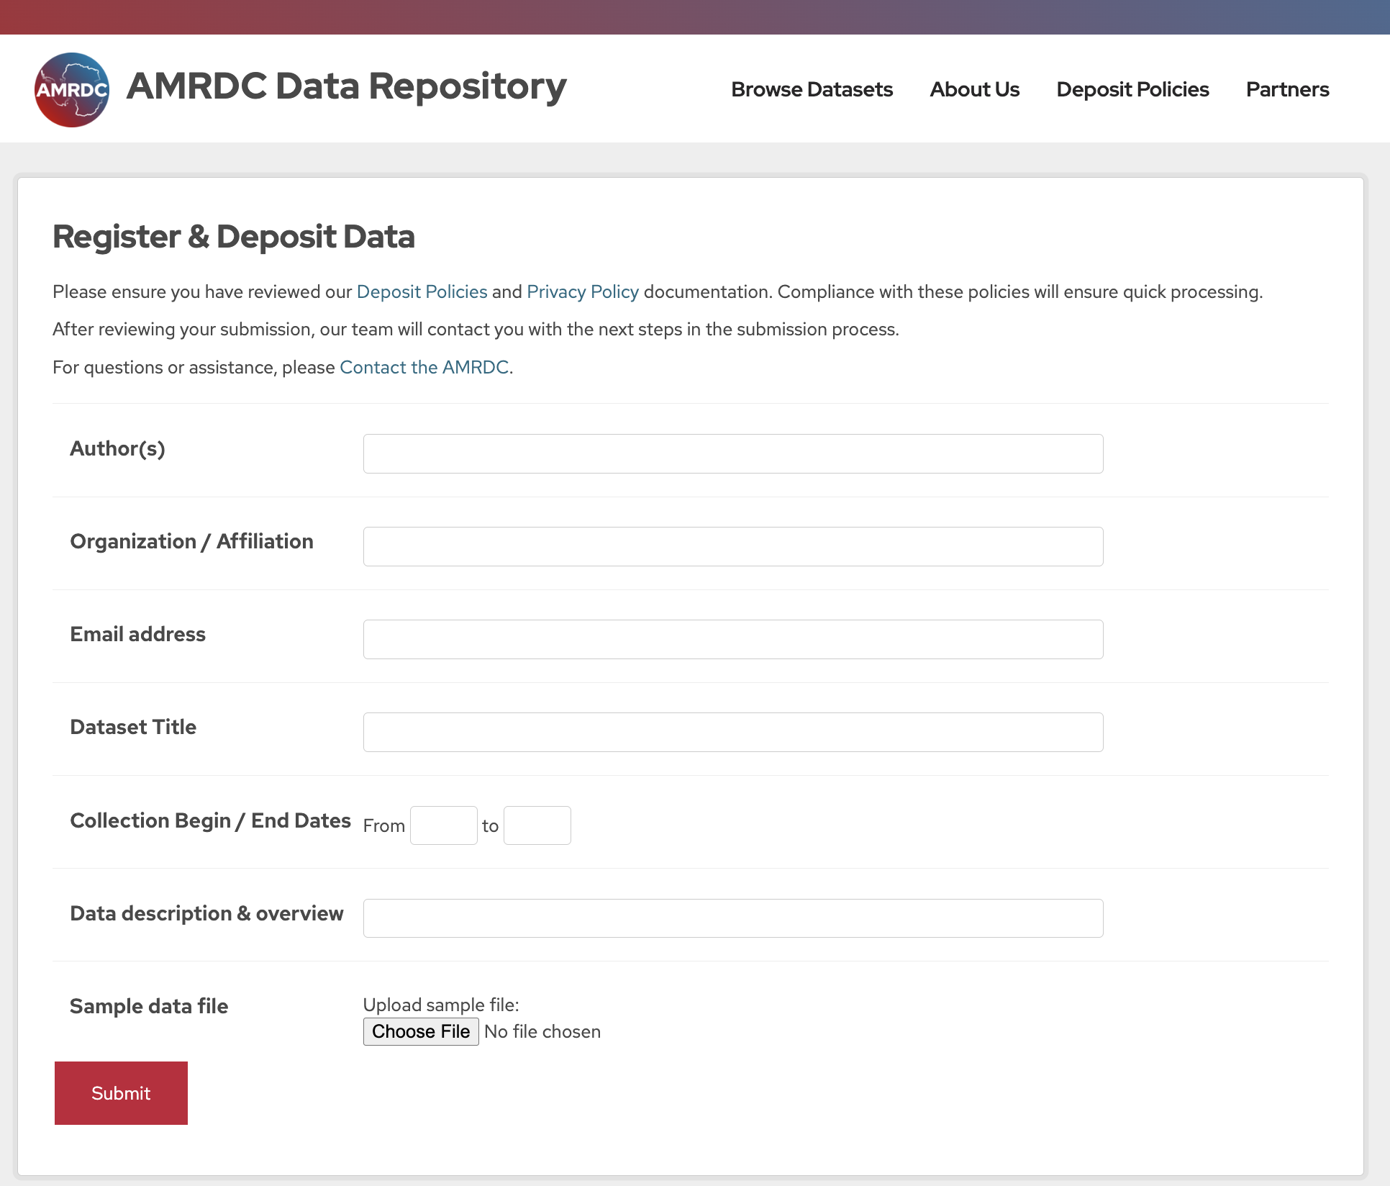

Slide 12
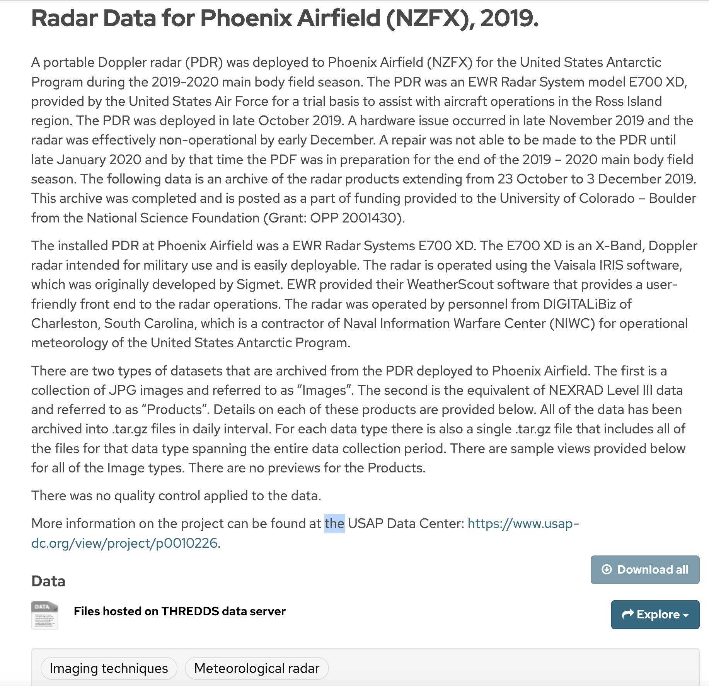

Slide 13
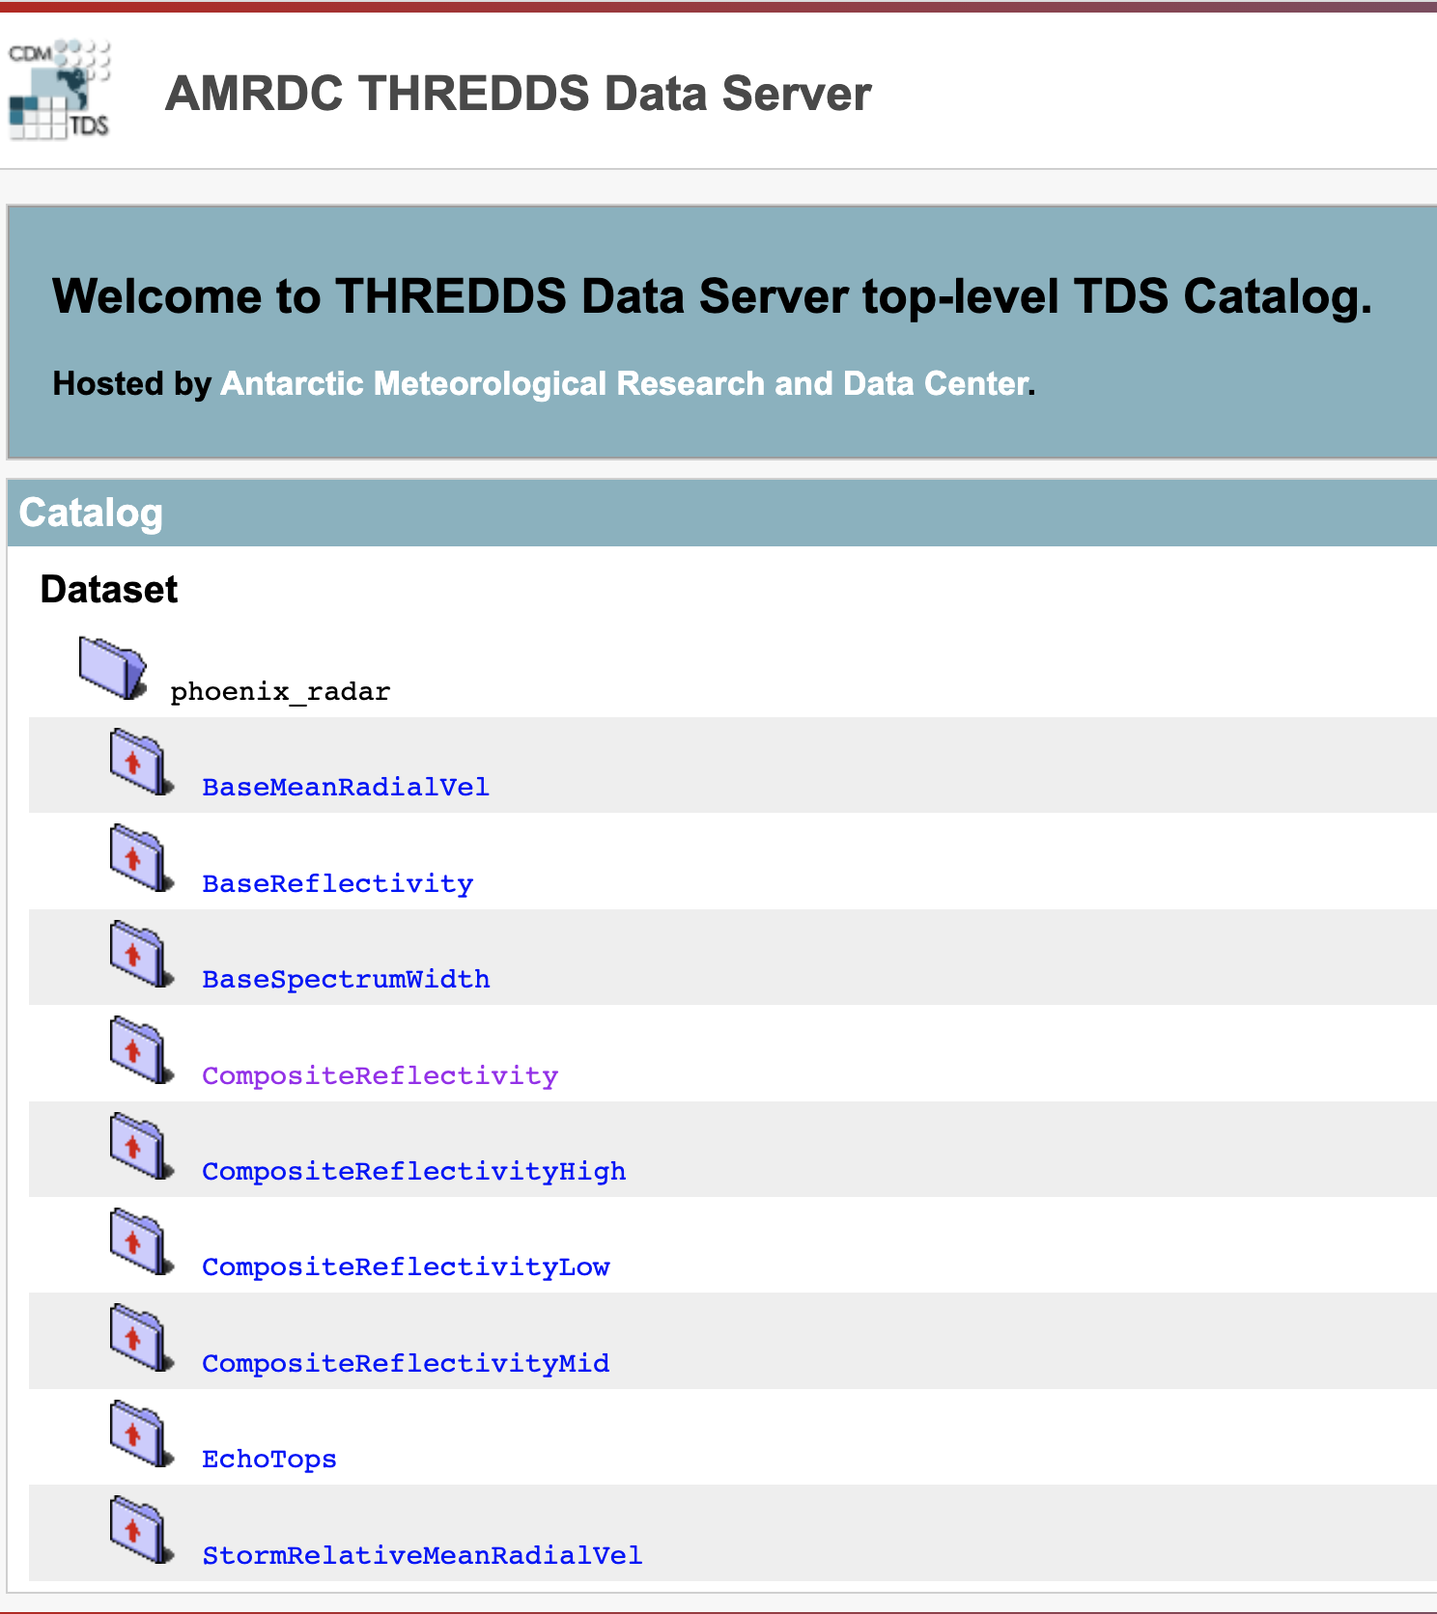

Slide 14
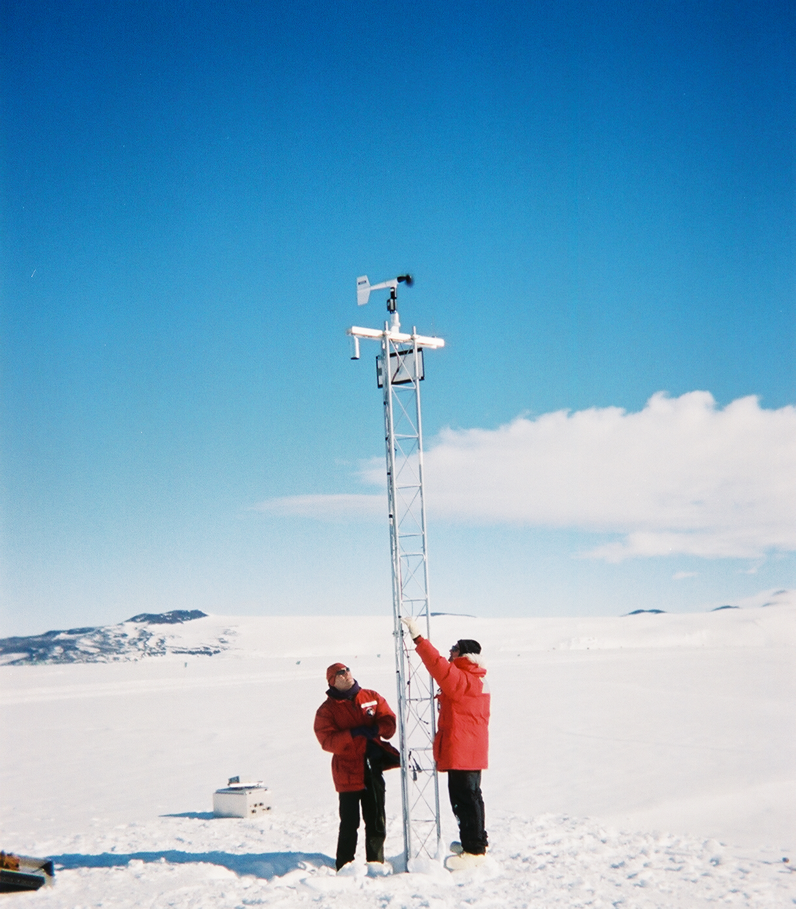
Some Statistics and Future…
Currently hosting:
4740+ datasets
  Many are AWS..
AntCLIM^{now} up to 98 links to external datasets
  Linking to 8 other organization’s data repositories
Up to 9 Collections either started or about to be started
More unique data to be added soon:
  USAP Field Camp
  YOPP-SH Atmospheric River scale analysis from CW3E
  South Pole Station
  Palmer Station
  etc

Slide 15
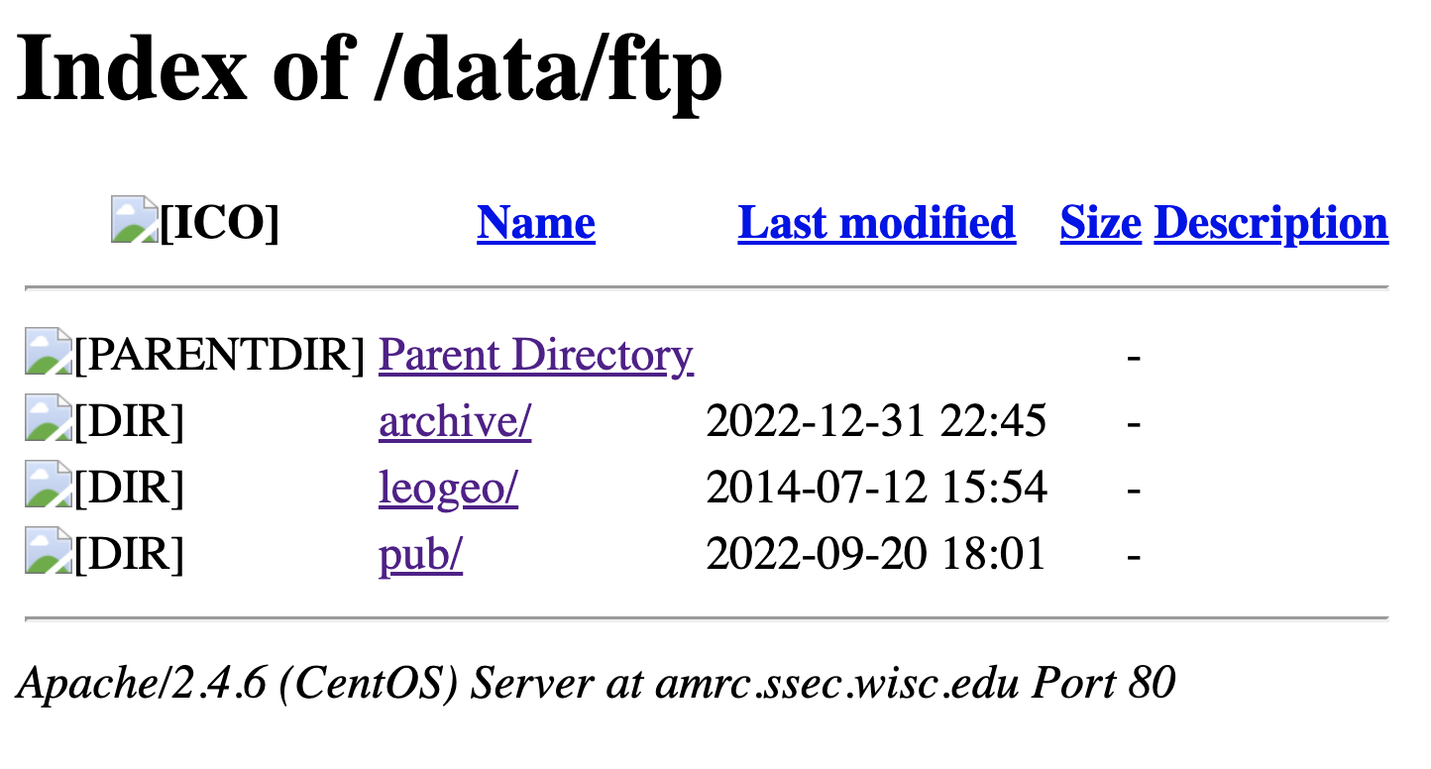
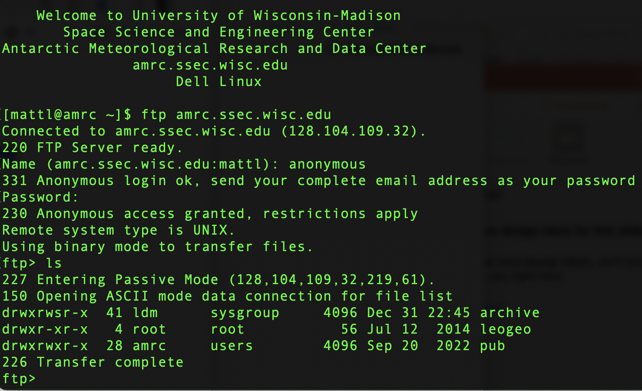
AMRC FTP site… is going away in 1 year

Slide 16
Other AMRDC Tasks
Data Visualizer coming soon
  Basic visualization from the repository…(AWS focus)
New AMRC website (will be AMRDC) coming in the near future…
  Includes a return to having and new weather displays
  Weather Widgets
Data Services:
  LDM/Antarctic-IDD
  ADDE
  THREDDS
Satellite composite activities
  Rotation to have 0° orientation
  Second-stage generation
Student engagement via case studies, investigations, etc.
  See Ethan and Mercedes’ Posters!
Advisory Board
  Thank you!!
Special tasking
  See Matthew’s prior talk ….
Future:
  Investigation of the ”cloud”

Slide 17
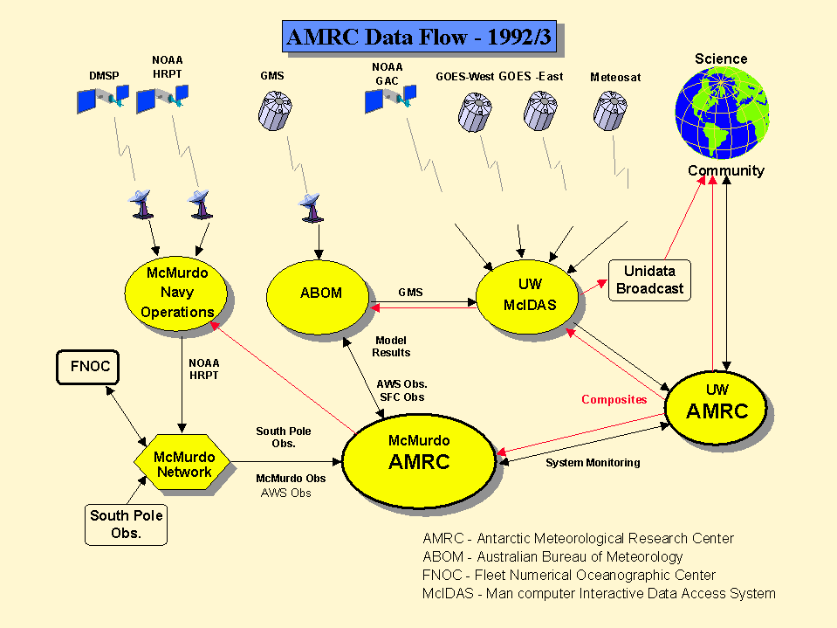

Slide 18
Antarctic-IDD
Active Use LDM
Status as of 2023
NOAA (Arctic Sat. Composites) Washington, DC
(degraded)
AMRC/Wisconsin
NOAA NCO/TG → GTS
(AWS BUFR)
NCAR/MMM
BPCRC/OSU
UCAR/Unidata
ASC
Phases:
CU
Phase I - Field Seasons 2005-2007
Phase II – Field Seasons 2007-2023
Phase III – Future ?
CSBF/LDB
NIWC
Charleston
Key:
Two-way, full data stream
Historical One-way, full data stream &
Firewall limited data return
Limited two-way data stream
Historically tested transmission only
Limited Data Queue connection
Future ?
McMurdo
Station
NIWC
& AMRC
CSBF/LDB
At Williams
Field

Slide 19
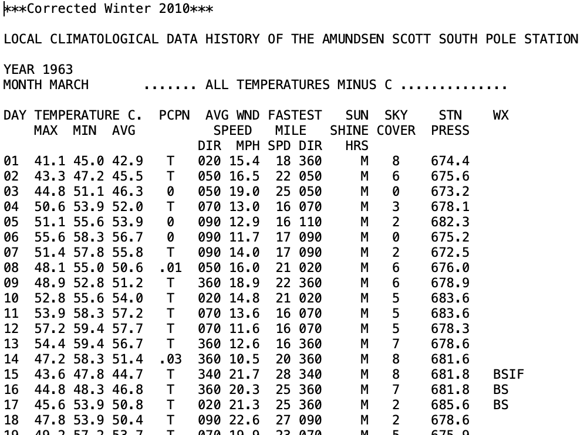
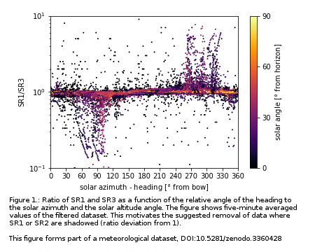
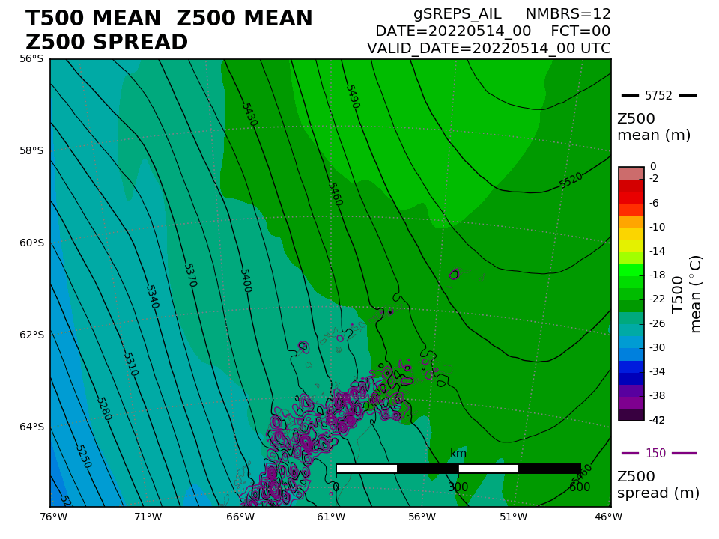
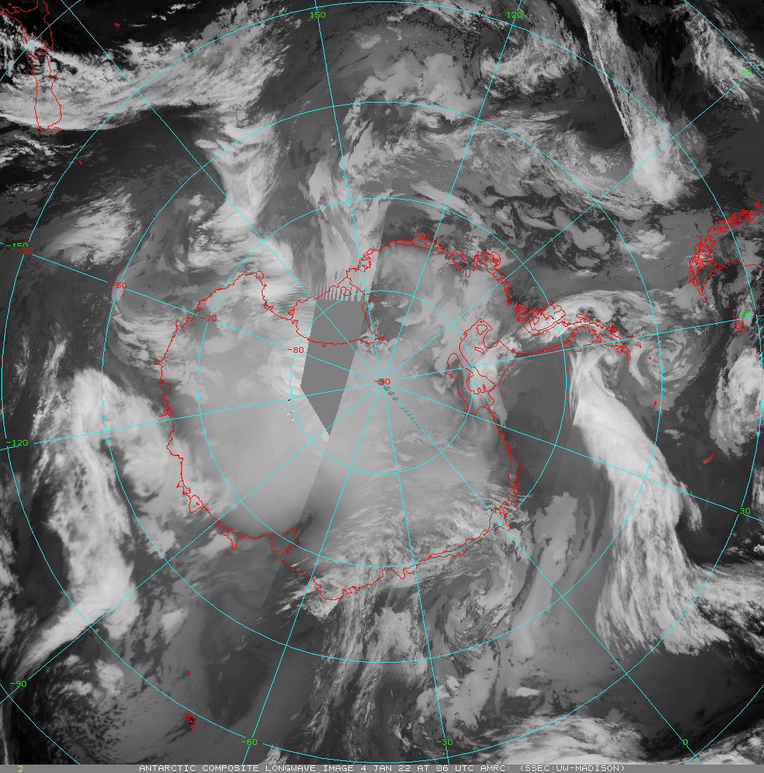
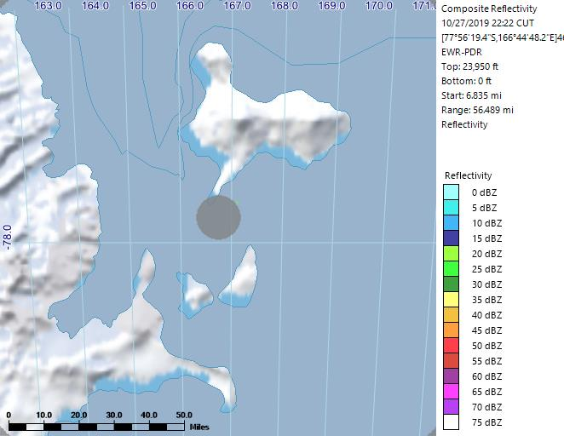
Thank you! Questions??
Acknowledgements:
NSF Grant # 1951720 (UW) and 1951603 (MATC)

