Slide 1
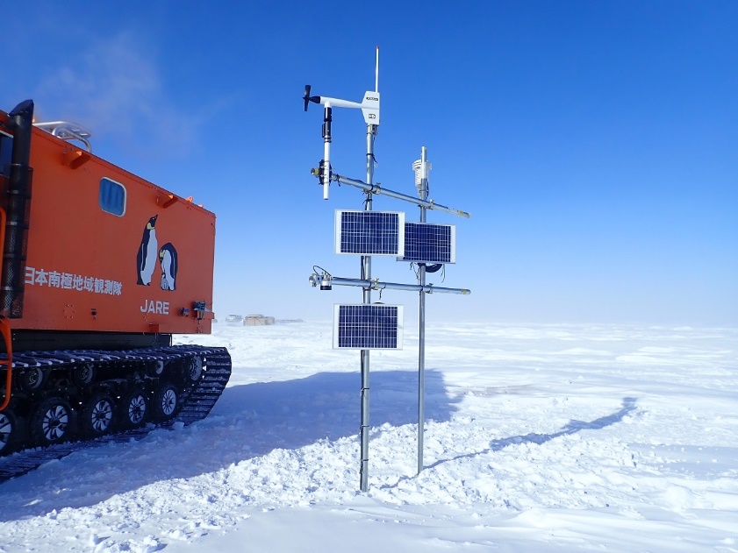
18th Workshop on Antarctic Meteorology and Climate (WAMC)
31 May 2023
SAT change at Relay Station in the interior East Antarctica during the last 30 years
Naoyuki Kurita¹, Takao Kameda², Naohiko Hirasawa³, Hideaki Motoyama³ , David Mikolajczyk^{4,5}, Lee Welhouse^{4,6}, Linda Keller^{4,5}, George Weidner^{4,5}, and Matthew Lazzara^{4,6}
¹Institute of Space-Earth Environmental Science (ISEE), Nagoya University
²Snow and Ice Research Laboratory, Kitami Institute of Technology
³National Institute of Polar Research (NIPR)
⁴Antarctic Meteorological Research and Data Center, Space Science and Engineering Center, University Wisconsin-Madison
⁵Department of Atmospheric and Oceanic Science, University of Wisconsin-Madison
⁶Department of Physical Sciences, School of Engineering, Science and Mathematics, Madison Area Technical College

Slide 2
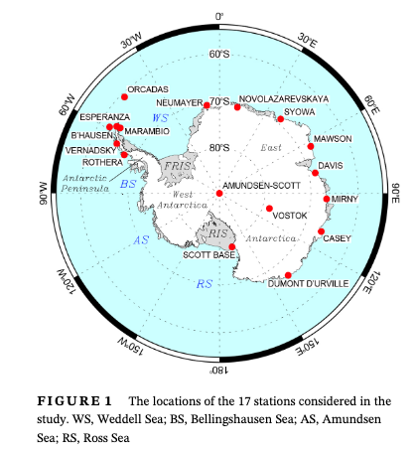
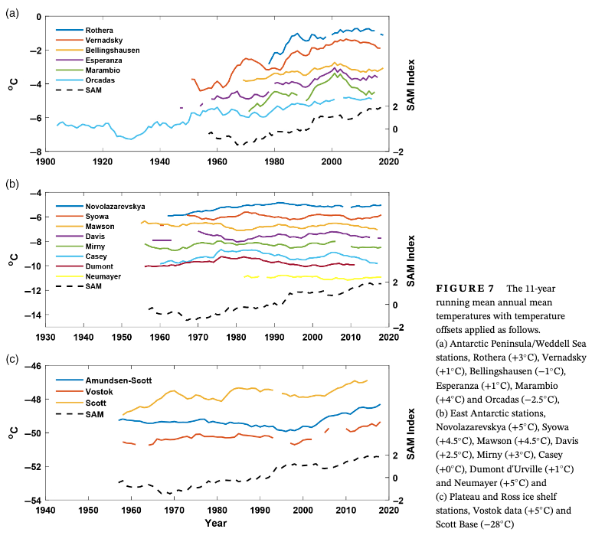
There is no available SAT data in the interior DML
Motivation
Variability and change in SAT is largely unknown in the interior East Antarctica (Dronning Maud Land).
Turner et al. ( Int. J. Climatol., 2020)
Create a new surface climate data in the interior DML
2

Slide 3
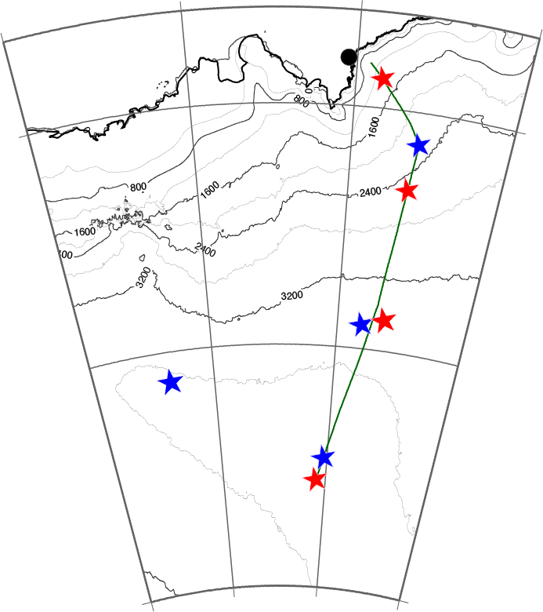
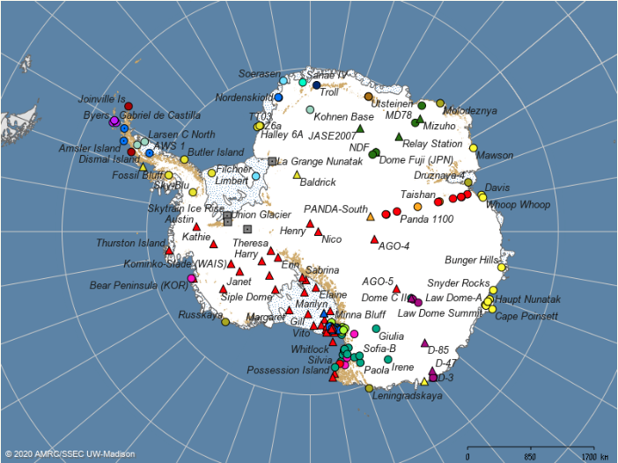
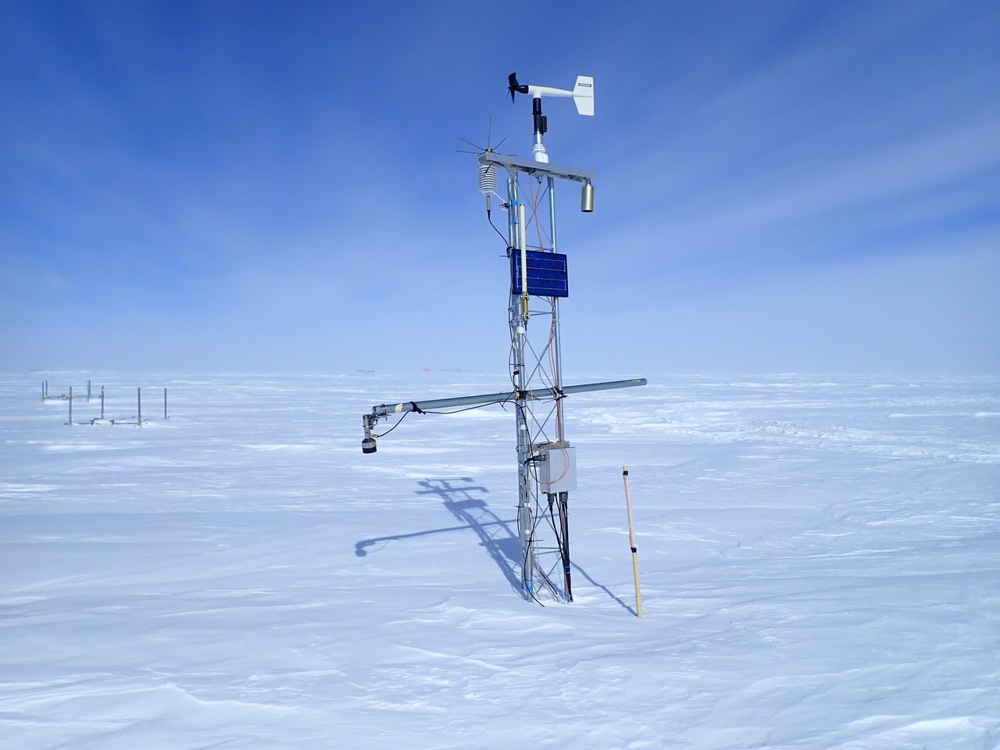
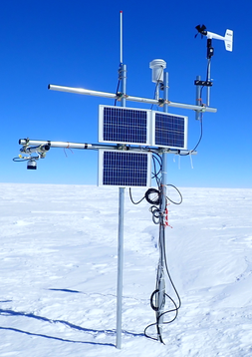
AWS stations in the interior DML (2023)
There are 8 stations in the DML.
AWS stations (2023)
H128
MIZUHO
MD78
JASE2007
Relay Station
https://amrc.ssec.wisc.edu/aws/map.php?region=All%20Stations&year=2023&mode=international
Dome Fuji
UW-AWS (CR1000)
JARE-AWS
NDF
UW-AWS
JARE-AWS
Relay Stations
3
Notes:
Although there is no staffed weather station in this remote interior, there are many AWS stations.
Here is the enlarged map of the AWS installed region.
The Japanese Antarctic Research Expedition, named JARE, installed four latest AWSs stations along the traverse route from Syowa to Dome Fuji station.
The uniqueness of our latest AWSs is using the force-ventilated radiation shield for temperature measurement.
In addition, we are also measuring the 4 component of the surface radiation balance.
Except for our Japanese AWSs, UW-AWSs are also installed as a joint collaboration with the University Wisconsin.

Slide 4
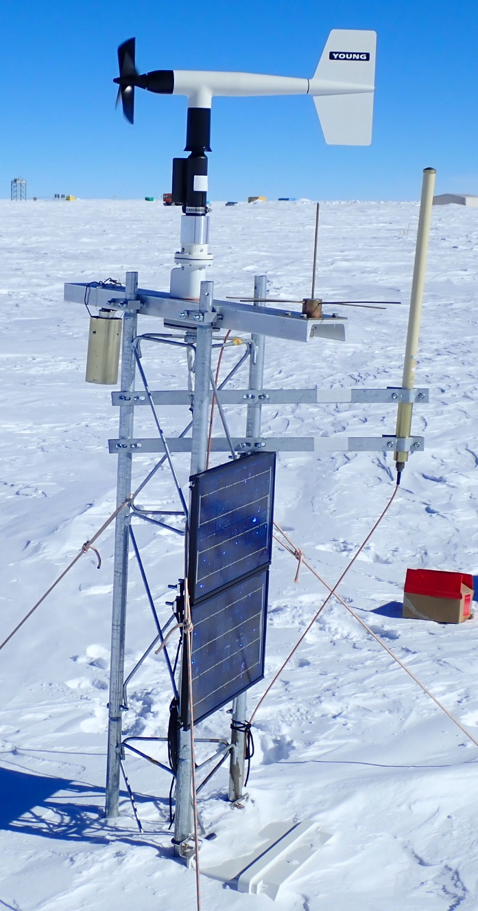
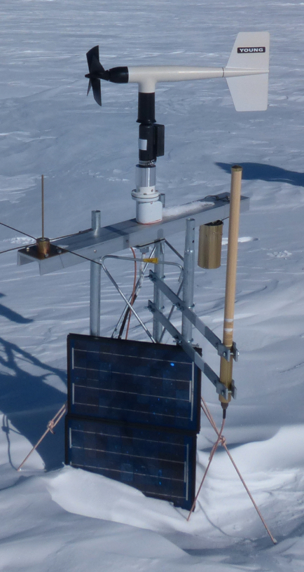
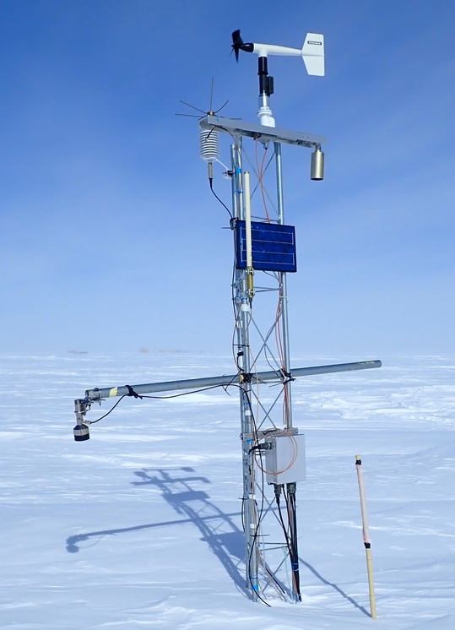
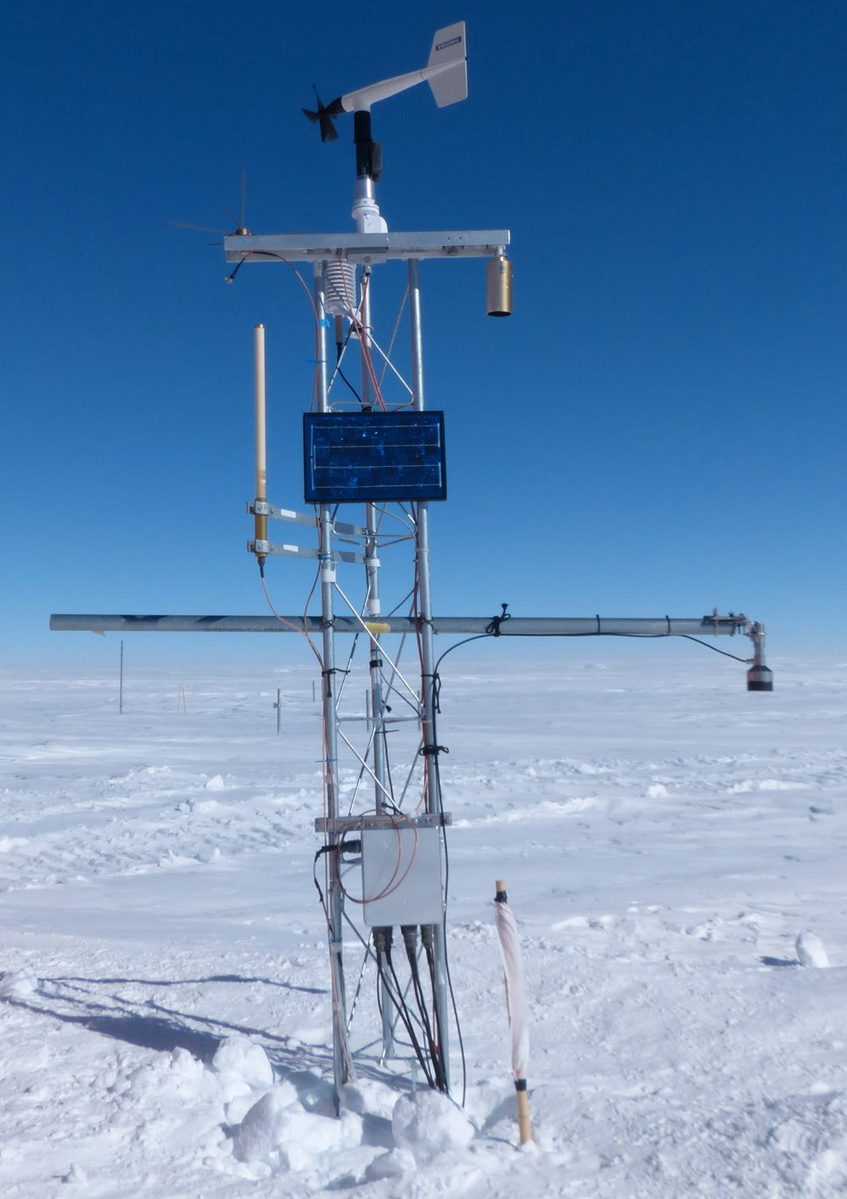
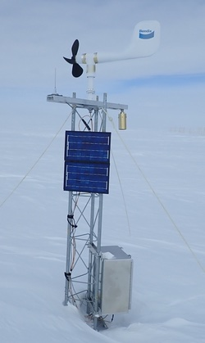
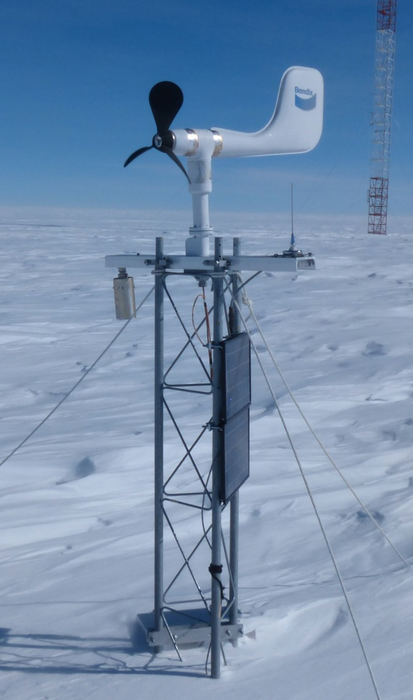
UW-AWSs in the interior DML (2022)
Dome Fuji
Relay Station
2018
2022
2018
2022
Mizuho
2018
2022
Changes in the height of sensor@DF
77 cm
57.2cm
12/2/2021
12/6/2022
4

Slide 5
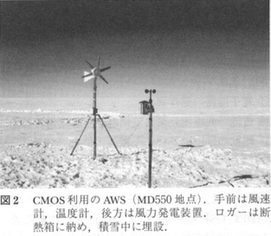
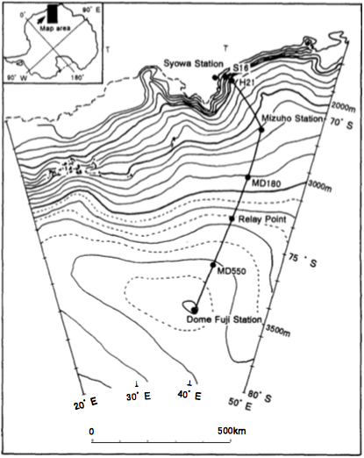
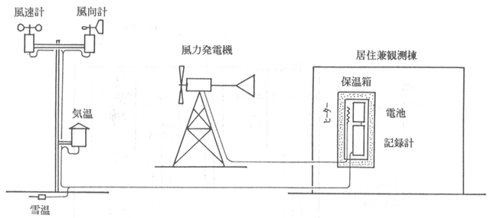
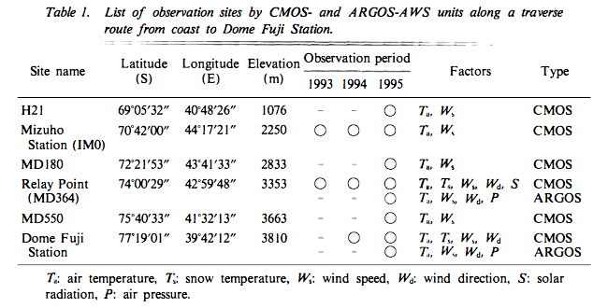
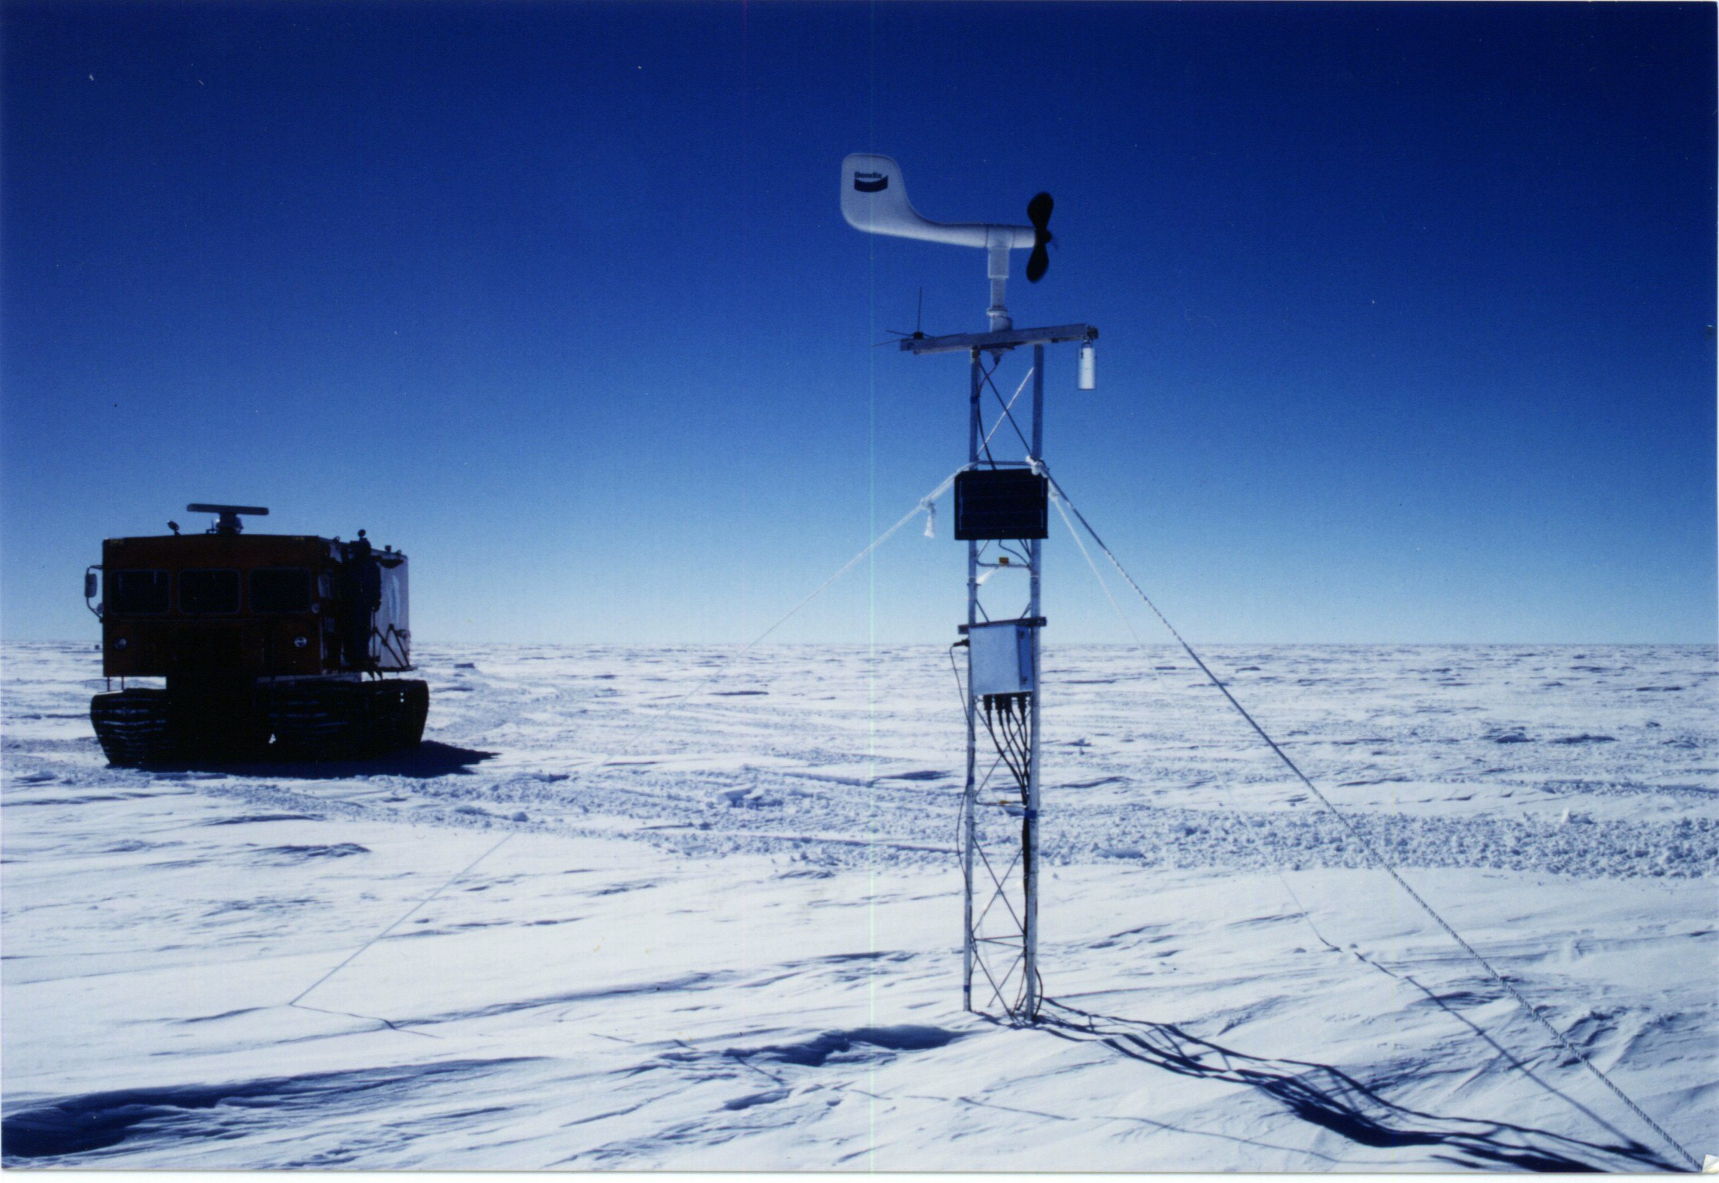
Antarctic AWS program of Japan since 1993
AWS stations along the Dome Fuji Traverse route from 1993.
CMOS-AWS
What is the CMOS-AWS?
Records the data in complimentary metal oxide semiconductor (CMOS) memories.
The observed data were retrieved once in a year during the summer field season.
H21
Mizuho
Relay Station
Dome Fuji
Wisconsin 2B AWS
Kameda (Proc. NIPR sympo, 1997)
5

Slide 6
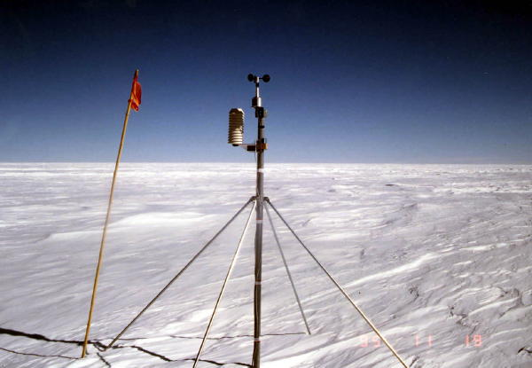
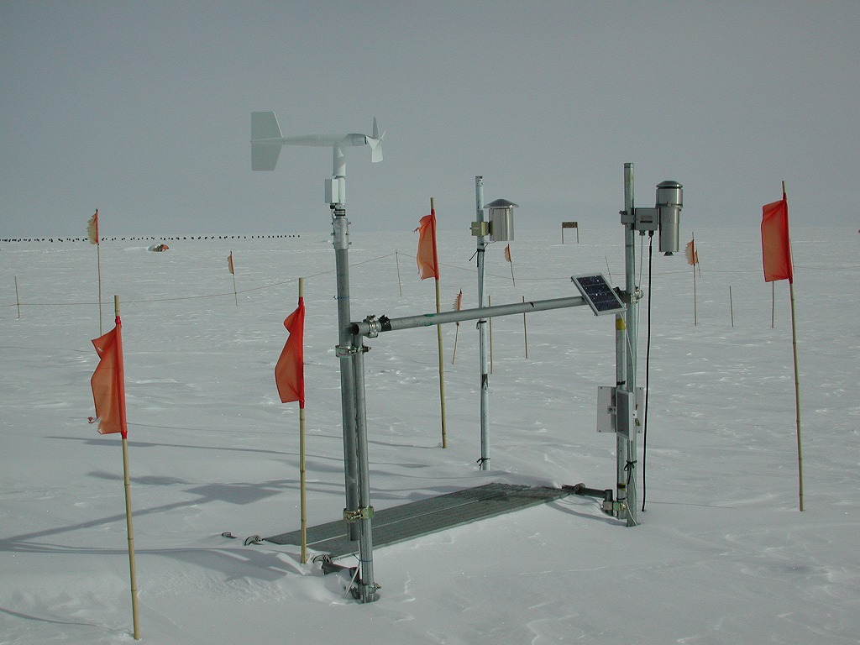
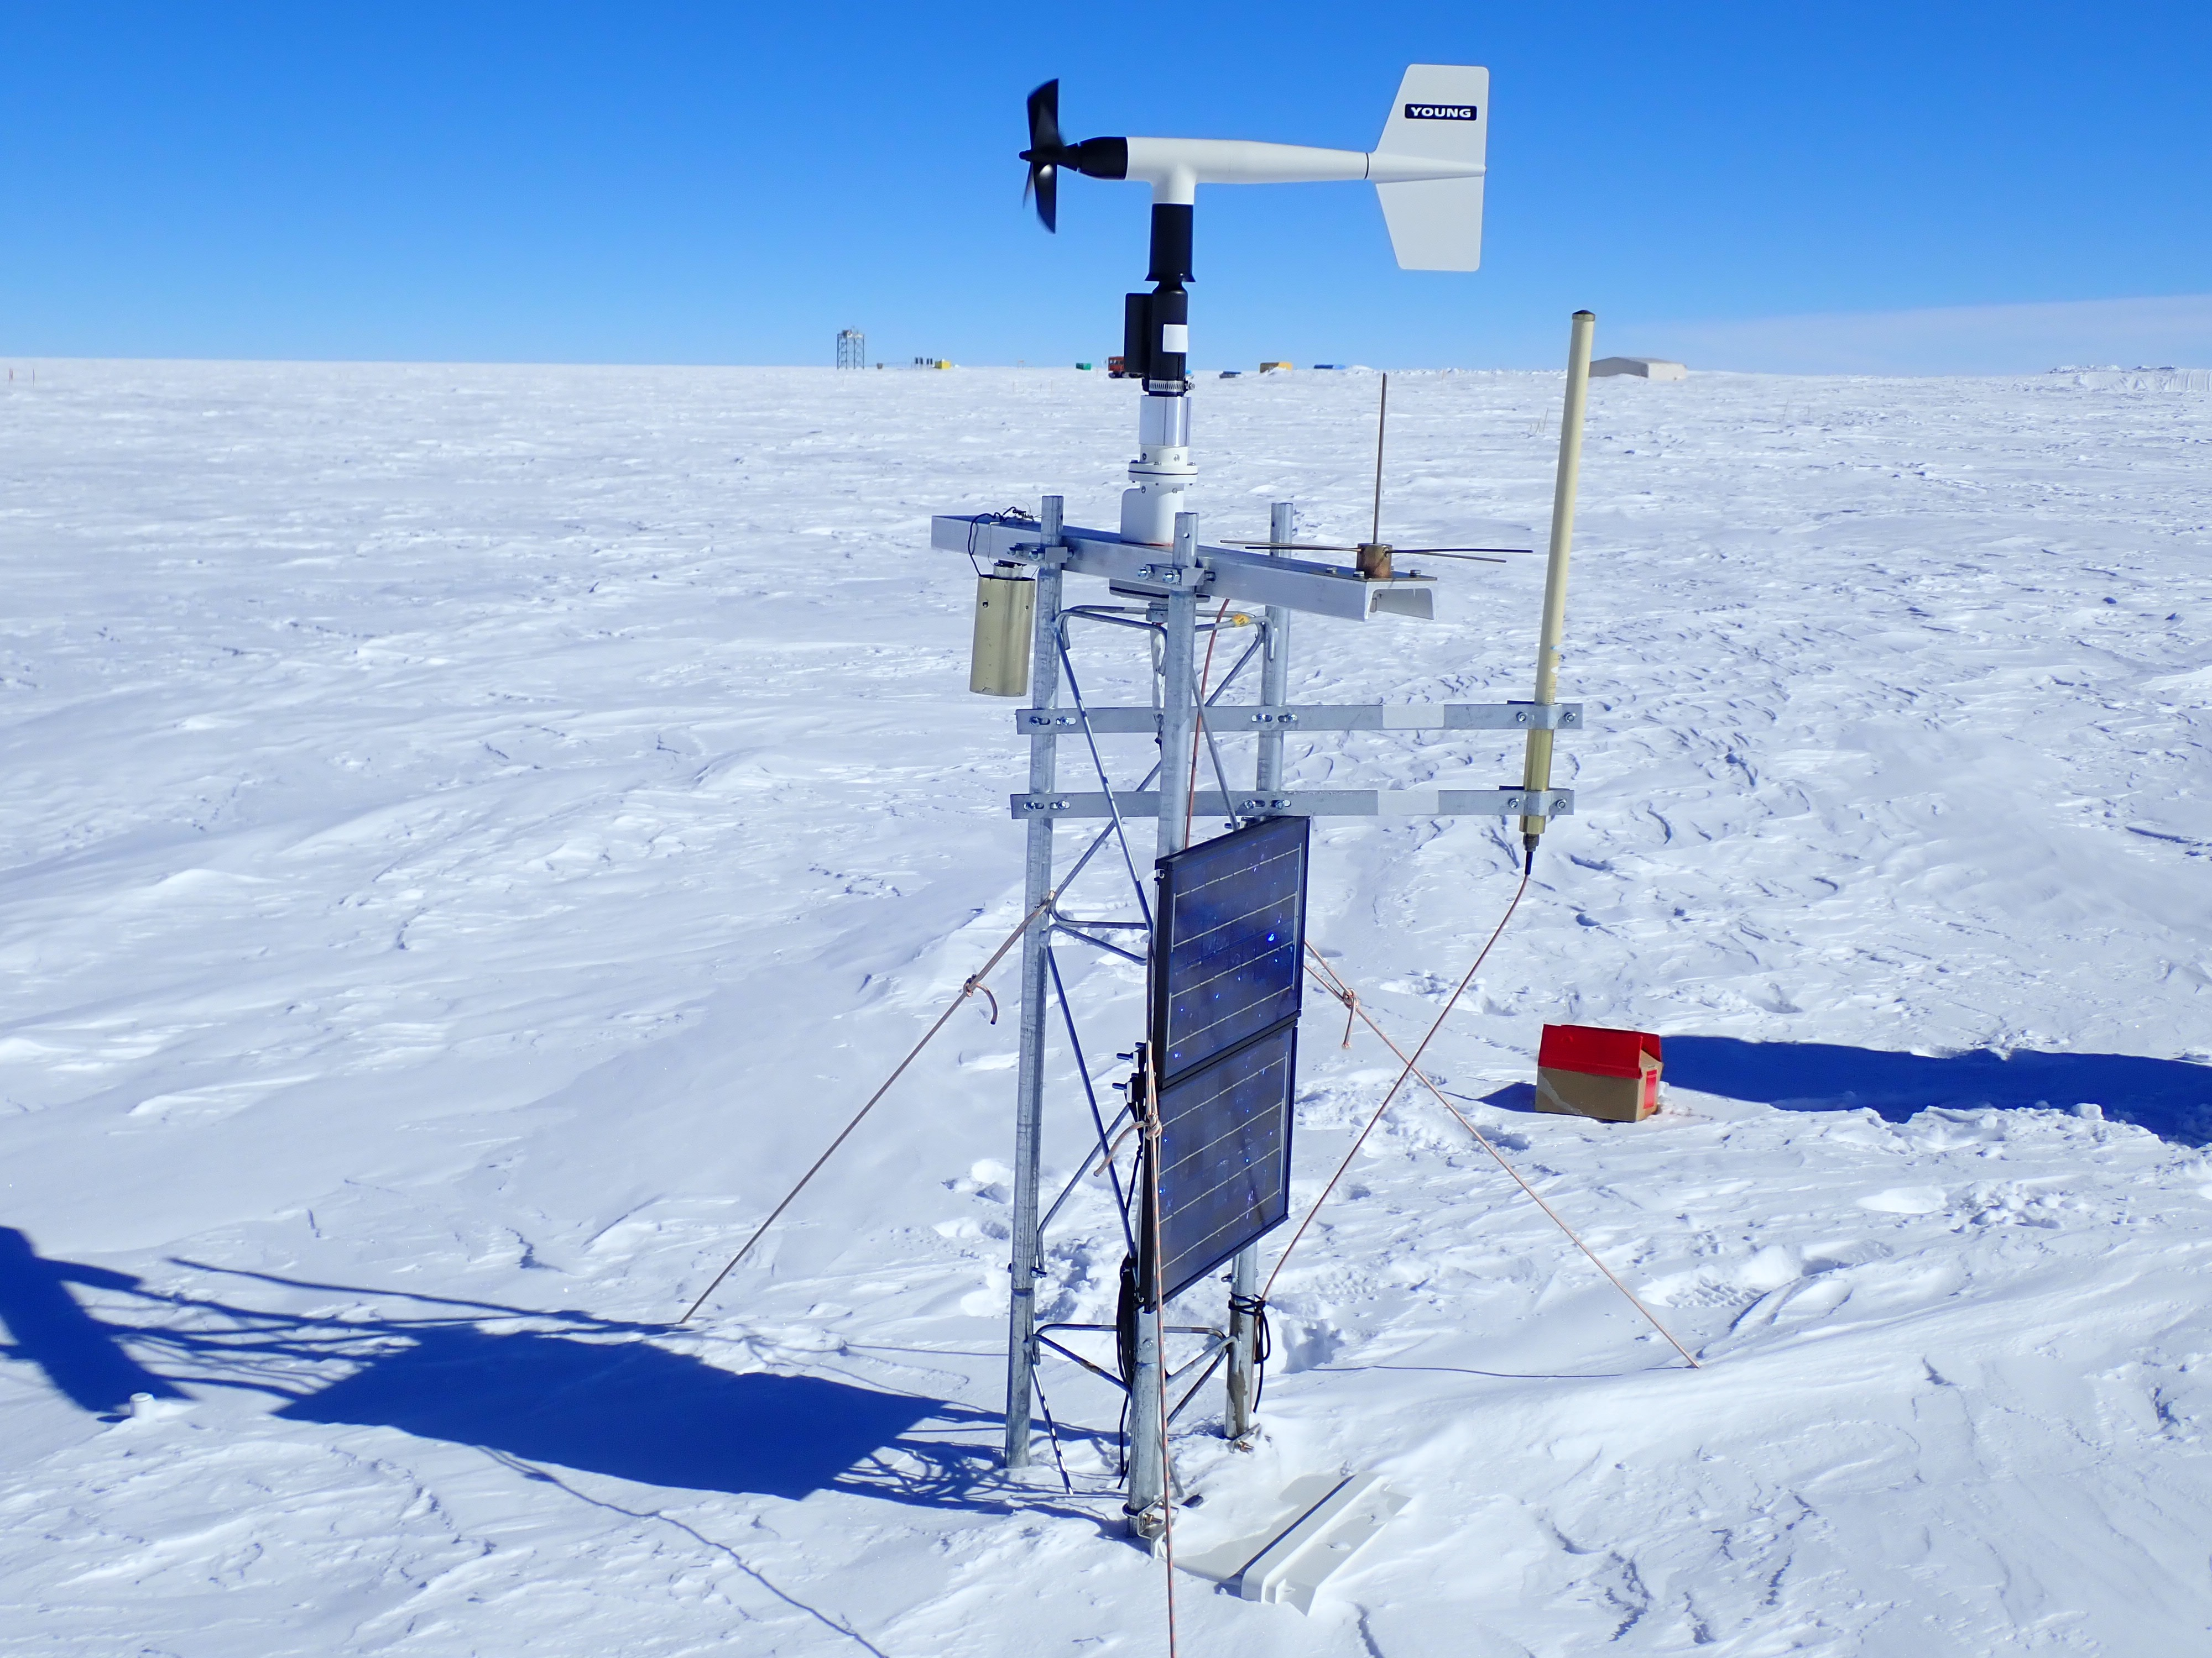
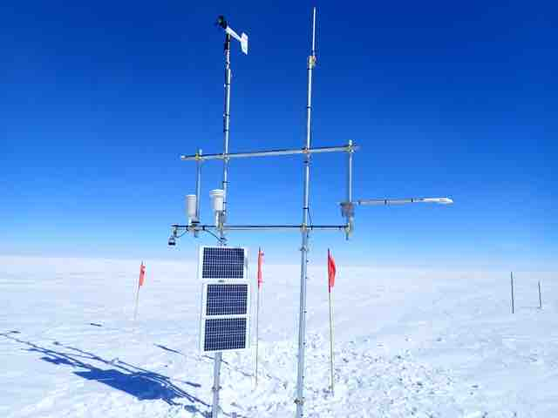
30 Years observations in the interior DML
Intercomparison campaign of the SAT measurement with different type of radiation shield at Dome Fuji.
2020
CMOS-SV
2015
JMA
CMOS
JMA
2010
UW-2B
CMOS-SV
2005
2000
CMOS-SV AWS
Solar powered fan-aspirated radiation shield
1995
UW-CR1000
NIPR
JMA-AWS
1990
24-hour fan aspirated radiation shield
6

Slide 7
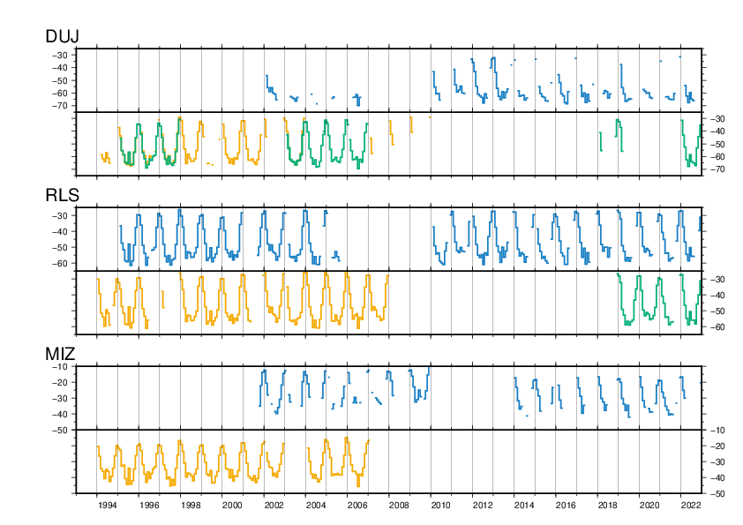
SAT records in the interior DLM (Raw data)
Dome Fuji (DUJ)
UW-AWS
JARE-AWS
Relay Station (RLS)
UW-AWS
JARE-AWS
Mizuho (MIZ)
UW-AWS
JARE-AWS
7

Slide 8
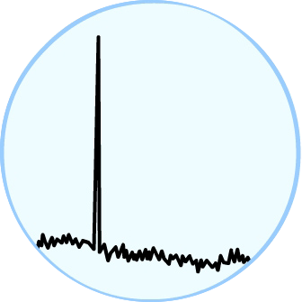
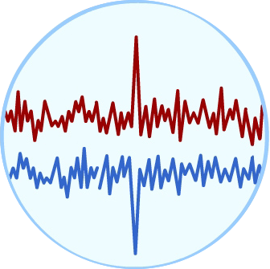
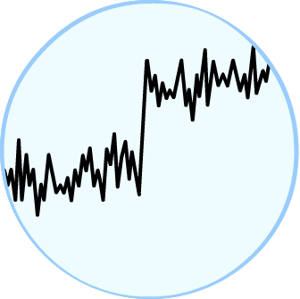
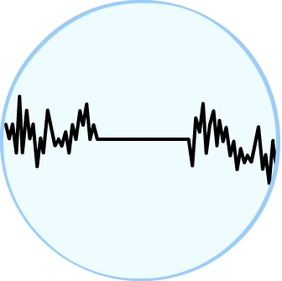
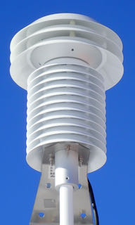
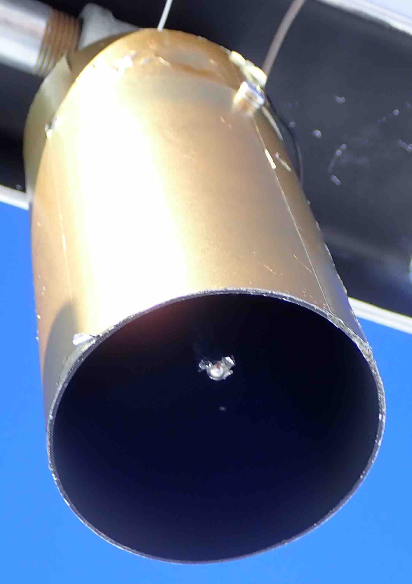
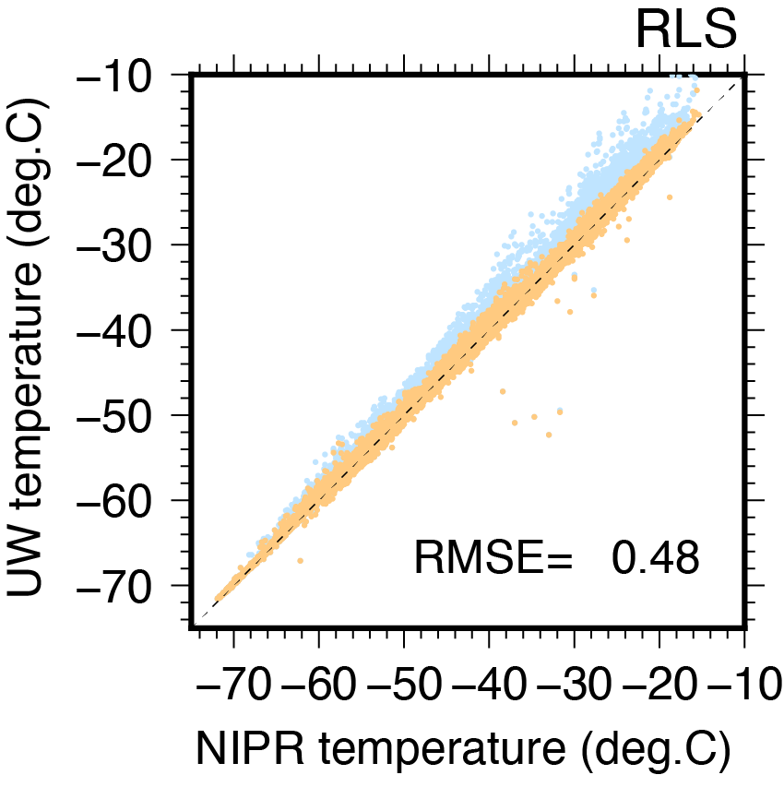
Quality control of AWS observations
★
Quality Control Process steps to climate data products
1
2
3
4
Gross error check
Warm bias correction
Systematic bias correction
Compute the monthly means
Remove data that was inconsistent with the prior or subsequent observations.
Correct the radiative heating errors due to sensor hearing by strong incoming solar radiation.
Correct the systematic bias between the various AWSs through intercomparison.
Merge all of available AWS data at each site and then compute the monthly means by following the order for the READER dataset.
QC program
1. Monthly means are based on 6-hourly data.
90% of the data is available in each month.
No gaps of more than two consecutive days.
No more than 50% of the missing values from one time period ( 0600, 1200 UTC, etc).
outlier
Fan-aspirated and non-aspirated radiation shield
Spike peaks were removed by hand.
Morino et al. (2021)
8
https://www.climate.gov/maps-data/climate-data-primer/how-do-weather-observations-become-climate-data

Slide 9
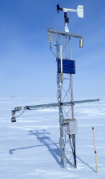
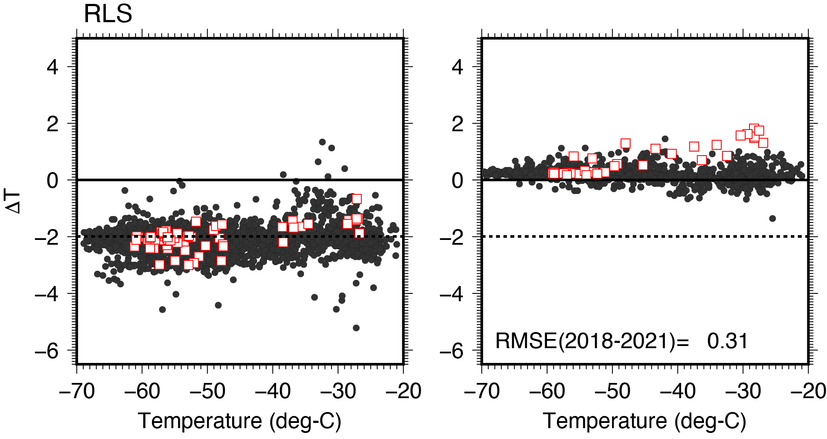
Systematic errors for UW-AWS at RLS
Relay Station (Monthly raw)
UW-AWS
JARE-AWS
Daily plot
UW- CMOS
UW- NIPR
The UW-AWS is cooler -2.0℃ than the CMOS-AWS.
READER shows warm bias in summer observations.
UW
CMOS
READER
NIPR
9

Slide 10
Which data is correct?
★
Comparison with the manual measurements in September 2000.
Date | Time | Man. T | UW-AWS | CMOS-AWS
Sep 8, 2000 | 19:10 | -54.7 | -56.5 (-1.8) | -54.6 (-0.1)
Sep 9, 2000 | 08:10 | -51.4 | -54.6 (-3.2) | -50.9 (-0.5)
Sep 9, 2000 | 15:00 | -51.4 | -53.5 (-2.1) | N/A
Sep 10, 2000 | 6:55 | -59.2 | -61.9 (-2.7) | -59.7 (0.5)
Sep 10, 2000 | 17:10 | -54.7 | -56.6 (-1.9) | -55.6 (0.9)
Sep 11, 2000 | 7:00 | -53.3 | -54.5 (-1.2) | -53.7 (0.4)
Sep 11, 2000 | 18:00 | -53.4 | -55.9 (-2.5) | -54.5 (1.1)
Sep 12, 2000 | 7:00 | -53.1 | -55.5 (-2.4) | -52.7 (-0.4)
Average Δ T :
-2.2℃
0.3℃
The UW-AWS seems to have cold bias before replacement to CR1000.
10

Slide 11
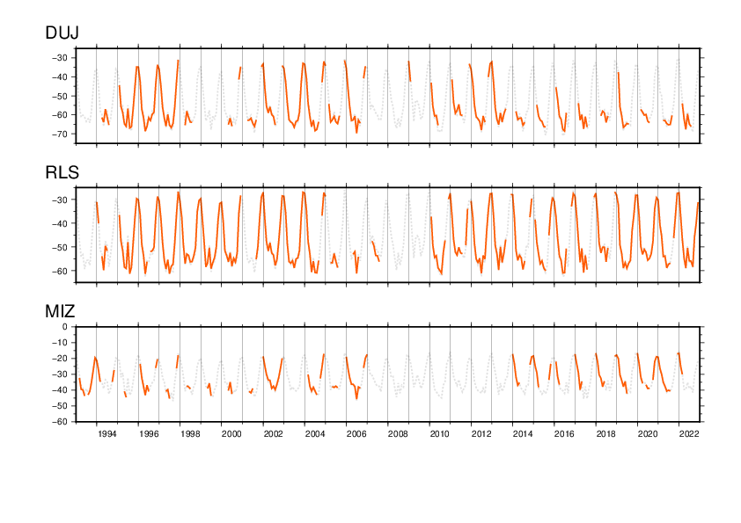
QC’ed SAT variability over last 30 years
Dome Fuji
UW-2B
UW-CR1000
ERA5
Relay Station
UW-2B
UW-CR1000
Mizuho
UW-2B
Missing observations have to be filled using another data.
11

Slide 12
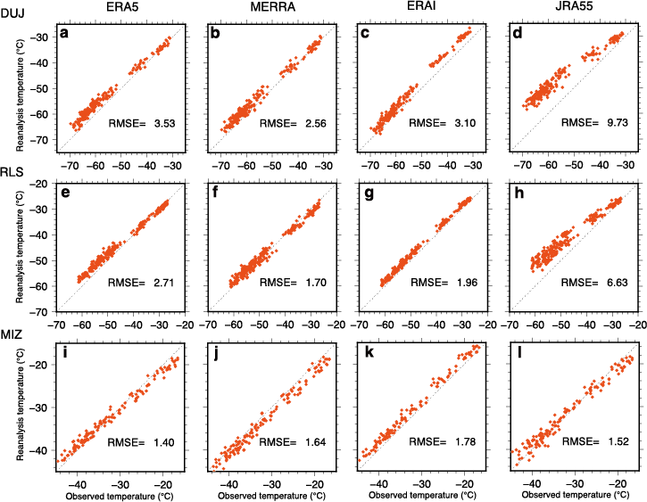
AWS data vs. Global reanalysis data
Dome Fuji
Relay
Station
Mizuho
Monthly mean 2-m temperature from four global reanalysis interpolated to observation site compared with the AWS observed monthly mean surface temperature during 1993-2021 at Dome Fuji (a-d), Relay Station (e-h), and Mizuho(i-l), respectively. The root-mean-square error (RMSE) of reanalysis temperature with respect to the observations is calculated from individual monthly values. The reanalysis datasets are: ERA5 (a,e,i); MERRA (b,f,j); ERA-Interim (c,g,k); and JRA-55 (d,h,l). For ERA-Interim, the monthly values from 1993 to 2018 are used. Difference between the modeled and the observed height is not adjusted since the influence is smaller than the uncertainty of measurements.
12

Slide 13
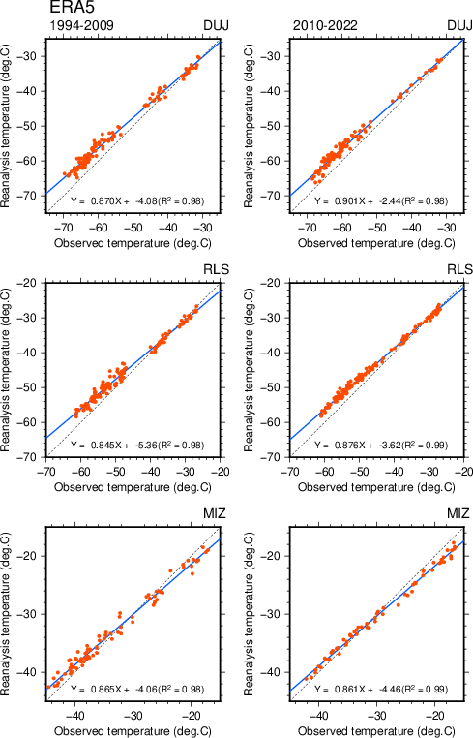
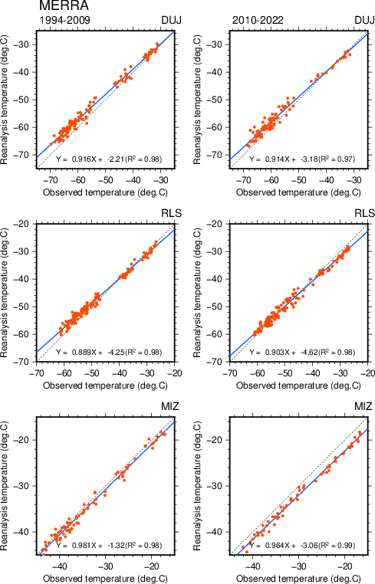
Which reanalysis data is better to use?
★
ERA Interim was outdated and stopped at 31 August 2019.
★
The ERA5 results do not change with time.
ERA5
MERRA
Monthly mean 2-m temperature from ERA5 (MERRA) compared with the AWS observed monthly mean surface temperature during 1993-2009 (left) and during 2010-2021 (right) at Dome Fuji (a,d), Relay Station (b,e), Mizuho(c,f), respectively. The regression line (blue) and correlation coefficient (R²) are calculated from individual monthly values at each station.
13

Slide 14
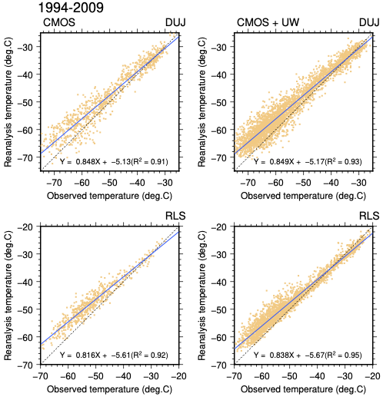
Impact of the AWS data to reanalysis data
CMOS-AWS
UW-AWS
On site data collection and unpublished data.
Real time acquisition from Argos satellite and providing data to the GTS.
★
CMOS-only period
There was no data sending to the GTS.
★
CMOS + UW-AWS period
UW-AWS data was provided to the GTS.
UW-AWS data seems not to use for data assimilation system.
Daily mean 2-m temperature from ERA5 compared with the CMOS-AWS observed daily mean temperature while there is no available UW-AWSs data in east DLM interior from 1993 to 2009 at Dome Fuji (a) and at Relay Station (b). c-d, Same as a-b, but for the period when the UW-AWS data is also available.
14

Slide 15
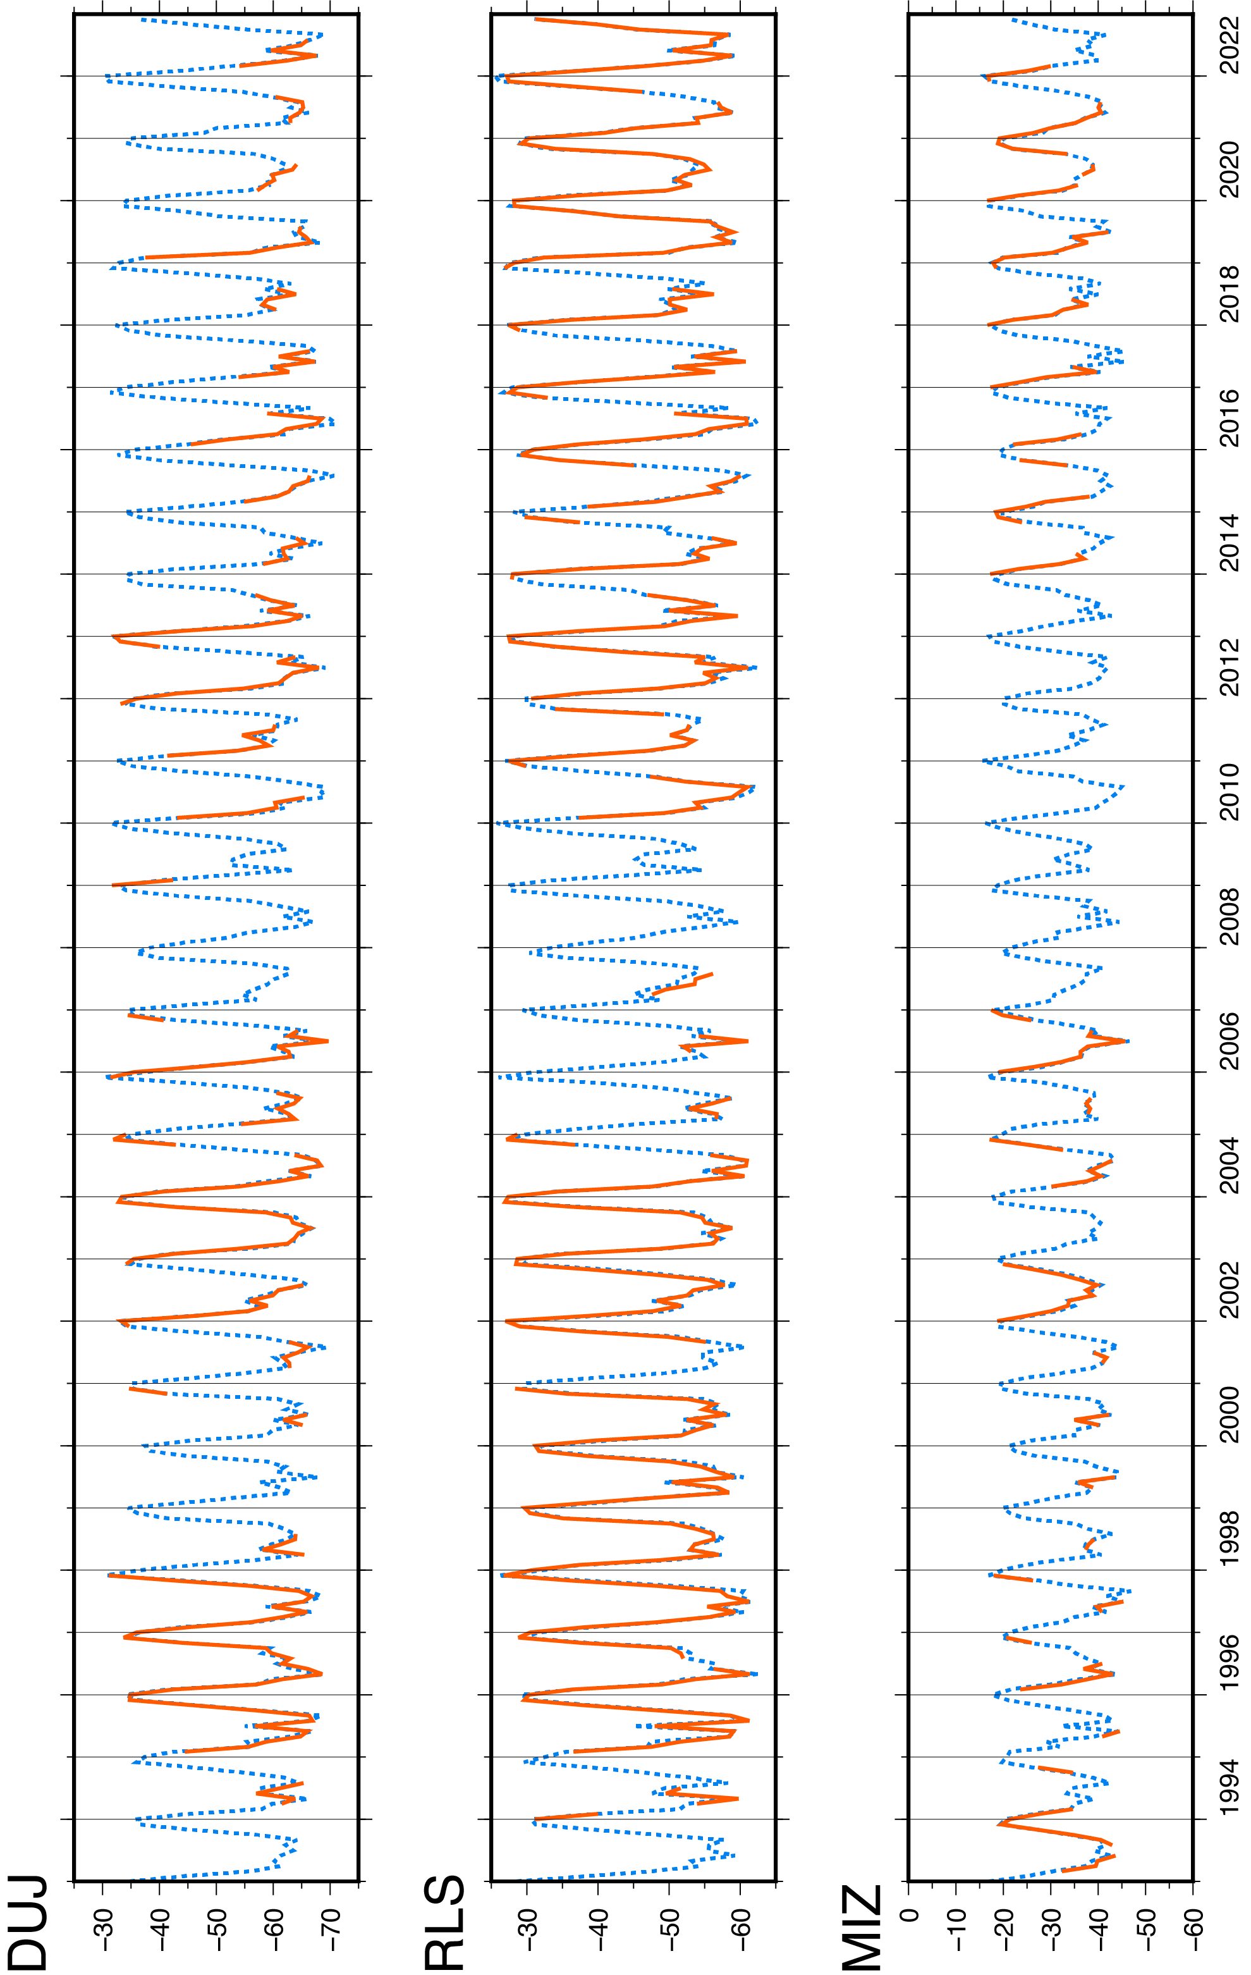
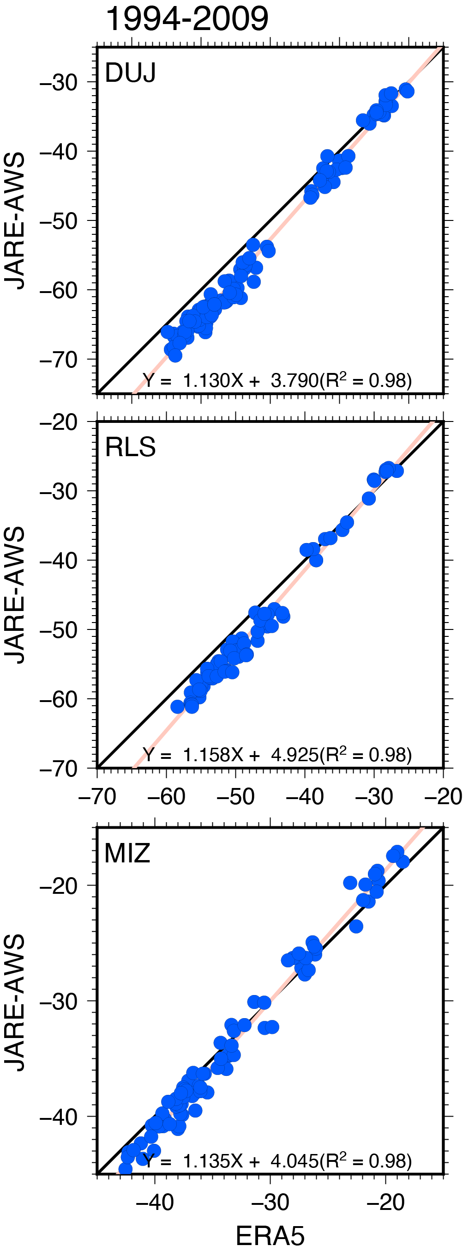
Filling of missing data using ERA5
★
Positive bias of ERA5 increases with decreasing of SAT.
★
T_{2m} of ERA5 is adjusted to the observations by using the regression approach.
Dome Fuji
Reconstructed SAT (T_{rec})
Relay Station
Mizuho
15

Slide 16
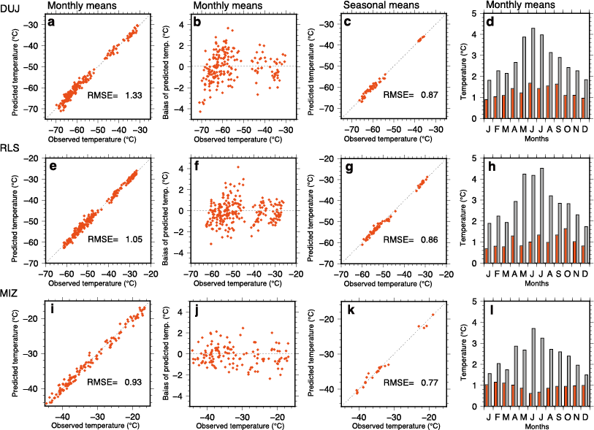
Uncertainty of the reconstructed SAT (T_{rec})
★
RMSE of seasonal means is less than measurement error (1.0℃).
★
RMSE is much smaller than the standard deviation of monthly means.
RMSE
Std.
Dome Fuji
a, Monthly mean temperatures (Trec) predicted by the regression model (see main text Method) versus the observed monthly temperature from the AWS during 1993-2022 at Dome Fuji. The root-mean-square error (RMSE) of Trec with respect to the observations is calculated from individual monthly values. b, Differences between predicted and observed monthly temperatures as a function of the observed temperature at Dome Fuji. c, Same as a, but for seasonal mean temperatures. d, Comparison of the RMSE (red bars) of predicted monthly temperatures and the standard deviation (gray bars) of the observed monthly temperatures for each month of the year during the 1993-2022. e-h (i-l), Same as a-d, but for Relay Station (Mizuho station).
Relay Station
Mizuho
16

Slide 17
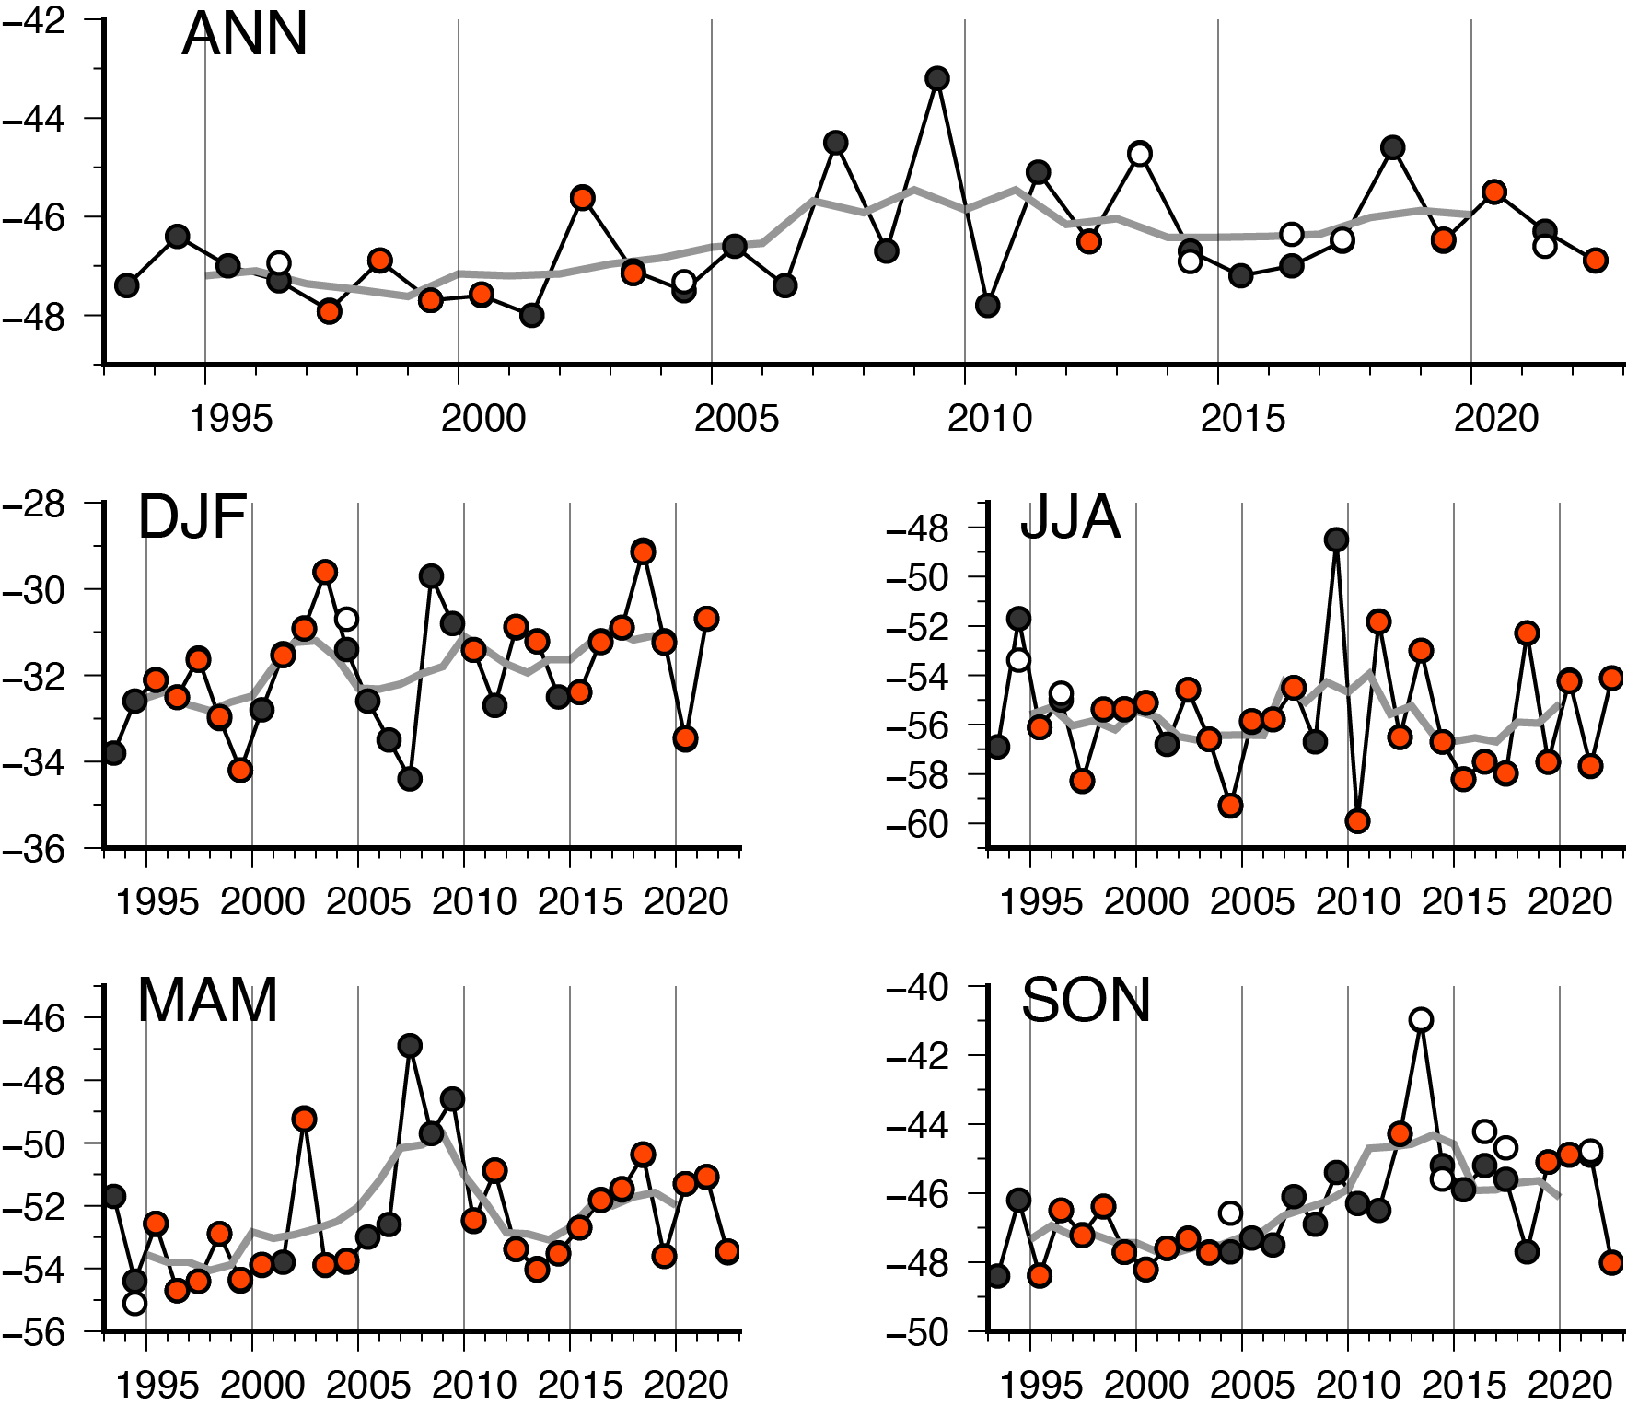
A complete SAT record at Relay Station
★
The SAT records from three stations are almost identical.
Relay station
a
T_{AWS} (more than 90% of data)
T_{AWS} (more than 70% of data)
Temperature (℃)
T_{Rec}
b
d
Temperature (℃)
Temperature (℃)
Annual (a) and seasonal (b-e) mean temperatures time series at Relay station from 1993 to 2022. Red circles denote the mean SAT computed using AWS data, which more than 90% of 6-hourly data are available in a month. White circles are same as red circles, but more than 70% of data in each month. Black circles are the means of reconstructed SAT from ERA5 (Trec). The solid gray represents the 5-year moving average temperature.
c
e
Temperature (℃)
Temperature (℃)
17

Slide 18
Trend analysis (1993-2022)
★
Annual and seasonal temperature trend (℃ decade⁻¹)for 1993-2022
Station | Annual | Spring | Summer | Autumn | Winter
Relay Station | 0.49±0.45 | 0.89±0.57 | 0.57±0.56 | 0.57±0.78 | -0.05±1.04
Vostok | 0.53±0.41 | 1.05±0.55 | 0.45±0.46 | 0.44±0.70 | 0.35±0.93
Amundsen-Scott | 0.56±0.36 | 0.51±0.59 | 0.76±0.55 | 0.62±0.61 | 0.38±0.83
Significance is indicated as bold (p < .05) and red bold (p < .01).
Summary of trend analysis
- Warming occurred in every season (except for winter) at Relay Station.
- The strongest warming was spring (0.89±0.57).
-
The correlation between annual mean at Relay Station and the other stations is low (R² < 0.50).
18

Slide 19
Take home messages
★
A complete 30-year long SAT record at Relay Station is created using all of AWS observations.
★
At Relay station, the READER monthly temperature before 2010 has systematic cold bias.
★
ERA5 seems not to assimilate the UW-AWS observations in the interior DLM.
★
All of reanalysis temperature has warm bias that increases with decreasing temperature.
★
Over the last 30 years, Relay station has experienced a statistically significant warming of 0.49±0.45℃ per decade.
19
Notes:
Here is a summary of this presentation.
I stop here
Thank you for your attention.

