Slide 1
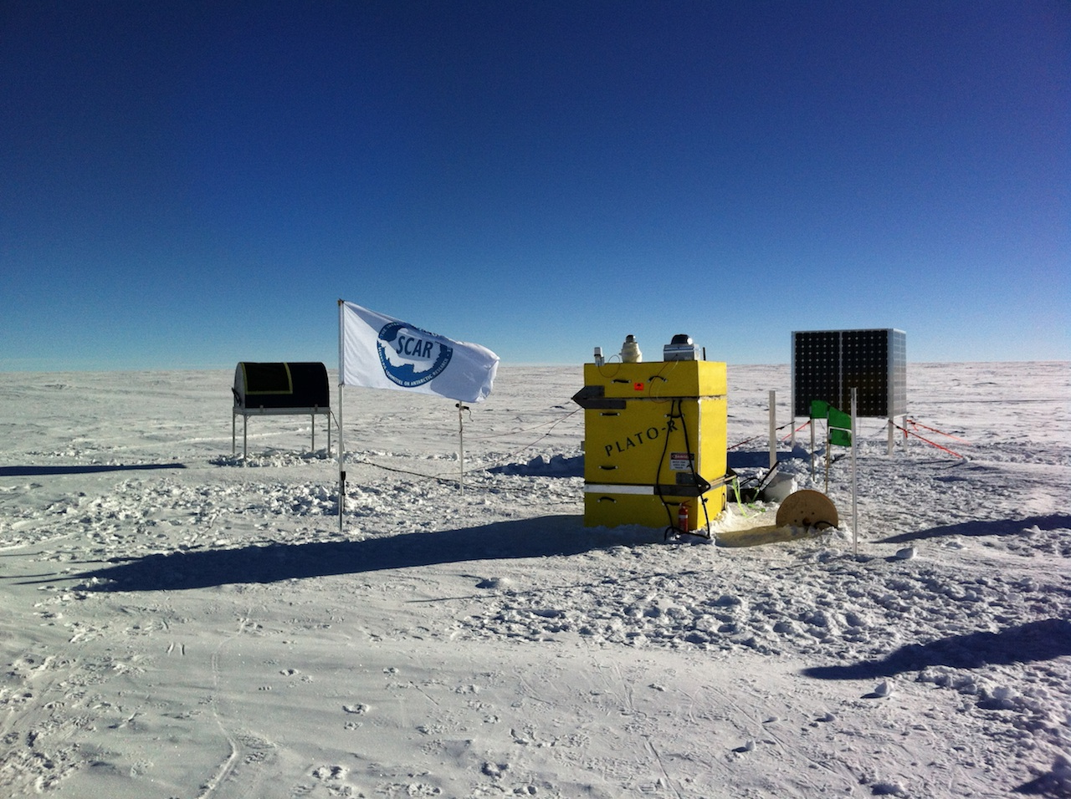
Re-Imagining the “AWS”
Lessons from Astronomy on the High Plateau
Craig Kulesa
University of Arizona

Slide 2
Who let the astronomer in?
Astronomy has many overlapping interests with meteorology and atmospheric science
Technological common ground for remote sensing
Astronomers are deeply invested in weather, forecasting, and climate
Critical for placement of observatories
Critical for planning of observations and facility safety
Astronomers routinely (and automatically) gather treasure troves of atmospheric data … usually discarding it.
Notes:
2

Slide 3
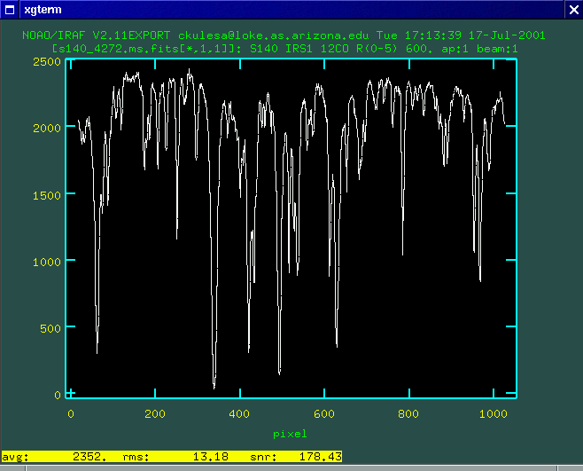
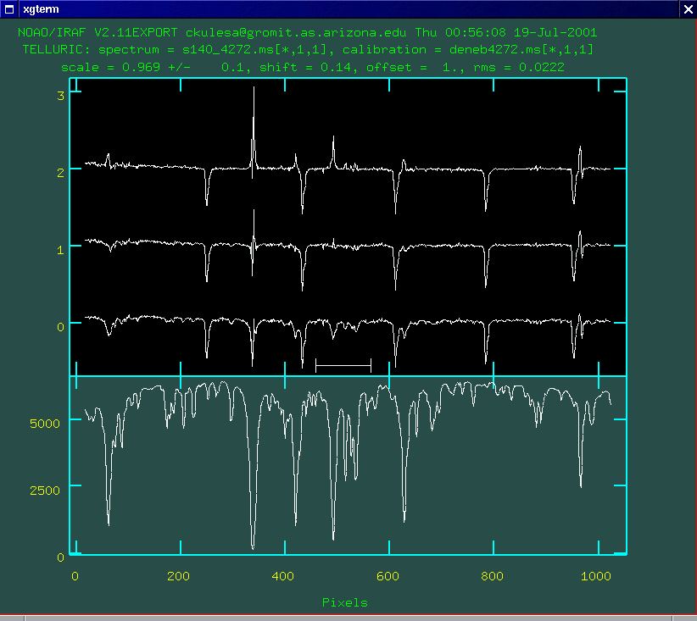
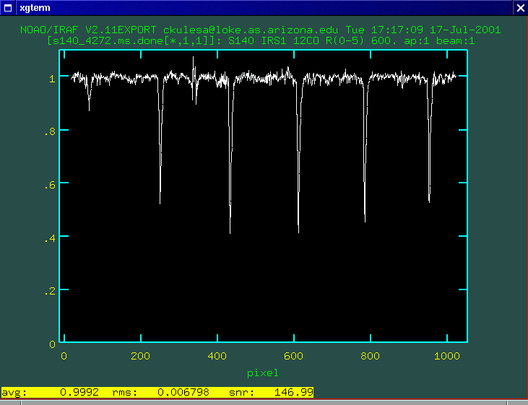
One person’s garbage is another person’s treasure
Raw IR spectrum of an astronomical source, mutilated by atmospheric lines
”atmosphere-free final spectrum”
Atmospheric modeling used to remove telluric features (but also yielding temperature and column density of dozens of atmospheric species)
Notes:
3

Slide 4
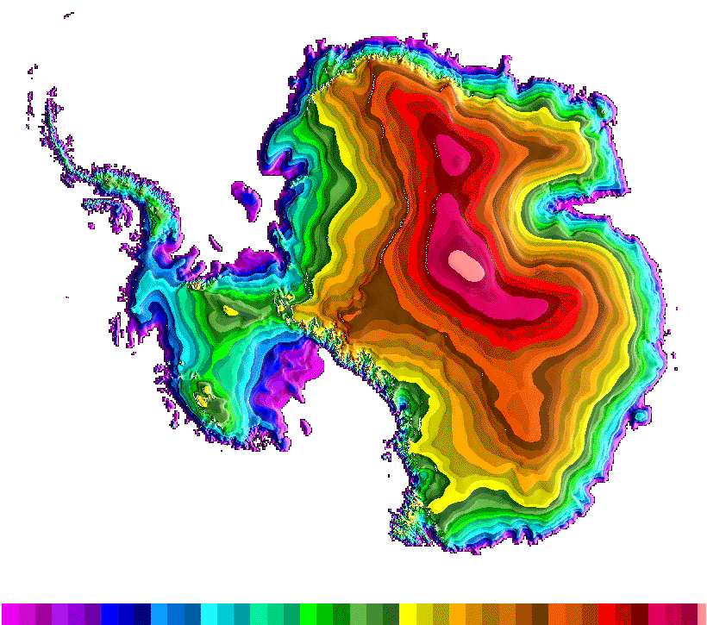
The Ridge A site
South Pole
4040m high
= 13,250’
Cold
High
Dry
Calm
Clear
Ridge A
Dome C
USGS image
Notes:
4

Slide 5
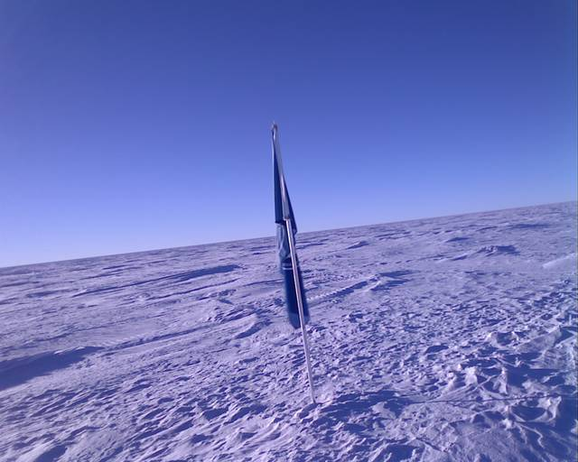
Truly a lunar landscape

Slide 6
What was on site?
From 2012 through 2019:
HEAT telescope
60 cm aperture telescope observing at 200-600 um (500-1500 GHz) using heterodyne spectrometers cooled to 50K
Engine Module
(“green box”, 2 Hatz diesel engines, 1.5 kW each, 200 gallons of AN-8)
Instrument Module (“yellow box”, 20 kWHr of LiFePO4 batteries, C&C, Iridium telemetry, 1kW of solar panels)
15m weather tower (telescoping, erected by 2 people in 30 min)
HEAT established several “firsts” for high-powered (500W) autonomous observatories on the Plateau
Notes:
6

Slide 7
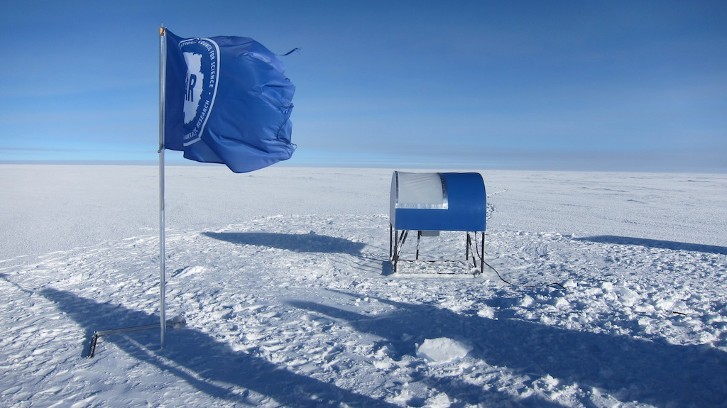
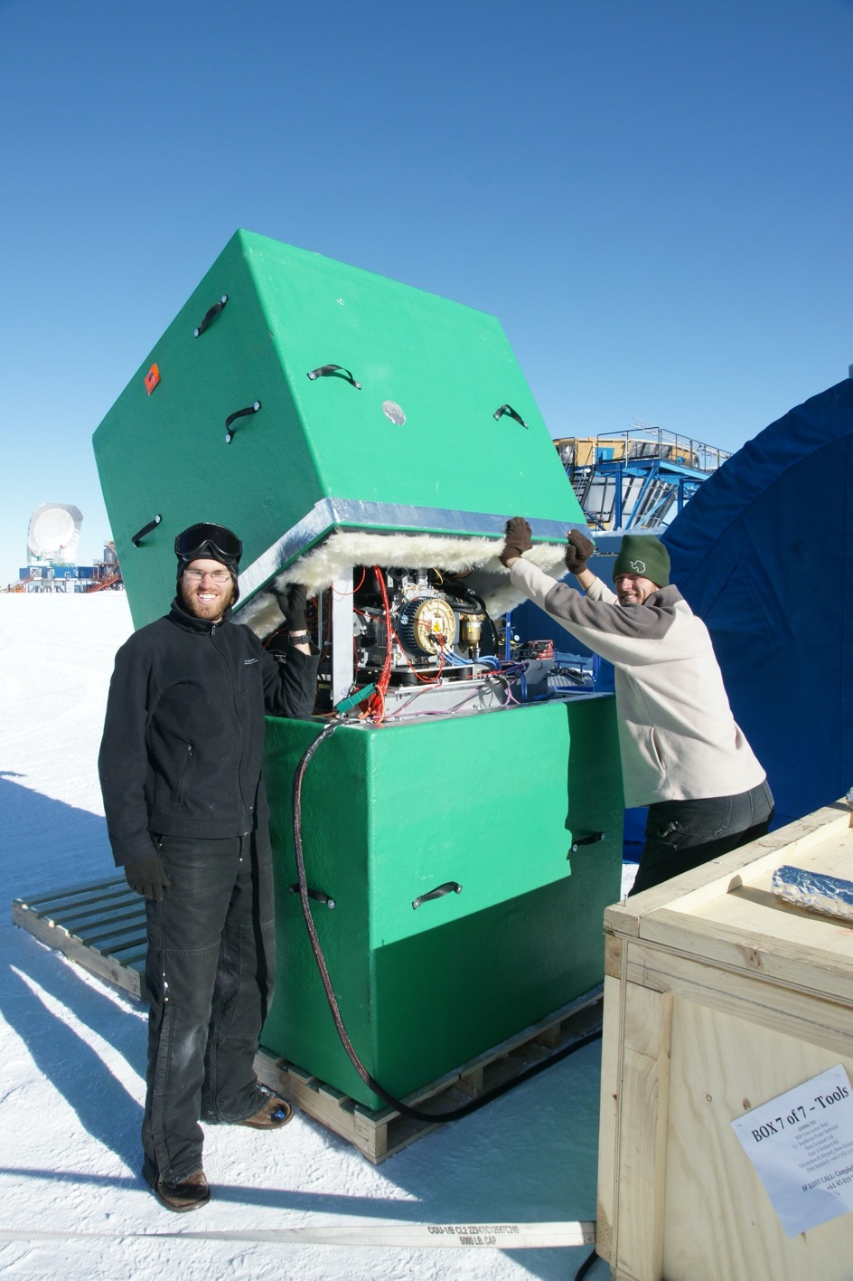
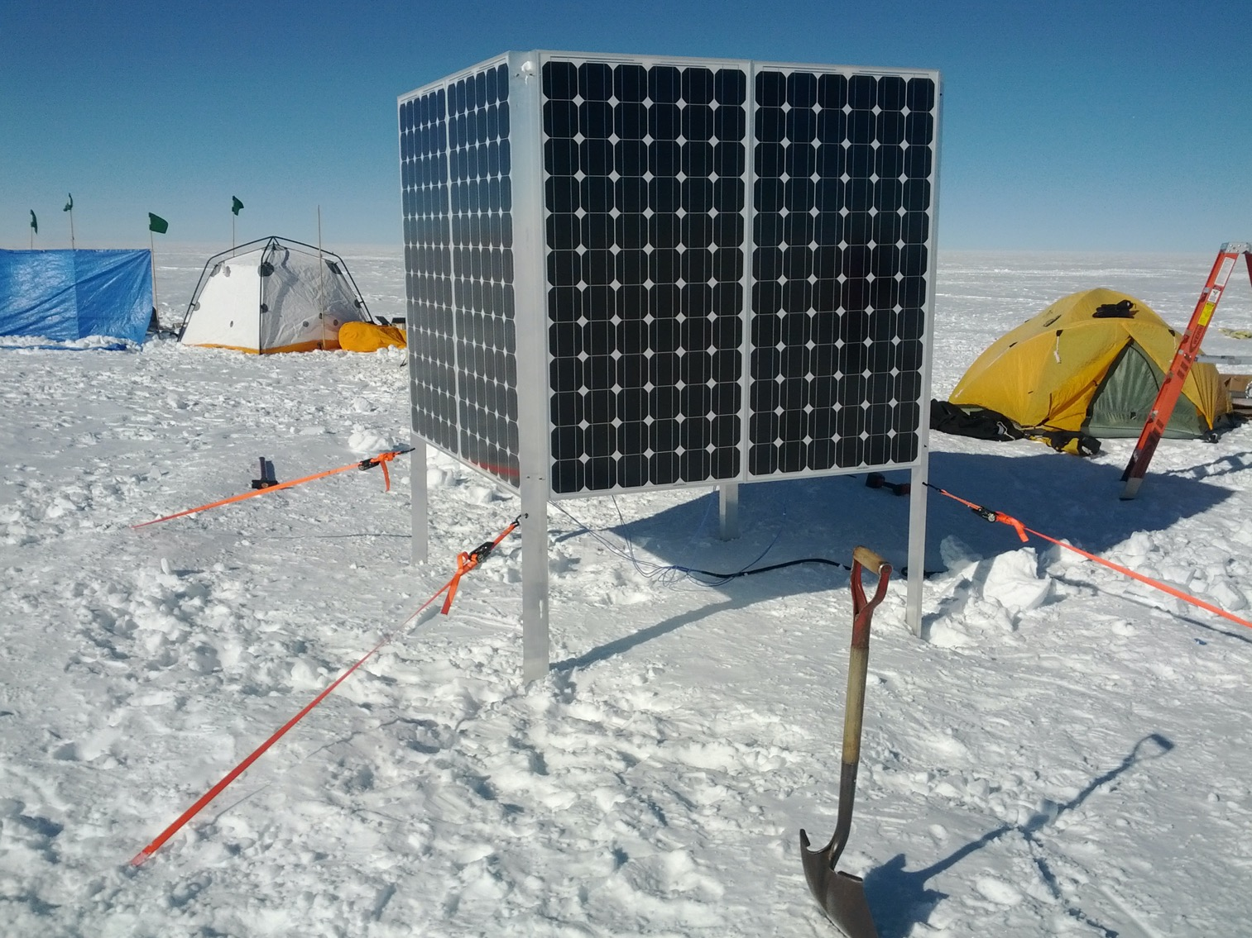
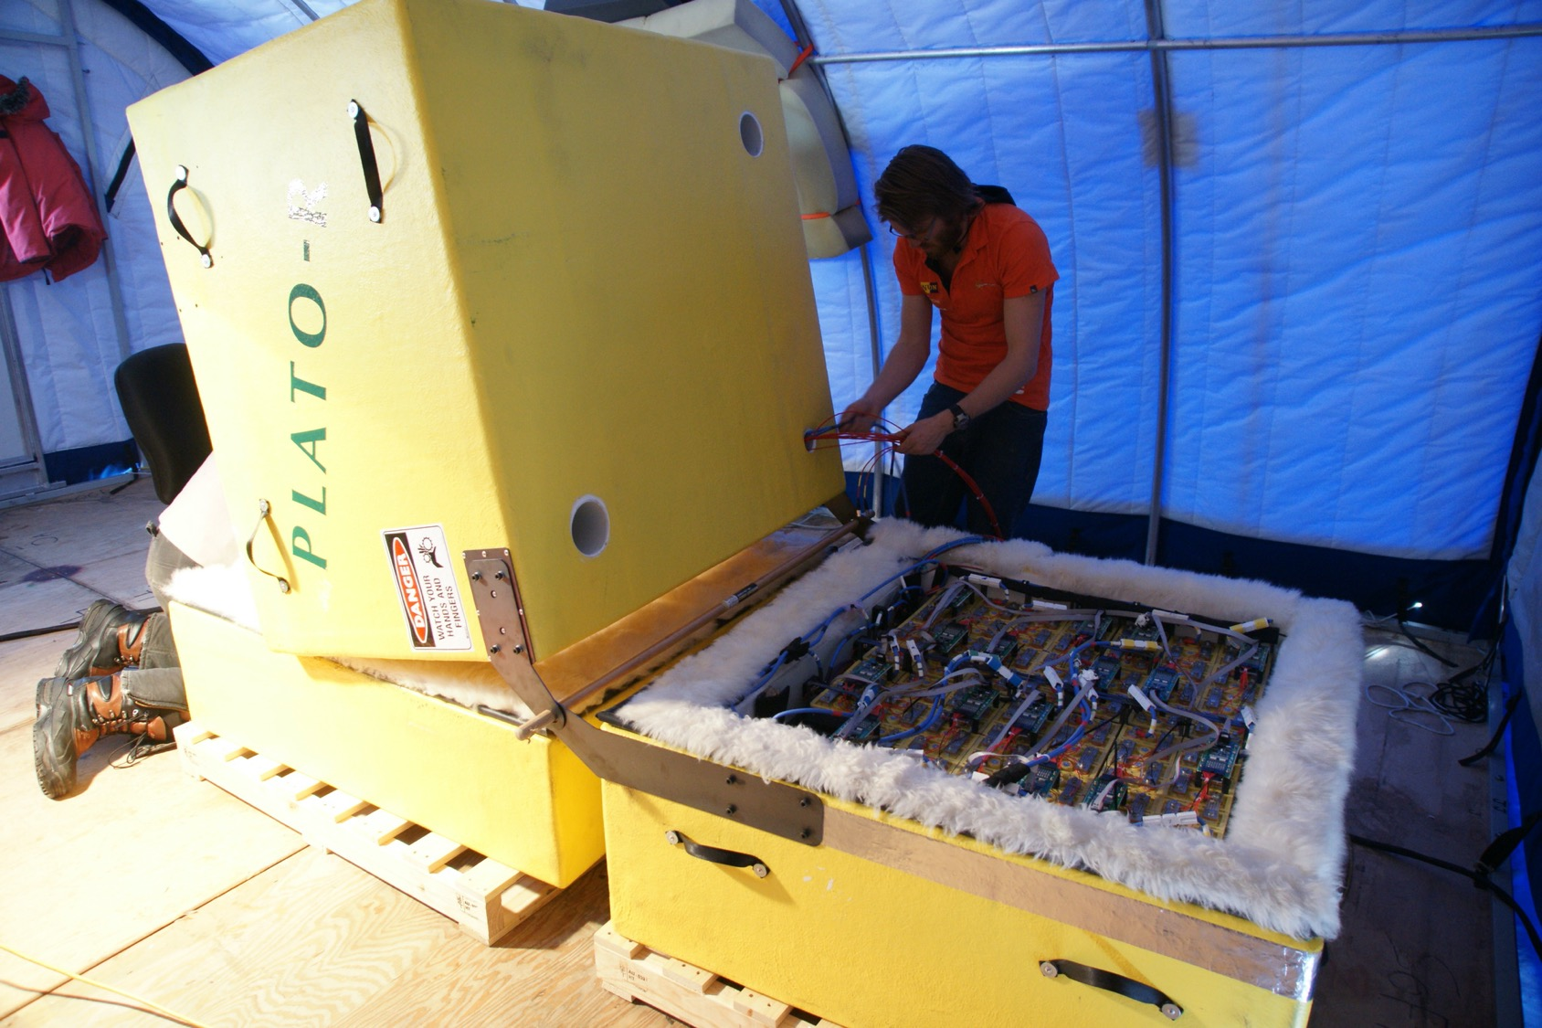
Diesel generators
Solar cube
LiFePO₄ batteries

Slide 8
Weather Monitored:
Wind speed/direction (cup anemometer, pressure transducers, visual on flag)
Temperature and dewpoint
Far-infrared radiometric measurement of precipitable water vapor
All sky camera
7-port panoramic webcam ←
“Why can’t you do this everywhere?”
2 April 2015: temperature -71C, pwv = 0.11 mm

Slide 9
Reimagining the low-cost “AWS”
For basic weather and on-site imagery, don’t need 90% of the Observatory…
What to keep:
Reliable single board computer, software, broad hardware support
Scaled down solar and MPPT
Direct-to-hardware extensible sensor and camera packages
Iridium dialup or SBD and flexible data transfer system
Goals:
low power (<5W), no configuration required
Twin-Otter deployable & installable by 1 person as a “deployment of opportunity” rather than explicitly scheduled
Low cost: <$1K hardware cost per module beyond the Iridium modem
What do you get?
Basic weather and imagery from anywhere, at any time (summer…)

Slide 10
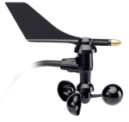
Iridium puck antenna
Strawman Concept
Insulated instrument box with SBC, modem, battery, 4-panel cameras
All parts are screened COTS
Build from low-level parts (IC-level sensors) – reduces cost and complexity
Tons of I/O: SPI, I²C, CAN bus, serial, USB, analog, digital I/O
Sealed access port for serial console and ethernet
Part selection is by test, test, and more test
All open-source software (NetBSD or Linux)
Calibrate sensors by co-operating adjacent to a reference wx station
Solar cube 30W at 12V
Top or bottom mount for cup anemometer
Rad shield
w/ temp, pressure, RH
8’ sections, aluminum or steel pole

Slide 11
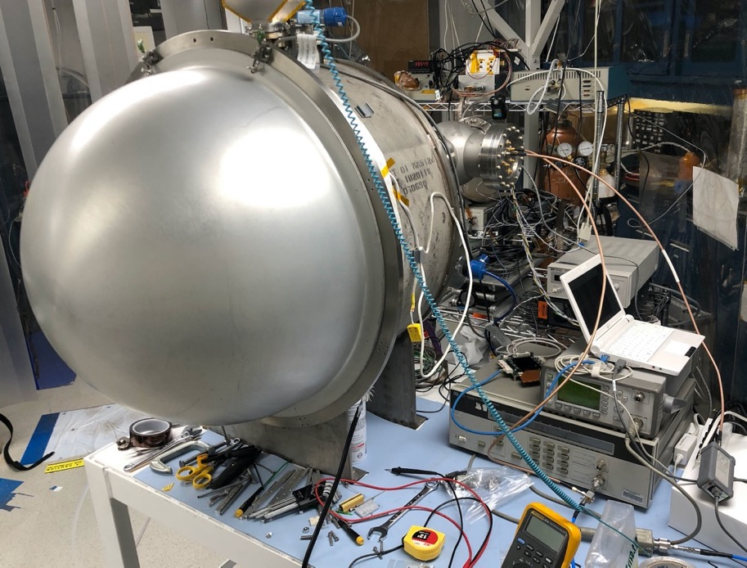
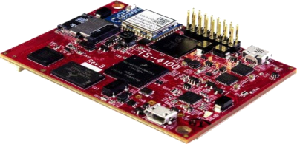
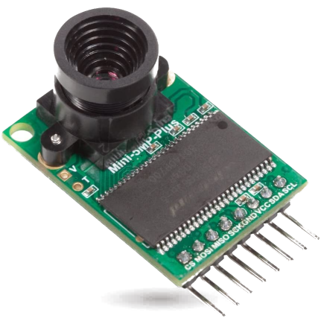
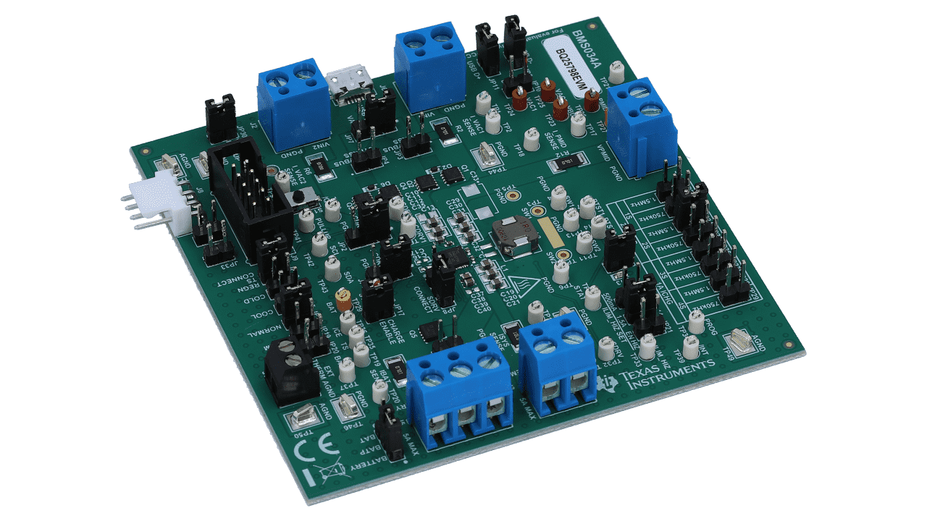
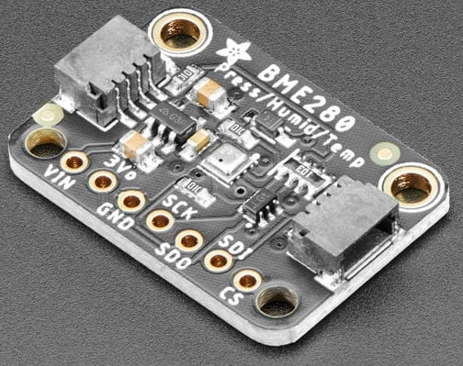
Environmental testing
Reliability testing and part selection, from -80C to +80C
“Identify parts that are better than their specs.”
So far:
OV5642 SPI cameras
Technologic Systems TS7553 or TS4100 SBCs
100 W-Hr LiFePO4 battery
AL3A-RS Iridium modem
TI BQ25798 MPPT and charger “on a chip”
AD, Bosch, Honeywell environmental sensors (I2C and SPI)
Davis 6410 anemometer (chosen purely for cost)

Slide 12
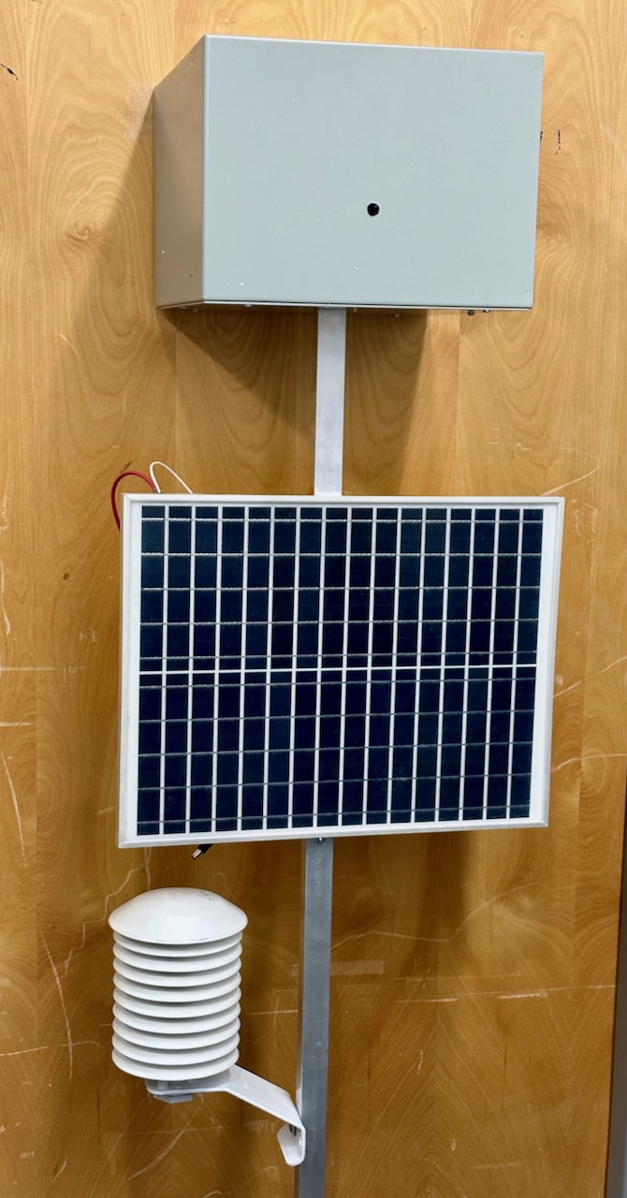
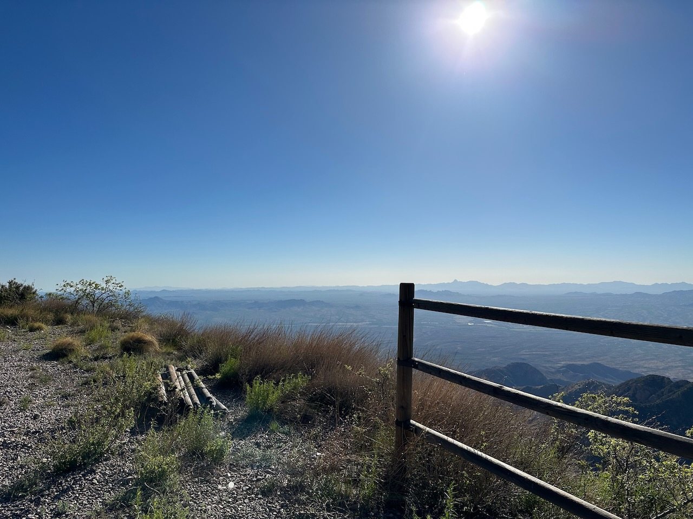
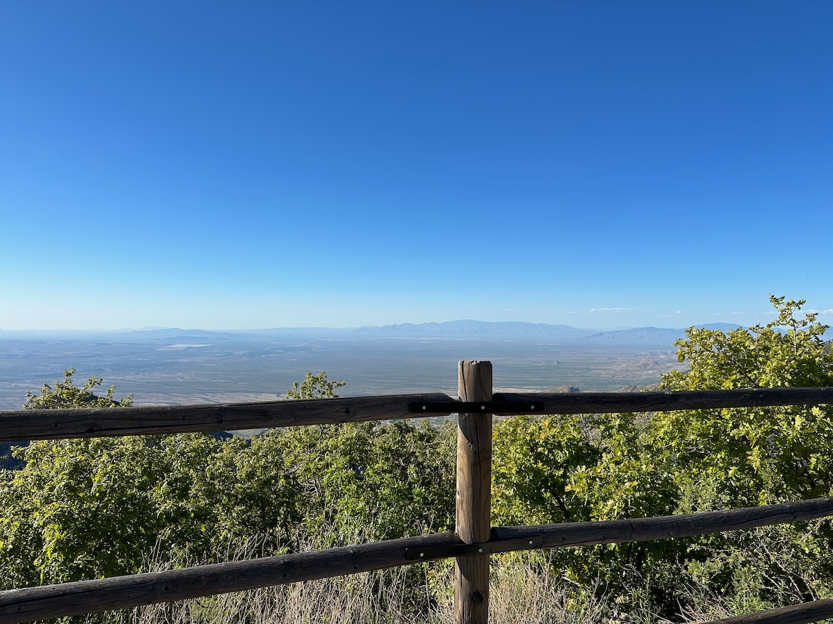
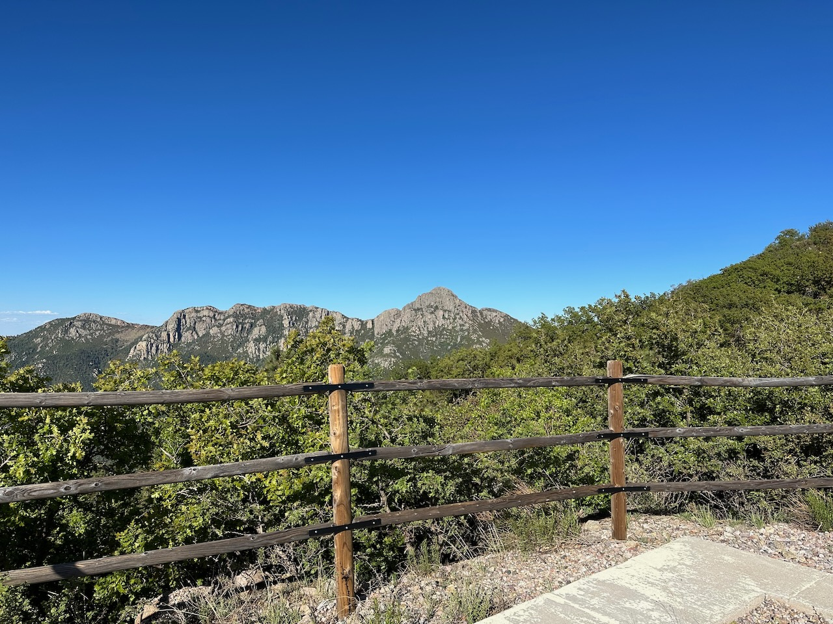
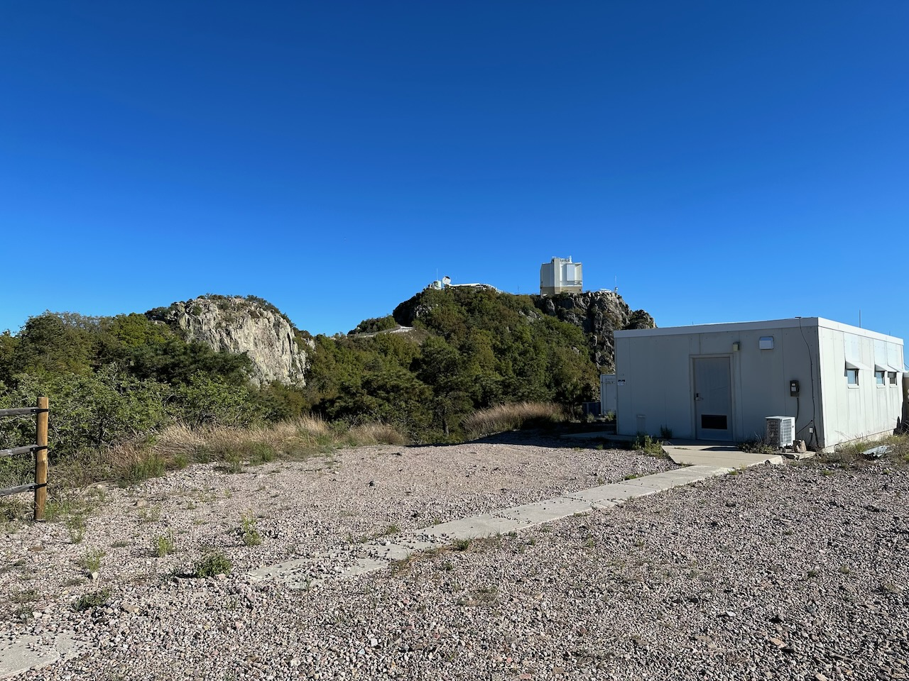
Prototyping
Single camera augmented to 4-camera mosaic with lens-swappable field of view
8-bit MSP430 microcontroller starts – either first applies solar power to battery’s kapton heater or connects the battery and boots the SBC – cold weather fault tolerance
Single 25W solar panel (to be replaced by a 4-panel cube)
Data/images automatically transfer to web page by
Wireless 802.11
Bluetooth to a nearby pre-paired cell phone
Iridium dialup
Tested in Tucson and at the MMT observatory (elevation 8500’)

Slide 13
Points for Discussion
Adapting the concept to match the needs/desires of this community
Open a dialogue -- is there interest? Worth the effort?
Impetus for improving logistical effectiveness seems sound enough
But can we exploit this platform better for this community? New sensors? What data do you want?
How best to improve forecasting capabilities on the continent? (How) can this platform help?
“Bipolar” operations (Arctic opportunities)
Where to go from here
From prototype to a product broadly usable for remote sensing for weather, USAP operations, and science
Challenges lie ahead for funding “non-science” efforts

Slide 14
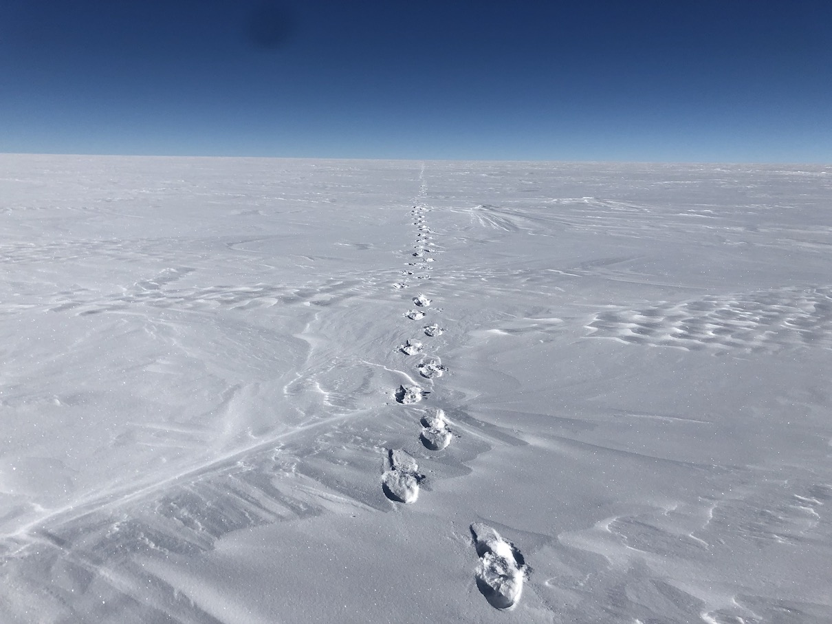
Thanks!

