Slide 1


18th WAMC, May 31, 2023
Analysis of a Rain Event on January 2-3, 2022
at Syowa Station, Antarctica
*Naohiko Hirasawa^{1,2},
Hiroyuki Konishi³, Yasushi Fujiyoshi⁴, Katsushi Iwamoto⁵
1. National Institute of Polar Research,
2. Graduate University for Advanced Studies (SOKENDAI),
3. Osaka-Kyoiku University,
4. Emeritus Prof., Hokkaido University,
5. Fisheries Research Division, City of Mombetsu, Hokkaido
JARE project : Observation of precipitation using radar at Syowa Station, Antarctica
EORA3 project : Antarctic snowfall and surface melt

Slide 2
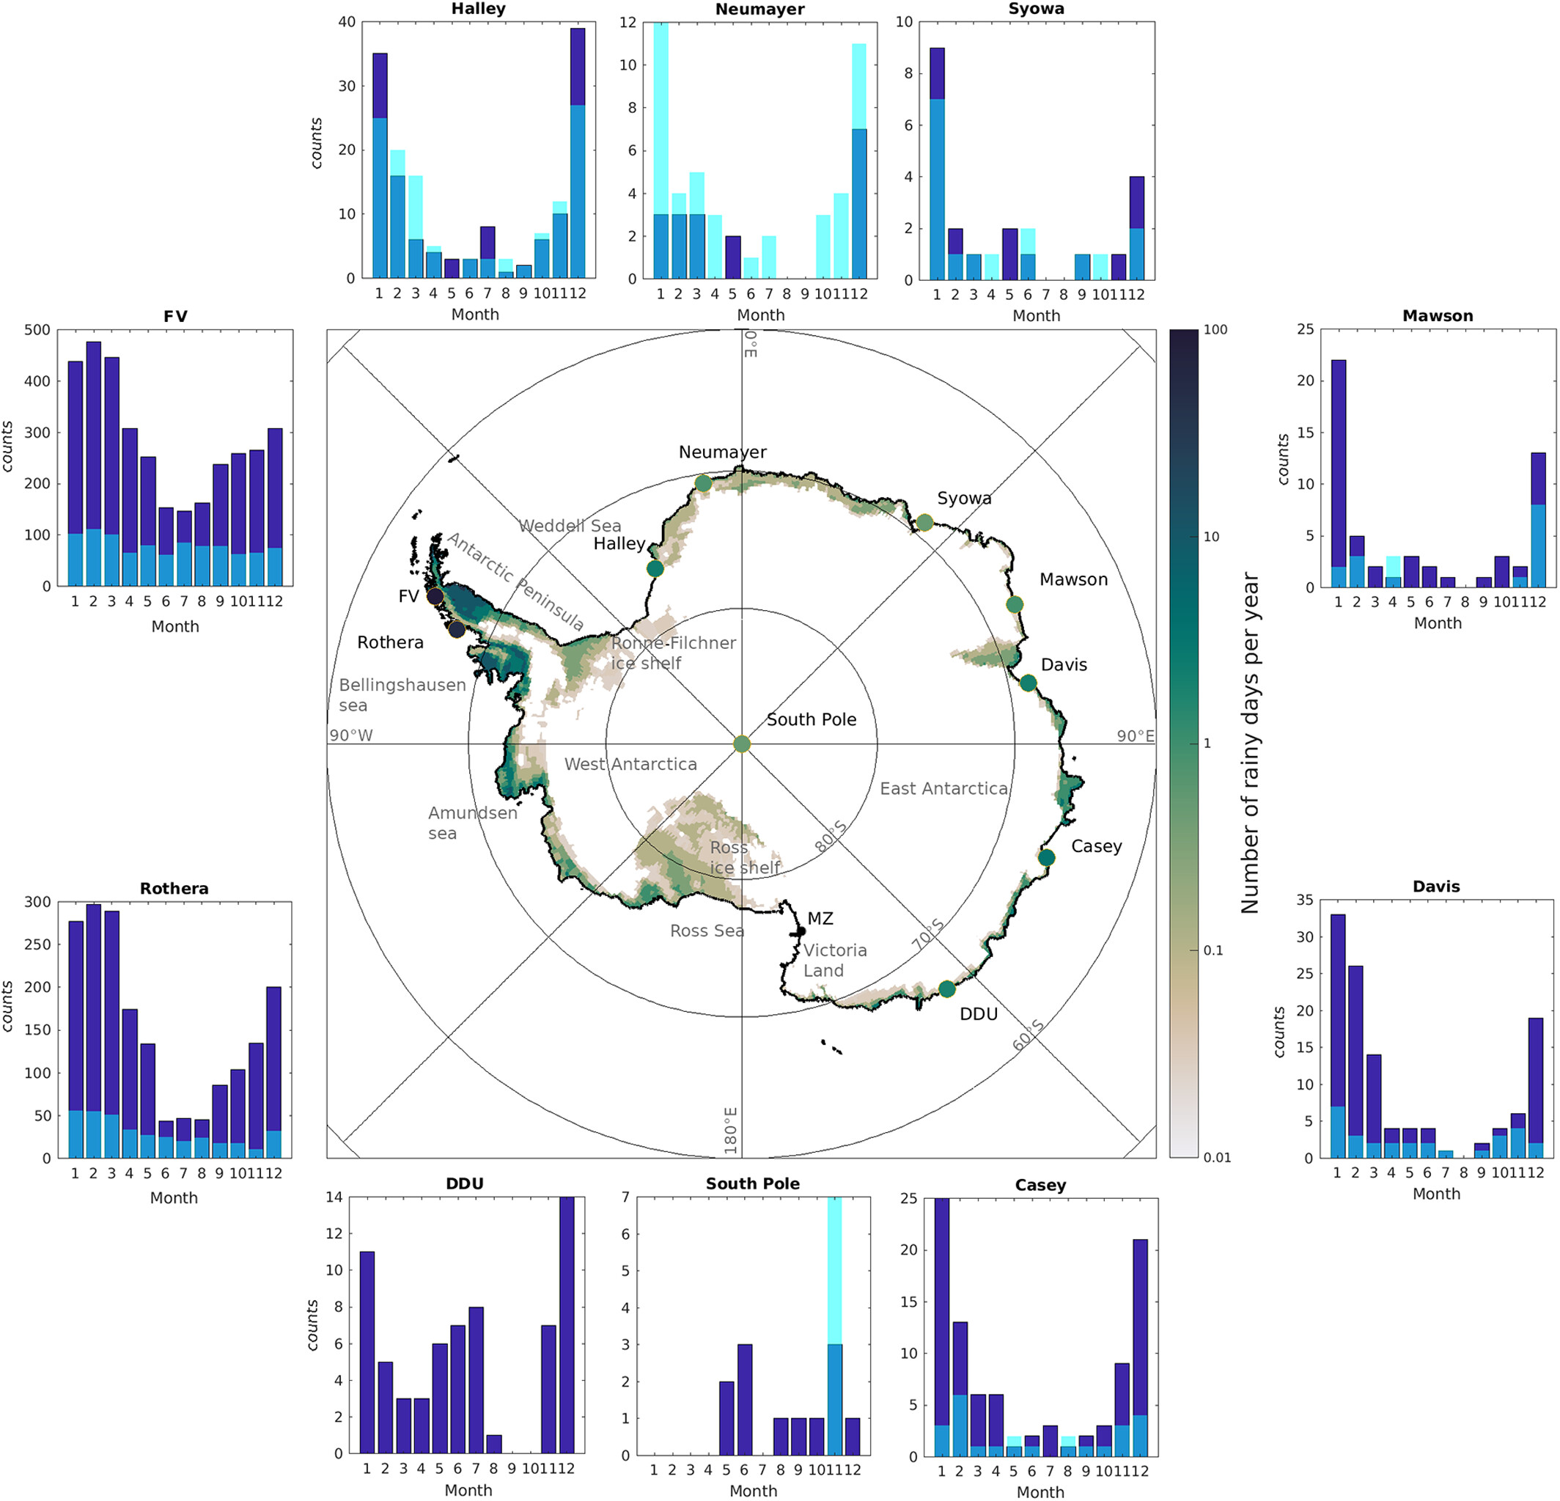
18th WAMC, May 31, 2023
History of rainfall events at Syowa Station
Rainfall at Syowa Station (JMA's report), still checking
Jan 2-3, 2022, rain
Dec 23-24, 2017, rain
Dec 22-3, 2012, rain & sleet
Jan 1, 2004, rain
Feb 2, 1997, rain
Jan 29-30, 1996, rain
?, 1991, rain
Jan 24-25, 1987, drizzle→rain &
Dec 7, 1986, drizzle
May 7-8, 1984, rain
Jan ?, 1981, drizzle
Jan 14-15, 1980, rain
Jan ?, 1979, sleet
Dec ?, 1978, ?
Jan 8, 1972, rain
Jan ?, 1971, sleet
Jan ?, 1959, sleet
Jan 1, 10, 29, 1958, sleet &
Nov 22 & Dec 31, 1957, rain/sleet
Vignon et al., 2021

Slide 3
18th WAMC, May 31, 2023
Motivation and presentation outline
Motivation
How is Antarctic rainfall affected by global warming? Will rainfall increase in frequency and amount?
Rainfall occurred at Syowa Station during the precipitation radar project period (2021-2022), providing very valuable data for understanding the formation process of Antarctic rainfall.
This study examines the rainfall formation and synoptic-scale meteorological conditions for the latest rainfall event on January 2, 2022.
Outline
Characteristics of the precipitation during the event with radar and other instruments.
Atmospheric vertical structure obtained by radiosonde.
Discussion the role of synoptic-scale circulation on the rainfall.
Synoptic-scale circulation in recent events.

Slide 4
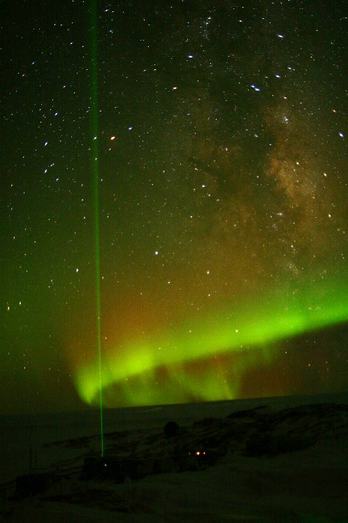
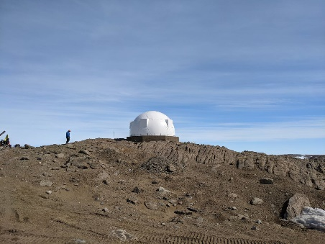
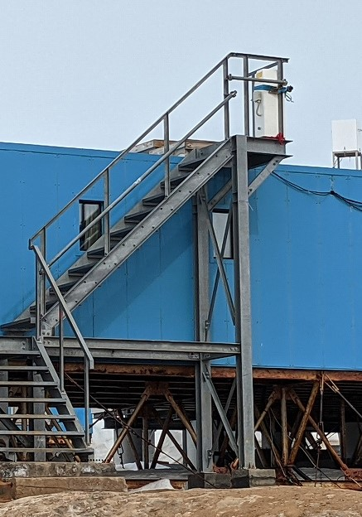
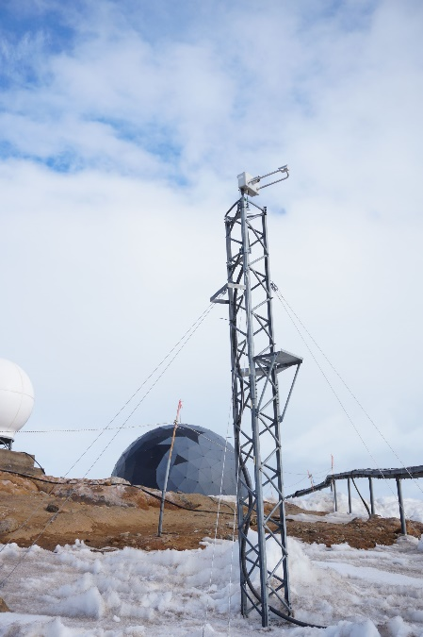
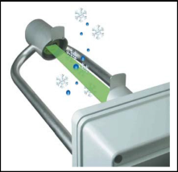
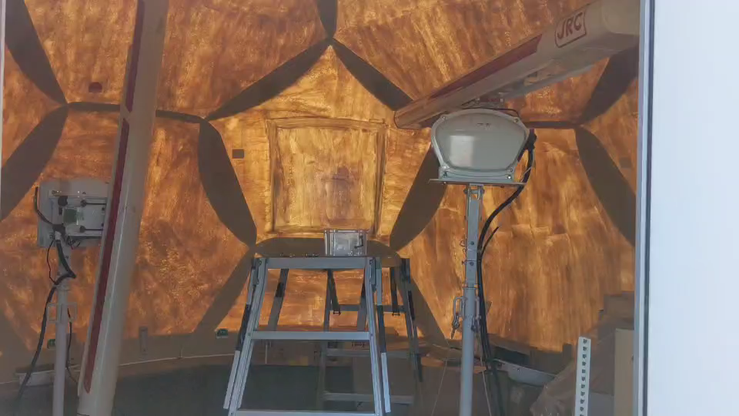
18th WAMC, May 31, 2023
Instruments at Syowa Station
NE
SW
PMPL, SigmaSpace, USA
Vertical interval: 30 m
Max height: 15000 m
Temporal interval: 60 s.
X-band-9.4-GHz Radar
Ceilometer
Disdrometer
PMPL
JRA, Japan
Transmission frequency: 9.4 GHz
Azimuth sampling interval: 0.33°
Radius sampling interval: 3.75 m
Rotation speed: 24 rpm
CT25K, Vaisala, Finland
Vertical interval: 30 m
Max height: 7500 m
Temporal interval: 90 s.
LPM, Thies Clima, Germany
Snowfall intensity
Particle size dist.
Particle fall velocity dist.
Temporal interval: 1 min.

Slide 5
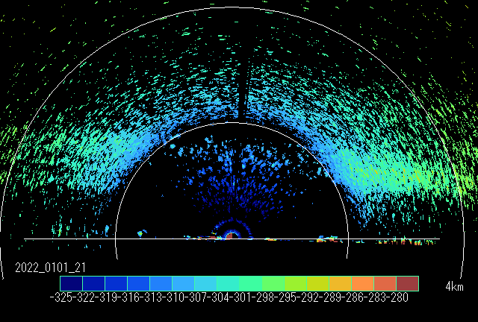
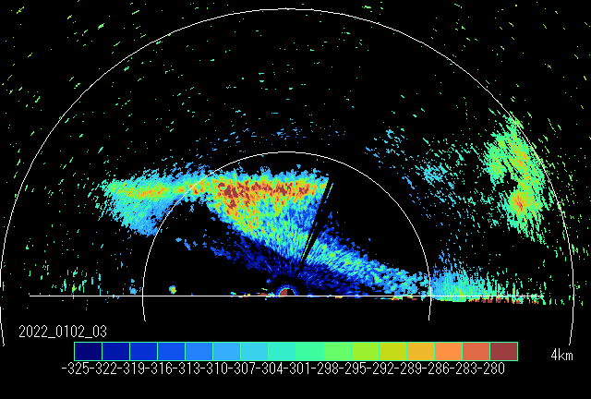
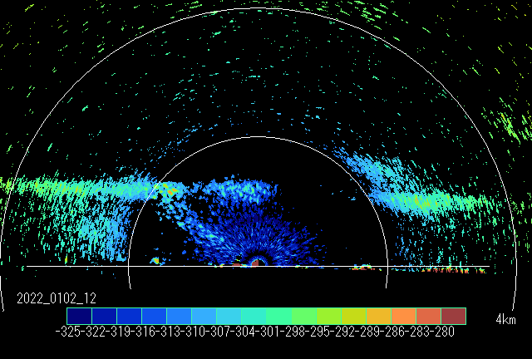
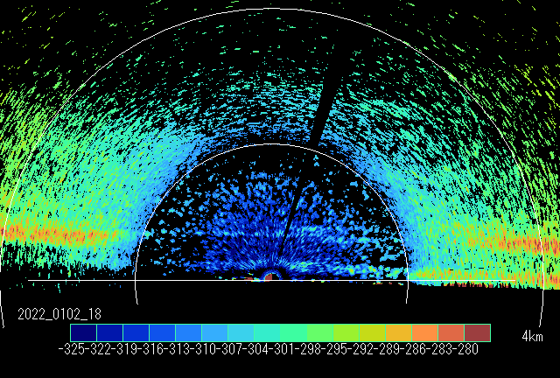
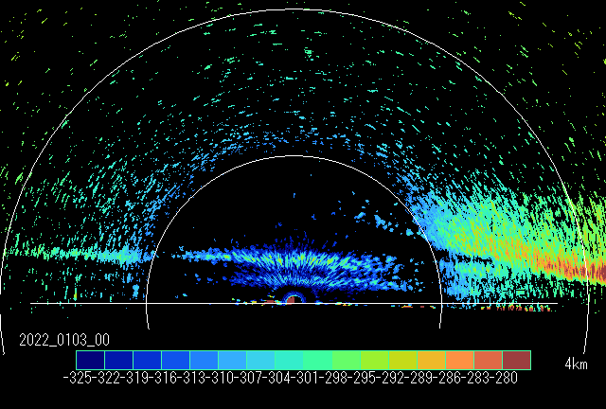
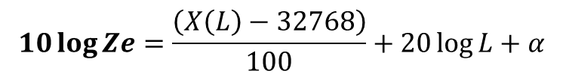
18th WAMC, May 31, 2023
“Bright band” in radar data
Jan 1, 21UT
6
Jan 1, 2022
Jan 2, 2022
Jan 3, 2022
Bright band
4
Height (km)
NE
SW
2
0
0
6
12
18
0
6
12
18
0
6
12
18
0
Time (UT)
Jan 2, 03UT
Jan 2, 12UT
Jan 2, 18UT
Jan 3, 00UT
4km
2km
NE
SW
NE
SW
NE
SW
NE
SW
Radar
Radar equation
Ze: Equivalent radar reflectivity factor,
Ze(dBZ): 10 log Ze
L: Distance from the radar, km
X(L): Electric power at distance L
α: Instrumental constant = 327
$$10\log{Ze}=\frac{\left(X\left(L\right)−32768\right)}{100}+20\log{L}+α$$

Slide 6
18th WAMC, May 31, 2023
Disdrometer & Polarization Lidar (PMPL)
6
Jan 1, 2022
Jan 2, 2022
Jan 3, 2022
4
Major “bright band”
Height (km)
2
0
0
6
12
18
0
6
12
18
0
6
12
18
0
Disdrometer
Time (UT)
4
Polarization Lidar
Depolarization
Major “bright band”
2
0
Ice
Water
Ice
Height (km)
Water
4
Backscatter
2
0
0
6
12
18
0
6
12
18
0
6
12
18
0
Jan 1, 2022
Jan 2, 2022
Jan 3, 2022

Slide 7
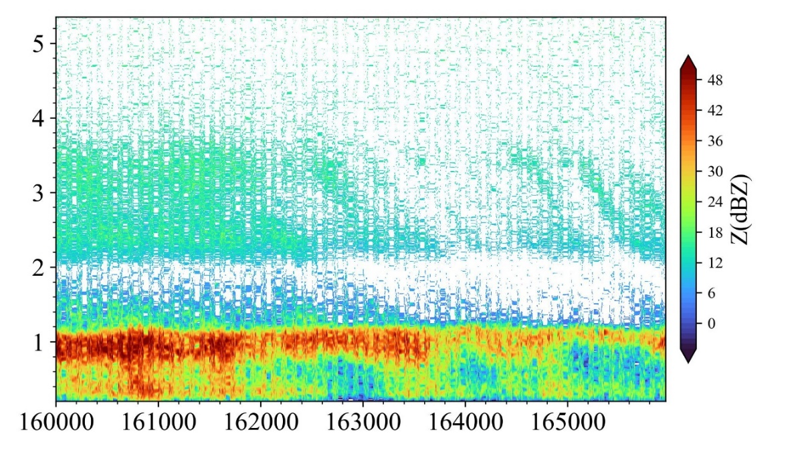
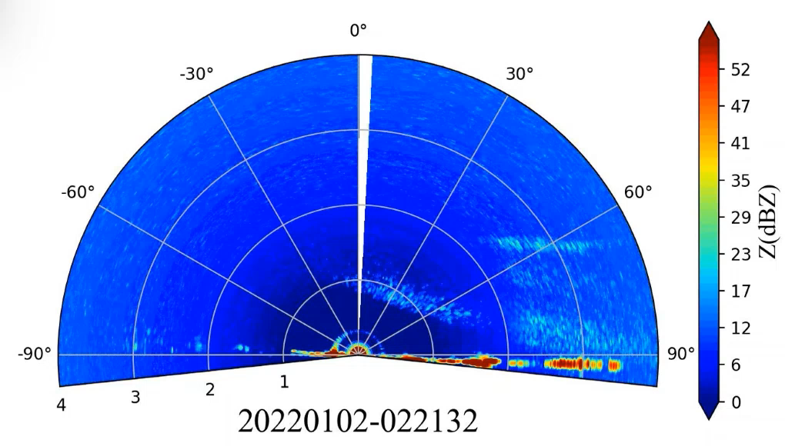
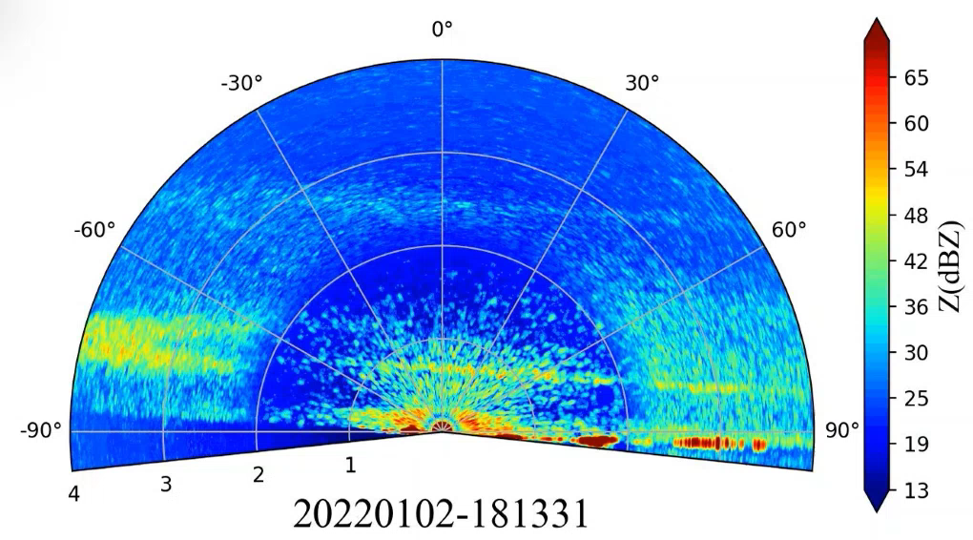
18th WAMC, May 31, 2023
Multiple “bright Bands”
Altitude (km)
Ice precipitation
Upper “bright band”
Lower “bright band”
Streak
Multi bands

Slide 8
18th WAMC, May 31, 2023
Low-level layers above 0°C
6
Jan 1, 2022
Jan 2, 2022
Jan 3, 2022
4
Height (km)
2
0
0
6
12
18
0
6
12
18
0
6
12
18
0
Time (UT)
Tropopause
Above 0 ℃
Saturation
Low-level jet

Slide 9
18th WAMC, May 31, 2023
Blocking ridge formation
6
Jan 1, 2022
Jan 2, 2022
Jan 3, 2022
4
Height (km)
2
0
0
6
12
18
0
6
12
18
0
6
12
18
0
Time (UT)
Tropopause
Jan 1, 00UT
Jan 2, 12UT
500 GPH
Blocking ridge
500 GPH
Syowa
850 T
Warm
850 T
Warm
Above 0 ℃
MERRA2 reanalysis data from NASA/GSFC

Slide 10
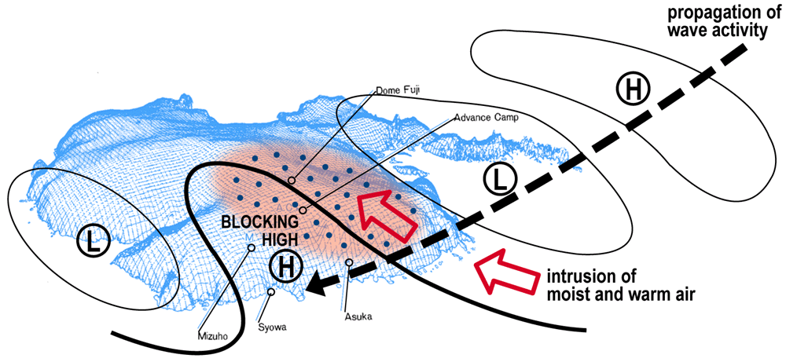
18th WAMC, May 31, 2023
Planetary wave propagation? - to be checked later
6
Jan 1, 2022
Jan 2, 2022
Jan 3, 2022
4
Height (km)
2
0
0
6
12
18
0
6
12
18
0
6
12
18
0
Time (UT)
Jan 2, 12UT
500 GPH
Blocking ridge
850 T
Warm
AR-like transport in the modern sense
(Hirasawa et al., 2000)

Slide 11
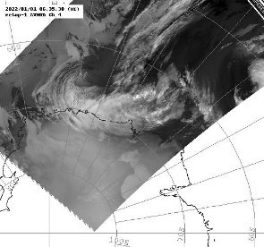
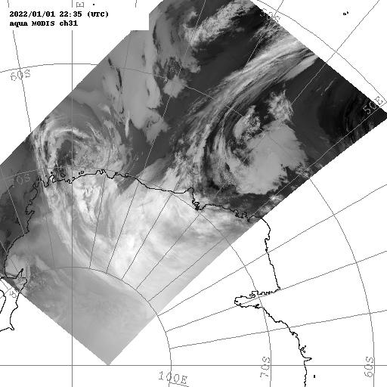
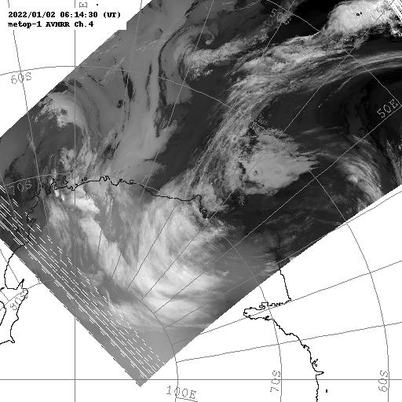
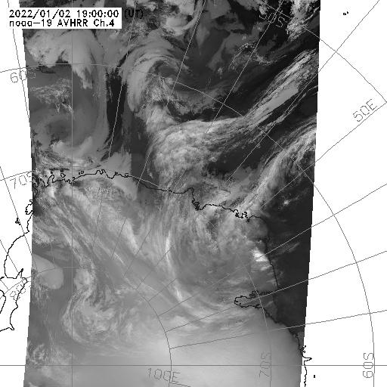
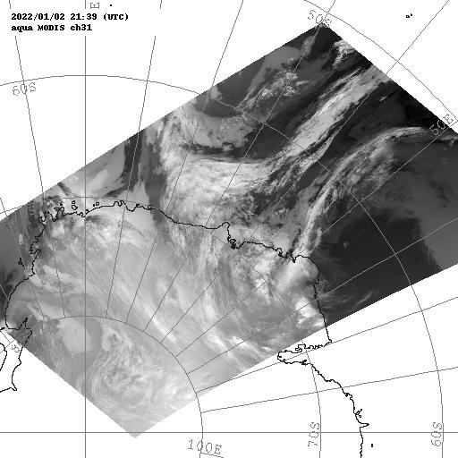
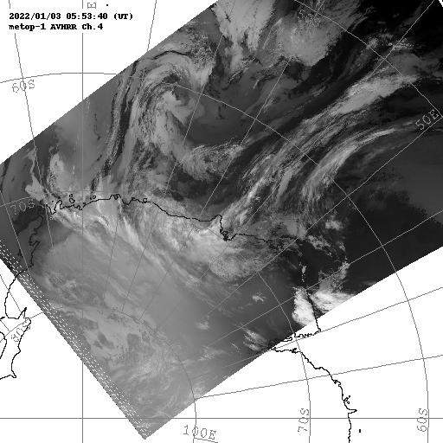
18th WAMC, May 31, 2023
Complicated temporal variation in cloud distribution
Jan 1, 06UT
Jan 1, 22UT
Jan 2, 06UT
Jan 2, 19UT
Jan 2, 21UT
Jan 3, 06UT

Slide 12
18th WAMC, May 31, 2023
Synoptic-scale circulation in recent rainfall events
Dec 23, 2017 12:00UT Rain
Dec 23, 2012, 10:00UT Rain & Sleet
500 GPH
500 GPH
850 T
Warm “High”
850 T
Warm air advection
Jan 1, 2004 12:00UT Rain
Feb 2, 1997 12:00UT Rain
500 GPH
500 GPH
850 T
Warm air advection
850 T
Warm air advection

Slide 13
18th WAMC, May 31, 2023
Summary
This study examines the rainfall formation and synoptic-scale meteorological conditions for the latest rainfall event on January 2, 2022, and compared to recent rainfall events. Results are as follows.
Bright bands were observed for about 24 hours in the radar data.
Time variability of bright bands was well captured by the radar observation with high-vertical resolution; three-layered bright bands and streak-like bright bands were observed.
The spatiotemporal variations in the “Bright Band” would reflect the fine-layer structure of the atmosphere during warm-air intrusion. This may explain the formation mechanisms of the diverse precipitation types (rain, sleet, freezing rain, and snowfall) reported by Vignon et al. (2021).
There was strong warm air advection from low latitudes across the entire troposphere with the blocking ridge formation, resulting in temperatures above 0°C in the layer below 2000 m altitude.
Planetary wave propagation may have played a role.
Comparisons with recent rainfall events show that the 2022 event was characterized by particularly strong warm air advection.

Slide 14
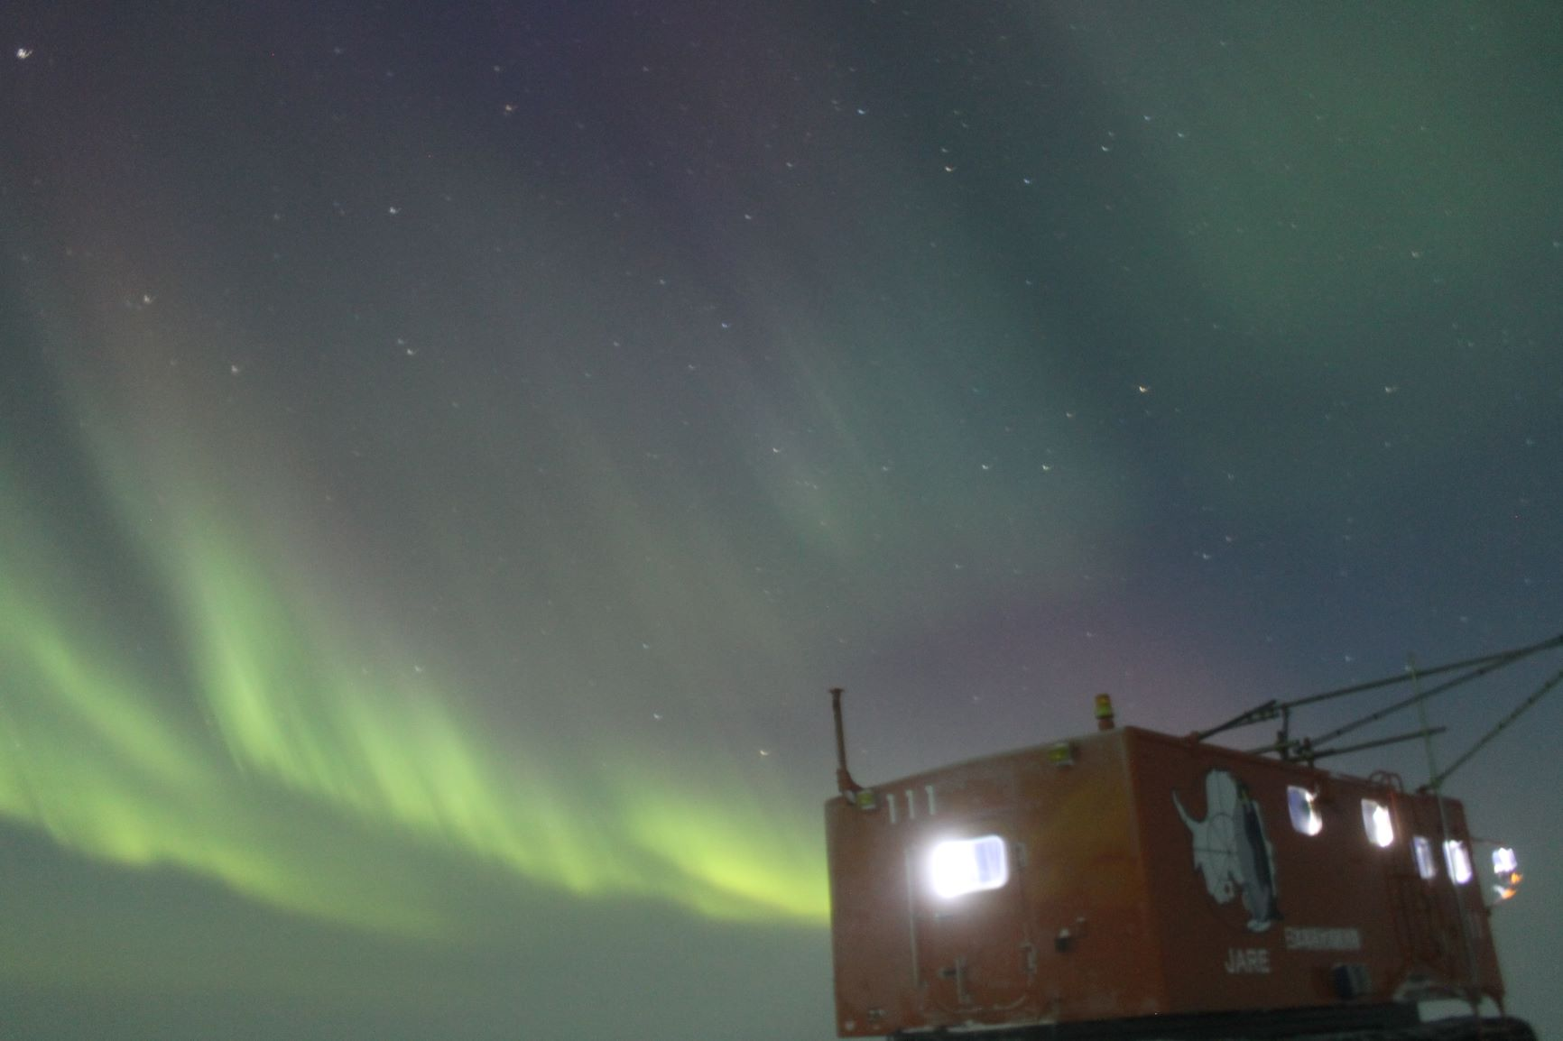
Thank you !
Naohiko Hirasawa

