Slide 1
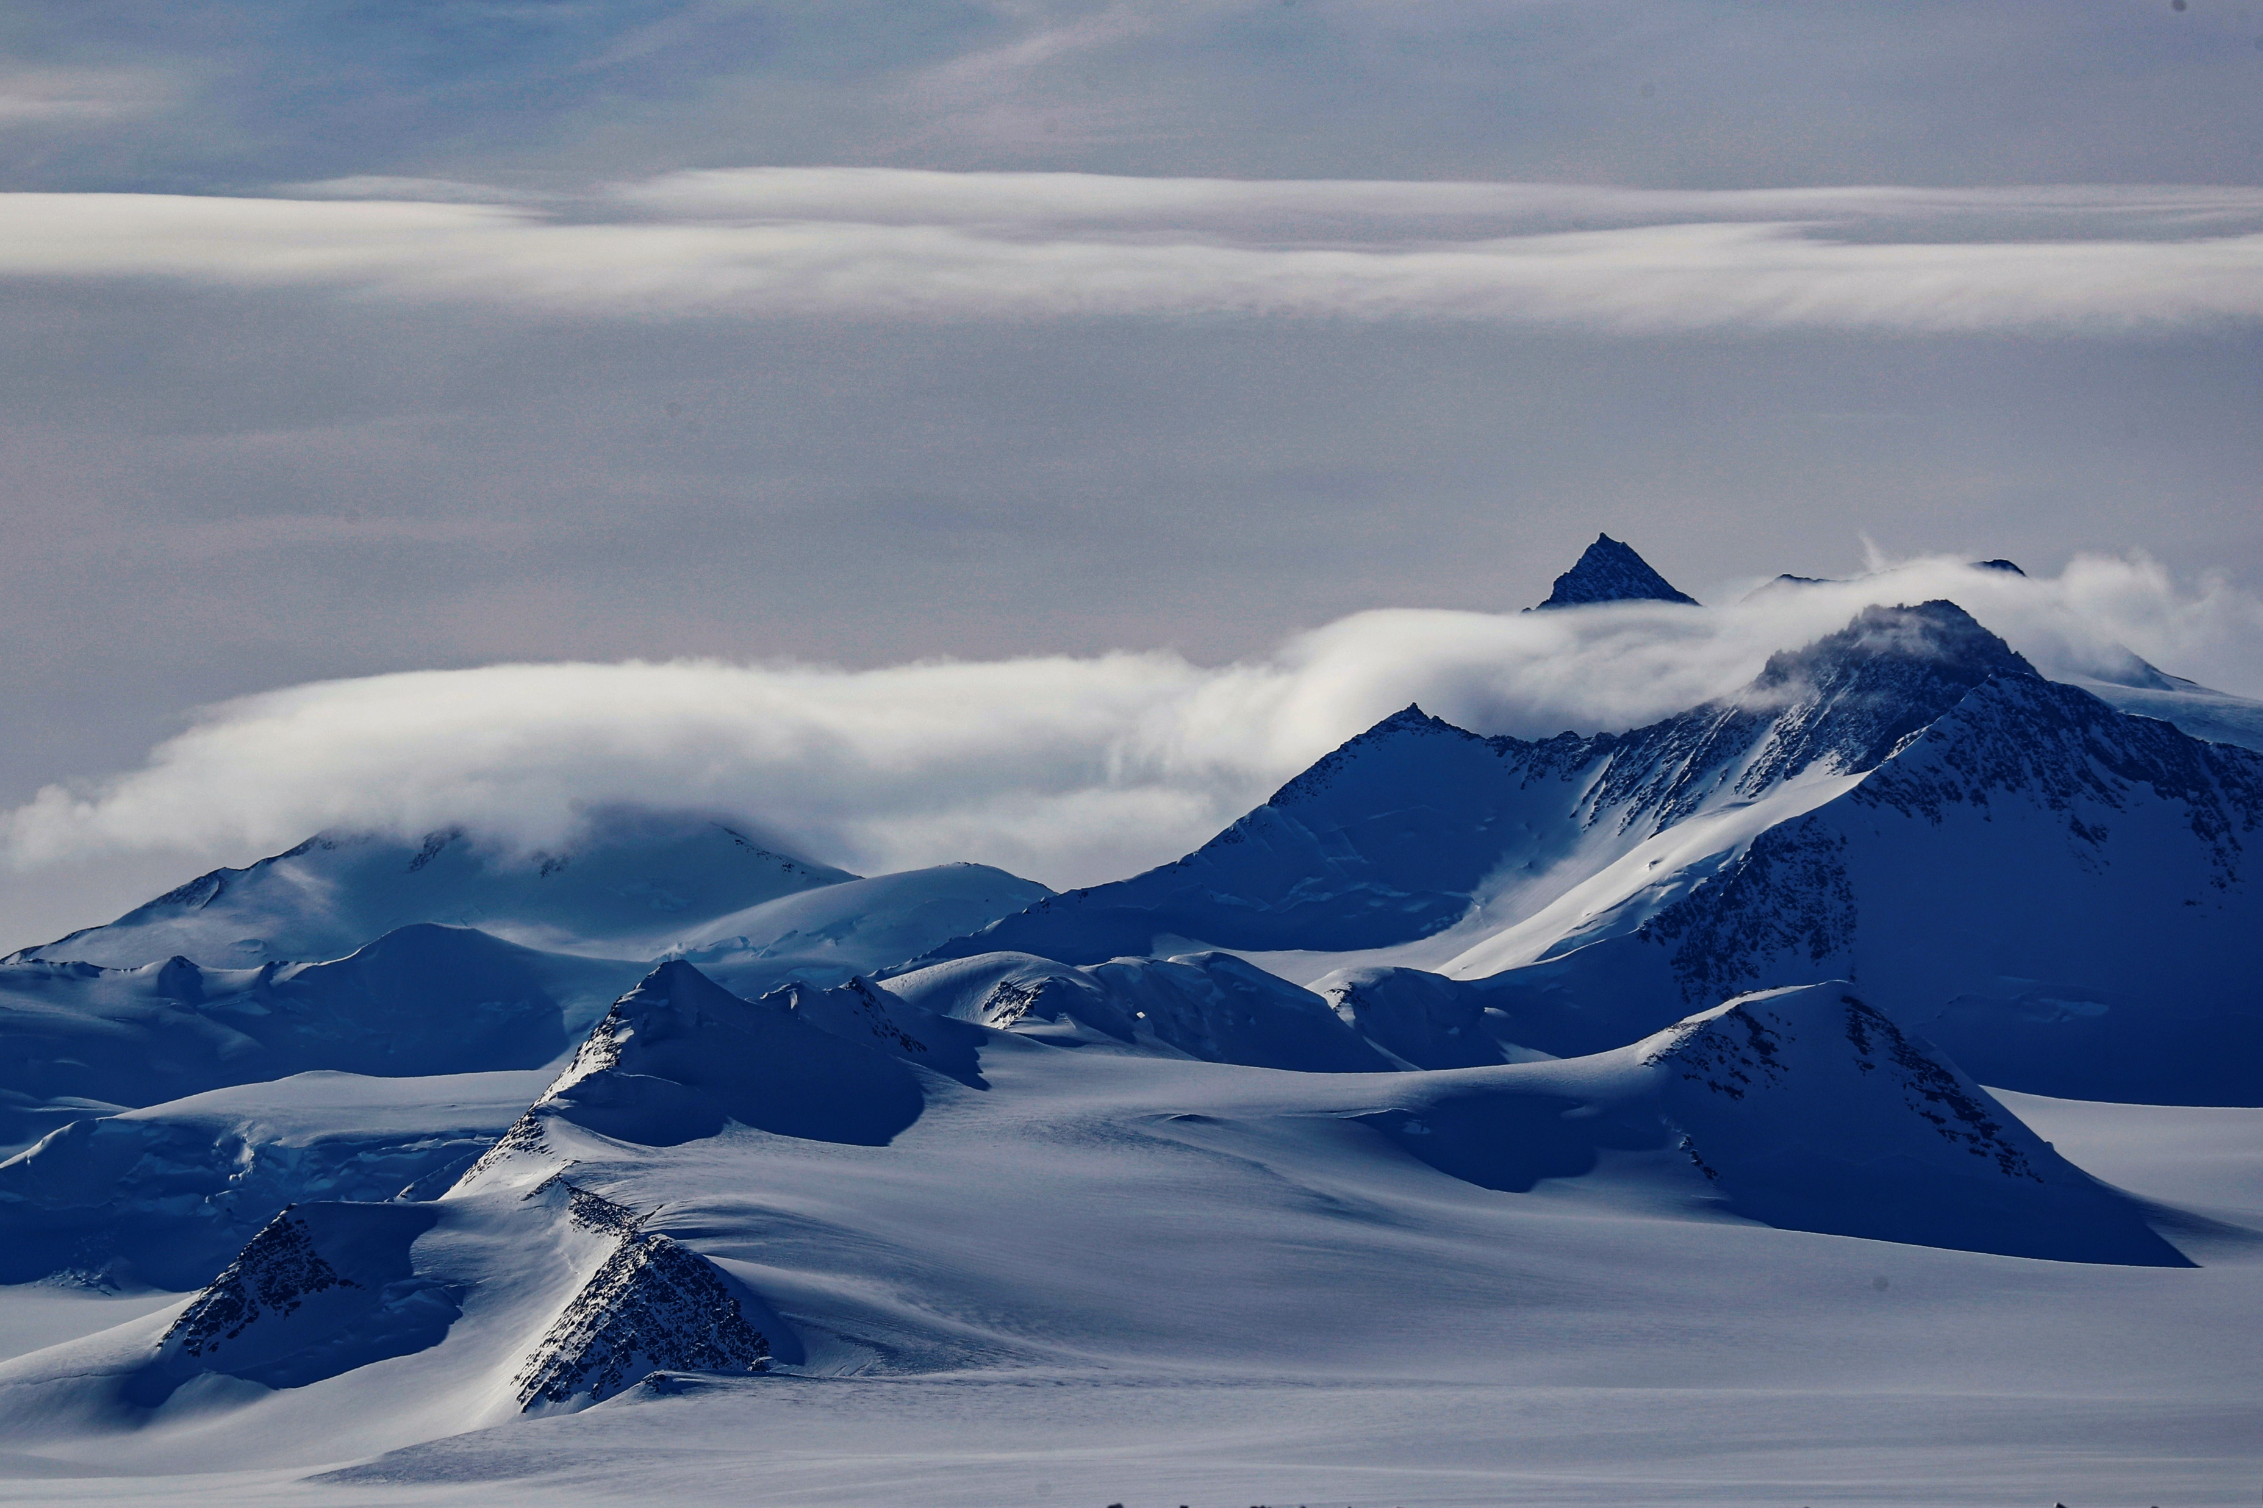
A total solar eclipse in the middle of the night
The 4-Dec-2021 event in Antarctica
René Garreaud (1,2), Deniz Bozkurt (2,3) Carl Spangrude (4), Tomas Carrasco-Escaff (2), Roberto Rondanelli (1,2), Ricardo Muñoz (1), Xavier M. Jubier (5), Mathew Lazzara (6,7), Linda Keller (6), Patricio Rojo (8)
(1) Geophysics Department, Universidad de Chile, Santiago, Chile
(2) Center for Climate and Resilience Research, Universidad de Chile, Santiago, Chile
(3) Universidad de Valparaíso, Valparaíso, Chile
(4) Montana Space Grant. Missoula, Montana, USA
(5) IAU, Paris, France
(6) Antarctic Meteorological Research and Data Center, University of Wisconsin-Madison, Madison, Wisconsin, USA
(7) Madison Area Technical College, Madison, Wisconsin USA
(8) Astronomy Department, Universidad de Chile, Santiago, Chile
® F. Trueba / Imagen País

Slide 2

Eclipse Meteorology 101
On average, a total solar eclipse (TSE) occurs approximately every 18 months on Earth, but a given location experiences a TSE only once every ∼380 years.
Natural experiment….impacts from BL to Ionosphere…
Only one Eclipse described in Antarctica…
Union Glacier
(80°S 80°W)
4:44 LT
SE Path
(100%)
TOA incident solar radiation
07:45 UTC 4th December 2021
Patricio Rojo
DAS-FCFM-UChile

Slide 3
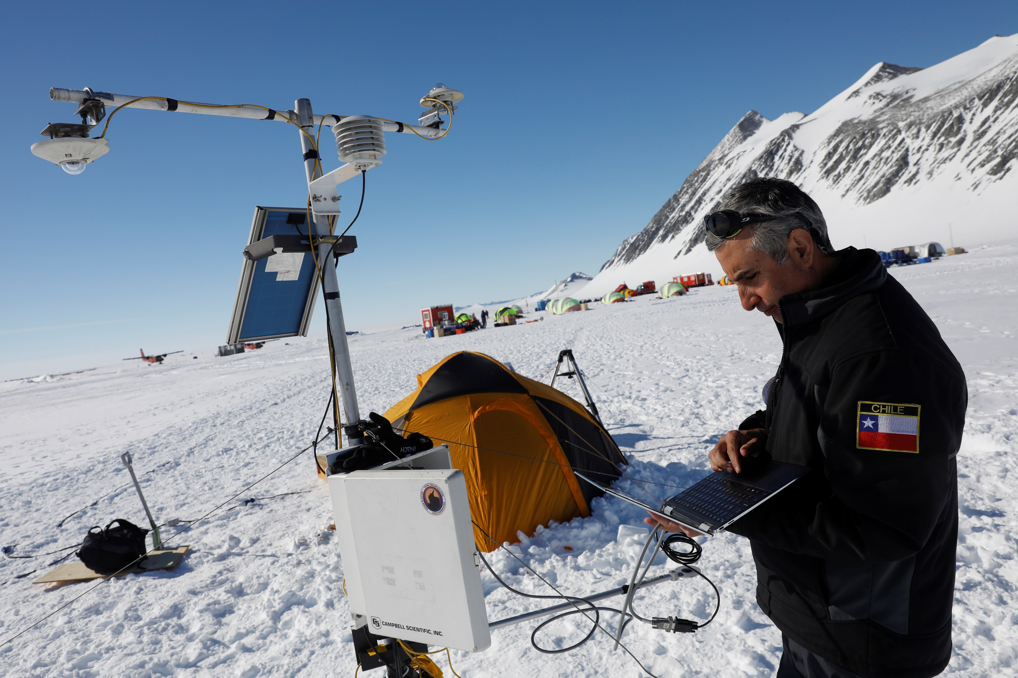


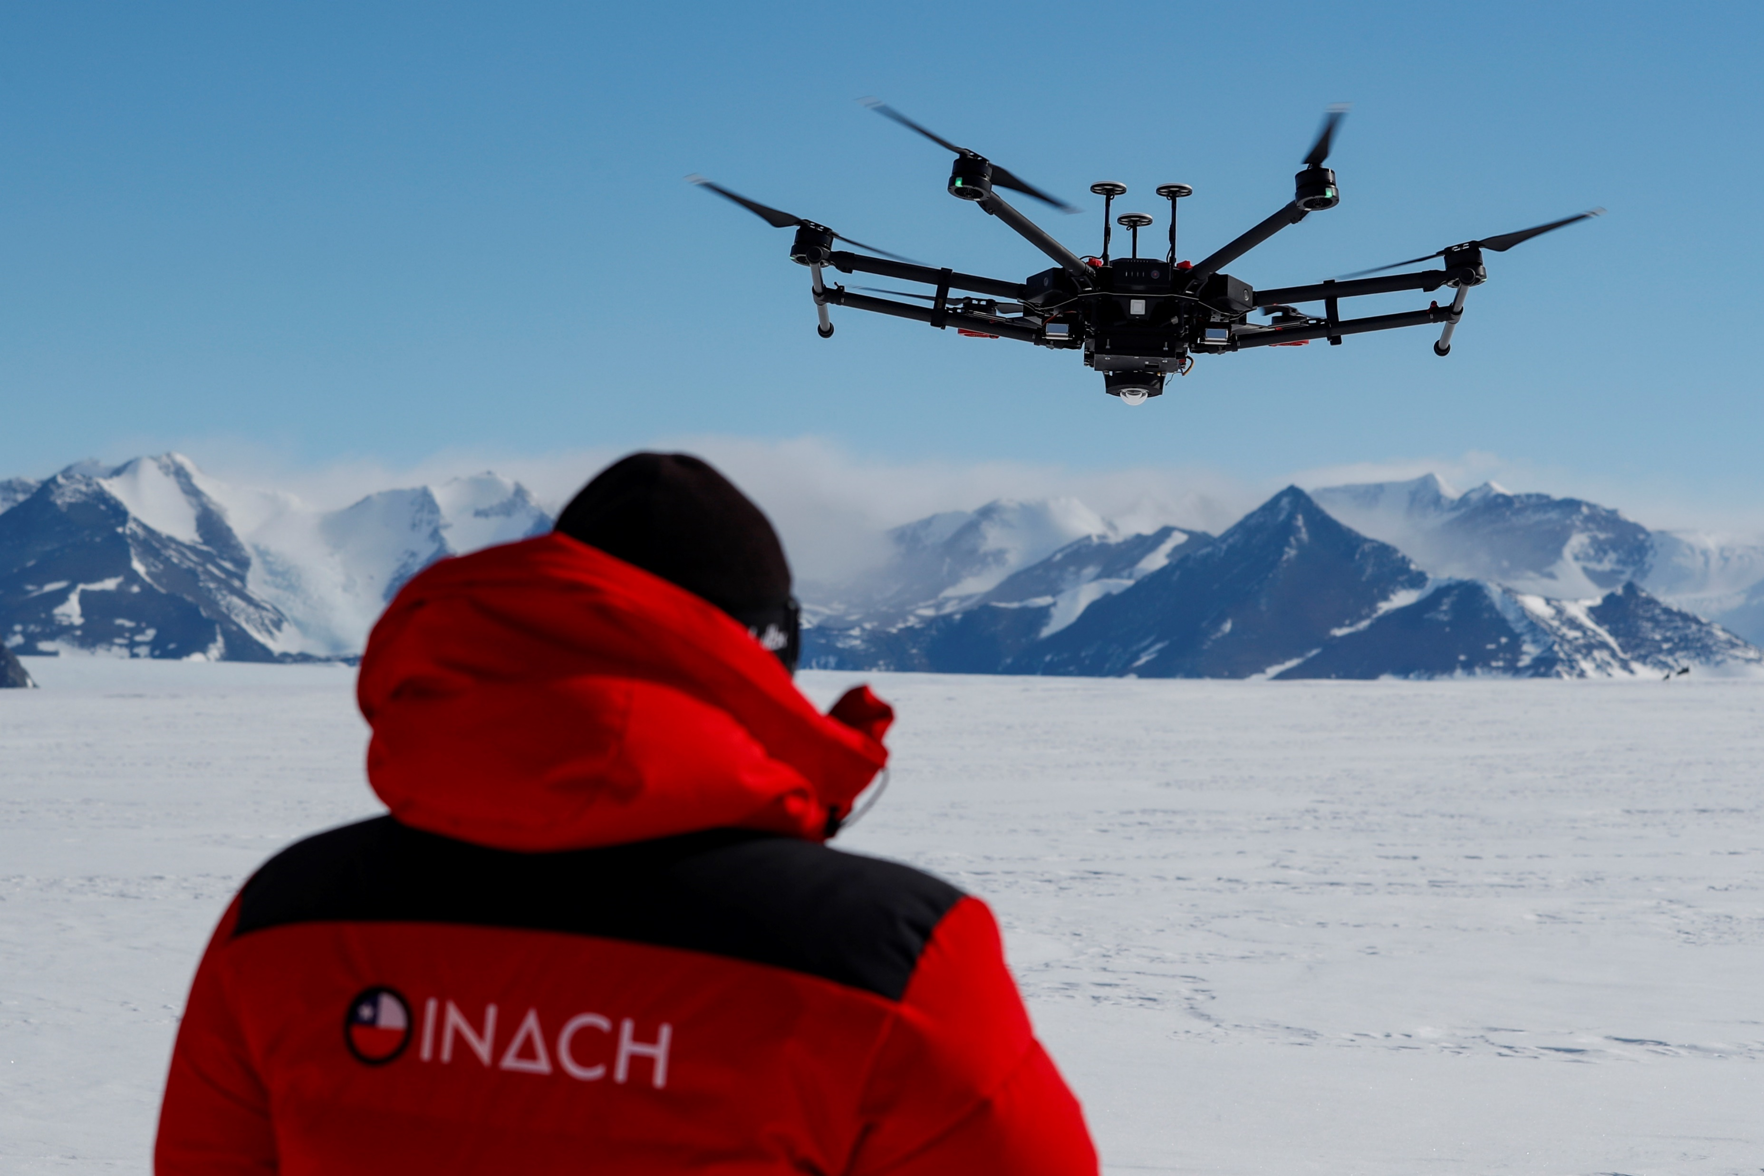
Ricardo Jaña et al
INACh
Edgardo Sepúlveda
Raúl Cordero et al
USaCh

Slide 4

To estimate temperature drop (dT) we need a simplified model…
The “eclipse depth” is the most difficult term to get.
Z
Z
H_{MBL}
H*
H*
ΔT
T
ΔT
NSRD ≈ ½ ρ ⋅ c_{p} H*⋅ ΔT

Slide 5


Clear sky solar radiation without eclipse
$$SW↓=SC∙\sin{(χ)∙T_{N}}$$
Δt
Under Clear Skies
T_{N} ≈ 0.8
Downward Solar Radiation
csSW↓_{noSE}
Clear sky solar radiation with eclipse
NSRD
Time
csSW↓_{SE} = (1−ω)*csSW↓_{noSE}
ω∼eclipse magnitude
Net solar radiation defict during the first half of the eclipse
NSRD ≈ ½ [½ ⋅ csSW↓_{noSE} ⋅ ω ⋅Δt ⋅(1- a_{snow})]
Ricardo Muñoz
DGF-FCFM-UChile

Slide 6
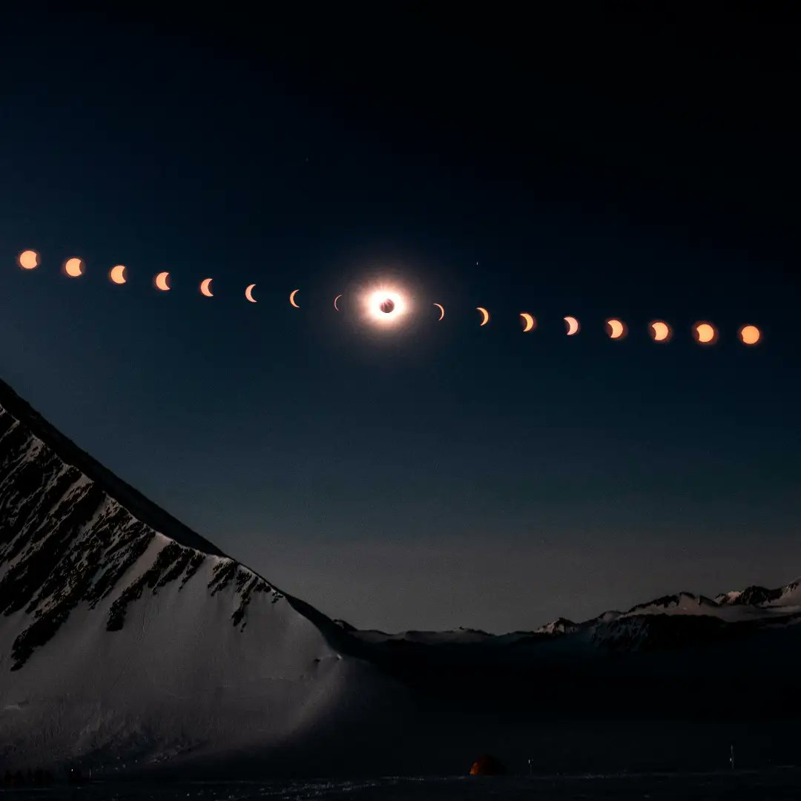
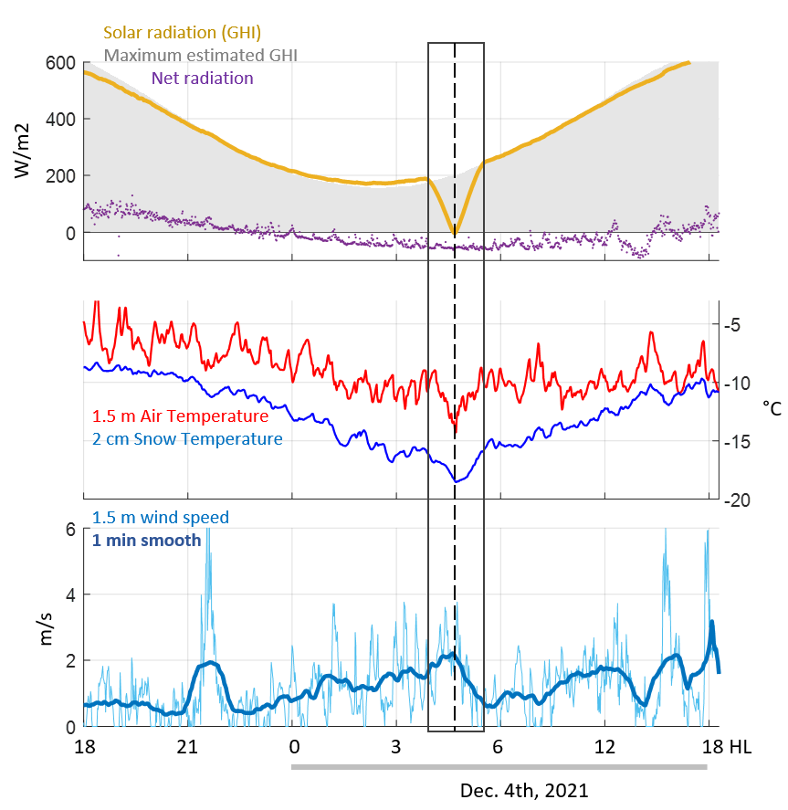
5-sec Meteorological at Union Glacier
(80°S 80°W 700 m ASL)
® F. Trueba / Imagen País

Slide 7
5-sec Meteorological at Union Glacier
(80°S 80°W 700 m ASL)

Slide 8
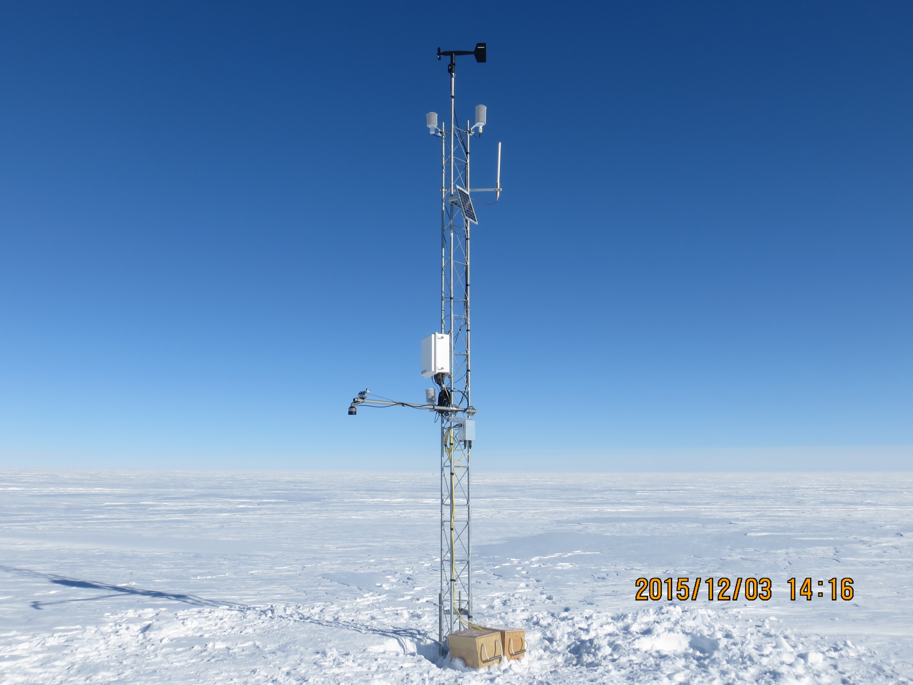
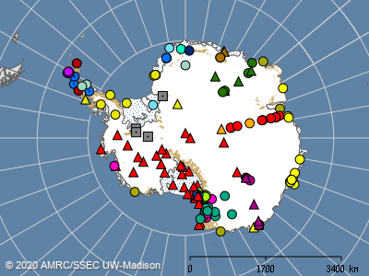

Antarctic AWS network
Great effort by Antarctic Meteorological Research Center (AMRC), Space Science and Engineering Center (SSEC), University of Wisconsin–Madison (UW–Madison)
Matthew Lazzara Linda Keller
et al…

Slide 9
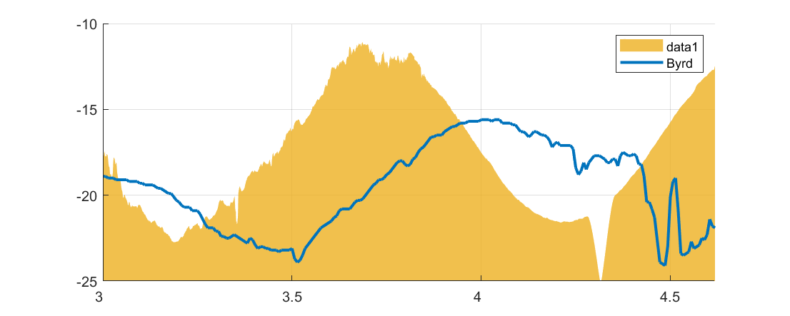
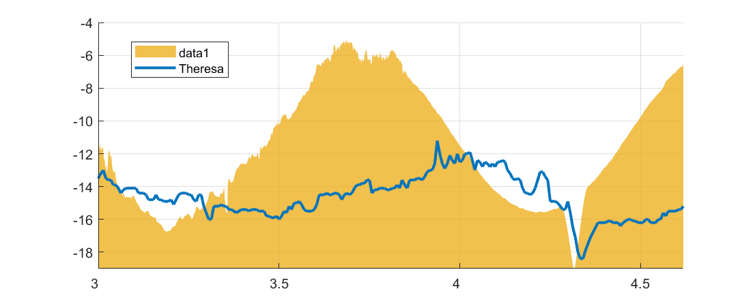
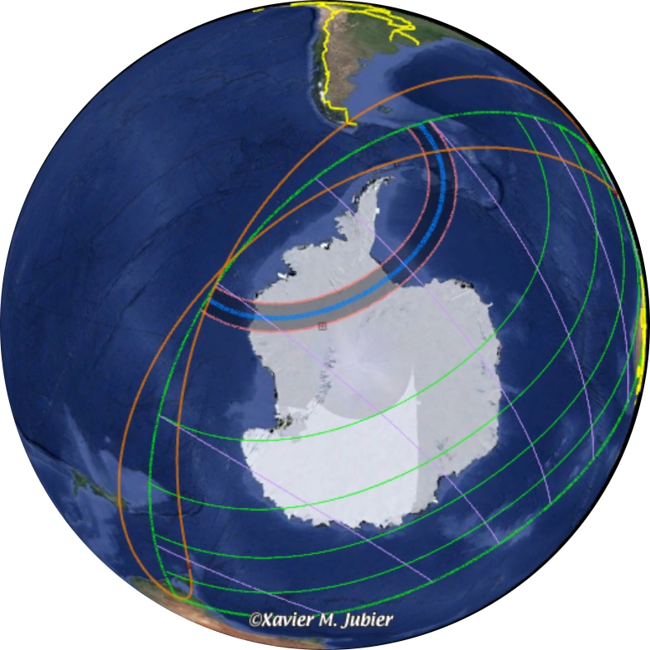
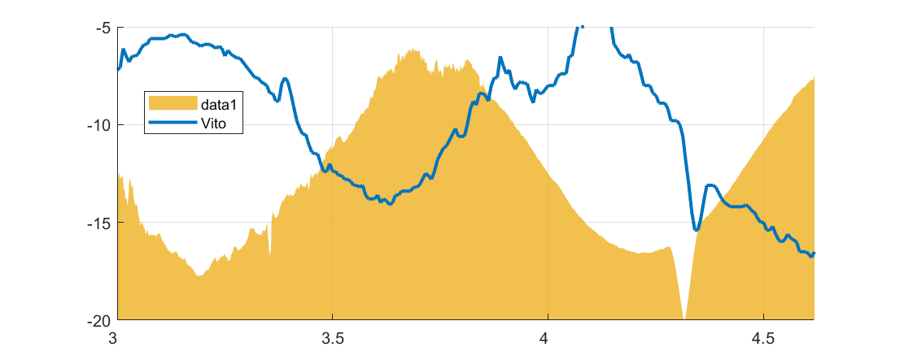
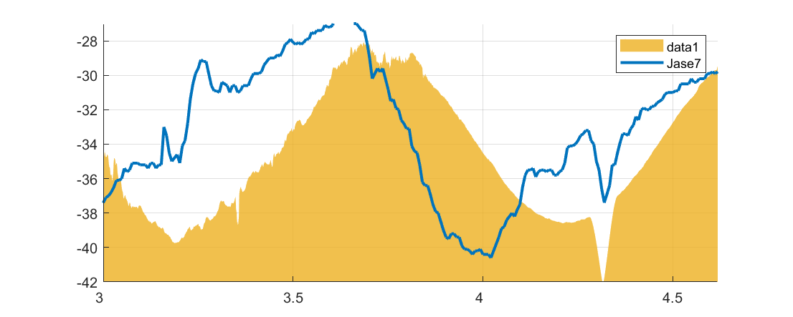
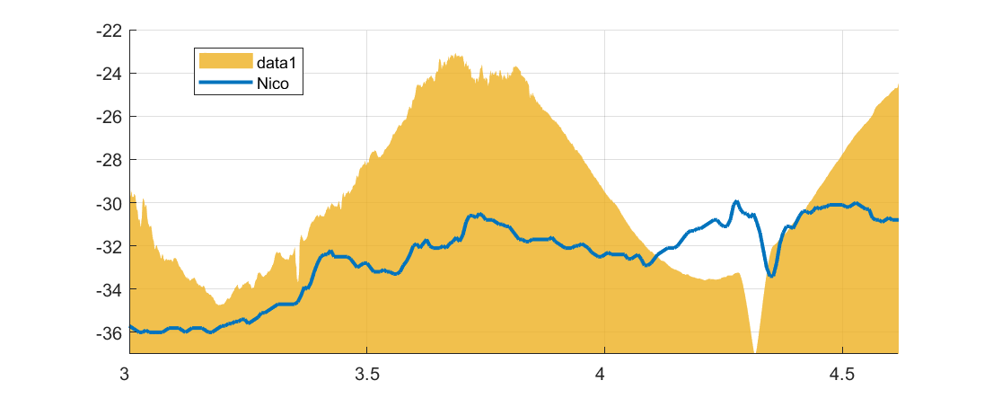
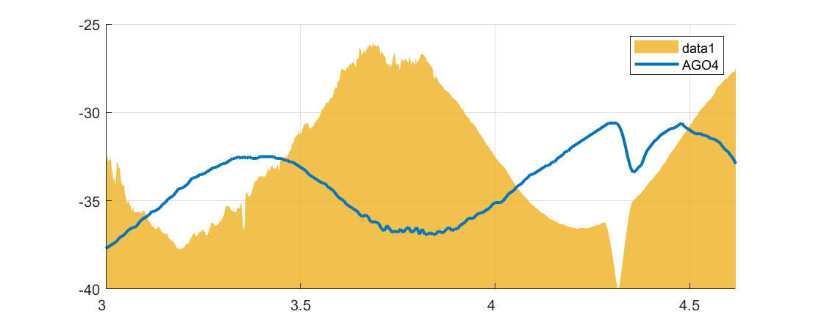

Air Temperature at local station (°C)
Solar Radiation at Union Glacier (W/m2)
Byrd 11.9° / 100 / 7:55
Stn Name SunElevation / Max. Obsc / Max Time
Theresa 16.9° / 97.7 / 7:54
UG 13° / 100 / 7:44
Vito 15.6° / 88.6 / 8:12
JASE7 33.7° / 78.2 / 7:37
Temperature drop estimation due to eclipse based on observations. In some cases is very evident, in others not so..
Tomas Carrasco
CR2-UChile
Nico 23.4° / 89.2 / 7:55
AGO4 28.3 / 78.6 / 8:02
4°C
Day/Hour (UTC)

Slide 10
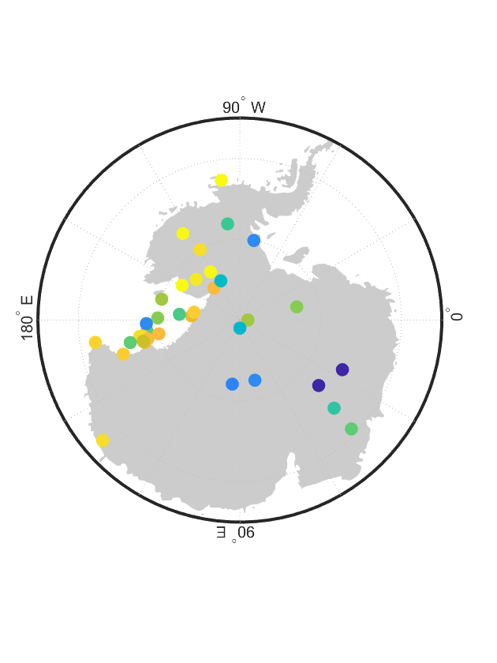
Temperature drop (°C) at máximum Eclipse
Night
100%
Janet
100%
UG
80%
Linda
Henry
JASE7
JASE7
60%

Slide 11
Let’s compare observations with simple model
Need Eclipse Local Circumstances (e.g., solar elevation at tmax and obscuration)

Slide 12

TSE 4 December 2021
Local Circumstances by Xavier Jubier
(a) Obscuration [%]
(b) Time Max [decimal UTC]
(c) Sun Elevation at Time Max [°]
UG
7:15
UG
8:00
8:15

Slide 13
Cooling the coldest place on earth
dT2m from radiative estimate (°C), ro variable
AIRS CF
Still, Not so good
1
0
UG

Slide 14

Estimating clouds over Antarctica is not easy
Little VIS/IR contrast over cold, white surface
ERA5 TCF 8 UTC
AIRS TCF 4-19 UTC
MODIS Terra 6-10 UTC
UG
UG
Clear
0%
100%
Roberto Rondanelli
DGF-CR2-UChile

Slide 15
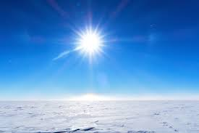
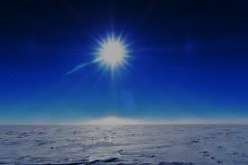
Simple estimate (model?) too simple
We need a full meteorological model in which the Eclipse can be simulated
Meteorological models do not consider Eclipses…must be incorporated as BC
dV
1
+ f k×V =
∇p – F_{R} + g
dV
1
dt
ρ
+ f k×V =
∇p – F_{R} + g
∂
dt
ρ
+ V⋅ ∇)T – S_{p}ω = Q_{RAD}+Q_{CON}+Q_{sfc}
(
∂
+ V⋅ ∇)T – S_{p}ω = Q_{RAD}+Q_{CON}+Q_{sfc}
∂t
(
∂ω
∂t
∇⋅V +
= 0
∂ω
∂t
∇⋅V +
= 0
∂(gz)
RT
∂t
–
∂(gz)
RT
=
p
–
∂p
=
∂p
p
Simulation without eclipse (contrafactual, default simulation)
Simulation with eclipse
(factual, not easy, not standard)
β (lat,lon,lev,time)
Δβ = β_{eclipse} - β_{No Eclipse}
ΔT2m = T2m_{eclipse} – T2m_{No Eclipse}

Slide 16


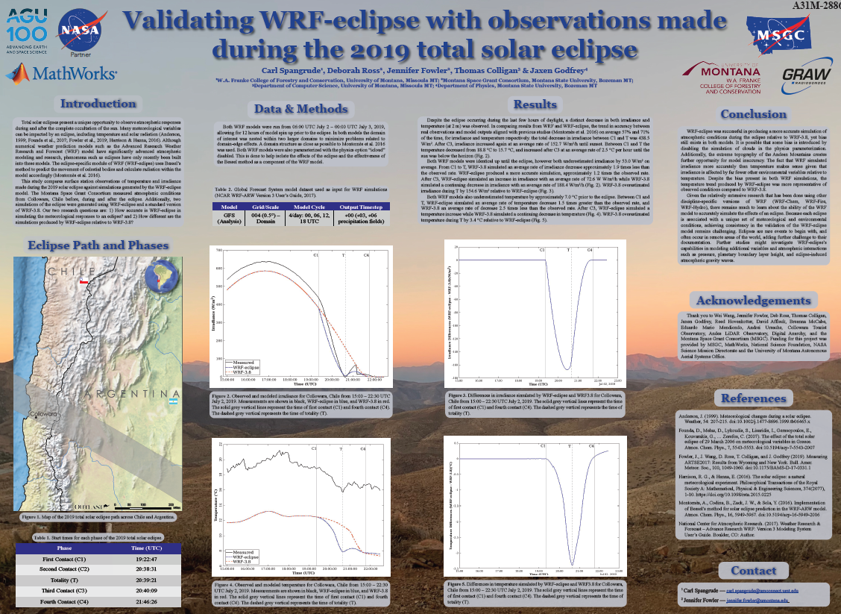
Carl Spangrude
Graham Moss
U. Montana + NASA

Slide 17
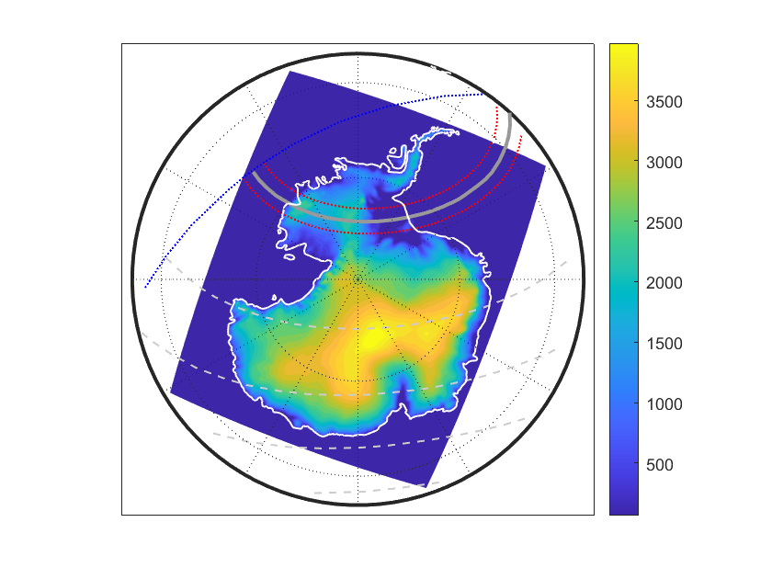
Polar WRF (versión XYZ) was integrated over Antarctica with Eclipse Disable (default option) and Eclipse Enable (new) configuration.
Five pairs of simulations were performed (different initial times) extending 2 or 3 days so all of them cover the full TSE day (December 4th 2021)
Feature | Value
Number of points | 180 × 226
Spatial Resolution | 27 km
Time resolution | XX sec
Sampling Interval | 1-hr (gridded fields), 30-sec (station points)
Initial / Boundary Conditions | NCEP GDAS/FNL 0.25
Parametrizations | XYZ
Initial time | 12 UTC 2 Dec 2021 18 UTC 2 Dec 2021 00 UTC 3 Dec 2021 (Baseline) 06 UTC 3 Dec 2021 12 UTC 3 Dec 2021

Slide 18
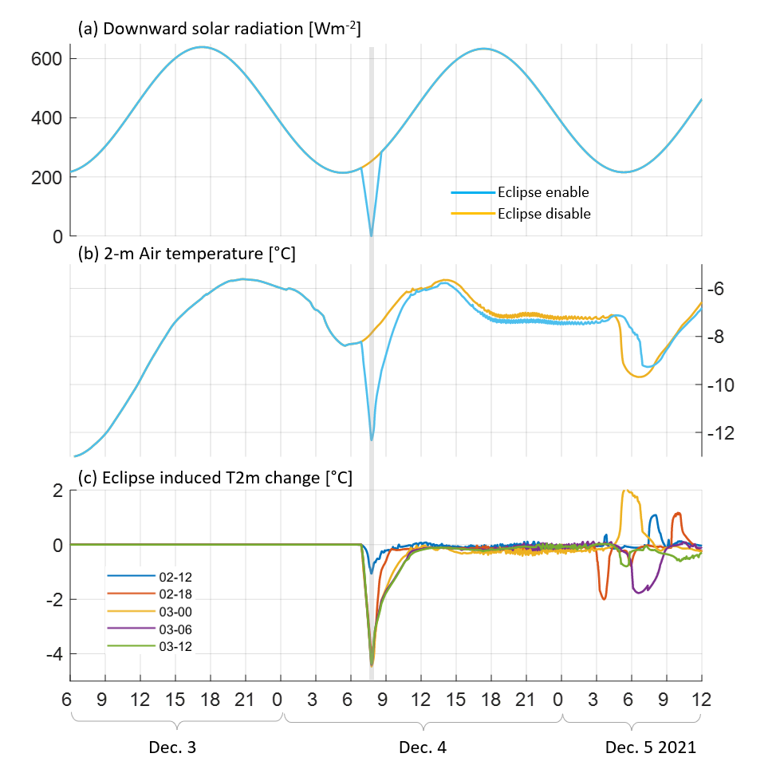

Union Glacier
Deniz Bozkurt
Uvalpo + CR2

Slide 19
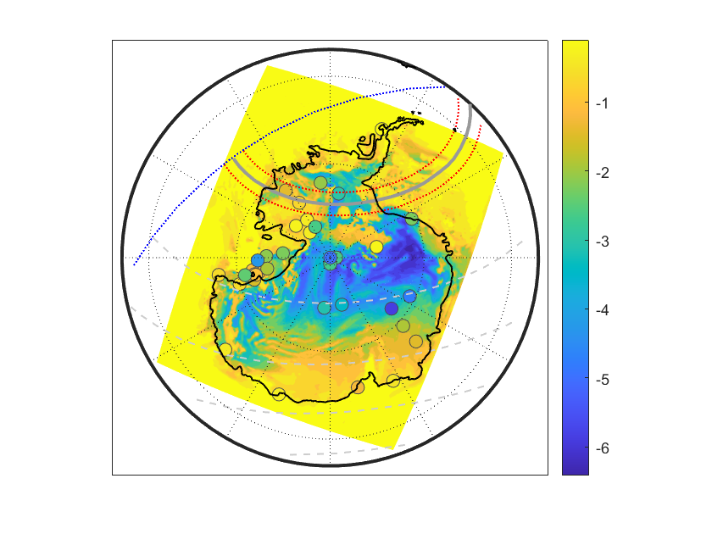
Cooling the coldest place on earth
WRF maximum dT2m (°C)
Good enough?
GU

Slide 20
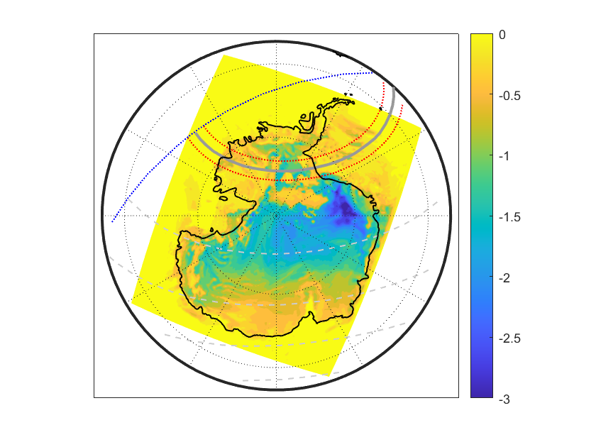
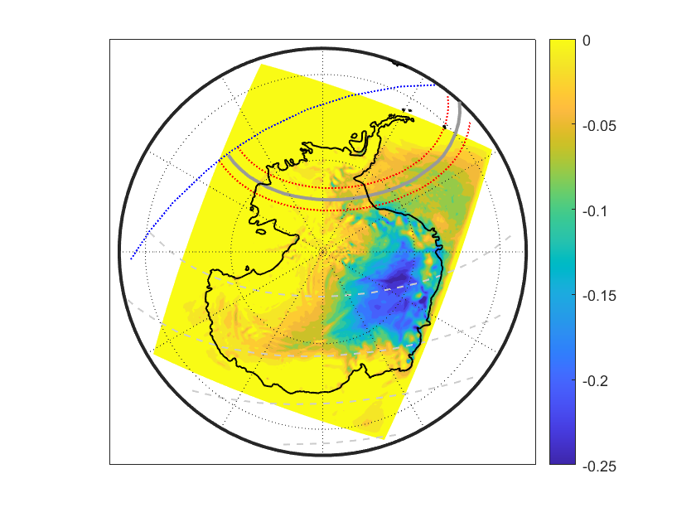
Cooling the coldest place on earth
Vertically integrated dTmax (2-100 m)
dPsfc max [hPa]

Slide 21
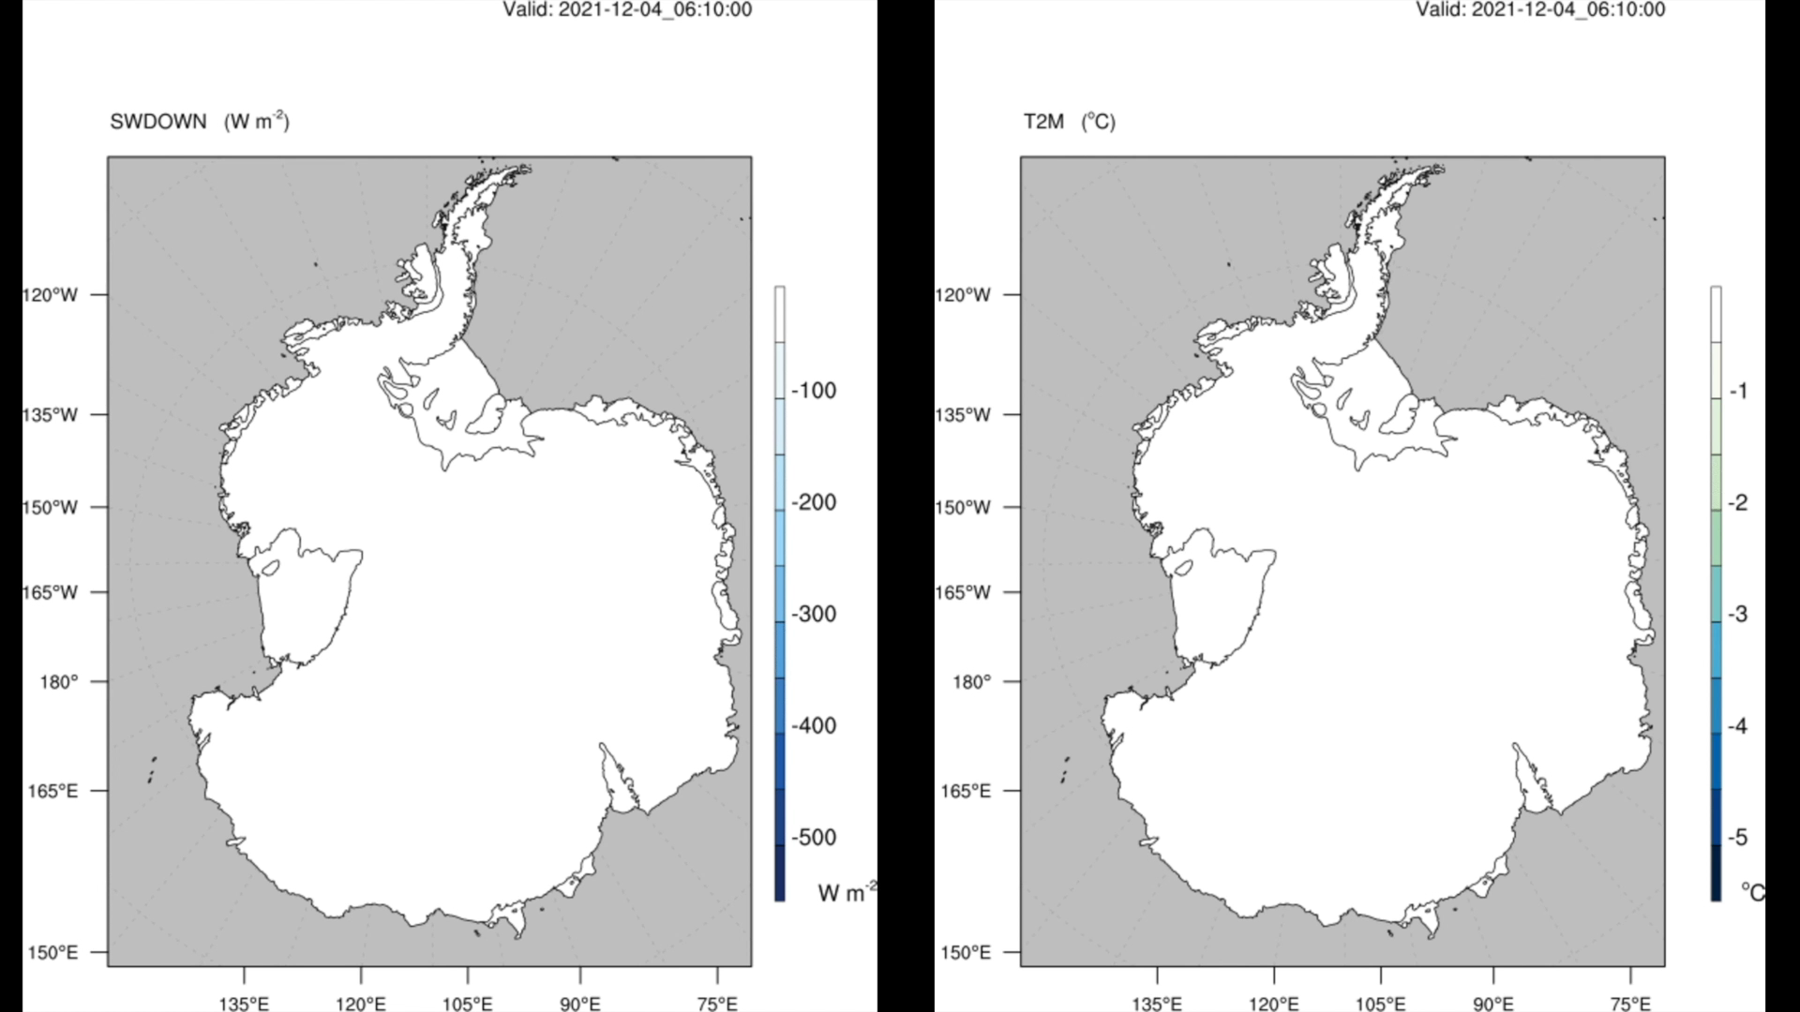

Slide 22
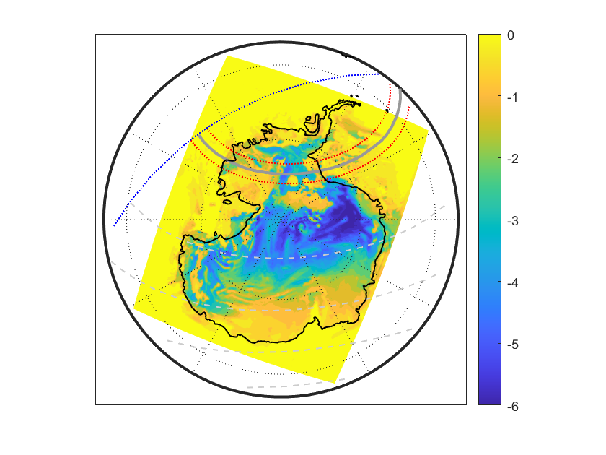
Cooling the coldest place on earth
Astronomical Eclipse induced Solar Radiation Deficit (Clear Skies)
Maximum dT2m
(°C)

Slide 23
Diagnosing WRF
Maximum dT2m [°C]
All points
Astronomical Eclipse induced Solar Radiation Deficit (Clear Skies) [W/m2]

Slide 24
Diagnosing WRF
Cloud Fraction < 0.3
All points
Maximum dT2m [°C]
Astronomical Eclipse induced Solar Radiation Deficit (Clear Skies) [W/m2]

Slide 25
Cooling the coldest place on earth
Actual Eclipse induced Solar Radiation Deficit (include clouds)
Maximum dT2m
(°C)

Slide 26
Cooling the coldest place on earth
Actual Eclipse induced Solar Radiation Deficit (include clouds)
Maximum dT2m
(°C)
?

Slide 27
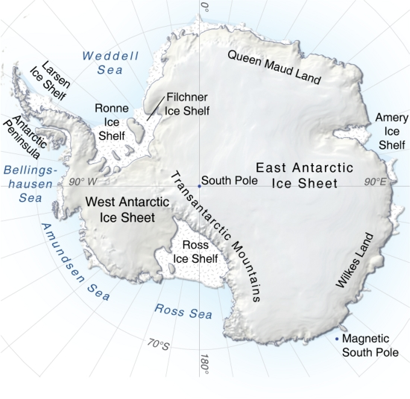
Diagnosing WRF
Cloud Fraction < 0.3
Region I
Maximum dT2m [°C]
Cloud Fraction < 0.3
Region II
All points
Astronomical Eclipse induced Solar Radiation Deficit (Clear Skies) [W/m2]

Slide 28
What causes the weak cooling over Wilkes land, Queen Maud Land and parts of the East Antarctic Ice Sheet?
Strong winds and deeper PBL seems relevant
Less radiative control, more advective control on near surface air temperature
L₉₅₈
L₁₀₂₀
L₉₇₀
L₉₈₀
H₁₀₀₀
L₉₅₅
L₉₇₈
SLP (hPa)
10 m wind speed (m/s)
PBL height (m)

Slide 29
Conclusions
Using a very simple surface-energy balance model we found that, under clear skies, the maximum cooling is dictated by the solar radiation deficit which depends on the product of the obscuration and the incident solar radiation flux that would have occurred in the absence of the eclipse.
As previously reported, the eclipse module implemented in WRF faithfully reproduces the reduction in solar radiation induced by the eclipse. The WRF-simulated cooling agrees well with the observations, especially when considering the uncertainty in both estimates, and reveals a quite complex pattern of cooling and surface pressure increase.
The quiescent conditions over West Antarctica and most of the interior plateau set the stage for a radiative regime, in which the maximum eclipse-induced cooling was largely dictated by the actual reduction in incoming solar radiation.
The strong winds over the periphery of East Antarctica led to a dynamical regime, in which the eclipse-induced cooling was very minor, irrespective of the actual solar radiation deficit, because of the strong advection of maritime air and the deep PBL in which the surface-based cooling was diluted.

Slide 30
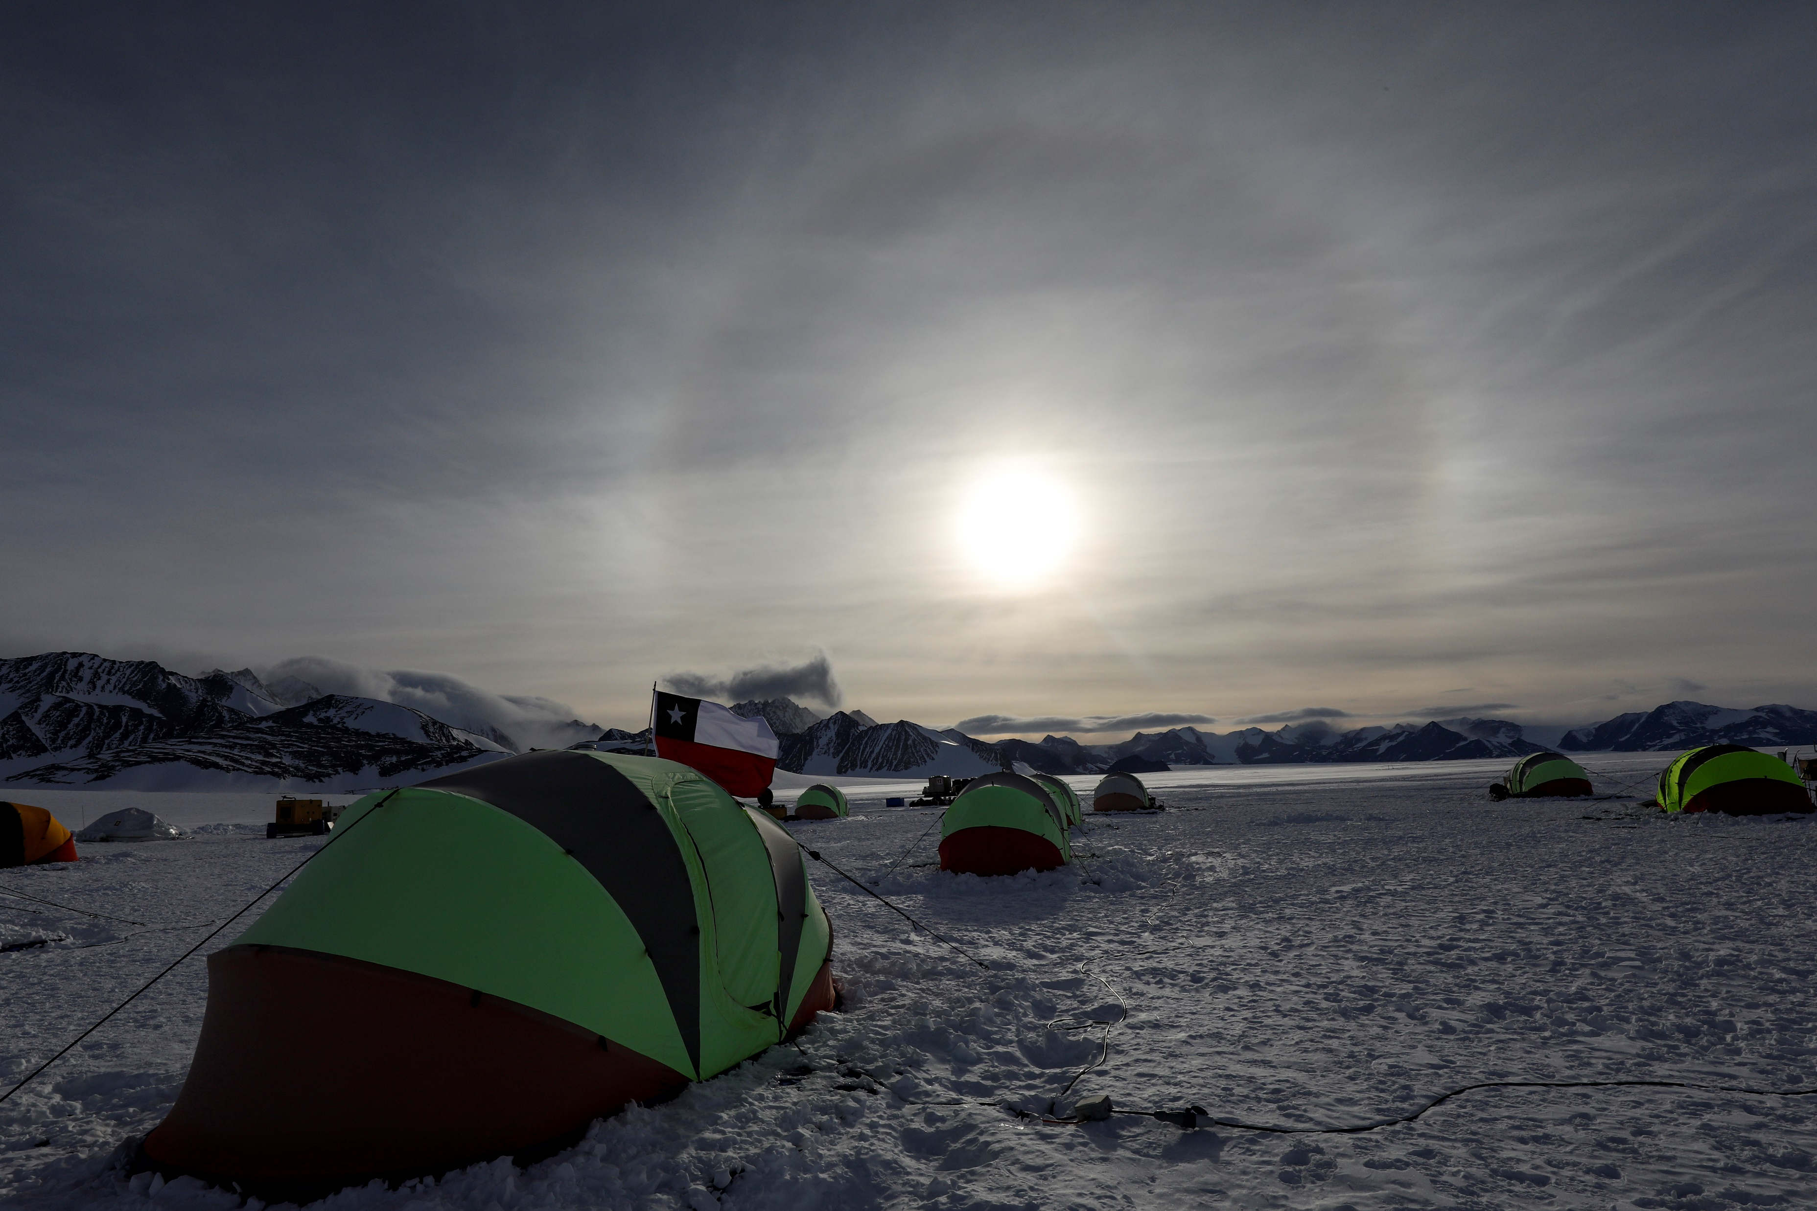
® F. Trueba / Imagen País
Special thanks to the personnel from INACh, Chilean Army, Air Force and Navy that made possible ECA54, Nov-Dec 2021

