Slide 1
EXPLORING THE POSSIBLE CONNECTION BETWEEN HUT POINT PENINSULA’S TERRAIN AND A MODERATE NORTHEAST WIND EVENT AT MCMURDO, ANTARCTICA
JEFFREY D. FOURNIER
NPP Meteorologist

Slide 2
Outline
Review
Hut Point Peninsula geography
“Moderate east - northeast wind regime”
Defining characteristics
Synoptic overview
19 – 20th February 2023 case
Synoptic & mesoscale overview
Model vertical cross-section

Slide 3
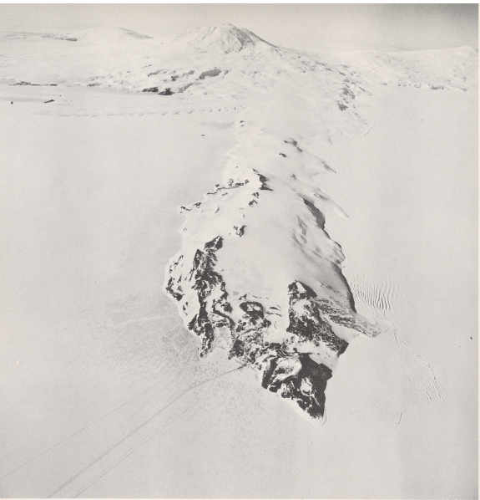
Erebus (3.8 km)
Windless
Bight
Photo courtesy of Operation Deep Freeze 1960, Task Force 43 (Lazzara, 2008).
2-4 km wide
22 km long
Hut Point Peninsula
200-400 m
high
McMurdo
N

Slide 4
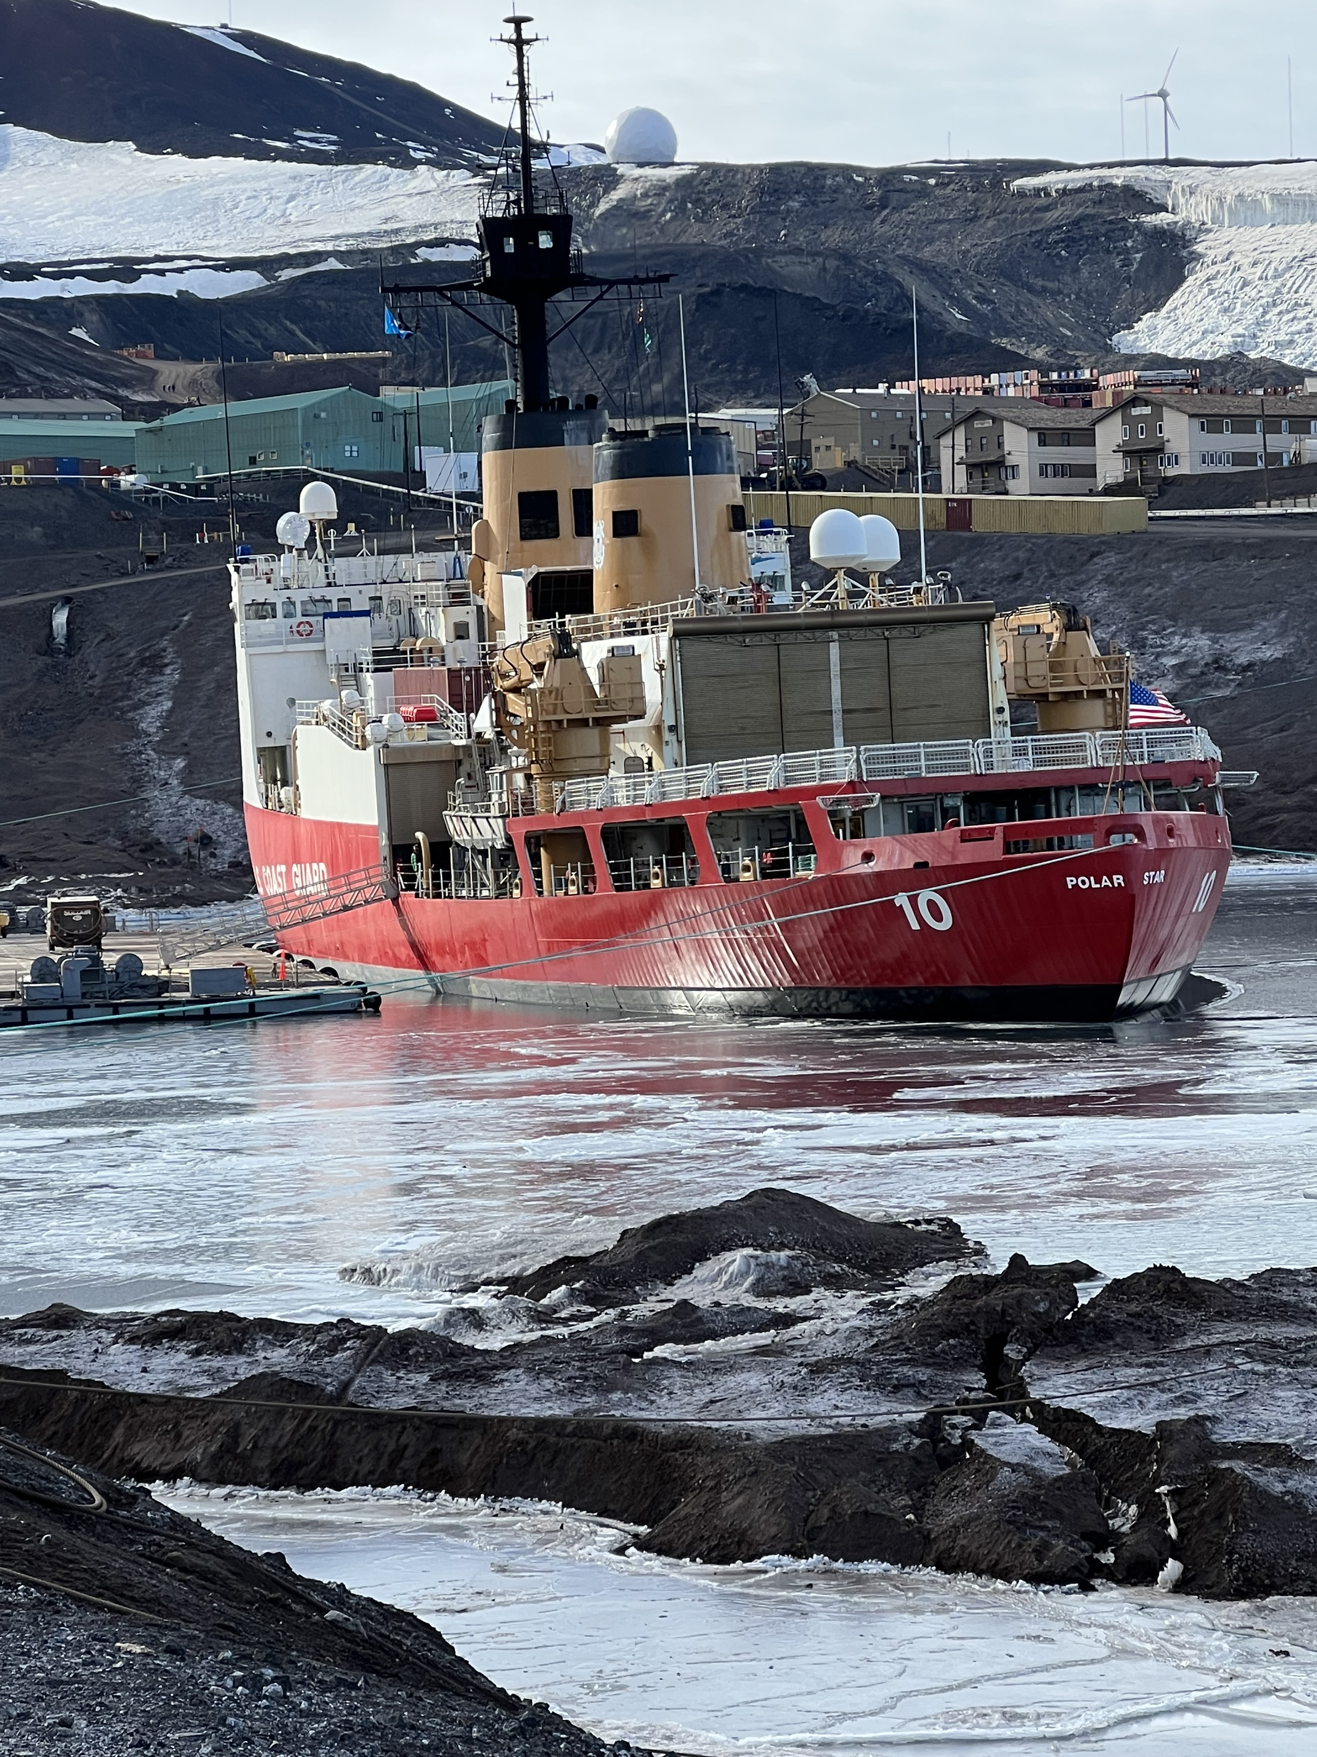
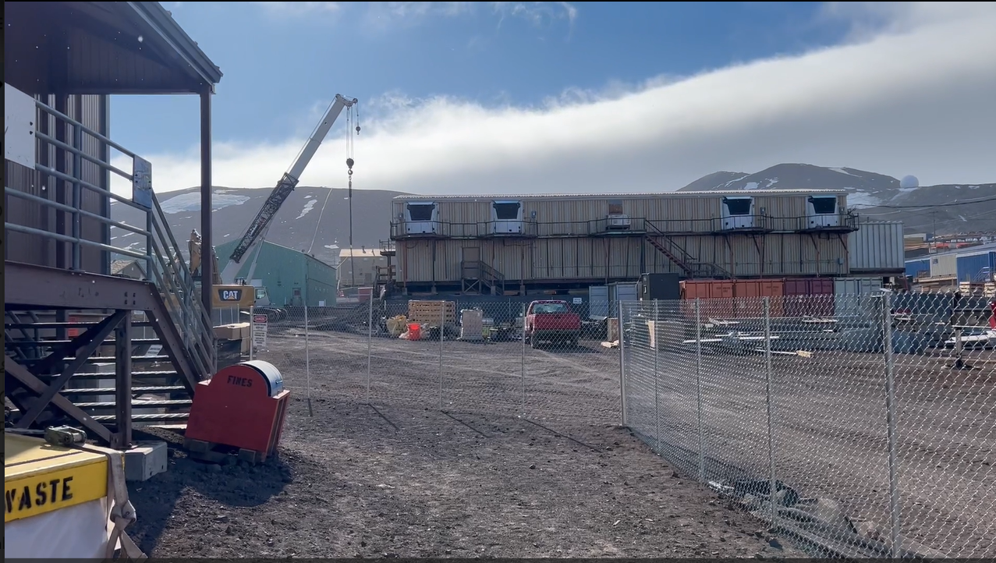
Case selection criteria (McMurdo surface wind observations)
Peak sustained wind 18+ KT
Sustained wind 14+ KT for 6+ consecutive hours
True wind between 30º to 90º
Diurnal component
event begins between 0500 and 0900 LT
ends by midnight

Slide 5
4 Cases matched criteria (February - early March, 2023)
19-20 FEB, 6-7 MAR, 7-8 MAR, 9-10 MAR
Notable characteristics at McMurdo
4º to 7º C cooling
pressure rises 1 to 3 mb
peak gust 26 to 31 KT

Slide 6
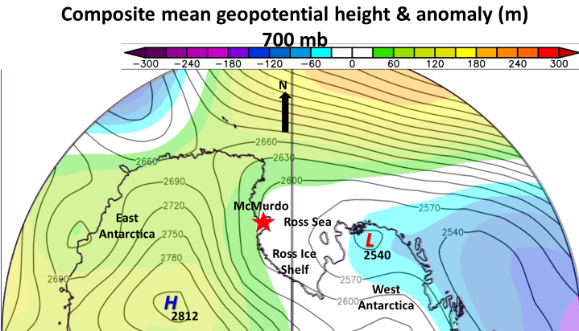
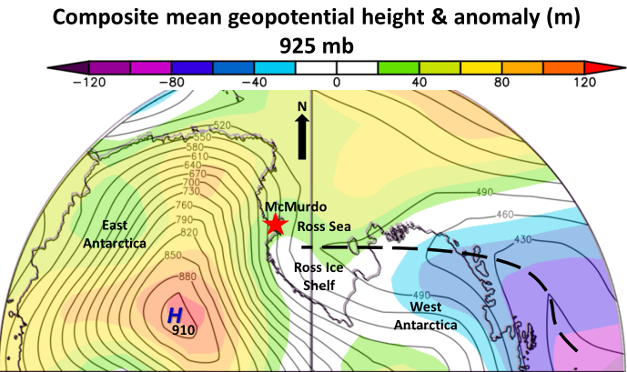
Composite charts
Climatology from 1991-2020

Slide 7
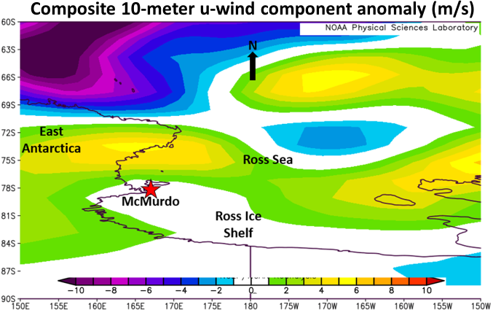
Composite charts continued
Climatology from 1991-2020

Slide 8
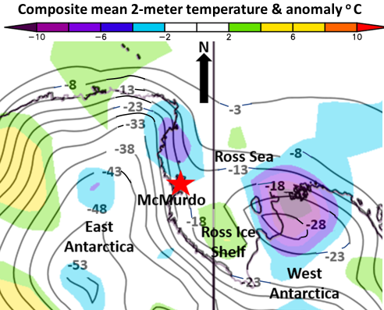
Composite charts continued
Climatology from 1991-2020

Slide 9
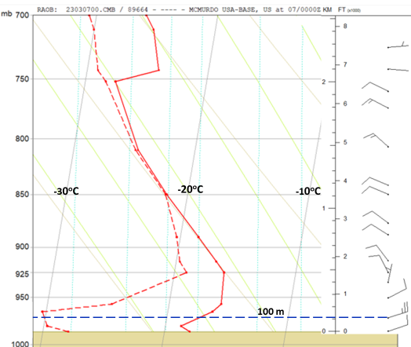
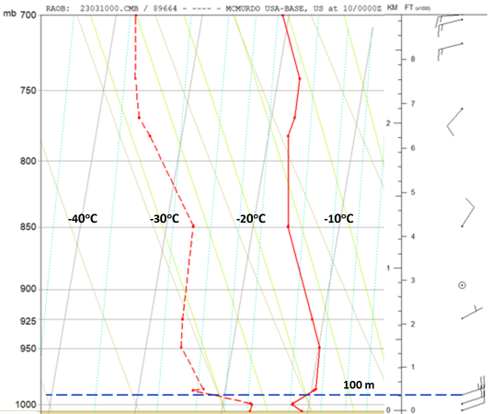
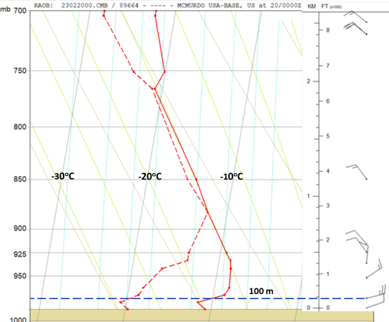
00 UTC McMurdo RAOBs (lowest 2.5 km)
McMurdo is 33 m above MSL

Slide 10
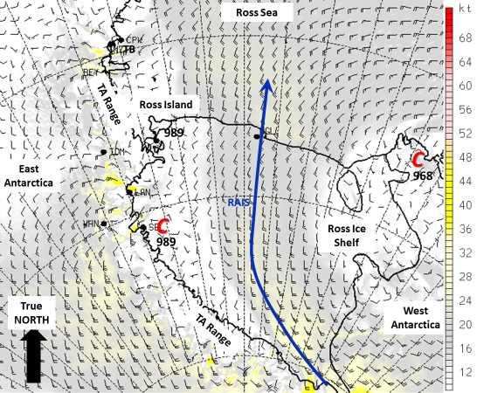
19-20 FEB Case- synoptic overview
00 UTC, 19 FEB 2.67 km resolution AMPS surface wind forecast (valid 17 UTC)

Slide 11
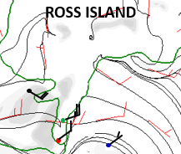
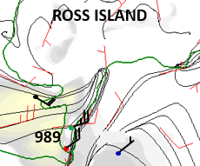
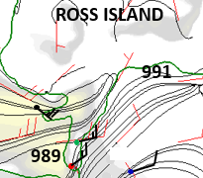
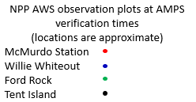
19-20 FEB Case- mesoscale overview focus on Hut Point Peninsula
17 UTC (06 LT), 19 FEB
21 UTC (10 LT), 19 FEB
00 UTC (13 LT), 20 FEB

Slide 12
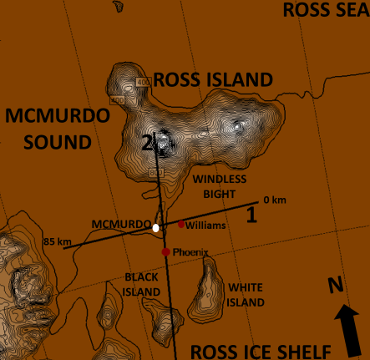
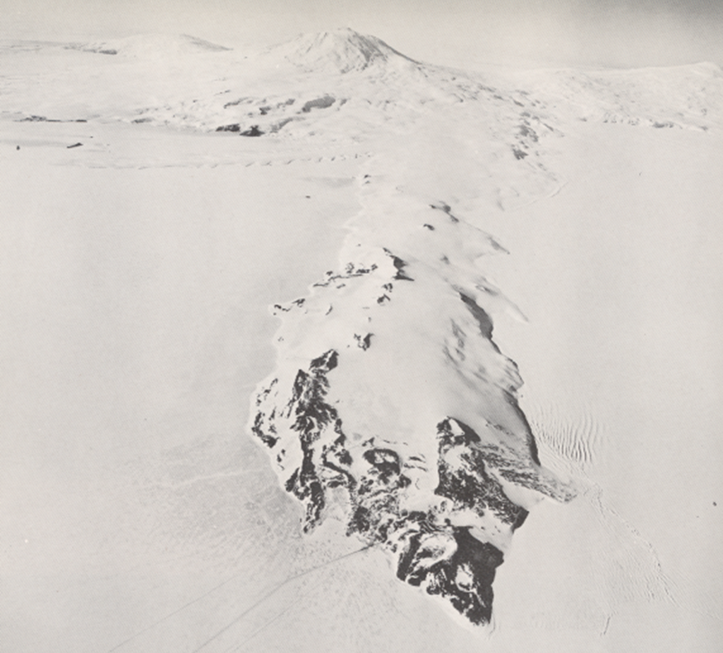
19-20 FEB Case- AMPS vertical cross-section analysis

Slide 13
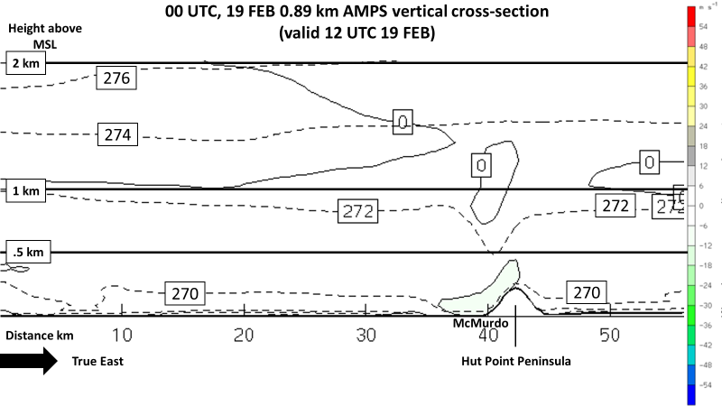
perturbation in isentropes

Slide 14
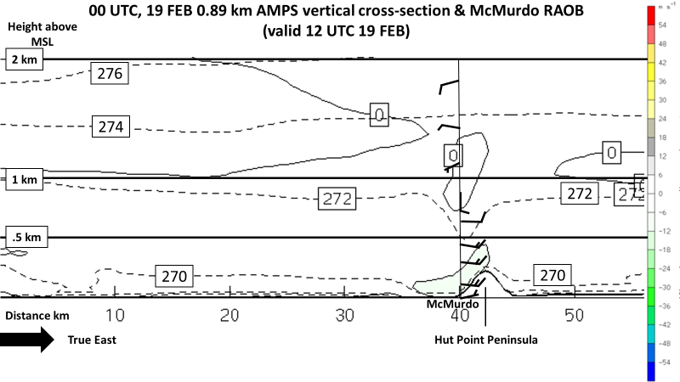

Slide 15
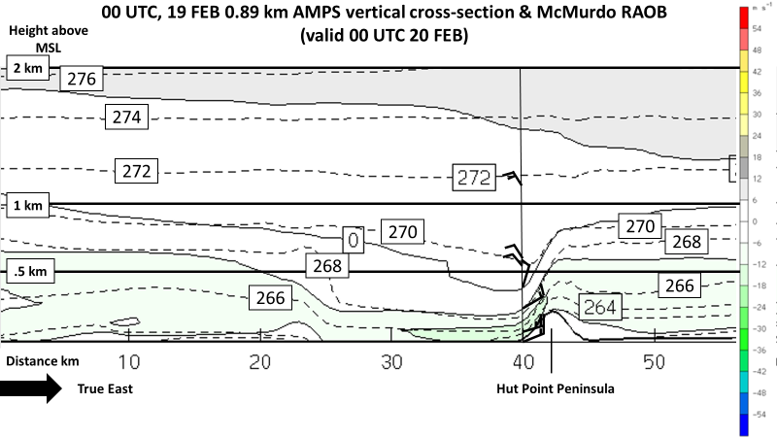
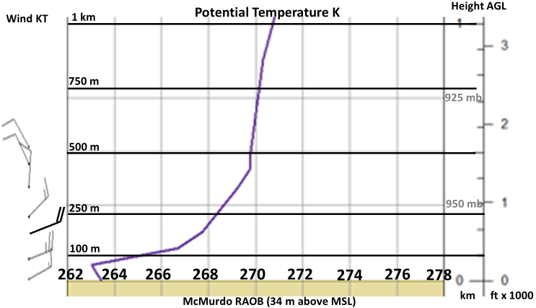

Slide 17
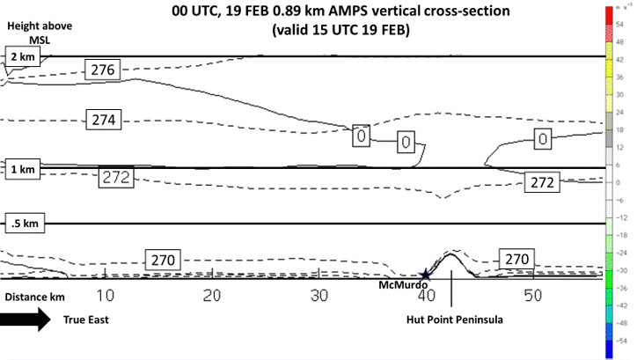

Slide 18
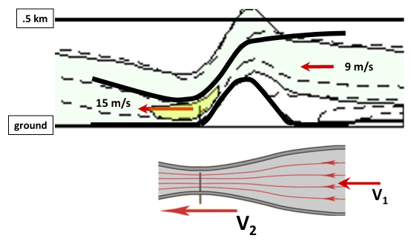
Bernoulli Principle

Slide 19
Summary
Moderate NE wind regime at McMurdo
cold temperatures & modest pressure rises
begins in morning; ends late afternoon or evening
Synoptic scale
positive height anomaly eastern Antarctica & Ross Sea
average heights Ross Ice Shelf
above-average west wind Terra Nova Bay
cold anomaly Ross Island to Cape Adare
Vertical profile at McMurdo
strongest wind (25 KT) 100 m AGL
strong temperature inversion 50-100 m AGL
W - NW wind above shallow boundary layer

Slide 20
Summary continued
High-res AMPS vertical cross section
horizontal isentropes become sharply angled on leeside
cold air east of peninsula deepens
begins to “spill” over terrain
Steep angle + tight packing of isentropes narrows flow channel
Wind accelerates leeside (Bernoulli principle)

Slide 21
SPECIAL THANK YOU TO:
AMPS team (Kevin Manning & Jordan Powers) at UCAR/NCAR for so quickly setting up the Hut Point Peninsula vertical cross-section.
Paul Gulli, Senior Forecast for NPP, for recounting his experience with moderate northeast wind events in McMurdo.

Slide 22
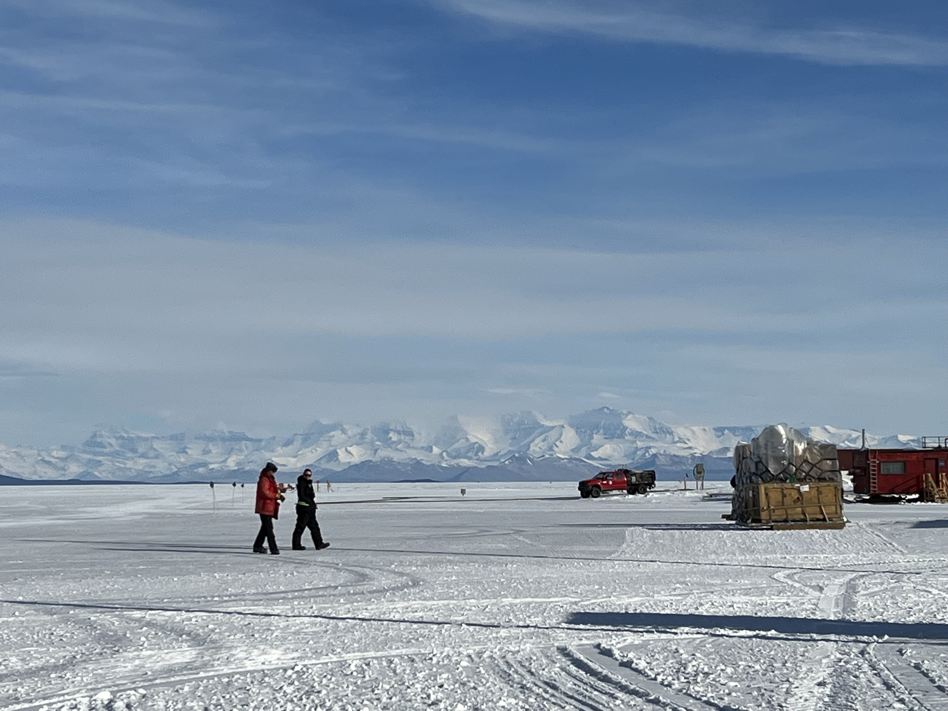
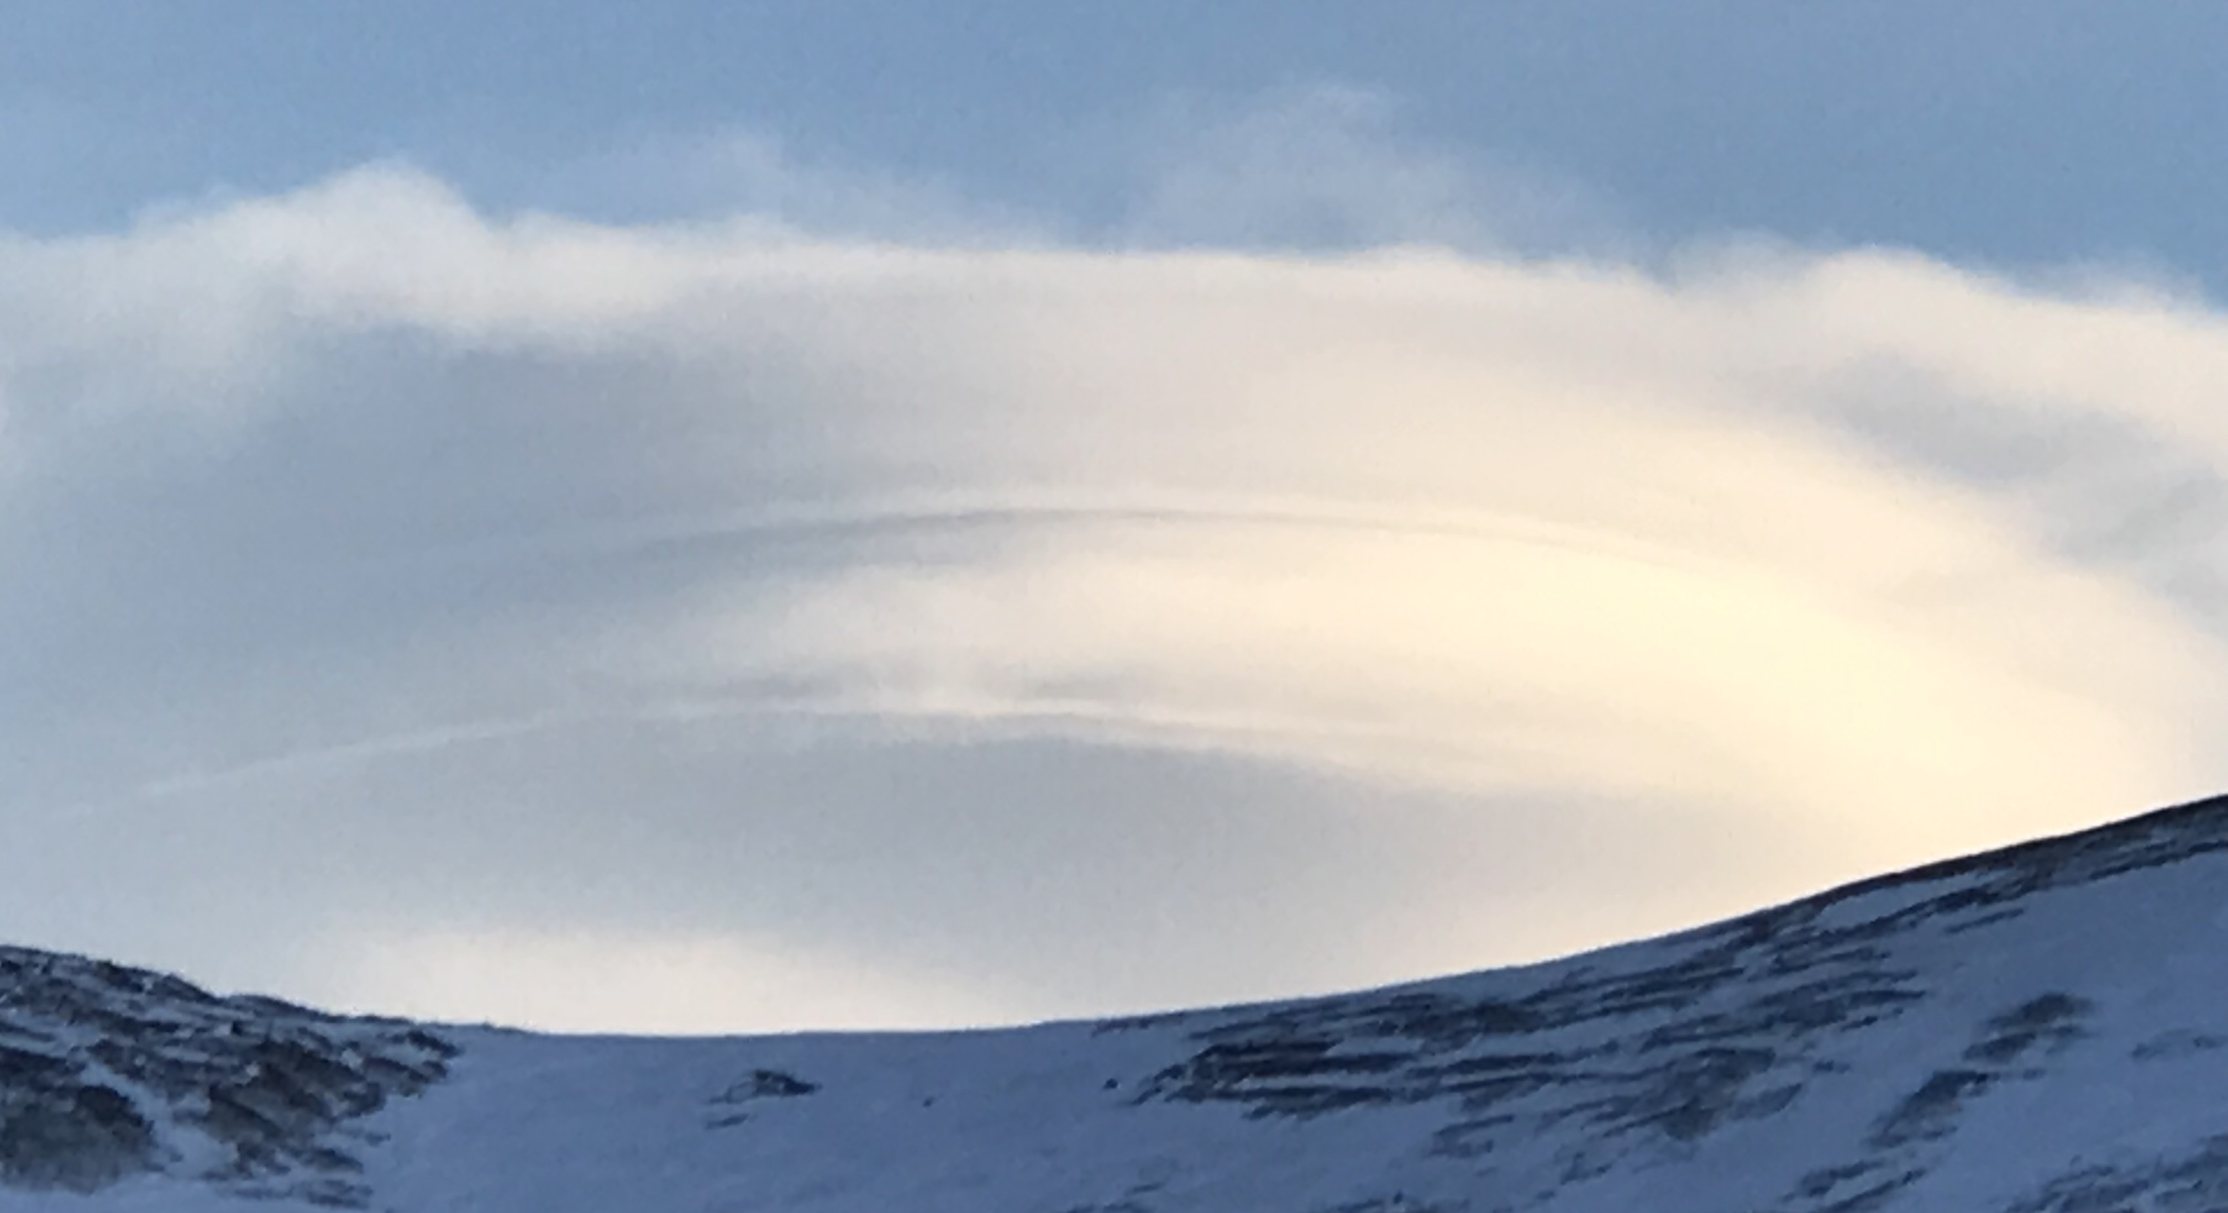
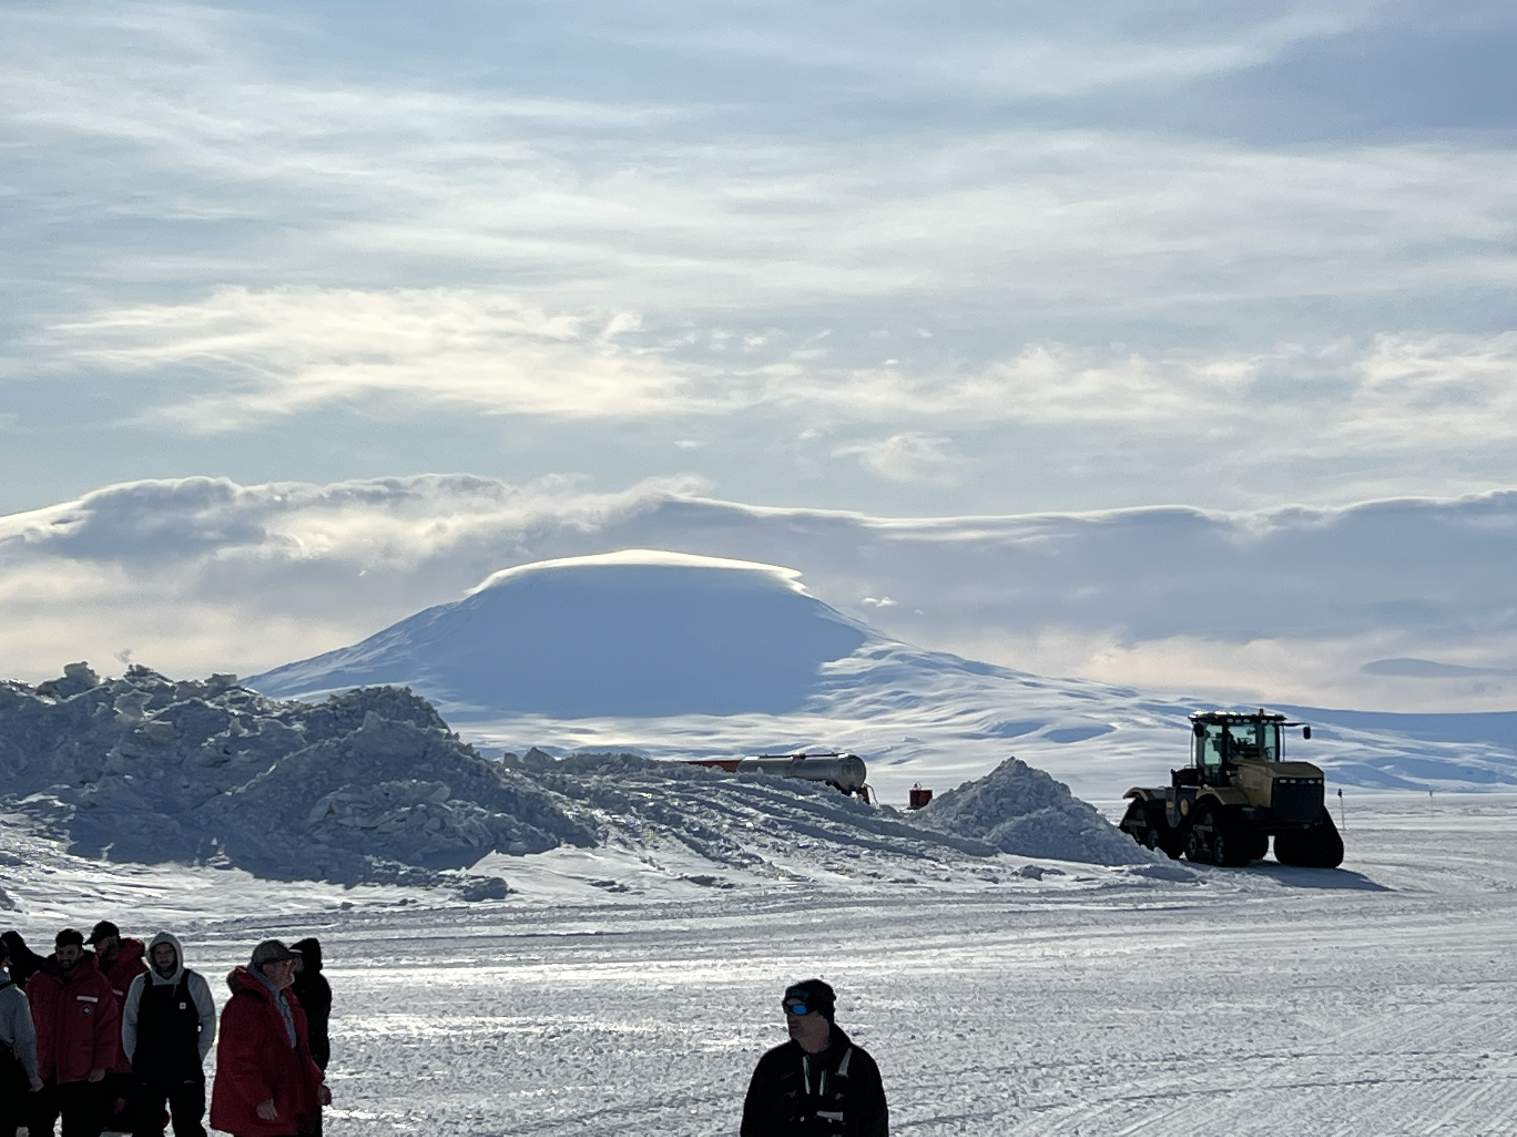
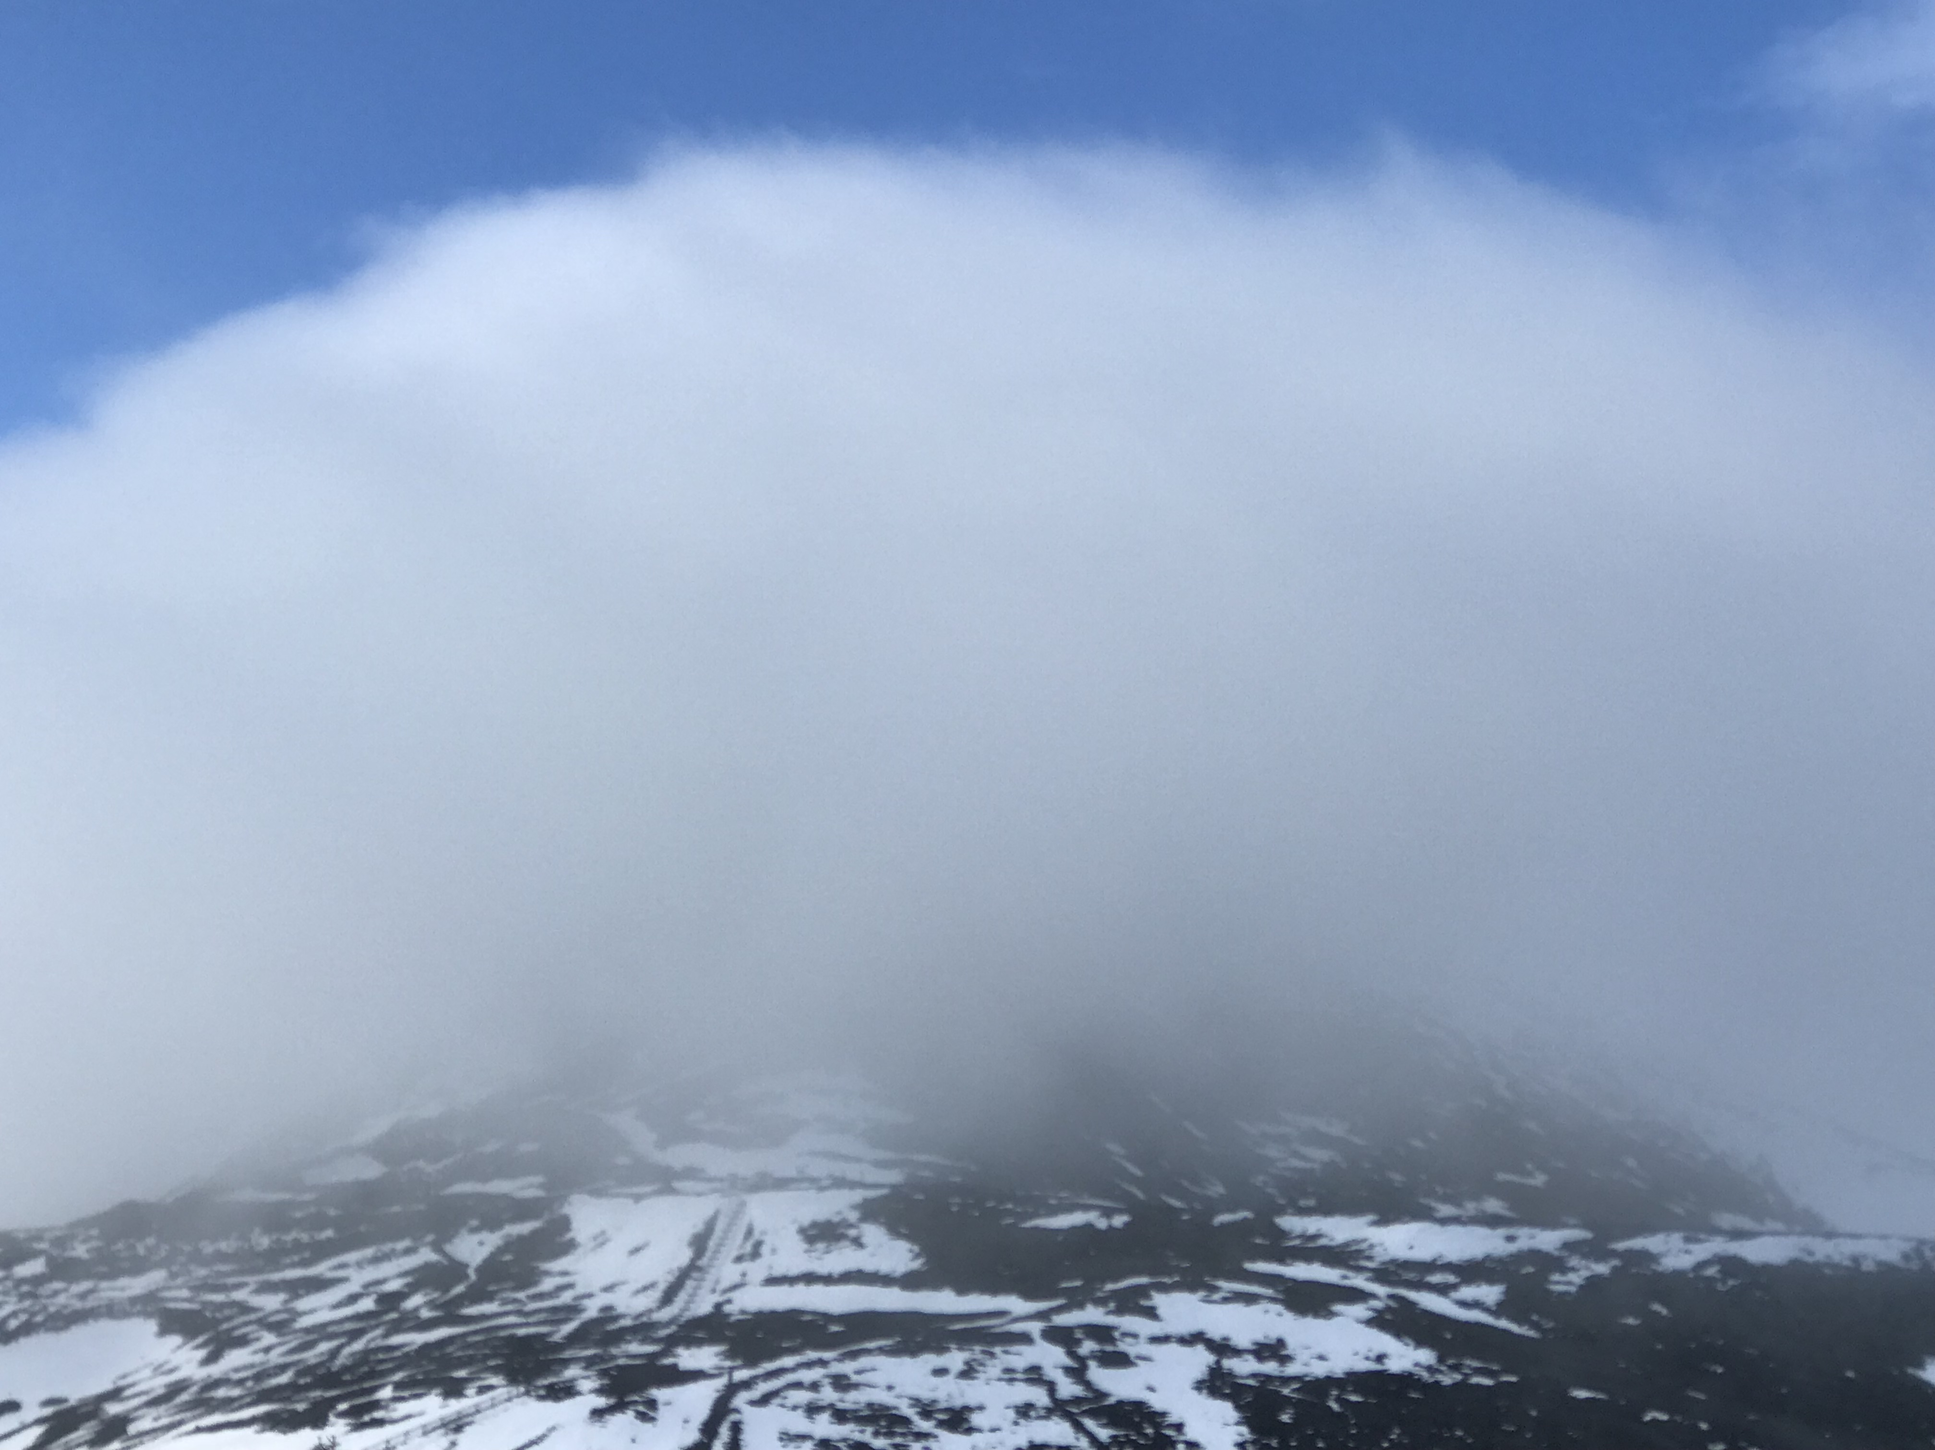
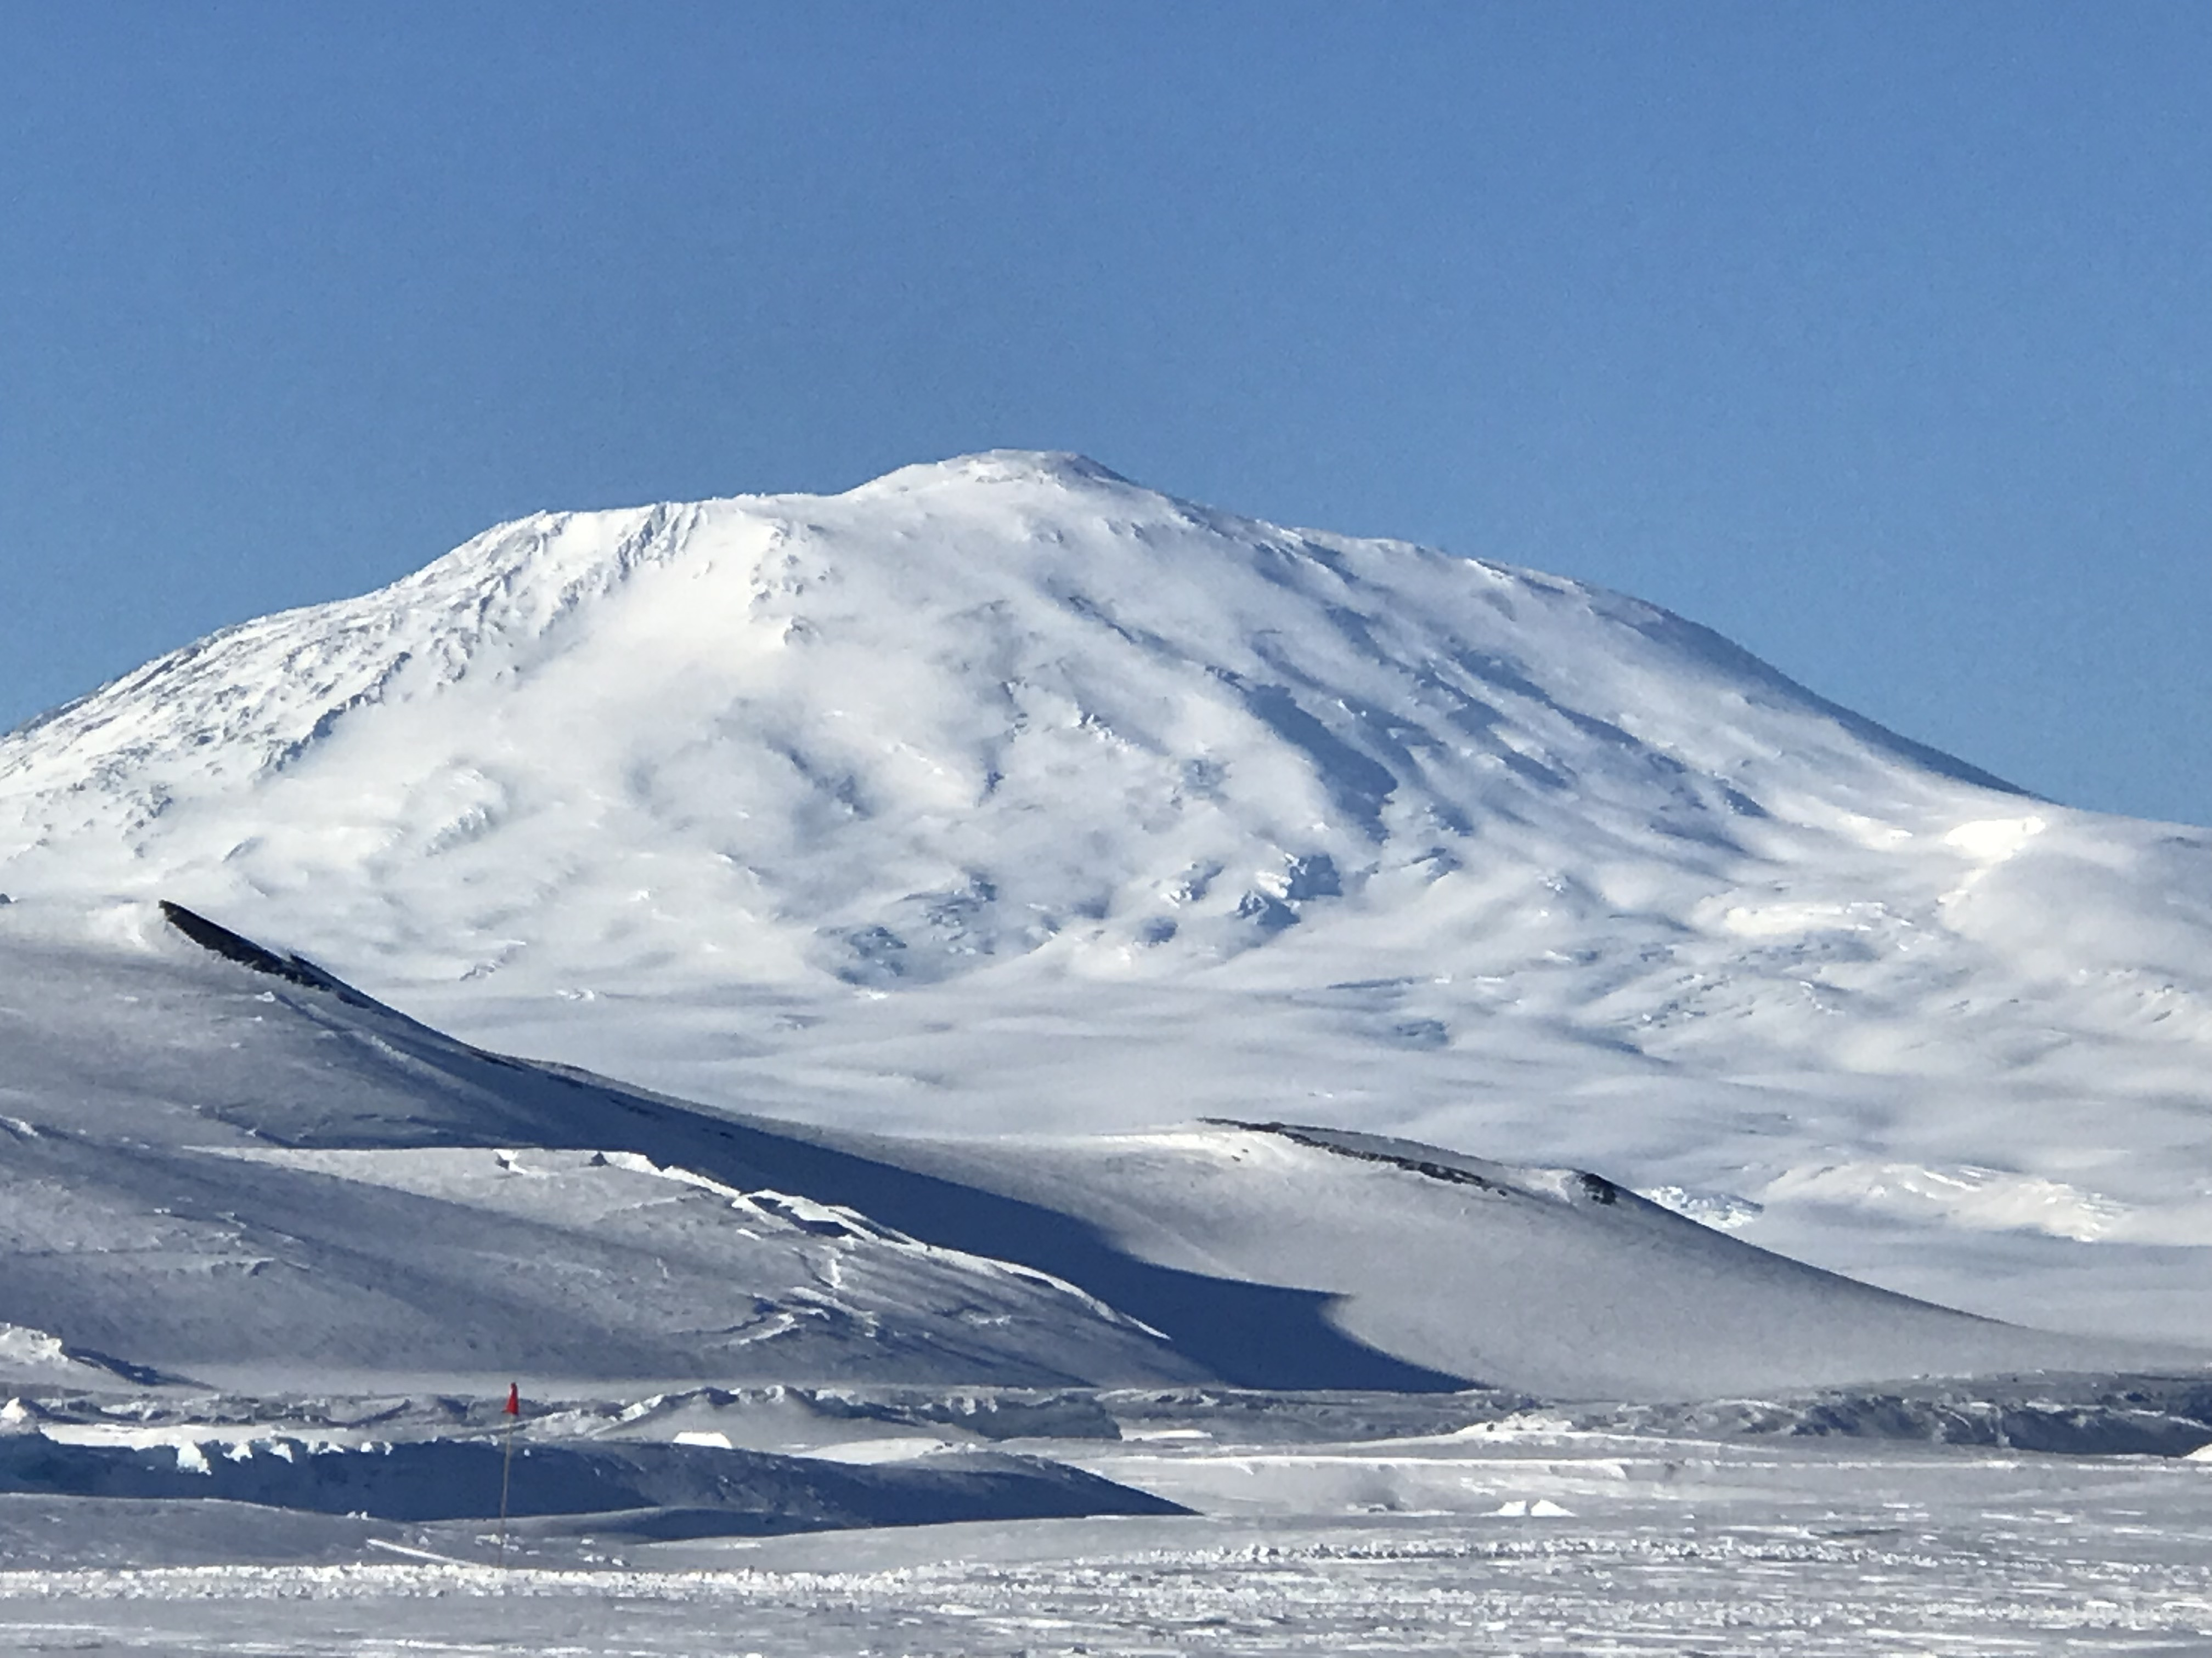
QUESTIONS?

Slide 23
References
All composite images provided by the NOAA Physical Sciences Laboratory, Boulder Colorado accessed 12 May 2023, https://psl.noaa.gov
Draxle, R.R. and G. D. Rolph, 2003: HYSPLIT (Hybrid Single-Particle Lagrangian Integrated Trajectory). National Oceanic and Atmospheric Administration (NOAA)/Air Resources Laboratory (ARL), Silver Spring, MD, accessed 12 May 2023, https://www.ready.noaa.gov/hypub-bin/trajtype.pl.
Manning, K. and Powers, J., 2001: All horizontal resolution output (png) from 00 UTC 19 February 2023, 00 UTC 7 MAR 2023, 00 UTC 8 MAR 2023, and 00 UTC 10 MAR 2023, runs of Antarctic WRF Mesoscale Prediction System (AMPS). NCAR, made available to author for download on 8 May 2023.
Naval Information Warfare Center Atlantic (NIWC): Antarctic Weather Forecasting Handbook OPSEA 22-23, NIWC Polar Programs IPT, North Charleston, SC, 97 pp.
Sun, WY., Sun, O.M. Bernoulli equation and flow over a mountain. Geosci. Lett. 2, 7 (2015). https://doi.org/10.1186/s40562-015-0024-1

