Slide 1

Climate Change and Variability in the East Antarctic Icescape
Ryan Eagan^{1,} Jack Stone^{2,} Dana Veron^{3,} Tracy DeLiberty⁴
¹ reagan@udel.edu, University of Delaware, ² University of Delaware, The Pennsylvania State University, ³ dveron@udel.edu, University of Delaware, ⁴ University of Delaware

Slide 2
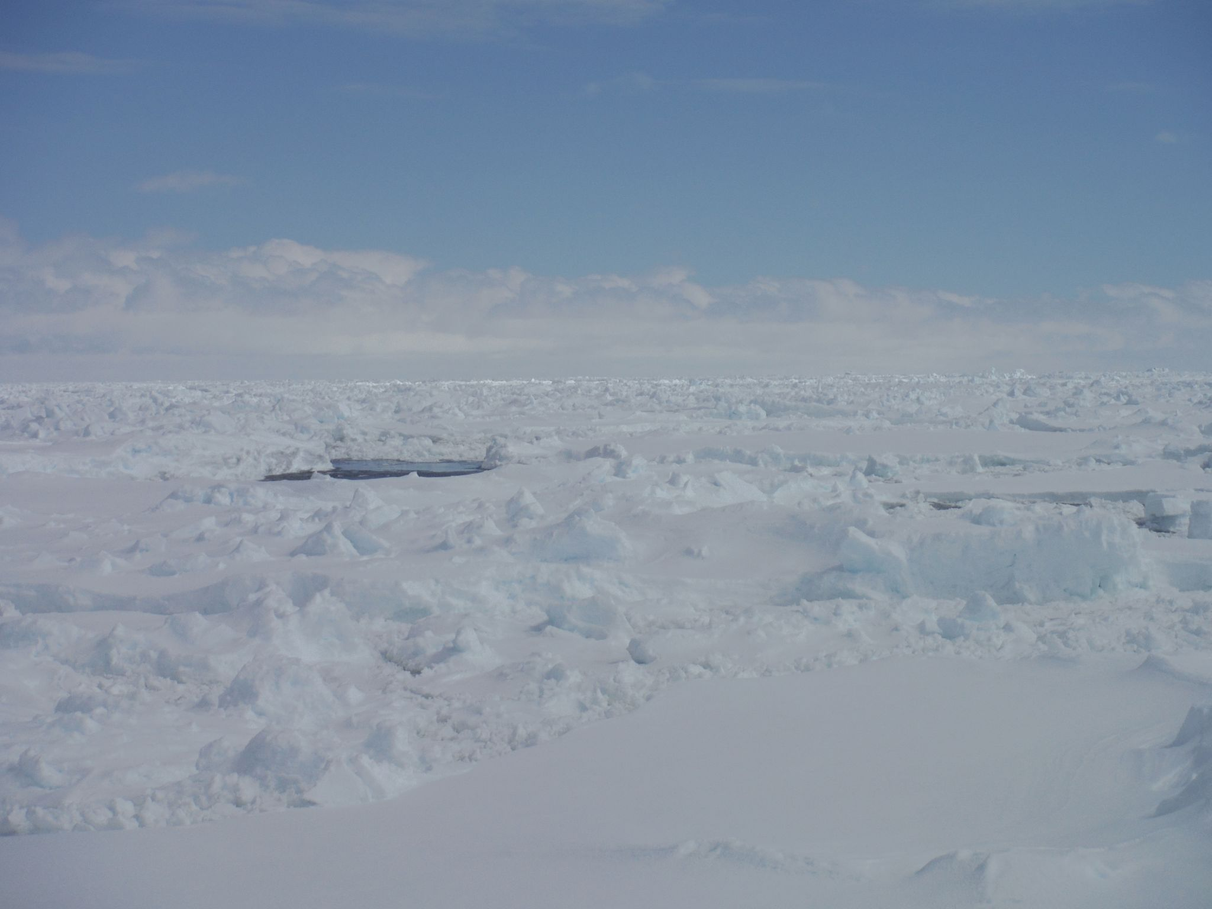
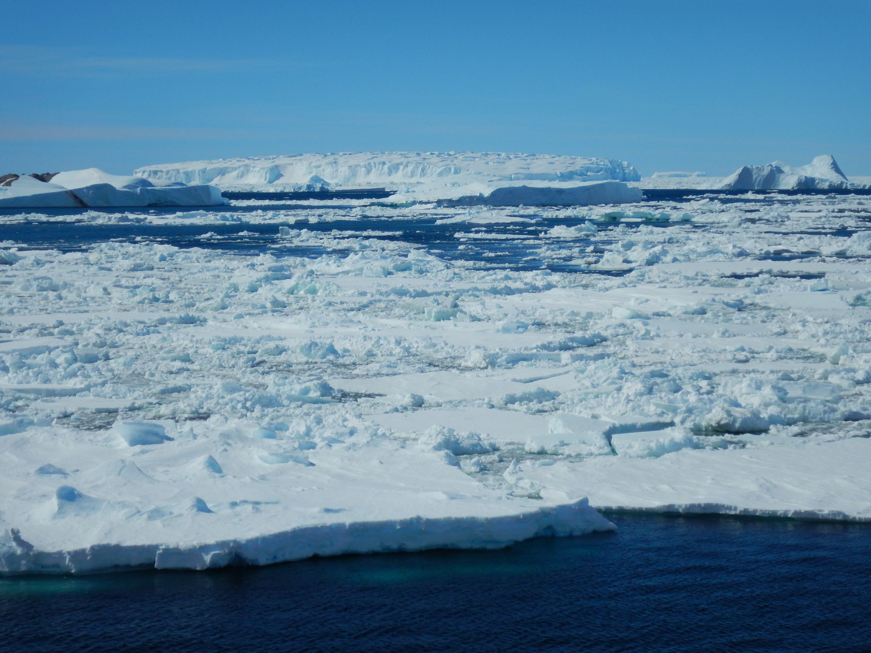
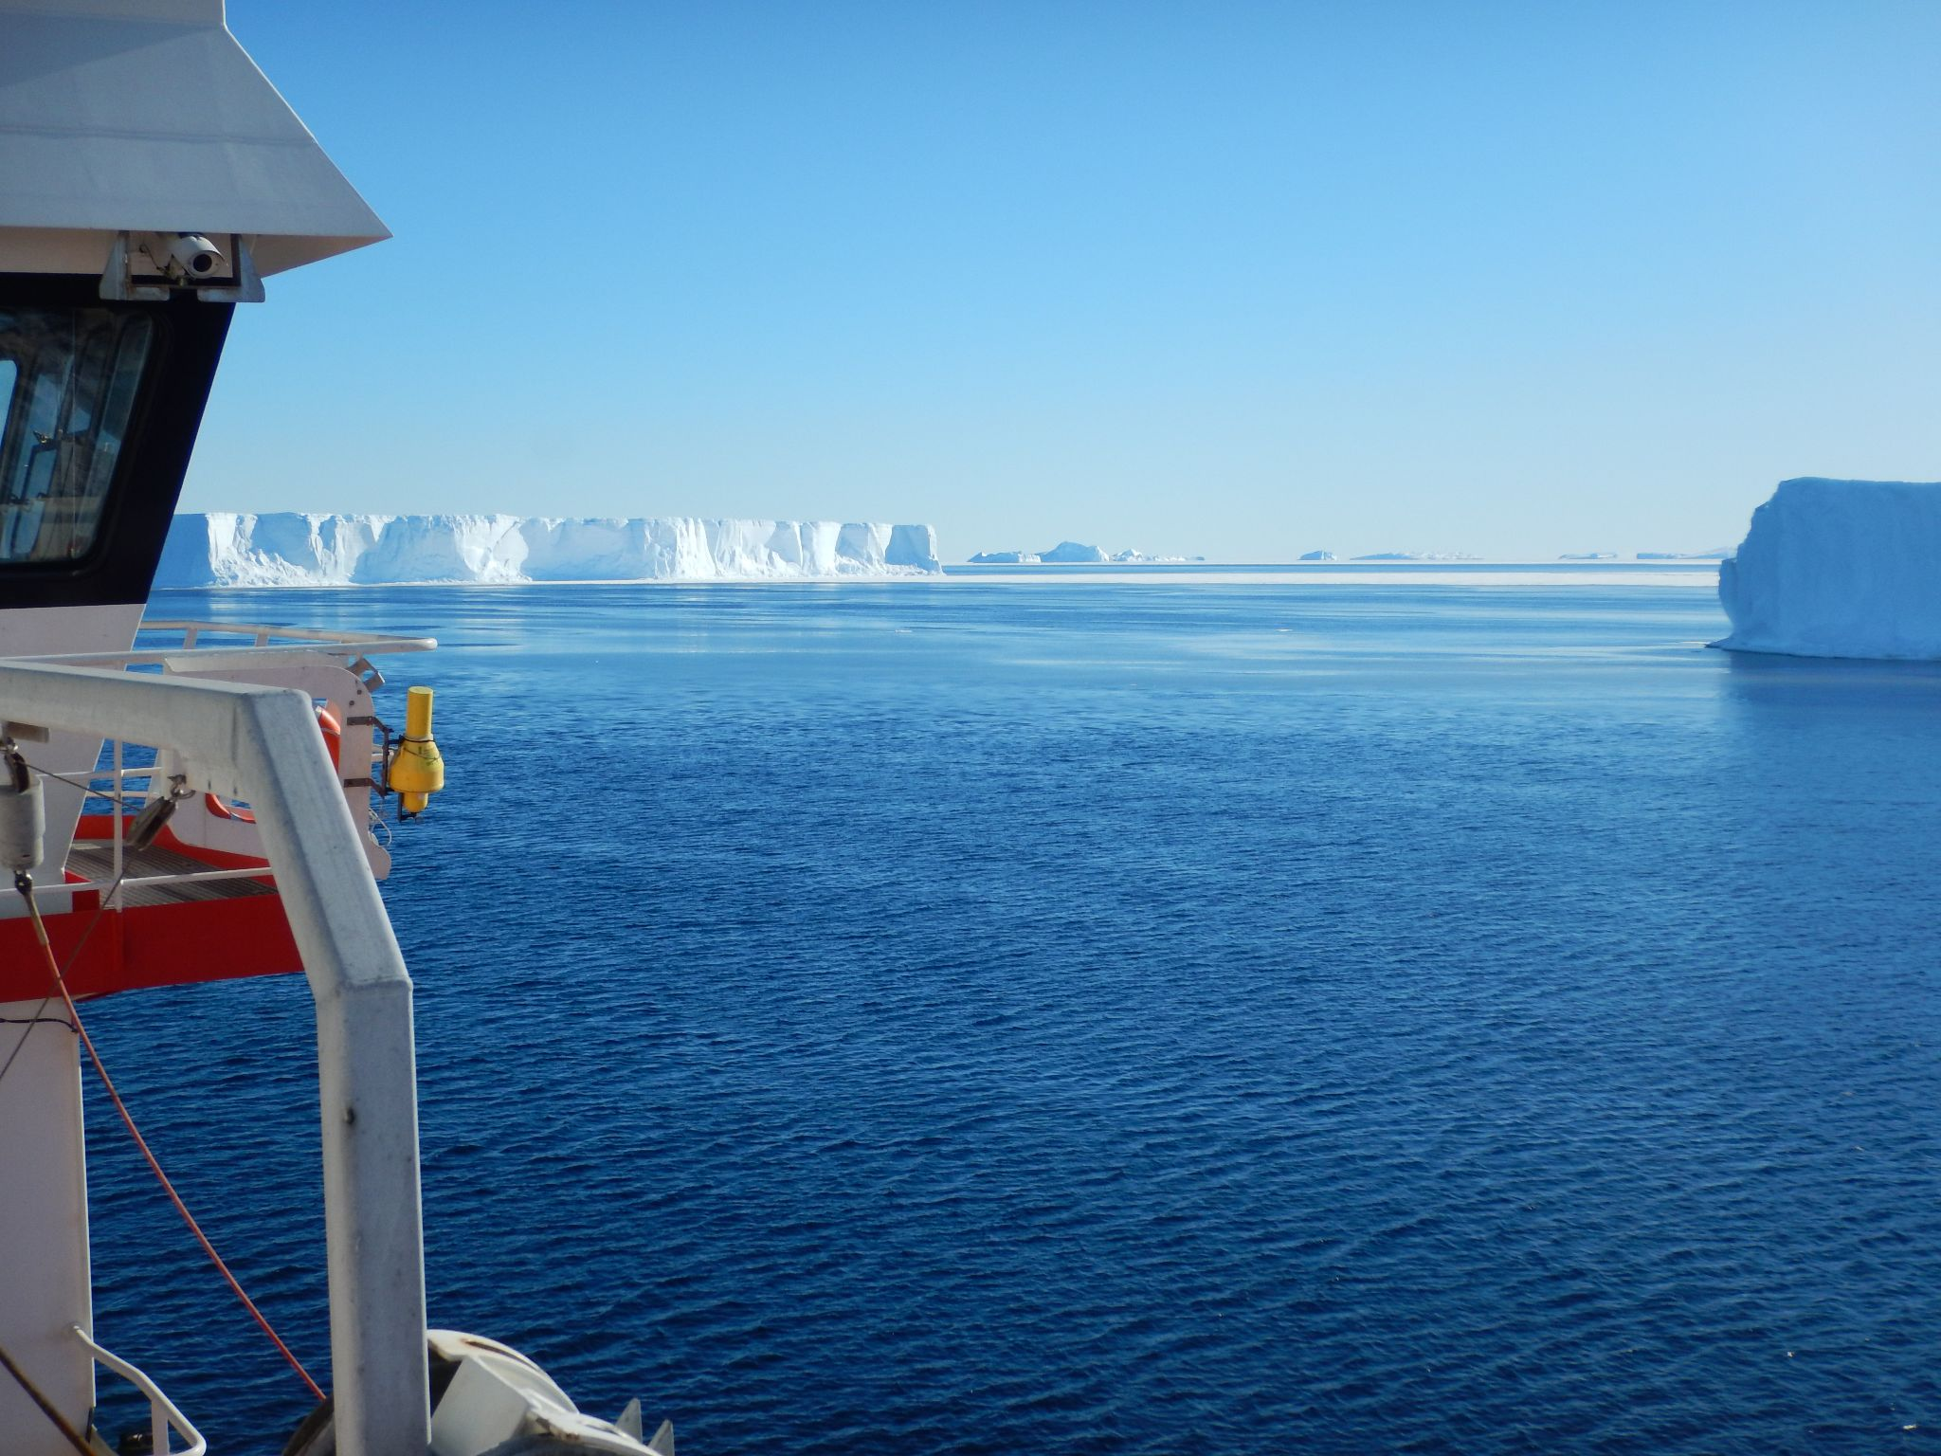
2016
2018
2020
Photographs taken of the sea ice conditions near Dumont d’Urville station in the summer seasons, from left to right, of 2016-2017, 2018-2019, and 2020-2021 (Photo credit: D. Veron).
If Antarctica were music it would be Mozart. Art, and it would be Michelangelo. Literature, and it would be Shakespeare. And yet it is something even greater; the only place on earth that is still as it should be. May we never tame it. – Andrew Denton
Notes:
Dana traveled to DDU 16,18,20 – just off shore of DDU, taken at same time of year
significant change in extent
prior to to 2016, consistent, now 2020 is the norm – is this a signal of something larger?

Slide 3
Motivation
Objectives
Sea ice in the Dumont d’Urville Sea (Smith et al. 2011)
  high seasonal & interannual variability
  out of phase with larger surrounding area
Identify forcing factors that may be early predictors for sea ice loss from climate change
  shelf water / circulation impacts
Understand how regional scaling impacts the association of atmospheric and oceanic variables on sea ice concentration and thickness.
Develop a better understanding of inter-seasonal and intra-seasonal variability.
Identify areas and modes of stable and variable sea ice.
Notes:
DDU sea ice is out of phase with the larger East Antarctic Coast
Drivers of variability are still a bit of an enigma, but atmospheric forcing seems to play a large role at the regional scale

Slide 4
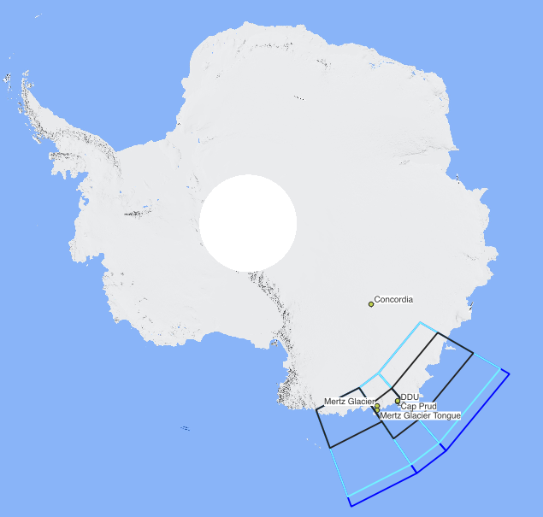
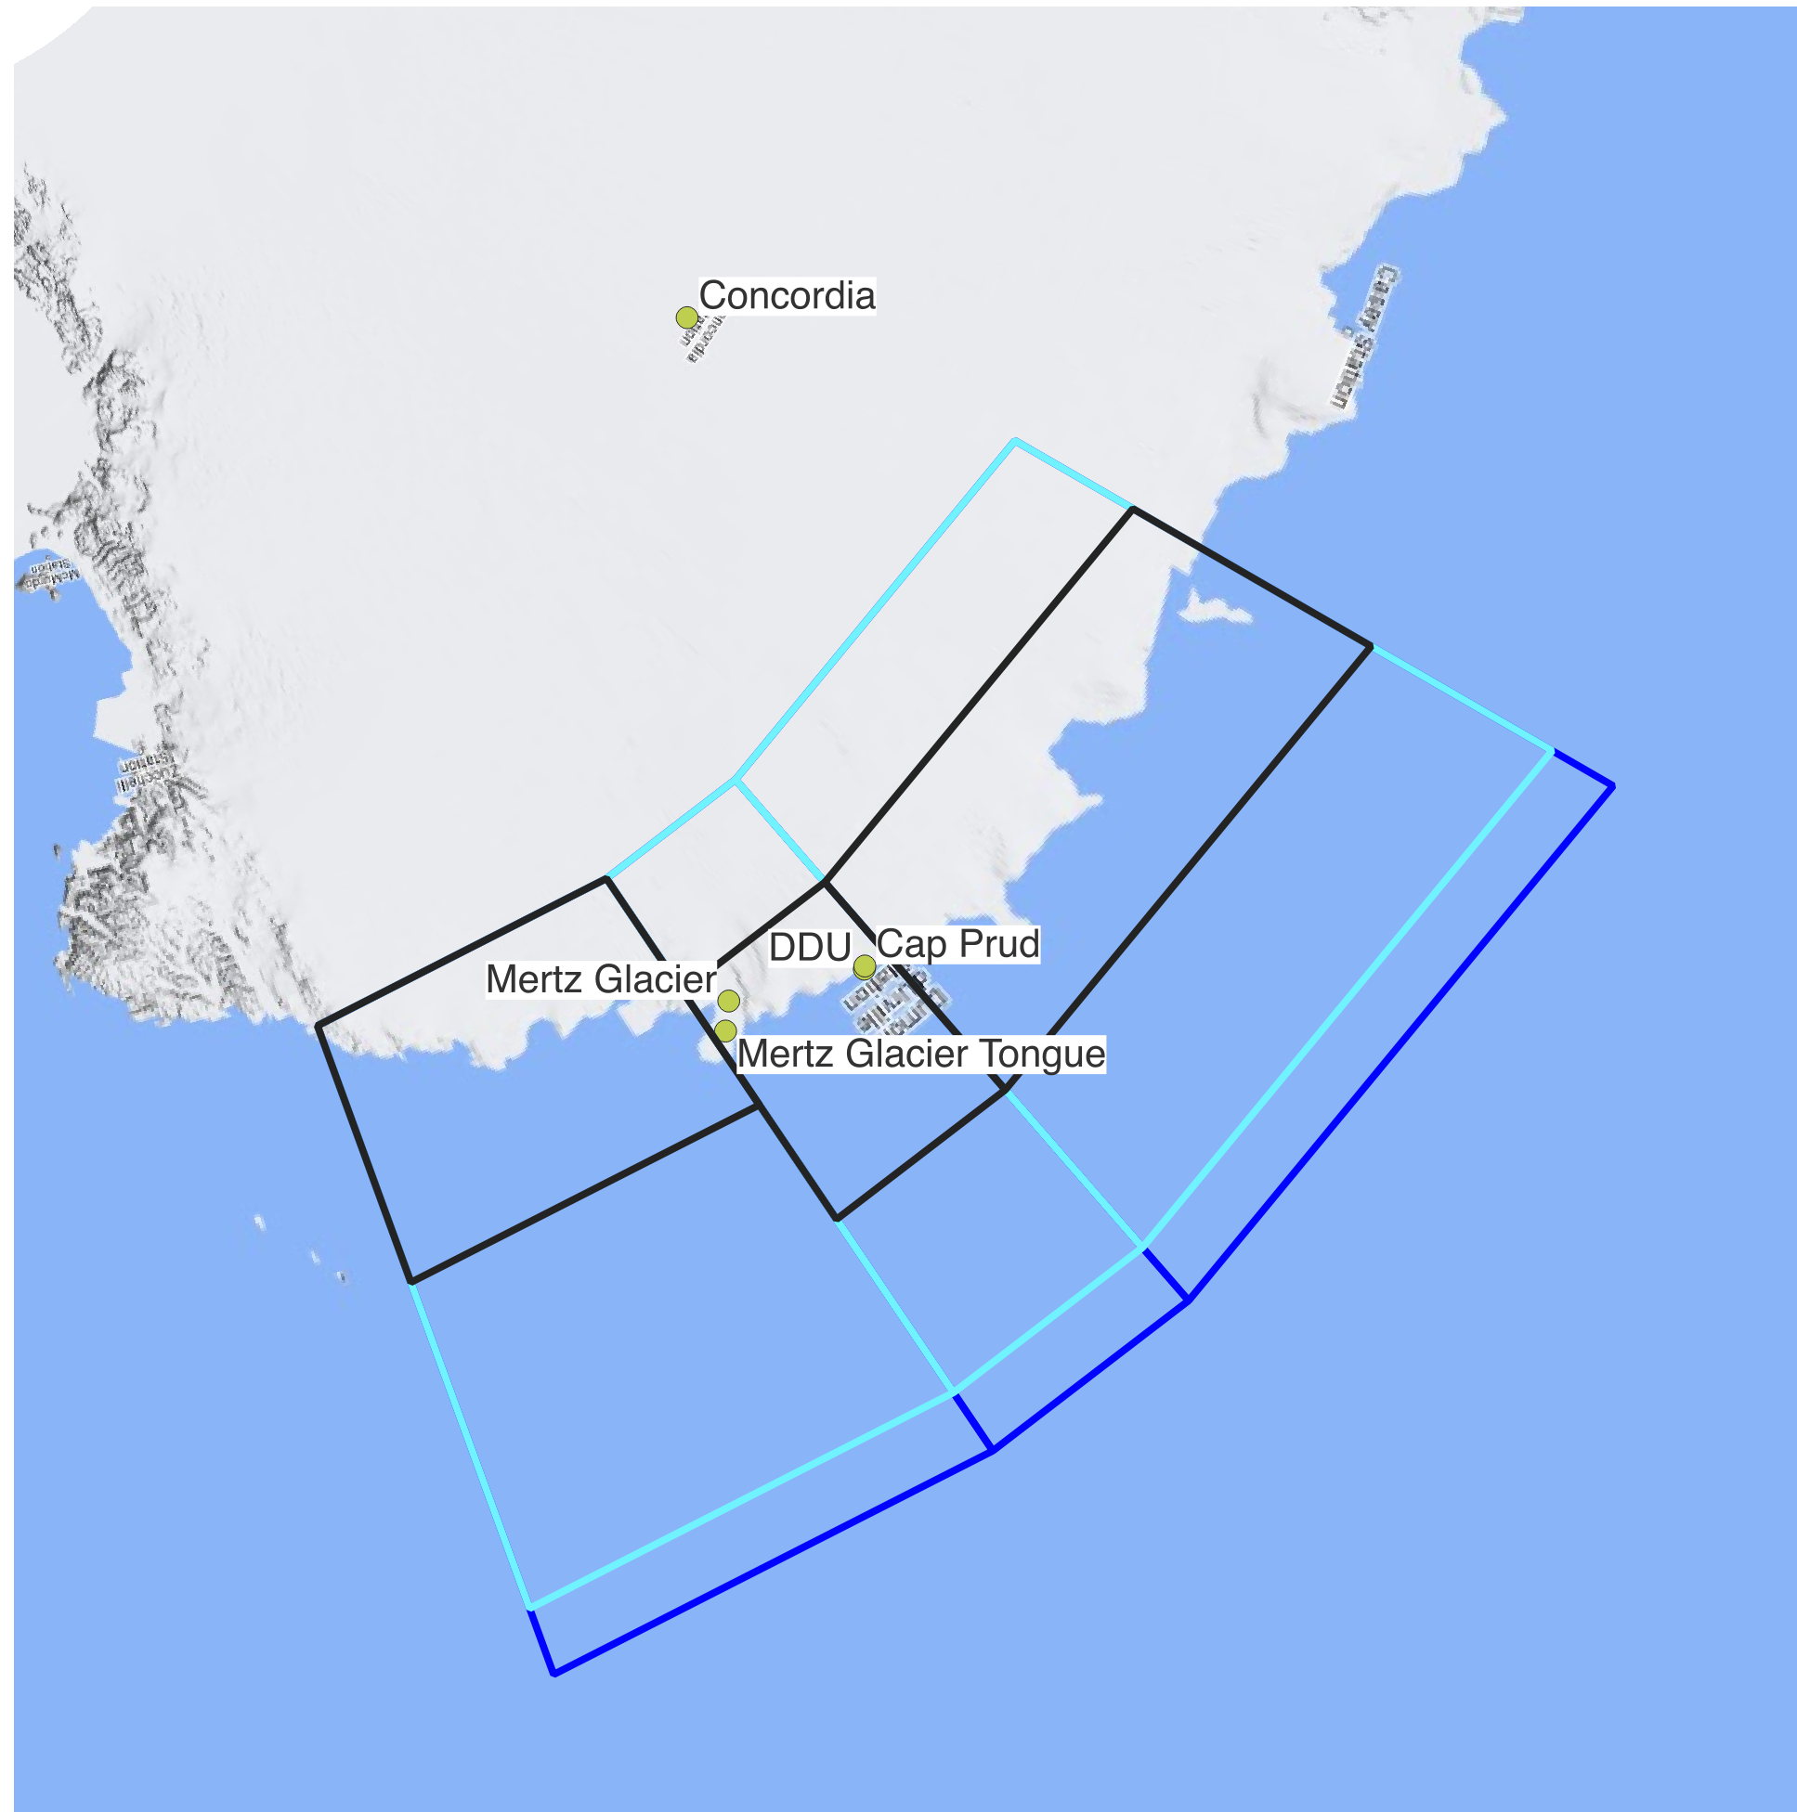
Study Area and Geographic Scales
Blue Outline
Full Study Area
(120 160E, -70 -60S)
Cyan Outline
Scale A Area
(120 160E, -70 -61S)
Black Outline
Scale B Area
(120 160E, -68 -64S for DDU/Mawson, -70 -66 Somov)
Mawson Sea
D’Urville Sea (DDU)
Somov Sea
Notes:
Latitudinal scaling of each area to understand regional to more local changes in forcings
DDU 139 – 146E
Original study area mirrors smith area from the smith paper, A GIS approach to estimating interannual variability in the Dumont d’Urville Sea near Terre Adelie from 2003 - 2009

Slide 5
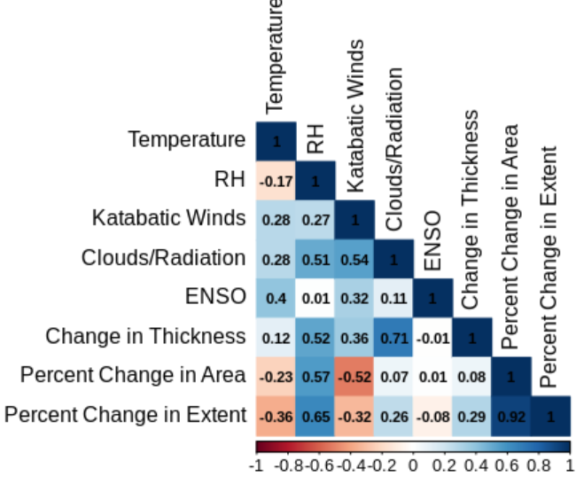
Initial Work
MeteoFrance/GLACIOCLIM in-situ data for atmospheric variables, NIC polygon data for sea ice, NOAA for ENSO-index
Weekly means for seasons from 2005-2019 correlated with sea ice thickness and percent change in area.
Strong negative relationship with katabatic winds at local scale, diminished at regional scale.
Notes:
In-situ observations were correlated with the full study area ice extent/concentration/thickness – order of magnitude in scale prompts a more thorough analysis using reanalysis
Identifies areas for further exploration/analysis
Preliminary look at local forcing using as much in-situ data as possible
Specify ice thickness

Slide 6
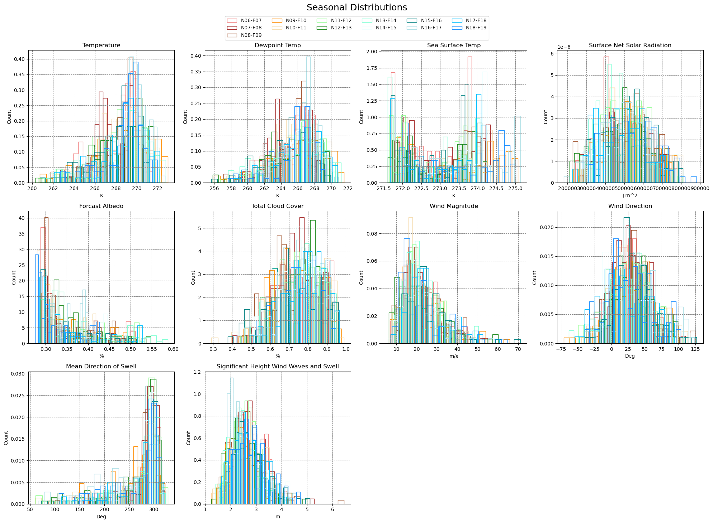
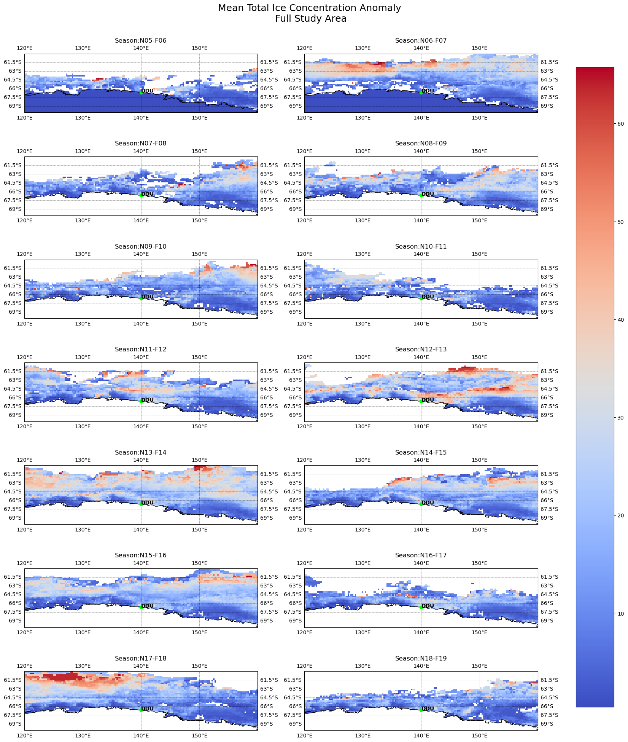
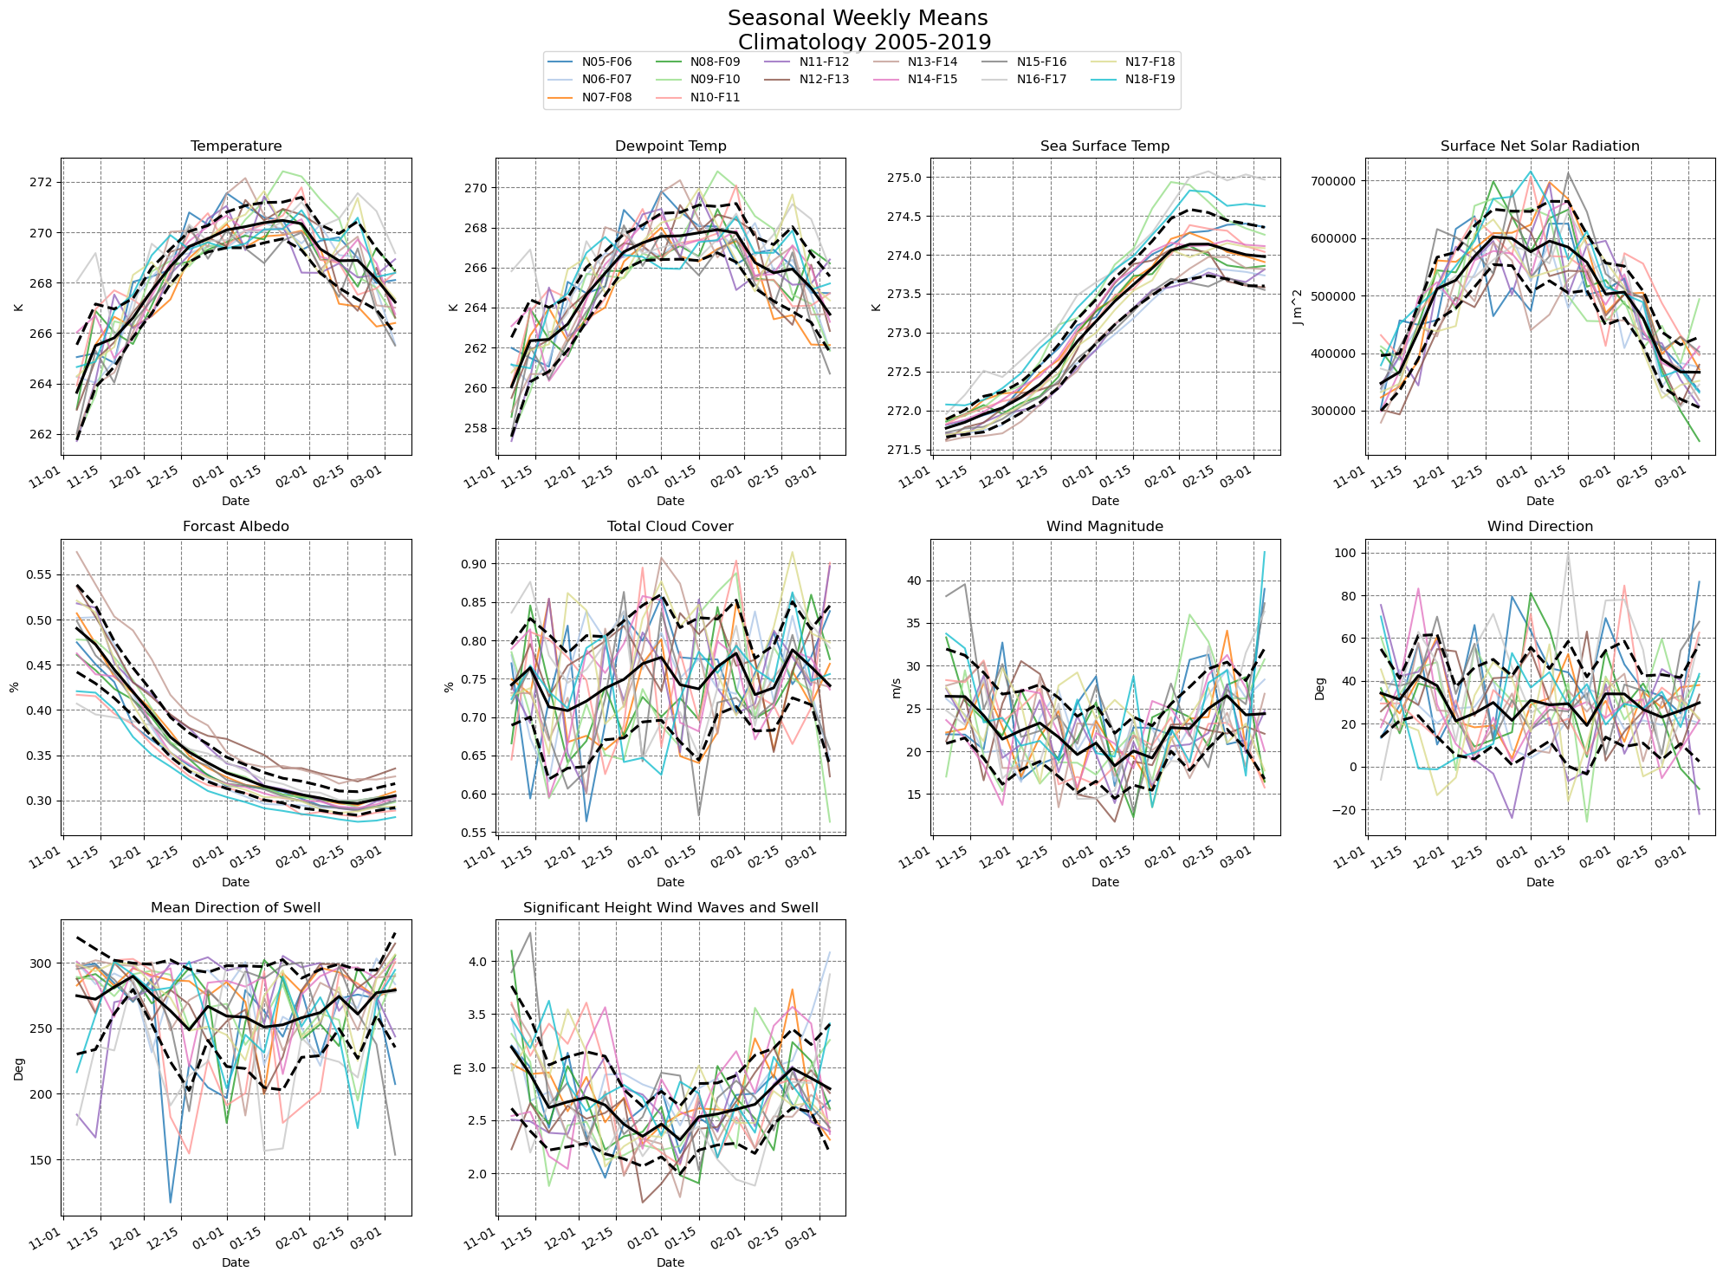
Regional Analysis
Summer/ablation season (Nov 1-Feb 28)
Work in Progress
All results are preliminary
ERA5 Reanalysis Data - European Centre for Medium-Range Weather Forecasts (ECMWF)
  0.25 x 0.25 degree, 31-km grid resolution
  hourly (0h,6h,12h,18h)
Gridded Ice Data – National Snow and Ice Data Center
  10km x 10km
  bi-weekly
Notes:
Larger regional analysis of atmospheric and oceanographic variables using ERA5
ERA5 is really popular, shown to be a good representation of polar region

Slide 7
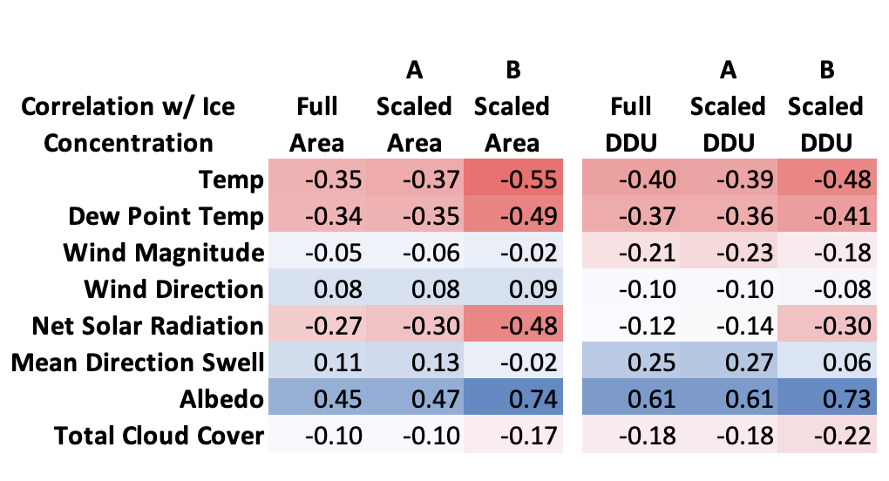
Correlation and Geographic Scale
Mawson Sea
D’Urville Sea (DDU)
Somov Sea
Pearson correlation coefficients for select atmospheric and oceanic variables with total max sea ice concentration for the entire study period over two spatial scales. Elementwise with no lag or shift applied.
Notes:
Daily means correlated with sea ice concentration for the full study area (120-160) and the DDU area 139 146E
Element wise, no lag or shift, pearson meathod correlation
Demonstrates a pattern of changes in magnitude of correlation across study area size - scale makes a difference

Slide 8
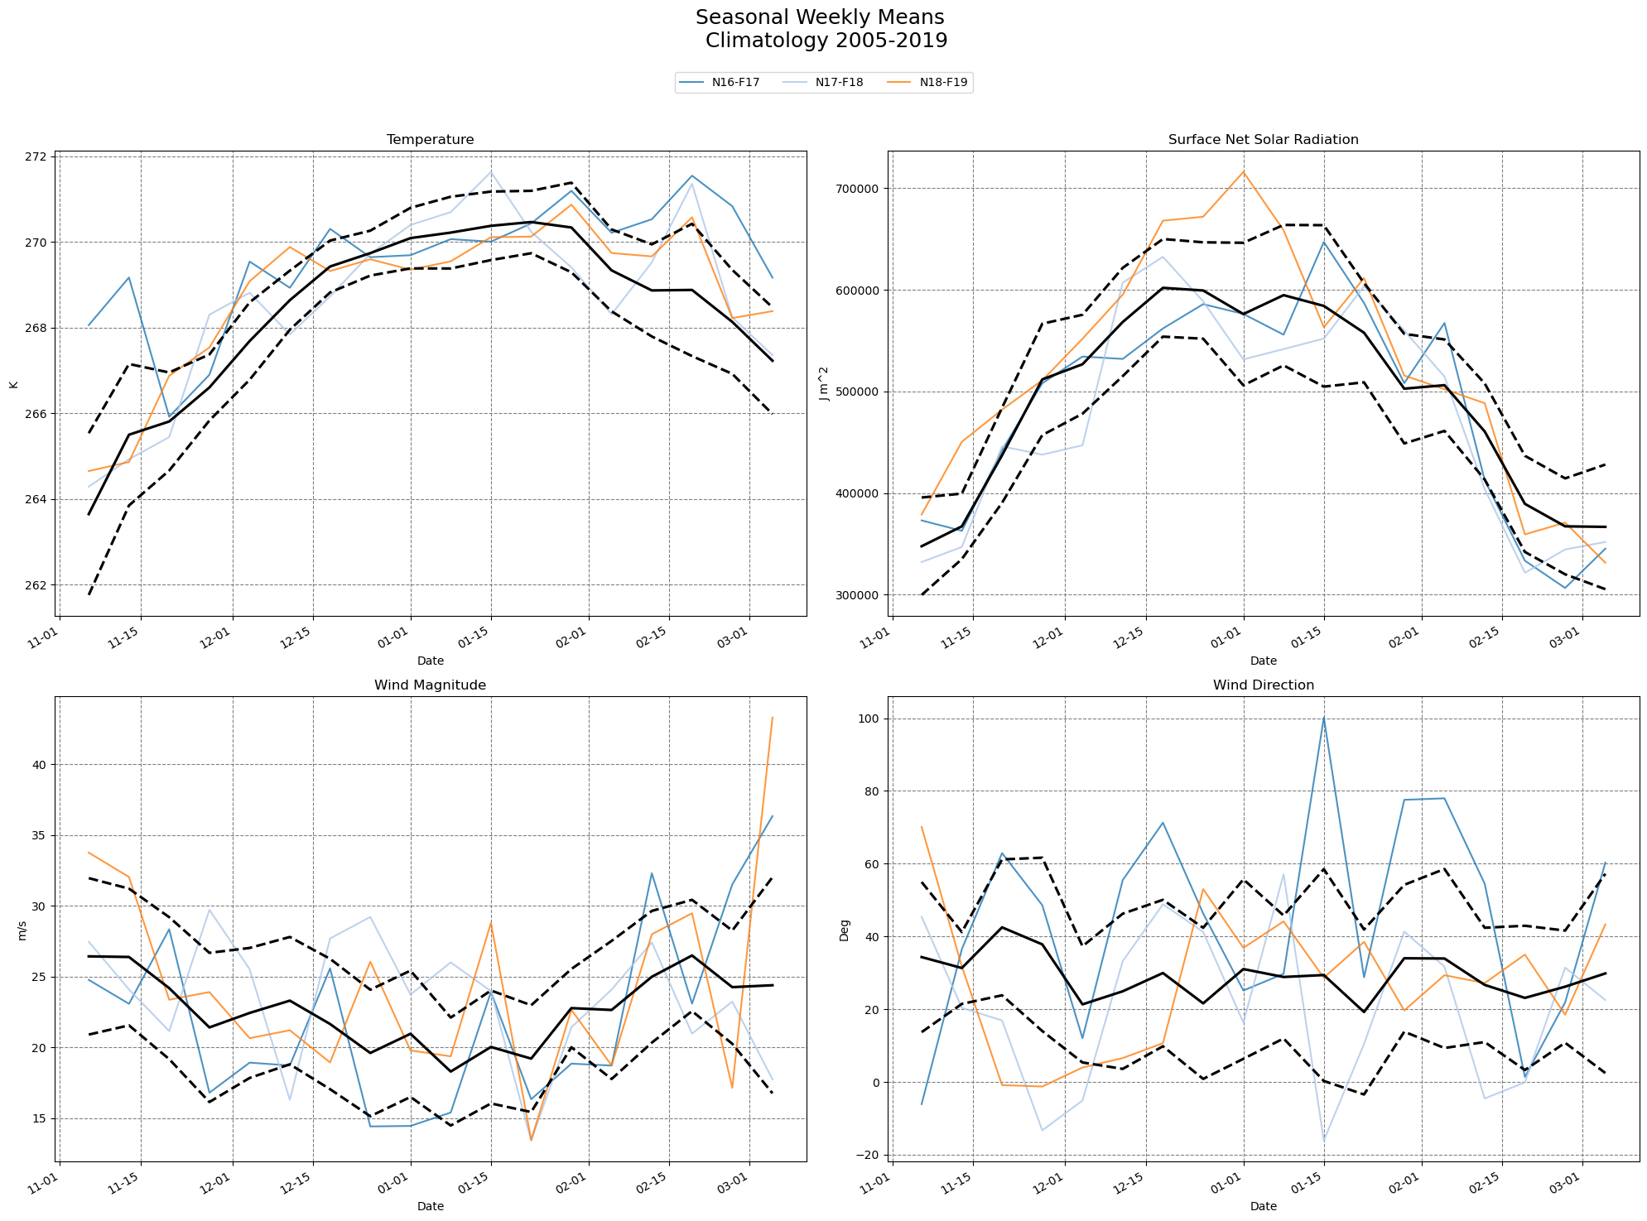
Climatology Variables
Notes:
ERA 5 Climate Variables – Weekly Averages
Weekly means for each season - select seasons respective of years where sea ice was minimal (16-19)
Tail end of seasons warmer
18-19 mid season peak in surface net solar radiation
2016 wind different than later two seasons, is this part of a larger change

Slide 9
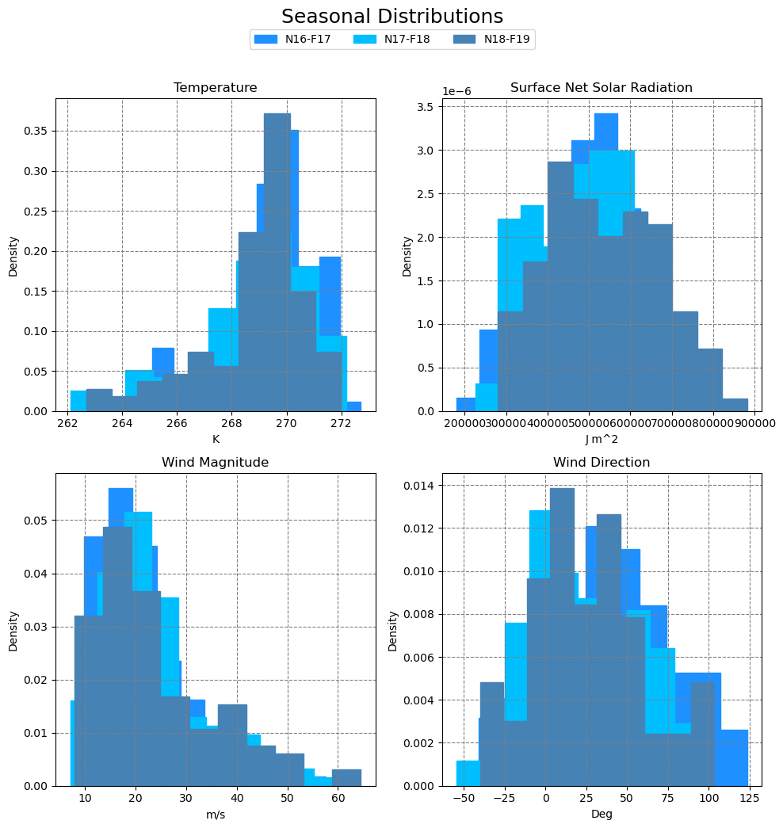
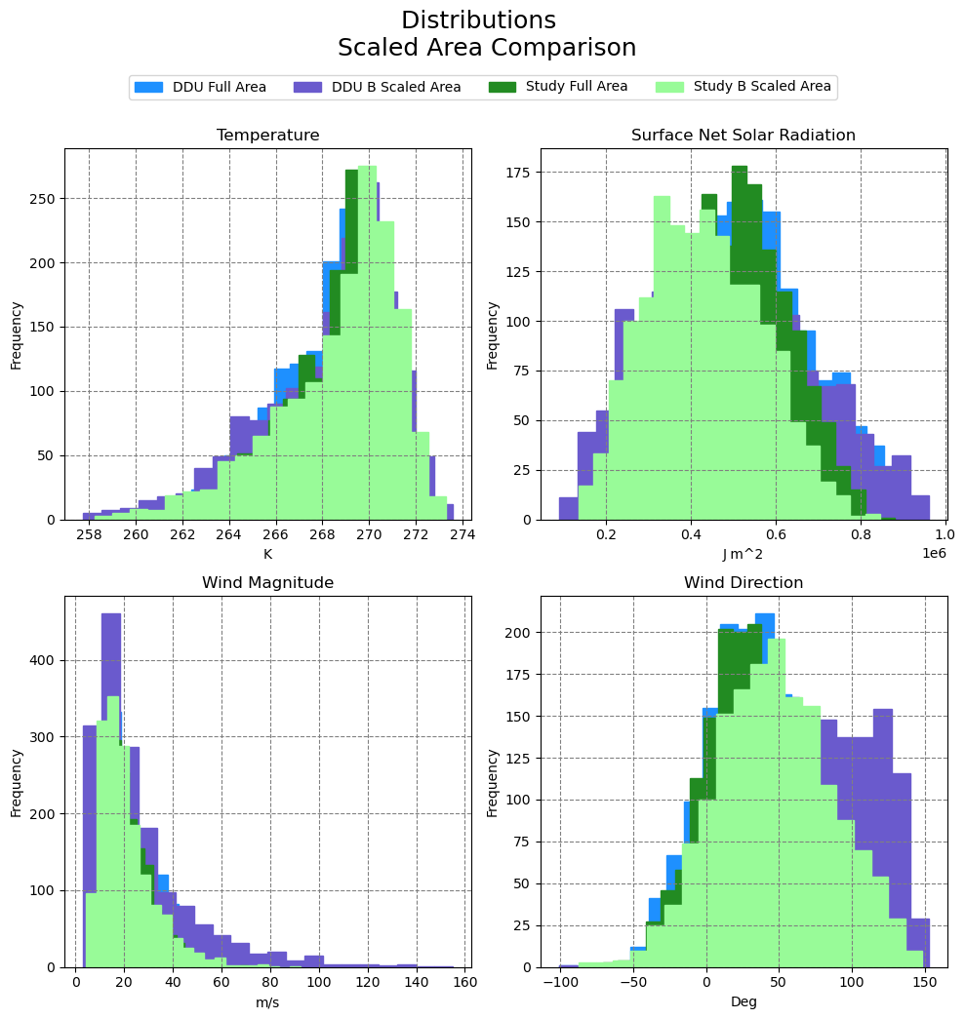
Seasonal and Scaling Distribution Comparison
Notes:
Surface Net Radiation shits
Wind Direction changes

Slide 10
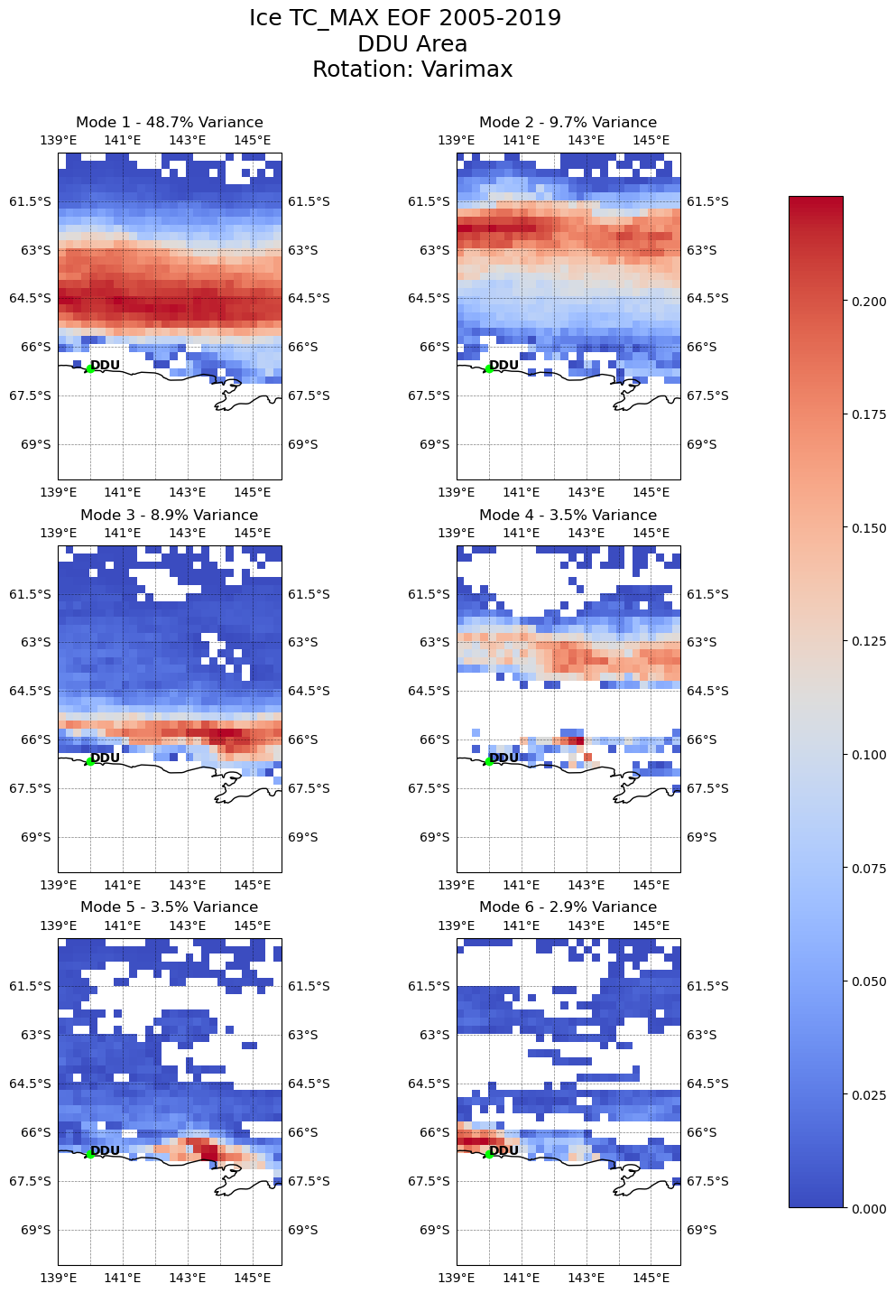
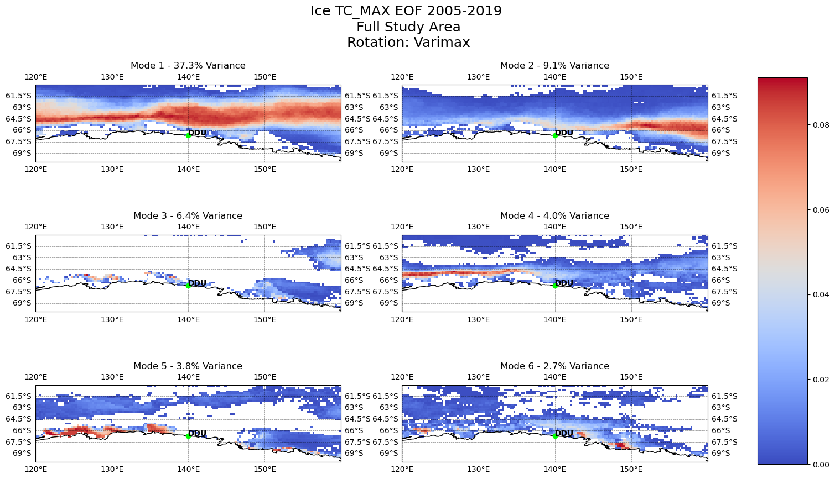
EOF Modes in Sea Ice Concentration
Notes:
EOF to help determine areas of variability and inform scaling
Each of these is its own analysis and not a zoomed in picture
We see the seasonal variability dominating the first and second mode, each contributing comparable percentages to the variability
Higher modes show some of the observed out of phase sea ice concentration right around DDU in the smaller geographic DDU area
Consistent modes of variability across scales will help identify the strongest signals for deeper analysis

Slide 11
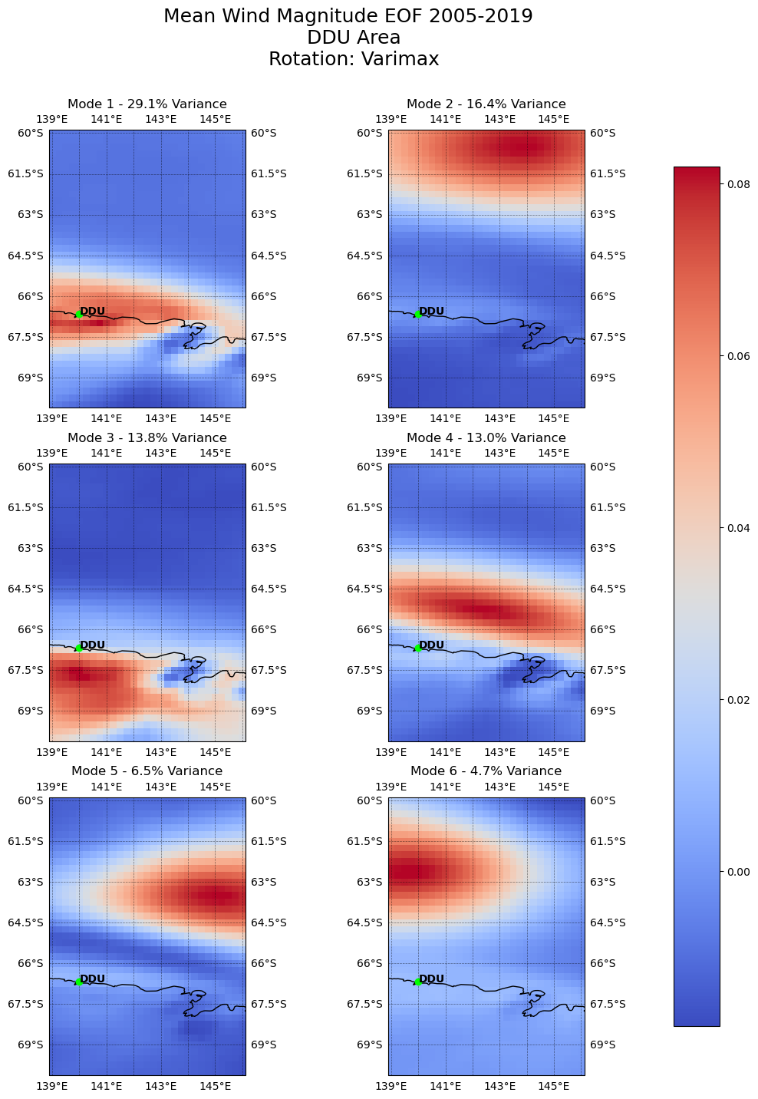
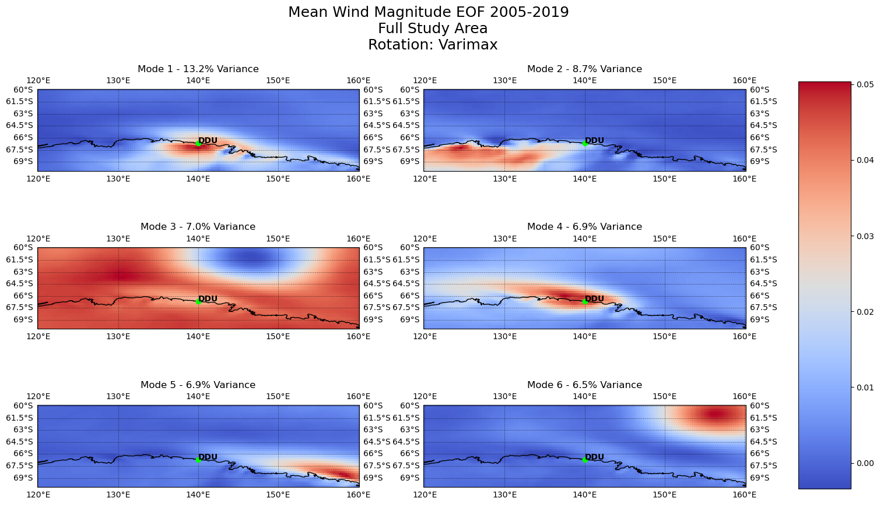
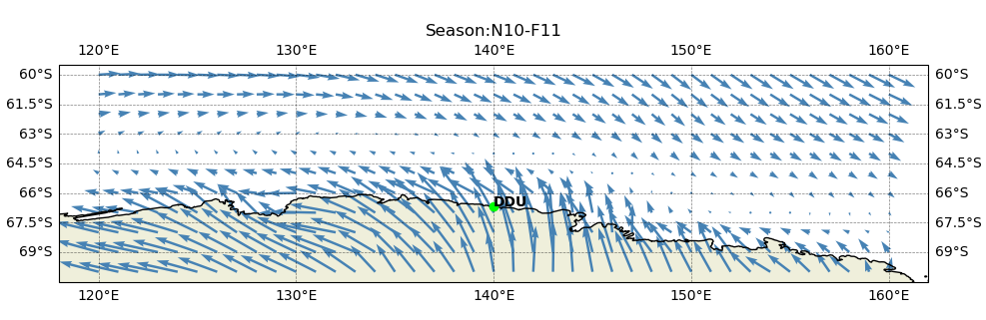
EOF Modes for Mean Wind Magnitude
Notes:
Katabatic winds around DDU are strong. Windiest place on Earth, at times reaching hurricane force.
They also contribute to sea ice formation and the driving away of sea ice (Wendler et al. 1997)
Variability at DDU dominants the modes
We can see the boundary between the katabatics and off shore westerlys
Interestingly, the boundary shifts between seasons

Slide 12
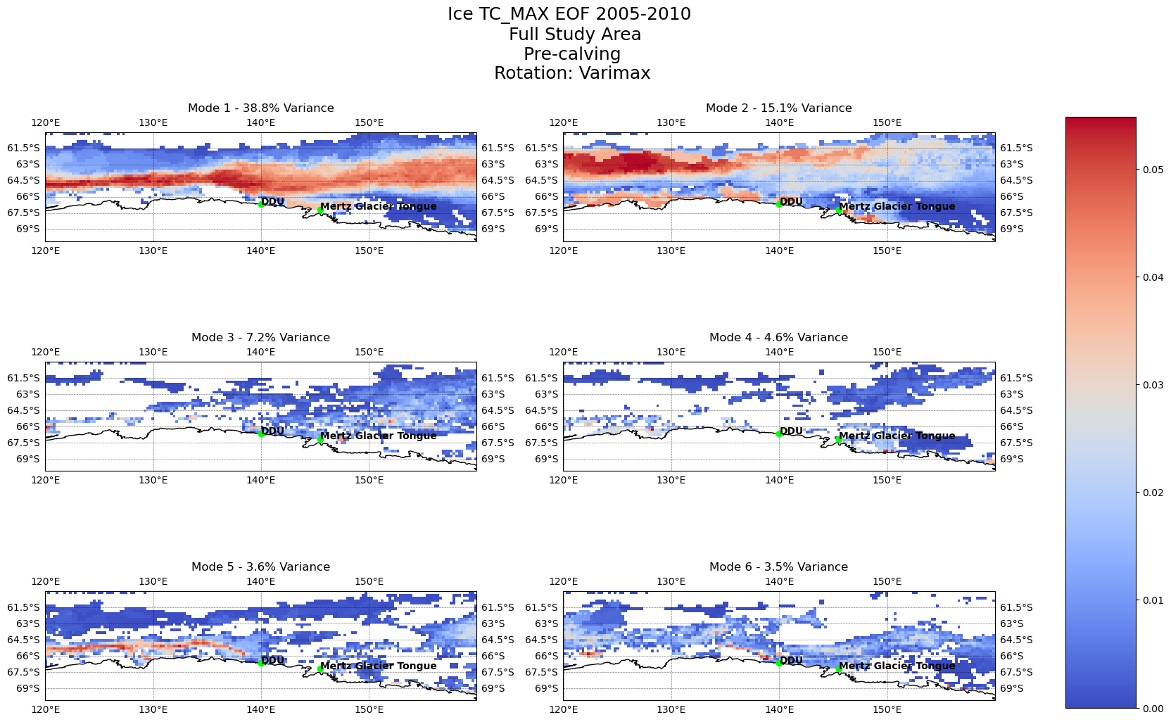
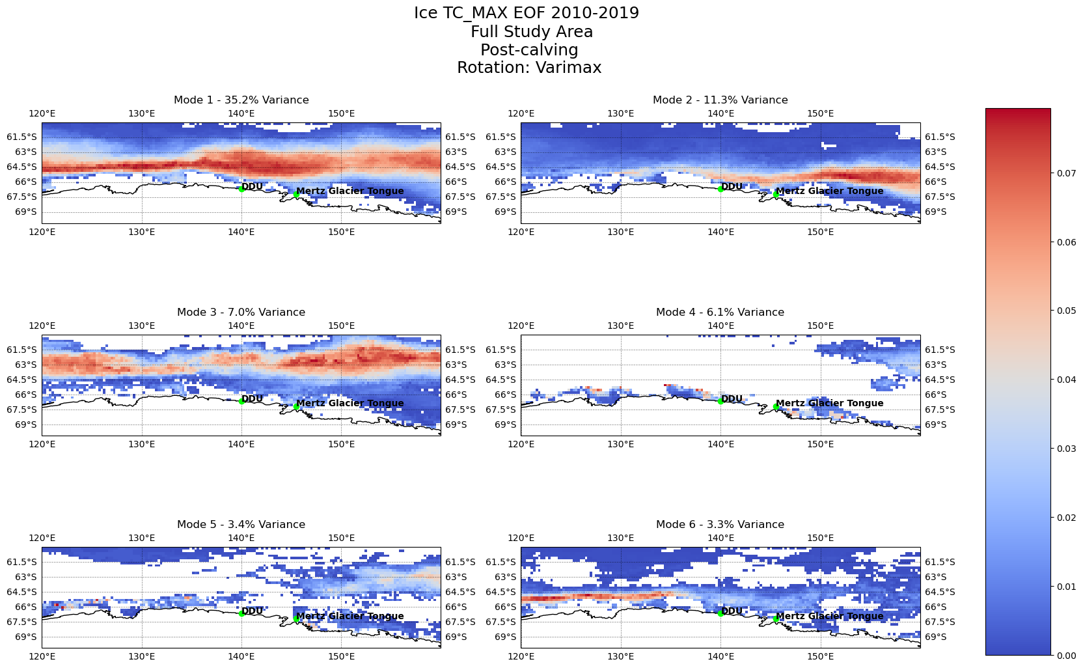
EOF Modes Pre and Post Mertz Tongue Calving
Notes:
Mertz area – Tamura et al. – demonstrated potential significant changes in sea ice production post calving of the Mertz Tongue
Pre calving, seasonal variation shows up in only two modes, but we also see some variability right along the coast
Post calving, seasonal variation dominants three modes and we don’t see as much variability along the coasts
Calving 2/12-13 2010

Slide 13
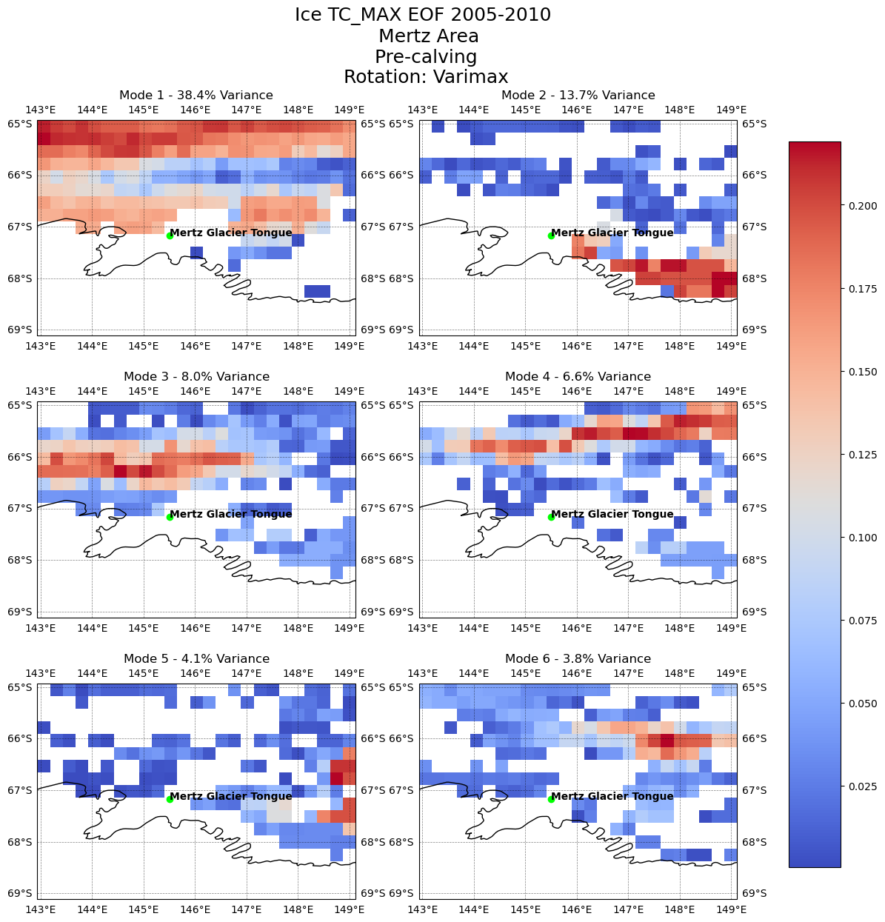
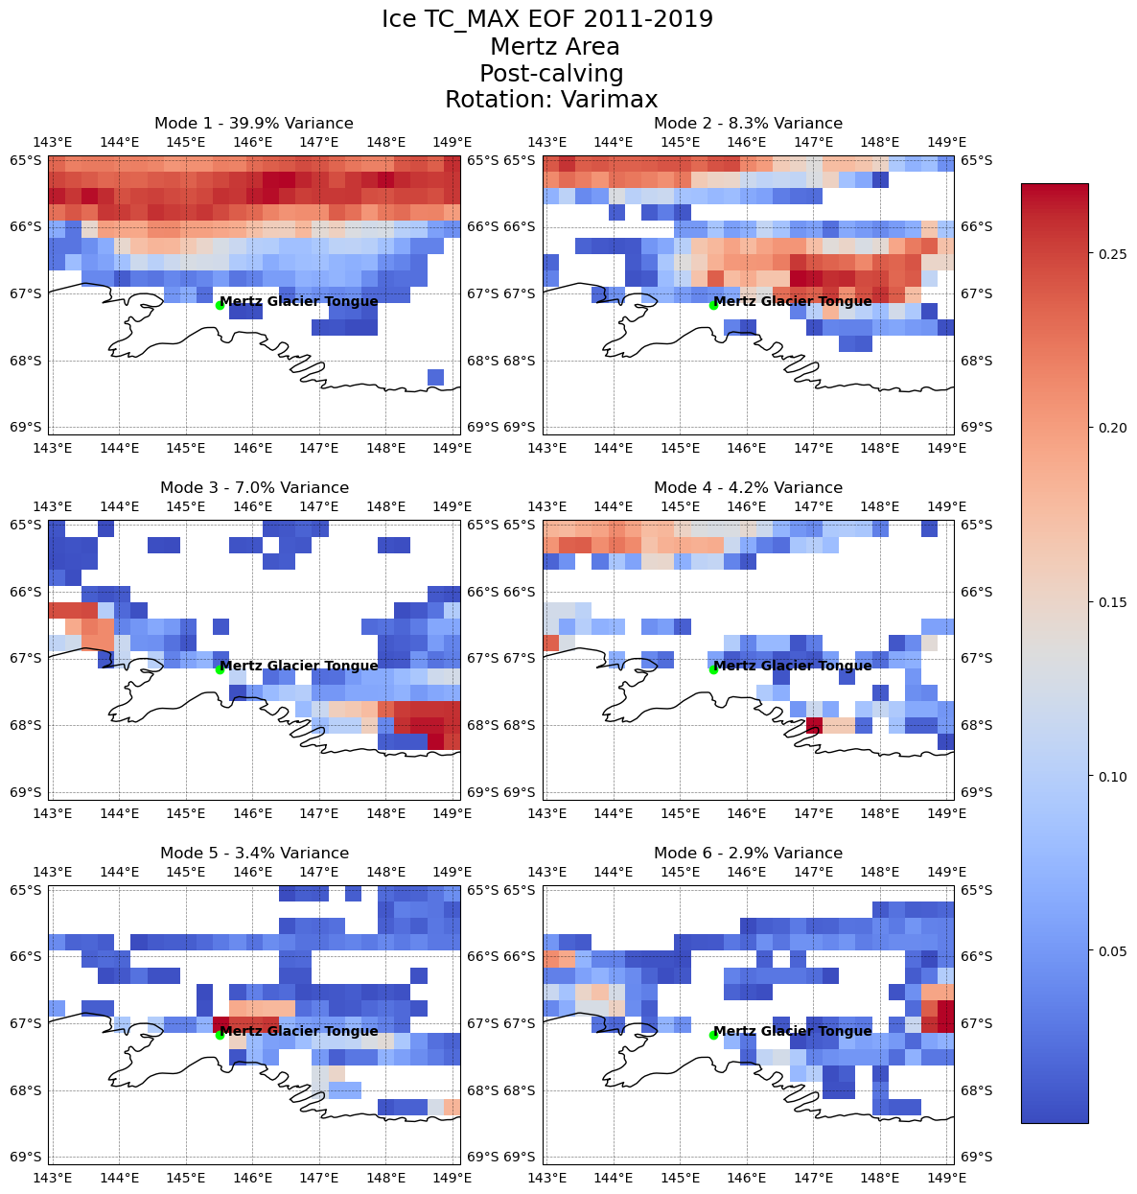
EOF Modes Pre and Post Mertz Tongue Calving
Notes:
Re-run EOF for a smaller geographic area around the Mertz Glacier and Tongue – how small is too small of a scale to be worthwhile?

Slide 14
Summary and Ongoing/Future Work
Continuing Improvements
  spatial projection, lagged correlation, regression with in-situ data
  additional variables: relative humidity, swell, fast ice
Initial exploration of data highlights questions to examine further
  Continued analysis of smaller areas and Mertz area pre and post calving
  Investigate relationship between radiative forcing and katabatic wind in DDU area
  Identify dominant modes of variability associated with synoptic scale modes (ENSO)
Future work may include a time-series analysis greater than 2005-2019 to explore longer term interannual variability and trends
Downscaling of reanalysis data for more localized analysis
ML for sub-grid processes?
Acknowledgements: Thank you to Dr. Dana Veron, Dr. Tracy DeLiberty and Jack Stone.
Notes:
More in-situ data from eastern antarctica would be great
Downscaling may help to bridge the gap from regional to local

Slide 15

Questions?
Comments?
Suggestions?
Notes:
All I know for sure is that there is a lot I don’t know.
Please email if you have thoughts, suggestions, or comments. I welcome the feedback.

Slide 16
References
Brands, S., J. M. Gutiérrez, S. Herrera, and A. S. Cofiño. 2012. On the Use of Reanalysis Data for Downscaling. Journal of Climate, 25(7):2517–2526, https://doi.org/10.1175/JCLI-D-11-00251.1.
Dawson, A. 2016. eofs: A Library for EOF Analysis of Meteorological, Oceanographic, and Climate Data. Journal of Open Research Software, 4(1):14, https://doi.org/10.5334/jors.122.
Dragon, A.-C., M.-N. Houssais, C. Herbaut, and J.-B. Charrassin. 2014. A note on the intraseasonal variability in an Antarctic polynia: Prior to and after the Mertz Glacier calving. Journal of Marine Systems, 130:46–55, https://doi.org/10.1016/j.jmarsys.2013.06.006.
Hersbach, H., B. Bell, P. Berrisford, S. Hirahara, A. Horányi, J. Muñoz‐Sabater, J. Nicolas, C. Peubey, R. Radu, D. Schepers, A. Simmons, C. Soci, S. Abdalla, X. Abellan, G. Balsamo, P. Bechtold, G. Biavati, J. Bidlot, M. Bonavita, G. Chiara, P. Dahlgren, D. Dee, M. Diamantakis, R. Dragani, J. Flemming, R. Forbes, M. Fuentes, A. Geer, L. Haimberger, S. Healy, R. J. Hogan, E. Hólm, M. Janisková, S. Keeley, P. Laloyaux, P. Lopez, C. Lupu, G. Radnoti, P. Rosnay, I. Rozum, F. Vamborg, S. Villaume, and J. Thépaut. 2020. The ERA5 global reanalysis. Quarterly Journal of the Royal Meteorological Society, 146(730):1999–2049, https://doi.org/10.1002/qj.3803.
Massom, R., P. Reid, S. Stammerjohn, B. Raymond, A. Fraser, and S. Ushio. 2013. Change and Variability in East Antarctic Sea Ice Seasonality, 1979/80–2009/10. PLoS ONE, 8(5):e64756, https://doi.org/10.1371/journal.pone.0064756.
Richman, M. B. 1986. Rotation of principal components. Journal of Climatology, 6(3):293–335, https://doi.org/10.1002/joc.3370060305.
Smith, M. B., J.-P. Labat, A. D. Fraser, R. A. Massom, and P. Koubbi. 2011. A GIS approach to estimating interannual variability of sea ice concentration in the Dumont d’Urville Sea near Terre Adélie from 2003 to 2009. Polar Science, 5(2):104–117, https://doi.org/10.1016/j.polar.2011.04.007.
Tamura, T., G. D. Williams, A. D. Fraser, and K. I. Ohshima. 2012. Potential regime shift in decreased sea ice production after the Mertz Glacier calving. Nature Communications, 3(1):826, https://doi.org/10.1038/ncomms1820.
Wendler, G., C. Stearns, G. Weidner, G. Dargaud, and T. Parish. 1997. On the extraordinary katabatic winds of Adélie Land. Journal of Geophysical Research: Atmospheres, 102(D4):4463–4474, https://doi.org/10.1029/96JD03438.

