Slide 1
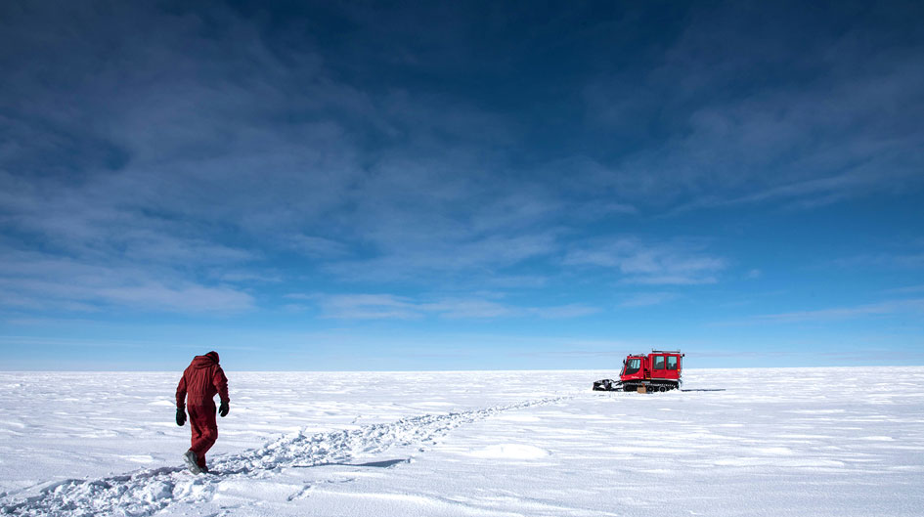
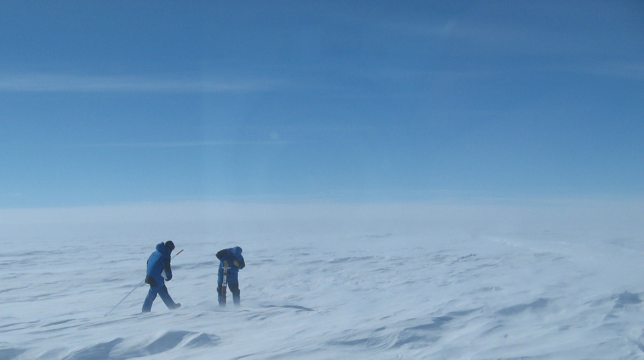
Small-scale temporal variability of surface winds in Adelie land
Cécile Davrinche
Cécile Agosta
Anaïs Orsi
WAMC, 2023
Cecile.davrinche@lsce.ipsl.fr

Slide 2
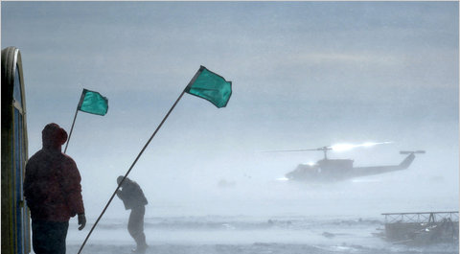
Intro
WAMC, 2023
Cécile Davrinche
Strongest winds on earth (up to 327 km/h recorded in DDU in the 70’s)
John Goodge, Ney York Times, 2010
2
Notes:
Strongest winds
Originate from large-scale pressure gradients
But also from pressure gradients associated with surface processes
The spatial patterns are quite known, thanks to, amongst others Michiel VdB
But little is understood about their temporal variability
Would be interesting to know what happens at a subseasonal large-scale, what drives the high wind-speed events that sometimes last for a few hours only

Slide 3
Intro
WAMC, 2023
Cécile Davrinche
Strongest winds on earth (up to 327 km/h recorded in DDU in the 70’s)
In the free atmosphere:
Winds governed by large scale pressure gradients
In the boundary layer:
Additional pressure gradients related to surface processes
John Goodge, Ney York Times, 2010
Notes:
Strongest winds
Originate from large-scale pressure gradients
But also from pressure gradients associated with surface processes
The spatial patterns are quite known, thanks to, amongst others Michiel VdB
But little is understood about their temporal variability
Would be interesting to know what happens at a subseasonal large-scale, what drives the high wind-speed events that sometimes last for a few hours only

Slide 4
Intro
WAMC, 2023
Cécile Davrinche
Strongest winds on earth (up to 327 km/h recorded in DDU in the 70’s)
In the free atmosphere:
Winds governed by large scale pressure gradients
In the boundary layer:
Additional pressure gradients related to surface processes
We want to separate these drivers using the Momentum Budget Equations (using the framework as in van den Broeke & van Lipzig, 2003, where they focused mostly on the spatial variability)
John Goodge, Ney York Times, 2010
2
Notes:
Strongest winds
Originate from large-scale pressure gradients
But also from pressure gradients associated with surface processes
The spatial patterns are quite known, thanks to, amongst others Michiel VdB
But little is understood about their temporal variability
Would be interesting to know what happens at a subseasonal large-scale, what drives the high wind-speed events that sometimes last for a few hours only

Slide 5
Intro
WAMC, 2023
Cécile Davrinche
Strongest winds on earth (up to 327 km/h recorded in DDU in the 70’s)
In the free atmosphere:
Winds governed by large scale pressure gradients
In the boundary layer:
Additional pressure gradients related to surface processes
We want to separate these drivers using the Momentum Budget Equations (using the framework as in van den Broeke & van Lipzig, 2003, where they focused mostly on the spatial variability)
John Goodge, Ney York Times, 2010
?
?
What drives their variability at different time-scale?
Is it more related to surface processes or large-scale pressure
gradients?
2
Notes:
Strongest winds
Originate from large-scale pressure gradients
But also from pressure gradients associated with surface processes
The spatial patterns are quite known, thanks to, amongst others Michiel VdB
But little is understood about their temporal variability
Would be interesting to know what happens at a subseasonal large-scale, what drives the high wind-speed events that sometimes last for a few hours only

Slide 6
Method: Regional Atmospheric Model
WAMC, 2023
Cécile Davrinche
For this analysis, we need:
3D data to study the strength of the inversion layer
At an « event » time-scale (i.e. sub-daily)
At a spatial resolution that enables us to take into account the effects of orography
Notes:
To do so, we need to access different parameters from the inversion layer
Therefore we need a 3D dataset
With a temporal resolution that enables us to look at specific events
Very important: a spatial resolution that enables us to study the effect of the slope
Considering the lack of observations in a 3D fields in Antarctica, we need a model
3hourly outputs
Resolution of 35 km
Bintanja (only GCM) , les RCM focused seulement sur la côte Renfrew (?)

Slide 7
Method: Regional Atmospheric Model
WAMC, 2023
Cécile Davrinche
For this analysis, we need:
3D data to study the strength of the inversion layer
At an « event » time-scale (i.e. sub-daily)
At a spatial resolution that enables us to take into account the effects of orography
MAR: Regional, hydrostatic model, nudged by ERA 5
3-hourly outputs for 2010-2020
35 x 35 km
Agosta & al. 2019, Kittel & al. 2021, Amory & al. 2017
Notes:
To do so, we need to access different parameters from the inversion layer
Therefore we need a 3D dataset
With a temporal resolution that enables us to look at specific events
Very important: a spatial resolution that enables us to study the effect of the slope
Considering the lack of observations in a 3D fields in Antarctica, we need a model
3hourly outputs
Resolution of 35 km
Bintanja (only GCM) , les RCM focused seulement sur la côte Renfrew (?)

Slide 8
Method: Regional Atmospheric Model
WAMC, 2023
Cécile Davrinche
Important features for the boundary layer:
Includes snowpack physics & interactions with the atmosphere
12 vertical levels between 2m and 1000m
Turbulent scheme well suited for stable boundary layers:
Roughness length parametrization:
z₀ = f(SAT)
Fits the vertical wind-speed gradient observations in Coastal Adélie land and in Dome C
MAR is a polar-oriented regional climate model with a good representation of the boundary layer
Agosta & al. 2019, Kittel & al. 2021,
Amory & al. 2017
Notes:
This model is well suited for our analysis because
Good representation of the boudary layer and its physics

Slide 9
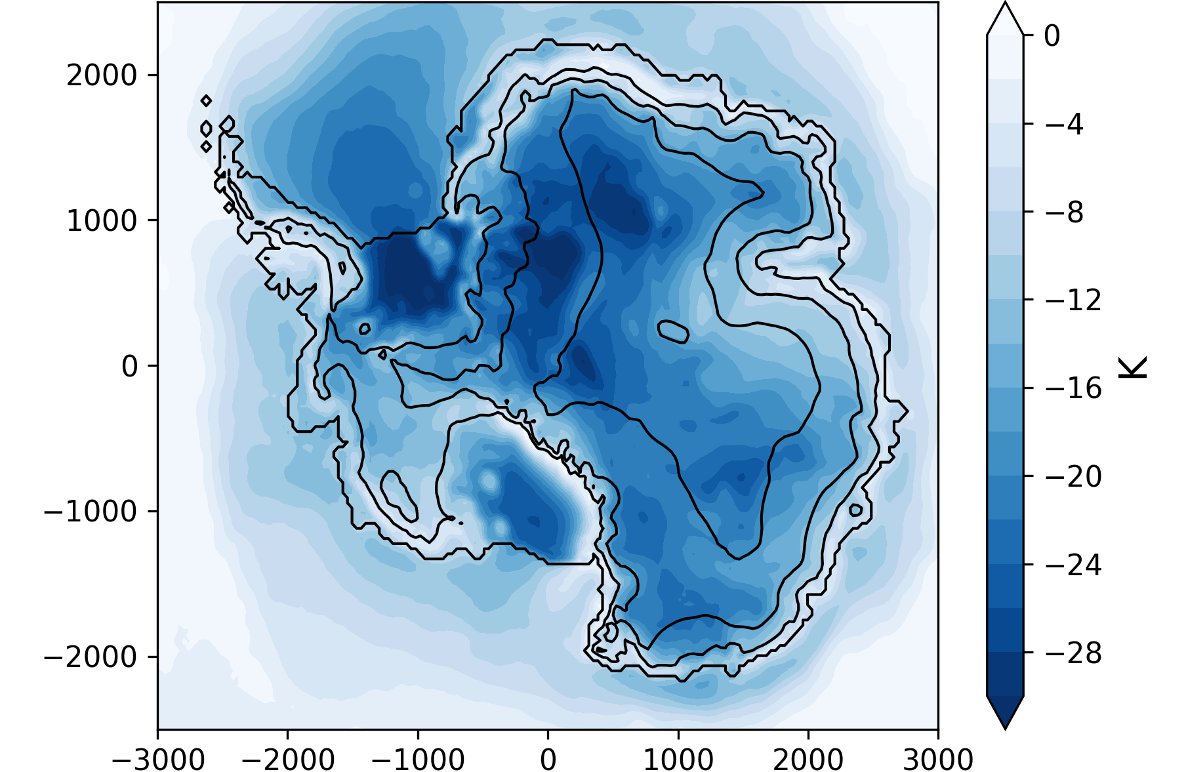
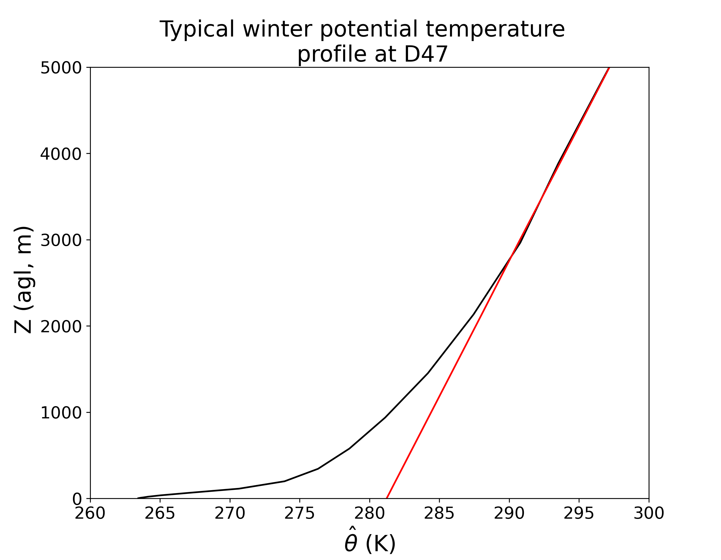
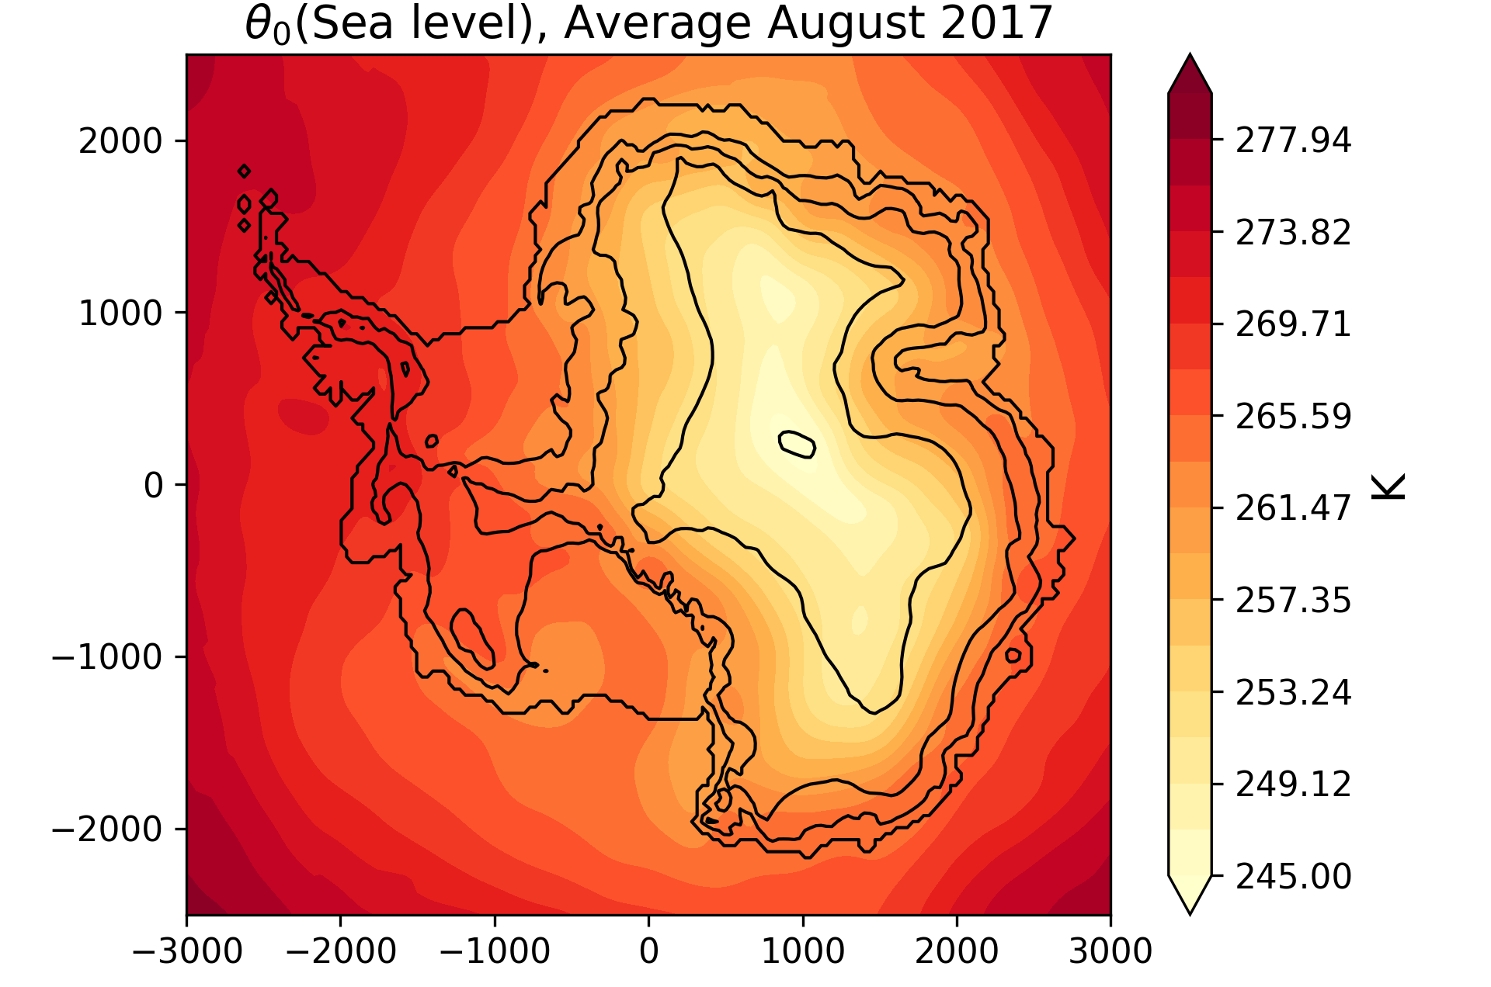
Theory: Surface winds in Antarctica
WAMC, 2023
Cécile Davrinche
Temperature deficit ($Δ_{θ}$)
Typical potential temperature profile
~ Katabatic
MAR, July 2010 - 2020
Background temperature $θ_{0}$
~ LSC
Notes:
A little bit about the theory of the drivers of surface winds in Antarctica:
Winds in Antarctica originate both from surface forcings. For instance the well known katabatic one: when the surface cools down the air mass just above, making it densier and heavier, in a and large-scale forcing.
We can separate these two contributions thanks to the vertical profile of potential temperatures.
In the free atmosphere, there is no influence of the surface and the profile is linear. We define this line, theta0, as the background temperarure profile.
By projecting this line up to the surface, we can estimate the influence of the large-scale processes.On the other hand, the difference between this background temp. And the actual background temp, called the temp. Deficit represents the influence of the surface.

Slide 10
Theory: Surface winds in Antarctica
WAMC, 2023
Cécile Davrinche
Temperature deficit ($Δ_{θ}$)
Typical potential temperature profile
Background temperature
$$θ_{0}$$
MAR, July 2010 - 2020
Background temperature $θ_{0}$
~ LSC
Synoptic
Large-scale
Notes:
A little bit about the theory of the drivers of surface winds in Antarctica:
Les principales caractéristiques de la climatologie en surface en Antarctique a. on a une inversion donc du katabatic, downslope et du thermal wind ( empilement d’air et gradient horizontal b. on a de la grande échelle
LSC = equ geostrophique avec theta0

Slide 11
Theory: Surface winds in Antarctica
WAMC, 2023
Cécile Davrinche
Temperature deficit ($Δ_{θ}$)
Typical potential temperature profile
~ Katabatic
Temperature
Deficit
($Δ_{θ}$)
Background temperature
$$θ_{0}$$
MAR, July 2010 - 2020
Background temperature $θ_{0}$
~ LSC
Inversion layer
Synoptic
Katabatic
Thermal wind
Large-scale
Notes:
A little bit about the theory of the drivers of surface winds in Antarctica:
Les principales caractéristiques de la climatologie en surface en Antarctique a. on a une inversion donc du katabatic, downslope et du thermal wind ( empilement d’air et gradient horizontal b. on a de la grande échelle
LSC = equ geostrophique avec theta0

Slide 12
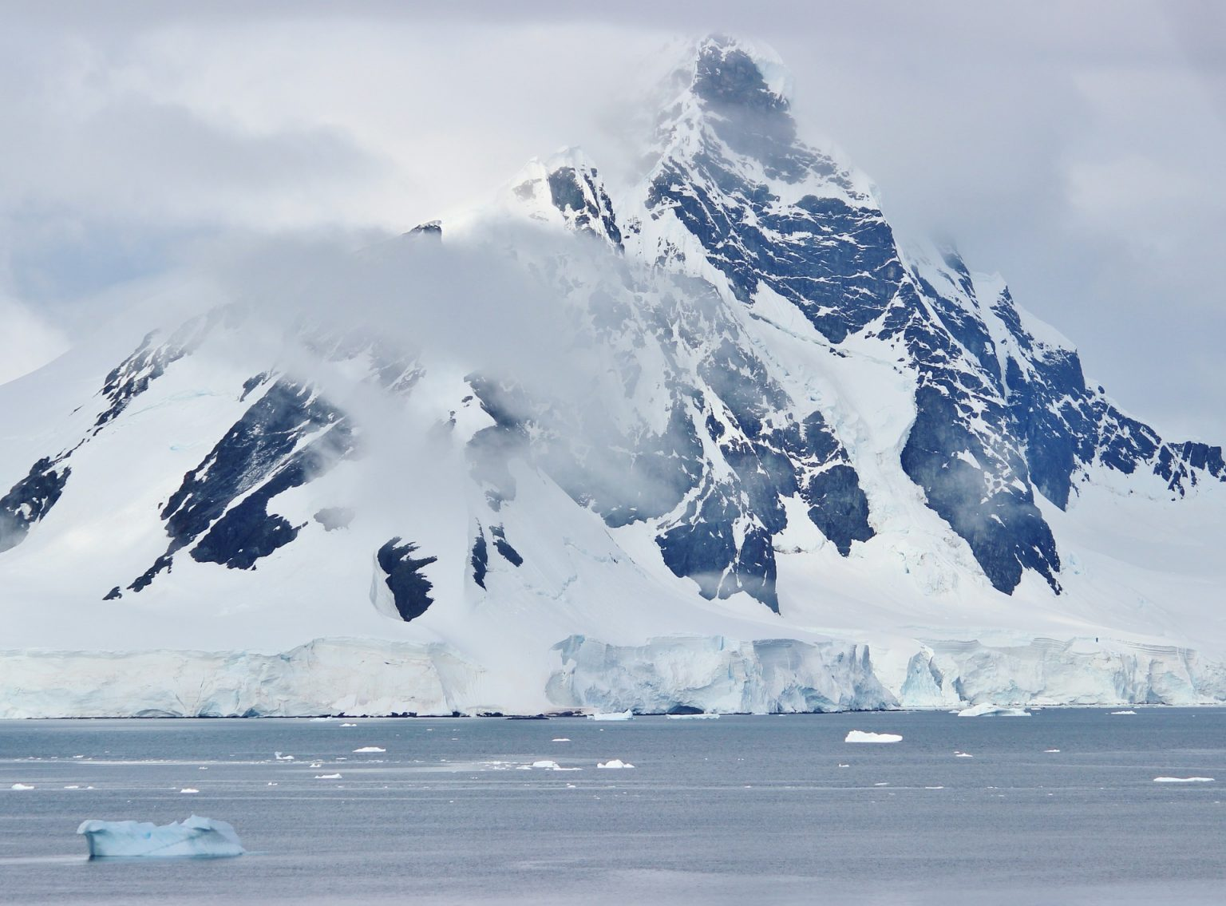
Method: Equations of the momentum budget
WAMC, 2023
Cécile Davrinche
Turbulence
Downslope
$$\frac{∂V}{∂t}=−fU−U\frac{∂V}{∂x}−V\frac{∂V}{∂y}−W\frac{∂V}{∂z}−\frac{∂\overline{vw}}{∂z}+\frac{g}{θ_{0}}\frac{∂\hat{θ}}{∂y}+fU_{LSC }\text{+ }\frac{g}{θ_{0}}Δ_{θ}\text{sin}\text{(}\text{α}\text{)}$$
Coriolis
Katabatic
Advection
Large-scale
Thermal wind
Cross-slope
Cross
$$\frac{∂U}{∂t}=fV−U\frac{∂U}{∂x}−V\frac{∂U}{∂y}−W\frac{∂U}{∂z}−\frac{∂\overline{uw}}{∂z}+\frac{g}{θ_{0}}\frac{∂\hat{θ}}{∂x}−fV_{LSC}$$
Down
van den Broeke & van Lipzig, 2003
Turbulence
Notes:
If we dive a little more into the details, we can separate the contributions of surface and large-scale drivers in the MBE as follows.
The time derivative of the wind speed is the sum of …

Slide 13
Method: Equations of the momentum budget
WAMC, 2023
Cécile Davrinche
Turbulence
Downslope
$$U=\frac{1}{f}(\frac{∂V}{∂t}−U\frac{∂V}{∂x}−V\frac{∂V}{∂y}−W\frac{∂V}{∂z}−\frac{∂\overline{vw}}{∂z}+\frac{g}{θ_{0}}\frac{∂\hat{θ}}{∂y}+fU_{LSC }\text{+ }\frac{g}{θ_{0}}Δ_{θ}\text{sin}\text{(}\text{α}\text{)}\text{)}$$
= 0
= 0
Katabatic
Advection
Large-scale
Thermal wind
WS $≈\frac{1}{f}\sqrt{{\left|LSC\right|}^{2}+|KA{T|}^{2}+{|THWD|}^{2}+|TUR{B|}^{2}}$
van den Broeke & van Lipzig, 2003
Notes:
If we dive a little more into the details, we can separate the contributions of surface and large-scale drivers in the MBE as follows.
The time derivative of the wind speed is the sum of …

Slide 14
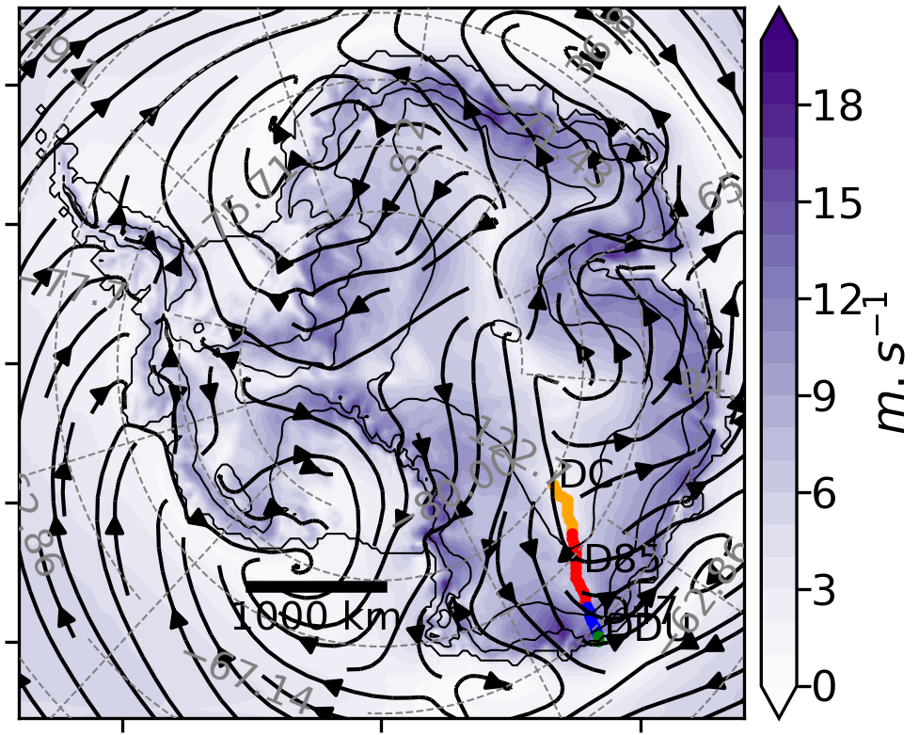
Surface winds in Antarctica (July 2010-2020)
WAMC, 2023
Cécile Davrinche
Wind-speed
Ecrire July 2010-2020 qqe part
Flèches ou Streamlines
plt.streamplot()
Pas overemphasize le THWD
Increases from the inland to the coast
Notes:
We focus on the winter-time, when the kat is the most active.
As a result, the wind increases from the inland to the coast.
Same for kat as it is proportionnal to the slope. Only active close to the coast
LSC is more uniform, usually in the same direction than the kat
And then, the second surface process, thwd, usually opposes the kat

Slide 15
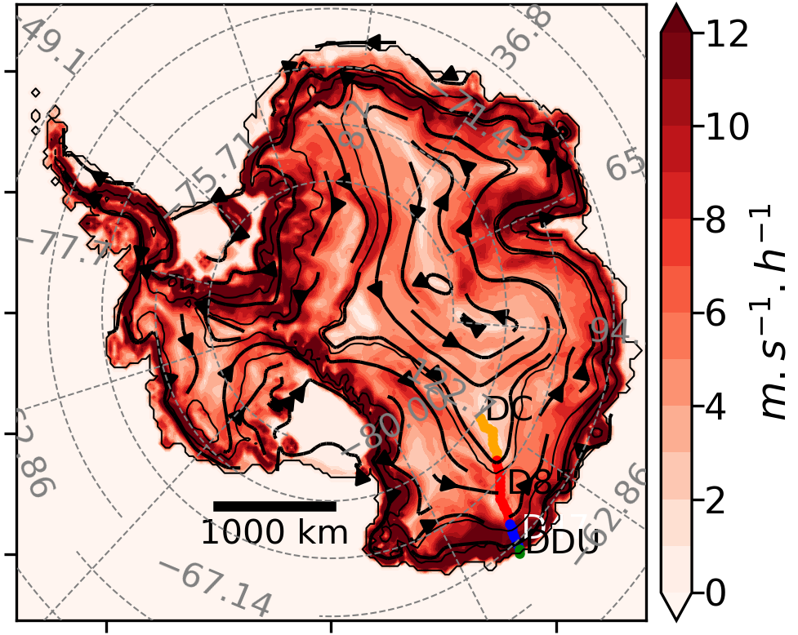
Surface winds in Antarctica (July 2010-2020)
WAMC, 2023
Cécile Davrinche
Wind-speed
Katabatic
Ecrire July 2010-2020 qqe part
Flèches ou Streamlines
plt.streamplot()
Pas overemphasize le THWD
Increases from the inland to the coast
Increase from the inland to the coast
Proportionnal to the slope angle
Directed downslope
Notes:
We focus on the winter-time, when the kat is the most active.
As a result, the wind increases from the inland to the coast.
Same for kat as it is proportionnal to the slope. Only active close to the coast
LSC is more uniform, usually in the same direction than the kat
And then, the second surface process, thwd, usually opposes the kat

Slide 16
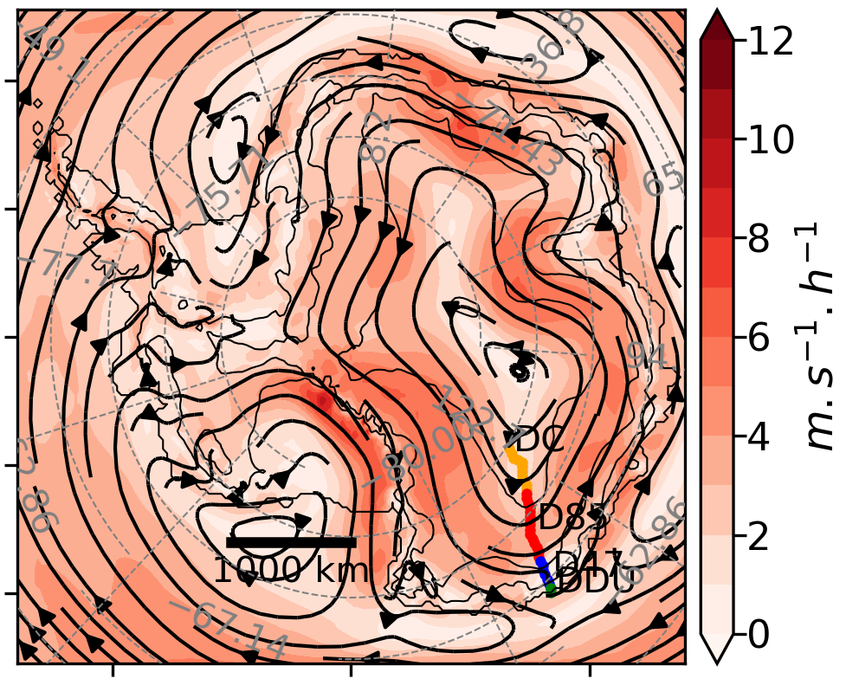
Surface winds in Antarctica (July 2010-2020)
WAMC, 2023
Cécile Davrinche
Wind-speed
Katabatic
Large-scale
Ecrire July 2010-2020 qqe part
Flèches ou Streamlines
plt.streamplot()
Pas overemphasize le THWD
Increases from the inland to the coast
Increase from the inland to the coast
Proportionnal to the slope angle
Directed downslope
Usually directed in the same direction than the katabatic acceleration
Notes:
We focus on the winter-time, when the kat is the most active.
As a result, the wind increases from the inland to the coast.
Same for kat as it is proportionnal to the slope. Only active close to the coast
LSC is more uniform, usually in the same direction than the kat
And then, the second surface process, thwd, usually opposes the kat

Slide 17
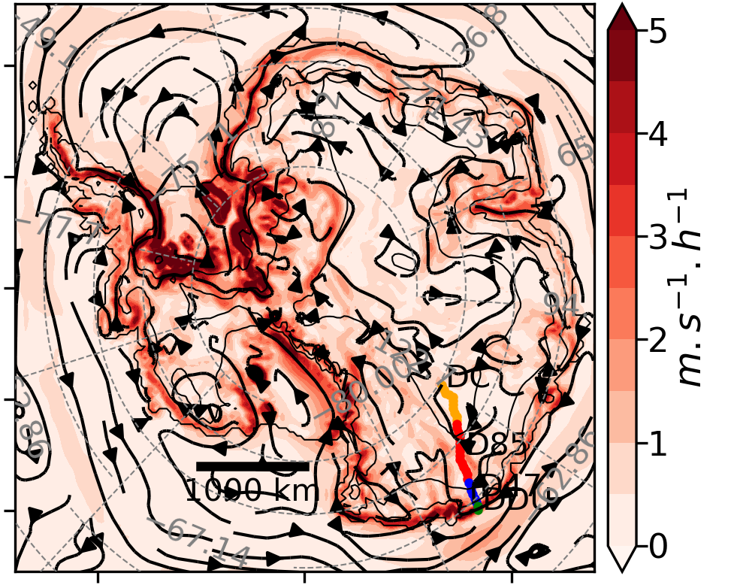
Surface winds in Antarctica (July 2010-2020)
WAMC, 2023
Cécile Davrinche
Wind-speed
Katabatic
Large-scale
Thermal-wind
Ecrire July 2010-2020 qqe part
Flèches ou Streamlines
plt.streamplot()
Pas overemphasize le THWD
Increases from the inland to the coast
Increase from the inland to the coast
Proportionnal to the slope angle
Directed downslope
Usually directed in the same direction than the katabatic acceleration
Only active on a narrow belt, close to the coast
Usually opposes the katabatic acceleration
Notes:
We focus on the winter-time, when the kat is the most active.
As a result, the wind increases from the inland to the coast.
Same for kat as it is proportionnal to the slope. Only active close to the coast
LSC is more uniform, usually in the same direction than the kat
And then, the second surface process, thwd, usually opposes the kat

Slide 18
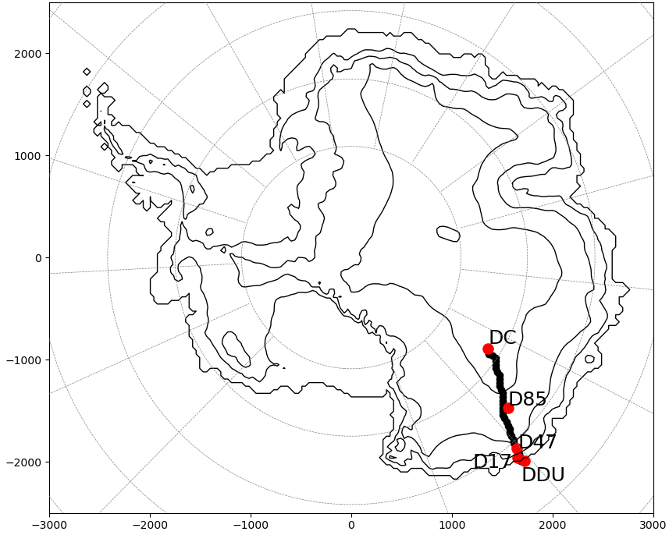
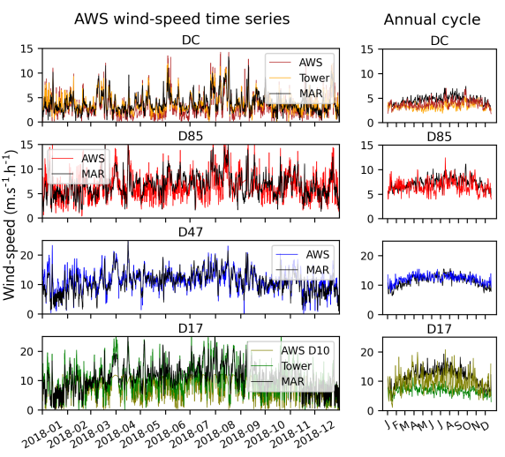
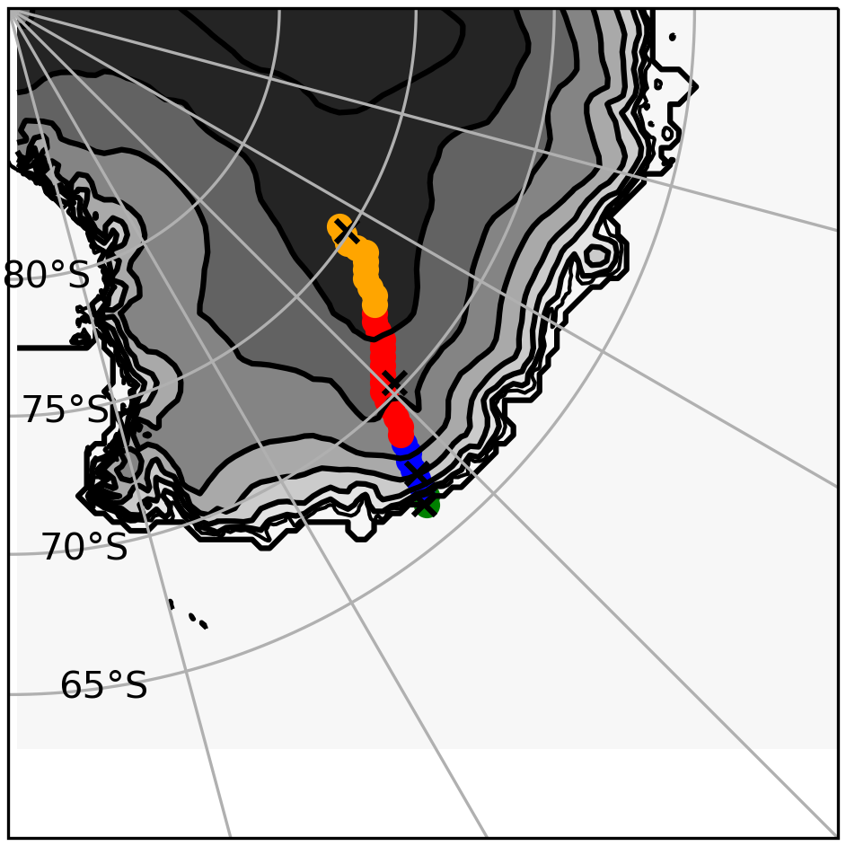
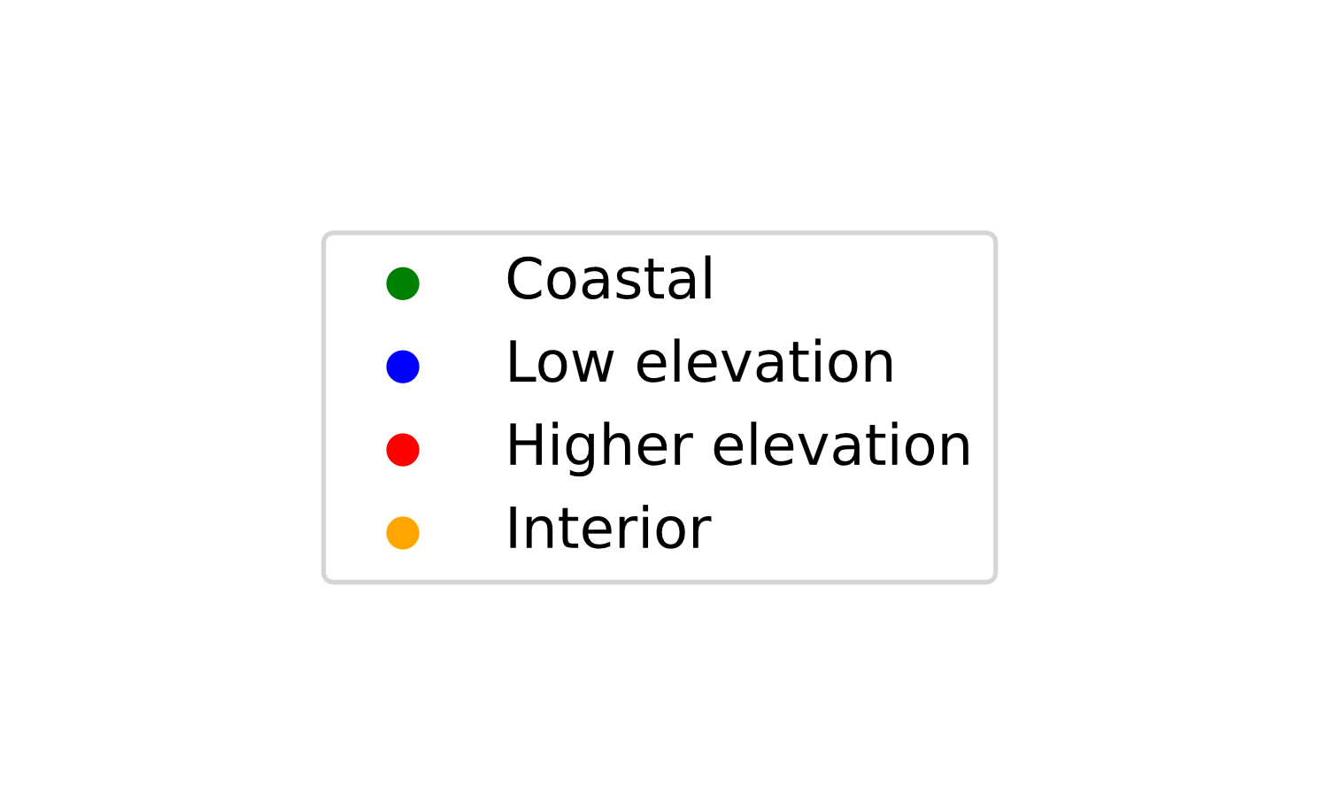
Results: Comparison observations/model
AntNow, 2022
Cécile Davrinche
R² (2010-2020,
3-Hourly)
^{0.47}
^{0.57}
D47
^{0.58}
^{0.61}
Notes:
Before moving to the temporal analysis, we want to make sure that our model reproduces well the surface winds.
We focus on a specific transect: large range of slopes
Multiple AWS stations to assess our model ability to represent the winds
MAR represents well the winds in Adélie land, with values of the square correlation coefficient around 0.5 and a better representation of high wind-speed

Slide 19
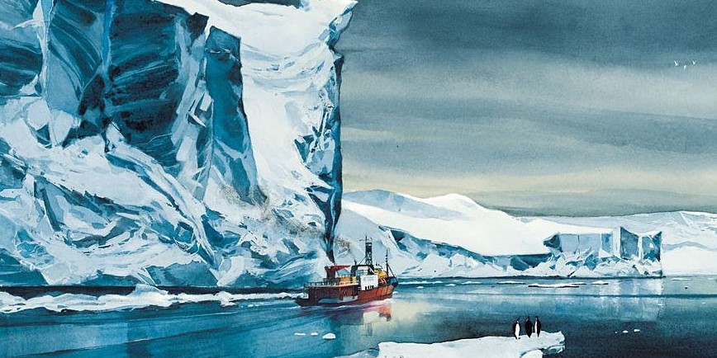
WAMC, 2023
Cécile Davrinche
What drives surface winds variability: Surface or large-scale forcing?
At seasonal scale
At a 3-hourly time-scale
Emmanuel Lepage, La lune est blanche
Notes:
Let’s move on to our real topic: the temporal variability of these surface winds

Slide 20
WAMC, 2023
Cécile Davrinche
What drives surface winds variability: Surface or large-scale forcing?
At seasonal scale
At a 3-hourly time-scale
Emmanuel Lepage, La lune est blanche
Notes:
First, we focus on the seasonal variability of these winds

Slide 21
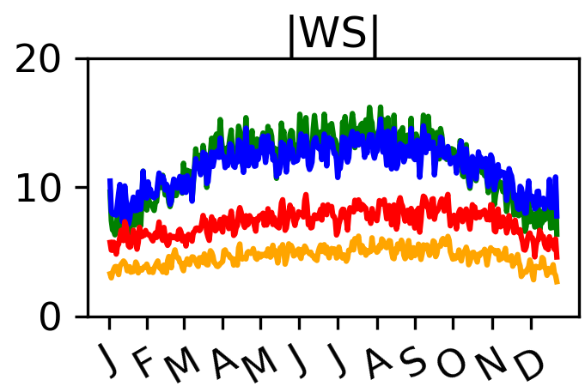
Results: Seasonal variability
WAMC, 2023
Cécile Davrinche
Wind-speed
Wind-speed, 2010-2020
|Thermal wind|
|Large-scale|
|Katabatic|
|Turbulence|
Notes:
Something that is not new is that the wind-speed has a seasonal cycle in Antarctica
It is more pronounced on the coast, where the katabatic accelerations are at play
We know that the katabatic and the thermal wind acceleration depend on the strength of the inversion layer.
That inversion layer has a strong seasonal cycle and is more pronounced in the winter.
LSC displays a very small seasonal cycle.
Thus, we can conclude that the spatial & seasonal cycle originate mostly from the surface induced pressure gradients.
At that temporal scale, almost all the variability originates from the surface induced processes. Is it still true at a smaller time-scale?

Slide 22
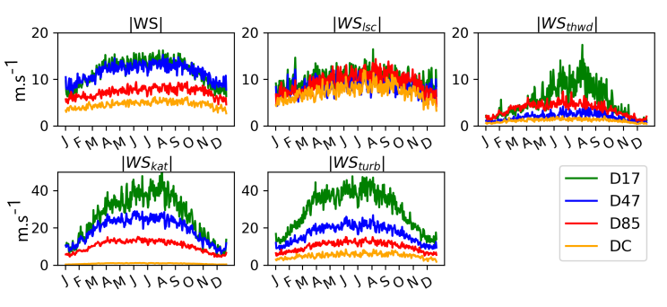
Results: Seasonal variability
WAMC, 2023
Cécile Davrinche
Wind-speed
|Large-scale|
|Thermal wind|
|Katabatic|
|Turbulence|
Notes:
Something that is not new is that the wind-speed has a seasonal cycle in Antarctica
It is more pronounced on the coast, where the katabatic accelerations are at play
We know that the katabatic and the thermal wind acceleration depend on the strength of the inversion layer.
That inversion layer has a strong seasonal cycle and is more pronounced in the winter.
LSC displays a very small seasonal cycle.
Thus, we can conclude that the spatial & seasonal cycle originate mostly from the surface induced pressure gradients.
At that temporal scale, almost all the variability originates from the surface induced processes. Is it still true at a smaller time-scale?

Slide 23
Results: Seasonal variability
WAMC, 2023
Cécile Davrinche
Wind-speed
|Large-scale|
|Thermal wind|
|Katabatic|
|Turbulence|
NB: Acceleration transformed to wind-speed (geostrophic equilibrium)
Seasonal variability originates mostly from katabatic and thermal wind seasonal cycle
Notes:
Something that is not new is that the wind-speed has a seasonal cycle in Antarctica
It is more pronounced on the coast, where the katabatic accelerations are at play
We know that the katabatic and the thermal wind acceleration depend on the strength of the inversion layer.
That inversion layer has a strong seasonal cycle and is more pronounced in the winter.
LSC displays a very small seasonal cycle.
Thus, we can conclude that the spatial & seasonal cycle originate mostly from the surface induced pressure gradients.
At that temporal scale, almost all the variability originates from the surface induced processes. Is it still true at a smaller time-scale?

Slide 24
Results
WAMC, 2023
Cécile Davrinche
What drives surface winds variability: Surface or large-scale forcing?
At seasonal scale: Surface driven
At a 3-hourly time-scale
Emmanuel Lepage, La lune est blanche

Slide 25
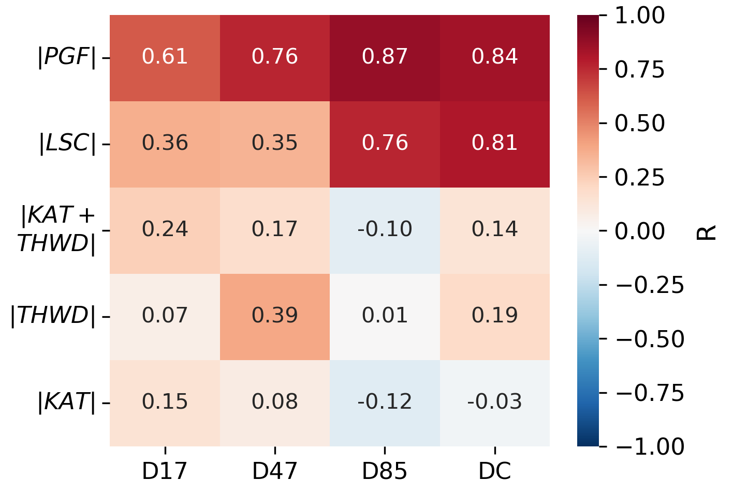
Results: Sub-seasonal variability
WAMC, 2023
Cécile Davrinche
Correlation coefficient with total wind-speed
July 2010-2020, 3-hourly
WS $≈\frac{1}{f}\sqrt{{\left|LSC\right|}^{2}+|KA{T|}^{2}+{|THWD|}^{2}+|TUR{B|}^{2}}$
Notes:
At DC, station on the East Antarctic plateau, excellent correlation between the large-scale acceleration & the total wind-speed.
Same for D85, where the slope is small and thus the effect of katabatic small as well.
But, the more we move towards the coast, the smaller the correlation between the large-scale and the total wind-speed.
That’s what we were expecting because at these locations, the katabatic acceleration increases a lot.
But then, we were expecting the katabatic acceleration to correlate with the total wind-speed. However, here it’s not the case!
In the litterature , high wind-speed events in Adélie land are usually described as katabatic, but here it doesn’t seem to be the case!
Is it because our transect is special?

Slide 26
Results: Sub-seasonal variability
WAMC, 2023
Cécile Davrinche
Correlation coefficient with total wind-speed
July 2010-2020, 3-hourly
WS $≈\frac{1}{f}\sqrt{{\left|LSC\right|}^{2}+|KA{T|}^{2}+{|THWD|}^{2}+|TUR{B|}^{2}}$
Notes:
At DC, station on the East Antarctic plateau, excellent correlation between the large-scale acceleration & the total wind-speed.
Same for D85, where the slope is small and thus the effect of katabatic small as well.
But, the more we move towards the coast, the smaller the correlation between the large-scale and the total wind-speed.
That’s what we were expecting because at these locations, the katabatic acceleration increases a lot.
But then, we were expecting the katabatic acceleration to correlate with the total wind-speed. However, here it’s not the case!
In the litterature , high wind-speed events in Adélie land are usually described as katabatic, but here it doesn’t seem to be the case!
Is it because our transect is special?

Slide 27
Results: Sub-seasonal variability
WAMC, 2023
Cécile Davrinche
Correlation coefficient with total wind-speed
July 2010-2020, 3-hourly
Large-scale responsible for sub-seasonal variability in the interior & high elevation
Low correlation of both katabatic and large-scale acceleration on the coast
WS $≈\frac{1}{f}\sqrt{{\left|LSC\right|}^{2}+|KA{T|}^{2}+{|THWD|}^{2}+|TUR{B|}^{2}}$
Notes:
At DC, station on the East Antarctic plateau, excellent correlation between the large-scale acceleration & the total wind-speed.
Same for D85, where the slope is small and thus the effect of katabatic small as well.
But, the more we move towards the coast, the smaller the correlation between the large-scale and the total wind-speed.
That’s what we were expecting because at these locations, the katabatic acceleration increases a lot.
But then, we were expecting the katabatic acceleration to correlate with the total wind-speed. However, here it’s not the case!
In the litterature , high wind-speed events in Adélie land are usually described as katabatic, but here it doesn’t seem to be the case!
Is it because our transect is special?

Slide 28
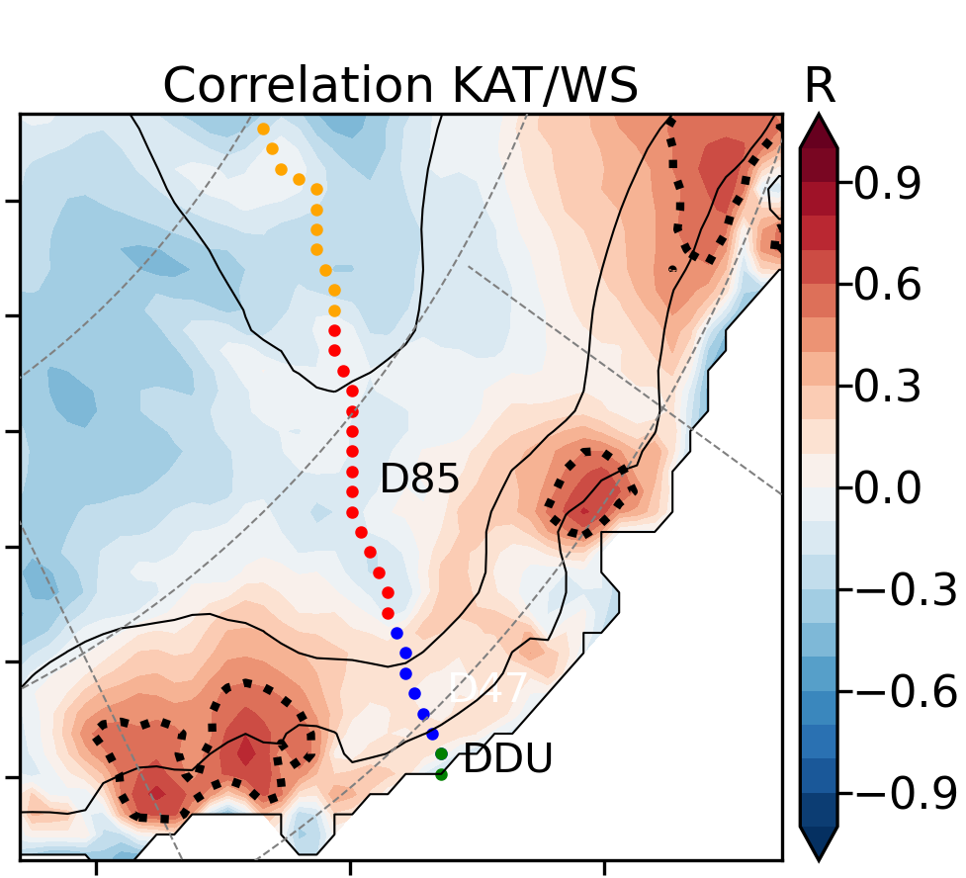
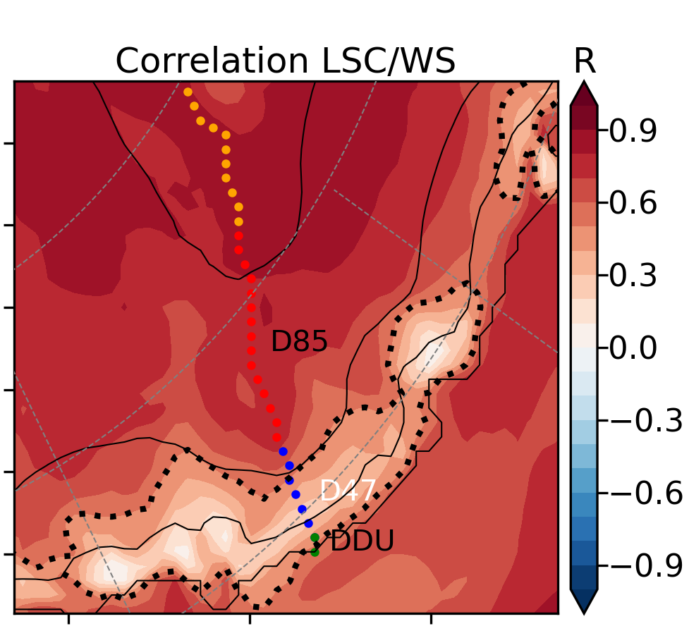
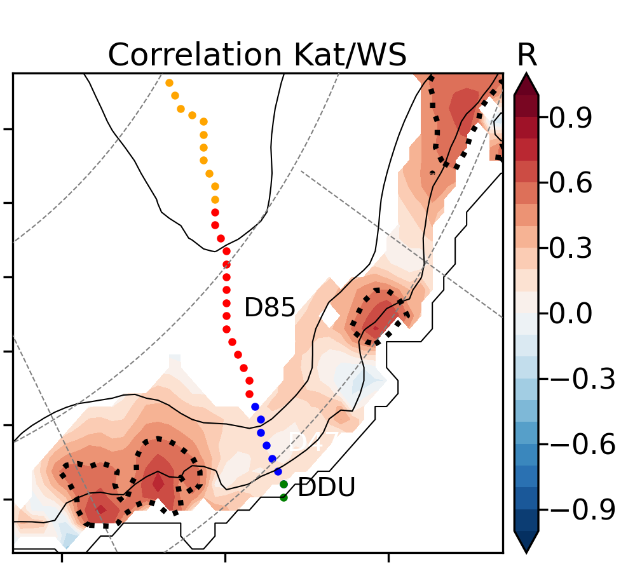
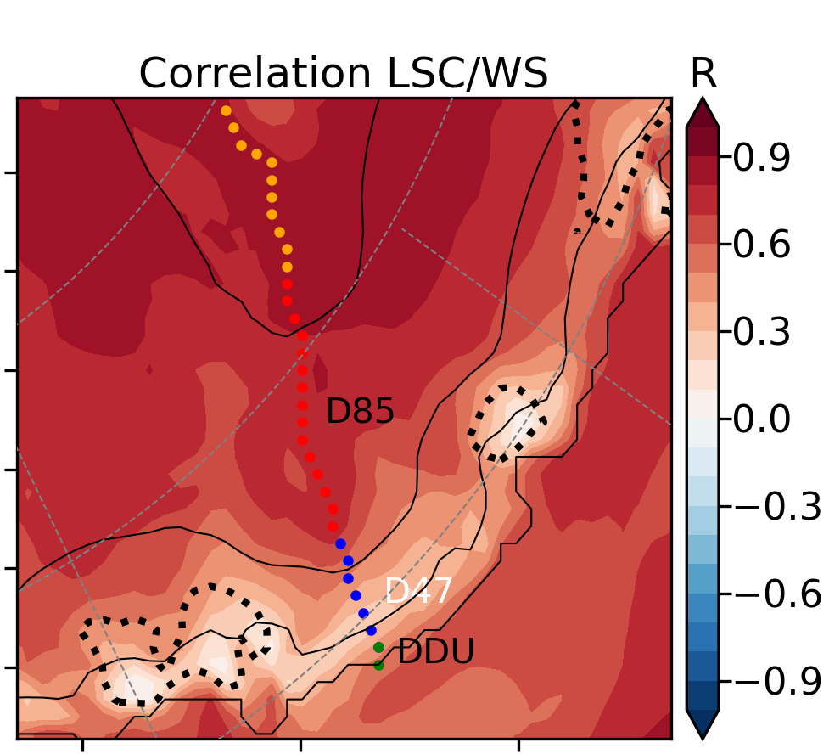
Results: Sub-seasonal variability
WAMC, 2023
Dashed line: R=0.5
Notes:
Yes, our transect is kind of special. At other locations with high katabatic accelerations, there is a good correlation.
So whenever the correlation between LSC & total wind-speed decreases, the katabatic, which is more active, becomes the dominant driver. That’s what we were expecting.
On our transect, it’s not the case because of the mean angle between the katabatic and LSC acceleration.
The direction of the katabatic acceleration is constant downslope.
The direction of the LSC is more variable but tends to align everywhere with the slope because the topography shapes the pressure gradient.
However, between D47 and Dumont d’Urville, the large-scale tends to oppose the katabatic acceleration, which leads to a poor correlation between katabatic acceleration and total wind-speed at that time scale.
So in this zone, we have 2 independant drivers that are competing, and none of them dominate.
As an example, I will present a few high wind-speed events.

Slide 29
Results: Sub-seasonal variability
WAMC, 2023
Cécile Davrinche
Notes:
Yes, our transect is kind of special. At other locations with high katabatic accelerations, there is a good correlation.
So whenever the correlation between LSC & total wind-speed decreases, the katabatic, which is more active, becomes the dominant driver. That’s what we were expecting.
On our transect, it’s not the case because of the mean angle between the katabatic and LSC acceleration.
The direction of the katabatic acceleration is constant downslope.
The direction of the LSC is more variable but tends to align everywhere with the slope because the topography shapes the pressure gradient.
However, between D47 and Dumont d’Urville, the large-scale tends to oppose the katabatic acceleration, which leads to a poor correlation between katabatic acceleration and total wind-speed at that time scale.
So in this zone, we have 2 independant drivers that are competing, and none of them dominate.
As an example, I will present a few high wind-speed events.

Slide 30
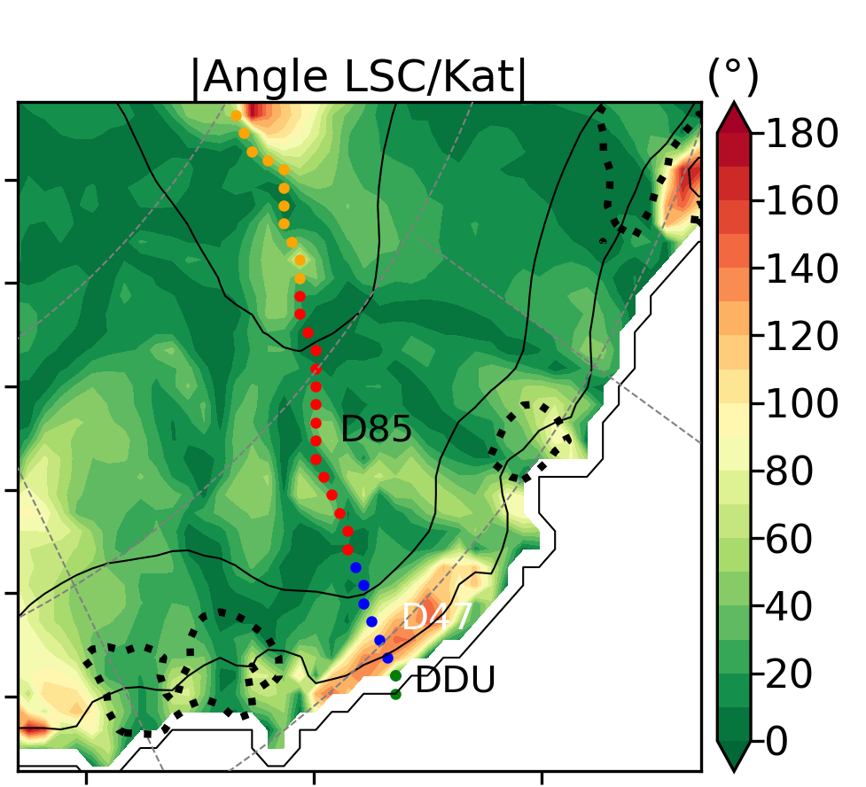
Results: Sub-seasonal variability
WAMC, 2023
Cécile Davrinche
LSC & KAT in opposition
LSC & KAT aligned
Notes:
Yes, our transect is kind of special. At other locations with high katabatic accelerations, there is a good correlation.
So whenever the correlation between LSC & total wind-speed decreases, the katabatic, which is more active, becomes the dominant driver. That’s what we were expecting.
On our transect, it’s not the case because of the mean angle between the katabatic and LSC acceleration.
The direction of the katabatic acceleration is constant downslope.
The direction of the LSC is more variable but tends to align everywhere with the slope because the topography shapes the pressure gradient.
However, between D47 and Dumont d’Urville, the large-scale tends to oppose the katabatic acceleration, which leads to a poor correlation between katabatic acceleration and total wind-speed at that time scale.
So in this zone, we have 2 independant drivers that are competing, and none of them dominate.
As an example, I will present a few high wind-speed events.

Slide 31
Results: Sub-seasonal variability
WAMC, 2023
Cécile Davrinche
LSC & KAT in opposition
LSC & KAT aligned
Low correlations partially explained by the mean angle between large-scale & Katabatic accelerations
On our transect, close to the coast, 2 independant and competing drivers
Notes:
Yes, our transect is kind of special. At other locations with high katabatic accelerations, there is a good correlation.
So whenever the correlation between LSC & total wind-speed decreases, the katabatic, which is more active, becomes the dominant driver. That’s what we were expecting.
On our transect, it’s not the case because of the mean angle between the katabatic and LSC acceleration.
The direction of the katabatic acceleration is constant downslope.
The direction of the LSC is more variable but tends to align everywhere with the slope because the topography shapes the pressure gradient.
However, between D47 and Dumont d’Urville, the large-scale tends to oppose the katabatic acceleration, which leads to a poor correlation between katabatic acceleration and total wind-speed at that time scale.
So in this zone, we have 2 independant drivers that are competing, and none of them dominate.
As an example, I will present a few high wind-speed events.

Slide 32
Example: High wind-speed events (HWSE)
WAMC, 2023
Low correlations between katabatic and total wind-speed partially explained by the alternance of katabatic driven and large-scale driven high wind-speed events
HWSE: $\left|ws\right|>99th percentile$
Notes:
We’ve seen in the previous slide that, at D47, there are two competing mechanisms. As none of them dominate at a 3-hourly time scale, it means that some events are surface-driven, and others large-scale driven.
This is what we observe here. I’ve selected high wind-speed events, plotted the time series and tried to understand the main driver.
The total wind-speed is plotted in black, the surface induced wind-speed in blue and the large-scale forcing in red.

Slide 33
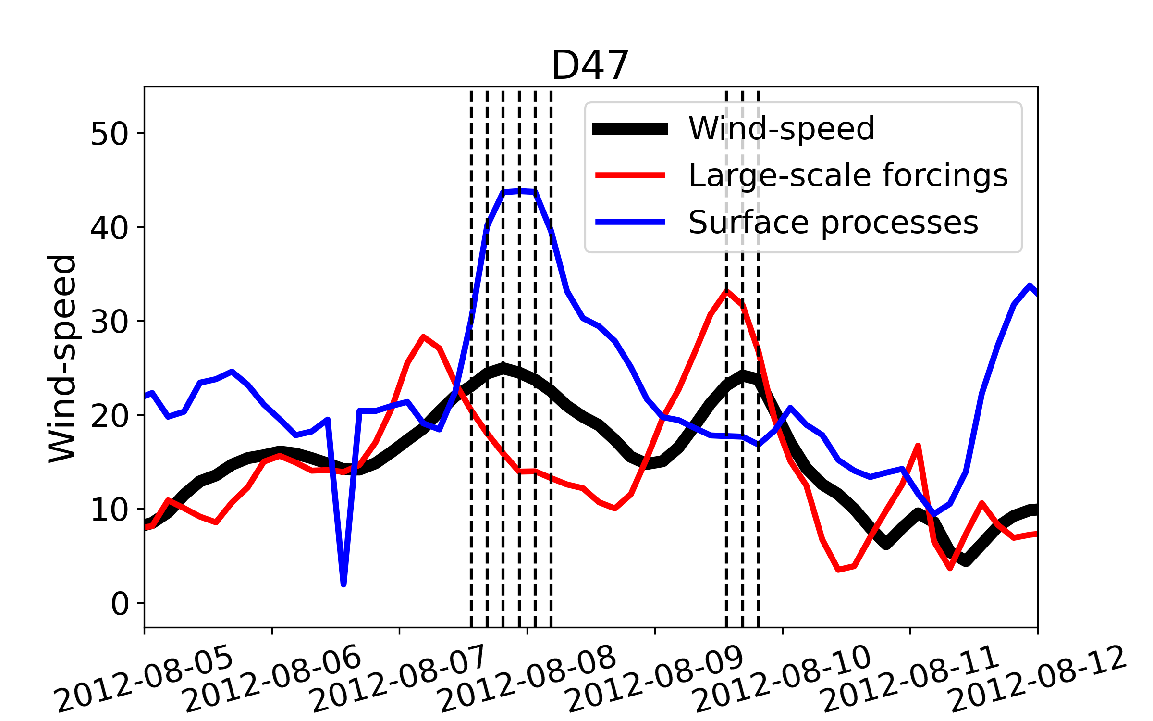
Example: High wind-speed events (HWSE)
WAMC, 2023
Low correlations between katabatic and total wind-speed partially explained by the alternance of katabatic driven and large-scale driven high wind-speed events
HWSE: $\left|ws\right|>99th percentile$
Surface
Notes:
We’ve seen in the previous slide that, at D47, there are two competing mechanisms. As none of them dominate at a 3-hourly time scale, it means that some events are surface-driven, and others large-scale driven.
This is what we observe here. I’ve selected high wind-speed events, plotted the time series and tried to understand the main driver.
The total wind-speed is plotted in black, the surface induced wind-speed in blue and the large-scale forcing in red.

Slide 34
Example: High wind-speed events (HWSE)
WAMC, 2023
Low correlations between katabatic and total wind-speed partially explained by the alternance of katabatic driven and large-scale driven high wind-speed events
HWSE: $\left|ws\right|>99th percentile$
Surface
Large-scale
Notes:
We’ve seen in the previous slide that, at D47, there are two competing mechanisms. As none of them dominate at a 3-hourly time scale, it means that some events are surface-driven, and others large-scale driven.
This is what we observe here. I’ve selected high wind-speed events, plotted the time series and tried to understand the main driver.
The total wind-speed is plotted in black, the surface induced wind-speed in blue and the large-scale forcing in red.

Slide 35
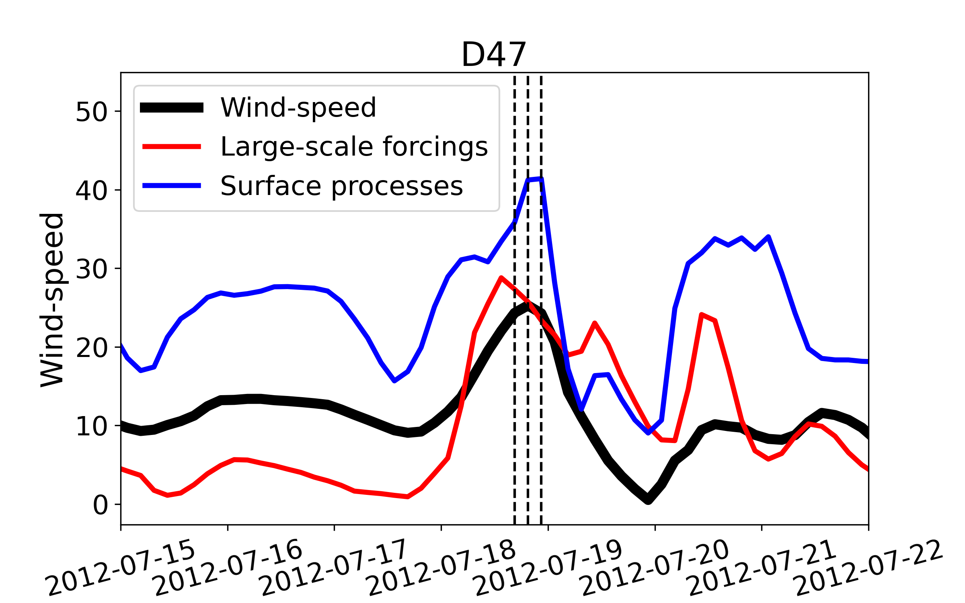
Example: High wind-speed events (HWSE)
WAMC, 2023
Low correlations between katabatic and total wind-speed partially explained by the alternance of katabatic driven and large-scale driven high wind-speed events
HWSE: $\left|ws\right|>99th percentile$
Both
Surface
Large-scale
Notes:
We’ve seen in the previous slide that, at D47, there are two competing mechanisms. As none of them dominate at a 3-hourly time scale, it means that some events are surface-driven, and others large-scale driven.
This is what we observe here. I’ve selected high wind-speed events, plotted the time series and tried to understand the main driver.
The total wind-speed is plotted in black, the surface induced wind-speed in blue and the large-scale forcing in red.

Slide 36
Conclusions
WAMC, 2023
Cécile Davrinche
?
?
What drives surface winds variability at different time-scale?
Is it more related to surface processes or large-scale pressure gradients?
Surface drives seasonal variability of WS
Model MAR,
3-Hourly
LSC responsible for sub-seasonal
variability on the plateau
Separation in the Momentum budget of LSC and surface processes
Close to the coast, on the transect:
Very low correlation of KAT
Correlations Acceleration/WS
Due to the opposing mean angle between KAT & LSC
Notes:
Some events are driven either by kat or LSC, so we really need our decomposition

Slide 37
Thanks for your attention

Slide 38
Outline
WAMC, 2023
Cécile Davrinche
1. Introduction
Importance of surface winds and especially high wind-speed events
Lack of observation to understand where the wind comes from
2. Method: momentum budget equation on a transect
Use of the Regional Atmospheric Model (MAR)
Theory of surface winds’ drivers
Comparison observations/model
3. Results
Seasonal variability is mostly controlled by changes in the inversion layer dynamics
Sub-seasonal variability cannot be explained solely by variations in the katabatic acceleration, but also by
The angle between the large-scale and katabatic acceleration
The alternance of large-scale and katabatic driven high wind-speed events

Slide 39
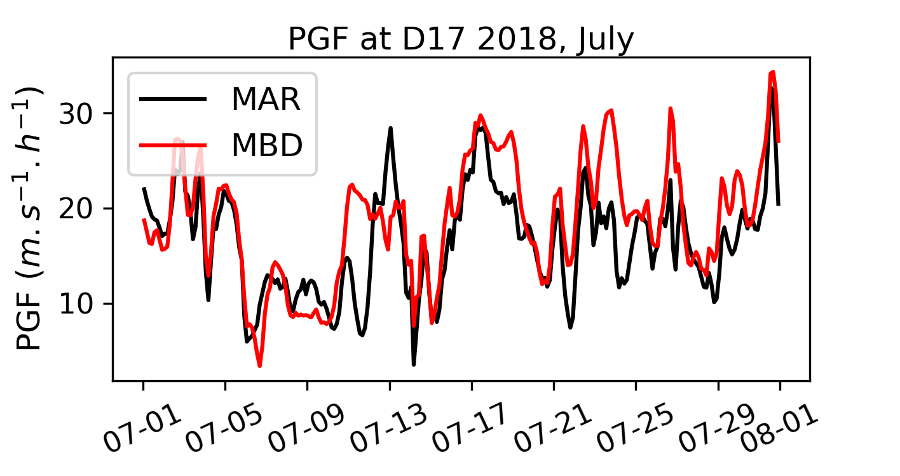
Comparison computations/model
WAMC, 2023
Cécile Davrinche
$$\frac{∂V}{∂t}=PGF∗+Turbulence$$
MAR numerical scheme:
Our additional decomposition:
$$PGF∗= Katabatic+Large scale+Thermal wind$$
PGF $∗$ = Pressure Gradient Force
Our set of equations seems to replicate fairly well the geopotential gradient used by the model to increment the wind-speed
Notes:
Bintanja (only GCM) , les RCM focused seulement sur la côte Renfrew (?)

Slide 40
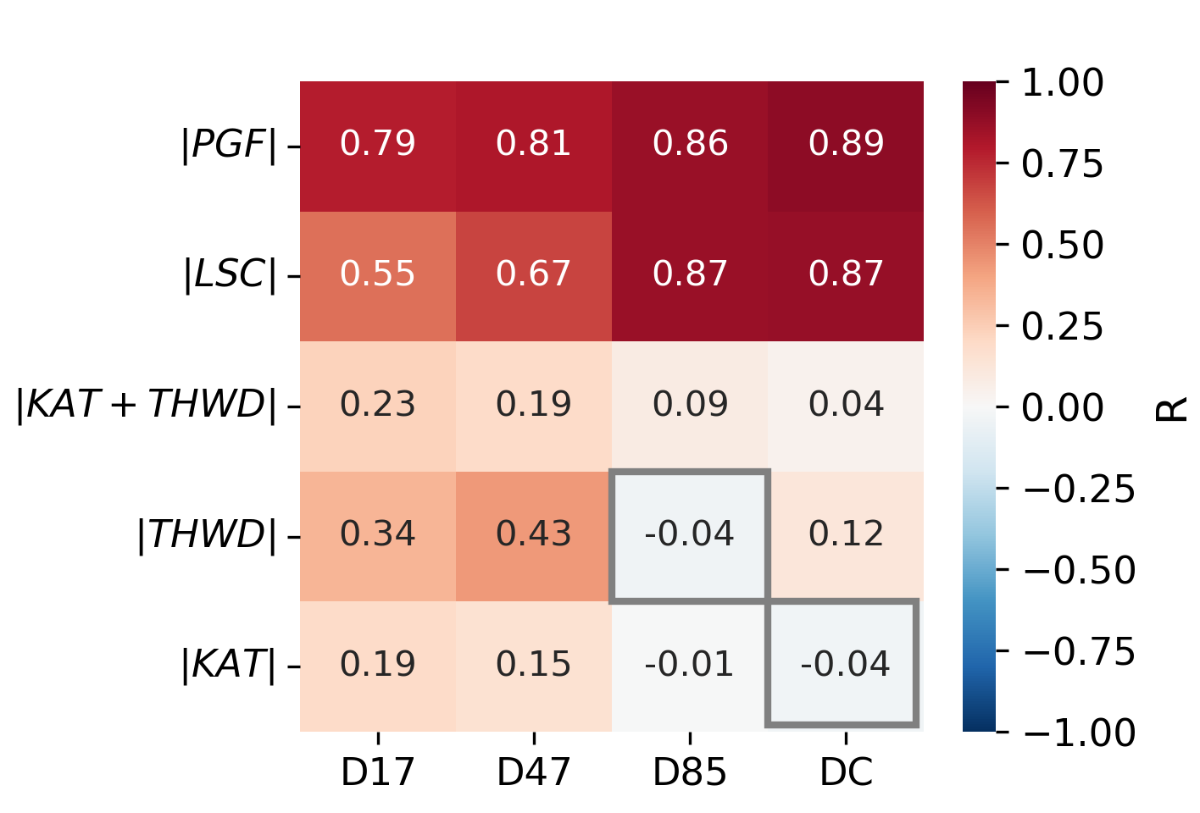
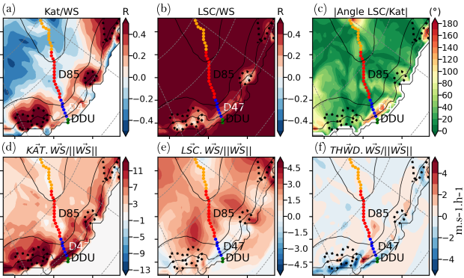
Results: Sub-seasonal variability
WAMC, 2023
Cécile Davrinche
Can seasonal variability be attributed solely to changes in the inversion layer and sub-seasonal variability by changes in the large-scale forcing?
Pearson coefficient with total wind-speed
Low correlations partially explained by the mean angle between large-scale & Katabatic accelerations
a. Large-scale responsible for sub-seasonal variability on the plateau
b. Low correlation of both katabatic and large-scale acceleration on the coast
Notes:
Bintanja (only GCM) , les RCM focused seulement sur la côte Renfrew (?)

