Slide 1

Summer extreme-high temperatures, surface melt and atmospheric rivers in the Antarctic Peninsula linked to central tropical Pacific convection
Kyle Clem
Victoria University of Wellington, New Zealand
Many collaborators: Deniz Bozkurt, Daemon Kennett, John King, John Turner, Niels Dutrievoz, Juliette Blanchet, Vincent Favier, Jonathan Wille, Benjamin Pohl, etc.
18th Workshop on Antarctic Meteorology and Climate
31 May 2023
Email
kyle.clem@vuw.ac.nz

Slide 2
15-23 March 2015
1-6 February 2020
Daily OLR & 200 hPa Divergent Wind Anomalies
2-8 February 2022

Slide 3
H
L
H
L
H
H
19-24 March 2015
2-6 February 2020
H
Daily OLR, 200 hPa Divergent Wind & 200 hPa Streamfunction Anomalies
L
H
3-7 February 2022

Slide 4
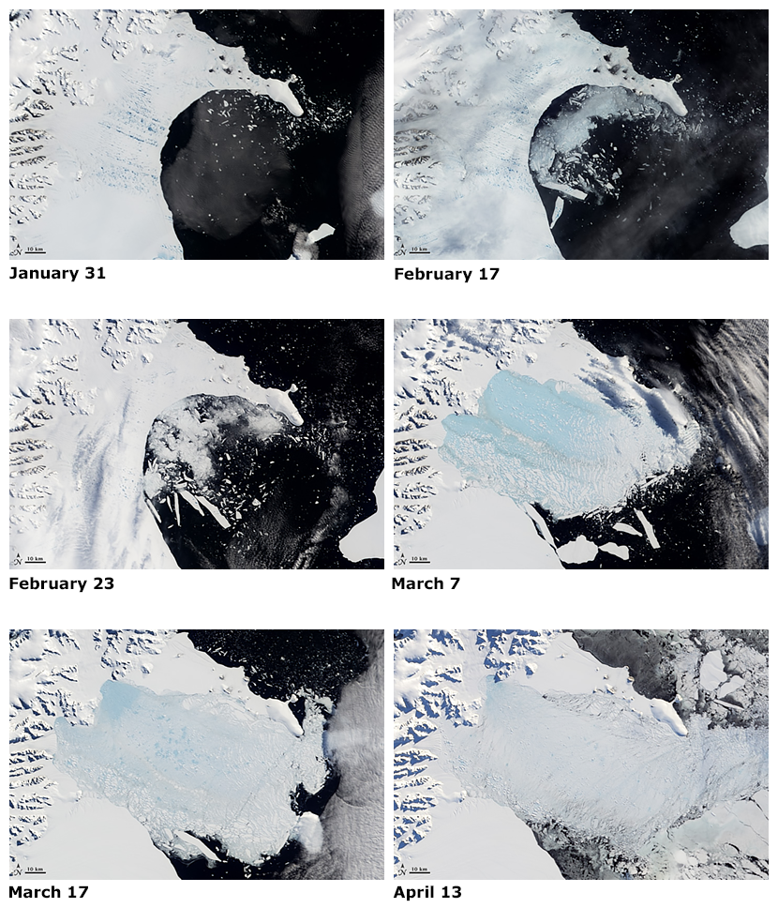
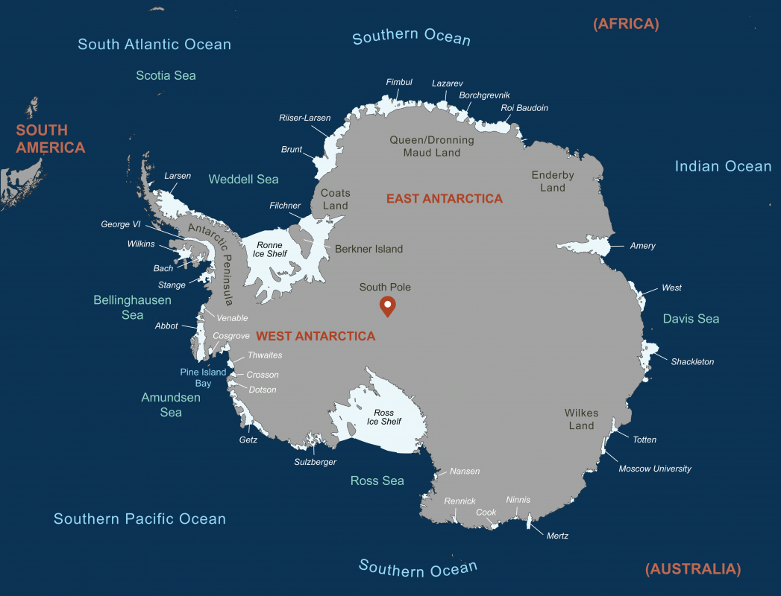
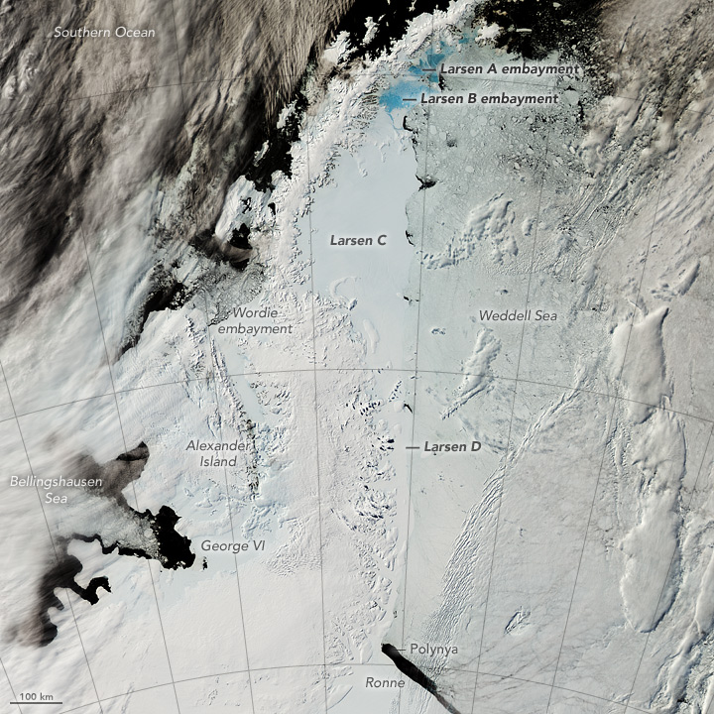
Ice Shelf Loss on the eastern Antarctic Peninsula
On the Antarctic Peninsula (AP), disintegration of Larsen A and B ice shelves in 1995 and 2002)
Ice shelves fringe around 75% of Antarctica’s coastline
State of the Larsen Ice Shelf in 2016
Iceberg A-68
July 2017
Credit: Agnieszka Gautier, NSIDC
Credit: NASA
Figures retrieved January 2022 from https://nsidc.org/cryosphere/icelights/2021/09/what-happened-larsen-ice-shelf
Credit: NASA
Notes:
The forced, anthropogenic signal from 1850-2018 (running 30-year SAT trends). Caveats: some models, such as GISS, simulate far too large of warming response to greenhouse gases and most models have overestimated sea ice melt, and so high uncertainty in the 1 °C. Regardless, observed multi-decadal variability 3x larger than estimated 1 °C signal.

Slide 5
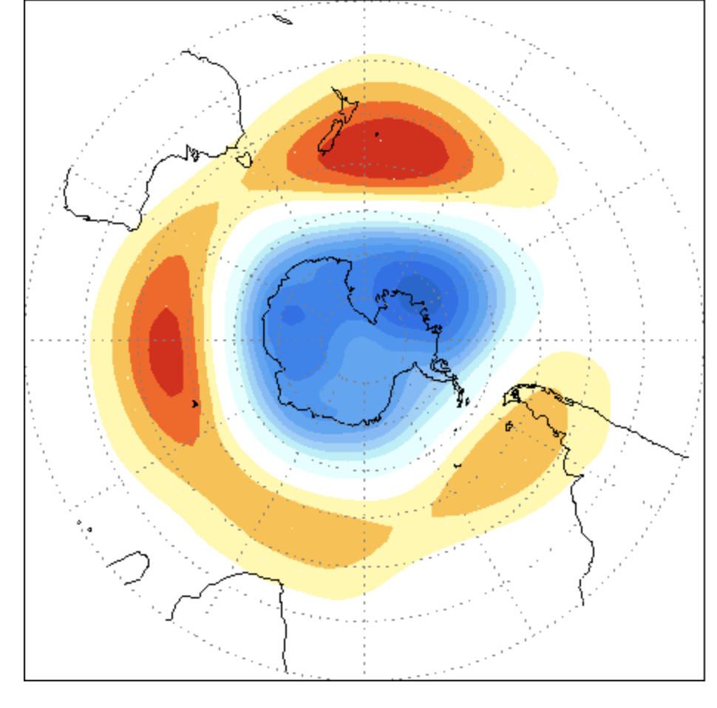
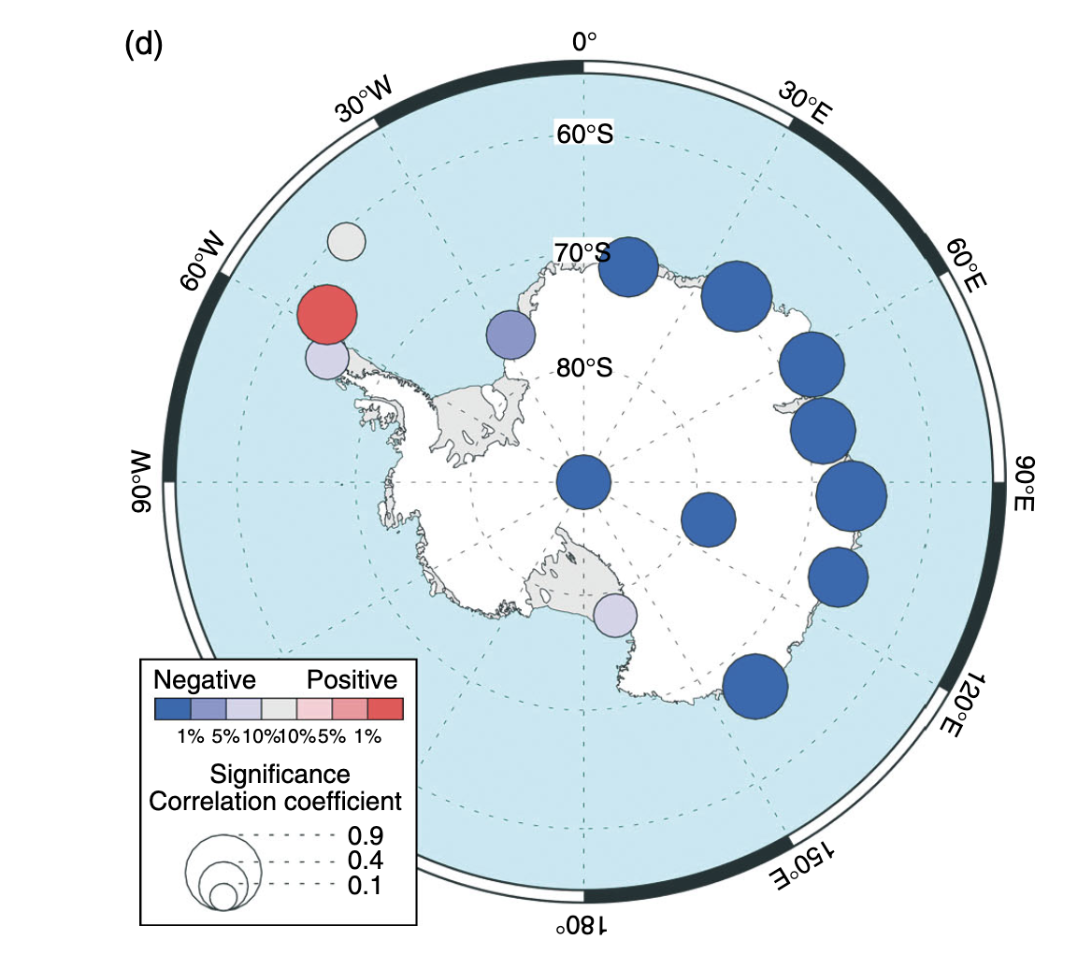
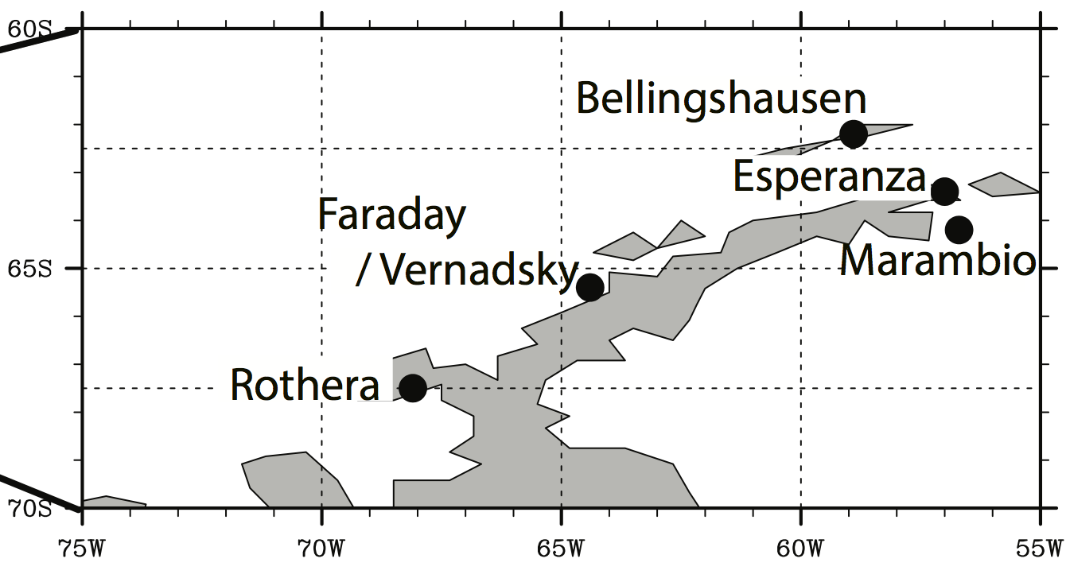
Summer temperatures on the eastern Antarctic Peninsula
DJF Correlation of Southern Annular Mode (SAM) index vs. temperature 1957-2004
Northeast AP warming known to be be triggered by Foehn
Esperanza
Wille et al. (2022) Comms. Earth & Env.
Atmospheric rivers can have multiple effects that can weaken AP ice shelves and lead to their collapse, including surface warming and surface melt
Marshall (2007) IJOC
+SAM → strong westerlies / deep Amundsen Sea Low → warm northeast AP (in summer)
But, long-term temperature measurements are confined to very northeast tip of AP
Notes:
The forced, anthropogenic signal from 1850-2018 (running 30-year SAT trends). Caveats: some models, such as GISS, simulate far too large of warming response to greenhouse gases and most models have overestimated sea ice melt, and so high uncertainty in the 1 °C. Regardless, observed multi-decadal variability 3x larger than estimated 1 °C signal.

Slide 6
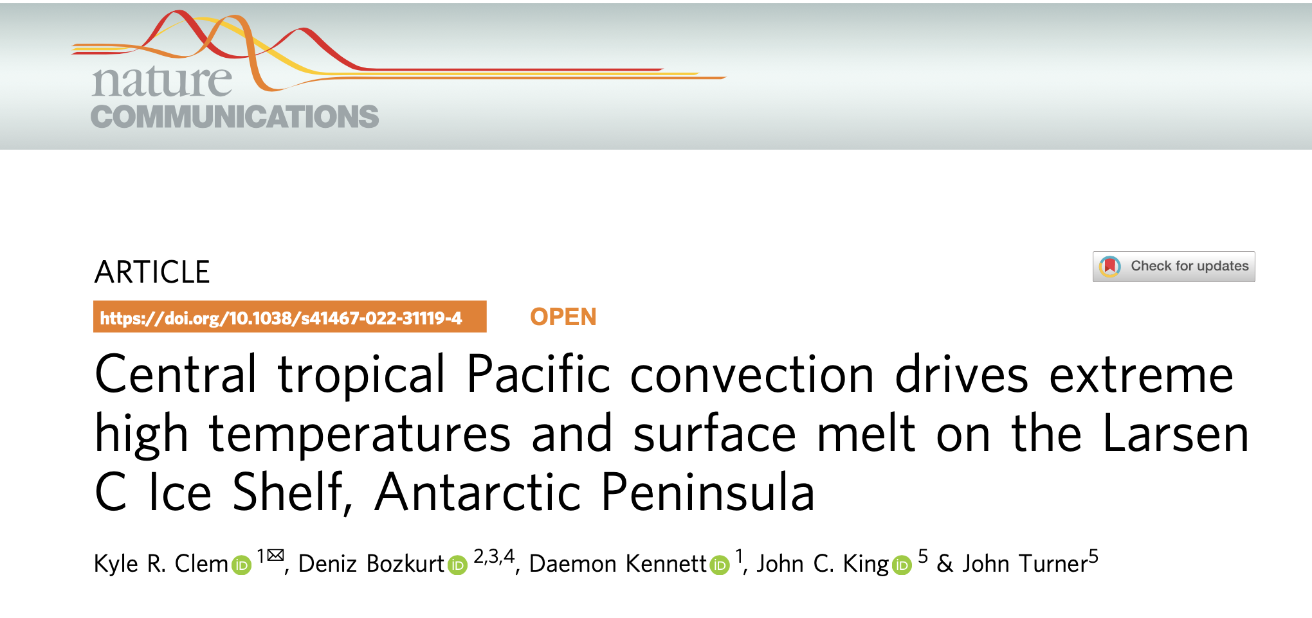
Citation
Clem, K.R., Bozkurt, D., Kennett, D., King, J., Turner, J. (2022). Central tropical Pacific convection drives extreme high temperatures and surface melt on the Larsen C Ice Shelf, Antarctic Peninsula. Nature Communications, https://doi.org/10.1038/s41467-022-31119-4

Slide 7
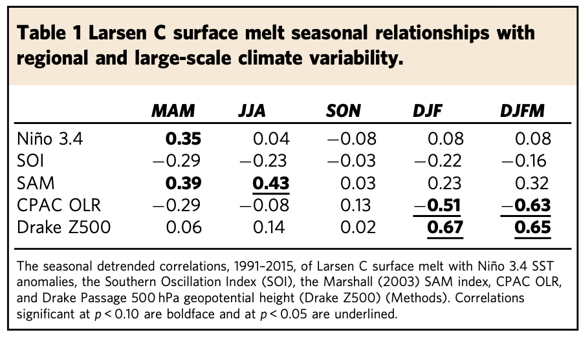
Larsen C Surface Melt Relationships
Study Area and Larsen C Domain
Seasonal Larsen C Surface Melt Correlations
-Simulated surface melt (mm) data from Polar-WRF version 3.9.1
-0.13° (∼15 km) spatial resolution
-December 1991 to March 2015
Clem et al. (2022)-Nat. Comms.
Notes:
The forced, anthropogenic signal from 1850-2018 (running 30-year SAT trends). Caveats: some models, such as GISS, simulate far too large of warming response to greenhouse gases and most models have overestimated sea ice melt, and so high uncertainty in the 1 °C. Regardless, observed multi-decadal variability 3x larger than estimated 1 °C signal.

Slide 8
Larsen C Surface Melt Summer (DJFM) Correlations
SST
El Niño-like, but correlation with ENSO is not significant (weak SST correlations along Equator)
OLR
Significant correlation with central tropical Pacific convection (south of Equator, more SPCZ)
250 hPa Streamfunction
Circulation pattern consists of alternating high and low pressure anomalies arcing from central tropical Pacific into South Atlantic
Z500
Strong correlation with high pressure anomaly over Bellingshausen Sea / Drake Passage & upstream low in mid-latitudes; no clear “zonally symmetric” SAM pattern (correlation with SAM is not significant)
Clem et al. (2022)-Nat. Comms.
Notes:
The forced, anthropogenic signal from 1850-2018 (running 30-year SAT trends). Caveats: some models, such as GISS, simulate far too large of warming response to greenhouse gases and most models have overestimated sea ice melt, and so high uncertainty in the 1 °C. Regardless, observed multi-decadal variability 3x larger than estimated 1 °C signal.

Slide 9
Relationship with central tropical Pacific Convection
DJFM correlations: Larsen C surface melt (left) and central tropical Pacific (CPAC) OLR (right)
250 hPa Streamfunction
250 hPa Streamfunction
Larsen C surface melt and CPAC OLR have similar circulation features: alternating high/low pressure anomalies arcing from CPAC into South Atlantic
Both associated with strong high pressure anomaly over Drake Passage, would lead to southwest flow across AP
Both associated with classic foehn signature: strong windward moisture flux convergence & leeward moisture flux divergence (particularly marked over Larsen C)
Z500
Z500
VINT Moisture Flux Divergence
VINT Moisture Flux Divergence
Top three Dec, Jan, Feb, Mar & DJFM surface melt events:
  13/15 years had strong CPAC convection (OLR≤-0.5σ)
  No preference for SAM phase
  No preference for ENSO phase
Clem et al. (2022)-Nat. Comms.
Notes:
The forced, anthropogenic signal from 1850-2018 (running 30-year SAT trends). Caveats: some models, such as GISS, simulate far too large of warming response to greenhouse gases and most models have overestimated sea ice melt, and so high uncertainty in the 1 °C. Regardless, observed multi-decadal variability 3x larger than estimated 1 °C signal.

Slide 10
24 March 2015 & 6 Feb 2020 Record-High Temperature at Esperanza
200 hPa SF/WaveFlx/OLR Anomalies
2015
22-26 March
+17.5°C
MSLP/T2m/10m Wind Anom
MSLP/IVT/Atmospheric River
850 hPa SF/WaveFlux/OLR Anomalies
2020
4-8 February
+18.3°C and record AP surface melt
Clem et al. (2022)-Nat. Comms.
Notes:
The forced, anthropogenic signal from 1850-2018 (running 30-year SAT trends). Caveats: some models, such as GISS, simulate far too large of warming response to greenhouse gases and most models have overestimated sea ice melt, and so high uncertainty in the 1 °C. Regardless, observed multi-decadal variability 3x larger than estimated 1 °C signal.

Slide 11
7-8 Feb 2022 Record-Warm Temperature at Esperanza
200-hPa Div. Wind & Rossby Wave Source
200-hPa ψ and Stationary Wave Flux
MSLP Anomalies and Std. Dev.
Gorodetskaya et al. (2023) in review in npj Clim. Atmos. Sci.

Slide 12
Simulated Atmospheric Response to CPAC Convection
200 hPa Streamfunction/Wave Flux and Precip Anomalies (Climatological 300 hPa Zonal Wind)
Z500 and 200 hPa Divergent Wind Anomalies
CESM version 1.2, atmosphere-only mode (CAM5 physics/dynamics) with prescribed SST/sea ice/ozone
+2C SST perturbation in CPAC
Difference in 30-year control climo and 30-year CPAC perturbed climo
Dec-Jan-Feb anomalies shown
T2m Anomalies
Precipitation Anomalies

Slide 13
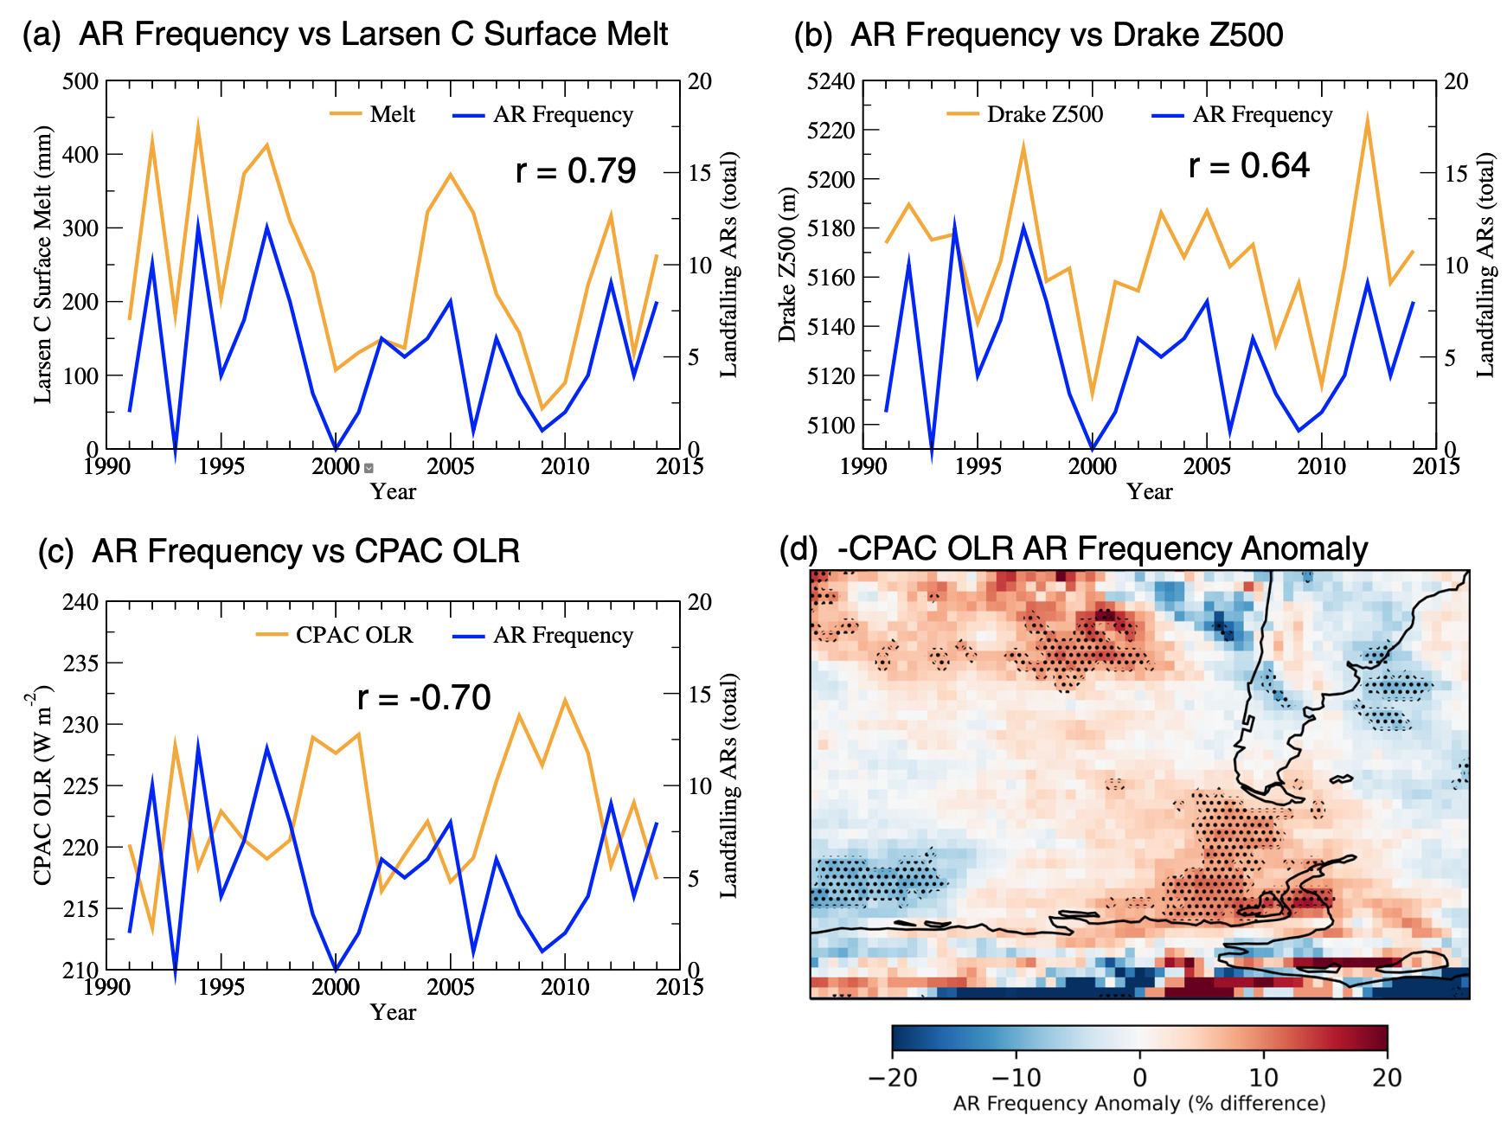
Larsen C Surface Melt and CPAC Convection Relationships with Atmospheric River Frequency
Summer Larsen C surface melt strongly tied to total number of extreme* landfalling ARs
Total number of extreme landfalling ARs strongly tied to CPAC convection and the Drake Passage anticyclone
15-20% increase in AR days over Peninsula during days of strong CPAC convection (OLR≤-0.5σ)
*Extreme landfalling AR events defined as AR (AR catalog V3.0, Guan and Waliser 2019) landfall days with daily-mean IVT area-averaged over the AP exceeding the 95th percentile (based on the DJFM IVT climatology from ERA-Interim)
Clem et al. (2022)-Nat. Comms.

Slide 14
Extreme high temperatures at Esperanza (AR vs noAR)
Non-atmospheric river extreme warm events
Strong high-low couplet
But large-scale pattern is zonal, reflecting a zonal wave (band of highs/lows oriented along ~60°S)
Atmospheric river-related extreme warm events
Strong high-low couplet
But large-scale pattern is tilted in a great circle path, reflecting a Rossby wave forced from tropics
This allows for poleward transport of heat and moisture from tropics to Antarctica
Dutrievoz et al. (2023) in prep

Slide 15
14-23 March 2015
2-8 February 2022
Central tropical Pacific convection (in summer) triggered along baroclinic/frontal zones
Frontal incursions are associated with extra-tropical wave intrusions from the southwest
Daily OLR (contours), 925 hPa temperature advection & 10-m wind

Slide 16
Summary & Conclusions
Antarctic Peninsula atmospheric rivers, Larsen C surface melt, and extreme-high temperatures triggered by high-low couplet
  High-low couplets characterized by strong northerly flow
  High-low couplets are relatively common around Antarctica (tied to zonal-wave activity)
During extreme warm/melt events, this circulation pattern is tied to a Rossby wave forced by central tropical Pacific convection
  Especially convection south of the equator along the South Pacific Convergence Zone (not ENSO)
When the circulation is forced from the tropics, the pattern features a northwest tilt into the tropics
  This sources tropical/subtropical heat and moisture
No significant relationship between surface melt and the SAM during summer
  Perhaps too ‘zonally-symmetric’? … asymmetries and northwest/southeast orientation are key
  SAM is tied to temperature on AP tip, but on an interannual basis only?

Slide 17
Thank you!!
Email
kyle.clem@vuw.ac.nz
Citation
Clem, K.R., Bozkurt, D., Kennett, D., King, J., Turner, J. (2022). Central tropical Pacific convection drives extreme high temperatures and surface melt on the Larsen C Ice Shelf, Antarctic Peninsula. Nat Commun.

Slide 18
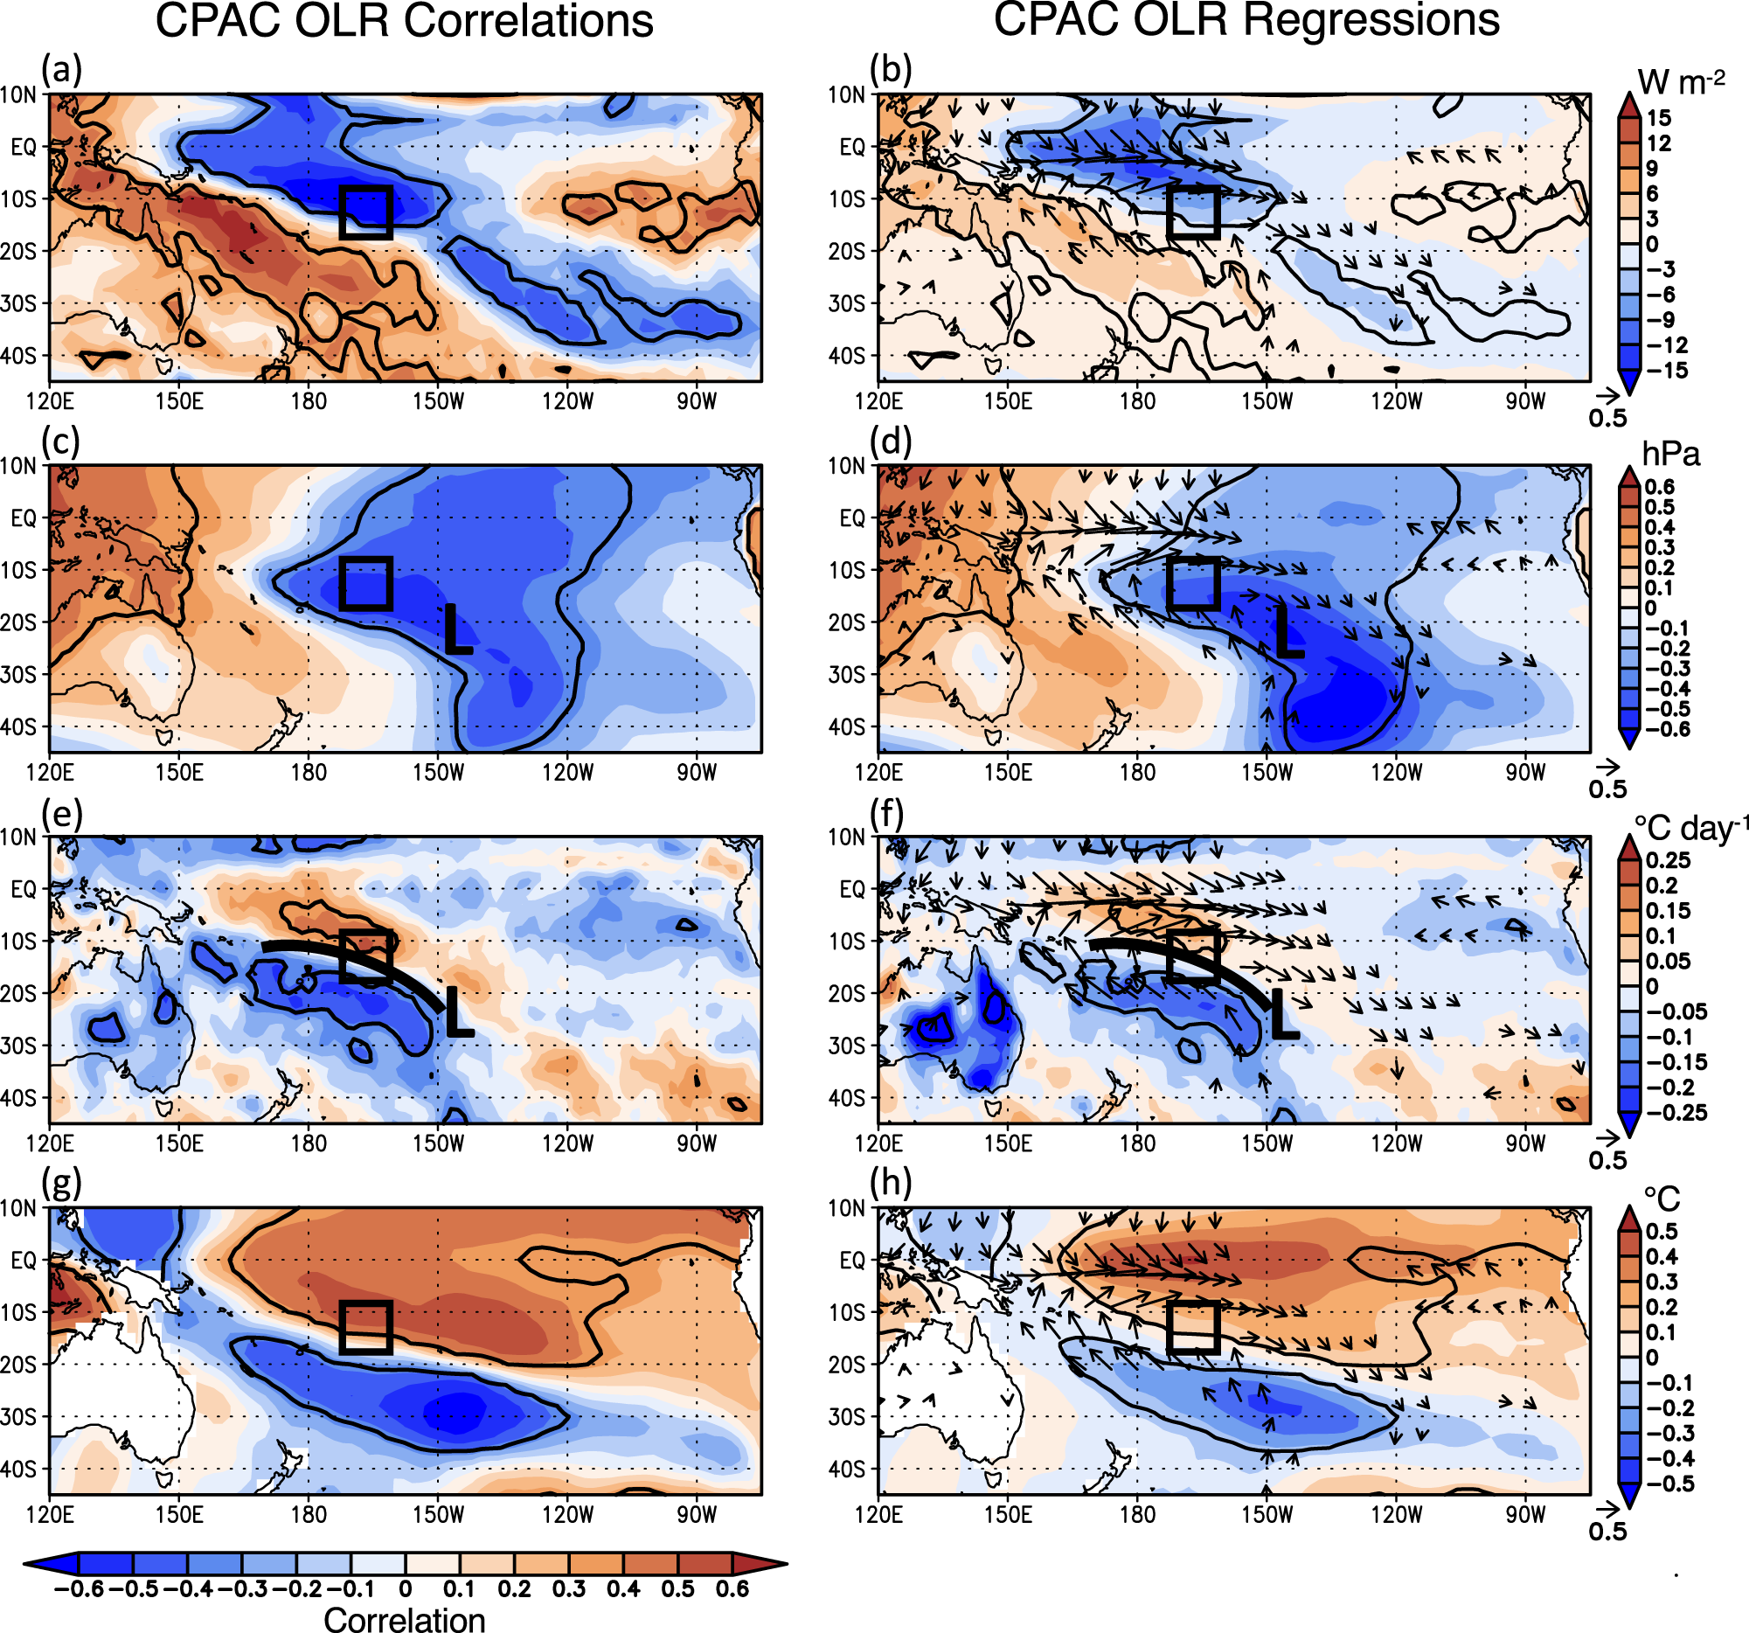
OLR
OLR
Environmental conditions that trigger CPAC convection
MSLP
MSLP
CPAC convection associated with an off-equatorial, diagonal band of convection resembling the SPCZ
Surface low pressure and southerly flow to the east and southeast of convection + surface convergence
The convection forms along a baroclinic frontal zone characterized by a cold front incursion from the south
CPAC convection associated with El Niño-like SST anomalies, but the convection itself does not form over positive SST anomalies (the baroclinic forcing is key)
925 hPa temp. advection
925 hPa temp. advection
SST
SST

Slide 19
Future research interests
Atmospheric circulation patterns associated with poleward heat/moisture transport to Antarctica
  Coupling between low-latitude and high-latitude circulation patterns
  When do low and high-latitude circulations constructively interfere to transport tropical air masses poleward to polar latitudes?
  And the role of “zonal wave” patterns consisting of strong north-south flow
The role of tropical convection in triggering these circulation patterns via planetary Rossby waves
  And vice-versa, the role of atmospheric circulation in triggering the convection
  Positive feedbacks (e.g., convection amplifies the initial circulation)
Range of time scales
  Spanning interannual and decadal time scales (e.g., drivers of multi-decadal “trends”)
  To individual extreme events occurring over several days (process-based analysis)

