Slide 1
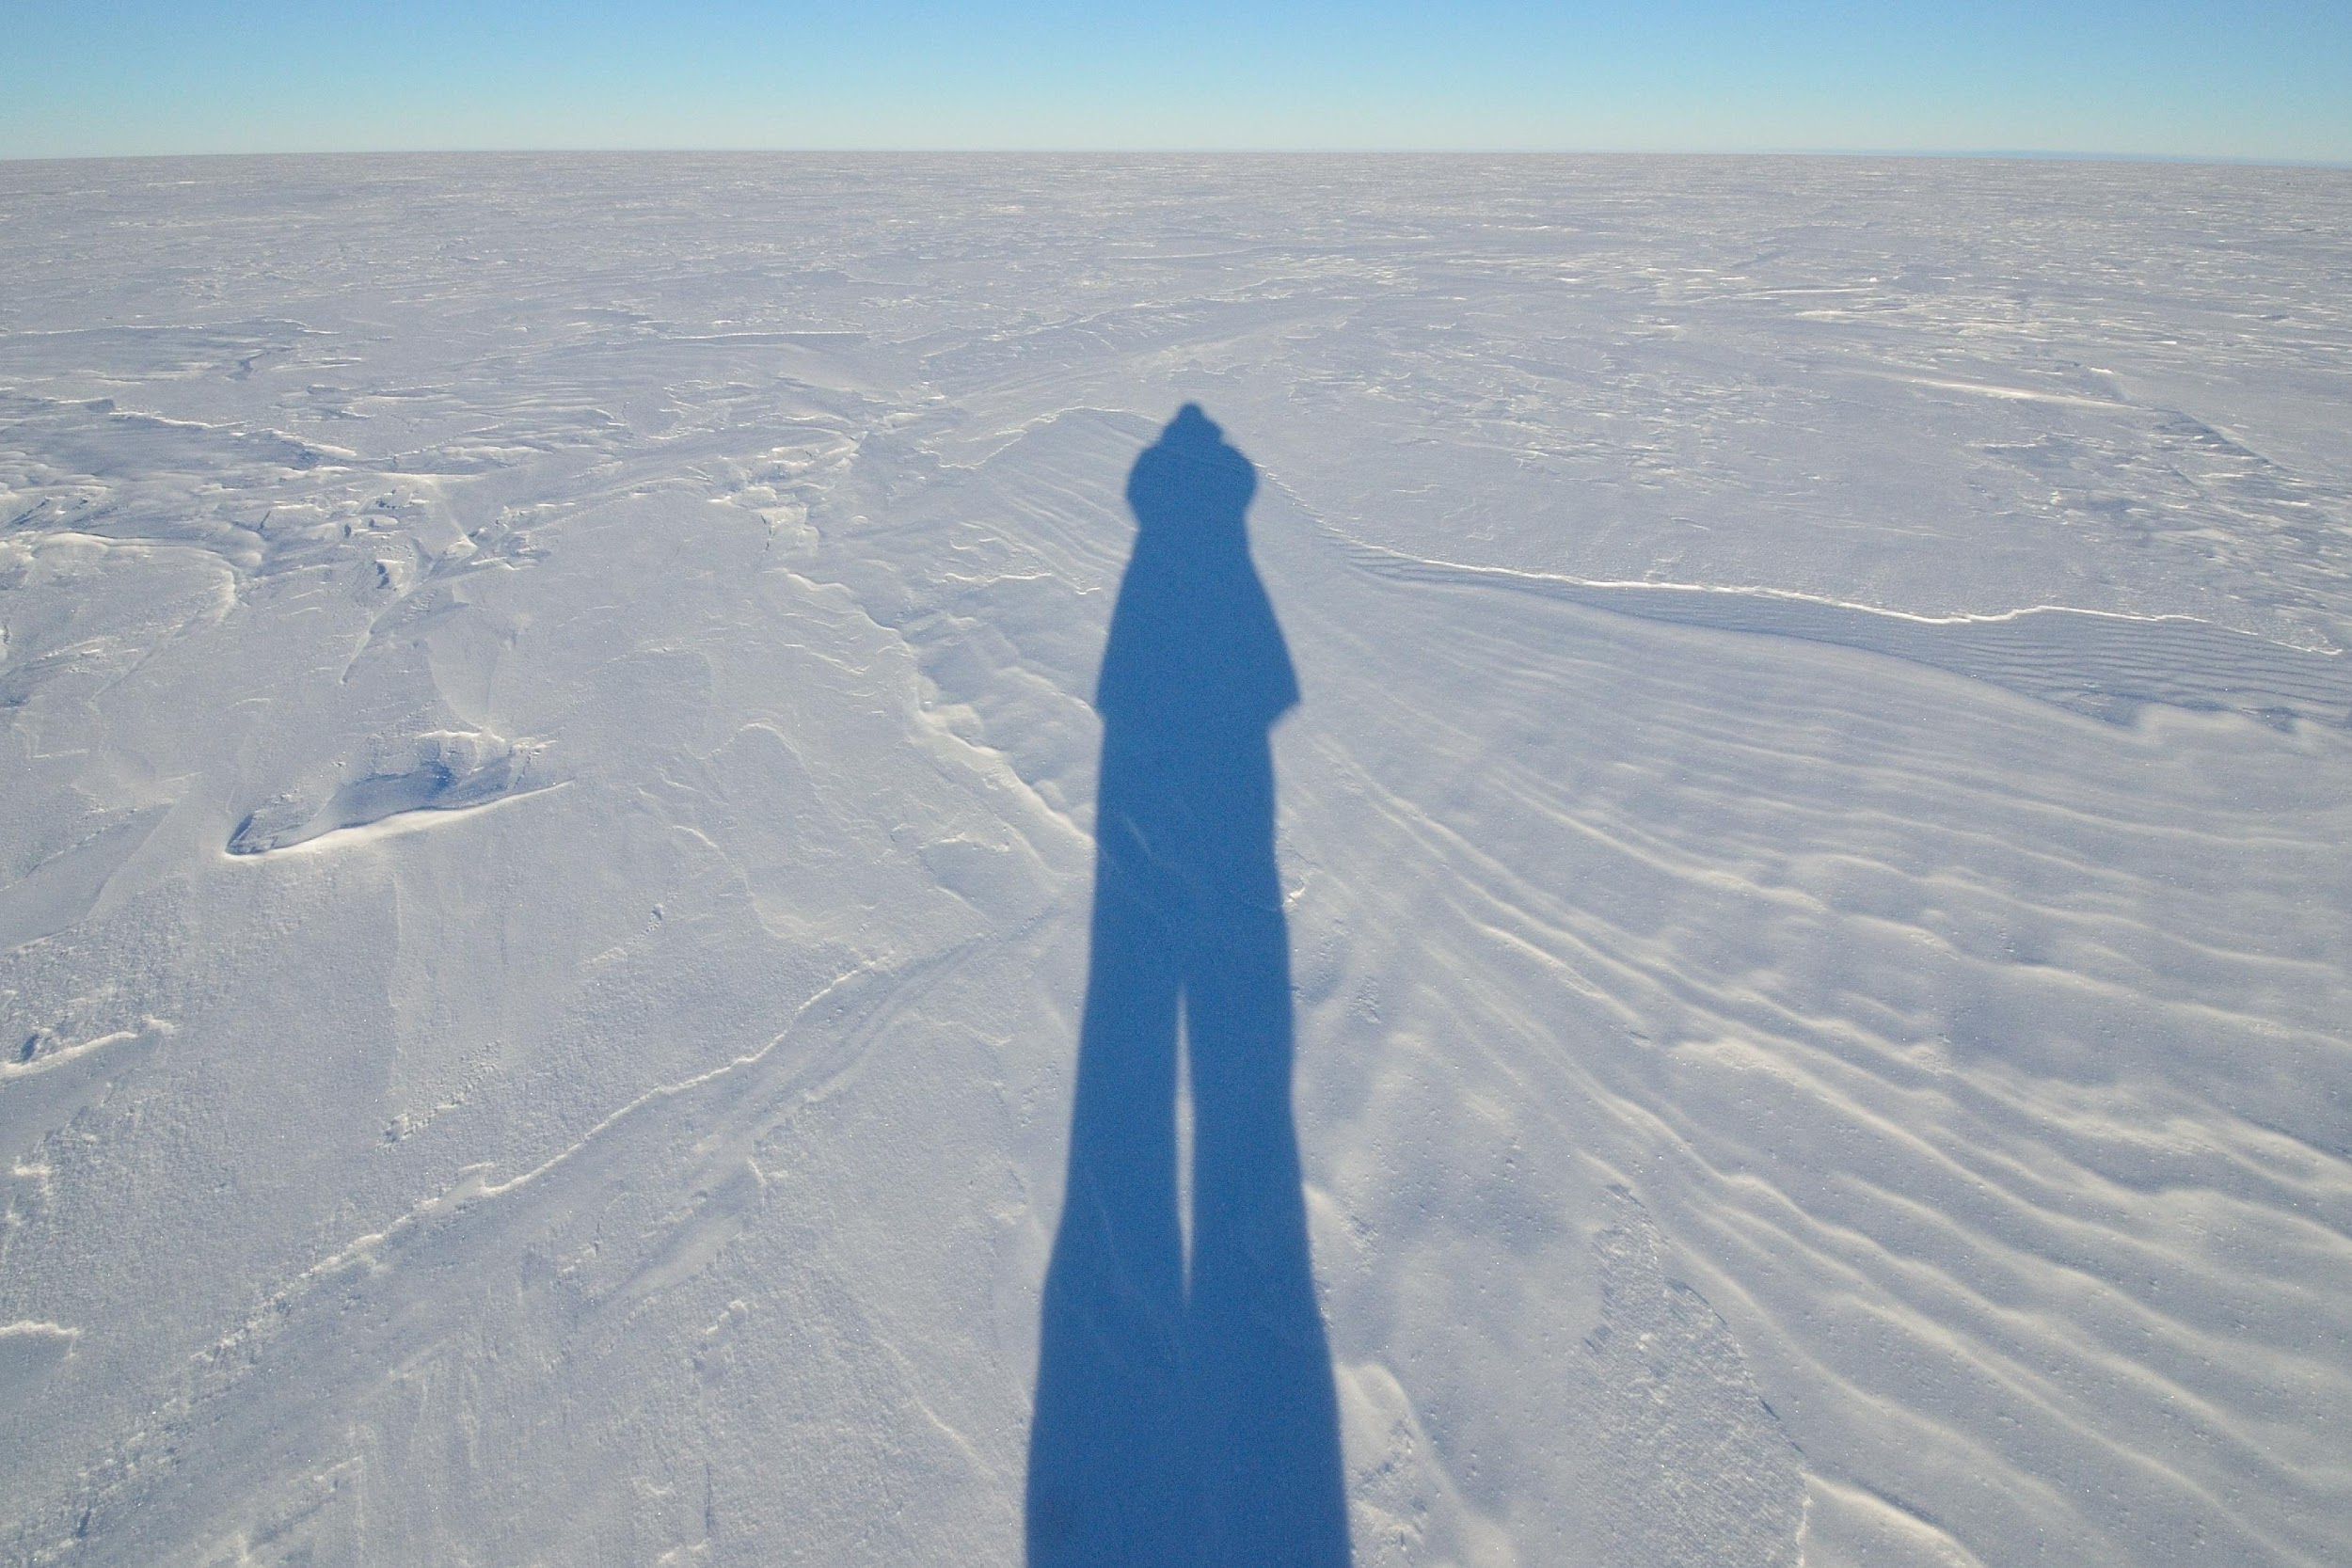


VARIABILITY IN BOUNDARY LAYER
STABILITY ACROSS ANTARCTICA
JOHN J CASSANO, MCKENZIE DICE AND GINA JOZEF
UNIVERSITY OF COLORADO

Slide 2
MOTIVATION AND OUTLINE
THE BOUNDARY LAYER IN POLAR REGIONS IS OFTEN DESCRIBED AS BEING DOMINATED BY STRONG STATIC STABILITY AND TEMPERATURE INVERSIONS
BUT, MORE DETAILED ANALYSES HAVE SHOWN THAT WEAK STABILITY IS ALSO COMMON, EVEN IN WINTER, AT SOME SITES
ANALYZE MULTIPLE YEARS OF RADIOSONDE OBSERVATIONS TO CHARACTERIZE THE STABILITY IN THE LOWEST 500 M OF THE ATMOSPHERE AT 5 SITES ACROSS ANTARCTICA
  USE SELF-ORGANIZING MAPS (SOMS) TO OBJECTIVELY IDENTIFY THE RANGE OF TEMPERATURE PROFILES PRESENT AT EACH SITE
  DEFINE STABILITY REGIME THRESHOLDS TO APPLY TO ALL 5 SITES
    COMPARE FREQUENCY OF STABILITY REGIMES ACROSS SITES
  DETERMINE DIFFERENCES IN NEAR SURFACE WIND SPEED AND DOWNWELLING LONGWAVE RADIATION FOR THE DIFFERENT STABILITY REGIMES AT EACH SITE

Slide 3
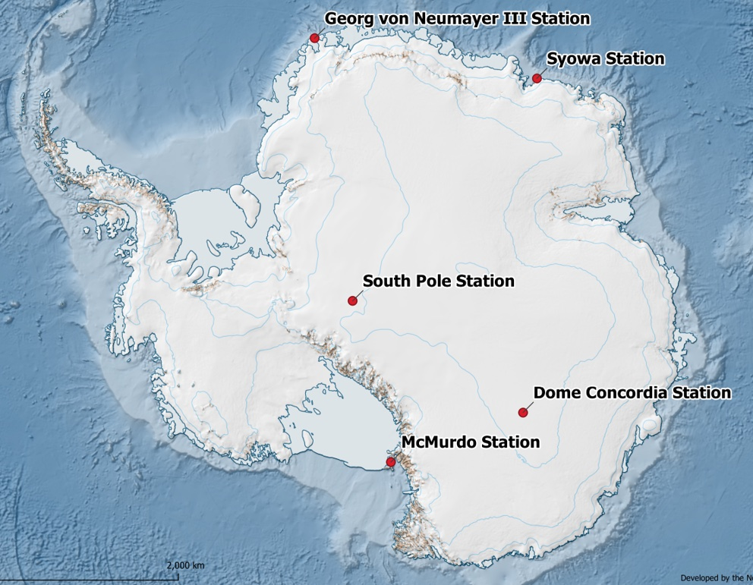
DATA
OBSERVATIONS FROM FIVE SITES ACROSS ANTARCTICA
  THREE COASTAL SITES: MCMURDO, NEUMAYER AND SYOWA
  TWO INTERIOR SITES: SOUTH POLE AND DOME C
RADIOSONDE PROFILES TO 500 M AGL
SURFACE RADIATIVE FLUXES FROM DOE AWARE CAMPAIGN (MCMURDO) AND BASELINE SURFACE RADIATION NETWORK (BSRN)

Slide 4
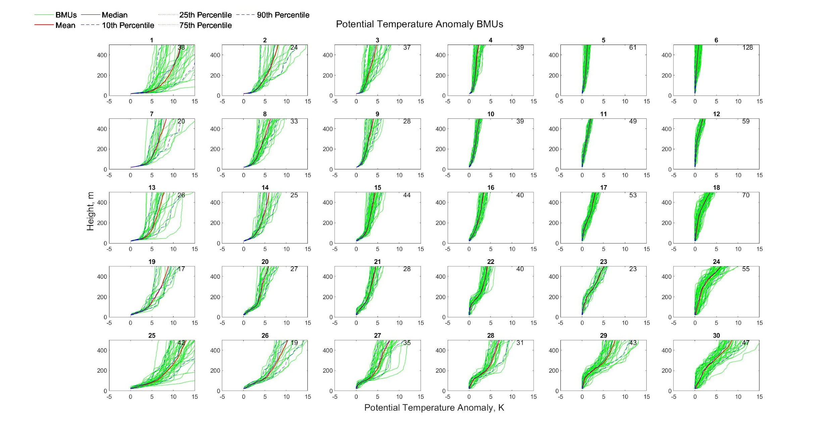
SELF-ORGANIZING MAPS (SOMS)
THE SOM TECHNIQUE IS AN ITERATIVE, UNSUPERVISED ARTIFICIAL LEARNING PROCESS THAT OBJECTIVELY IDENTIFIES PATTERNS IN A TRAINING DATASET
THE OUTPUT FROM THE SOM TRAINING IS A ”MAP” OF PATTERNS THAT SPAN THE RANGE OF CONDITIONS PRESENT IN THE TRAINING DATA
EXAMPLE: 30 PATTERN SOM TRAINED ON >1200 PROFILES

Slide 5
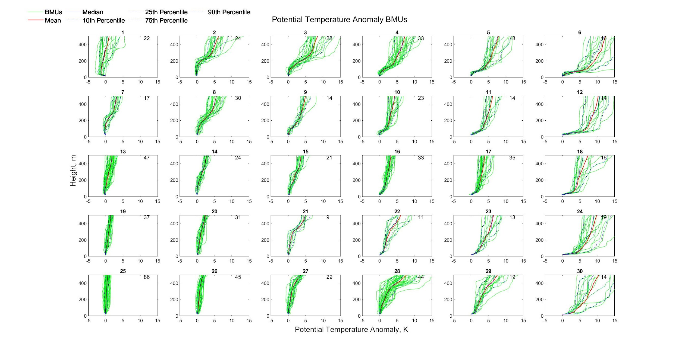
COASTAL SITES: MCMURDO
NOV 2015 – JAN 2017
786 SOUNDINGS
LOCATION
ROSS ISLAND
77.85 S, 166.66 E
10 M ASL
NEARLY WELL MIXED (BOTTOM LEFT) TO STRONGLY STABLE (RIGHT) PROFILES
SOME PROFILES WITH STRONGER STABILITY ALOFT (E.G. TOP CENTER)

Slide 6
COASTAL SITES: NEUMAYER
JUN 2018 – JAN 2021
1220 SOUNDINGS
LOCATION
EKSTRÖM ICE SHELF
70.65 S, 8.17 W
38 M ASL
SIMILAR RANGE OF PROFILE TYPES AS SEEN AT MCMURDO

Slide 7
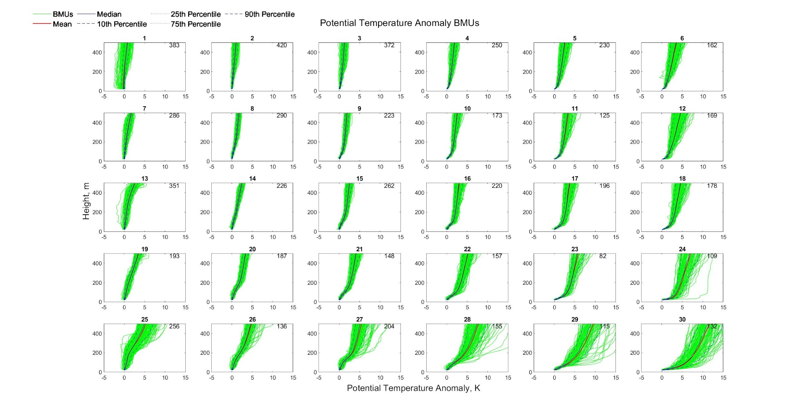
COASTAL SITES: SYOWA
FEB 2007 – JAN 2020
6390 SOUNDINGS
LOCATION
ONGUL ISLAND
69.00 S, 39.58 W
18 M ASL
SIMILAR RANGE OF PROFILE TYPES AS SEEN AT MCMURDO

Slide 8
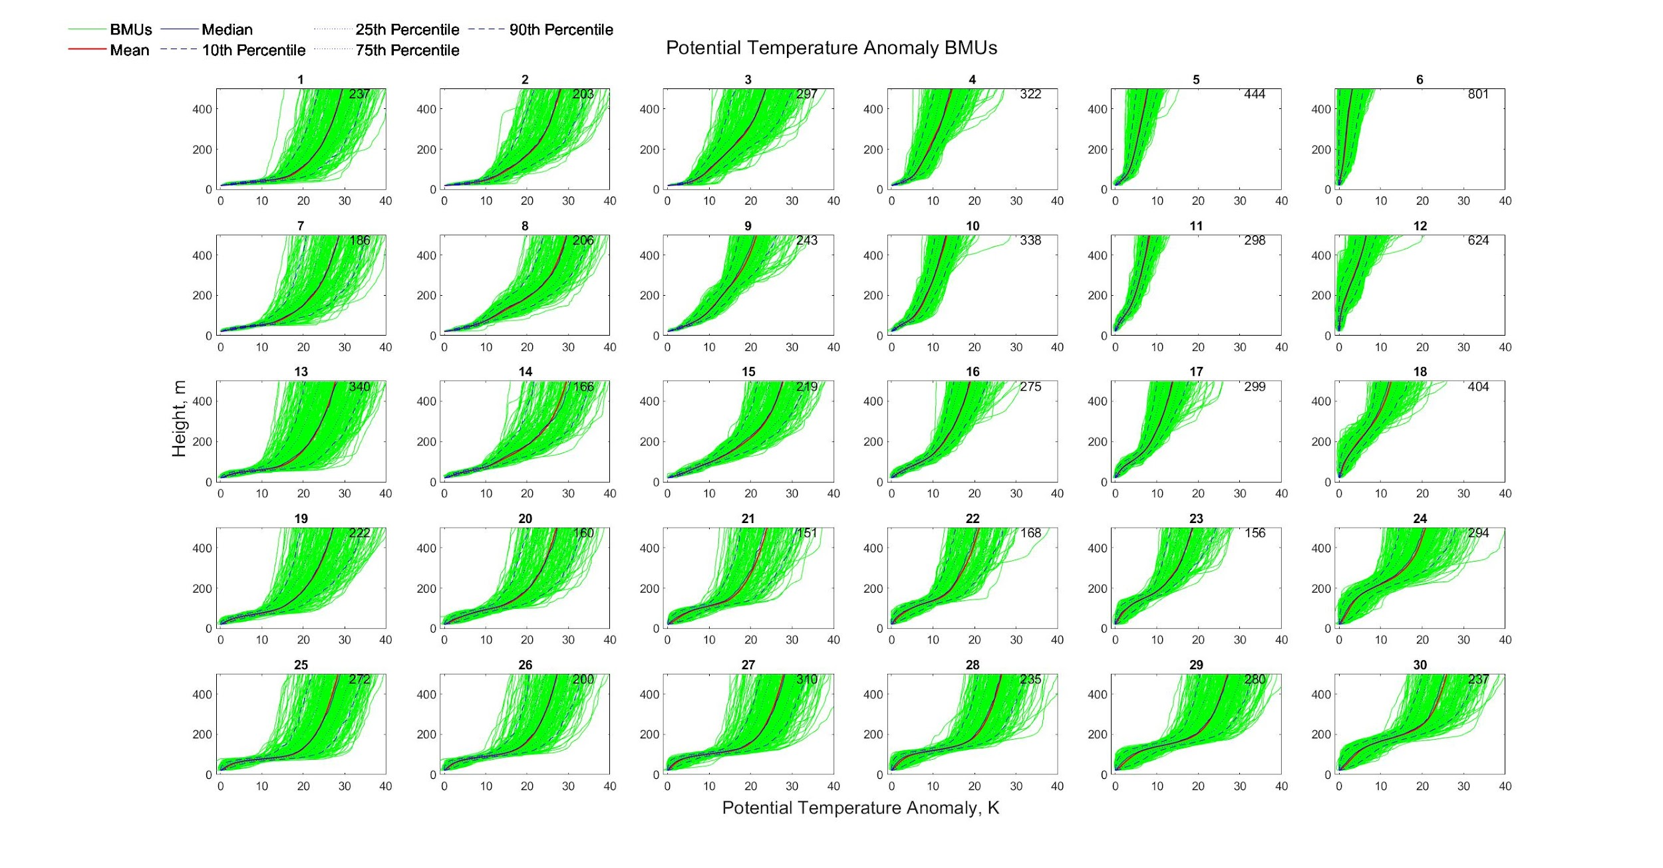
INTERIOR SITES: SOUTH POLE
JAN 2005 – SEP 2021
8587 SOUNDINGS
LOCATION
EAST ANTARCTIC ICE SHEET
89.98 S, 24.80 W
2836 M ASL
MUCH STRONGER STABILITY THAN AT COASTAL SITES (LEFT) BUT SOME WEAK STABILITY PROFILES TOO (TOP RIGHT)
PROFILES WITH WEAKER STABILITY NEAR SURFACE AND MUCH STRONGER ALOFT (BOTTOM)

Slide 9
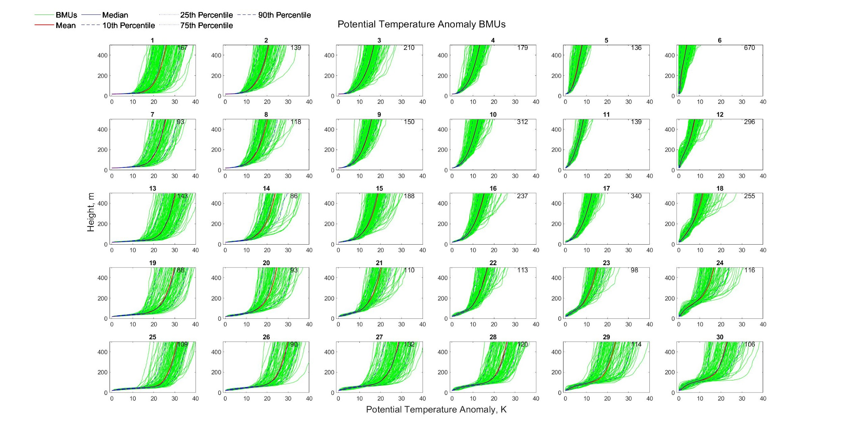
INTERIOR SITES: DOME C
JAN 2006 – OCT 2021
5147 SOUNDINGS
LOCATION
EAST ANTARCTIC ICE SHEET
75.10 S, 123.33 E
3251 M ASL
SIMILAR PROFILES TO THOSE SEEN AT SOUTH POLE BUT FEWER PROFILES WITH WEAK STABILITY NEAR SURFACE AND STRONGER ALOFT (BOTTOM RIGHT)

Slide 10
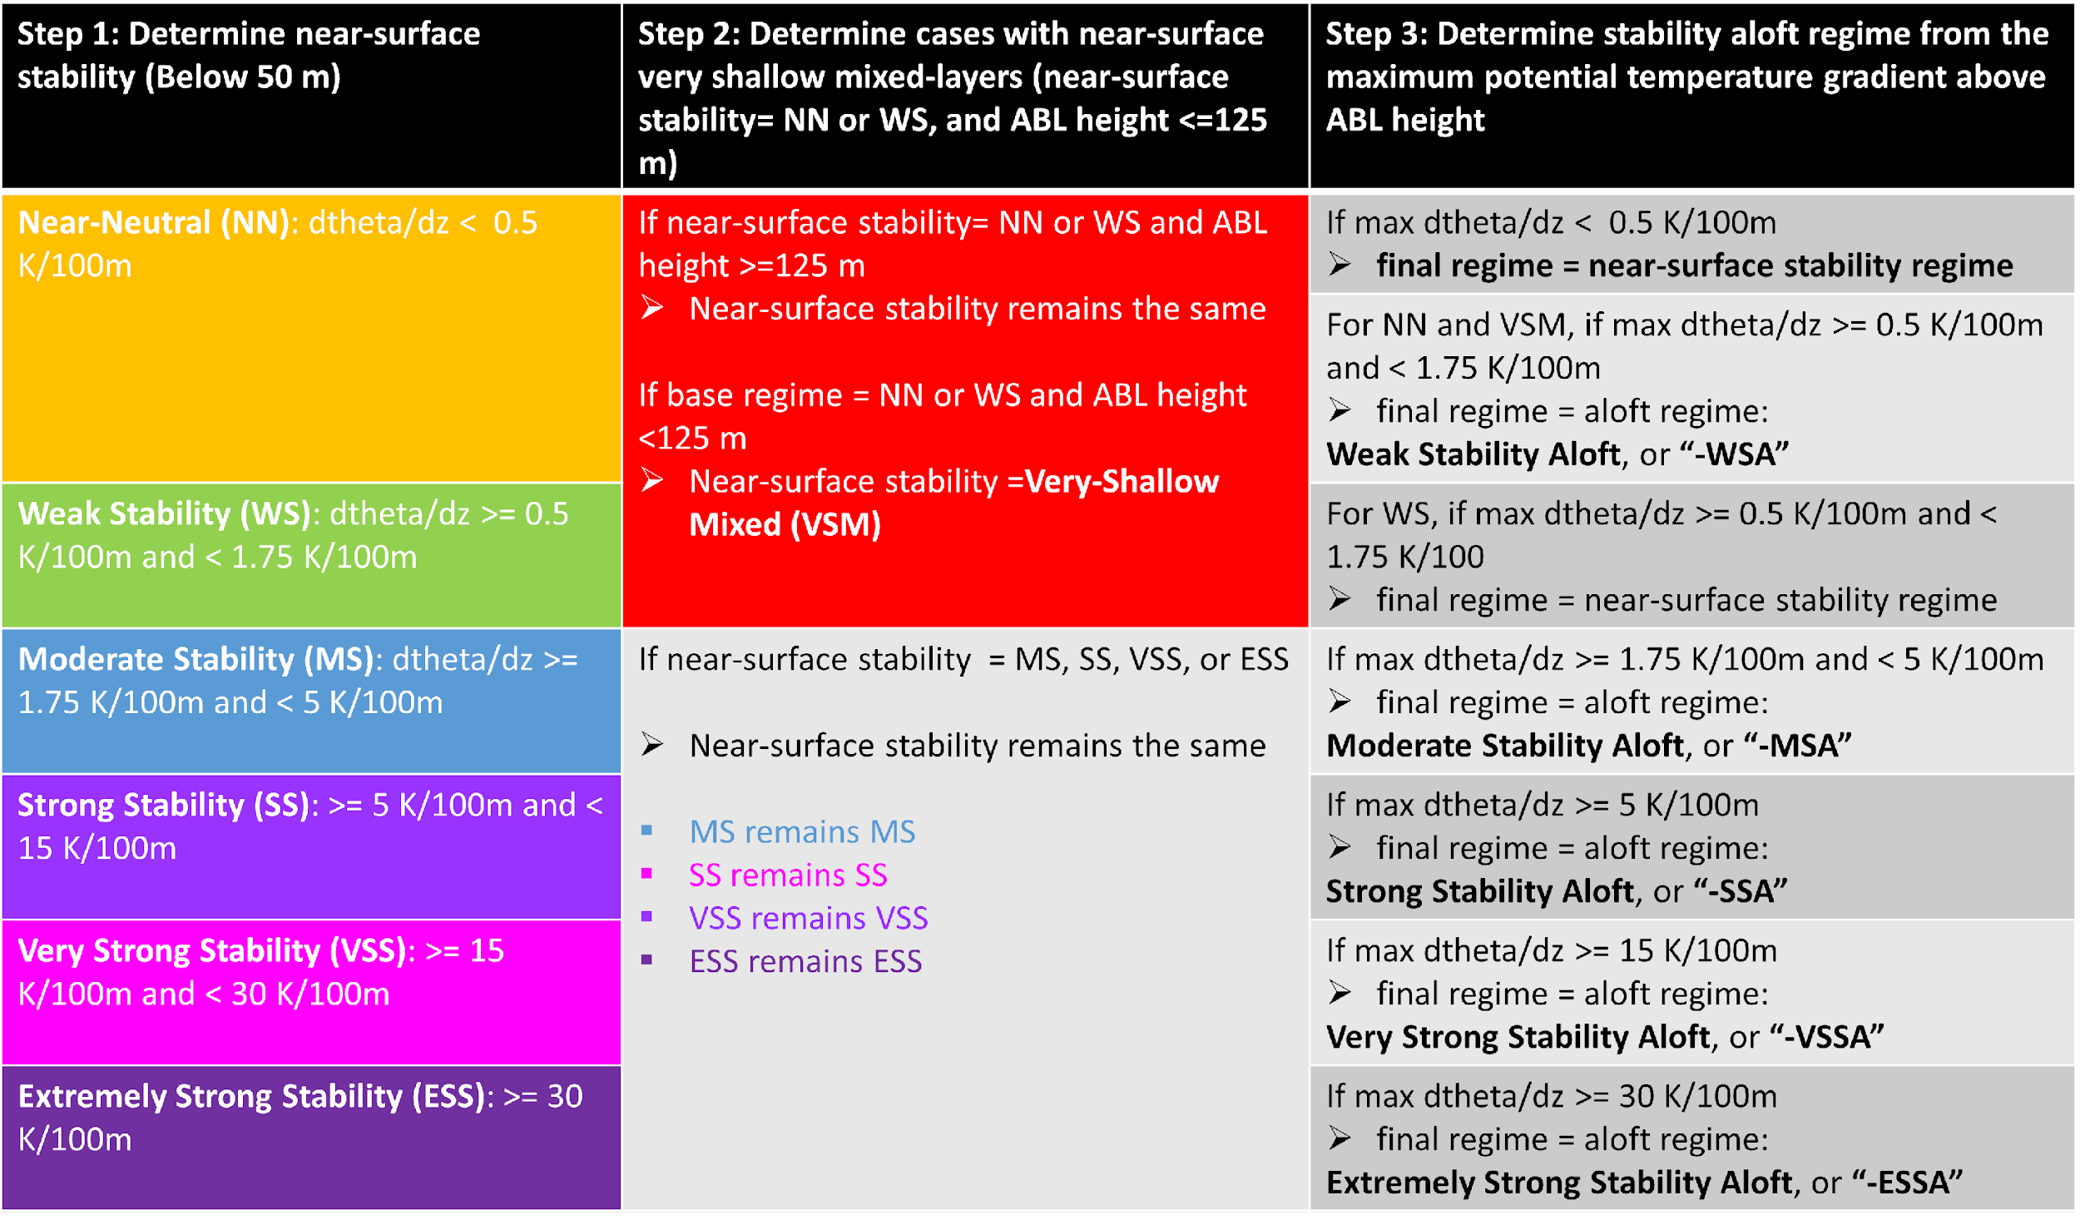
STABILITY REGIMES
STABILITY DEFINED BY VERTICAL POTENTIAL TEMPERATURE GRADIENT RANGING FROM:
NEAR NEUTRAL (<0.5 K / 100 M) TO EXTREMELY STRONG STABILITY (>30 K / 100 M)
DEFINE STABILITY
NEAR SURFACE: 20 TO 50 M
ALOFT: BL TOP TO 500 M
ALSO CONSIDER CASES WITH WEAK STABILITY AND SHALLOW BOUNDARY LAYER (VSM)
TOTAL OF 20 STABILITY REGIMES

Slide 11
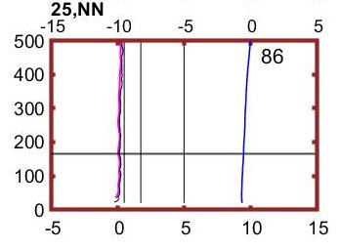
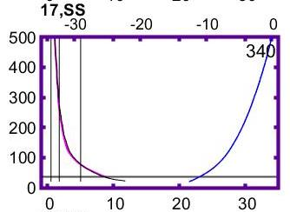
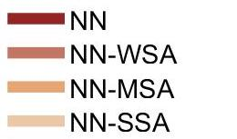
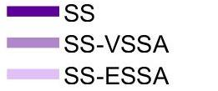
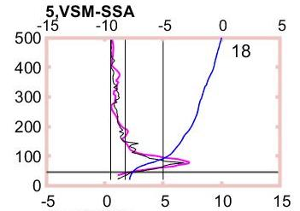
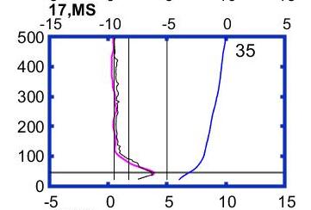
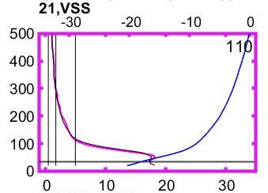
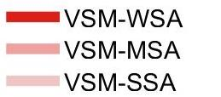
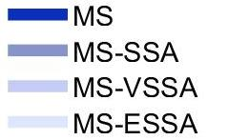

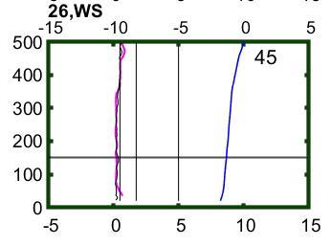
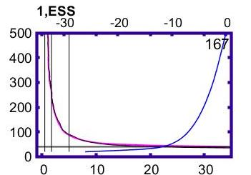
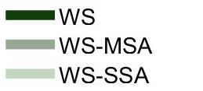

STABILITY REGIMES
NN: <0.5 K / 100 m
SS: 5 to 15 K / 100 m
VSM: <1.75 K / 100 m and BL < 125 m
MS: 1.75 to 5 K / 100 m
VSS: 15 to 30 K / 100 m
WS: 0.5 to 1.75 K / 100 m
Blue line: Potential T anomaly (top axis, K)
Pink line: Potential T gradient (bottom axis, K / 100 m)
Note different scales for
NN to MS and SS to ESS
ESS: >30 K / 100 m

Slide 12
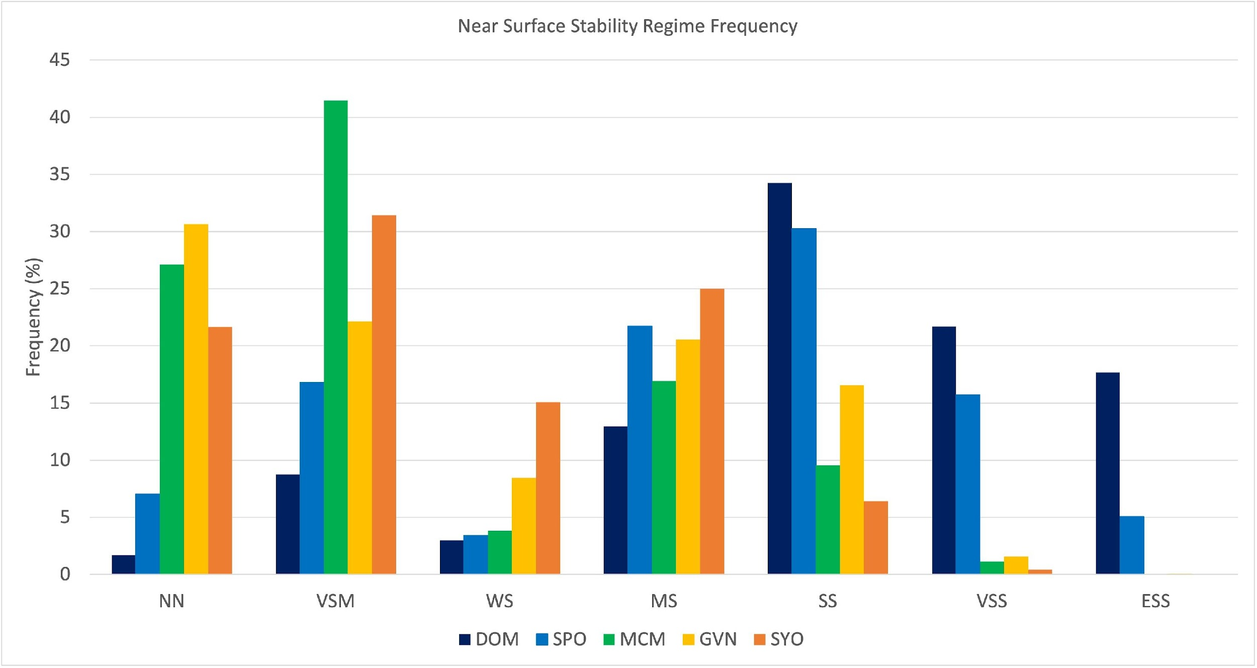
STABILITY REGIME FREQUENCY
ANNUAL FREQUENCY OF NEAR SURFACE (20 TO 50 M AGL) STABILITY REGIMES
NN AND VSM REGIMES MORE COMMON AT COASTAL SITES
WS REGIMES ARE INFREQUENT AT ALL SITES, BUT MORE COMMON AT COASTAL SITES
MS REGIMES HAVE SIMILAR FREQUENCY AT ALL SITES
SS, VSS AND ESS MORE COMMON AT INTERIOR SITES

Slide 13
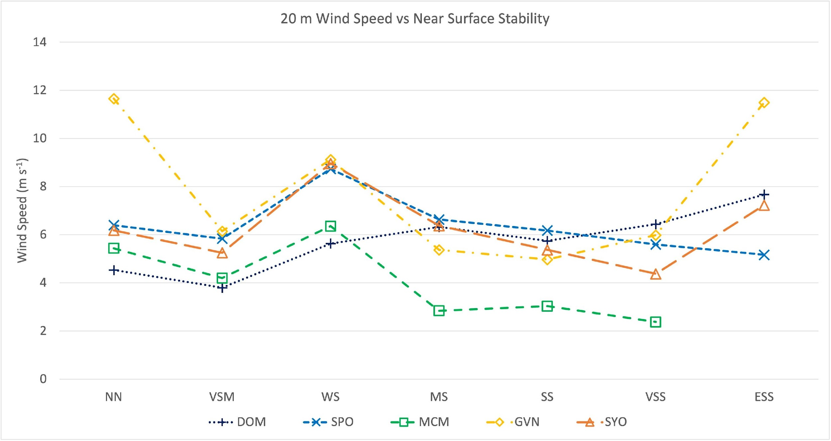
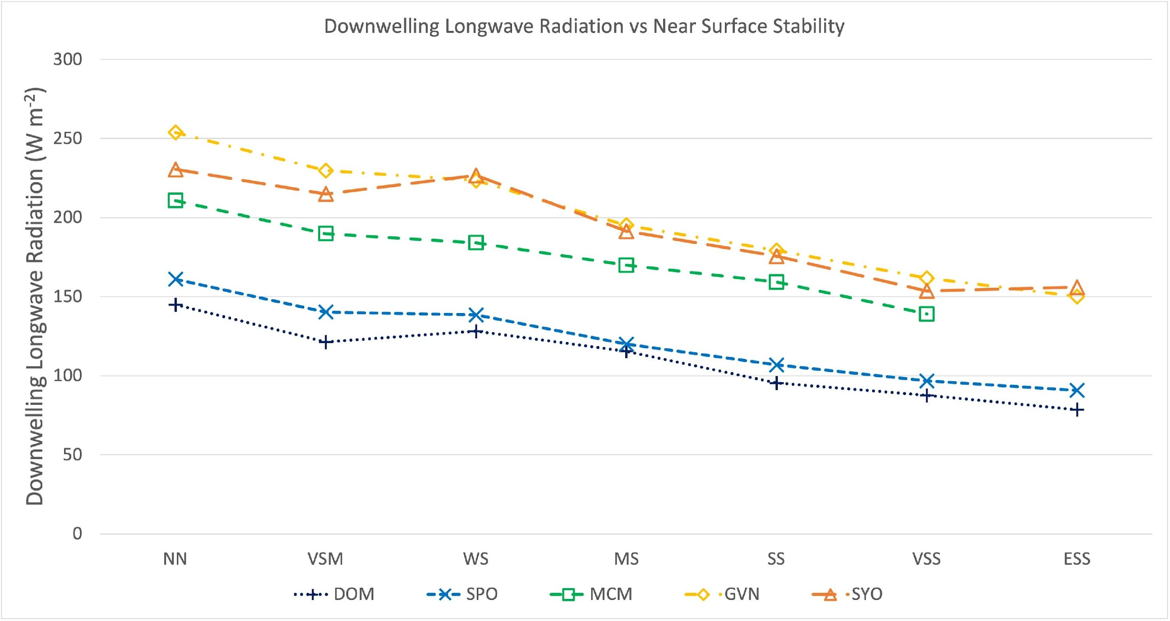
STABILITY VS LWD (BELOW)
CONSISTENT DECREASE IN DOWNWELLING LONGWAVE RADIATION AS NEAR SURFACE STABILITY INCREASES AT ALL SITES
STABILITY VS 20 M WIND SPEED (ABOVE)
FEW CLEAR PATTERNS OF WIND SPEED VS STABILITY
WIND SPEED GENERALLY INCREASES WITH STABILITY AT DOME C (DOTTED BLUE LINE)
WIND SPEED GENERALLY DECREASES WITH STABILITY AT MCMURDO (GREEN DASHED LINE)

Slide 14
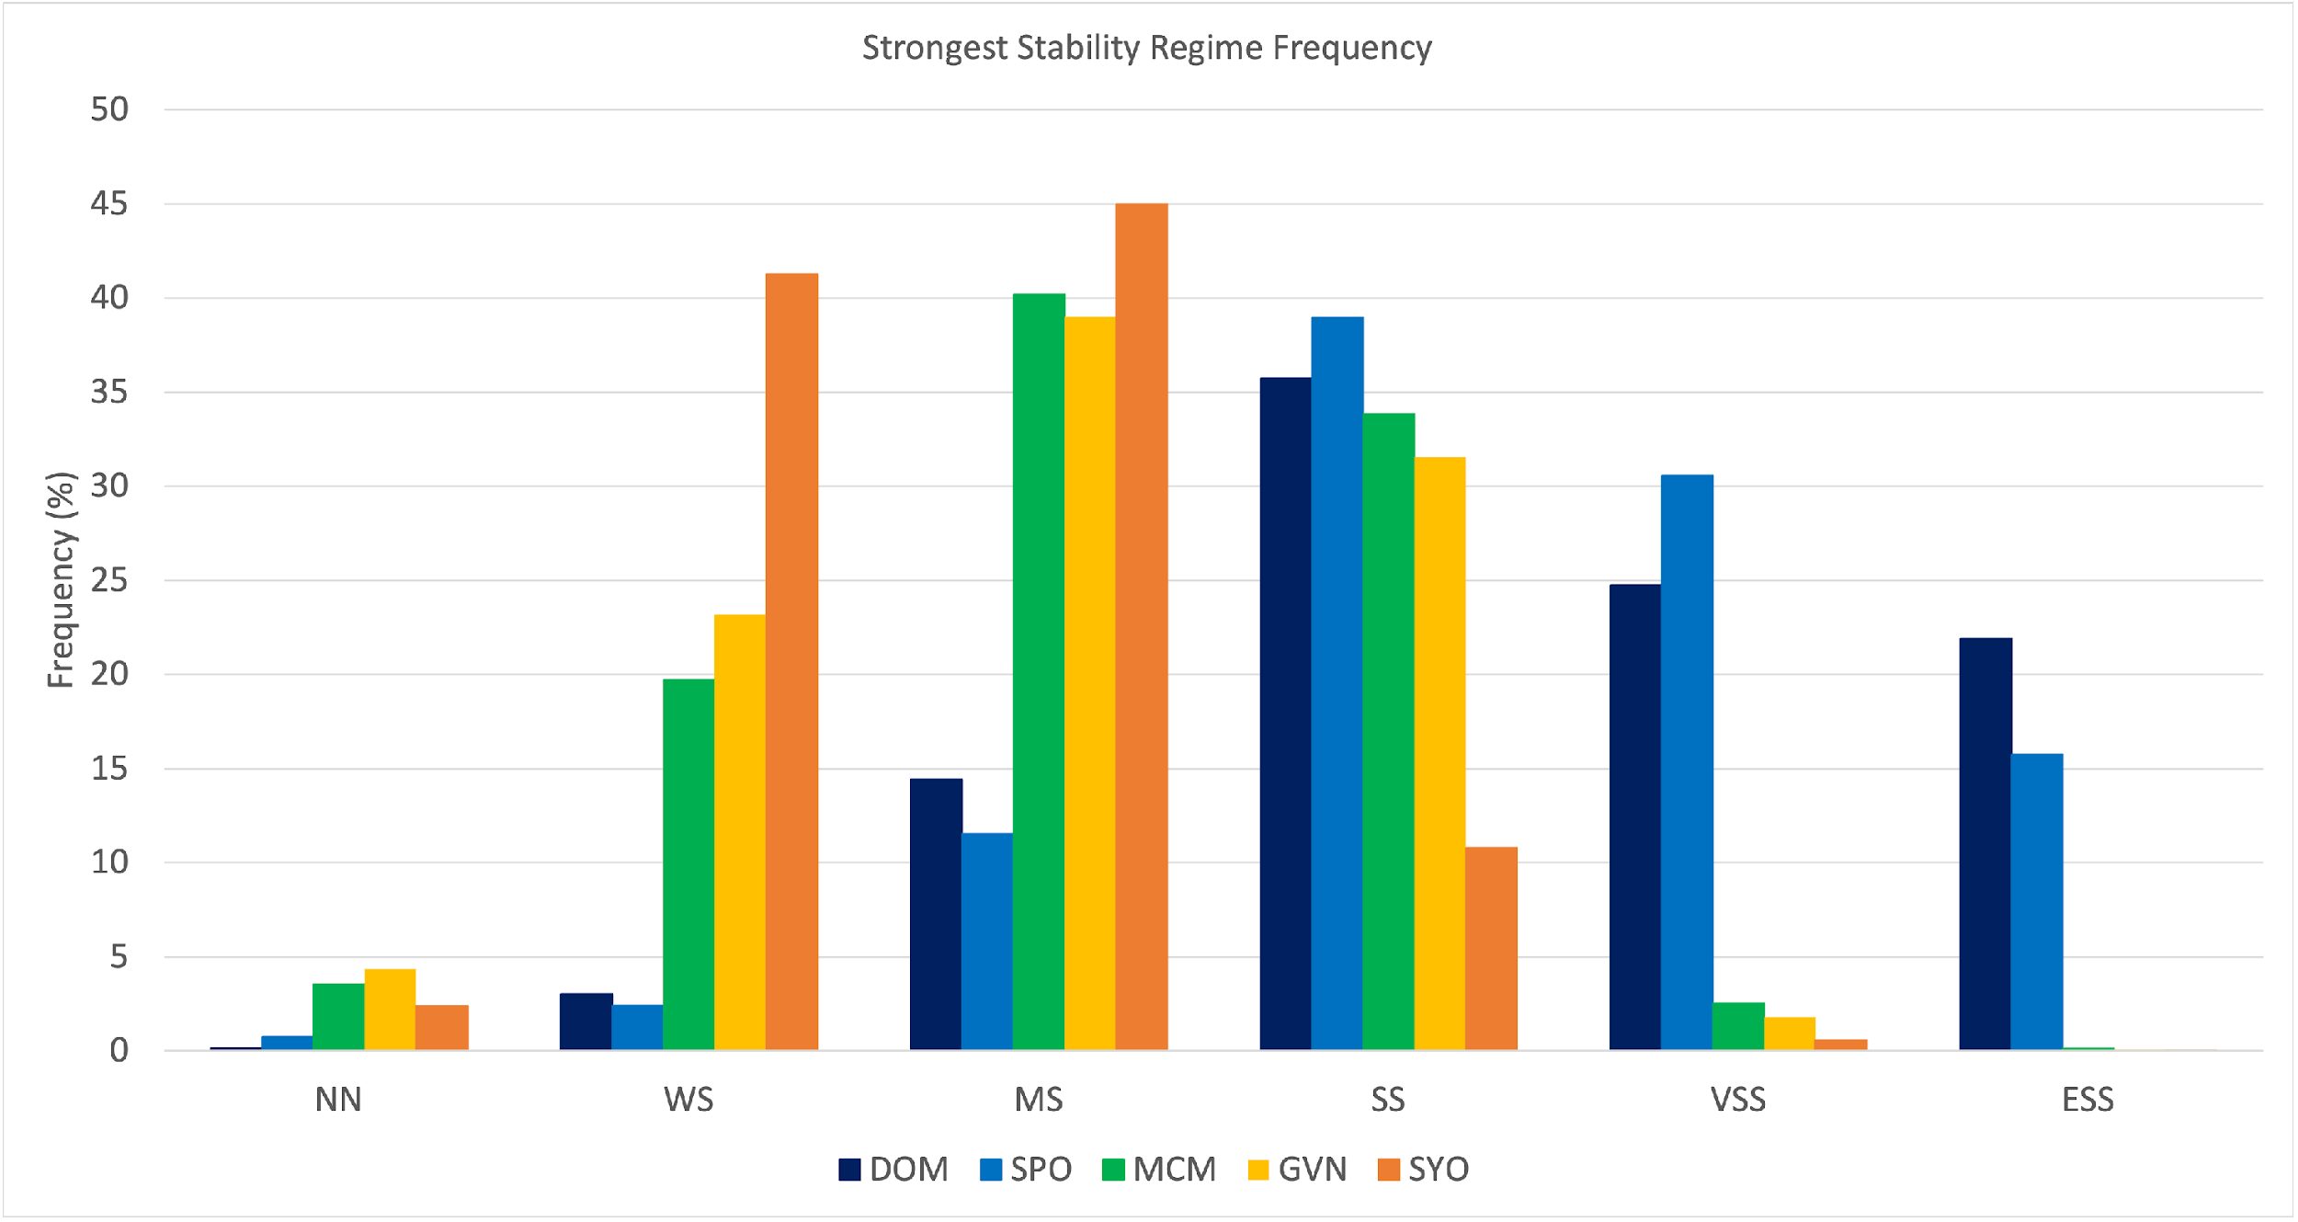
STABILITY REGIME FREQUENCY
CONSIDER STRONGEST STABILITY BELOW 500 M AGL (NEAR SURFACE AND ALOFT)
NN IS UNCOMMON (<5%) AT ALL SITES
WS AND MS MORE COMMON (20-45%) AT COASTAL SITES
SS OCCURS MORE THAN 30% OF THE TIME AT ALL SITES EXCEPT SYOWA
  SYOWA HAS THE WEAKEST STABILITY OF ALL 5 SITES
VSS AND ESS OCCUR 15-30% OF THE TIME AT INTERIOR SITES

Slide 15
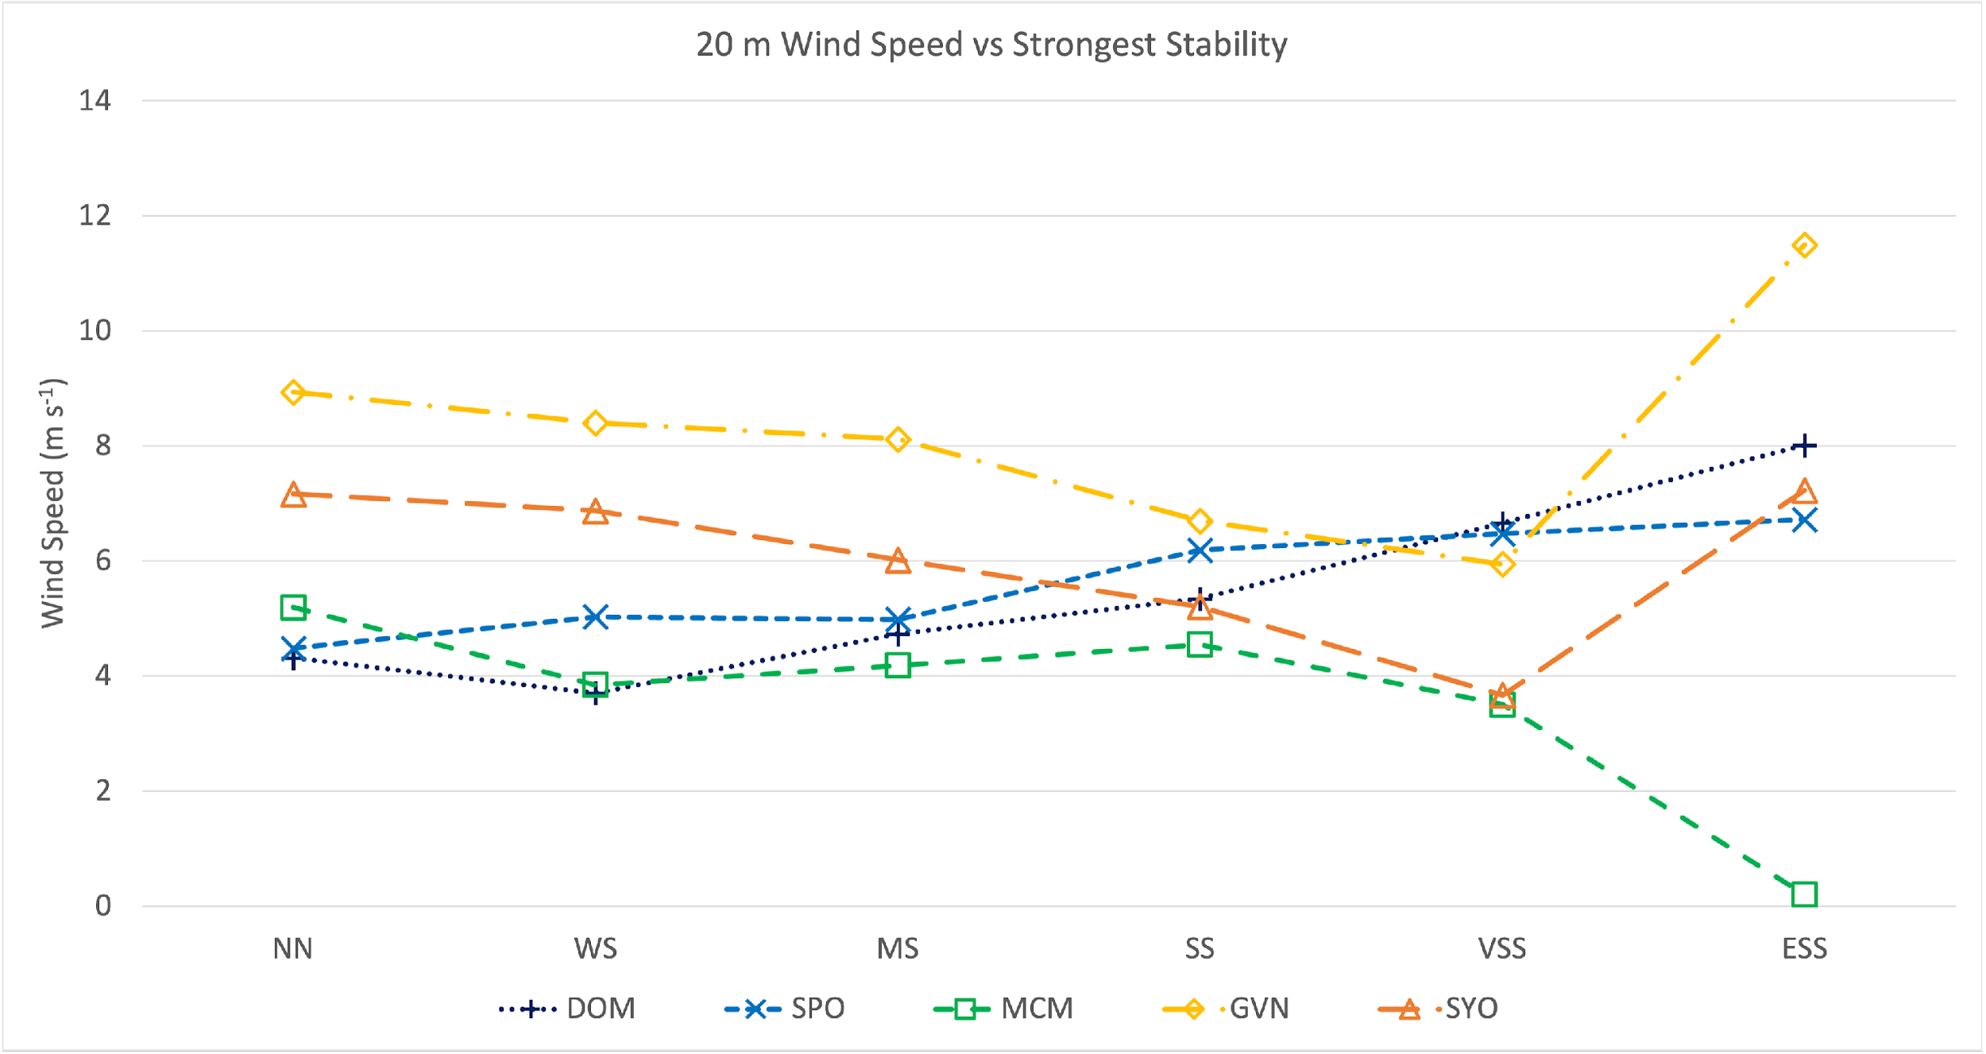
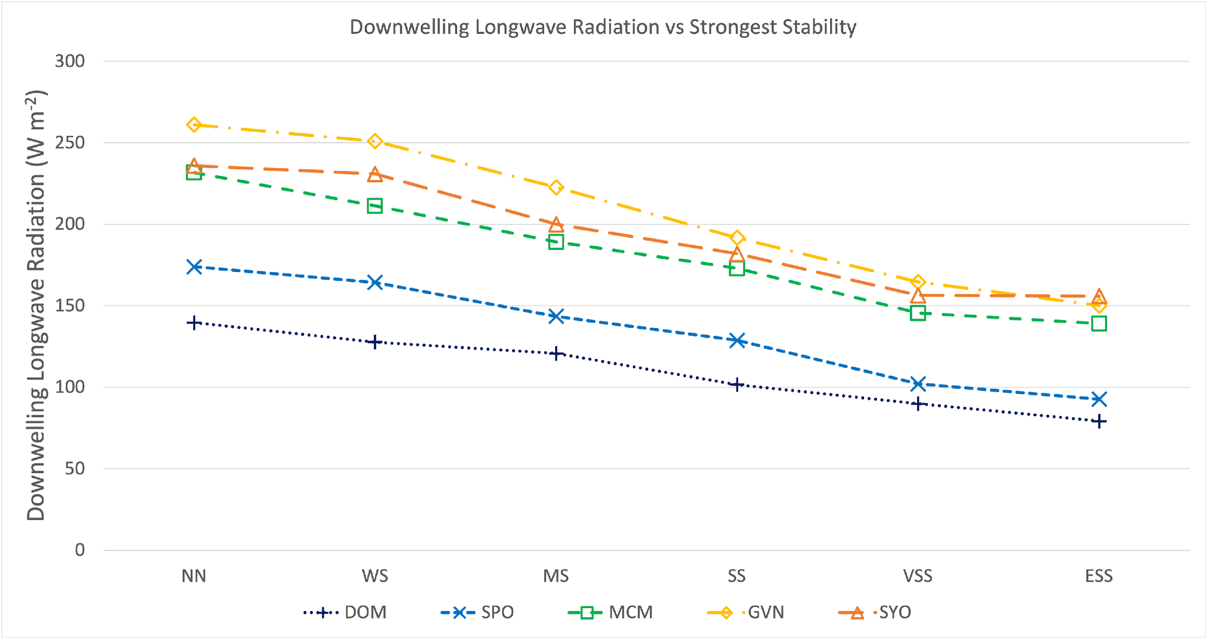
STABILITY VS LWD (BELOW)
CONSISTENT DECREASE IN DOWNWELLING LONGWAVE RADIATION AS STRONGEST STABILITY BELOW 500 M AGL INCREASES AT ALL SITES
STABILITY VS 20 M WIND SPEED (ABOVE)
WIND SPEED INCREASES WITH STABILITY AT PLATEAU SITES (DARK BLUE AND BLUE LINES)
WIND SPEED DECREASES WITH STABILITY NEUMAYER (YELLOW LINE) AND SYOWA (ORANGE LINE) NEGLECTING ESS
SMALLER CHANGES IN WIND SPEED AT MCMURDO (GREEN LINE) NEGLECTING ESS

Slide 16
SUMMARY
SOMS ALLOW EASY VISUALIZATION OF THE FULL RANGE OF TEMPERATURE PROFILES IN HUNDREDS TO THOUSANDS OF OBSERVED SOUNDINGS
20 STABILITY REGIMES DEFINED BASED ON POTENTIAL TEMPERATURE GRADIENT NEAR SURFACE (20-50 M AGL) AND ABOVE BOUNDARY LAYER TO ALLOW COMPARISON ACROSS ALL 5 SITES
NEAR SURFACE STABILITY DOMINATED BY NN AND VSM AT COASTAL SITES AND SS AND STRONGER STABILITY AT INTERIOR SITES
STRONGEST STABILITY BELOW 500 M DOMINATED BY WS AND MS AT COASTAL SITES AND SS AND STRONGER AT INTERIOR SITES
CLEAR DECREASE IN DOWNWELLING LONGWAVE RADIATION WITH INCREASED STABILITY AT ALL SITES, BUT WIND SPEED RELATIONSHIP WITH STABILITY IS LESS CLEAR

Slide 17

Questions?
john.cassano@colorado.edu

