Slide 1
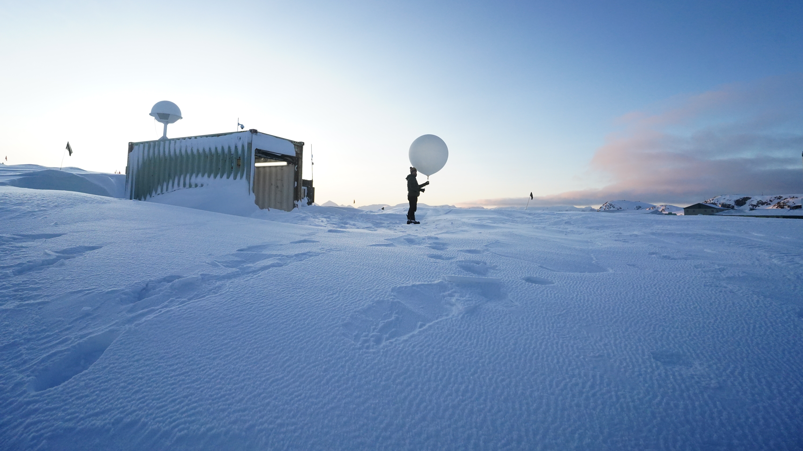
An Overview of YOPP-SH 2022 Winter Special Observing Period
David H. Bromwich¹ , YOPP-SH Community, Mariana F. Litell, Jordan G. Powers, Kevin W. Manning
¹Lead, YOPP-SH Task Team
Byrd Polar and Climate Research Center
The Ohio State University Columbus, Ohio , USA
Picture source: Rothera Station – Jonathan Witherstone

Slide 2
Outline
Picture source: McMurdo Station – Stephen Allinger and Katie Koster
Introduction
Winter Special Observing Period
  Additional radiosonde collection during the TOPS
  Process-related observations
  Sea Ice Prediction Network (SIPN) South
  YOPPsiteMIP
  Antarctic YOPP-SH data impact study
Summary

Slide 3
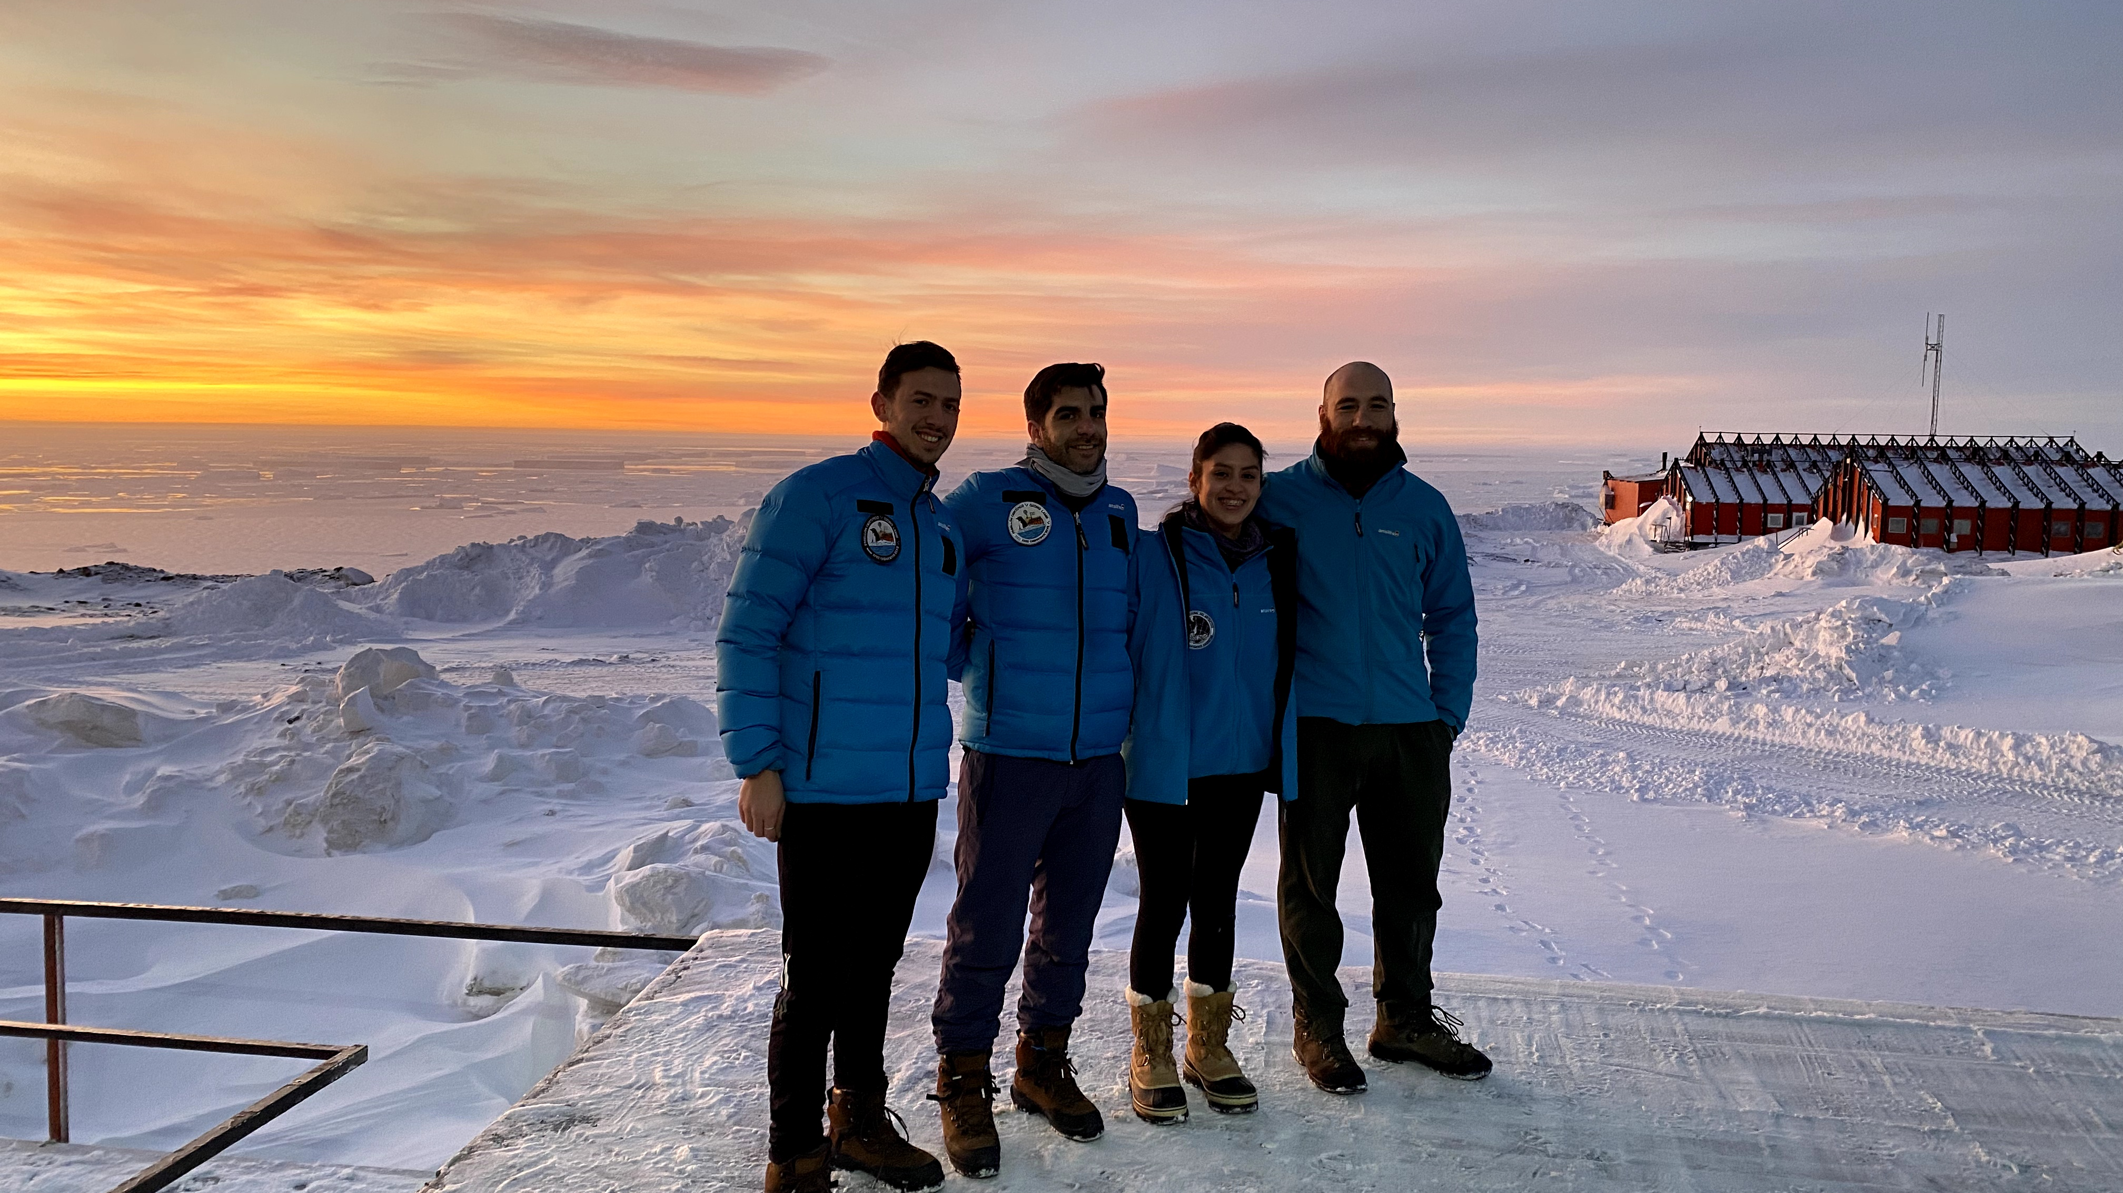
Introduction
WMO Polar Prediction Project (PPP) (2013–2022)
  Goal: Promote research toward improved environmental prediction for the polar regions
  Year of Polar Prediction: 2017–2019
YOPP–Southern Hemisphere (YOPP-SH) (2015 - 2024)
  Focus: Observation & prediction in the high southern latitudes
  Winter Special Observing Period (SOP): April – August 2022
Extra radiosondes
Picture source: Marambio Station

Slide 4
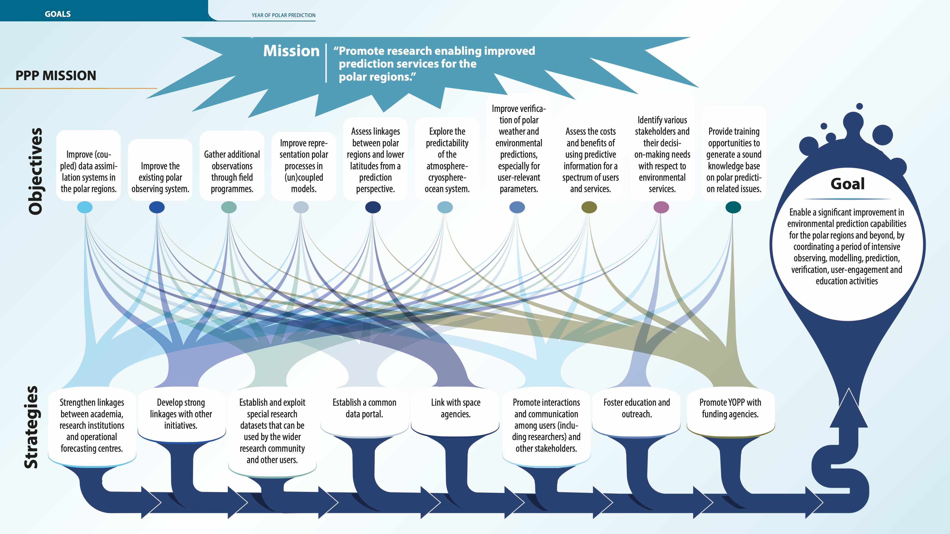
WMO PPP Booklet
Courtesy of Martin Kuenstig graphic designer

Slide 5
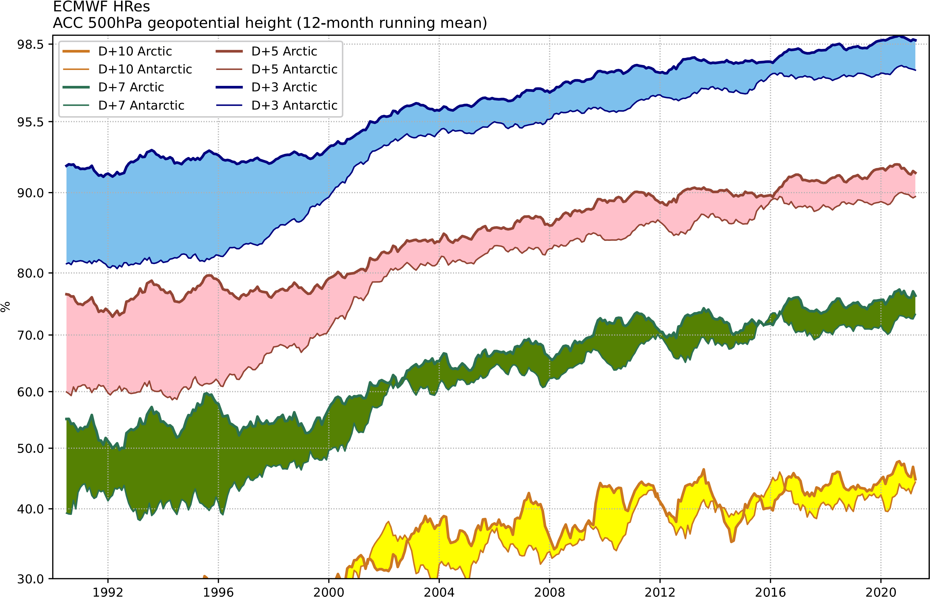
Today’s Forecast Skill in the Polar Regions:
The Antarctic Lags Behind the Arctic
Anomaly correlation for 500-hPa geopotential height from the ECMWF high resolution global deterministic forecast for forecast days 3, 5, 7 and 10 for the Arctic and Antarctic (both poleward of 60 degrees latitude). 7-day forecast for Antarctic (lower green) significantly clears the useful 60% threshold. Figure courtesy of Peter Bauer ECMWF.

Slide 6
Winter Special Observing Period:
  April 15 – August 31, 2022
  Within the SOP umbrella, targeted observing periods (TOPs) of enhanced observations are being used.
  Primarily have additional radiosonde ascents
  Targeted at the East Antarctica-Ross Sea and the Antarctic Peninsula Region.
Red dots are radiosonde stations that participated
Numbers outside the parenthesis are extra per day
Numbers inside are regular per day

Slide 7
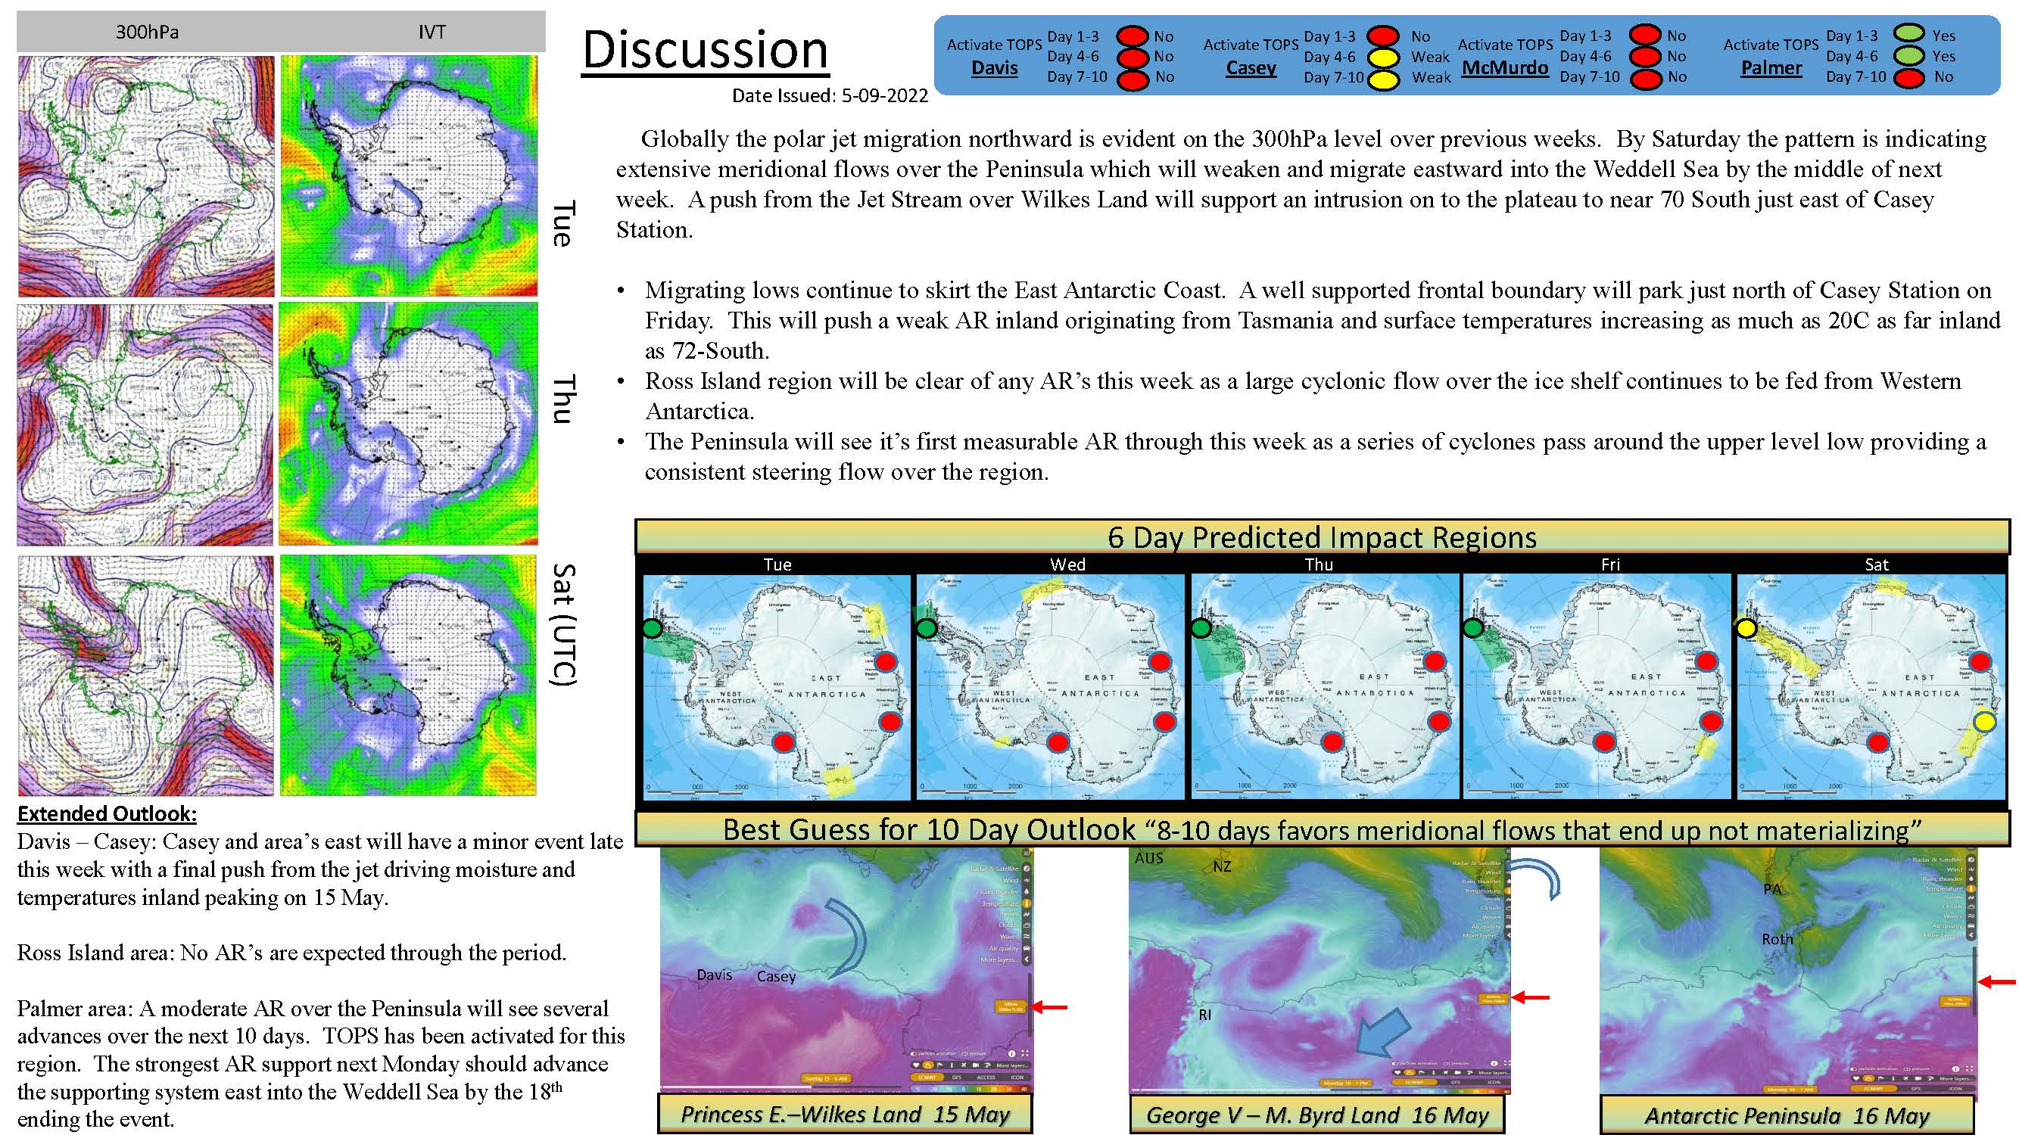
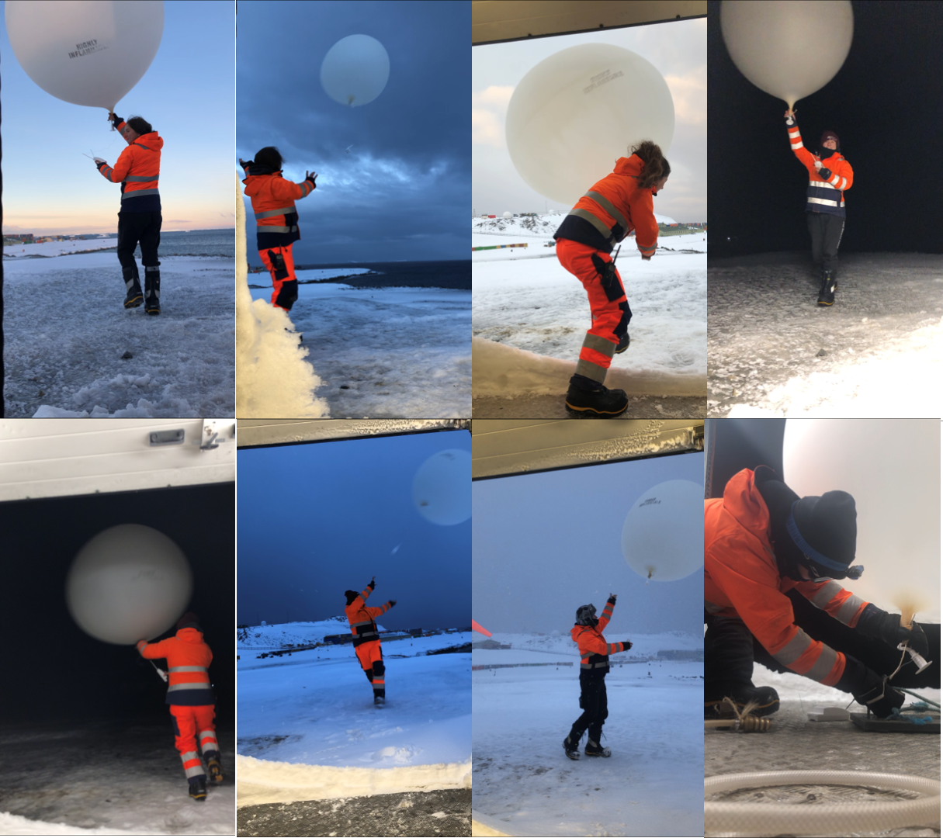
Forecasting for the TOPS
Art Cayette’s Forecast Guidance
McMurdo
Rothera

Slide 8
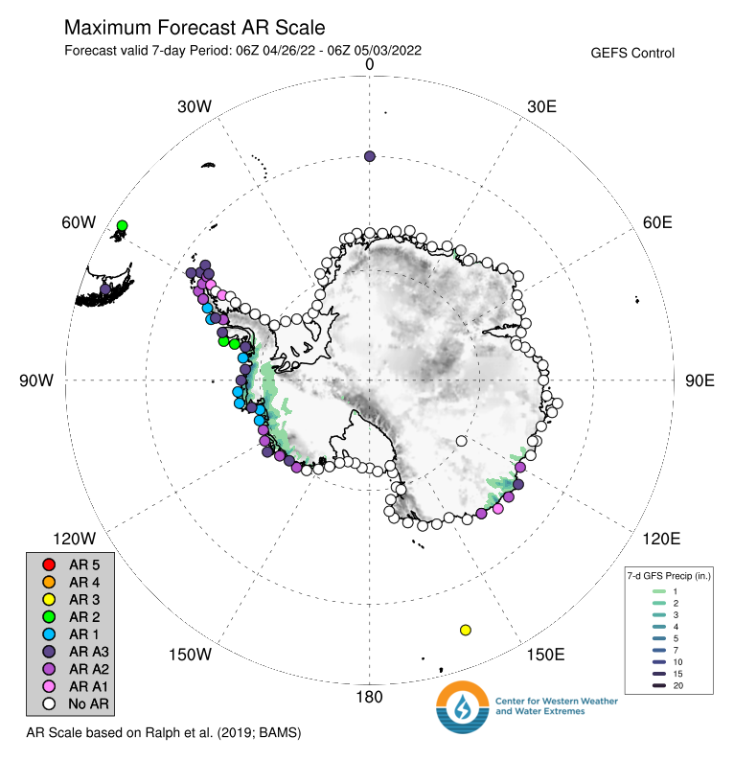
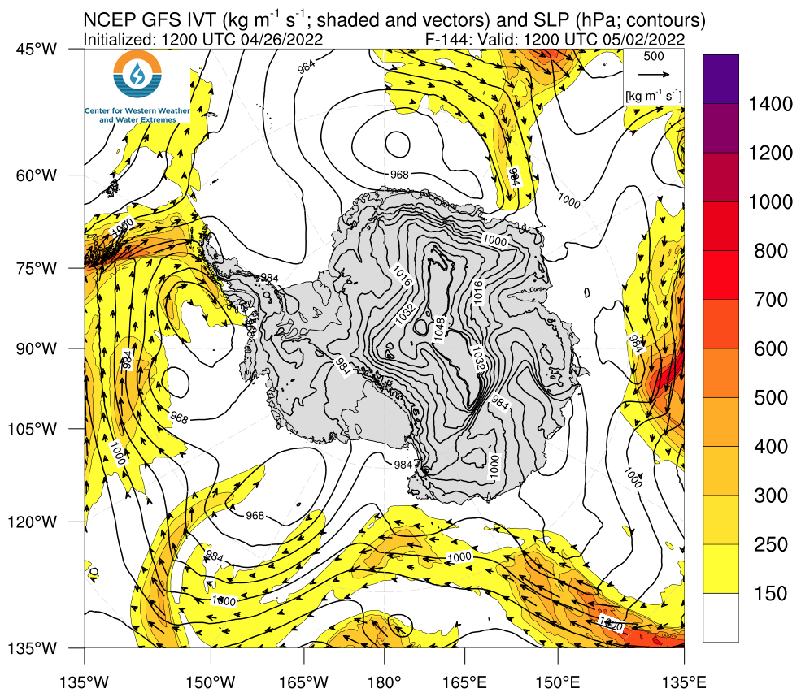
Forecasting for the TOPS
Cool New Forecasting Tool for Atmospheric Rivers: Courtesy of Scripps: https://cw3e.ucsd.edu/arscale_antarctica/

Slide 9
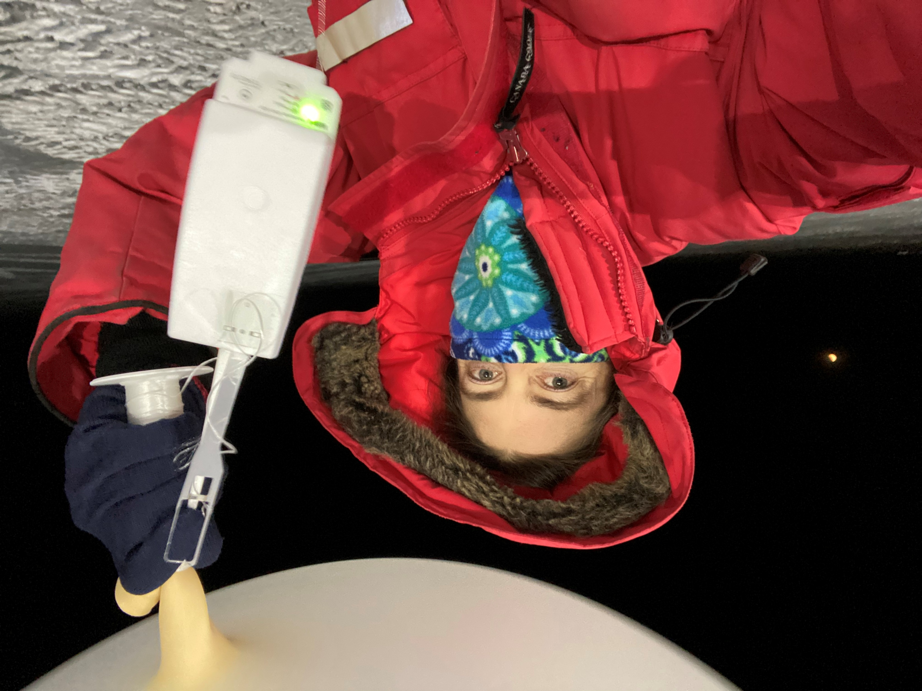
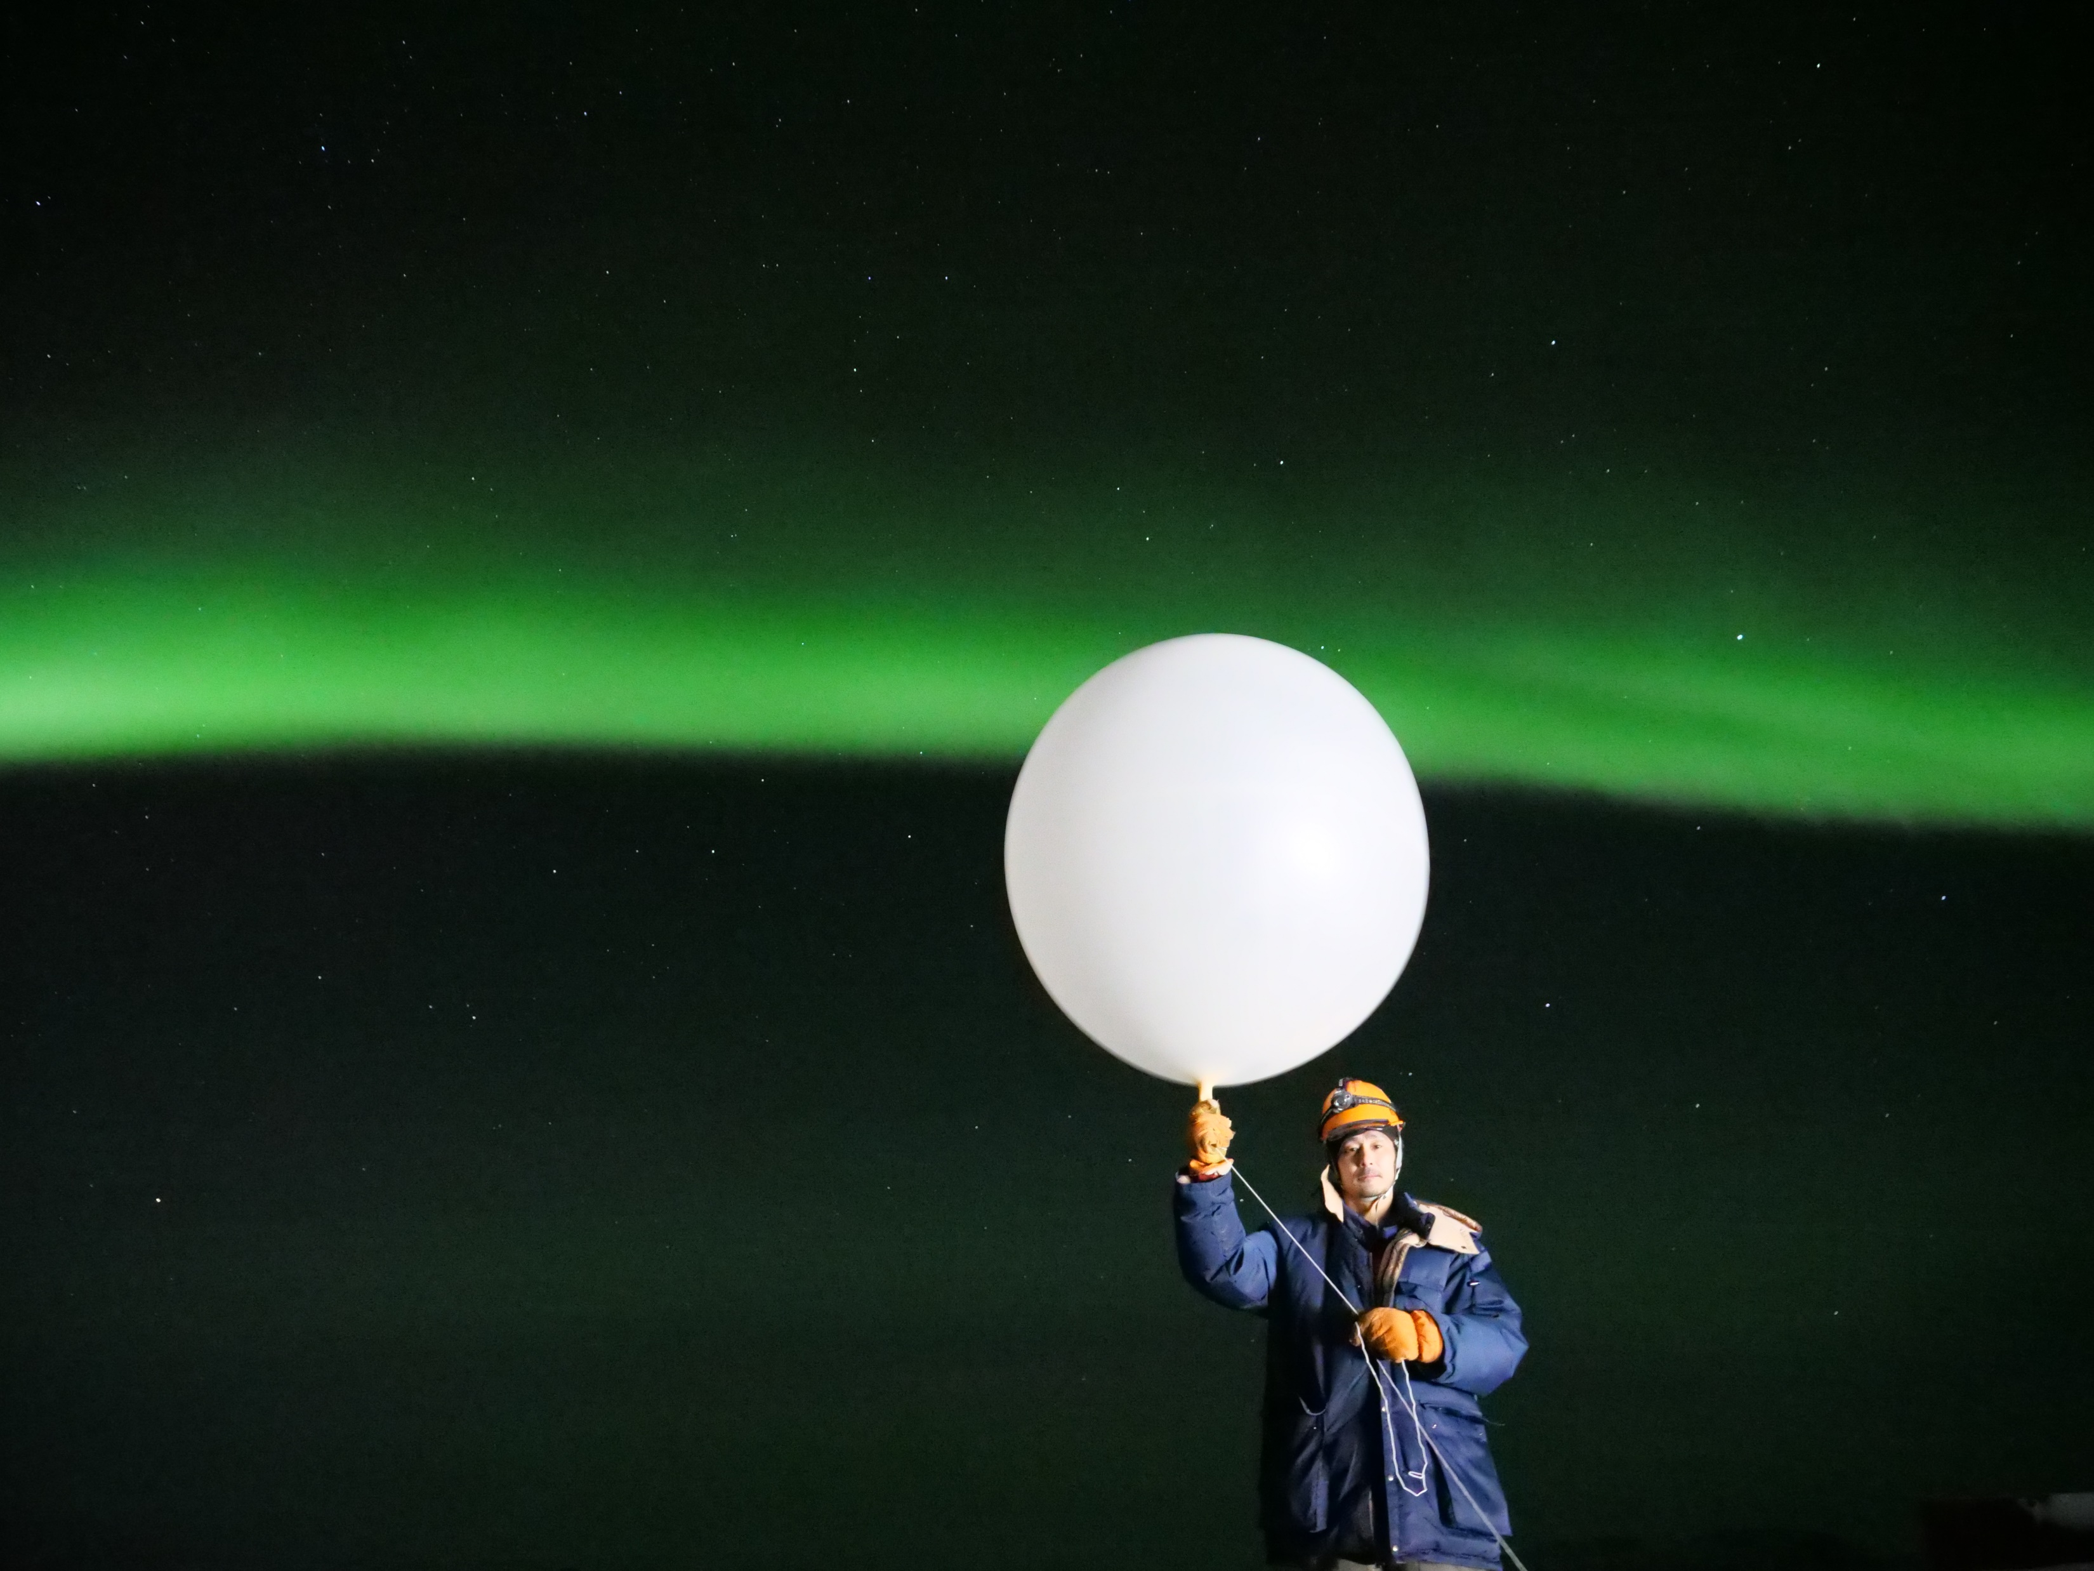
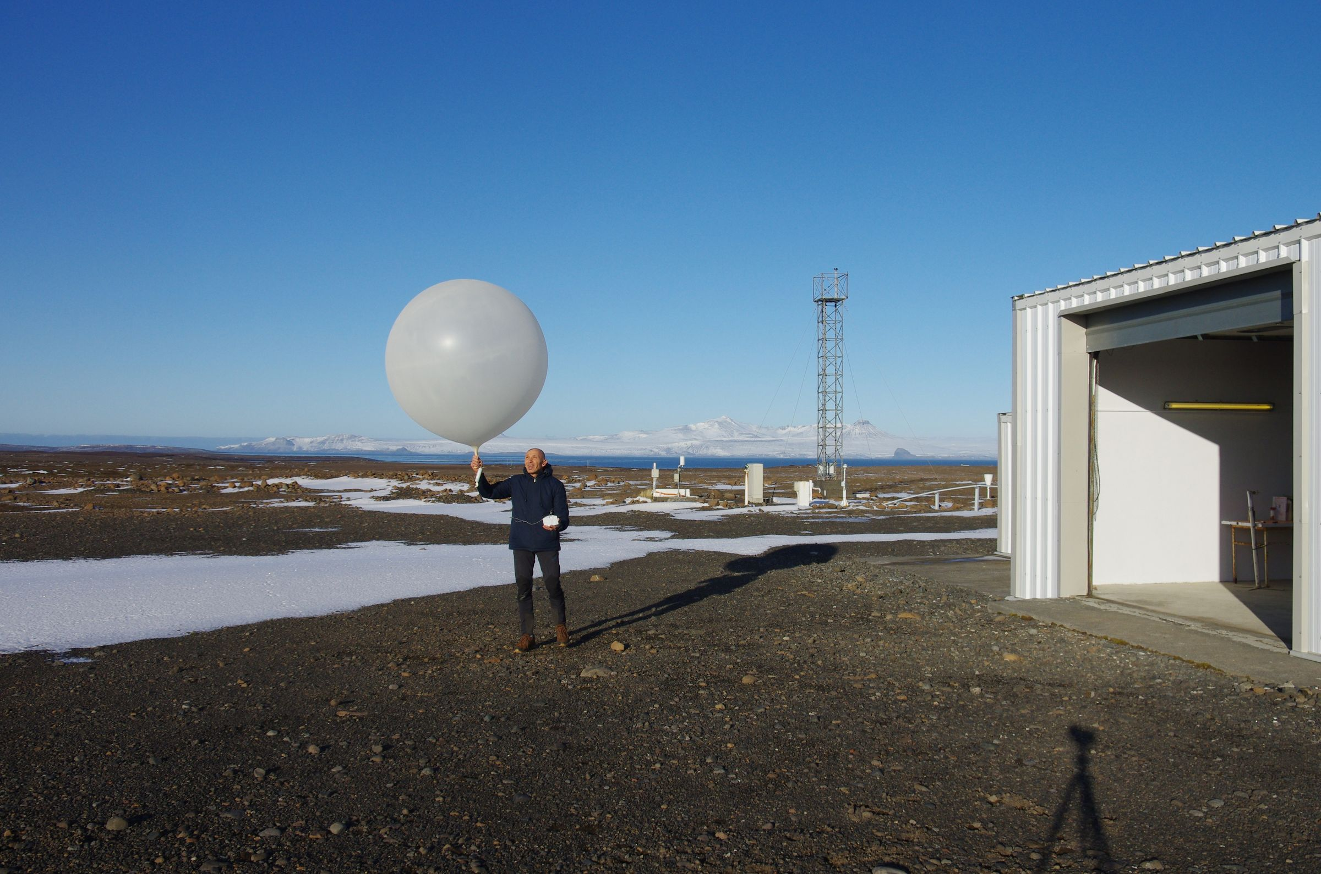
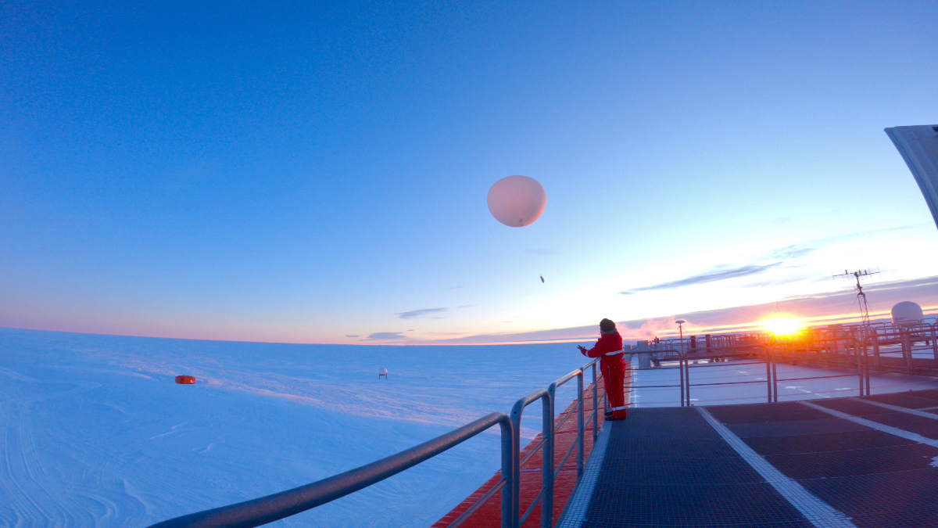
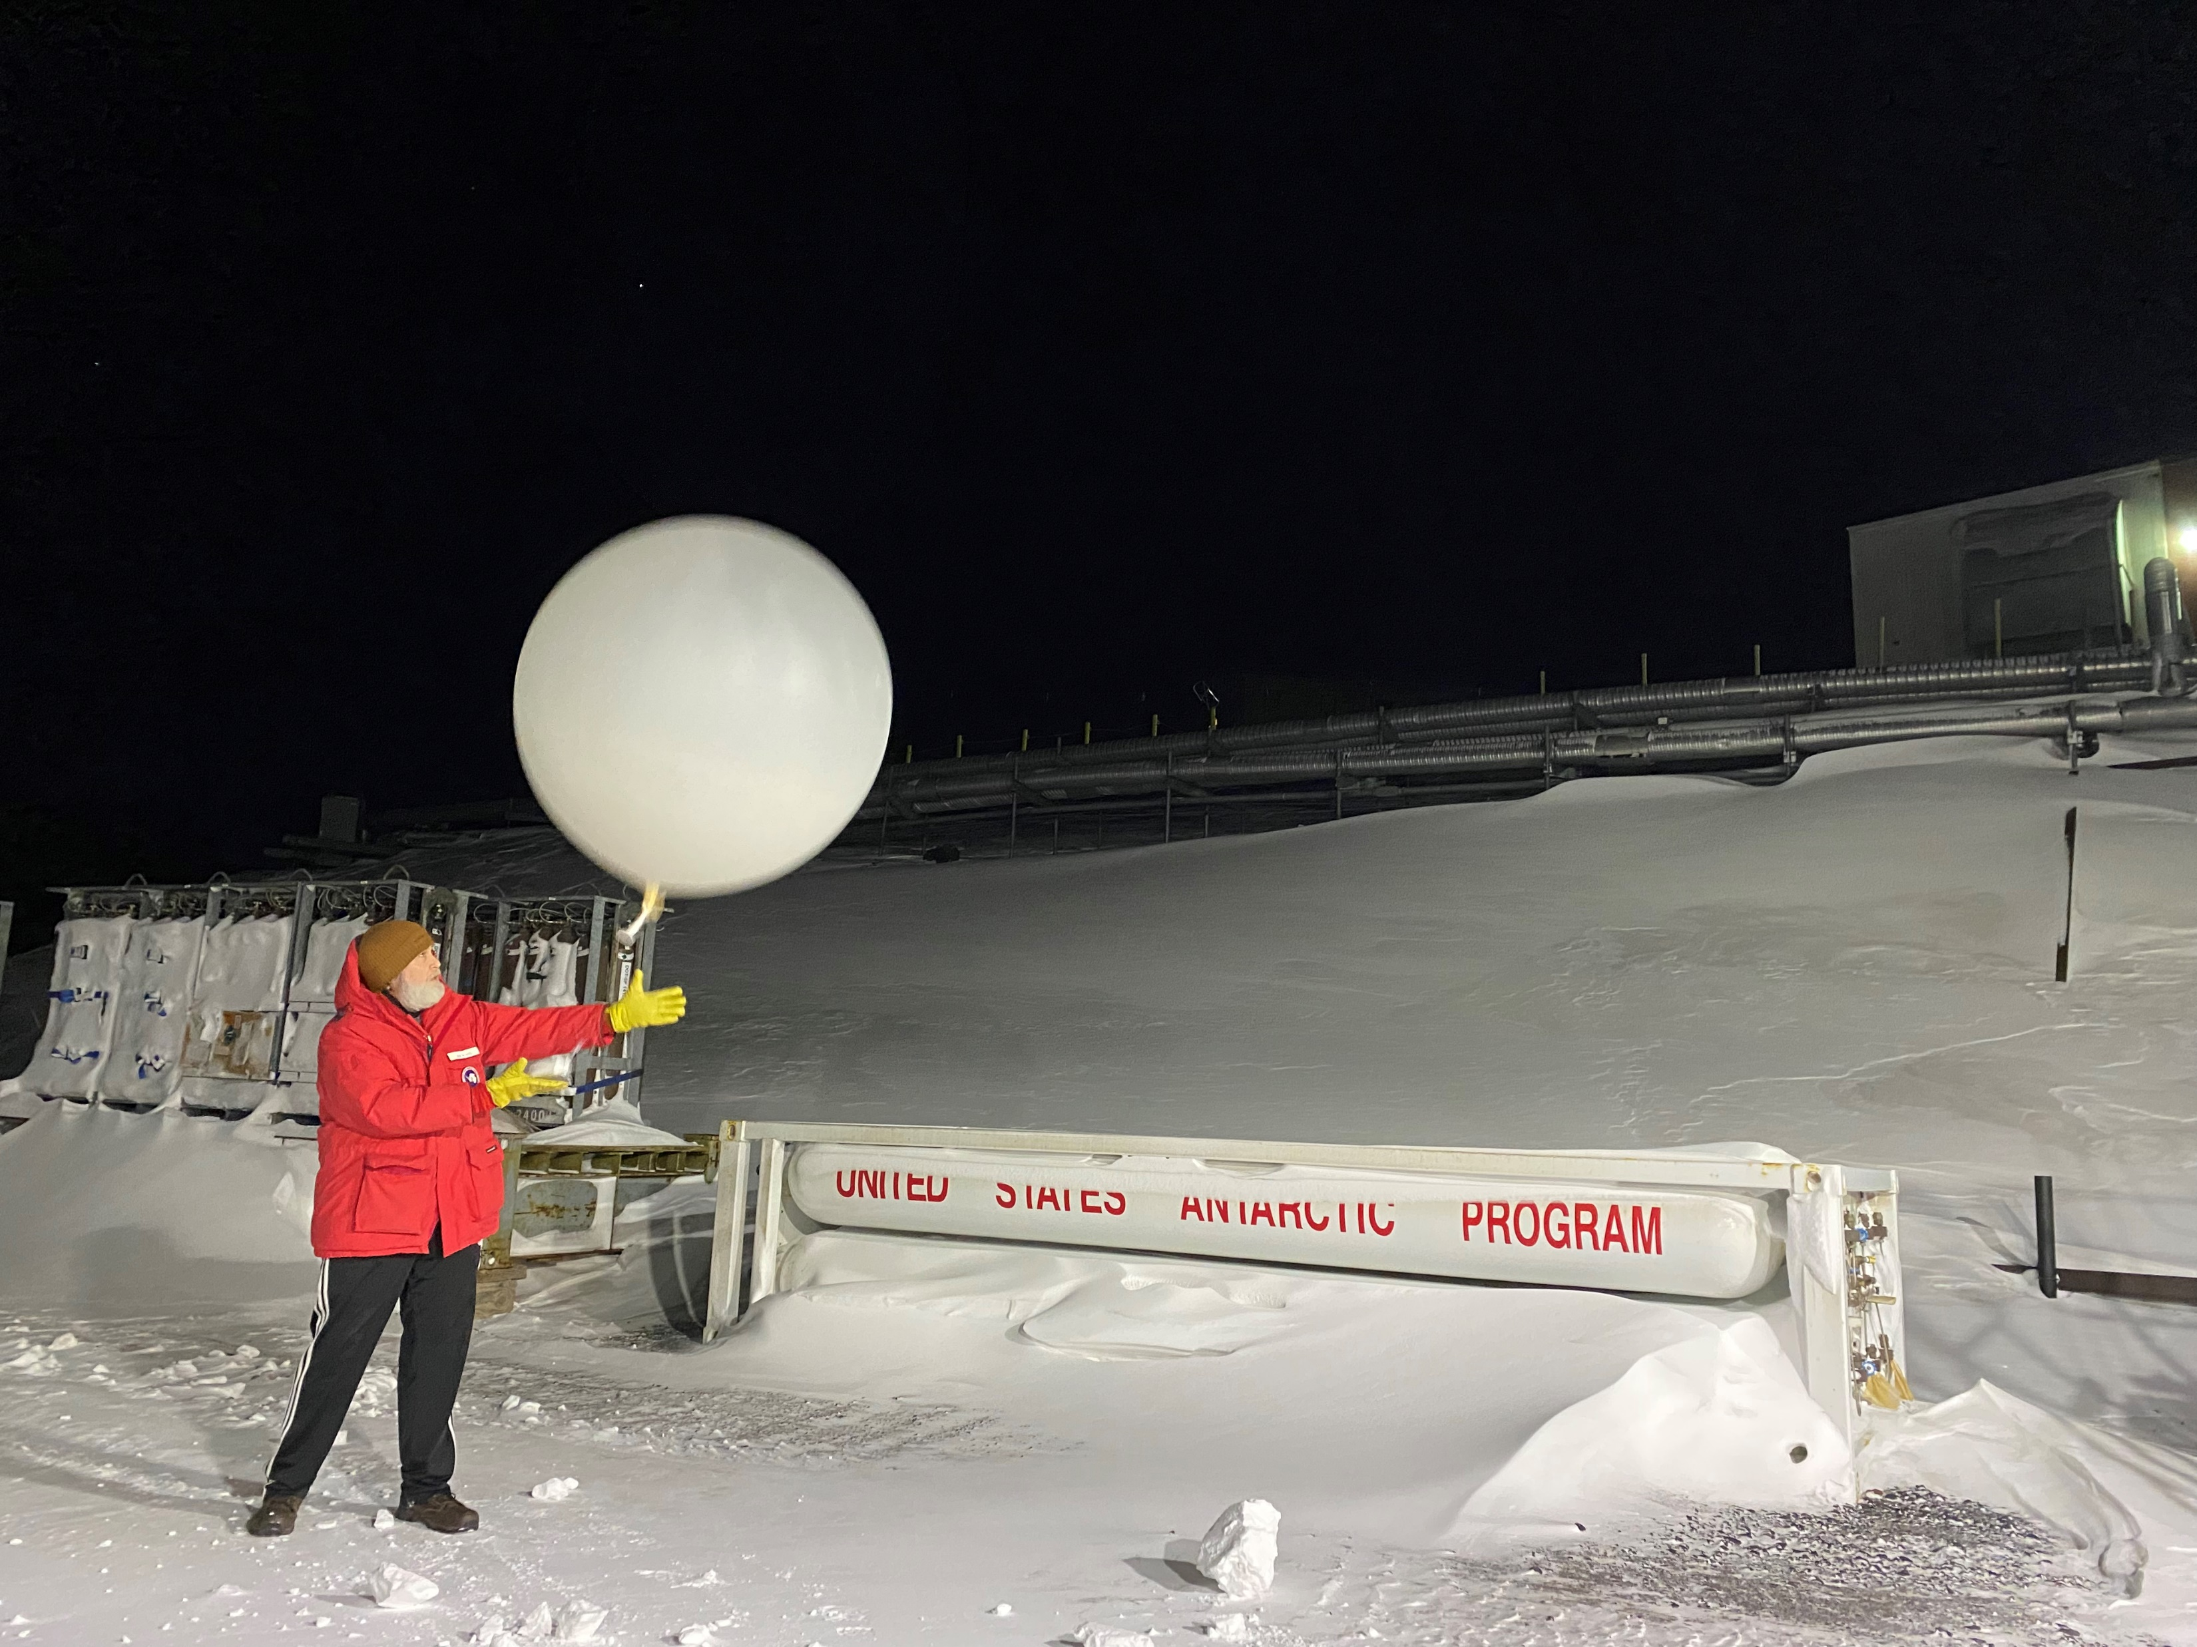
Targeted Observing Periods (TOPs)
TOP1 – Antarctic wide – May 9-16
TOP2 – Antarctic wide – June 2-7
TOP3 – East Antarctica – July 1-9
TOP4 – Antarctic wide – July 14-19
TOP5 – Antarctic Peninsula – July 23-30
TOP6 – East Antarctica – July 29 – Aug 3
TOP7 – Antarctic wide – Aug 20-30
1100 extra radiosondes released
More than doubling the routine observing schedule
McMurdo
Syowa
Kerguelen
Neumayer
McMurdo

Slide 10
The two target regions are the Ross Sea-East Antarctica and the greater Antarctic Peninsula. Further investigation on weather and climate phenomena over the high-latitude Southern Hemisphere continues, including topics like major coastal cyclones, atmospheric rivers, and cloud impacts.
Also, the impact of extra radiosonde observations on weather forecasts are being identified and quantified, and better predictions of extreme weather will be delivered for scientists and operational activities in Antarctica.
(Bromwich et al. 2021)

Slide 11
Enhanced Cloud Measurements – Antarctic Peninsula
Information from Penny Rowe
AP region for example (still in progress)
E – Escudero; R – Rothera, M- Marambio
Instrument | Measurements | Duration | Site | Products
Multifilter radiometer | Direct, diffuse, and global irradiance at 12 wavelengths | Continuous | E | Global and direct UV-VIS Irradiance
Spectro- radiometer | Downwelling global shortwave irradiance 280 – 700 nm | Continuous | E | Global irradiance 280 – 700 nm
Photometer | Spectral Direct Irradiance | Continuous | R | Aerosol Optical Depth, H2O column
Balloon-Borne Radiosondes | Various | Summers, TOP | E^{b}, R, M | Pressure, temperature, humidity, winds, UWC^{b}, 0 to 30 km
Universal Water Content | Supercooled liquid water and total water. | Summers, TOP | E | Profiles of total water, ice water, and super-cooled liquid water.
Micropulse Lidar | Backscatter and depolarization ratio | Continuous | E, R, ship^{b} | Cloud height, thermodynamic phase
Pyranometer | Solar Irradiance (300-4000 nm) | Continuous | E, R | Solar all-sky flux and cloud radiative forcing
Pyrgeometer | Infrared irradiance (4000-55000 nm) | Continuous | E, R | IR all-sky flux and cloud radiative forcing
All-sky camera | Visible imagery | Continuous | E | Cloud fraction
BAS instrumented aircraft | Various | During campaigns | aircraft | cloud and aerosol properties
Collaborative observation plans are supported by various institutions to collect information on cloud cover, height, phase, etc.
The observations of clouds are valuable for investigations on weather events, such as atmospheric rivers, extreme precipitation, foehn warming, and surface melting (e.g., Gorodetskaya et al., 2020).
ªComplemented by radiosondes at nearby King Sejong Station. ^{b}Instrumentation is planned to be moved from Rothera to the ship during the ship cruise, after which it will be returned to Rothera.
Notes:
Dan Lubin’s group is working on get more observation at station Palmer. Surface energy balance will be the target variable.

Slide 12
Continuous Atmospheric Water Cycle Measurements at Davis
Instrument | Measurements | Duration | Site | Products
VHF clear-air wind-profiling radar | Horizontal and vertical winds from 1500m to the lower stratosphere | Continuous | Davis | Zonal, Meridional and Vertical wind speeds, 6-minute resolution
Micro Rain Radar PRO | Vertical profiles of (K-band) radar reflectivity | Continuous | Davis | Vertical profiles of precipitation reflectivity and vertical motion; snowfall rate (derived product)
Vaisala ceilometer CT25K | Vertical profiles of lidar backscatter | Continuous | Davis | Cloud base height, cloud backscatter
Parsivel disdrometer | Drop size distributions | Continuous | Davis | Precipitation intensity, drop size distributions
Pyranometer | Solar irradiance (300-4000nm) | Continuous | Davis | Solar all-sky flux and cloud radiative forcing
Pyrgeometer | Infrared irradiance (4000-55000nm) | Continuous | Davis | IR all-sky flux and cloud radiative forcing
All-sky camera | Visible cloud imagery | Continuous | Davis | Cloud fraction
Picarro water vapour isotope sensor | Isotopes of water present in precipitation | Continuous | Davis | Isotopes of water present in precipitation
Radiosondes | Various | Continuous (2x daily), plus 1 extra per day during SOPs | Davis | P, T, RH, zonal & meridional wind speeds
More observations at Davis planned by AAD
Clouds, precipitation, wind, radiative fluxes, etc.
Information provided by Simon Alexander

Slide 13
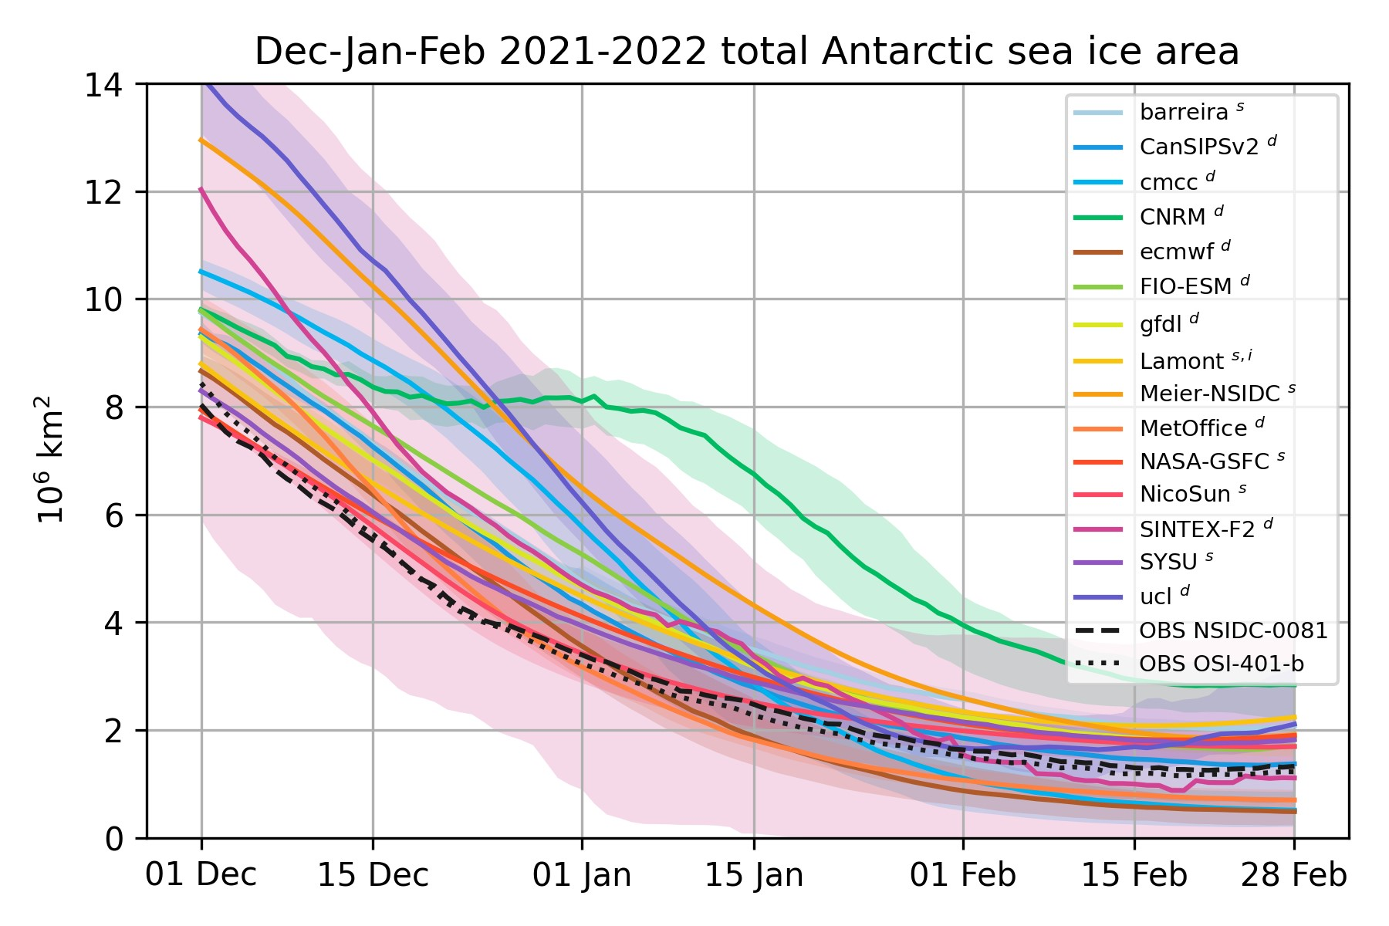
SIPN-South
Forecasts of total Antarctic sea ice area for the 2021-2022 melting season (submitted before 1st December 2021) contributed by 15 groups. Verifying observations are in black . Courtesy of Francois Massonnet and colleagues.
Are examining the sea ice area forecasts for the growth season, May-August 2022

Slide 14
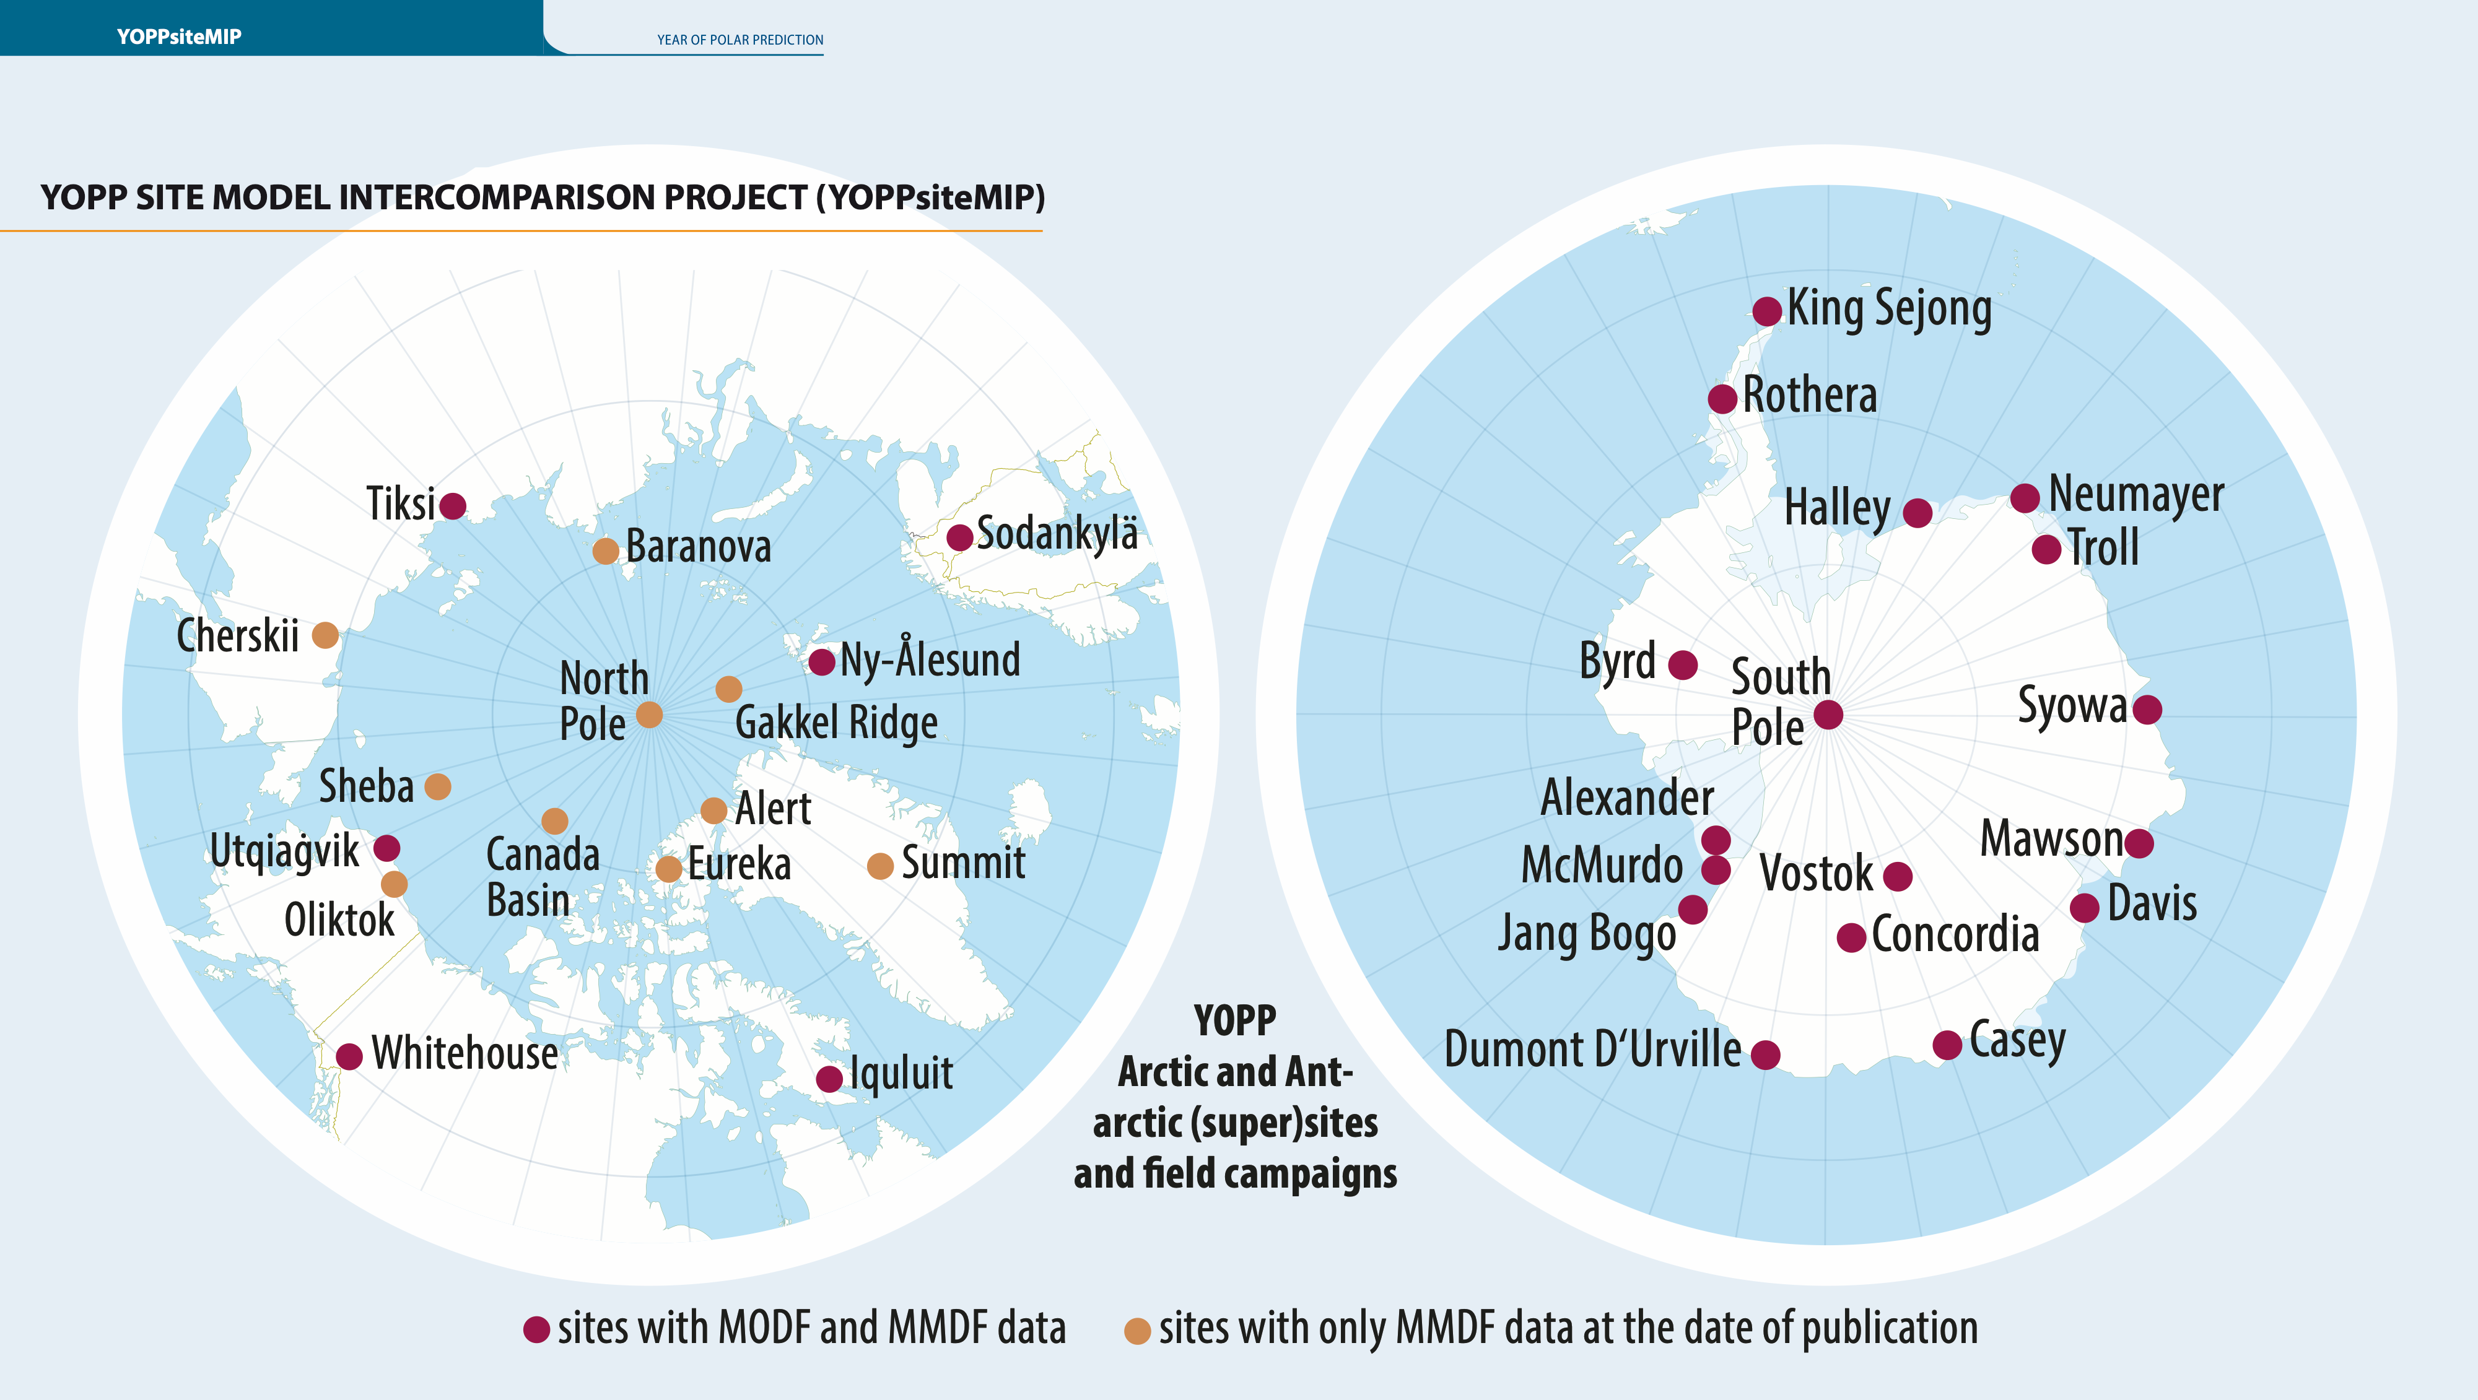
WMO PPP Booklet
Courtesy of Martin Kuenstig graphic designer

Slide 15
YOPP-SH presentations at WAMC 2023
Wednesday May 31st
An Overview of the YOPP-SH 2022 Winter Special Observing Period- David Bromwich
Friday June 2nd
Observational Analysis of an Atmospheric River Impacting the Antarctic Peninsula During the Winter YOPP-SH Special Observing Period - Marianna Fontolan Litell
Polar WRF Modeling of a May 2022 Atmospheric River Impact on the Antarctic Peninsula - Keith M. Hines
Polar WRF Forecast Performance for Antarctica and the Southern Ocean - David H. Bromwich
The AMPS Winter YOPP-SH Forecast Data Impact Study - Jordan Powers

Slide 16
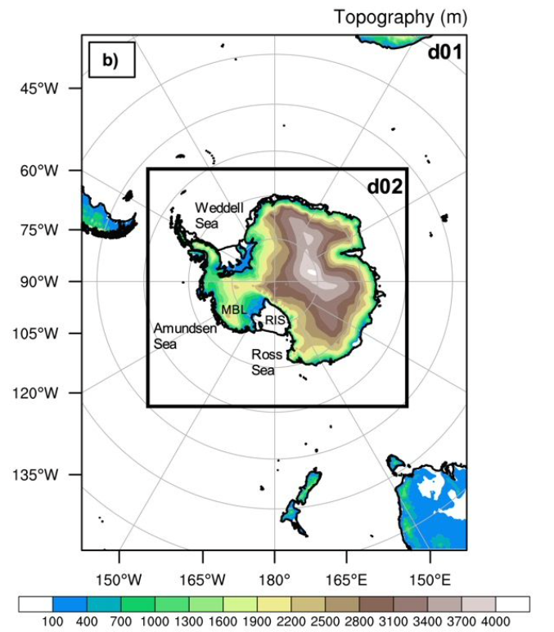
Data Denial Experiments – OSU & NCAR
Approach: Conduct Model Forecast Experiments by Varying the Observations.
Add YOPP-SH Winter TOP soundings in model initialization
  Do the additional YOPP-SH observations improve the forecasts significantly?
Framework: AMPS WRF Domains – 24-km (Southern Ocean) & 8-km (Antarctica) grids
Two sets of WRF experimental forecasts
NoTOP: assimilation of the standard observational dataset of the routine soundings and other data available to AMPS
TOP: reflecting the addition of the TOP extra sounding data to NoTOP.

Slide 17
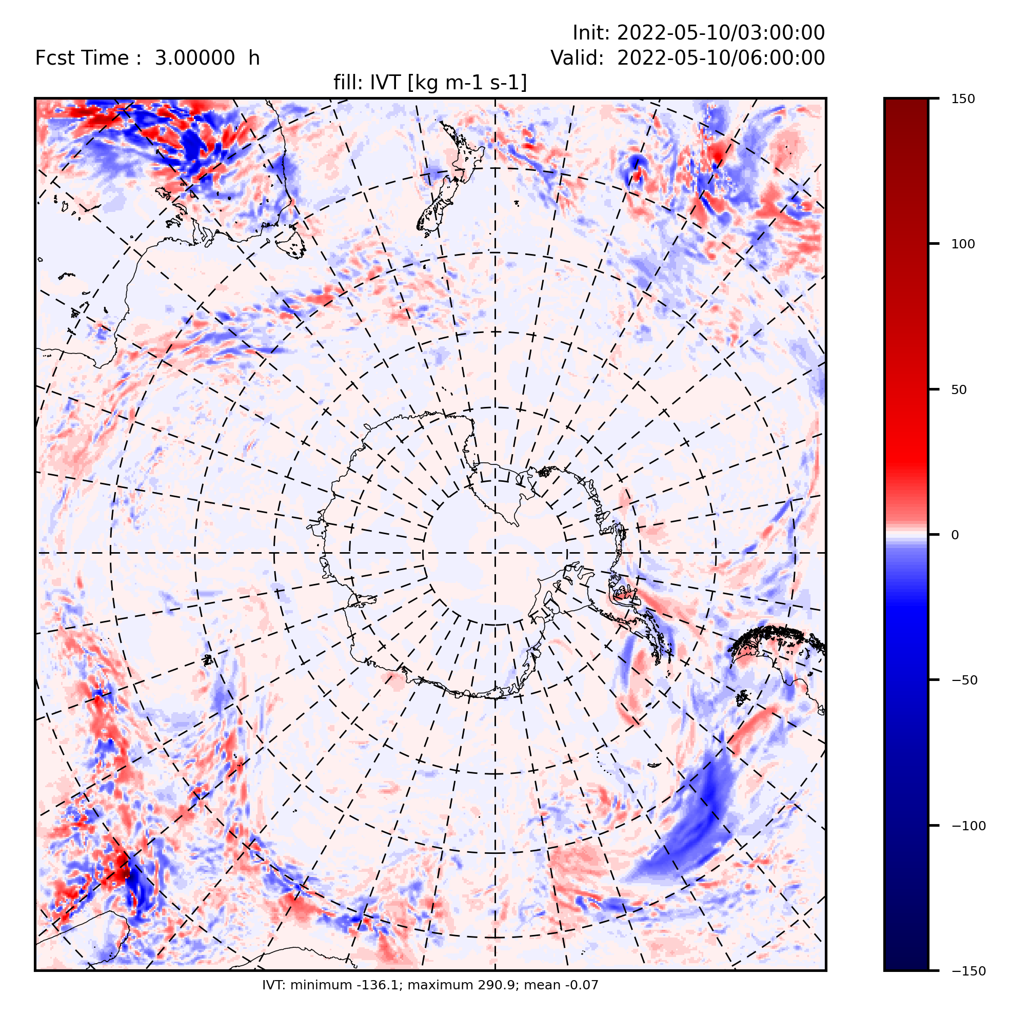
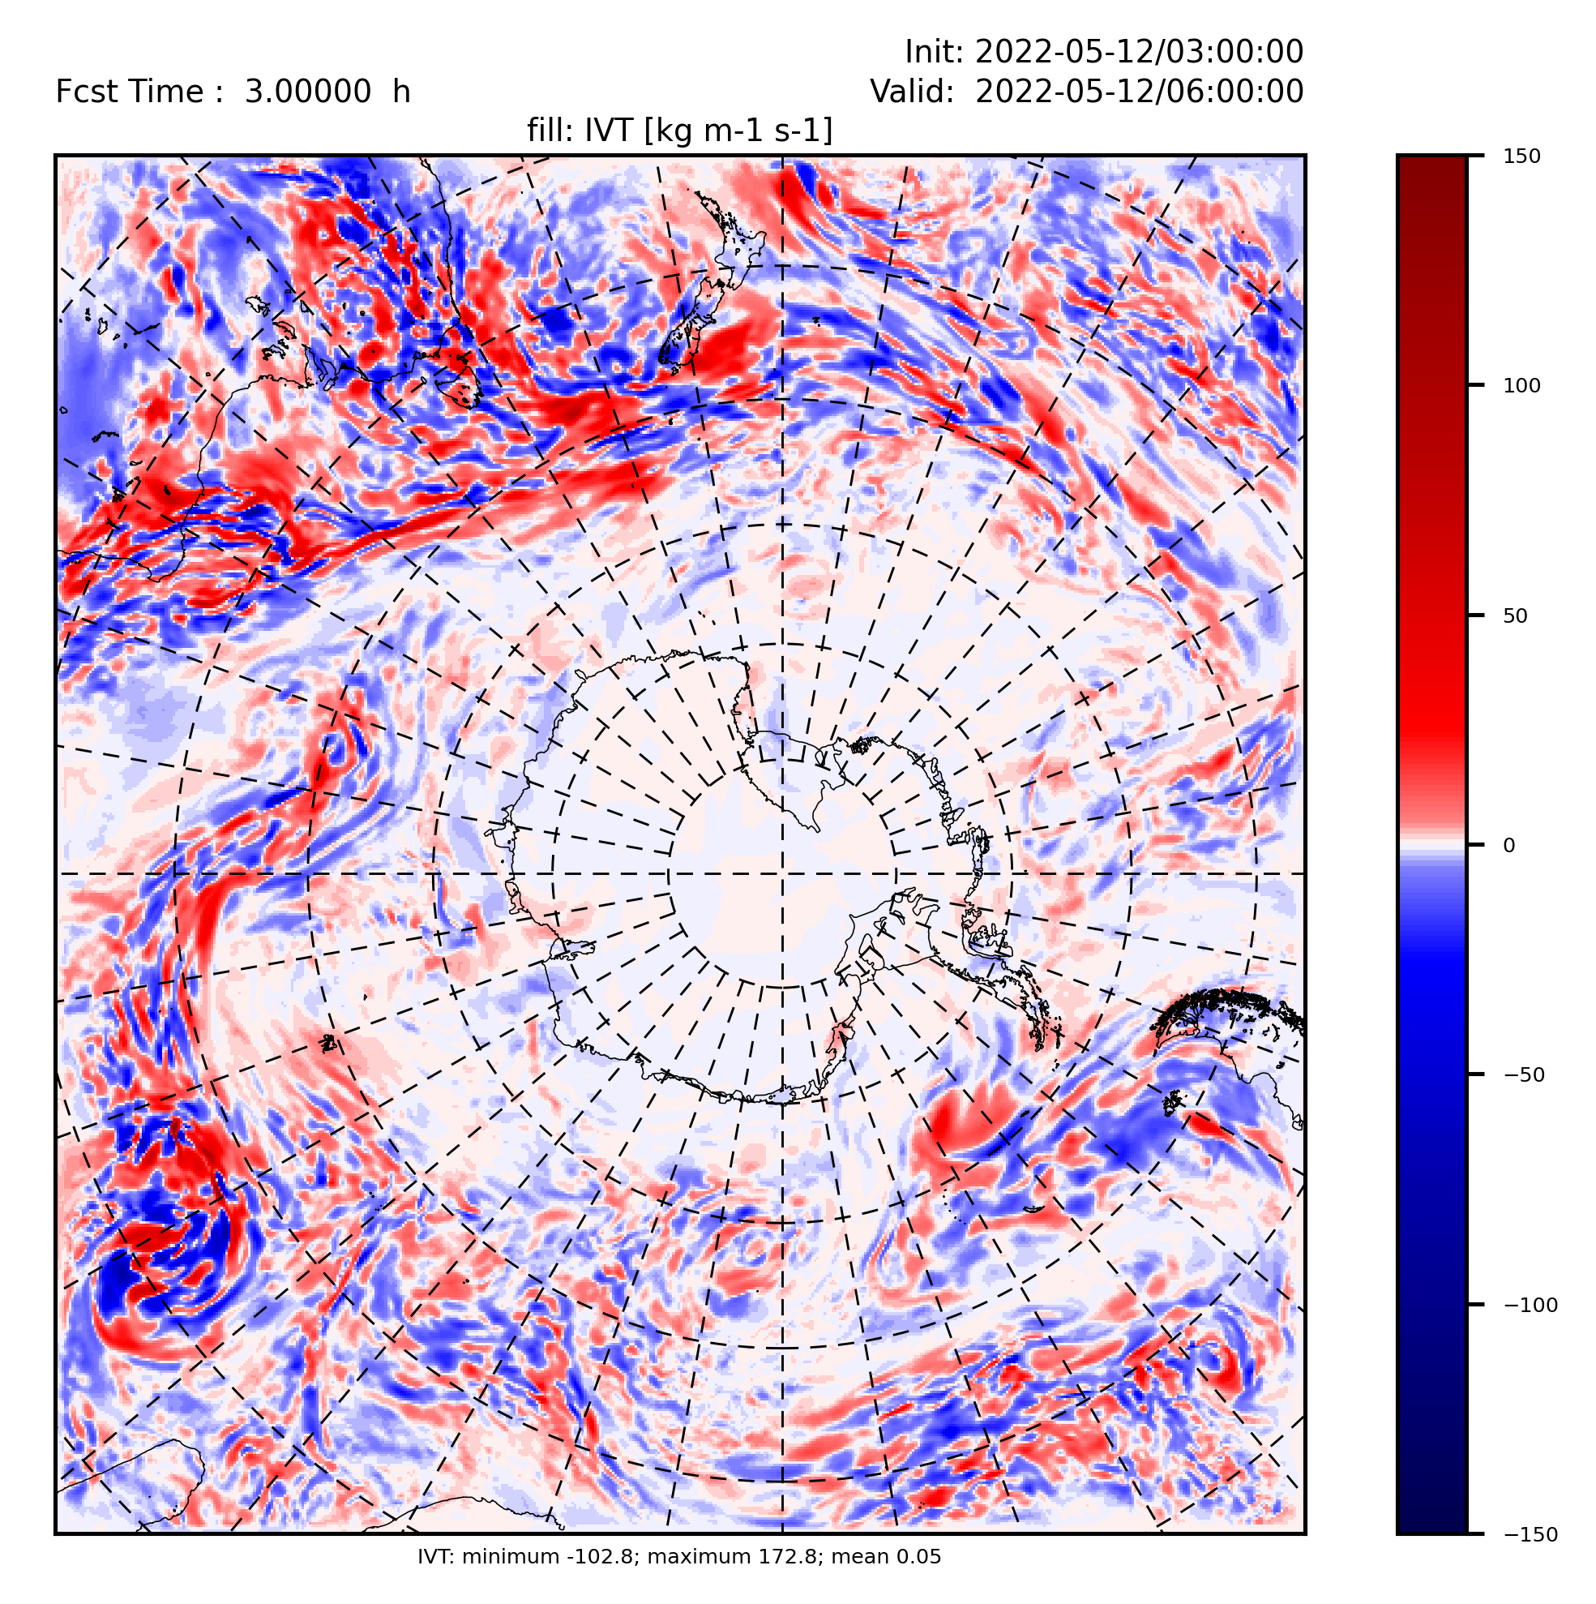
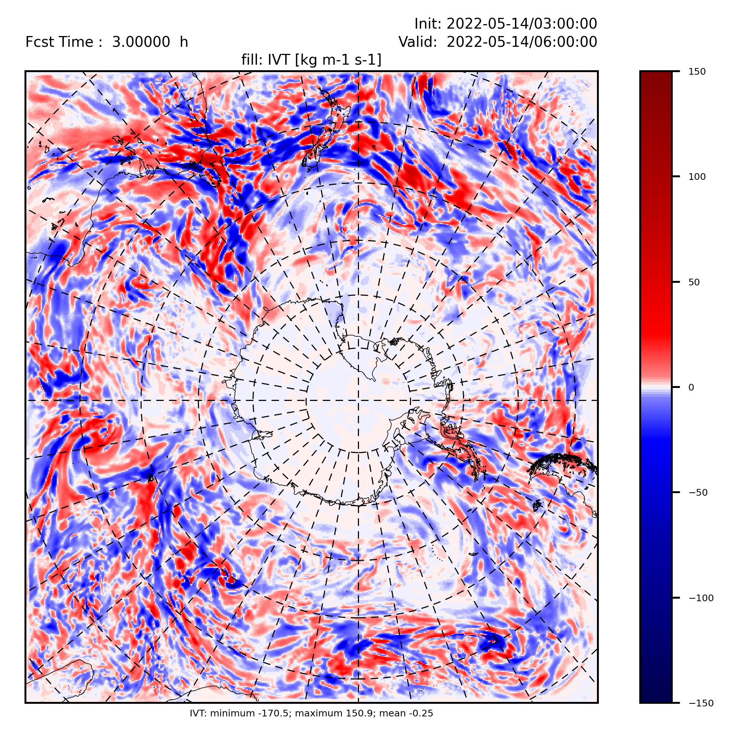
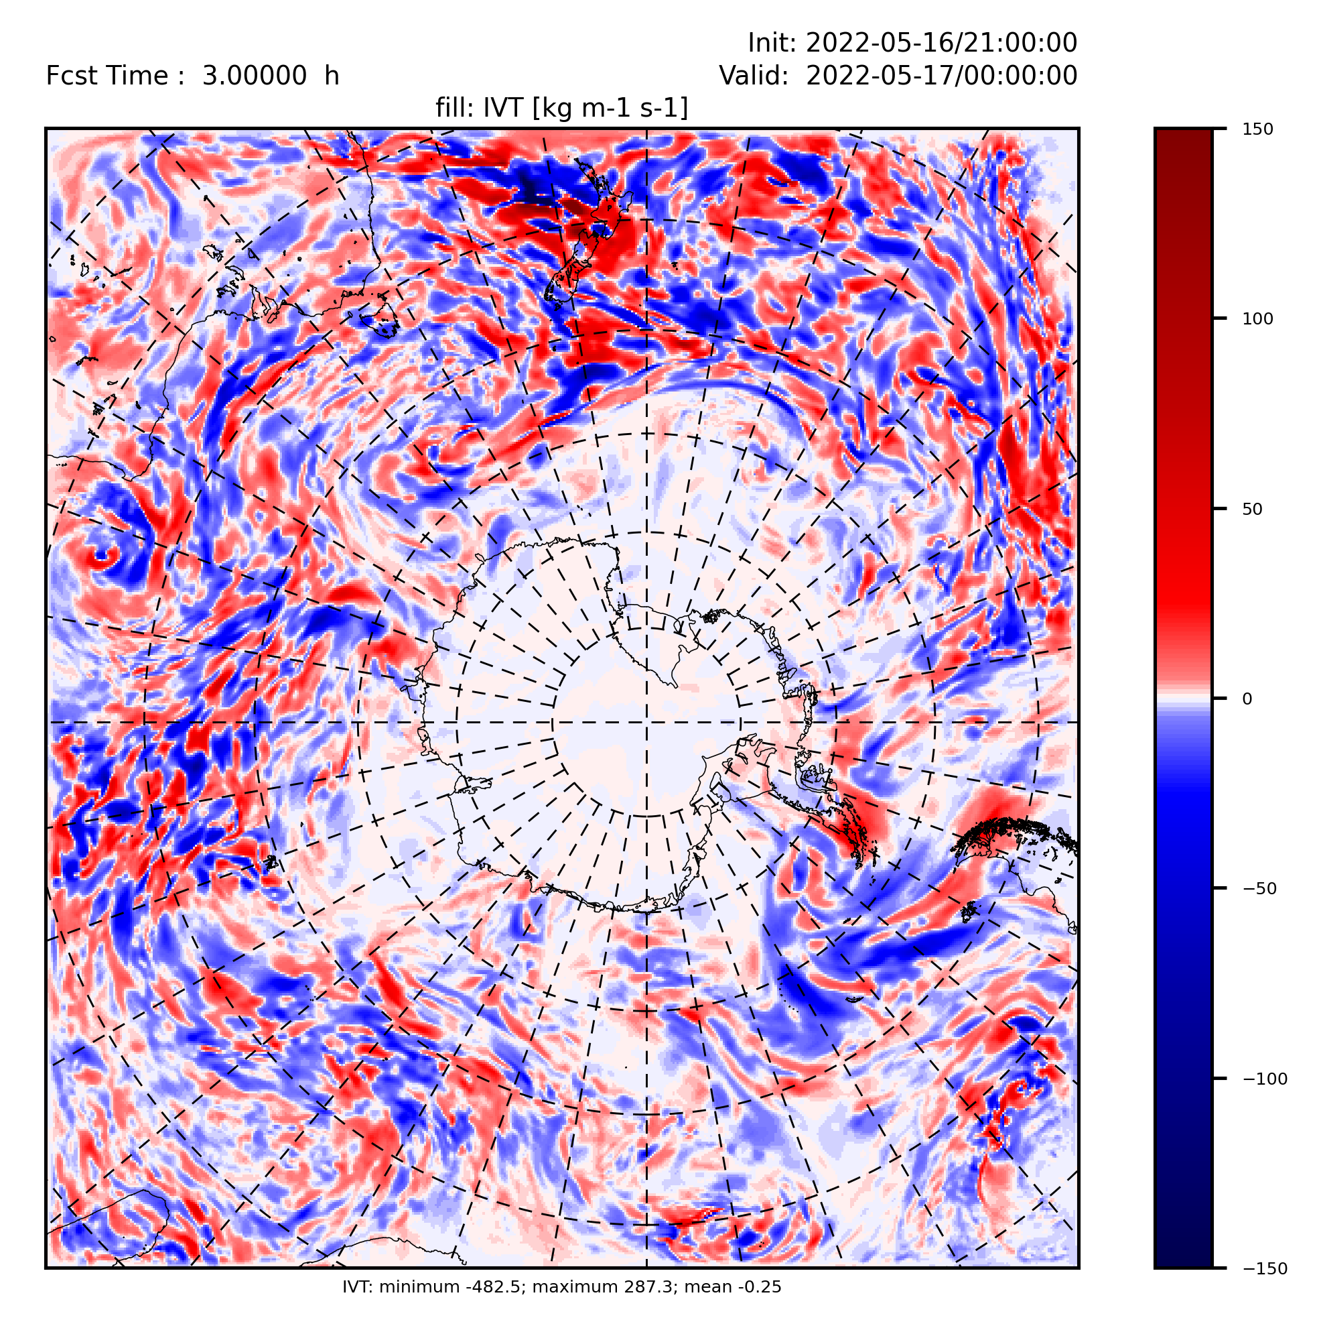
Antarctic YOPP-SH Data Impact Study
Cycling assimilation impact on integrated vapor transport (IVT kg m⁻¹ s⁻¹)
TOP1 difference between extra radiosondes added and only routine radiosondes
May 10
May 12
May 14
May 17
-136, +291
-102, +172
-170, +150
-482, +278

Slide 18
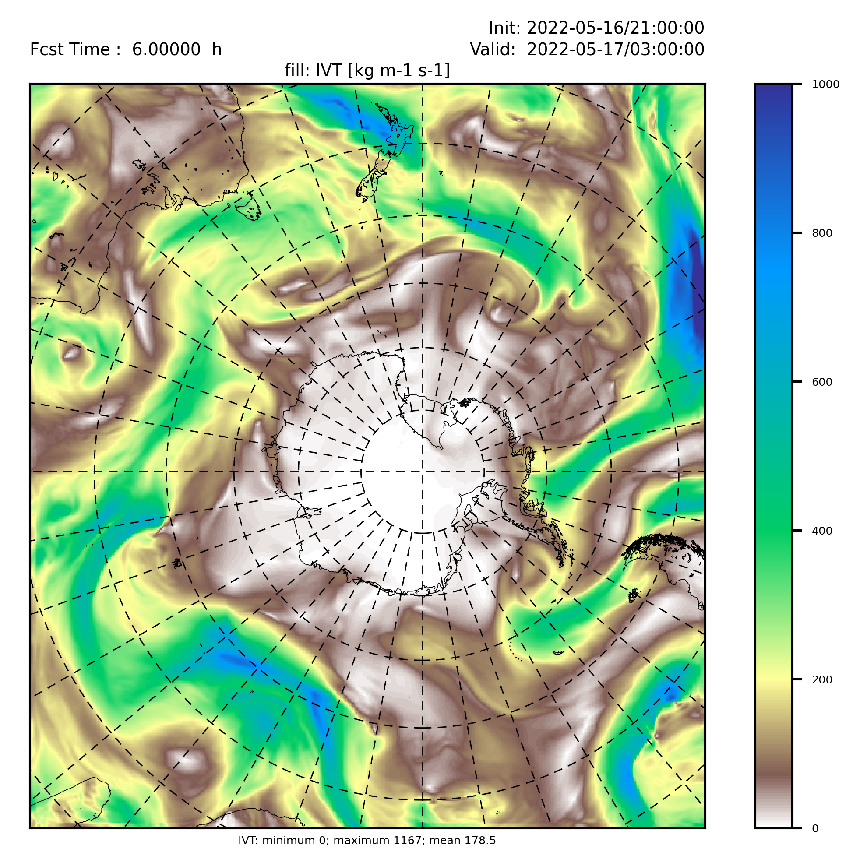
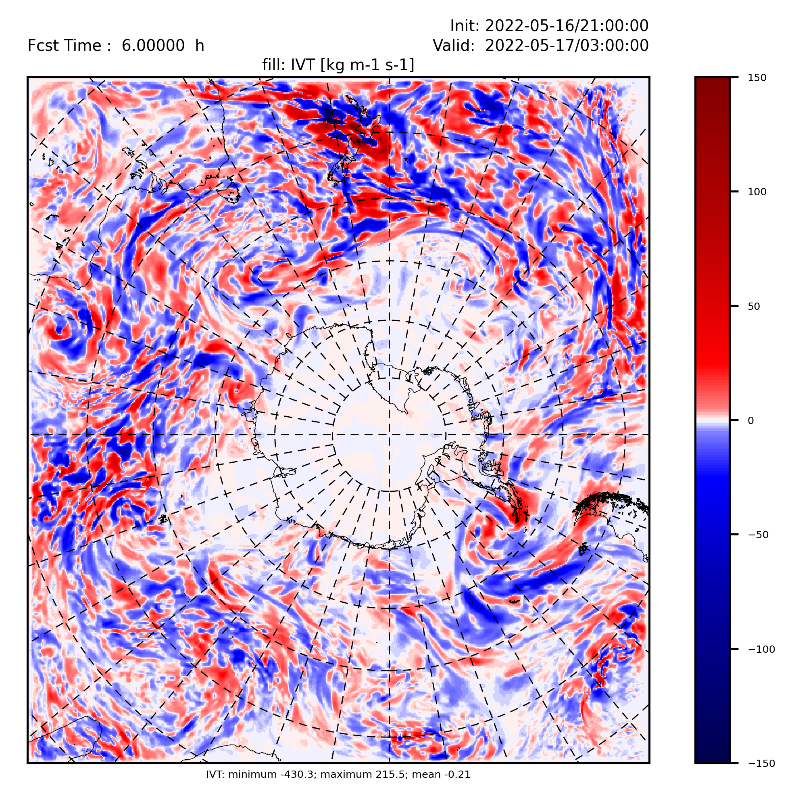
Antarctic YOPP-SH Data Impact Study
Cycling assimilation impact on forecast integrated vapor transport (IVT kg m⁻¹ s⁻¹)
TOP1
May 17 - Forecast IVT
May 17 - Cycling DA difference
-430,215

Slide 19
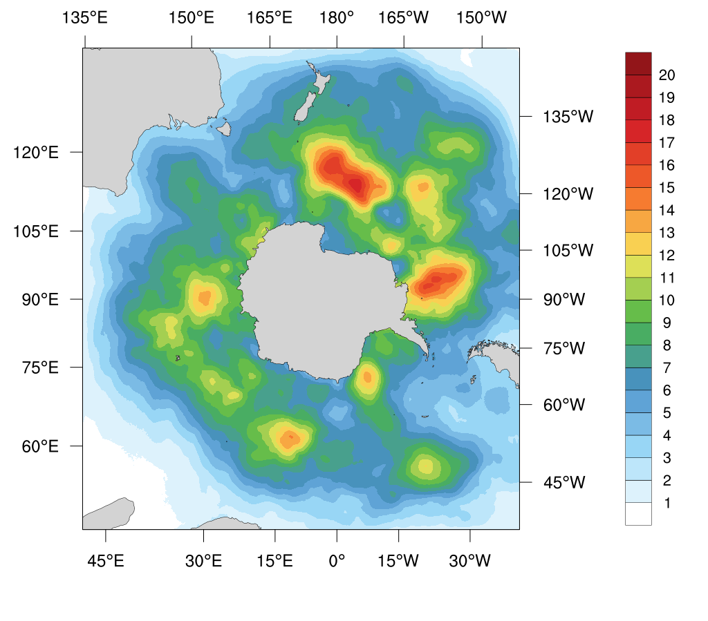
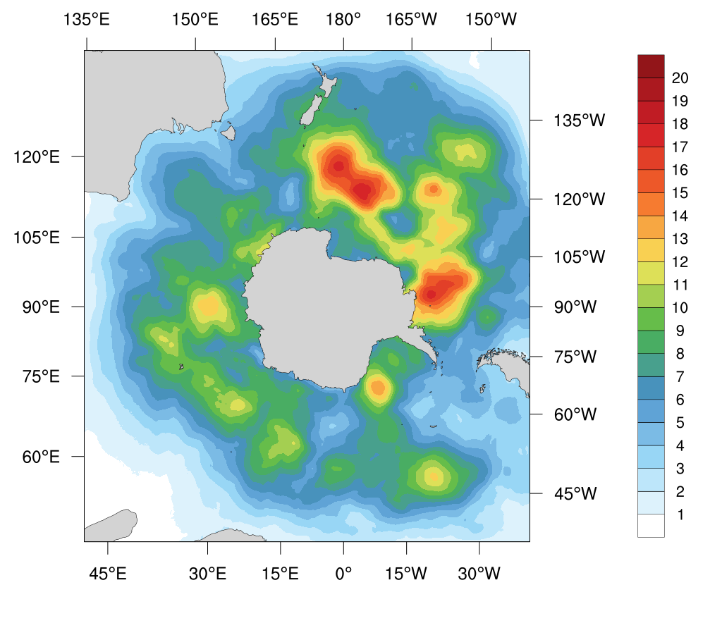
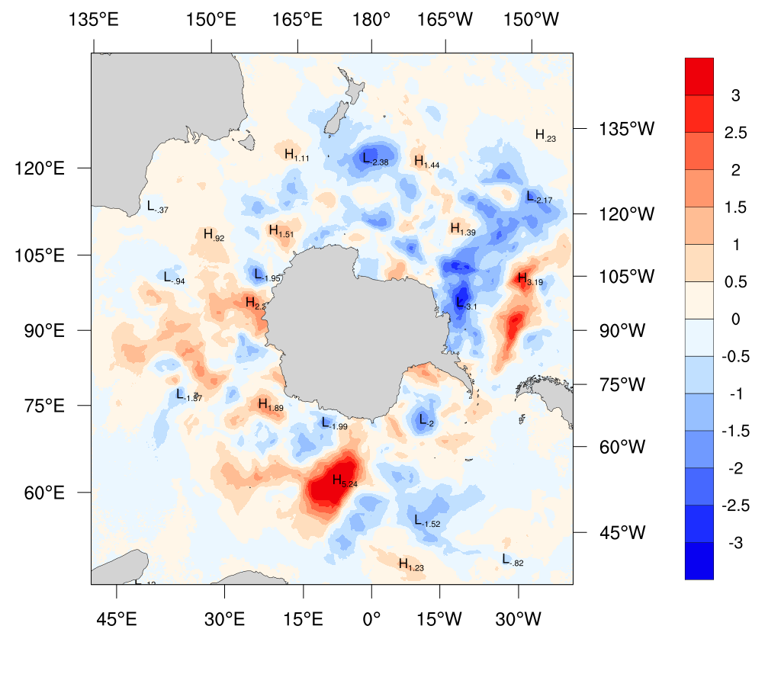
Antarctic YOPP-SH Data Impact Study
SLP Mean Absolute Error (MAE)
ERA5 minus TOP1 forecast experiments – averaged over 8 forecasts
Difference between extra radiosondes added and only routine radiosondes
ERA5 – Extra at 108h forecast
ERA5 – Only routine at 108h forecast
Difference: Extra - Routine
average = 6.20 hPa
average = 6.20 hPa
difference = 0 hPa

Slide 20

The Winter Special Observing Period with the embedded Targeted Observing Periods was a big international achievement. More than 1100 additional radiosondes were released.
Investigations of the processes governing mixed phased clouds and precipitation are ongoing – see Litell et al. and Hines et al. talks on Friday.
Numerical data denial experiments are exploring the forecast improvement resulting from the additional TOP radiosondes – see Powers et al. talk on Friday.
Summary
Contact: David Bromwich
bromwich.1@osu.edu for more information

Slide 21
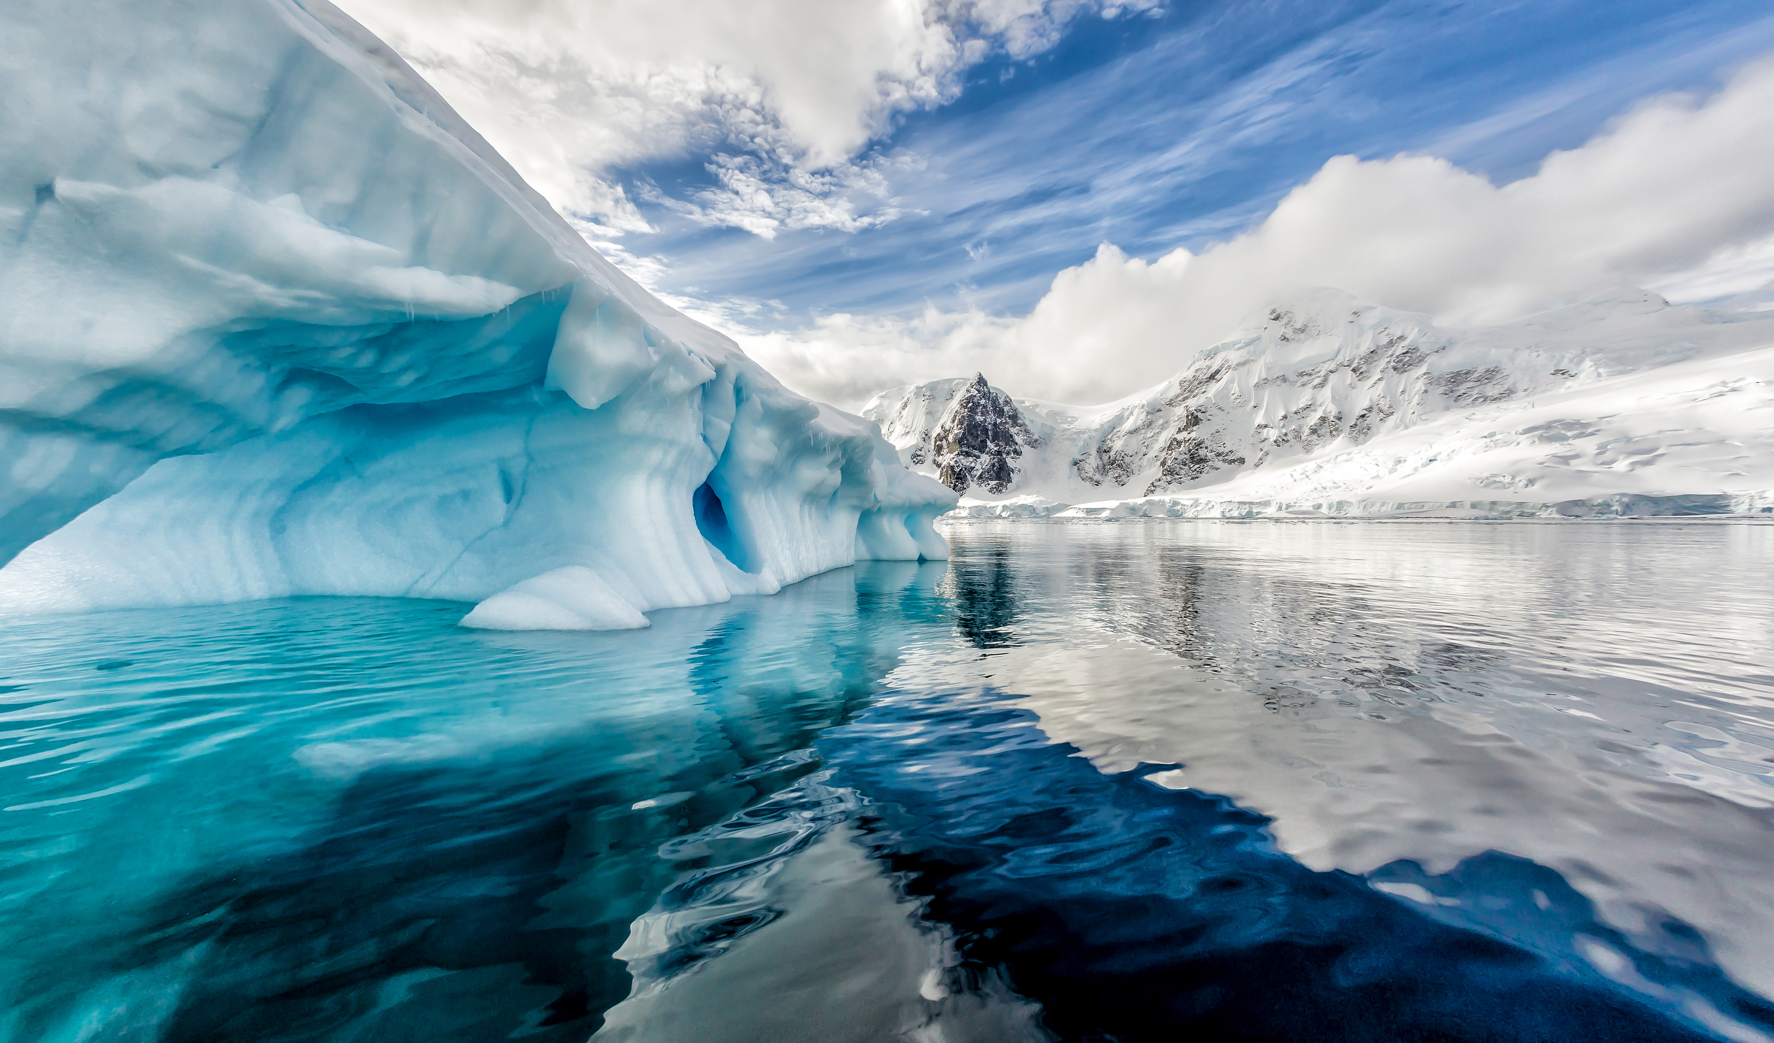
Thank you!

