Slide 1
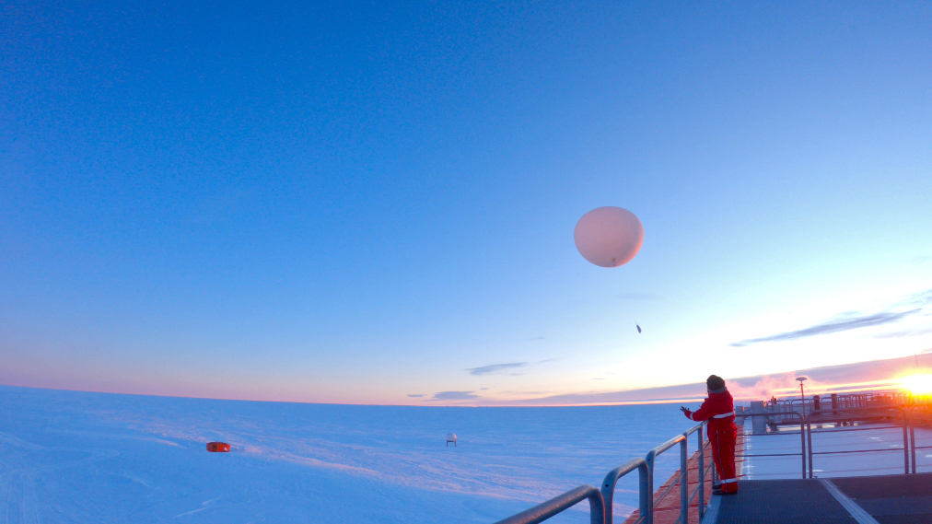
Polar WRF Forecast Performance for Antarctica and the Southern Ocean
David H. Bromwich¹, Jianjun Xue², Ziniu Xiao², Lesheng Bai¹
¹Polar Meteorology Group
Byrd Polar and Climate Research Center
The Ohio State University Columbus, Ohio , USA
² Institute of Atmospheric Physics, Chinese Academy of Sciences, Beijing, China

Slide 2
Polar WRF Set Up
Description | Forecast Mode Test | Climate Mode Test
Horizontal Resolution | 15km | 60km
Simulation | Forecast Mode 48hours run | Climate Mode Monthly
Spin-up | 24 hours | 10 days
Initial and Lateral Boundary | ERA-Interim
Vertical Level | 71, Model top level at 3hPa
Coordinate | Hybrid Vertical Coordinate, eta = 0.3
Land Surface | Noah NoahMP
Microphysics | Morrison 2-mom
PBL Scheme | MYNN2
Short/Long Wave | Both RRTMG
Cumulus | Kain-Fritsch
Surface Layer | MYNN
Sea ice | SEAICE_THICKNESS_DEFAULT = 1.0, SEAICE_SNOWDEPTH_MAX = 0.05(Jul.) , 0.02 (Jan.) SEAICE_SNOWDEPTH_MIN = 0.02(Jul.), 0.002(Jan.) SEAICE_ALBEDO_DEFAULT = 0.80
Spectral Nudging | Spectral Nudging u,v,t, ph above 200 mb

Slide 3
Polar WRF 4.1.1 Numerical Experiments Performed

Slide 4
Observational Sites Employed
Location of the observation sites. (a) Total surface data stations used (97). Red dots (43), blue dots (54) denotes stations from OGIMET and AMRC, respectively. Inset maps are for the Antarctic Peninsula (top) and Ross ice shelf (bottom). (b) Five BSRN stations used (DOM, GVN, LAU, SPO, and SYO). (c) Total upper air radiosonde stations used (22). Red dots (21), blue dots (1) denotes stations from UW and PNRA, respectively.

Slide 5
Forecast Skill for Temperature and Moisture
Temperature (°C)
Dew Point (°C)
Correlation
Cold bias but smaller in summer
Low Td in winter
Bias
RMSE
(a)–(c) Domain-averaged monthly 2 m air temperature statistics, total station numbers from June 2008 to May 2009 are 70, 67, 67, 67, 67, 75, 87, 87, 91, 90, 89, 85, respectively
(a)–(c) Domain-averaged monthly 2 m dew point statistics, total station numbers from June 2008 to May 2009 are 58, 57, 57, 57, 57, 64, 71, 70, 75, 73, 73, 70, respectively

Slide 6
Forecast Skill for Temperature and Moisture
Wind Speed (m/s)
Pressure (hPa)
Highest forecast skill
Correlation
Positive bias in winter
Bias
RMSE
(a)–(c) Domain-averaged monthly 10m wind speed statistics,
total station numbers from June 2008 to May 2009 are 59, 59, 56, 59, 58, 65, 80, 80, 83, 84, 78, 71, respectively
(a)–(c) Domain-averaged monthly surface pressure statistics, total station numbers from June 2008 to May 2009 are 67, 66, 62, 66, 64, 71, 84, 83, 84, 83, 83, 80,respectively

Slide 7
Forecast Skill for Longwave Downward Radiation
Bias Coastal (W/m²)
Deficit
(a)–(b) Mean monthly incident longwave radiation at the surface. BSRN, Model, denotes station-averaged observation and forecast data (NoahMP FM simulation) respectively. Group is computed for additional locations of similar characteristics from the forecasts. (a) Coastal stations, Group number is 16, including 3 BSRN station sites (GVN, LAU, SYO). (b) Inland stations, Group number is12, including 2 BSRN station sites (DOM, SPO).
Bias Inland (W/m²)
Excess

Slide 8
Forecast Skill for Shortwave Downward Radiation
Bias Coastal (W/m²)
Excess
(a)–(c) Mean monthly incident shortwave radiation at the surface. BSRN, Model, denotes station-averaged observation and forecast data (NoahMP FM simulation) respectively. Group is computed for additional locations of similar characteristics from the forecasts. (a) Coastal stations. Group number is 16, including 3 BSRN station sites (GVN, LAU, SYO). (b) Plateau stations. Group number is 5, including 1 BSRN station site (DOM). (c) South Pole other inland stations. Group number is 7, including 1 BSRN station site (SPO).
Bias Plateau (W/m²)
Variable bias
Bias South Pole + (W/m²)
Excess

Slide 9
Forecast Skill for Upper Air Temperature
High forecast skill in winter and summer
(a)–(c) July 2008 and (d)–(f) January 2009 monthly means vertical temperature profiles for 22 stations of observations (Figs. 8(a) and 8(d)), PWRFs (Figs. 8(b) and 8(e)), and means (Figs. 8(c) and 8(f)) plotted from 925 hPh to 100 hPa vertical levels. Figures 8(a), 8(b), 8(d), and 8(e) are individual stations plotted with dashed lines. Figures 8(c) and 8(f) are the station means with the blue solid line for observation and red dashed line for PWRF. Thick horizontal bars (blue) and thin horizontal bars (red) at the vertical standard levels represent standard deviation for observation and PWRF, respectively.
July
Jan

Slide 10
Forecast Skill for Upper Air Wind Speed
High forecast skill in winter and summer
(a)–(c) July 2009 and (d)–(f) January 2009 monthly means vertical distribution of horizontal wind speed profiles for 22
stations of observations (Figs. 9(a) and 9(d)), PWRFs (Figs. 9(b) and 9(e)), and means (Figs. 9(c) and 9(f)) plotted from 925 hPh to 100 hPa vertical level. Figures 9(a), 9(b), 9(d), and 9(e) are individual stations plotted with dashed lines. Figures 9(c) and 9(f) are the stations means with the blue solid line for observation and red dashed line for PWRF. Thick horizontal bars (blue) and thin horizontal bars (red) at the vertical standard levels represent standard deviation for observation and PWRF, respectively
July
Jan

Slide 11
Forecast Summer Temperature with Different Land Surface Models
PWRF411 NoahMP greatly reduces the forecast temperature errors
Model vs. Observations
Model vs. ERA-Interim
The bias (Model versus Observations) of 2 m temperature for (a) PWRF411 NoahMP, (b) PWRF411 Noah, and (c) WRF NoahMP in January 2009. The total station number is 87. Dots with a black circle means the correlation ≥ the annual average of domain-averaged (0.81).
The bias of (Model versus ERA-Interim forecast) of 2 m temperature for (a) PWRF411 NoahMP, (b) PWRF411 Noah, and (c) WRF NoahMP in January 2009

Slide 12
Forecast Longwave Down for Different Land Surface Models
PWRF411 NoahMP greatly reduces the forecast longwave radiation errors
The bias (Model versus ERA-Interim forecast) of longwave radiation at the surface down for (a) PWRF411 NoahMP, (b) PWRF411 Noah, and (c) WRF NoahMP in January 2009.

Slide 13
Forecast Shortwave Down for Different Land Surface Models
Model vs. ERA-Interim
PWRF411 NoahMP greatly reduces the forecast shortwave down errors especially over the ocean
The bias (Model versus ERA-Interim forecast) of shortwave radiation at the surface down for (a) PWRF411 NoahMP, (b) WRF411 NoahMP, (c) PWRF403 NoahMP, (d) PWRF411 Noah, (e) WRF411 Noah, and (f) PWRF403 Noah in January 2009
NoahMP
Noah

Slide 14
Forecast Diurnal Temperature Cycle
The forecast diurnal temperature cycle is too strong
Diurnal 2 m temperature cycle of nine stations located at Antarctic coastline for observation (solid blue line), PWRF411 NoahMP simulated with FM and CM (solid green line and dashed green line), and PWRF411 Noah simulated with FM and CM (solid red line and dashed red line), respectively. The standard deviation plotted as vertical error bar for observation (OBS), NoahMP and Noah in FM. Note that observations are every 3 h at Halley, Neumayer, Syowa, Mawson, Davis, Casey, and Dumont D’Urville while every 6 h at Mirny and McMurdo.

Slide 15
Conclusions
Cold bias in winter along with stronger winds.
Forecast pressure has high skill.
Deficit of cloud effects in the model along the coast.
Deficit of cloud effects in the interior is more muted.
Upper air forecasts show very good skill throughout the year.
Month-long simulations are as skillful as short-term forecasts (not shown).
Ongoing work is aimed at reducing overly strong diurnal temperature cycle.
Xue, J., Z. Xiao, D. H. Bromwich, L. Bai, 2022: Polar WRF V4.1.1 simulation and evaluation for the Antarctic and Southern Ocean. Front. Earth Sci., 16, 1005-1024, https://doi.org/10.1007/s11707-022-0971-8.

Slide 16
Polar WRF Modifications (version 4.3.3, 4.4.0 and 4.5.0)
Noah-MP
Modified albedo scheme along the coastal region of Antarctic, Noah MP ice sheet: albedo limitation > 0.8 over Antarctic (above 1000m) and ~0.5 (below 1000m to remove cold bias along coast)
Revised the parameters of Noah-MP snow temperature scheme over ice sheet to remove strong diurnal cycle over ice sheet
Sea ice
Revised monthly snow thickness over sea ice to reduce temperature bias
Microphysics
Modification of droplet number (NDCNST: 50)
Revised qvqvsi (wintertime value) to reduce warm bias over ice sheet

Slide 17
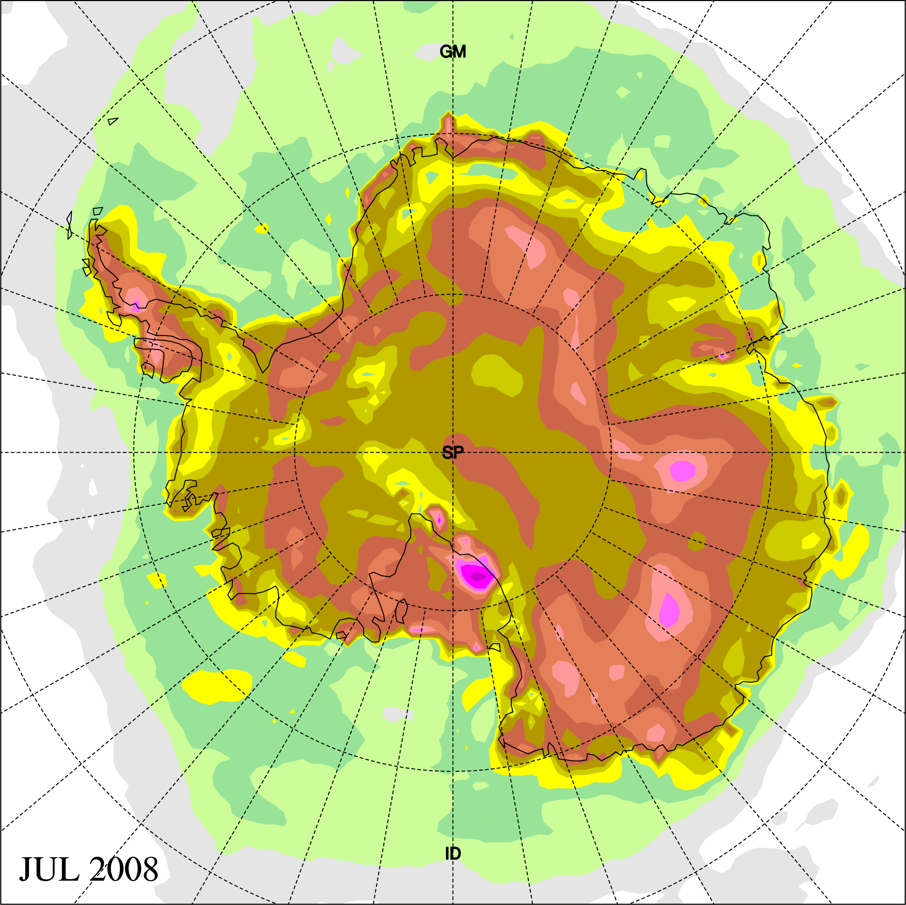
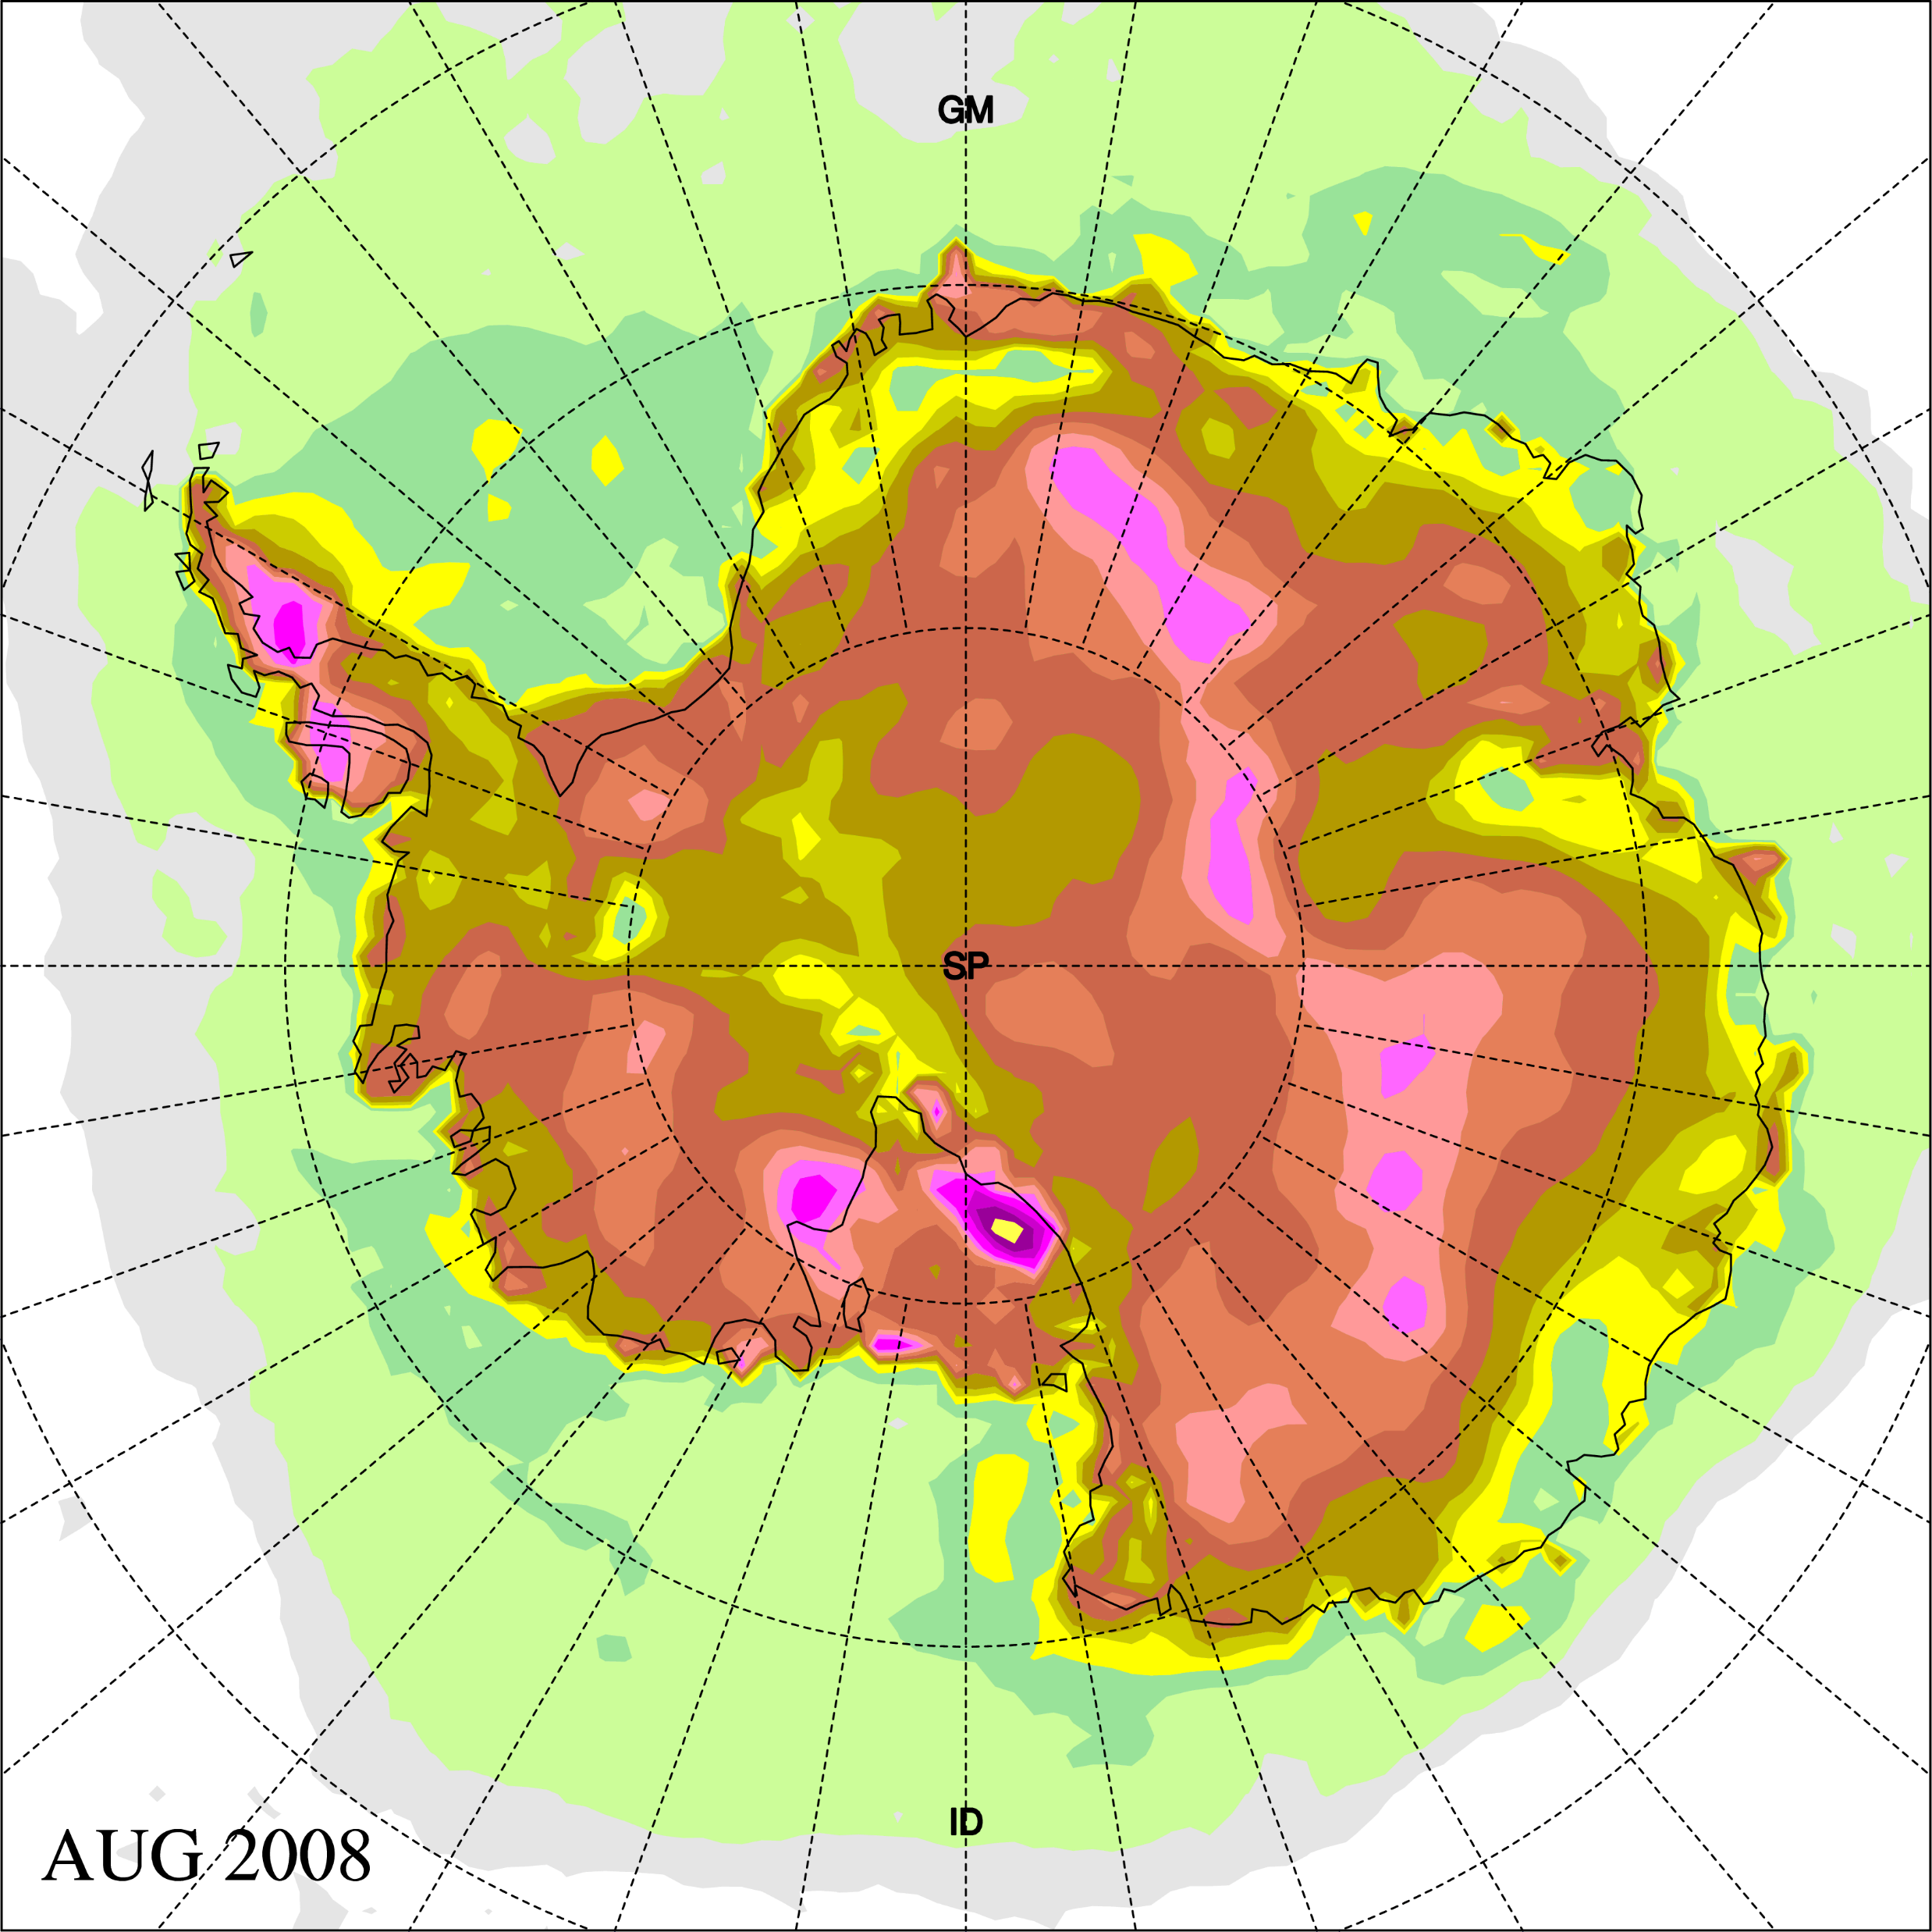
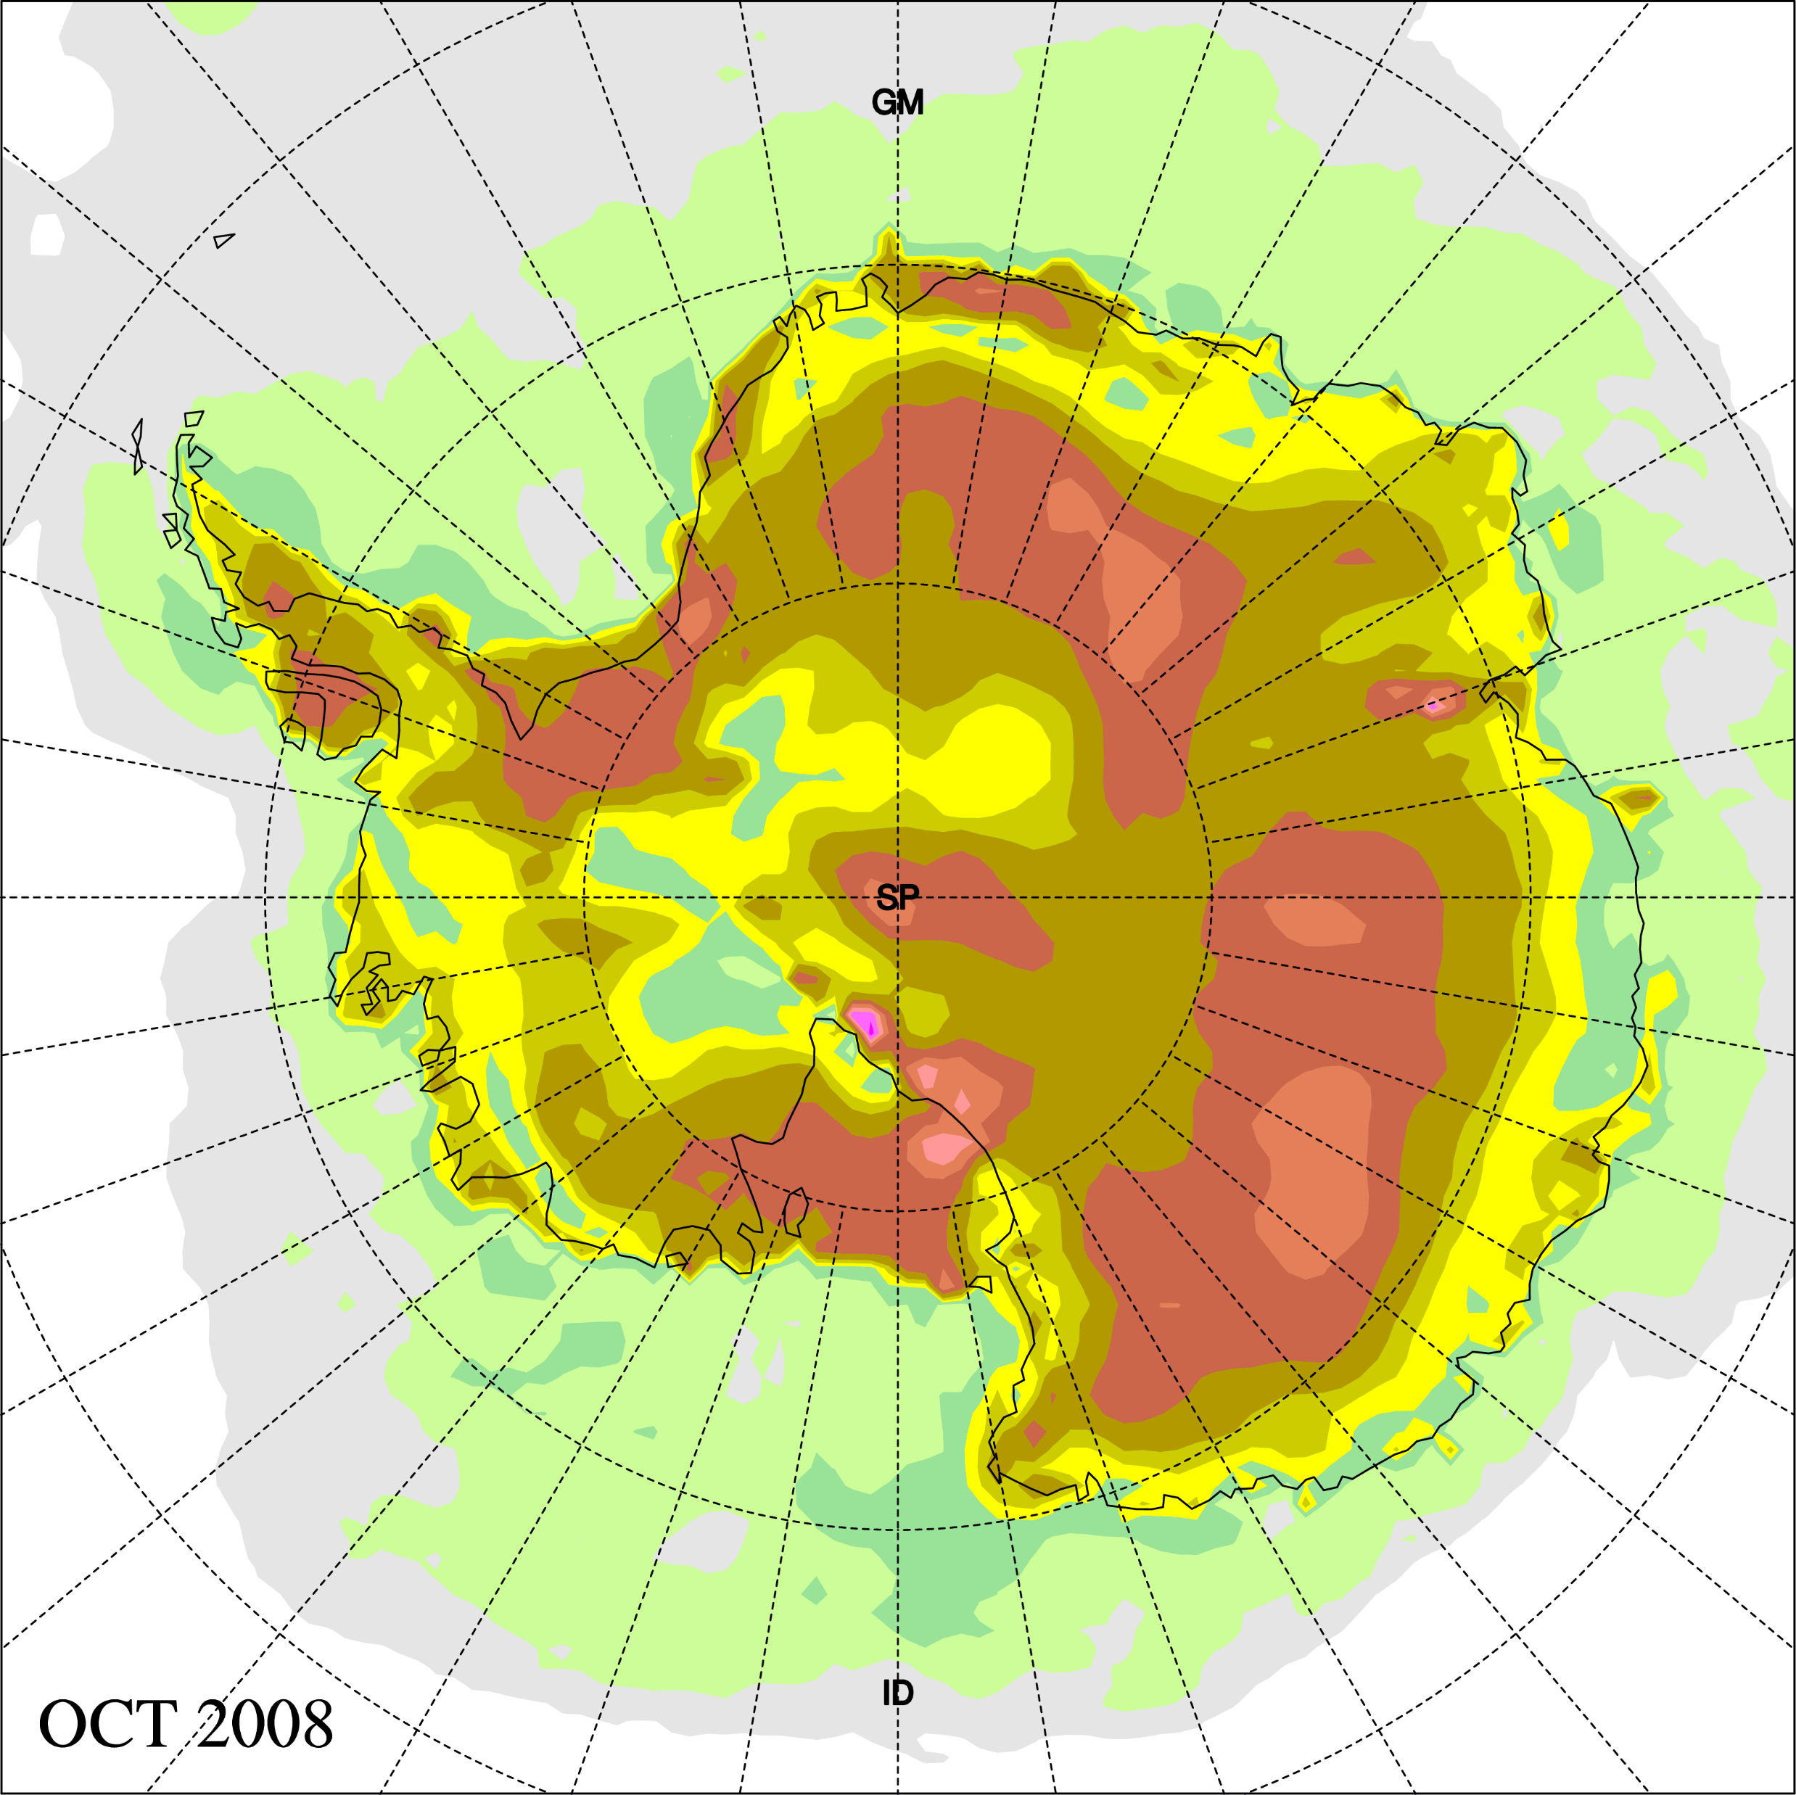
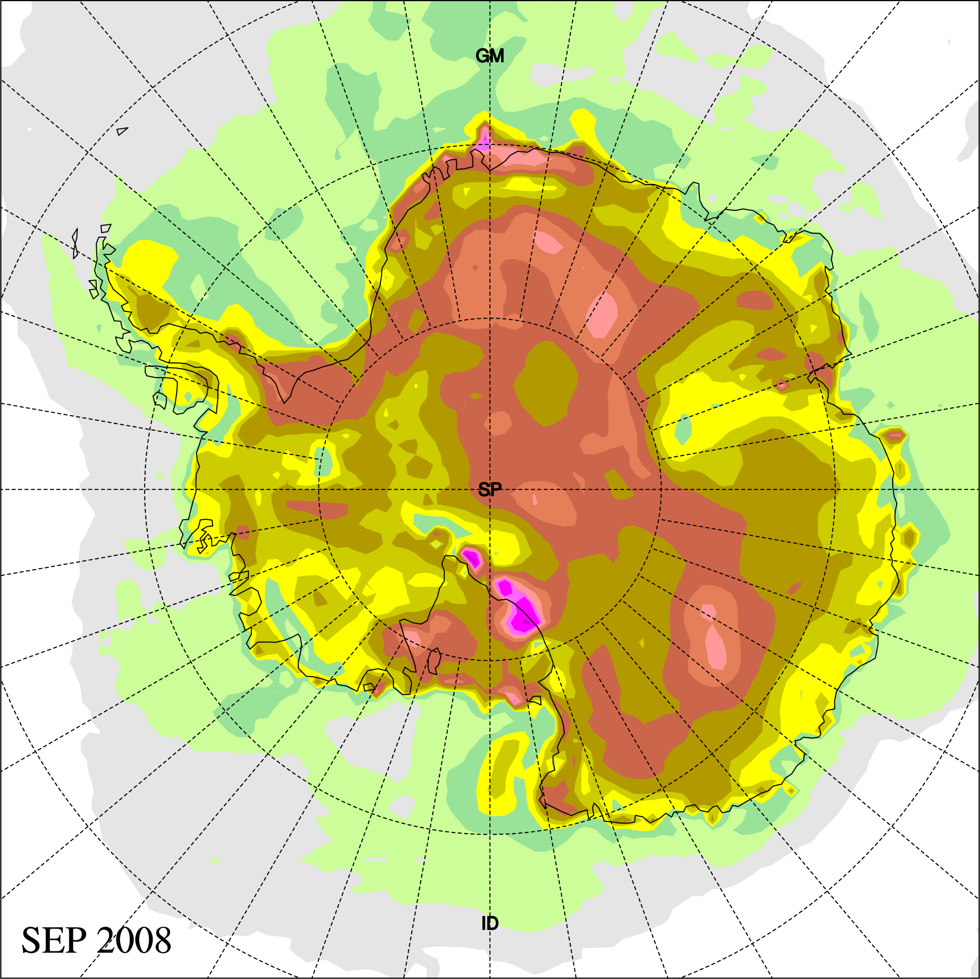
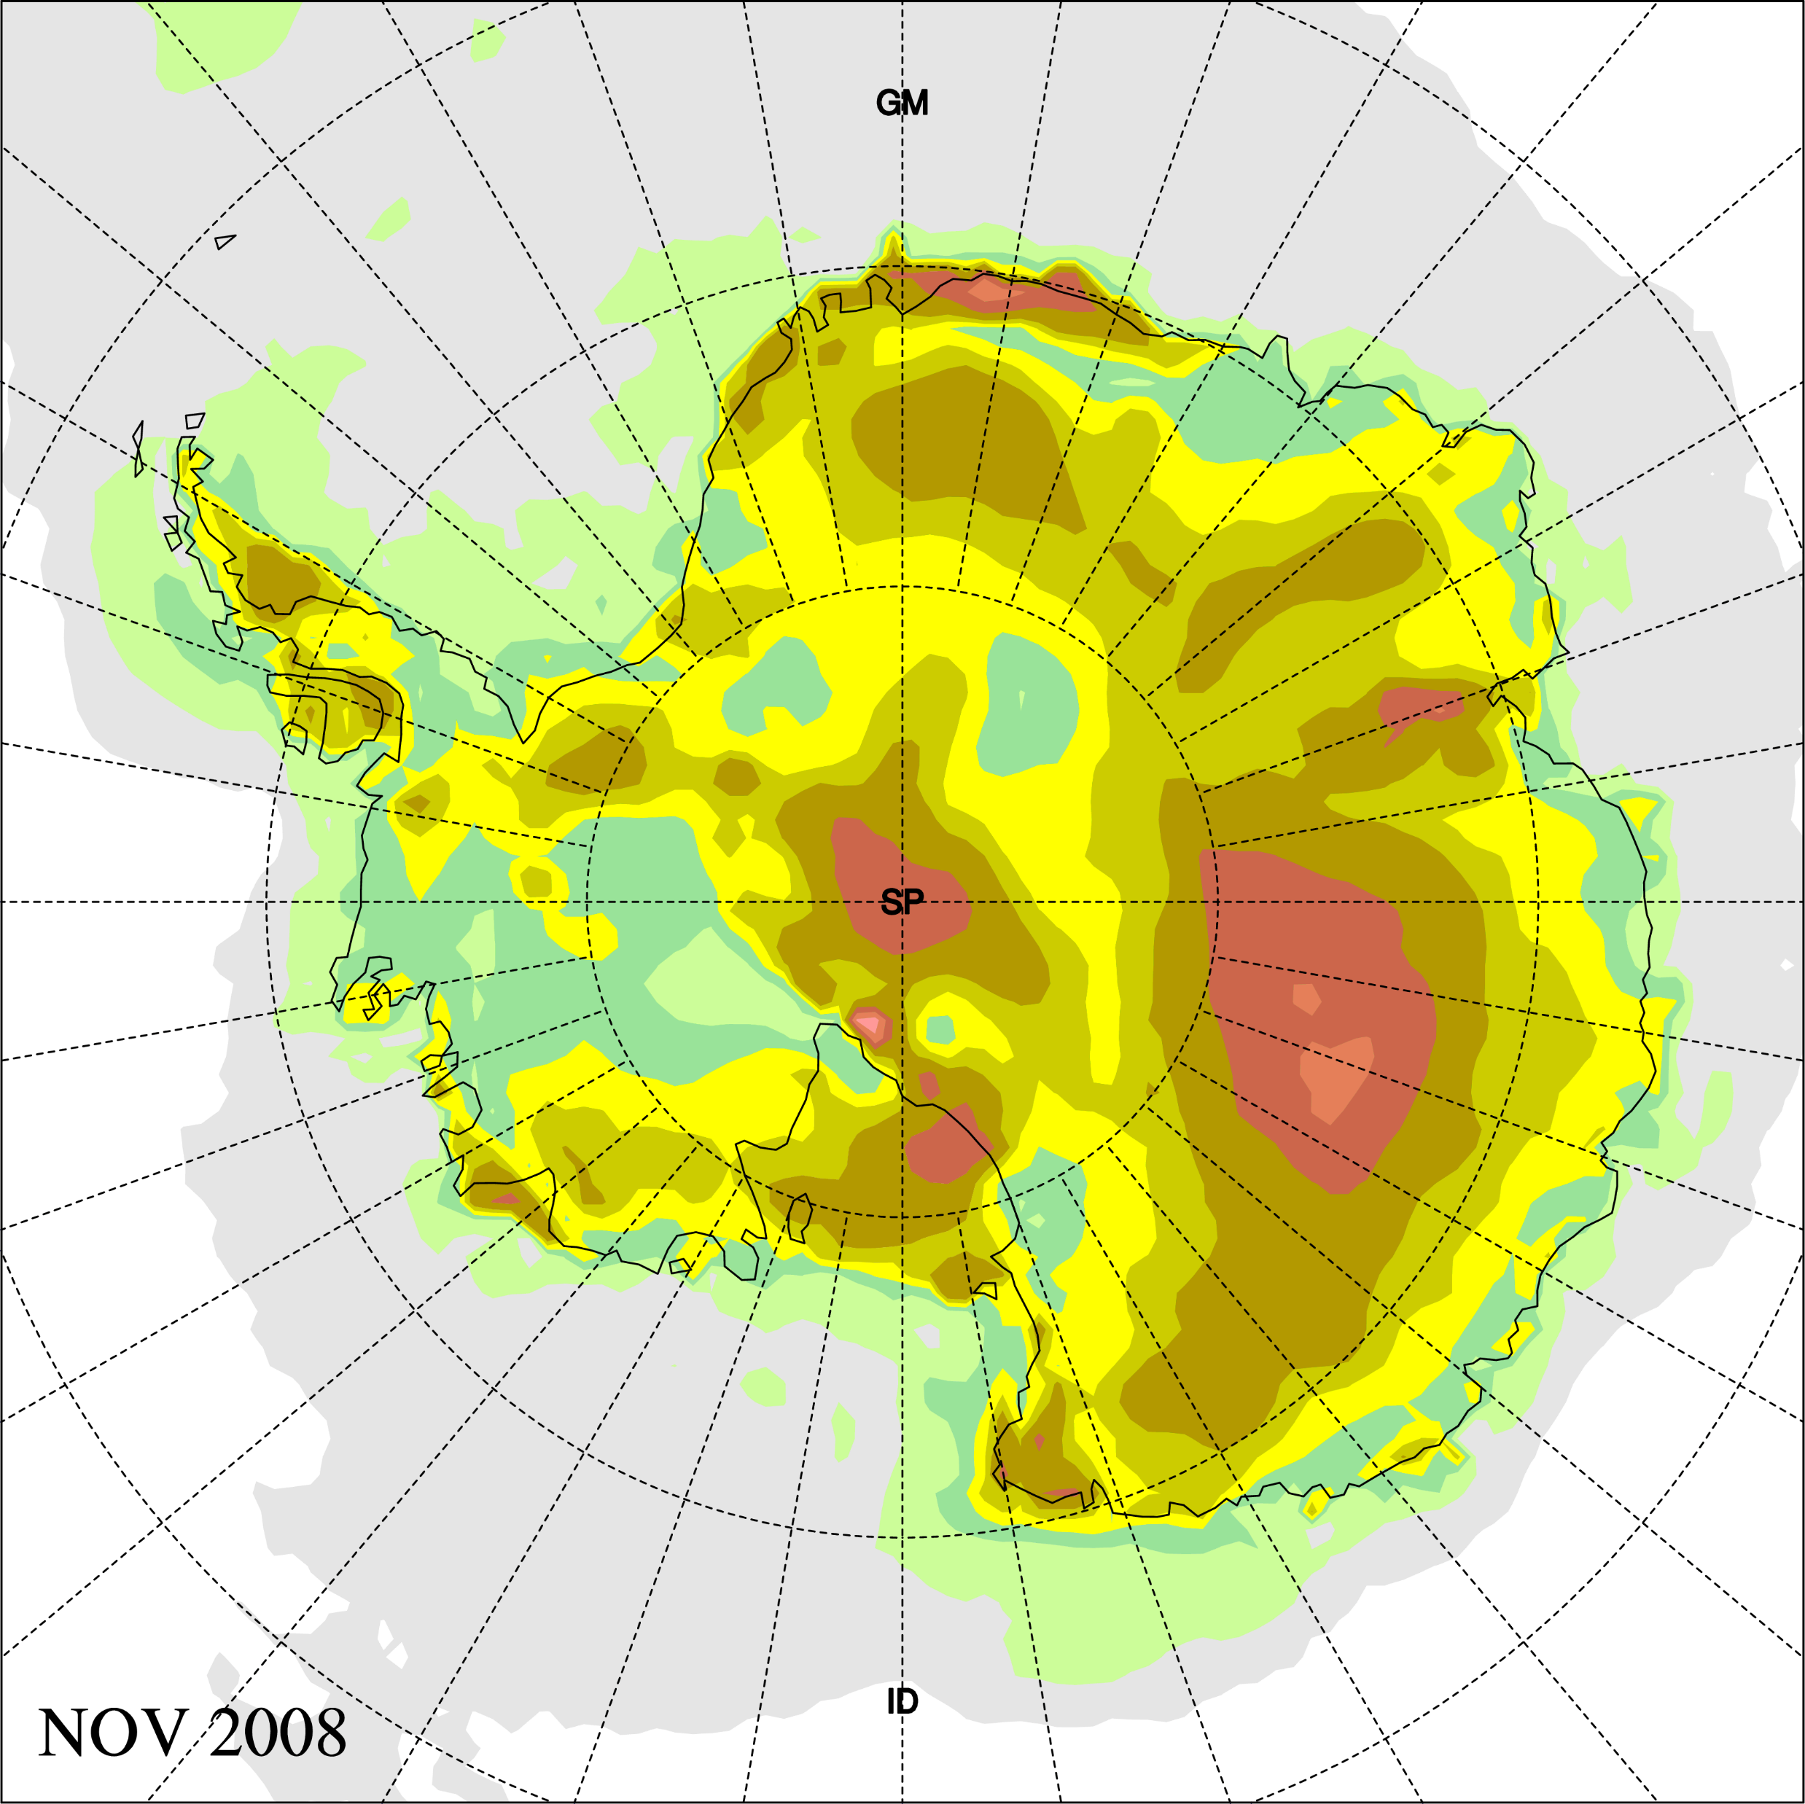
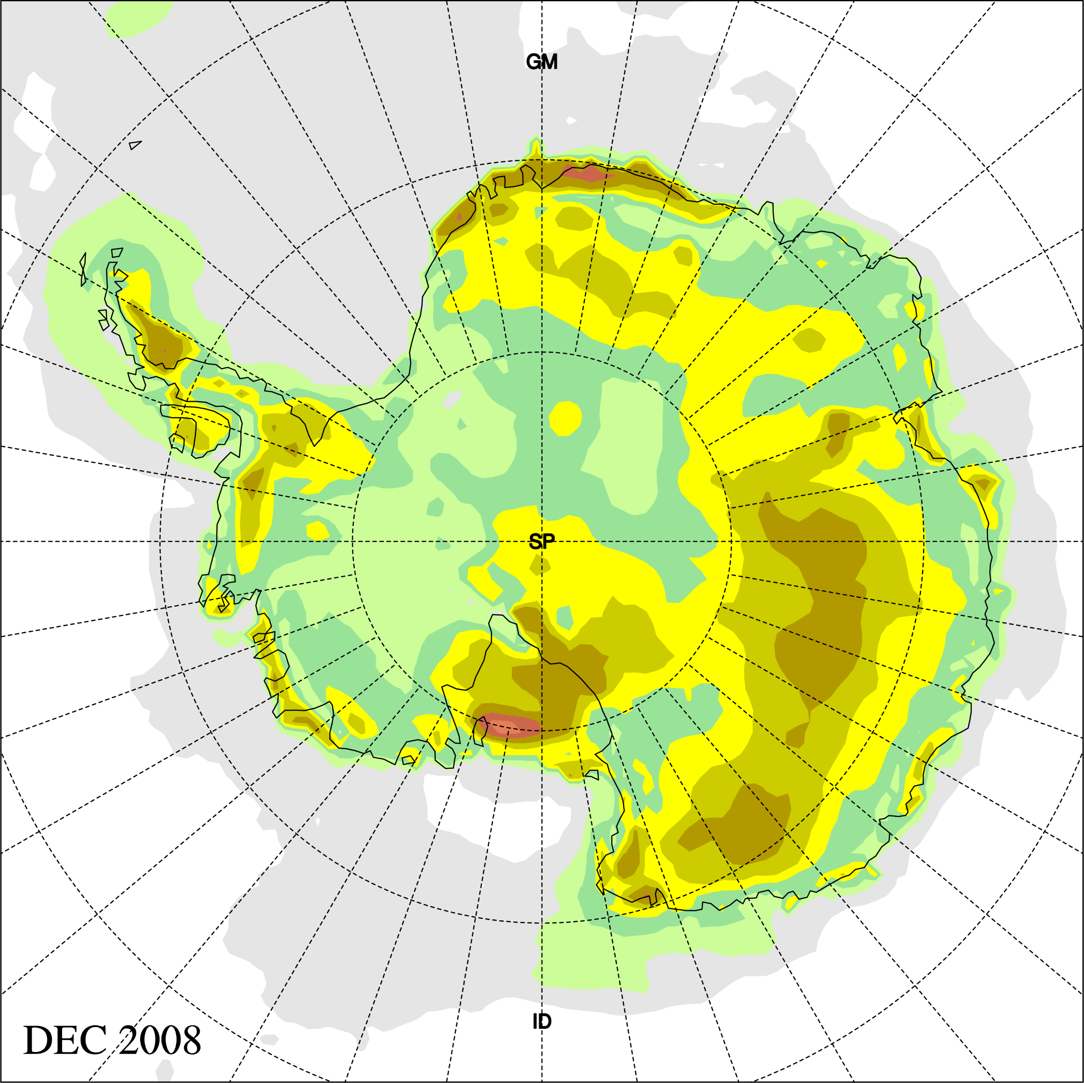
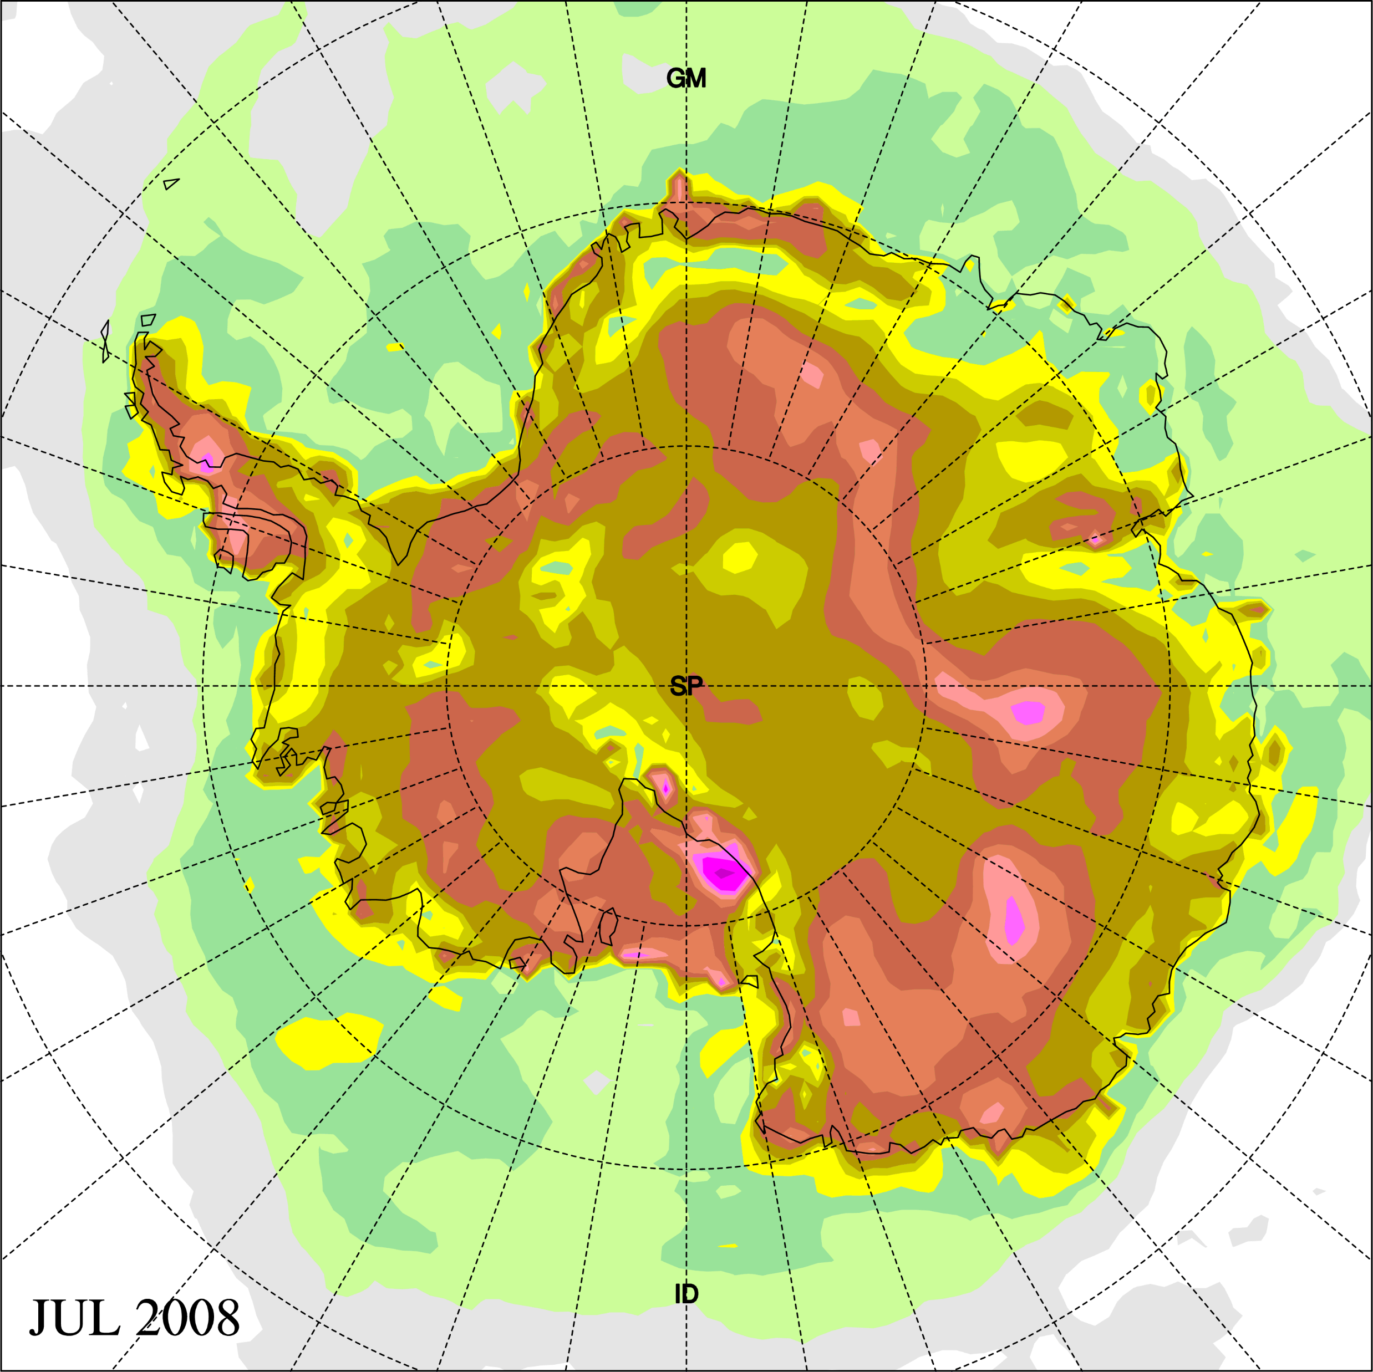
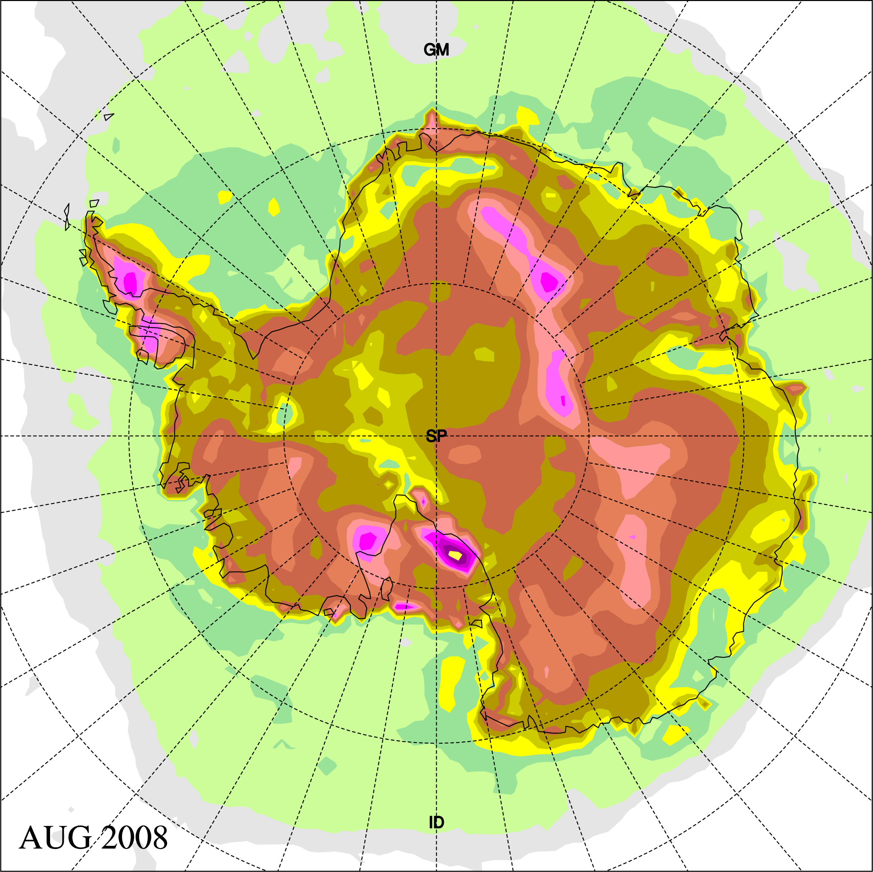
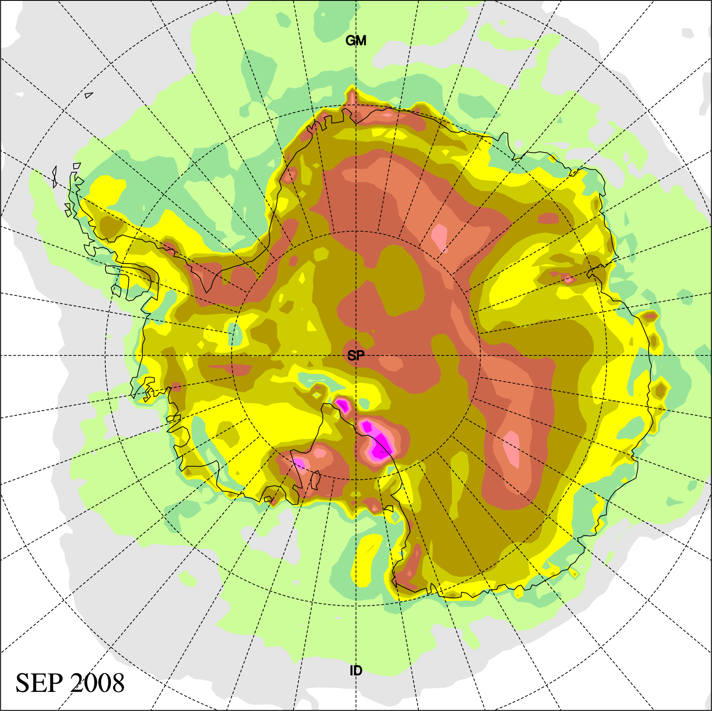
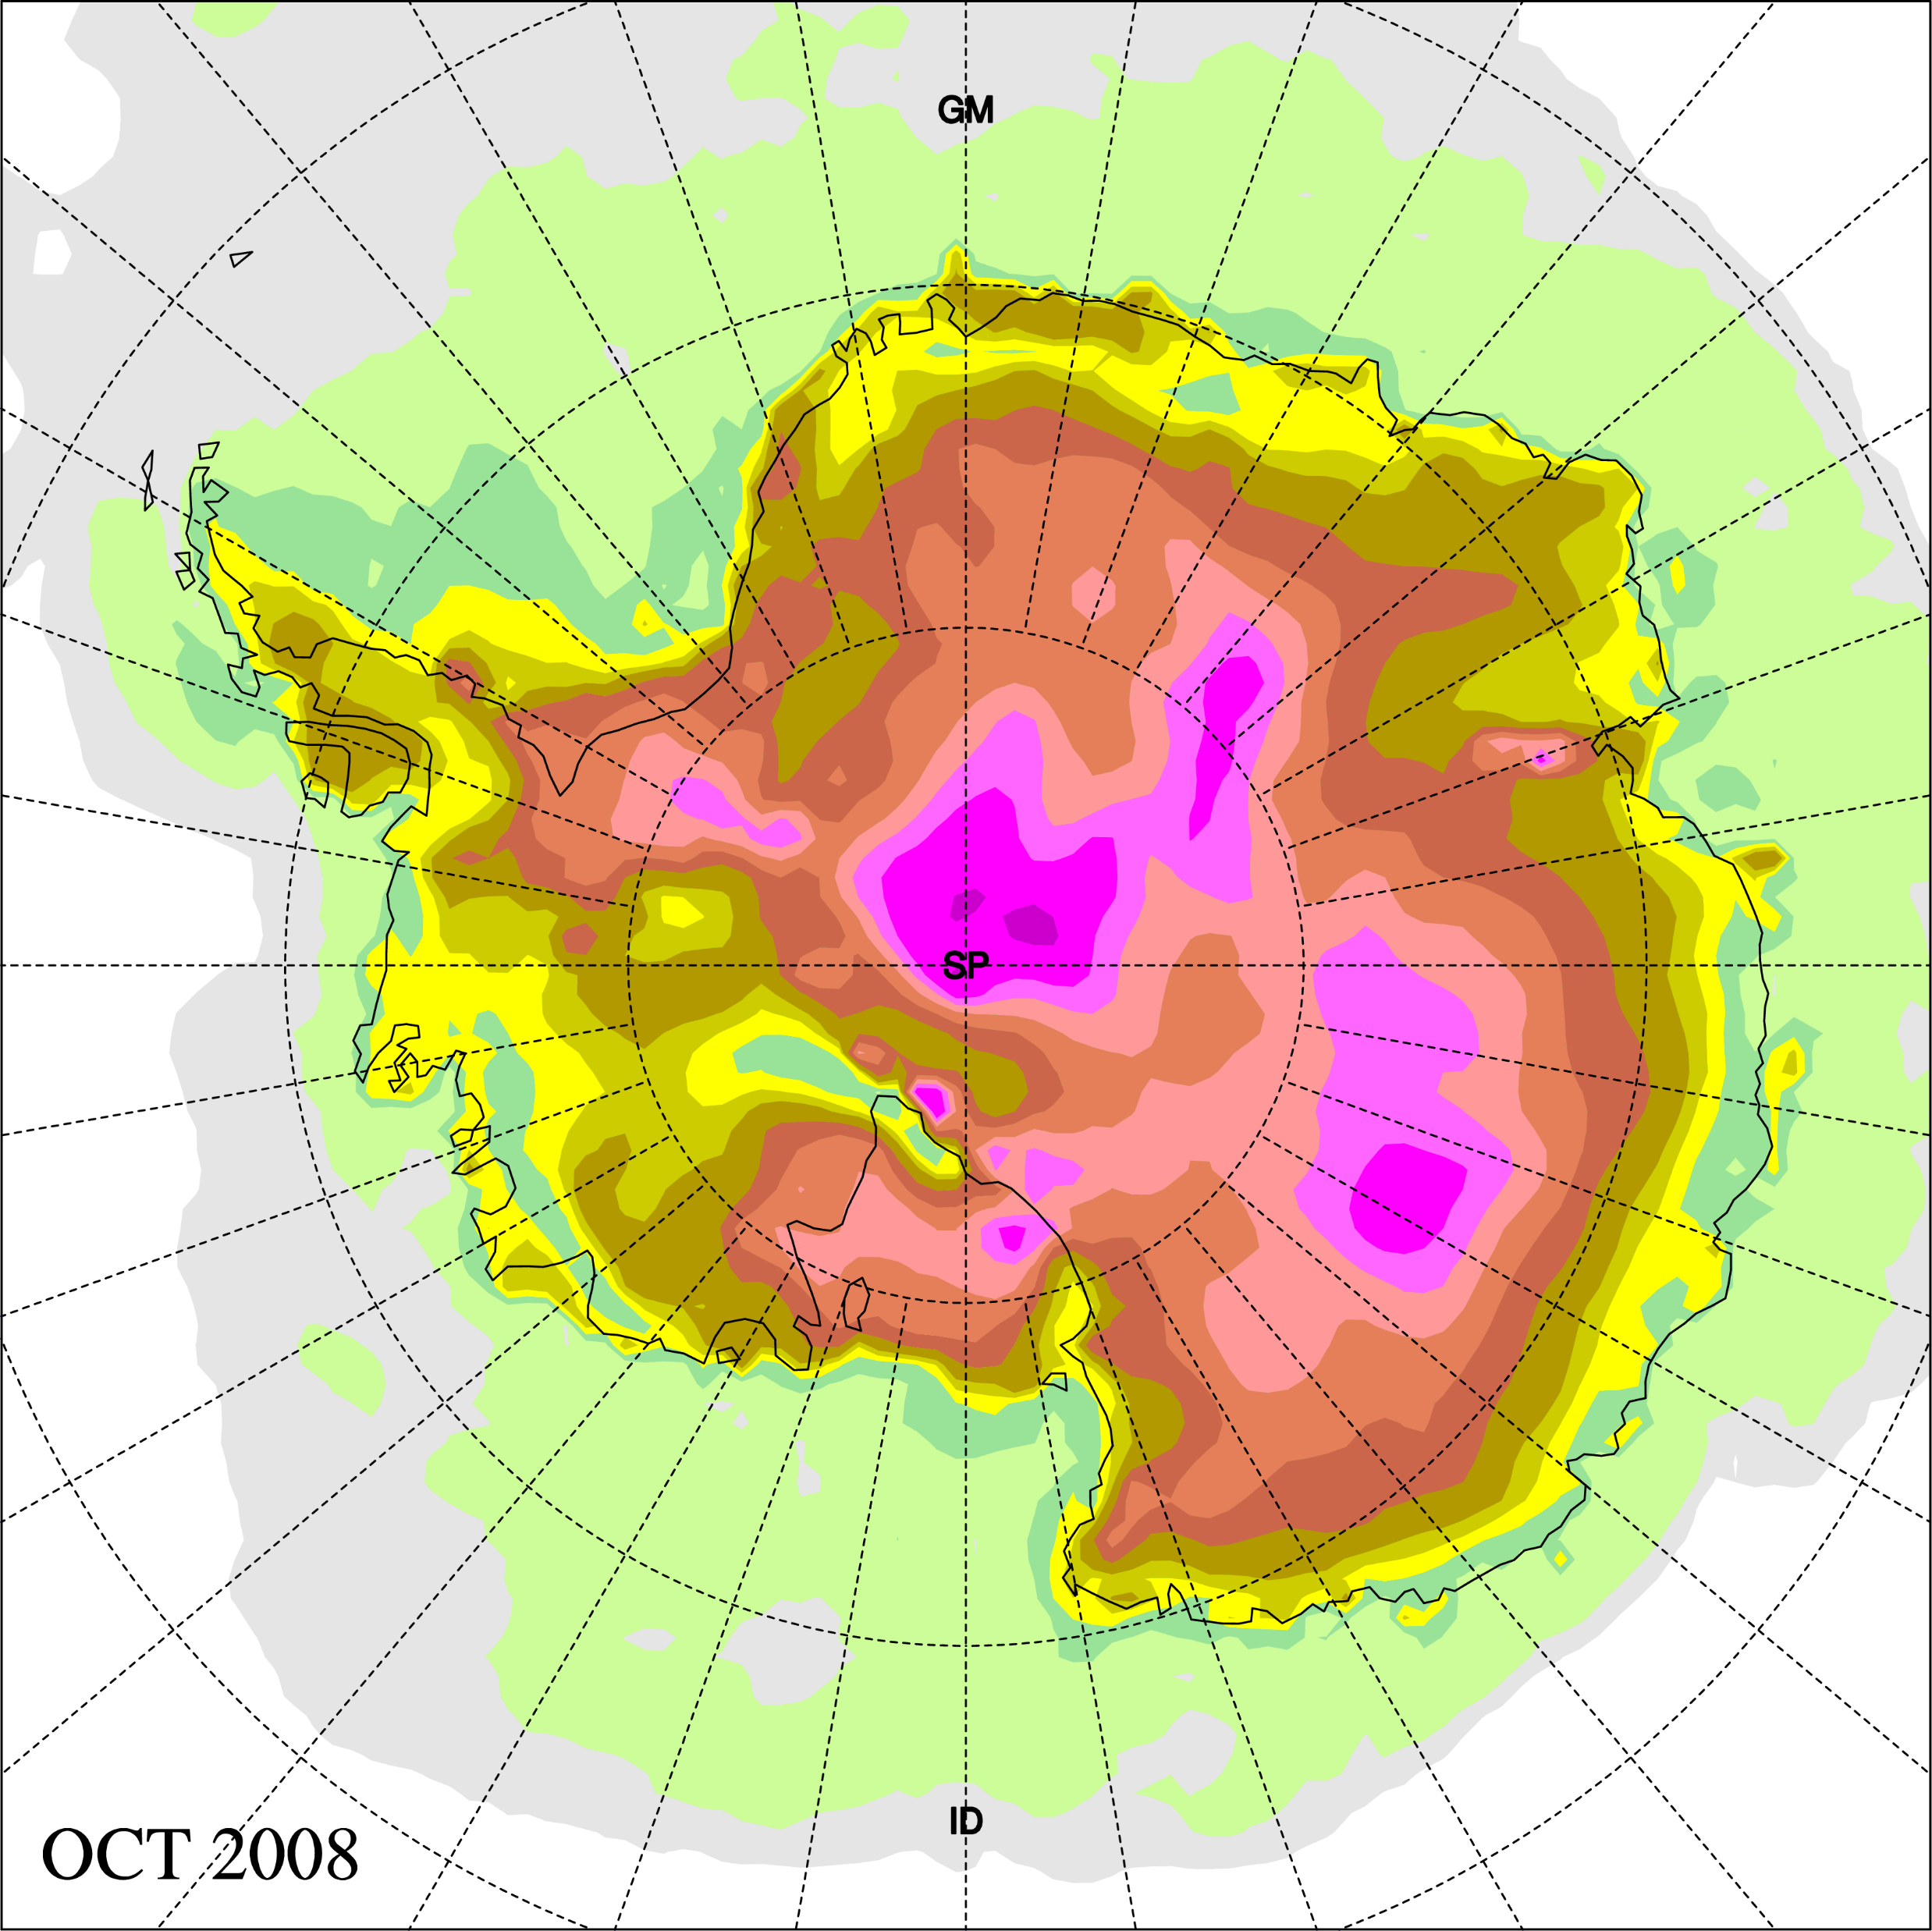
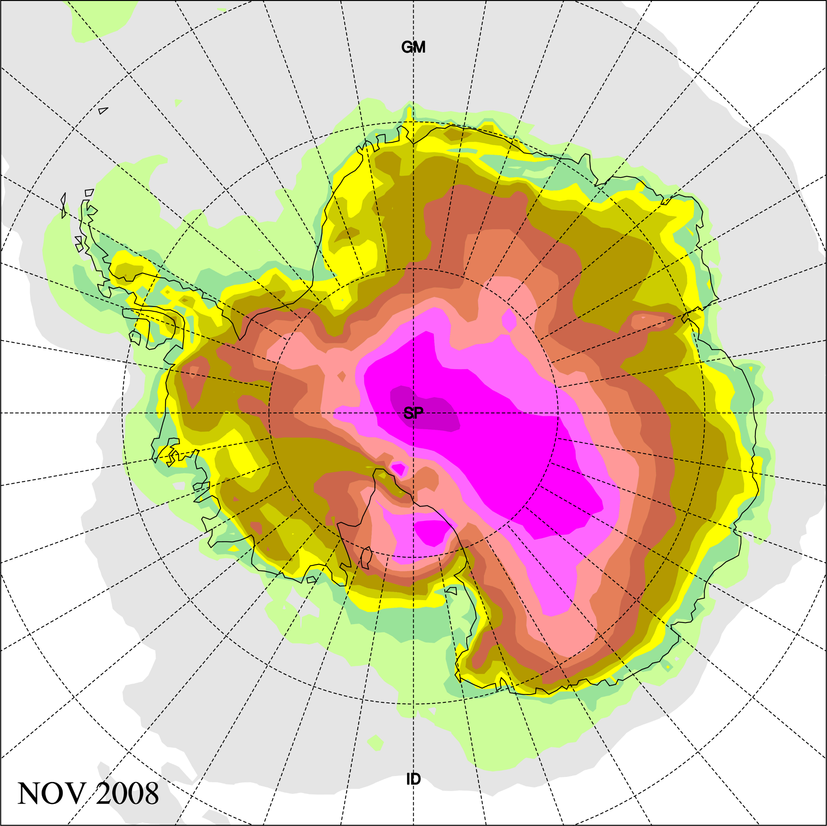
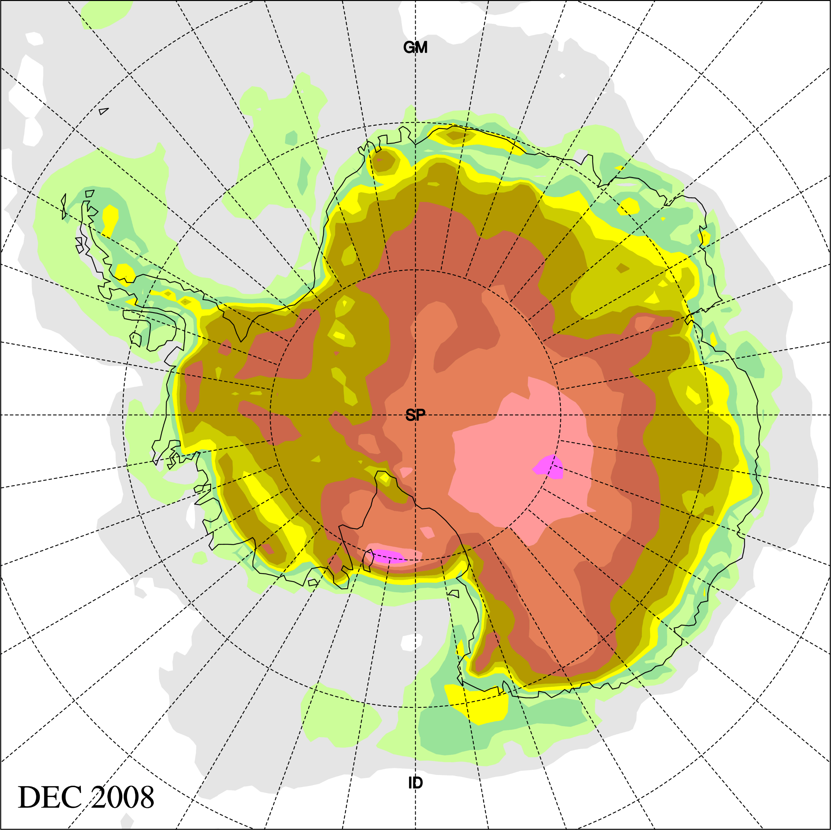
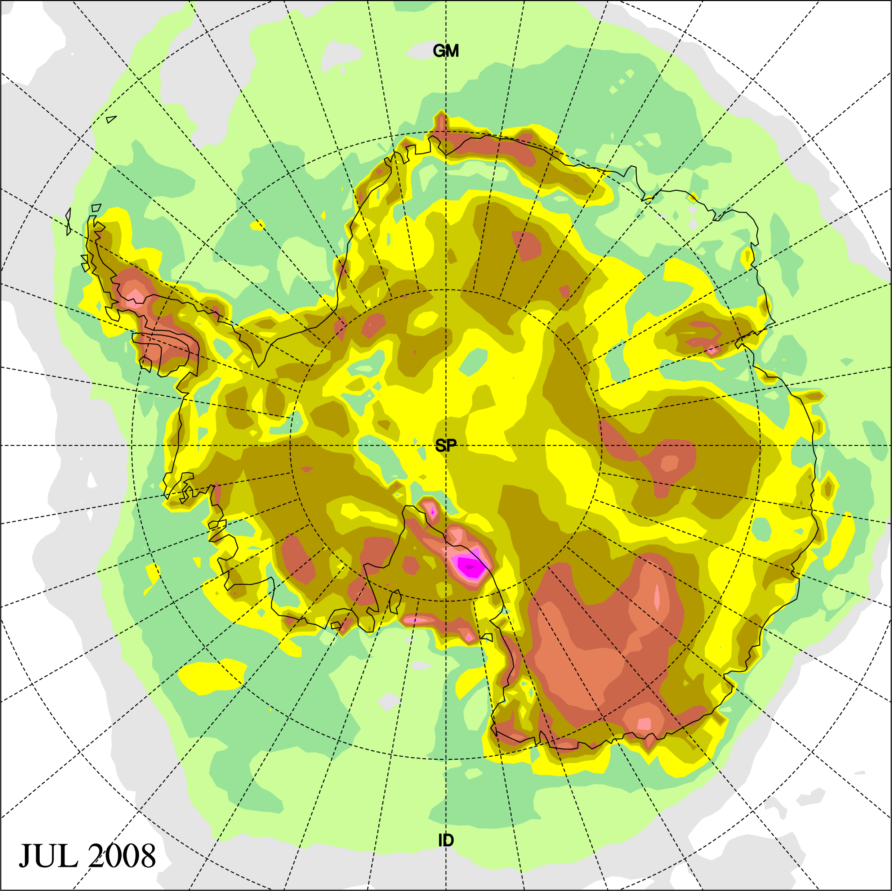
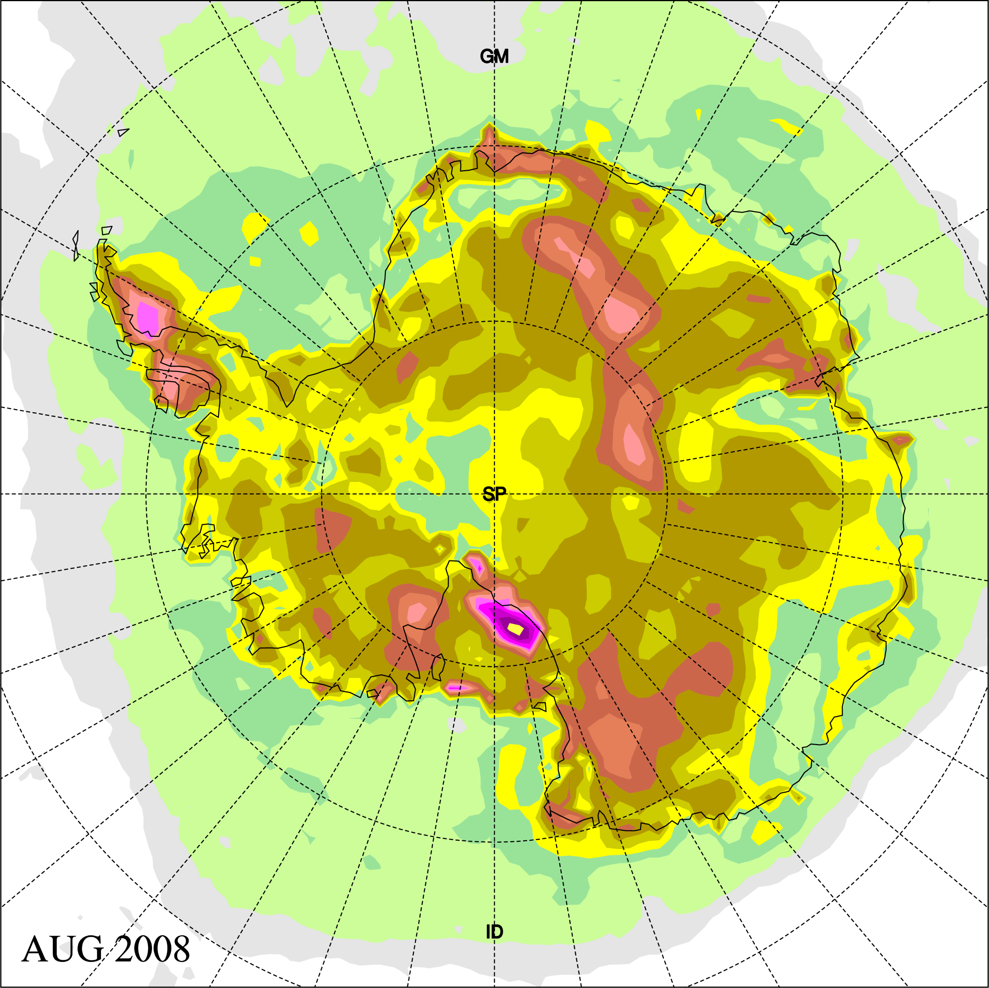
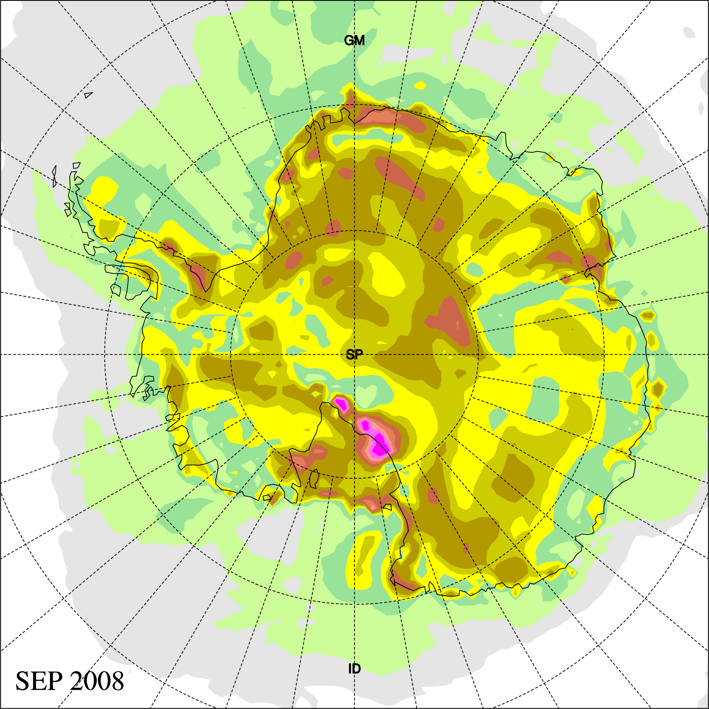
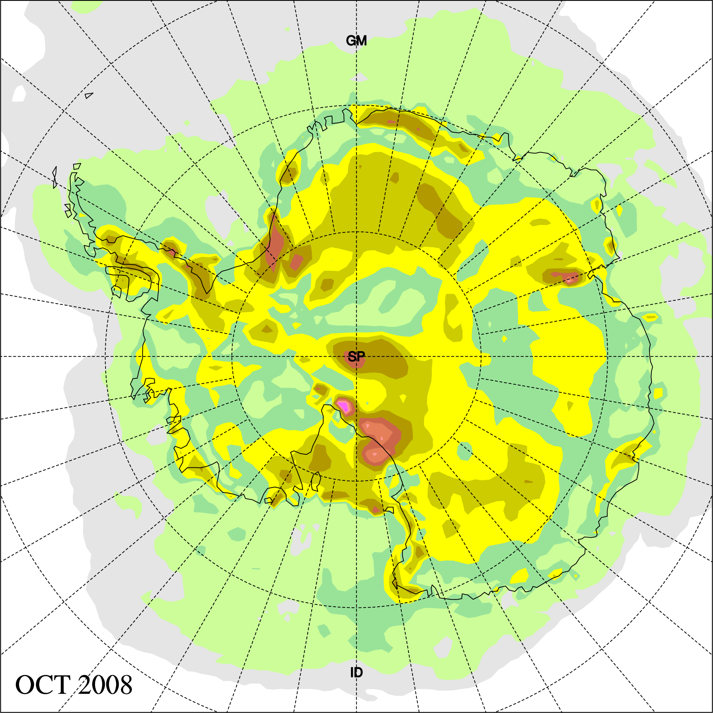
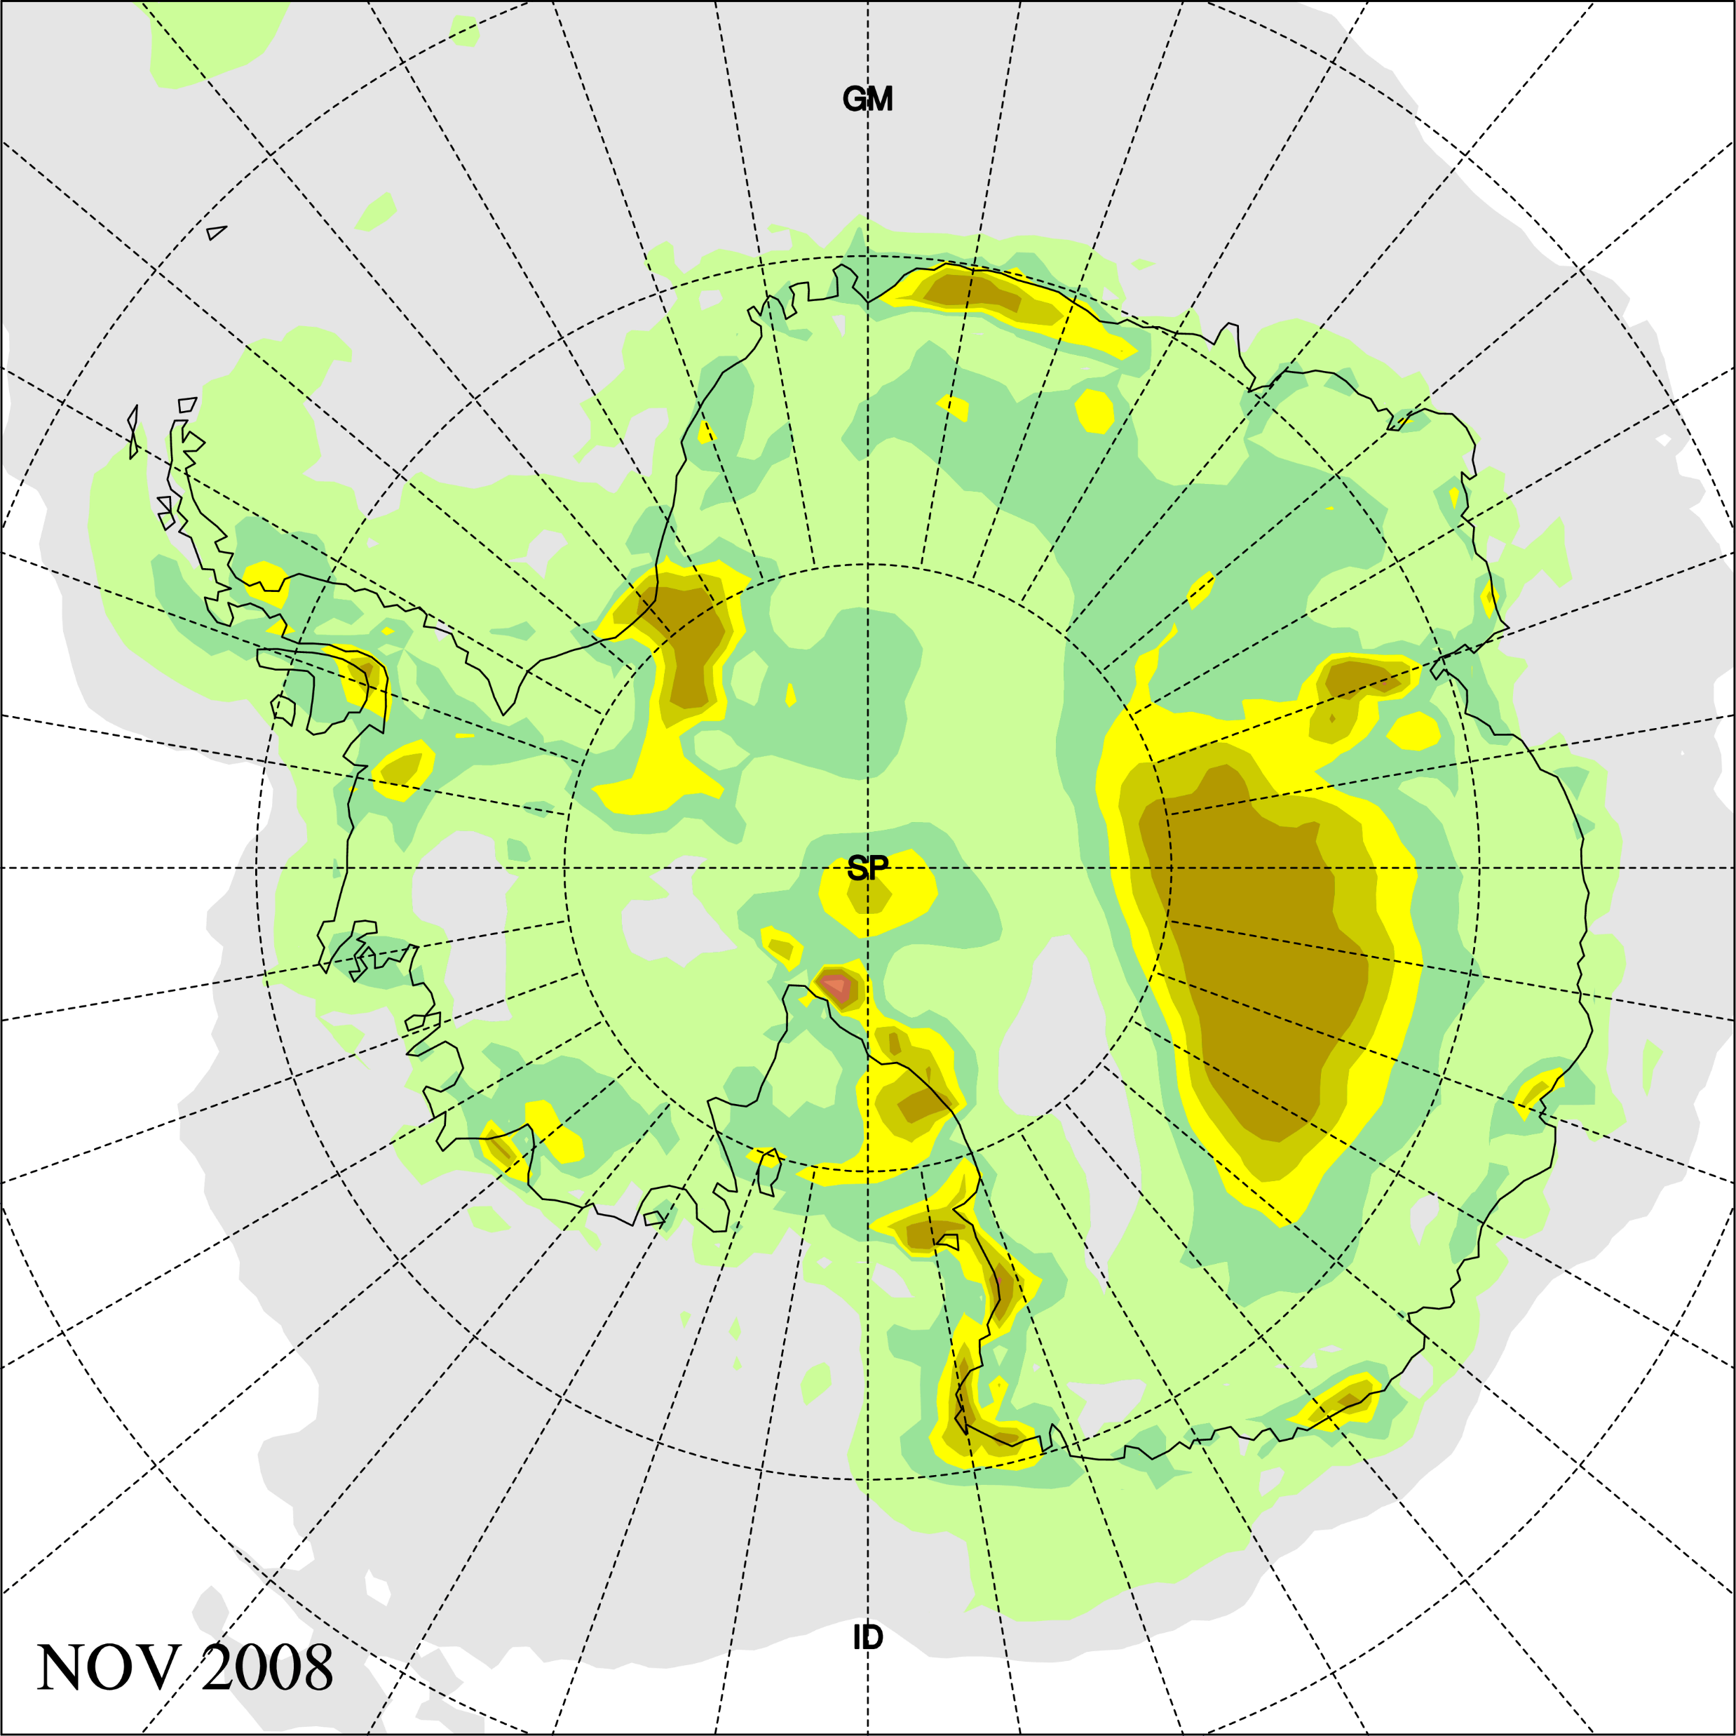
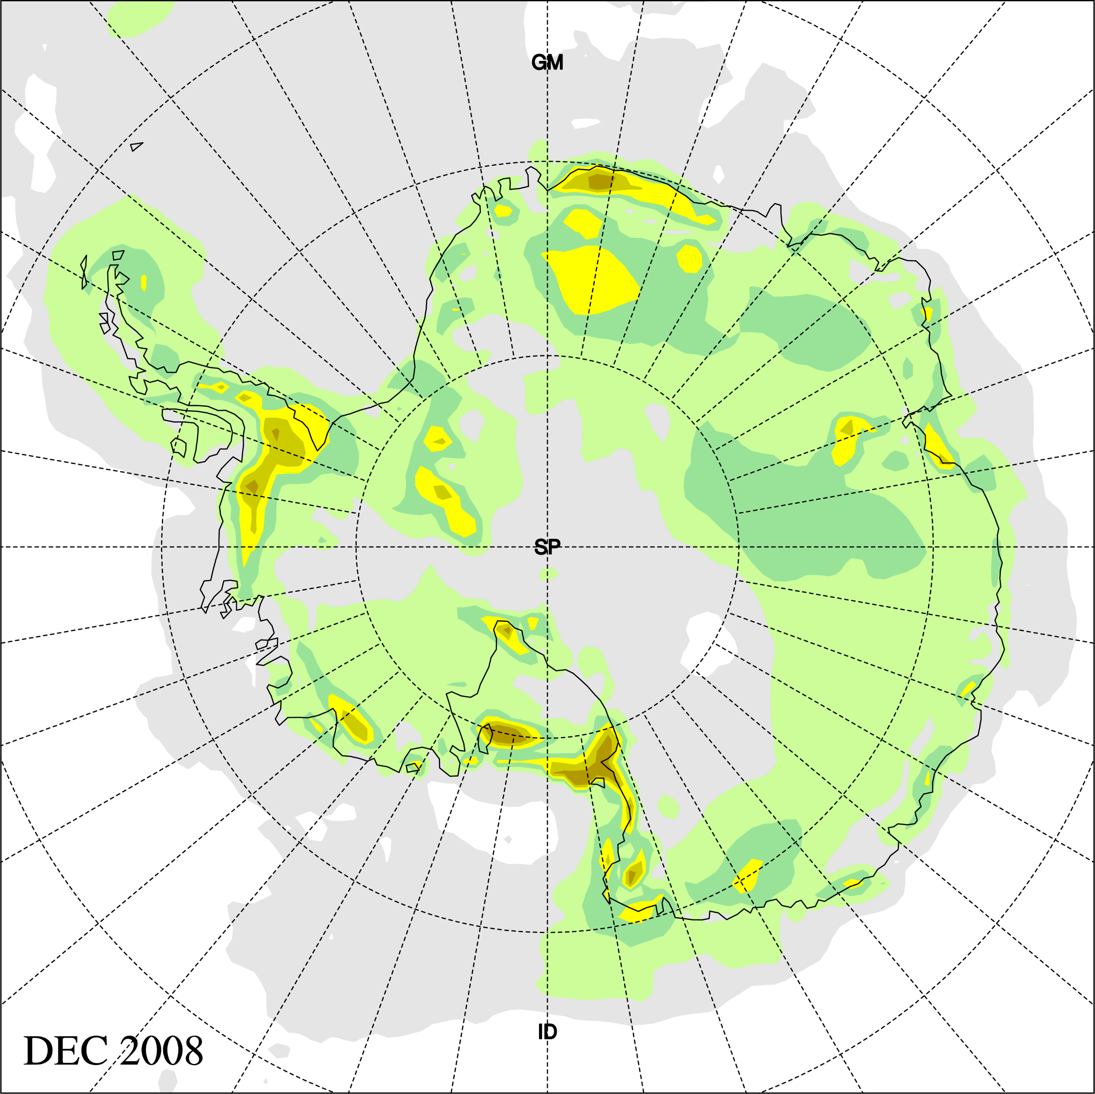
Polar WRF (4.4.0) Monthly Simulations (60km): Temperature absolute error at 2m (vs. ERA-Interim)
PWRF-Noah WRF-NoahMP PWRF-NoahMP

Slide 18
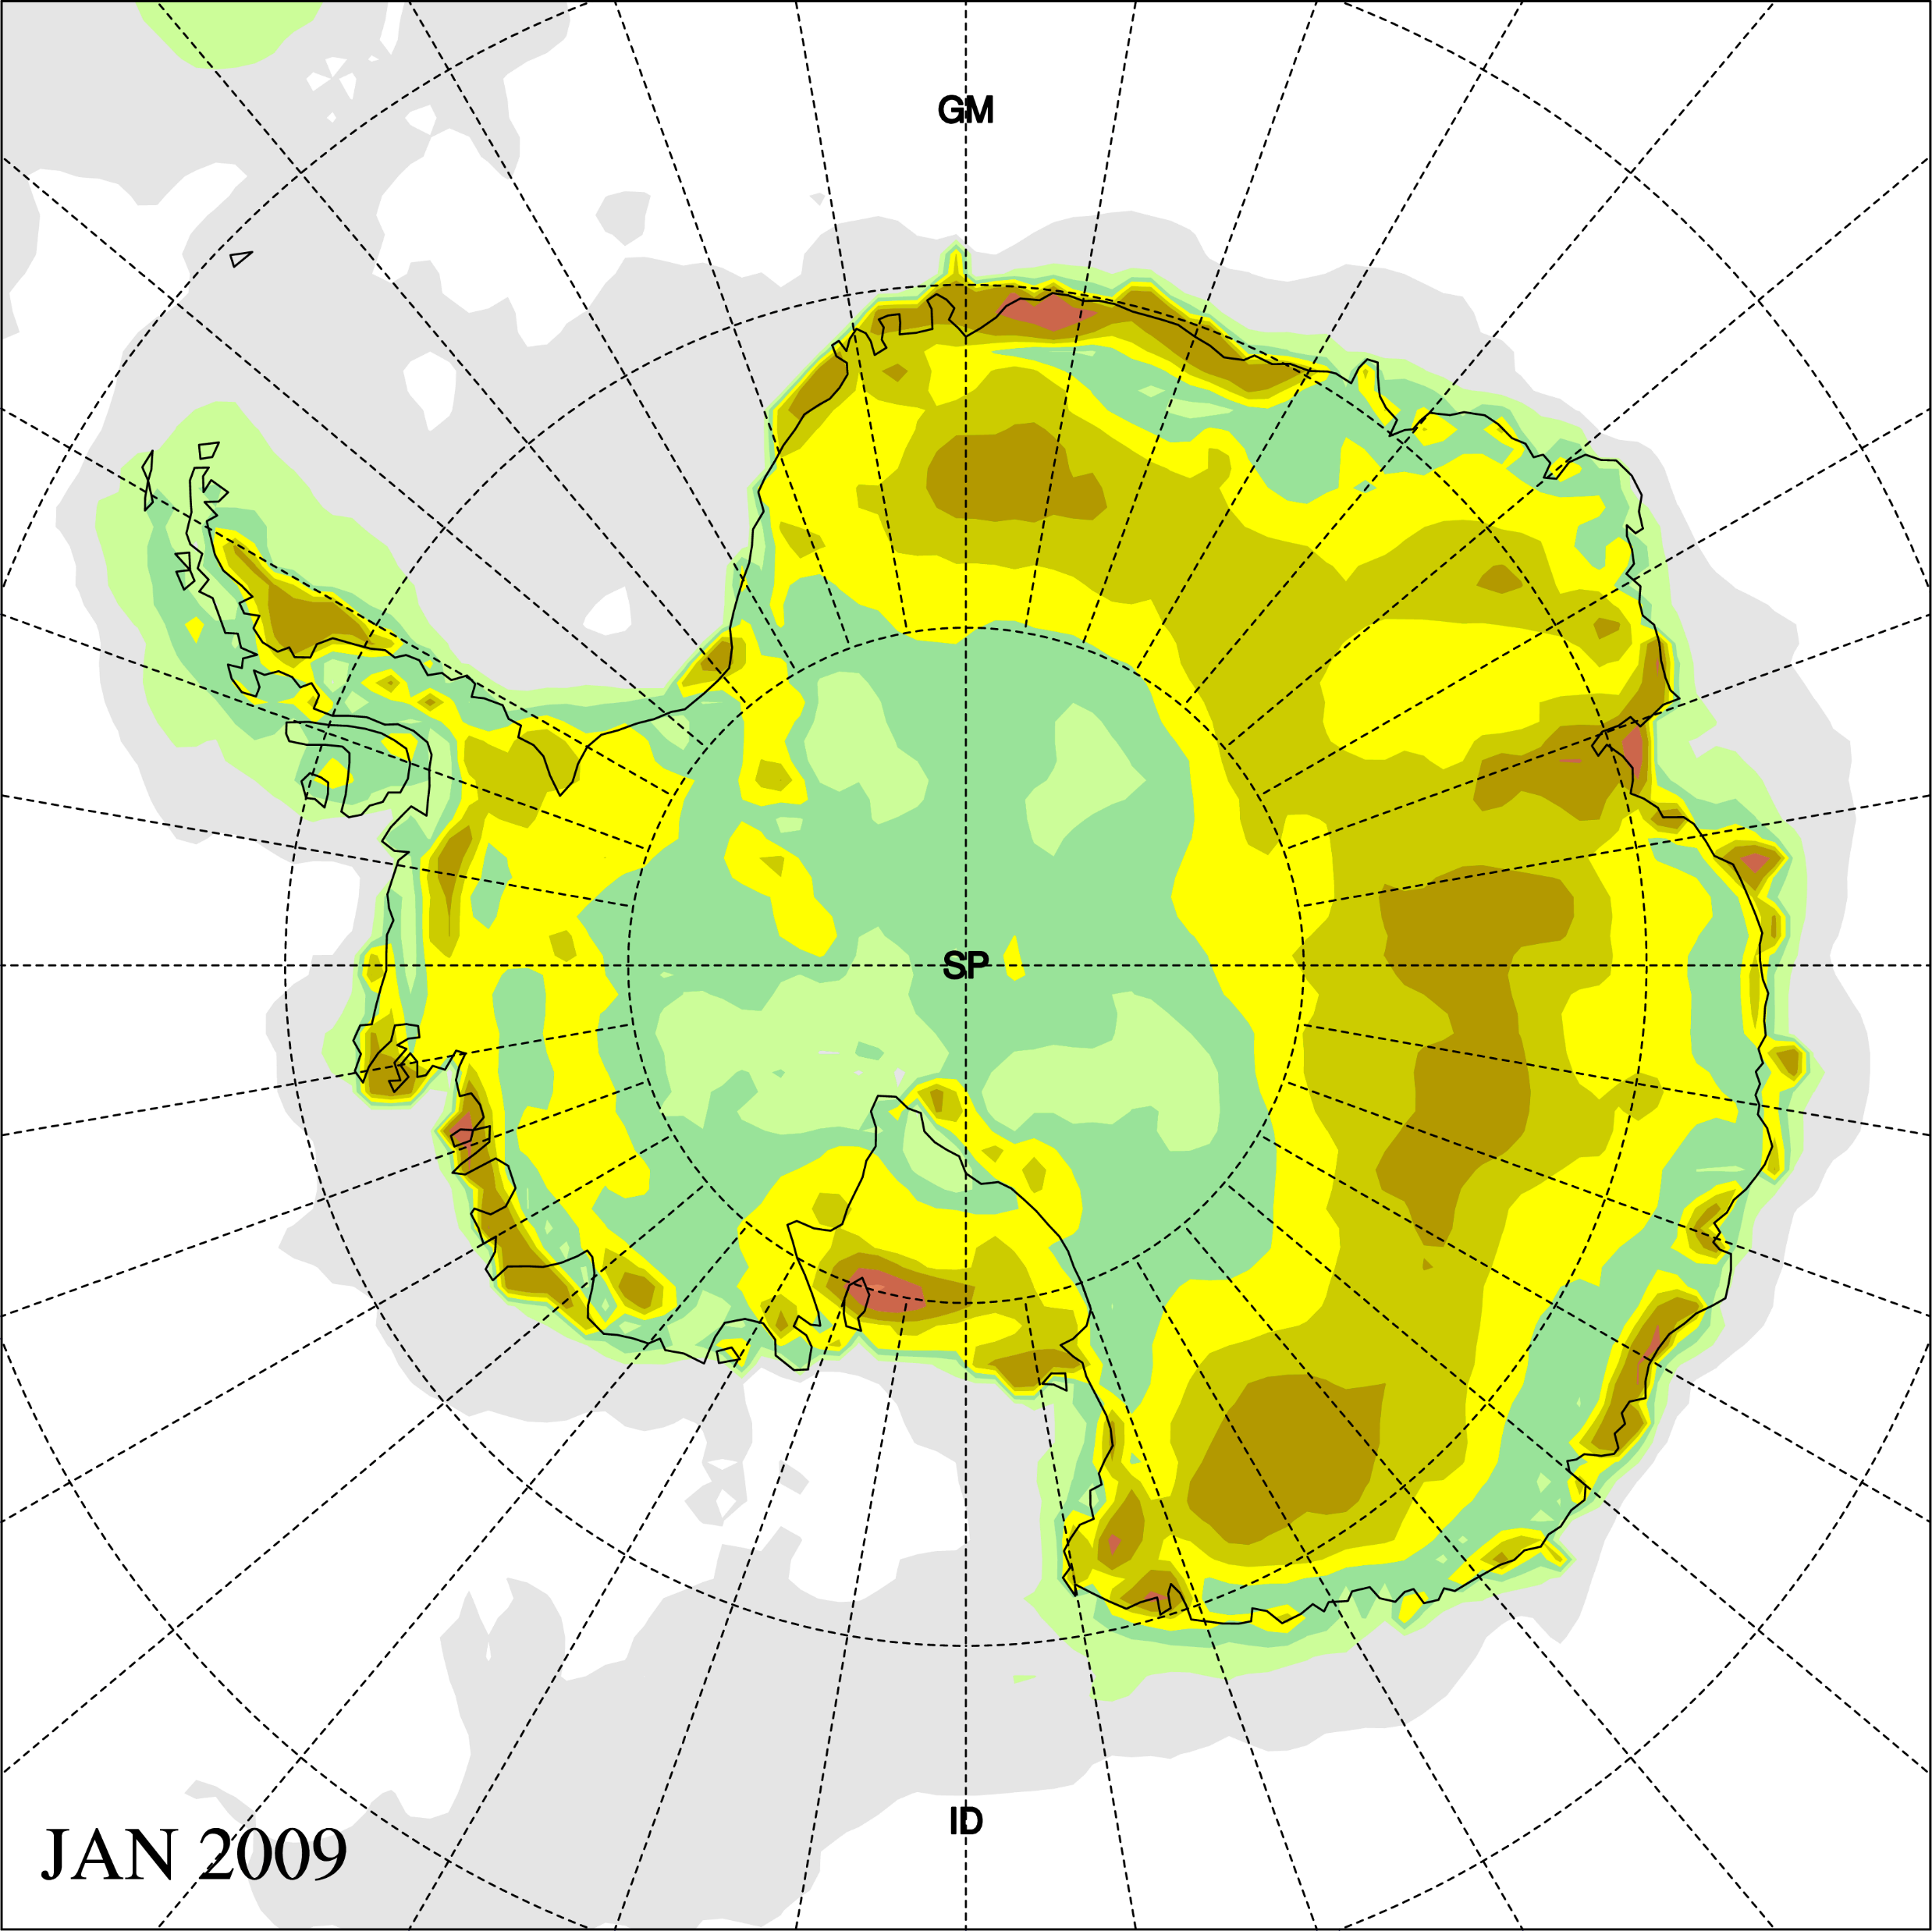
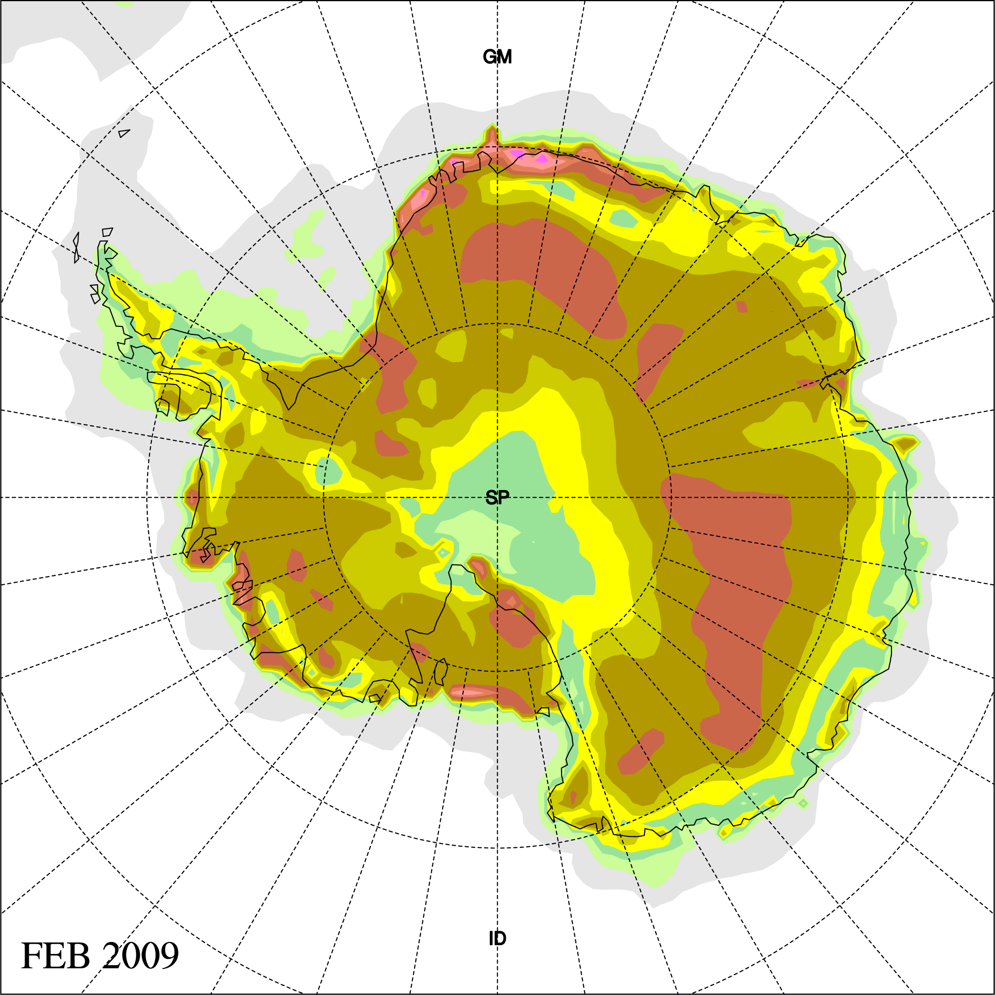
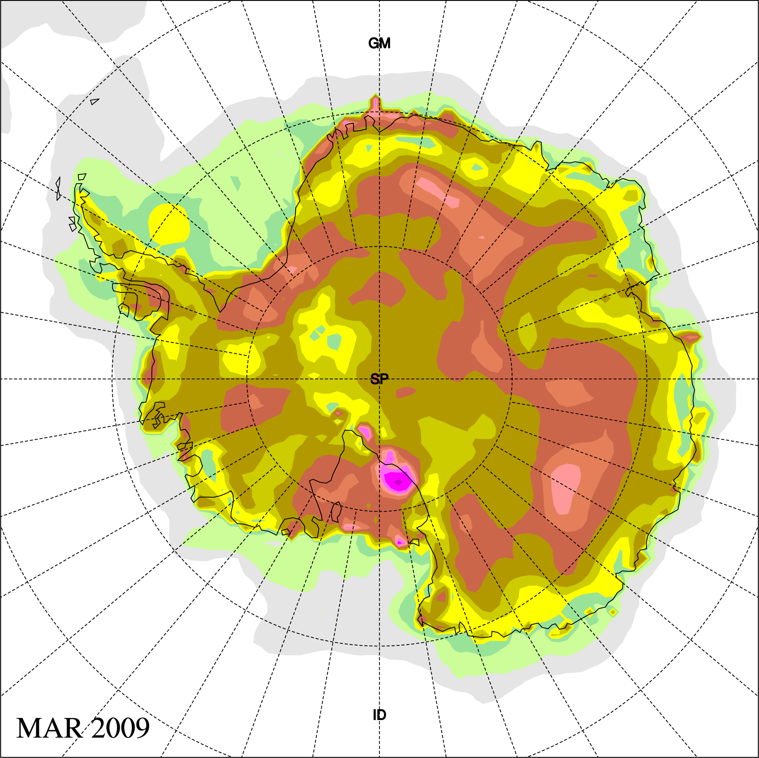
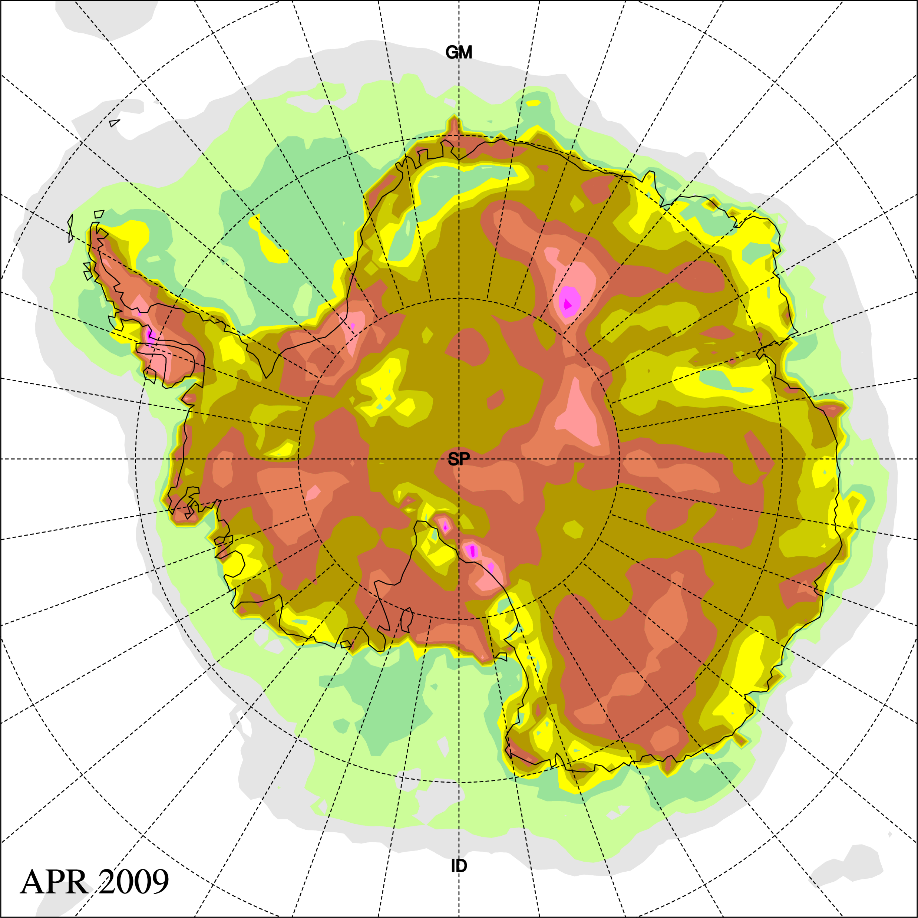
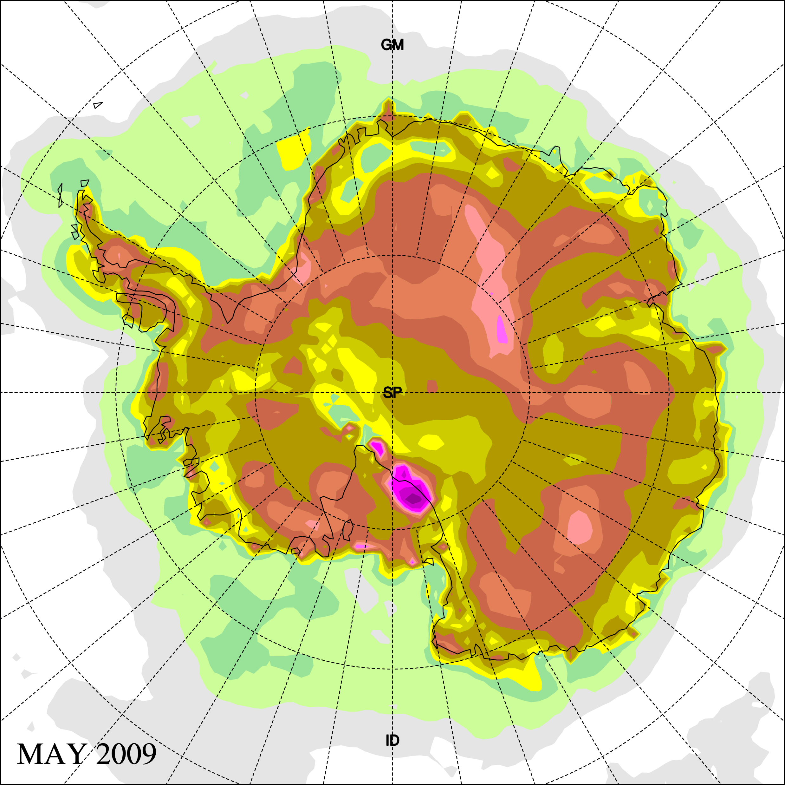
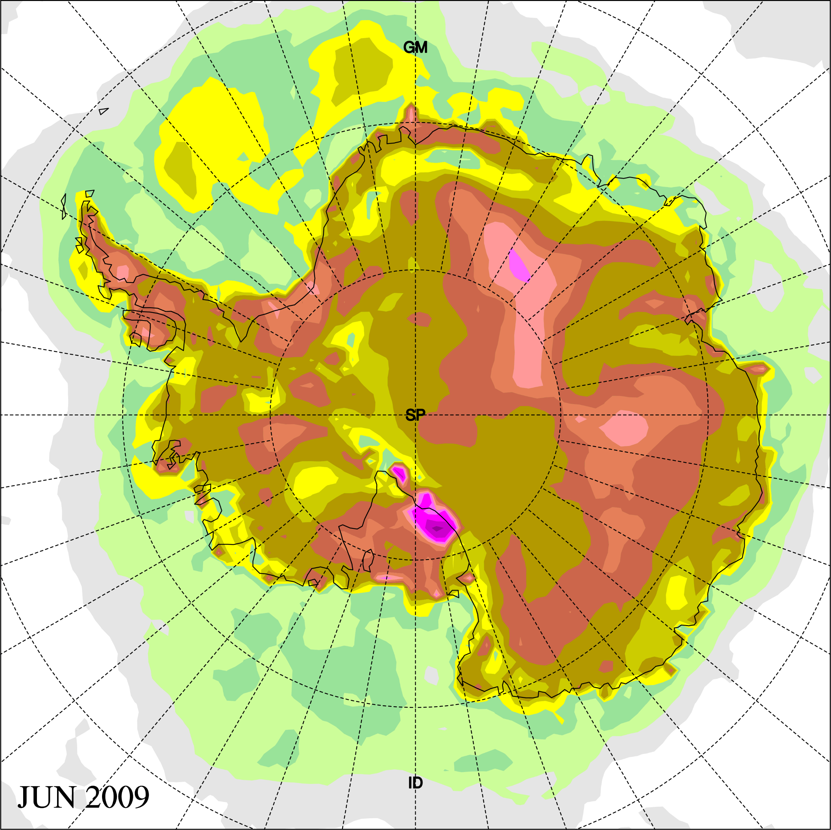
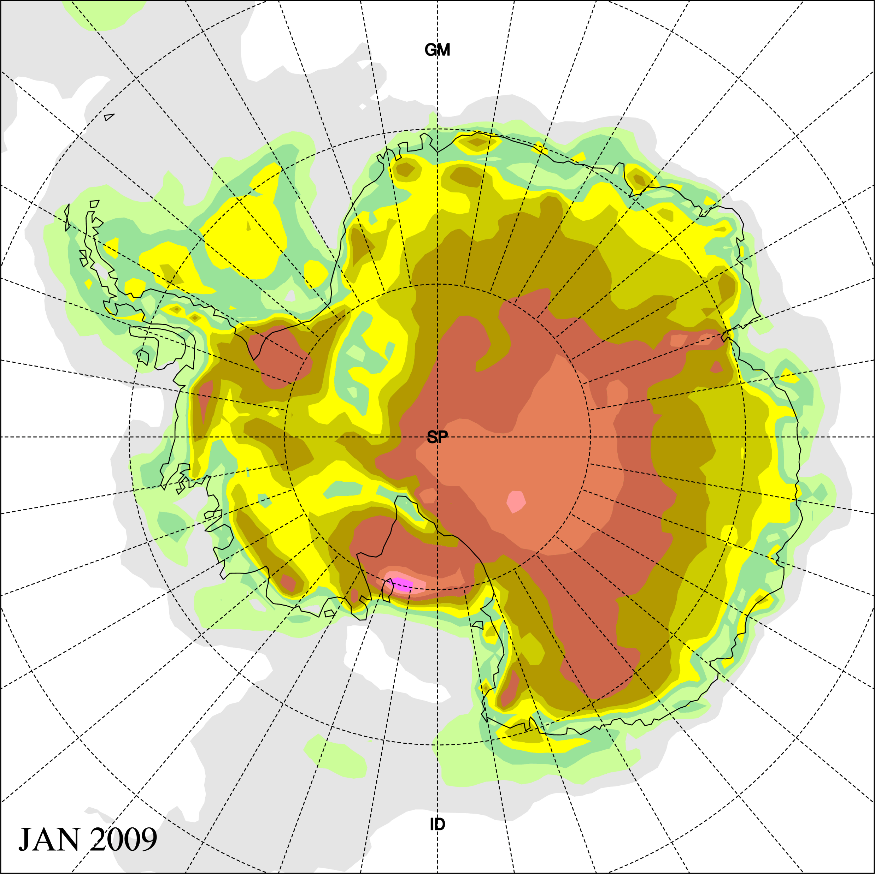
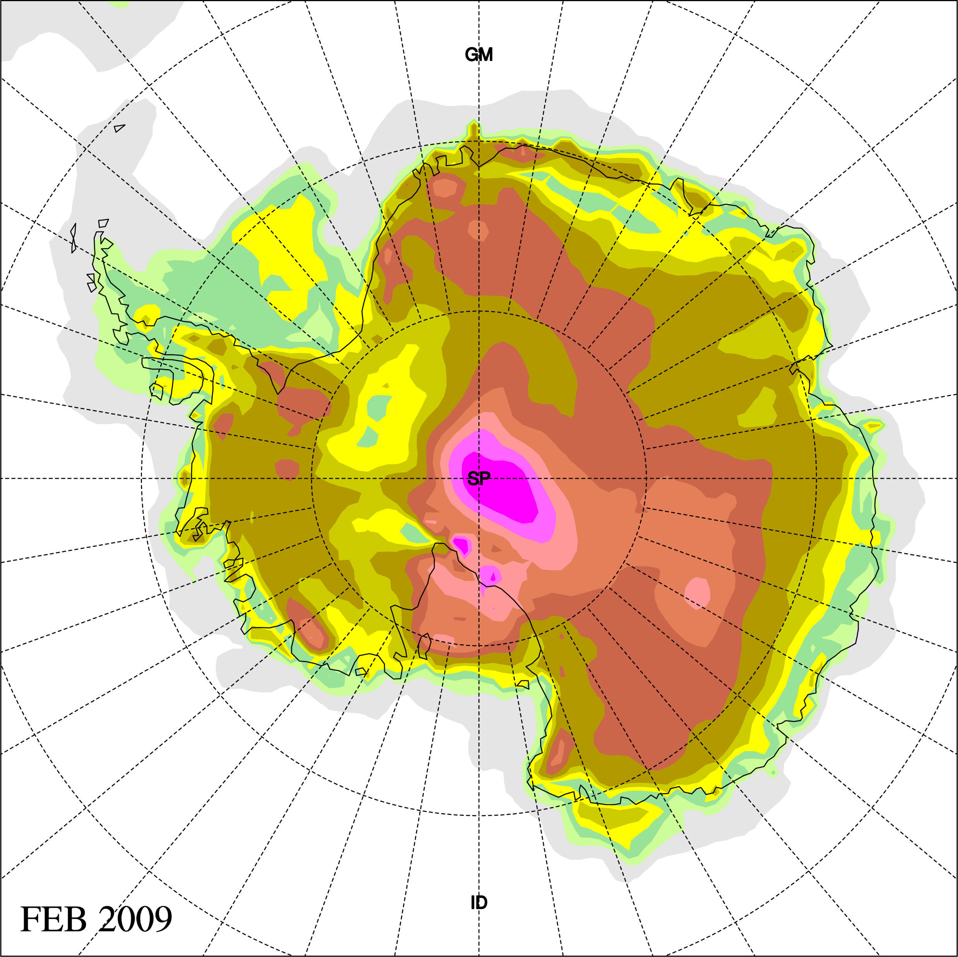
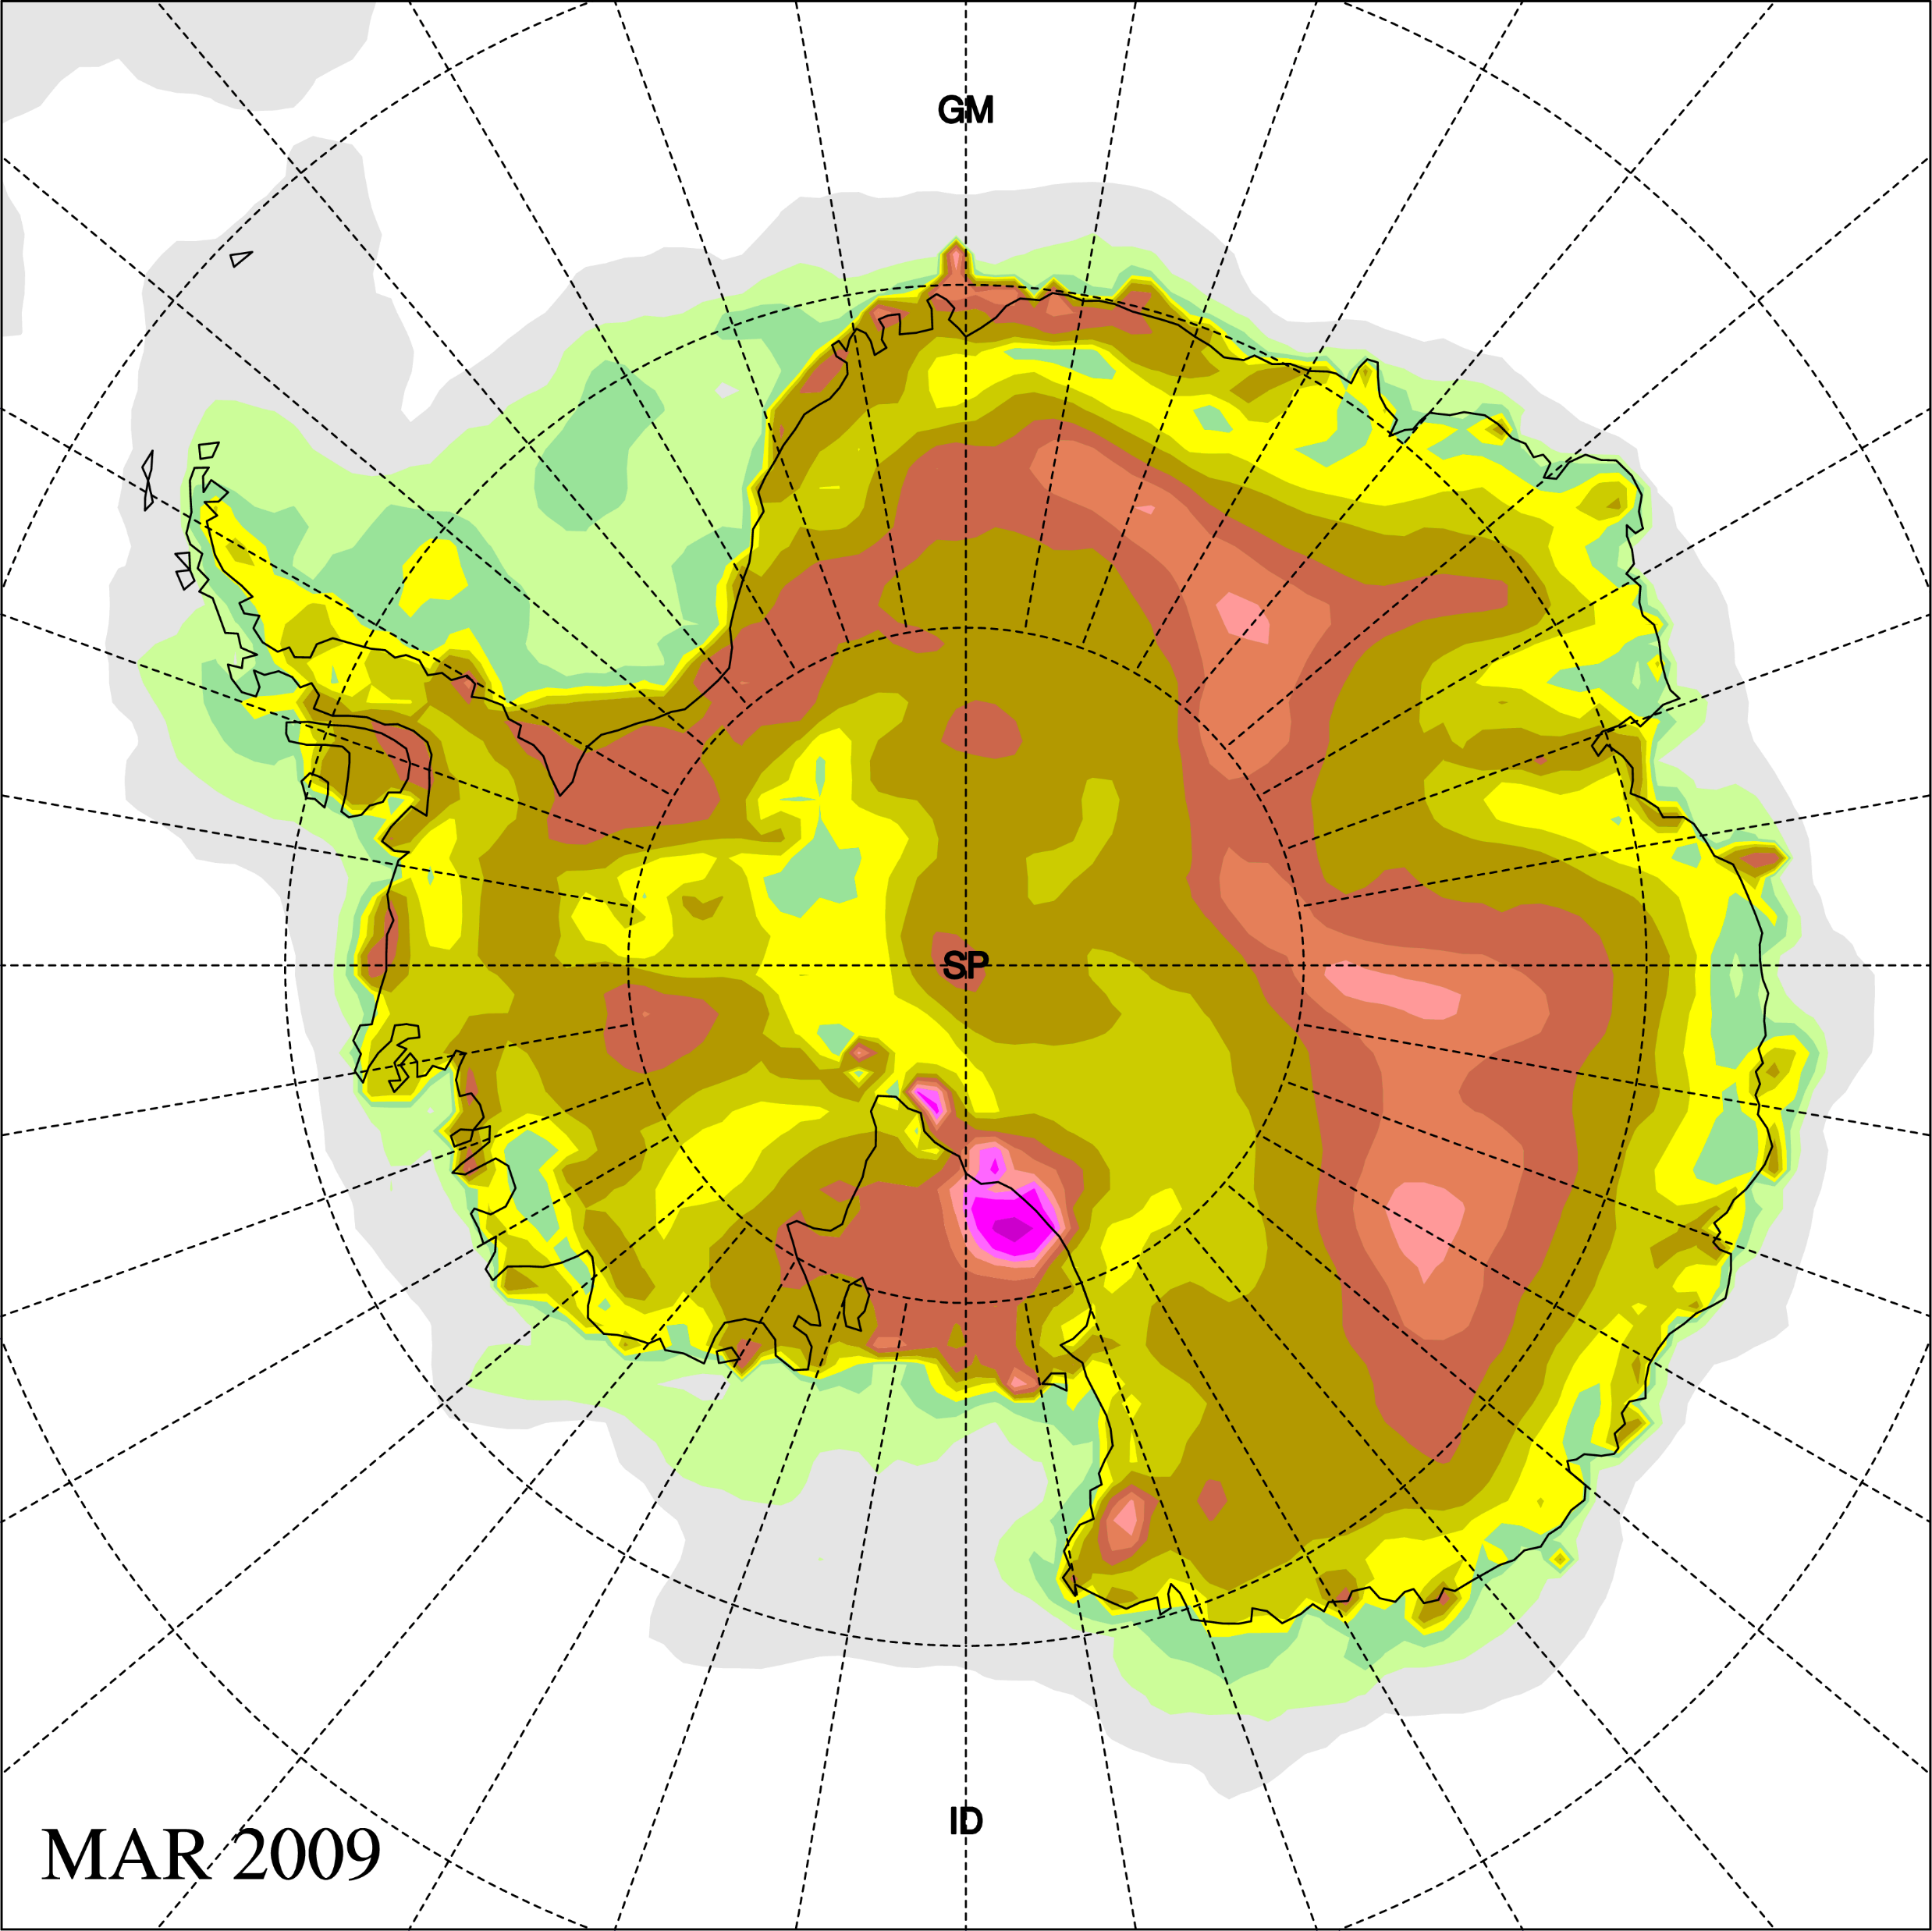
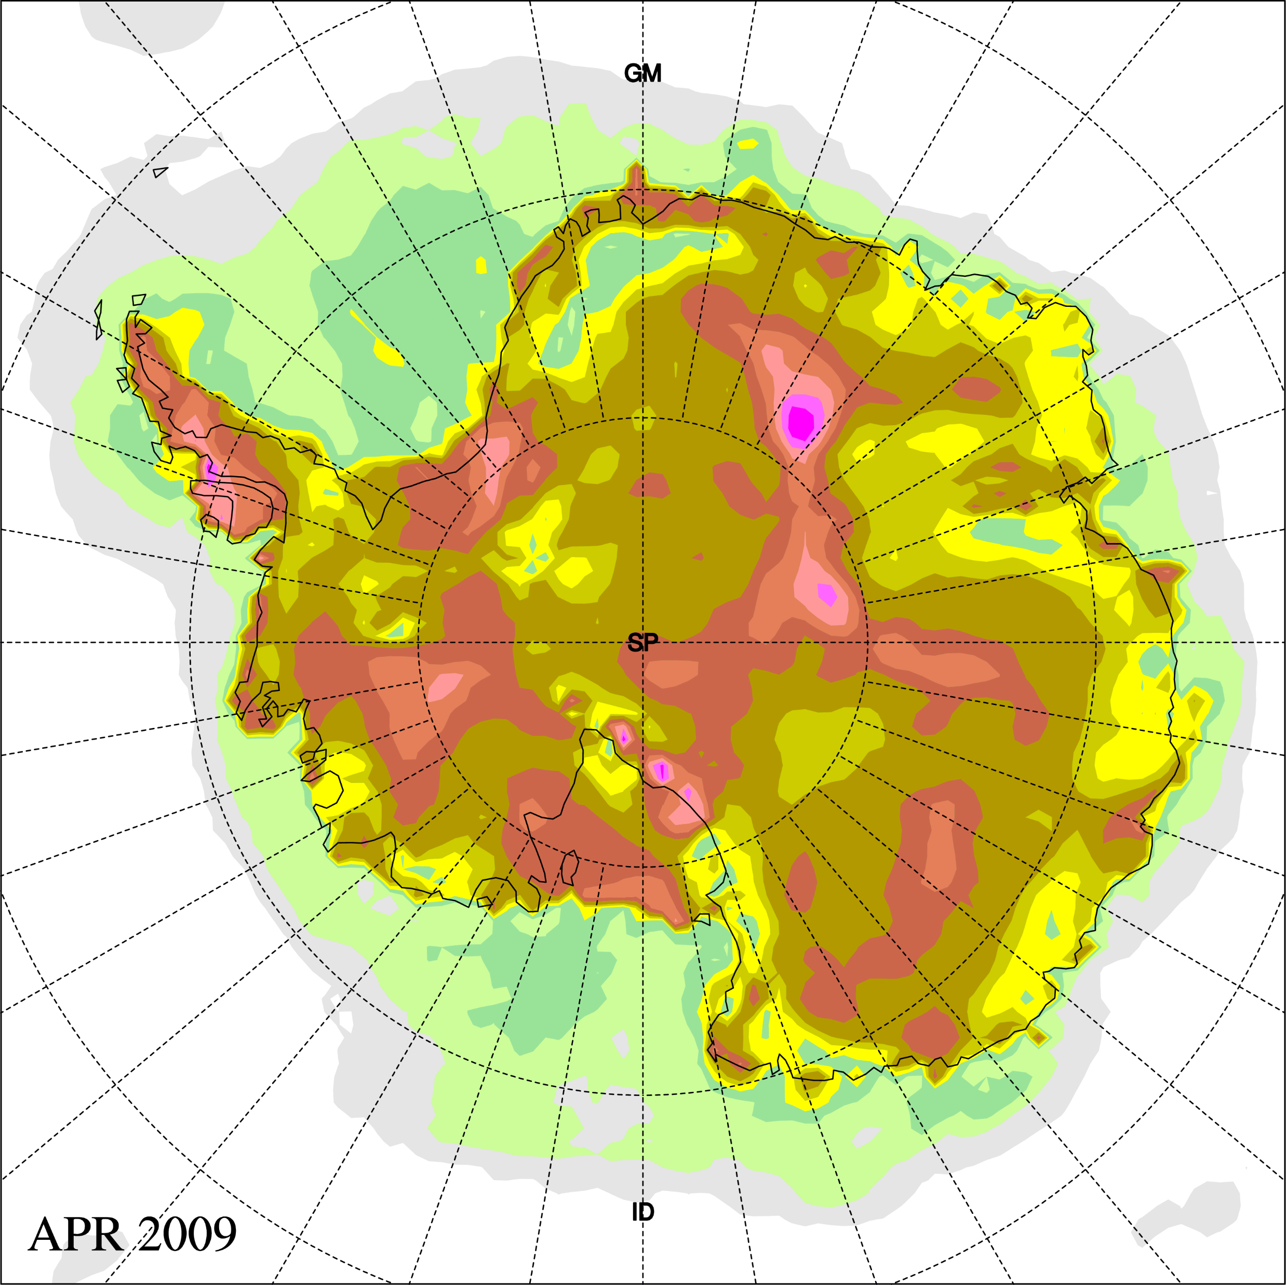
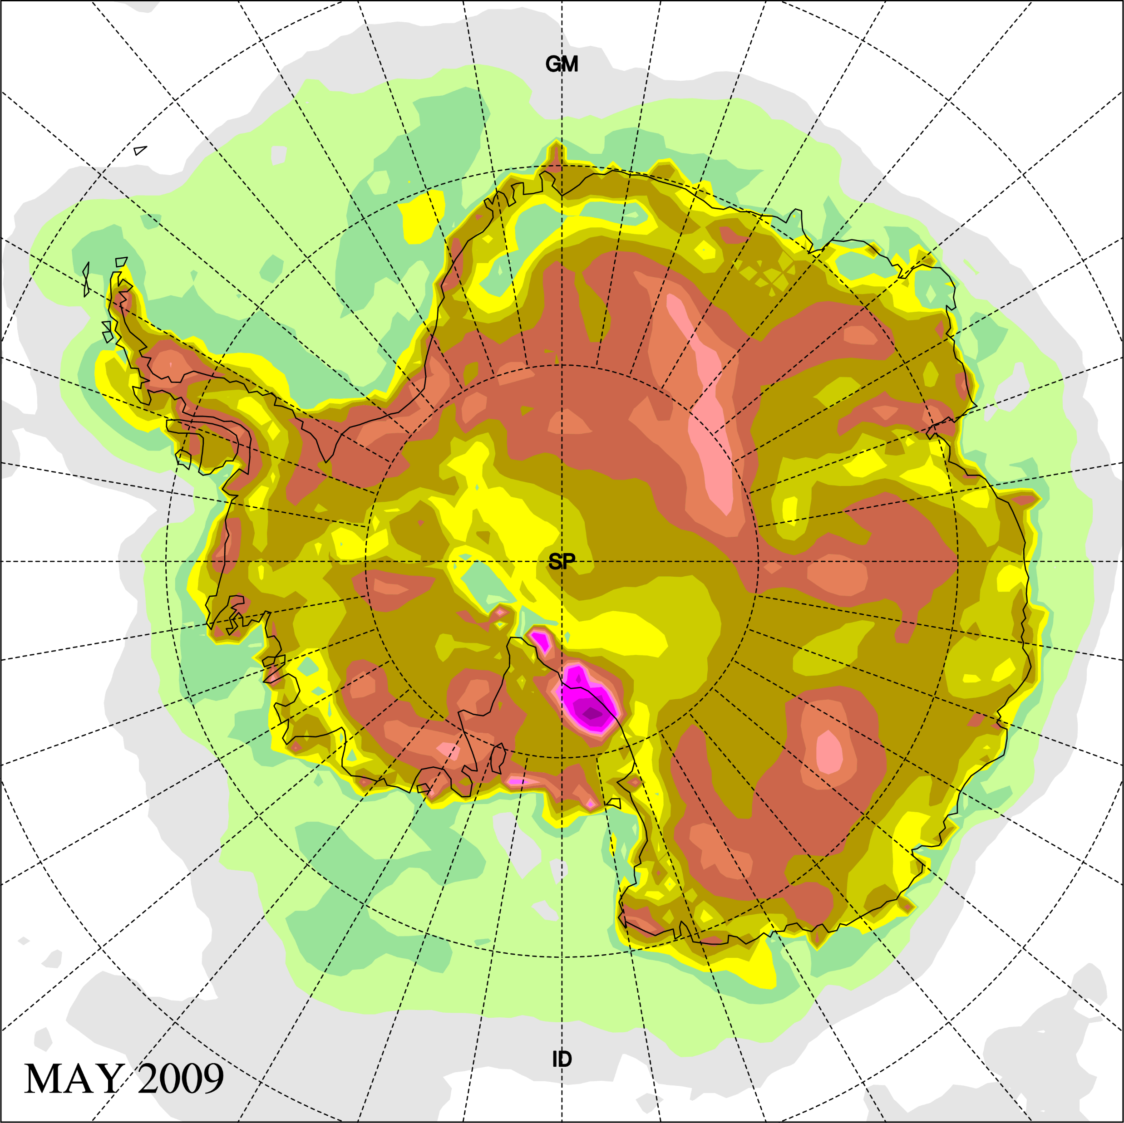
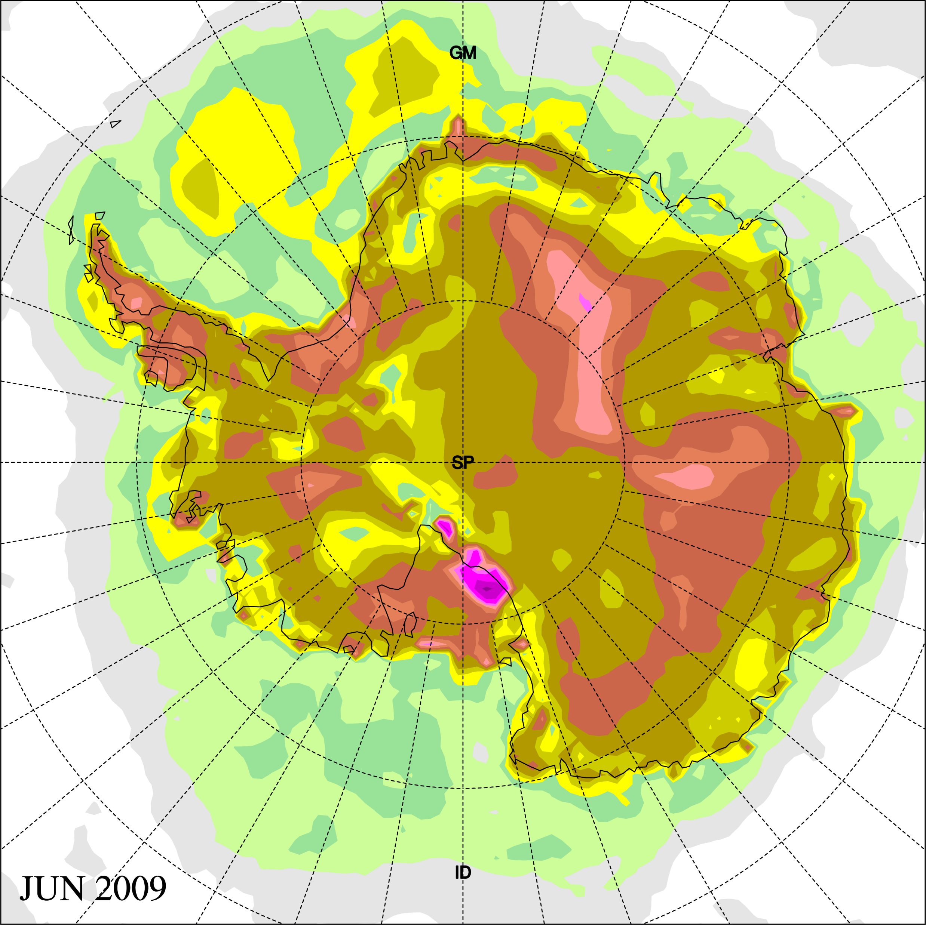
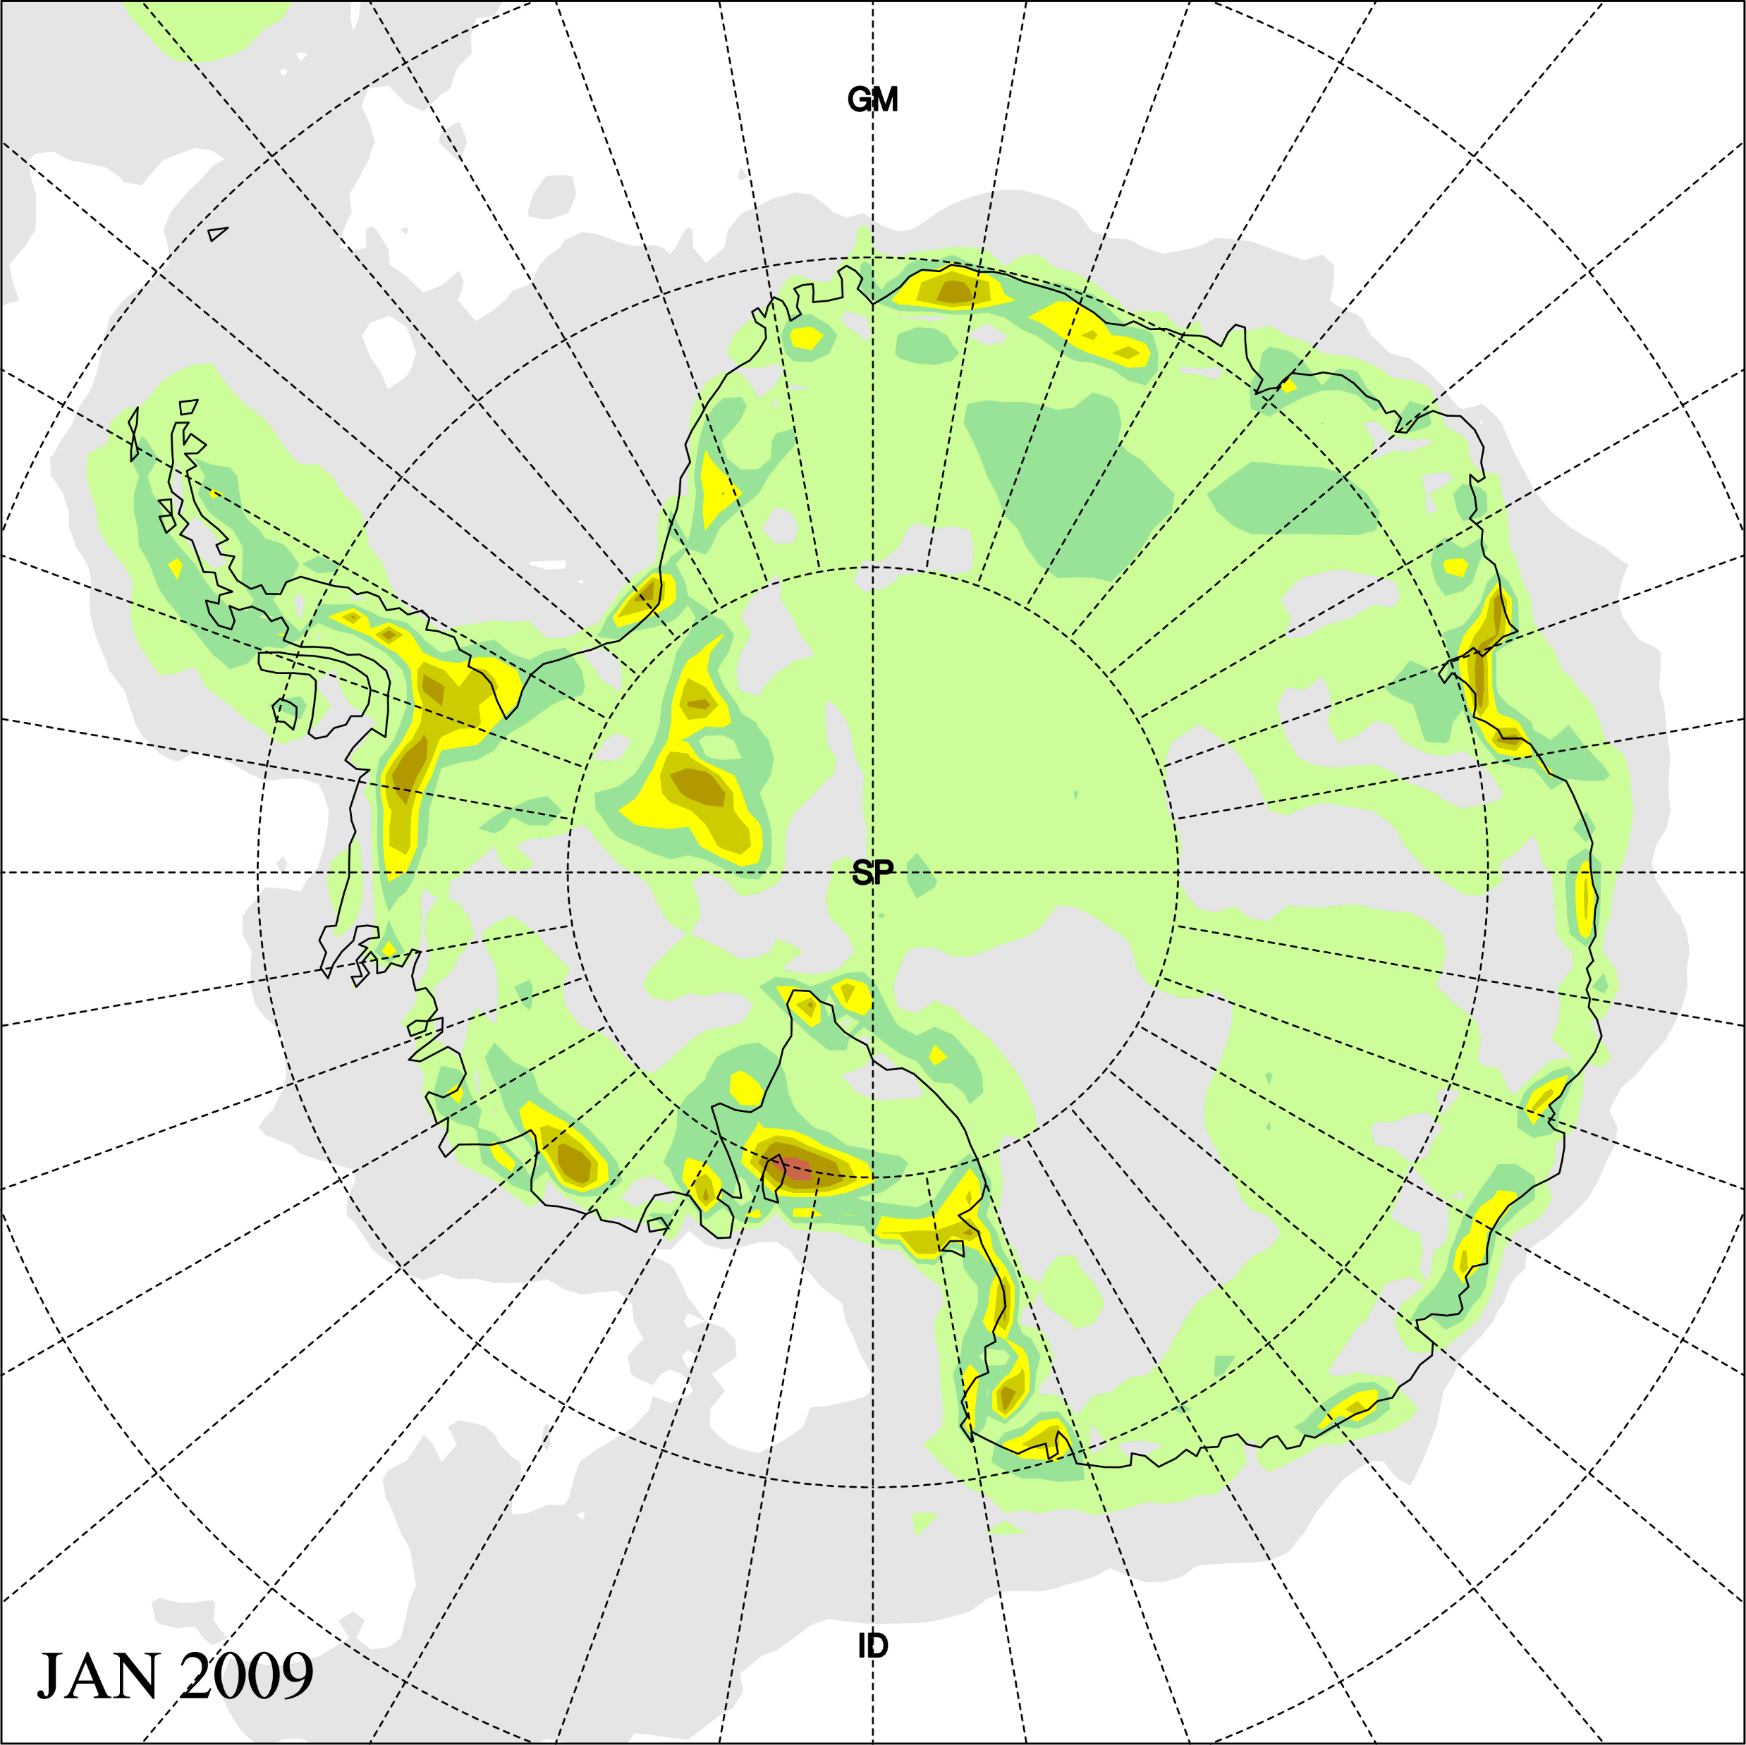
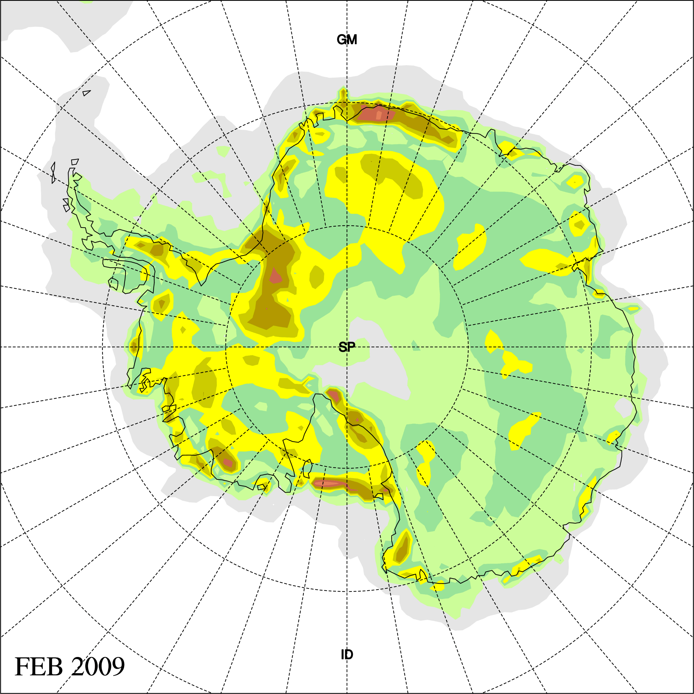
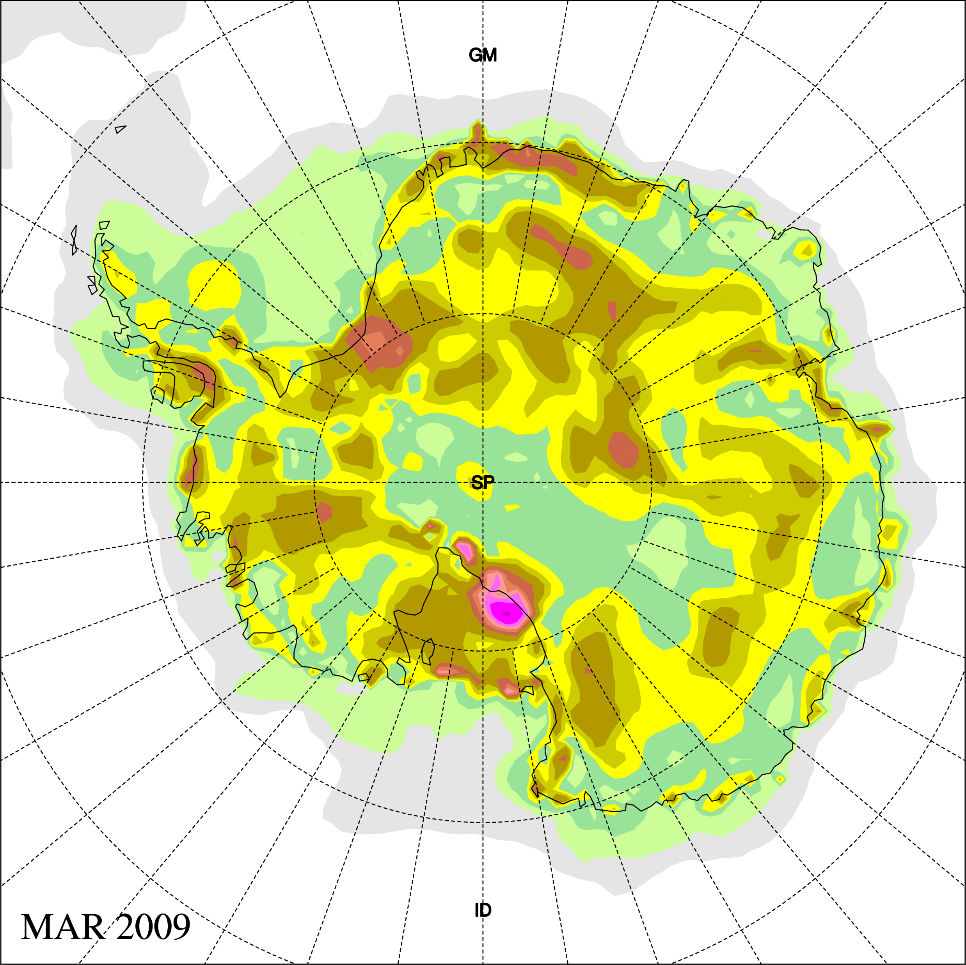
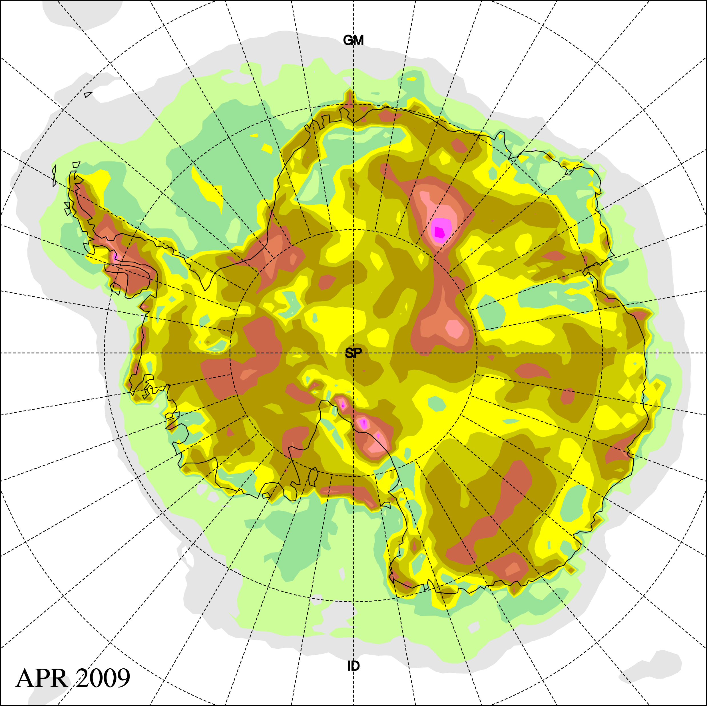
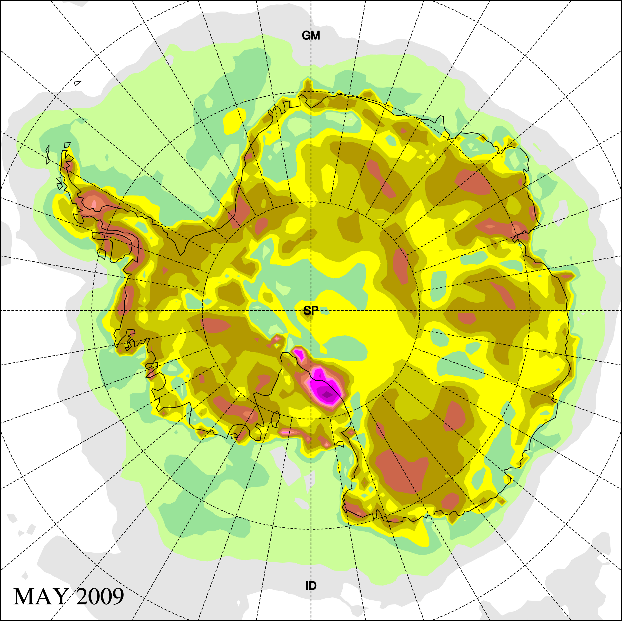
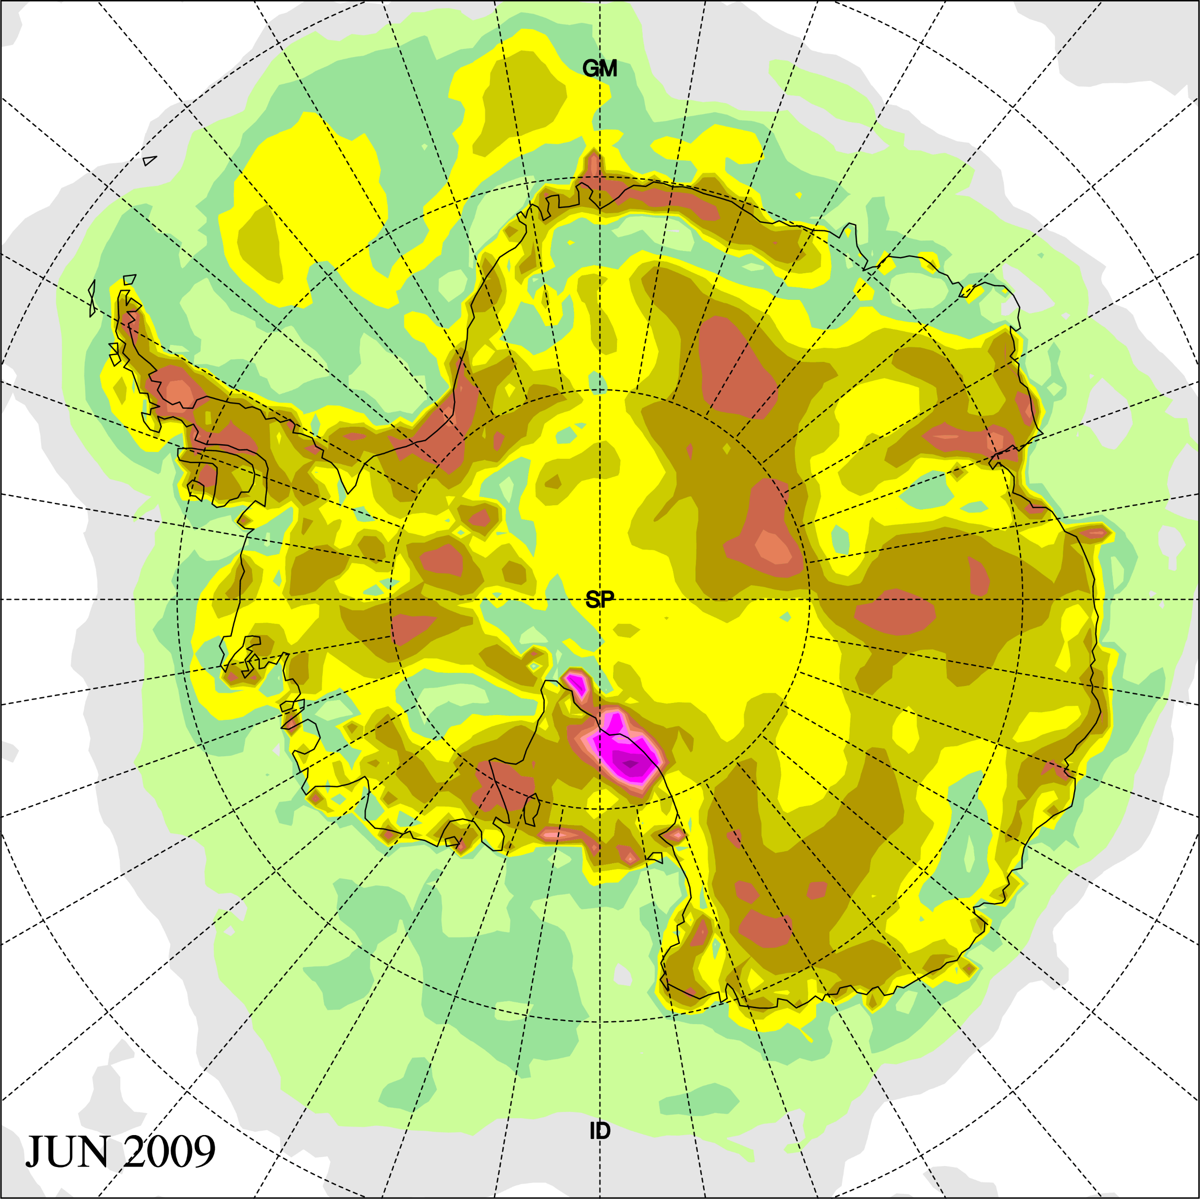
Polar WRF (4.4.0) Monthly Simulations (60km): Temperature absolute error at 2m (vs. ERA-Interim)
PWRF-Noah WRF-NoahMP PWRF-NoahMP

Slide 19
Thank you!

