Slide 1
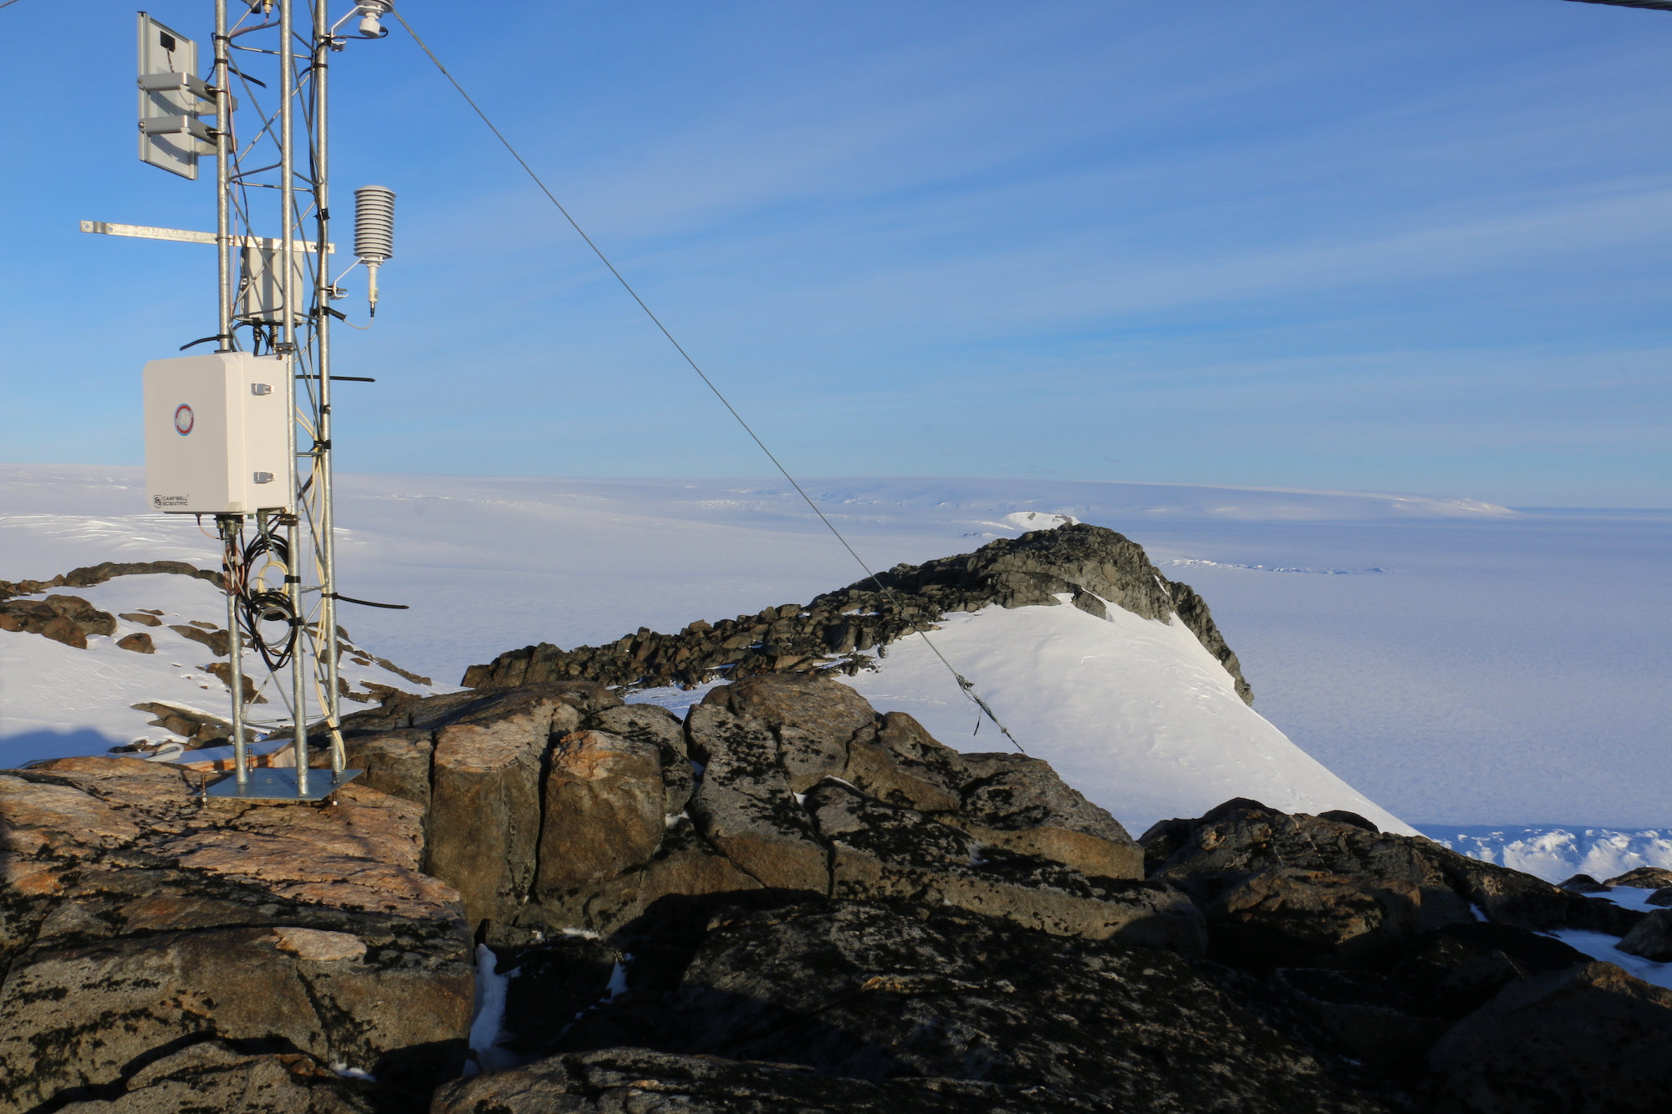





UW-Madison AWS Future Field Season Plans
David Mikolajczyk^{1,3}, Matthew Lazzara^{1,2}, Lee Welhouse^{1,2}, Taylor Norton^{1,3}, George Weidner^{1,3}, Linda Keller^{1,3}, and John Cassano⁴
¹Antarctic Meteorological Research Center, Space Science and Engineering Center, University of Wisconsin-Madison
²Dept. of Physical Sciences, School of Arts and Sciences, Madison Area Technical College
²Dept. of Atmospheric and Oceanic Sciences, University of Wisconsin-Madison
⁴Cooperative Institute for Research in Environmental Sciences, University of Colorado-Boulder
Workshop on Antarctic Meteorology and Climate, 2020

Slide 2
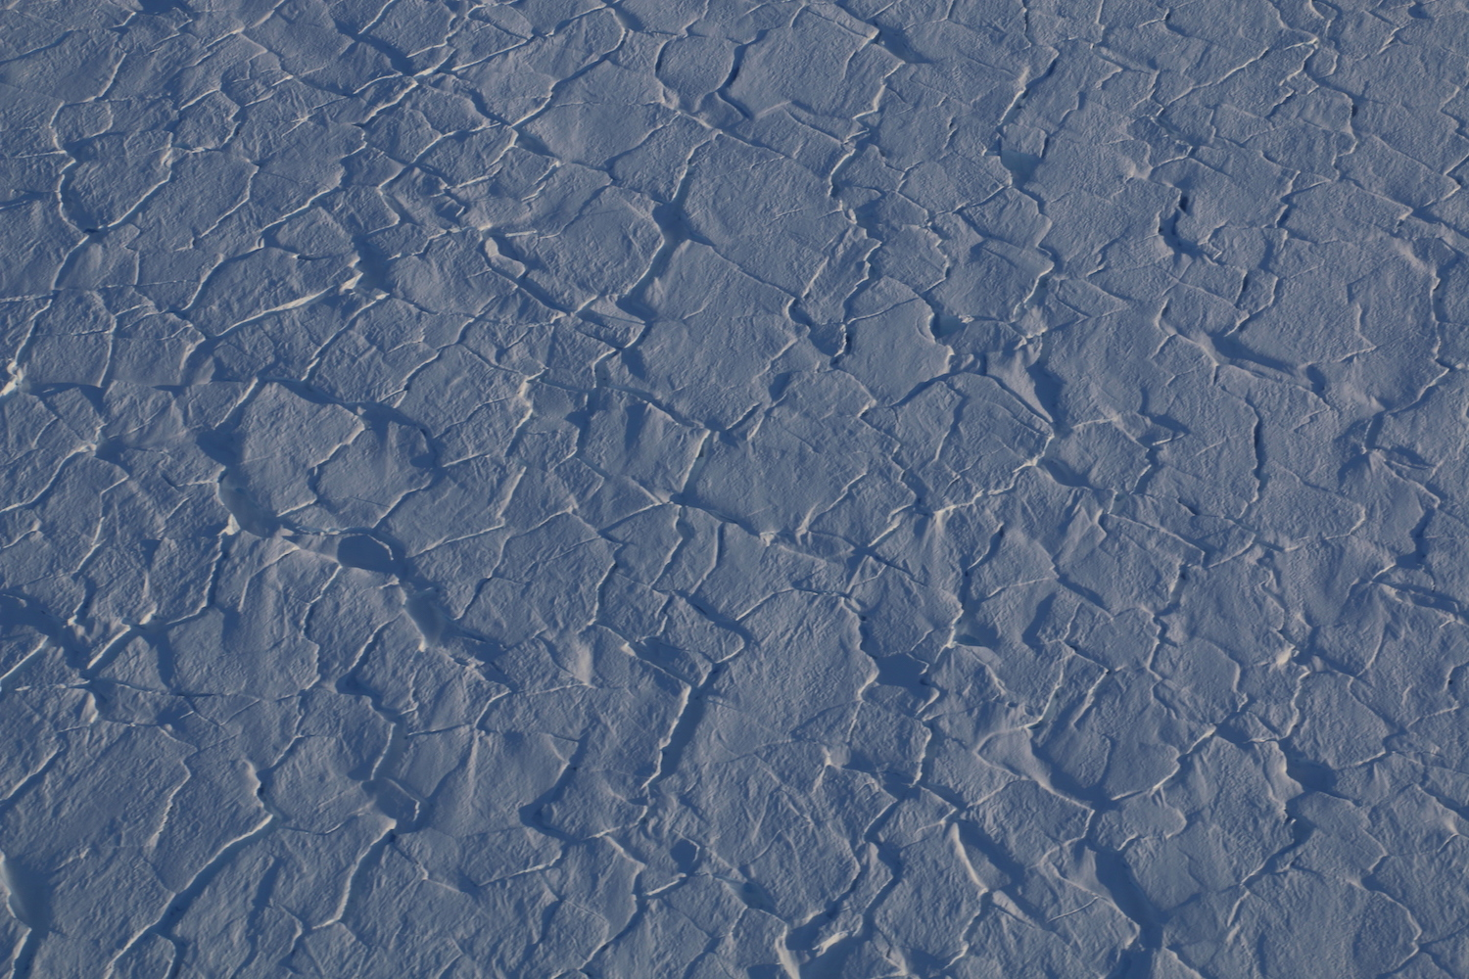
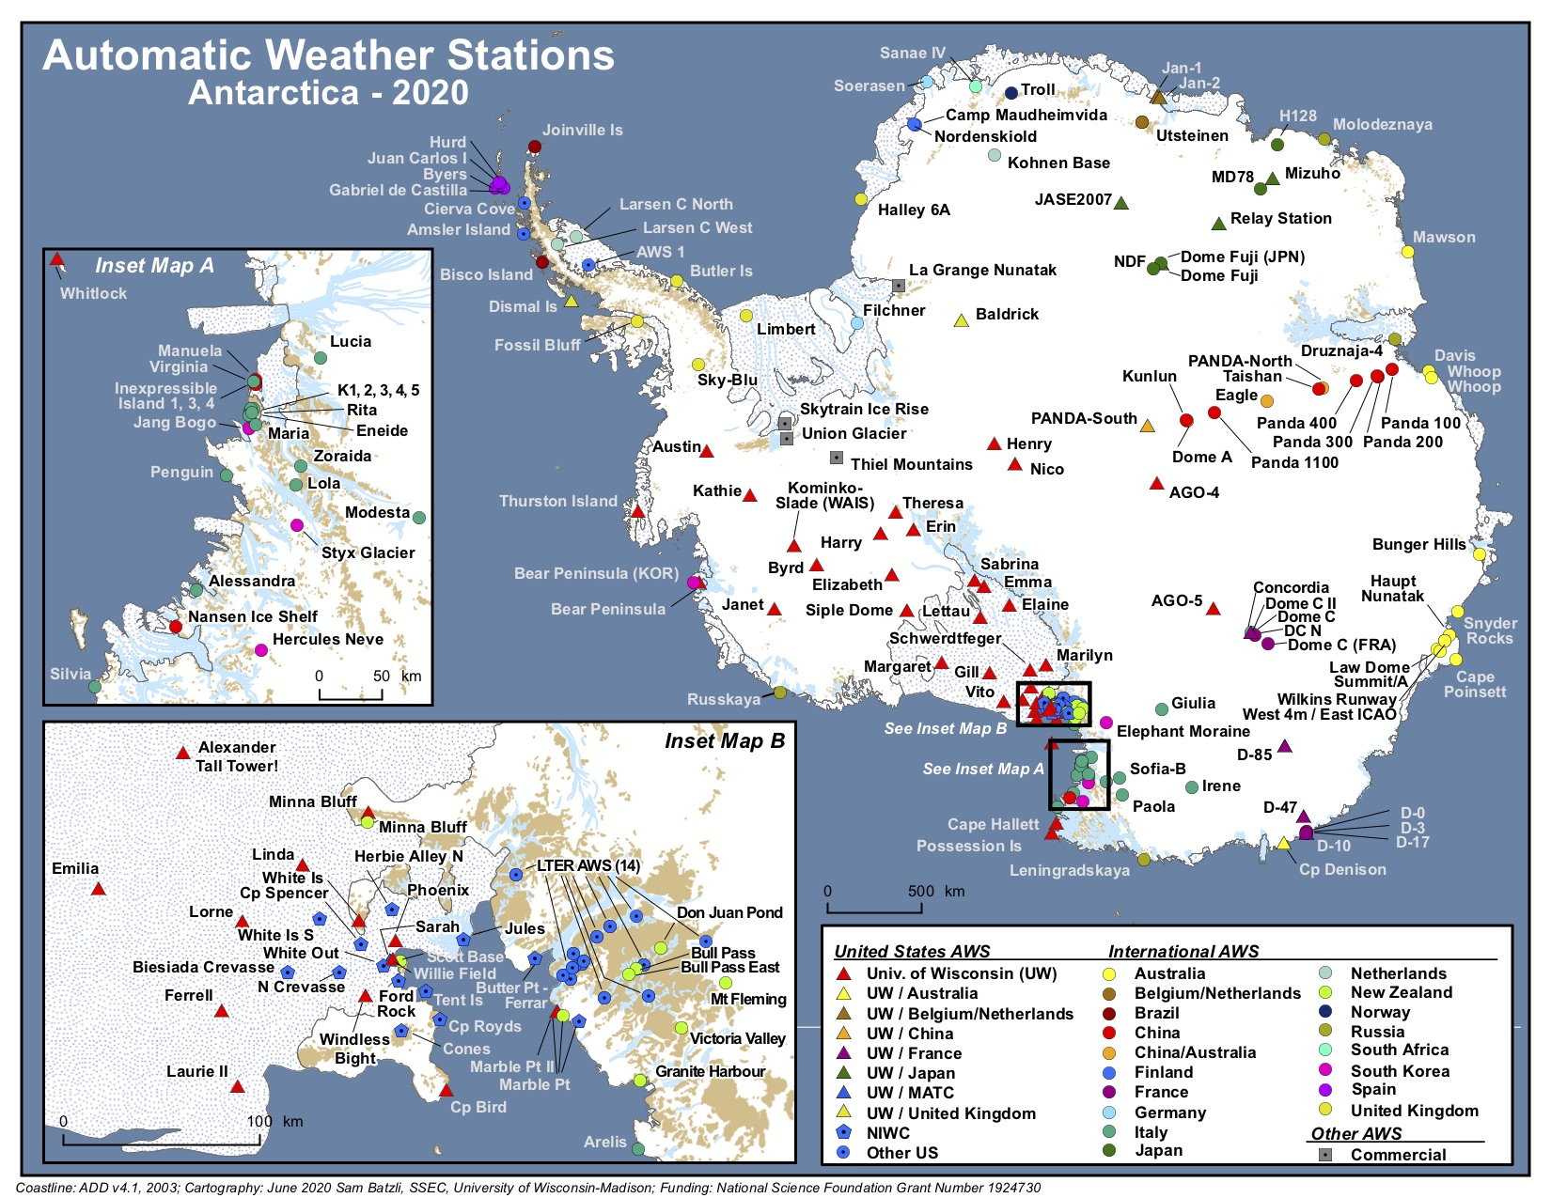
Outline
Tentative plans for 2020-21 Field Season
  COVID-19 impacts
  AWS network servicing (O-283)
  Byrd Tall Tower (O-400), canceled for this season
  AMRDC work
Plans beyond this coming field season
  AWS network servicing
  AMRDC (see Matthew Lazzara’s presentation “Antarctic Meteorological Research & Data Center”)

Slide 3
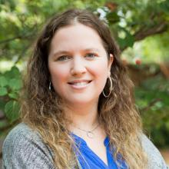
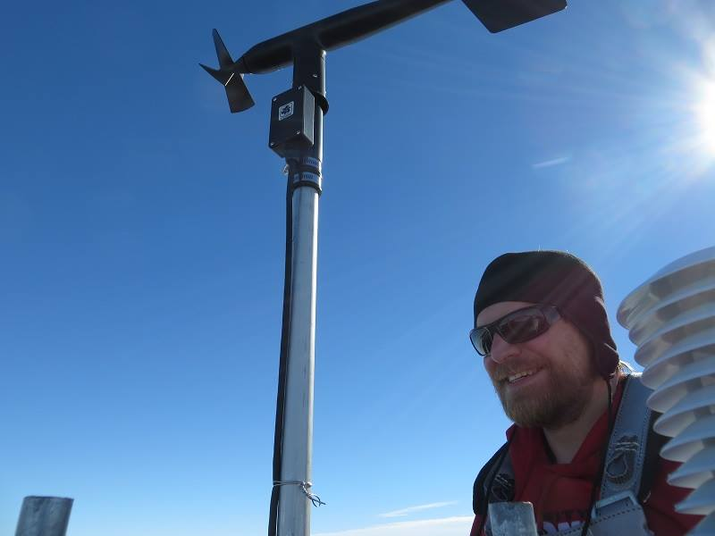
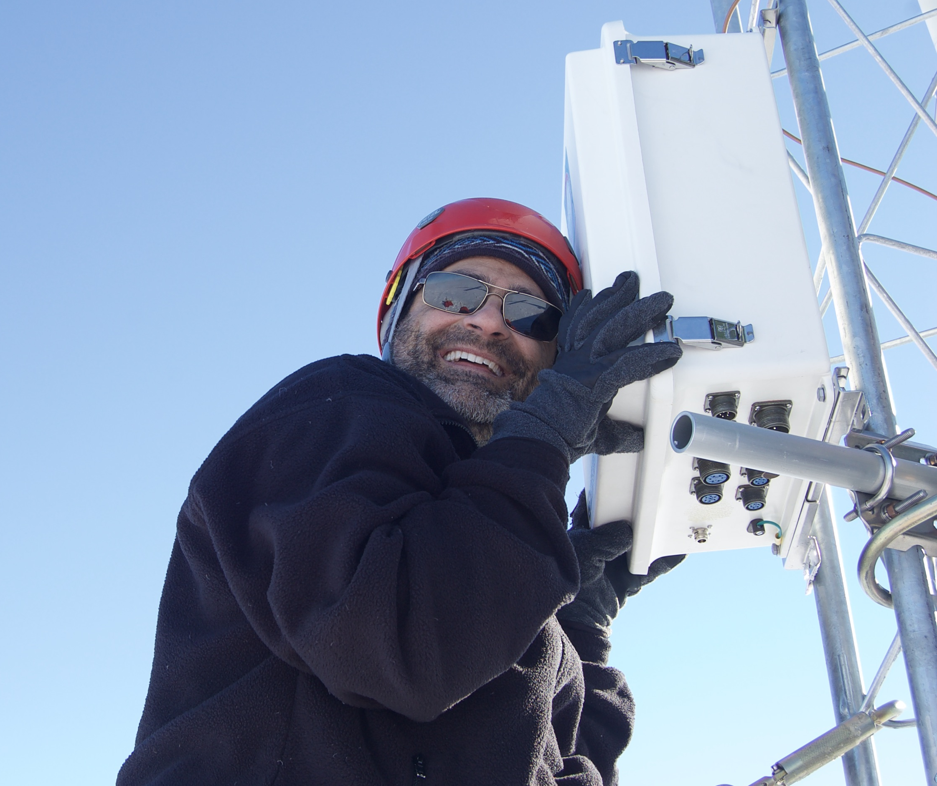
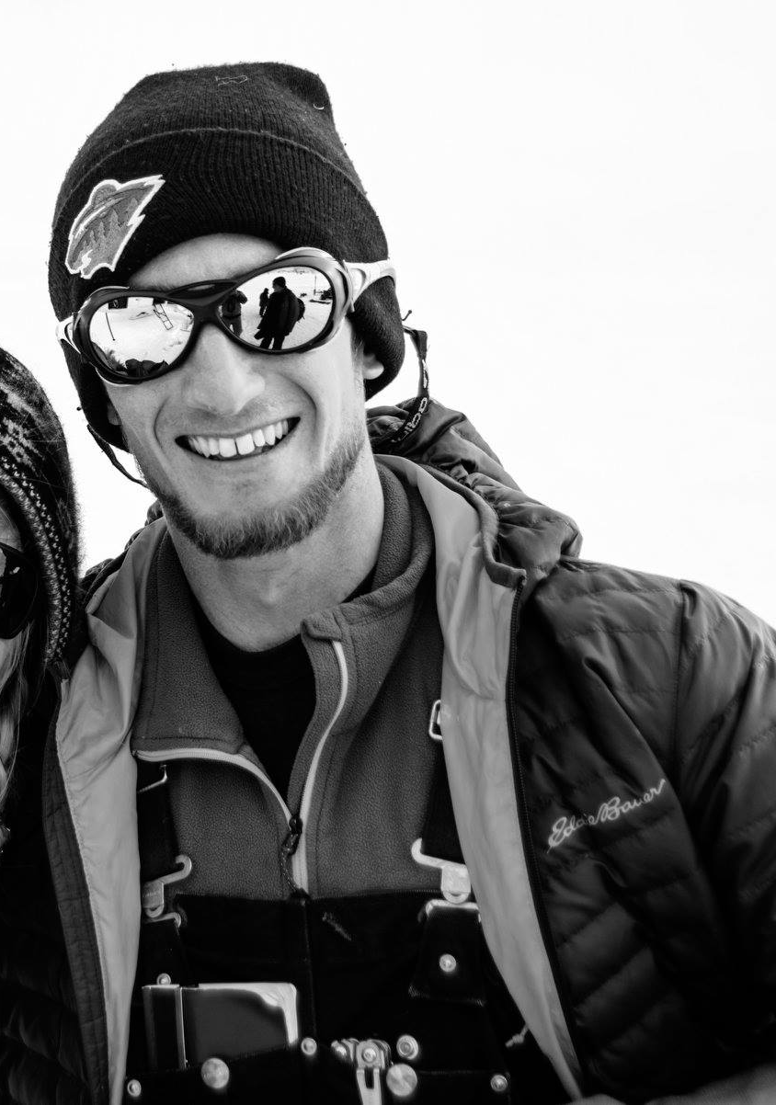
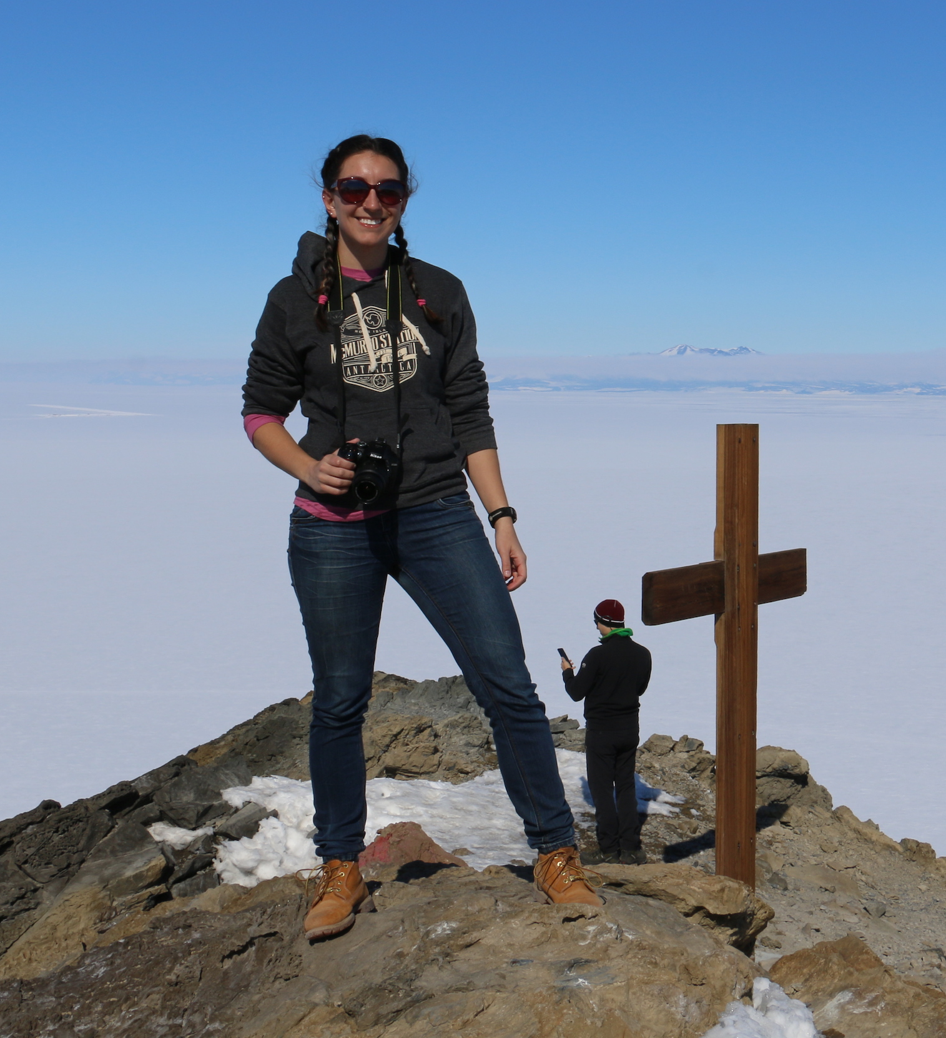
Personnel
Lee Welhouse
O-283/O-400
Cassie Kautzer, PolarTREC
O-283
Matthew Lazzara, PI
Dave Mikolajczyk
O-283
Marian Mateling
O-400

Slide 4
2020-21 Field Season... Activation still TBD
O-283
  AWS network servicing, from McMurdo only
  PolarTREC deployment postponed for following field season (teacher Cassie Kautzer)
O-400: Byrd Tall Tower
  Field season canceled
AMRDC
  Install a server in McMurdo
  O-283 AWS personnel would complete work

Slide 5
Servicing from McMurdo
Marilyn
Elaine
Schwerdtfeger
Laurie II
Minna Bluff
Others, as needed
Servicing from
WAIS/Byrd camp
Austin
Kathie
Thurston Island
Bear Peninsula
Kominko-Slade
Others, as needed

Slide 6
Contingency plans for future field seasons
If no O-283 field season in 2020-21
  West Antarctica (Austin, Kathie) is a high priority
  Fix AWS wind monitors at Marilyn, Elaine, Laurie II
O-400: Byrd Tall Tower
  Install at next available opportunity
AMRDC
  Server install will happen whenever possible

Slide 7
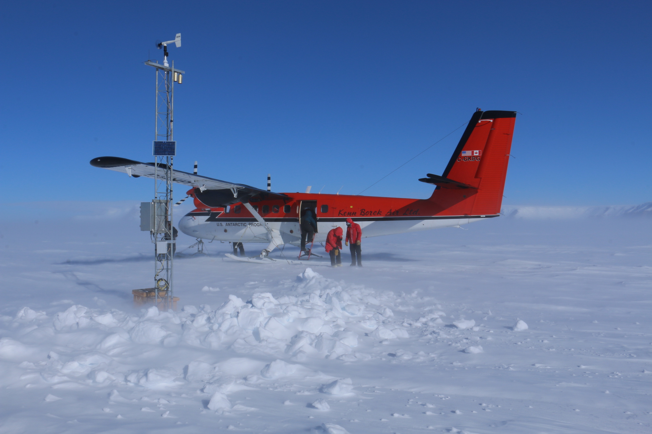
Thank you!
For more information, and if you have any questions, please feel free to contact us:
http://amrc.ssec.wisc.edu/
http://amrc.ssec.wisc.edu/contactus.html
Support for this work is provided by
NSF Grants 1543305, 1848710 and 1924730 (AWS Program) and 1744878 (Byrd Tall Tower)

