Slide 1

British Antarctic Survey
Automatic Weather Station Network
2019/20 Season Review
Mairi Simms, Steve Colwell, John Law, Jack Farr, Hannah Walker and Josh Eveson

Slide 2

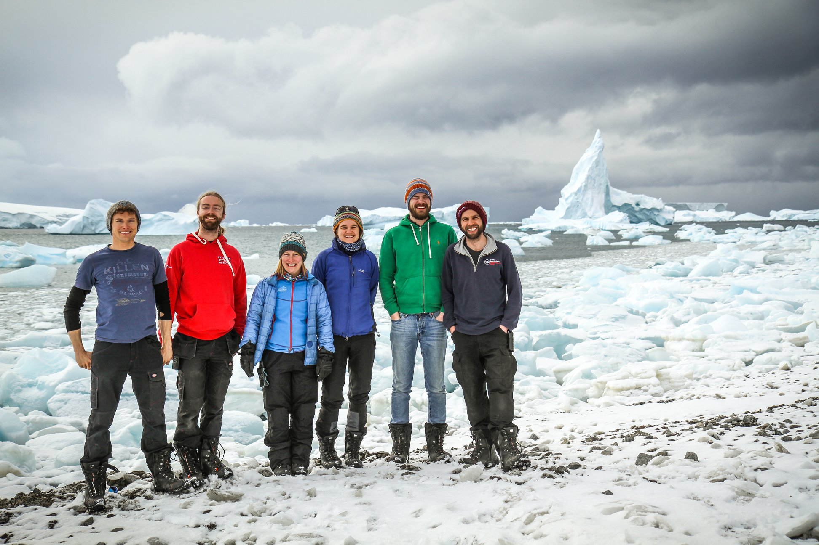
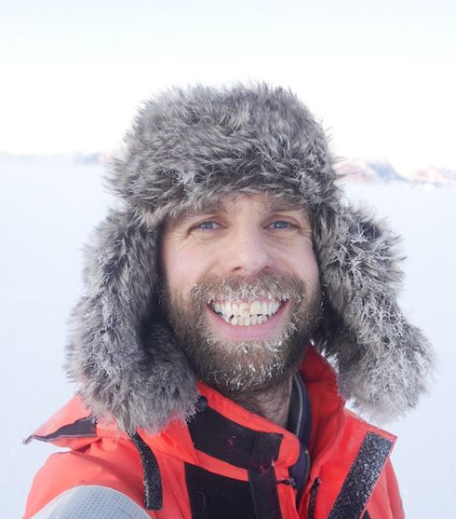
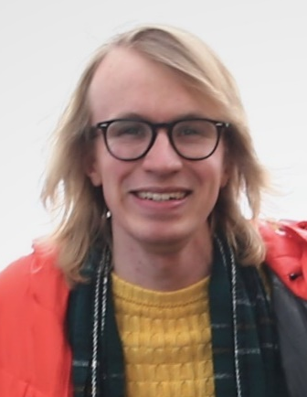
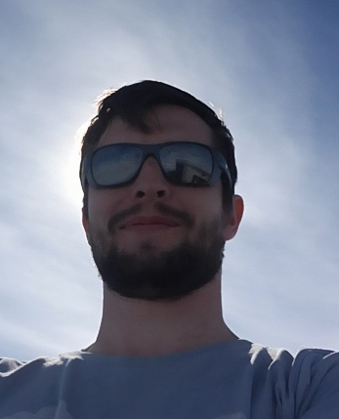
The Summer 2019/20 Team
Thanks to the whole team and the many other volunteer diggers for their efforts this past season!
Rothera
Halley
Hannah Walker
Mairi Simms
John Law
Jack Farr
Josh Eveson
Notes:
The Rothera and Halley summer and winter meteorologists

Slide 3
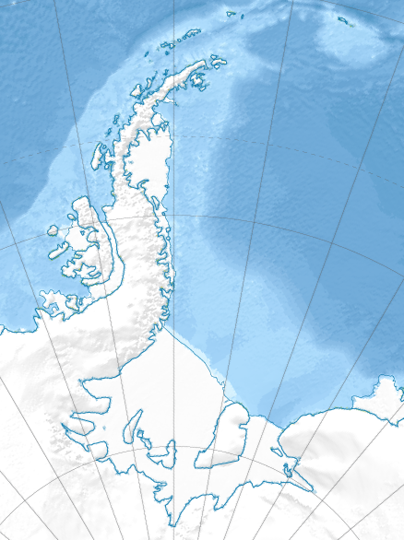
BAS AWS Network
Rothera
BAS manned station
Fossil Bluff
BAS manned station (summer only)
Butler Island
BAS AWS
Sky Blu
Limbert
Halley Sites
Baldrick
Notes:
BAS currently run 8 AWS on the Antarctic Peninsula and around the Halley and Coats Land region - they are denoted by circles on this map. Fossil Bluff, Butler Island, Sky Blu, Limbert, Baldrick and three in the Halley region. Rothera is manned 365 days of the year whereas Halley is now a summer only base. The BAS met team aim to service all of these AWS annually during the summer months when weather and aircraft availability comply.

Slide 4
AWS Network
IMAU Sites
(University of Utrecht)
+
+
+
Non-BAS AWS
+
+
Koni Steffan AWS
Dismal Island
(University of Wisconsin)
BAS manned station
BAS manned station (summer only)
BAS AWS
Notes:
The team also aim to service AWS in this area that are owned by other institutions if asked, either on a regular annual basis or an ad hoc basis. These AWS are denoted by crosses on the map and are owned by the Institute for Marine and Atmospheric Research at the University of Utrecht, Koni Steffan AWS from WSL and a University of Wisconsin AWS at Dismal Island.

Slide 5
AWS Network
+
+
• Capability of sending SYNOPS to GTS
• No capability at this time
+
+

Slide 6
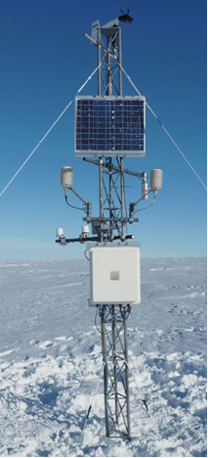
BAS AWS Network
Propvane, sonic ranging snow accumulation sensor, HMP temperature and humidity sensor, PRT air temperature sensor, pressure sensor
Powered by two or four x 100Ah 12V batteries (buried), charged by solar panel.
Campbell Scientific CR1000 data loggers.
10 minute averaged data saved to card.
10 minute averaged data are transmitted via SBD Iridium every three hours.
Complete data set is sent via Iridium once a week.
Notes:
This is a typical BAS AWS set up. The only thing not visible in this photo is the battery box which is buried beneath the surface of the snow. This requires digging out each visit and raising to the surface. A piece of plywood is placed on the top and bottom of the battery box to prevent summer melt and therefore ice layers forming making digging difficult the following season. Other standard site visit procedures are raising the instruments higher up the mast due to snow accumulation and adding a guyed mast section if required. Standard checks involve visual inspections of instruments, cables and mast infrastructure, uploading new software, downloading data if necessary, checking instrument values and checking power.

Slide 7
BAS AWS Network
Work Carried out 2019/20
All BAS AWS sites (apart from Baldrick) visited this season
Serviced
Accessed from Rothera
Fossil Bluff
Butler Island
Sky Blu
Limbert
Accessed from Halley
6a AWS
TT03 (10 km from Halley)
CASLab (2km from Halley)
Baldrick
All raised and guy ropes lowered
Logger box, dump box and battery box raised
All raised
All raised
Not visited

Slide 8

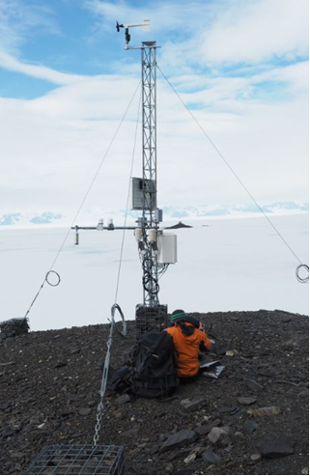
Fossil Bluff
On arrival
All instruments, power and data transmission working well and cables secure
Inside of logger box dry (condensation had been an issue a couple of seasons ago)
Work carried out
CF card replaced
Guy ropes (metal) tightened and locking wire applied
Service time – 1 hr
Notes:
Fossil Bluff AWS is located at a summer-only manned refuelling depot for BAS aircraft. The depot is regularly visited for refuelling purposes and personnel swap-outs making a flight to Fossil Bluff easy to achieve in the summer season. It is roughly 1.5 hrs flight south of Rothera. Fossil Bluff AWS is also mounted on rock, meaning that the usual digging out of the battery box and the raising of instruments and mast sections does not apply here. Standard service visits are therefore normally very short.

Slide 9
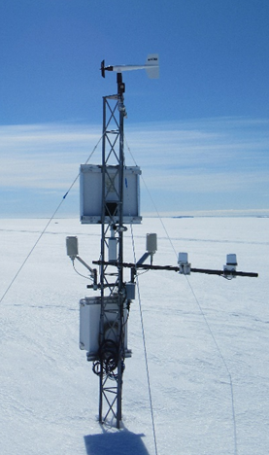
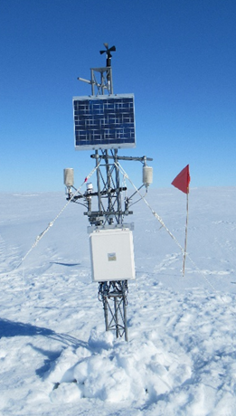
Before
Butler Island
After
On arrival
All instruments, power and data transmission working well and cables secure
44cm accumulation since last visit (13 months)
Work carried out
Battery box dug up and raised (thin layer of ice 10cm from surface)
All instruments raised (except propvane)
Guy ropes removed and reattached lower down to aid raising of solar panel
Service time – 4 hrs 15 mins
Notes:
Butler Island AWS is normally serviced via a refuel stop at Fossil Bluff. It is just over an hours flight ESE from Fossil Bluff.

Slide 10
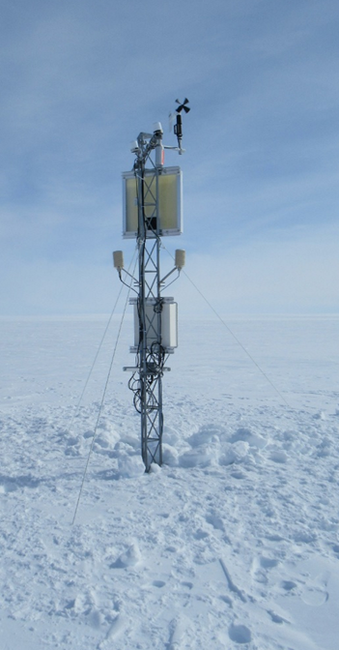
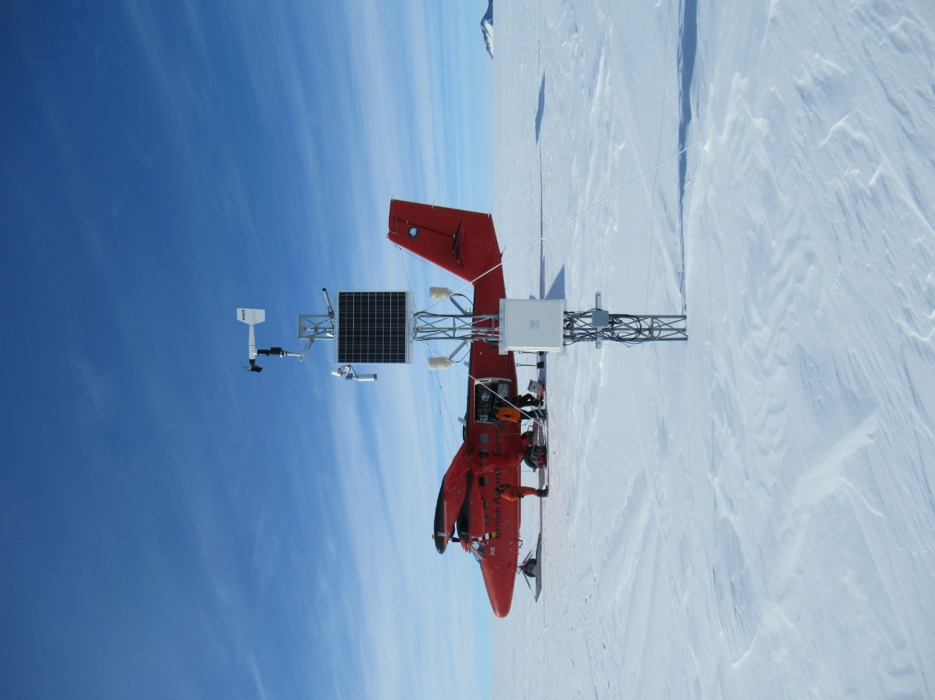
Before
Sky Blu
After
On arrival
Power, data transmission and most instruments working well and cables secure, SR50 not working
Work carried out
SR50 replaced
Battery box dug up and raised (50cm accumulated estimated since last visit, 11 months ago)
Logger box and dump box raised
Service time – 3 hrs 15 mins
Notes:
Sky Blu AWS is situated around 10km N of the busy BAS manned, summer-only refuelling depot at Sky Blu. Therefore it, like Fossil Bluff is easy to get to. However to access the AWS from Sky Blu a flight is necessary as to get there on foot or skidoo would involve a 600ft accent through crevassed territory. The flight from Sky Blu takes around 3 minutes but it takes longer when you have to try and spot the AWS and trail aircraft skis before making sure it’s safe to land.

Slide 11
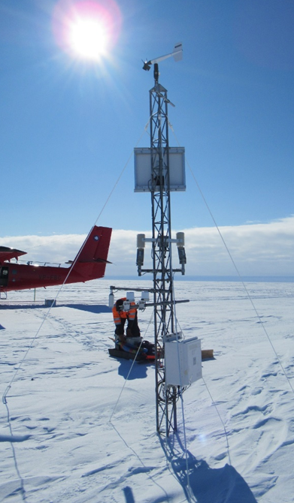
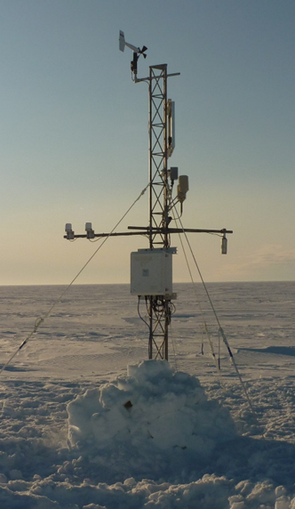
Before
Limbert
After
Before
After
On arrival
All instruments, power and data transmission working well and cables secure
119cm accumulation since last visit - 25 months ago
Work carried out
Battery box dug up (1m down), raised to surface and covered with snow blocks (as opposed to being buried just below surface)
All instruments raised (except propvane) as high as possible but with some metalwork restricting maximum height achievable
Service time – 6 hrs 17 mins
Notes:
Limbert is the furthest of the AWS serviced by the Rothera met team making visits very opportunistic. BAS aircraft have many depots on the Ronne ice shelf and regularly take this route when transiting from or to Halley. This makes the chances of an aircraft flying via the AWS (it is located next to an unmanned fuel depot) high, however the distances and payload involved mean that other projects and logistics often take priority, not to mention hitting the required weather and time critical windows at refuelling locations en route. Never-the-less the Limbert AWS is serviced most seasons, although not in the 2018/19 season.

Slide 12
BAS AWS Network
Work Carried out 2019/20
Over at Halley….
6a AWS, TT03 AWS and CASLab AWS all raised but problem persists with CASLab power system

Slide 13
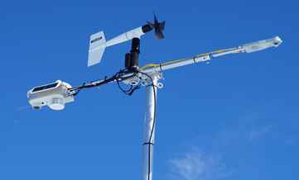
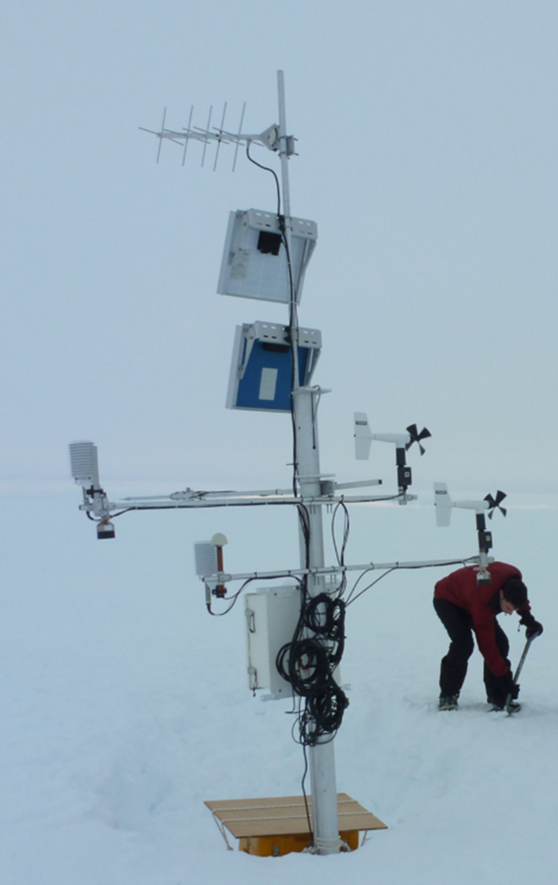
Non-BAS AWS Network
Work Carried out 2019/20
iWS 18
iWS18
iWS 14
+
+
iWS14
University of Utrecht – IMAU
iWS 14 (Larsen)
iWS 18 (Cabinet Inlet)
WSL
Koni Steffen AWS
+
+
Koni Steffen AWS

Slide 14
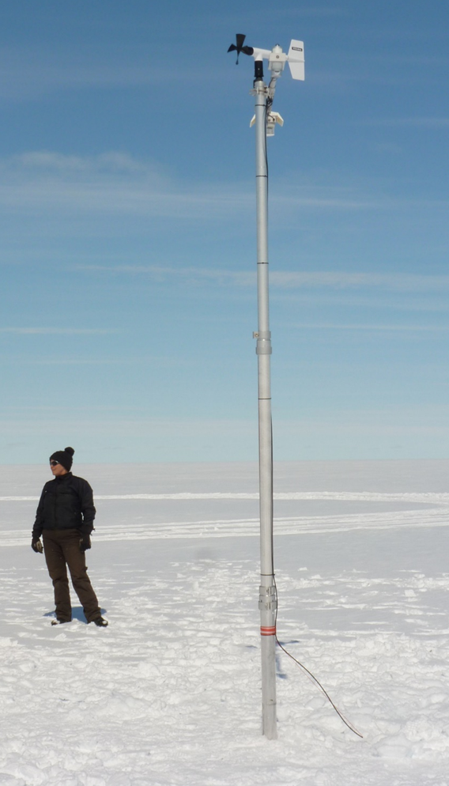
Before
University of Utrecht
IMAU iWS 14
After
After
Before
On arrival
The mast was at a slight angle
Boom was 180⁰ out due to error on last visit
Fragile thermocouple broken
Work carried out
iWS, thermocouple and thermistor string replaced
Temperature string mistakenly coiled up before burying rather than stretched out – will be rectified next visit
Service time – 1 hrs 30 mins
Notes:
The University of Utrecht IMAU iWS 14 is located on the Northern side of Larsen ice shelf. A flight to here normally takes around 1 hour.

Slide 15
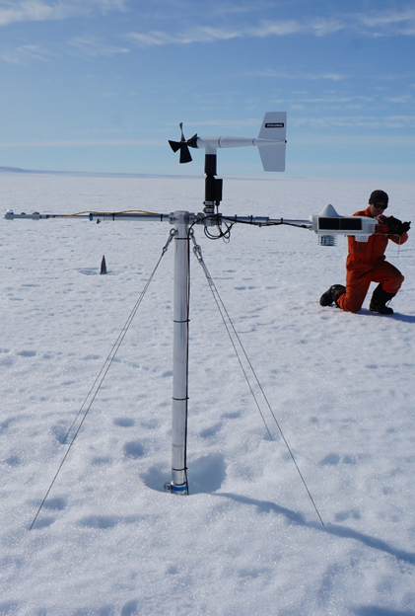
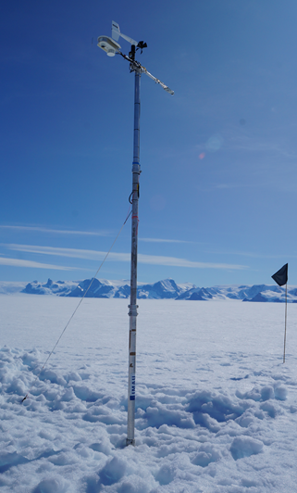
Before
University of Utrecht
IMAU iWS 18
After
Before
After
After
Before
On arrival
The mast had an extensive melt hole around it
Fragile thermocouple broken
Work carried out
iWS, thermocouple and thermistor string replaced
New telescopic mast section added
Boom raised by 314cm
Service time – 1hr 15 mins
Notes:
The University of Utrecht IMAU iWS 18 is located at Cabinet Inlet on the Northern side of Larsen ice shelf. A flight to this site normally takes around 45 minutes.

Slide 16
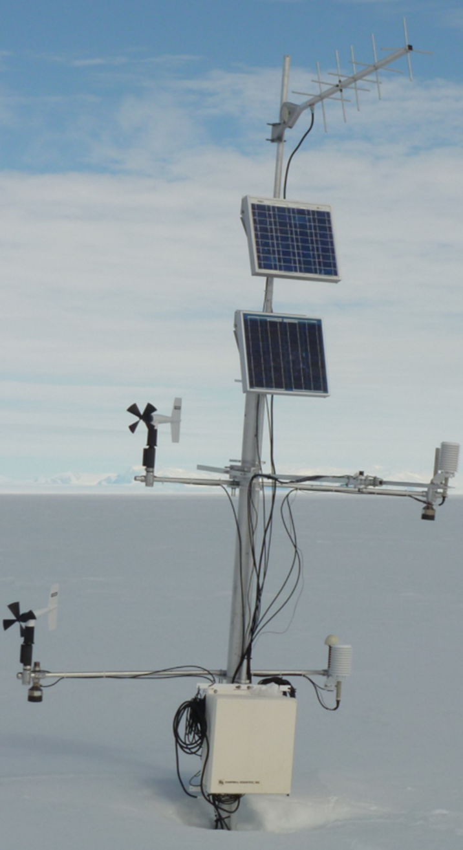

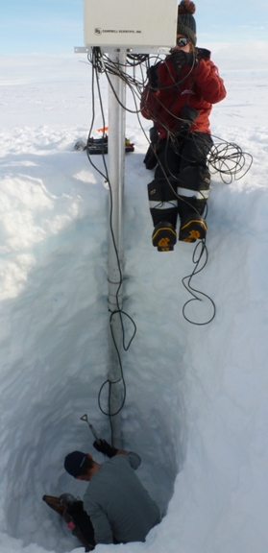
Before
Koni Steffen AWS – First visit
Before
After
Before
On arrival
Power and instruments working but no data transmission
Work carried out
Battery box 4m below surface, many layers of ice, dug up then raised (5 people over 6 hours)
35 months since last visit
Snapped battery connectors re-crimped and reattached, hole in battery box repaired
Snapped cable ties replaced, tangled and loose cables coiled and secured
Degraded tape around logger box cable replaced
Saturated desiccant bag in logger box replaced
Lower boom and logger box raised
Data downloaded and CF card swapped but not accepted by logger……..possible revisit necessary
Service time – 8 hrs 34 mins
Notes:
The WSL Koni Steffen AWS is situated on the Larsen Ice Shelf. It is a 40 minute flight from Rothera. It had not been visited for 3 seasons. The site was easy to spot from the air. On arrival the mast was at a slight angle and although the instruments and power system seemed to be working the site had suffered from not being visited for a while. The lower boom and logger box were raised but with no new mast section the ideal 1m vertical separation between booms could not be adhered to. The logger would not accept the CF card on departure. Further tests were not possible due to time running out so the AWS was left in this state.

Slide 17

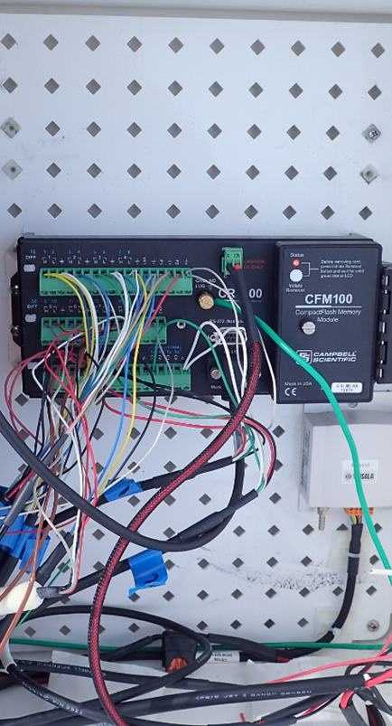
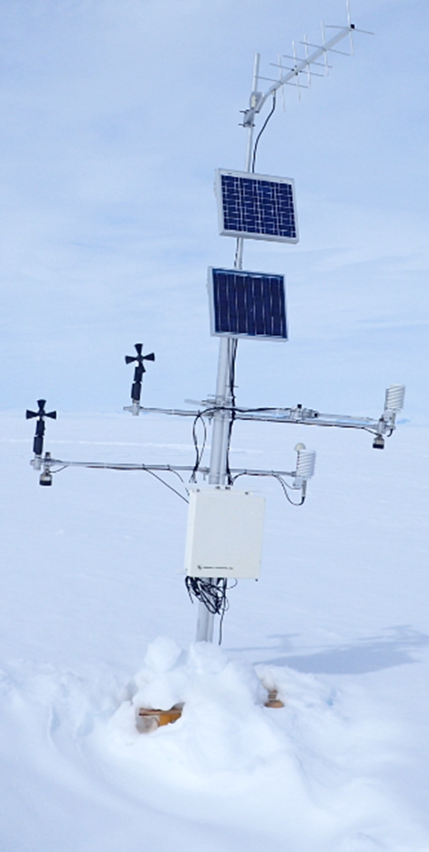
CF card error
Koni Steffen AWS –
Second visit
After
Before
After
After
Before
Work carried out
CF card replaced and logger power cycled successfully
Revisit time – 15 mins
Notes:
Luckily a second visit was made a week or so later to rectify the CF card issue.

Slide 18
Current AWS Status
AWS | Sensors |  |  |  |  | Power | Iridium | SBD
 | Wind | Temperature | Pressure | Humidity | Snow Depth
Fossil Bluff |  |  |  |  | Intermittent
Butler Island
Sky Blu
Limbert
Halley Sites |  |  |  |  |  | CASLab |  | 6a AWS
AWS | Sensors |  |  |  |  | Power | ARGOS
 | Wind | Temperature | Pressure | Humidity | Snow Depth
Baldrick
Koni Steffan AWS | Unsure of status
iWS14
iWS18

Slide 19
Intentions for 2020/21 season
(if it goes ahead, otherwise re-assess for 2021/22 season)
Swap iWS units
+
+
BAS AWS
Replace existing masts with pole masts.
Fossil Bluff – Replace SR50
Halley Sites – Sort out power system at the CASLab and SBD on 6a.
University of Utrecht - IMAU
iWS14 and iWS18 – Swap iWS unit, replace thermocouple and thermistor string
+
+
Replace SR50
Raise and check iridium
Raise and check iridium
Change batteries at 6a

Slide 20
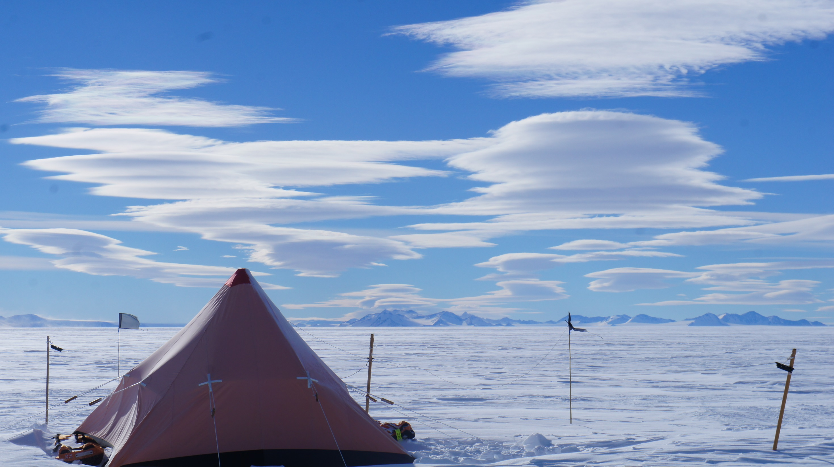
Thank you
Photo Credit: Scott Webster

