Slide 1





The Antarctic Meteorological Research and Data Center Data Repository:
A Project Update
Matthew Lazzara^{1,2}, Matthew Noojin¹, David Mikolajczyk², Lee Welhouse^{1,2}, Karissa Shannon², Sophie Orendorf², Taylor Norton^{1,2}, Caleb Cullum², Ethan Koudelka², Kathryn Marek², and Jerrold Robiadek²
1 Department of Physical Sciences, School of Science, Technology, Engineering, and Mathematics, Madison Area Technical College, Madison, WI, USA
2 Antarctic Meteorological Research and Data Center, Space Science and Engineering Center, University of Wisconsin-Madison, Madison, WI, USA
20th Workshop on Antarctic Meteorology and Climate
30th International Symposium on Polar Science

Slide 2
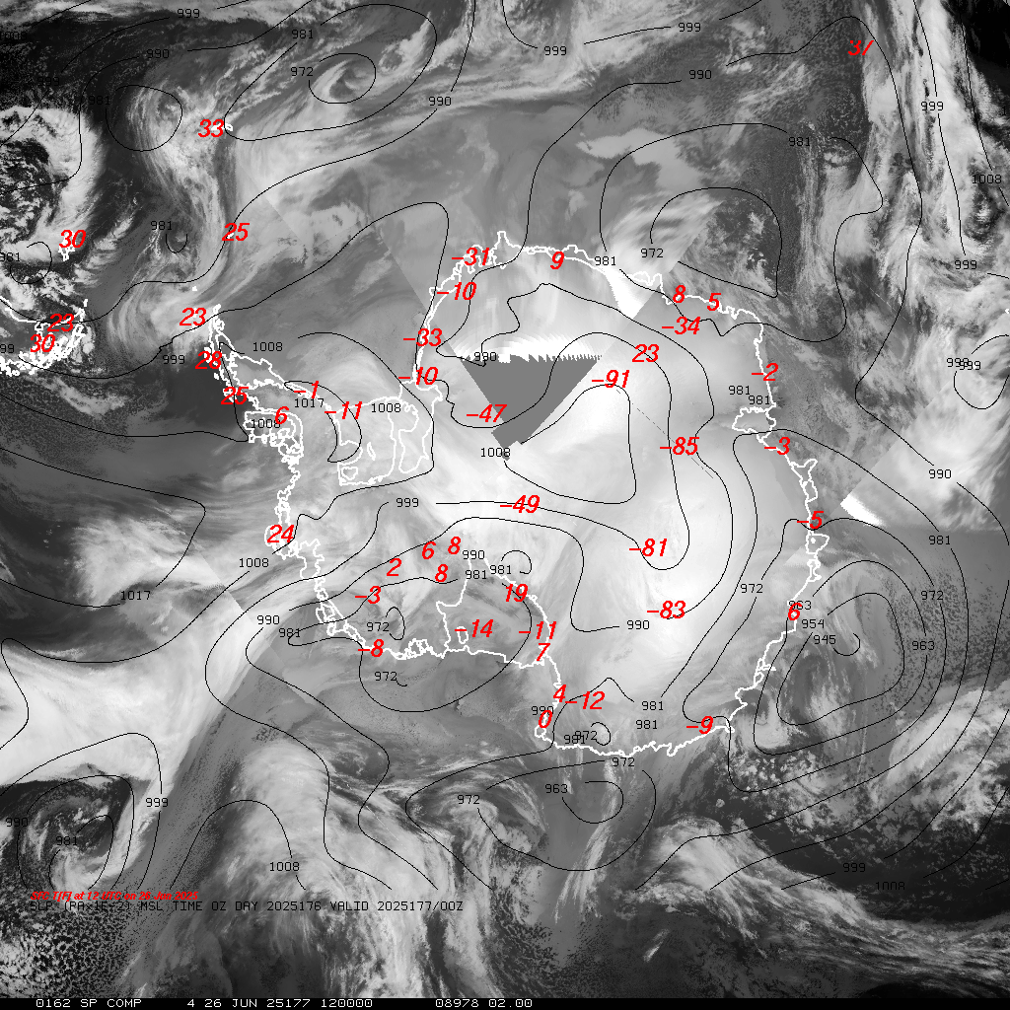
Outline
AMRDC Data Repository (ADR)
Satellites
  The end of several eras…
Real-time Data Relay
Automatic Weather Stations
Special Projects and Special Challenges
WMO OSCAR & AntRCC/AntCF
Questions and Answers
Antarctic satellite IR composite with 24 hr AMPS MSLP forecast (black)
AWS, Synoptic & Ship/Buoy Surface Temperatures (red)
June 26, 2025 12 UTC

Slide 3
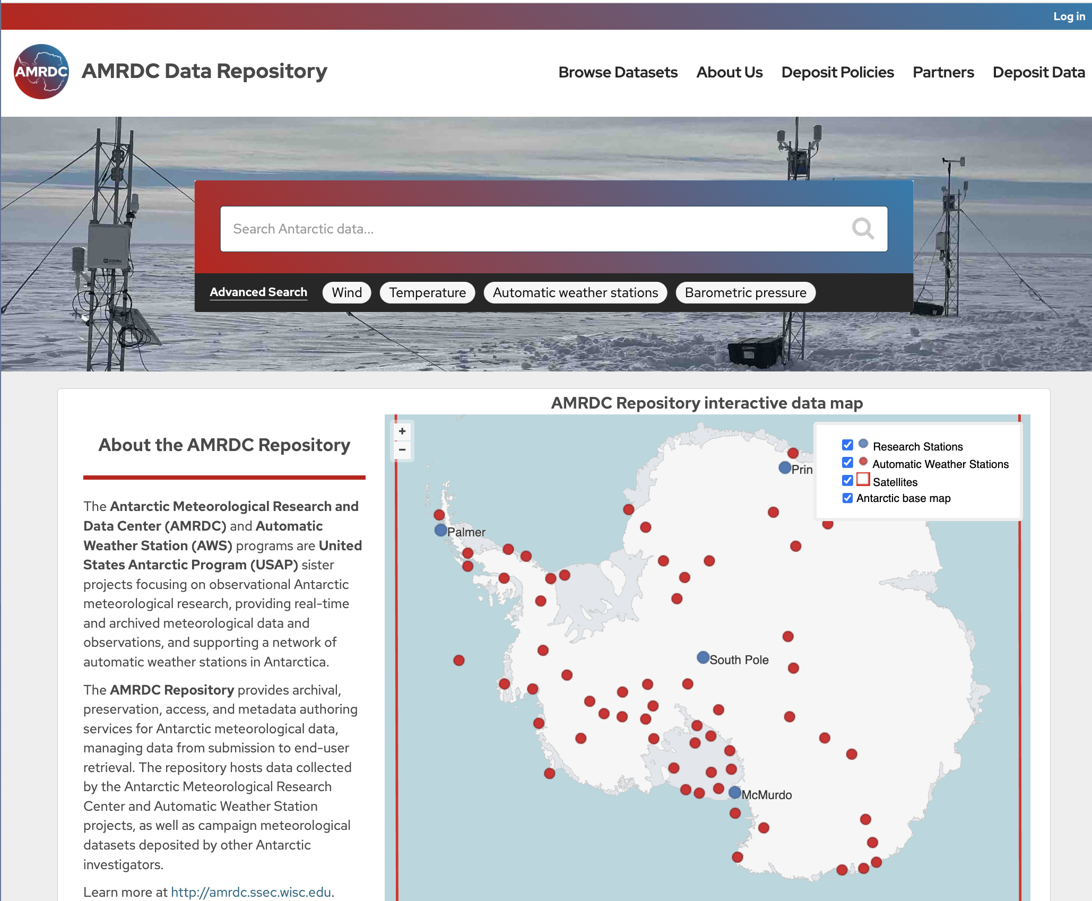
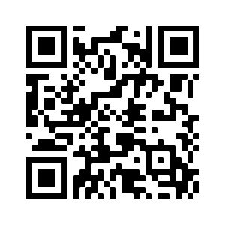





Antarctic Meteorological Research and Data Center (AMRDC)
Data Repository (ADR)
Official US Antarctic Meteorological Data Repository and Archive!
This is a community asset!!
  Submit your data!
  Use data from here!
Over 5400 Datasets!…and growing
https://amrdcdata.ssec.wisc.edu

Slide 4
AMRDC Data Repository (ADR)
Data Holdings
  5400 total datasets and growing
  110 external links and growing
Metadata, FAIR, DOIs
Publication in BAMS!
  Lazzara, M. A., M. G. Noojin, K. J. Shannon, D. E. Mikolajczyk, and L. J. Welhouse, 2025: An Antarctic Meteorological Data Repository. Bull. Amer. Meteor. Soc., Accepted. DOI: 10.1175/BAMS-D-24-0178.1

Slide 5
Sample Data Holdings…
Satellite | Point Source | Model Output - Grid | ASCII Text | Satellite Navigation
Antarctic composites | METAR – Surface Hourly | MRF/AVN/GFS (coming soon) | USAP Field Camps | Two-line orbital elements (coming soon)
NOAA LAC | Surface Synoptic | ECMWF (limited) (coming soon) | South Pole and McMurdo radiosonde launch data | McIDAS System Navigation (coming soon)
NOAA HRPT from McMurdo Station (coming soon) | Automatic Weather Stations | UKMET (limited) (coming soon) | USAP TAFs (coming soon)
 | Ship and Buoy | AMPS (campaign) | USAP main stations surface observations
 | Aircraft | AEMET-ySREPS (campaign)
 | Radiosonde / Rawinsonde

Slide 6

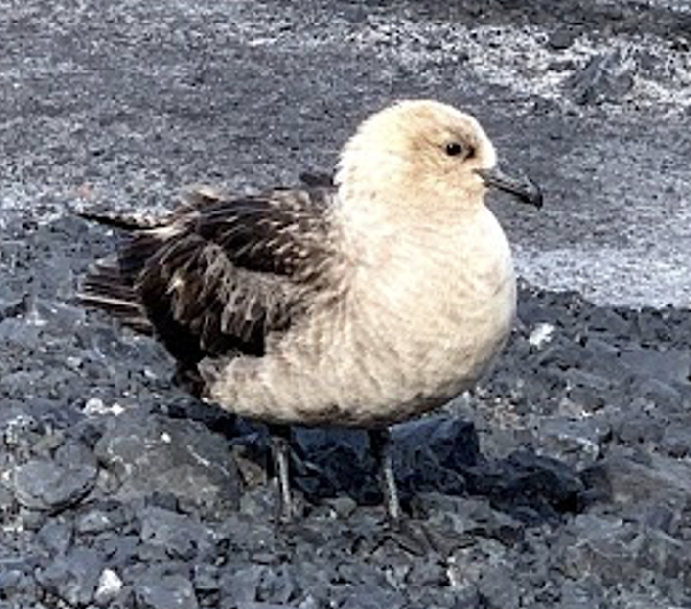
Antarctic Meteorological Data
AMRDC – The Meteorological Data Skua of the Antarctic!
AMRDC is interested in any meteorological collections for longer term storage and community availability
Contact us if you have anything to provide!
Courtesy PJ Carpenter

Slide 7
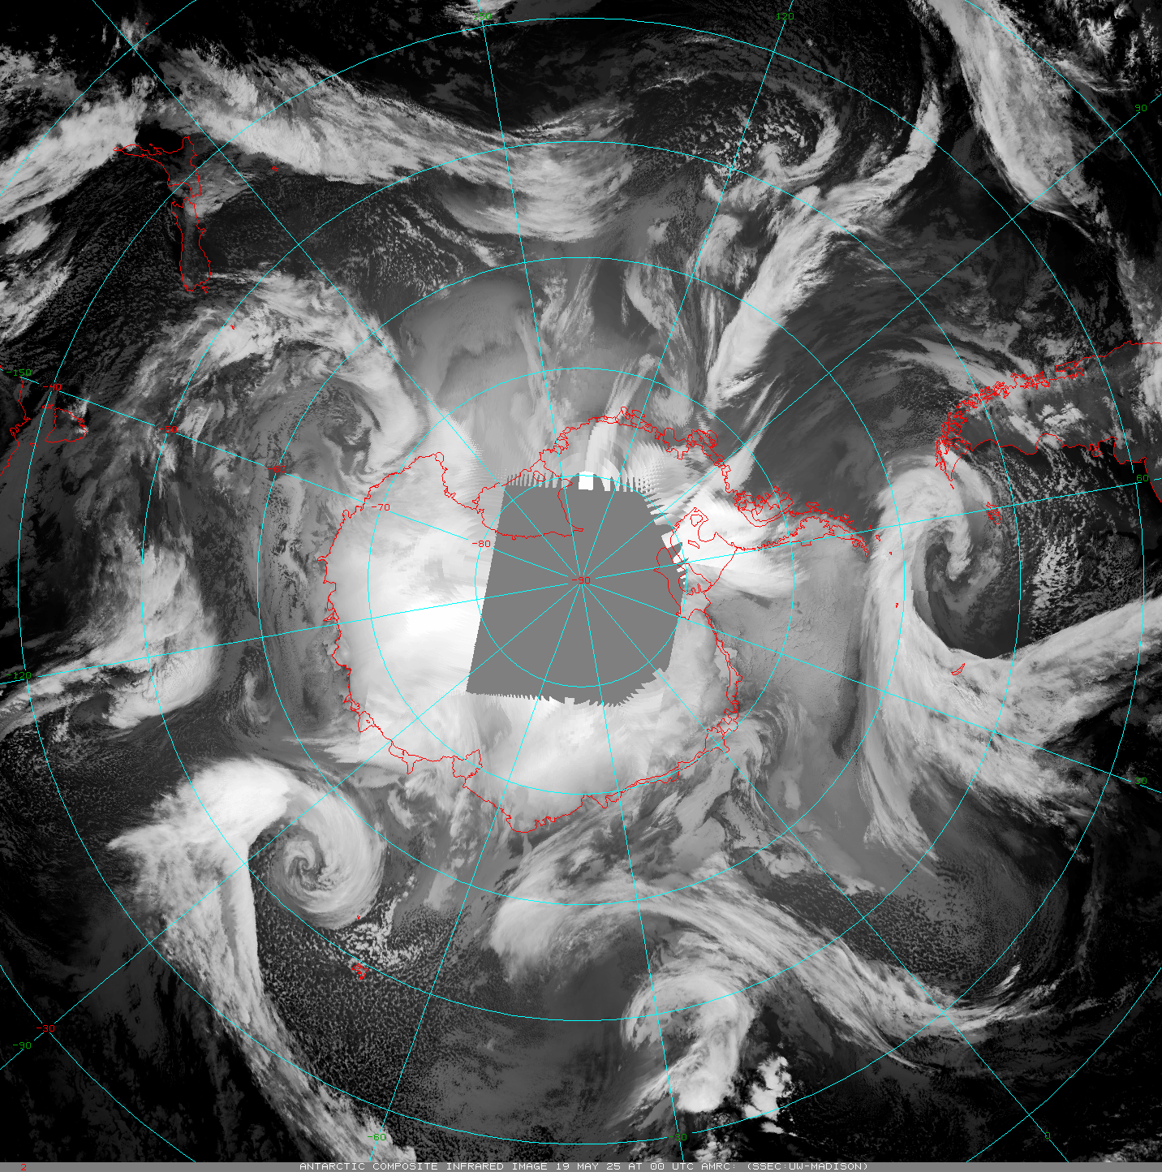
Satellites
Polar Satellites
Satellite Composites
USA
  Old NOAAs (-15 and -19)
    Sunset this summer (-18 is off)
  Old DMSP
    Sunset in 2026
    SSMIS global processing off July 30
  NASA – beyond end of life
    Aqua
    Terra – Direct Broadcast offline
    Sunset as soon as 9/1/2025
  S-NPP a backup satellite (sunset 2026?)
  Current: NOAA-20, NOAA-21
  Coming soon: JPSS-3, JPSS-4
EUMETSAT
  Current: Metop-B and Metop-C
  Coming soon: Metop-SG
China - FY- Series
Russia - Meteor- Series
Others…
A Sample Animation - Wisconsin Composites:
Other composites made by Russia and China…
https://space.oscar.wmo.int/satellitestatuses/status

Slide 8
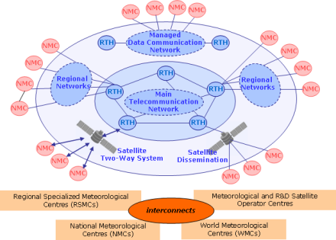
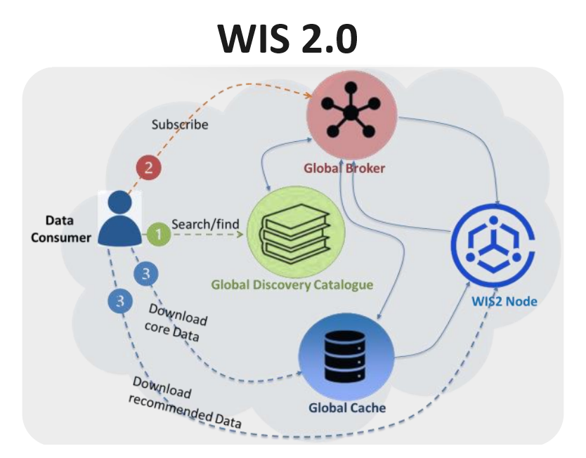
Real-time Data Relay
McIDAS ADDE Servers
  Great for McIDAS-X, McIDAS-V, IDV
  Re-organization in progress:
THREDDS
  Connected to the AMRDC Data Repository
  Service in and of itself
https://amrdcdata.ssec.wisc.edu/thredds/catalog/catalog.html
Via the WMO
  GTS – Global Telecommunications System
  WIS2.0 – WMO Information System 2.0
  Funding issues...
  30% cut
Antarctic-IDD
  (See next few slides)
  Relay of some datasets … uneven Radiosonde observations from McMurdo
  Need to have *more* folks use this system to relay data
Group Name | Server
AMRC | amrc.ssec.wisc.edu
ARCHIVE COMPARCH | amrc.ssec.wisc.edu
AMRDC | mcw.ssec.wisc.edu
ARCHIVE (Coming soon) | mcw.ssec.wisc.edu
Courtesy WMO

Slide 9
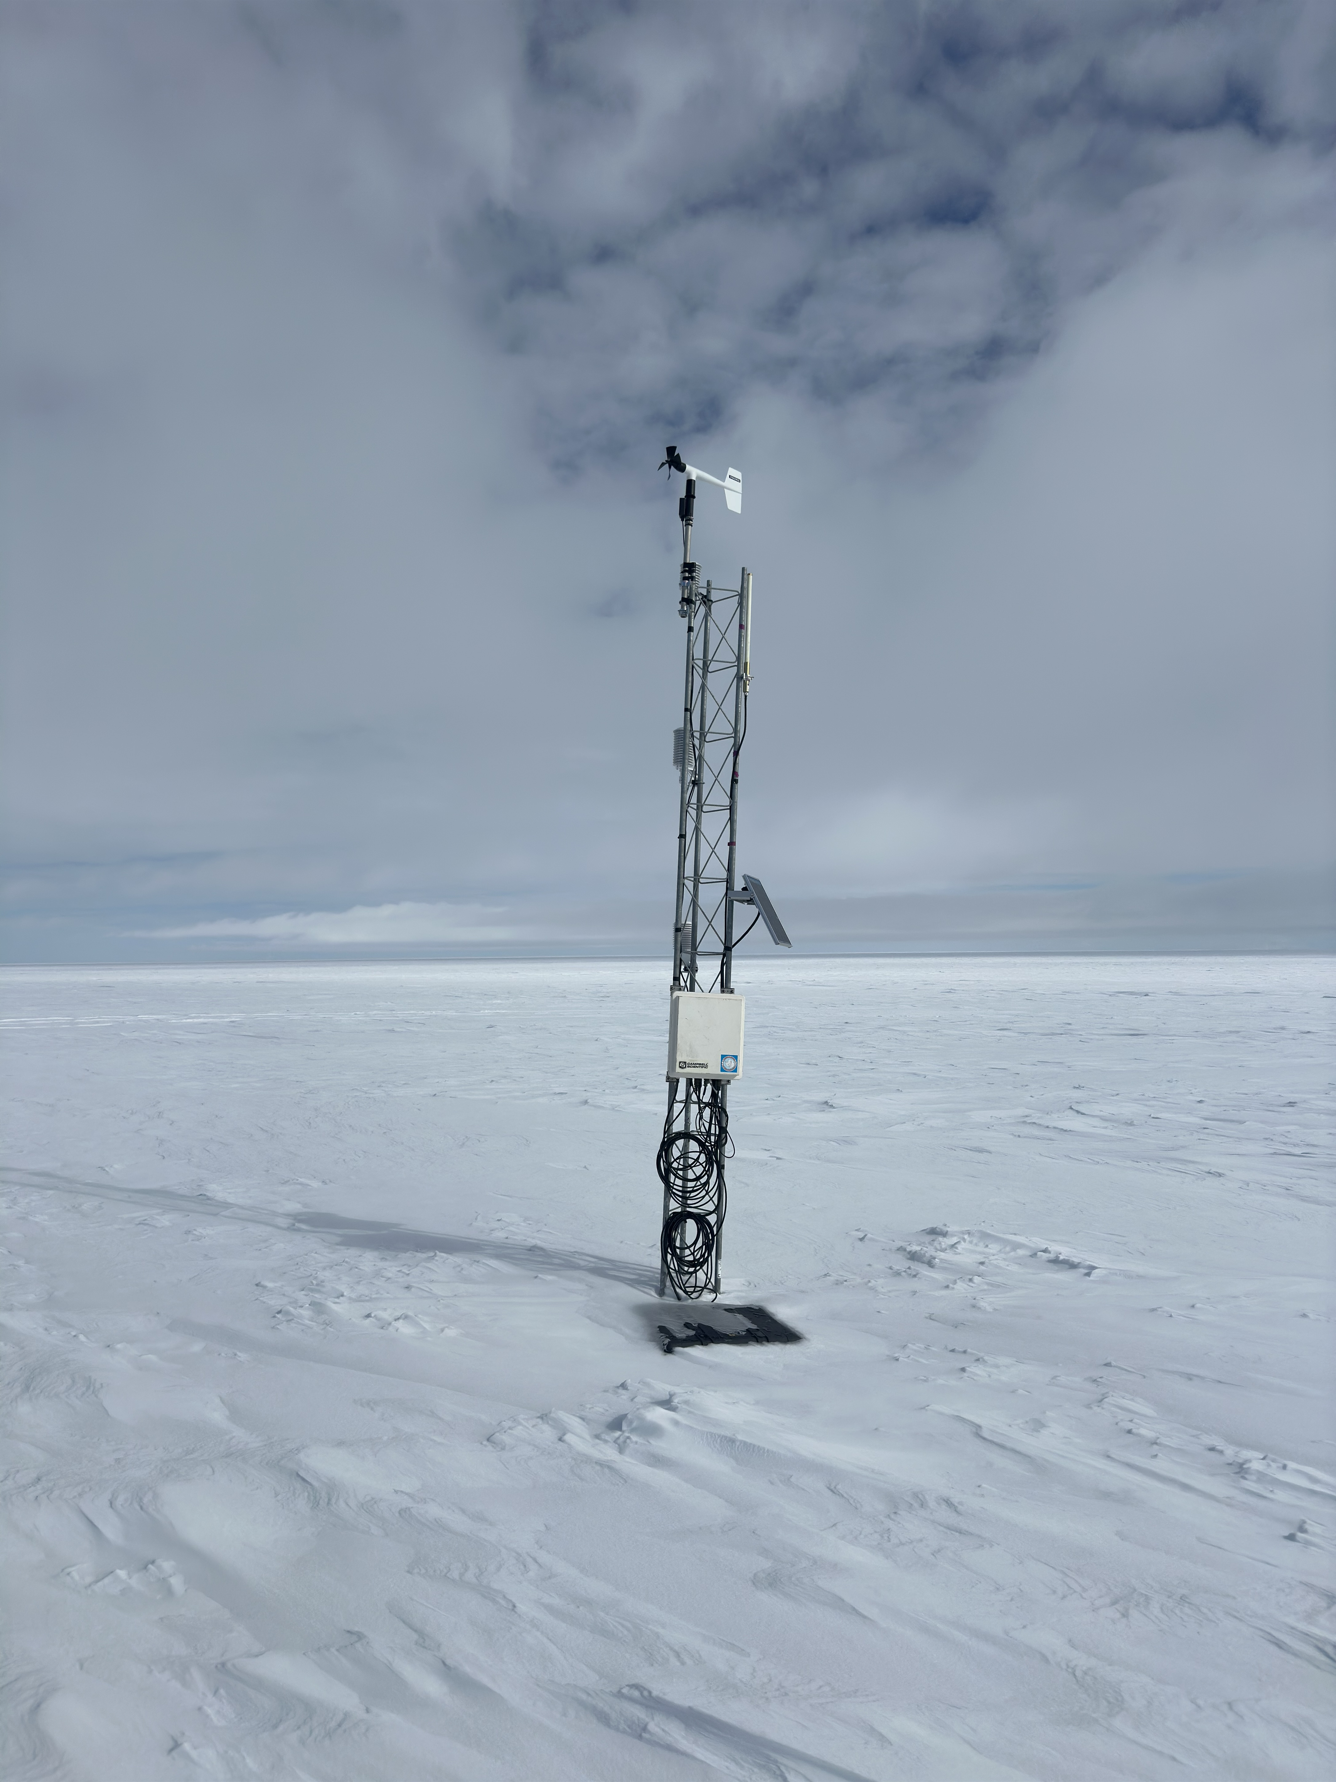

What is the Antarctic-IDD?
A federated sharing of Antarctic meteorological data built on the freely available LDM software from the Unidata Project
  Sort of like a Global Telecommunications System of the Antarctic!
Datasets available in real-time
Participants can provide data as well as acquire data
  Data is quantized to allow end user to select as much or as little data as desired. (e.g. you do not have to get a whole AMPS model run)
Sample datasets:
  Antarctic Mesoscale Prediction System model output
  Automatic Weather Station observations
  Satellite composite Imagery
  Additional weather displays, products
We welcome contributions from the community!
Contact mattl@ssec.wisc.edu if you wish to join in!!
Emilia AWS Courtesy of Tyler Plekan

Slide 10
Antarctic-IDD
Active Use LDM
NOAA (Arctic Sat. Composites) Washington, DC
AMRDC/Wisconsin
Status as of 2025
20th Anniversary!
NOAA NCO/TG → GTS
(AWS BUFR)
NCAR/MMM
BPCRC/OSU
UCAR/Unidata
ASC
CU
Phases:
CSBF/LDB
NIWC
Charleston
Phase I - Field Seasons 2005-2007
Phase II – Field Seasons 2007-2025
Phase III – Future
Key:
McMurdo
Station
NIWC
& AMRDC
CSBF/LDB
At Williams
Field
Two-way, full data stream
Limited two-way data stream
Limited distribution connection

Slide 11
NOAA (Arctic Sat. Composites) Washington, DC
Antarctic-IDD
AMRDC/Wisconsin
A Possible US Future
NOAA NCO/TG → GTS
(AWS BUFR)
NCAR/MMM
BPCRC/OSU
UCAR/Unidata
?
ASC
CU
Phases:
Phase I - Field Seasons 2005-2007
Phase II – Field Seasons 2007-2025
Phase III – Future ?
CSBF/LDB
NIWC
Charleston
AMRDC
McMurdo
Station
Key:
McMurdo
Station
NIWC
Two-way, full data stream
Limited two-way data stream
Limited distribution connection
Future ?
CSBF/LDB
At Williams
Field

Slide 12
Antarctic-IDD
NOAA (Arctic Sat. Composites) Washington, DC
AMRDC/Wisconsin
A Possible International Future
NOAA NCO/TG → GTS
(AWS BUFR)
NCAR/MMM
NIPR
Japan
BPCRC/OSU
BAS
United Kingdom
UCAR/Unidata
KOPR
Korea
?
ASC
CU
AWI
Germany
CSBF/LDB
NIWC
Charleston
NIWC
New Zealand
AMRDC
McMurdo
Station
Please Join in!!
Contact:
mattl@ssec.wisc.edu
Key:
McMurdo
Station
NIWC
Two-way, full data stream
Limited two-way data stream
Limited distribution connection
Future ?
CSBF/LDB
At Williams
Field

Slide 14
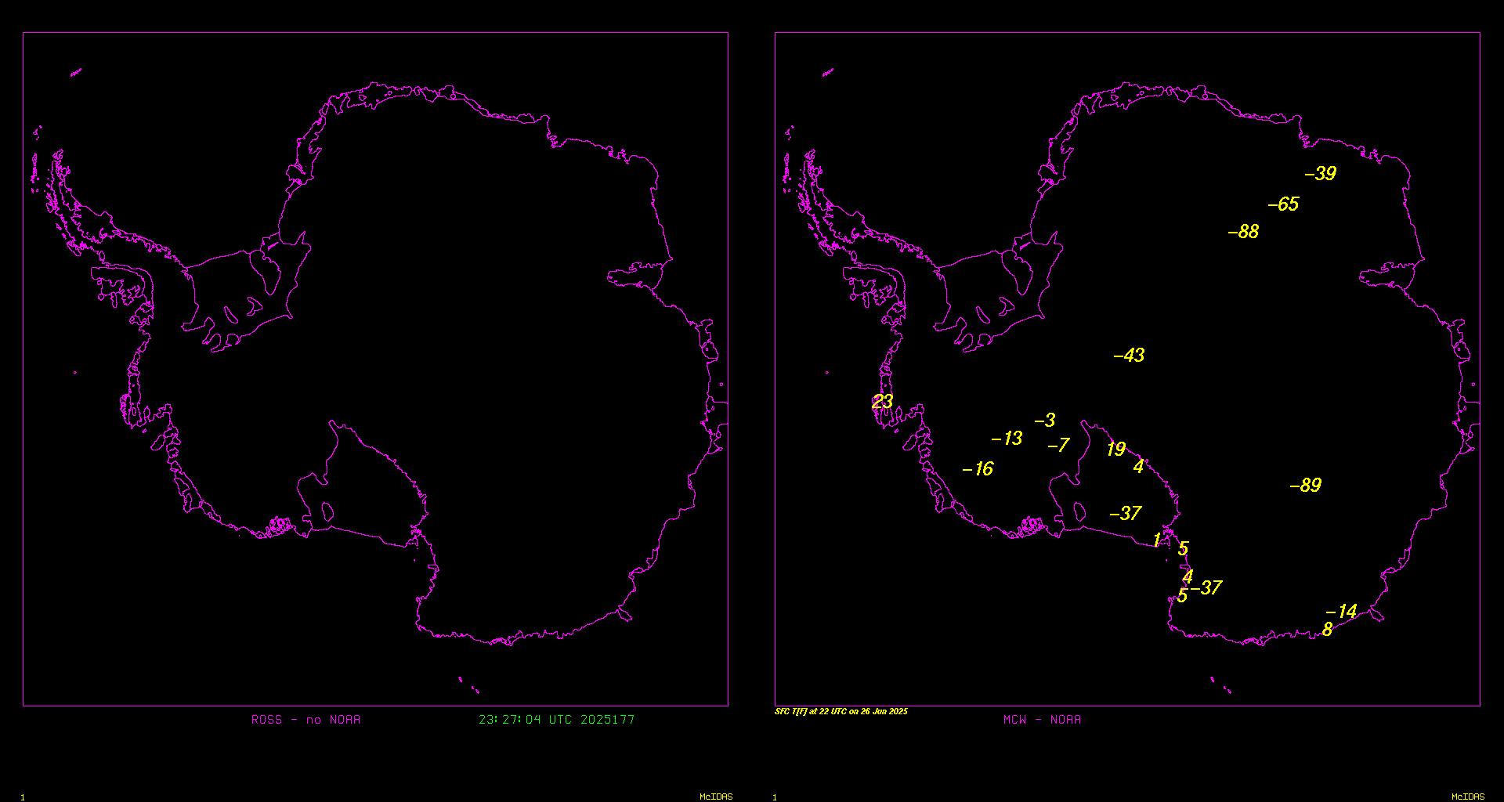
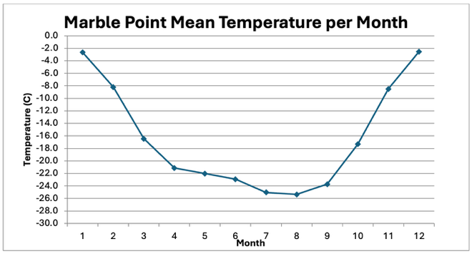
Special Challenges & Special Projects
Automatic Weather Stations Observations
  Exploring means beyond DCS acquisition
  Options do cost:
  e.g. Real-time via Woodshole/CLS
Email into the AMRDC Data Repository (ADR)
  Many datasets provided via email
  Creates by hand effort to organize…significant
  Welcome ideas for other options
Marble Point Climatological Analysis
  One of the longest running AWS…40+ years!
  Significant change! (Koudelka, in prep.)
No NOAA data vs. NOAA AWS data

Slide 15
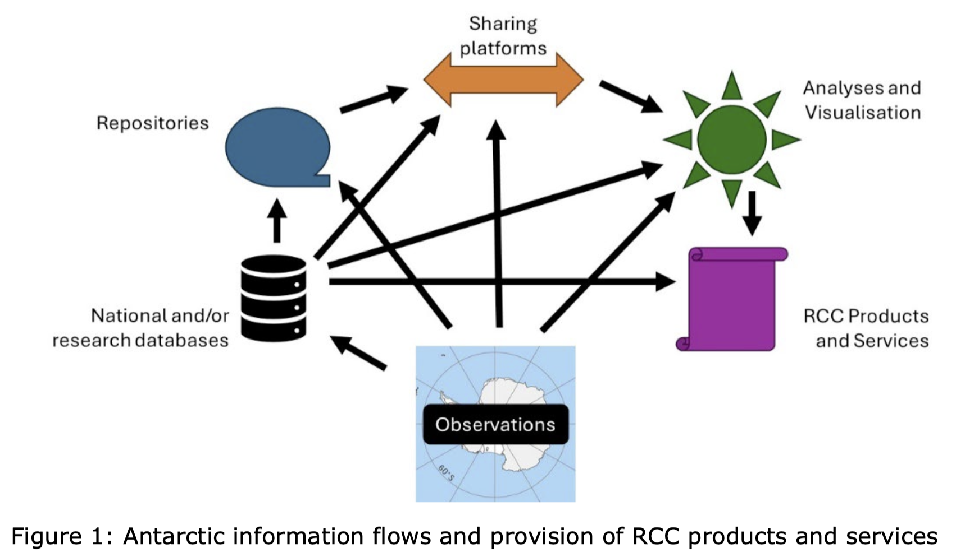
Antarctic Regional Climate Center Network
https://antarcticrcc-network.org/

Slide 16
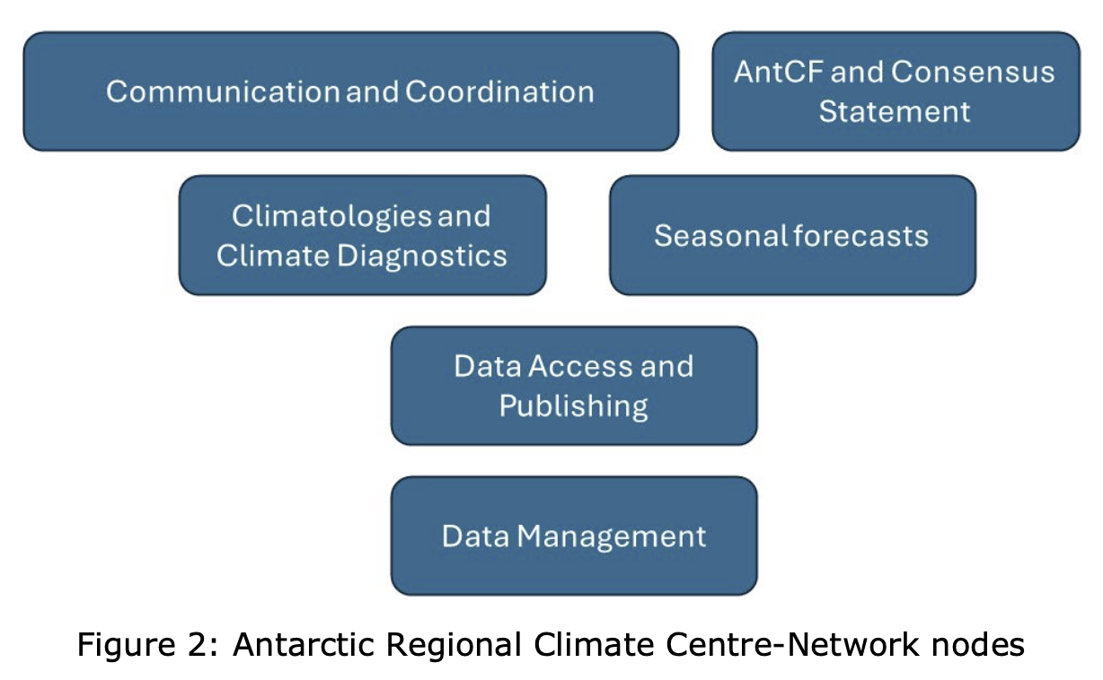
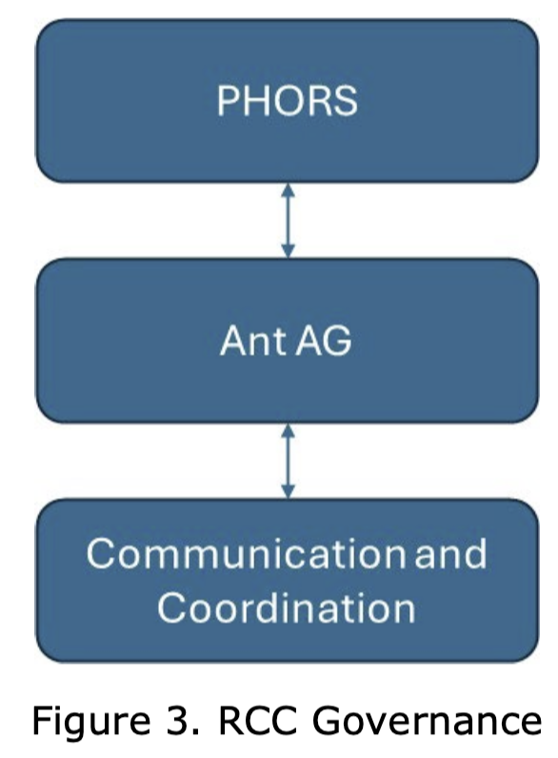
WMO OSCAR & AntRCC/AntCF
World Meteorological Organization
Observing Systems Capability Analysis and Review tool (OSCAR):
  Current US AWS Network has been filed on OSCAR!
Antarctic Regional Climate Center (AntRCC):
  A “networked” regional climate center.
  This is moving forward!
  Leading efforts:
    South Africa to lead and coordinate
    Italy to lead climatologies and climate diagnostics node
    Australia to lead seasonal forecasting node
    China: Data Access and publishing node
    United Kingdom: Data management node
Antarctic Climate Forum (AntCF):
  Create Antarctic Climate Consensus Statement

Slide 17
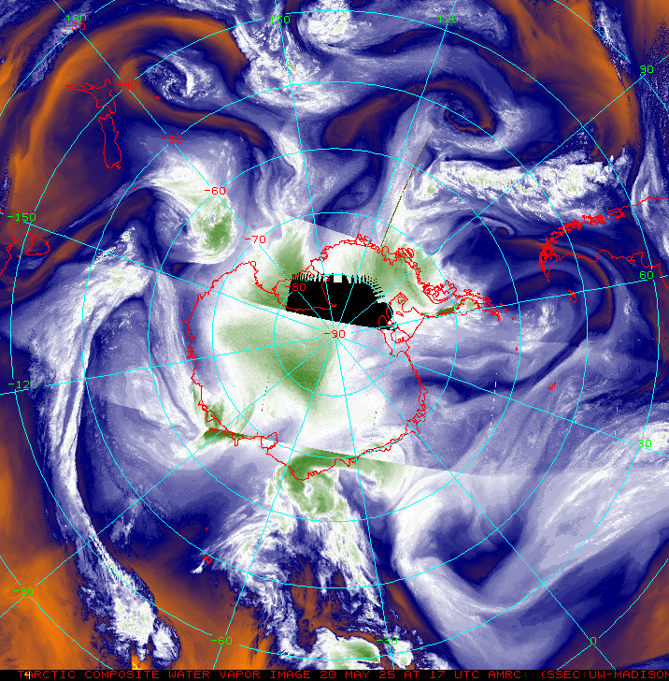
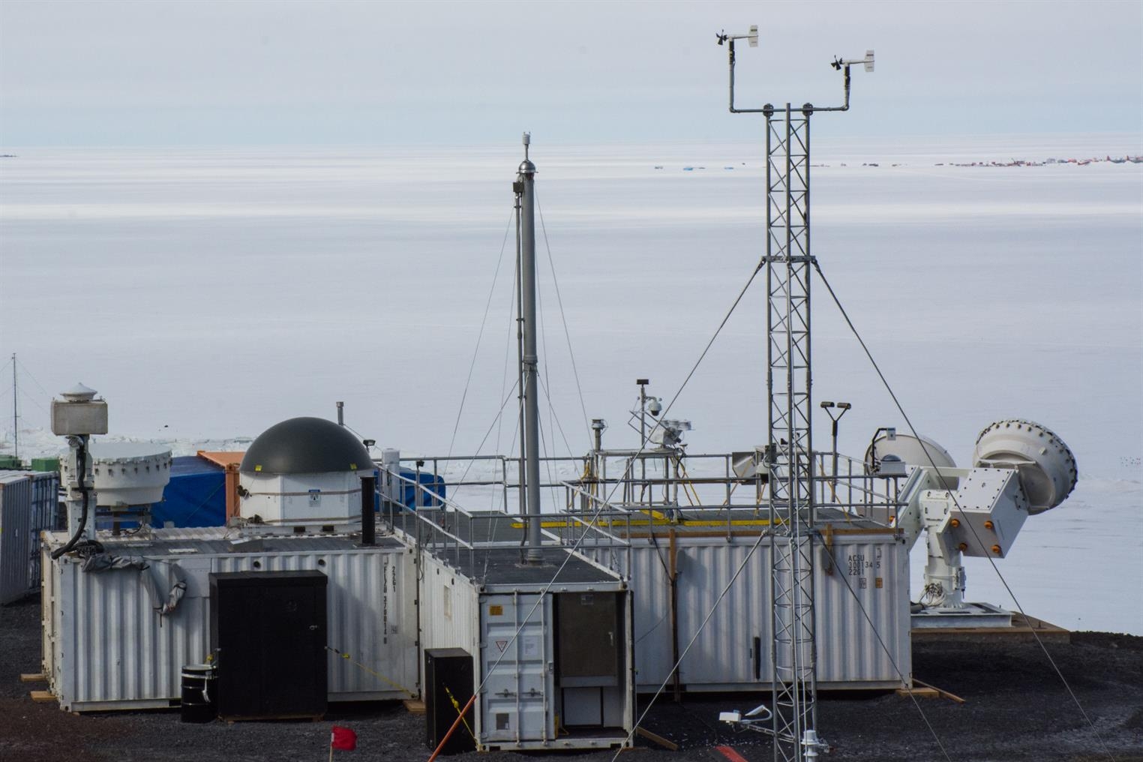
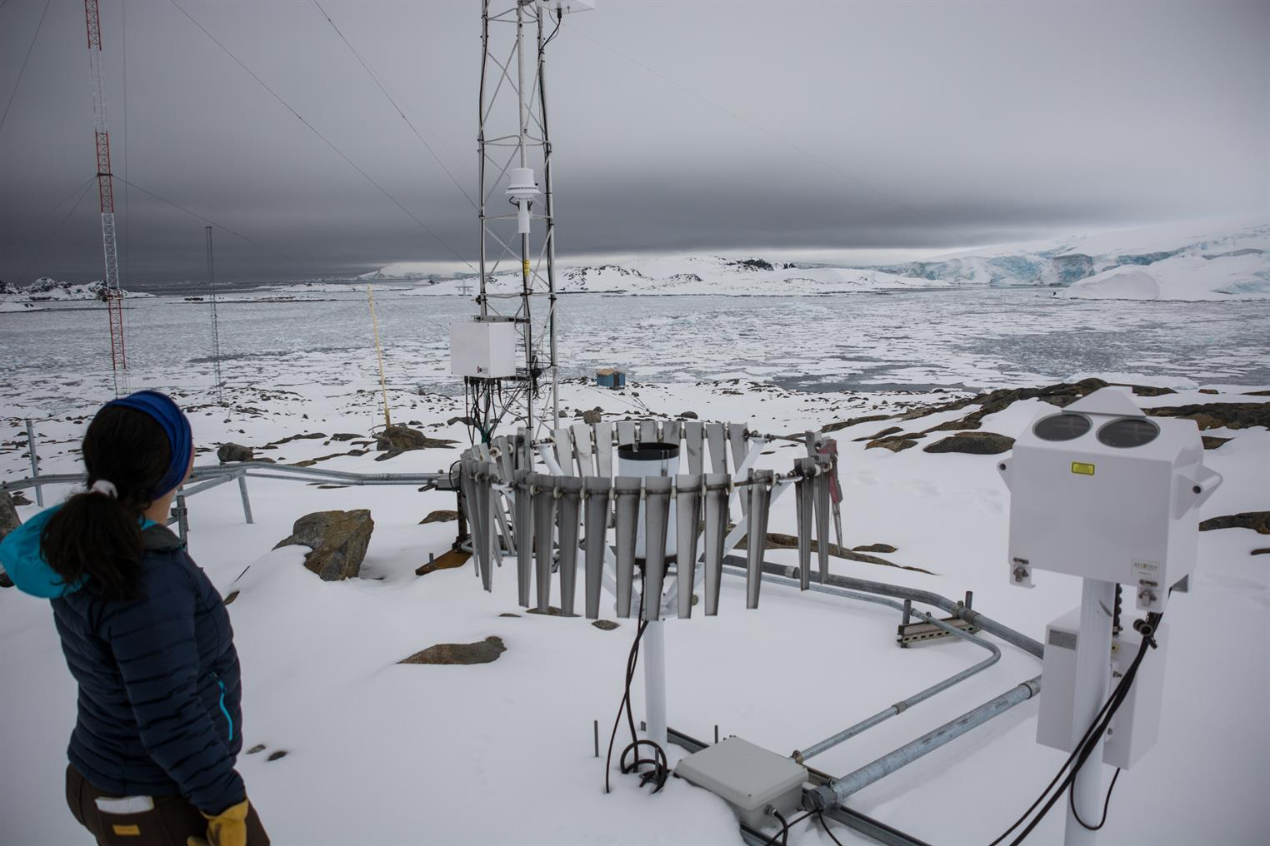
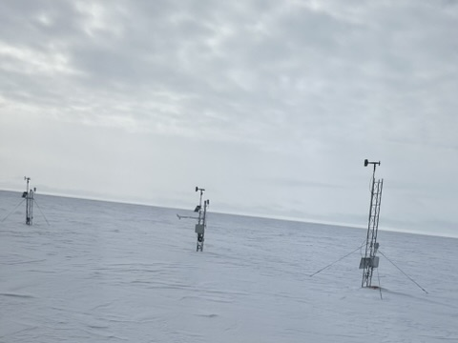
“We’re all in this together!”
What are our needs, as a community?
  More in-situ? More satellite platforms?
  Better communications? Improved data sharing (real-time/archive)?
  Real-time ground based high end remote sensing?
No one can do it alone…
Everyone contributes…
Everyone benefits…
Please contact mattl@ssec.wisc.edu if you have input on our Antarctic community observing needs!
Courtesy of Mike Lucibella
Courtesy of Tyler Plekan

Slide 18
Questions? Thank You!!
Acknowledgements:
The authors appreciate the support of the National Science Foundation under grant numbers 1951720 and 2301362 (UW), and 1951603 (MATC).
Thank you to this community!
Thank you to our hosts for WAMC and ISPS!!
Emilia AWS Courtesy of Tyler Plekan

