Slide 1

Aviation Weather
Precipitation and Weather Radar

Slide 2
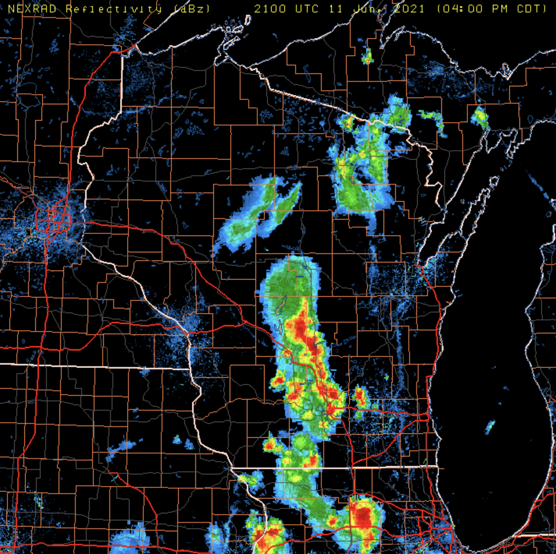
Outline
Precipitation formation methods
Collision and Coalescence
Ice Crystal Process
Weather Radar
How it works
False Returns
Interpretation

Slide 3
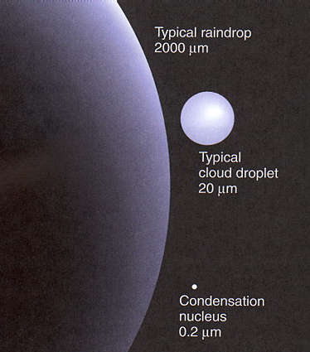
Making Precipitation Method 1: Collision and Coalescence
Notes:
The average cloud droplet is only 20μm, and is easily suspended by slight upward air currents.
Those that do fall evaporate when they get below the cloud base and into drier air.
The condensation process alone is too slow to produce rain drops.
Under ideal conditions it would take condensation several days to produce rain drops!!!
Collision and Coalescence
It takes about one million cloud droplets to make one rain drop!
In order to produce enough collisions to form a rain drop, some cloud droplets must be larger than others.
Cloud droplets can be different sizes due to the different sizes of condensation nuclei.
Or due to turbulent mixing with the drier environment.

Slide 4
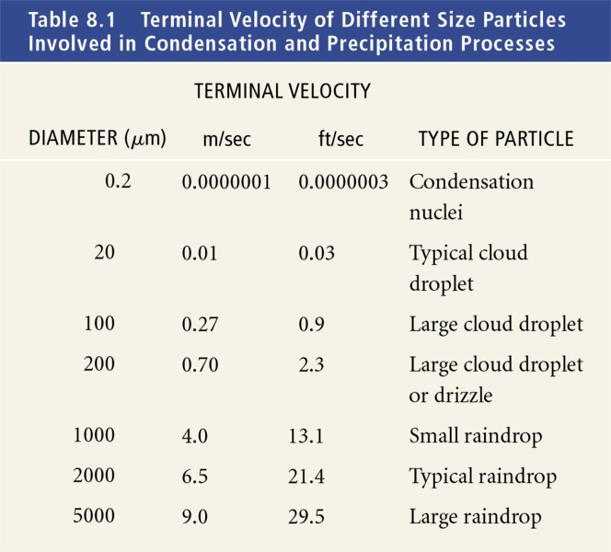
Terminal Velocity
Air Resistance (drag)
Gravity (an acceleration)
The constant speed obtained by falling objects when the upward drag on the object balances the downward force of gravity.

Slide 5
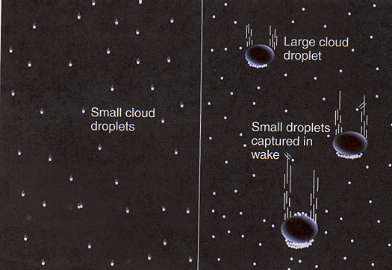
Larger droplets have a smaller surface area to weight ratio…. Huh?
Large droplets must fall faster to reach their terminal velocity.
Large droplets fall faster than small droplets!!!!
As large droplets fall quickly down, they capture smaller droplets in their path.
Notes:
Large drops overtake and collide with smaller drops in their path.
The merging of cloud droplets by collision is called coalescence.
Collision does not always result in coalescence!
Sometimes droplets collide and then bounce off each other rather than merging.
Water has a high surface tension (the force that holds the droplet together).

Slide 6
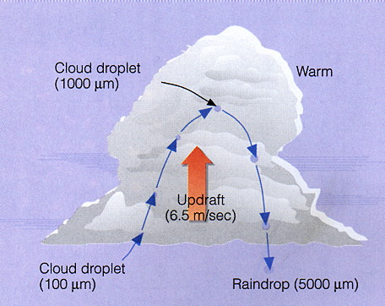
Droplet Growth
The longer a droplet spends in a cloud the bigger it can grow.
Thicker clouds produce larger drops
Strong updrafts in clouds leads to larger drops.

Slide 7
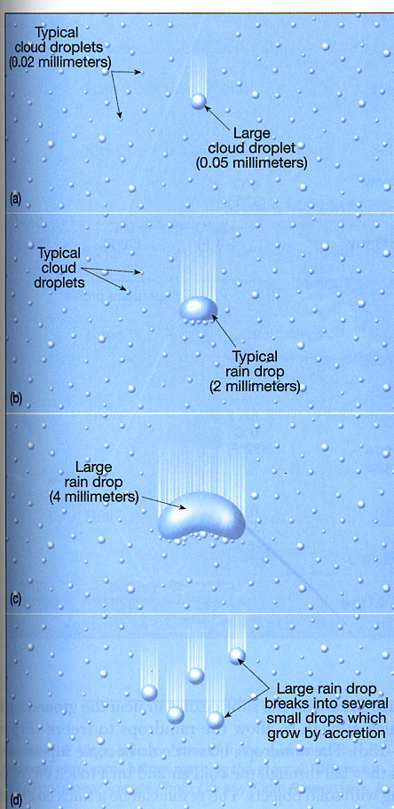
Collision and Coalescence
Acts as the precipitation formation process in warm clouds.
A cloud is considered a “warm cloud” when the cloud is above freezing at all levels.
Rain that falls from warm clouds is sometimes called “warm rain”.
Raindrops reaching the earth’s surface are seldom bigger than 5mm....why?
As the drops fall they continue to collide with other rain drops and break each other apart.

Slide 8
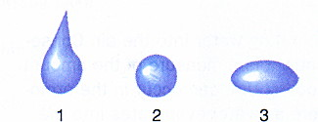
Shape of Rain Drops
Raindrops are not tear drop shaped!
The shape of the drop depends on it’s size.
Rain drops less than 2mm in size are not quite spherical in shape. This is due to the surface tension shaping the drop into the shape with least surface area.
Raindrops greater than 2mm, are elongated, flat on the bottom, and rounded on top. (Like a hamburger bun). This is due to the greatest air pressure being on the bottom of the drop.

Slide 9
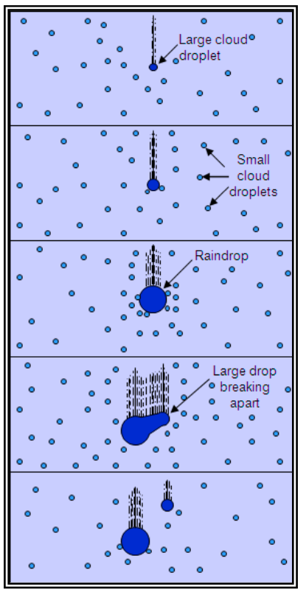
Important Factors in Rain Formation
Most important factor is: liquid water content.
Assuming enough liquid water than the following are also important:
The range of droplet sizes
The cloud thickness
The updrafts of the cloud
The electric charge of the droplets and the electric field in the cloud.

Slide 10
Making Precipitation Method 2: Bergeron Process
Also called the “ice-crystal process” and “Wegener-Bergeron-Findeisen process”
Occurs in cold clouds. (Clouds that get below freezing in temperature.)
Cold clouds will have both liquid water droplets and ice.
Cold clouds may also have supercooled droplets.
Supercooled droplets are at temperatures below freezing, but remain in the liquid form.

Slide 11
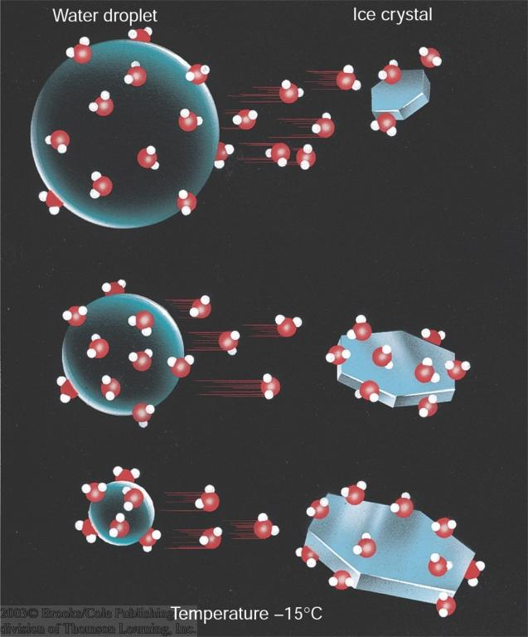
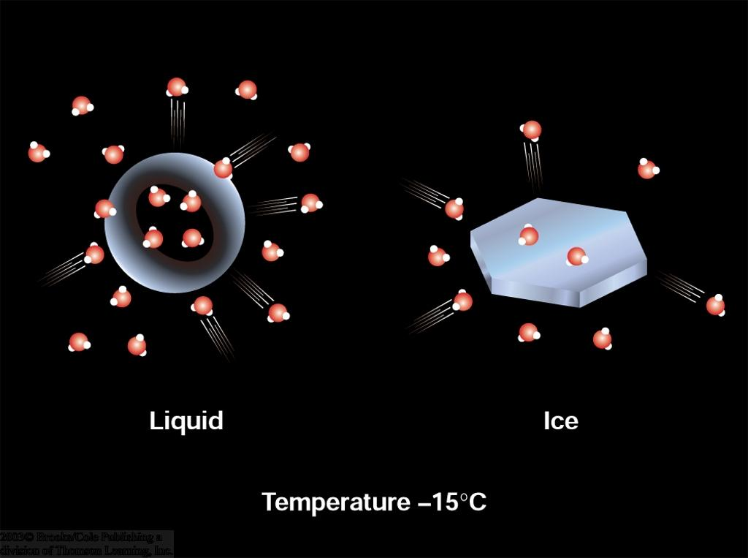
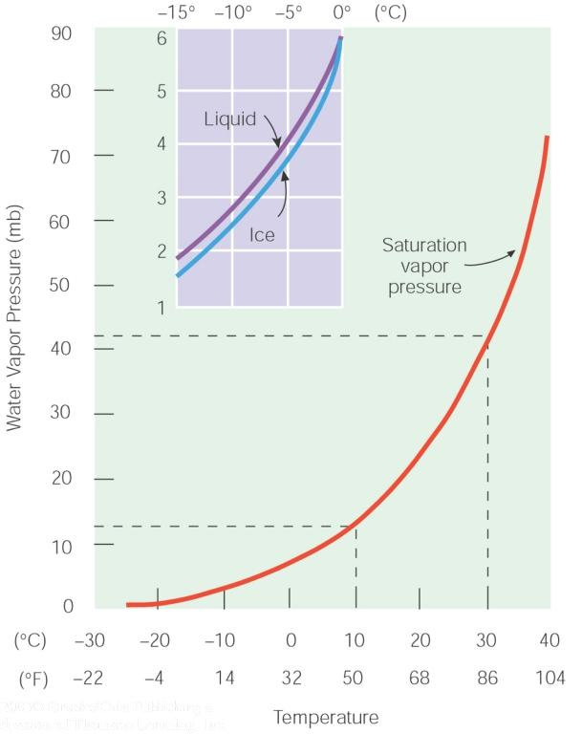
So how do ice crystals grow compared to water droplets?
Ice has a lower saturation vapor pressure than liquid water.
Thus, during the ice-crystal process, ice grows at the expense of the surrounding water droplets.
Water vapor molecules above the water droplet will move toward the ice crystal.
The ice crystals now have a continuous source of water vapor and will quickly grow.
Water droplet is now out of equilibrium and will evaporate.

Slide 12
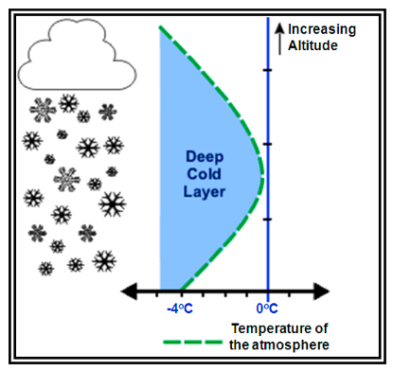
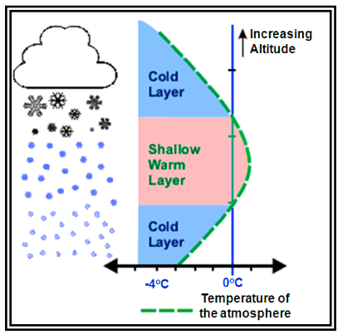
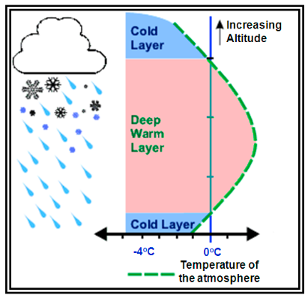
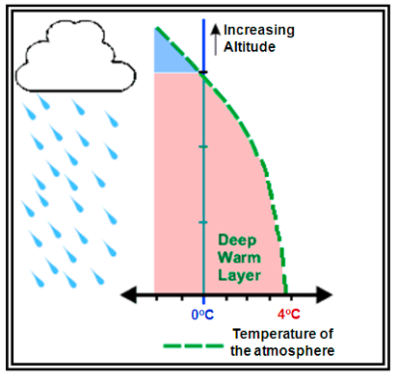
Freezing Rain
Snow
Rain
Sleet – Ice Pellets

Slide 13
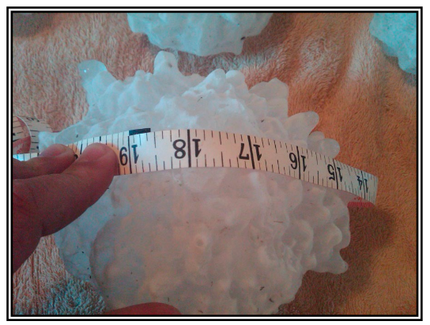
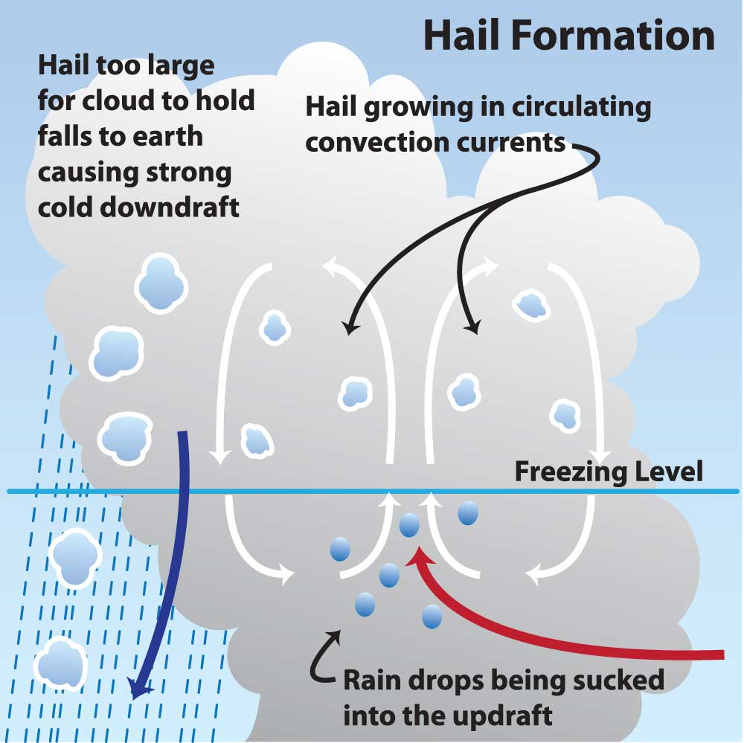
Record Hail:
Vivian South Dakota
23 July 2010
8 inches in diameter
18.625 inches in circumference
1.9375 pounds!

Slide 14
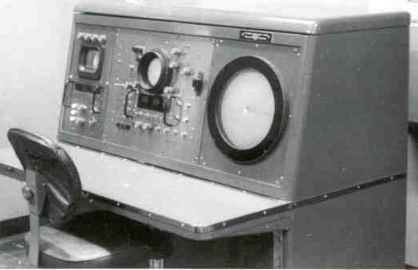
Radar Observations
By-product of World War II
Acronym radar stands for RAdio Detection And Ranging
Radar initially developed to detect other aircraft
Precipitation got in the way of detecting other aircraft
Adopted to civilian use after WWII
Varity of radar systems in 1950s
WSR3 Ft. Wayne, IN
mid-1950s
Notes:
Many countries during WWII were experimenting with radar observations aimed at aircraft and submarine detection, including the U.S. Russia, Japan, Canada,, England, Germany.
Research was done at a variety of radar warvelengths.
WSR = Weather Surveillance Radar

Slide 15
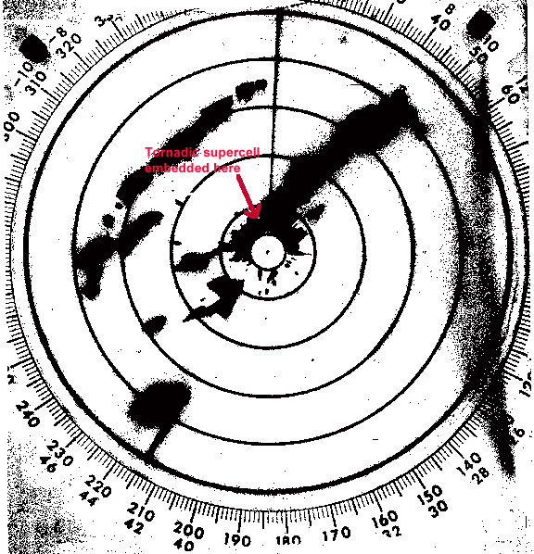
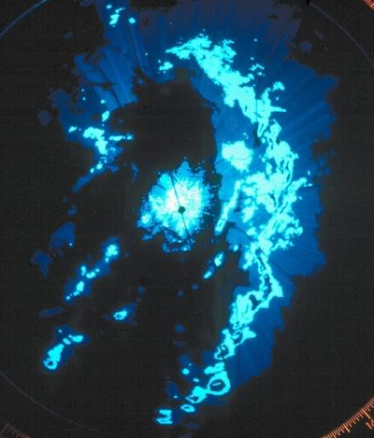
Radar Observations
Technology advances in the 1950s and 1960s resulted in improved radar imagery.
Initially, just location and movement of precipitation, then intensity became available.
Notes:
Image was fairly accurate for position/placement of precipitation, but lacked resolution and no velocity data available.

Slide 16
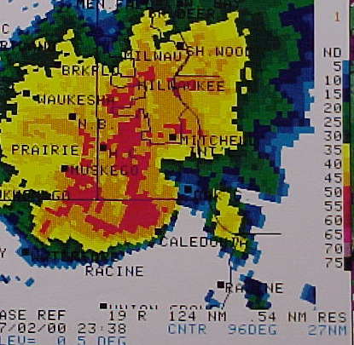
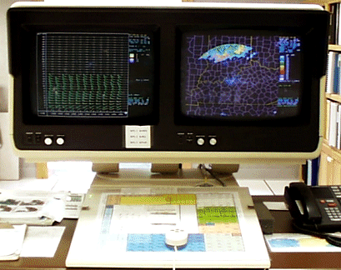
Radar Observations
From 1990 to 1997, NWS upgraded to WSR 88-D Doppler radar system.
Greater resolution, velocity information, rainfall estimates.
WFO Milwaukee/Sullivan upgraded Oct 1993.
Notes:
122 WFOs upgraded. Additional 38 military sites upgraded.
In 1842 (172 years ago) an Austrian physicist, Christian Doppler, proposed in a paper that the “Doppler effect” is a change in frequency of a wave for an observer moving relative to its source.

Slide 17
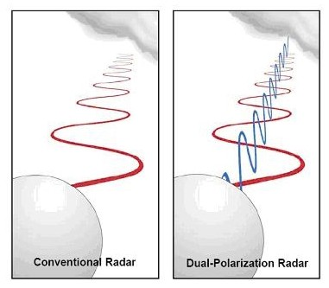
Radar Observations
Radar energy is a form of electro-magnetic energy…consisting of electric and magnetic fields.
Weather radars typically transmit/receive in a single electric field (single polarization – usually horizontal).
Radar pulses – 1000 per second (Pulse Repetition Frequency).
Part of signal reflects off of targets (reflectivity) & returns to radar site.
Signal can be attenuated by heavy rains, leaving less energy to reflect off of targets downstream (under-estimate of intensity & rainfall).
Form of remote sensing
Basic radar – provides location/intensity/movement of precipitation
Doppler radar – provides…
Better resolution and intensity gradients
Velocity and movement of targets
Rough rainfall estimates
Dual-Polarization radar – additional benefits…
Resolution of precipitation types
Better rainfall estimates (removal of hail contamination)
Better detection of non-meteorological targets (tornado debris, smoke, birds)
Notes:
Radar is a form of remote sensing such as thermometers, satellites, cat-scans, ultra-sound scans, x-rays, etc.

Slide 18
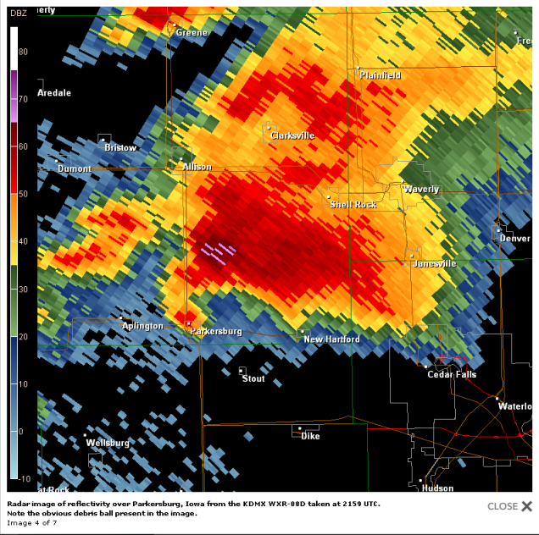
Radar Observations
Part of the radar pulse is reflected from a target back to the radar site – reflectivity.
The amount of reflected energy is directly proportional to the size and density (concentration) of the targets.
Large, round targets (hail) are ideal reflectors compared to snow or rain drops.
A high density or concentration of small to medium size targets can reflect as much radar energy as just a few, but large targets.
Notes:
Pink-colored area in image most likely large hail.

Slide 19

Reflectivity (dBz)
Reflectivity imagery has a variety of colors depicted.
Colors represent variations in the intensity (power) of reflected radar energy.
Intensity variations are plotted on a scale in terms of decibels (dBz)…pronounced d-b-z.
Two operational modes
Precipitation
Mode
Clear Air
Mode
Notes:
Two Clear Air Mode exist and operate under the strategy of five elevations scans (the lowest five) in 10 minutes.
There are seven strategies for precipitation mode. They vary from the lowest 9 elevations to all fourteen elevations in 4 to 6 minutes.
Typically, the warning meteorologist will work the radar harder during severe weather and want imagery from all fourteen elevation slices every 4 minutes.

Slide 20
What is Detected by Doppler Radar?
Boundaries (lake-breeze, cold front)
Cloud streets
Insect swarms
Smoke plumes
Cloud bases and tops
Bird migrations
Sunrise/sunset “spikes”
Vehicle convoy movement on freeways
Chaff (military counter-measure)
Rain
Snow
Hail
Tornado debris
Circulations which suggest tornado
Powerful thunderstorm winds
Clear-Air
Mode
Precipitation
Mode
Notes:
A lower receiver noise level (better hardware) and the higher peak power allow the WSR-88D system to detect more than just precipitation.
Clear-Air mode is better in detecting the first 8 items above while precipitation mode is better in detecting the last 6 items. However, the first 8 items above can be detected in precipitation mode if the reflected signal is appreciable.

Slide 21
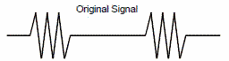
Doppler Radar
Peak power = 750 Kw (kilo-watt)
Signal wavelength = 10.0 to 11.1 cm
Pulse Repetition Frequency = 318 to 1304 per second
Depending on scan strategy, anywhere from 15 to 70 pulses “sample” a given area.
Beamwidth = 0.88 to 0.96 degrees (angular)
In 1 hour of operation, it transmits only 5.7 seconds. So it listens 99.843% of the time for reflected energy!
dBz is converted to a rainfall rate of millimeters per hour (or inches per hour).
Rain usually reaches the ground at about 15 to 20 dBz.
dBz values above 55 usually indicate hail is present.
Notes:
Most other commercial radars have peak power of 250 to 500 Kw and their signal wavelength is 5 to 8 cm, and their beamwidth is 1.4 to 2 degrees. Consequently, these other radars don’t have the same resolution and ability to detect precipitation or other targets as well as the NWS’s WSR-88D Doppler radar system.

Slide 22
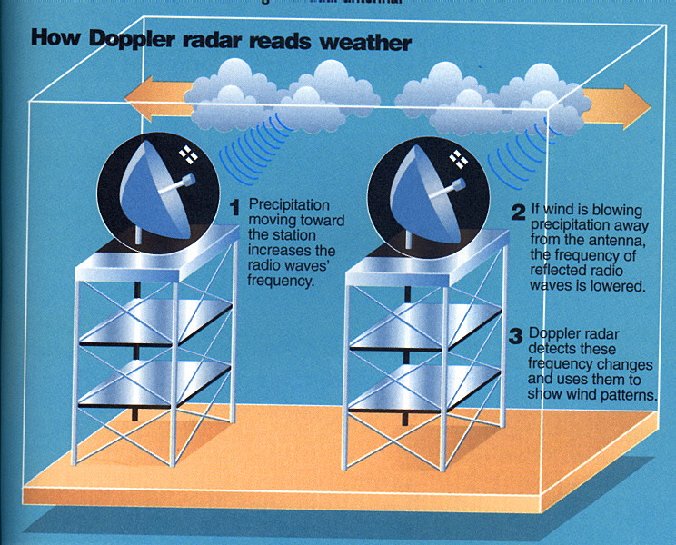
Doppler Radar
Notes:
Uses the principle of doppler shift to determine the speed of falling rain drops and other targets.
What is the doppler shift effect?
Think about how a train horn changes pitch as it moves towards you.
Targets moving toward the radar are painted with green colors. Targets moving away from the radar are painted with red colors.

Slide 23
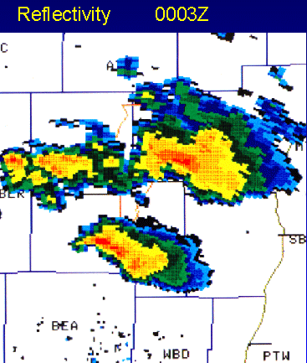
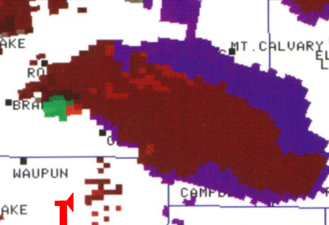
Doppler Radar
Storm Relative Motion
Base Reflectivity (0.5 degree slice/tilt)
Notes:
Doppler radar provided better resolution of intensity of rainfall and also the internal motions within storms, called Storm Relative Motion (velocity).
Targets moving away from radar site (toward bottom of this slide) are painted as red. Targets moving toward the radar site are painted green.
Two small, bright green-red patches adjacent to each other are called a “velocity couplet.” This couplet represents the so-called “mesocyclone” signature within the rotating updraft of a potentially tornadic thunderstorm.

Slide 24
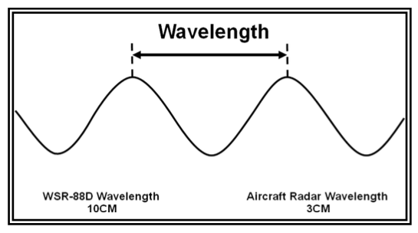
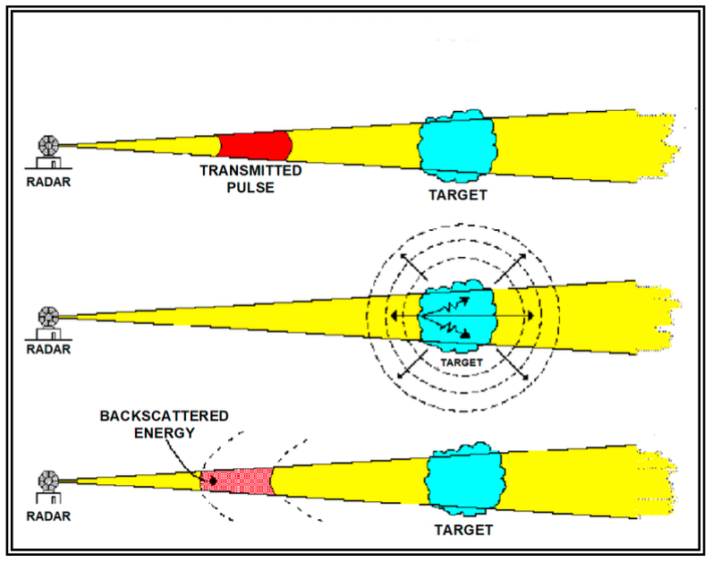
How does it work??

Slide 25
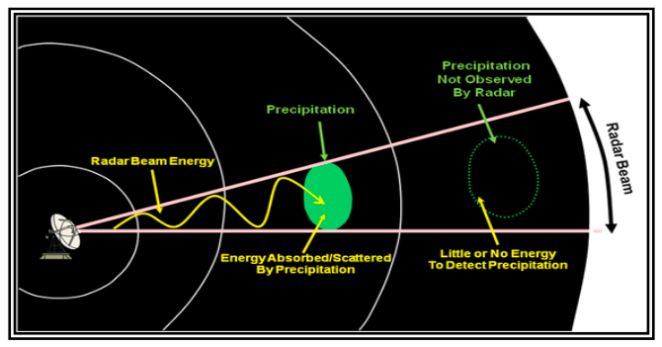

Slide 26
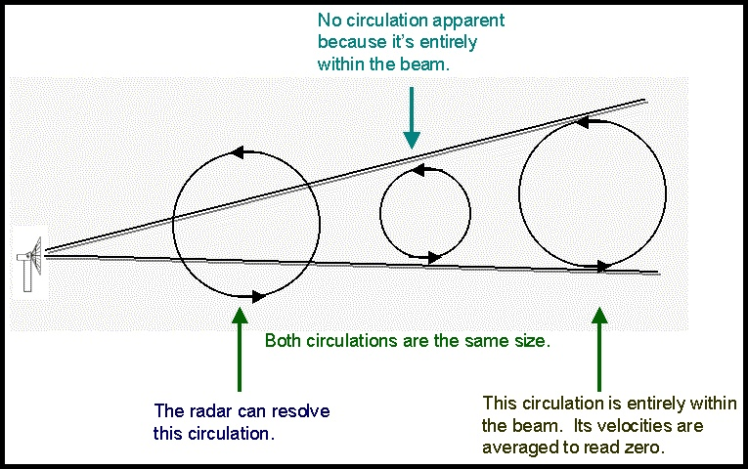

Slide 27
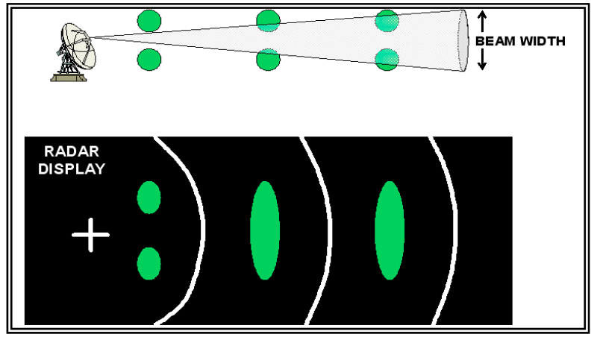

Slide 28
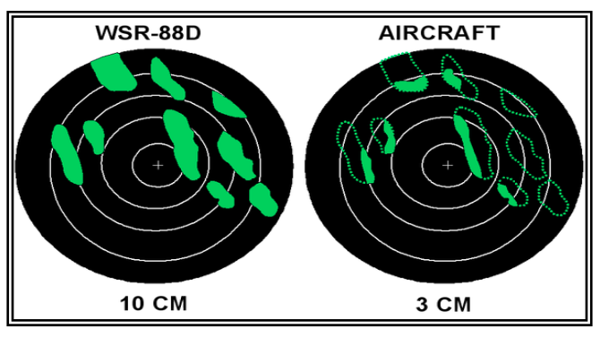

Slide 29
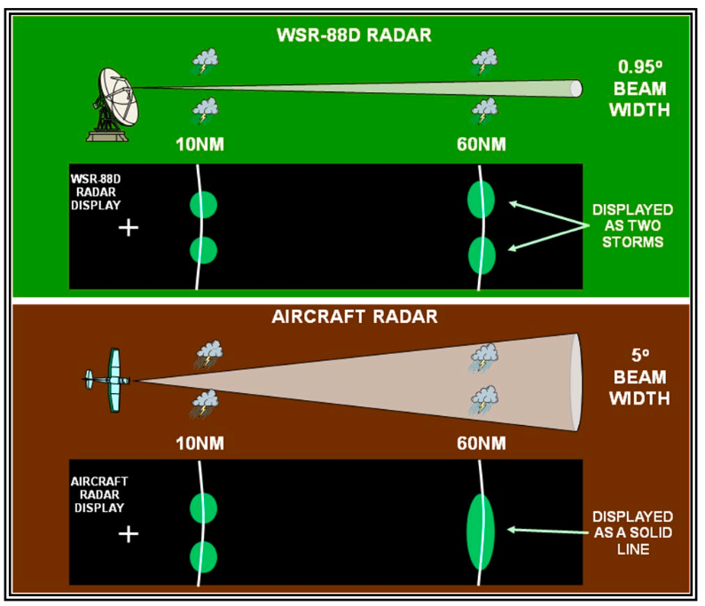

Slide 30
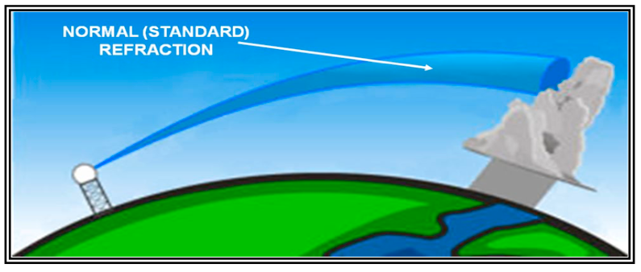
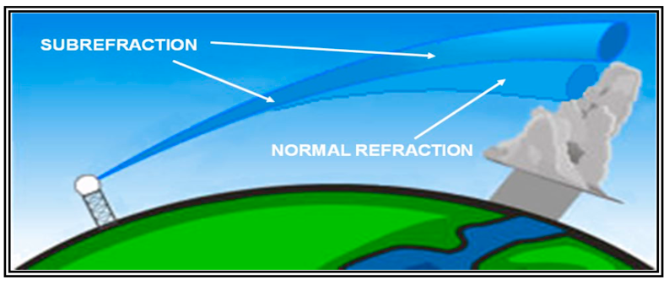
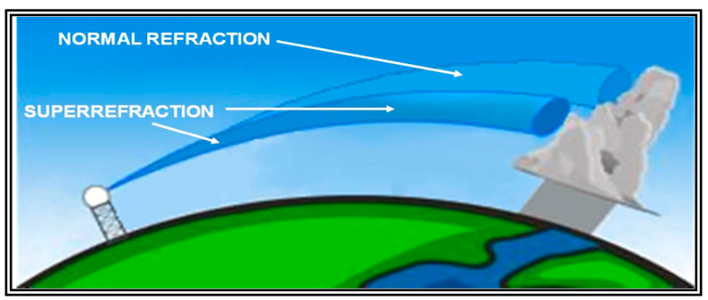
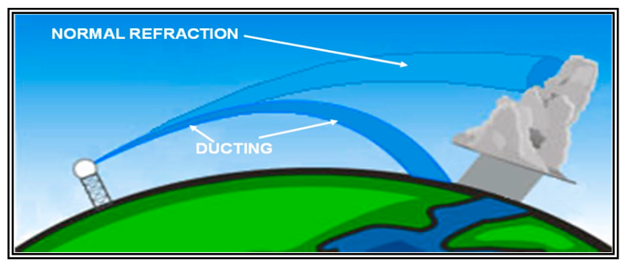
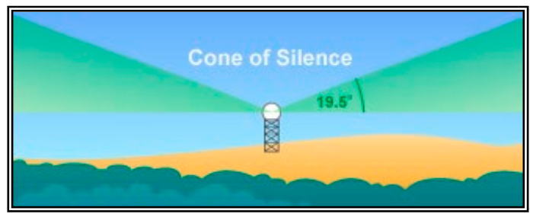

Slide 31
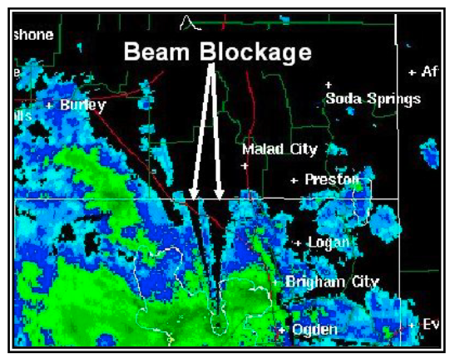
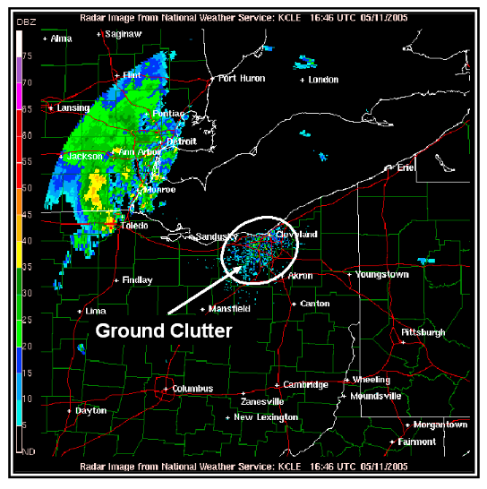

Slide 32
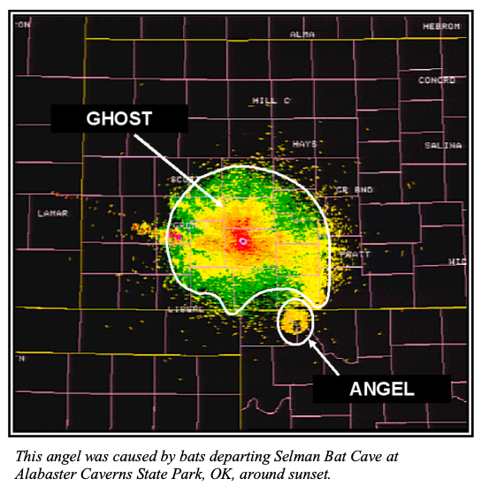
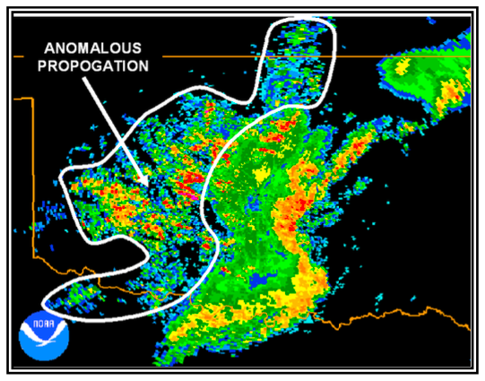
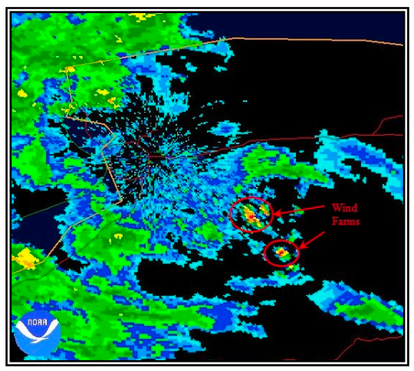

Slide 33
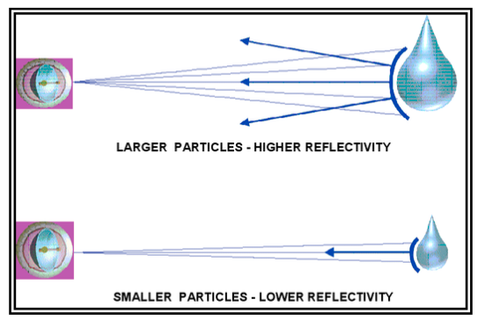
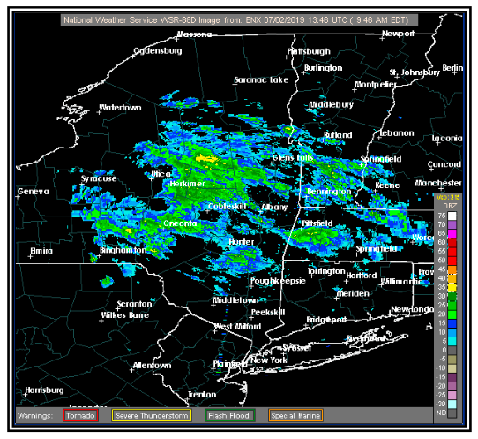
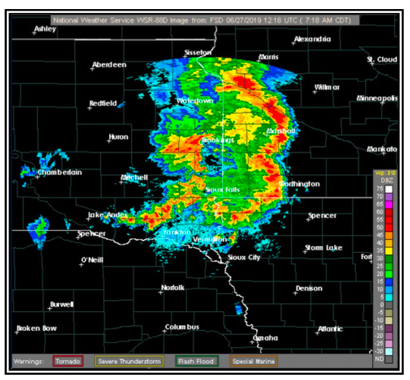

Slide 34
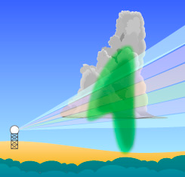
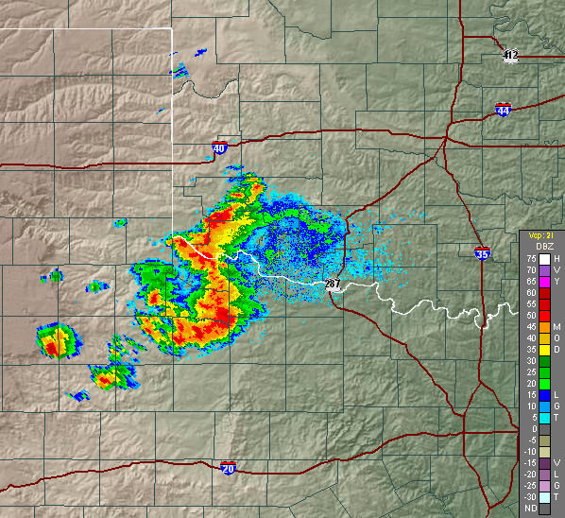

Base Versus Composite Reflectivity
Base Reflectivity
Composite
Notes:
A quick look at both the base reflectivity and composite image will tell you if the storm is “holding” more rain and/or hail aloft. Eventually what goes up must come down!

Slide 35
Extra Slides

Slide 36
Range Folding
In Base Velocity & Storm Relative Velocity images.
Purple color: “Range Folding”
Radar system has difficulty determining velocity information due to interference from targets at a greater distance.
Notes:
Radar computer system unable to properly determine velocity values in purple-colored areas due to range-folding. Range-folding occurs when a radar pulse reflects off a target at a greater distance and is unable to return to the radar site before the next pulse is transmitted. Or there may be nearby and distant targets with both sending reflected energy. Radar computer can’t tell if reflected energy is coming from a near-by target or a distant target.

Slide 37

Radar Image - Hurricane

Slide 38

Radar Image – Wind Turbine Farms
Note the “echo” does not move. There are no clouds or precipitation in the area.
The bottom of the radar beam intersects with the top of the moving turbine blades.
Notes:
The bottom of the beam of the lowest radar slice (1/2 degree) senses the top of the wind turbine blades. Wind turbines are found on hills or ridges.

Slide 39

Radar Image – Bird Flocks
Notes:
Flocks of birds leaving lakes/marshes. November 23, 2012.

Slide 40

Chaff – Military Countermeasure
Highly reflective material like aluminum which floats slowly downward
Released by military planes in order to confuse enemy and make it more difficult to detect your planes
Notes:
View of chaff released by military planes. The wind then takes the chaff downstream.

Slide 41

Radar Image – Sunset Spike
Interference between Sun’s energy with Doppler signal
when Sun near horizon (near sunrise or sunset)
Notes:
When the sun sets there is a brief time when the sun’s radiation beam points directly at the dish of the NWS’s Doppler radar system. This results in an interference at those wavelengths around 10 to 11 cm. Remember, the sun emits radiation at many different wavelengths. We see only the visible light which has wavelengths of 0.4 to 0.7 microns, much smaller than a wavelength of 10 to 11 cm.

Slide 42

Radar Image – Smoke Plume
Note: any moving “target” on radar is being moved/pushed by the wind.
Notes:
Smoke plume drifting northeast on southwest low-level winds. March 10, 2012.

Slide 43

Anomalous Propagation (AP)
AP refers to false echoes due to trapped radar signal during temperature inversions.
“Super-refraction”
The area circled in red is anomalous propagation. The area circled in green is a tornadic thunderstorm.
AP does not move but disappears when inversion falls apart.

Slide 44

Convective Rolls – Cloud Streets
Rising Air
Ground
Clear–Air Mode
Notes:
Low-level heating at or near the ground results in rising air. By compensation, there has to be returning, sinking air. These convective rolls line up in rows which are parallel to the prevailing low-level winds, or in streets.

Slide 45


Low-level Boundaries
Notes:
Temperature and humidity contrasts in the air on either side of a lake-breeze front shows up as a thin blue-colored line on radar. This boundary pushes inland due to daytime heating ahead of it. Essentially lake breezes are a dry mini-cold-front.
The animation image shows a lake-breeze pushing west while a dry cold front drops south through Wisconsin. An accumulation of dust, pollen, and insects was concentated in the boundaries resulting in higher reflectivity returns (narrow band of yellow reflectivity values).

Slide 46

Sept 2, 2011 Appleton Wind Storm
Base Reflectivity Base Velocity
Notes:
Red circle indicates powerful thunderstorm winds in excess of 60 mph moving through Appleton area. Green-blue colors are in-bound winds moving toward the Green Bay radar site.

Slide 47

May 30, 2001 Texas Storm
Note thunderstorm outflow boundaries –
…thin green
or blue lines
Notes:
Thunderstorms “exhale” rain, hail, and rain-cooled air in the form of strong, gusty winds. All of this is called “outflow.” The leading edge of the “outflow” is depicted by thin green or blue lines. Essentially, you’re looking at small cold fronts generated by rain-cooled air. Some of the rain in storms evaporates before it reaches the ground and becomes heavier. Gravity then accelerates the rain-cooled air down to the earth’s surface in the form of gusty winds.
You can see the wind direction and speed change (in the station model plot) after an outflow boundary moves through a given area.

Slide 48

Tornadic Thunderstorm
Storm-scale rotation
High reflectivity
Hook echo
(debris ball at end?)
Notes:
Hook echo guarantees rotation within the storm, but doesn’t guarantee a tornado is present. Some researchers suggest only about 10% of radar-detected meso-cyclones are related to a tornado.

Slide 49

May 20, 2013 Moore Tornado
Base Reflectivity

Slide 50

May 20, 2013 Moore Tornado
Storm Relative Velocity

Slide 51


Slide 52

June 21, 2010 EF2 Eagle WI Tornado
Base Reflectivity Storm Relative Velocity

Slide 53



Dec 19-20, 2012 Winter Storm
Notes:
Impressive snow totals of 15 to 20 inches in Dane County. Surface wind direction in Madison area during worst of storm was northeast. However, radar imagery showed precipitation was moving from southwest to northeast, or 180 degrees out of phase with surface wind direction. Is there a disconnect here? Is there a problem? Shouldn’t the precipitation be coming from the northeast since the surface winds are from the northeast? What do we know about the vertical wind structure in the vicinity of the storm?

Slide 54

Dual-Polarization Overview
Radar pulse transmits both horizontal and vertical components – can determine shape and orientation of target.
Better rainfall estimates since hail contamination is removed.
Precipitation types are determined by algorithms. Not perfect!
Can’t predict tornado ahead of time!
Can confirm likelihood of tornado (debris ball).

Slide 55

Dual-Polarization Precipitation Types
Notes:
Image above is available in each elevation slice. Can be composited into a vertical cross-section, which is shown in Aukerman/Knox’s Meteorology text book..

Slide 56


Precipitation Types
10 “target” classifications
3 additional classifications: no data, unknown, and range-folding
Notes:
There are 10 distinct “target” classifications, ranging from biological (birds, insects) to hail. Additionally, there are 3 other classifications – no data plotted, unknown, and range-folding. The red color represents hail, or in some cases, rain-coated hail.

Slide 57

Dual-Polarization Rainfall Estimate
Dual-Polarization Old Doppler Legacy
Notes:
Hail contamination in the old legacy product lead to an over-estimate of rainfall amounts. Mathematically is can be removed, at least partially, Hailstones are a good reflector due to their size.

