Slide 1









Connecting Antarctic Observations to the World!
Naoyuki Kurita¹
Ella Gilbert², Irina Gorodetskaya³, Linda Keller⁴, Matthew Lazzara^{4,5,*}, Michelle Maclennan², David Mikolajczyk, Taylor Norton⁴, Lee Welhouse⁴, Jonathan Wille⁶, Xun (Jerry) Zou⁷, Sibin Simon⁸, and Xichen Li⁹
1 Nagoya University, Nagoya, Japan
2 British Antarctic Survey, Cambridge, UK
3 CIIMAR, University of Porto, Matosinhos, Portugal
4 University of Wisconsin-Madison, Madison, WI, USA
5 Madison Area Technical College, Madison, WI, USA
^{6 ETH Zurich, Switzerland}
7 Scripps Institute of Oceanography, San Diego, CA, USA
8 Laboratory for Climate and Environmental Sciences, Paris-Saclay, France
9 Peking University, Bejing, China
* Matthew sends his regrets….
BACO-25 Assembly - JCMP08
Notes:
Thank you for this invited talk! Matthew sends his regrets in not being able to be here. All of the coauthors have contributed to this presentation about Antarctic observations and their connection to research

Slide 2
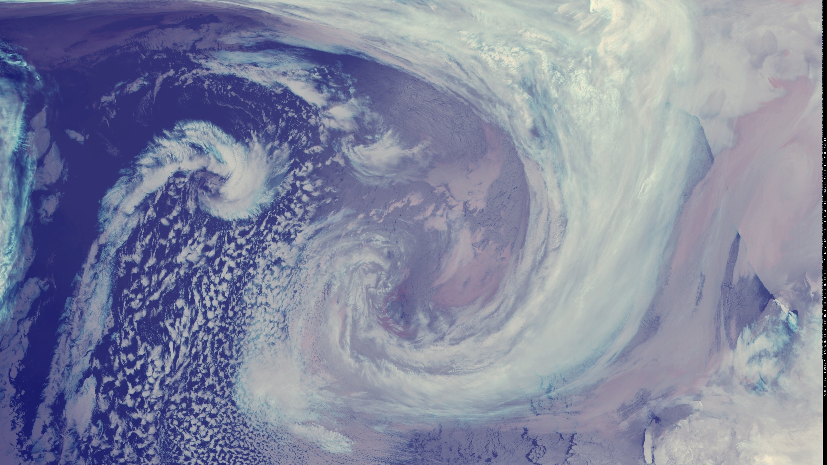
Outline
Status Report – The state of Antarctic Meteorological Observing Systems:
  Antarctic Automatic Weather Stations Network
  Satellite observing systems
  Other meteorological observing networks…
Sample Research Review
  Atmospheric River Events
    Antarctic Peninsula
    East Antarctica
  Teleconnections between the tropics and Antarctic
    ENSO and Rossby wave propagation
  Warming Events
    2022 East Antarctic Event
Notes:
This talk is in two parts: 1. A status report to the community on the observing of the Antarctic from a meteorology point of view. 2. A sample of the research that utilizes observations…a review…examples.

Slide 3
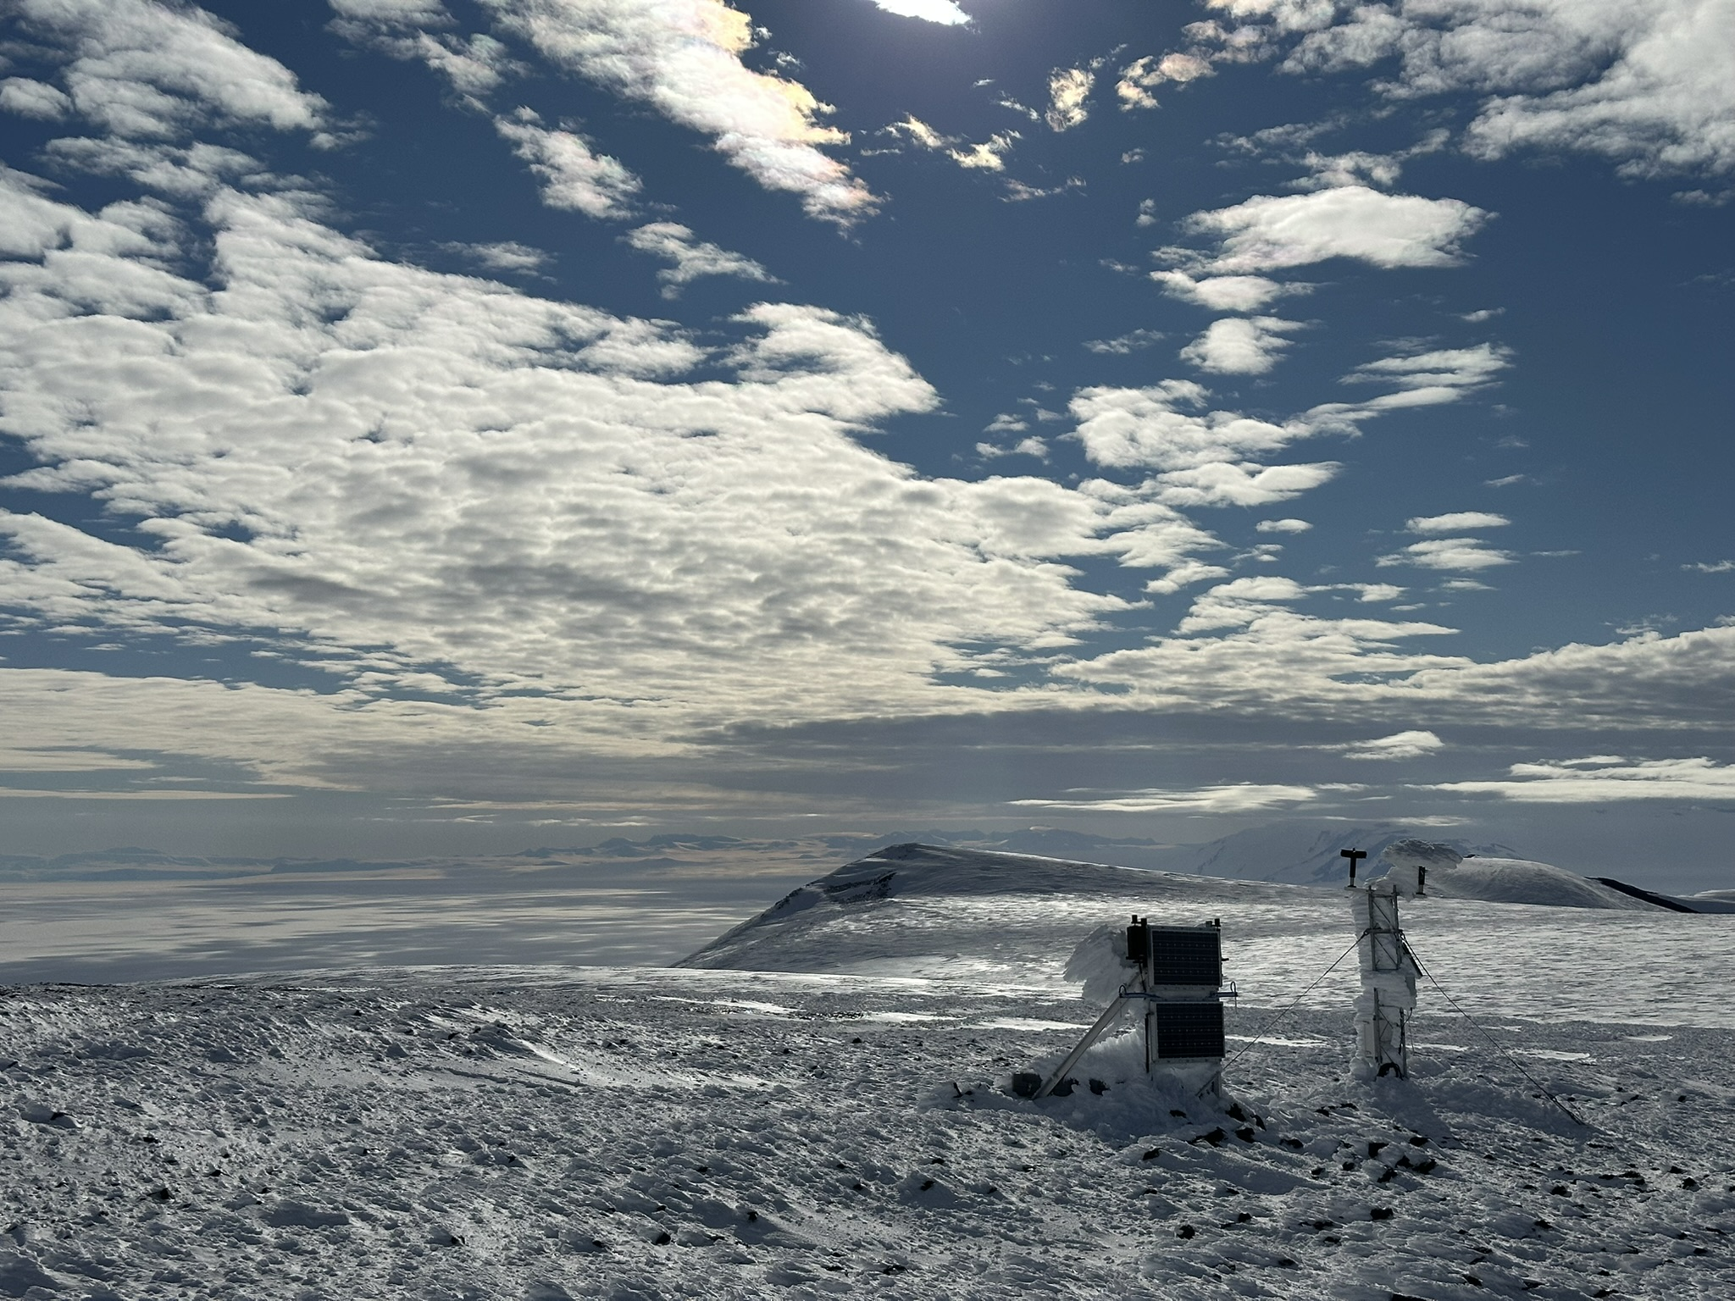
Antarctic Observations
A status report to the community
Notes:
And we must show off nice photos of Antarctica and observing systems!

Slide 4
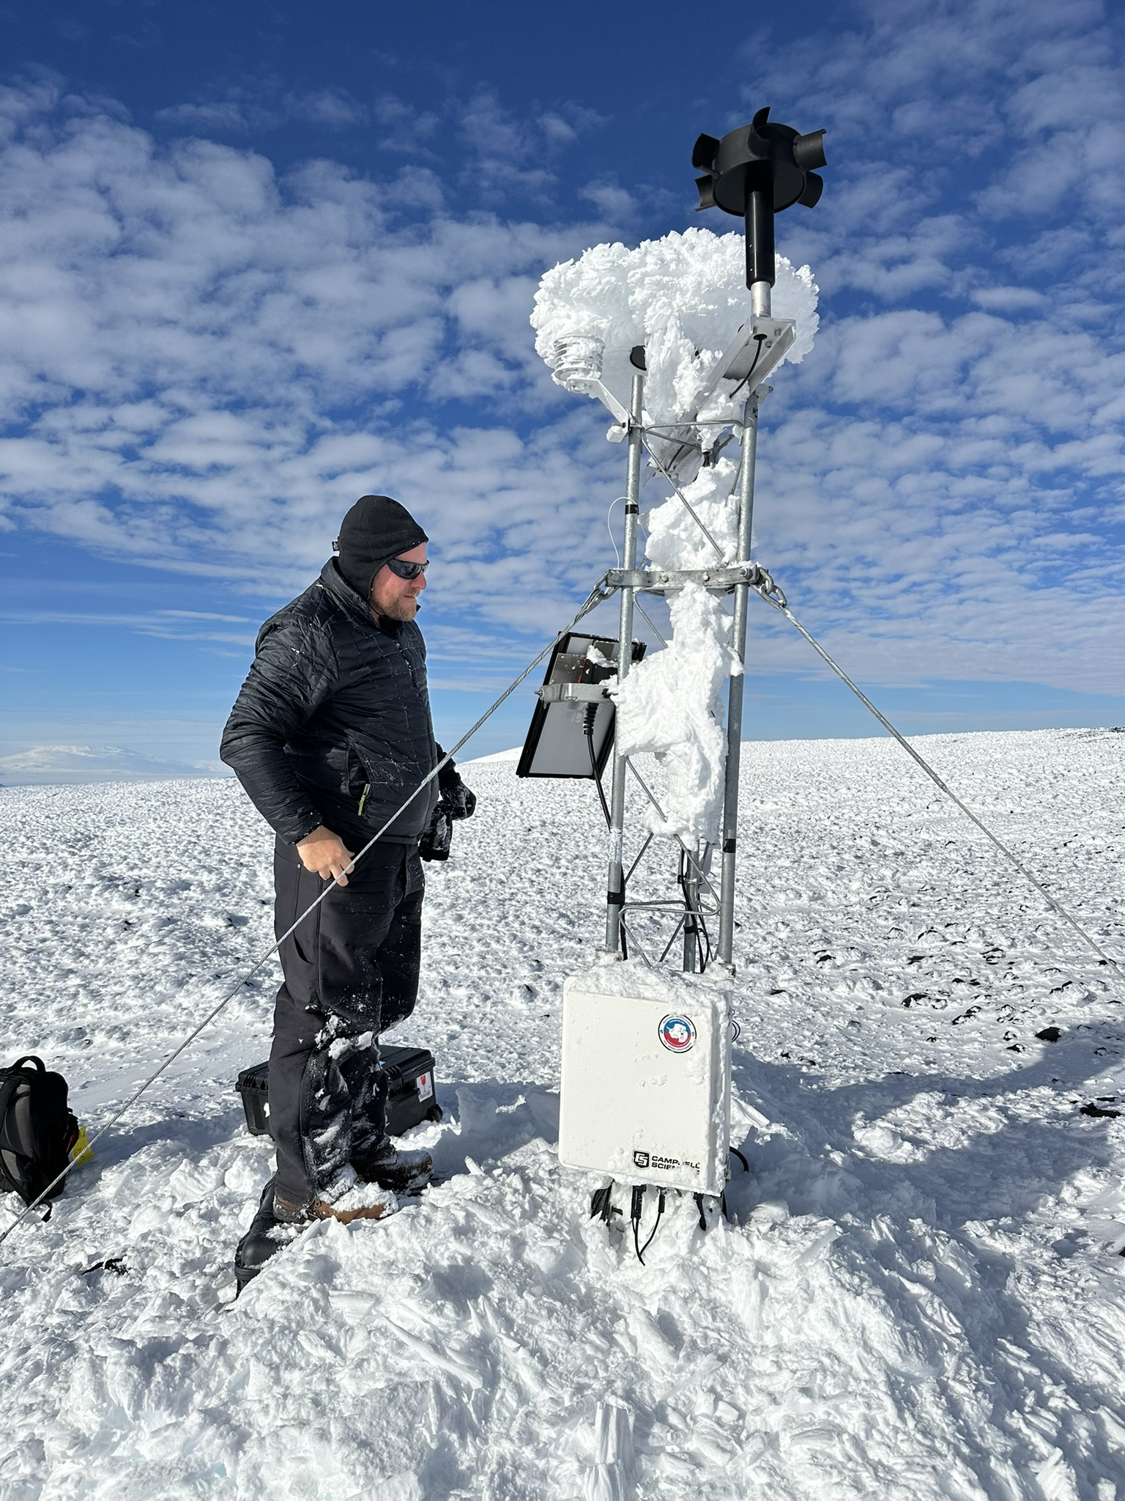
Automatic Weather Stations AWS
The Antarctic AWS network news:
  New AWS stations from China and Chile in recent years
  Decline in operating AWS stations from USA and Netherlands
  Overall stability across the continent for providing the bulk of surface observing
Some Challenges:
  Recovering from lack of field work during the pandemic
  A problem for the Wisconsin network – real-time (see next slide)
  Issues with visiting sites in West Antarctica and deep East Antarctica
Some Successes:
  AWS accepted in the community for climate analysis
  AWS are operationally essential for direct use and numerical weather prediction
Please check out the map on the next slide – sent updates, corrections to: Matthew Lazzara mattl@ssec.wisc.edu
Minna Bluff AWS
Courtesy of
Tyler Plekan
Notes:
Here’s our status – The Antarctic AWS network has some growth from some nations like China and Chile….and some declines from USA and the Dutch. While the network is thus over all the same, we as a world are not growing our observing network. Ruth Mottrm has noted at a WMO function last year – we need more AWS. AWS are an accepted platform for everything and they are getting used – forecasting direct NWP, etc.

Slide 5
Automatic Weather Station Map…
Please send updates to:
Matthew Lazzara
mattl@ssec.wisc.edu
Notes:
This is the known network for all AWS in Antarctica. What is missing? What is incorrect? What should be removed? Please contact Matthew so we can get this updated!

Slide 6
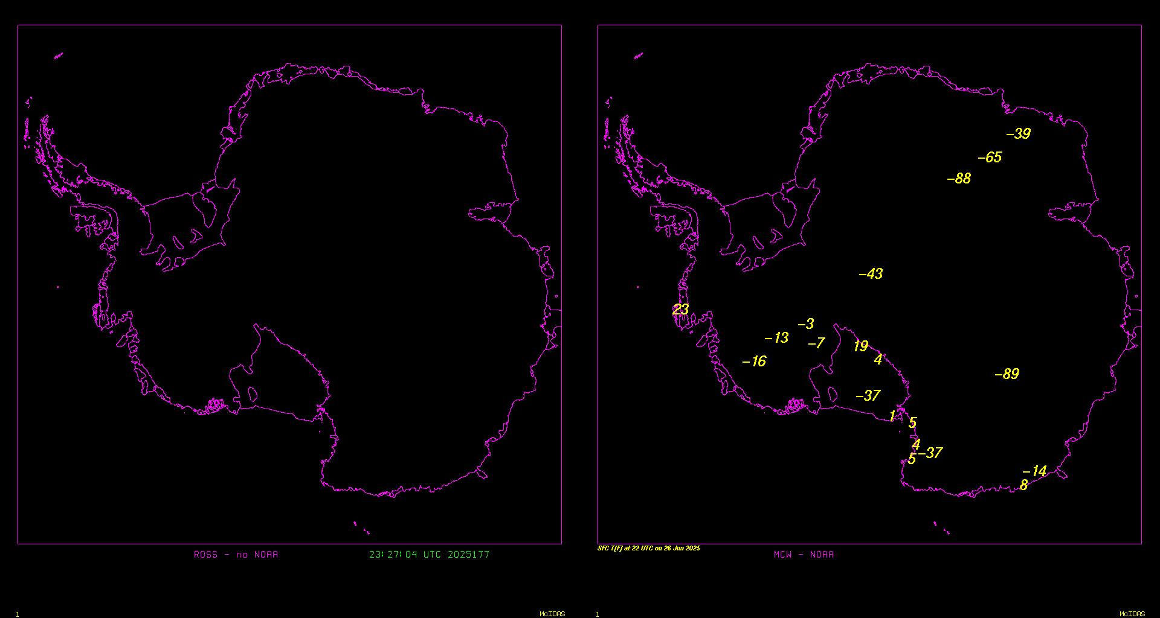
No NOAA Argos/DCS Data vs. NOAA Argos/DCS Data
Notes:
One issue is the sunset of older NOAA satellites carrying the Argos DCS data relay. We are now seeing less data at times….and most delays of availability. (gaps 3 to 5 hours….mostly 3 hours)

Slide 7
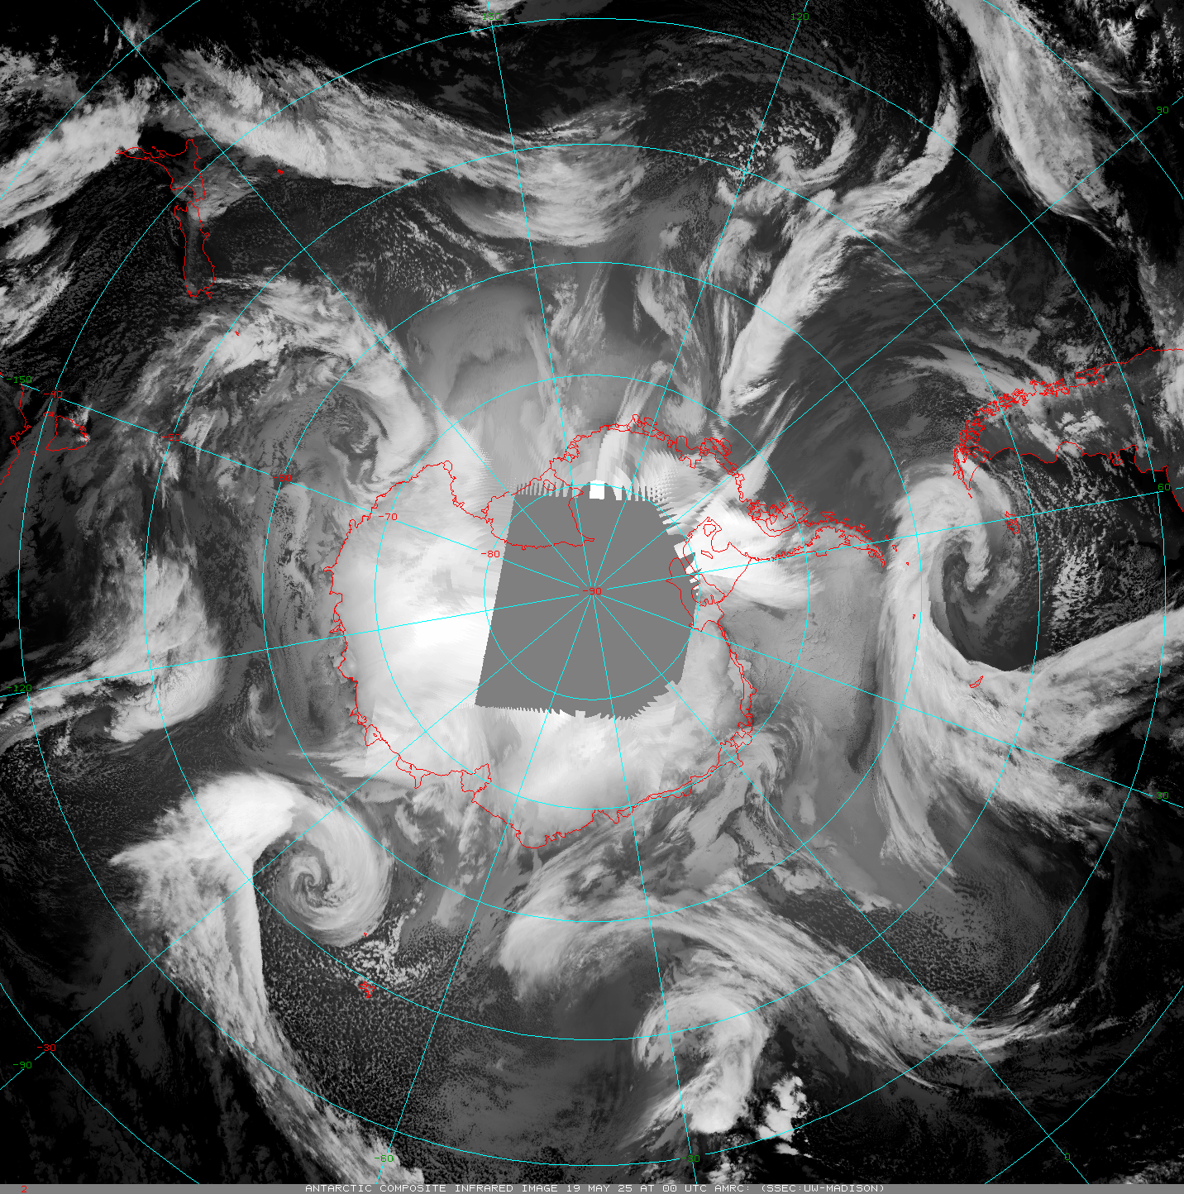
Satellites
Polar Satellites
Satellite Composites
USA
  Old NOAAs (-15 and -19)
    Sunset this summer (-18 is already off)
  Old DMSP
    Sunset in 2026
    SSMIS – global processing sunset already
  NASA – beyond end of life
    Aqua
    Terra – Direct Broadcast offline
    May sunset as soon as 9/1/2025
  S-NPP a backup satellite (end soon 2026)
  Current: NOAA-20, NOAA-21
  Coming soon: JPSS-3, JPSS-4
EUMETSAT
  Current: Metop-B and Metop-C
  Coming soon: Metop-SG
China - FY- Series
Russia - Meteor- Series
Others…
A Sample Animation - Wisconsin Composites:
Other composites made by Russia and China…
https://space.oscar.wmo.int/satellitestatuses/status
Notes:
Old satellite series are being shutdown…

Slide 8
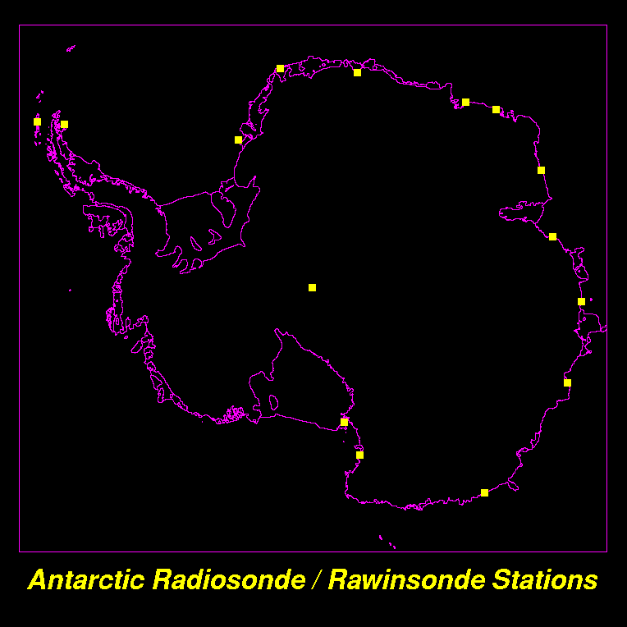
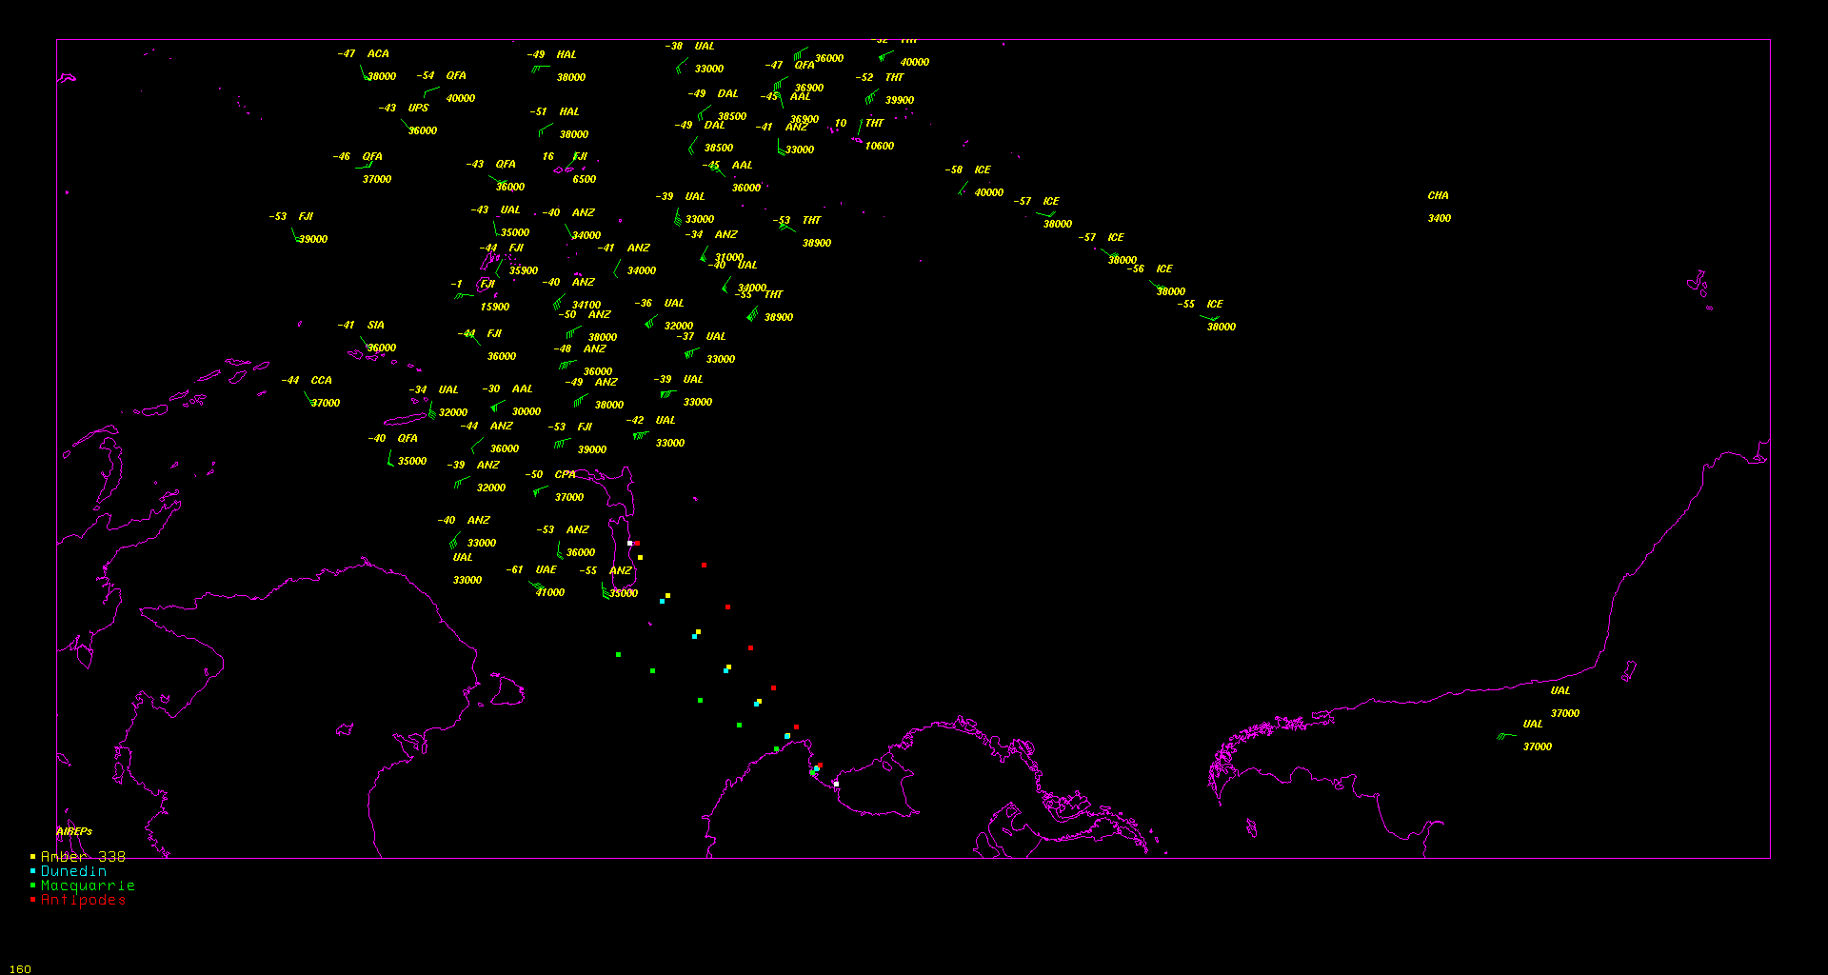
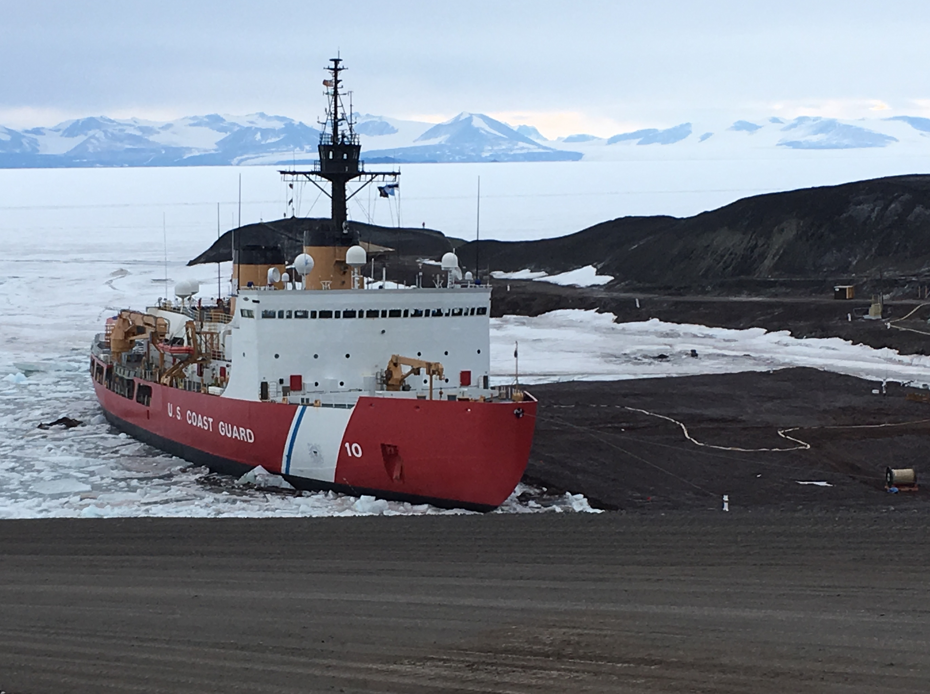
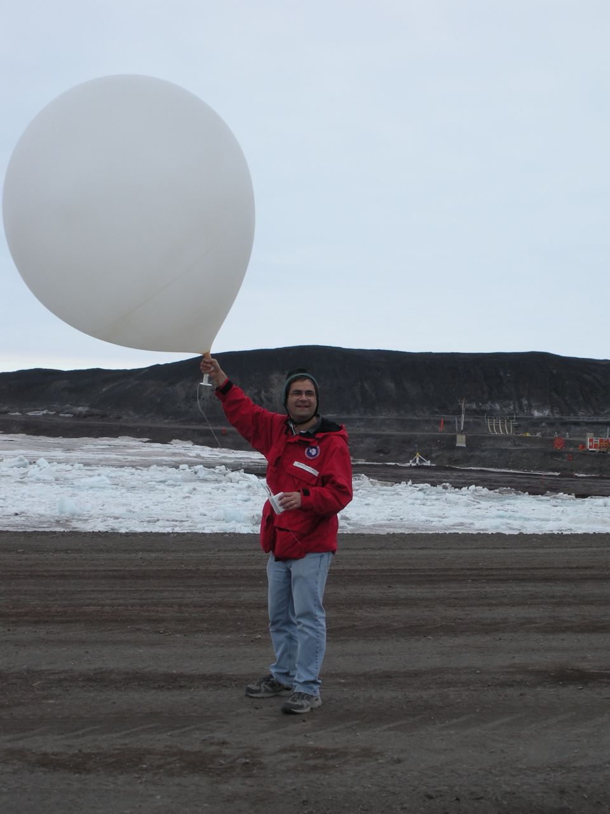
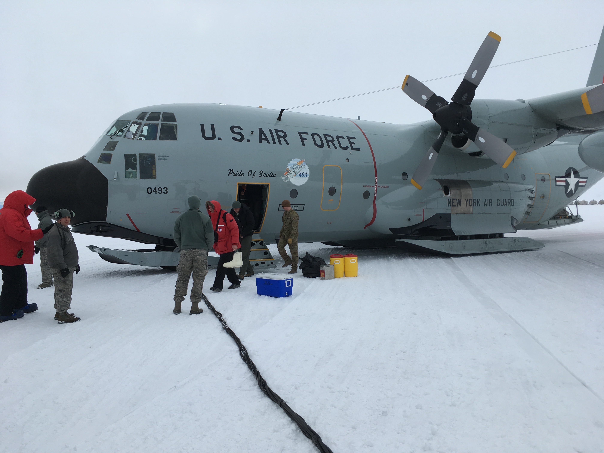
Other Antarctic Meteorological Observing Networks
Staffed Stations
Radiosondes
Ship/Buoy
Aircraft
‘LDM’ →
  Sharing Data Networks – Antarctic–Internet Data Distribution (Antarctic-IDD)
Aircraft
Notes:
There are other observational networks in Antarctica…the typical/classic means…

Slide 9
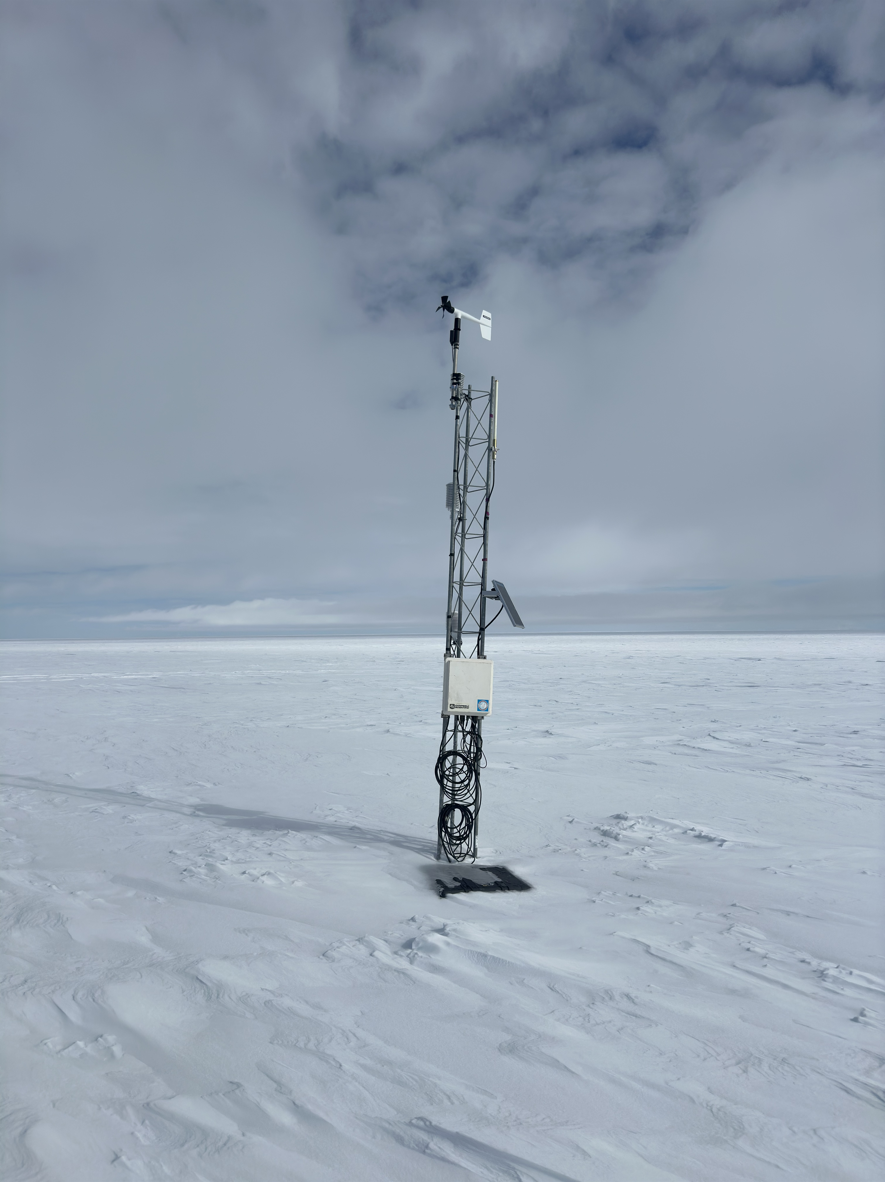

What is the Antarctic-IDD?
A federated sharing of Antarctic meteorological data built on the freely available LDM software from the Unidata Project
  Sort of like a Global Telecommunications System of the Antarctic!
Datasets available in real-time
Participants can provide data as well as acquire data
  Data is quantized to allow end user to select as much or as little data as desired. (e.g. you do not have to get a whole Polar WRF model run)
Sample datasets:
  Antarctic Mesoscale Prediction System (AMPS) model output
  Automatic Weather Station observations
  Satellite composite Imagery
  Additional weather displays, products
We welcome contributions from the community!
Contact mattl@ssec.wisc.edu if you wish to join in!!
Emilia AWS Courtesy of Tyler Plekan
Notes:
This is a data – communication method to share data amongst all of us here at this meeting and the Antarctic meteorological community!

Slide 10
Antarctic-IDD
Active USA Use LDM
NOAA (Arctic Sat. Composites) Washington, DC
AMRDC/Wisconsin
Status as of 2025
20th Anniversary!
NOAA NCO/TG → GTS
(AWS BUFR)
NCAR/MMM
BPCRC/OSU
UCAR/Unidata
ASC
CU
Phases:
CSBF/LDB
NIWC
Charleston
Phase I - Field Seasons 2005-2007
Phase II – Field Seasons 2007-2025
Phase III – Future
Key:
McMurdo
Station
NIWC
& AMRDC
CSBF/LDB
At Williams
Field
Two-way, full data stream
Limited two-way data stream
Limited distribution connection
Notes:
This is the network today…not all it used to be…

Slide 11
Antarctic-IDD
NOAA (Arctic Sat. Composites) Washington, DC
A Possible USA Future
AMRDC/Wisconsin
NOAA NCO/TG → GTS
(AWS BUFR)
NCAR/MMM
BPCRC/OSU
UCAR/Unidata
?
ASC
CU
Phases:
Phase I - Field Seasons 2005-2007
Phase II – Field Seasons 2007-2025
Phase III – Future ?
CSBF/LDB
NIWC
Charleston
AMRDC
McMurdo
Station
Key:
McMurdo
Station
NIWC
Two-way, full data stream
Limited two-way data stream
Limited distribution connection
Future ?
CSBF/LDB
At Williams
Field
Notes:
We could be like this – USA based only.

Slide 12
Antarctic-IDD
NOAA (Arctic Sat. Composites) Washington, DC
A Possible International Future
AMRDC/Wisconsin
NOAA NCO/TG → GTS
(AWS BUFR)
NCAR/MMM
NIPR
Japan
BPCRC/OSU
BAS
United Kingdom
UCAR/Unidata
KOPR
Korea
& more!
?
ASC
CU
AWI
Germany
& more!
CSBF/LDB
NIWC
Charleston
NIWC
New Zealand
AMRDC
McMurdo
Station
Please Join in!!
Contact:
mattl@ssec.wisc.edu
Key:
McMurdo
Station
NIWC
Two-way, full data stream
Limited two-way data stream
Limited distribution connection
Future ?
CSBF/LDB
At Williams
Field
Notes:
We could be like this on the international stage!! Join in!!! Contact Matthew Lazzara would work!

Slide 13
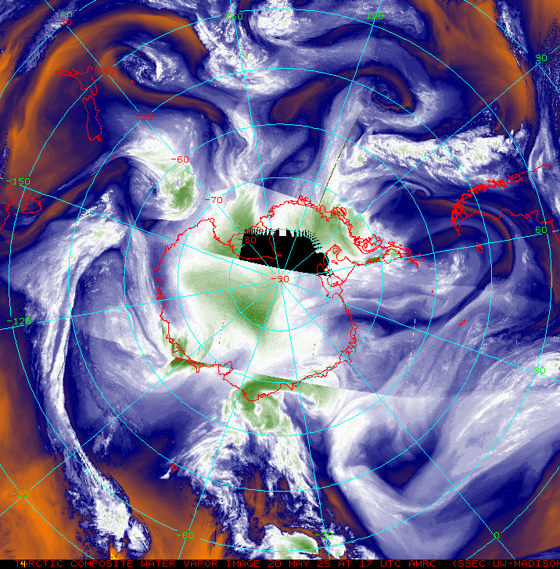
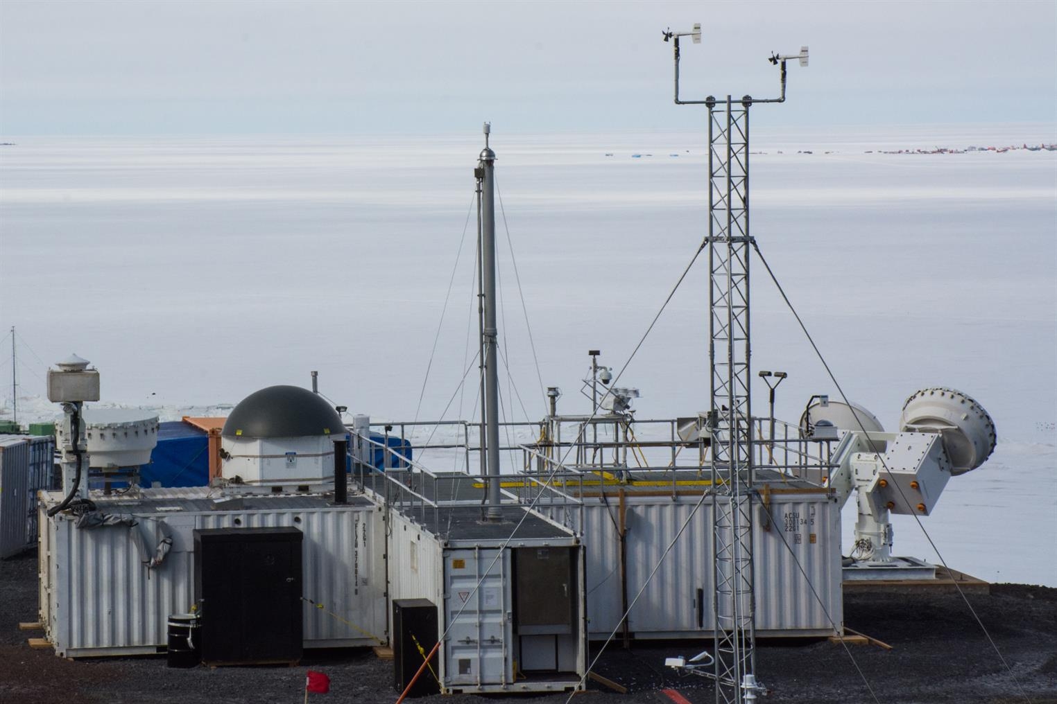
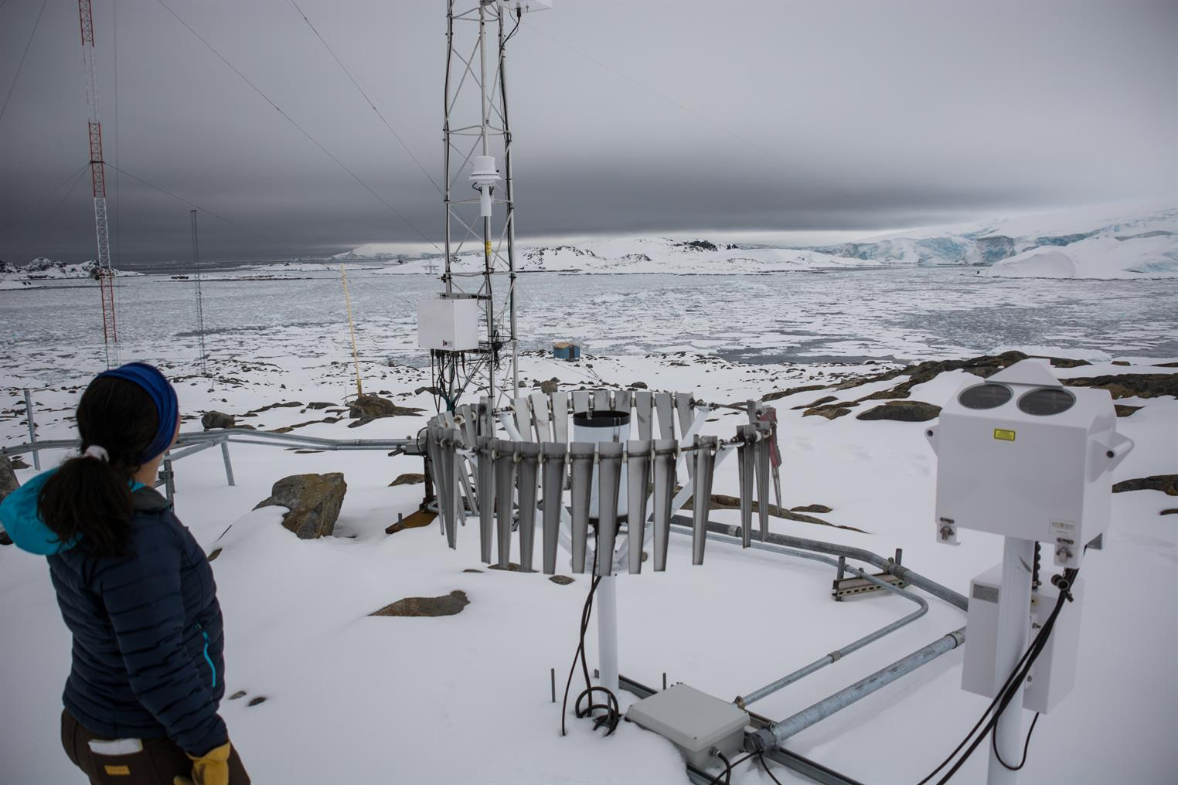
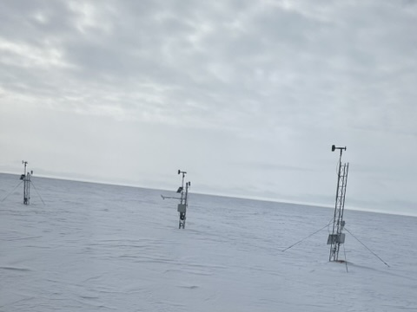
“We’re all in this together!”
What are our needs, as a community?
  More in-situ? More satellite platforms?
  Better communications? Improved data sharing (real-time/archive)?
  Real-time ground based high end remote sensing?
No one can do it alone…
Everyone contributes…
Everyone benefits…
Please contact mattl@ssec.wisc.edu if you have input on our Antarctic community observing needs!
Courtesy of Mike Lucibella
Courtesy of Tyler Plekan
Notes:
We are in this together!

Slide 14
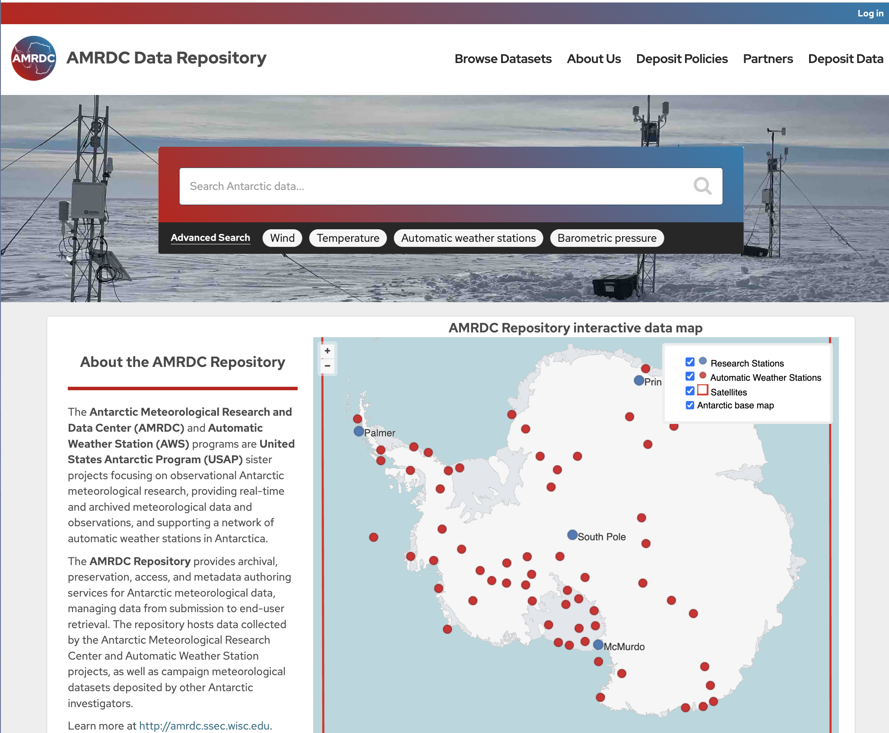






Antarctic Meteorological Research and Data Center (AMRDC)
Data Repository (ADR)
Official Antarctic Meteorological Data Repository and Archive!
This is a community asset!!
  Submit your data!
  Use data from here!
Over 5400! Datasets…and growing
https://amrdcdata.ssec.wisc.edu
Notes:
Get your phone out! Get the QR codes in this talk – here is the first! This data repository is for you – an Antarctic Meteorological Disciplinary based repository for the community! We welcome data input and please use this is a data source!!

Slide 15
Sample Data Holdings…
Satellite | Point Source | Model Output - Grid | ASCII Text | Satellite Navigation
Antarctic composites | METAR – Surface Hourly | MRF/AVN/GFS (limited) | USAP Field Camps | Two-line orbital elements (coming soon)
NOAA LAC | Surface Synoptic | ECMWF (limited) | South Pole and McMurdo radiosonde launch data | McIDAS System Navigation (coming soon)
NOAA HRPT from McMurdo Station (coming soon) | Automatic Weather Stations | UKMET (limited) | USAP TAFs (coming soon)
 | Ship and Buoy | AMPS (campaign) | USAP main stations surface observations
 | Aircraft | AEMET-ySREPS (campaign) | Automatic Weather Stations
 | Radiosonde
Notes:
What does the repository have? Here is a sample….

Slide 16
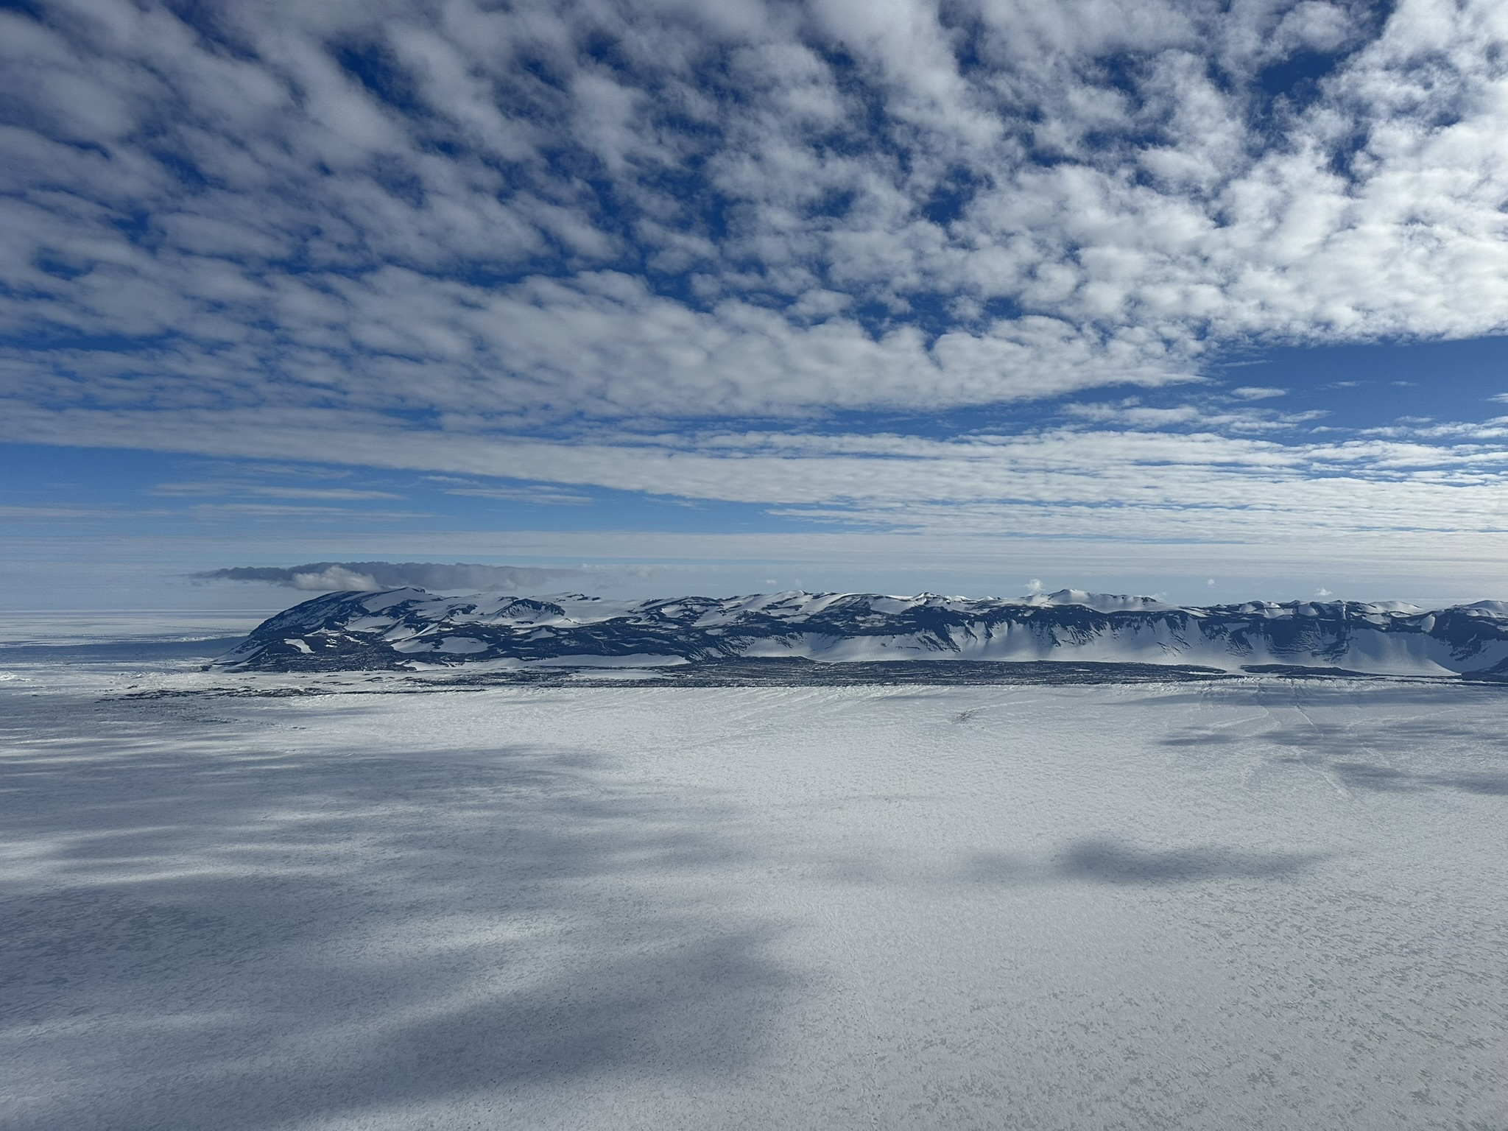
Antarctic Research
A sample review using observations

Slide 17
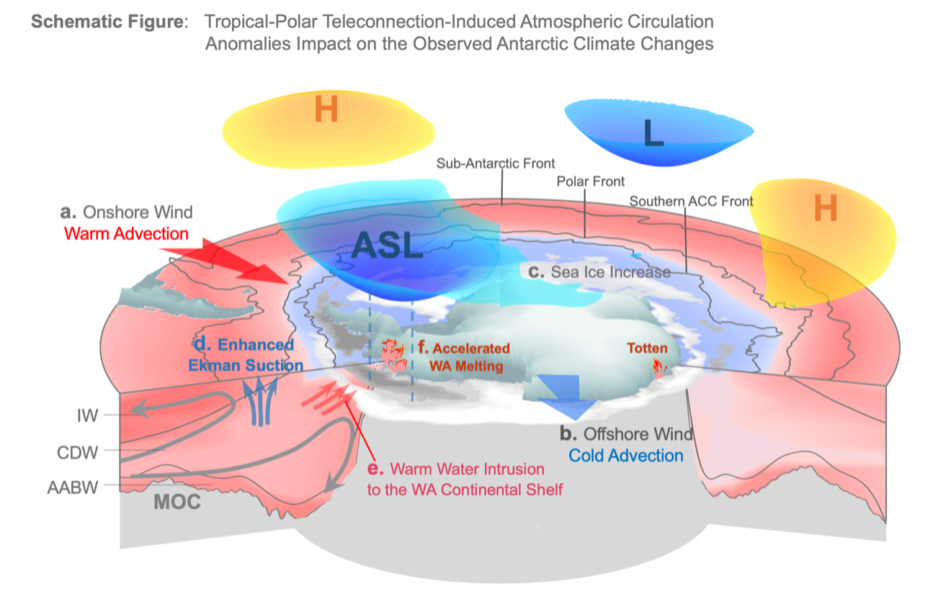
Xichen Li, et al.
Tropical – Polar Teleconnections
Notes:
Since the 1990s, the tropical-polar teleconnections from the Atlantic and Pacific Oceans deepen the Amundsen Sea Low (ASL) in association with positive phase of Southern Annular Mode (SAM). Through geostrophic balance, the ASL drives increased warm-air advection (a, red arrow, onshore wind) over West Antarctica (WA) and the Antarctic Peninsula, together with increased cold-air advection (b, blue arrow, offshore wind) over the Ross Sea. These surface wind changes contributed to the overall increase in Antarctic sea ice (c. the Antarctic sea ice paradox) and redistributed sea ice around West Antarctica. Anomalously strong westerly surface winds associated with the negative phase of the IPO and positive SAM strengthened Ekman suction (d. blue arrows) over the Southern Ocean, moving warm subsurface waters closer to the surface. Wind-driven ocean circulation changes drive variability in warm-water intrusions to the West Antarctic continental shelf (e. red arrows) that are implicated in the loss of glacial ice around West Antarctica (f). When the IPO transitioned to positive around 2015 and the SAM became positive in 2016, the westerly winds over the Southern Ocean weakened leaving the entire upper ocean column anomalously warm, thus contributing to the Antarctic sea ice retreat that started in 2016.

Slide 18
Extreme Precipitation Event (EPE)
Simon, et al.
EPE with Atmospheric River Event details:
EPE on 8–9 November 2015 – This was the highest precipitation event recorded at the ice core site located at 71.5°S, 10.5°E, delivering approximately 22% of the total annual precipitation in just two days (about 45 mm).
A combination of extreme conditions in both the upper and lower atmosphere (a deep low-pressure cyclone to the west and a record-strong high-pressure ridge) triggered the occurrence of this EPE.
Sudden deepening of the cyclone was favoured by the presence of 'jet streaks' in the upper atmosphere (at 250 hpa)

Slide 19
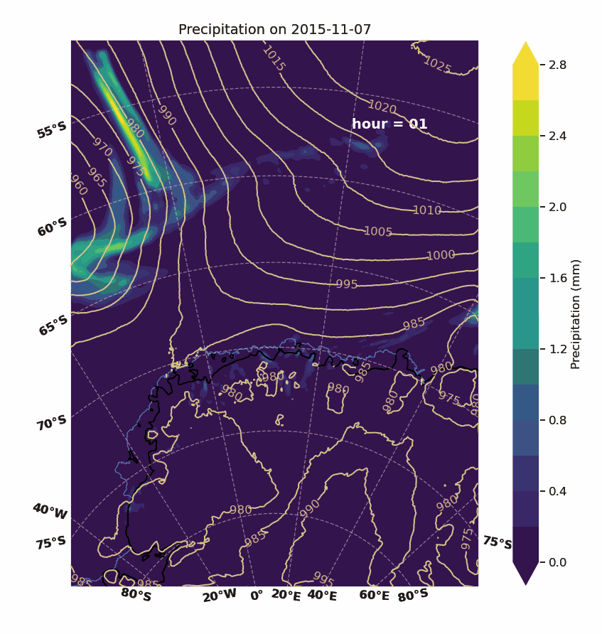
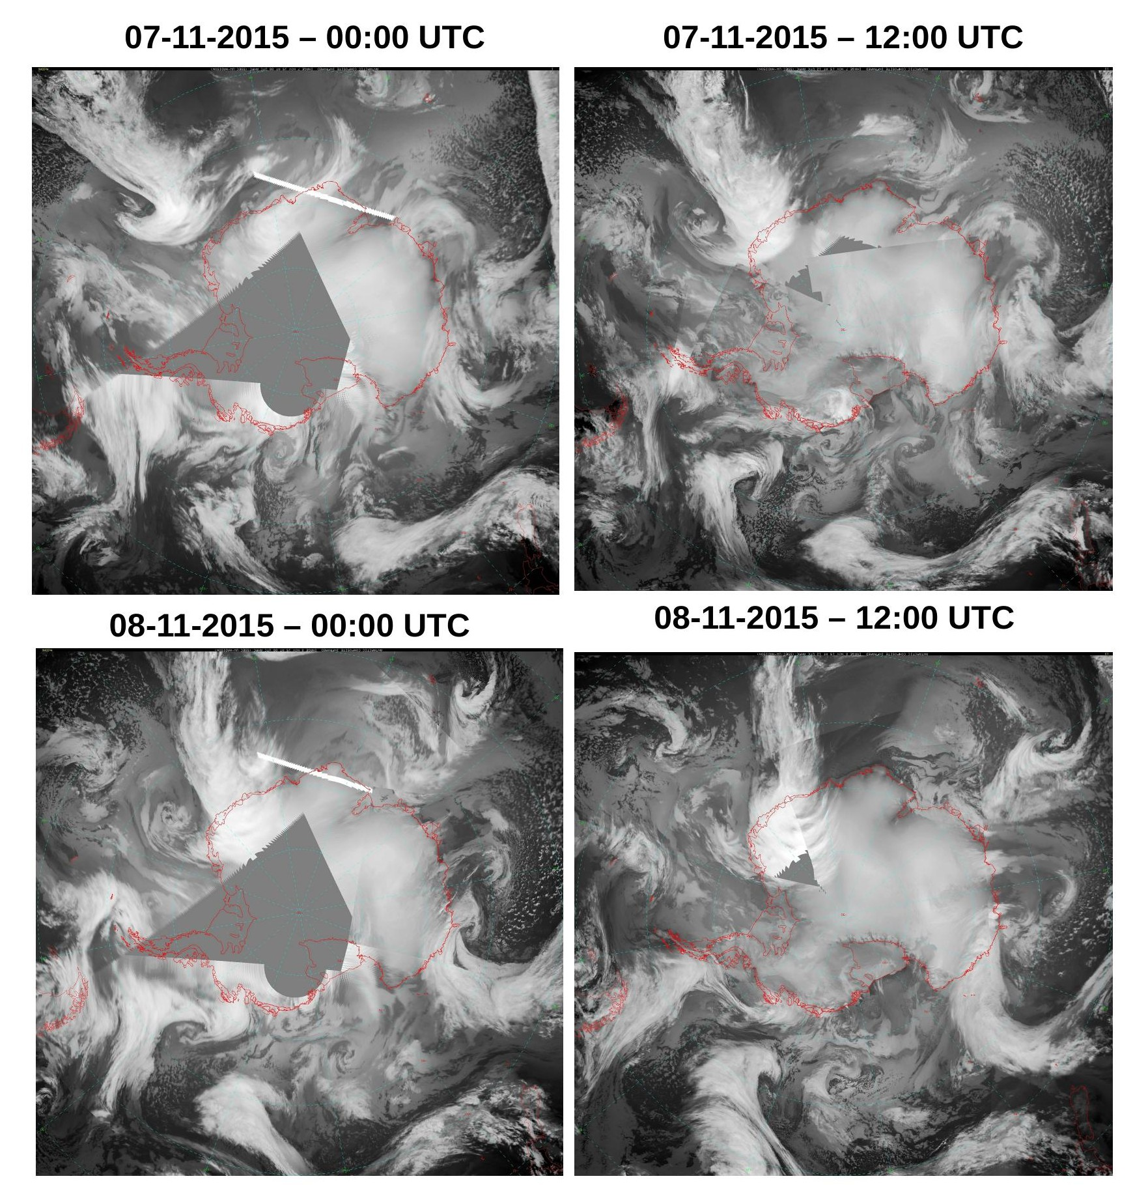
Simon, et al.
Notes:
Merged satellite imagery during the event period – Antarctic Composite Satellite imagery from University of Wisconsin
An animation of the event showing hourly precipitation simulated by Polar WRF

Slide 20
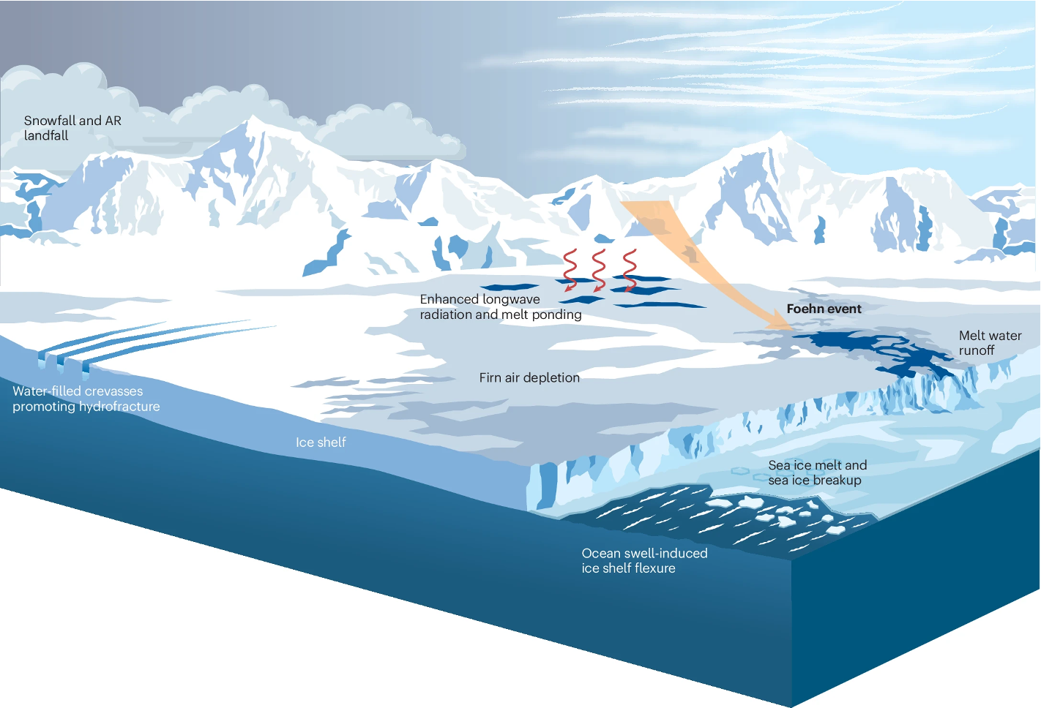

Jonathan Wille et al.
Review paper on Antarctic Atmospheric Rivers
Recently published in Nature Reviews Earth and Environment
Contributions from 32 coauthors
Covers topics like ...
  AR dynamics (global, synoptic, mesoscale)
  Microphysical processes
  Climatology and variability
  Surface mass balance impacts
  AR extremes
  Ice shelf destablization risks
  Sea ice impacts
  Ecosystem impacts
  Water stable isotopes
Wille et al. (2025)
Notes:
See above…

Slide 21
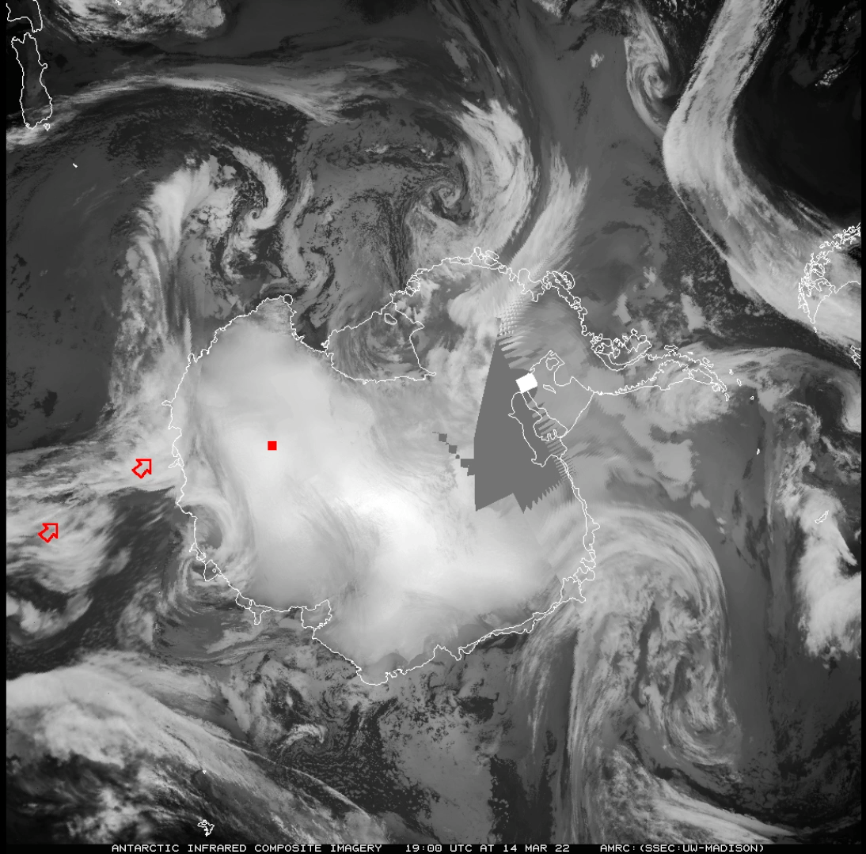



The extraordinary March 2022 East Antarctic Heatwave
Jonathan Wille et al.
Largest recorded temperature anomaly globally (39° C at Dome C)
54 researchers from around the world exploring interdisciplinary aspects of event
Focusing on …
  Synoptic scale meteorological drivers
  Atmospheric river dynamics
  Surface mass balance impacts
  Surface energy budget
  Conger Ice Shelf collapse
  Isotope measurements
  Historical event significance/probability
Wille et al. (2021) AR detection catalogs (ERA5 and MERRA2 1980-2023)
Paper (part 1)
Paper (part 2)
Notes:
See above…

Slide 22
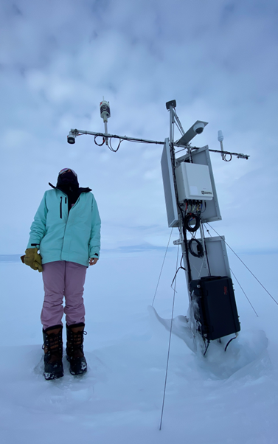
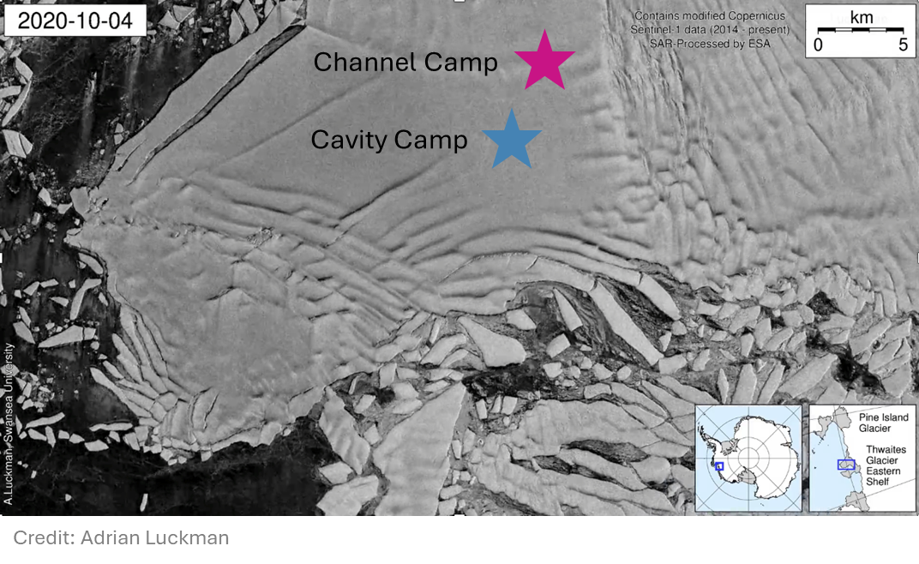
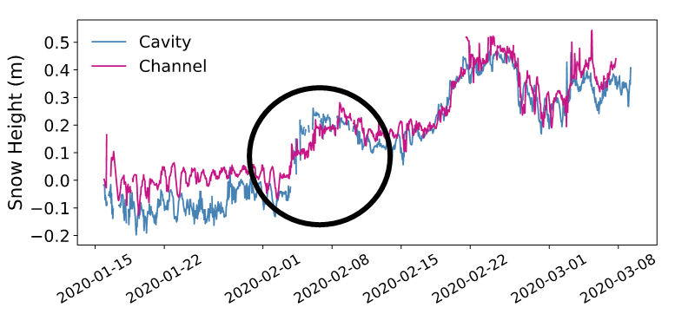
February 2020 atmospheric river family on Thwaites Glacier
Michelle Maclennan et al.
AWS on Thwaites Eastern Ice Shelf, January 2023
Notes:
Represents a highly interdisciplinary approach to analysing an extreme event, with the AMIGOS AWS observations at the core of the work - used to identify the occurrence of the event in the first place, characterize the near surface conditions, quantify biases in MERRA-2 and ERA5 reanalyses, validate output from the regional models, and force a firn model to reconstruct the surface impacts on accumulation and melt.
•ARs induce complex surface impacts: sometimes melt, rainfall and snowfall at once
•Families can produce prolonged surface impacts

Slide 23
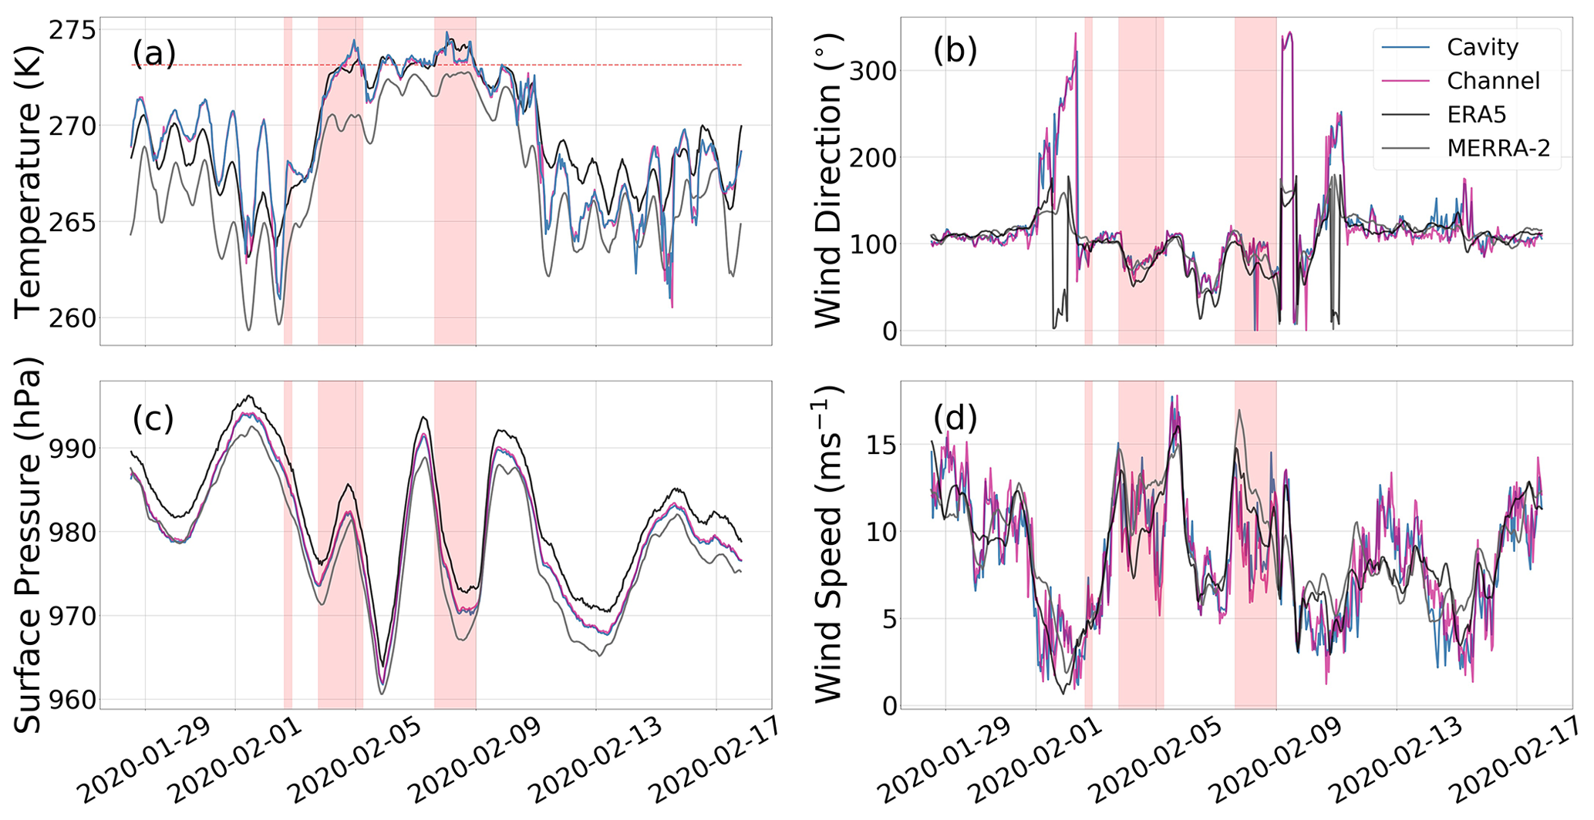
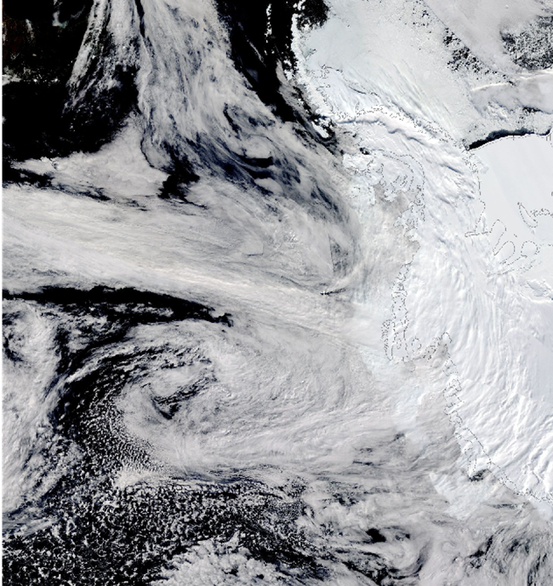
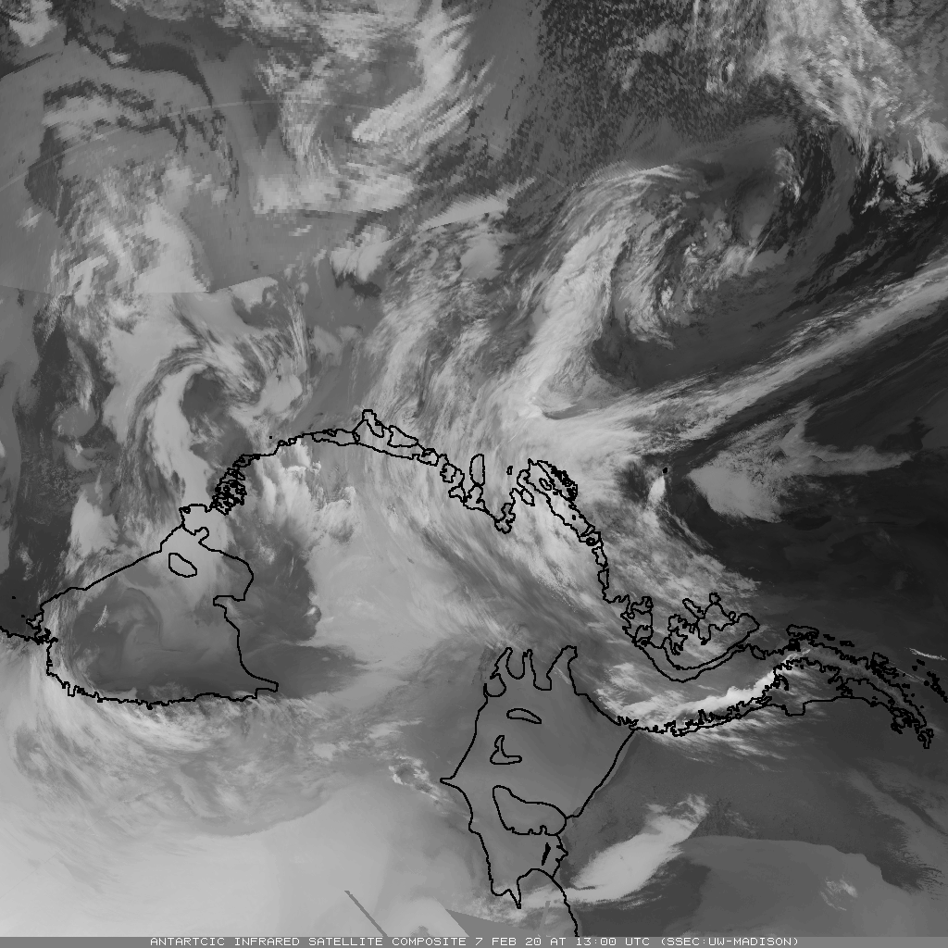
Michelle Maclennan et al.
February 2020 atmospheric river family on Thwaites Glacier
MODIS Corrected Reflectance, 07 February 2020
NASA Worldview Database
What happened?
3 atmospheric rivers make landfall in the ASE in rapid succession from February 2-8, 2020
100 mm w.e. accumulation – about 90% of the average annual accumulation from atmospheric rivers here
surface temperatures ~ 0° C for 5 days
Maclennan et al. 2023
Wisconsin Satellite Infrared Satellite Composite Imagery 13 UTC on 7 Feb 2020
Notes:
Represents a highly interdisciplinary approach to analysing an extreme event, with the AMIGOS AWS observations at the core of the work - used to identify the occurrence of the event in the first place, characterize the near surface conditions, quantify biases in MERRA-2 and ERA5 reanalyses, validate output from the regional models, and force a firn model to reconstruct the surface impacts on accumulation and melt.
•ARs induce complex surface impacts: sometimes melt, rainfall and snowfall at once
•Families can produce prolonged surface impacts

Slide 24

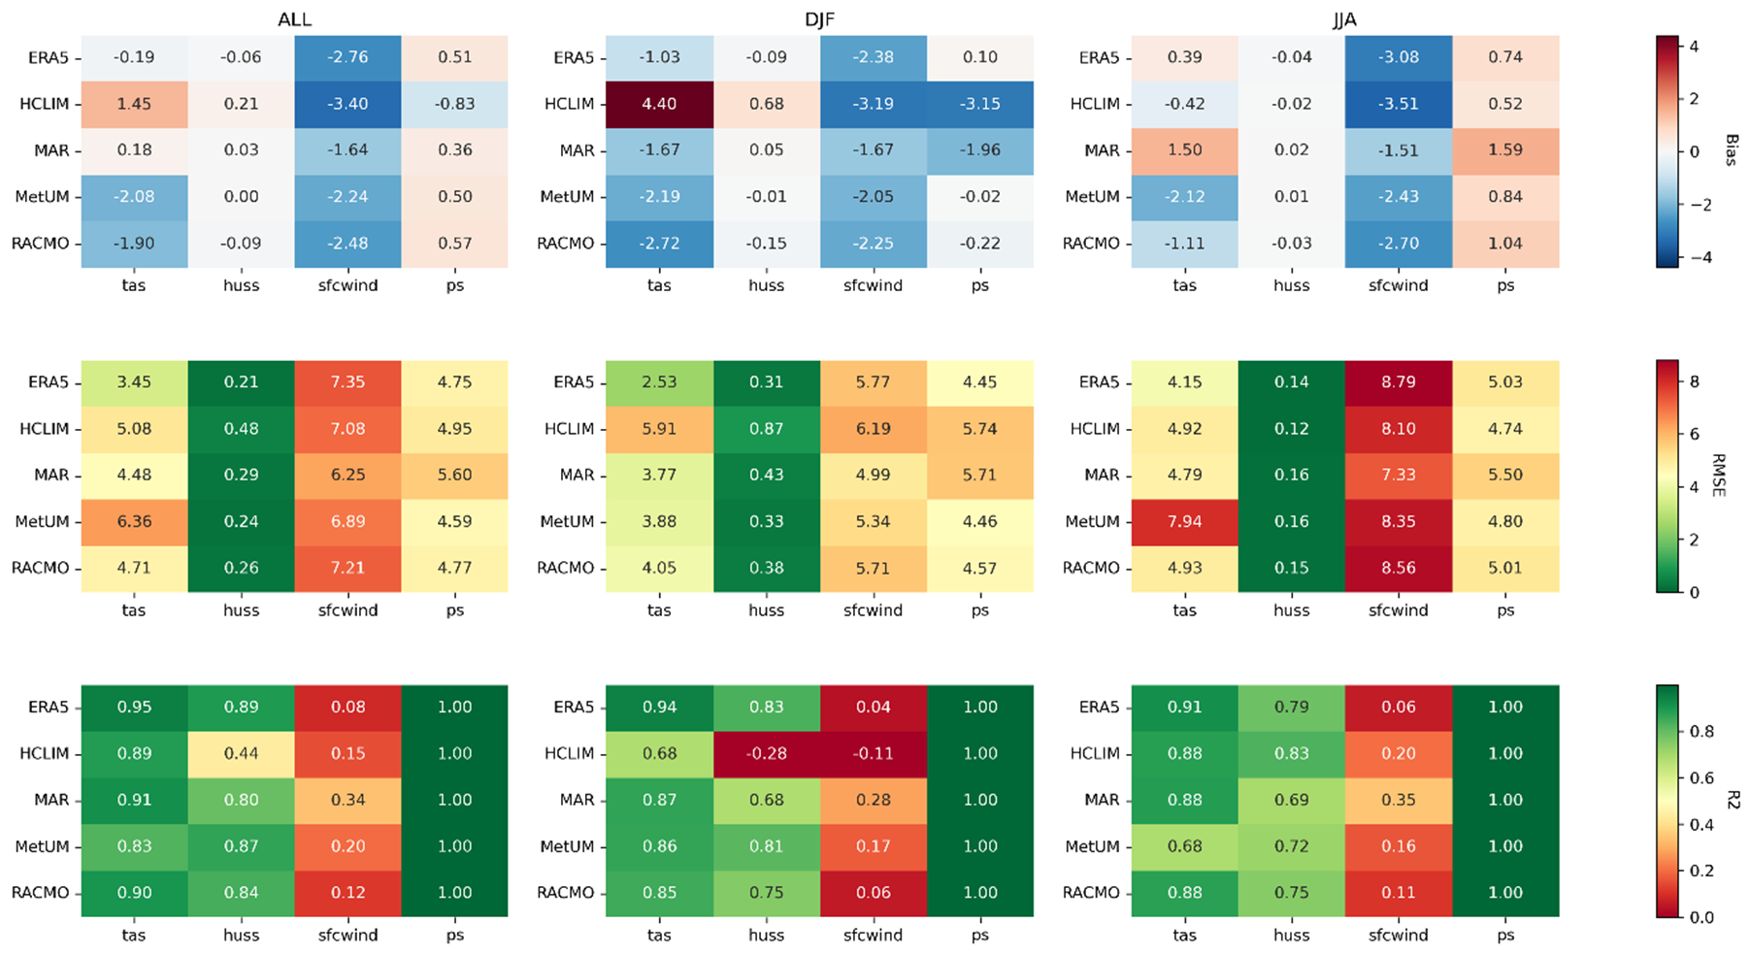
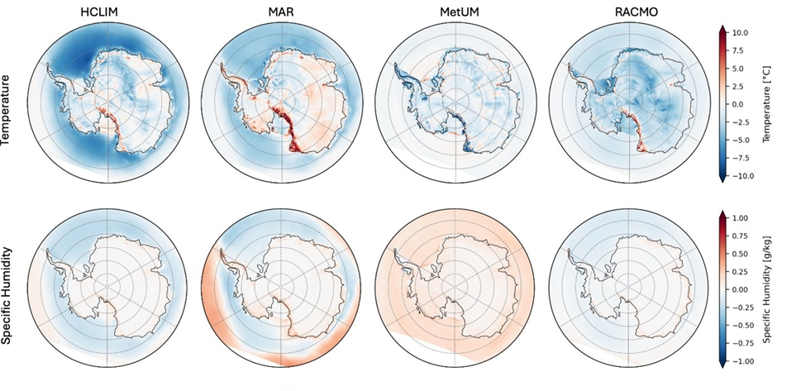
Ella Gilbert et al.
Presenting: The PolarRES ensemble, a state-of-the-art modelling resource for polar climate applications.
What is it? 4 state-of-the-art regional climate models, (HCLIM, MAR*, MetUM & RACMO2.4) run at 11 km (12km*) resolution over a pan-Antarctic domain.
polarres.eu
All RCMs perform well with respect to AntAWS observations (left) and ERA5 (below). For more info, watch out for our forthcoming publication...
3 simulations available :
ERA5 hindcast (2000-2022, with some RCMs running 1995-2024)
2 x GCM-driven future projections (1985-2100) following storylines of Antarctic climate change (after Williams et al., 2024)
Figures: Marte Hofsteenge (from Gilbert et al., in prep)
All data will be on ESGF by end of August 2025 – please use them :)
Notes:
We're nearing the end of a project, polarres, which has involved running a suite of sophisticated high-resolution regional climate models for the Antarctic (and Arctic).
It's a big improvement vs previous generations of models, better than ERA5 and better than GCMs.
Fig (left) shows performance of ERA5+RCMs for different variables – detail unimportant but colour code helps understand bias (top), RMSE (middle) and correlation (bottom). Winds are the dodgiest (i.e. red!), probably because of measurement error
Fig (right) shows comparison between ERA5 + RCMs. This plot shows temp and humidity differences (not biases!) in JJA
We want people to use the data! It's freely available and will (v soon) be on the ESGF for download.

Slide 25
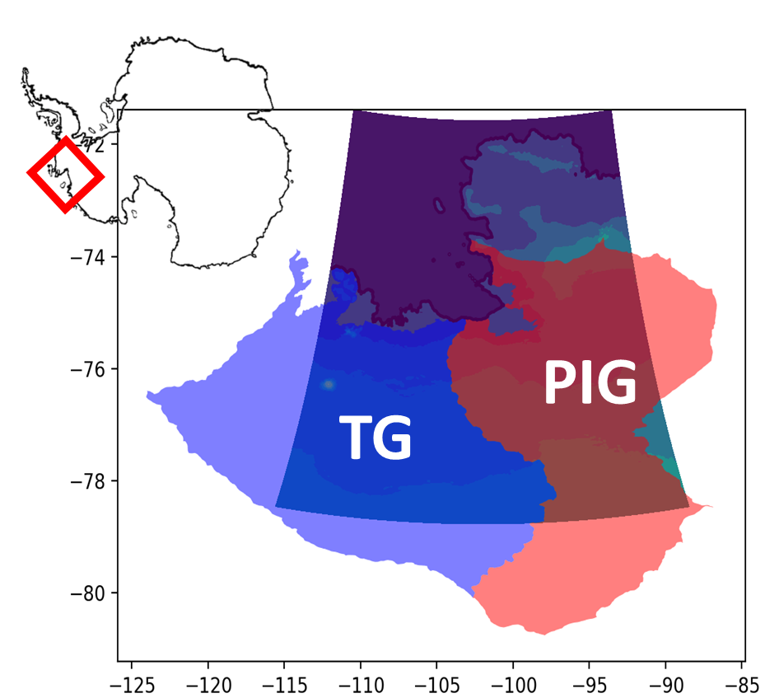

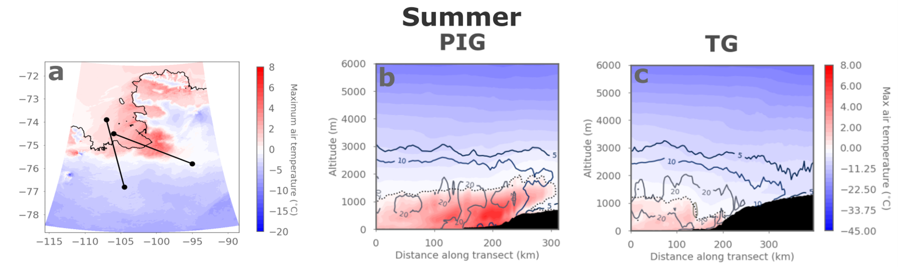


Super-cooled rain falls during West Antarctic atmospheric rivers
Ella Gilbert et al.
Warm near-surface conditions induced by airflow over steep topography (foehn effect)
Read the paper
Colours: max air temps during extreme AR event
Contours: accumulated rainfall totals during AR
b
c
Watch the video
Gilbert et al. (2025)
Liquid precip falling above 0°C line, i.e. supercooled rain. Topography generates more snowfall via seeder-feeder effects, plus supercooled rain falling above melt line
We need in situ obs of rain in Antarctica!
Use the data
Notes:
Atmospheric rivers are super important in West Antarctica, and can bring huge % of annual snowfall. But can also bring rain, which we don't measure at the moment!
Used several regional climate models (from PolarRES ensemble) to simulate impacts of ARs on Thwaites and Pine Island ice shelves. This was v high resolution, 1 km.
Max air temperatures rose above freezing because of warm air advection + foehn effect produced by the AR moving over steep terrain (far left panel )
Looking vertically (middle & right panels), we can see a warm pool of air over the ice shelves and inland up the glaciers (TG/PIG). However, *rain* is falling above the 0deg line, indicating that it is supercooled liquid – not just melted snow falling through a warm layer. Shows the complexity of microphysics in ARs – needs high res (<5 km) to capture this
We need OBSERVATIONS of rain in Antarctica!

Slide 26
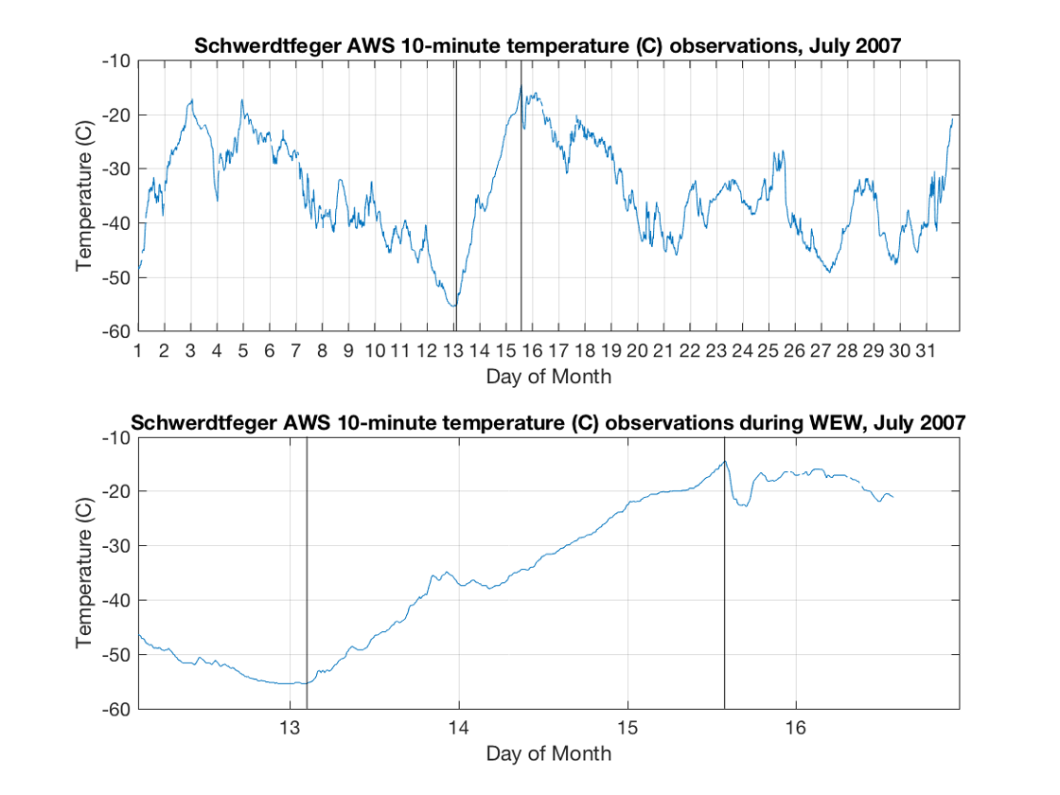
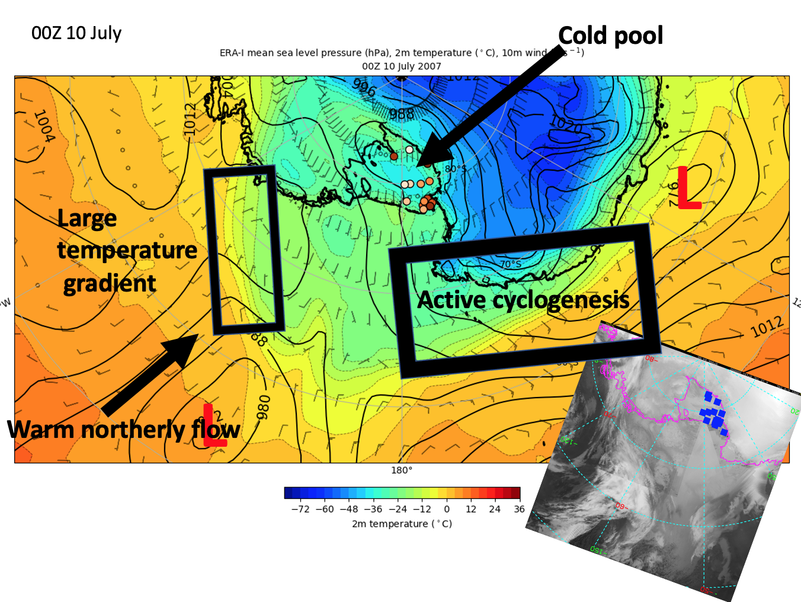
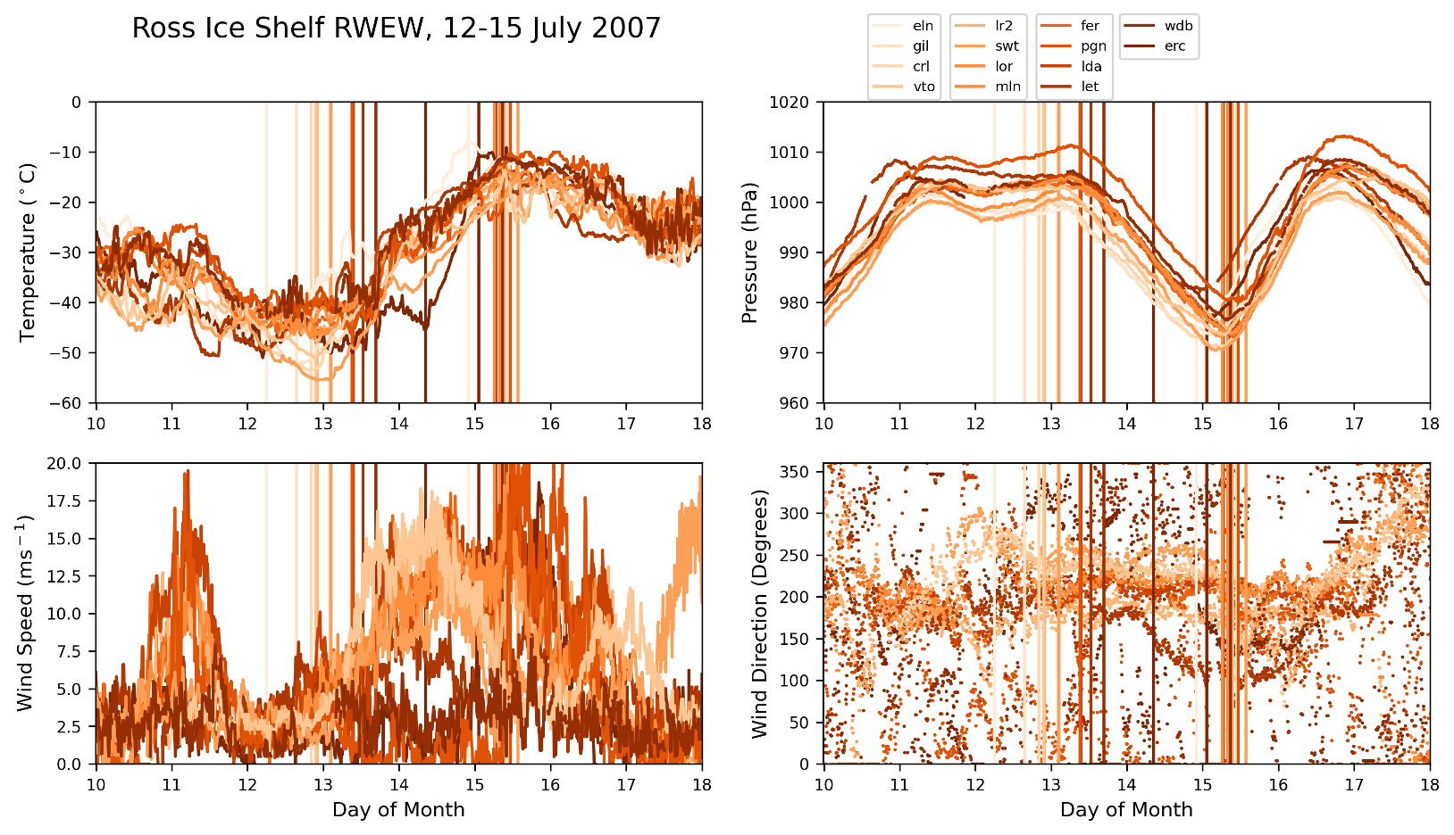
Regional Warming Event in Winter on the Ross Ice Shelf, Antarctica as Observed by UW-Madison Automatic Weather Stations
David Mikolajczyk
AWS Observations
Schematic Overview
Warming Event in Winter defined as an increase in temperature at an AWS of 30˚ C or greater in 5 or fewer days
In this event, from 12-15 July 2007, 14 AWS observed such a warming event on the Ross Ice Shelf
Notes:
I have 3 animations for this slide as you click through: 1) Time series of temperature at Schwerdtfeger AWS for July 2007 and 12-15 July 2007, showing one warming event. 2) Time series showing AWS observations at all 14 AWS that observed a warming event, with temperature, pressure, wind speed, and wind direction plotted (sorry it's messy). 3) A Schematic Overview of the synoptic setup of this regional warming event, with ERA-Interim 2-m temperature and mean sea level pressure plotted, showing a cold pool and calm conditions over the Ross Ice Shelf, warm northerly flow in the Ross Sea from a persistent stationary low in the Ross Sea and ridge in the Amundsen Sea that built up a strong baroclinic zone near the RIS and Marie Byrd Land coast, and finally a region of active cyclogenesis along a baroclinic zone off the coast of Victoria Land.
During 10-11 July, calm and clear conditions over the Ross Ice Shelf led to surface cooling and cold temperatures observed at the AWS. As cyclones that formed off the coast of Victoria Land progressed eastward into the Ross Sea during this time, they combined with the Ross Sea low and aided in its progression southward towards the Ross Ice Shelf. Beginning on 12 July, the approaching Ross Sea low brought cloud cover over the Ross Ice Shelf, and throughout 12-15 July, a warm front swept across the Ross Ice Shelf, brigning with it clouds, high winds, and warm air advection. These factors led to the regional warming event, with temperatures increasing from around –45˚ C to around -10˚ C in these few days.

Slide 27
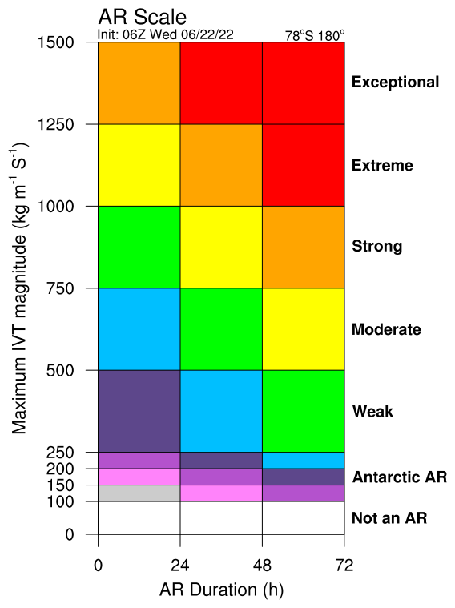
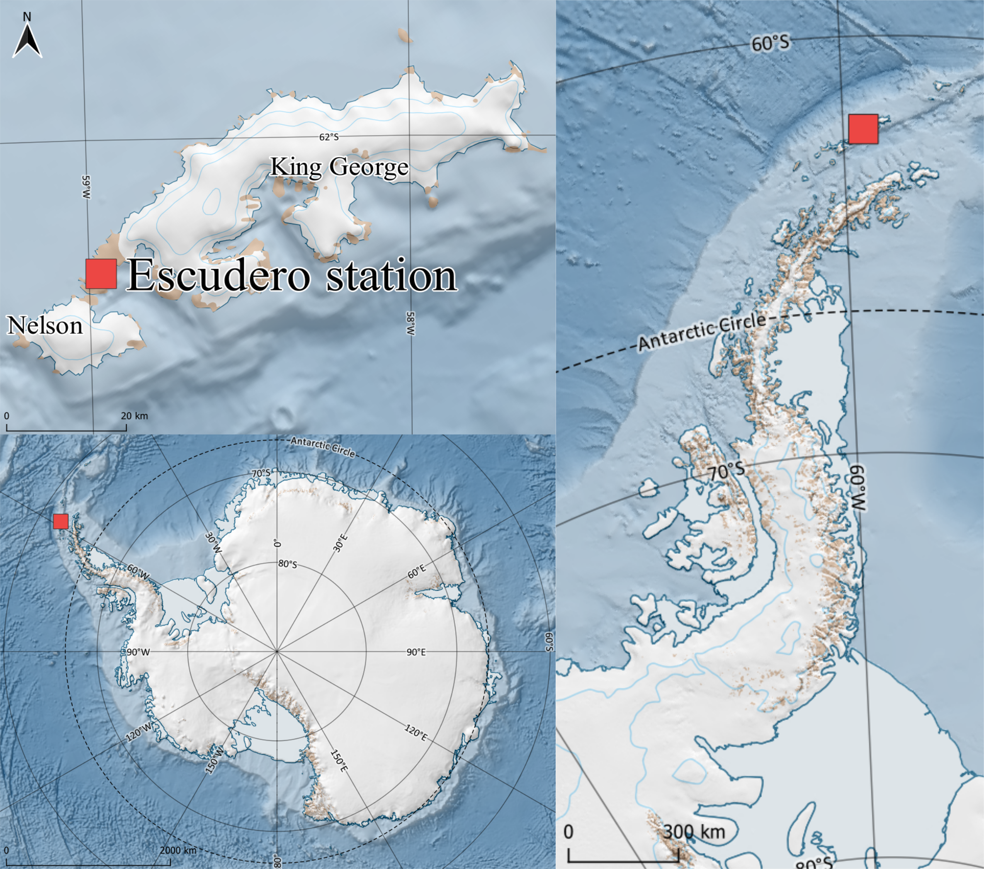
Extreme state of the troposphere during an intense AR event (Feb 7-8 2022 hot spell)
Temperature
Humidity
Moisture flux
King Sejong &Escudero
Maximum temperature, humidity, wind speed and moisture flux above the surface (~1 km)
Entire troposphere was anomalously warm and humid – from the surface up to 10 km
Gorodetskaya et al. NPJ Atm&Clim (2023)
Notes:
Figure: 7-8 Feb 2022 hot spell (radiosonde = solid and ERA5 = dash) compared to 1980-2022 climatology (ERA5)
7-8 February AR event: radiosondes - yellow (7 Feb@12UTC) and red (8 Feb@00UTC) lines
ERA5 reanalysis for the same times – dashed
ERA5 climatology (1980-2022 mean/std) for Jan-Feb
AR event: category up to 3 reaching the Antarctic Peninsula coast (and category 5 reaching Chile)

Slide 28
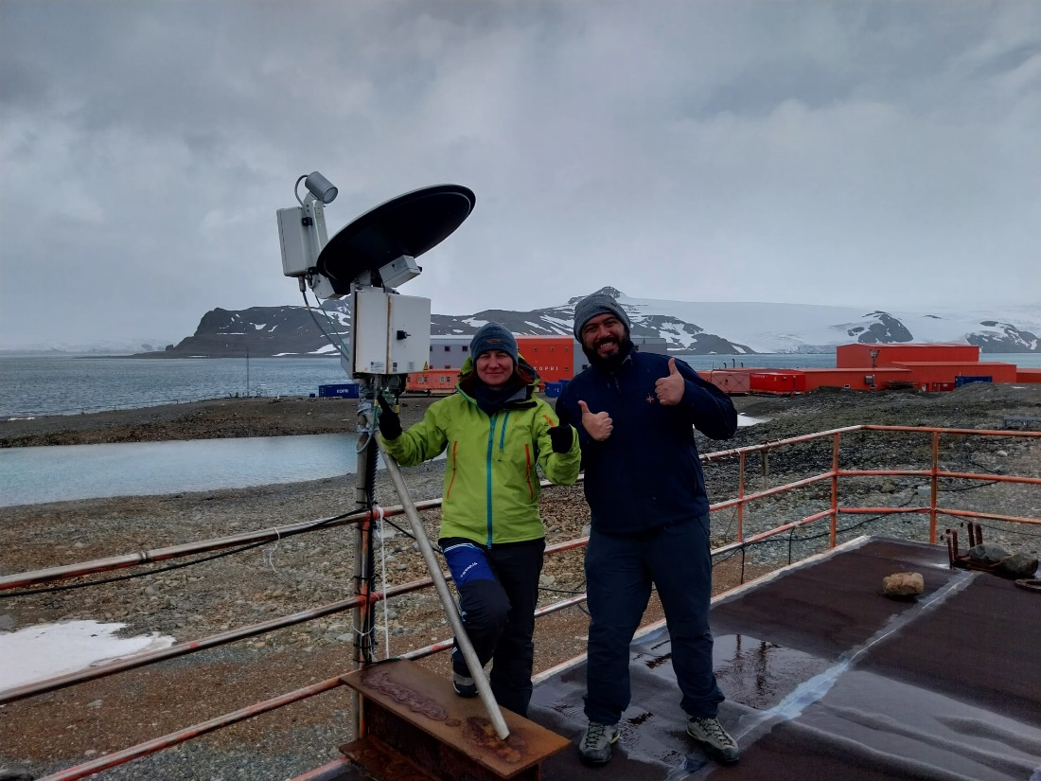
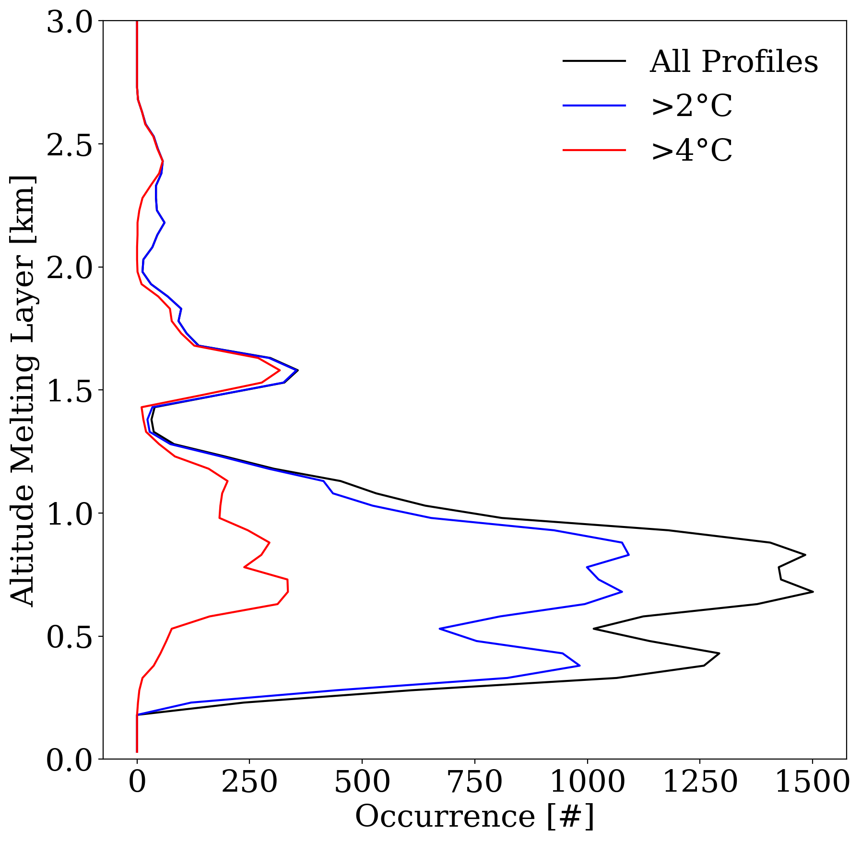
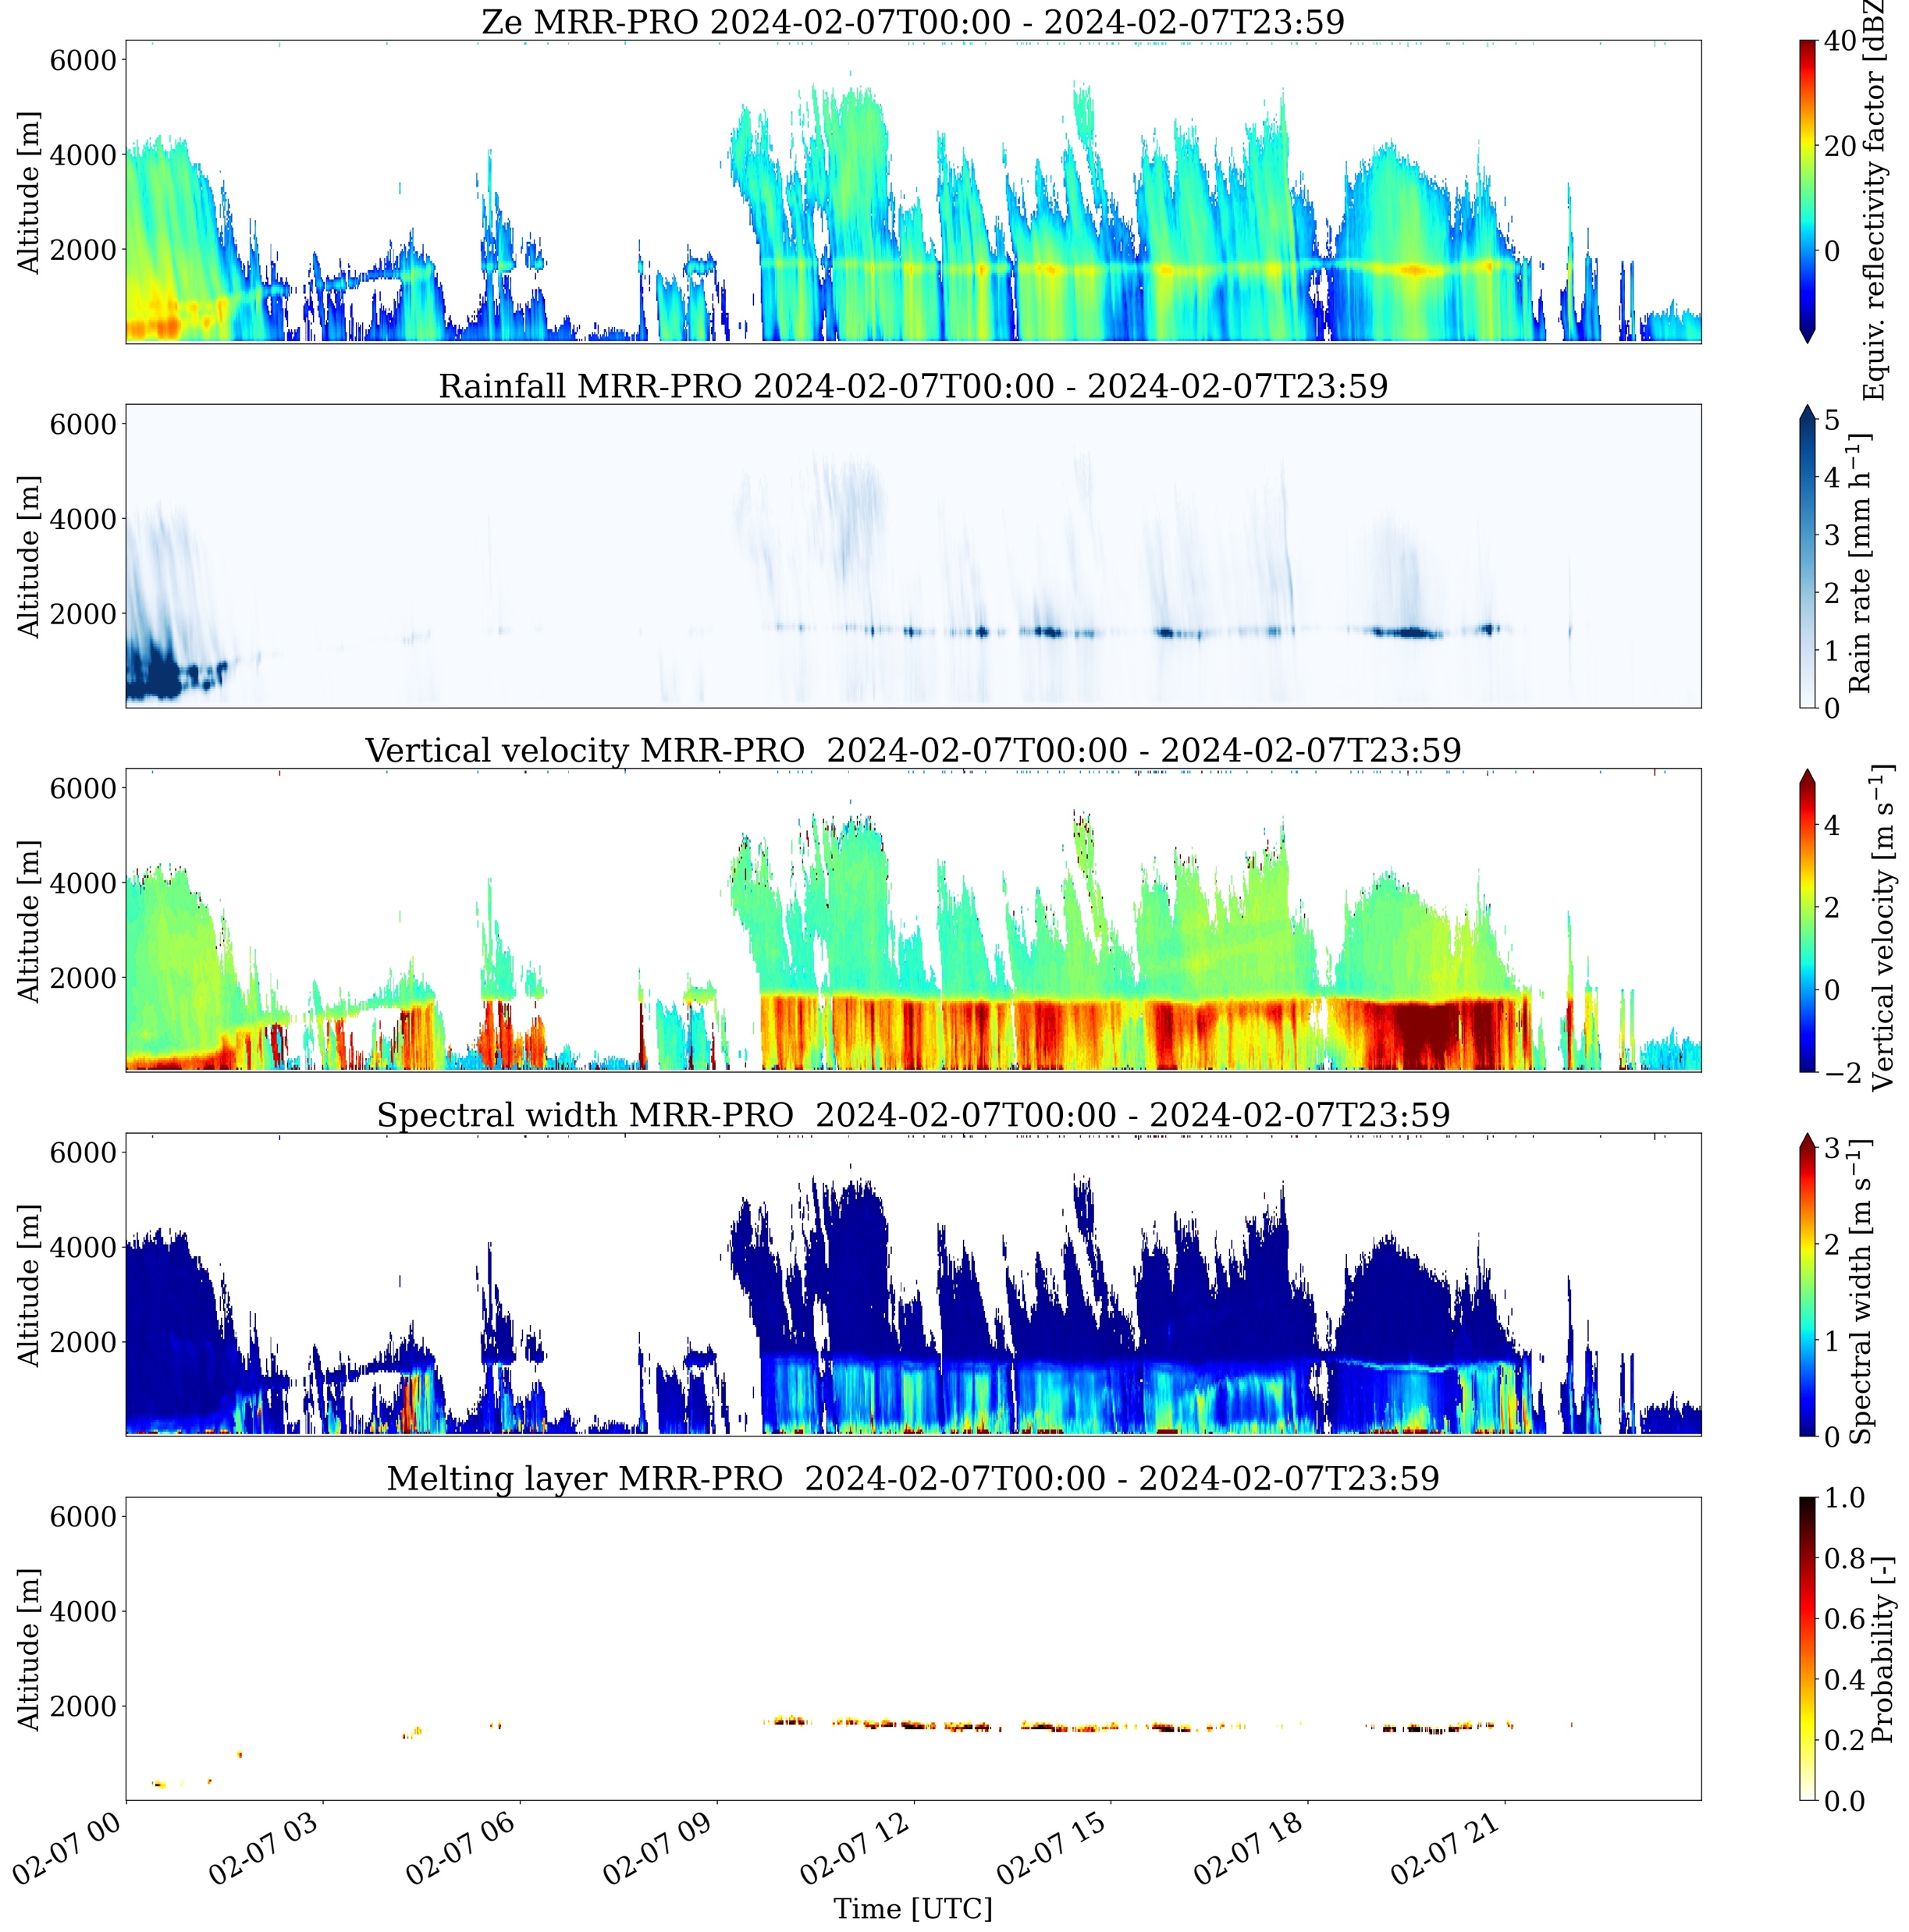
Highlights from radar observations at King Sejong station:
Melting layer height and warm near-surface temperatures - rain starts at higher altitudes and reaches further inland of Antarctica…
Photo: MRR-PRO at King Sejong station and CIIMAR team (Irina&Claudio)
Melting layer
Melting layer derived from MRR-PRO during 7 Feb 2024 AR
and warm event
Melting layer heights frequency of occurrence during Feb 2023-April 2025 for all profiles and composites near-surface temperatures > 2º and 4ºC
Irina Gorodetskaya et al.
Notes:
Melting layer derived from MRR-PRO during 7 Feb 2024 warm event
compared to all hours during the year 9/02/2023 – 8/02/2024

Slide 29



Antarctic AR and Extreme Weather
Jerry Zou & Penny Rowe
Datasets
Observations of Cloud Properties at King George Island (2017-2023)
Stillwell et al. 2025: Cloud Mask Data: https://doi.org/10.48567/1wd1-ea27.
Rowe et al, 2025: Radiosonde measurements: https://doi.org/10.48567/jqv8-r657.
Rowe et al, 2025: Shortwave/Longwave Downward Radiative: https://doi.org/10.48567/peeg-7j35; https://doi.org/10.48567/hnhz-f486
AR Scale & High-Resolution Model Simulations
Zou et al. 2025: Gridded Enhanced AR Scale: https://doi.org/10.48567/ssm5-x097.
Zou et al. 2025: Historical AR events over the Antarctic Peninsula: Data transferring
Publications:
Zou et al. 2023: Atmospheric River and Foehn Events: Contribution of Shortwave Radiation and Turbulence. J. Geophys. Res. Atmos., 128: e2022JD038138, https://doi.org/10.1029/2022JD038138.
Zhang et al. 2024: Extending the Center for Western Weather and Water Extremes (CW3E) atmospheric river scale to the polar regions. Cryosphere, 18: 5239–5258, https://doi.org/10.5194/tc-18-5239-2024.
Rowe et al. 2025a: Comparison of Cloud and Radiation Measurements to Models over the Southern Ocean at Escudero Station, King George Island. J. Geophys. Res. Atmos. Accept.
Rowe et al. 2025b: Observations of Clouds and Radiation Over King George Island and Implications for the Southern Ocean and Antarctica. J. Geophys. Res. Atmos. In revision.
Antarctic AR Real-time Forecast
More Upcoming!
Real-time AMPS outputs from NSF NCAR included
Historical Antarctic AR catalog under development.
Arctic Website will be launched soon!
Details next slide~
NSF 2127632, 2229392, 2331992
Notes:
Nothing needs to be emphasize here. I am just adding a few notes for clarification.
Most publications here is AR and extreme weather related work, including surface melting/warming and cloud radiative impacts. A) Observations data at AMRDC provides a benchmark for model evaluation; b) All cloud data collected during this project is archived at AMRDC.
Penny Rowe took the lead on all observation collection and data preprocess.
Gridded enhanced AR Scale for Antarctic is archived at AMRDC. It is calculated from ERA5 reanalysis based on the Enhanced AR scale developed at CW3E (Zhang et al. 2024). No shape filter is applied to this dataset (provided AS IS). A global gridded enhanced AR scale likely will be published by CW3E by the end of this year. The updated version will cover Arctic, Antarctic and high latitudes, with shape filter.

Slide 30
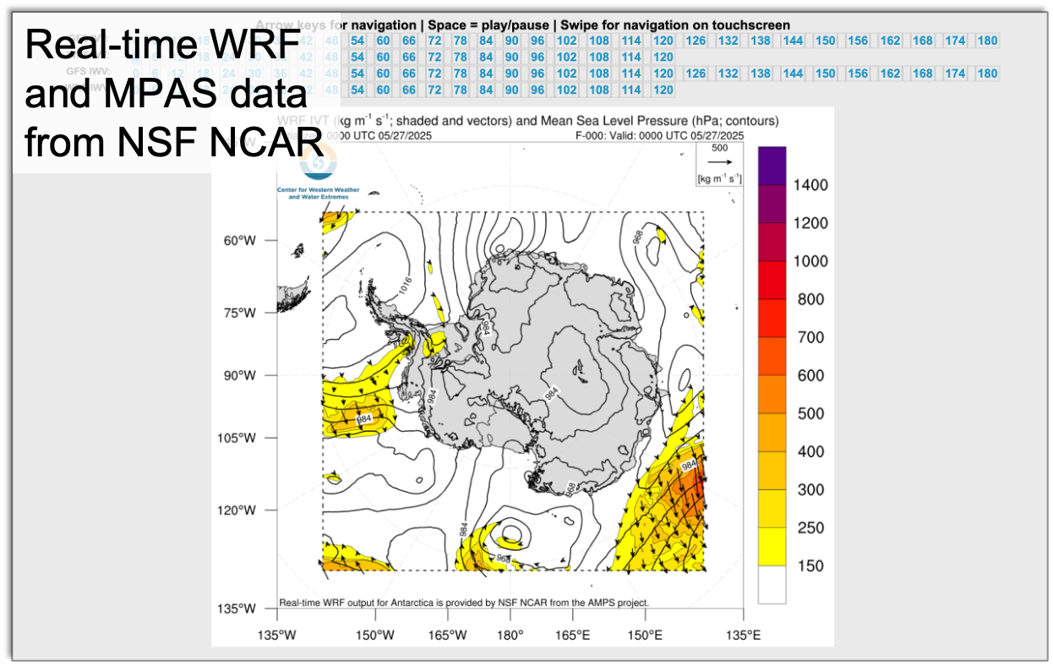
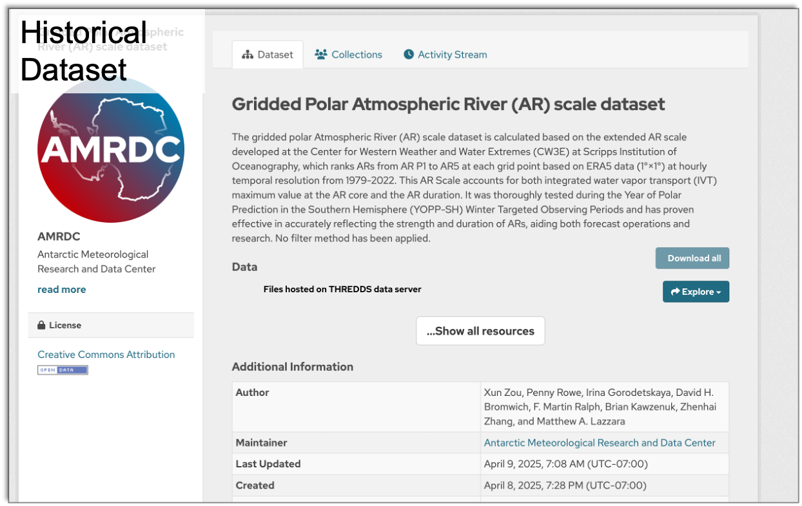
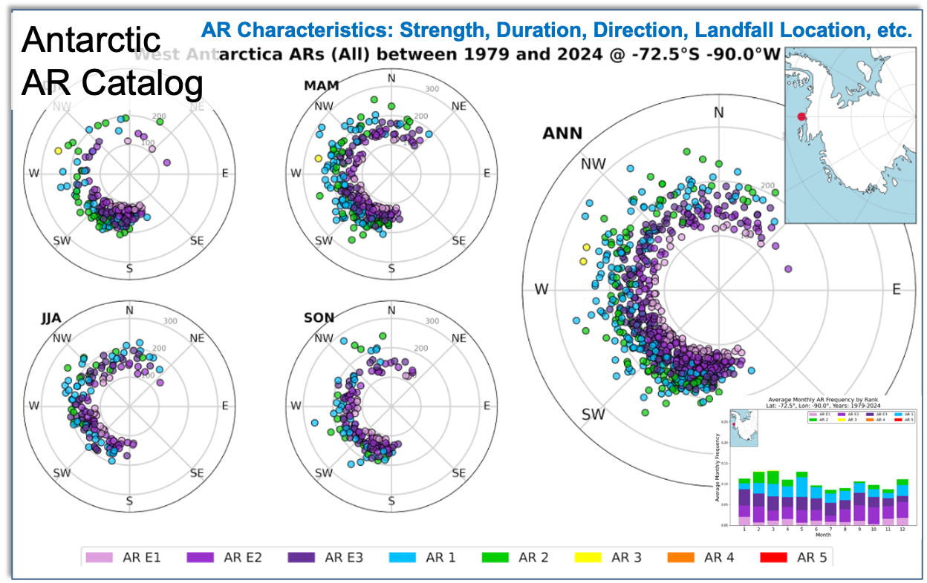
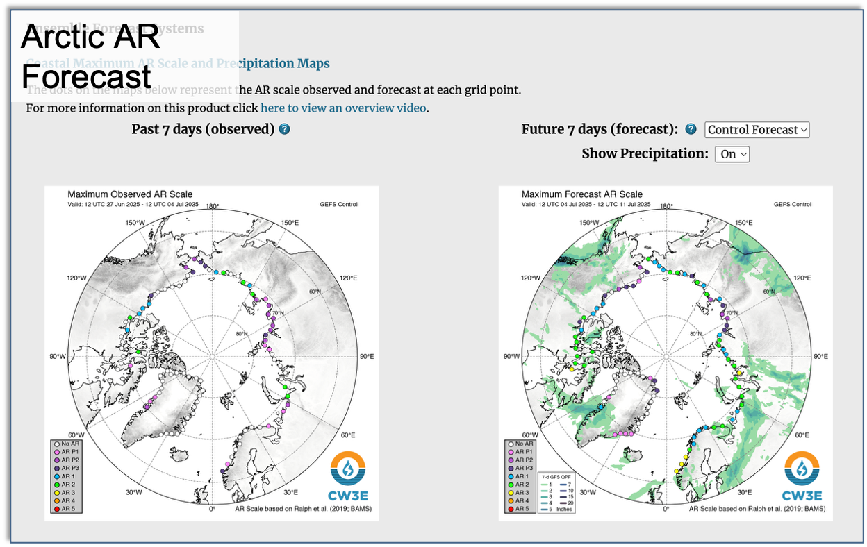
Datasets and Web tools developed for AR science
Contact: x4zou@ucsd.edu
Thanks to AMRDC. Selected data are/will be archived for Antarctic community
Notes:
Both WRF and MPAS data produced by AMPS team at NSF NCAR (thanks to Jordan Powers and Kevin Mannning) is transferred to CW3E in real time. We only preprocess WRF data for web development.
Antarctic AR Catalog is a web currently under development. It is aimed to provide a database and visualization tool for historical AR events based on ERA5 reanalysis. It will show AR strength, duration, landfall location and direction.
Arctic AR website is fully developed and under internal testing now. It will be launched in weeks~

Slide 31
Naoyuki

Slide 32
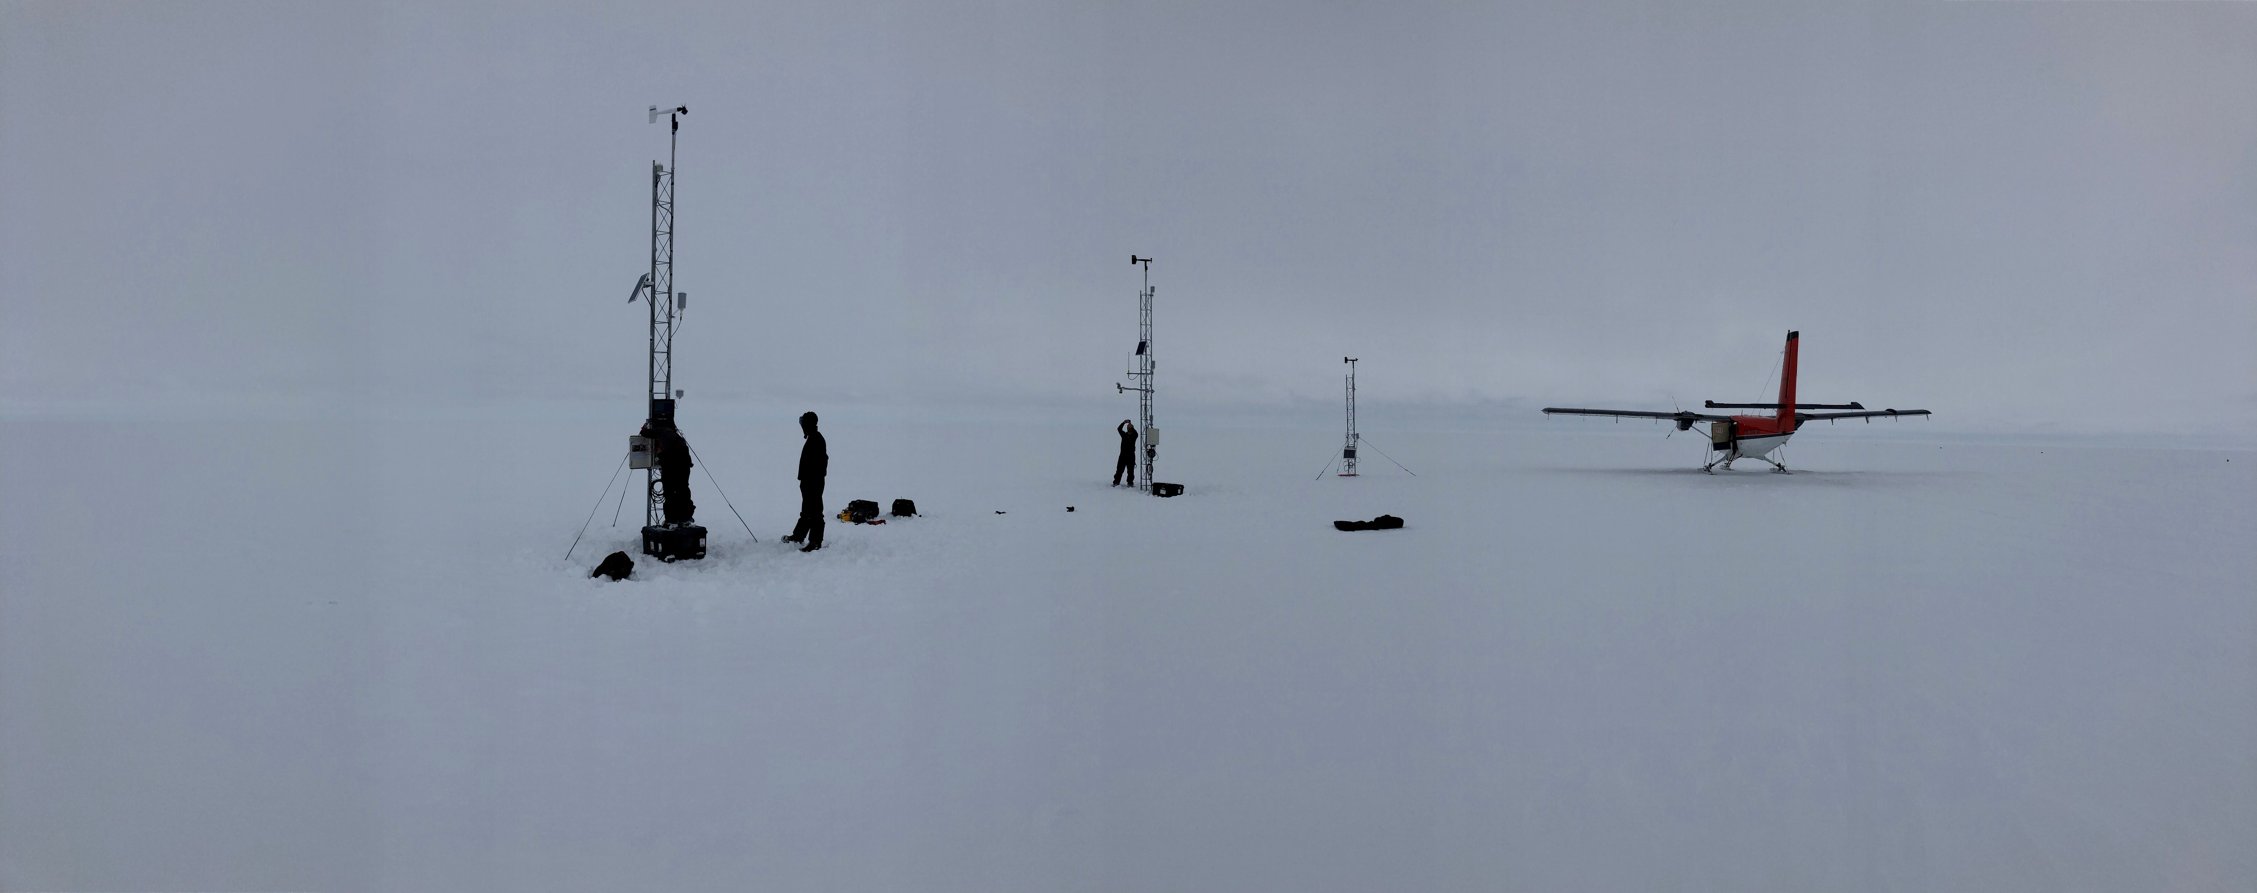
Thank you! Questions?
O-283 Field Team
Madison College PCWS
Skomik
Wisconsin AWS
Schwerdtfeger
NIWC AWS
Acknowledgements:
Thanks for the support from the National Science Foundation, Grants: 1924730, 1951720, 19516603, 2301362
Horizon 2020 project, netGEMS
National Centre for Polar and Ocean Research (NCPOR), Goa, India & Dr. John Turner
E-mail: mattl@ssec.wisc.edu mlazzara@madisoncollege.edu

