Slide 1









Connecting Antarctic Observations to the World!
Naoyuki Kurita¹
Ella Gilbert², Irina Gorodetskaya³, Linda Keller⁴, Matthew Lazzara^{4,5,*}, Michelle Maclennan², David Mikolajczyk, Taylor Norton⁴, Lee Welhouse⁴, Jonathan Wille⁶, Xun (Jerry) Zou⁷, Sibin Simon⁸, and Xichen Li⁹
1 Nagoya University, Nagoya, Japan
2 British Antarctic Survey, Cambridge, UK
3 CIIMAR, University of Porto, Matosinhos, Portugal
4 University of Wisconsin-Madison, Madison, WI, USA
5 Madison Area Technical College, Madison, WI, USA
^{6 ETH Zurich, Switzerland}
7 Scripps Institute of Oceanography, San Diego, CA, USA
8 Laboratory for Climate and Environmental Sciences, Paris-Saclay, France
9 Peking University, Bejing, China
* Matthew sends his regrets….
BACO-25 Assembly - JCMP08
Notes:
Thank you for this invited talk! Matthew sends his regrets in not being able to be here. All of the coauthors have contributed to this presentation about Antarctic observations and their connection to research

Slide 2
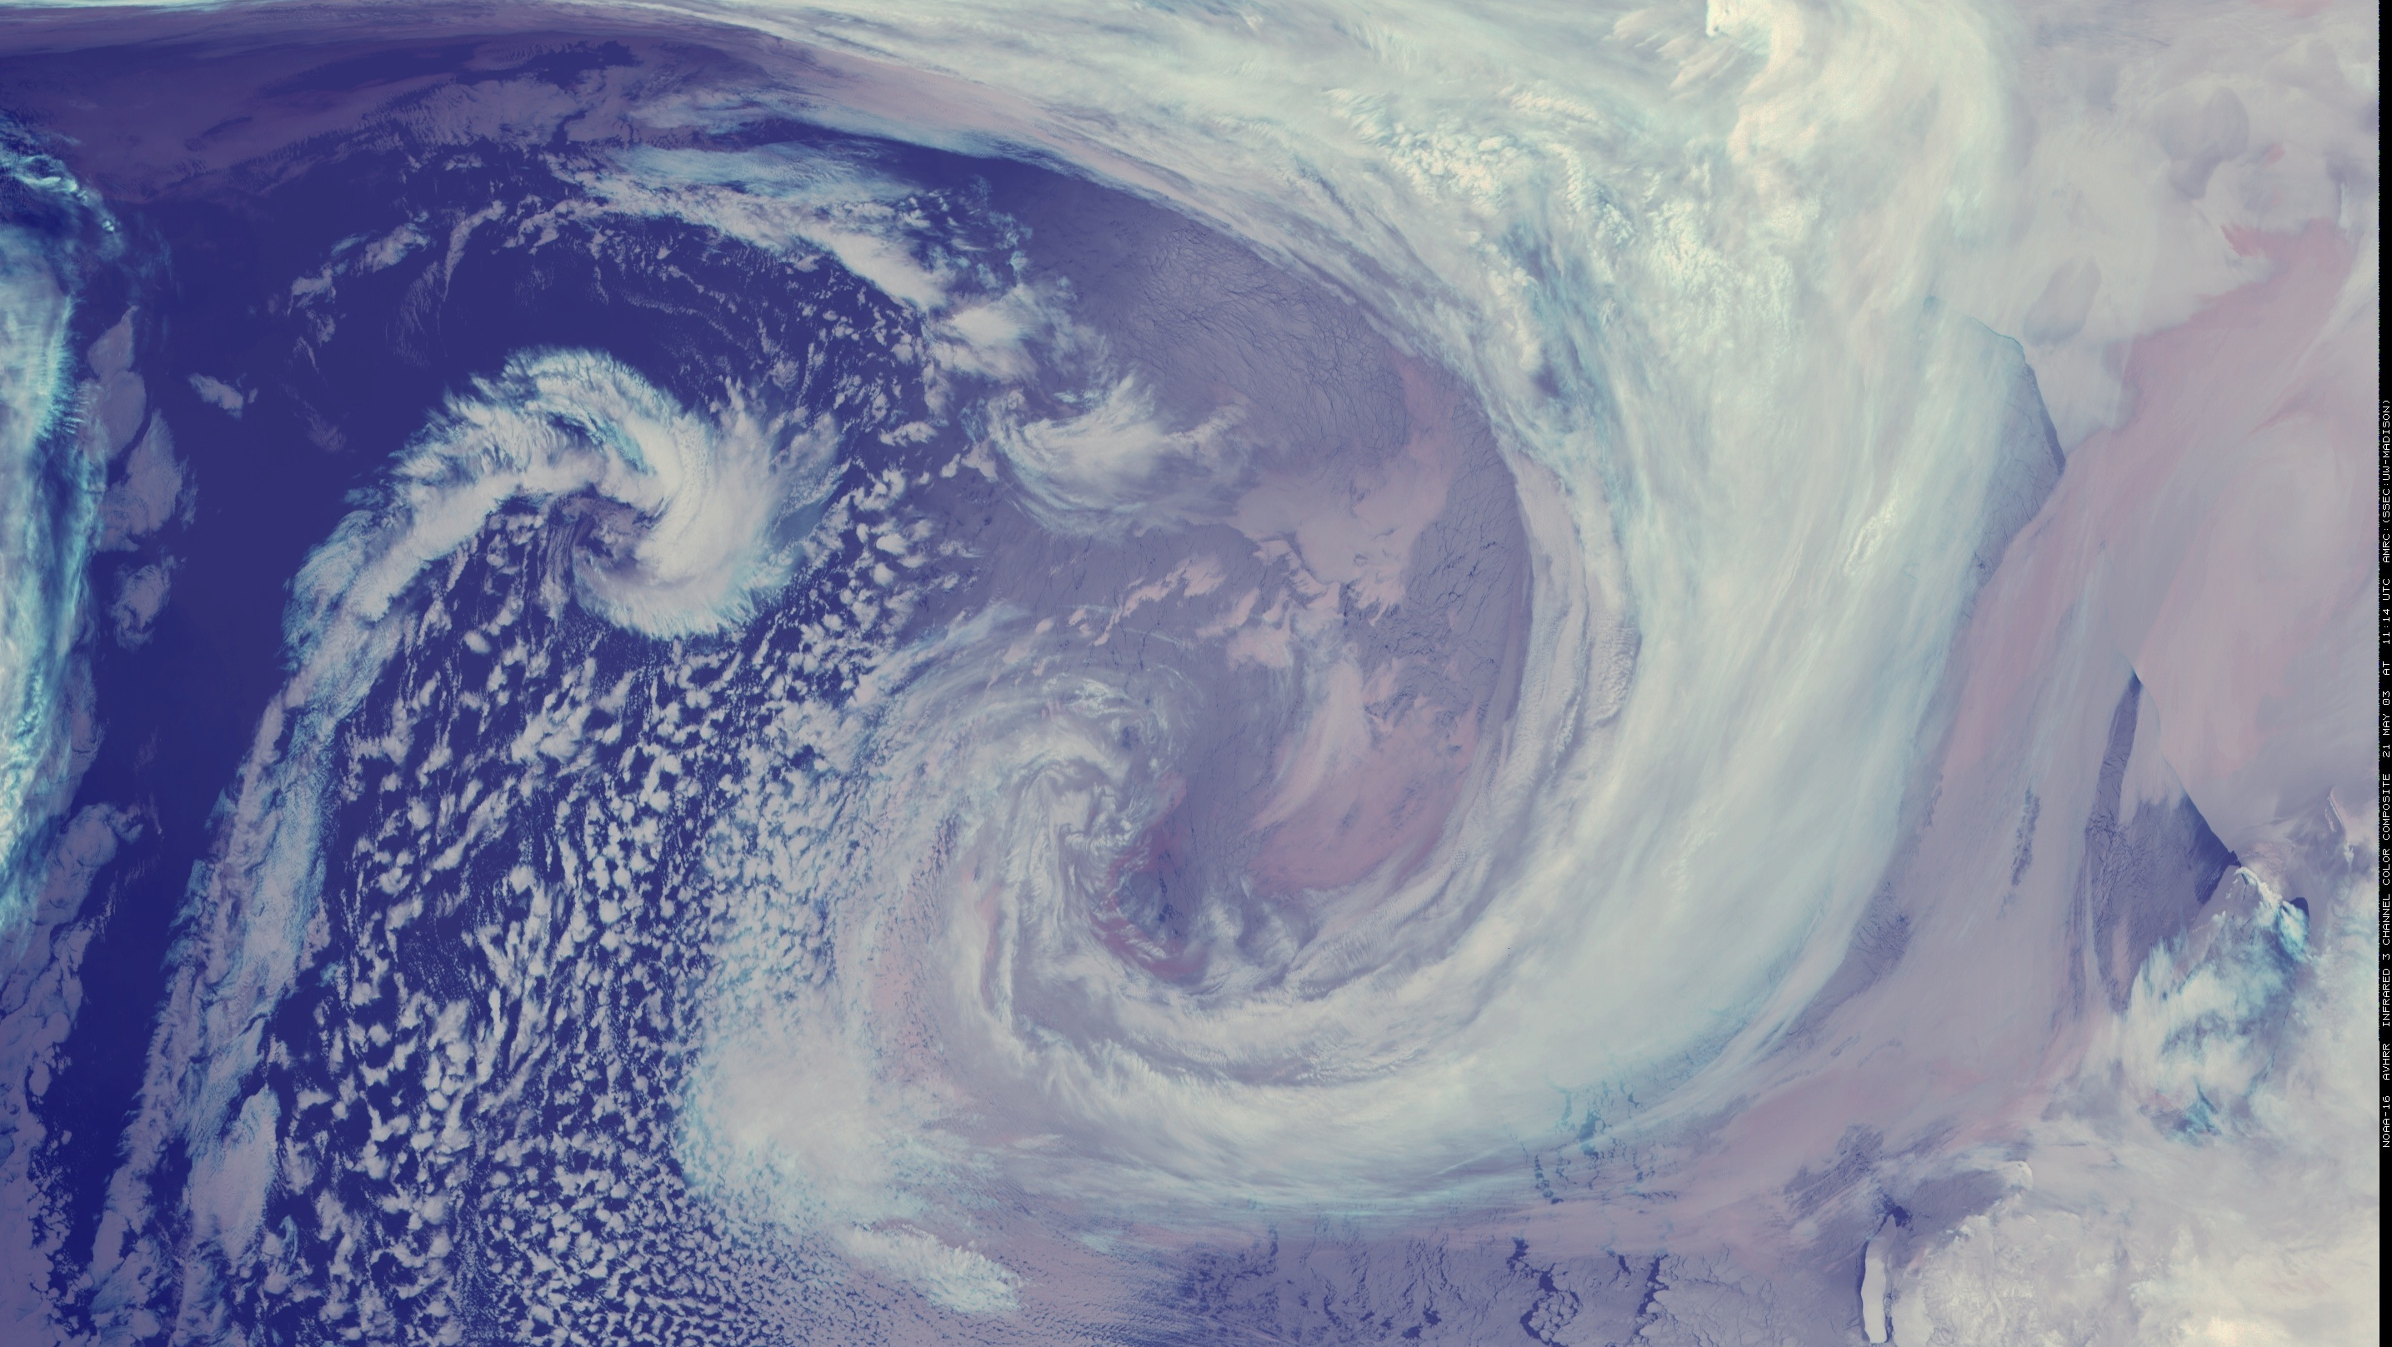
Outline
Status Report – The state of Antarctic Meteorological Observing Systems:
  Antarctic Automatic Weather Stations Network
  Satellite observing systems
  Other meteorological observing networks…
Sample Research Review
  Atmospheric River Events
    Antarctic Peninsula
    East Antarctica
  Teleconnections between the tropics and Antarctic
    ENSO and Rossby wave propagation
  Warming Events
    2022 East Antarctic Event
Notes:
This talk is in two parts: 1. A status report to the community on the observing of the Antarctic from a meteorology point of view. 2. A sample of the research that utilizes observations…a review…examples.

Slide 3
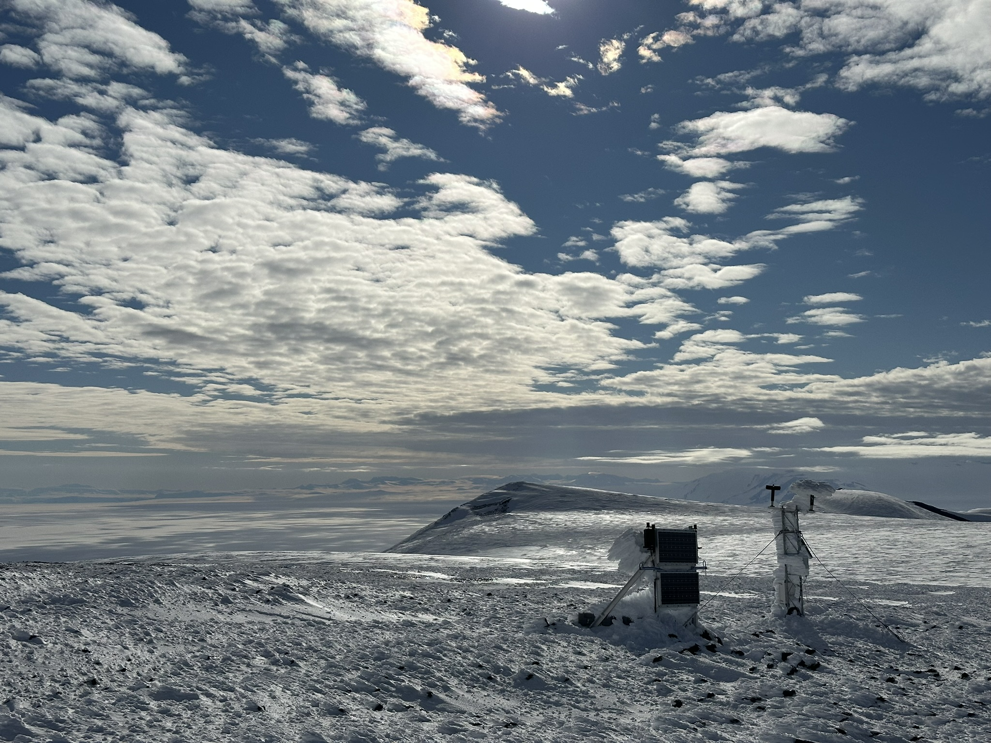
Antarctic Observations
A status report to the community
Notes:
And we must show off nice photos of Antarctica and observing systems!

Slide 4
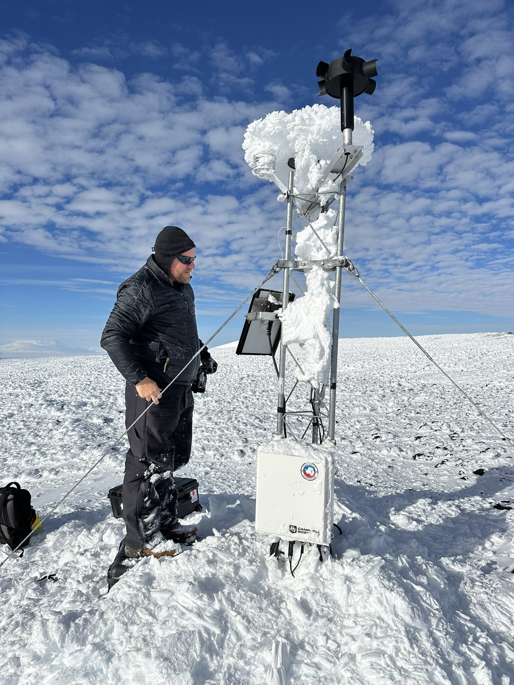
Automatic Weather Stations AWS
The Antarctic AWS network news:
  New AWS stations from China and Chile in recent years
  Decline in operating AWS stations from USA and Netherlands
  Overall stability across the continent for providing the bulk of surface observing
Some Challenges:
  Recovering from lack of field work during the pandemic
  A problem for the Wisconsin network – real-time (see next slide)
  Issues with visiting sites in West Antarctica and deep East Antarctica
Some Successes:
  AWS accepted in the community for climate analysis
  AWS are operationally essential for direct use and numerical weather prediction
Please check out the map on the next slide – sent updates, corrections to: Matthew Lazzara mattl@ssec.wisc.edu
Minna Bluff AWS
Courtesy of
Tyler Plekan
Notes:
Here’s our status – The Antarctic AWS network has some growth from some nations like China and Chile….and some declines from USA and the Dutch. While the network is thus over all the same, we as a world are not growing our observing network. Ruth Mottrm has noted at a WMO function last year – we need more AWS. AWS are an accepted platform for everything and they are getting used – forecasting direct NWP, etc.

Slide 5
Automatic Weather Station Map…
Please send updates to:
Matthew Lazzara
mattl@ssec.wisc.edu
This map is for all!!
Community use!
Notes:
This is the known network for all AWS in Antarctica. What is missing? What is incorrect? What should be removed? Please contact Matthew so we can get this updated!

Slide 6
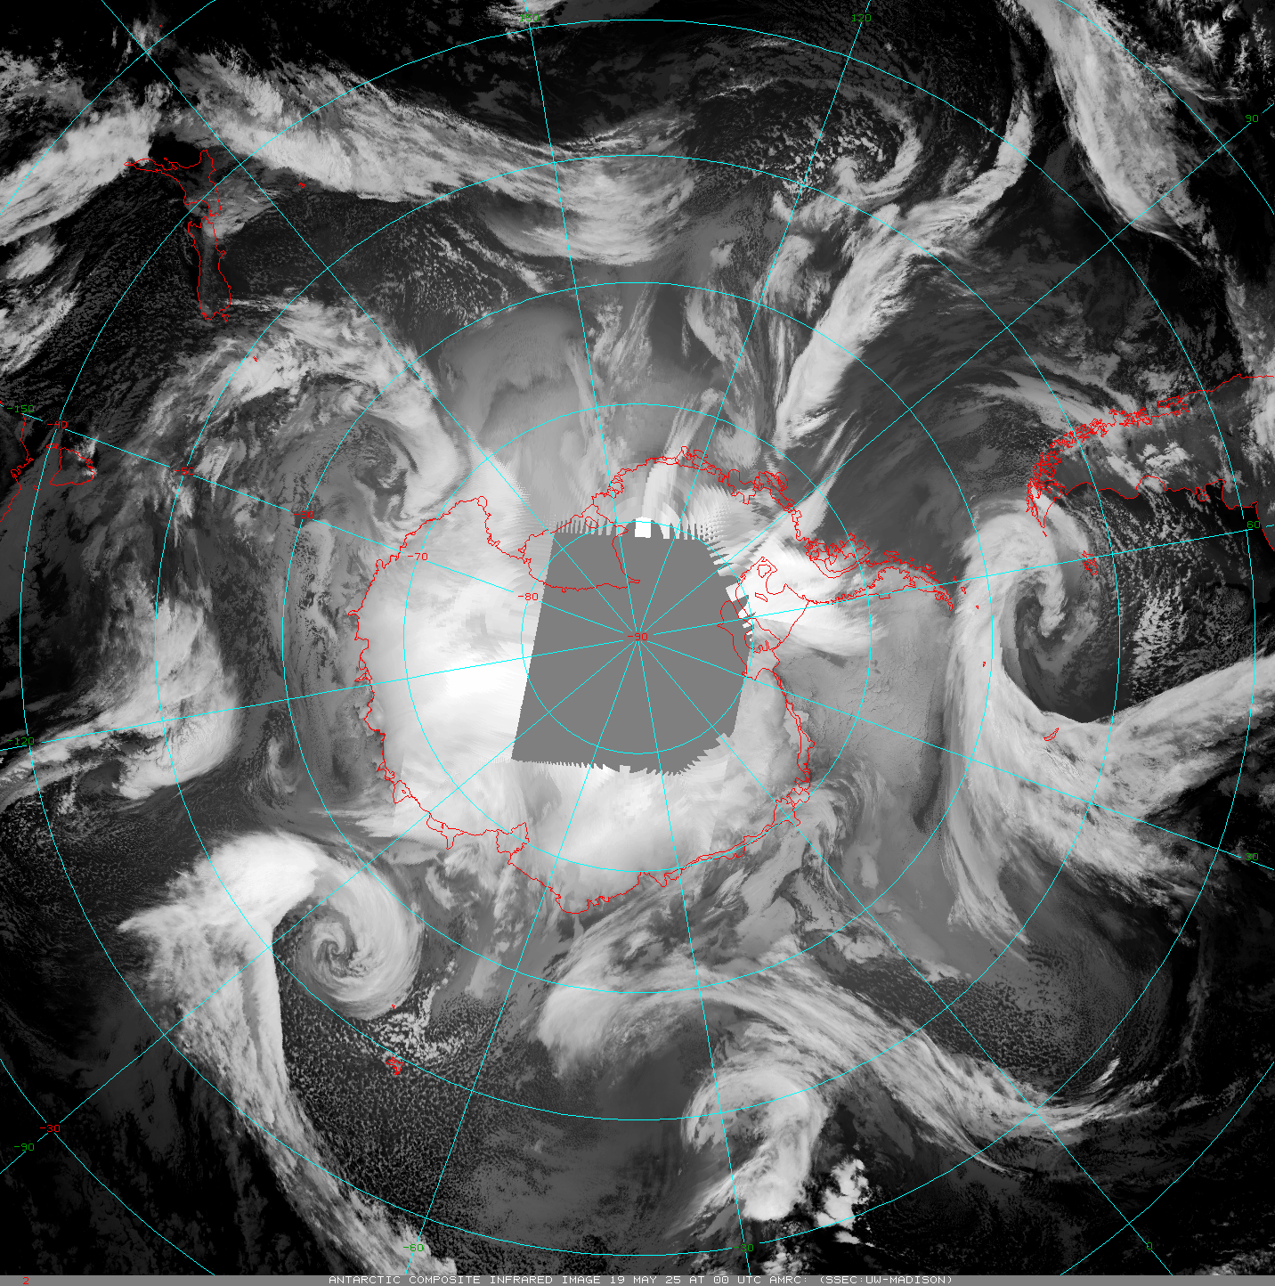
Satellites
Polar Satellites
Satellite Composites
USA
  Old NOAAs (-15 and -19)
    Sunset this summer (-18 is already off)
  Old DMSP
    Sunset in 2026
    SSMIS – global processing sunset already
  NASA – beyond end of life
    Aqua
    Terra – Direct Broadcast offline
    May sunset as soon as 9/1/2025
  S-NPP a backup satellite (end soon 2026)
  Current: NOAA-20, NOAA-21
  Coming soon: JPSS-3, JPSS-4
EUMETSAT
  Current: Metop-B and Metop-C
  Coming soon: Metop-SG
China - FY- Series
Russia - Meteor- Series
Others…
A Sample Animation - Wisconsin Composites:
Other composites made by Russia and China…
https://space.oscar.wmo.int/satellitestatuses/status
Notes:
Old satellite series are being shutdown…

Slide 7
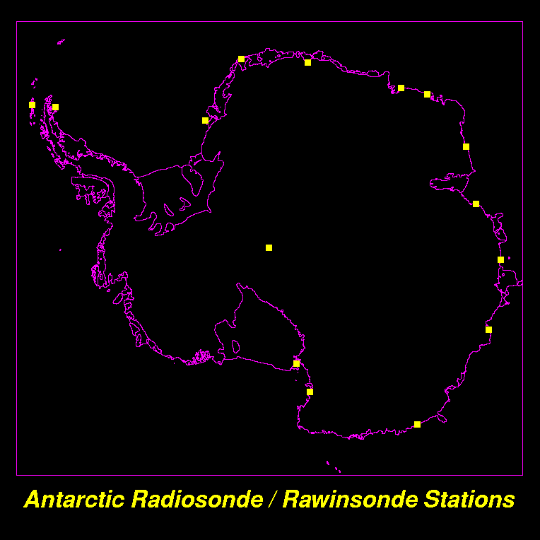
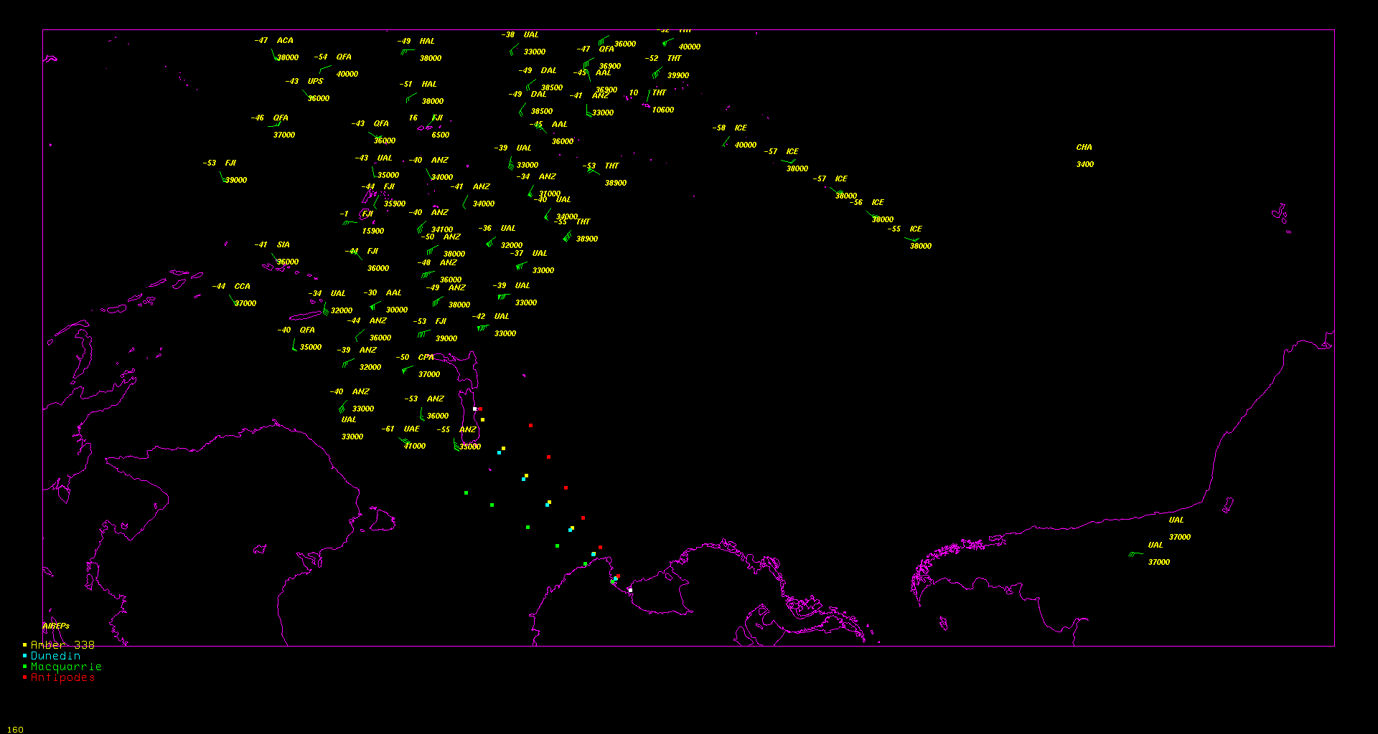
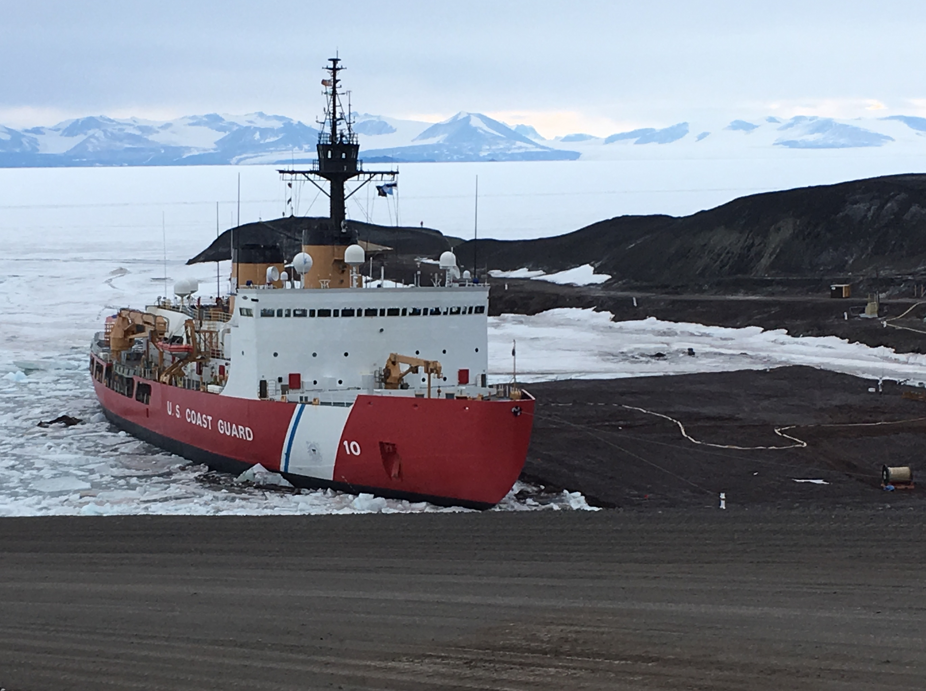
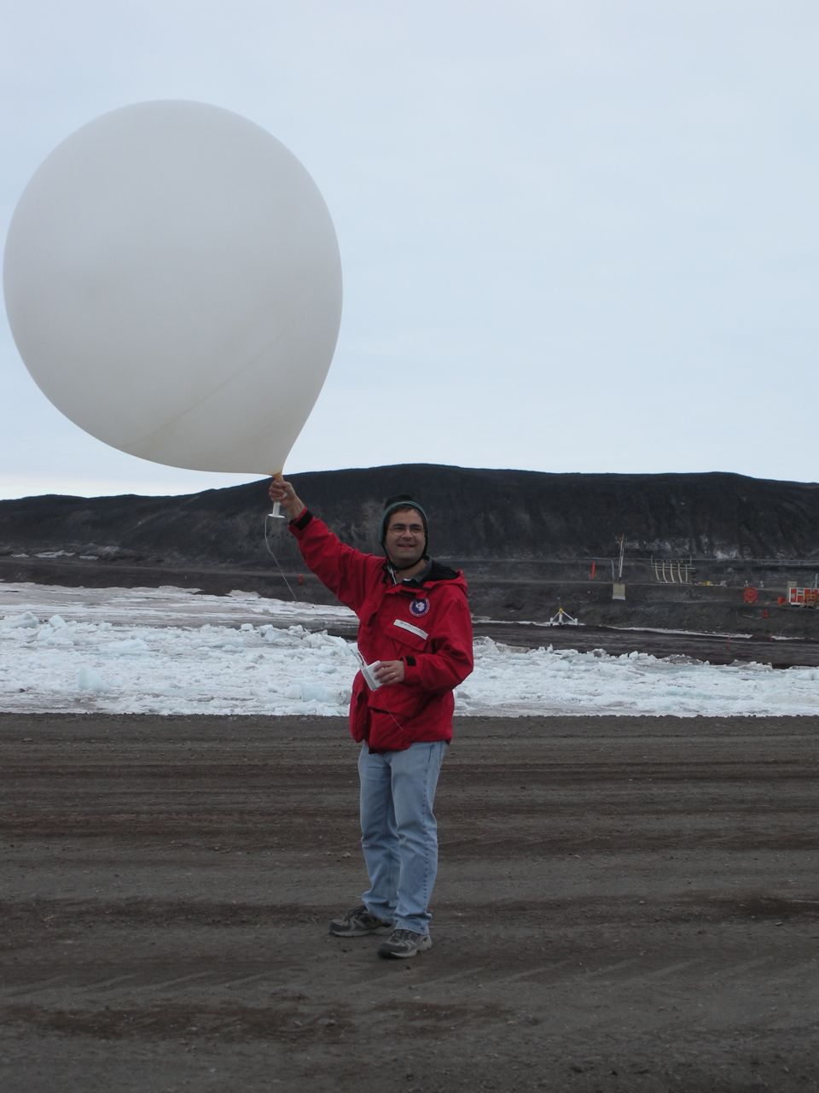
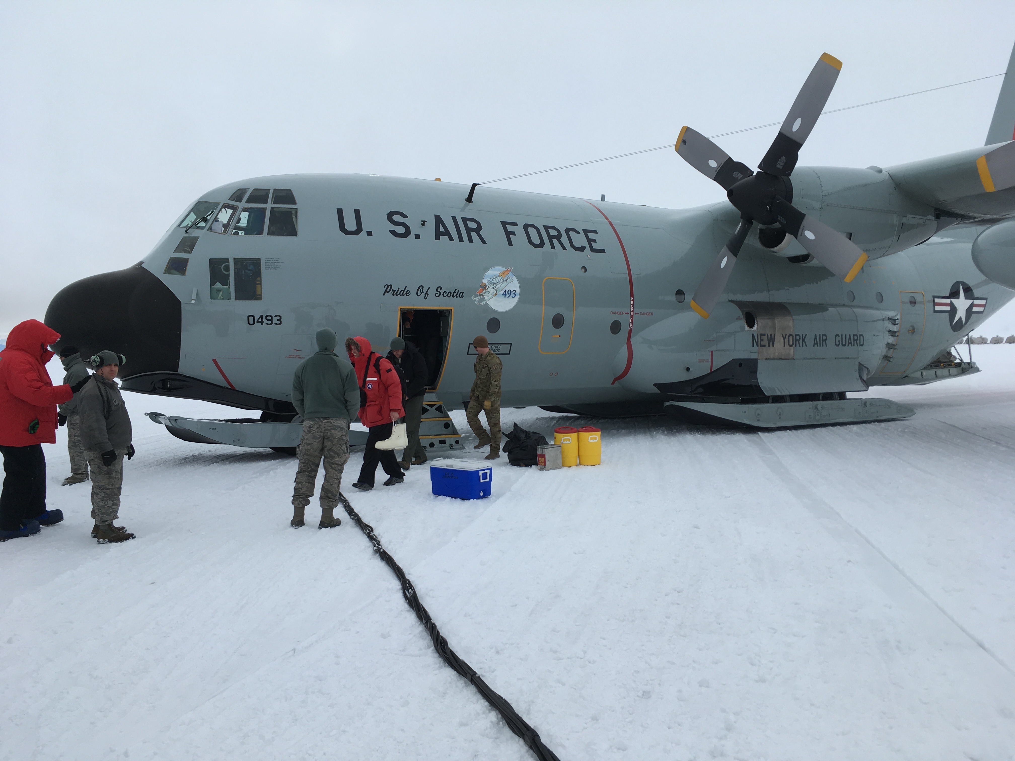
Other Antarctic Meteorological Observing Networks
Staffed Stations
Radiosondes
Ship/Buoy
Aircraft
Aircraft
Notes:
There are other observational networks in Antarctica…the typical/classic means…

Slide 8
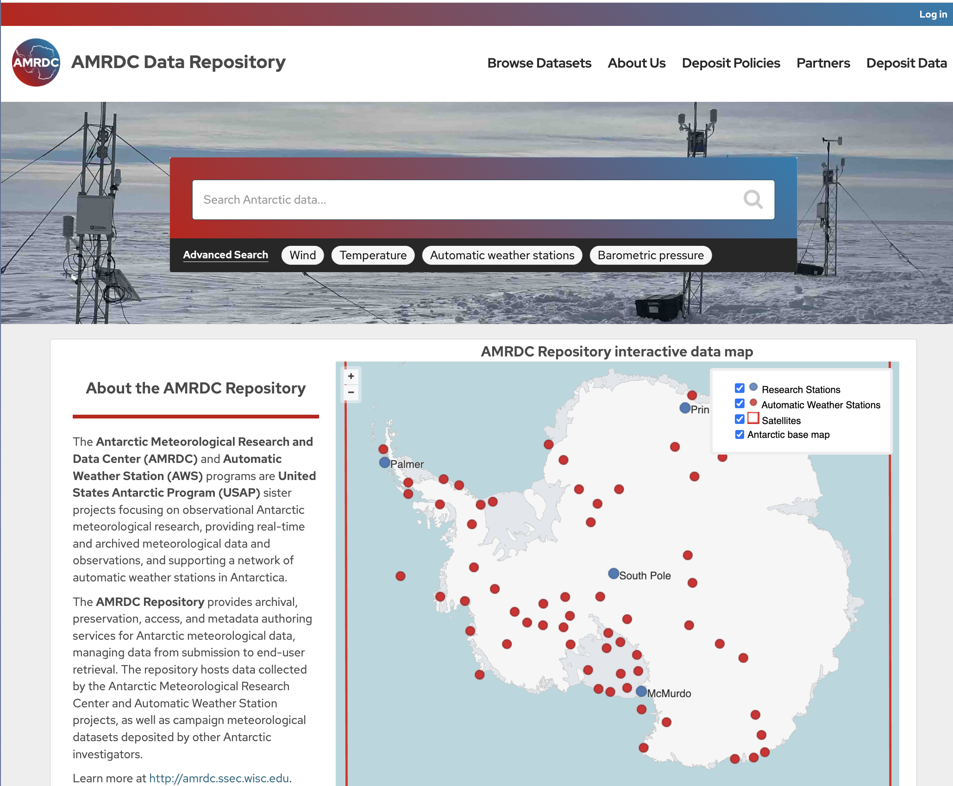






Antarctic Meteorological Research and Data Center (AMRDC)
Data Repository (ADR)
Official Antarctic Meteorological Data Repository and Archive!
This is a community asset!!
  Submit your data!
  Use data from here!
Over 5400! Datasets…and growing
https://amrdcdata.ssec.wisc.edu
Notes:
Get your phone out! Get the QR codes in this talk – here is the first! This data repository is for you – an Antarctic Meteorological Disciplinary based repository for the community! We welcome data input and please use this is a data source!!

Slide 9
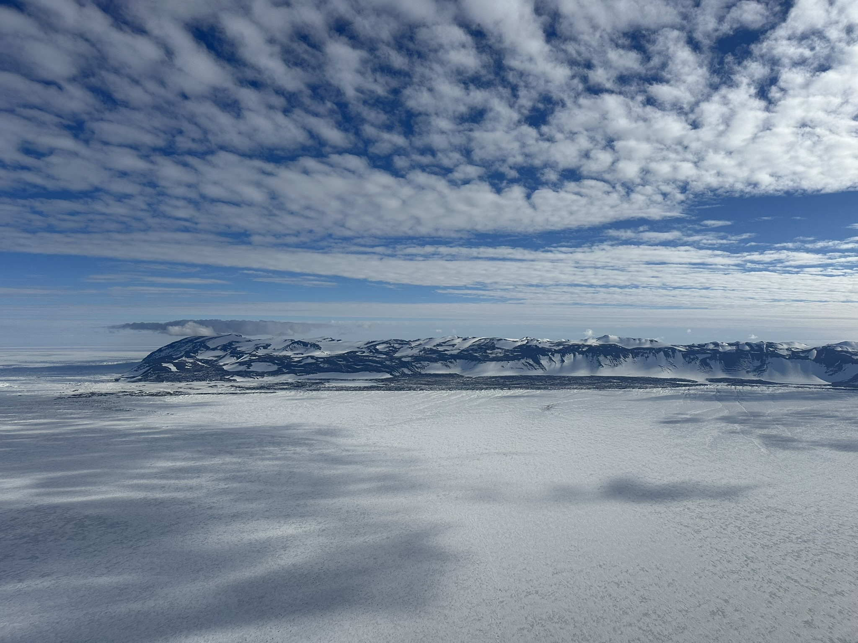
Antarctic Research
A sample review using observations

Slide 10
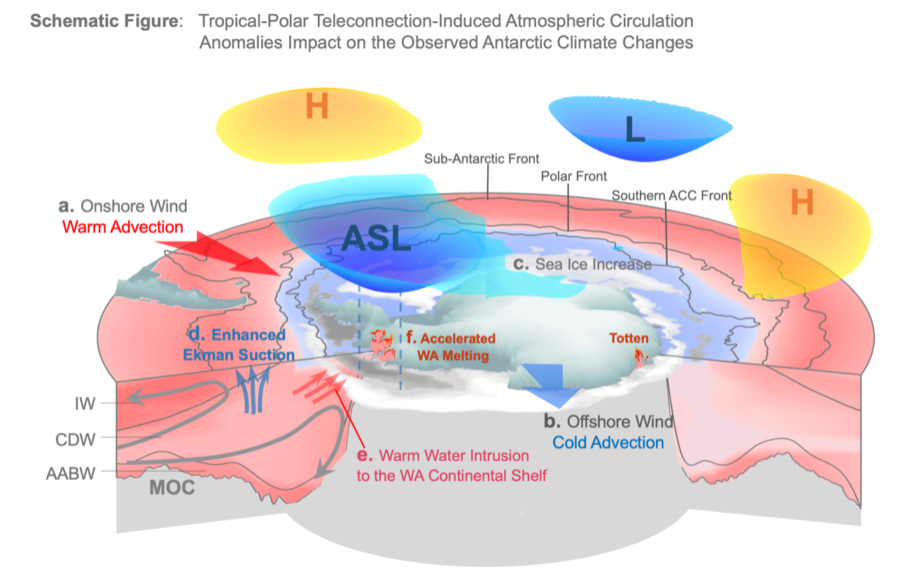
Xichen Li, et al.
Tropical – Polar Teleconnections
Notes:
Since the 1990s, the tropical-polar teleconnections from the Atlantic and Pacific Oceans deepen the Amundsen Sea Low (ASL) in association with positive phase of Southern Annular Mode (SAM). Through geostrophic balance, the ASL drives increased warm-air advection (a, red arrow, onshore wind) over West Antarctica (WA) and the Antarctic Peninsula, together with increased cold-air advection (b, blue arrow, offshore wind) over the Ross Sea. These surface wind changes contributed to the overall increase in Antarctic sea ice (c. the Antarctic sea ice paradox) and redistributed sea ice around West Antarctica. Anomalously strong westerly surface winds associated with the negative phase of the IPO and positive SAM strengthened Ekman suction (d. blue arrows) over the Southern Ocean, moving warm subsurface waters closer to the surface. Wind-driven ocean circulation changes drive variability in warm-water intrusions to the West Antarctic continental shelf (e. red arrows) that are implicated in the loss of glacial ice around West Antarctica (f). When the IPO transitioned to positive around 2015 and the SAM became positive in 2016, the westerly winds over the Southern Ocean weakened leaving the entire upper ocean column anomalously warm, thus contributing to the Antarctic sea ice retreat that started in 2016.

Slide 11
Extreme Precipitation Event (EPE)
Simon, et al.
EPE with Atmospheric River Event details:
EPE on 8–9 November 2015 – This was the highest precipitation event recorded at the ice core site located at 71.5°S, 10.5°E, delivering approximately 22% of the total annual precipitation in just two days (about 45 mm).
A combination of extreme conditions in both the upper and lower atmosphere (a deep low-pressure cyclone to the west and a record-strong high-pressure ridge) triggered the occurrence of this EPE.
Sudden deepening of the cyclone was favoured by the presence of 'jet streaks' in the upper atmosphere (at 250 hpa)

Slide 12
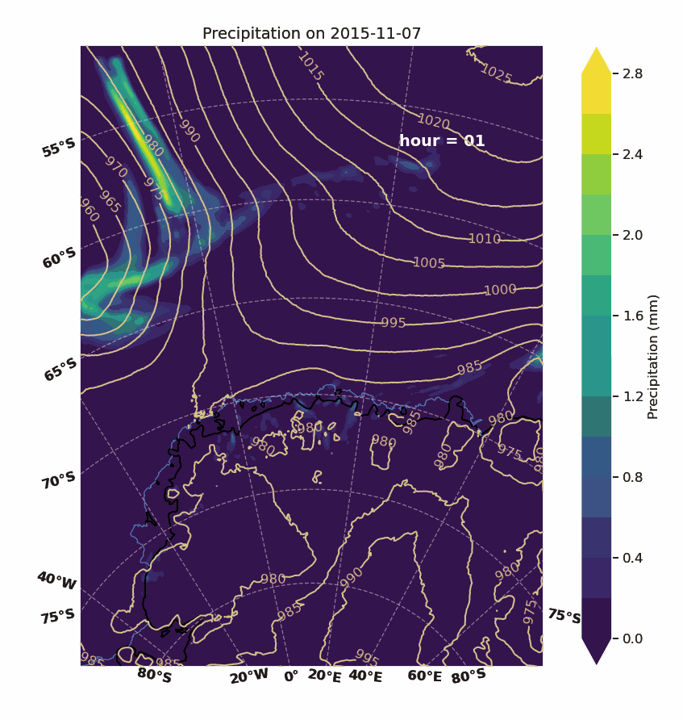
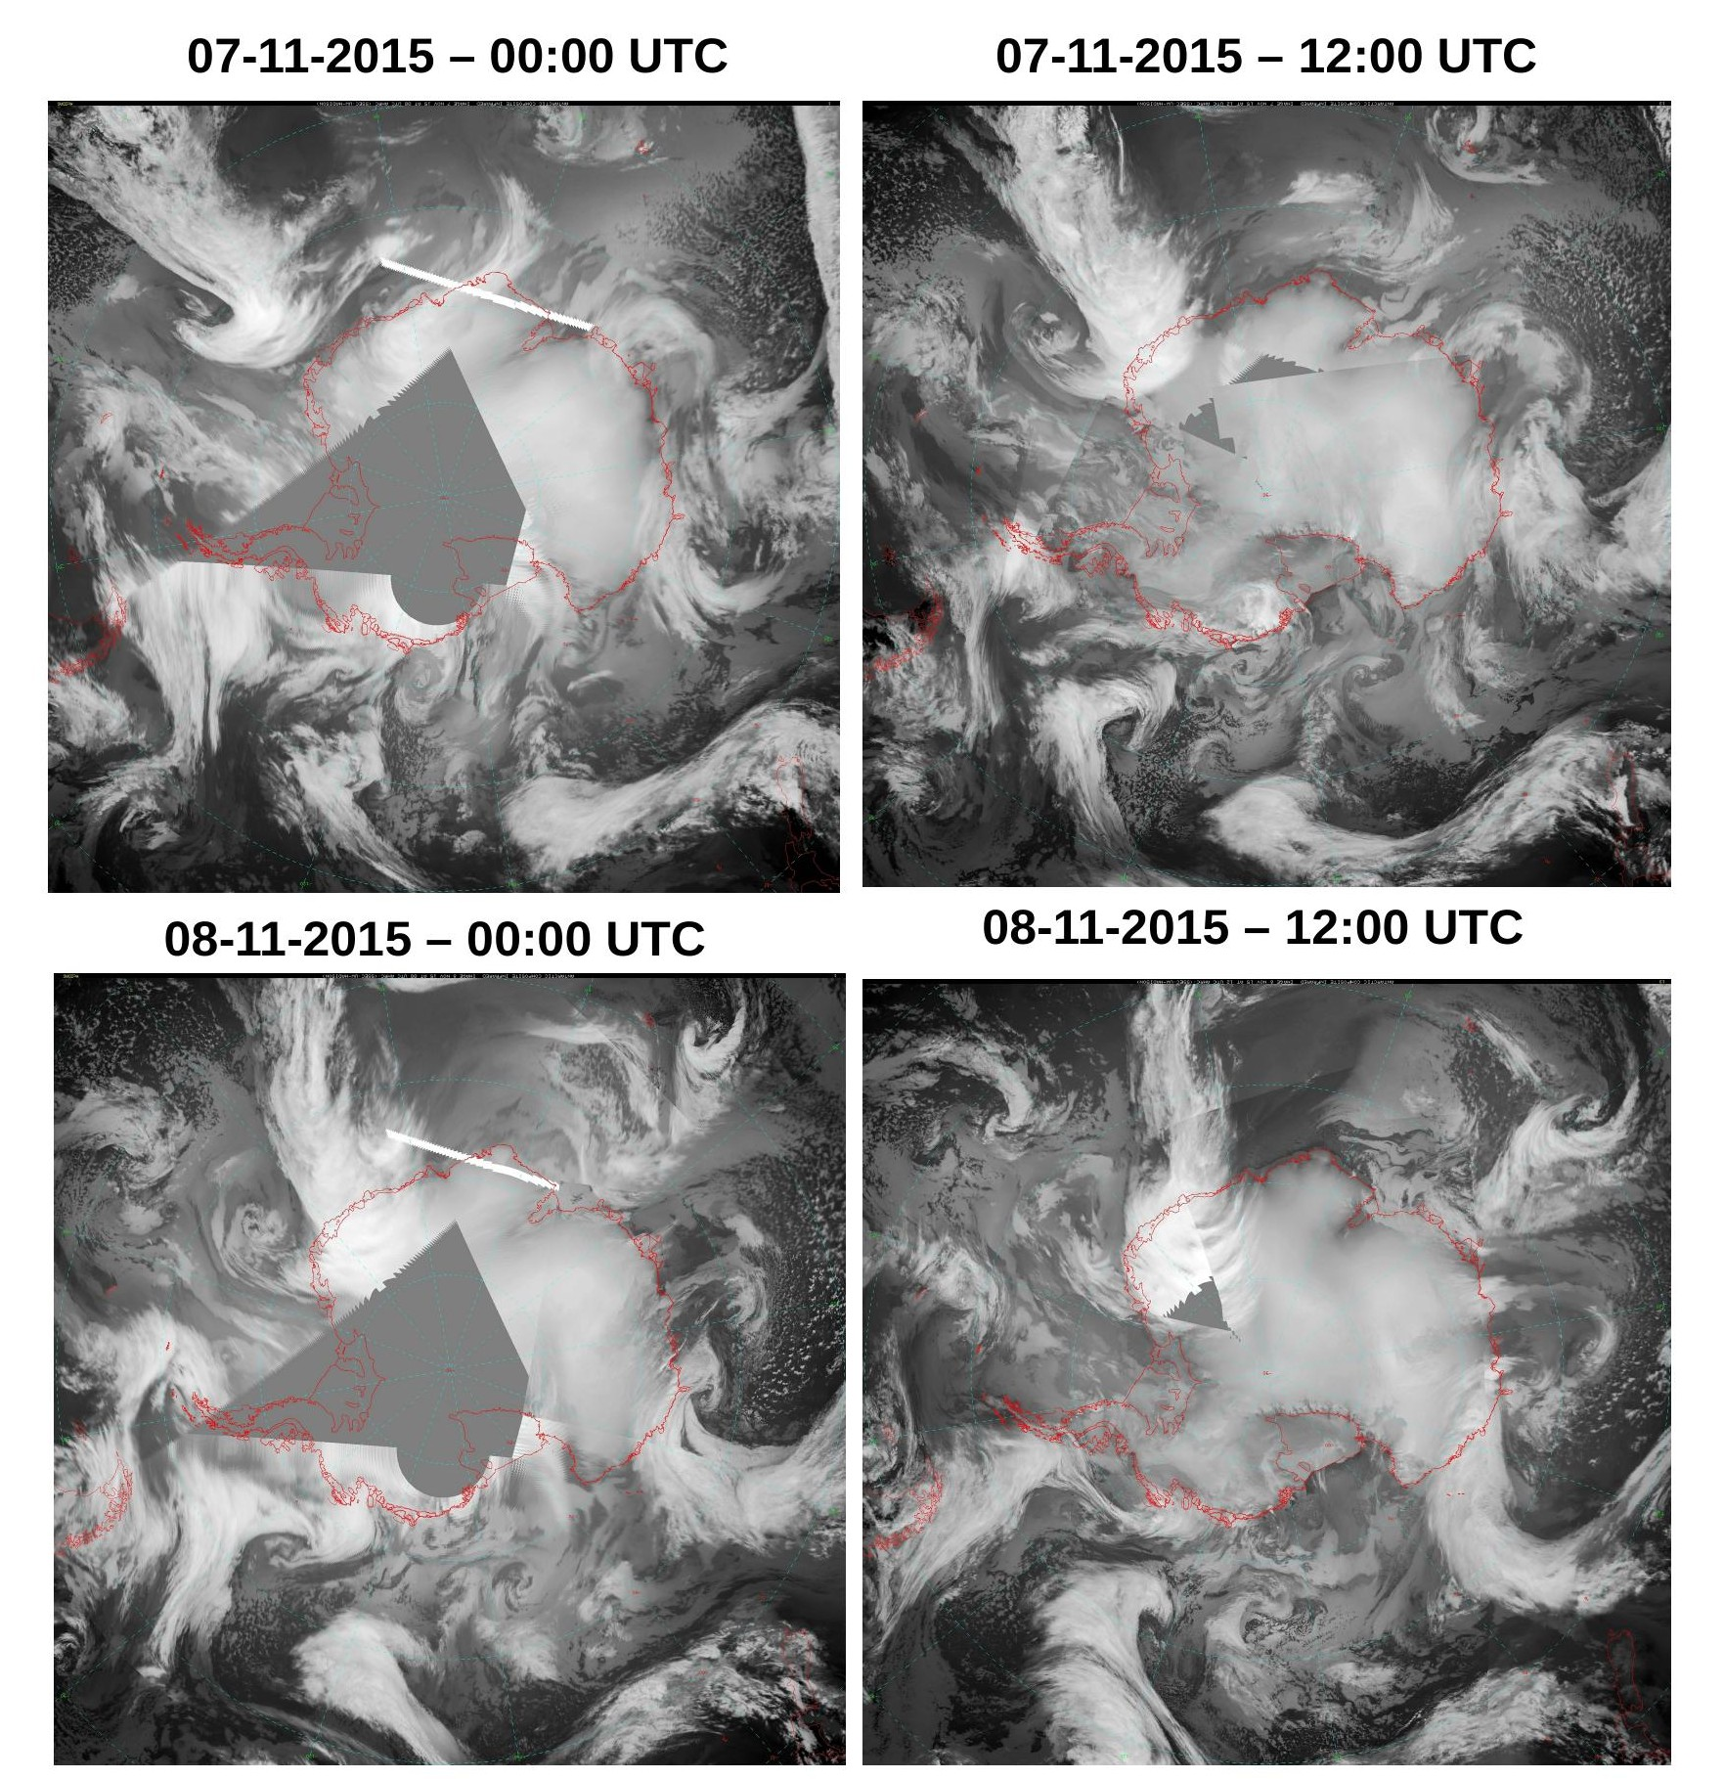
Simon, et al.
Notes:
Merged satellite imagery during the event period – Antarctic Composite Satellite imagery from University of Wisconsin
An animation of the event showing hourly precipitation simulated by Polar WRF

Slide 13
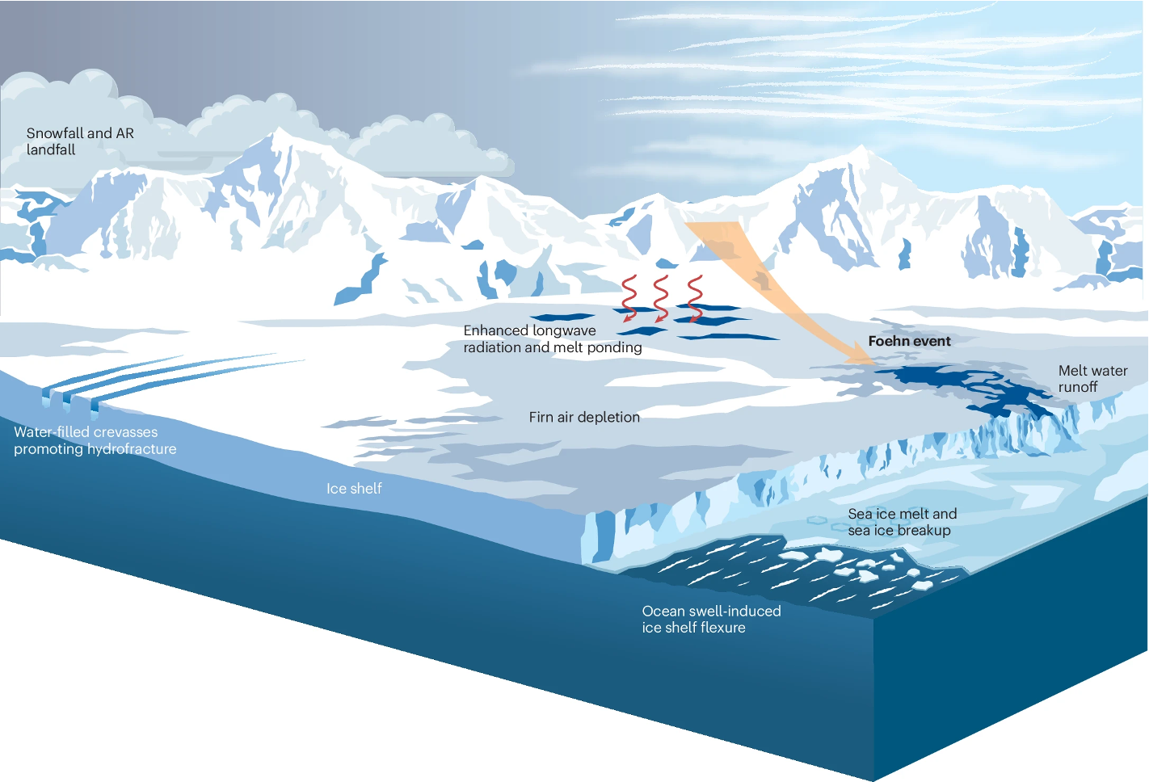

Jonathan Wille et al.
Review paper on Antarctic Atmospheric Rivers
Recently published in Nature Reviews Earth and Environment
Contributions from 32 coauthors
Covers topics like ...
  AR dynamics (global, synoptic, mesoscale)
  Microphysical processes
  Climatology and variability
  Surface mass balance impacts
  AR extremes
  Ice shelf destablization risks
  Sea ice impacts
  Ecosystem impacts
  Water stable isotopes
Wille et al. (2025)
Notes:
See above…

Slide 14
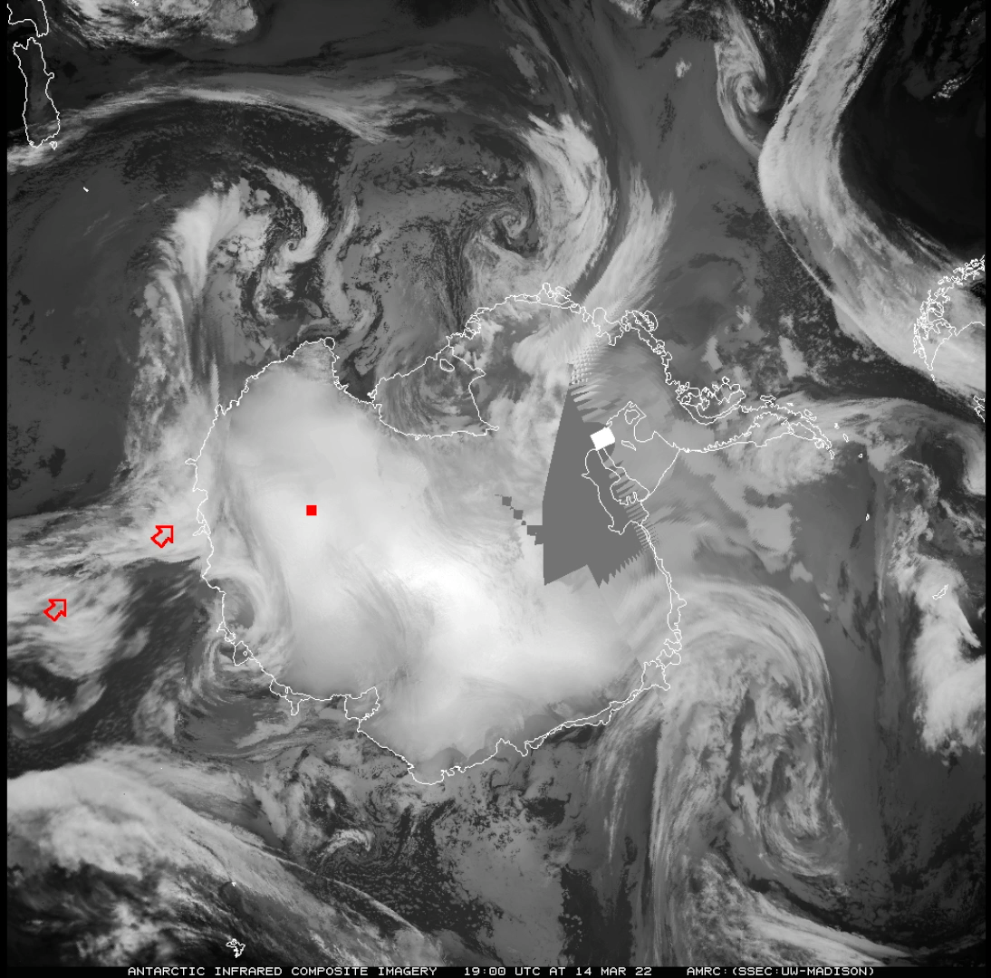



The extraordinary March 2022 East Antarctic Heatwave
Jonathan Wille et al.
Largest recorded temperature anomaly globally (39° C at Dome C)
54 researchers from around the world exploring interdisciplinary aspects of event
Focusing on …
  Synoptic scale meteorological drivers
  Atmospheric river dynamics
  Surface mass balance impacts
  Surface energy budget
  Conger Ice Shelf collapse
  Isotope measurements
  Historical event significance/probability
Wille et al. (2021) AR detection catalogs (ERA5 and MERRA2 1980-2023)
Paper (part 1)
Paper (part 2)
Notes:
See above…

Slide 15
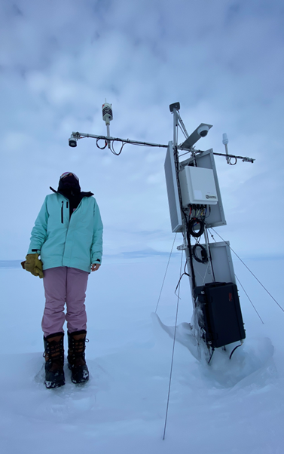
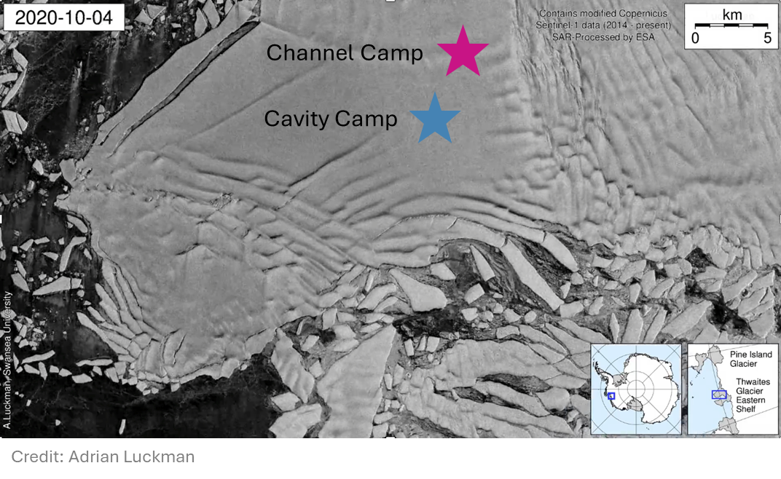
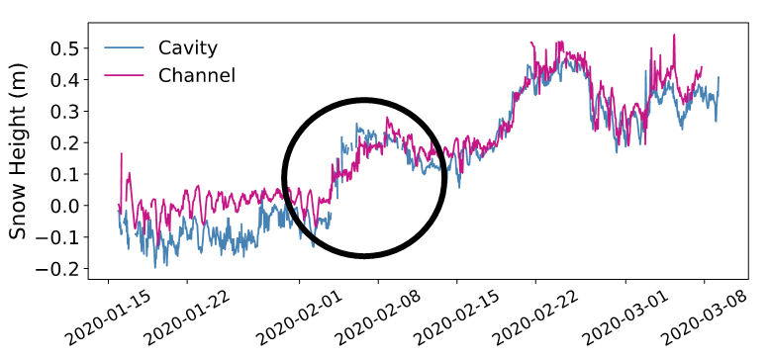
February 2020 atmospheric river family on Thwaites Glacier
Michelle Maclennan et al.
AWS on Thwaites Eastern Ice Shelf, January 2023
Notes:
Represents a highly interdisciplinary approach to analysing an extreme event, with the AMIGOS AWS observations at the core of the work - used to identify the occurrence of the event in the first place, characterize the near surface conditions, quantify biases in MERRA-2 and ERA5 reanalyses, validate output from the regional models, and force a firn model to reconstruct the surface impacts on accumulation and melt.
•ARs induce complex surface impacts: sometimes melt, rainfall and snowfall at once
•Families can produce prolonged surface impacts

Slide 16
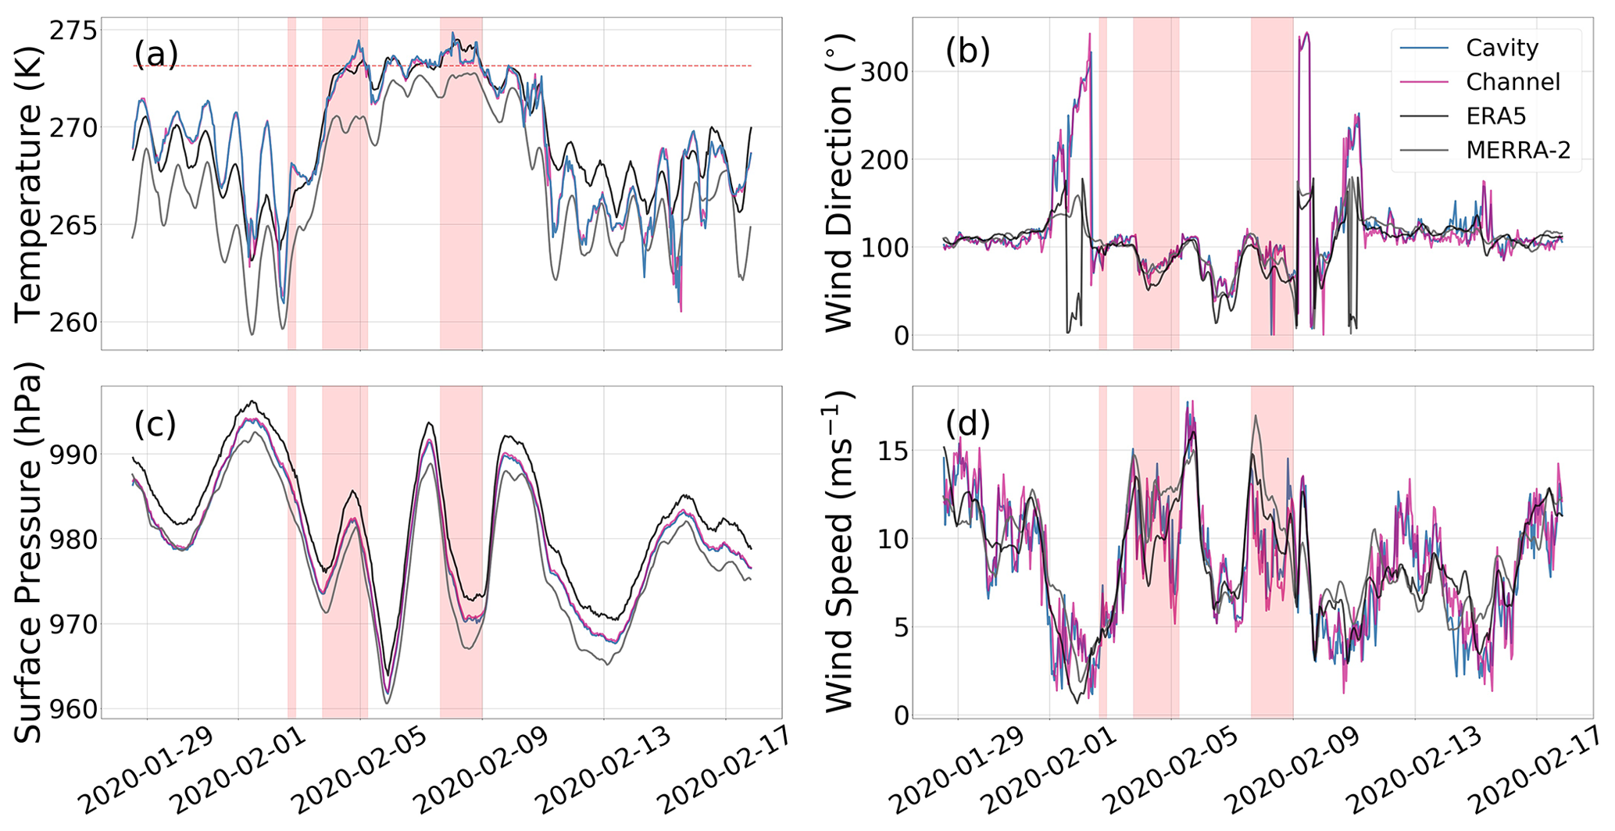
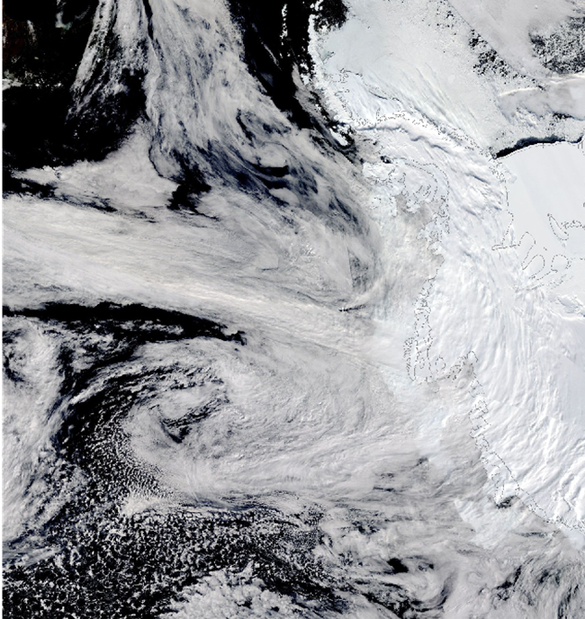
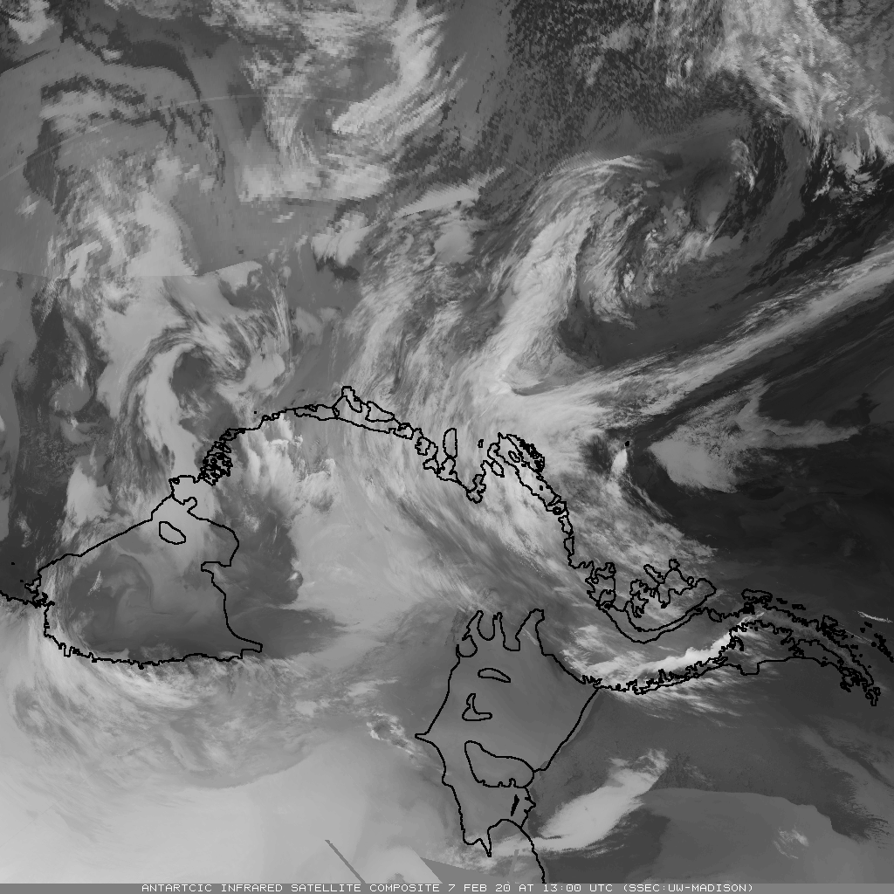
Michelle Maclennan et al.
February 2020 atmospheric river family on Thwaites Glacier
MODIS Corrected Reflectance, 07 February 2020
NASA Worldview Database
What happened?
3 atmospheric rivers make landfall in the ASE in rapid succession from February 2-8, 2020
100 mm w.e. accumulation – about 90% of the average annual accumulation from atmospheric rivers here
surface temperatures ~ 0° C for 5 days
Maclennan et al. 2023
Wisconsin Satellite Infrared Satellite Composite Imagery 13 UTC on 7 Feb 2020
Notes:
Represents a highly interdisciplinary approach to analysing an extreme event, with the AMIGOS AWS observations at the core of the work - used to identify the occurrence of the event in the first place, characterize the near surface conditions, quantify biases in MERRA-2 and ERA5 reanalyses, validate output from the regional models, and force a firn model to reconstruct the surface impacts on accumulation and melt.
•ARs induce complex surface impacts: sometimes melt, rainfall and snowfall at once
•Families can produce prolonged surface impacts

Slide 17

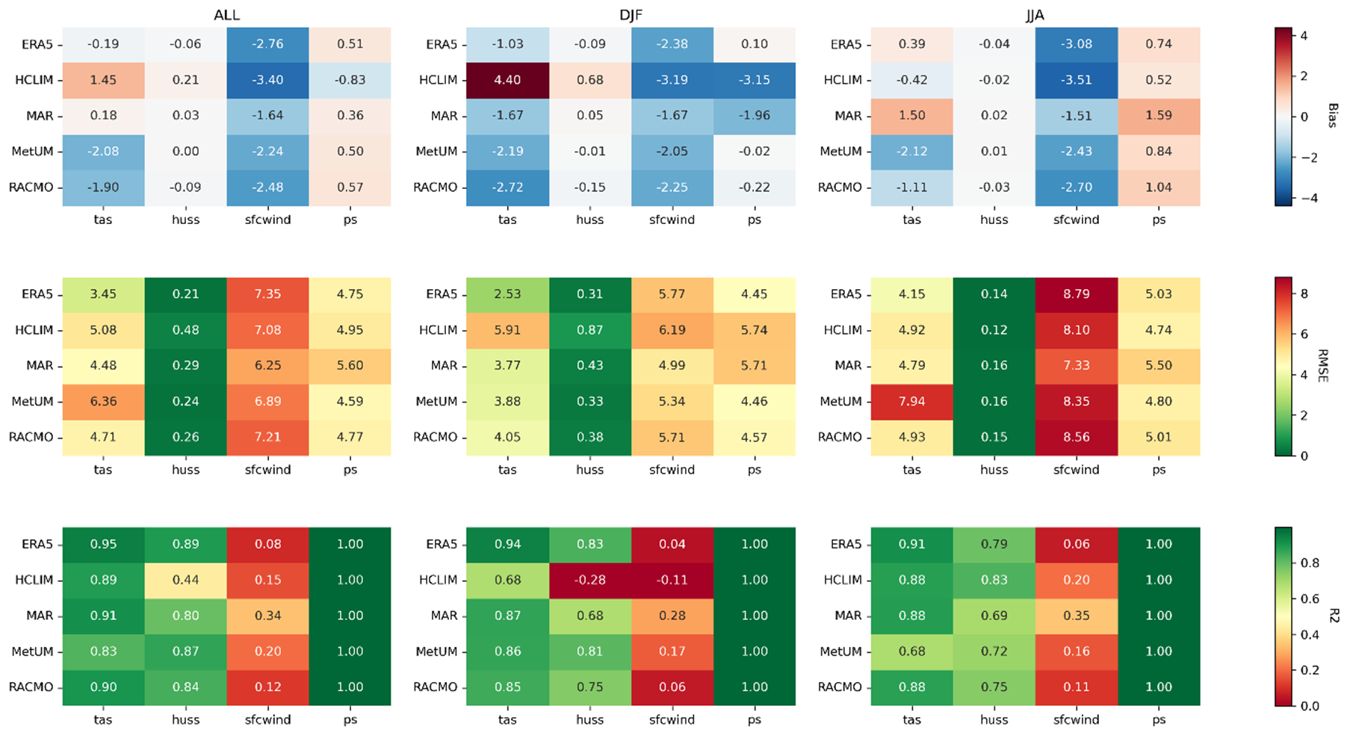
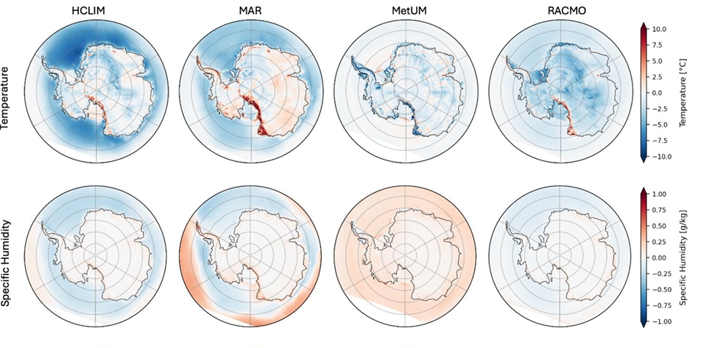
Ella Gilbert et al.
Presenting: The PolarRES ensemble, a state-of-the-art modelling resource for polar climate applications.
What is it? 4 state-of-the-art regional climate models, (HCLIM, MAR*, MetUM & RACMO2.4) run at 11 km (12km*) resolution over a pan-Antarctic domain.
polarres.eu
All RCMs perform well with respect to AntAWS observations (left) and ERA5 (below). For more info, watch out for our forthcoming publication...
3 simulations available :
ERA5 hindcast (2000-2022, with some RCMs running 1995-2024)
2 x GCM-driven future projections (1985-2100) following storylines of Antarctic climate change (after Williams et al., 2024)
Figures: Marte Hofsteenge (from Gilbert et al., in prep)
All data will be on ESGF by end of August 2025 – please use them :)
Notes:
We're nearing the end of a project, polarres, which has involved running a suite of sophisticated high-resolution regional climate models for the Antarctic (and Arctic).
It's a big improvement vs previous generations of models, better than ERA5 and better than GCMs.
Fig (left) shows performance of ERA5+RCMs for different variables – detail unimportant but colour code helps understand bias (top), RMSE (middle) and correlation (bottom). Winds are the dodgiest (i.e. red!), probably because of measurement error
Fig (right) shows comparison between ERA5 + RCMs. This plot shows temp and humidity differences (not biases!) in JJA
We want people to use the data! It's freely available and will (v soon) be on the ESGF for download.

Slide 18
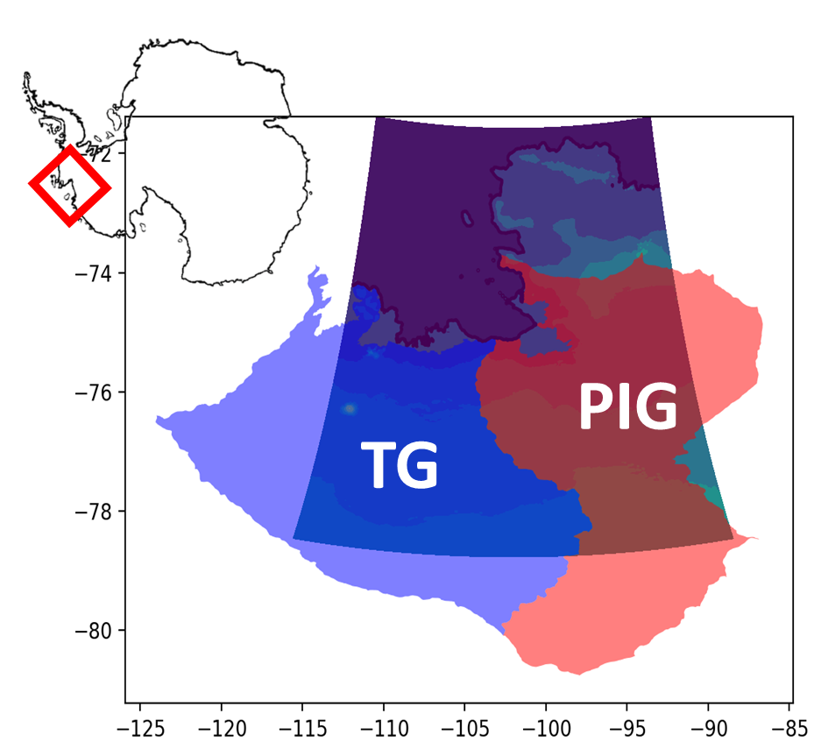

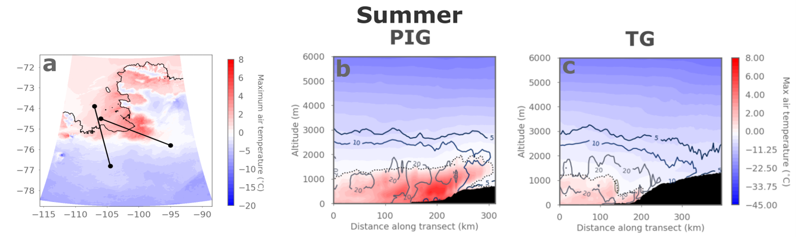


Super-cooled rain falls during West Antarctic atmospheric rivers
Ella Gilbert et al.
Warm near-surface conditions induced by airflow over steep topography (foehn effect)
Read the paper
Colours: max air temps during extreme AR event
Contours: accumulated rainfall totals during AR
b
c
Watch the video
Gilbert et al. (2025)
Liquid precip falling above 0°C line, i.e. supercooled rain. Topography generates more snowfall via seeder-feeder effects, plus supercooled rain falling above melt line
We need in situ obs of rain in Antarctica!
Use the data
Notes:
Atmospheric rivers are super important in West Antarctica, and can bring huge % of annual snowfall. But can also bring rain, which we don't measure at the moment!
Used several regional climate models (from PolarRES ensemble) to simulate impacts of ARs on Thwaites and Pine Island ice shelves. This was v high resolution, 1 km.
Max air temperatures rose above freezing because of warm air advection + foehn effect produced by the AR moving over steep terrain (far left panel )
Looking vertically (middle & right panels), we can see a warm pool of air over the ice shelves and inland up the glaciers (TG/PIG). However, *rain* is falling above the 0deg line, indicating that it is supercooled liquid – not just melted snow falling through a warm layer. Shows the complexity of microphysics in ARs – needs high res (<5 km) to capture this
We need OBSERVATIONS of rain in Antarctica!

Slide 19
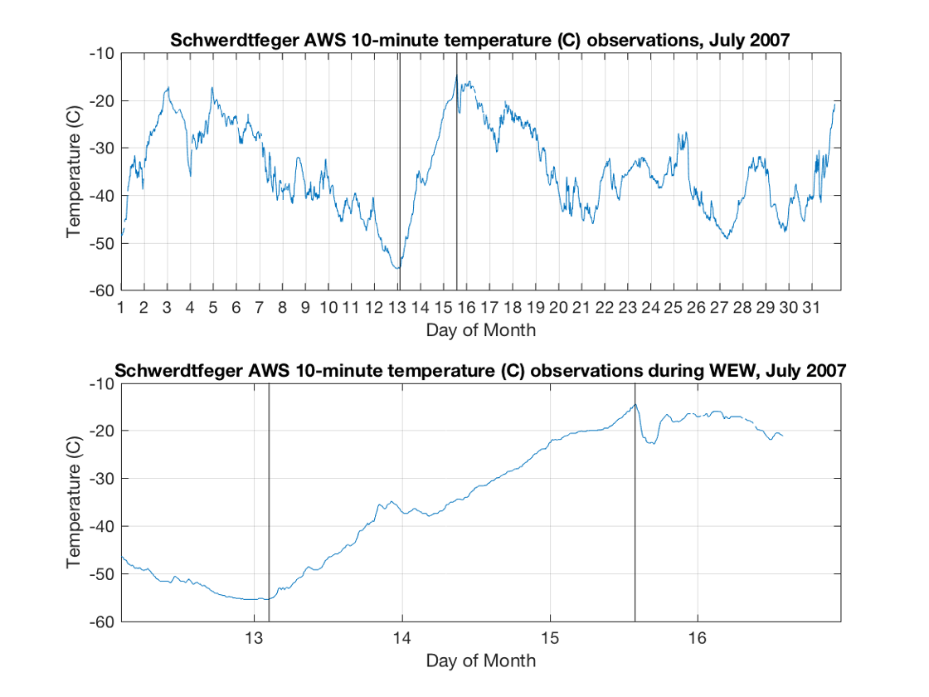
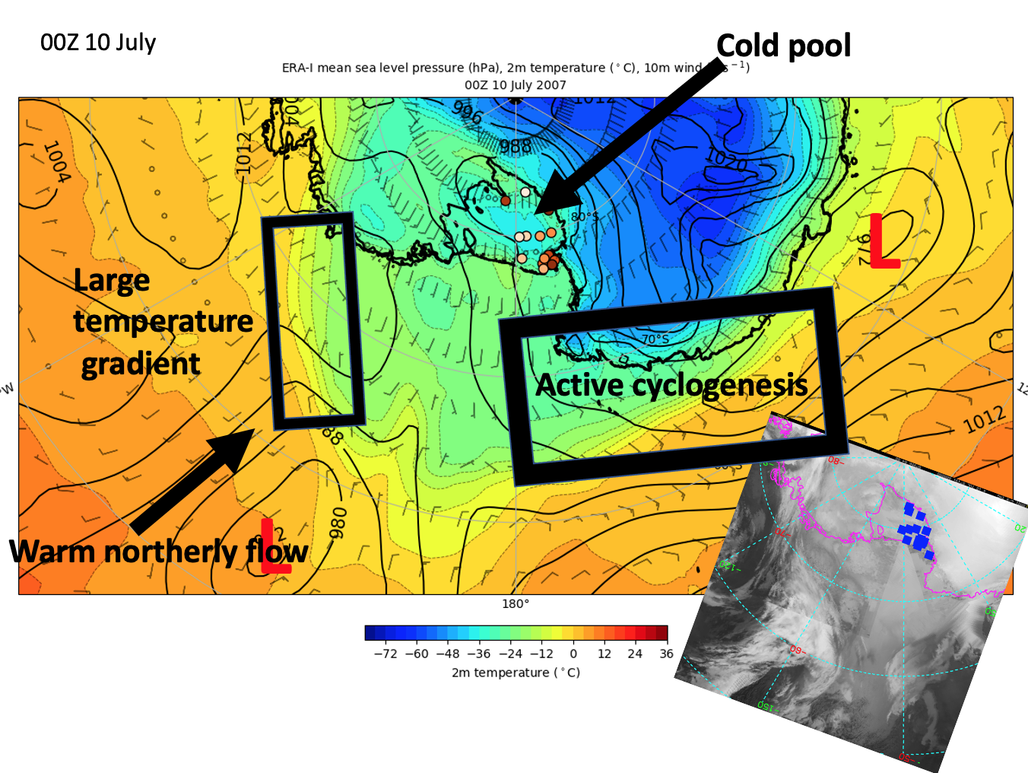
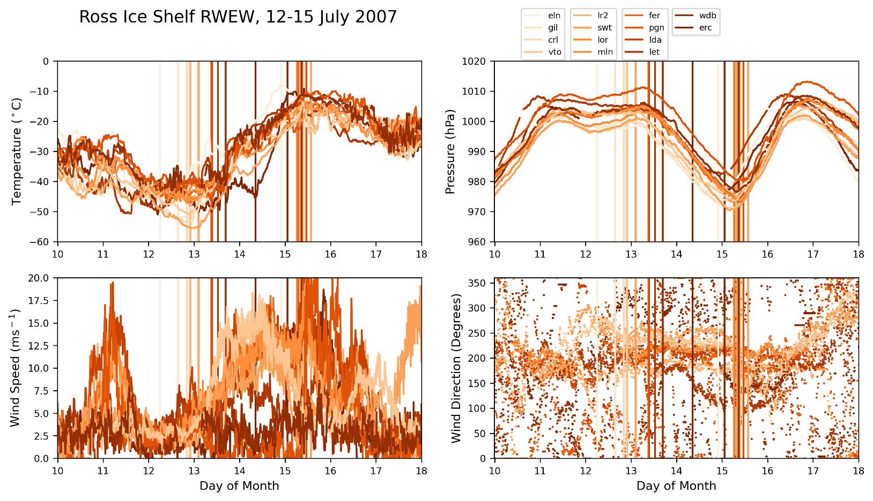
Regional Warming Event in Winter on the Ross Ice Shelf, Antarctica as Observed by UW-Madison Automatic Weather Stations
David Mikolajczyk
AWS Observations
Schematic Overview
Warming Event in Winter defined as an increase in temperature at an AWS of 30˚ C or greater in 5 or fewer days
In this event, from 12-15 July 2007, 14 AWS observed such a warming event on the Ross Ice Shelf
Notes:
I have 3 animations for this slide as you click through: 1) Time series of temperature at Schwerdtfeger AWS for July 2007 and 12-15 July 2007, showing one warming event. 2) Time series showing AWS observations at all 14 AWS that observed a warming event, with temperature, pressure, wind speed, and wind direction plotted (sorry it's messy). 3) A Schematic Overview of the synoptic setup of this regional warming event, with ERA-Interim 2-m temperature and mean sea level pressure plotted, showing a cold pool and calm conditions over the Ross Ice Shelf, warm northerly flow in the Ross Sea from a persistent stationary low in the Ross Sea and ridge in the Amundsen Sea that built up a strong baroclinic zone near the RIS and Marie Byrd Land coast, and finally a region of active cyclogenesis along a baroclinic zone off the coast of Victoria Land.
During 10-11 July, calm and clear conditions over the Ross Ice Shelf led to surface cooling and cold temperatures observed at the AWS. As cyclones that formed off the coast of Victoria Land progressed eastward into the Ross Sea during this time, they combined with the Ross Sea low and aided in its progression southward towards the Ross Ice Shelf. Beginning on 12 July, the approaching Ross Sea low brought cloud cover over the Ross Ice Shelf, and throughout 12-15 July, a warm front swept across the Ross Ice Shelf, brigning with it clouds, high winds, and warm air advection. These factors led to the regional warming event, with temperatures increasing from around –45˚ C to around -10˚ C in these few days.

Slide 20
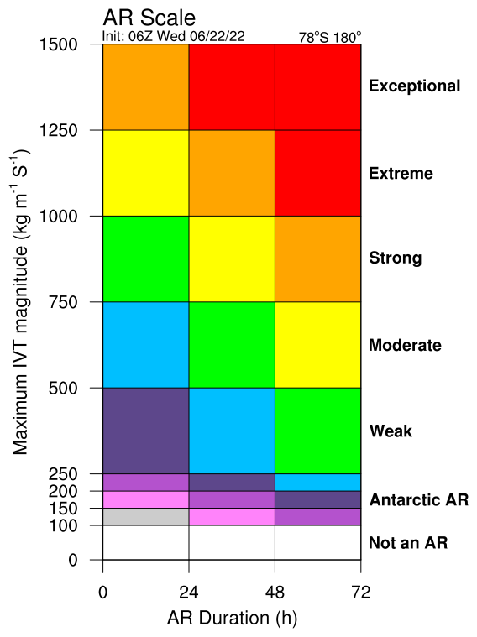
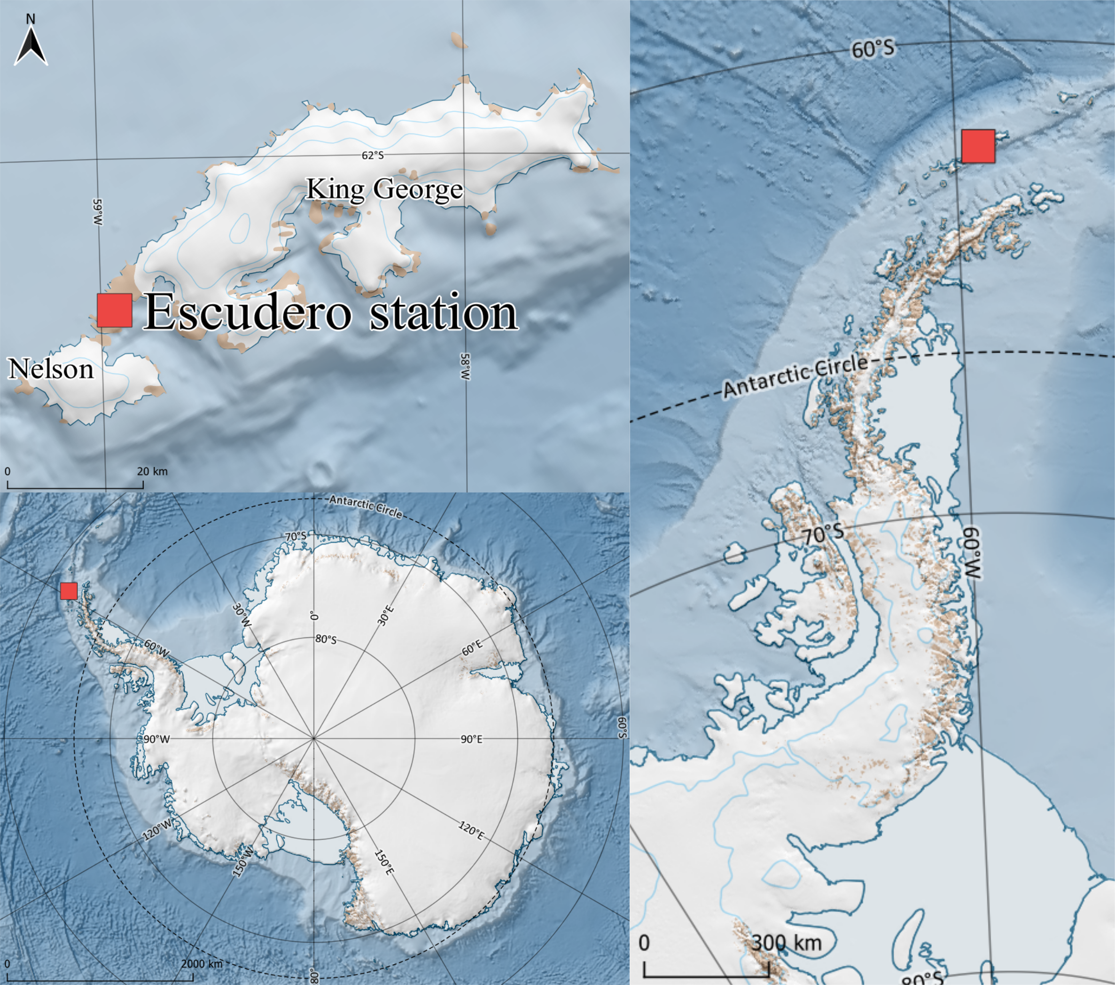
Extreme state of the troposphere during an intense AR event (Feb 7-8 2022 hot spell)
Temperature
Humidity
Moisture flux
King Sejong &Escudero
Maximum temperature, humidity, wind speed and moisture flux above the surface (~1 km)
Entire troposphere was anomalously warm and humid – from the surface up to 10 km
Gorodetskaya et al. NPJ Atm&Clim (2023)
Notes:
Figure: 7-8 Feb 2022 hot spell (radiosonde = solid and ERA5 = dash) compared to 1980-2022 climatology (ERA5)
7-8 February AR event: radiosondes - yellow (7 Feb@12UTC) and red (8 Feb@00UTC) lines
ERA5 reanalysis for the same times – dashed
ERA5 climatology (1980-2022 mean/std) for Jan-Feb
AR event: category up to 3 reaching the Antarctic Peninsula coast (and category 5 reaching Chile)

Slide 21
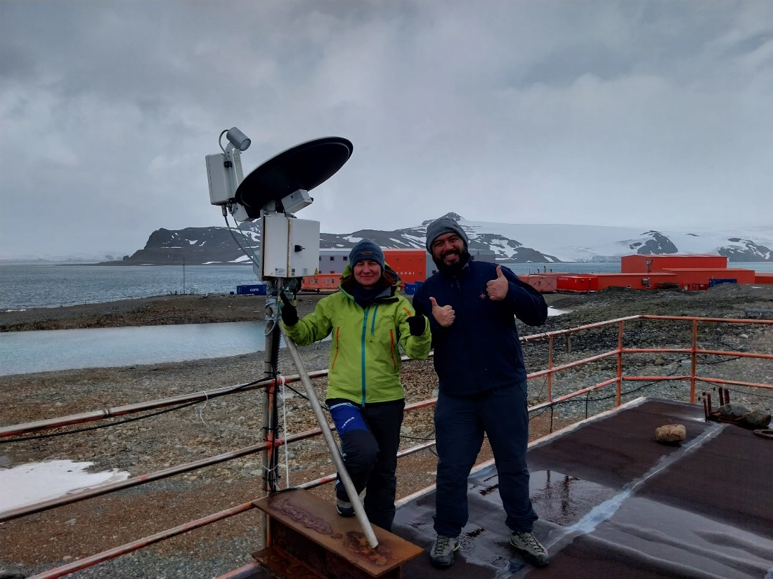
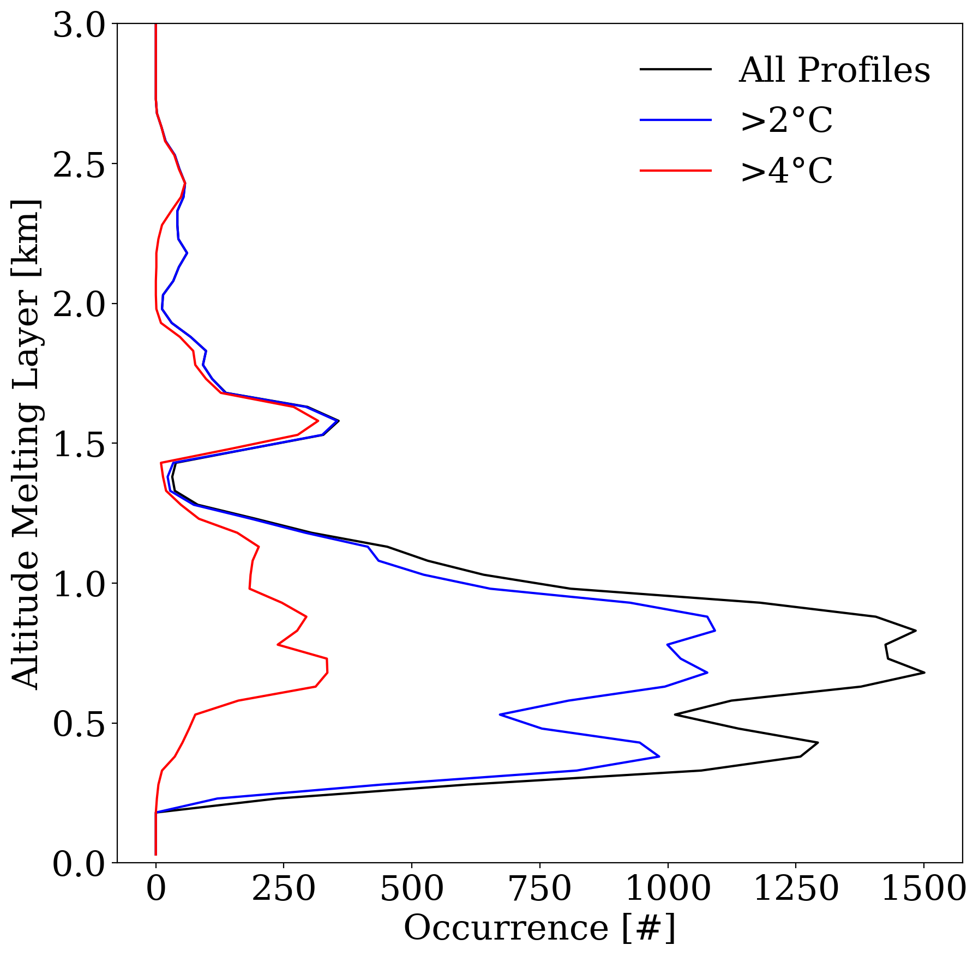
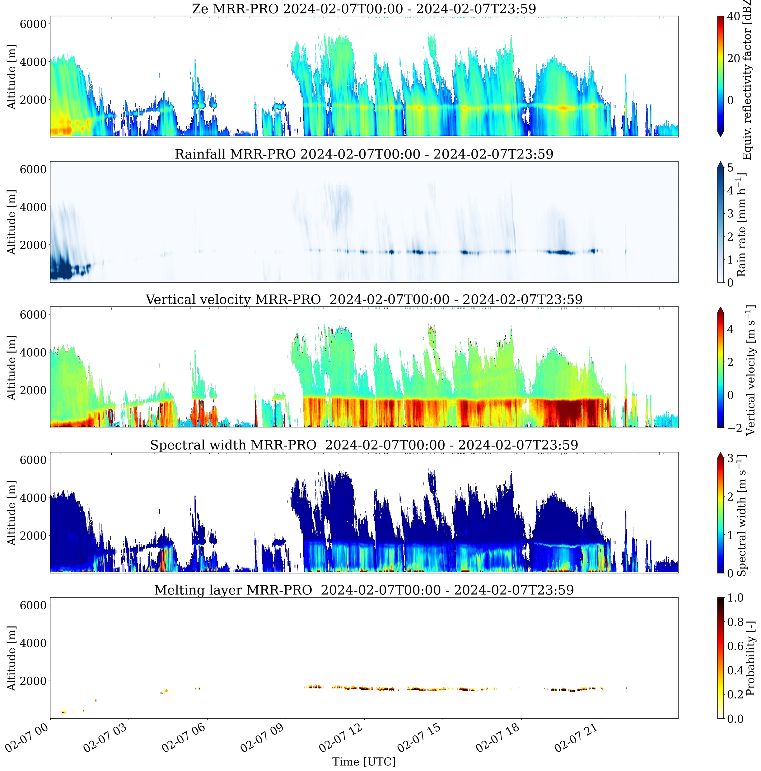
Highlights from radar observations at King Sejong station:
Melting layer height and warm near-surface temperatures - rain starts at higher altitudes and reaches further inland of Antarctica…
Photo: MRR-PRO at King Sejong station and CIIMAR team (Irina&Claudio)
Melting layer
Melting layer derived from MRR-PRO during 7 Feb 2024 AR
and warm event
Melting layer heights frequency of occurrence during Feb 2023-April 2025 for all profiles and composites near-surface temperatures > 2º and 4ºC
Irina Gorodetskaya et al.
Notes:
Melting layer derived from MRR-PRO during 7 Feb 2024 warm event
compared to all hours during the year 9/02/2023 – 8/02/2024

Slide 22



Antarctic AR and Extreme Weather
Jerry Zou & Penny Rowe
Datasets
Observations of Cloud Properties at King George Island (2017-2023)
Stillwell et al. 2025: Cloud Mask Data: https://doi.org/10.48567/1wd1-ea27.
Rowe et al, 2025: Radiosonde measurements: https://doi.org/10.48567/jqv8-r657.
Rowe et al, 2025: Shortwave/Longwave Downward Radiative: https://doi.org/10.48567/peeg-7j35; https://doi.org/10.48567/hnhz-f486
AR Scale & High-Resolution Model Simulations
Zou et al. 2025: Gridded Enhanced AR Scale: https://doi.org/10.48567/ssm5-x097.
Zou et al. 2025: Historical AR events over the Antarctic Peninsula: Data transferring
Publications:
Zou et al. 2023: Atmospheric River and Foehn Events: Contribution of Shortwave Radiation and Turbulence. J. Geophys. Res. Atmos., 128: e2022JD038138, https://doi.org/10.1029/2022JD038138.
Zhang et al. 2024: Extending the Center for Western Weather and Water Extremes (CW3E) atmospheric river scale to the polar regions. Cryosphere, 18: 5239–5258, https://doi.org/10.5194/tc-18-5239-2024.
Rowe et al. 2025a: Comparison of Cloud and Radiation Measurements to Models over the Southern Ocean at Escudero Station, King George Island. J. Geophys. Res. Atmos. Accept.
Rowe et al. 2025b: Observations of Clouds and Radiation Over King George Island and Implications for the Southern Ocean and Antarctica. J. Geophys. Res. Atmos. In revision.
Antarctic AR Real-time Forecast
More Upcoming!
Real-time AMPS outputs from NSF NCAR included
Historical Antarctic AR catalog under development.
Arctic Website will be launched soon!
Details next slide~
NSF 2127632, 2229392, 2331992
Notes:
Nothing needs to be emphasize here. I am just adding a few notes for clarification.
Most publications here is AR and extreme weather related work, including surface melting/warming and cloud radiative impacts. A) Observations data at AMRDC provides a benchmark for model evaluation; b) All cloud data collected during this project is archived at AMRDC.
Penny Rowe took the lead on all observation collection and data preprocess.
Gridded enhanced AR Scale for Antarctic is archived at AMRDC. It is calculated from ERA5 reanalysis based on the Enhanced AR scale developed at CW3E (Zhang et al. 2024). No shape filter is applied to this dataset (provided AS IS). A global gridded enhanced AR scale likely will be published by CW3E by the end of this year. The updated version will cover Arctic, Antarctic and high latitudes, with shape filter.

Slide 23
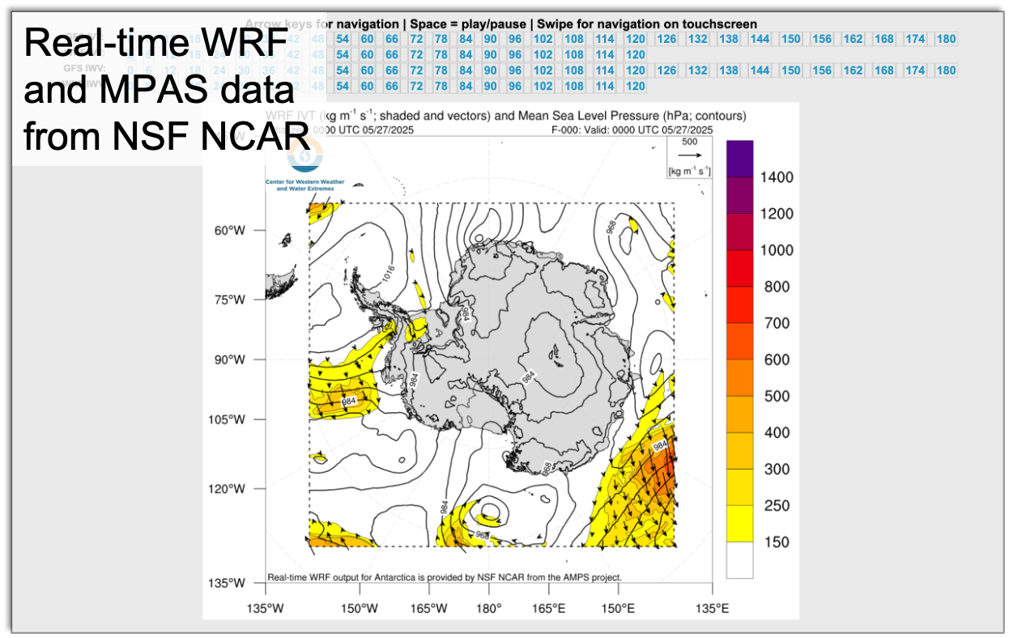
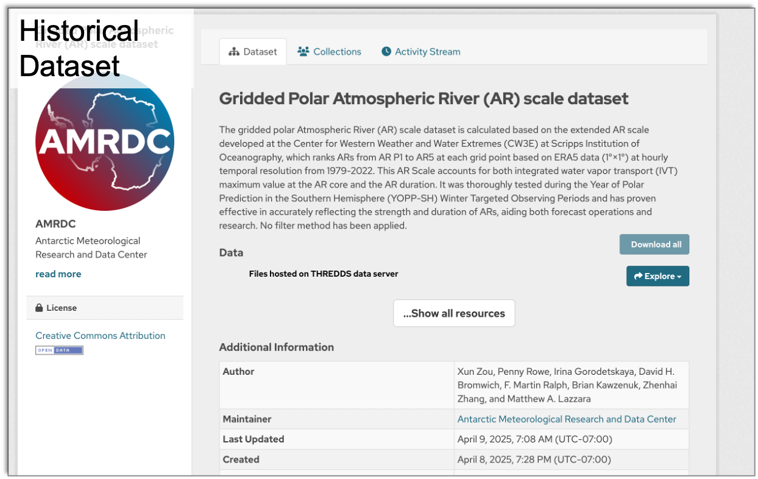
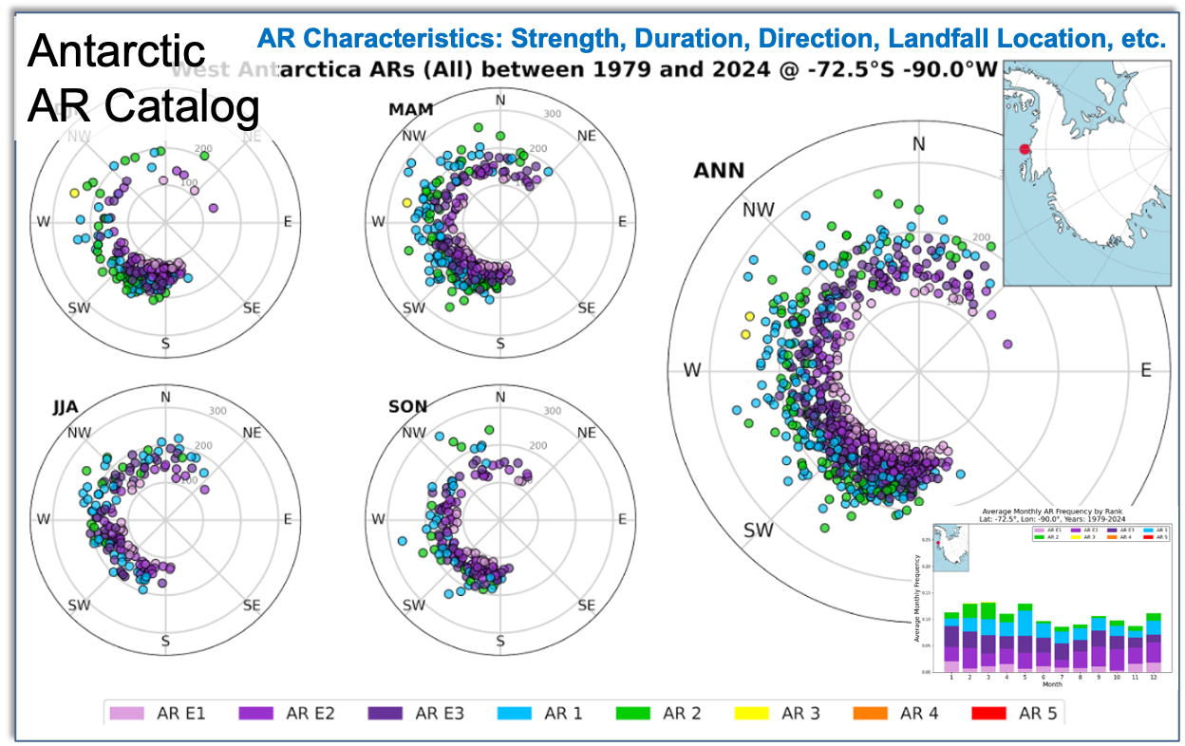
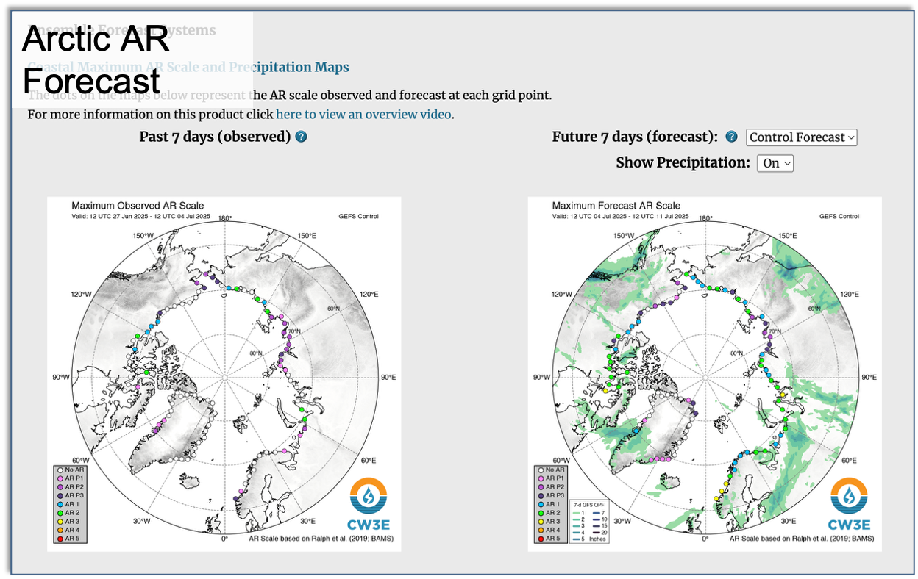
Datasets and Web tools developed for AR science
Contact: x4zou@ucsd.edu
Thanks to AMRDC. Selected data are/will be archived for Antarctic community
Notes:
Both WRF and MPAS data produced by AMPS team at NSF NCAR (thanks to Jordan Powers and Kevin Mannning) is transferred to CW3E in real time. We only preprocess WRF data for web development.
Antarctic AR Catalog is a web currently under development. It is aimed to provide a database and visualization tool for historical AR events based on ERA5 reanalysis. It will show AR strength, duration, landfall location and direction.
Arctic AR website is fully developed and under internal testing now. It will be launched in weeks~

Slide 24
Naoyuki

Slide 25
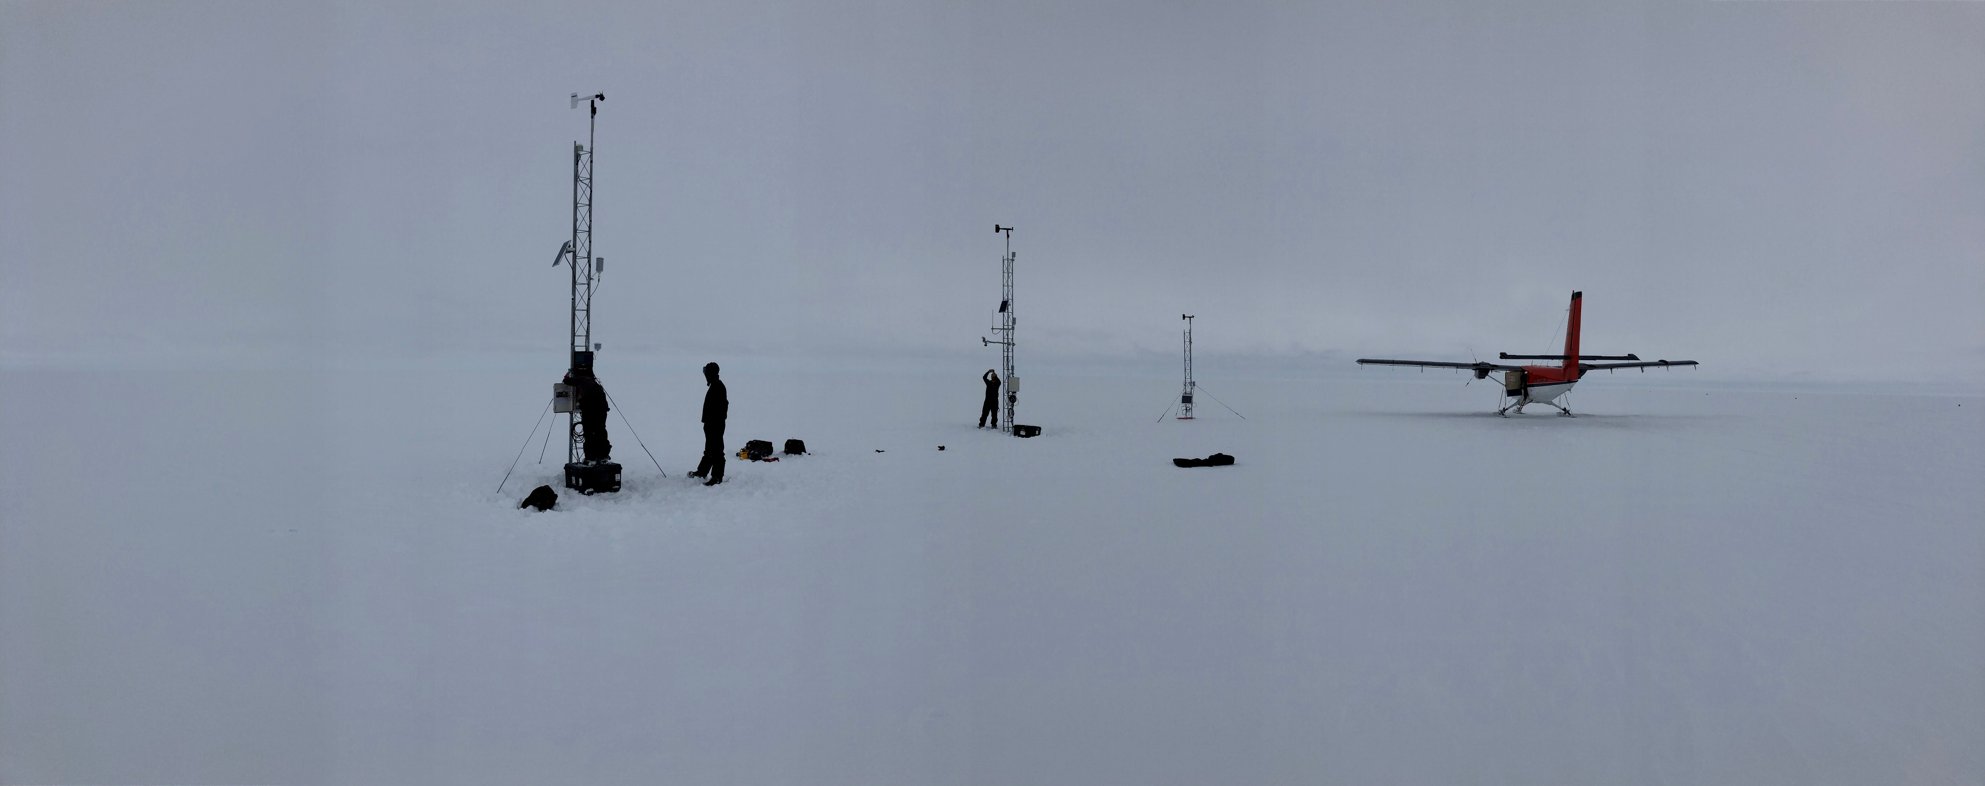
Thank you! Questions?
O-283 Field Team
Madison College PCWS
Skomik
Wisconsin AWS
Schwerdtfeger
NIWC AWS
Acknowledgements:
Thanks for the support from the National Science Foundation, Grants: 1924730, 1951720, 19516603, 2301362
Horizon 2020 project, netGEMS
National Centre for Polar and Ocean Research (NCPOR), Goa, India & Dr. John Turner
E-mail: mattl@ssec.wisc.edu mlazzara@madisoncollege.edu

