Slide 1









Connecting Antarctic Observations to the World!
Naoyuki Kurita¹
Ella Gilbert², Irina Gorodetskaya³, Linda Keller⁴, Matthew Lazzara^{4,5,*}, Michelle Maclennan², David Mikolajczyk, Taylor Norton⁴, Lee Welhouse⁴, Jonathan Wille⁶, Xun (Jerry) Zou⁷, Sibin Simon⁸, and Xichen Li⁹
1 Nagoya University, Nagoya, Japan
2 British Antarctic Survey, Cambridge, UK
3 CIIMAR, University of Porto, Matosinhos, Portugal
4 University of Wisconsin-Madison, Madison, WI, USA
5 Madison Area Technical College, Madison, WI, USA
^{6 ETH Zurich, Switzerland}
7 Scripps Institute of Oceanography, San Diego, CA, USA
8 Laboratory for Climate and Environmental Sciences, Paris-Saclay, France
9 Peking University, Bejing, China
* Matthew sends his regrets….
BACO-25 Assembly - JCMP08

Slide 2
Automatic Weather Station Map
Outline
Status Report on observations:
  Automatic Weather Station network
  Satellite observations
Research informed by observations:
  Extreme Precipitation Event
  Winter Warming Events
  Atmospheric Rivers (AR)
    2022 Heatwave event
    2020 Family event
    Super-cooled rain event
    Melt-layers with AR events
    Peninsula hot spell event
    AR and Extreme weather
  AR Data
    AR Index/forecasts
    AMRDC Data Repository
    PolarRES (see next talk!)
This map is for all!! It is for community use!!!
Please send updates to Matthew Lazzara mattl@ssec.wisc.edu

Slide 3
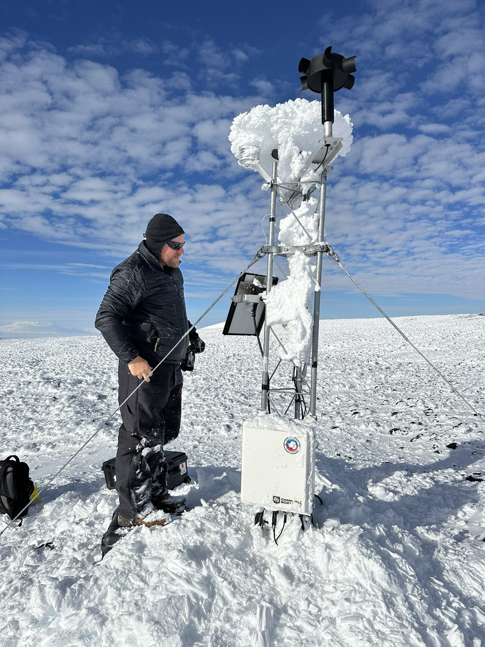
Automatic Weather Stations (AWS)
The Antarctic AWS network news:
  New AWS stations from China and Chile in recent years
  Decline in operating AWS stations from USA and Netherlands
  Overall stability across the continent for providing the bulk of surface observing
Some Challenges:
  Recovering from lack of field work during the pandemic
  A problem for the Wisconsin network – real-time availability
  Issues with visiting sites in West Antarctica and deep East Antarctica
Some Successes:
  AWS accepted in the community for climate analysis
  AWS are operationally essential for direct forecasting use and numerical weather prediction along with reanalysis (e.g. ERA5, NCEP/NCAR…)
Please send updates and corrections on the map to: Matthew Lazzara mattl@ssec.wisc.edu
Minna Bluff AWS
Courtesy of
Tyler Plekan

Slide 4
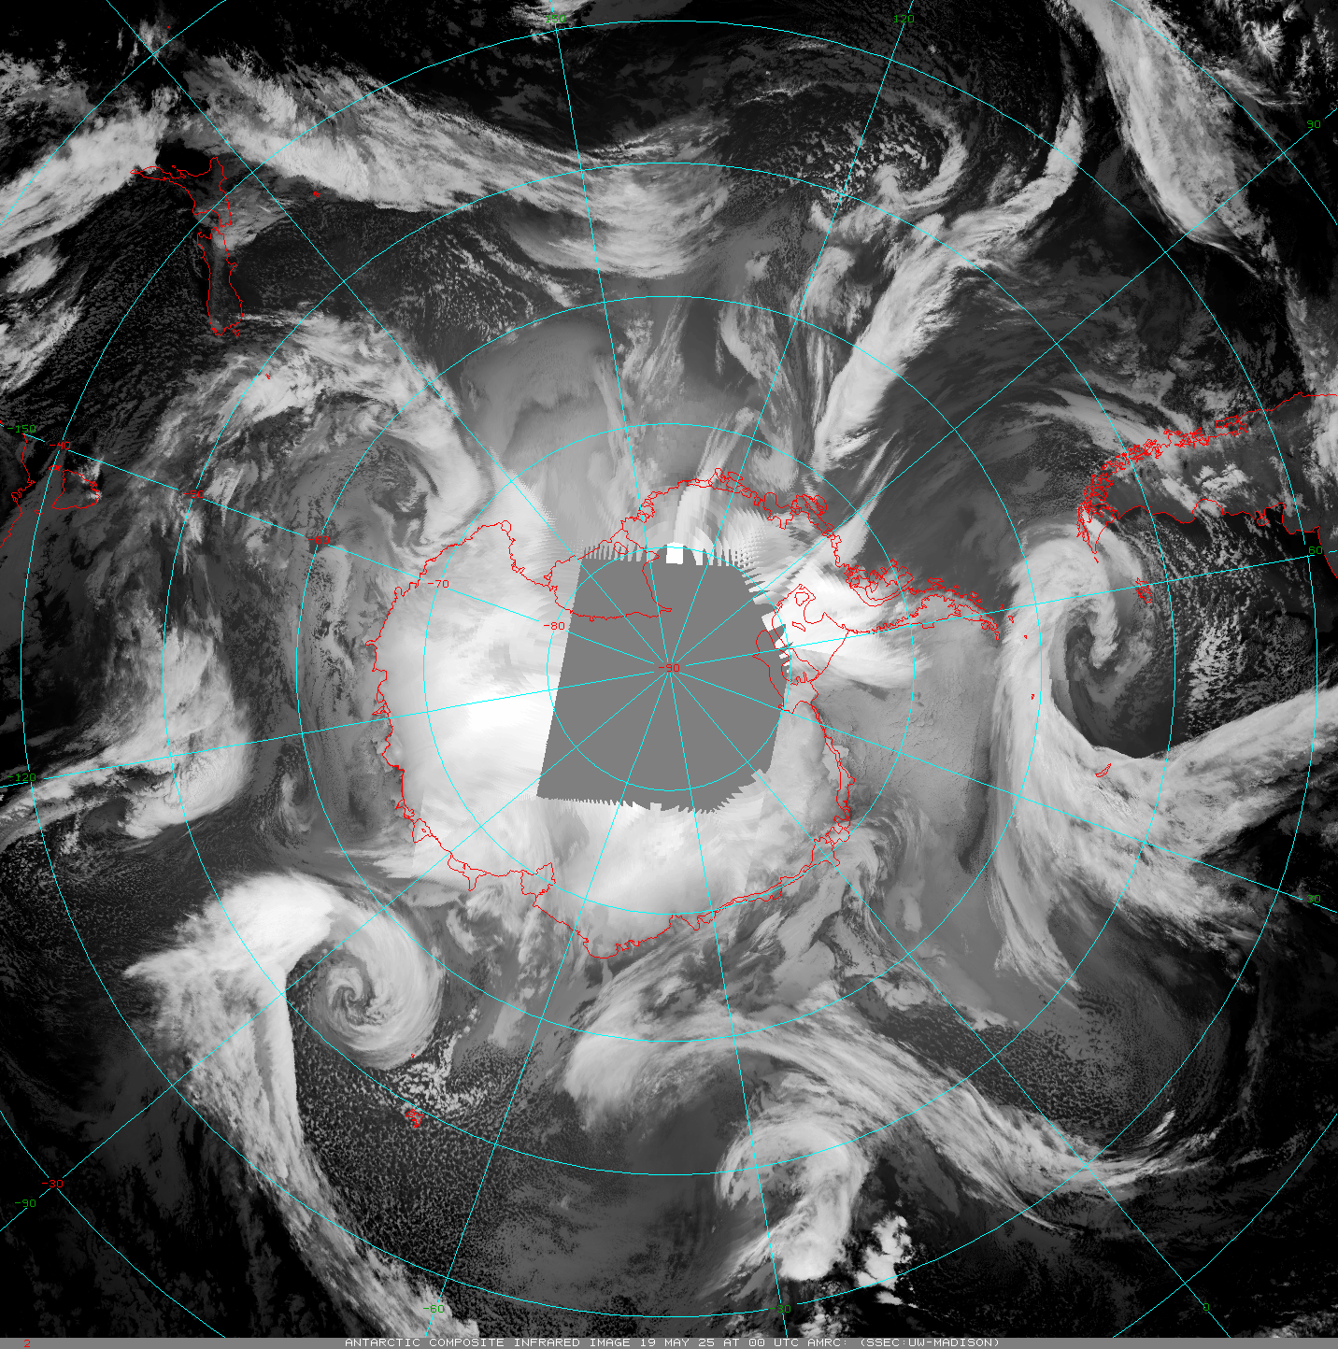
Satellites
Polar Satellites
Satellite Composites
USA
  Old NOAAs (-15 and -19)
    Sunset this summer (-18 is already off)
  Old DMSP
    Sunset in 2026
    SSMIS – global processing sunset already
  NASA – beyond end of life
    Aqua
    Terra – Direct Broadcast offline
    May sunset as soon as 9/1/2025
  S-NPP a backup satellite (end soon 2026)
  Current: NOAA-20, NOAA-21
  Coming soon: JPSS-3, JPSS-4
EUMETSAT
  Current: Metop-B and Metop-C
  Coming soon: Metop-SG
China - FY- Series
Russia - Meteor- Series
Others…
A Sample Animation - Wisconsin Composites:
Other composites made by Russia and China…(?)
https://space.oscar.wmo.int/satellitestatuses/status

Slide 5
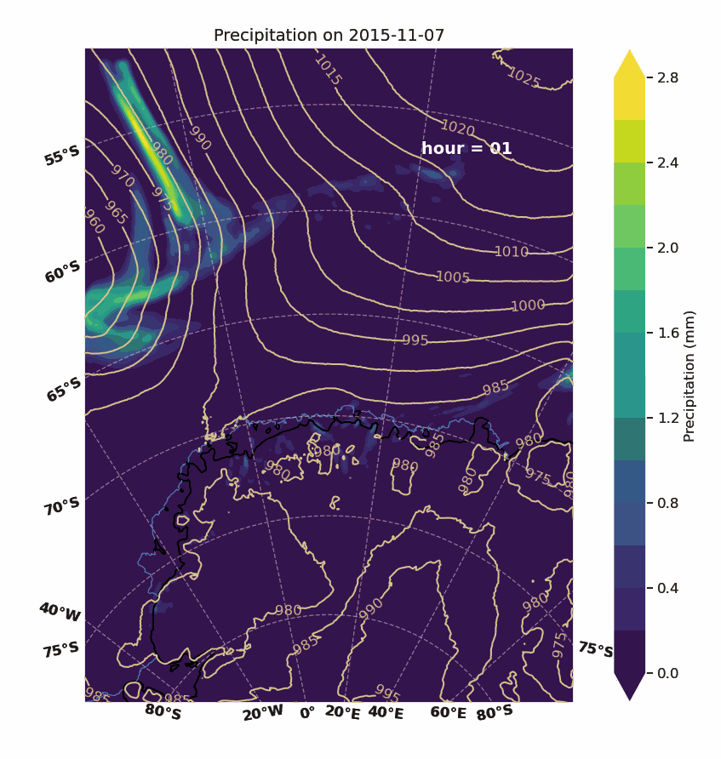
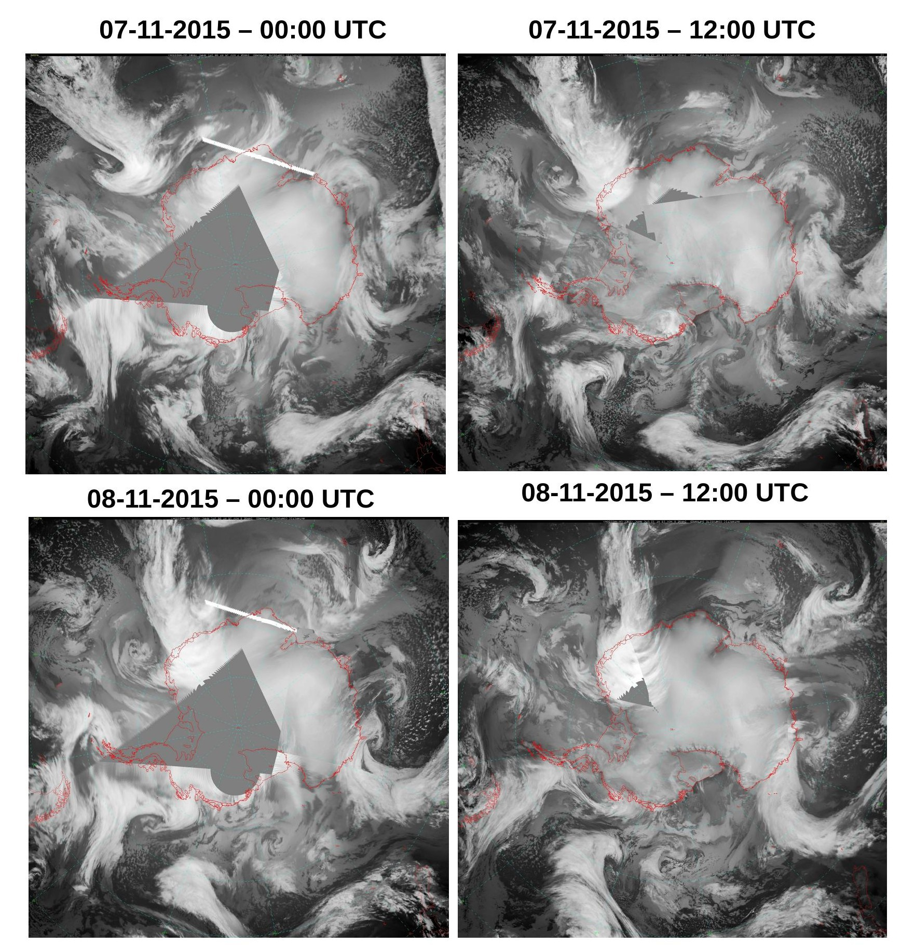
Extreme Precipitation Event (EPE)
Simon, et al.
EPE with Atmospheric River Event details:
EPE on 8–9 November 2015 – This was the highest precipitation event recorded at the ice core site located at 71.5°S, 10.5°E, delivering approximately 22% of the total annual precipitation in just two days (about 45 mm).
A combination of extreme conditions in both the upper and lower atmosphere (a deep low-pressure cyclone to the west and a record-strong high-pressure ridge) triggered the occurrence of this EPE.
Sudden deepening of the cyclone was favored by the presence of 'jet streaks' in the upper atmosphere (at 250 hpa)

Slide 6
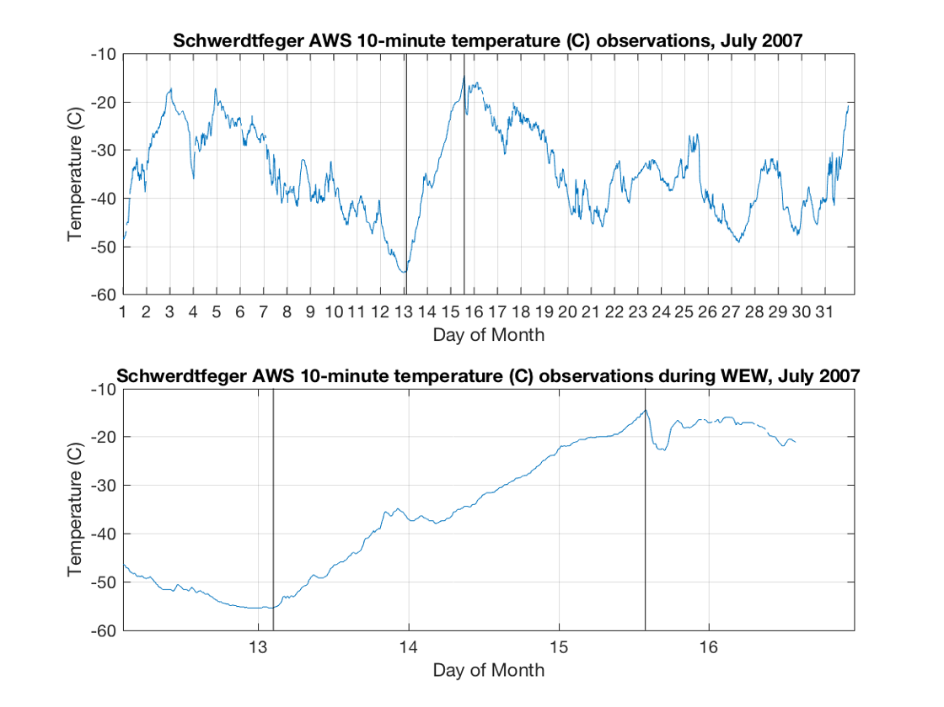
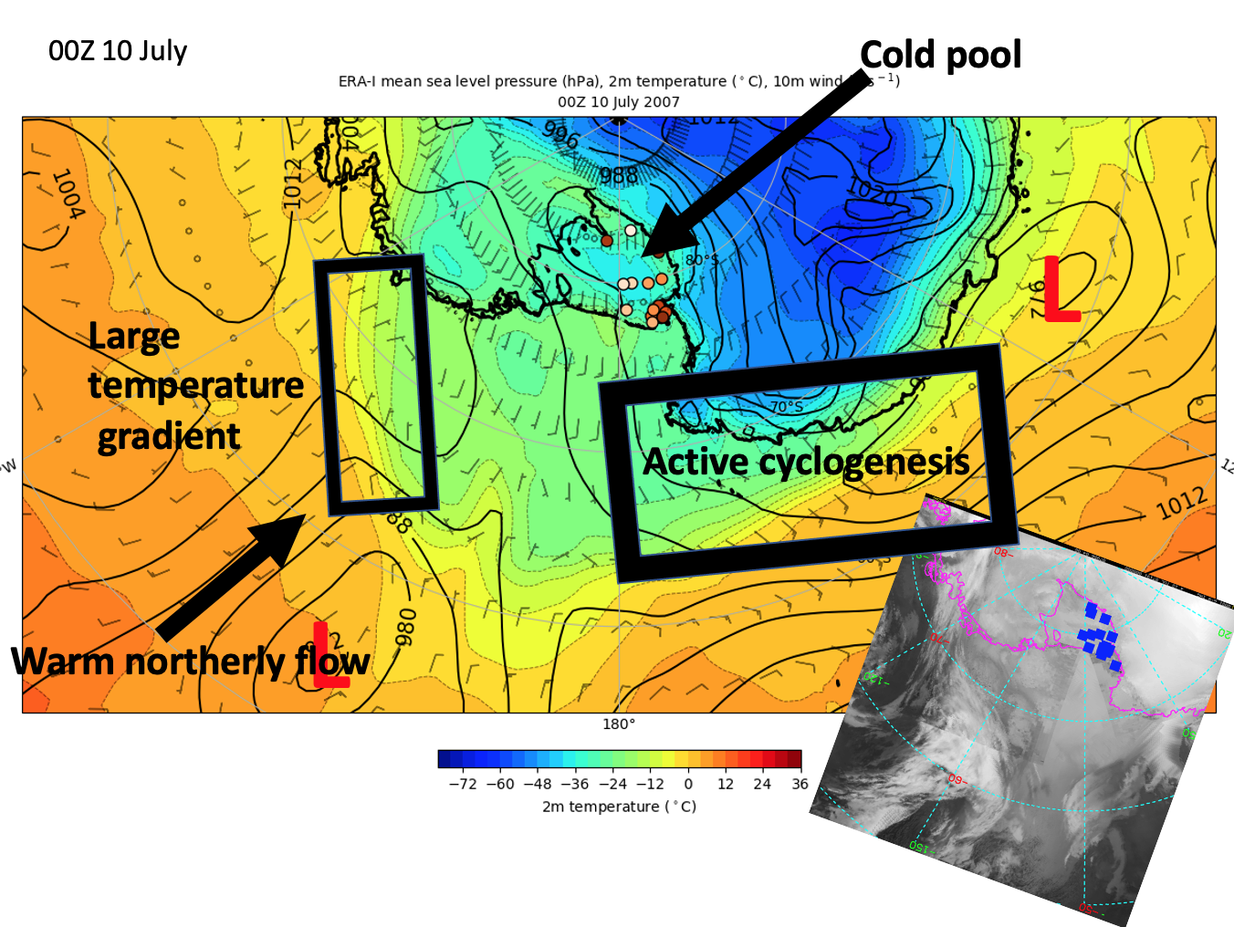
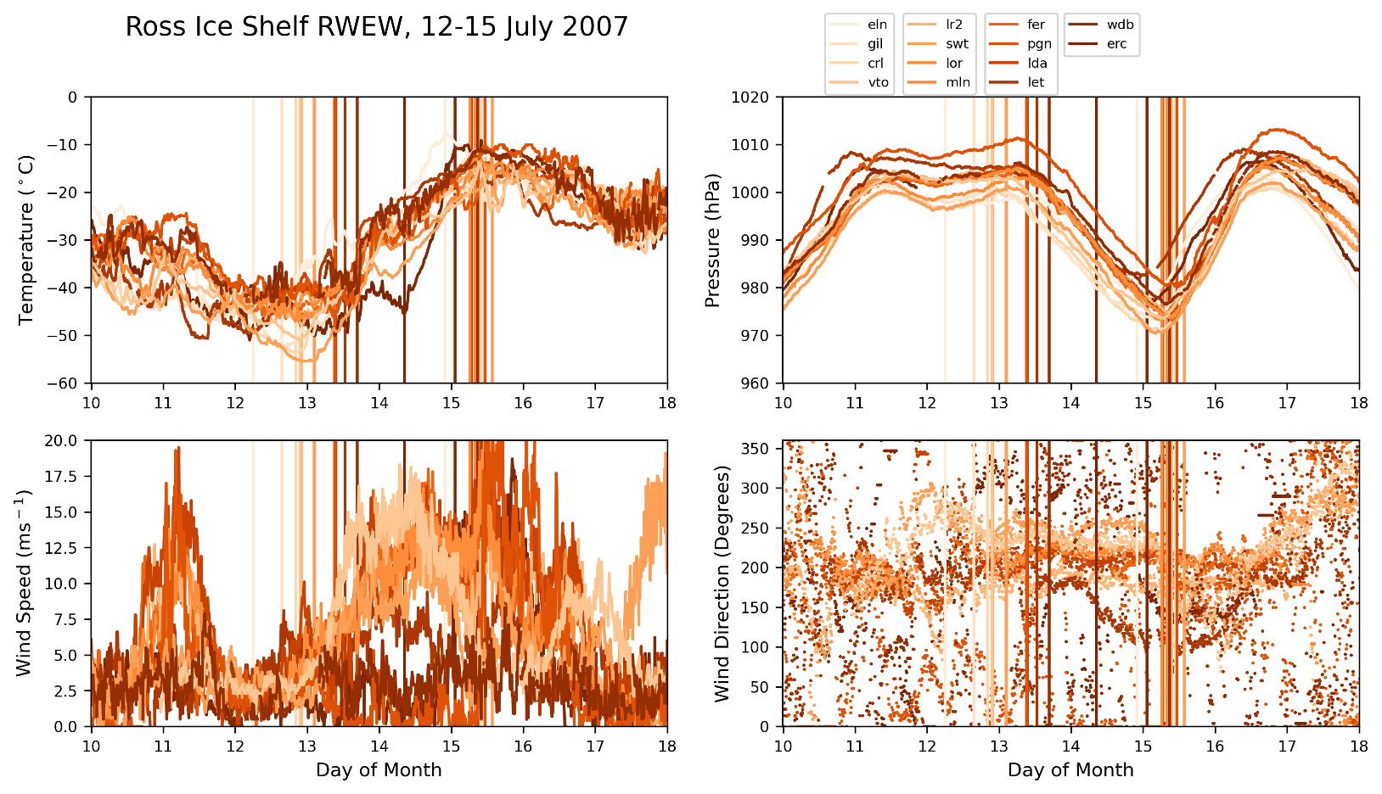
Regional Warming Event in Winter on the Ross Ice Shelf, Antarctica as Observed by UW-Madison Automatic Weather Stations
David Mikolajczyk
AWS Observations
Schematic Overview
Warming Event in Winter defined as an increase in temperature at an AWS of 30˚ C or greater in 5 or fewer days
In this event, from 12-15 July 2007, 14 AWS observed such a warming event on the Ross Ice Shelf

Slide 7
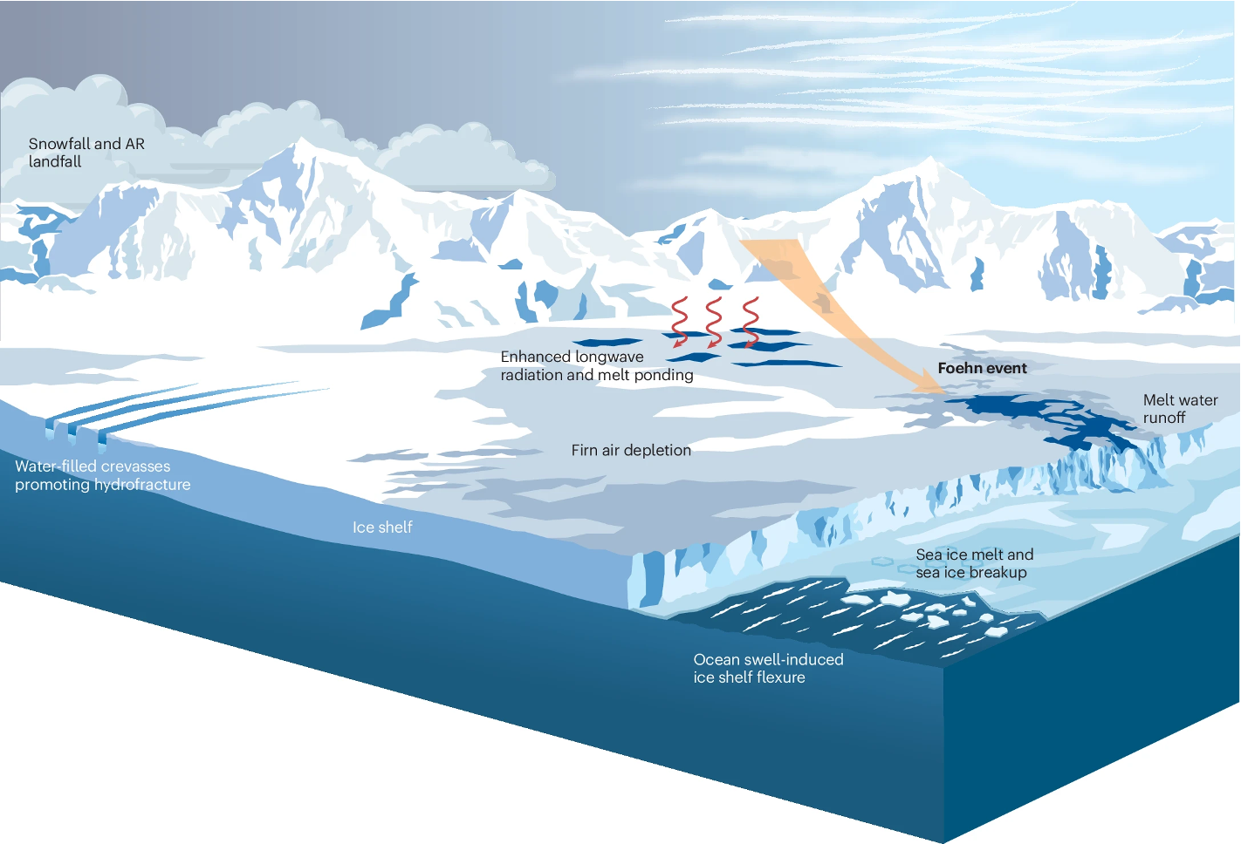

Jonathan Wille et al.
Review paper on Antarctic Atmospheric Rivers
Recently published in Nature Reviews Earth and Environment
Contributions from 32 coauthors
Covers topics like ...
  AR dynamics (global, synoptic, mesoscale)
  Microphysical processes
  Climatology and variability
  Surface mass balance impacts
  AR extremes
  Ice shelf destablization risks
  Sea ice impacts
  Ecosystem impacts
  Water stable isotopes
Wille et al. (2025)
Notes:
See above…

Slide 8
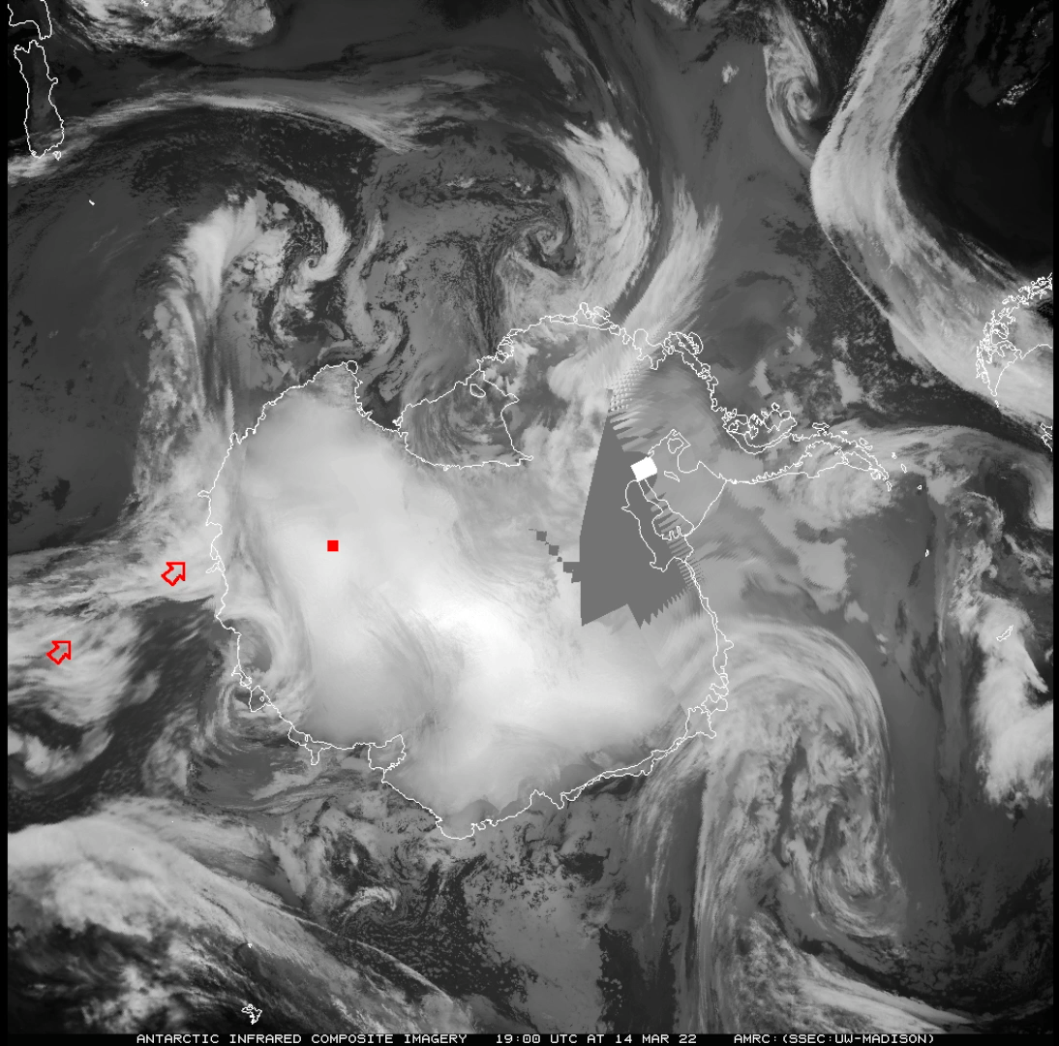



The extraordinary March 2022 East Antarctic Heatwave
Jonathan Wille et al.
Largest recorded temperature anomaly globally (39° C at Dome C)
54 researchers from around the world exploring interdisciplinary aspects of event
Focusing on …
  Synoptic scale meteorological drivers
  Atmospheric river dynamics
  Surface mass balance impacts
  Surface energy budget
  Conger Ice Shelf collapse
  Isotope measurements
  Historical event significance/probability
Wille et al. (2021) AR detection catalogs (ERA5 and MERRA2 1980-2023)
Paper (part 1)
Paper (part 2)
Notes:
See above…

Slide 9
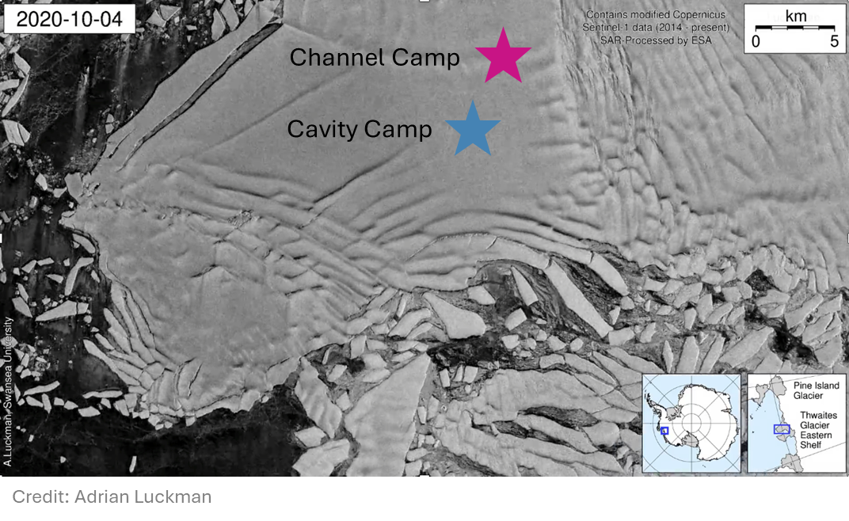
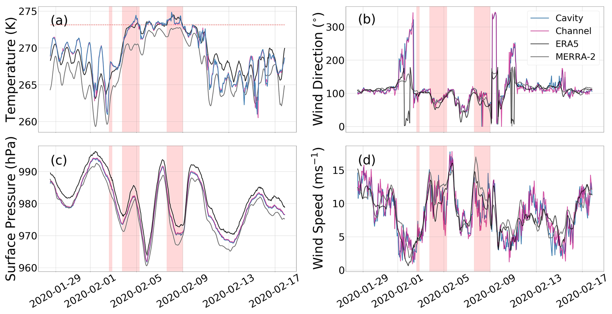
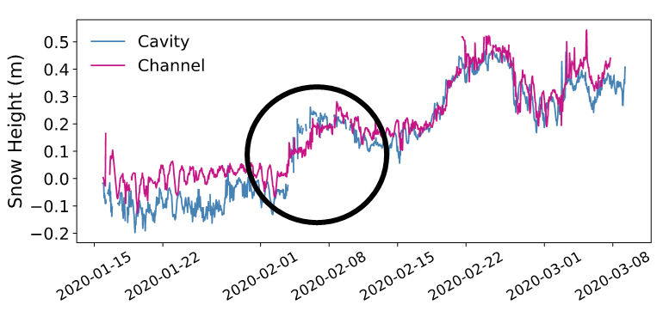
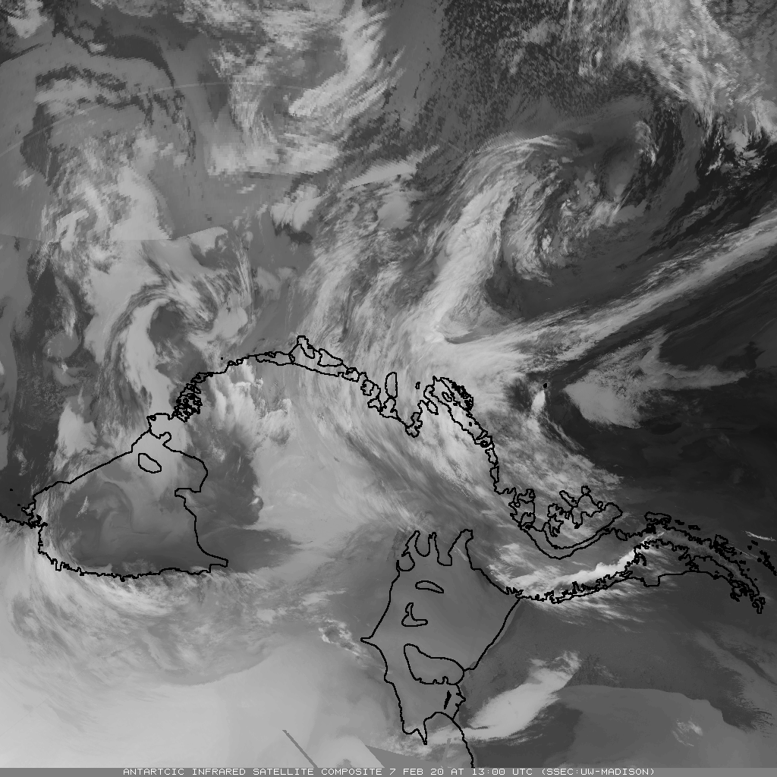
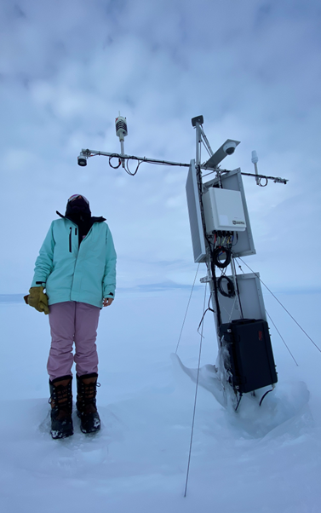
February 2020 atmospheric river family on Thwaites Glacier
Michelle Maclennan et al.
What happened?
3 atmospheric rivers make landfall in the ASE in rapid succession from February 2-8, 2020
100 mm w.e. accumulation – about 90% of the average annual accumulation from atmospheric rivers here
surface temperatures ~ 0° C for 5 days
Maclennan et al. 2023
Wisconsin Satellite Infrared Satellite Composite Imagery 13 UTC on 7 Feb 2020
AWS on Thwaites Eastern Ice Shelf, January 2023

Slide 10
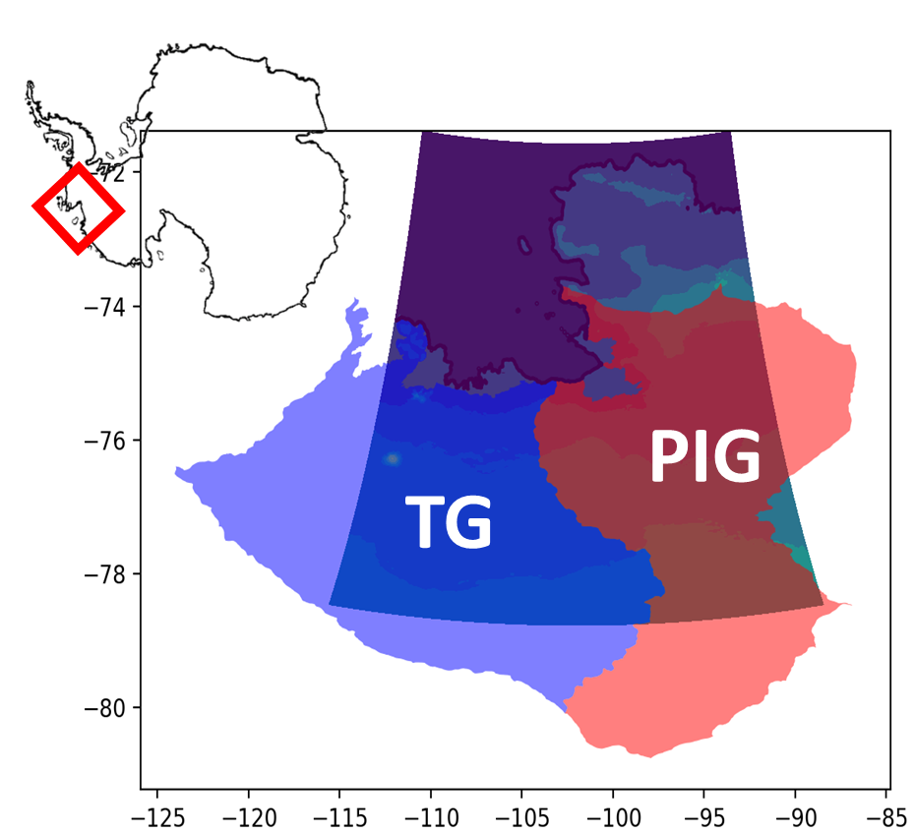

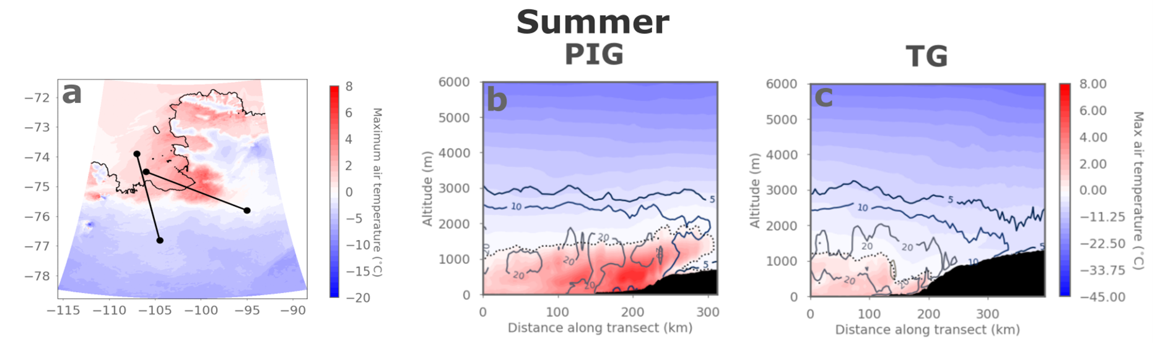


Super-cooled rain falls during West Antarctic atmospheric rivers
Ella Gilbert et al.
Warm near-surface conditions induced by airflow over steep topography (foehn effect)
Read the paper
Colours: max air temps during extreme AR event
Contours: accumulated rainfall totals during AR
b
c
Watch the video
Gilbert et al. (2025)
Liquid precip falling above 0°C line, i.e. supercooled rain. Topography generates more snowfall via seeder-feeder effects, plus supercooled rain falling above melt line
We need in situ obs of rain in Antarctica!
Use the data

Slide 11
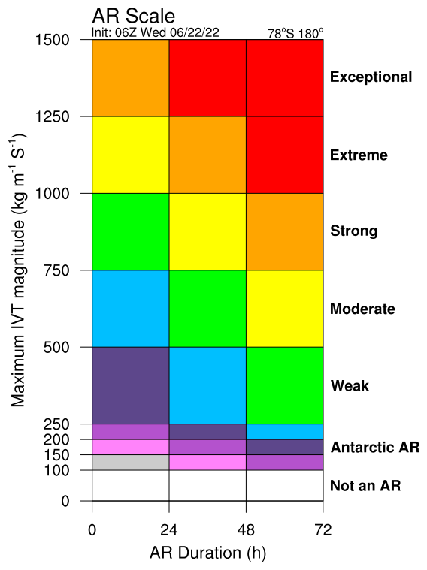
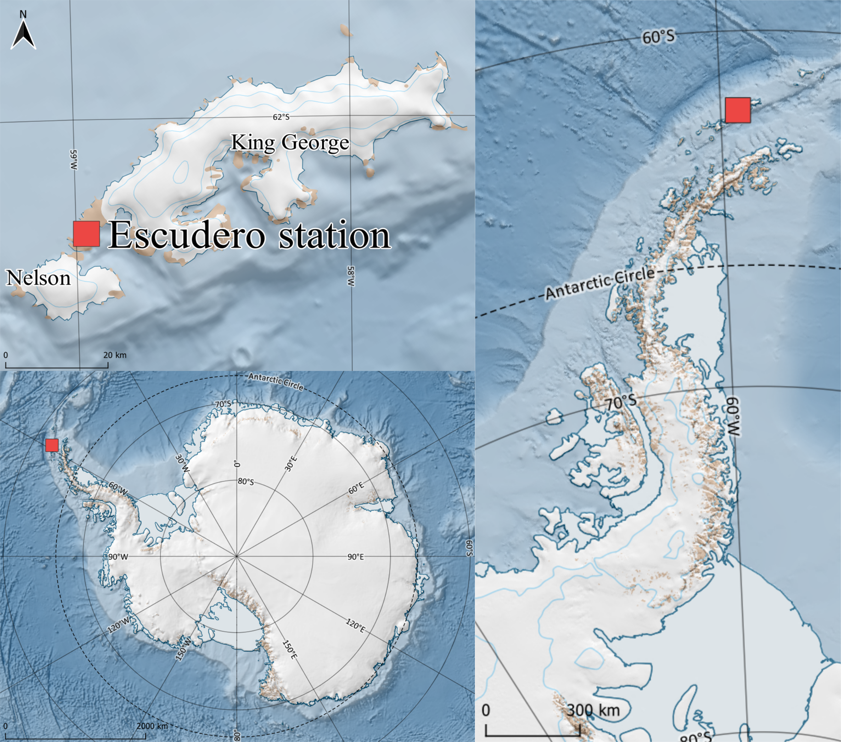
Extreme state of the troposphere during an intense AR event (Feb 7-8 2022 hot spell)
Temperature
Humidity
Moisture flux
King Sejong &Escudero
Maximum temperature, humidity, wind speed and moisture flux above the surface (~1 km)
Entire troposphere was anomalously warm and humid – from the surface up to 10 km
Gorodetskaya et al. NPJ Atm&Clim (2023)

Slide 12
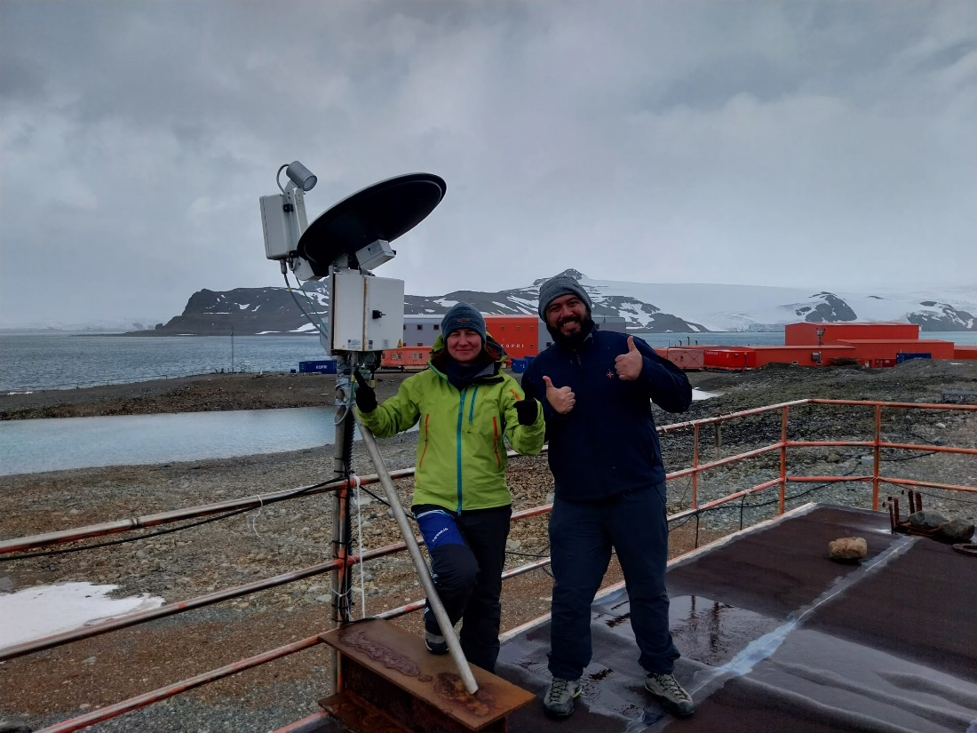
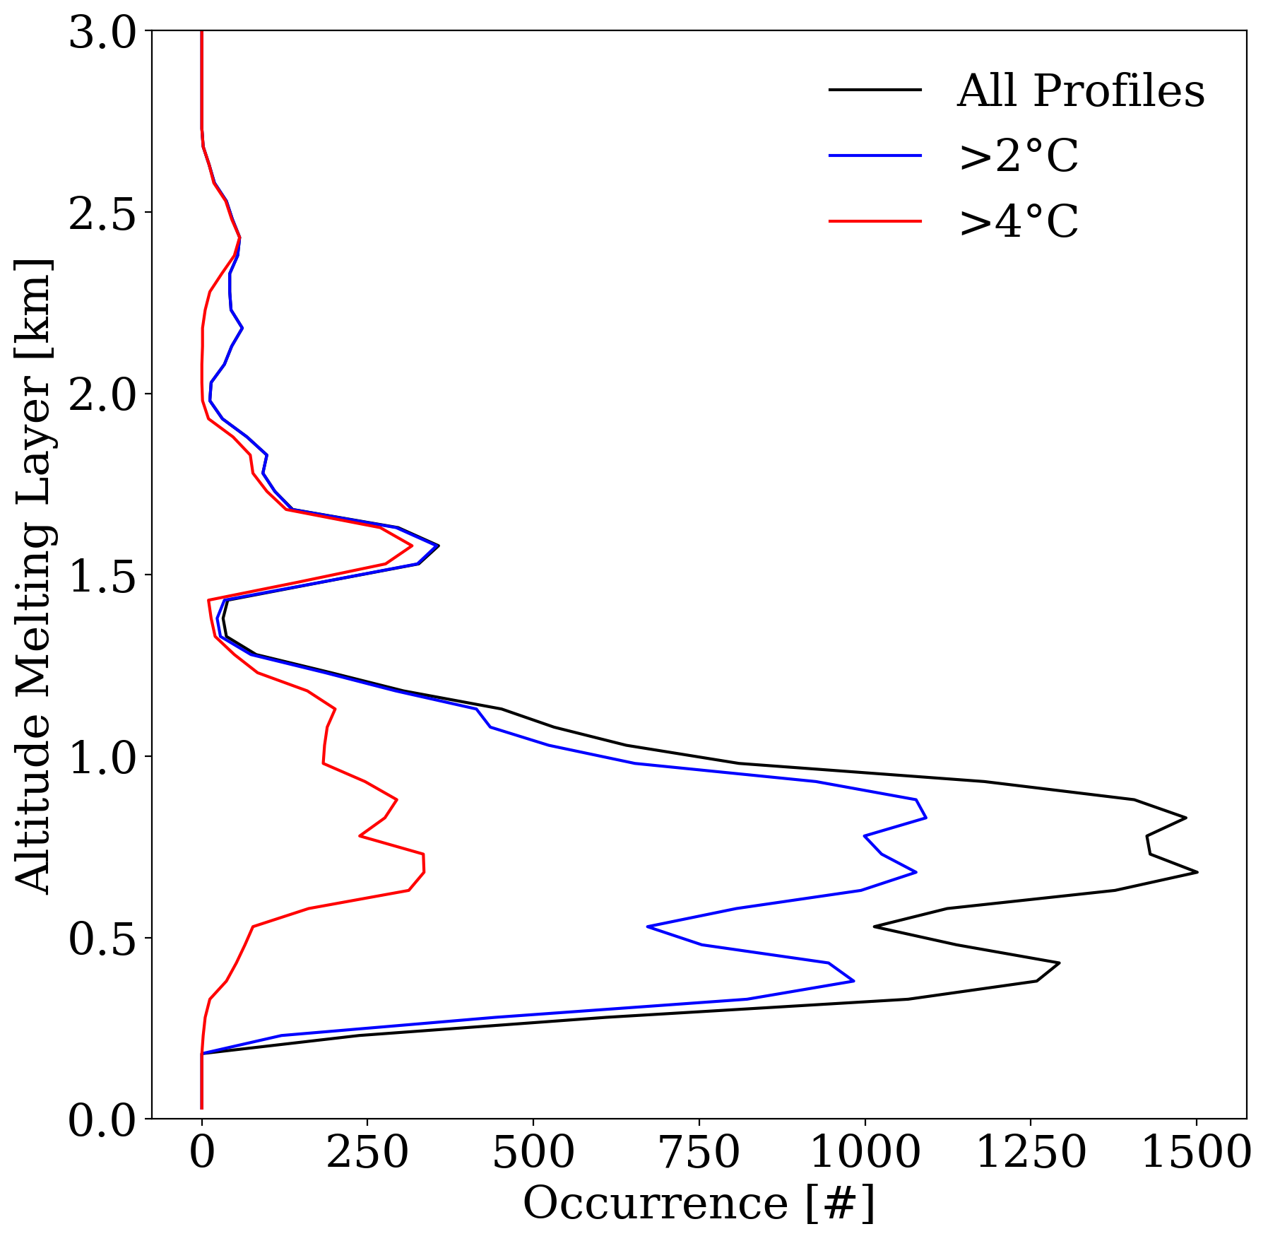
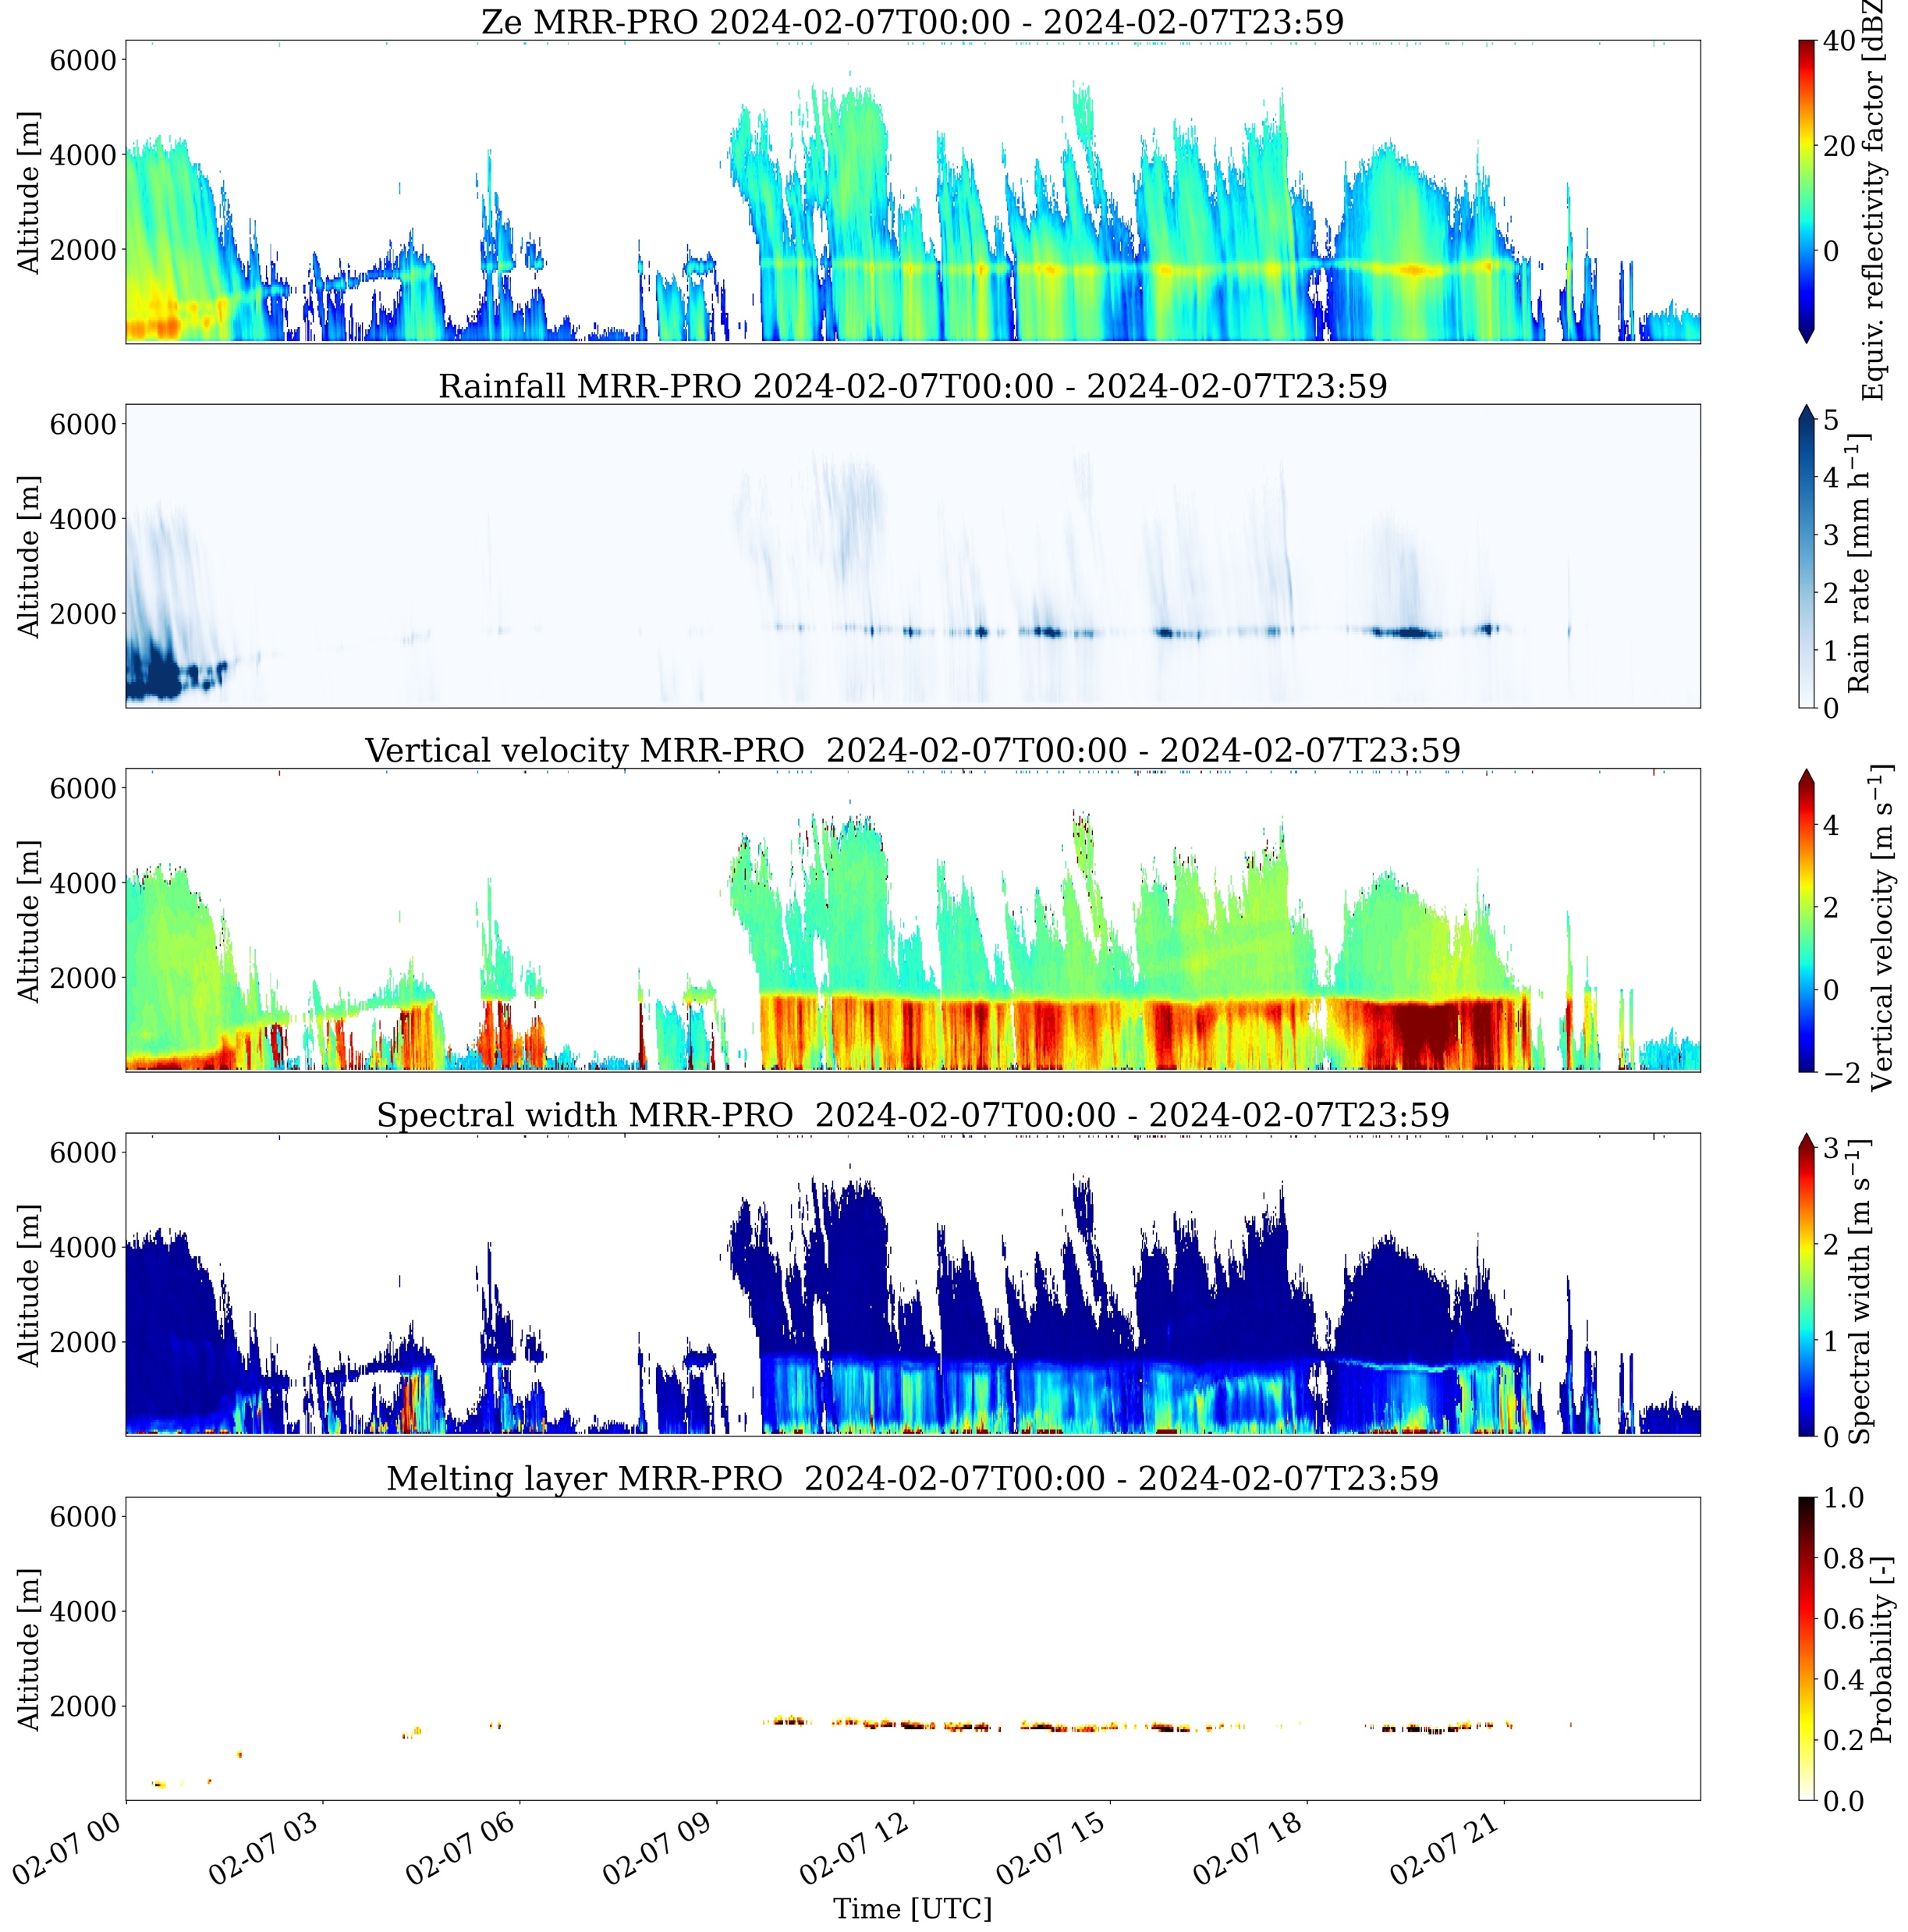
Highlights from radar observations at King Sejong station:
Melting layer height and warm near-surface temperatures - rain starts at higher altitudes and reaches further inland of Antarctica…
Photo: MRR-PRO at King Sejong station and CIIMAR team (Irina&Claudio)
Melting layer
Melting layer derived from MRR-PRO during 7 Feb 2024 AR
and warm event
Melting layer heights frequency of occurrence during Feb 2023-April 2025 for all profiles and composites near-surface temperatures > 2º and 4ºC
Irina Gorodetskaya et al.
Notes:
Melting layer derived from MRR-PRO during 7 Feb 2024 warm event
compared to all hours during the year 9/02/2023 – 8/02/2024

Slide 13
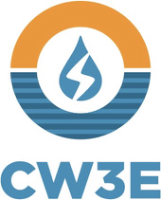


Antarctic AR and Extreme Weather
Jerry Zou & Penny Rowe
Datasets
Observations of Cloud Properties at King George Island (2017-2023)
Stillwell et al. 2025: Cloud Mask Data: https://doi.org/10.48567/1wd1-ea27.
Rowe et al, 2025: Radiosonde measurements: https://doi.org/10.48567/jqv8-r657.
Rowe et al, 2025: Shortwave/Longwave Downward Radiative: https://doi.org/10.48567/peeg-7j35; https://doi.org/10.48567/hnhz-f486
AR Scale & High-Resolution Model Simulations
Zou et al. 2025: Gridded Enhanced AR Scale: https://doi.org/10.48567/ssm5-x097.
Zou et al. 2025: Historical AR events over the Antarctic Peninsula: Data transferring
Publications:
Zou et al. 2023: Atmospheric River and Foehn Events: Contribution of Shortwave Radiation and Turbulence. J. Geophys. Res. Atmos., 128: e2022JD038138, https://doi.org/10.1029/2022JD038138.
Zhang et al. 2024: Extending the Center for Western Weather and Water Extremes (CW3E) atmospheric river scale to the polar regions. Cryosphere, 18: 5239–5258, https://doi.org/10.5194/tc-18-5239-2024.
Rowe et al. 2025a: Comparison of Cloud and Radiation Measurements to Models over the Southern Ocean at Escudero Station, King George Island. J. Geophys. Res. Atmos. Accept.
Rowe et al. 2025b: Observations of Clouds and Radiation Over King George Island and Implications for the Southern Ocean and Antarctica. J. Geophys. Res. Atmos. In revision.
Antarctic AR Real-time Forecast
More Upcoming!
Real-time AMPS outputs from NSF NCAR included
Historical Antarctic AR catalog under development.
Arctic Website will be launched soon!
Details next slide~
NSF 2127632, 2229392, 2331992

Slide 14
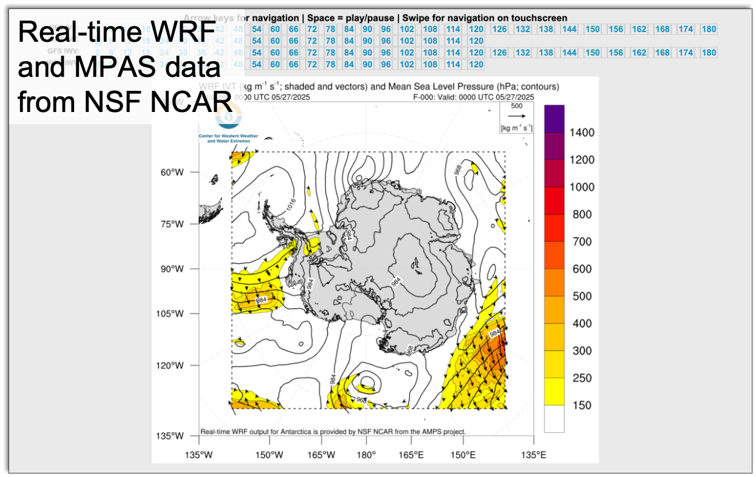
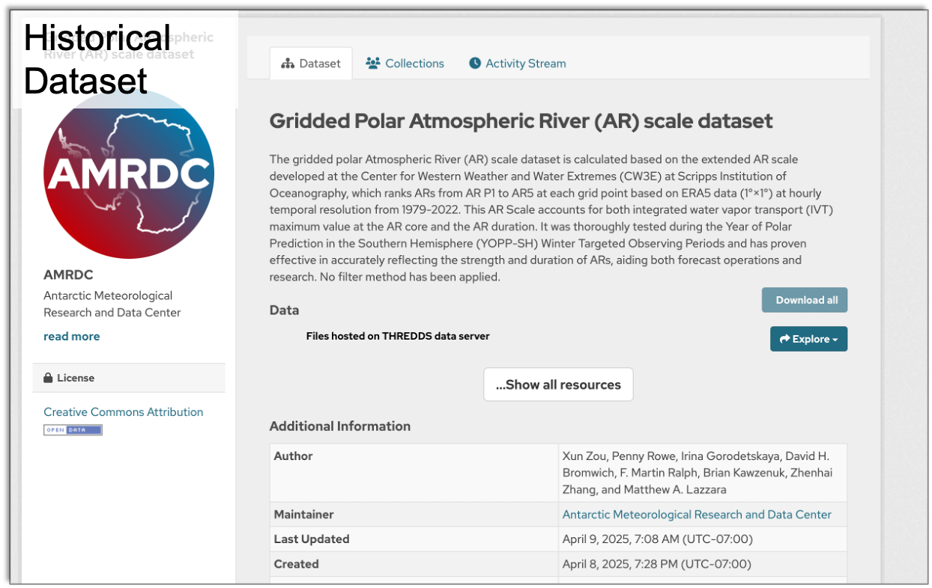
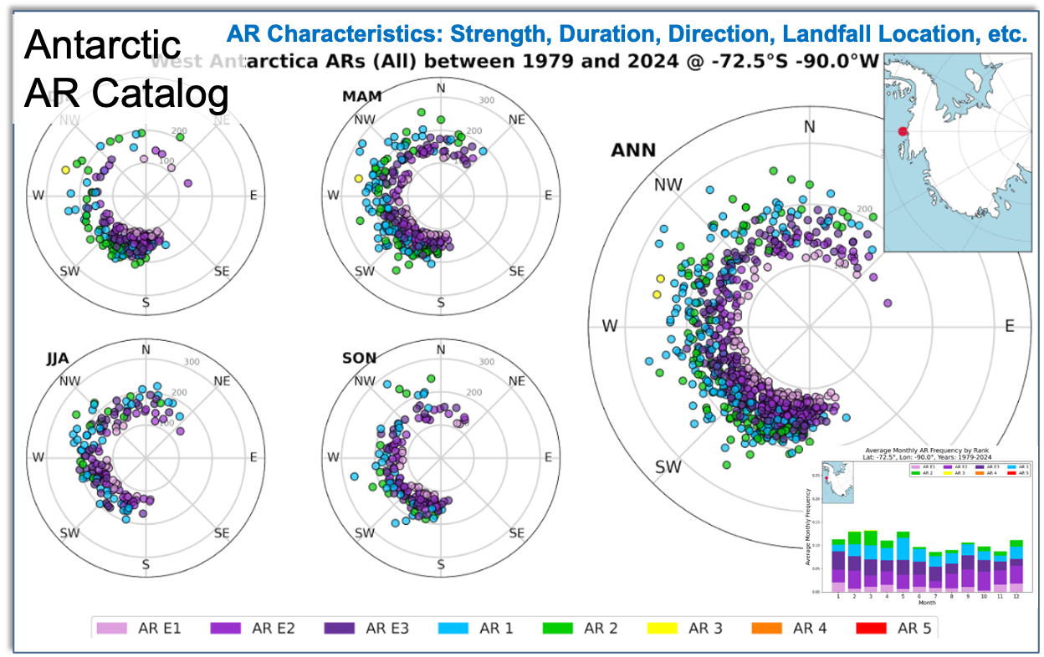
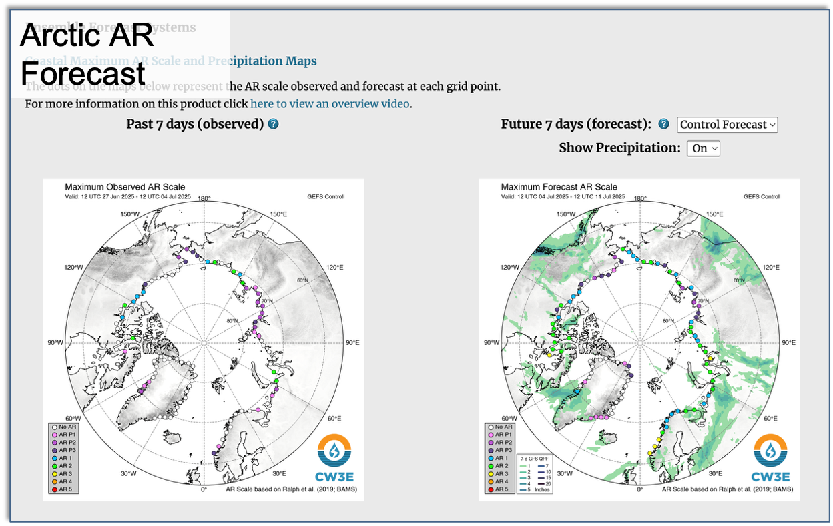
Datasets and Web tools developed for AR science
Contact: x4zou@ucsd.edu
Thanks to AMRDC. Selected data are/will be archived for Antarctic community

Slide 15
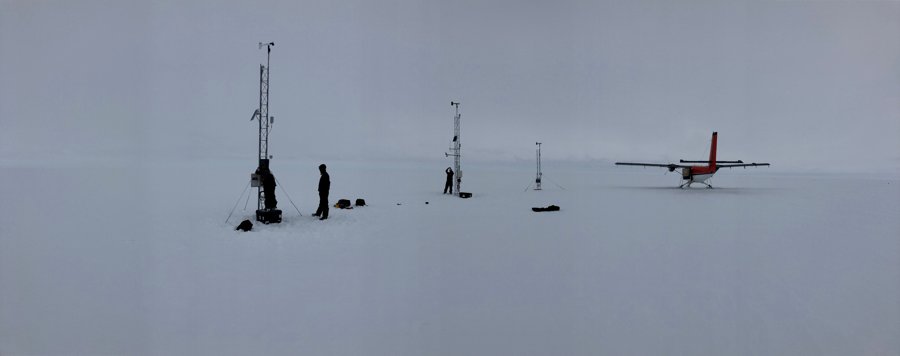
Thank you! Questions?
O-283 Field Team
Madison College PCWS
Skomik
Wisconsin AWS
Schwerdtfeger
NIWC AWS
Acknowledgements:
Thanks for the support from the US National Science Foundation, Grants: 1924730, 1951720, 19516603, 2301362, 2127632, 2229392, 2331992
Horizon 2020 project, netGEMS
National Centre for Polar and Ocean Research (NCPOR), Goa, India & Dr. John Turner
E-mail: mattl@ssec.wisc.edu or mlazzara@madisoncollege.edu

