Slide 1
The Antarctic Meteorological Research and Data Center Data Website: An Overview and discussion of the AMRDC website, featured projects, and real-time data display
David Mikolajczyk¹, Matthew Lazzara^{1,2}, Matthew Noojin², Karissa Shannon¹, Sophie Orendorf¹, Clayton Suplinski¹, Taylor Norton¹, Caleb Cullum¹, Ethan Koudelka¹, Kathryn Marek¹, and Lee Welhouse¹
¹Antarctic Meteorological Research and Data Center, Space Science and Engineering Center, University of Wisconsin-Madison, Madison, WI, USA
²Department of Physical Sciences, School of Science, Technology, Engineering, and Mathematics, Madison Area Technical College, Madison, WI, USA

Slide 2
Outline
Re-introducing the new AMRDC website
Main features of website
Projects
Real-time data
Web Applications
Group discussion

Slide 3
Out with the old, in with the new
Farewell to the old website, https://amrc.ssec.wisc.edu/

Slide 4
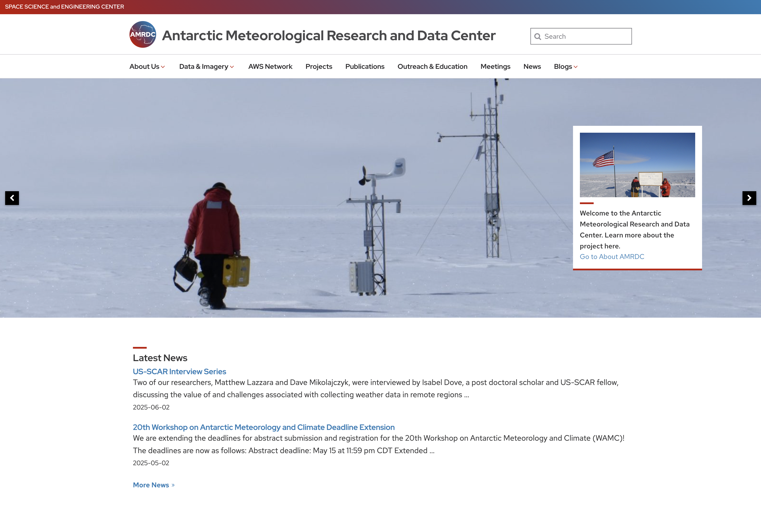
Out with the old, in with the new
Hello to the new website! https://amrdc.ssec.wisc.edu

Slide 5
Main features of website
Now built on Wordpress
Following University of Wisconsin-Madison formatting/layouts
Data Visualization
Visualizer
Dashboard
Real-time Data
Observations and satellite imagery
Links to AMRDC Data Repository
Projects
Past and present
General information
News, Meetings, etc.
Catalogue of outreach activities

Slide 6
Projects
AMPS-AWS Verification:
https://amrdc.ssec.wisc.edu/real-time-data/forecasts/aws-observations-amps-output
Developed by Karissa Shannon, with initial help from Kevin Manning (UCAR)
Real-time comparisons between Antarctic Mesoscale Prediction System (AMPS) forecast output and AWS observations from UW and the Naval Information Warfare Center (NIWC)
Compare obs with most recent two or three AMPS forecast runs
Temperature, pressure, relative humidity, and wind
Time series plots and maps
Dashboard allows user to display multiple plots at once (shown in figure)

Slide 7
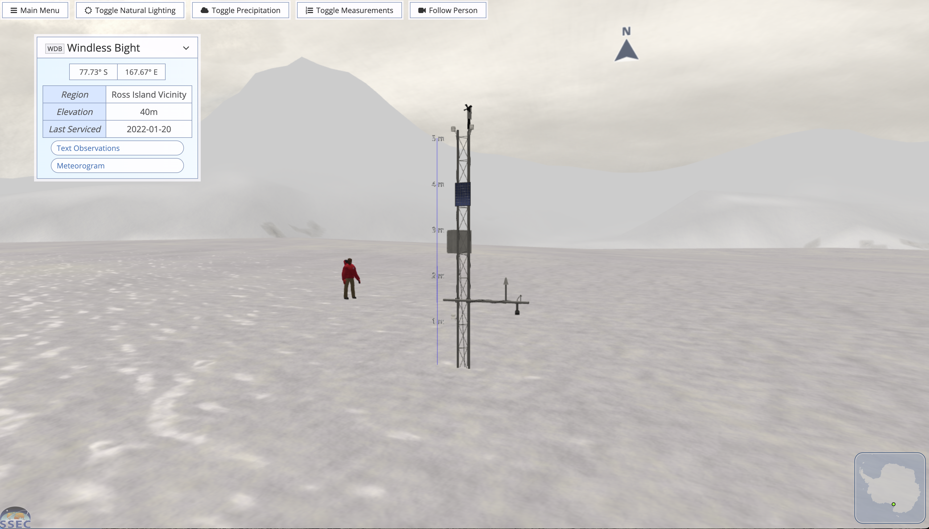
Projects
Antarctica Simulation: https://amrdc.ssec.wisc.edu/web_products/antarctica_simulation/
Developed by Clayton Suplinski
Simulations made for each UW AWS site
Emulates tower, instrumentation, and surrounding geography
Use in a web browser, or with virtual reality headsets

Slide 8
Real-time data
A work in progress!

Slide 9
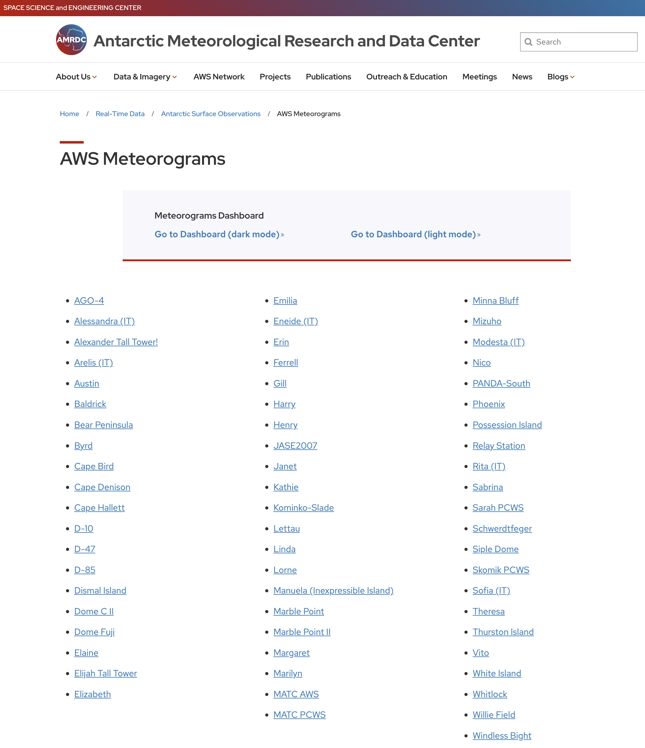
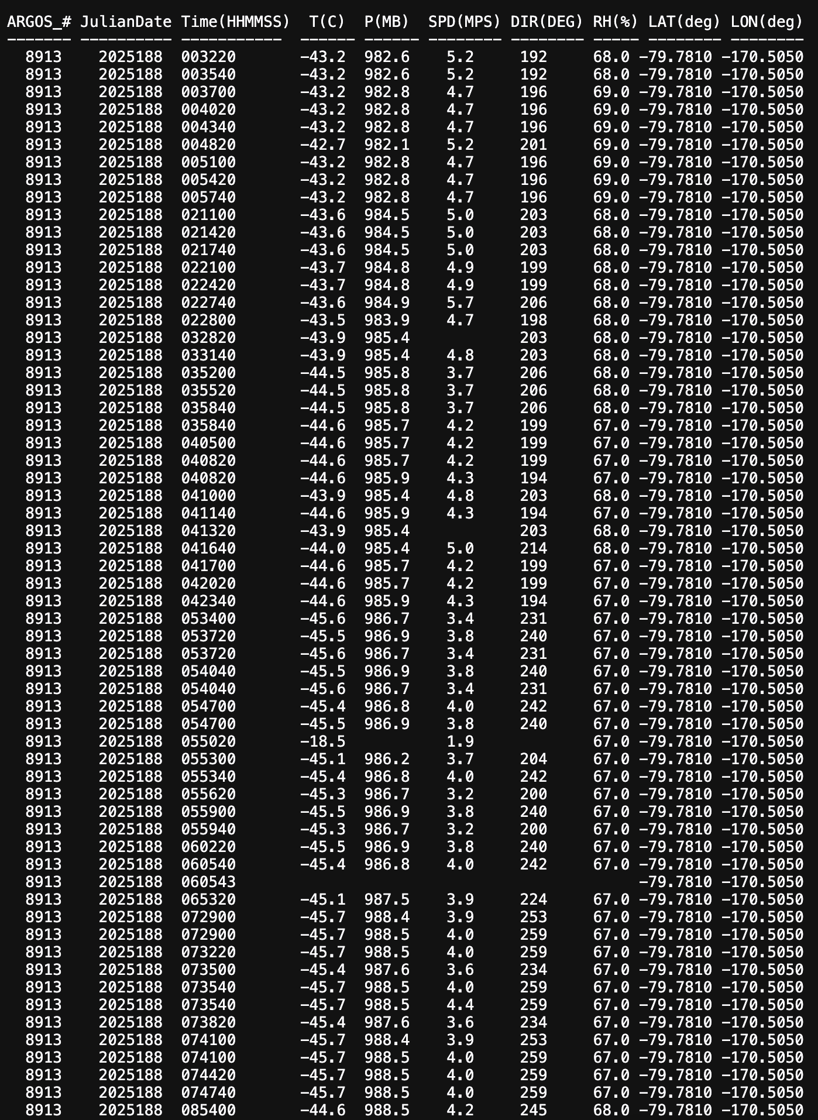
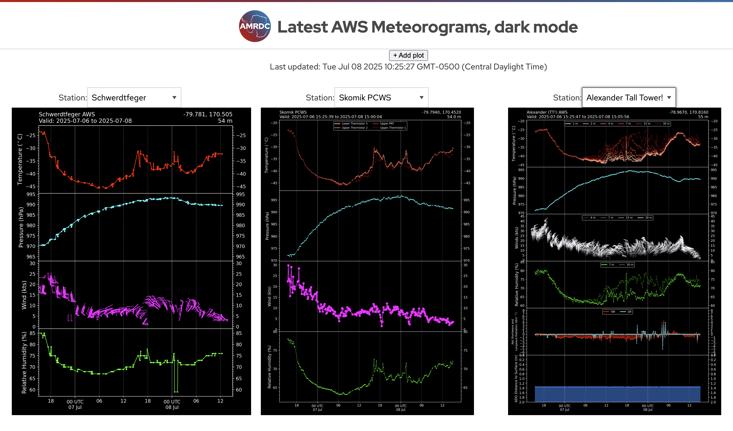
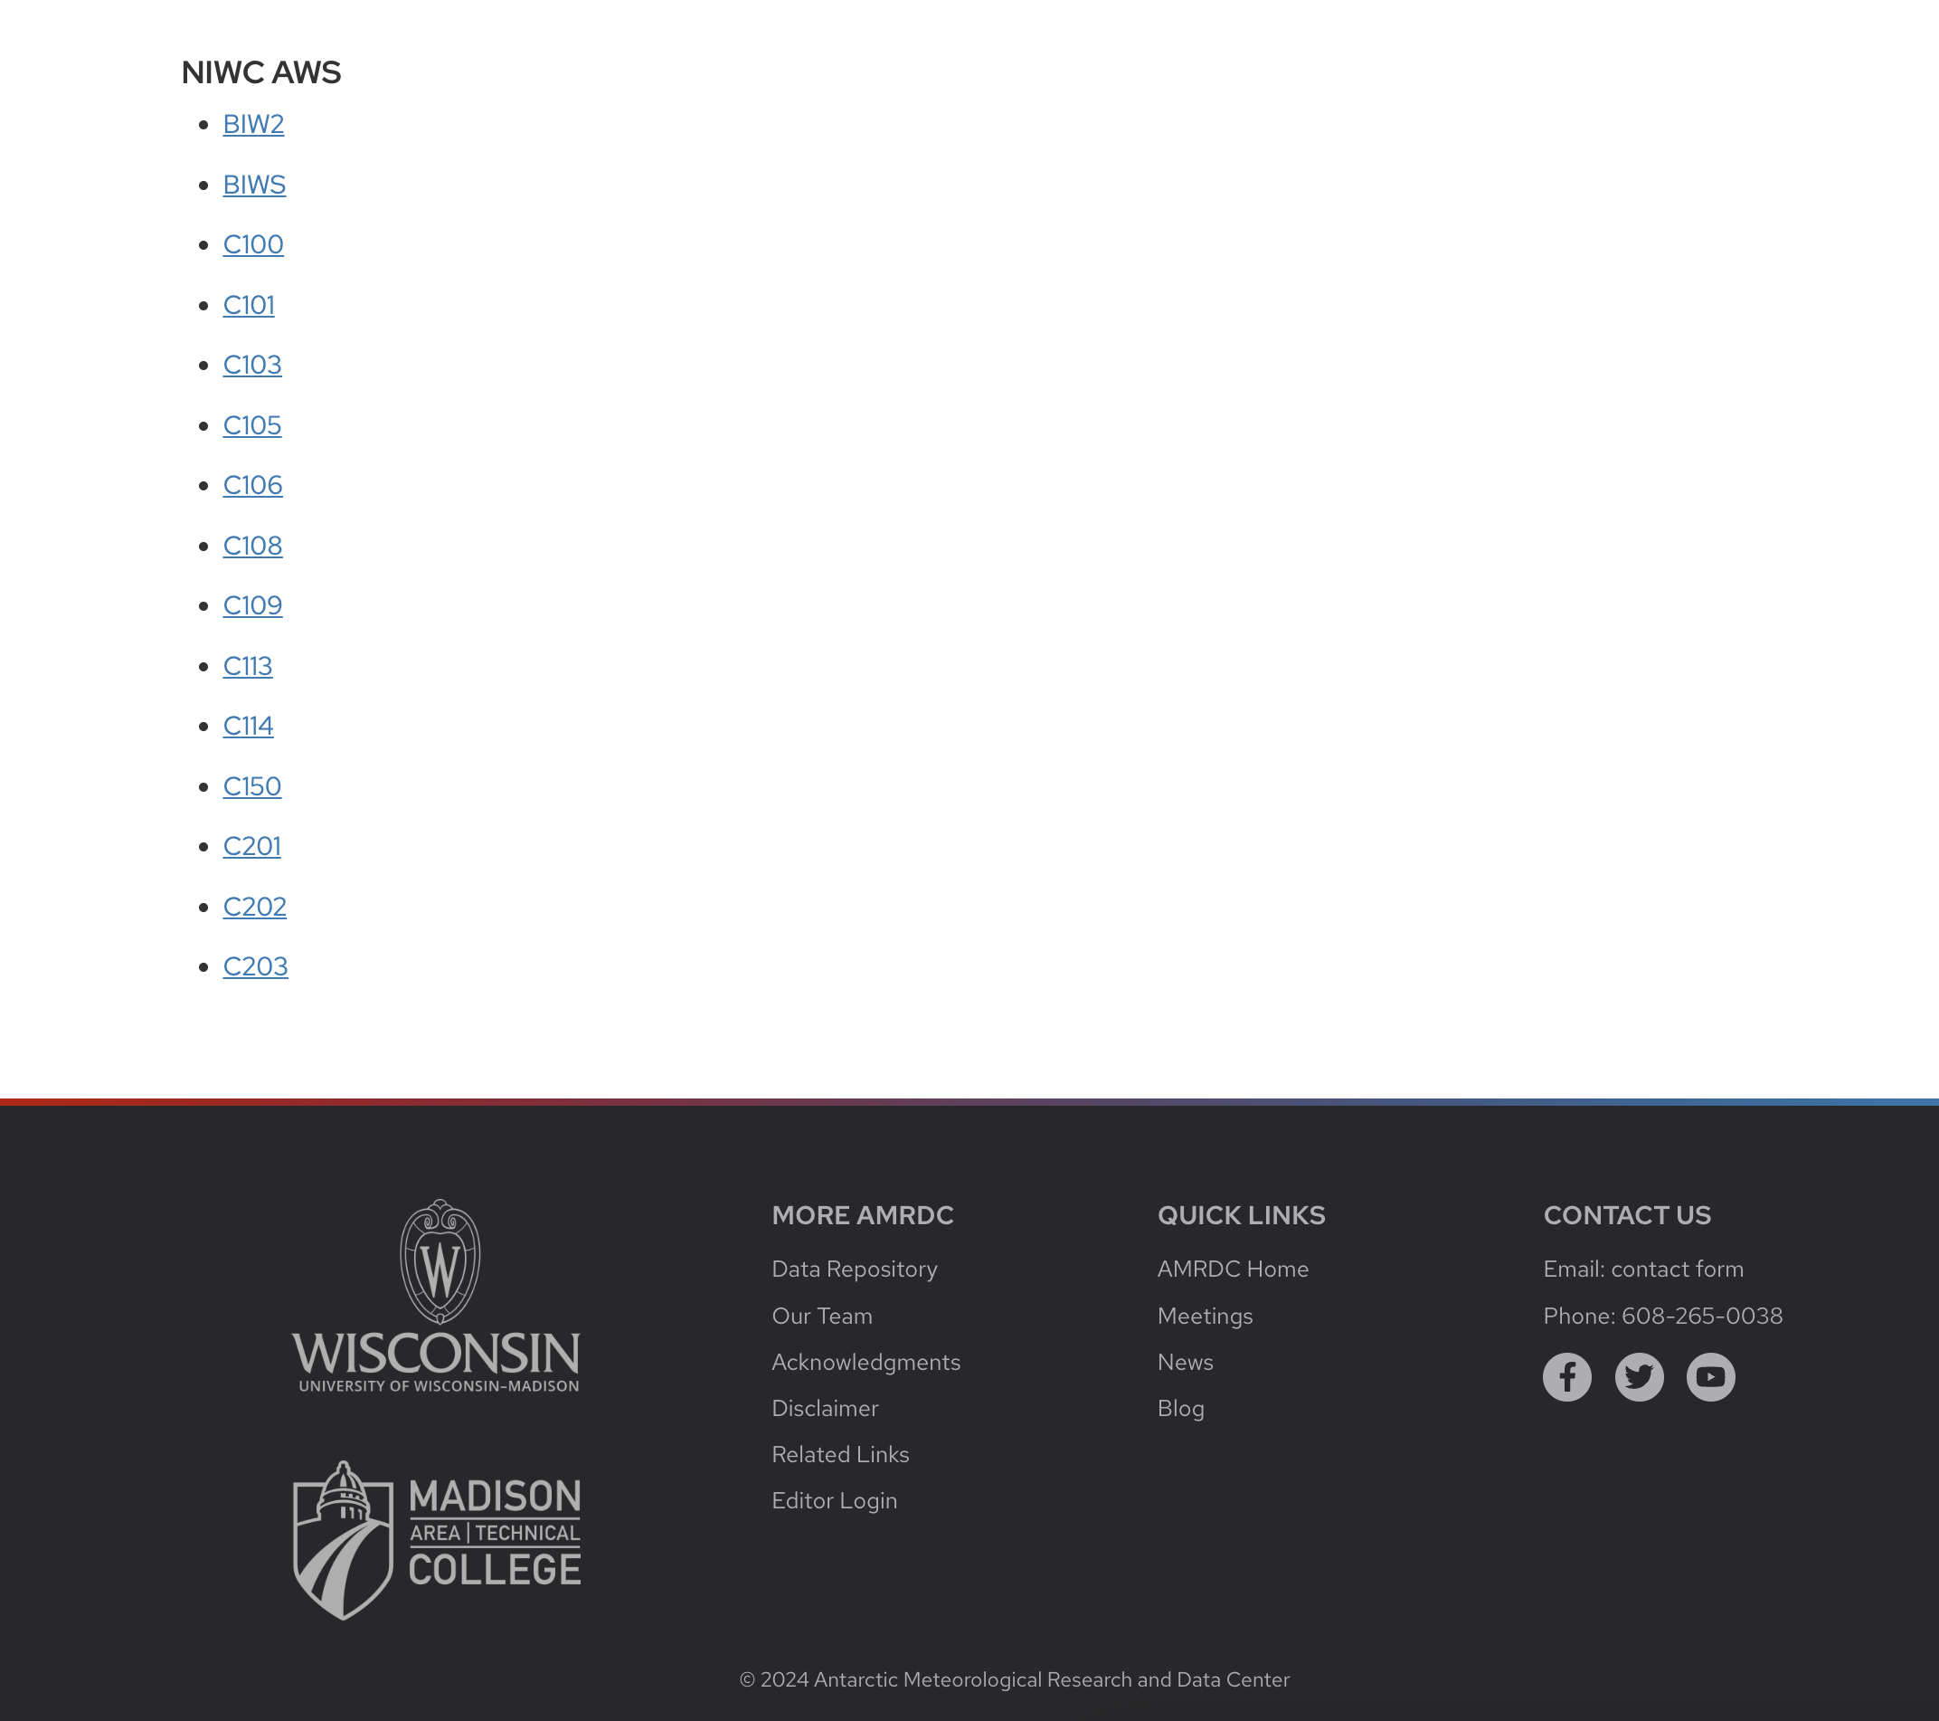
Real-time data
Antarctic Surface Observations
Text listing
Meteorogram

Slide 10
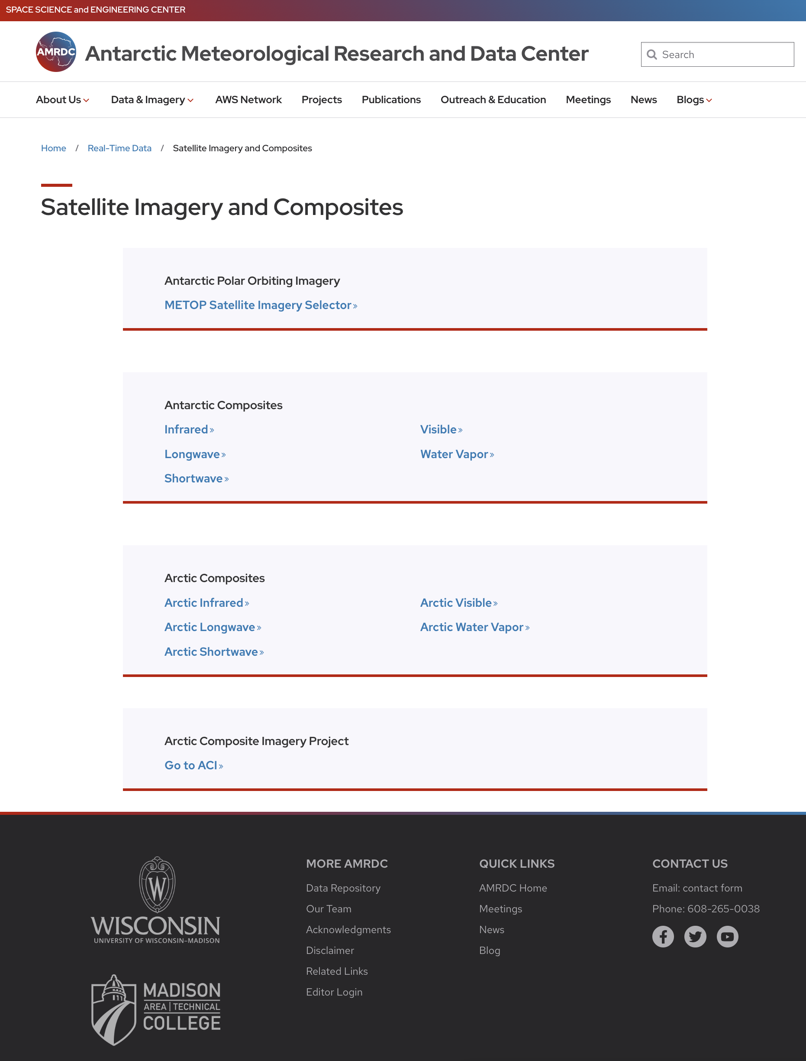
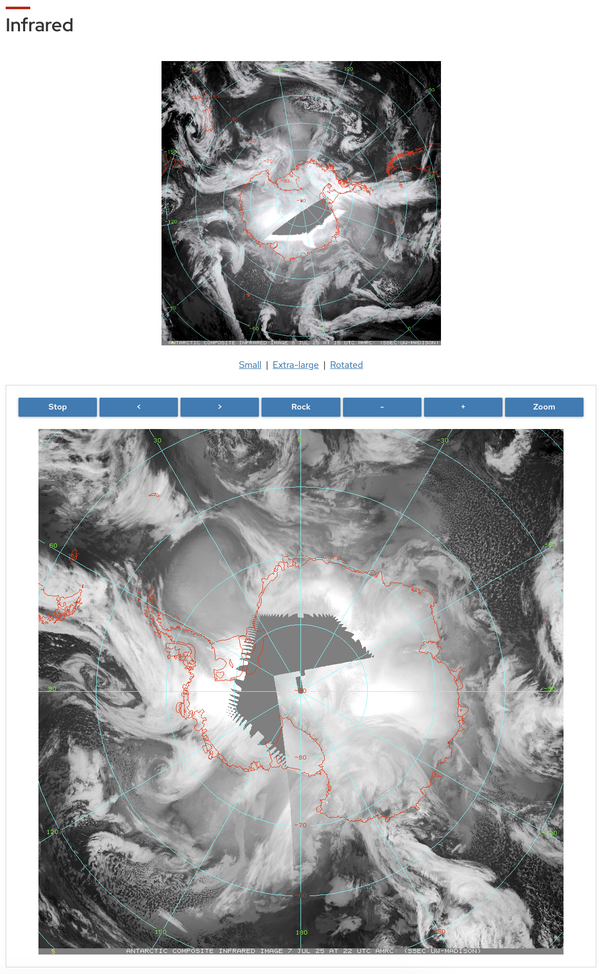
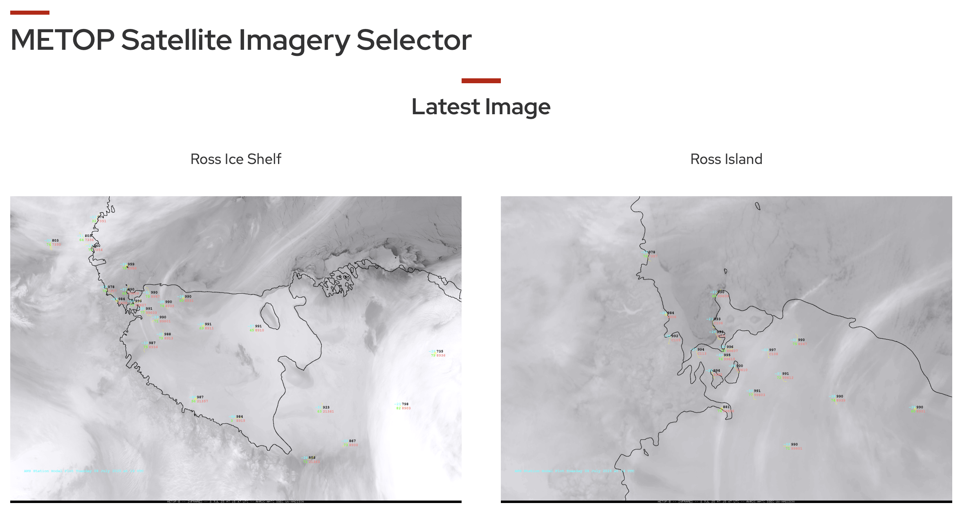
Real-time data
Satellite Imagery and Composites
Imagery
Composites

Slide 11
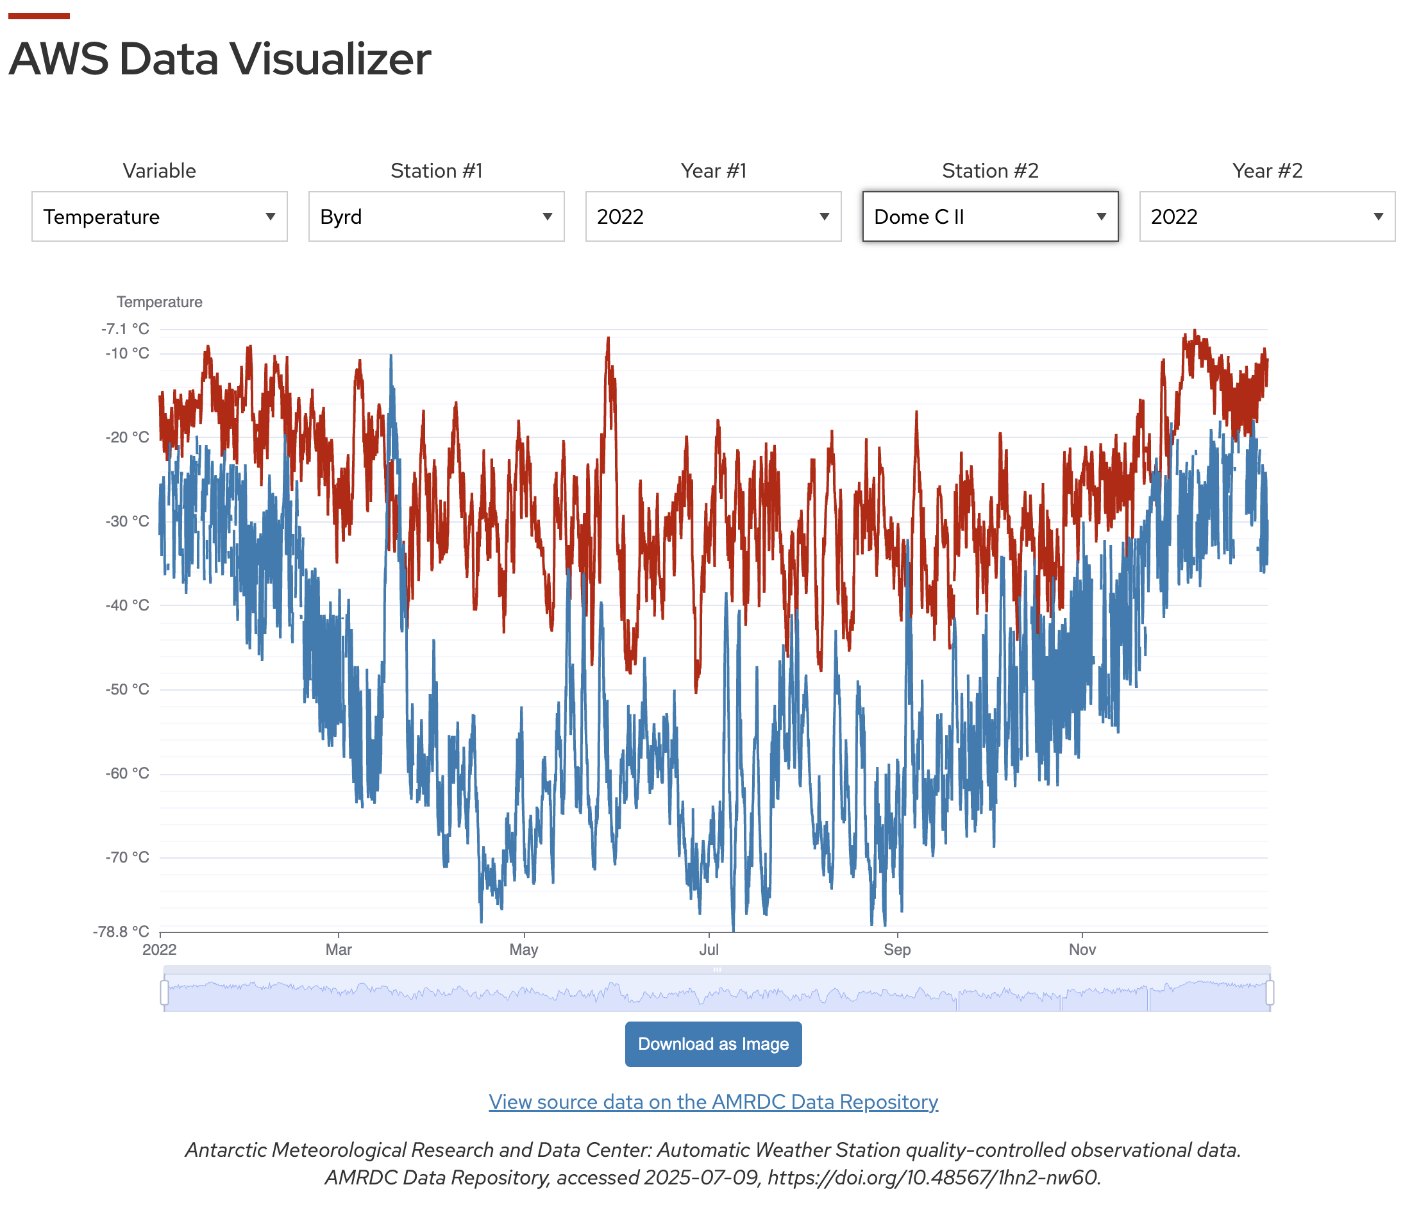
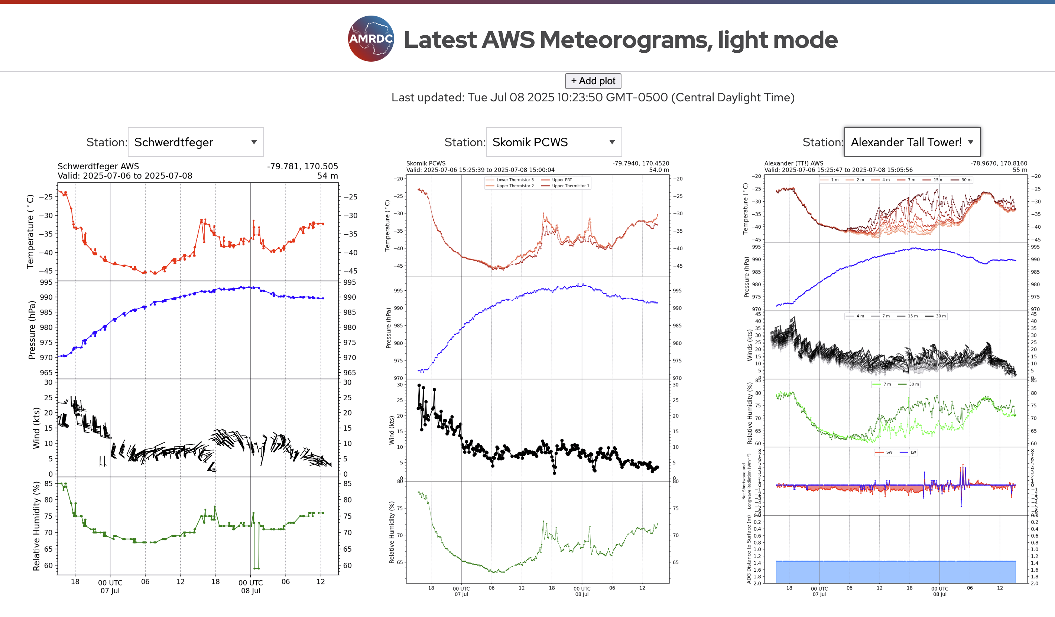
Web Applications
Real-time meteorogram and data time series “dashboards”
E.g. AWS meteorograms, AMPS-UW verification project
Archive AWS data visualizer
Plots QC’d data from repository

Slide 12
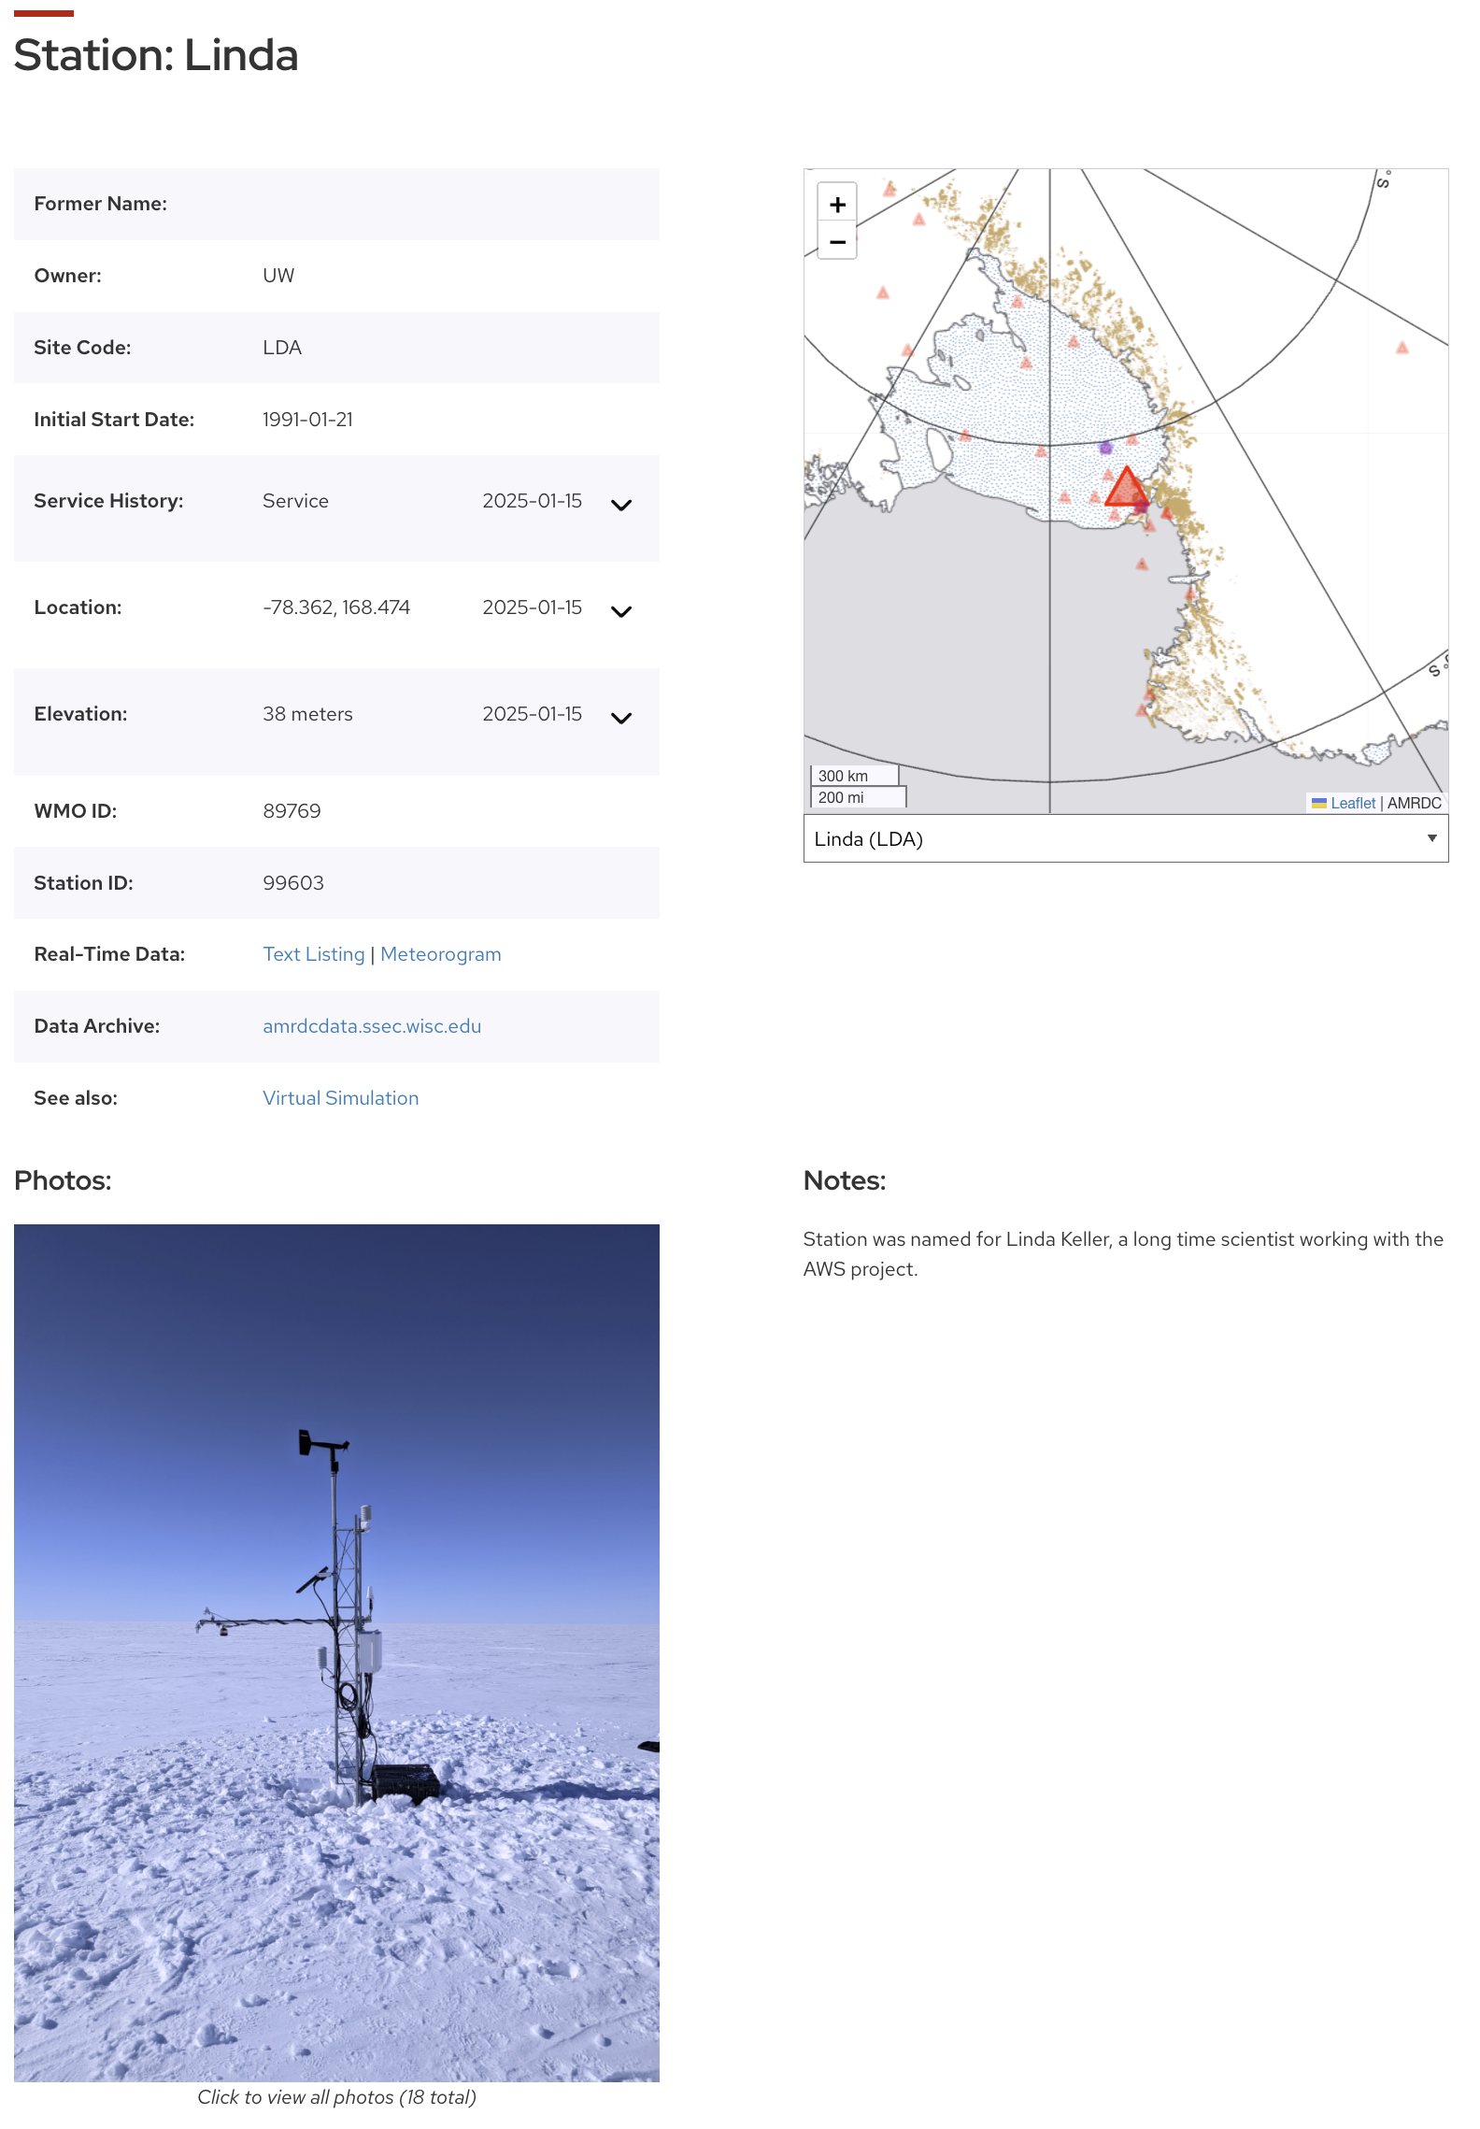
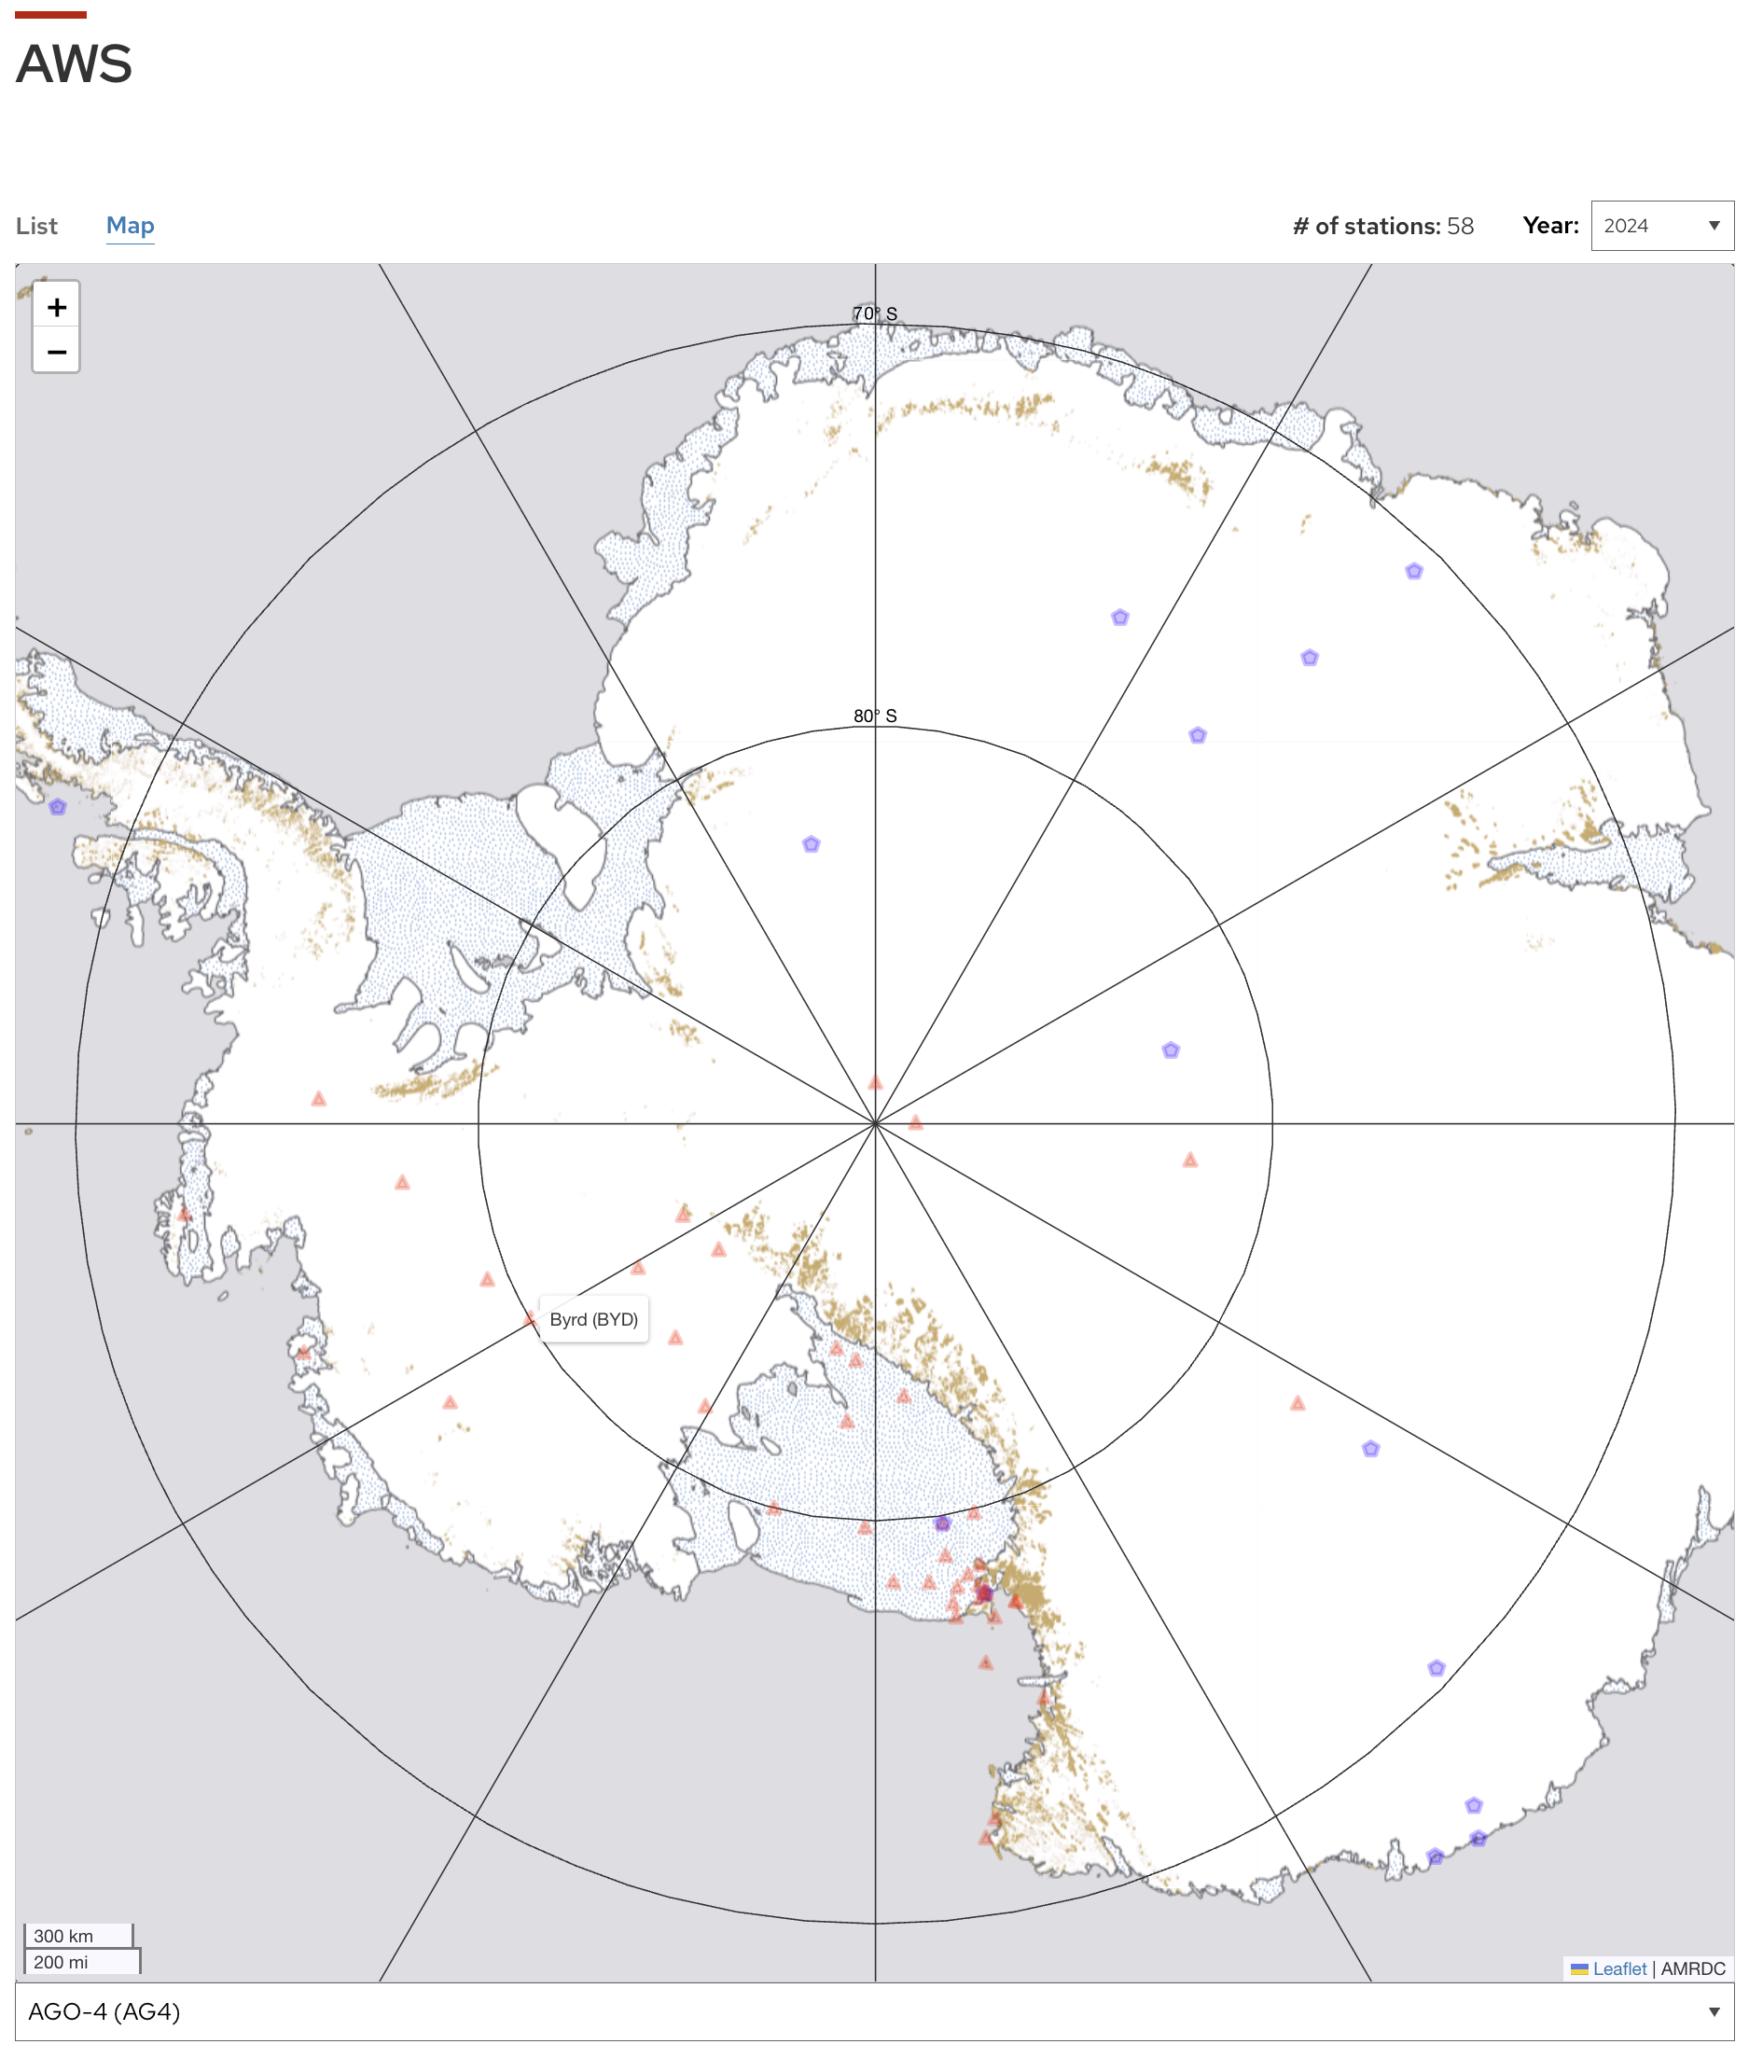
Web Applications
AWS Station Pages
New AWS interactive map
Links to individual AWS station pages

Slide 13
Questions and Discussion
Are information and data products intuitive to find?
Any suggestions on layout?
Any products that you want to see included on the website?

Slide 14
Thank you!
Acknowledgments
The authors appreciate the support of the National Science Foundation under grant number 1951720 and 2301362 (UW), and 1951603 (MATC).
References
Lazzara, M., G. Weidner, L. Keller, J. Thom, and J. Cassano, 2012: Antarctic Automatic Weather Station Program: 30 Years of Polar Observation. Bull. Amer. Meteor. Soc., 93, 1519-1537. https://doi.org/10.1175/BAMS-D-11-00015.1
Lazzara, M. A., M. G. Noojin, K. J. Shannon, D. E. Mikolajczyk, and L. J. Welhouse, 2025: An Antarctic Meteorological Data Repository. Bull. Amer. Meteor. Soc., Accepted. DOI: 10.1175/BAMS-D-24-0178.1

