Slide 1







Overview of the UW-Madison
AWS Program Field Season 2023-24
David Mikolajczyk¹, Wenhua Wu², Matthew Lazzara^{1,3}, Lee Welhouse^{1,3}, Taylor Norton¹, Linda Keller¹, George Weidner⁴, Andy Kurth⁵, and Forbes Filip⁵
¹Antarctic Meteorological Research and Data Center, Space Science and Engineering Center, University of Wisconsin-Madison, Madison, WI
²Office of Research Support, Space Science and Engineering Center, University of Wisconsin- Madison, Madison, WI
³Department of Physical Sciences, School of Arts and Sciences, Madison Area Technical College, Madison, WI
⁴Atmospheric and Oceanic Sciences Department, University of Wisconsin-Madison, Madison, WI
⁵Dept. of Electrical Engineering Technology Department, School of Applied Science, Engineering and Technology, Madison Area Technical College, Madison, WI

Slide 2
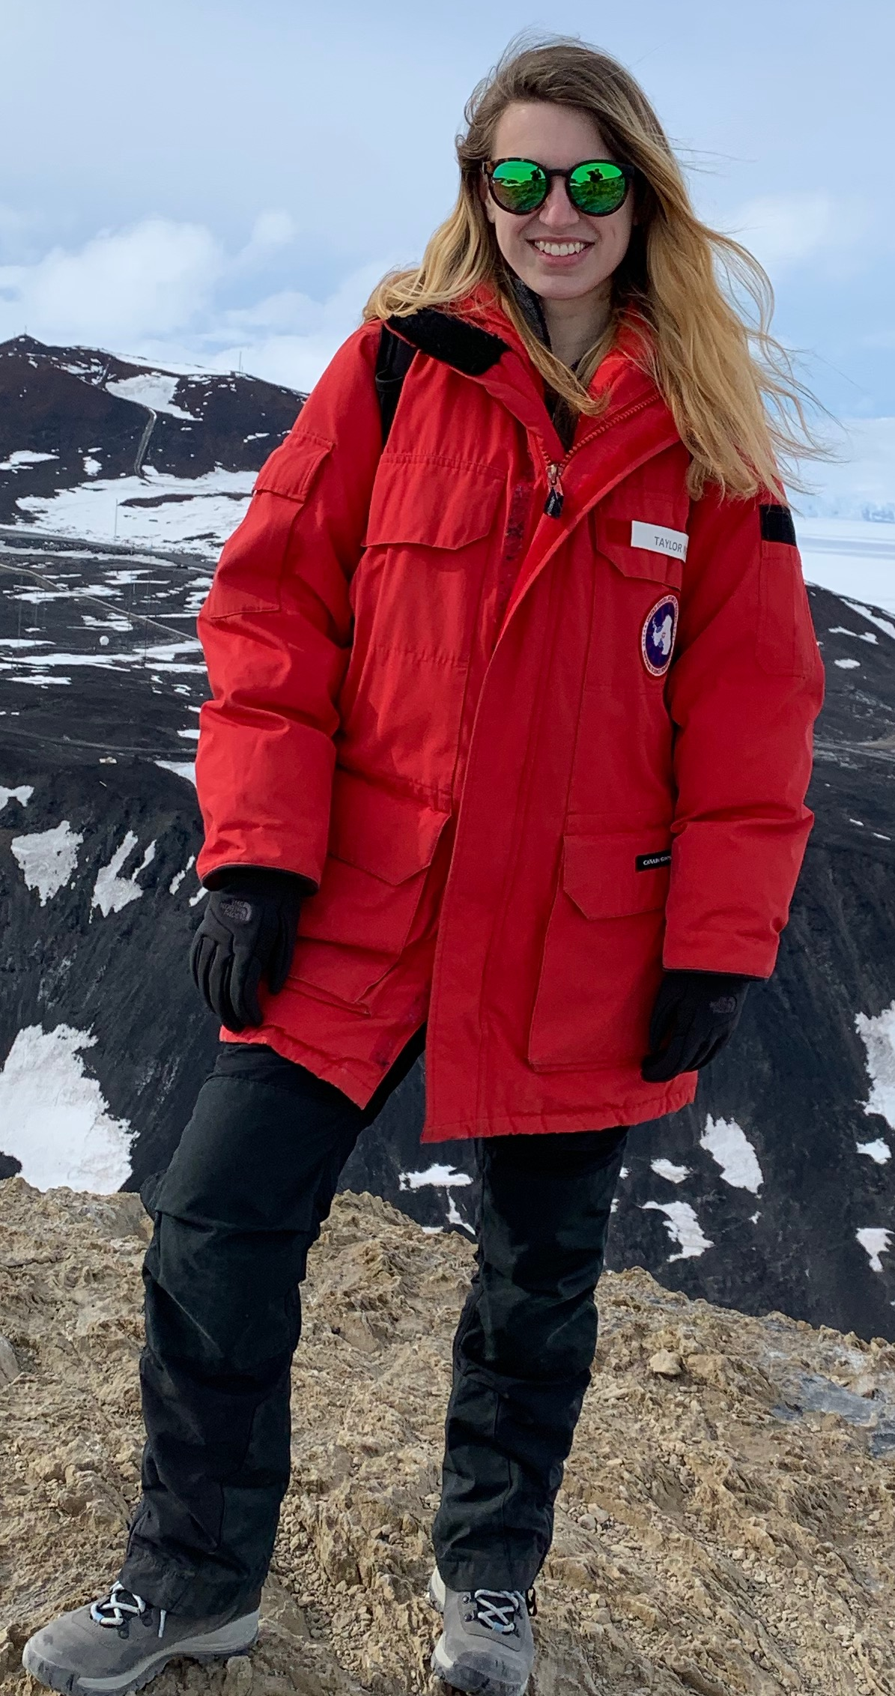
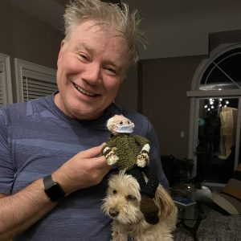
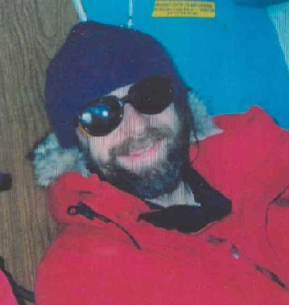
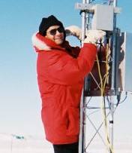
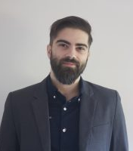
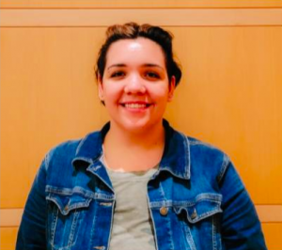
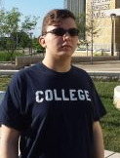
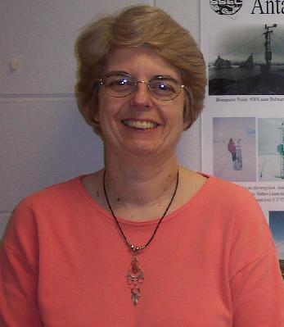
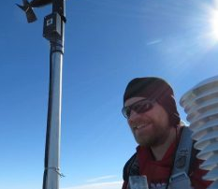


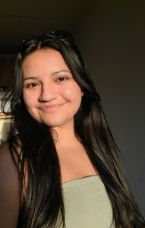
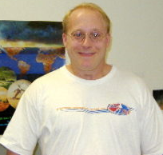
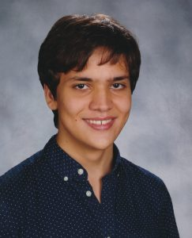
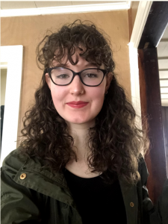
The AMRDC/AWS Team
Jeff Havens
Taylor Norton
George Weidner
Dr. Matthew Lazzara
Matt Noojin
Anastasia Tomanek
Owen
Graham
Lee Welhouse
Linda Keller
…and many USA and
international collaborators!
Ethan Koudelka
Mercedes Hernandez-Natera
Jerry Robaidek
Zakariah Idrissi
Karissa Shannon

Slide 3
Quick overview of UW AWS Network
55 Automatic Weather Stations total
  57 including Polar Climate and Weather Stations (PCWS)
University of Wisconsin-Madison:
  Ross Ice Shelf
  West Antarctica
  South Pole
Japan – Japanese Antarctic Research Expedition (JARE)
UK – British Antarctic Survey (BAS)
China – Chinese National Antarctic Research Expedition (CHINARE)
France – French Polar Institute Paul-Émile Victor (IPEV)
Australia – Mawson’s Hut Foundation
4
2
1
12
4
4
29
1

Slide 4
2023-24 Field Season
The team: Dave and Wenhua
Initial plan:
  WAIS work (12 AWS)
  McMurdo work (20 AWS/PCWS)
Actual plan:
  All work done out of McMurdo
  Service 20 AWS/PCWS (circled in blue)
The timeline:
  Arrived on the ice 7 Nov 2023, redeployed 10 Jan 2024

Slide 5
2023-24 Field Season
Help from other teams/programs:
  Naval Information Warfare Center (NIWC):
    Skomik enclosure removal
  Japanese Antarctic Research Expedition (JARE):
    Pictures of Mizuho, Relay Station, Dome Fuji
  POLENET:
    Pictures of Bear Peninsula, Thurston Island, Byrd
  GHOST/TIME groups:
    Kominko-Slade instrument retrieval

Slide 6
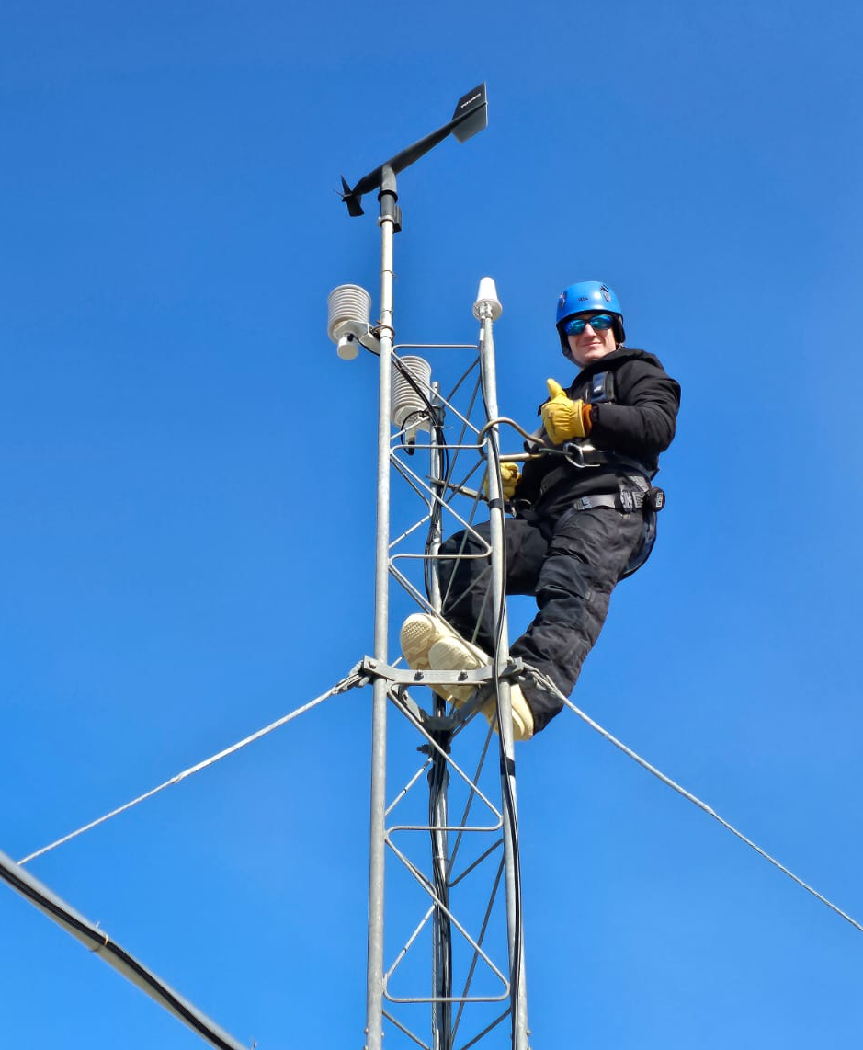
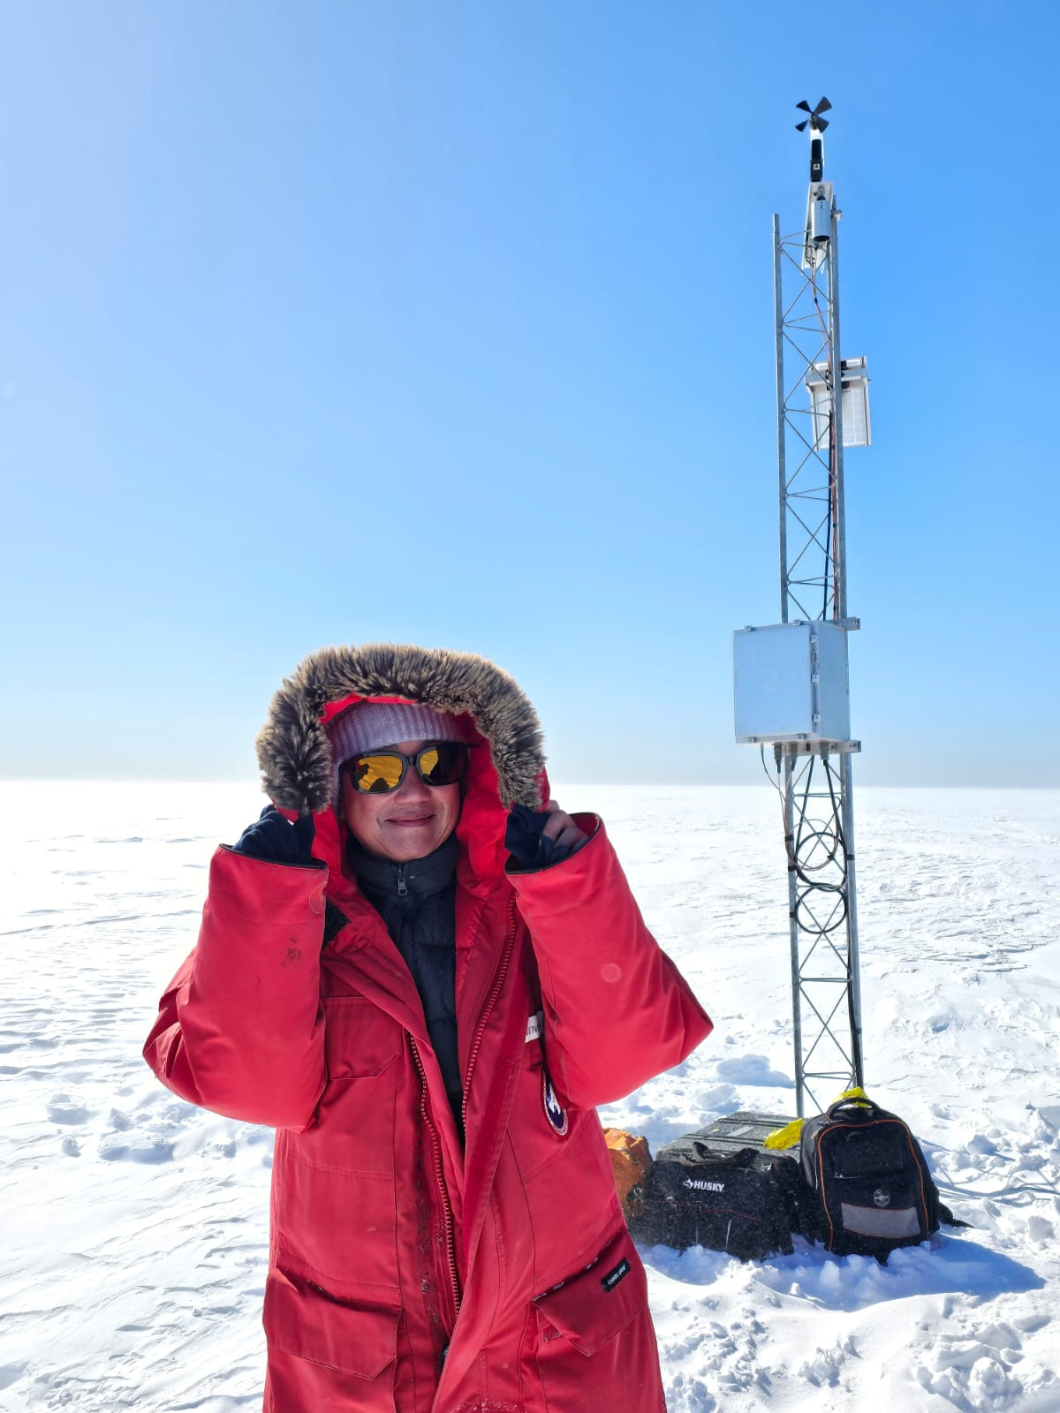
The 2023-24 UW AWS Field Team
Dave
Wenhua

Slide 7
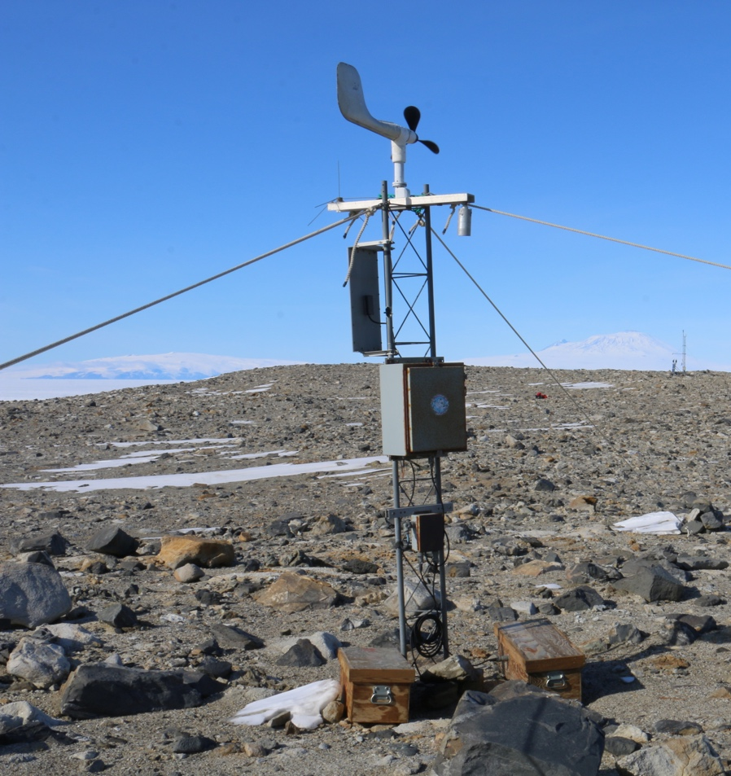
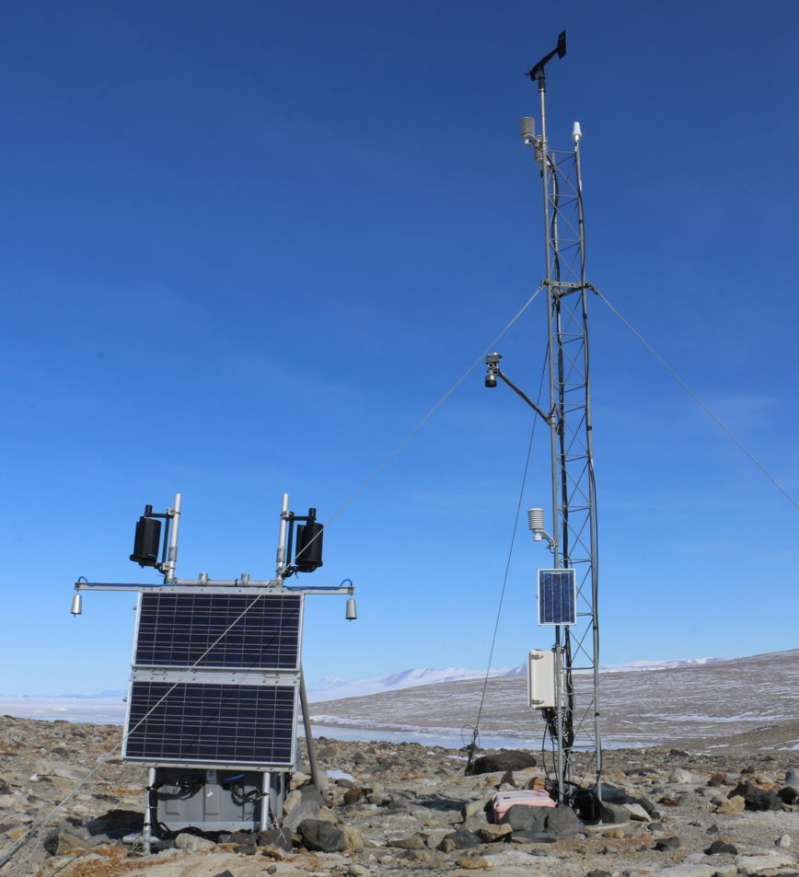
Nov 17 – Marble Pt I/II AWS
Purpose: Station checkup
Marble Point
Marble Point II

Slide 8
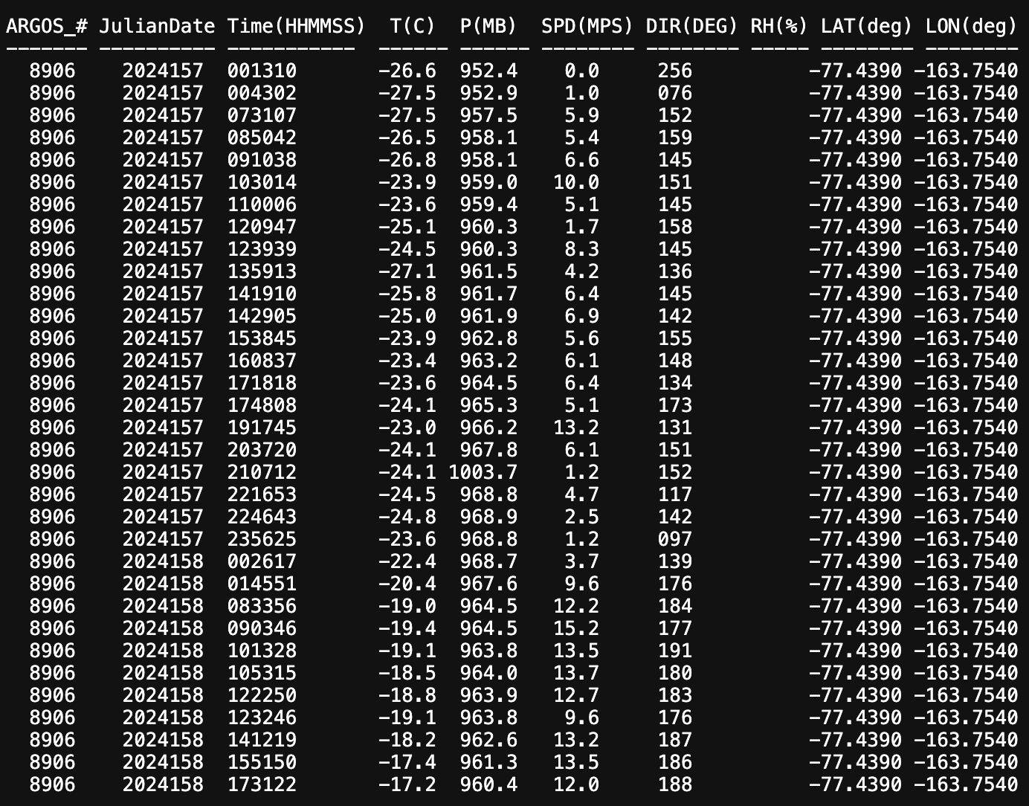
Marble Pt AWS current status
Marble Point

Slide 9
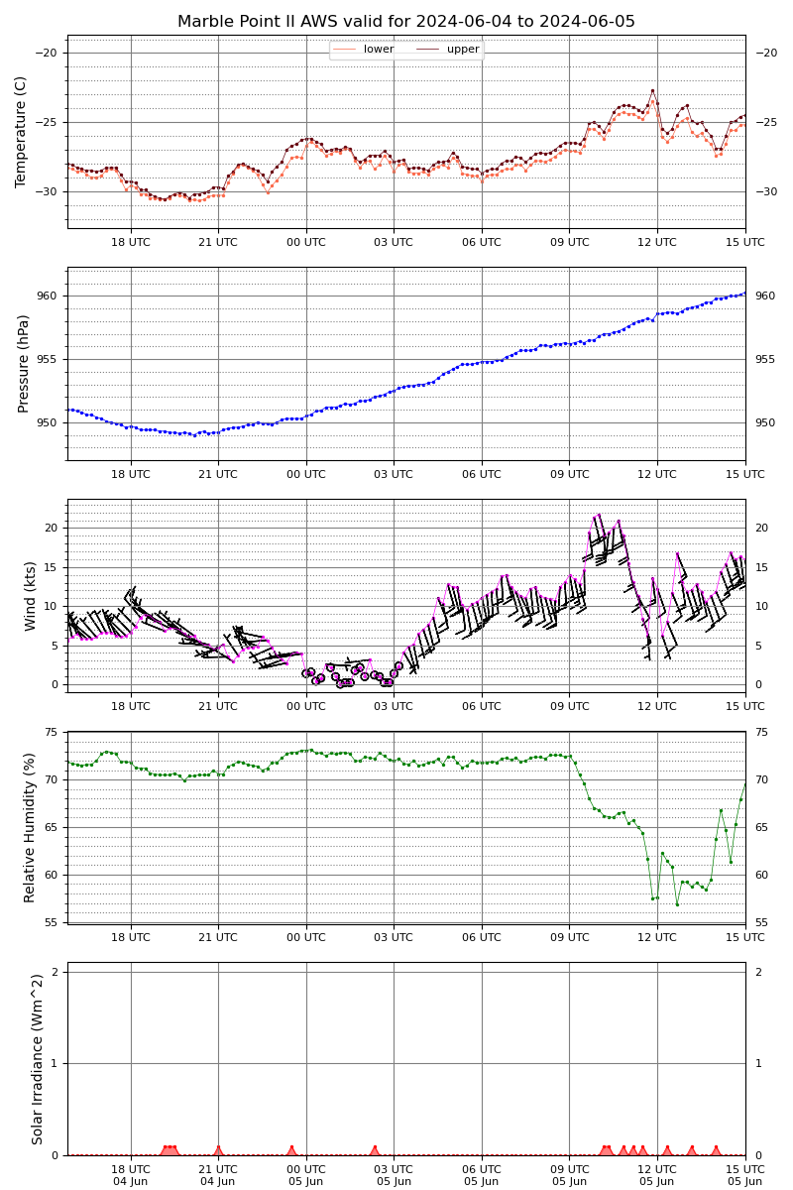
Marble Pt II AWS current status

Slide 10
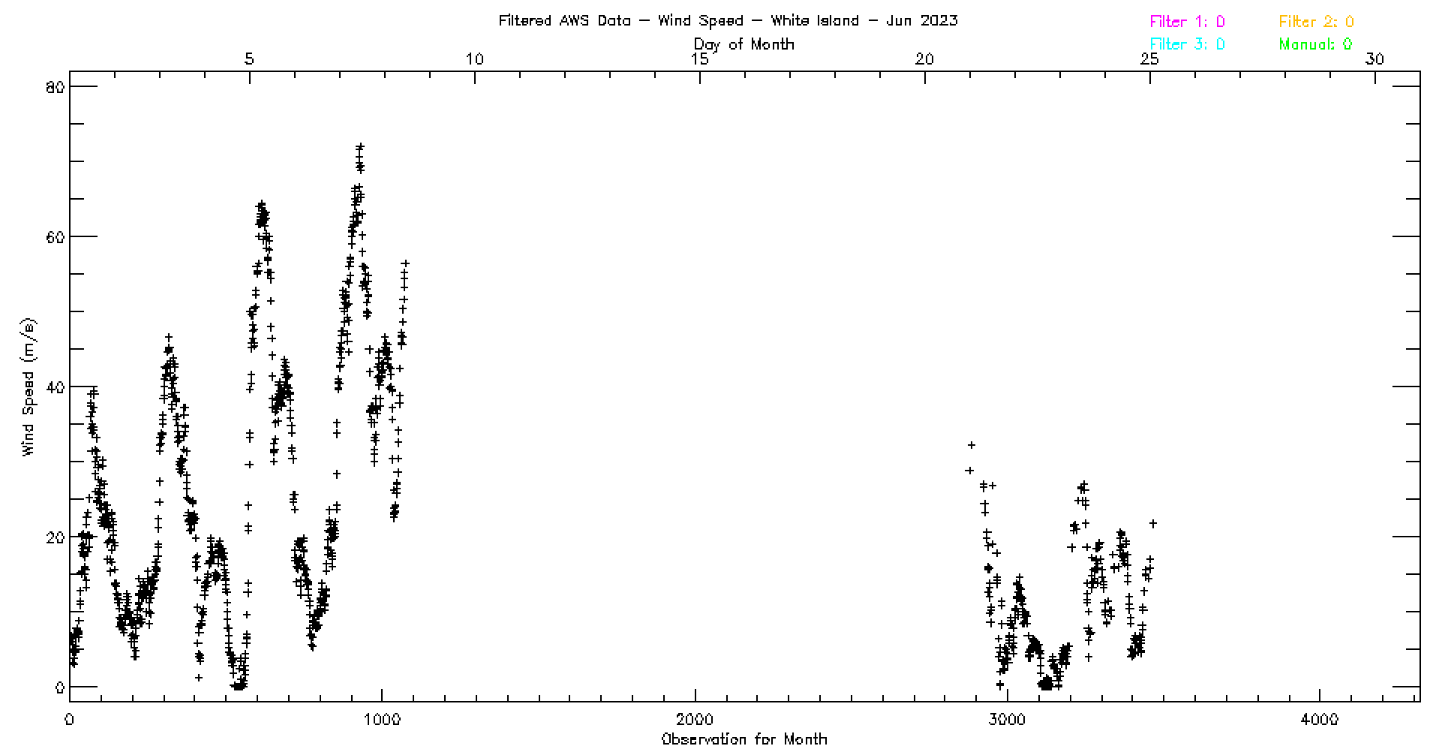
Nov 18 – White Island AWS
Purpose: Swap instrumentation
June 2023
Potential new record high wind speed:
72 m/s or 140 knots or 161 mph!

Slide 11
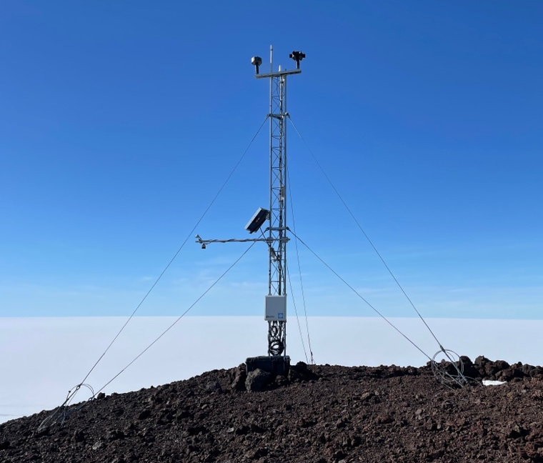
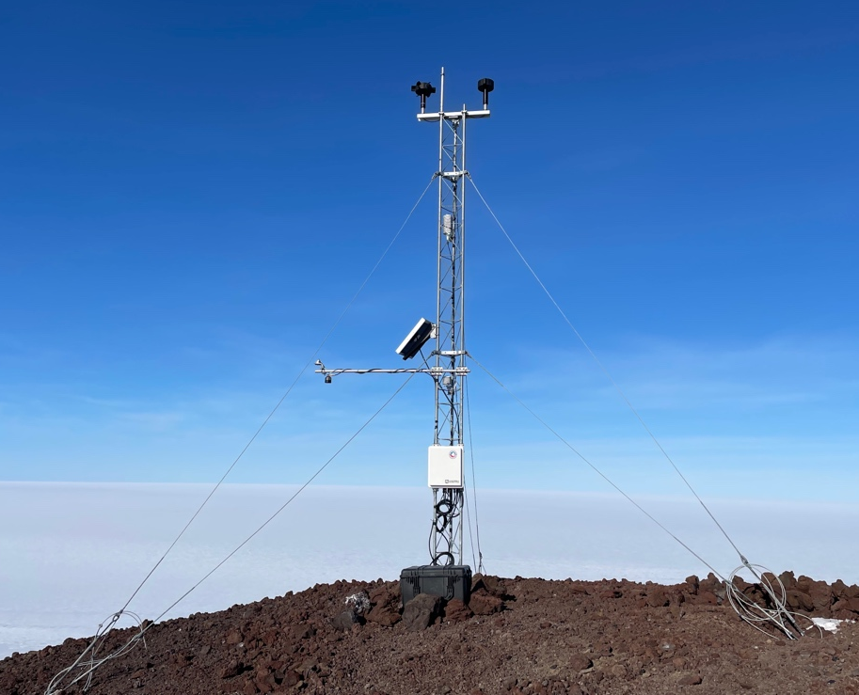
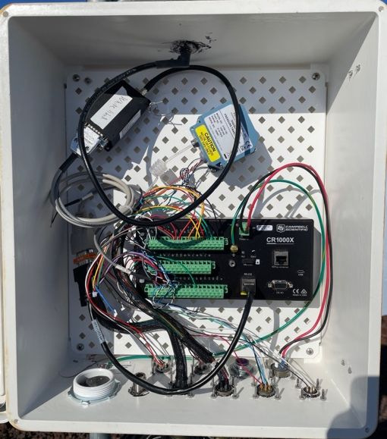
Nov 18 – White Island AWS
Purpose: Swap instrumentation
Before
Inside enclosure
After instrument swap

Slide 12
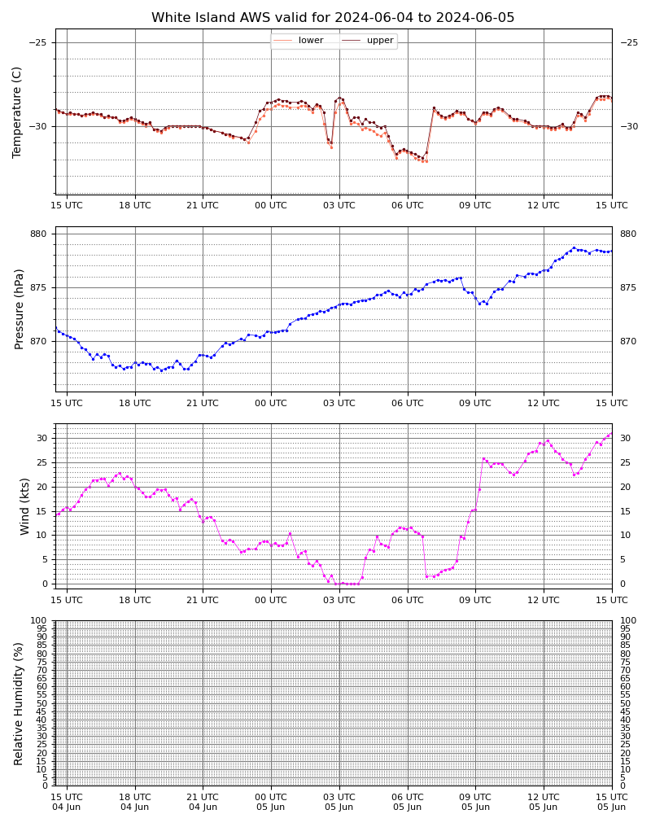
White Island AWS current status

Slide 13
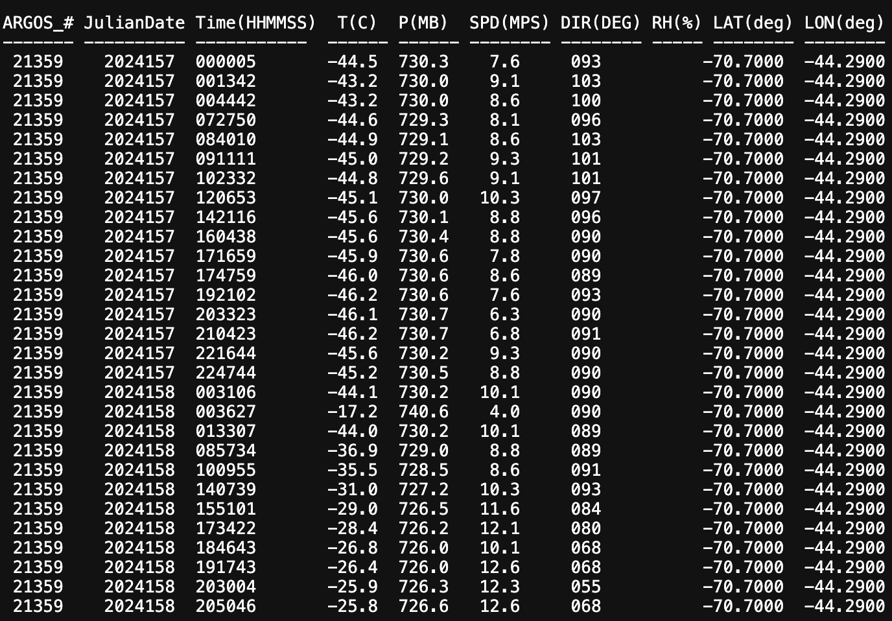
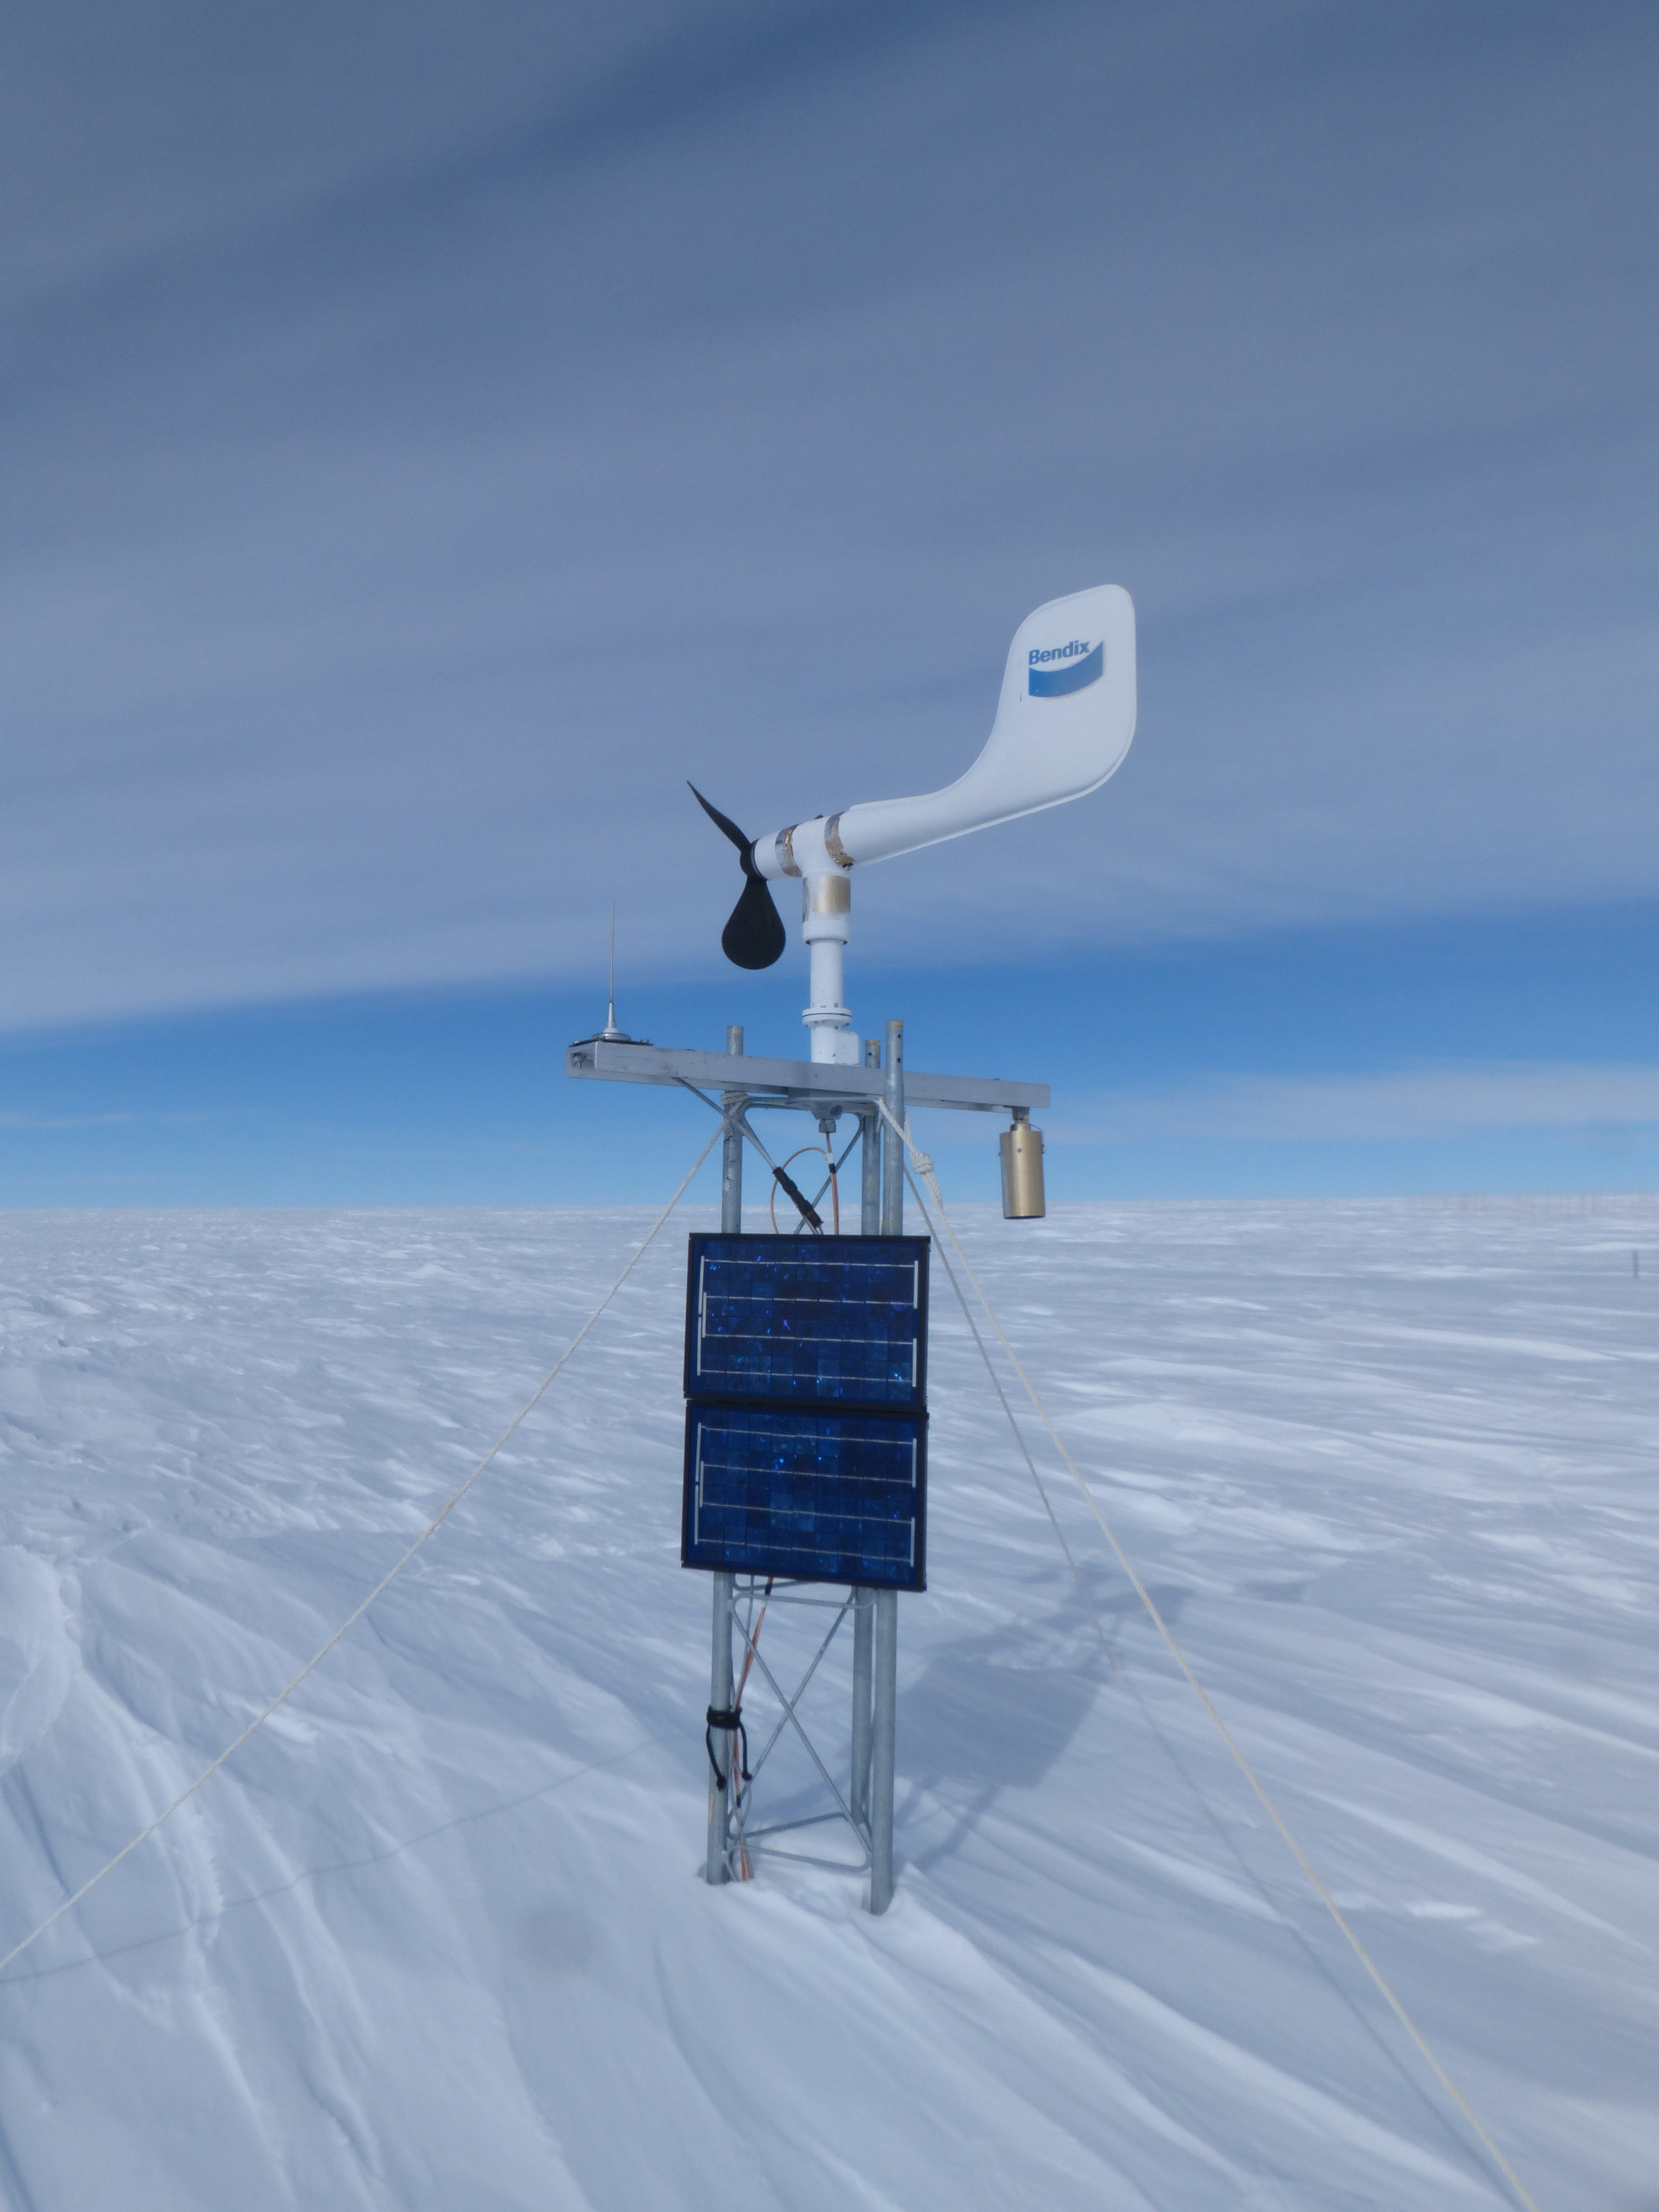
Nov 20 – Mizuho AWS
Visit by JARE
Photo credit: Dr. Fumio Nakazawa at NIPR

Slide 14
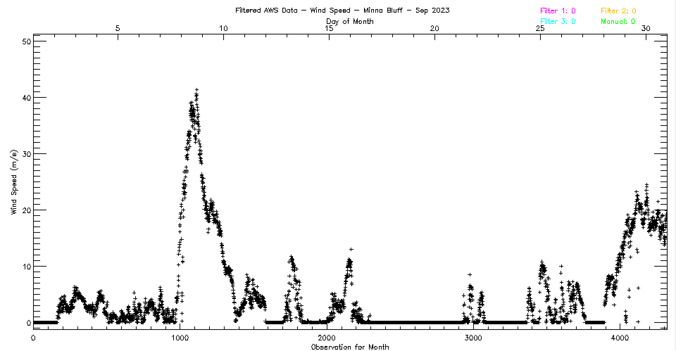
Nov 22 – Minna Bluff AWS
Purpose: Swap instrumentation

Slide 15
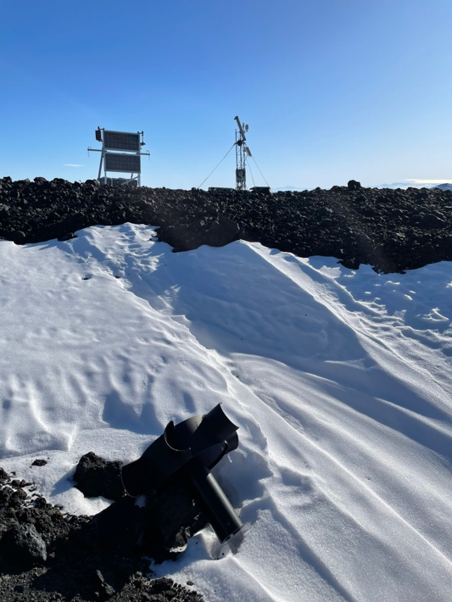
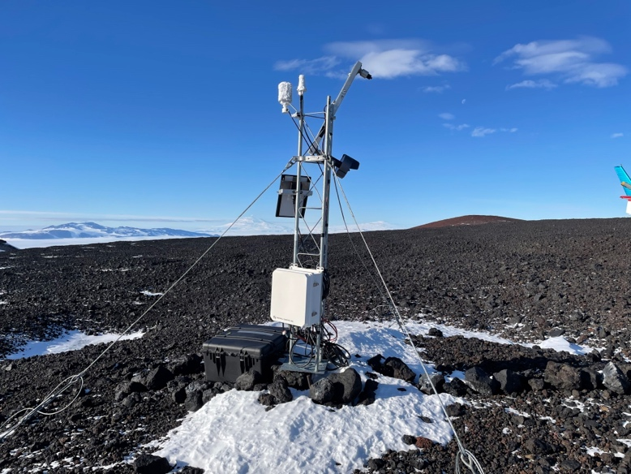
Nov 22 – Minna Bluff AWS
Purpose: Swap instrumentation
Upon arrival
Potential new record, farthest flung sensor?!

Slide 16
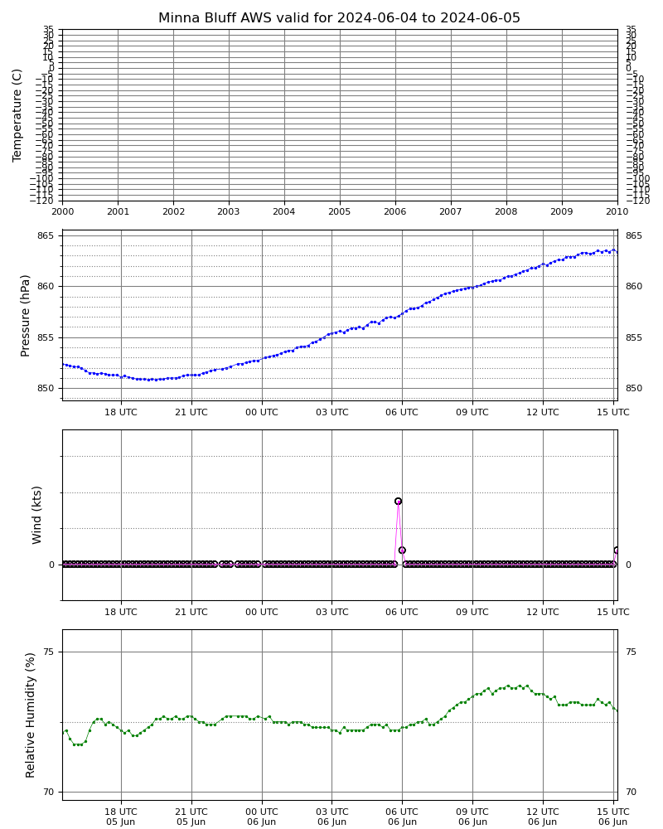
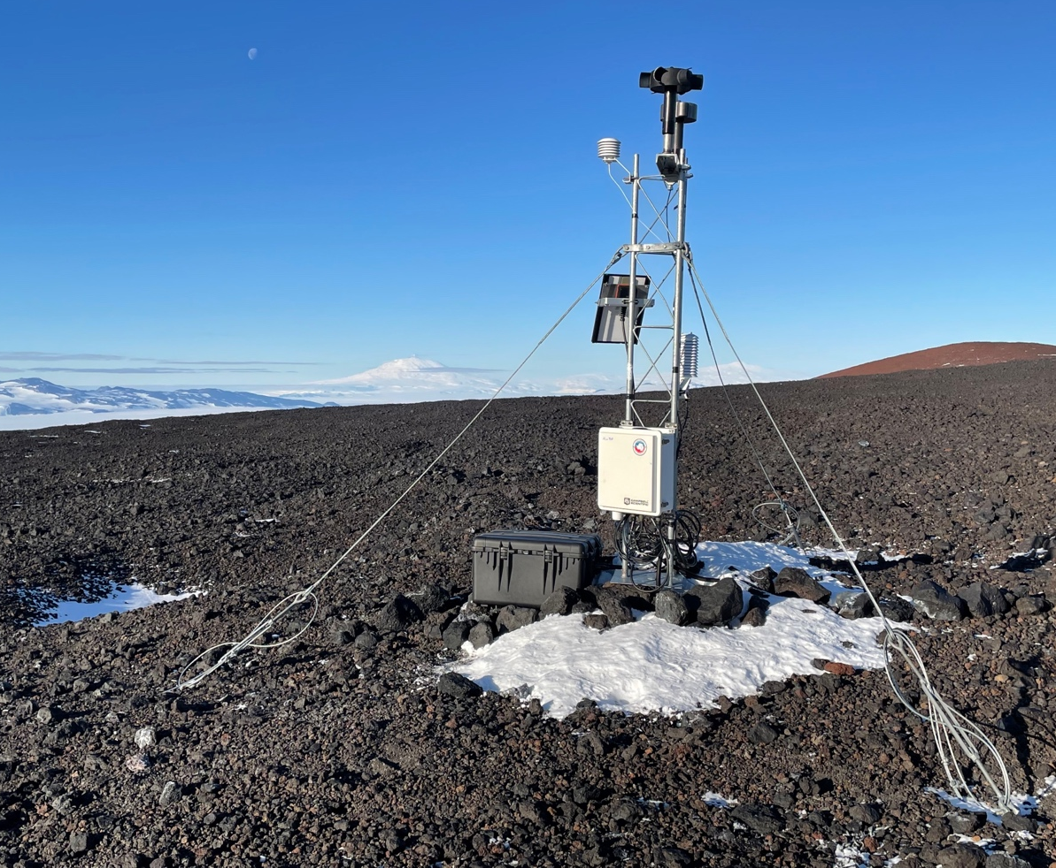
Nov 22 – Minna Bluff AWS
Purpose: Swap instrumentation
After instrument swap

Slide 17
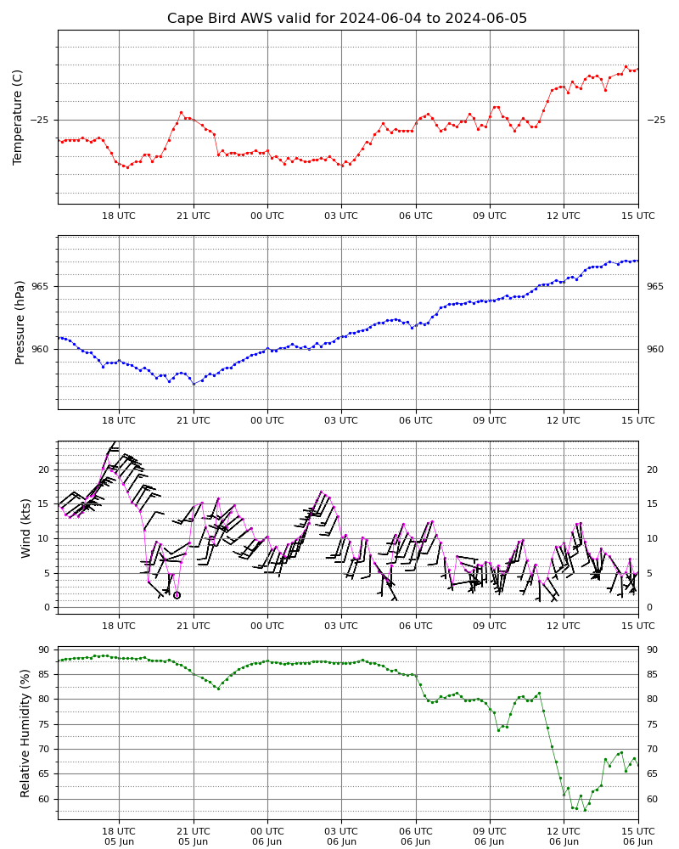
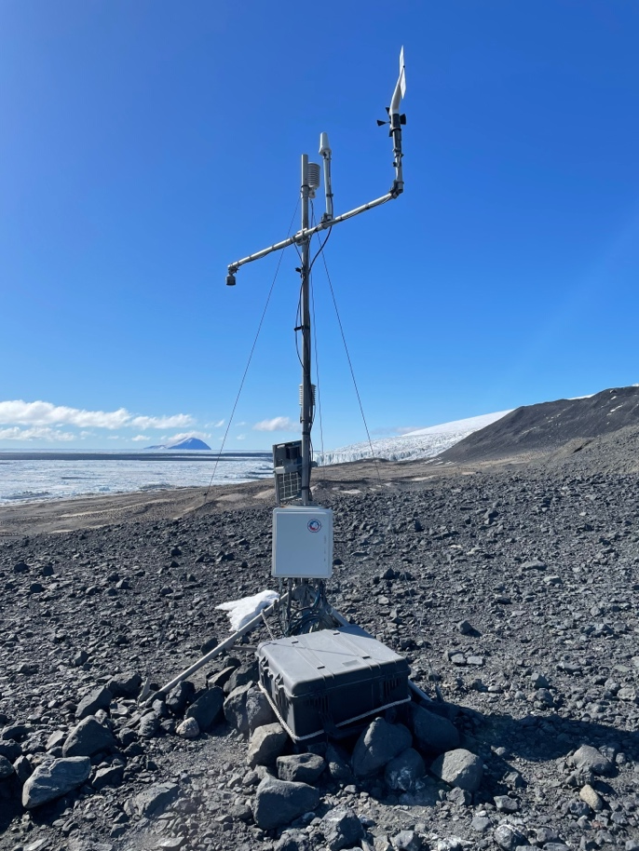
Nov 23 – Cape Bird AWS
Purpose: Station checkup

Slide 18
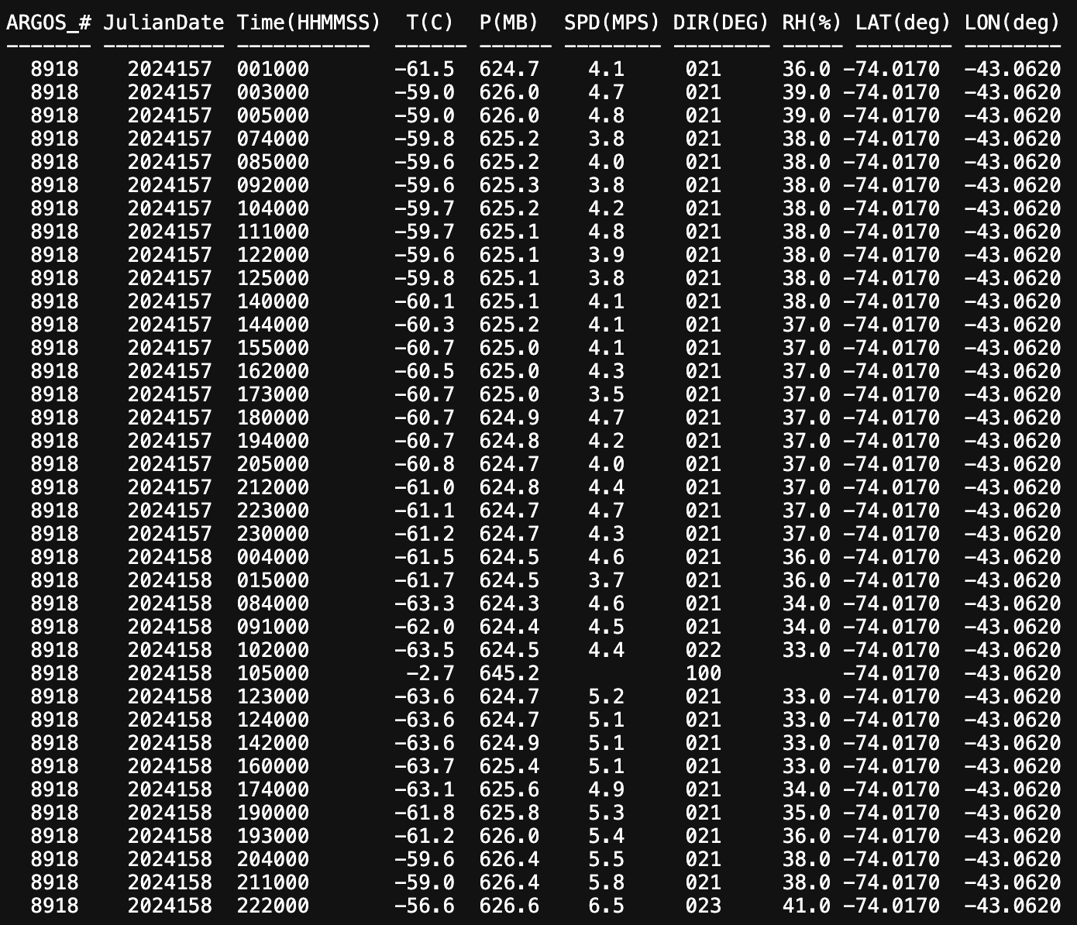
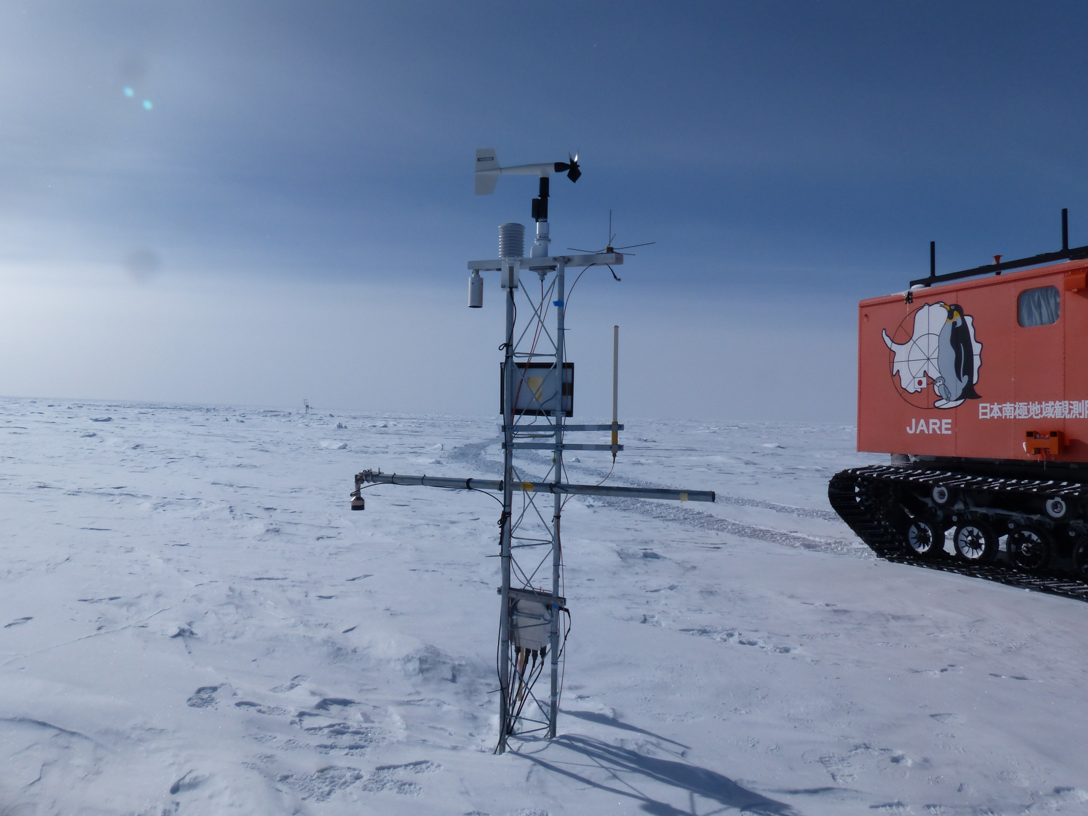
Nov 20 – Relay Station AWS
Visit by JARE - Photo credit: Dr. Fumio Nakazawa at NIPR

Slide 19
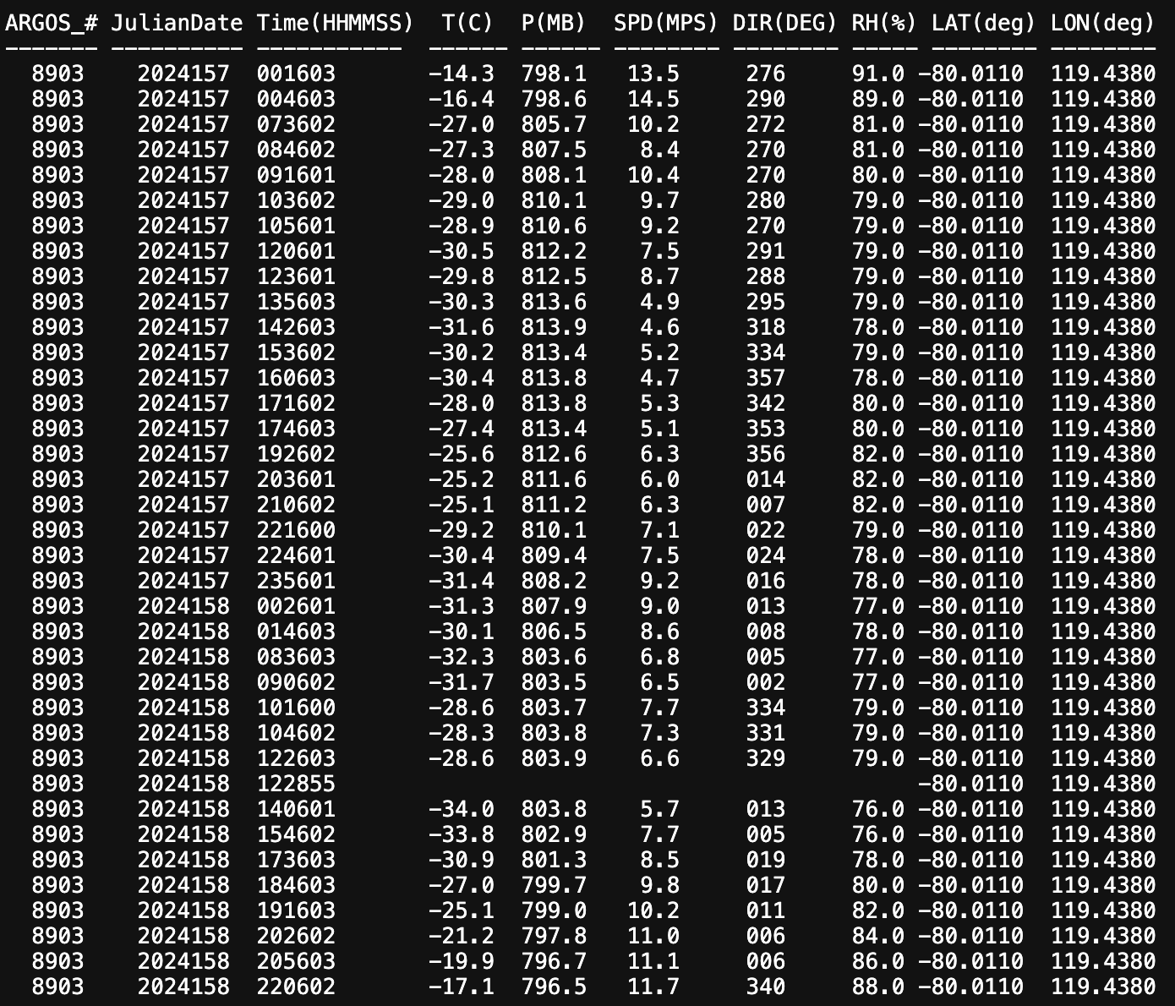
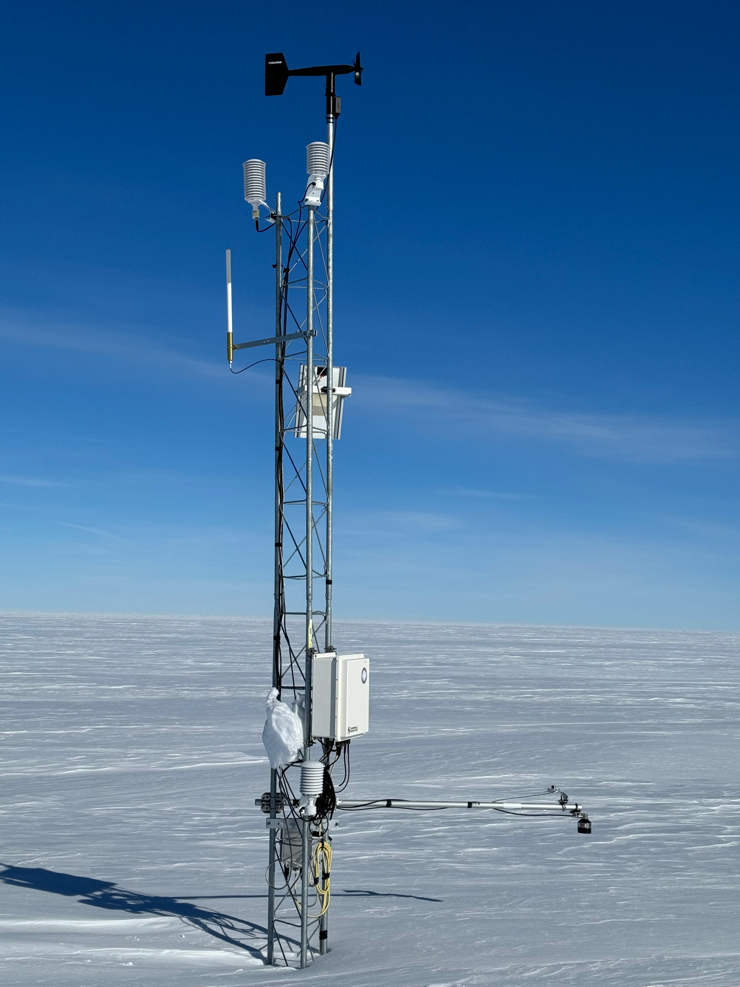
Nov 28 – Byrd AWS
Visit by POLENET – Photo credit: Terry Wilson

Slide 20
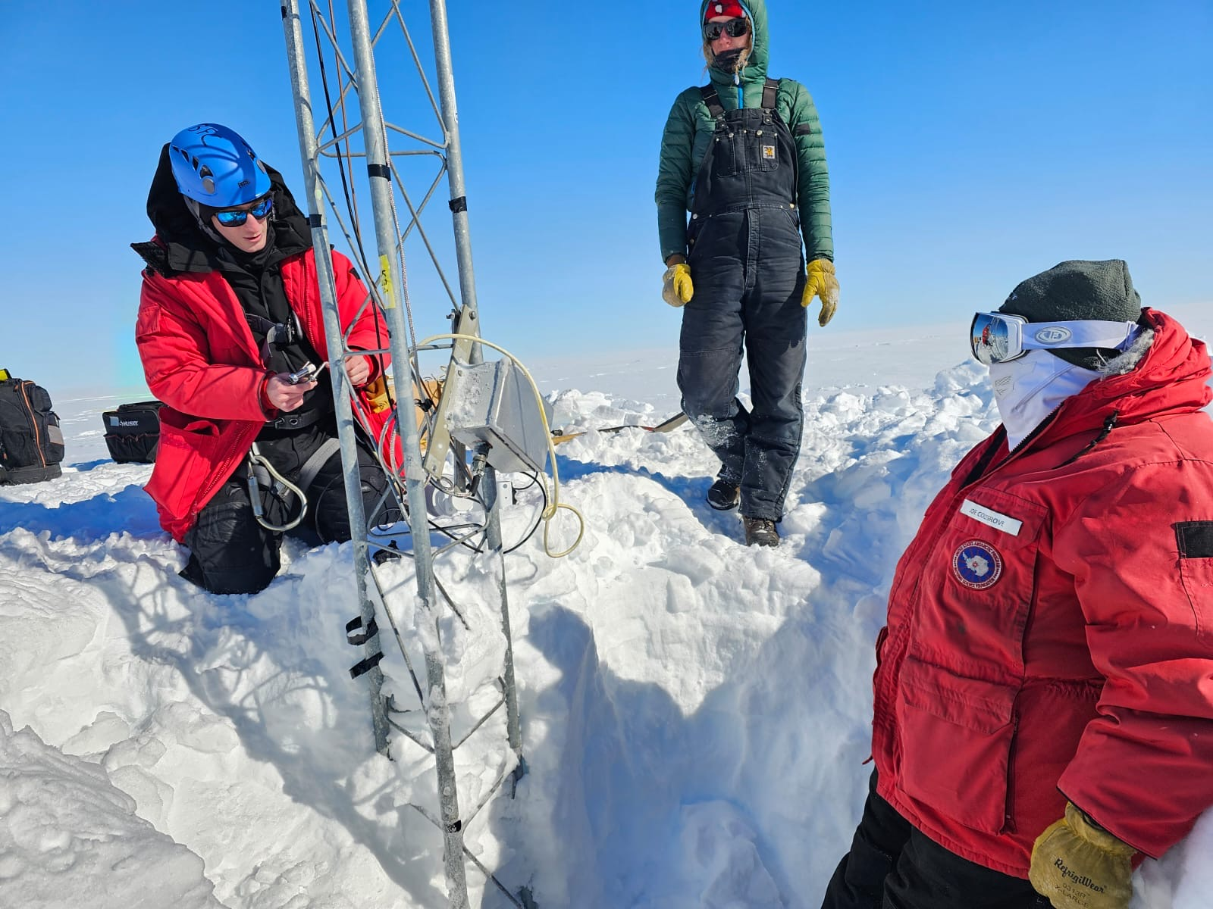
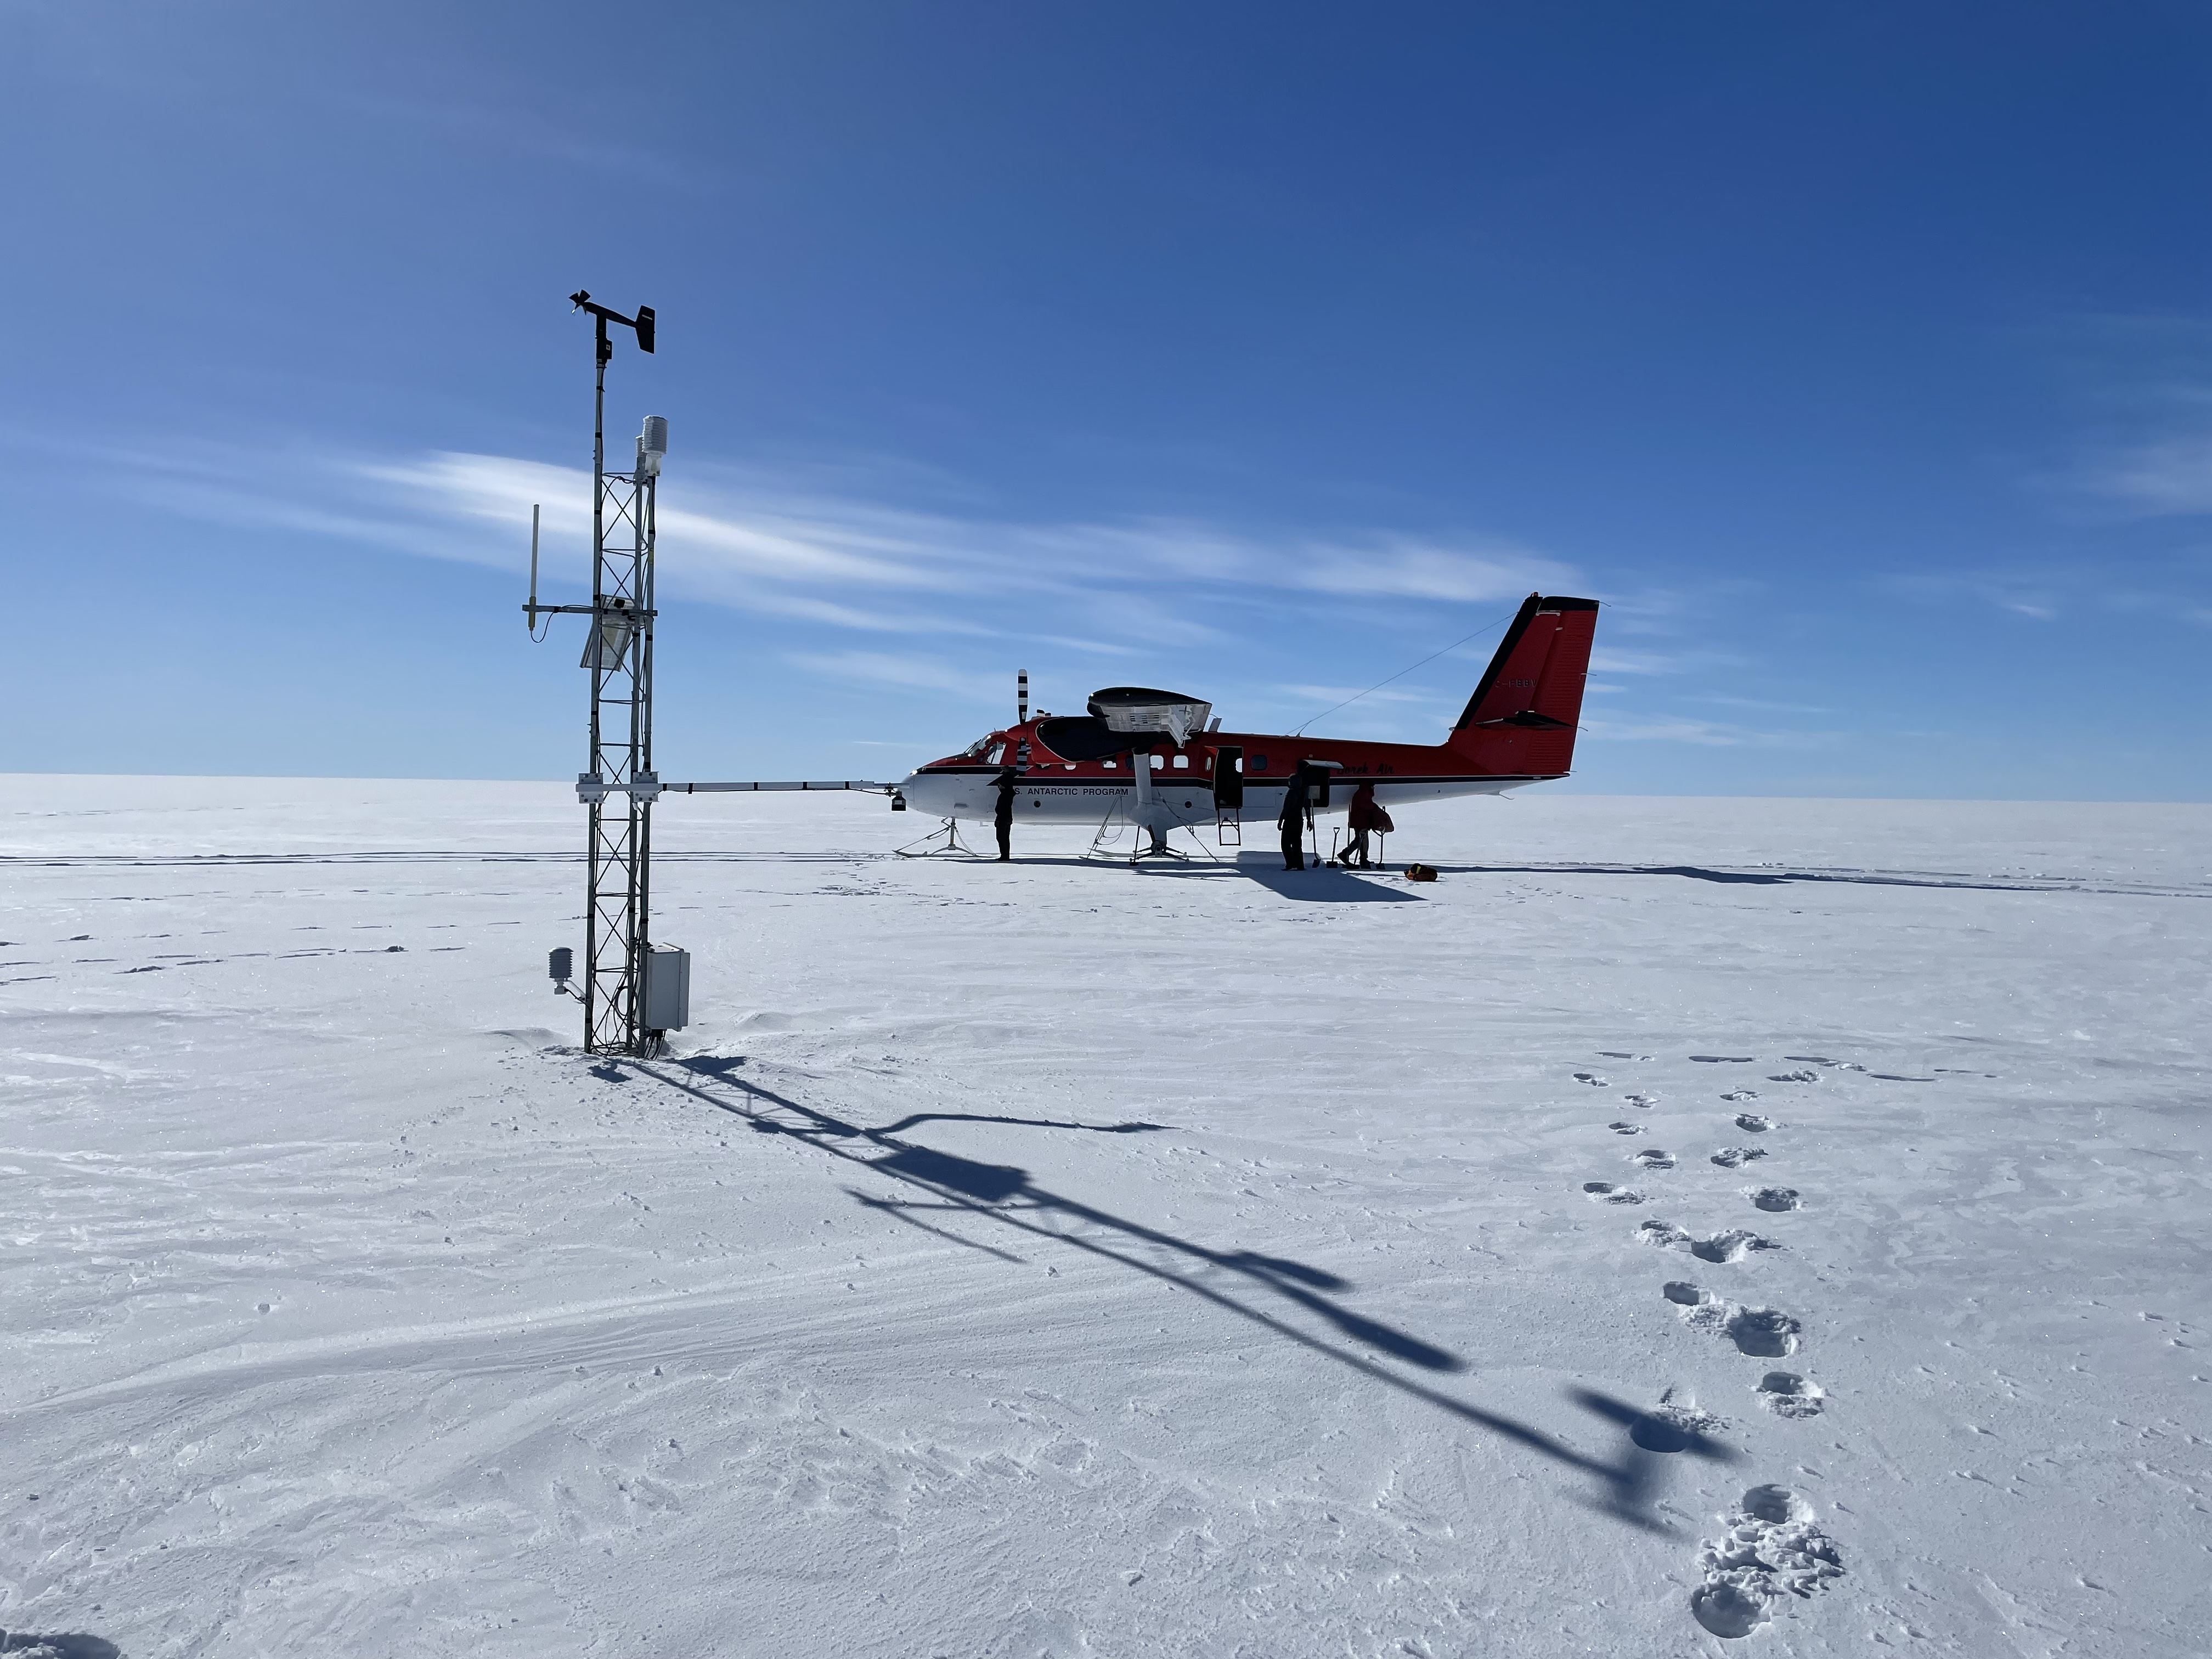
Nov 30 – Gill AWS
Purpose: Station raise
Before
During

Slide 21
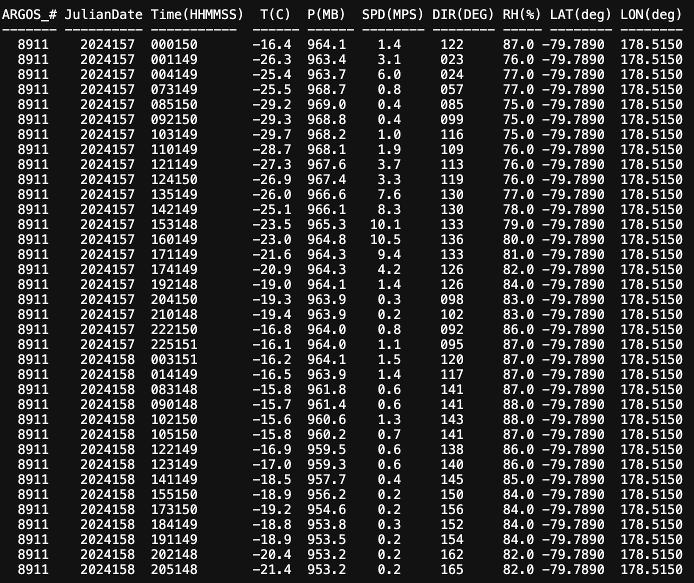
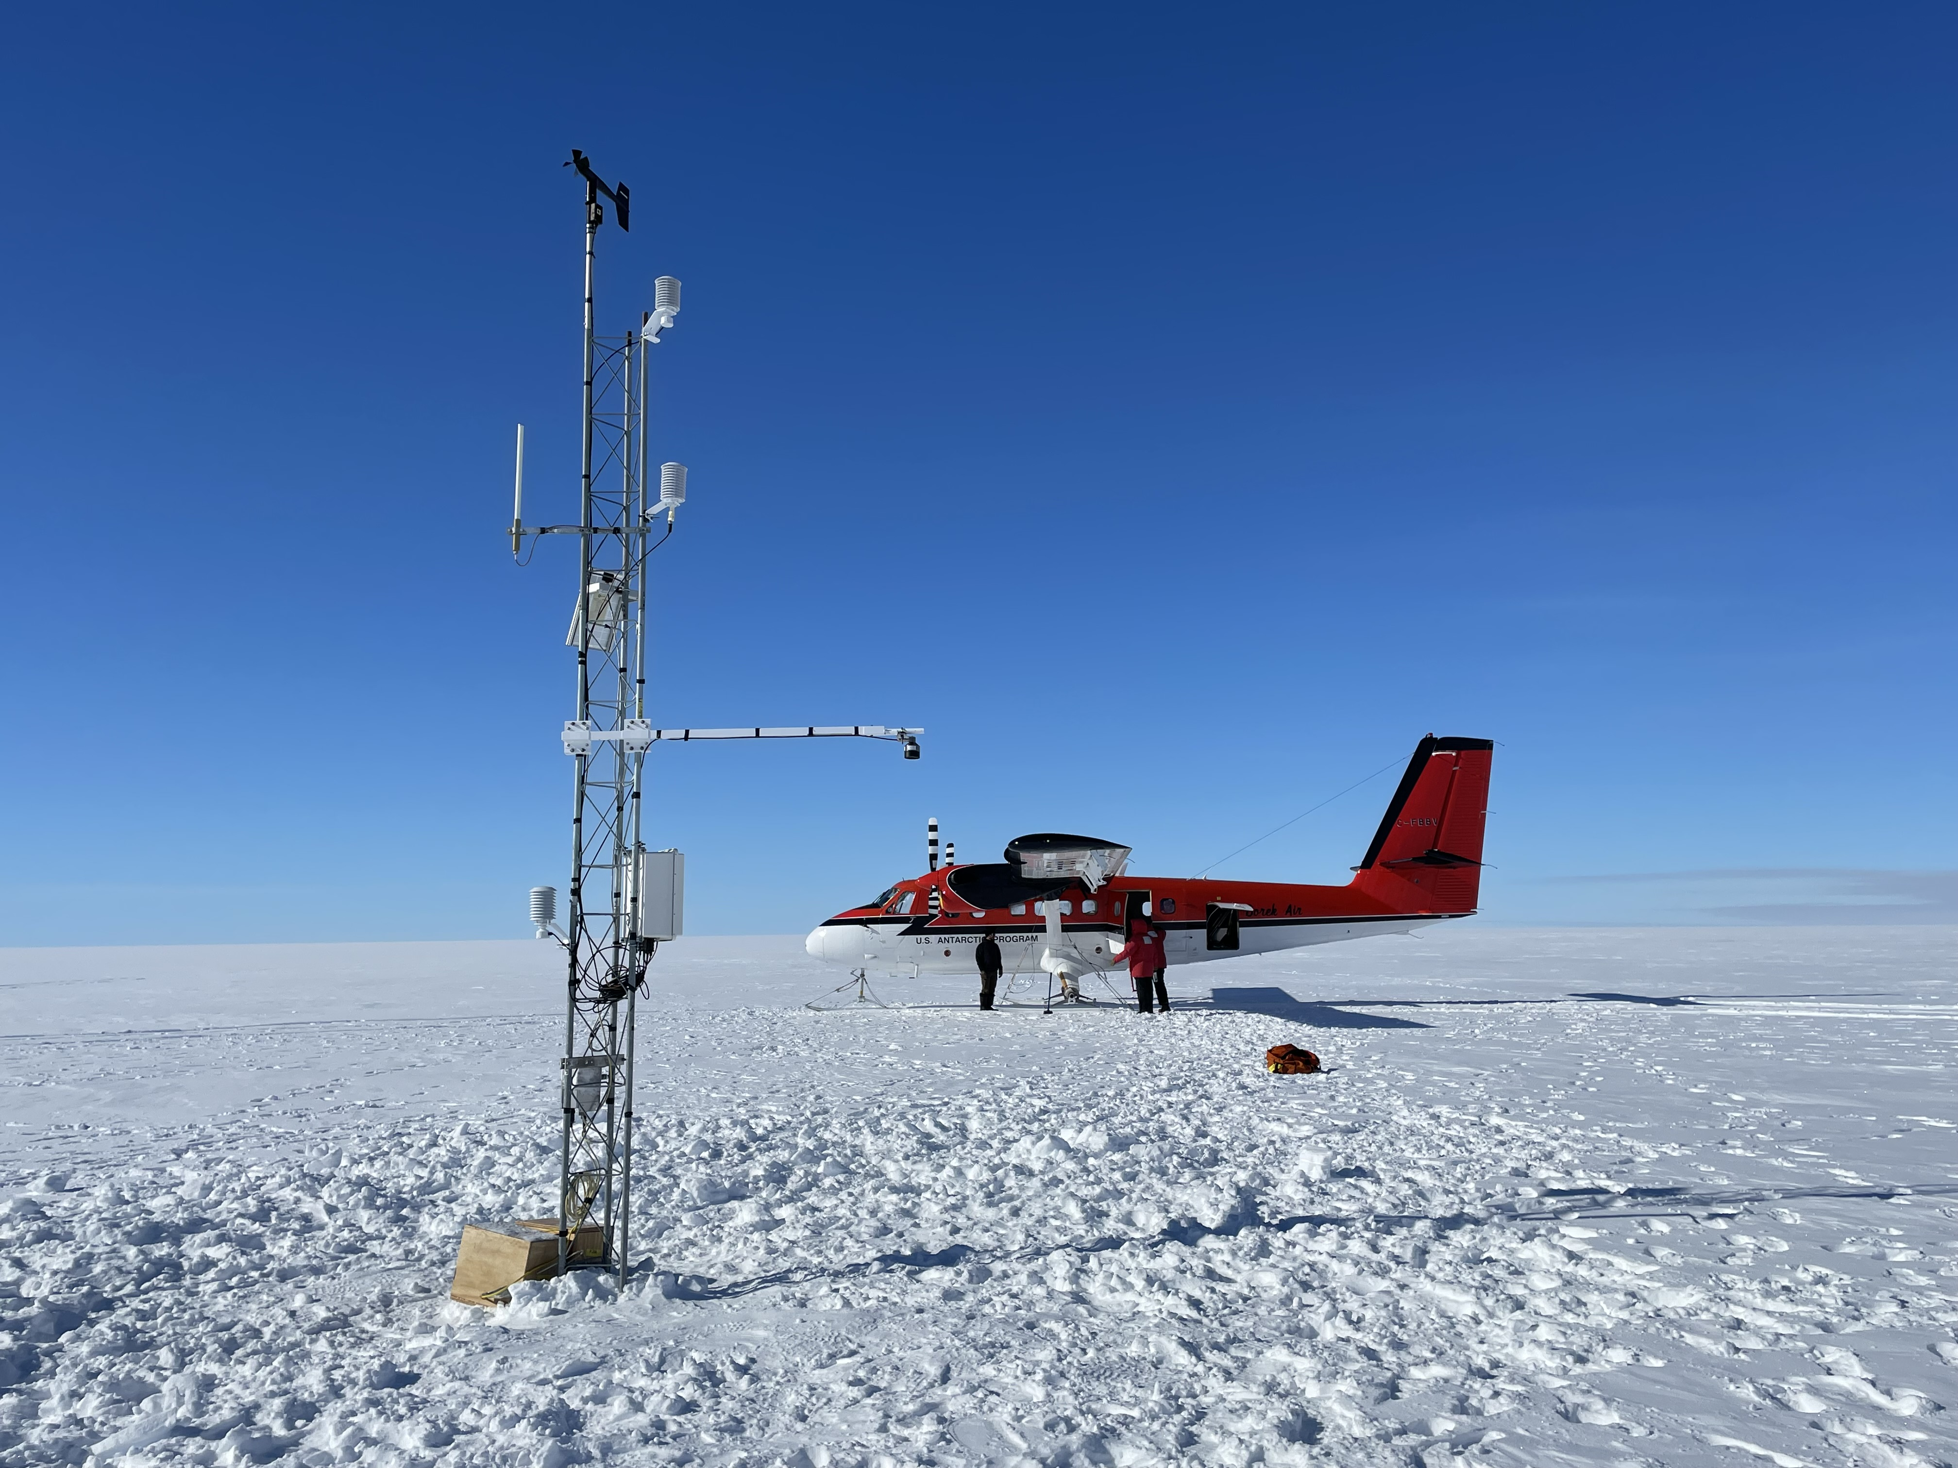
Nov 30 – Gill AWS
Purpose: Station raise
After

Slide 22
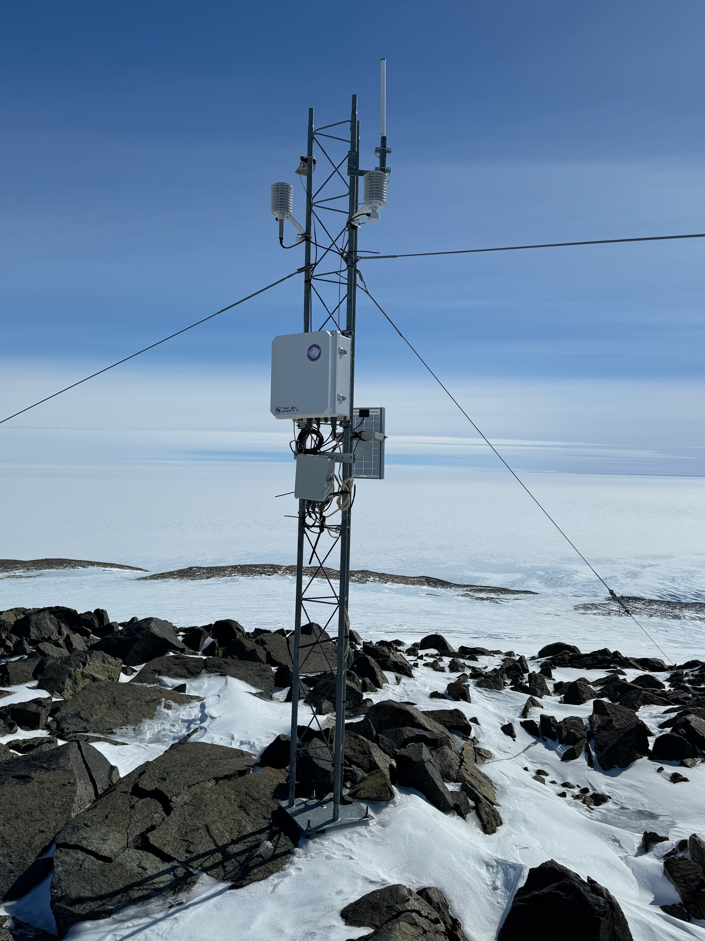
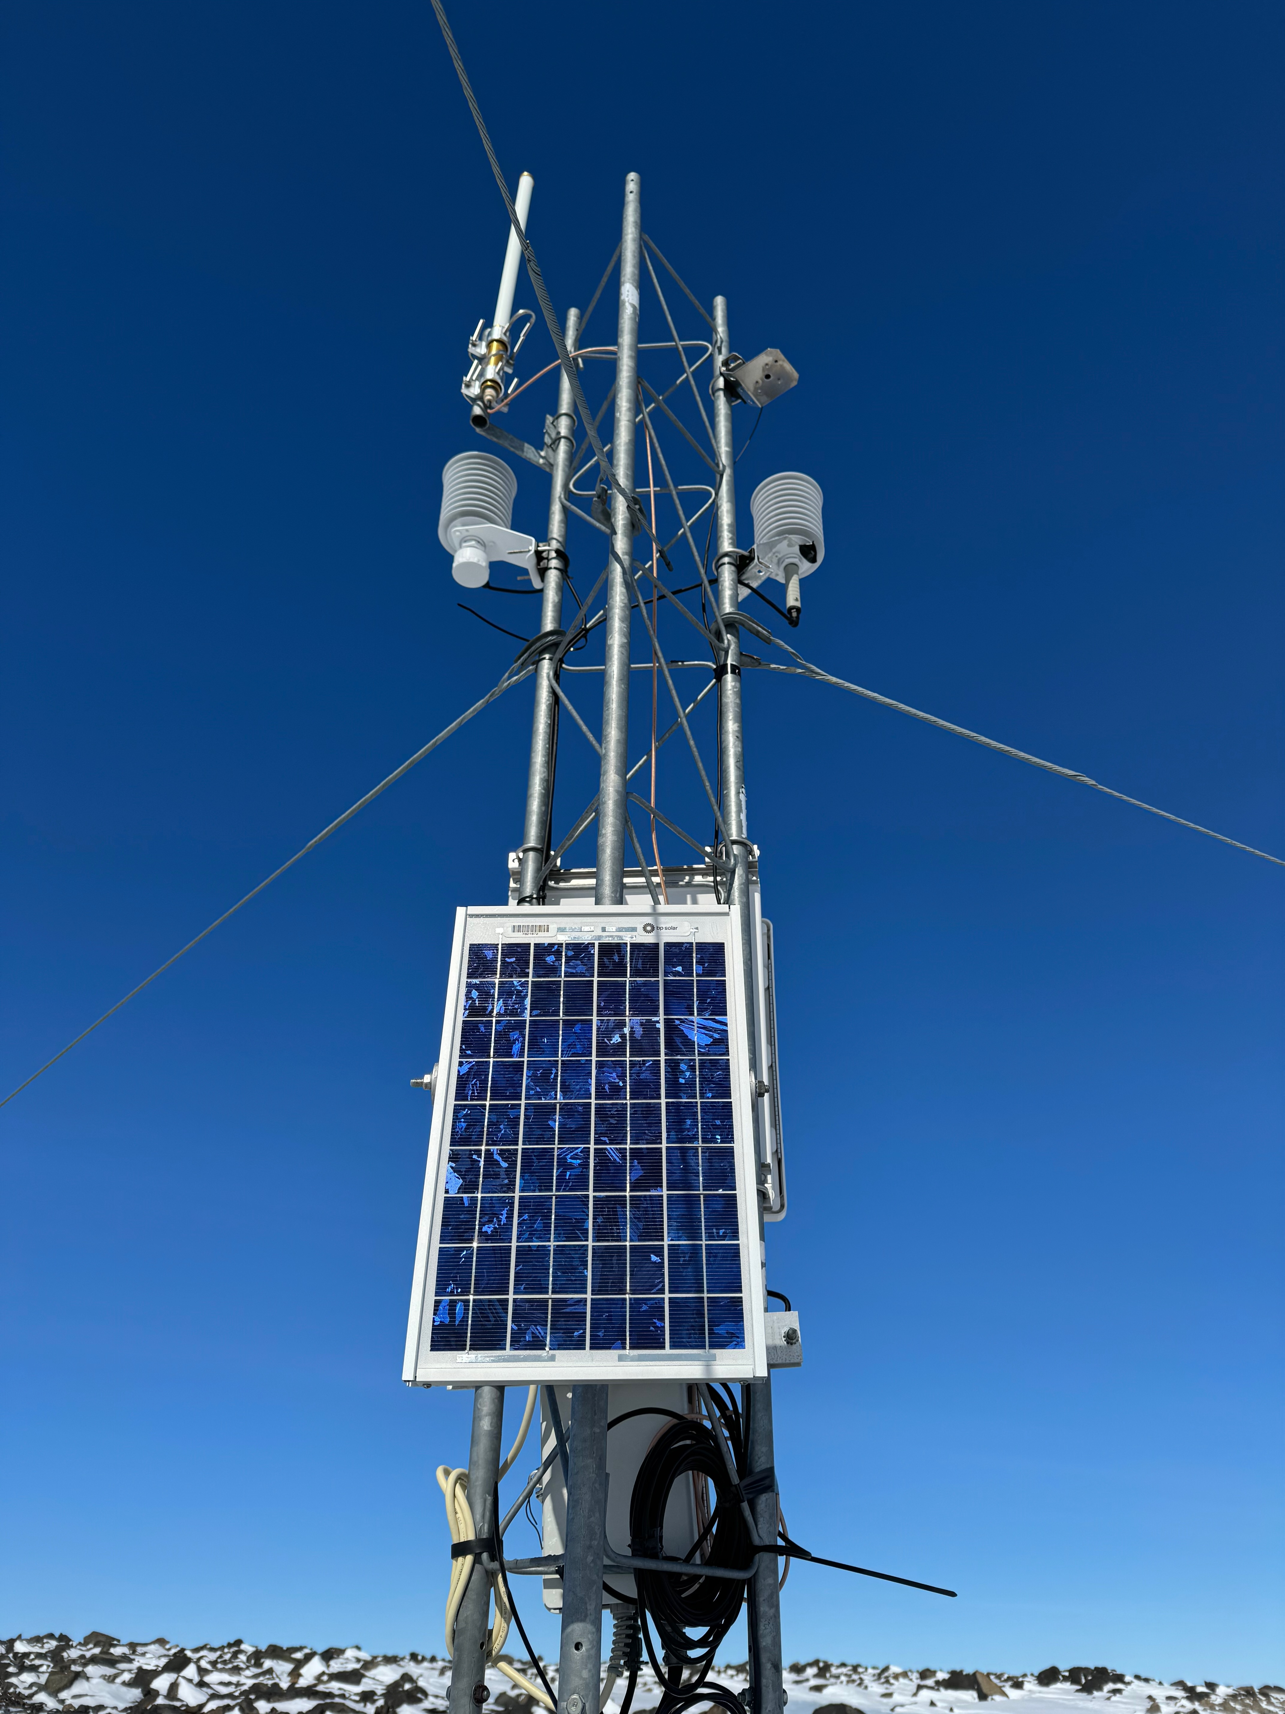
Nov 30 – Bear Peninsula AWS
Visit by POLENET – Photo credit: Terry Wilson

Slide 23
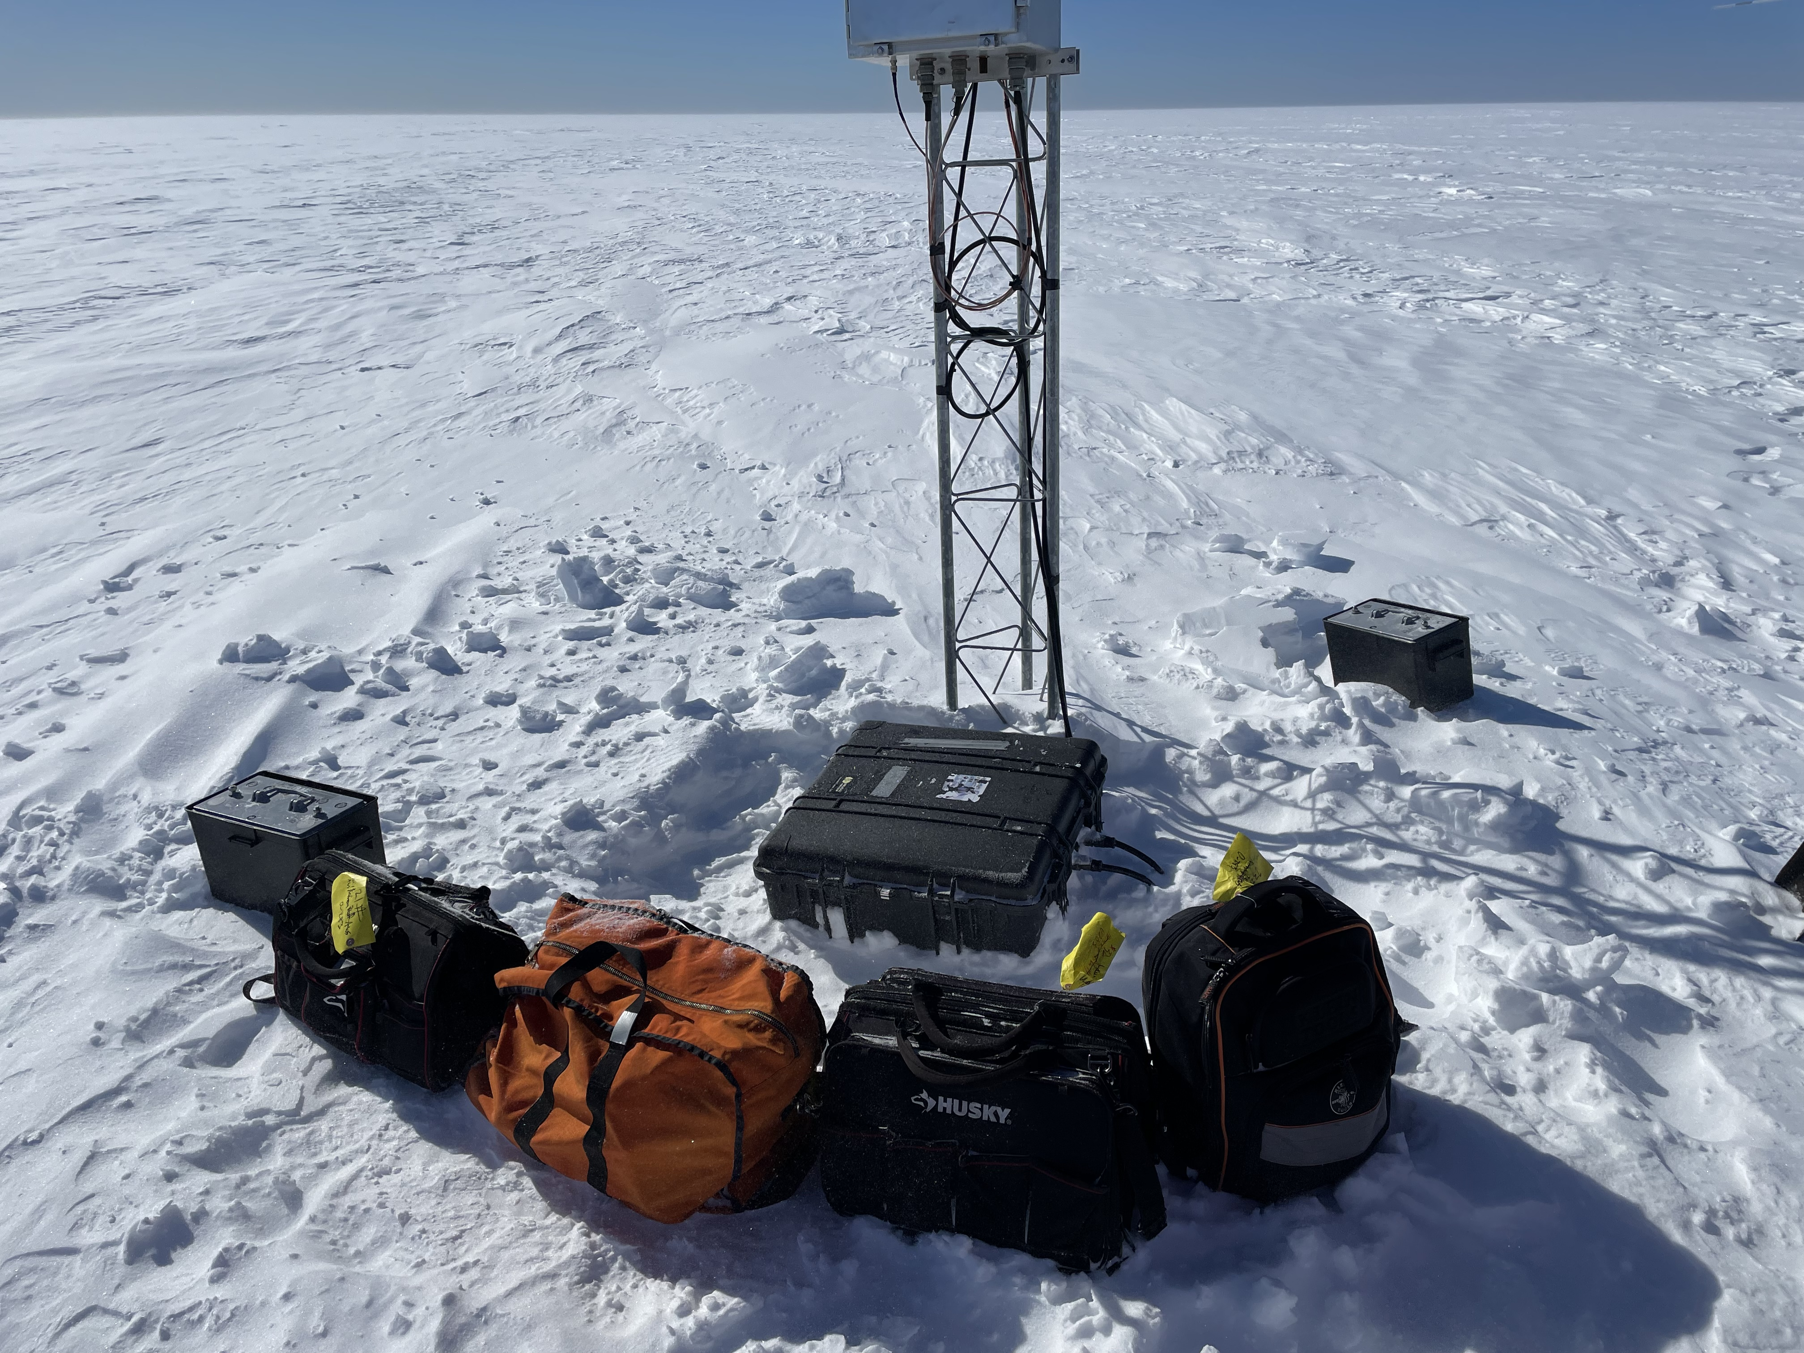
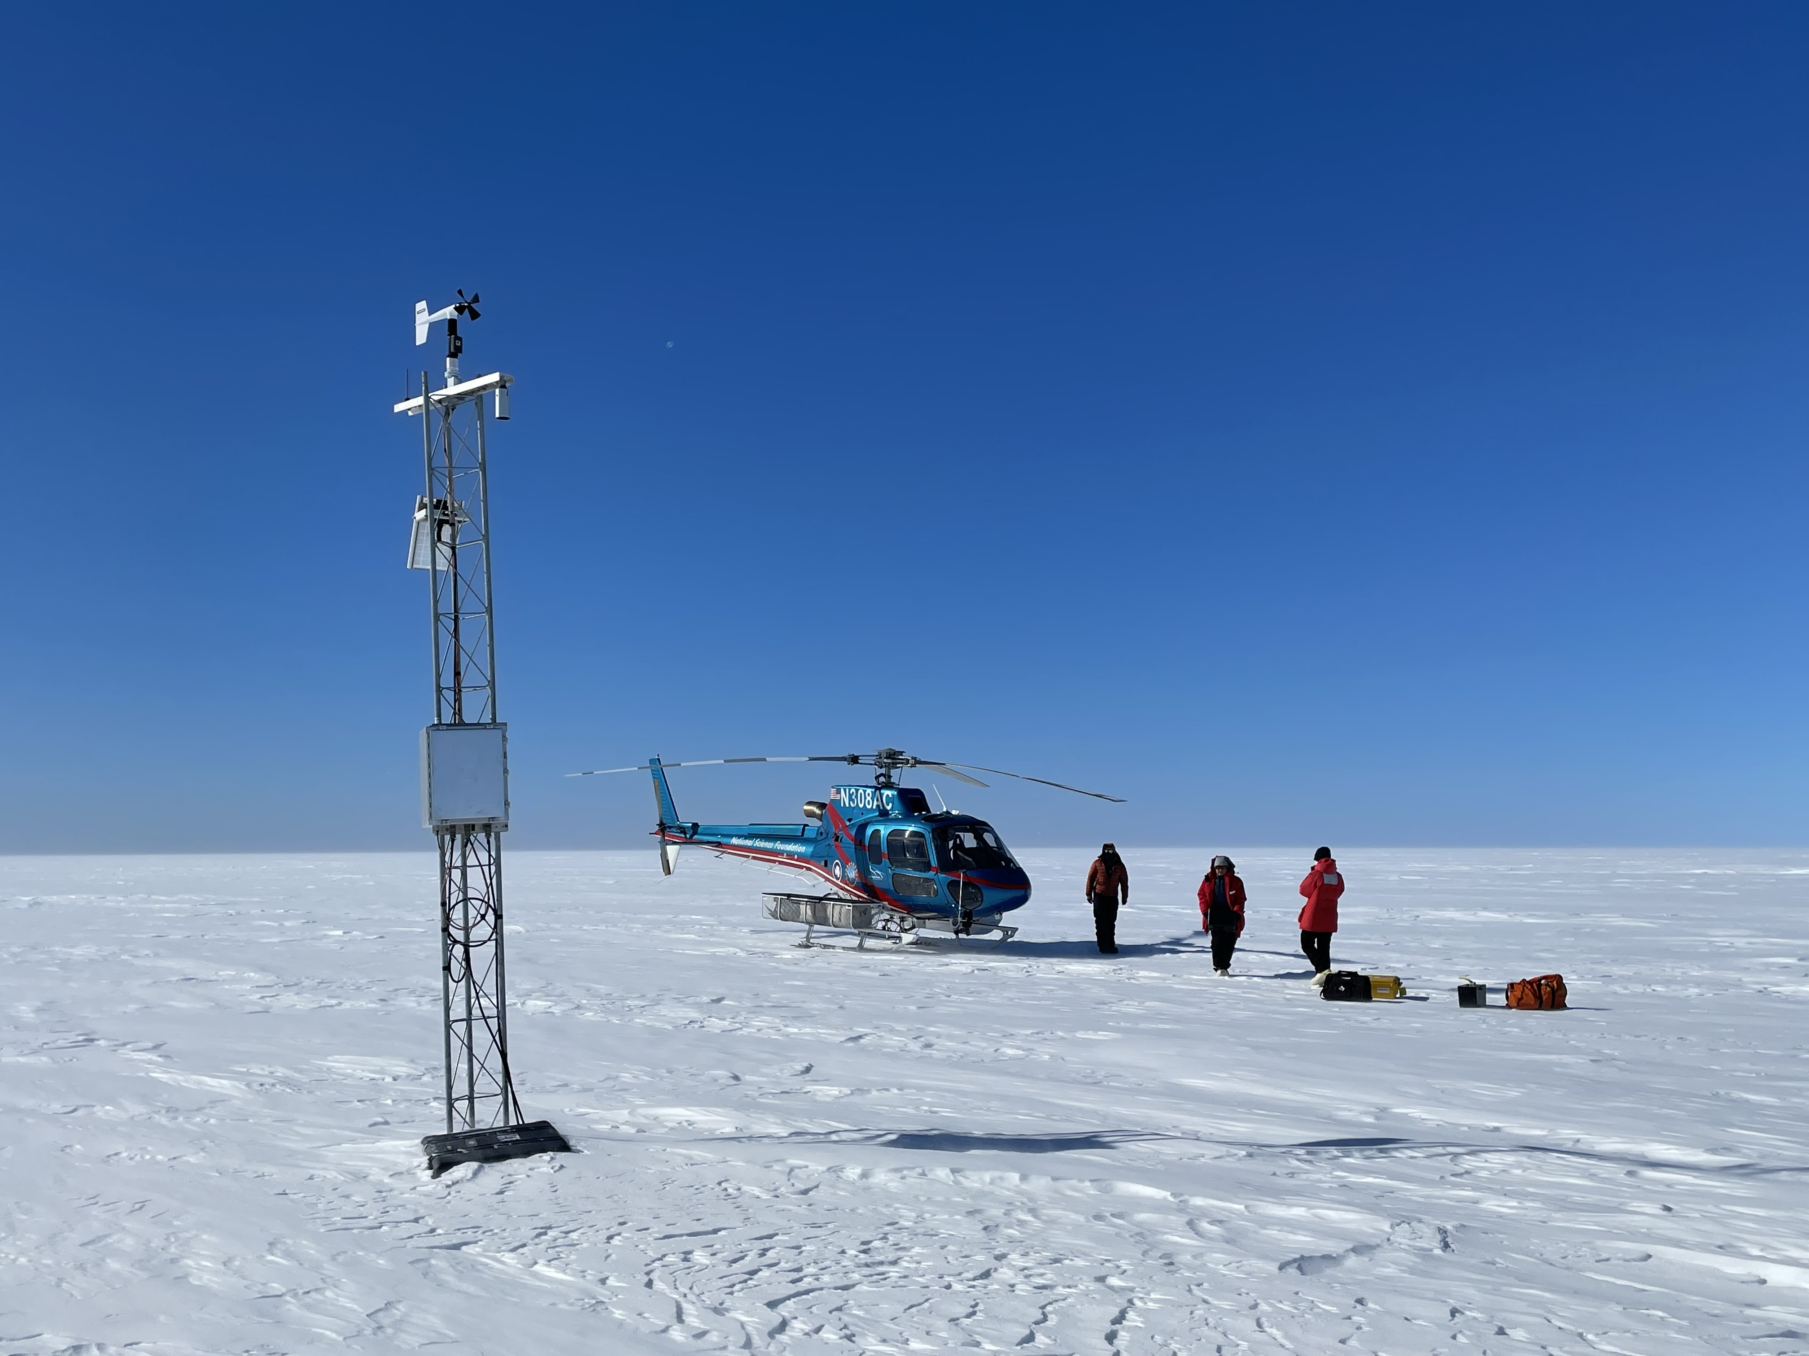
Dec 1 – Laurie II AWS
Purpose: Replace batteries in power system
During
Before

Slide 24
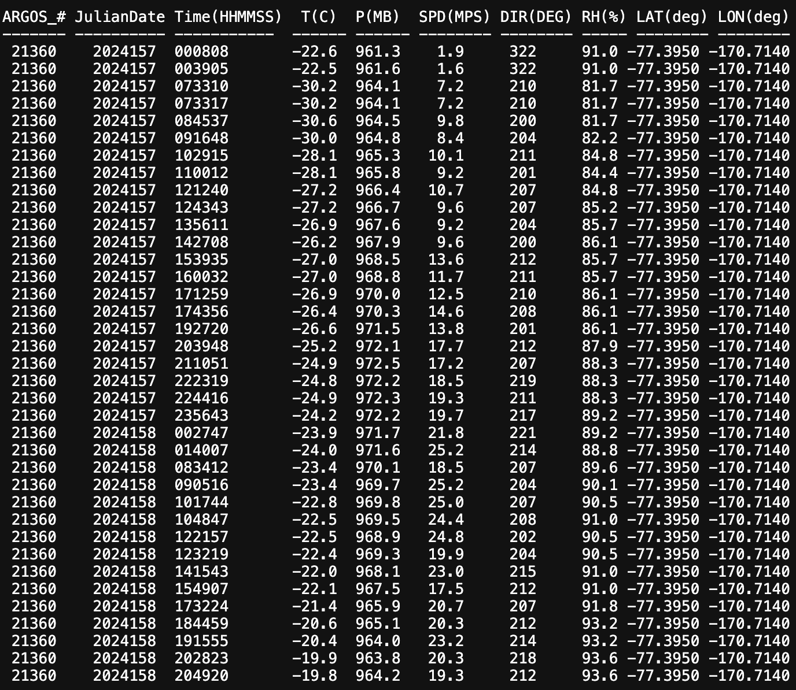
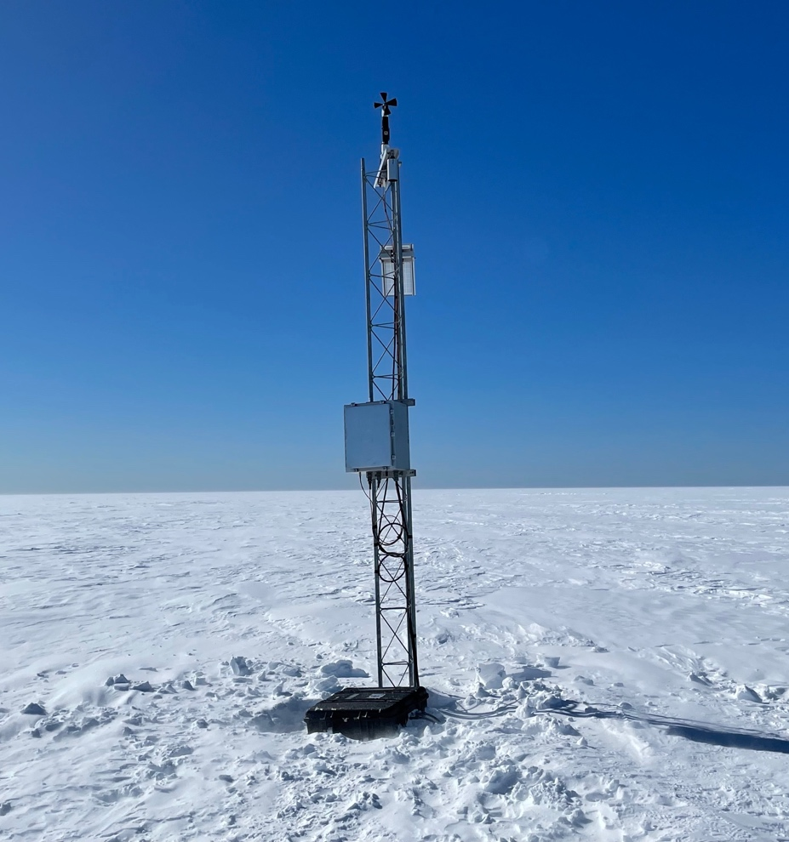
Dec 1 – Laurie II AWS
Purpose: Replace batteries in power system
After

Slide 25
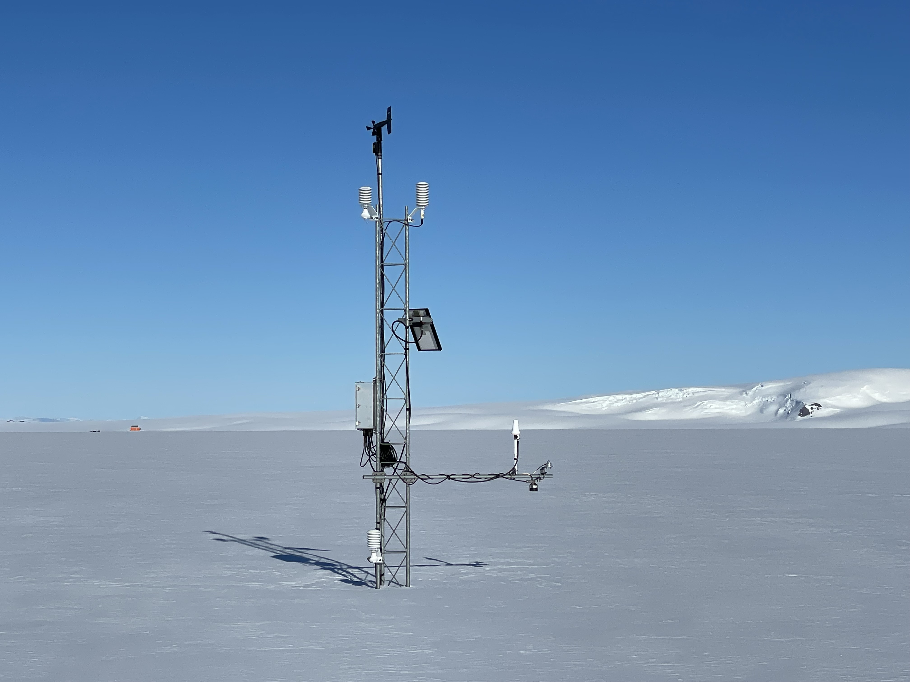
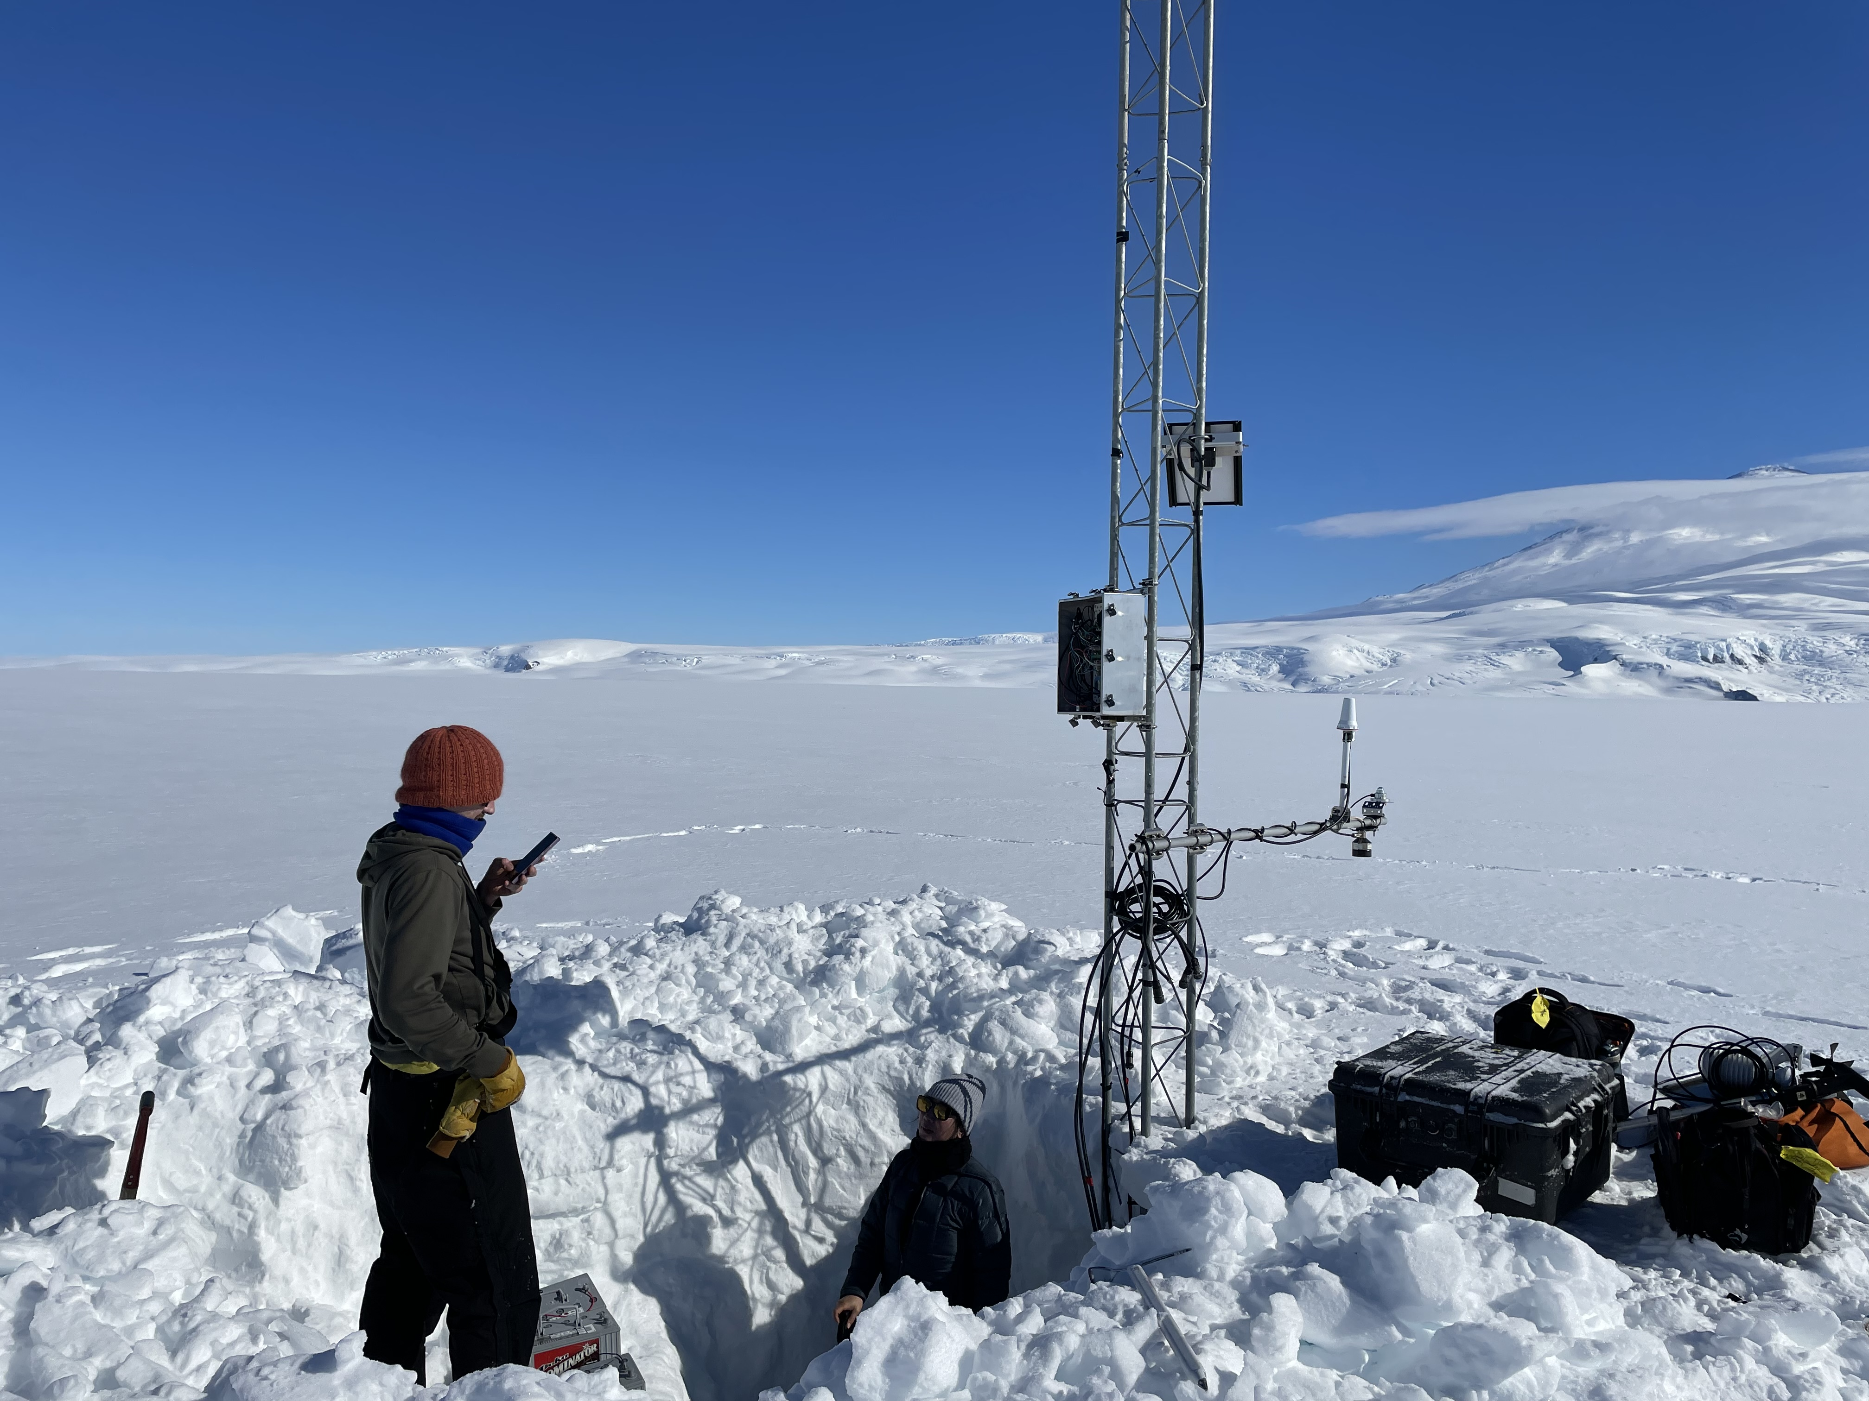
Dec 2 – Windless Bight AWS
Purpose: Station raise
Before
During

Slide 26
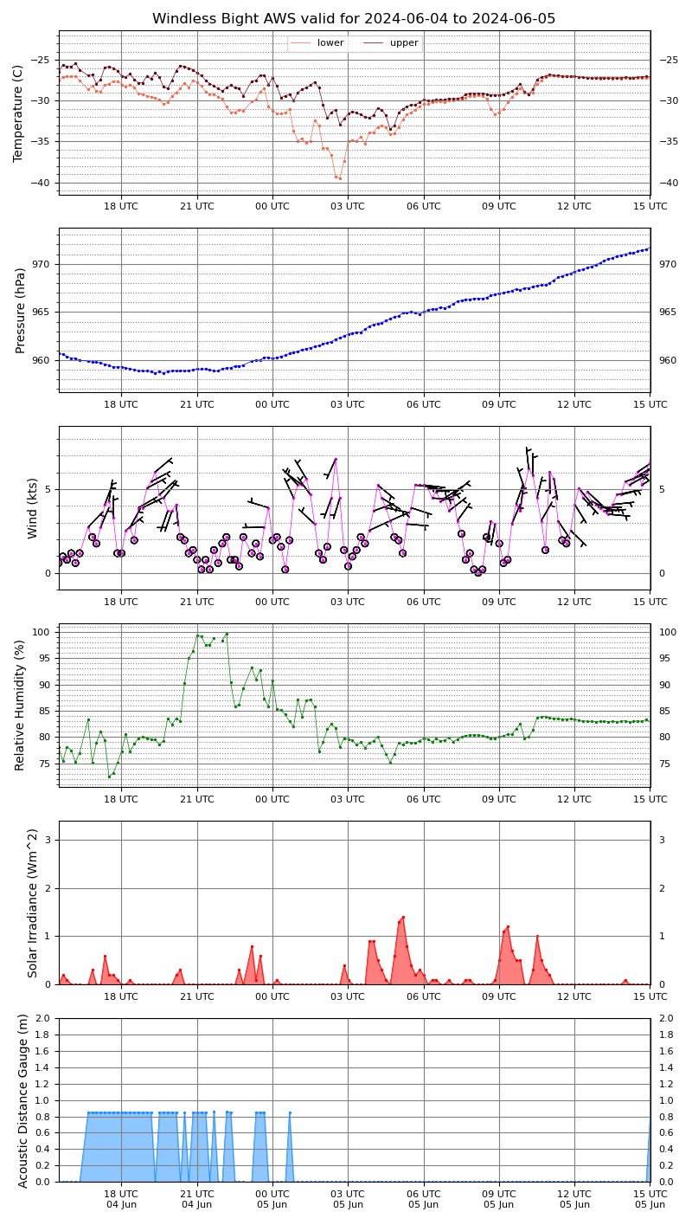

Dec 2 – Windless Bight AWS
Purpose: Station raise
After

Slide 27


Dec 5 – Emilia AWS
Purpose: Swap enclosure (switch from AWS2B to CR1000 datalogger)
Suspected that pressure gauge had an offset of approx. -10 mb
Before
During

Slide 28


Dec 5 – Emilia AWS
Pressure is accurate now!
After

Slide 29



Dec 7 – Sabrina AWS
Purpose: Station raise
Before
After

Slide 30


Dec 7 – Alexander Tall Tower! AWS
Purpose: Rigger station checkup
Tall Tower!

Slide 31


Dec 9 – Dome Fuji AWS
Visit by JARE - Photo credit: Dr. Fumio Nakazawa at NIPR

Slide 32


Dec 11/12 – Phoenix AWS, Willie Field AWS, Sarah PCWS
Purpose: Swap Phoenix batteries, remove Willie Field and Sarah for relocation
Phoenix

Slide 33

Dec 11/12 – Phoenix AWS, Willie Field AWS, Sarah PCWS
Purpose: Swap Phoenix batteries, remove Willie Field and Sarah for relocation
Sarah and Willie Field

Slide 34

Dec 13 – Kominko-Slade AWS
Purpose: Remove instruments, to be replaced in a future field season
  Thank you Paul Summers/TJ Young/TIME (Thwaites Interdisciplinary Margin Evolution) and GHOST (Geophysical Habitat of Subglacial Thwaites)

Slide 35



Dec 19 – Thurston Island AWS
Visit by POLENET – Photo credit: Terry Wilson

Slide 36


Dec 19 – Lettau AWS
Purpose: Station raise
During
Before

Slide 37

Dec 19 – Lettau AWS
Purpose: Station raise
After

Slide 38


Dec 19 – Emma AWS
Purpose: Removal

Slide 39
To recap:
19 out of 20 AWS/PCWS serviced/visited
  18 by UW team
  1 (Skomik PCWS) visited by NIWC
  1 by GHOST/TIME
  Of the 18 serviced, 14 were completed while 4 have more work to be done (reinstall, datalogger issues, etc.)
6 AWS visited by collaborators
In total: 25 AWS/PCWS serviced/visited this season!

Slide 40

Thank you!
Questions?
Thanks to the McMurdo community, NSF, helo and fixed wing flight coordinators, the Riggers, and our international collaborators for making our field work possible!
Thanks to:
National Science Foundation
  Office of Polar Programs Grants 2301362 (AWS) & 1951720 (AMRDC at UW)
  Office of Integrative Activities, Major Research Instrumentation Program
Madison College
  School of Arts and Sciences
  School of Applied Science, Engineering and Technology
  Grants Office
UW-Madison/SSEC
  AMRDC Staff
  Support Staff
  Directors
Windless Bight AWS

